Slide 1
Geodesy, Map Projections and Coordinate Systems
Geodesy - the shape of the earth and definition of earth datums
Map Projection - the transformation of a curved earth to a flat map
Coordinate systems - (x,y,z) coordinate systems for map data

Slide 2
Readings
What are Map Projections
http://desktop.arcgis.com/en/arcmap/latest/map/projections/what-are-map-projections.htm
Geographic Coordinate Systems
http://desktop.arcgis.com/en/arcmap/latest/map/projections/about-geographic-coordinate-systems.htm
Map Projections
http://desktop.arcgis.com/en/arcmap/latest/map/projections/about-map-projections.htm
Projection Types
http://desktop.arcgis.com/en/arcmap/latest/map/projections/projection-types.htm
ArcGIS Pro Help (More about tools than concepts)
https://pro.arcgis.com/en/pro-app/help/mapping/properties/specify-a-coordinate-system.htm

Slide 3
Learning Objectives:
By the end of this class you should be able to:
describe the role of geodesy as a basis for earth datums
list the basic types of map projection
identify the properties of common map projections
properly use the terminology of common coordinate systems
use spatial references in ArcMap so that geographic data is properly displayed
  determine the spatial reference system associated with a feature class or data frame
  use ArcGIS to convert between coordinate systems
calculate distances on a spherical earth and in a projected coordinate system

Slide 4
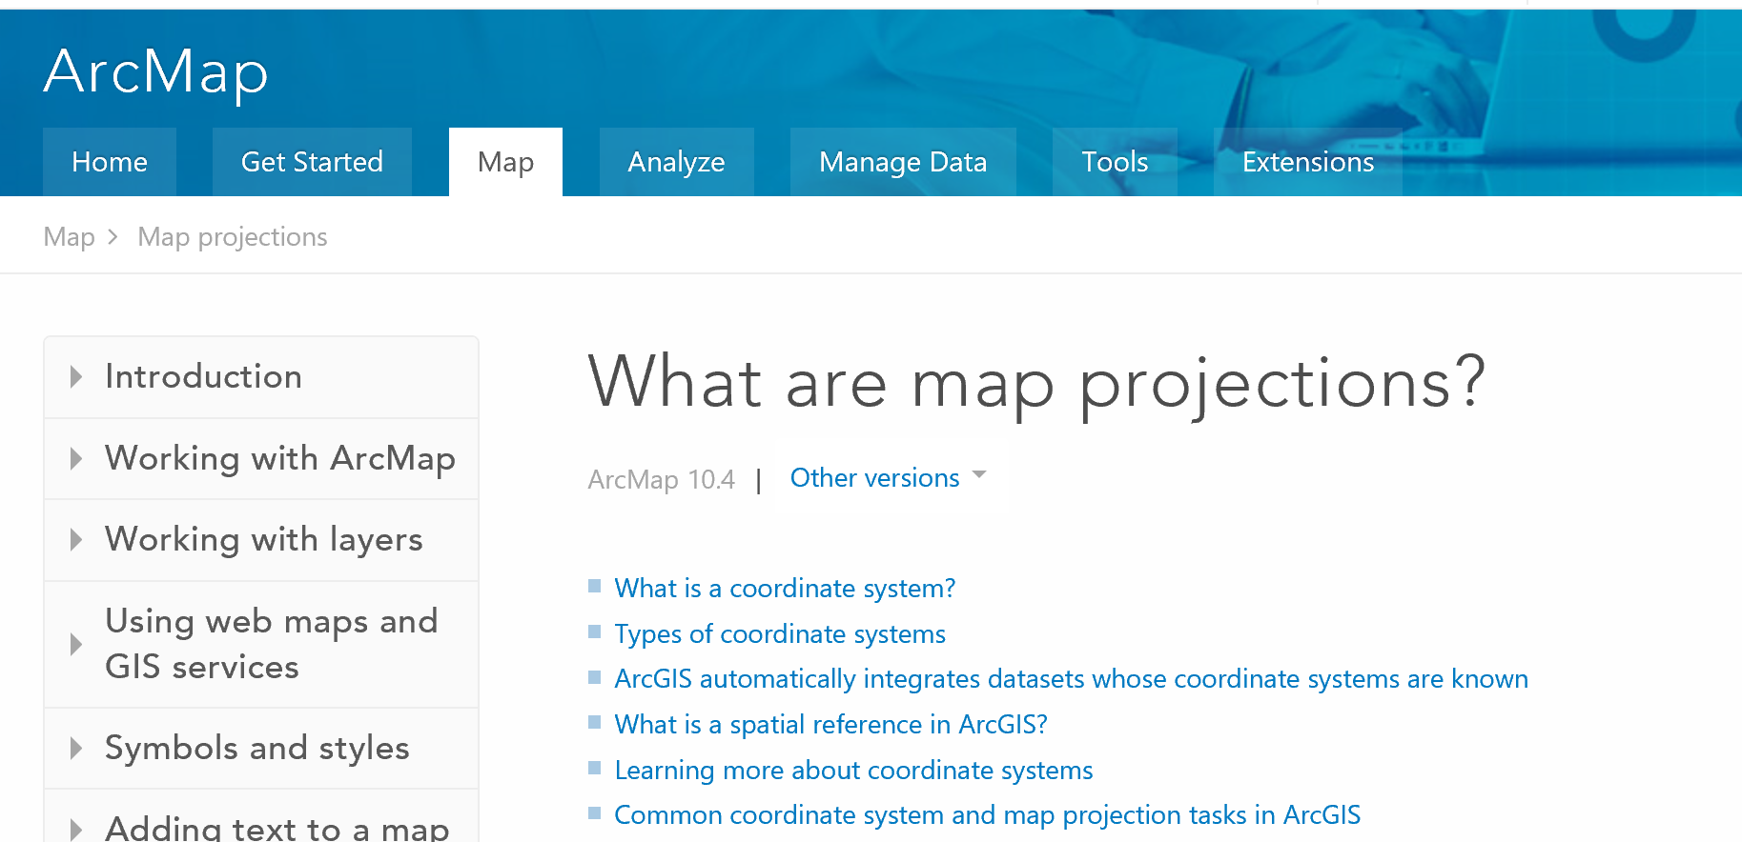
Readings: Map Projection
http://desktop.arcgis.com/en/arcmap/latest/map/projections/what-are-map-projections.htm

Slide 5
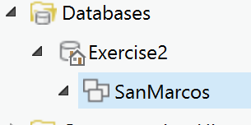
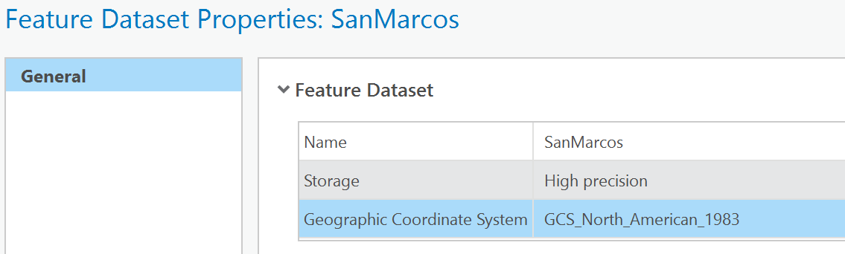
Description of Feature Dataset
Geographic Coordinate System – North American Datum of 1983

Slide 6
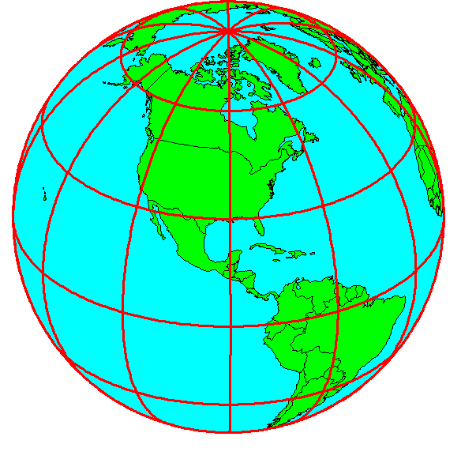
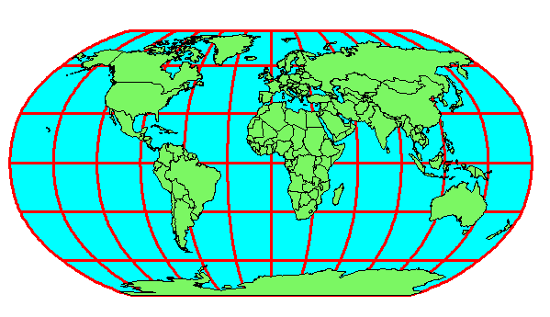
Horizontal Coordinate Systems
Geographic Coordinates
Projected Coordinates
North American Datum of 1983 (NAD83)
North American Datum of 1927 (NAD27)
World Geodetic System of 1984 (WGS84)
Albers Equal Area
Transverse Mercator
(φ, λ) − (Latitude, Longitude)
(decimal degrees)
(x, y) − (Easting, Northing)
(meters, ft)

Slide 7
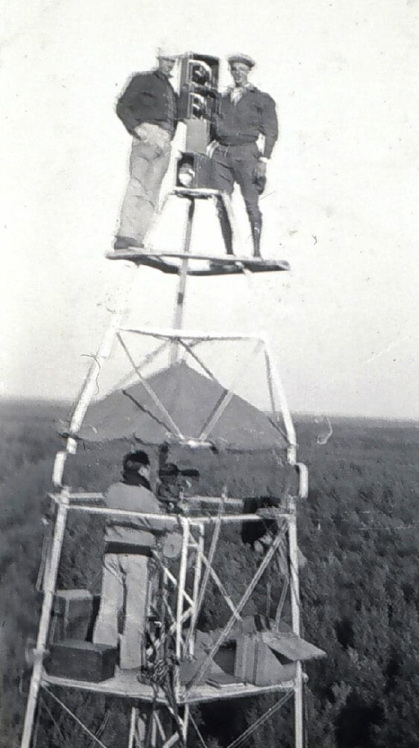
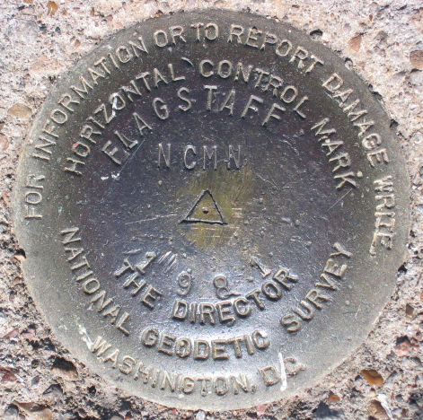
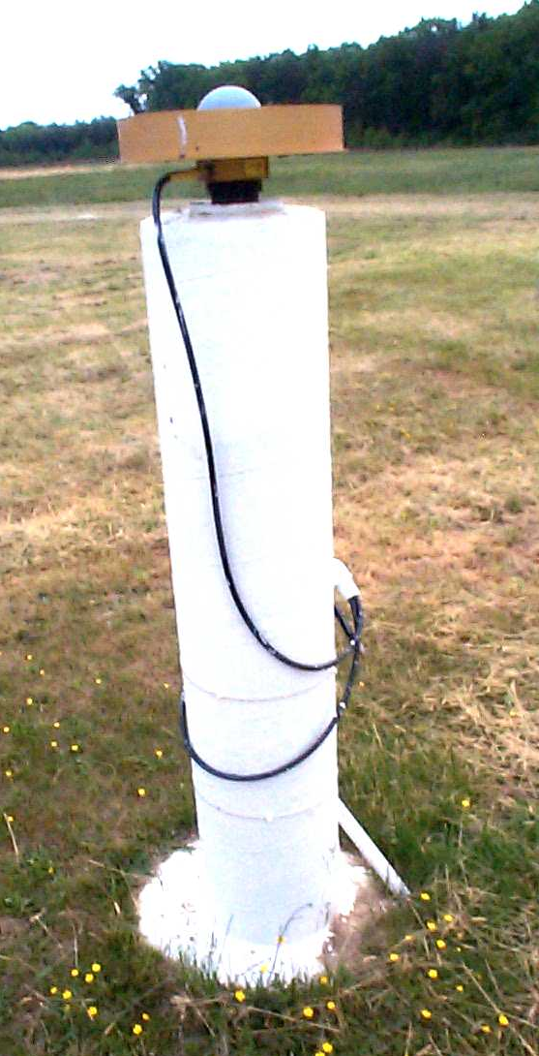
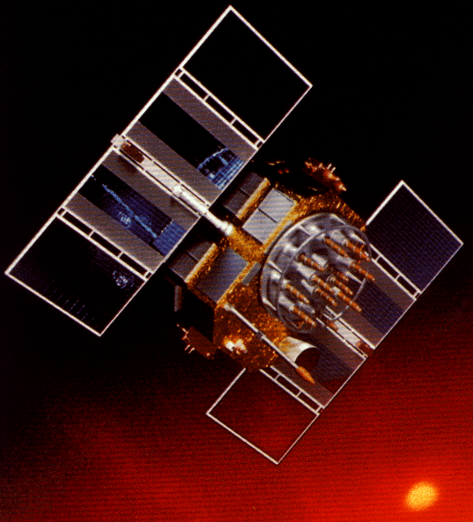
Revolution in Earth Measurement
Some images and slides from Michael Dennis, National Geodetic Survey and Lewis Lapine, South Carolina Geodetic Survey
Traditional Surveying uses benchmarks as reference points
Global Positioning uses fixed GPS receivers as reference points (Continuously Operating Reference System, CORS)

Slide 8
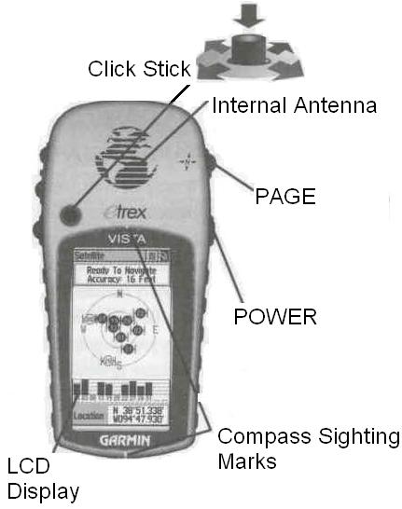
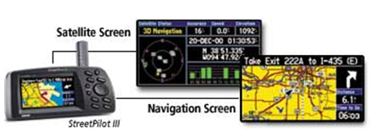
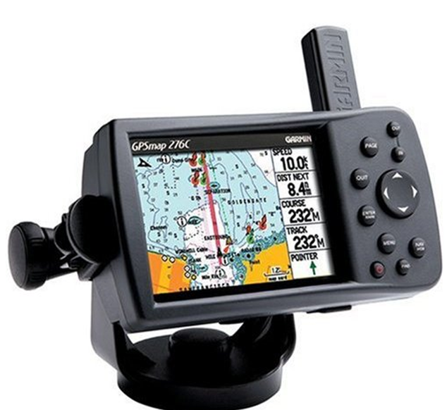
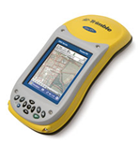
Global Position Systems
(Press and hold)
Garmin GPSMAP 276C GPS Receiver
Trimble GeoXHTM

Slide 9
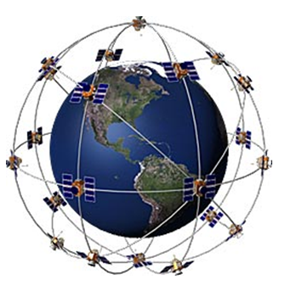
GPS Satellites
24 satellites
6 orbital planes
12 hour return interval for each satellite
Satellites are distributed among six offset orbital planes
Notes:
making two complete orbits in less than 24 hours

Slide 10
How GPS works in five logical steps:
The basis of GPS is triangulation from satellites
GPS receiver measures distance from satellite using the travel time of radio signals
To measure travel time, GPS needs very accurate timing
Along with distance, you need to know exactly where the satellites are in space. Satellite location. High orbits and careful monitoring are the secret
You must correct for any delays the signal experiences as it travels through the atmosphere
Notes:
Here's how GPS works in five logical steps:
1. The basis of GPS is "triangulation" from satellites.
2. To "triangulate," a GPS receiver measures distance using the travel time of radio signals.
3. To measure travel time, GPS needs very accurate timing which it achieves with some tricks.
4. Along with distance, you need to know exactly where the satellites are in space. High orbits and careful monitoring are the secret.
5. Finally you must correct for any delays the signal experiences as it travels through the atmosphere.

Slide 11
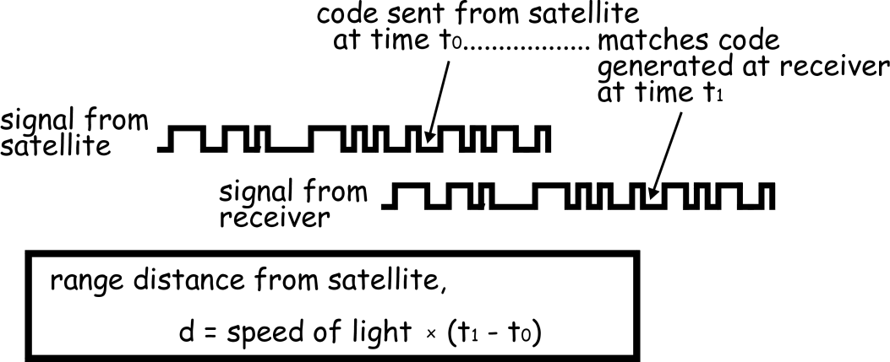
Distance from satellite
Radio waves = speed of light
  Receivers have nanosecond accuracy (0.000000001 second)
All satellites transmit same signal “string” at same time
  Difference in time from satellite to time received gives distance from satellite
Notes:
In a sense, the whole thing boils down to those "velocity times travel time" math problems we did in high school. Remember the old: "If a car goes 60 miles per hour for two hours, how far does it travel?"
Velocity (60 mph) x Time (2 hours) = Distance (120 miles)
In the case of GPS we're measuring a radio signal so the velocity is going to be the speed of light or roughly 186,000 miles per second.
The problem is measuring the travel time.

Slide 12
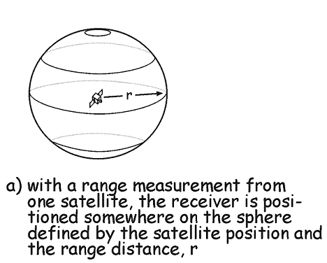
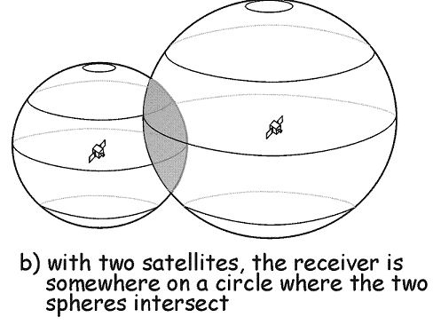
Triangulation
Notes:
Suppose we measure our distance from a satellite and find it to be 11,000 miles.
Knowing that we're 11,000 miles from a particular satellite narrows down all the possible locations we could be in the whole universe to the surface of a sphere that is centered on this satellite and has a radius of 11,000 miles.
Next, say we measure our distance to a second satellite and find out that it's 12,000 miles away.
That tells us that we're not only on the first sphere but we're also on a sphere that's 12,000 miles from the second satellite. Or in other words, we're somewhere on the circle where these two spheres intersect.

Slide 13
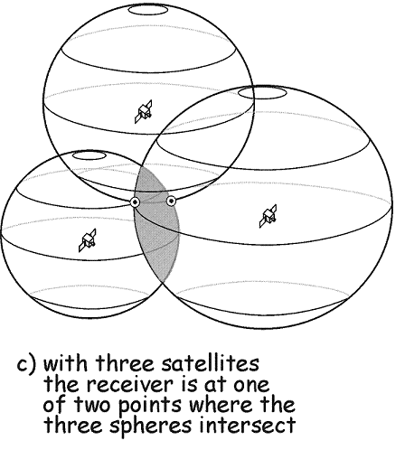
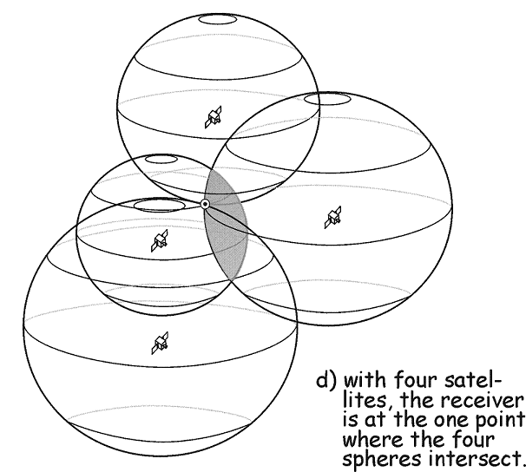
Triangulation
Notes:
If we then make a measurement from a third satellite and find that we're 13,000 miles from that one, that narrows our position down even further, to the two points where the 13,000 mile sphere cuts through the circle that's the intersection of the first two spheres.
So by ranging from three satellites we can narrow our position to just two points in space.
To decide which one is our true location we could make a fourth measurement. But usually one of the two points is a ridiculous answer (either too far from Earth or moving at an impossible velocity) and can be rejected without a measurement.
A fourth measurement does come in very handy for another reason however, but we'll tell you about that later

Slide 14
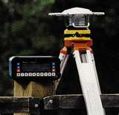
Differential GPS
Differential GPS uses the time sequence of observed errors at fixed locations to adjust simultaneous measurements at mobile receivers
A location measurement accurate to 1 cm horizontally and 2cm vertically is now possible in 3 minutes with a mobile receiver
More accurate measurements if the instrument is left in place longer

Slide 15
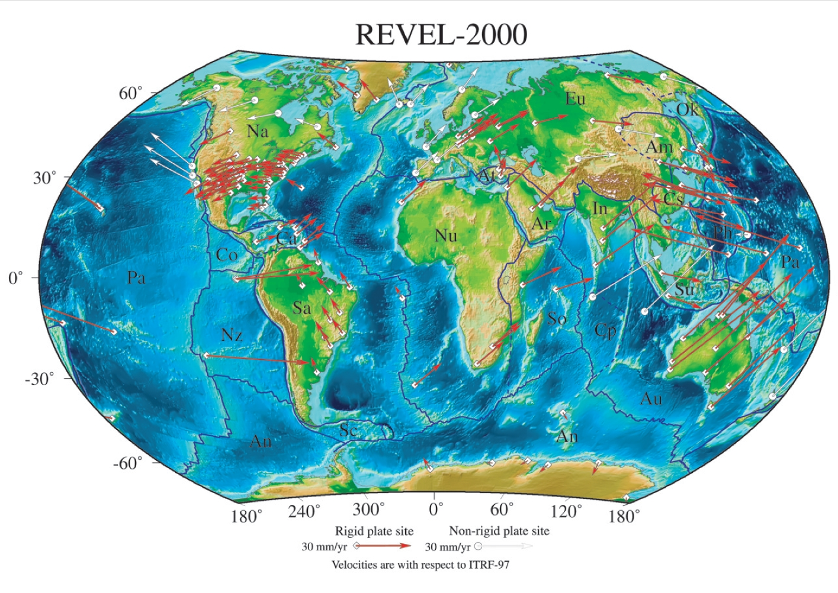
Tectonic Motions
This has to take Tectonic Motions into account
From Sella et al., 2002

Slide 16
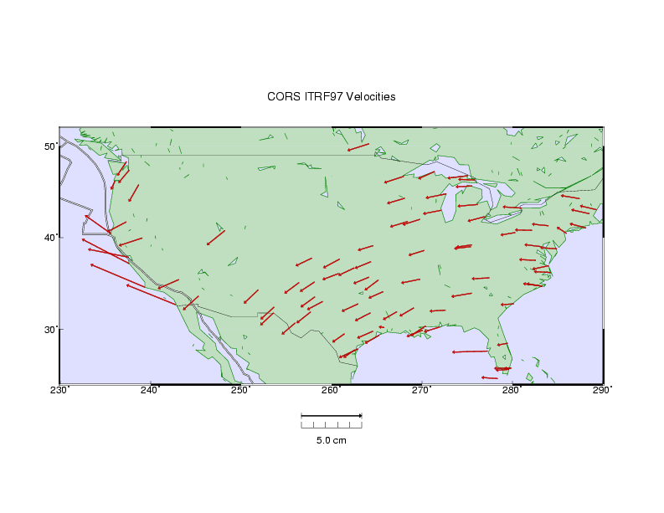

HORIZONTAL TECTONIC MOTIONS
Motion in cm/year
North American Plate
Pacific Plate
When is California not in North America …
…. when its on the Pacific Plate!

Slide 17
This leads to adjustments in locations of the national network of survey benchmarks
Survey Benchmark
{Latitude (φ), Longitude (λ), Elevation (z)}

Slide 18
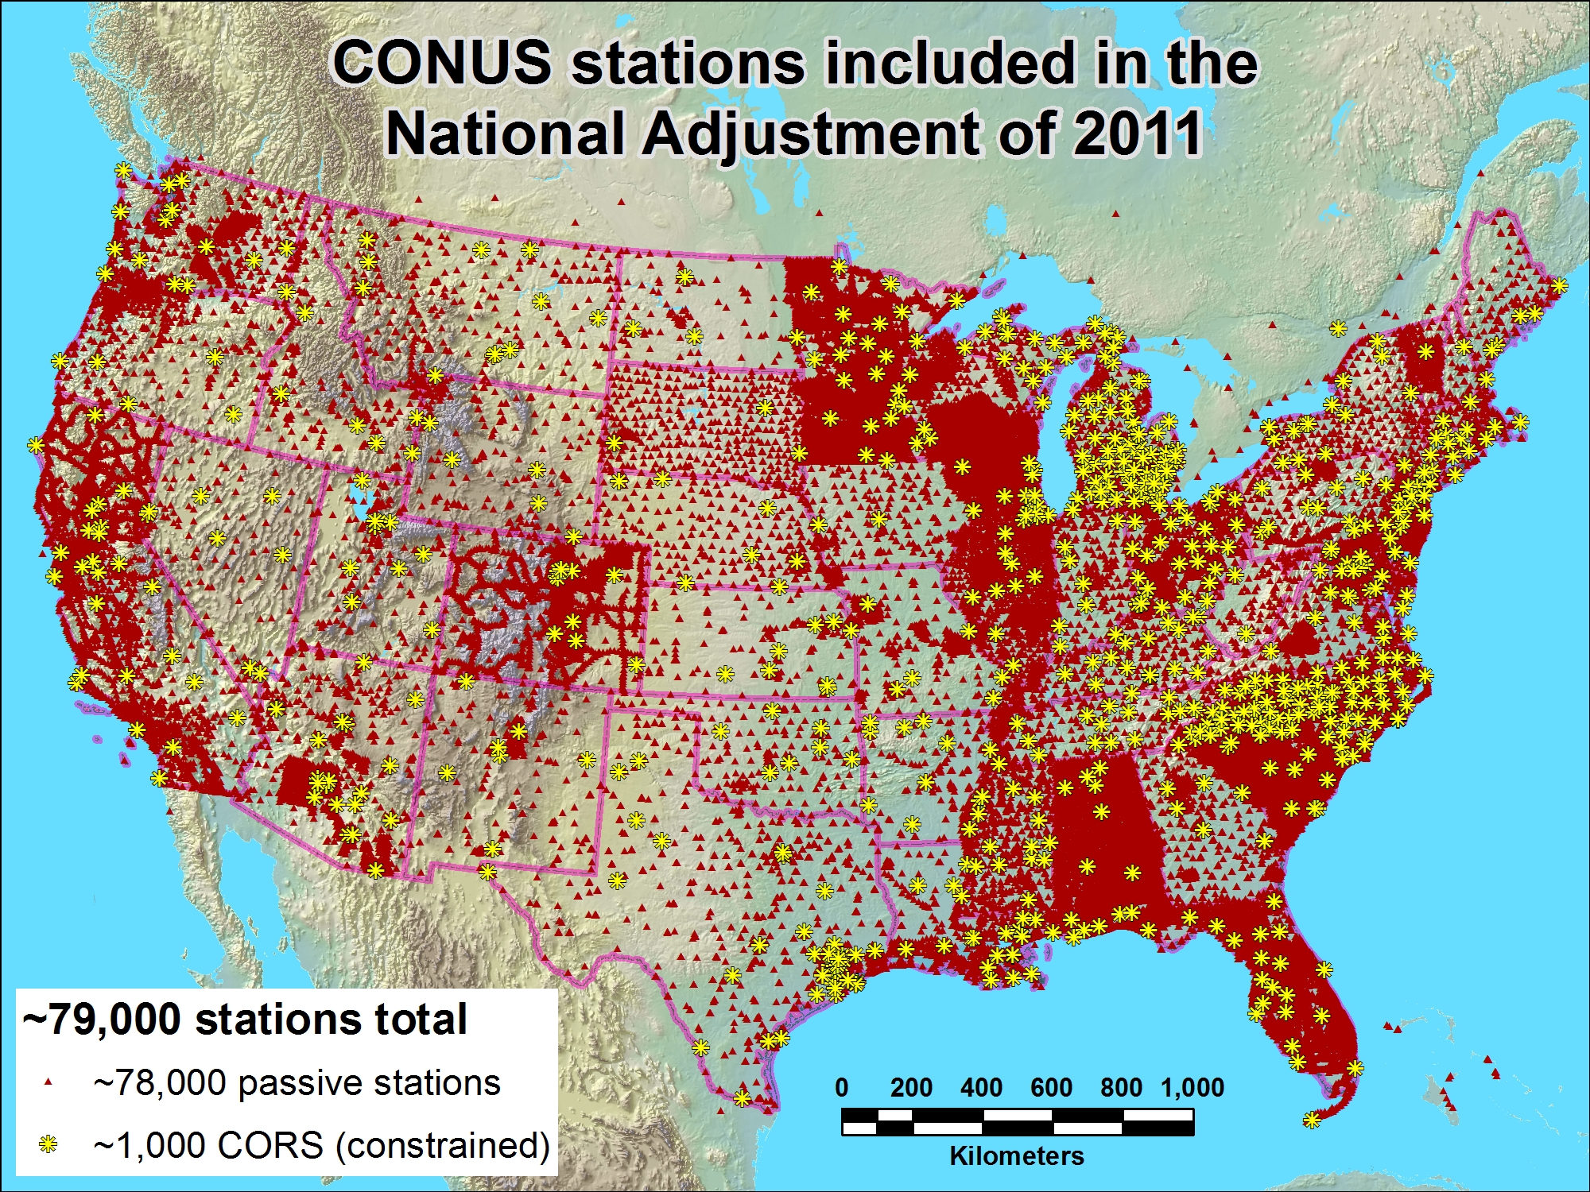

Slide 19
Geographic Coordinates (φ, λ, z)
Latitude (φ) and Longitude (λ) defined using an ellipsoid, an ellipse rotated about an axis
Elevation (z) defined using geoid, a surface of constant gravitational potential
Earth datums define standard values of the ellipsoid and geoid

Slide 20
Shape of the Earth
It is actually a spheroid, slightly larger in radius at the equator than at the poles
We think of the
earth as a sphere

Slide 21
Ellipse
An ellipse is defined by:
Focal length = ε
Distance (F1, P, F2) is
constant for all points
on ellipse
When ε = 0, ellipse = circle
Z
b
O
a
X
F₁
ε
ε
F₂
For the earth:
Major axis, a = 6378 km
Minor axis, b = 6357 km
Flattening ratio, f = (a-b)/a
~ 1/300
P

Slide 22
Ellipsoid or Spheroid
Rotate an ellipse around an axis
Z
b
O
a
Y
a
X
Rotational axis

Slide 23
Standard Ellipsoids
Ref: Snyder, Map Projections, A working manual, USGS
Professional Paper 1395, p.12

Slide 24
Geodetic Datums
World Geodetic System (WGS) – is a global system for defining latitude and longitude on earth independently of tectonic movement (military)
North American Datum (NAD) – is a system defined for locating fixed objects on the earth’s surface and includes tectonic movement (civilian)

Slide 25
Horizontal Earth Datums
An earth datum is defined by an ellipse and an axis of rotation
NAD27 (North American Datum of 1927) uses the Clarke (1866) ellipsoid on a non geocentric axis of rotation
NAD83 (NAD,1983) uses the GRS80 ellipsoid on a geocentric axis of rotation
WGS84 (World Geodetic System of 1984) uses GRS80, almost the same as NAD83

Slide 26
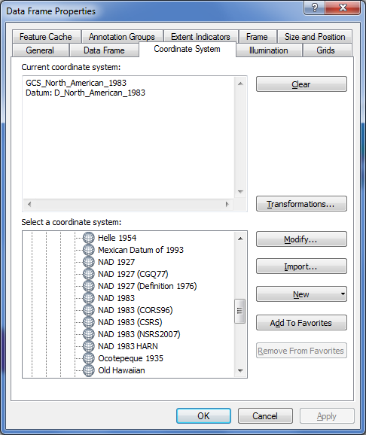

Adjustments of the NAD83 Datum
Slightly different (φ, λ) for benchmarks
Continuously Operating Reference System
Canadian Spatial Reference System
National Spatial Reference System
High Accuracy Reference Network

Slide 27
Representations of the Earth
Mean Sea Level is a surface of constant
gravitational potential called the Geoid
Sea surface
Ellipsoid
Earth surface
Geoid

Slide 28
THE GEOID AND TWO ELLIPSOIDS
CLARKE 1866 (NAD27)
GRS80-WGS84
(NAD83)
Earth Mass
Center
Approximately
236 meters
GEOID

Slide 29

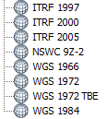
WGS 84 and NAD 83
North American Datum of 1983 (NAD 83) (Civilian Datum of US)
International Terrestrial Reference Frame (ITRF) includes updates to WGS-84 (~ 2 cm)
Earth Mass
Center
2.2 m (3-D)
dX,dY,dZ
World Geodetic System of 1984 (WGS 84) is reference frame for Global Positioning Systems
GEOID

Slide 30
Definition of Latitude, φ
m
S
p
O
n
φ
q
r
(1) Take a point S on the surface of the ellipsoid and define there the tangent plane, mn
(2) Define the line pq through S and normal to the
tangent plane
(3) Angle pqr which this line makes with the equatorial
plane is the latitude φ, of point S

Slide 31
Cutting Plane of a Meridian
P
Prime Meridian
Equator
Meridian
plane

Slide 32
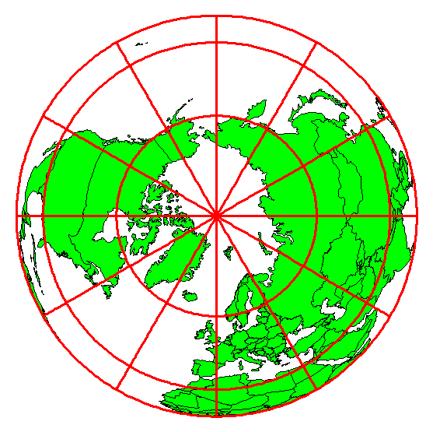
Definition of Longitude, λ
λ = the angle between a cutting plane on the prime meridian
and the cutting plane on the meridian through the point, P
180°E, W
-150°
150°
-120°
120°
90°W
(-90 °)
90°E
(+90 °)
-60°
P
λ
-60°
-30°
30°
0°E, W

Slide 33
Latitude and Longitude on a Sphere
Greenwich
meridian
Z
Meridian of longitude
N
Parallel of latitude
λ=0°
P
•
ϕ=0-90°N
λ - Geographic longitude
ϕ - Geographic latitude
W
O
ϕ
E
•
Y
λ
R
•
R - Mean earth radius
λ=0-180°W
Equator
=0°
•
ϕ
λ=0-180°E
O - Geocenter
X
ϕ=0-90°S

Slide 34

Length on Meridians and Parallels
(Lat, Long) = (φ, λ)
Length on a Meridian:
AB = R_{e} Δφ
(same for all latitudes)
R
Δλ
D
30 N
R
C
R_{e}
Δφ
B
0 N
R_{e}
Length on a Parallel:
CD = R Δλ = R_{e} Δλ Cos φ
(varies with latitude)
A

Slide 35
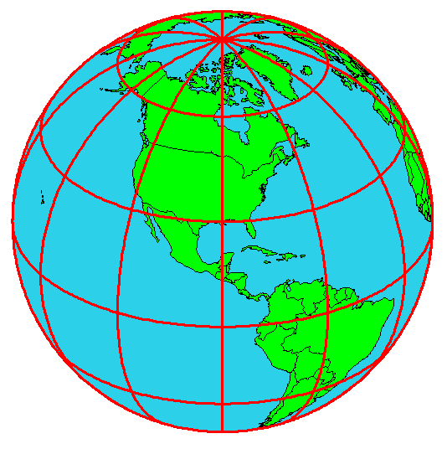
Example: What is the length of a 1º increment along
on a meridian and on a parallel at 30N, 90W?
Radius of the earth = 6370 km.
Solution:
A 1º angle has first to be converted to radians
π radians = 180 º, so 1º = π/180 = 3.1416/180 = 0.0175 radians
For the meridian, ΔL = R_{e} Δφ = 6370 ∗ 0.0175 = 111 km
For the parallel, ΔL = R_{e} Δλ Cos φ
= 6370 ∗ 0.0175 ∗ Cos 30
= 96.5 km
Parallels converge as poles are approached

Slide 36
Curved Earth Distance
(from A to B)
Shortest distance is along a “Great Circle”
A “Great Circle” is the intersection of a sphere with a plane going through its center.
1. Spherical coordinates converted to Cartesian coordinates.
2. Vector dot product used to calculate angle α from latitude and longitude
3. Great circle distance is Rα, where R=6378.137 km²
Z
B
A
α
•
Y
X
Ref: Meyer, T.H. (2010), Introduction to Geometrical and Physical Geodesy, ESRI Press, Redlands, p. 108

Slide 37
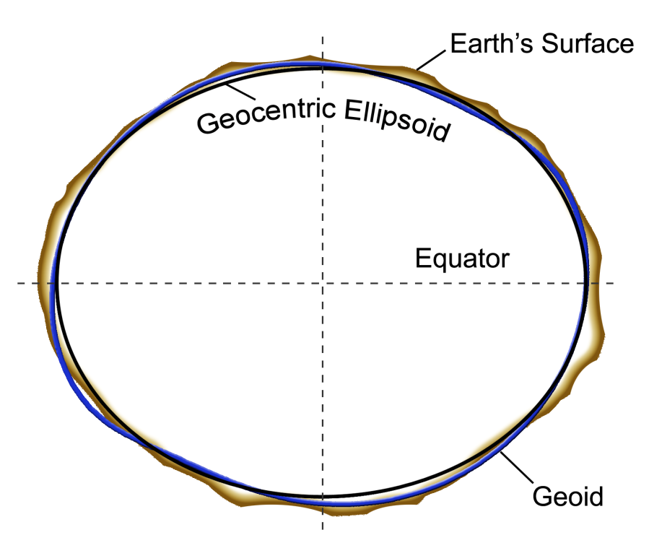
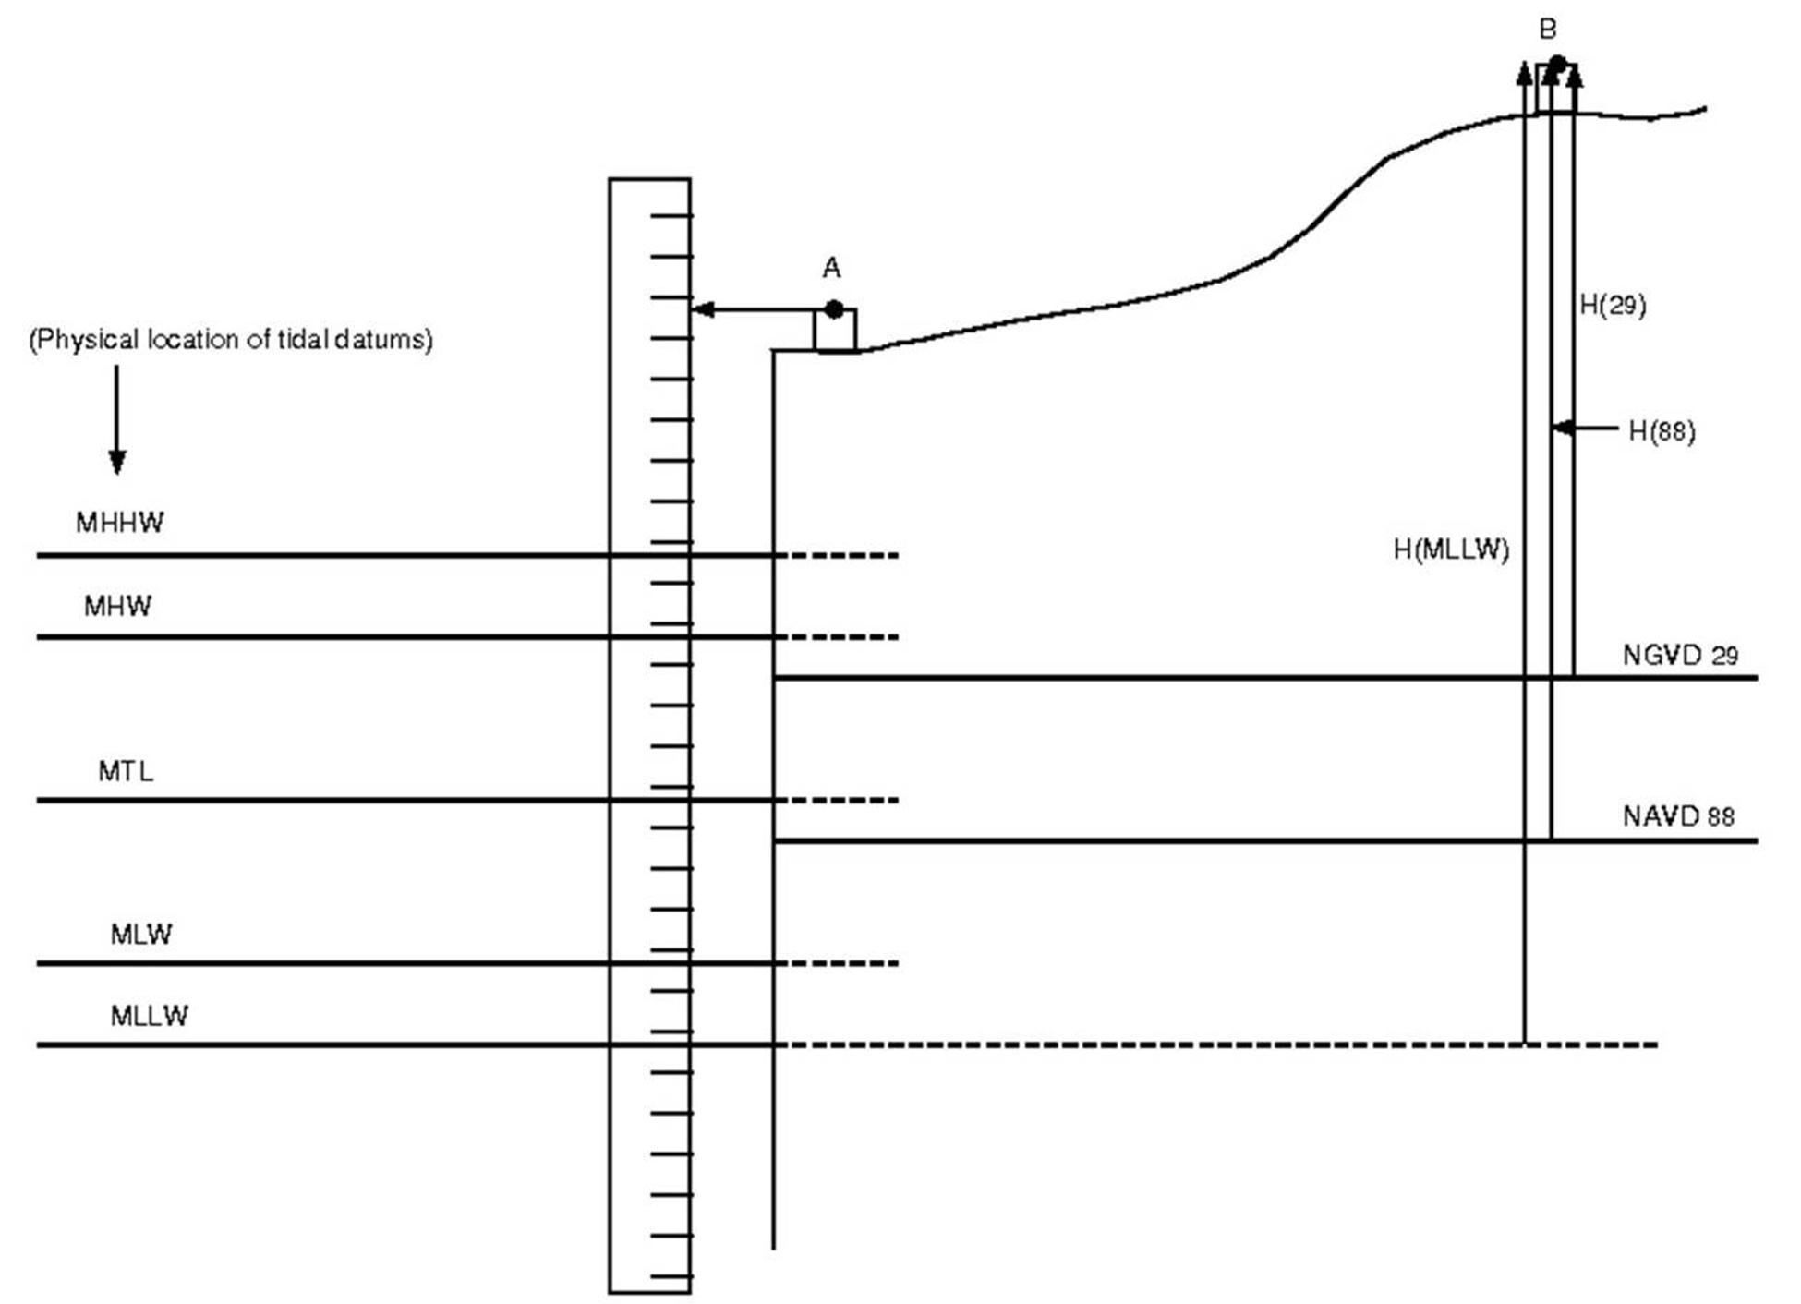
Three systems for measuring elevation
Orthometric heights
(land surveys, geoid)
Ellipsoidal heights
(lidar, GPS)
Tidal heights
(Sea water level)
Conversion among these height systems has some uncertainty

Slide 38
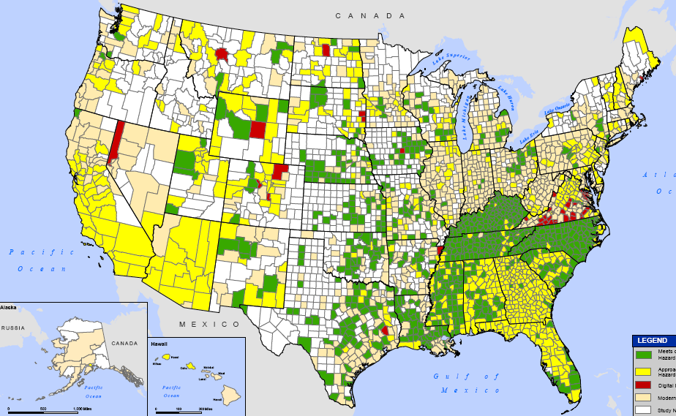
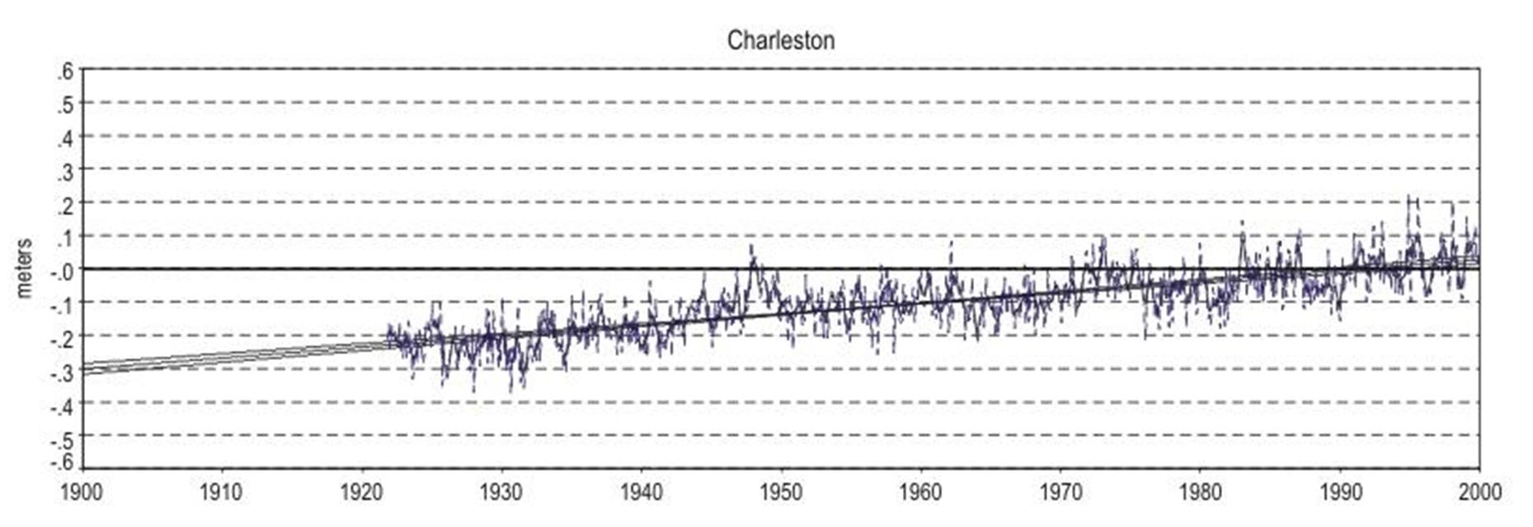
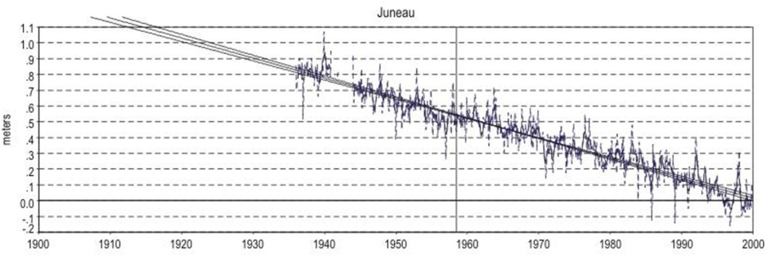
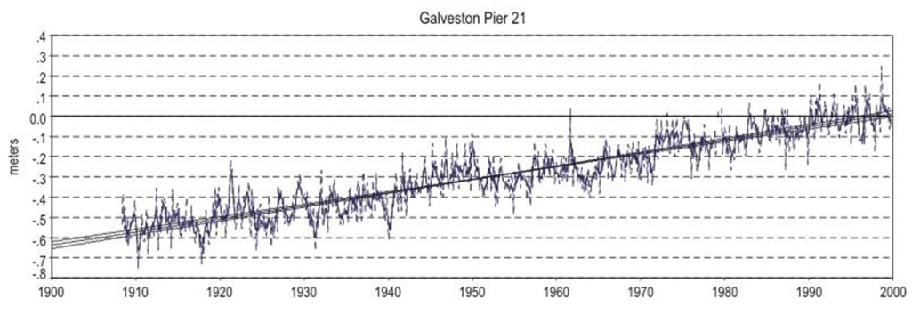
Trends in Tide Levels
(coastal flood risk is changing)
Charleston, SC
+ 1.08 ft/century
1900
2000
Galveston, TX
+ 2.13 ft/century
- 4.16 ft/century
1900
2000
Juneau, AK
1900
2000

Slide 39
Geoid and Ellipsoid
Earth surface
Ellipsoid
Ocean
Geoid
Gravity Anomaly
Gravity anomaly is the elevation difference between
a standard shape of the earth (ellipsoid) and a surface
of constant gravitational potential (geoid)

Slide 40
Definition of Elevation
Elevation Z
P
z = z_{p}
•
z = 0
Land Surface
Mean Sea level = Geoid
Elevation is measured from the Geoid

Slide 41
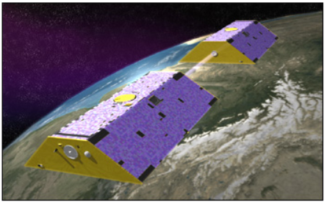
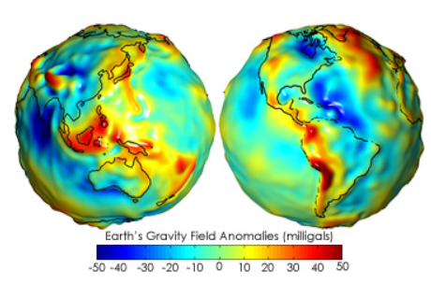
Gravity Recovery and Climate Experiment (GRACE)
http://earthobservatory.nasa.gov/Features/GRACE/
NASA Mission launched in 2002
Designed to measure gravity anomaly of the earth
Two satellites, 220 km apart, one leading, one trailing
Distance between them measured by microwave to 2µm
High gravity force pulls satellites together
Lower gravity force, lets them fly apart more
Gravity anomaly = difference from average

Slide 42
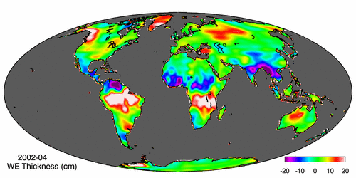
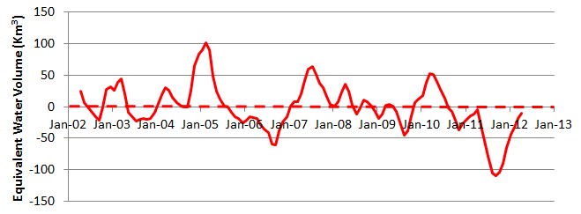
Gravity Recovery and Climate Experiment (GRACE)
Force of gravity responds to changes in water volume
Water is really heavy! Gravity is varying in time and space.
Gravity Anomaly of Texas, 2002 – 2012
Normal
In 2011, we lost 100 Km³ of water or 3 Lake Mead’s

Slide 43
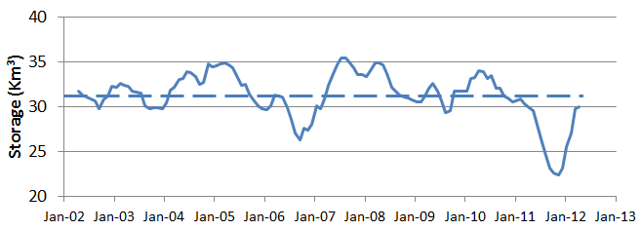

GRACE and Texas Reservoir Water Storage
Surface water reservoir storage is closely correlated with the GRACE data
Grace Satellites
Normal
In 2011 we lost 100 Km³ of water overall
Surface Water Reservoirs
Normal
In 2011 we lost 9 Km³ of water from reservoirs

Slide 44
Vertical Earth Datums
A vertical datum defines elevation, z
NGVD29 (National Geodetic Vertical Datum of 1929)
NAVD88 (North American Vertical Datum of 1988)
takes into account a map of gravity anomalies between the ellipsoid and the geoid

Slide 45
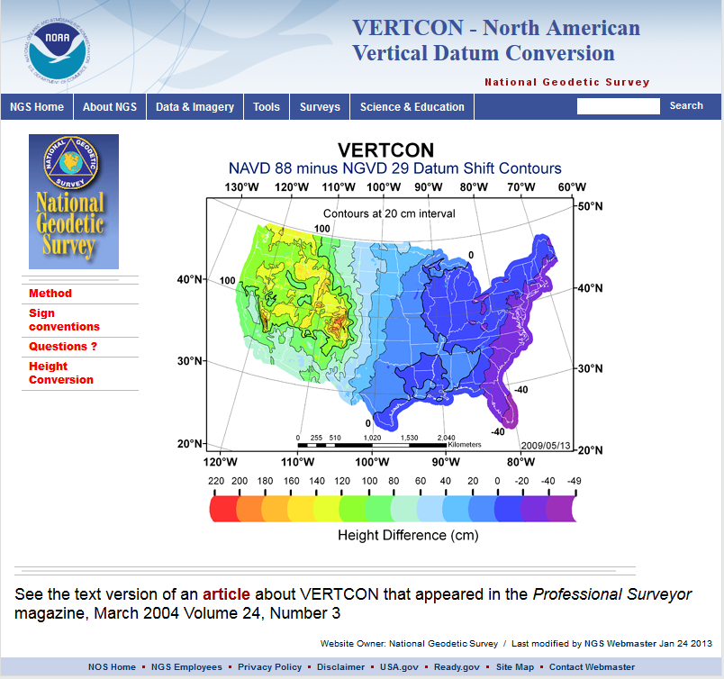
Converting Vertical Datums
VERTCON (not in ArcInfo)
  http://www.ngs.noaa.gov/TOOLS/Vertcon/vertcon.html
  Tool http://www.ngs.noaa.gov/cgi-bin/VERTCON/vert_con.prl

Slide 46
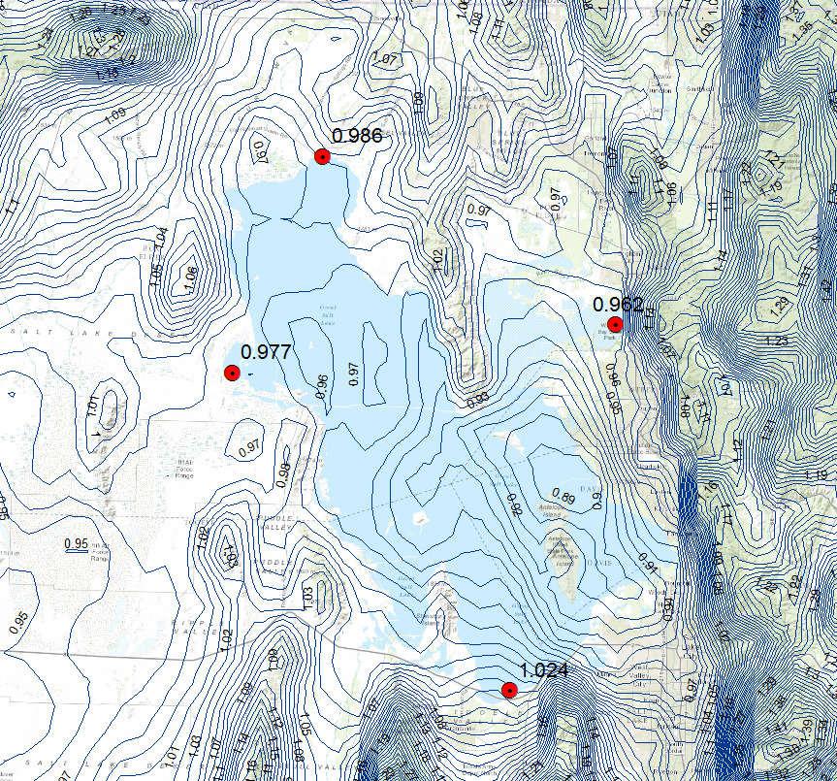
Geodetic Datum differences in the Great Salt Lake Region
NAVD88-NGVD29 from http://download.osgeo.org/proj/vdatum/vertcon/
Surprising that differences vary by up to 0.1 m (4 inches) across the extent of the GSL
National Elevation dataset uses NAVD 88
GSL Level records use NGVD29

Slide 47
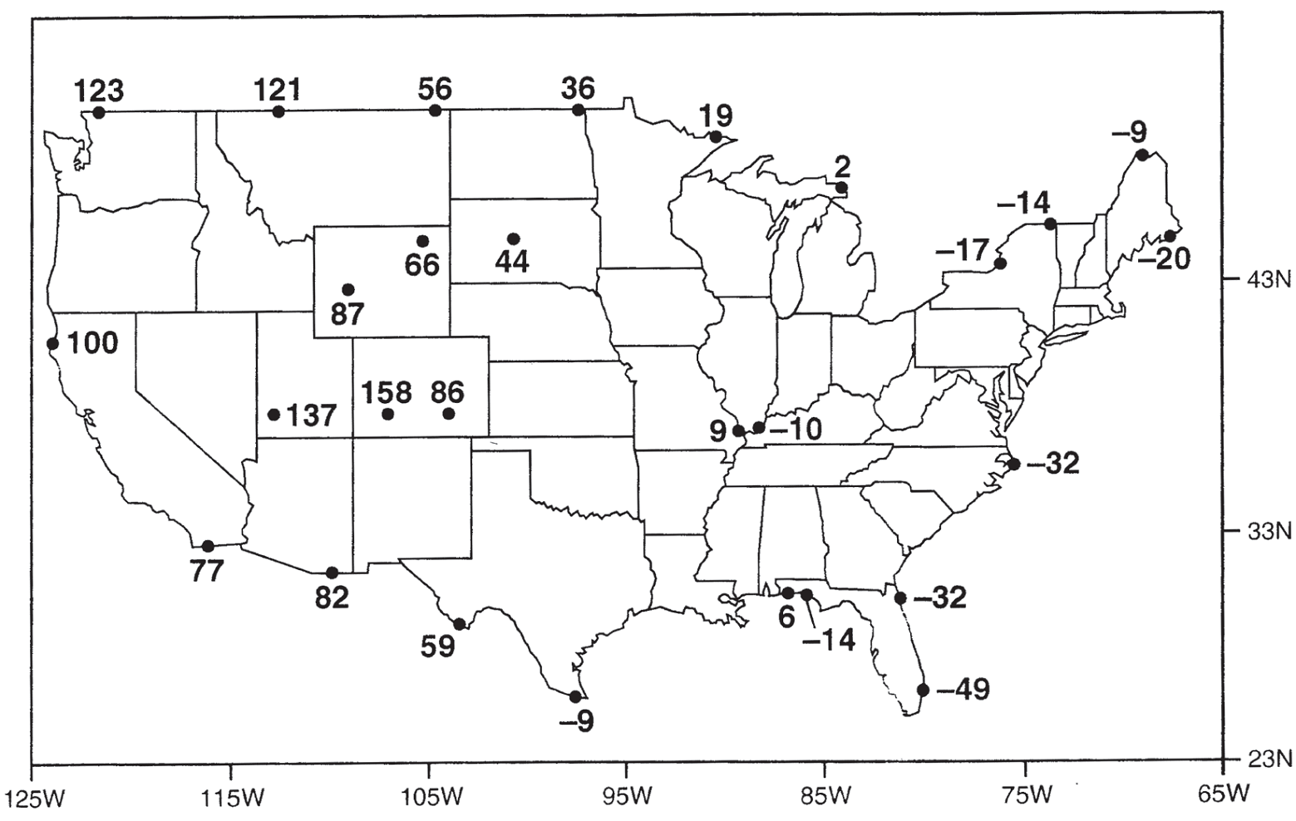
Importance of geodetic datums
NAVD88 – NGVD29 (cm)
NGVD29 higher in East
More than 1 meter difference
NAVD88 higher in West
Orthometric datum height shifts are significant relative to BFE accuracy, so standardization on NAVD88 is justified

Slide 48
Geodesy and Map Projections
Geodesy - the shape of the earth and definition of earth datums
Map Projection - the transformation of a curved earth to a flat map
Coordinate systems - (x,y) coordinate systems for map data

Slide 49
Earth to Globe to Map
Map Scale:
Map Projection:
Representative Fraction
Globe distance
Earth distance
Scale Factor, k
Map distance
Globe distance
=
=
(e.g. 1:24,000)
(e.g. 0.9996)

Slide 50
Geographic and Projected Coordinates
(φ, λ)
(x, y)
Map Projection

Slide 51
Types of Projections
Conic (Albers Equal Area, Lambert Conformal Conic) - good for East-West land areas
Cylindrical (Transverse Mercator) - good for North-South land areas
Azimuthal (Lambert Azimuthal Equal Area) - good for global views

Slide 52
Conic Projections
(Albers, Lambert)

Slide 53
Cylindrical Projections
(Mercator)
Transverse
Oblique

Slide 54
Azimuthal
(Lambert)

Slide 55
Albers Equal Area Conic Projection
Land area preservation is really important in hydrology
k x 1/k = 1 preserves area
1/k
k
Area is preserved because k on meridians is inverse of k on parallels
Scale factor k
Map distance
Globe distance
k =

Slide 56
Lambert Conformal Conic Projection

Slide 57
Universal Transverse Mercator Projection

Slide 58
Lambert Azimuthal Equal Area Projection

Slide 59
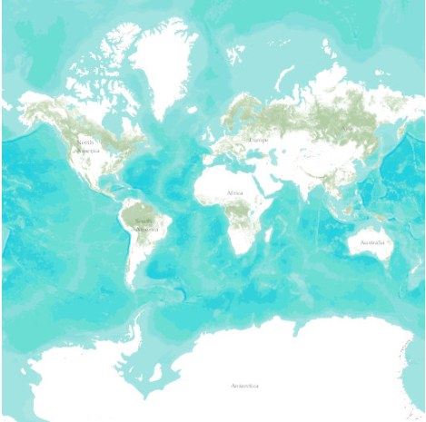
Web Mercator Projection
(used for ESRI Basemaps)
Web Mercator is one of the most popular coordinate systems used in web applications
Fits the entire globe into a square area that can be covered by 256 by 256 pixel tiles useful for caching maps at different scales for web applications
Maintains accuracy of local shapes important for web visualization
The spatial reference for the ArcGIS Online / Google Maps / Bing Maps tiling scheme is WGS 1984 Web Mercator (Auxiliary Sphere).

Slide 60
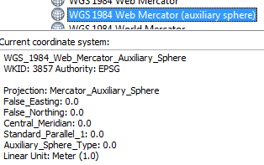
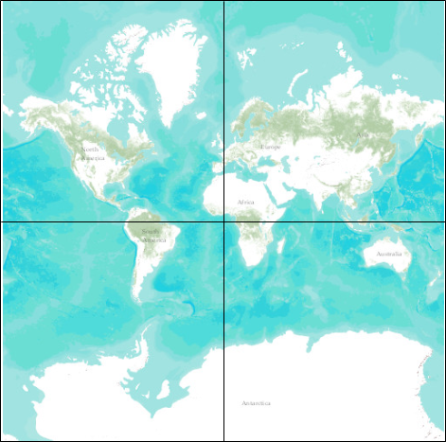
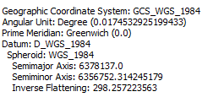
Web Mercator Parameters
(20037, 19971 km)
= earth rad * Π
Standard Parallel
(0,0)
6357 km
Away from the equator, significantly inaccurate length and area are obtained if computed using Web Mercator coordinates
6378 km
Earth radius
Central Meridian

Slide 61
Projections Preserve Some
Earth Properties
Area - correct earth surface area (Albers Equal Area) important for mass balances
Shape - local angles are shown correctly (Lambert Conformal Conic, Web Mercator)
Direction - all directions are shown correctly relative to the center (Lambert Azimuthal Equal Area)
Distance - preserved along particular lines
Some projections preserve two properties

Slide 62
Projection and Datum
Two datasets can differ in both the projection and the datum, so it is important to know both for every dataset.

Slide 63
Geodesy and Map Projections
Geodesy - the shape of the earth and definition of earth datums
Map Projection - the transformation of a curved earth to a flat map
Coordinate systems - (x,y) coordinate systems for map data

Slide 64
Coordinate Systems
Universal Transverse Mercator (UTM) - a global system developed by the US Military Services
State Plane Coordinate System - civilian system for defining legal boundaries
Texas Centric Mapping System - a statewide coordinate system for Texas

Slide 65
Coordinate System
A planar coordinate system is defined by a pair
of orthogonal (x,y) axes drawn through an origin
Y
Origin
X
(x_{o},y_{o})
(φ_{o},λ_{o})

Slide 66
Universal Transverse
Mercator
Uses the Transverse Mercator projection
Each zone has a Central Meridian (λ_{o}), zones are 6° wide, and go from pole to pole
60 zones cover the earth from East to West
Reference Latitude (φ_{o}), is the equator
(Xshift, Yshift) = (x_{o},y_{o}) = (500000, 0) in the Northern Hemisphere, units are meters

Slide 67
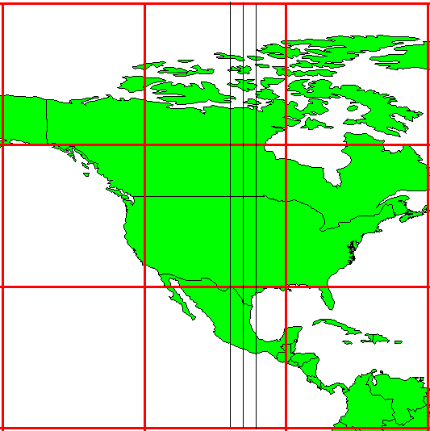
UTM Zone 14
-99°
-102°
-96°
6°
Origin
Equator
-120°
-90 °
-60 °

Slide 68
State Plane Coordinate System
Defined for each State in the United States
East-West States (e.g. Texas) use Lambert Conformal Conic, North-South States (e.g. California) use Transverse Mercator
Texas has five zones (North, North Central, Central, South Central, South) to give accurate representation
Greatest accuracy for local measurements

Slide 69
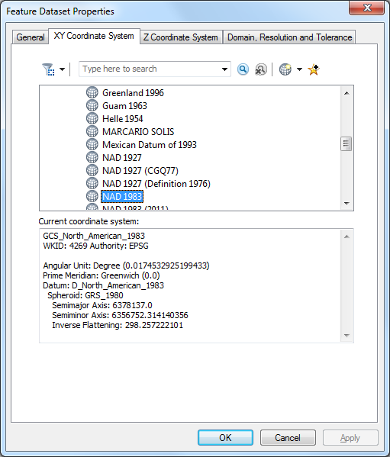
ArcGIS Spatial Reference
Defined for a feature dataset in ArcCatalog
XY Coordinate System
  Projected
  Geographic
Z Coordinate system
Domain, resolution and tolerance

Slide 70
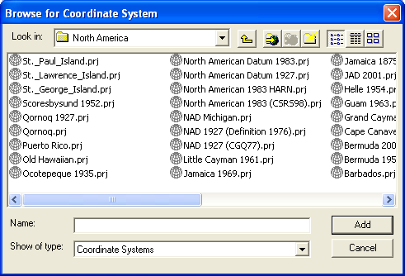
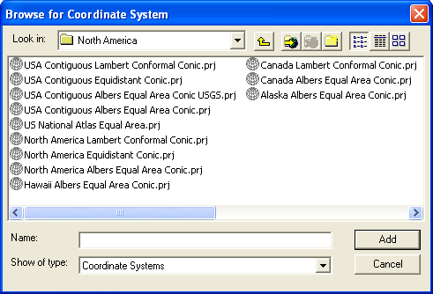
Horizontal Coordinate Systems
Geographic coordinates (decimal degrees)
Projected coordinates (length units, ft or meters)

Slide 71
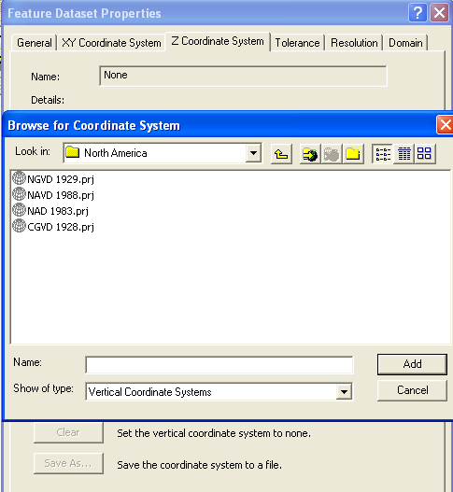
Vertical Coordinate Systems
None for 2D data
Necessary for 3D data

Slide 72


ArcGIS .prj files

Slide 73




Distances in Projected Coordinate Systems
Pythagoras Theorem
$${L^{2}=∆x}^{2}+{∆y}^{2}$$
$$L=\sqrt{∆x^{2}+{∆y}^{2}}$$
$=sqrt({\left(167061−1299211\right)}^{2}+$
L
$${\left(802664−2190785\right)}^{2})$$
$$L=1791268 m=1791 km$$
Coordinates in USA Contiguous Albers Equal Area Conic USGS
From ArcGIS Add Geometry Attributes tool

Slide 74
Summary Concepts
The coordinate system of a dataset comprises
  Its measurement framework (geographic or projected)
  Units of measurement
  Definition of map projection (for projected coordinates)
  Origin, datum and projection parameters such as spheroid of reference, standard parallels, central meridian and shifts in x and y directions (false easting and northing)

Slide 75
Summary Concepts (Cont.)
The spatial reference of a dataset comprises the coordinate system and properties such as tolerance, precision and extent.
For consistent analysis the spatial reference of data sets should be the same.
ArcGIS does projection on the fly so can display data with different spatial references properly if they are properly specified.
ArcGIS terminology
  Define projection. Specify the projection for some data without changing the data.
  Project. Change the data from one projection to another.

Slide 76
Summary Concepts (Cont.)
Two basic locational systems: geometric or Cartesian (x, y, z) and geographic or gravitational (φ, λ, z)
Mean sea level surface or geoid is approximated by an ellipsoid to define an earth datum which gives (φ, λ) and distance above geoid gives (z)

Slide 77
Summary Concepts (Cont.)
To prepare a map, the earth is first reduced to a globe and then projected onto a flat surface
Three basic types of map projections: conic, cylindrical and azimuthal
A particular projection is defined by a datum, a projection type and a set of projection parameters

Slide 78
Summary Concepts (Cont.)
Standard coordinate systems use particular projections over zones of the earth’s surface
Types of standard coordinate systems: UTM, State Plane
Web Mercator coordinate system (WGS84 datum) is standard for ArcGIS basemaps and web based mapping

