Slide 1
GIS in Water Resources Midterm Review 2018

Slide 2
Blooms Taxonomy of Educational Objectives
6. Evaluation – advantages and limitations
of alternative approaches
Final Exam
5. Synthesis – bring new knowledge
together
Term Project
4. Analysis – break a problem into
parts and solve sequentially
Numerical
problems
3. Application – calculate a formula
Midterm
2. Comprehension – what does it mean?
Define,
explain,
illustrate
1. Knowledge – basic facts

Slide 3
GISWR 2018 Review for Midterm
Using ArcGIS for Water Resources
Location and Measurement on the earth
Spatial Analysis
Hydrologic Analysis

Slide 4
GISWR 2018 Review for Midterm
Using ArcGIS for Water Resources
Location and Measurement on the earth
Spatial Analysis
Hydrologic Analysis

Slide 5
Geographic Data Model
“All geographic information systems are built using formal models that describe how things are located in space. A formal model is an abstract and well-defined system of concepts. A geographic data model defines the vocabulary for describing and reasoning about the things that are located on the earth. Geographic data models serve as the foundation on which all geographic information systems are built.”
Scott Morehouse, Preface to “Modeling our World”, First Edition. He was the chief software engineer at ESRI
Or, more simply: the way that data is organized can enhance or inhibit the analysis that can be done

Slide 6
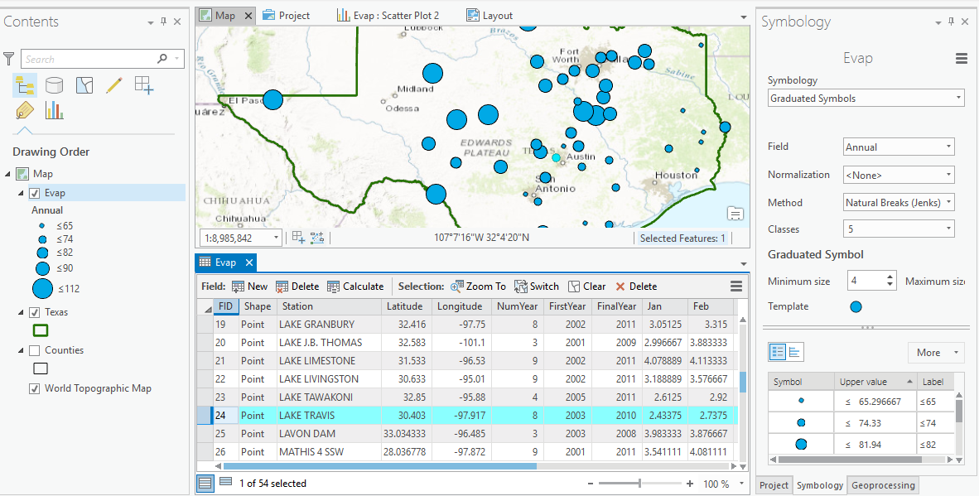
GIS: Map Features and Tabular Records

Slide 7
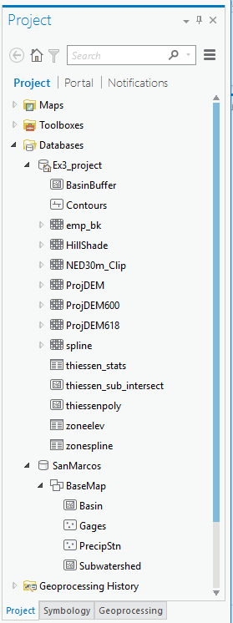
Databases and their components
Geodatabase
Raster
Table
Feature Dataset
Feature Class

Slide 8
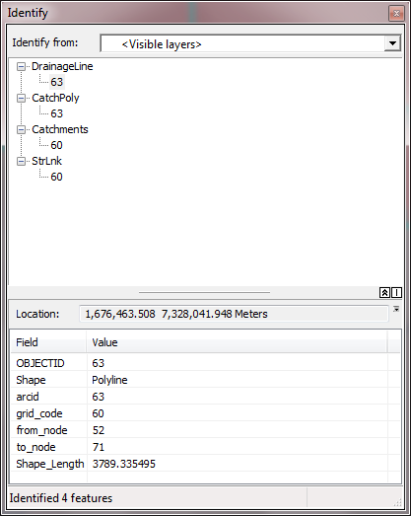
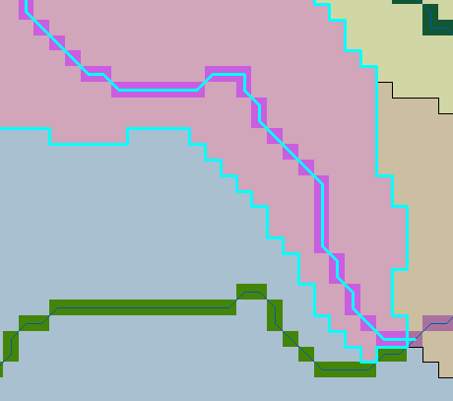
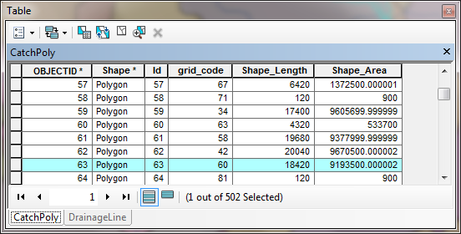
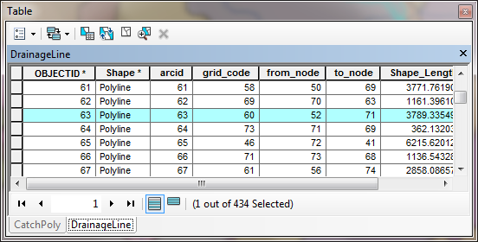
Database keys, values and relationships in support of analysis
The grid values for Catchments and the corresponding StrLnk rasters are the same. These values are inherited by the gridcode attribute of DrainageLine and CatchPoly thereby providing a one to one association between drainage lines and the subwatershed polygon that drains to them.

Slide 9
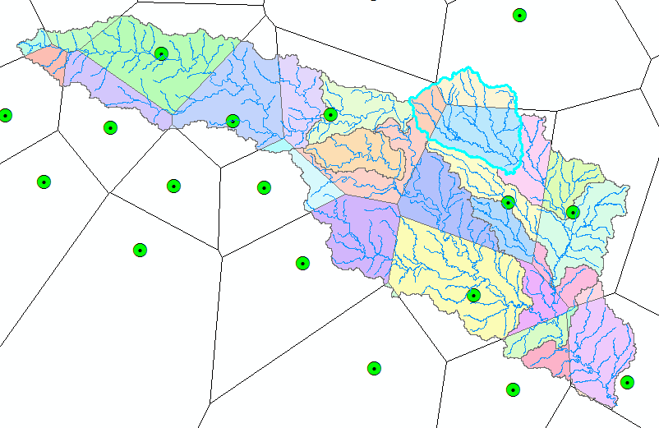
Subwatershed Precipitation by Thiessen Polygons
Thiessen Polygons
Intersect with Subwatersheds
Evaluate A*P Product
Summarize by subwatershed
$$P_{i}=\frac{\sum_{k}{A_{ik}P_{k}}}{\sum_{k}{A_{ik}}}$$

Slide 10
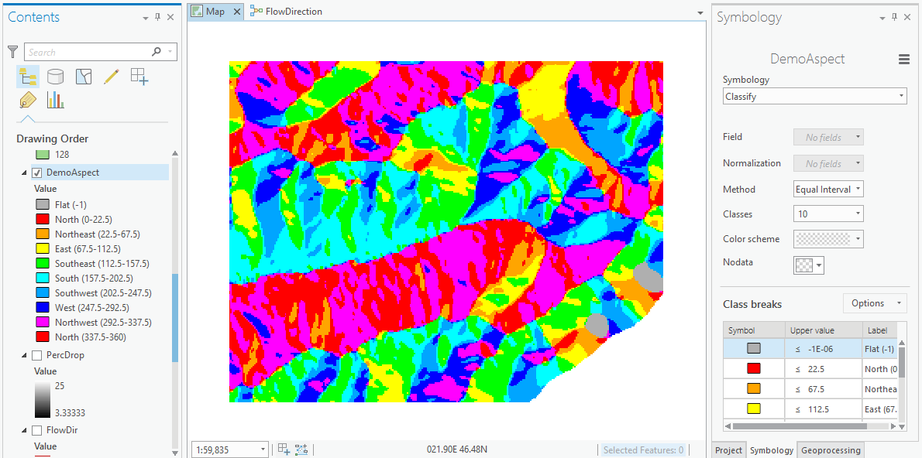
Visualization and Map Symbology

Slide 11
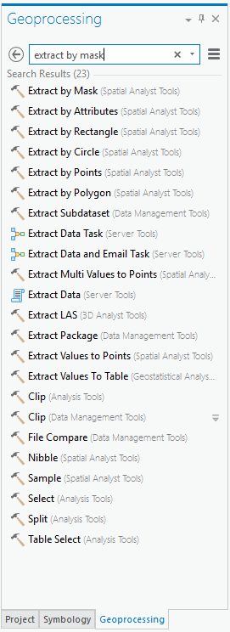
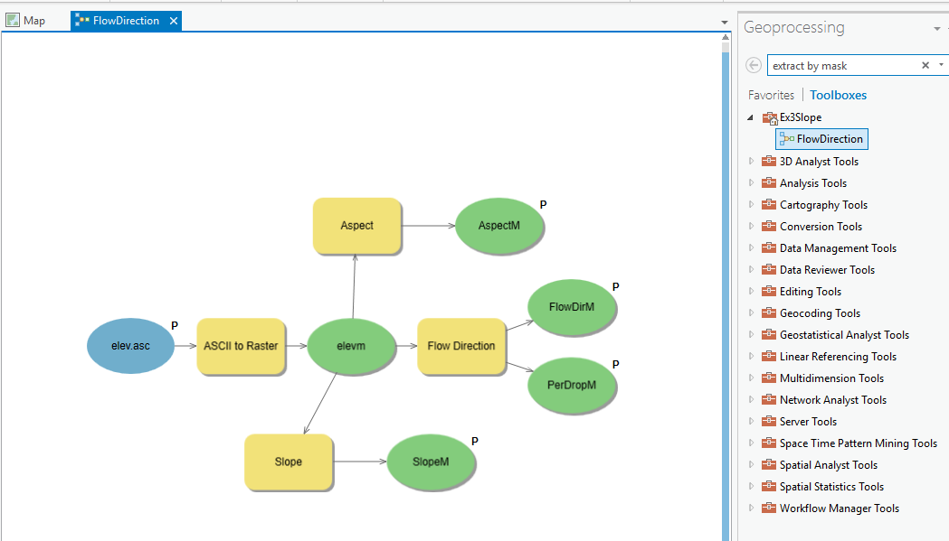
Analysis using Geoprocessing
Tools and Toolboxes
Model Builder for executing Workflows

Slide 12
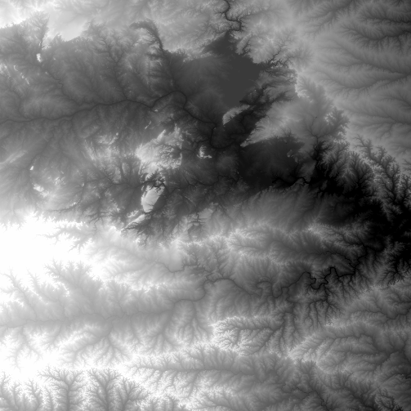
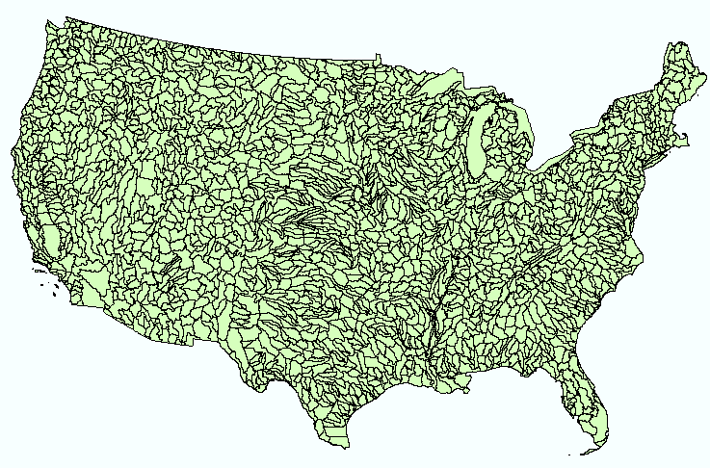
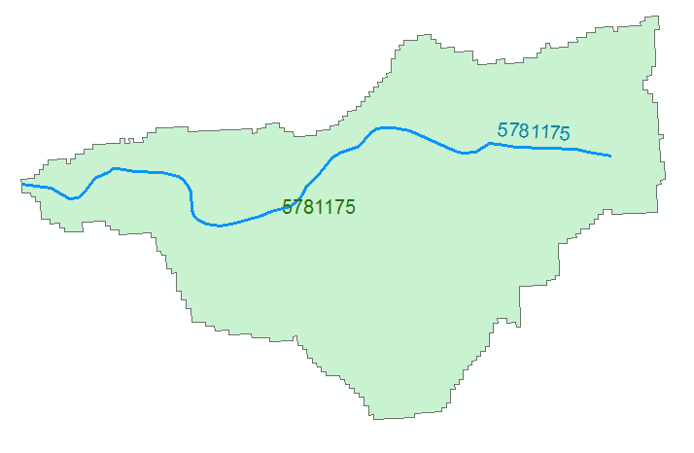
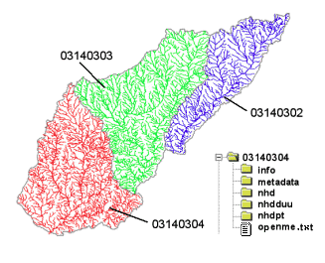
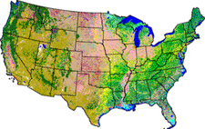
NHDPlus Version 2.1
Foundation for a Geospatial Hydrologic Framework for the United States
NHDPlus
2.7 million reach catchments in US
average area 3 km²
reach length 2 km
Uniquely labelled
National Elevation Dataset
Watershed Boundary Dataset
National Hydrography Dataset
National Land Cover Dataset

Slide 13
National Water Prediction Model Configurations
Four Forecasting Horizons for National Water Model
Analysis & Assimilation
Short-Range
‘Flood Prediction’
Medium Range
‘Flow Prediction’
Long Range
‘Water Resources’
Cycling Frequency
Hourly
3-Hourly
Daily
~Daily (x16)
Forecast Duration
- 3 hrs
0-2 days
0-10 days
0-30 days
Spatial Discretization & Routing
1km/250m/NHDPlus Reach
1km/250m/NHDPlus Reach
1km/250m/NHDPlus Reach
1 km/catchment /NHDPlus Reach
Meteorological Forcing
MRMS blend/ HRRR-NAM bkgnd.
Downscaled HRRR /RAP/NAM blend
Short-range + Downscaled GFS
Downscaled & bias-corrected CFS

Slide 14
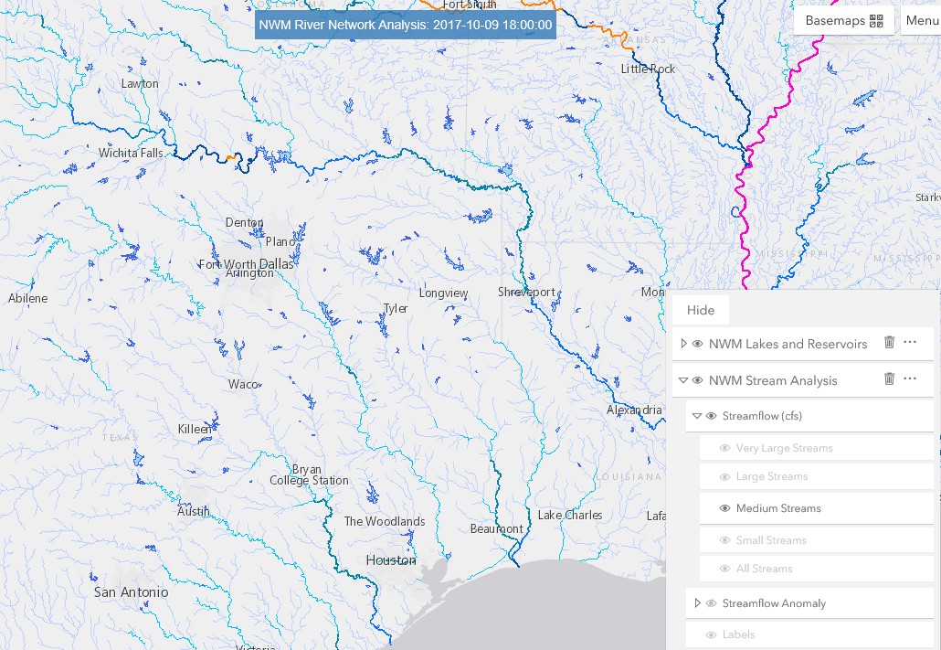
NWM Forecast Viewer
http://water.noaa.gov/map

Slide 15
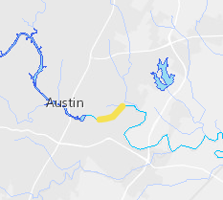
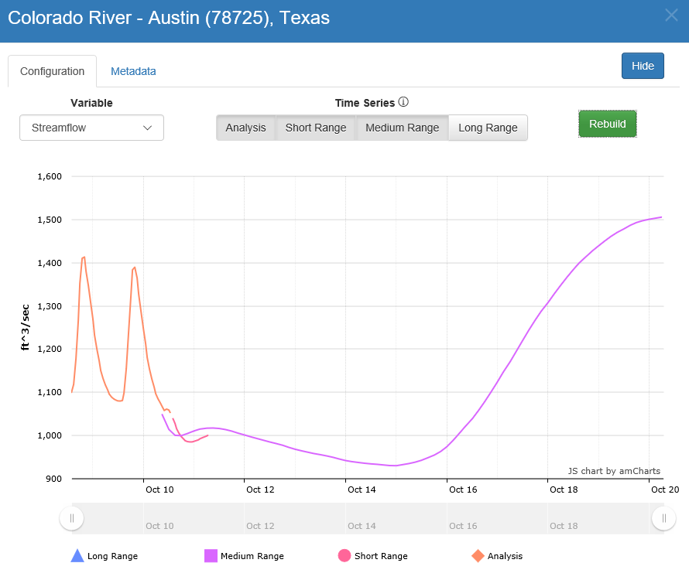
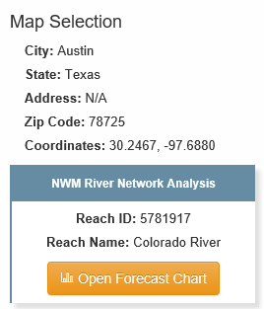
Streamflow Forecast
http://water.noaa.gov/map

Slide 16
GISWR 2018 Review for Midterm
Using ArcGIS for Water Resources
Location and Measurement on the earth
Spatial Analysis
Hydrologic Analysis

Slide 17
Readings on Map Projections
What are Map Projections
http://desktop.arcgis.com/en/arcmap/latest/map/projections/what-are-map-projections.htm
Geographic Coordinate Systems
http://desktop.arcgis.com/en/arcmap/latest/map/projections/about-geographic-coordinate-systems.htm
Map Projections
http://desktop.arcgis.com/en/arcmap/latest/map/projections/about-map-projections.htm
Projection Types
http://desktop.arcgis.com/en/arcmap/latest/map/projections/projection-types.htm

Slide 18
Definition of Latitude, φ
m
S
p
O
n
φ
q
r
(1) Take a point S on the surface of the ellipsoid and define there the tangent plane, mn
(2) Define the line pq through S and normal to the
tangent plane
(3) Angle pqr which this line makes with the equatorial
plane is the latitude φ, of point S

Slide 19
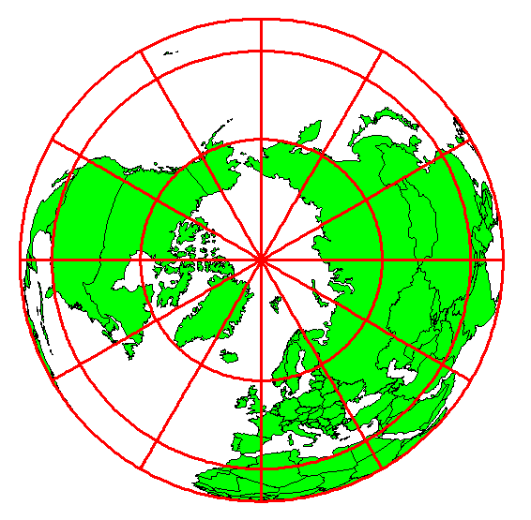
Definition of Longitude, λ
λ = the angle between a cutting plane on the prime meridian
and the cutting plane on the meridian through the point, P
180°E, W
-150°
150°
-120°
120°
90°W
(-90 °)
90°E
(+90 °)
-60°
P
λ
-60°
-30°
30°
0°E, W

Slide 20
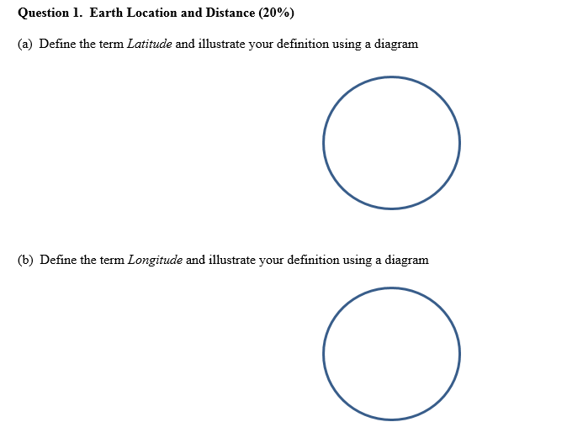
Questions on Earth Location and Distance

Slide 21
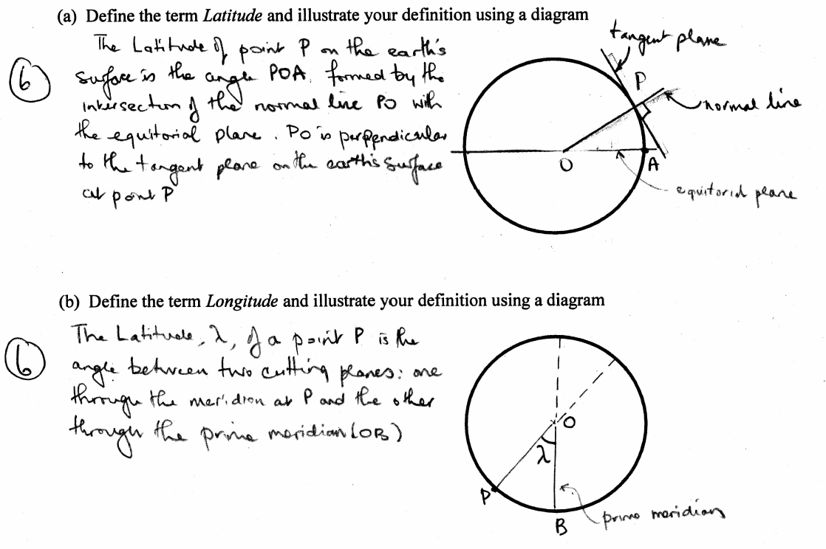

Slide 22
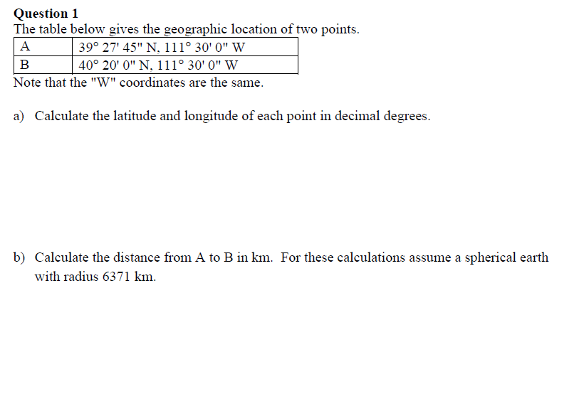
Questions on Geographic Coordinates

Slide 24
Length on Meridians and Parallels
(Lat, Long) = (φ, λ)
Length on a Meridian:
AB = R_{e} Δφ
(same for all latitudes)
R
Δλ
D
30 N
R
C
R_{e}
Δφ
B
0 N
R_{e}
Length on a Parallel:
CD = R Δλ = R_{e} Δλ Cos φ
(varies with latitude)
A

Slide 25
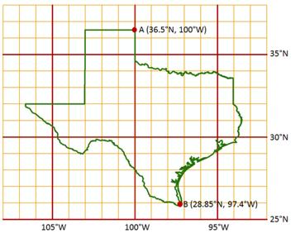
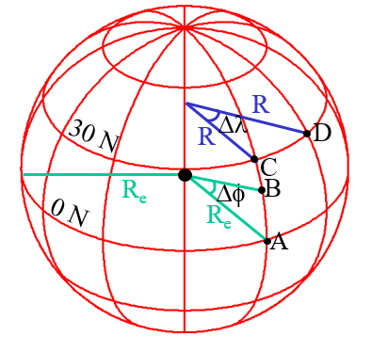
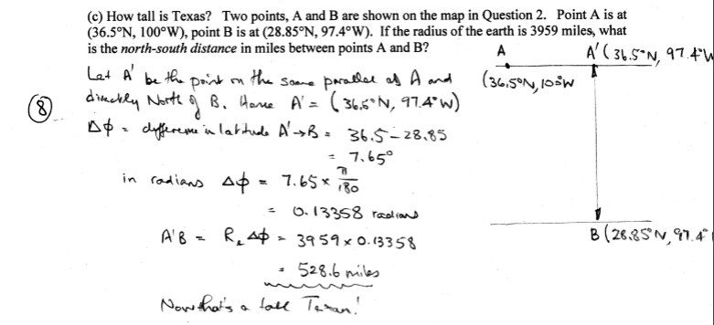
Calculating Length on Meridians and Parallels

Slide 26
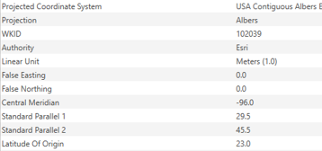
Points of Origin in Homework 1
Projected (X_{o},Y_{o}) = (0, 0) meters
Geographic (φ_{o},λ_{o}) = (23°N, 96°W)

Slide 27
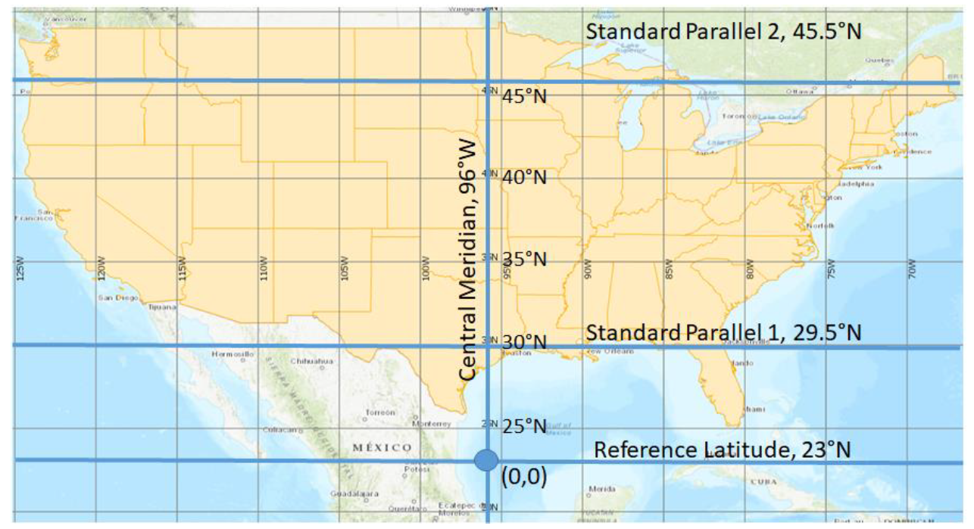
Homework 1 Map

Slide 28
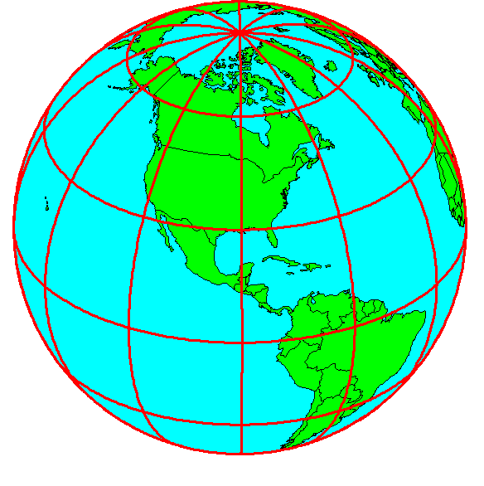
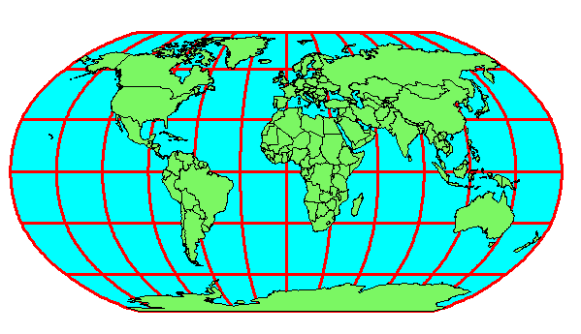
Geospatial Reference Frames
A planar coordinate system is defined by a pair
of orthogonal (x,y) axes drawn through an origin
Y
Origin
X
(x_{o},y_{o})
(φ_{o},λ_{o})
Projected Coordinates
Geographic Coordinates

Slide 29
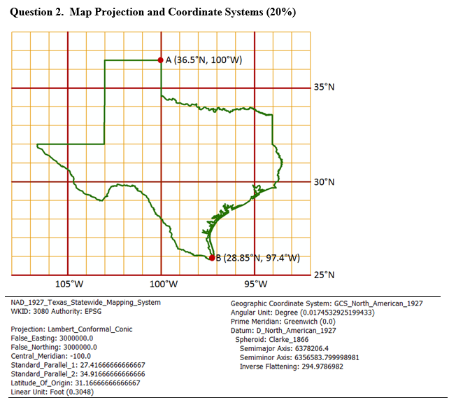
Questions on Geospatial Reference Frame
A map of Texas and a set of map projection parameters for the state are given above.
(a) Please draw and label on the map: the central meridian, the latitude of origin, and the two standard parallels.
(b) Give the numerical values (in degrees and minutes) for (ϕ₀, λ₀):
(c) Give the numerical values for (X₀, Y₀):
(d) What earth datum is used?
(e) What spheroid is used?
(f) What map projection is used?
(g) What are the distance units in the coordinate system?

Slide 30
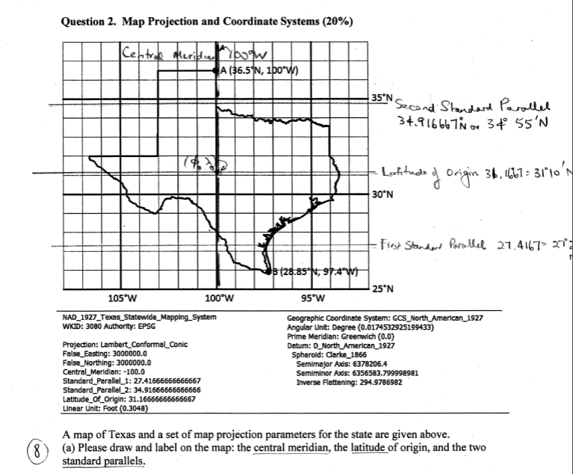

Slide 31
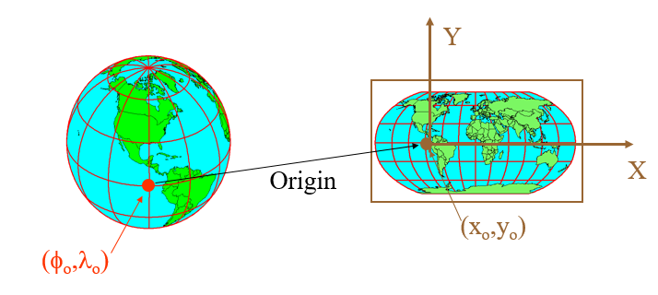
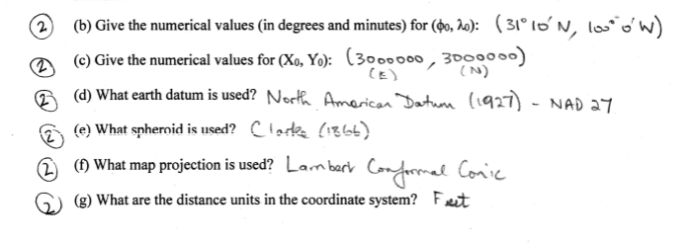

Slide 32
GISWR 2018 Review for Midterm
Using ArcGIS for Water Resources
Location and Measurement on the earth
Spatial Analysis
Hydrologic Analysis

Slide 33
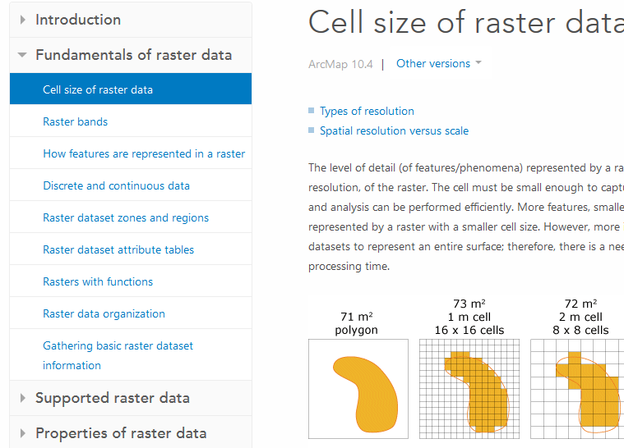
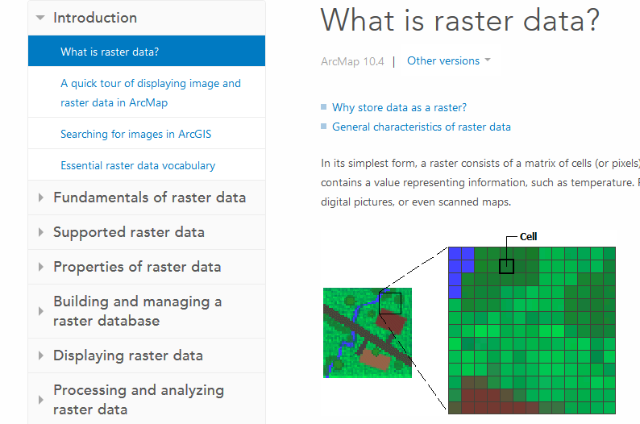
Readings - Theory
ArcMap help: What is raster data? http://desktop.arcgis.com/en/arcmap/latest/manage-data/raster-and-images/what-is-raster-data.htm
ArcMap help: Fundamentals of raster data from Cell size of raster data to Raster dataset attribute tables http://desktop.arcgis.com/en/arcmap/latest/manage-data/raster-and-images/cell-size-of-raster-data.htm

Slide 34
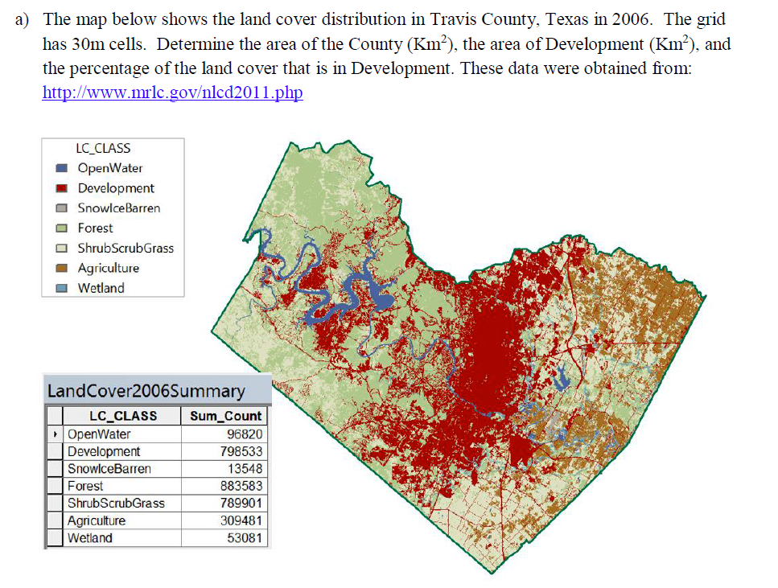
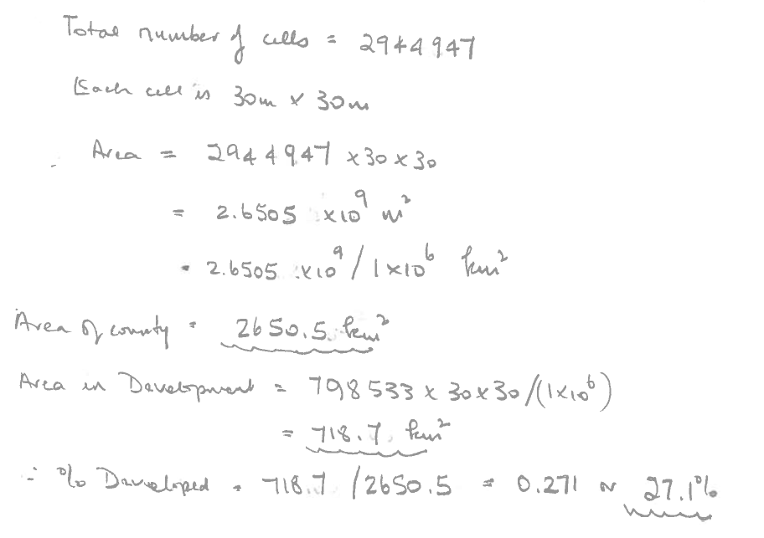

Slide 35
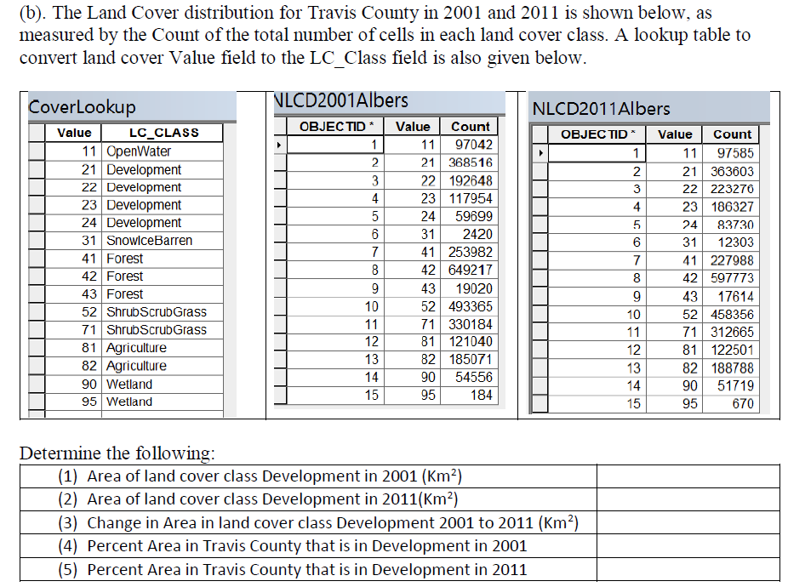
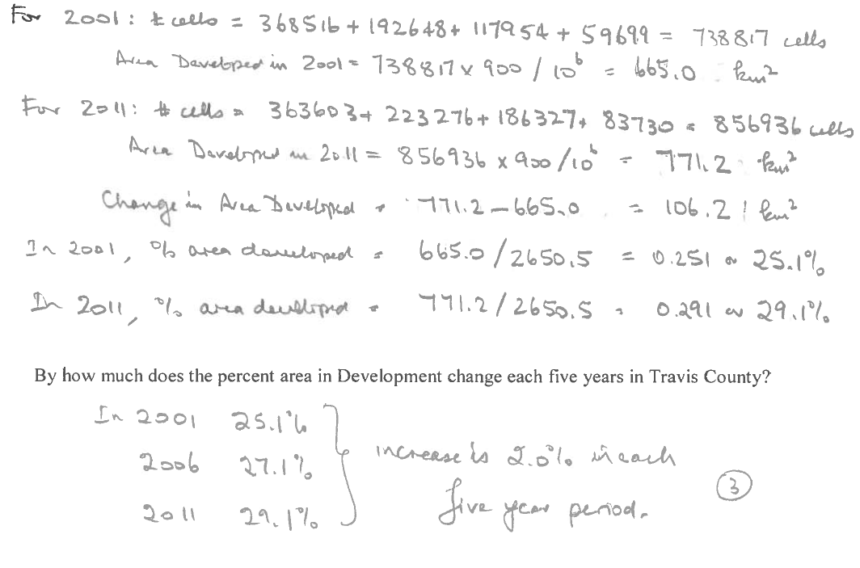
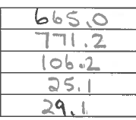

Slide 36
Readings – Slope and Aspect
How Slope Works https://pro.arcgis.com/en/pro-app/tool-reference/spatial-analyst/how-slope-works.htm
How Aspect Works https://pro.arcgis.com/en/pro-app/tool-reference/spatial-analyst/how-aspect-works.htm

Slide 37
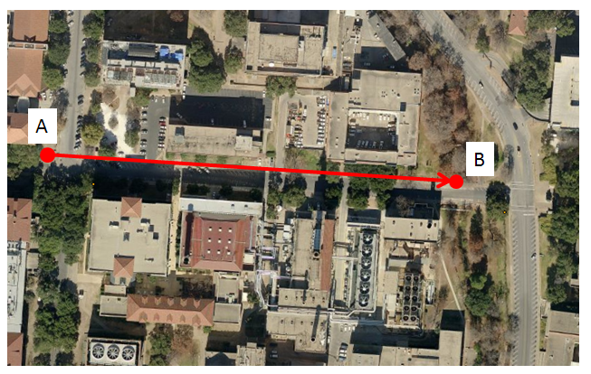
Slope Handout
http://hydrology.usu.edu/dtarb/giswr/2016/Slope.pdf
Determine the length, slope and azimuth of the line AB.

Slide 38
ArcGIS “Slope” tool
y
a
b
c
$$\frac{\frac{\frac{a−c}{2∆}+\frac{d−f}{2∆}}{2}+\frac{\frac{d−f}{2∆}+\frac{g−i}{2∆}}{2}}{2}$$
$$\frac{dz}{dx}=\frac{\left(a+2d+g\right)−\left(c+2f+i\right)}{8∆}$$
Similarly
$$\frac{dz}{dy}=\frac{\left(g+2h+i\right)−\left(a+2b+c\right)}{8∆}$$
Slope magnitude =
$$\sqrt{{\left(\frac{dz}{dx}\right)}^{2}+{\left(\frac{dz}{dy}\right)}^{2}}$$
d
e
f
g
h
i
x
$$\frac{a−c}{2∆}$$
$$\frac{d−f}{2∆}$$
c
$$\frac{g−i}{2∆}$$
$$∆$$
b
f
a
e
i
d
h
g
$$2∆$$
x
y

Slide 39
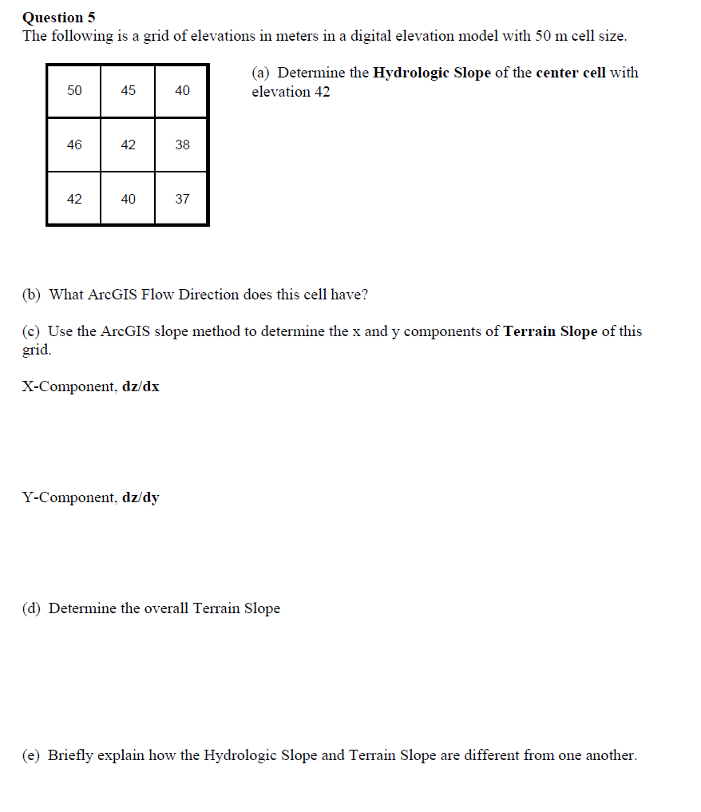
Questions on Slope Computation

Slide 40
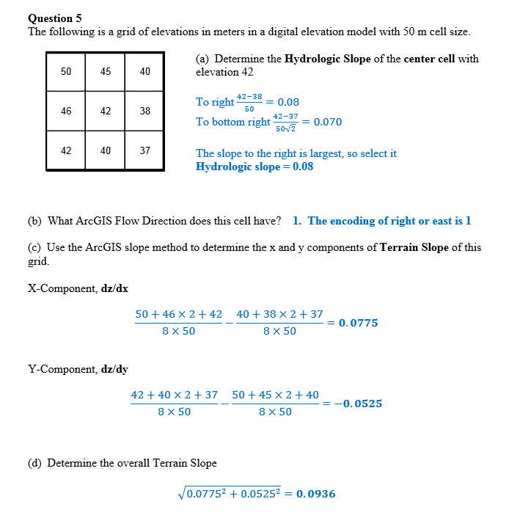

Slide 41
ArcGIS Aspect – the steepest downslope direction
$$Δy=$$
$$Δx=$$
$$Δx$$
Use atan2 to resolve ambiguity in atan direction
$$Δy$$
$$α$$
$$−Δx$$
$$−Δy$$
$$α+{180}^{o}$$

Slide 42
Example
30
a
b
c
80
74
63
d
e
f
145.2º
69
67
56
g
h
i
60
52
48

Slide 43
Raster calculation and resampling
Resampling or interpolation (and reprojection) of inputs to target extent, cell size, and projection within region defined by analysis mask
+
=
Analysis mask
Analysis cell size
Analysis extent

Slide 44
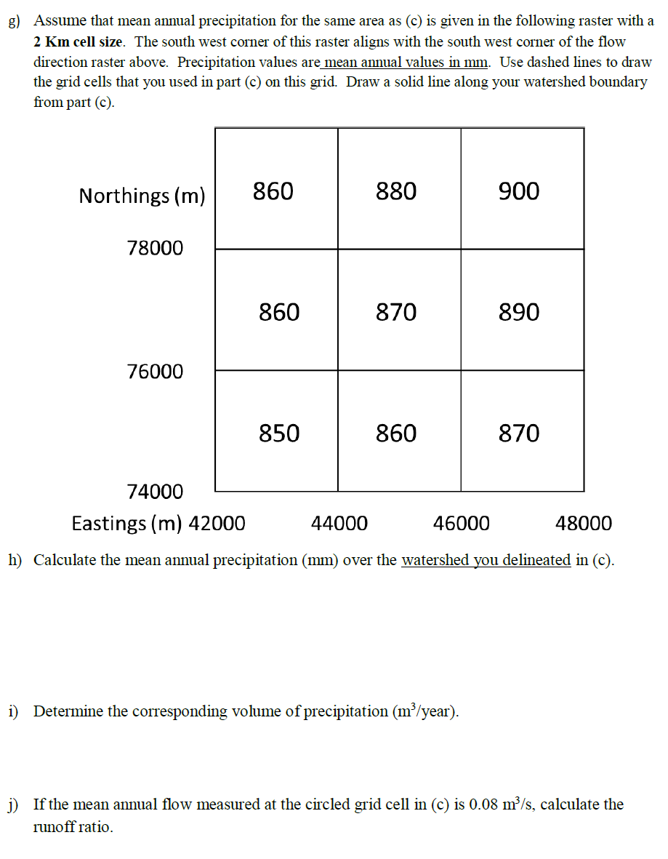

Slide 45
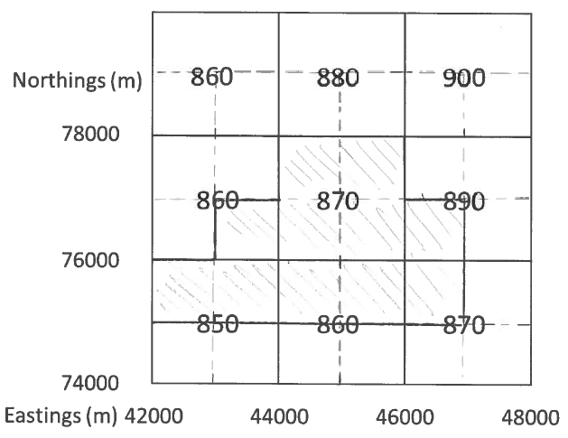
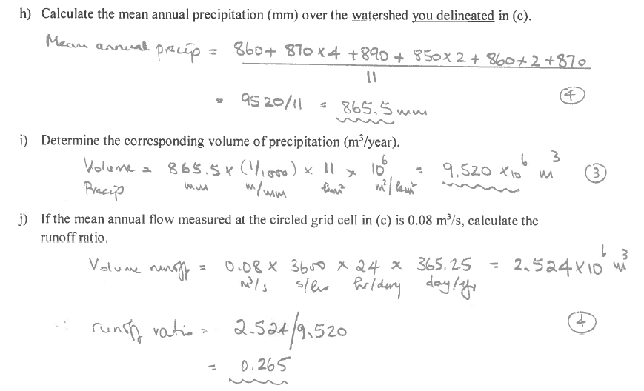

Slide 46
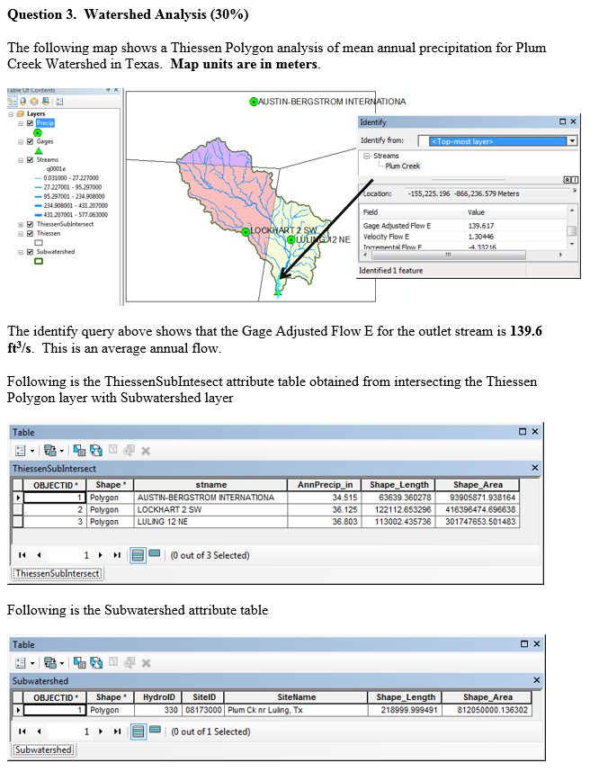
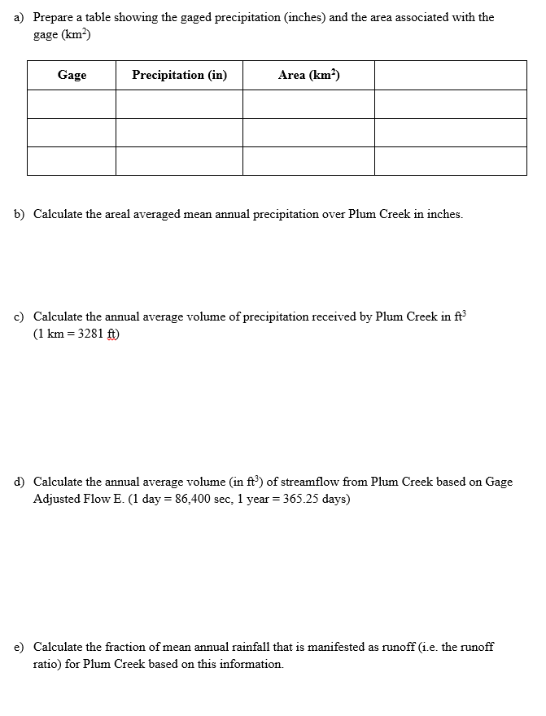

Slide 47
Subwatershed Precipitation by Thiessen Polygons
Thiessen Polygons
Intersect with Subwatersheds
Evaluate A*P Product
Summarize by subwatershed
$$P_{i}=\frac{\sum_{k}{A_{ik}P_{k}}}{\sum_{k}{A_{ik}}}$$

Slide 48
GISWR 2018 Review for Midterm
Using ArcGIS for Water Resources
Location and Measurement on the earth
Spatial Analysis
Hydrologic Analysis

Slide 49
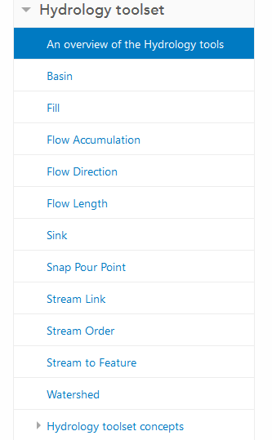
Digital Elevation Model Based Watershed and Stream Network Delineation
Reading
https://pro.arcgis.com/en/pro-app/tool-reference/spatial-analyst/an-overview-of-the-hydrology-tools.htm
How to use
Understanding

Slide 51
Pit Filling
Original DEM
Pits Filled
Pits
Pour Points
Grid cells or zones completely surrounded by higher terrain
The lowest grid cell adjacent to a pit
Notes:
Elevations are filled to that of the pools pour point

Slide 52
Hydrologic Slope
- Direction of Steepest Descent
30
30
80
74
63
80
74
63
69
67
56
69
67
56
60
52
48
60
52
48
Slope:

Slide 53
13
9
9

Slide 54
Question on Flow Direction

Slide 55
Solution for this question

Slide 57
Flow Accumulation Grid.
Area draining in to a grid cell
0
0
0
0
0
0
0
0
0
0
0
2
2
2
0
0
2
2
2
0
0
0
10
0
1
0
0
1
0
10
1
0
0
14
0
1
0
0
0
14
0
4
1
19
1
0
4
1
1
19
ArcHydro Page 72

Slide 58
Stream Network for 10 cell Threshold Drainage Area
Flow Accumulation > 10 Cell Threshold
0
0
0
0
0
0
0
0
0
0
0
2
2
2
0
0
2
2
2
0
0
0
10
0
1
0
0
1
0
10
1
0
0
14
0
1
0
0
0
14
0
4
1
19
1
0
4
1
1
19

Slide 59
Watershed Draining to Outlet
Watershed mapped as all grid cells that drain to an outlet
Streams mapped as grid cells with flow accumulation greater than a threshold

Slide 60
Watershed and Stream Grids
Watershed mapped as all grid cells that drain to an outlet
Streams mapped as grid cells with flow accumulation greater than a threshold

Slide 62
Midterm exam
You may bring into the quiz an 8.5” x 11” review sheet with anything you want written or printed on it, front and back. You are not allowed to have access to any other reference materials.
You should bring a calculator and straight edge to help you draw nice diagrams in your answers.
Past exams are available at http://hydrology.usu.edu/dtarb/giswr/pastexams.html

