Slide 1
Data Sources for GIS in Water Resources by David R. Maidment, and David G. Tarboton GIS in Water Resources Fall 2018

Slide 2
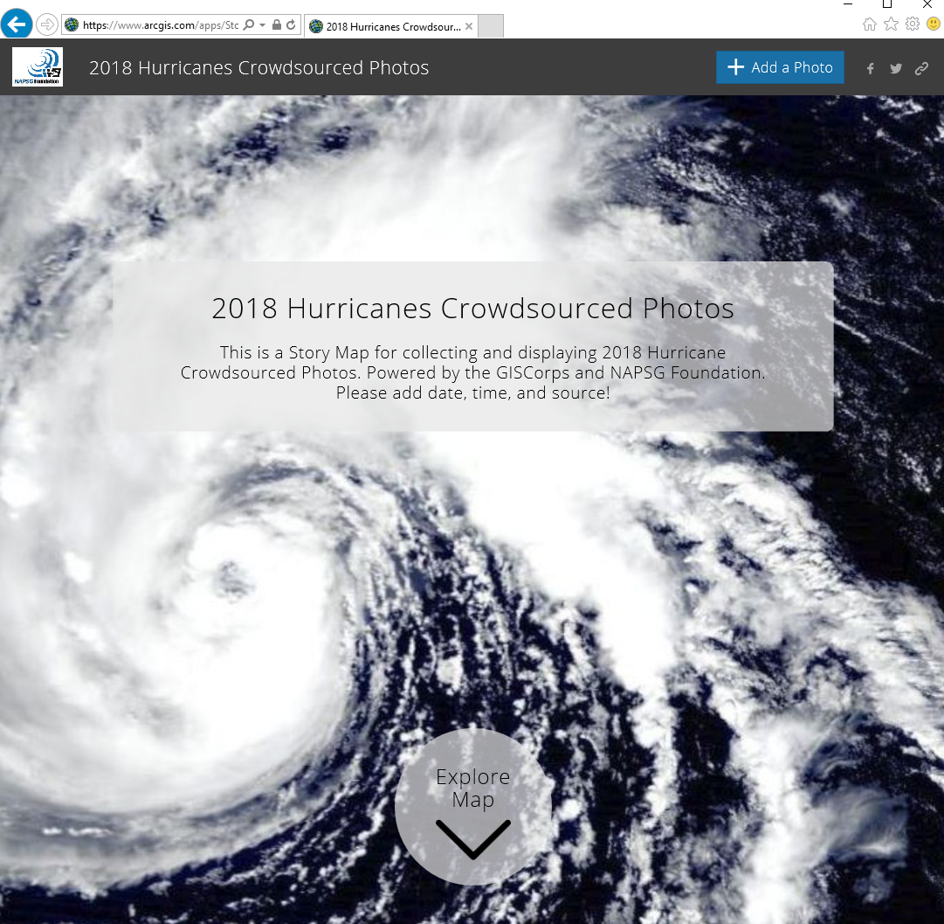
Hurricane Story Map
http://bit.ly/2018HurricanePhotos

Slide 3
Length on Meridians and Parallels
(Lat, Long) = (φ, λ)
Length on a Meridian:
AB = R_{e} Δφ
(same for all latitudes)
R
Δλ
D
30 N
R
C
R_{e}
Δφ
B
0 N
R_{e}
Length on a Parallel:
CD = R Δλ = R_{e} Δλ Cos φ
(varies with latitude)
A

Slide 4
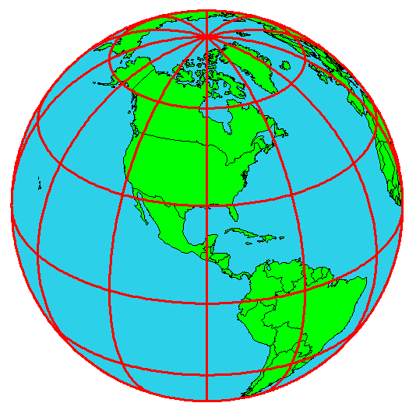
Example: What is the length of a 1º increment along
on a meridian and on a parallel at 30N, 90W?
Radius of the earth = 6370 km.
Solution:
A 1º angle has first to be converted to radians
π radians = 180 º, so 1º = π/180 = 3.1416/180 = 0.0175 radians
For the meridian, ΔL = R_{e} Δφ = 6370 ∗ 0.0175 = 111 km
For the parallel, ΔL = R_{e} Δλ Cos φ
= 6370 ∗ 0.0175 ∗ Cos 30
= 96.5 km
Parallels converge as poles are approached

Slide 5
Curved Earth Distance (from A to B)
Shortest distance is along a “Great Circle”
A “Great Circle” is the intersection of a sphere with a plane going through its center.
1. Spherical coordinates converted to Cartesian coordinates.
2. Vector dot product used to calculate angle α from latitude and longitude
3. Great circle distance is Rα, where R=6378.137 km²
Z
B
A
α
•
Y
X
Ref: Meyer, T.H. (2010), Introduction to Geometrical and Physical Geodesy, ESRI Press, Redlands, p. 108

Slide 6
https://nhd.usgs.gov/wbd.html

Slide 7
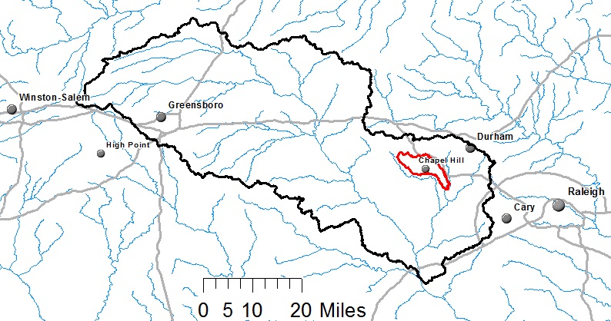
Watershed Hierarchy
Each hydrologic unit is identified by a unique hydrologic unit code (HUC) consisting of two to or more digits based on the levels of classification in the hydrologic unit system.
Digit #
2
4
6
8 HUC
10
12
NHDPlus
HAW HUC 8 03030002
Little Creek HUC 12 030300020603

Slide 8
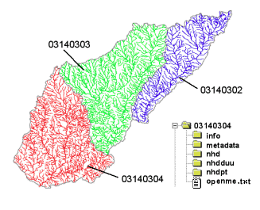
River networks
for 8-digit HUC
watersheds
http://nhd.usgs.gov/

Slide 9
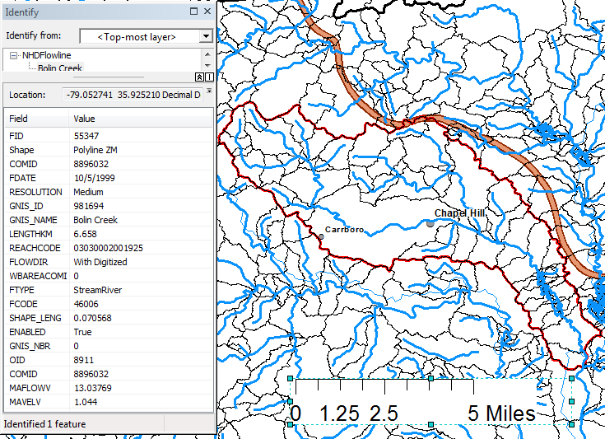
Slope
Elevation
Mean annual flow
Corresponding velocity
Drainage area
% of upstream drainage area in different land uses
Stream order
http://www.horizon-systems.com/nhdplus/

Slide 10
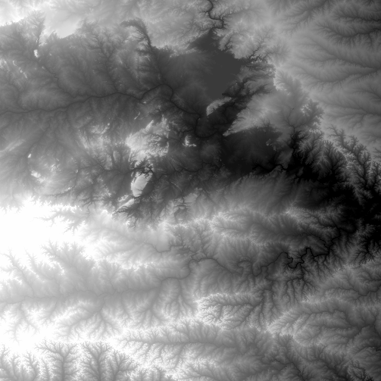
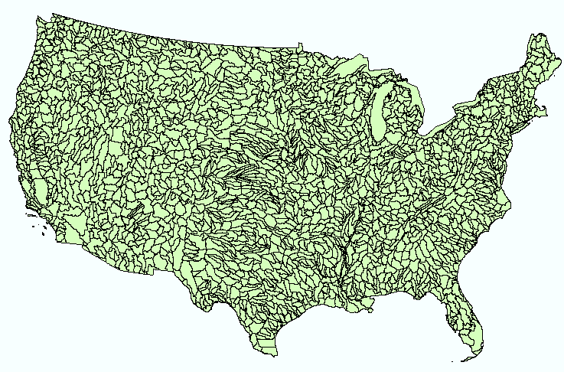
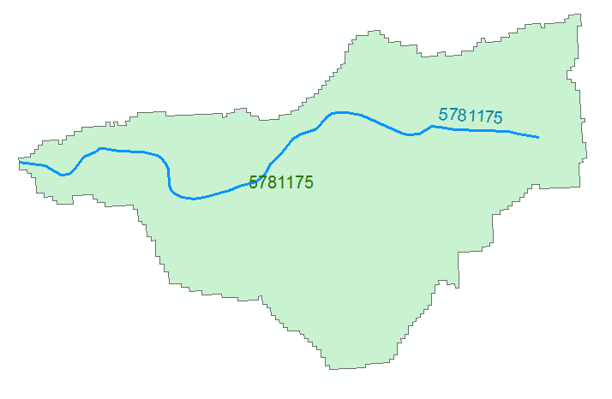
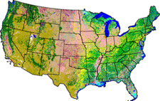
NHDPlus Version 2.1
Foundation for a Geospatial Hydrologic Framework for the United States
NHDPlus
2.7 million reach catchments in US
average area 3 km²
reach length 2 km
Uniquely labelled
National Elevation Dataset
Watershed Boundary Dataset
National Hydrography Dataset
National Land Cover Dataset
http://www.arcgis.com/home/item.html?id=5600cf6b463043ec97b764fb258997be#!

Slide 11
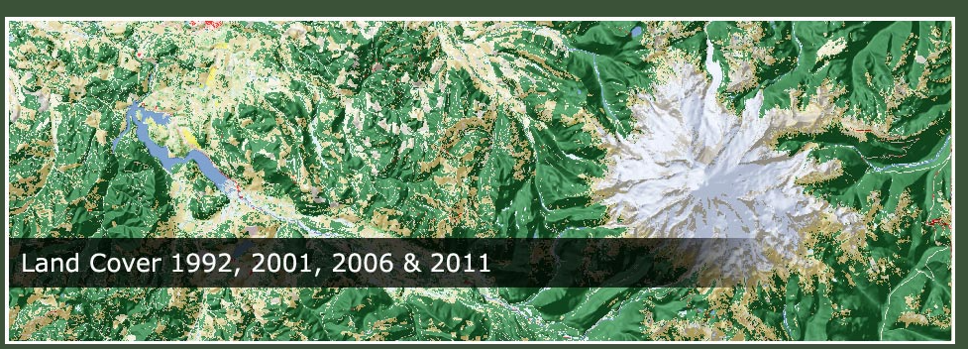
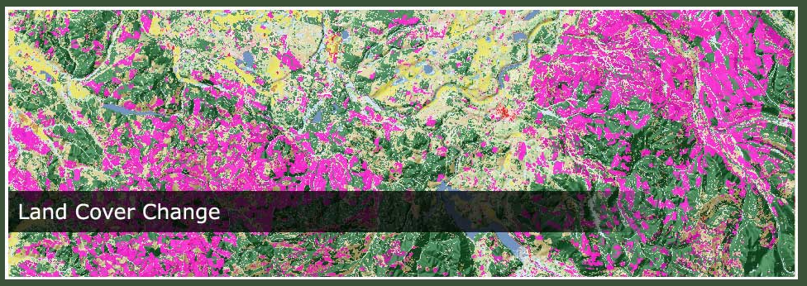
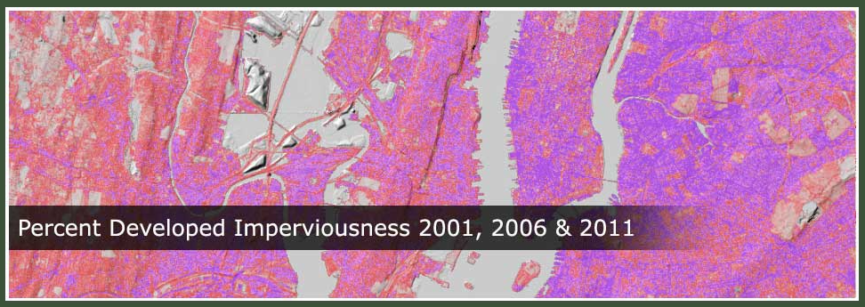
National Land Cover Data
http://www.mrlc.gov/

