Slide 1
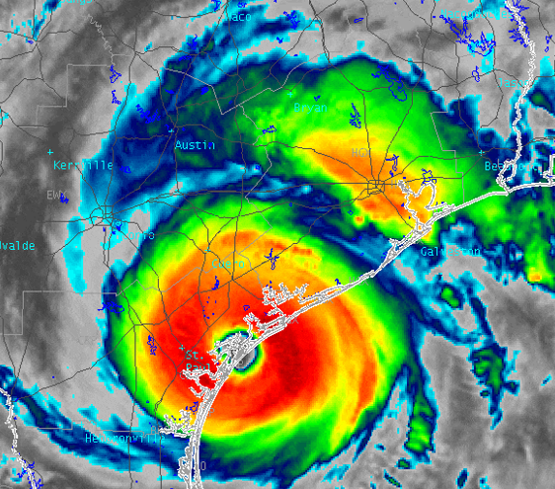
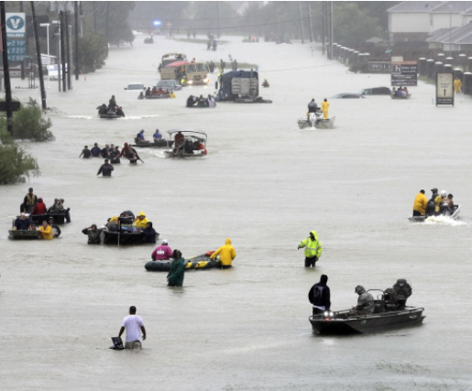
Hurricane Harvey: Flood Emergency Response
Hurricane Harvey
Flood forecasting
Texas Flood Response System
How can we do better?

Slide 2
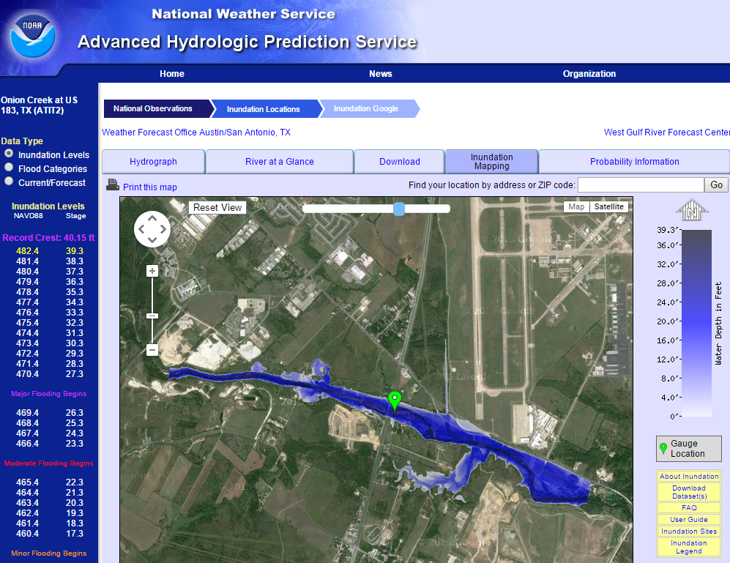
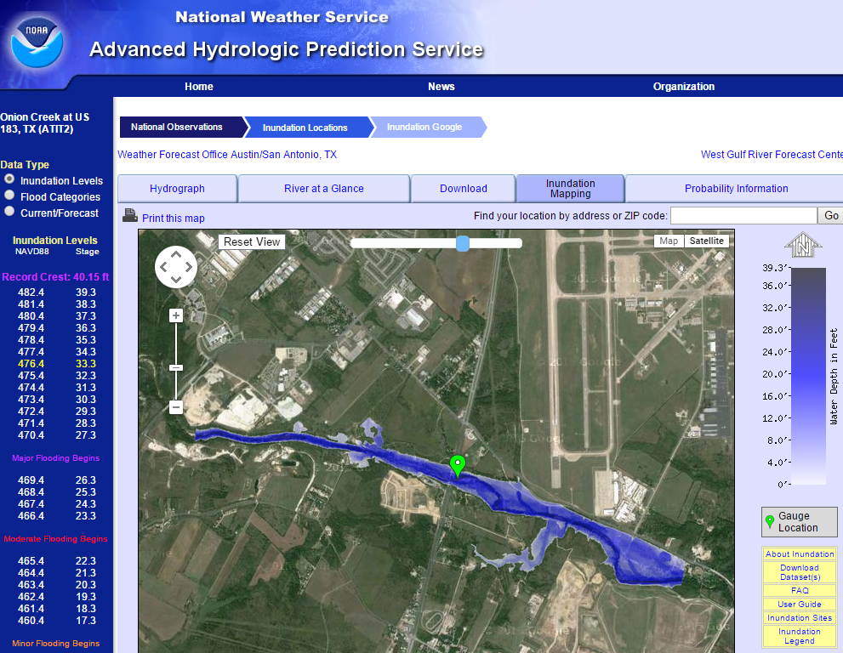
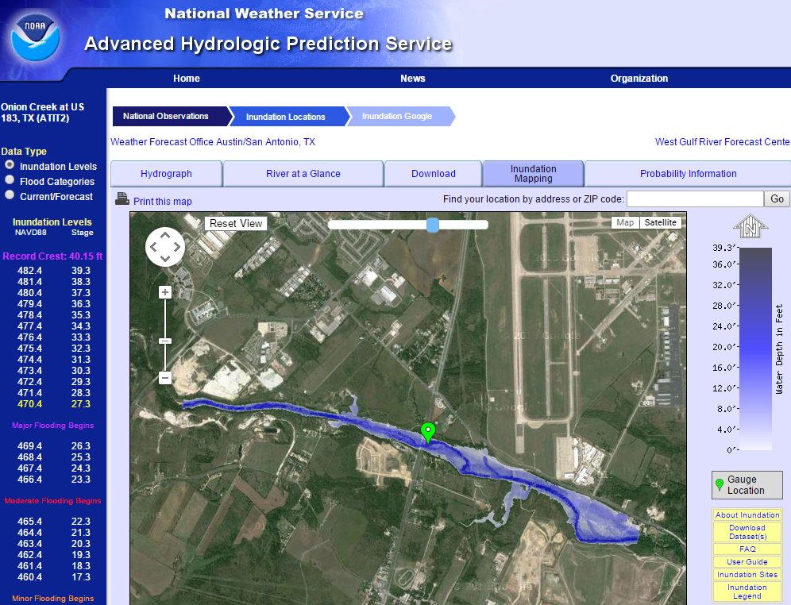

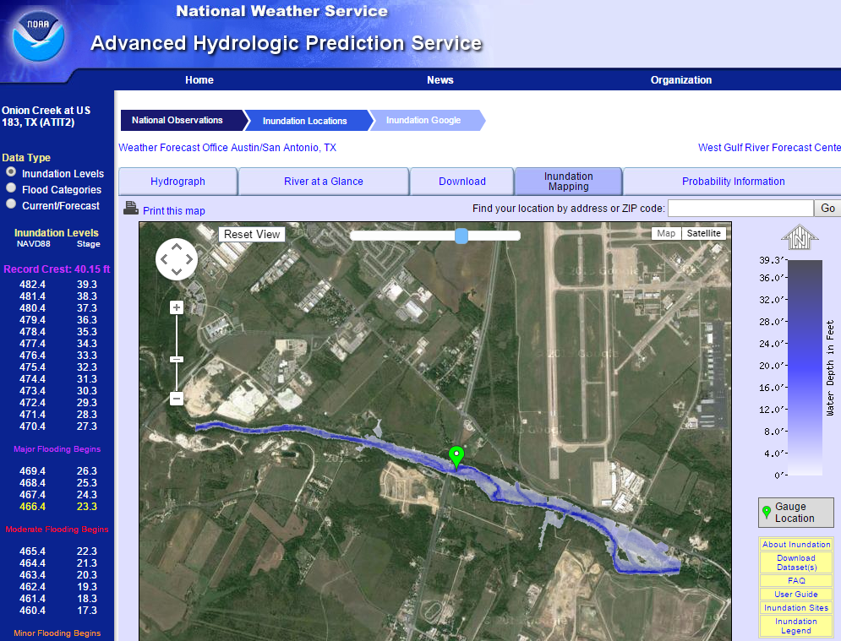
Real-Time Flood Inundation Mapping
Onion Creek at Highway 183
http://water.weather.gov/ahps2/inundation/inundation_google.php?gage=atit2

Slide 3
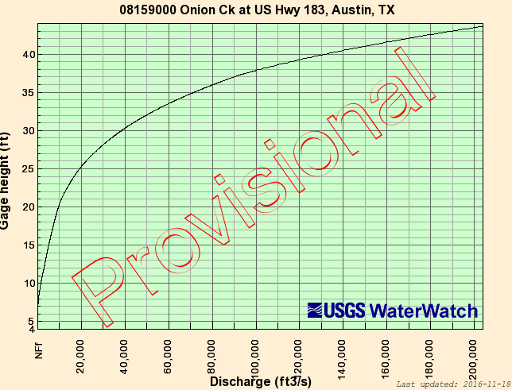
Rating Curve at a Stream Gage
Water Level
Discharge

Slide 4
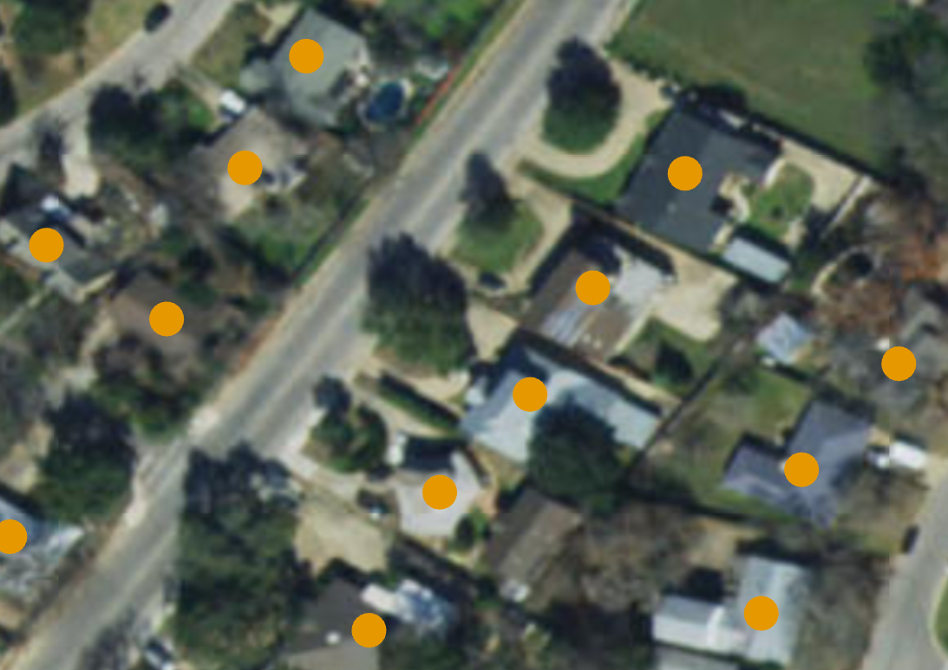
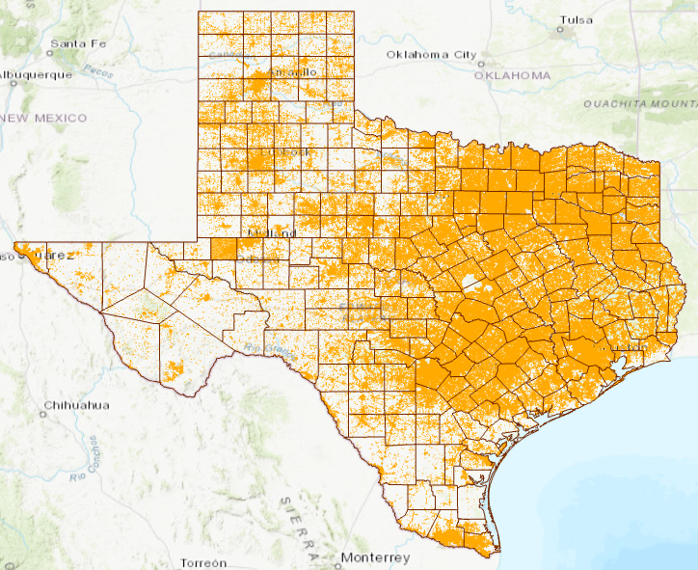
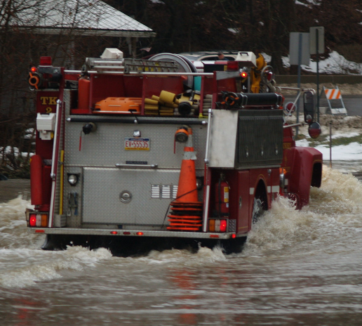

Texas Address Points
9.28 million points
Point on every building
used for dispatching
emergency response
vehicles by 911 systems
Notes:
Over the summer we collected all 8.7million address points across Texas. Dr. David Arctur has assembled all the data and done some quality checks. When you have this much data from hundreds of sources, there are always some inconsistencies. However, in my opinion, for public safety this strategic snapshot is a good starting point for describing overall impact to a region or district.

Slide 5
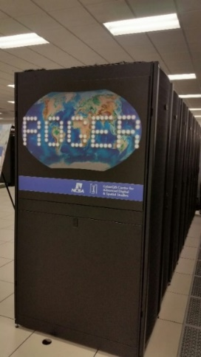
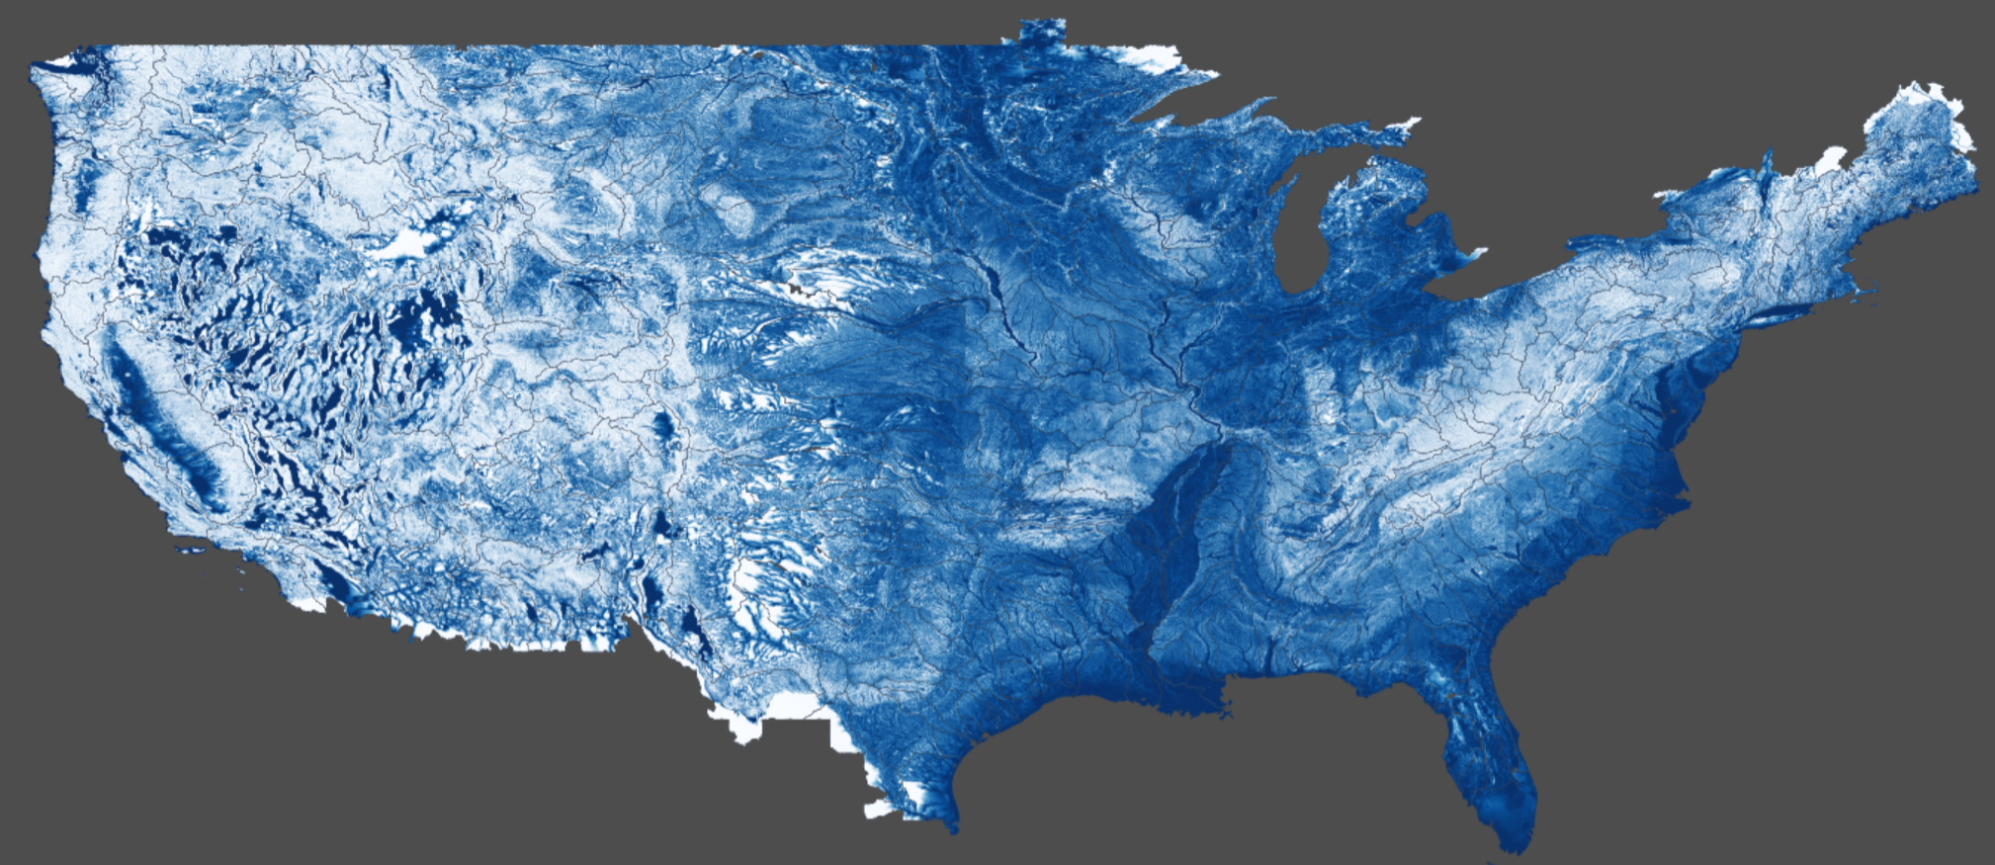
Method for Determining Flood Risk:
Height Above Nearest Drainage (HAND)
Flooding occurs when Water Depth is greater than HAND
Address Point
Flood
HAND
Normal
Computed for continental US
Notes:
How do we answer the question of how many people are going to be impacted, especially if large areas of the state are not covered by LIDAR or National Flood Hazard Layer? The researchers developed a process called Height Above Nearest Drainage or HAND.

Slide 6
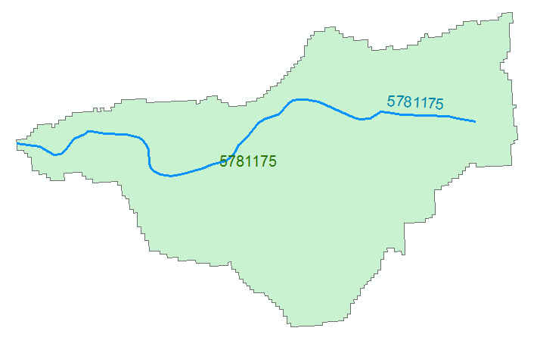




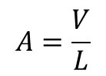
Reach Hydraulic Parameters
Comid | y | A | R | P | T | V | Ab | As
5781175 | 3
5781175 | 4
A_{s}
Surface Area
Wetted Bed Area
L
V
Volume
A_{b}
T
$$A=\frac{V}{L}$$
Cross Section Area
Depth
y
A
P
P$=\frac{Ab}{L}$
Wetted Perimeter
T$=\frac{As}{L}$
Top Width
R$=\frac{A}{P}$
Hydraulic Radius

Slide 7
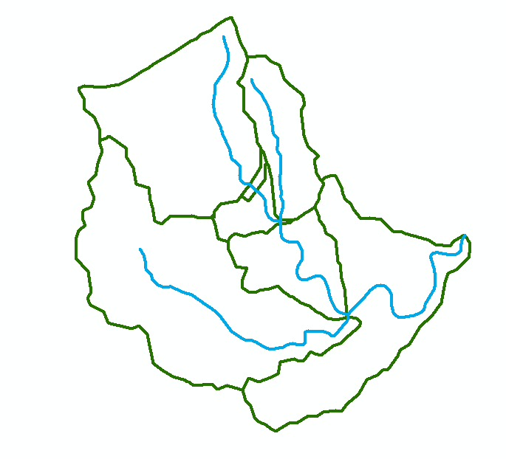
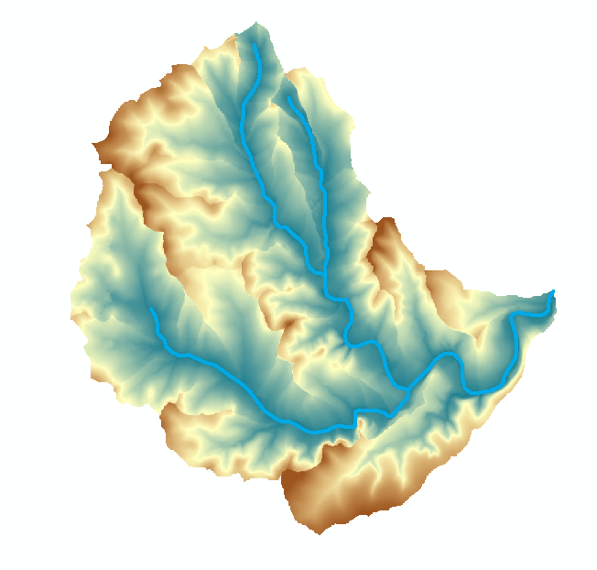
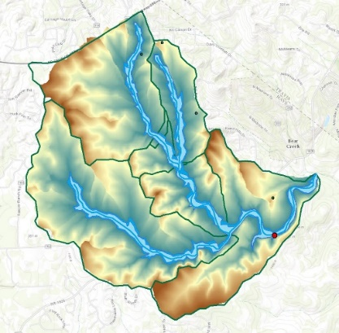

Flood Inundation Mapping – NHDPlus-HAND Method
Water surface elevation
h = z + y
y
NHDPlus
h
z
Geodetic datum
Catchments and Flowlines
Height Above Nearest
Drainage (HAND)
(relative elevation of land
surface cell above cell in
NHDPlus stream to which it flows)
Inundation map
Height above
drainage < 15 ft)
Digital Elevation Model

Slide 8
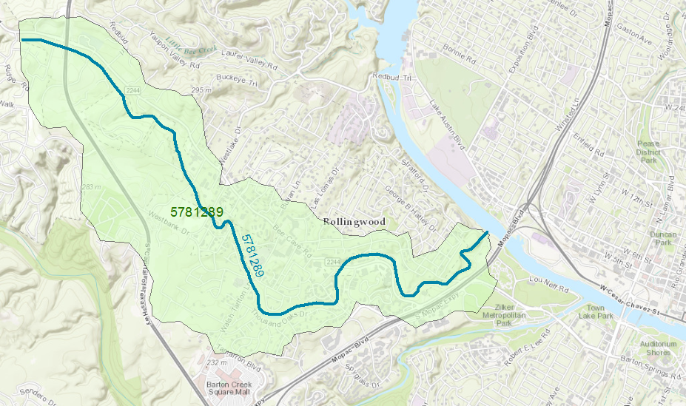
Reach Catchment 5781289
Eanes Creek, Rollingwood, Texas
Drainage area = 3.13 mi²
Reach Length = 4.3 miles

Slide 9
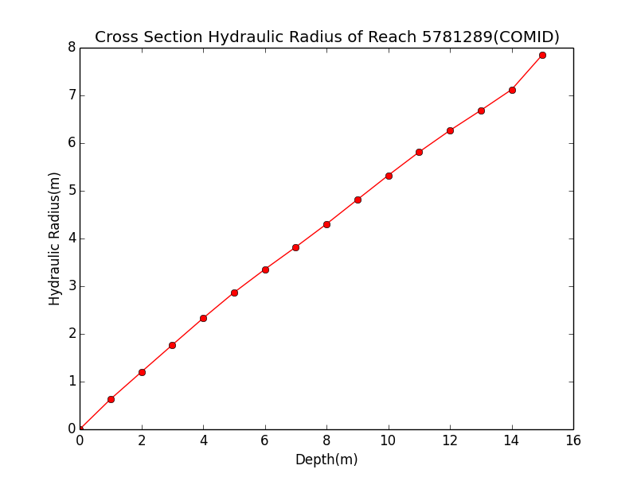
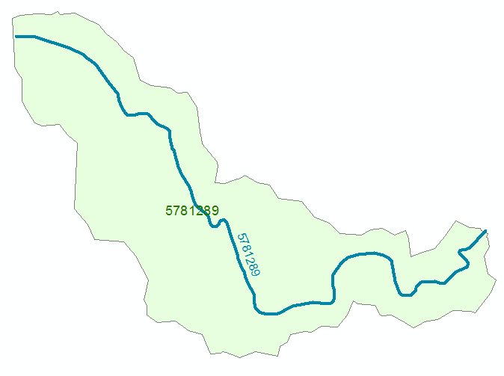
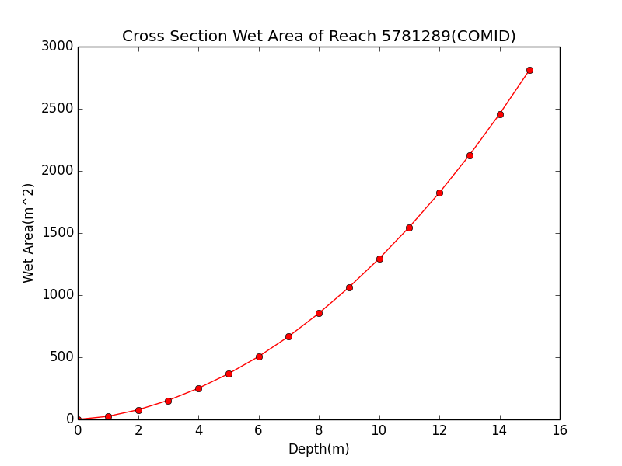

Rating Curve Computation
Hydraulic Radius, R
Flood Discharge, Q (cfs)
$$Q=\frac{1.49}{n}AR^{2/3}S_{o}^{1/2}$$
Flood Depth, h (ft)
Cross section Area, A
n = 0.035 Manning roughness of channel
S_{o} = 0.0163 Bed slope

Slide 10
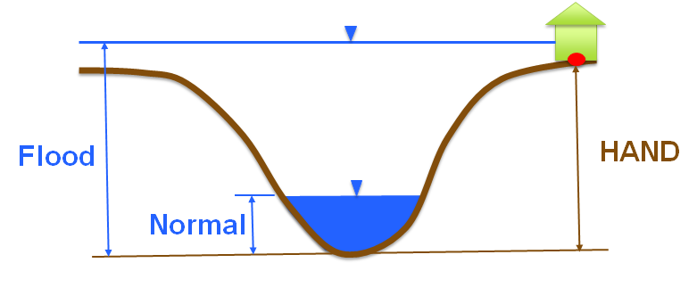
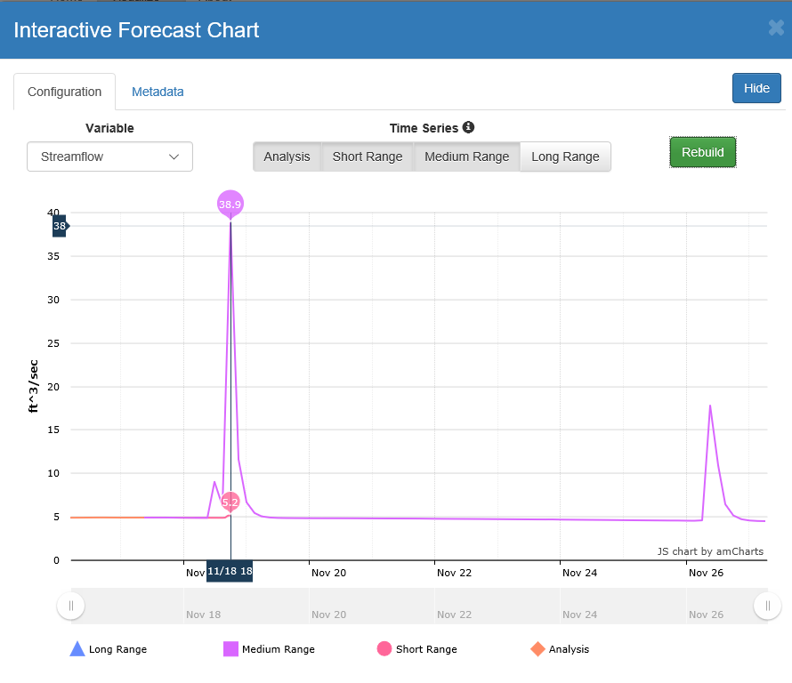


Rating Curve – Connects Discharge with Depth
Flood Depth, y (ft)
$$Q=\frac{1.49}{n}AR^{2/3}S_{o}^{1/2}$$
Forecast Discharge, Q,
from National Water Model

Slide 11
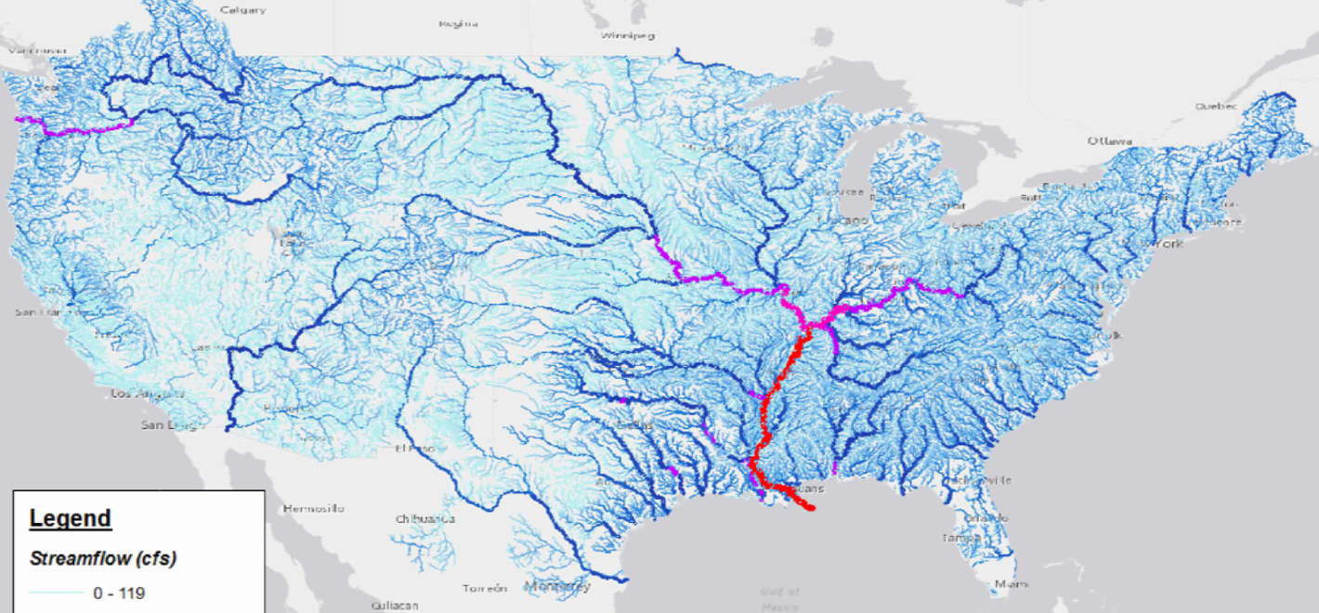
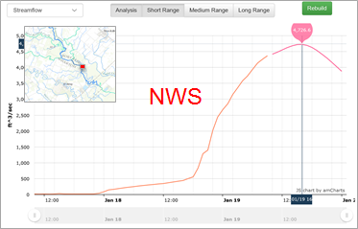
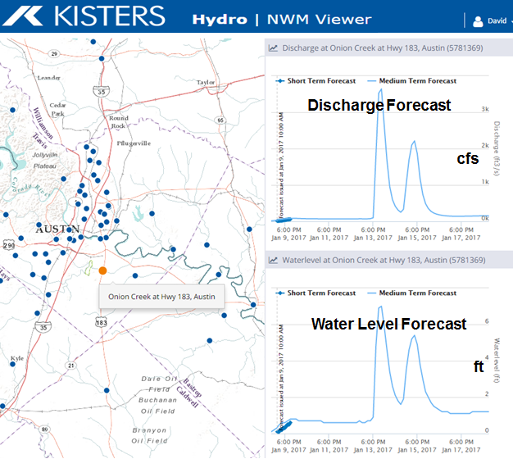
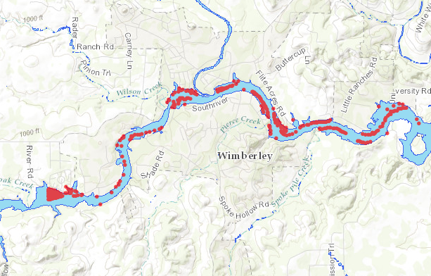
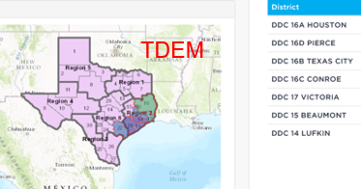
Texas Flood Response System
Take discharge forecast from the National Water Model
Discharge
Transform discharge to depth by rating curve
or hydraulic model
Depth
Create flood inundation map from water depth
Inundation
Assess impact on people and property
Impact
Flood emergency response depends on assessment of impact

Slide 12
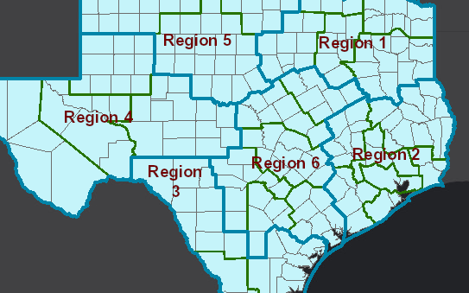
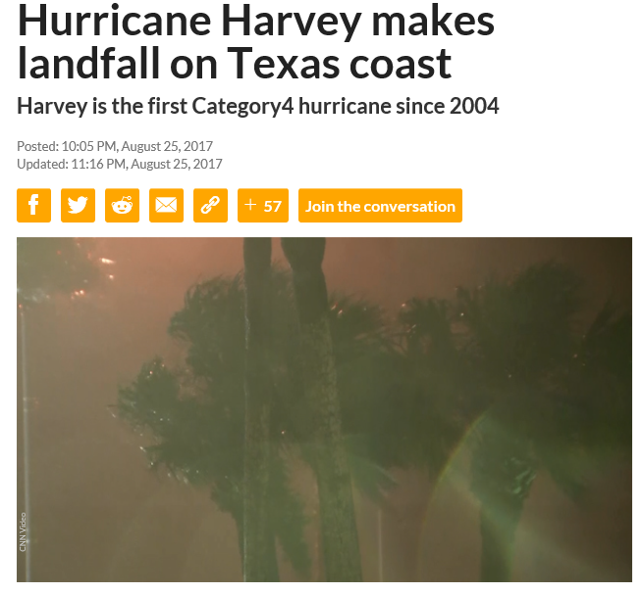
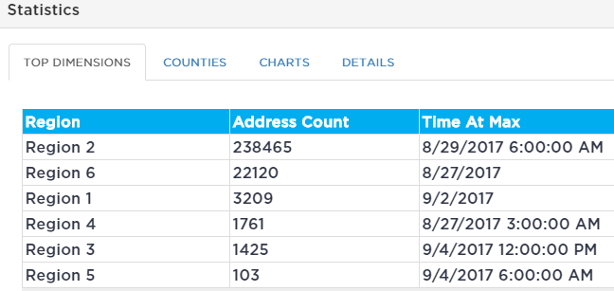
Flood Impact from National Water Model forecast at 3PM Friday 25 August
Using National Water
Model Medium Range forecast
Houston is going to get inundated
10 PM, Friday 25 August

Slide 13
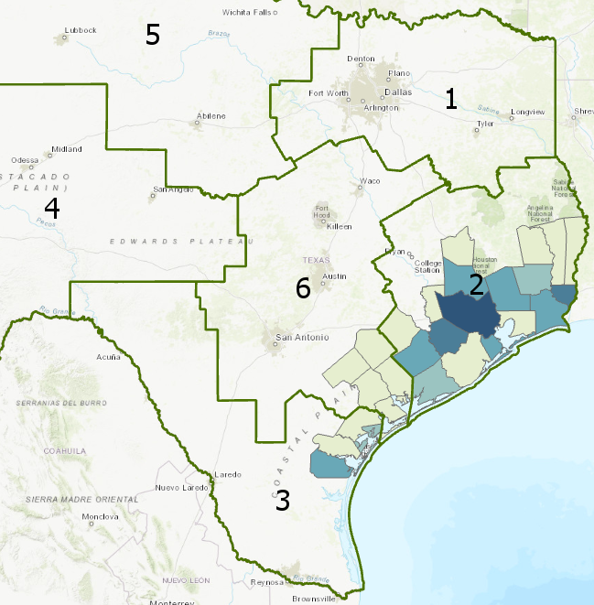
Buildings Damaged
Data: Texas Division of Emergency Management
Total = 152,800
NWM Predicted Top 5 Counties
Harris
Fort Bend
Brazoria
Galveston
Montgomery
Actual Top 5 counties
Harris
Orange
Fort Bend
Montgomery
Jefferson

Slide 14
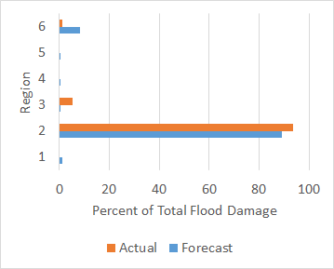
Texas Flood Response System correctly located the major damage zone before the hurricane reached the coast
Actual Damage
Forecast Damage

Slide 15
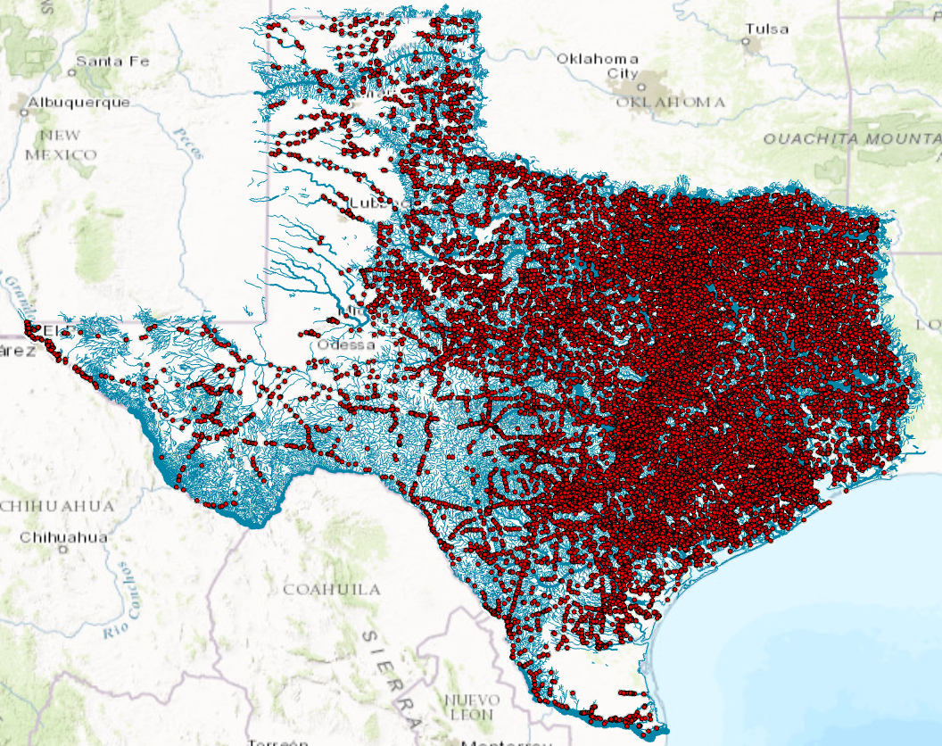
27,000 Texas bridges on 15,700 stream reaches forecast by the National Water Model
Flood forecasting system
for Texas Bridges

Slide 16
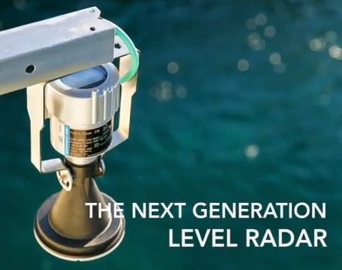
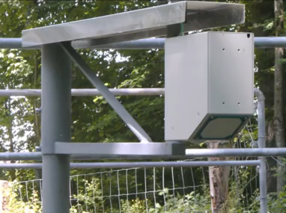
Radar Measurement Technologies
Measures surface velocity
Measures water level
Densified forecasting requires densified measurement

Slide 17
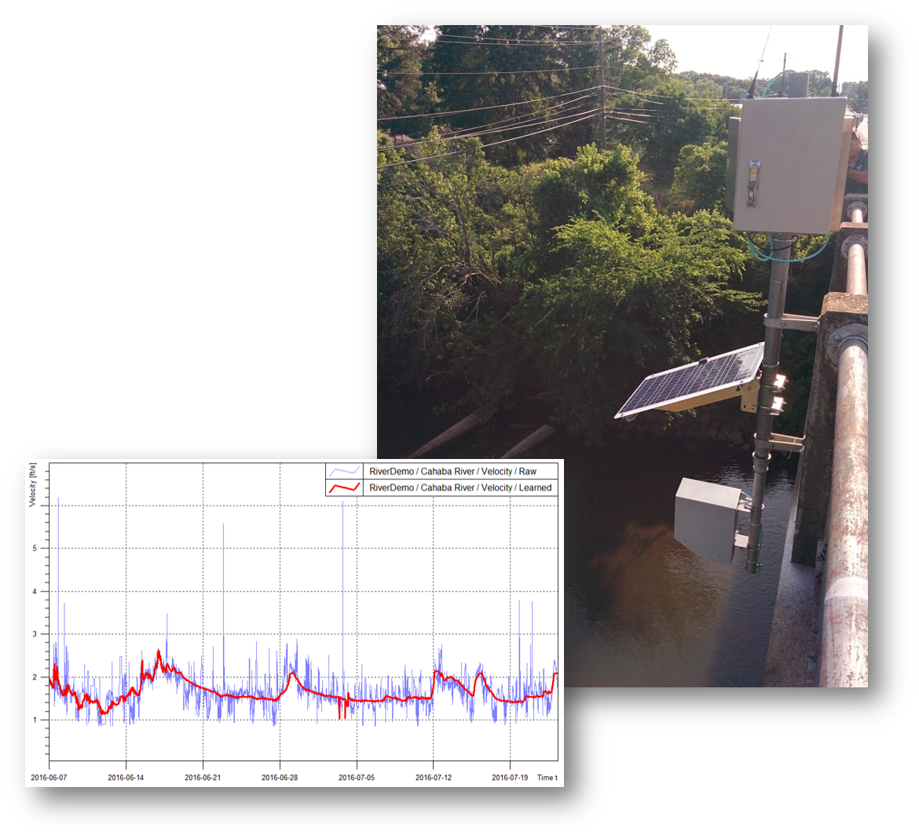

Radar Measurement of Discharge using RQ-30
Combine with Acoustic Doppler Current Profiler
velocity profile
to get discharge
Measure velocity at one
point on water surface

Slide 18


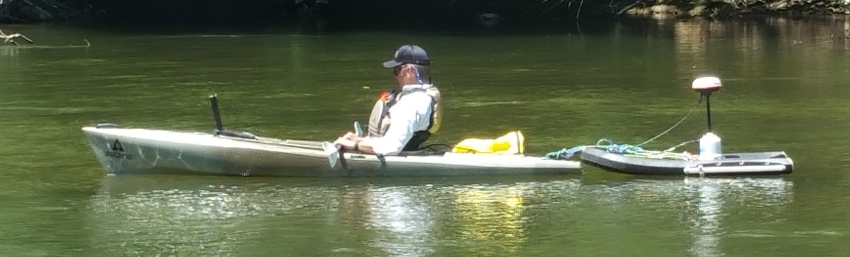
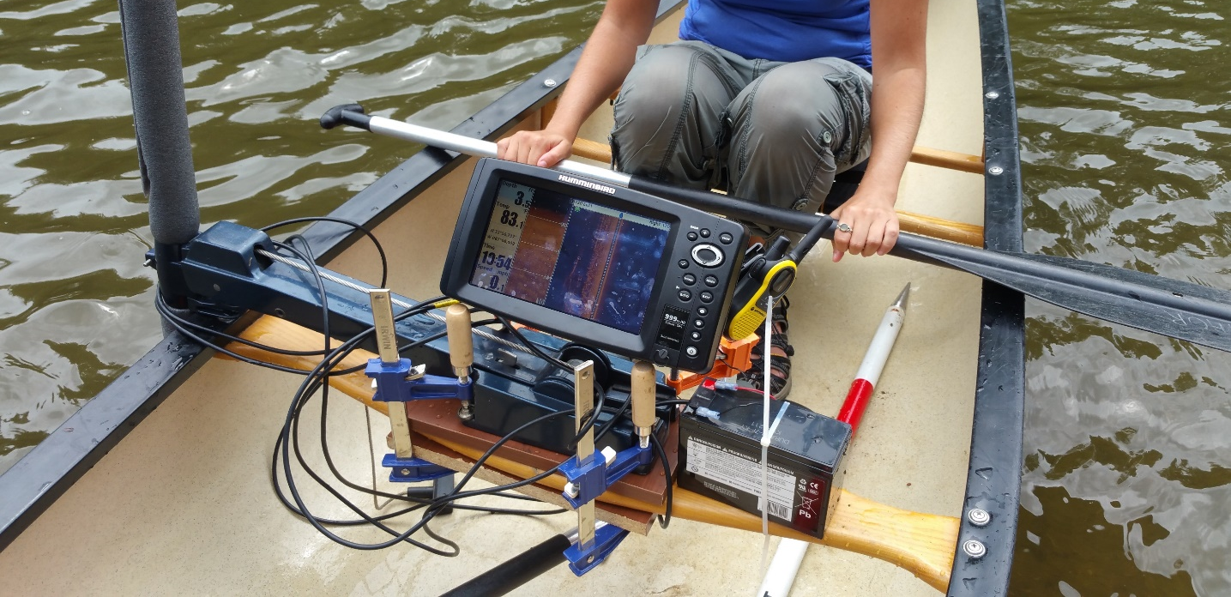

Densified Measurements
ADCP
Humminbird Helix Radar
Sommer Radar
Images: John Sloat, WaterCube

Slide 19
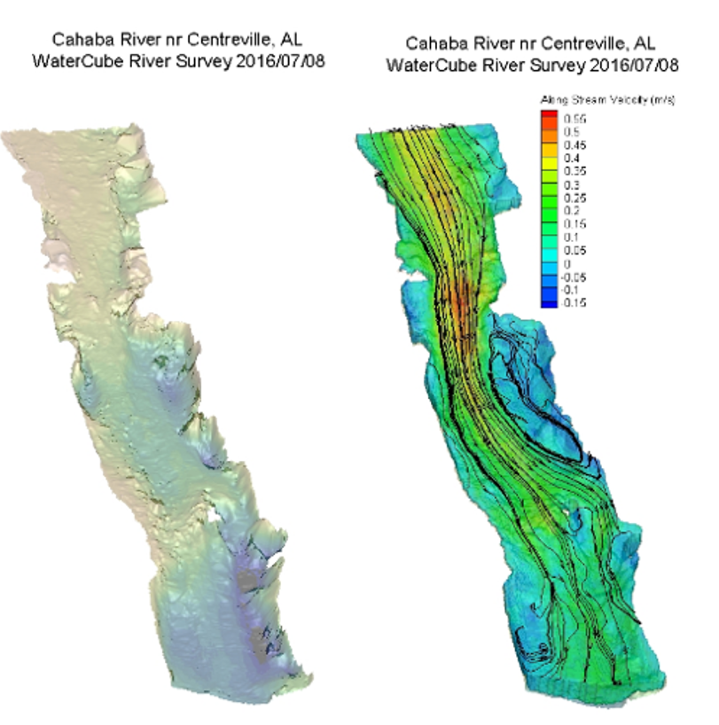
River Bathymetry and Velocity Maps

Slide 20
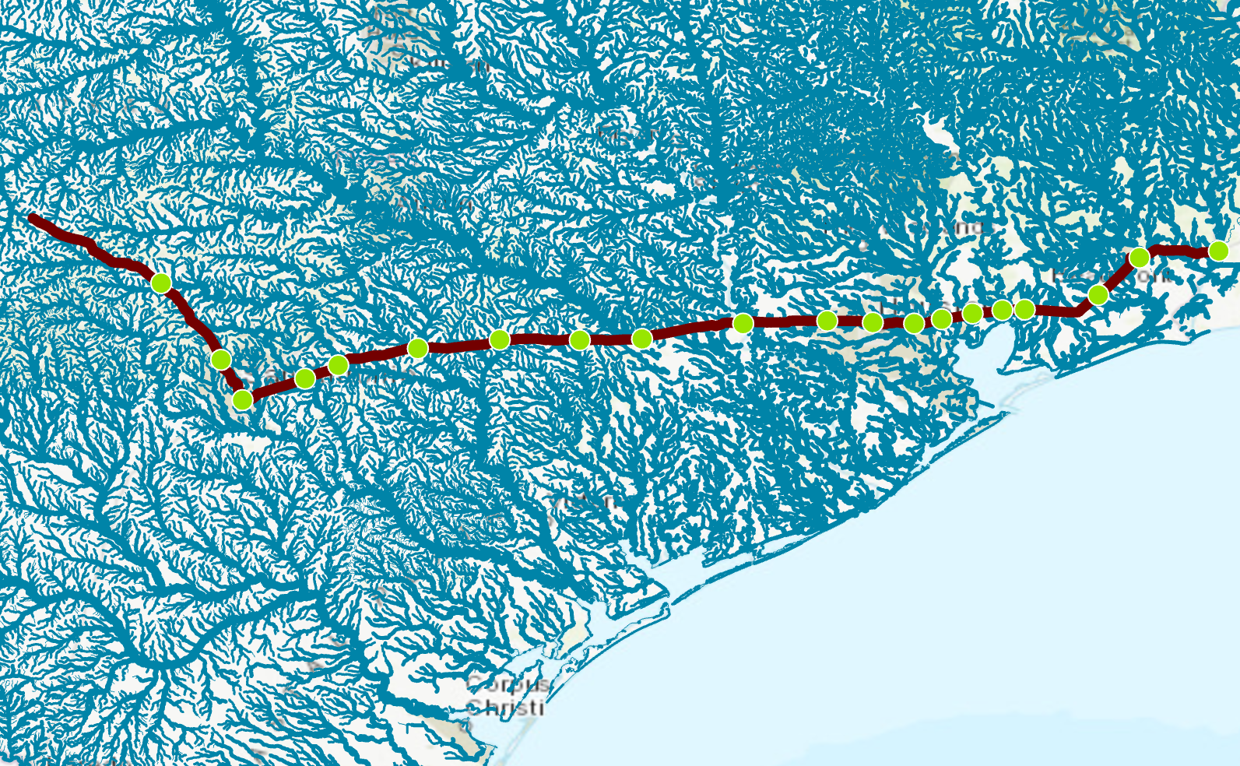

Radar Streamflow Measurement on I-10
20 Sensors from San Antonio
to LA border

Slide 21

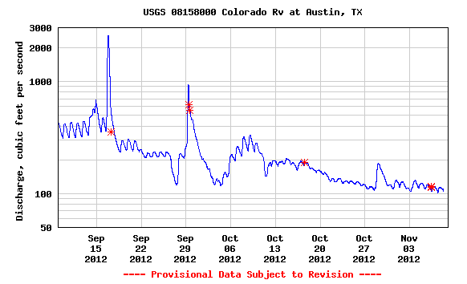
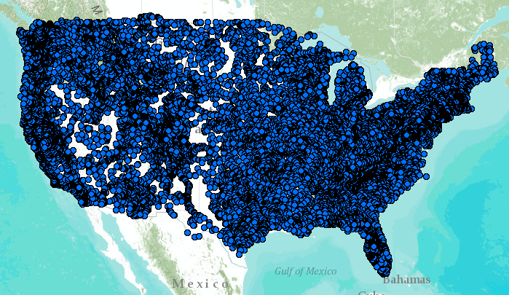
“Internet of Water” using the WaterML language
XML
Colorado River at Austin
24/7/365 service
For daily and real-time data
WaterML2 is the international standard internet language for water resources times series…
http://waterservices.usgs.gov/nwis/iv/?format=waterml,2.0&sites=08158000&period=P1D&parameterCd=00060

Slide 22
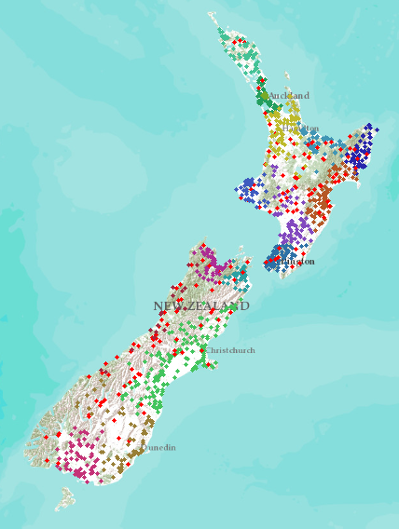
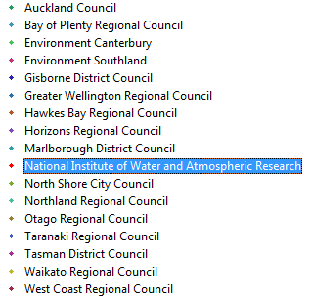
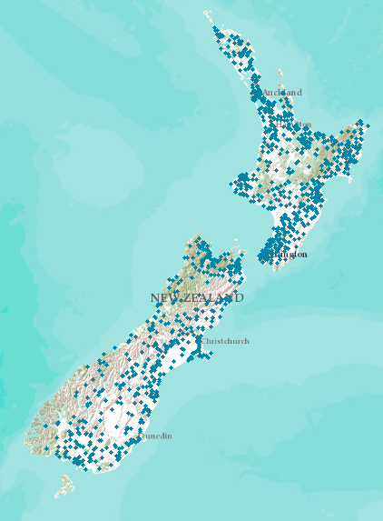
Internet of Water for New Zealand
National synthesis without centralizing data
New Zealand
Water Information System
Data from 16 regions and one national agency. . .
. . . all accessible through water data services

Slide 23
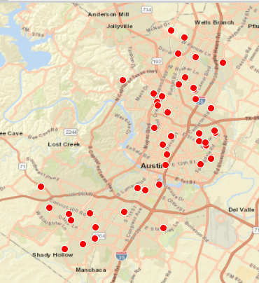
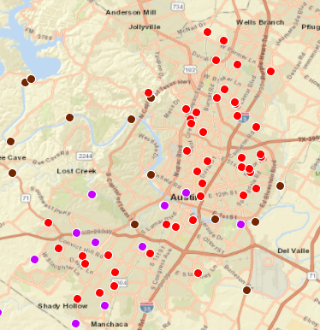
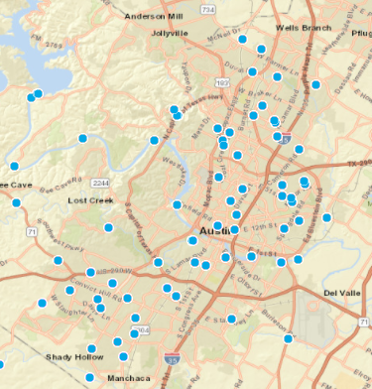
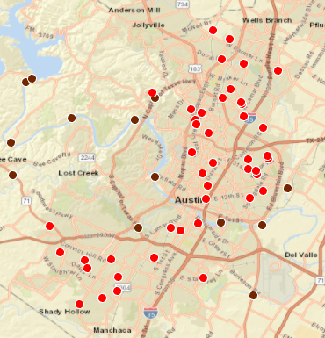

City of Austin Flood Alert System
City of Austin gages
LCRA gages
USGS gages
All gages accessed
by water data services
Rainfall and Water Level gages

Slide 24

Three-Tier Flood Alert System
Tier 1: Standard USGS Gages
– measure everything
Tier 2: Radar Sensors on Bridges (TxDOT)
– medium and high flows
Cost
Tier 3: Water Level Sensors
– local flood alert systems
All connected using WaterML data services

