Slide 1
Ven Te Chow Award Lecture
David R. Maidment
ASCE EWRI World Conference
Palm Springs, 24 May 2011

Slide 2
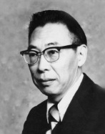
Ven Te Chow, 1919-1981
On the faculty of the University of Illinois 1951-1981
I was a graduate student there in the Hydrosystems Laboratory from 1972-1976
  MS 1974
  PhD 1976
Ven Te Chow was my graduate advisor

Slide 3
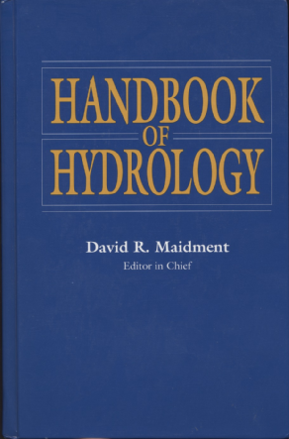
Handbook of Hydrology
Dedicated to Ven Te Chow
Scholar, Teacher, Author, Friend

Slide 4
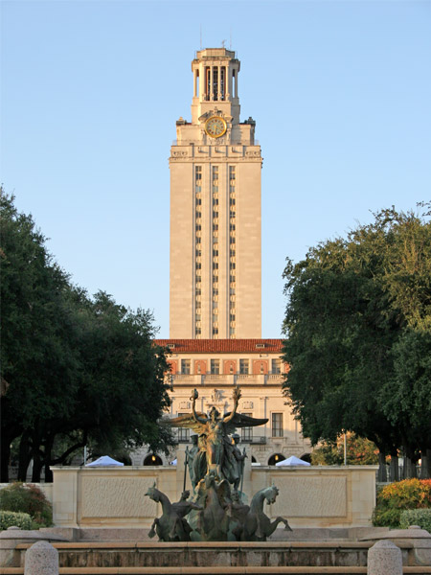
The University of Texas at Austin
Department of Civil, Architectural and Environmental Engineering faculty, 1981 to present
Director of the Center for Research in Water Resources, 1997 to present

Slide 5

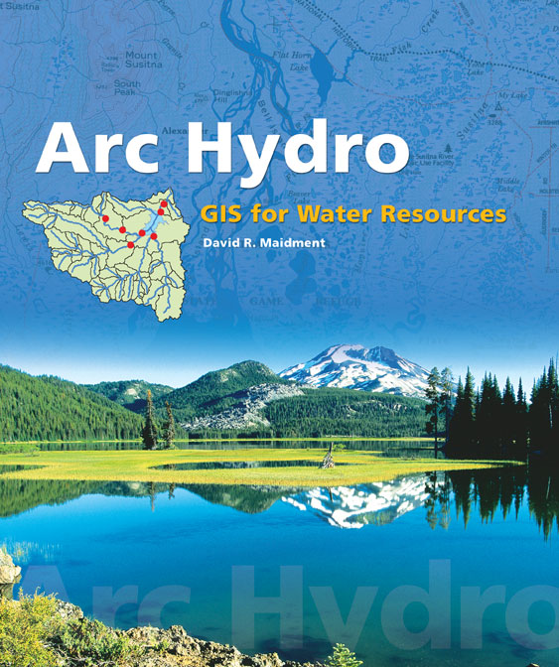
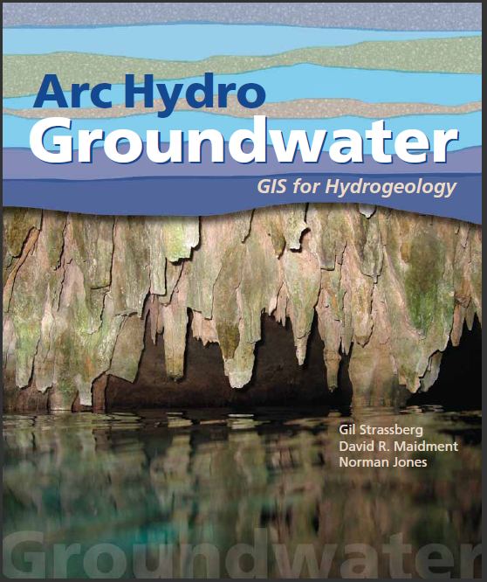
2002
2011

Slide 6
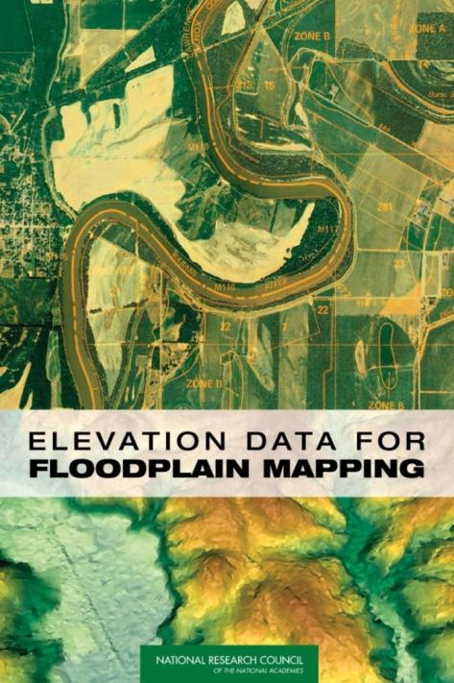
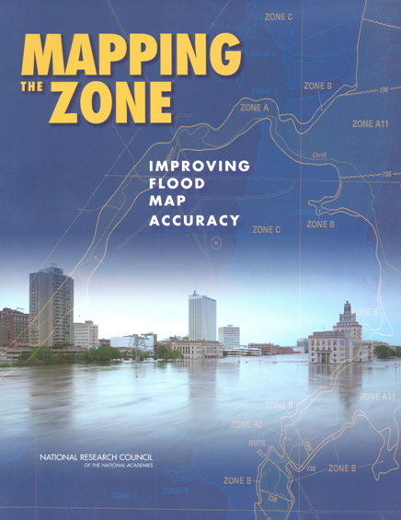
2007
2009

Slide 7
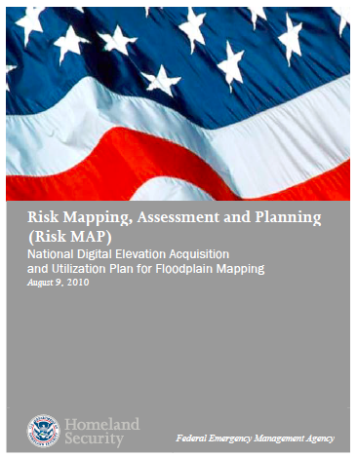
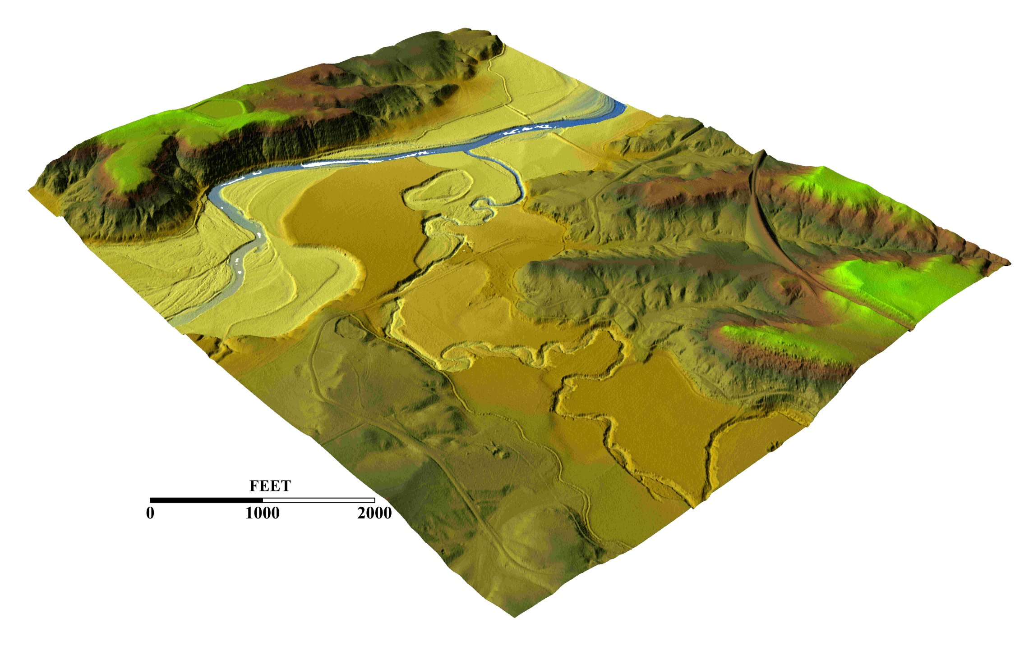
LIDAR Data Collection
$20 million per year for data collection
Image: Roberto Gutierrez
UT Center for Space Research
2010

Slide 8

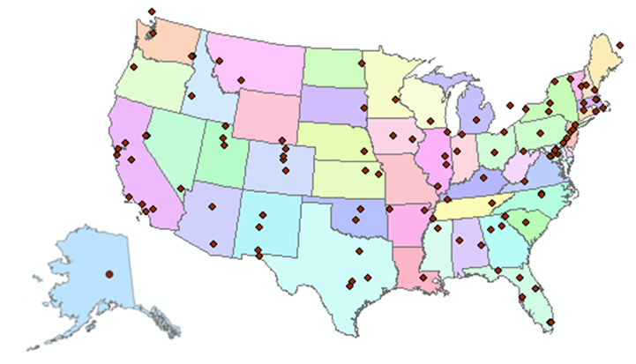
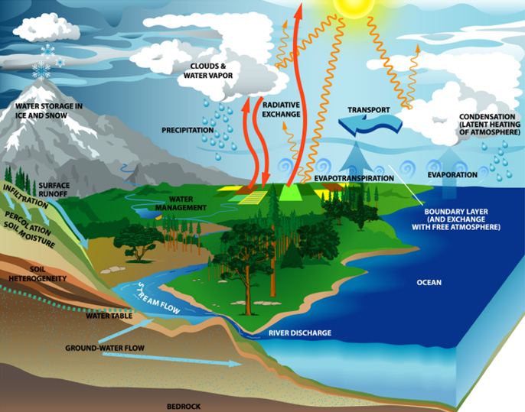
http://www.cuahsi.org
CUAHSI is a consortium representing 125 US universities
Supported by the National Science Foundation Earth Science Division
Advances hydrologic science in nation’s universities
Includes a Hydrologic Information System project

Slide 9
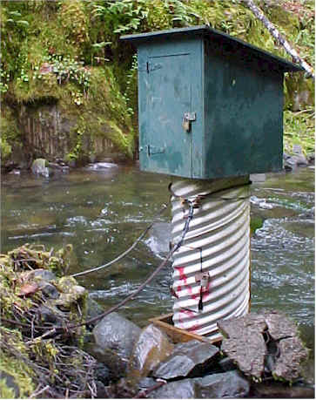
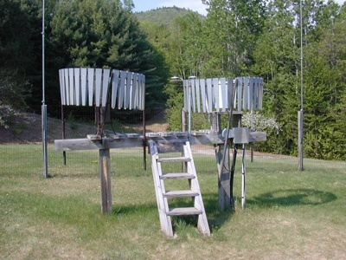
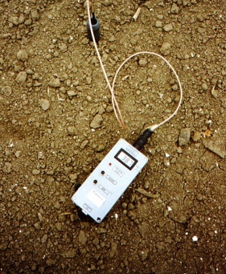
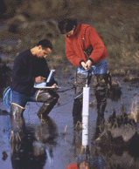
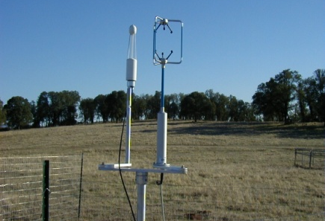
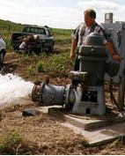
We Collect Lots of Water Data
Water quantity
Rainfall
Soil water
Water quality
Meteorology
Groundwater

Slide 10
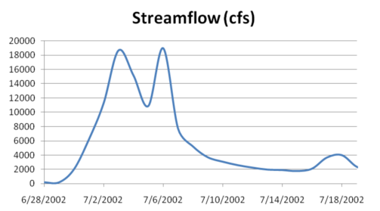
The Data have a Common Structure
A point location in space
A series of values in time
Gaging – regular time series
Sampling – irregular time series
Notes:
These data are recorded over time to monitor a hydrologic process or property.

Slide 11
How the web works
Catalog
(Google)
Catalog harvest
Search
Web Server
(CNN.com)
Access
Browser
(Firefox)
HTML – web language for text and pictures

Slide 12
Services-Oriented Architecture for Water Data
Catalog
Service registration
Search
Catalog harvest
Server
Data access
User
WaterML – web language for water data

Slide 13
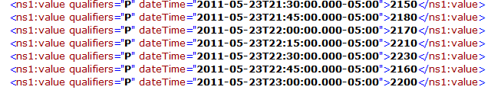
Colorado River at Austin
I accessed this WaterML service from USGS at 12:02AM this morning
http://waterservices.usgs.gov/nwis/iv?sites=08158000&period=P7D&parameterCd=00060
and got back these flow data from USGS which are up to 11:00PM Central time
USGS provides this service at 22,000 locations in the US

Slide 14
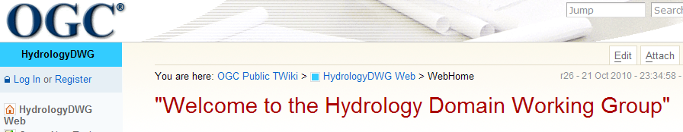
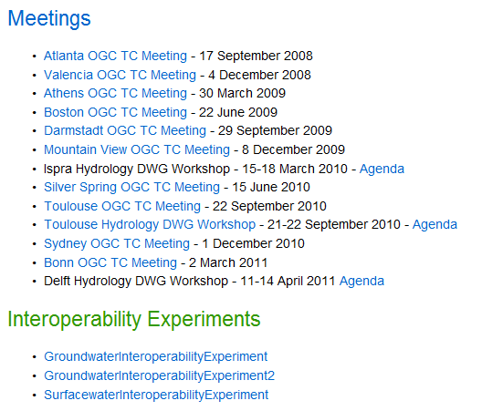
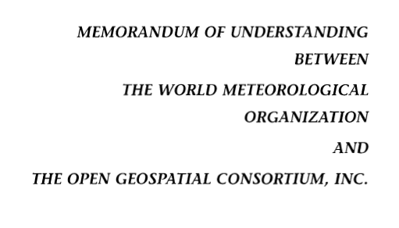
Jointly with World Meteorological Organization
Evolving WaterML into an International Standard
Meets every 3 months
Teleconferences most weeks
November 2009
Hydrology, Meteorology, Climatology, and Oceanography
WaterML Version 2 standard proposed
Notes:
The Hydrology Domain Working Group was initiated by the Open Geospatial Consortium in September 2008. The OGC has about 400 companies and agencies that have developed the most widely used standards for conveying geospatial information on the internet (Web Mapping Service, Web Feature Service, Web Coverage Service, Catalog Services for the Web, Sensor Observation Service). In November 2009, OGC and WMO agreed to collaborate to provide information data exchange standards in hydrology, climatology, oceanography and meteorology – there are now two working groups – the OGC/WMO Joint Hydrology Domain Working Group and a similar Met-Oceans Working Group. HDWG is proposing a new standard for WaterML in December 2010 that is a customization of the OGC Sensor Observation Services’ Get Observations function adapted for conveying time series through the internet (WaterML2). The technical specification for the “service stack” will be presented and peer-reviewed through the Hydrology Domain Working Group.

Slide 15
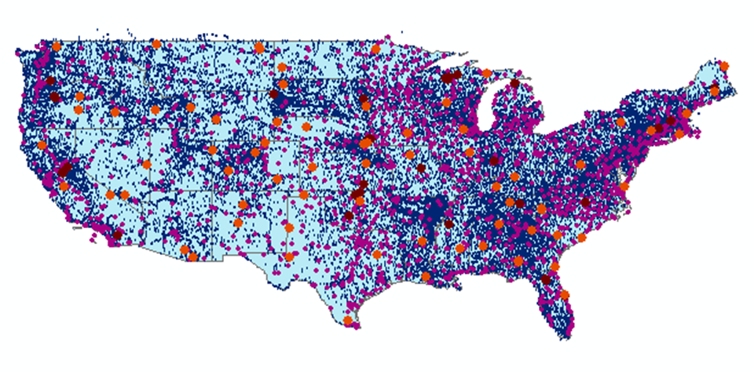
CUAHSI Water Data Services Catalog
66 public services
18,000 variables
1.9 million sites
23 million series
5.1 billion data values
And growing
The largest water data
catalog in the world
maintained at the San Diego Supercomputer Center

Slide 16
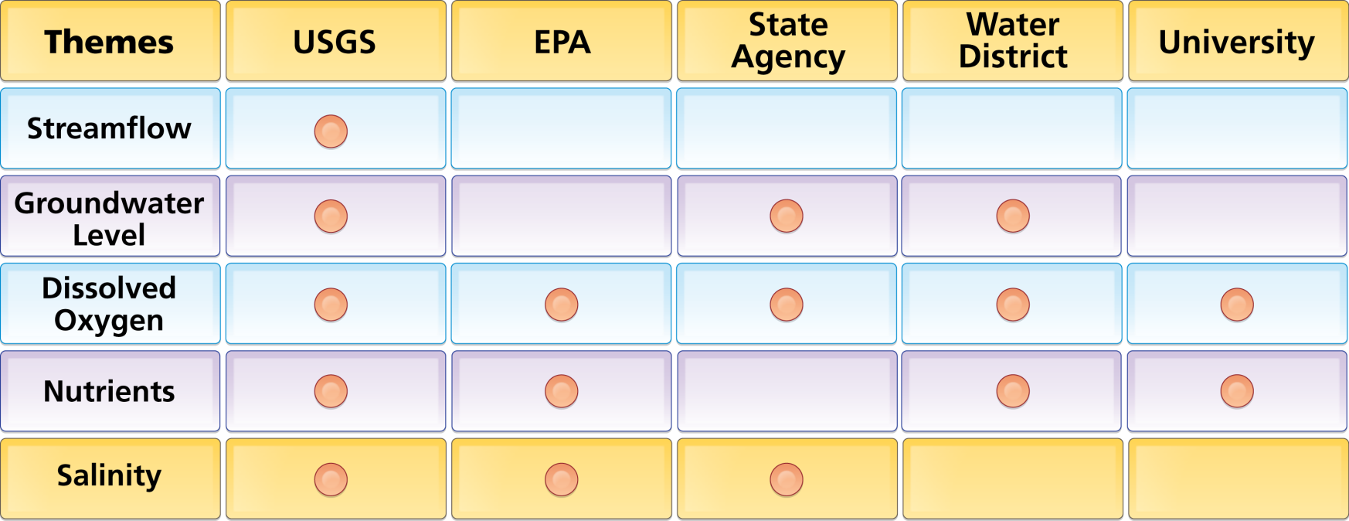
Organize Water Data Into “Themes”
Integrating Water Data Services From Multiple Sources
WaterML
WaterML
WaterML
WaterML
WaterML
. . . Across Groups of Organizations

Slide 17
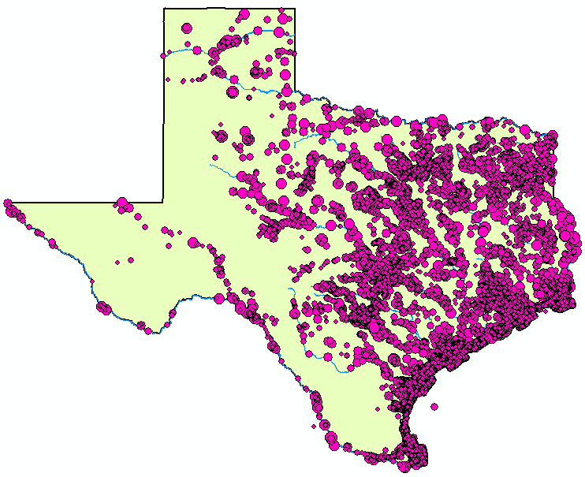
Dissolved Oxygen
5 services
18 variables
10,823 sites
21,655 series
930,571 records

Slide 18






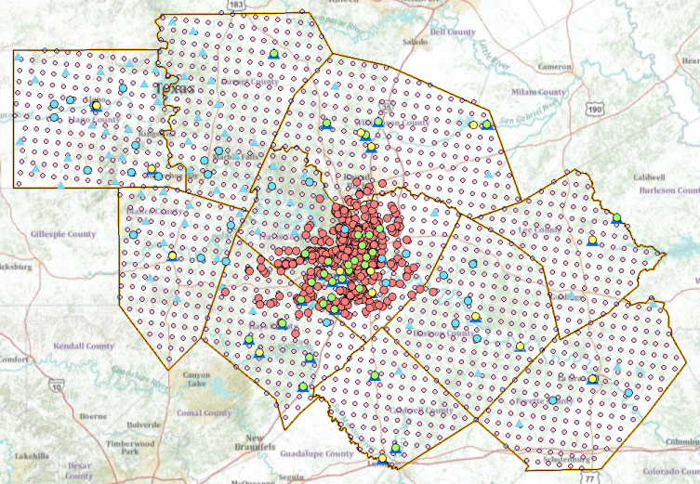
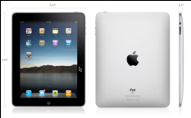




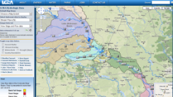


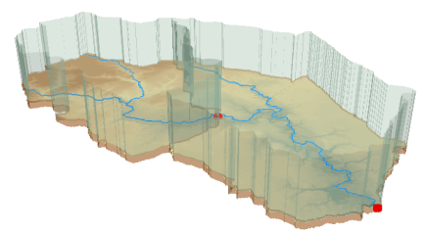

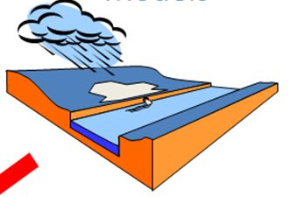

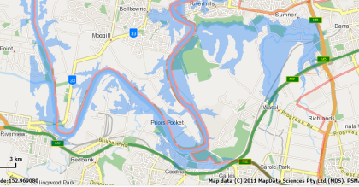
Flash flood information
Outputs
Inputs
Web Services HUB
Data
Services
(WaterML)
USGS
Data
Services
(WaterML)
LCRA
COA
Mapping
Services
NWS
Mapping
Services
NDFD
Data and Mapping
Services
Modeling
Services
Flood Mapping
Services
Models
Maps

Slide 19

Thank you to America
for giving me an opportunity

