Slide 1
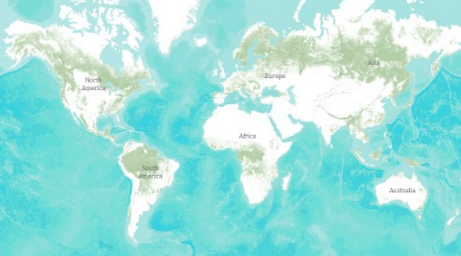
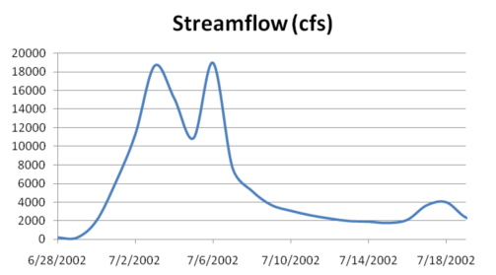
Information Systems in Water Resources
Web GIS
Water Web Services
By David R. Maidment
Center for Research in Water Resources
University of Texas at Austin
Presented at the Civil Engineering Department
Brigham Young University, 17 February 2011

Slide 2
Democratic Revolution in Egypt
…. empowered by internet technologies

Slide 3
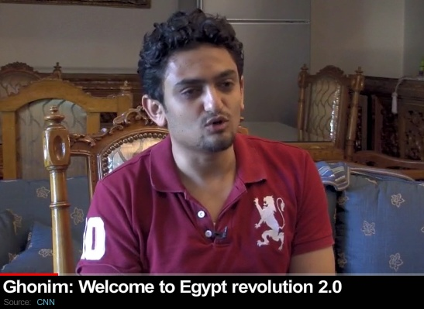
Wael Ghonim: Sparked the Revolution
“If you want to free a society, give them the internet”
…. a revolution sparked by a computer system administrator!

Slide 4
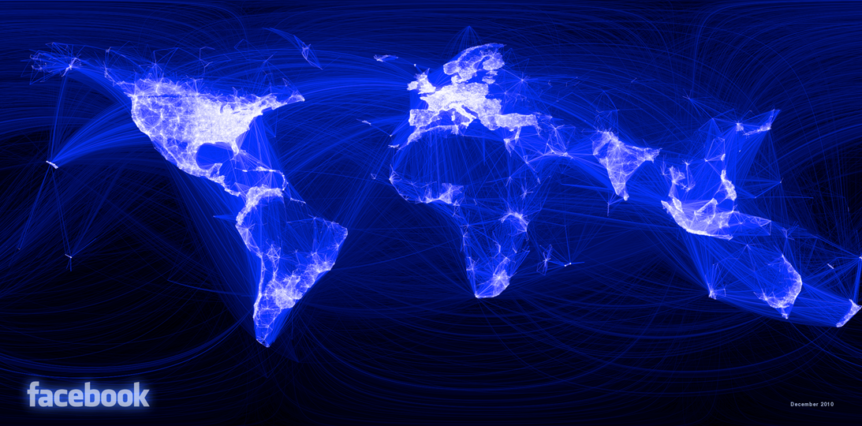
Visualizing Friendship – Facebook Connections
http://www.facebook.com/notes/facebook-engineering/visualizing-friendships/469716398919
…. People are empowered by being connected

Slide 5
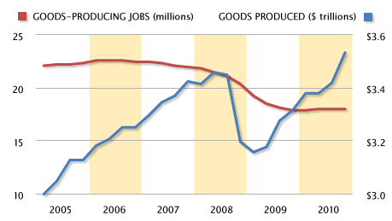
US Labor Productivity in Manufacturing A quiet revolution: same production with 4 million less jobs ….
http://www.msnbc.msn.com/id/41415001/ns/business-stocks_and_economy/
…. education is an investment in your mind

Slide 6
iPad Book Reader
Information gains mobility when it is electronic

Slide 7
Information gains power when it is aggregated
HuffPost has 200 employees and 6000 bloggers who write for free ….
…. It was sold to AOL on February 7, 2011, for $315 million

Slide 8
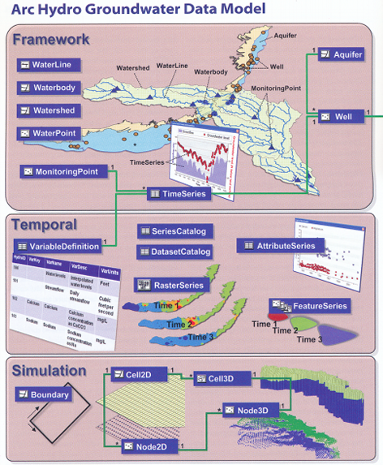
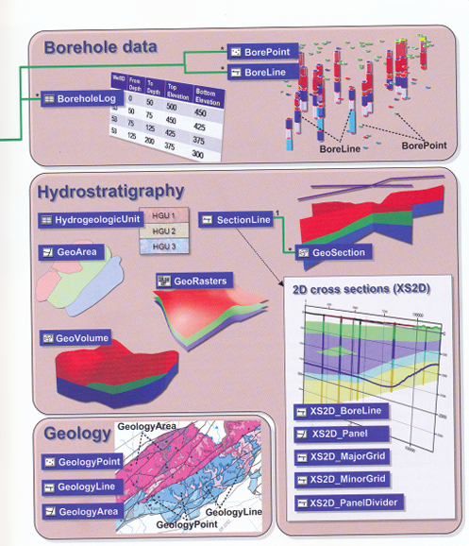
Arc Hydro Groundwater
Information is more useful when it is organized

Slide 9
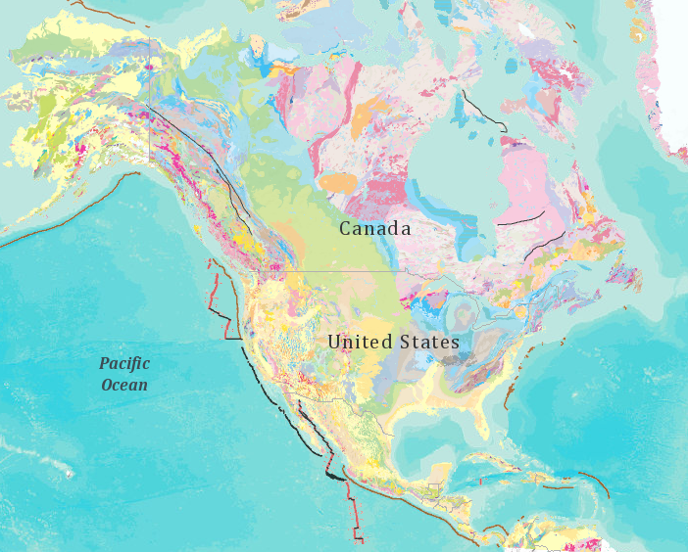
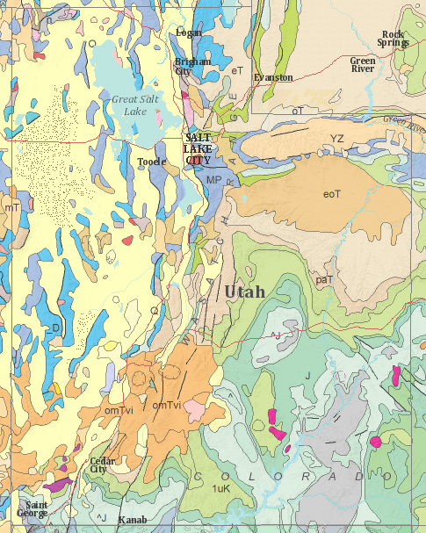
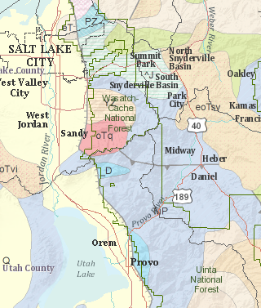
Geological Map of North America
Information is more compelling when it is visual
Global, multiscale community base mapping

Slide 10
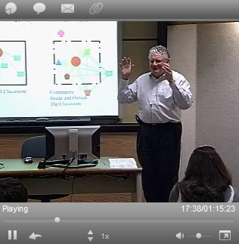
University Without Walls
Traditional Classroom
Community
Inside and Outside
The Classroom
Lectures on streaming video
Information is more valuable when it is accessible

Slide 11
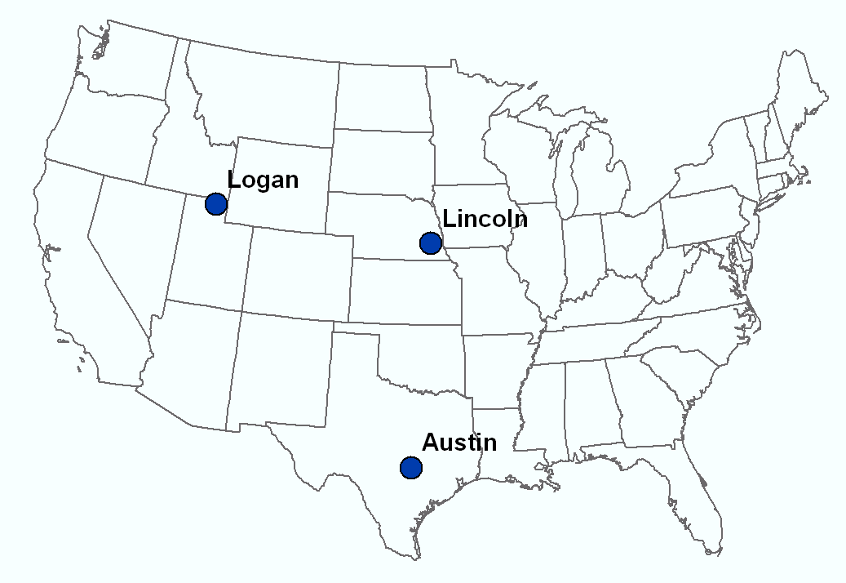
Video Connected Classroom
Dr David Tarboton
Students at Utah State University
Dr Ayse Irmak Students at University of Nebraska - Lincoln
Dr David Maidment Students at UT Austin
…. GIS in Water Resources class taught each Fall

Slide 12
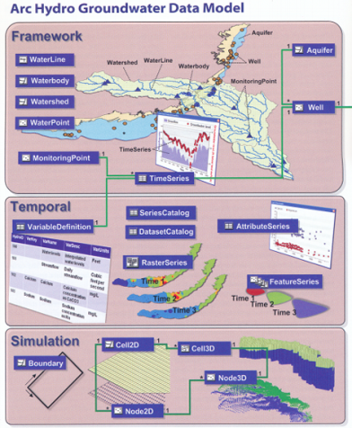
Education is Enhanced by Information that is:
Mobile
Visual
Connected
Accessible
Aggregated
Organized
…. How can we achieve this in water resources engineering?

Slide 13
Global Vision of BYU

Slide 14
Global Vision of EMRL
http://www.emrl.byu.edu/home.htm

Slide 15
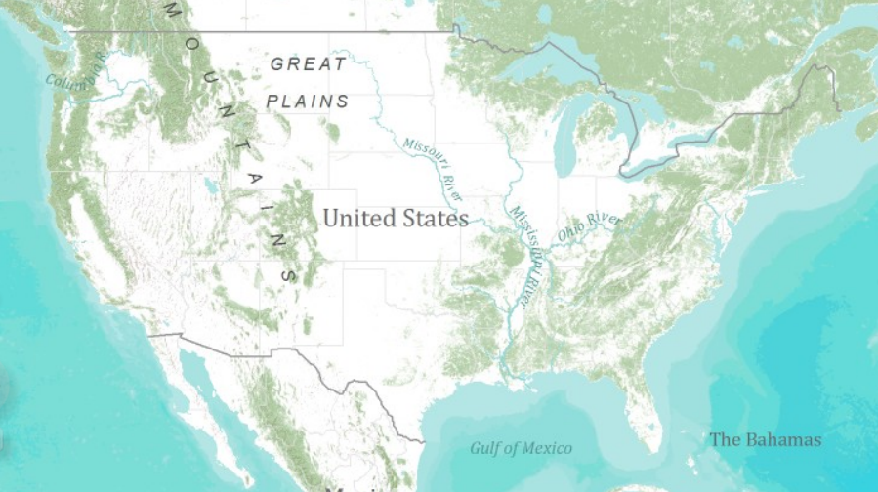
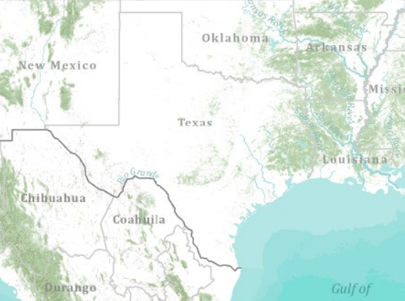
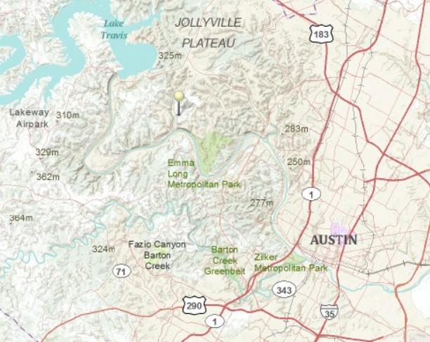
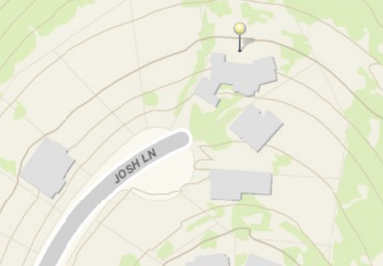
Global Topographic Basemap in ArcGIS Online
Information contributed by many cities and countries
World
United States
Texas
Austin
Home
ArcGIS Online Topo Map
Tiled base map synthesizing information across map scales

Slide 16
Storm Runoff at My Home
What do I need to know?
What is the topography?
How much drainage area is uphill?
How severe is the rain?
What kind of soil?
What kind of land cover?
Calculate the watershed runoff and surface flow
Data, Map and Modeling Web Services
Storm Runoff
Plus

Slide 17
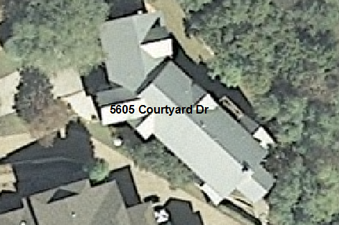
Digital Orthophoto Image Services (basis of Google Earth)
A continuous photograph that has been rectified so that at every point you are looking straight down vertically
Standard for describing land cover
These give quite precise (x, y) coordinates for infrastructure

Slide 18
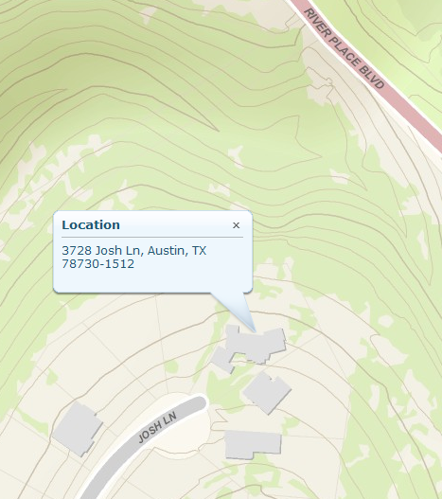
Topographic Map and Data Service
Calculate magnitude and direction of land surface slope
Adds elevation-values to give (x, y, z) coordinates for infrastructure

Slide 19
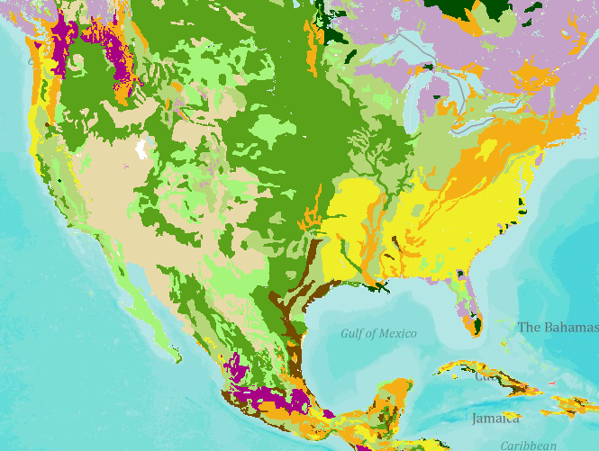
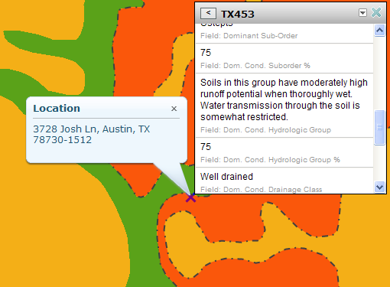
Soil Map and Data Service
ArcGIS Online Soil Map

Slide 20
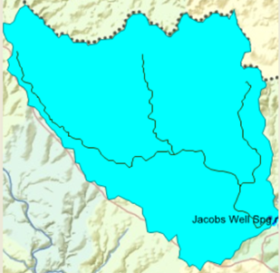
Geospatial Water Web Services from EPA
Automated watershed delineation anywhere in the continental US

Slide 21
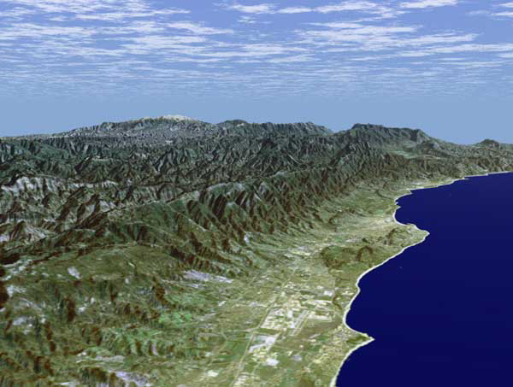
Santa Barbara, California
http://srtm.usgs.gov/srtmimagegallery/index.html

Slide 22
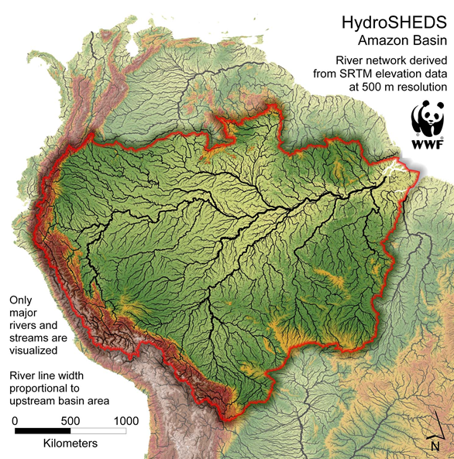
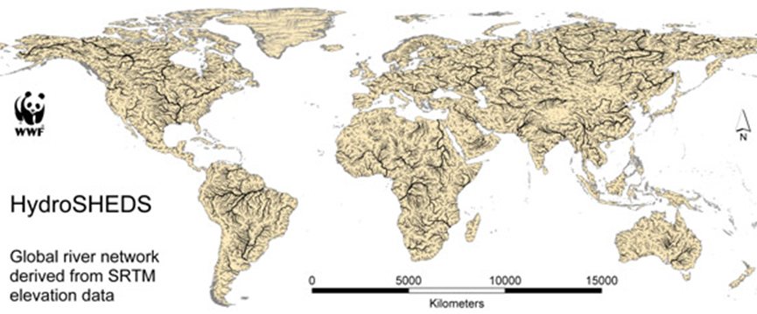
Global watersheds and stream networks

Slide 23
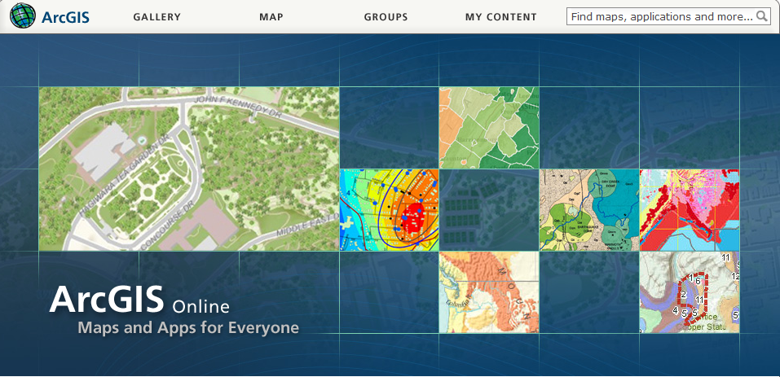
Web GIS
…. is making map information globally and freely accessible

Slide 24
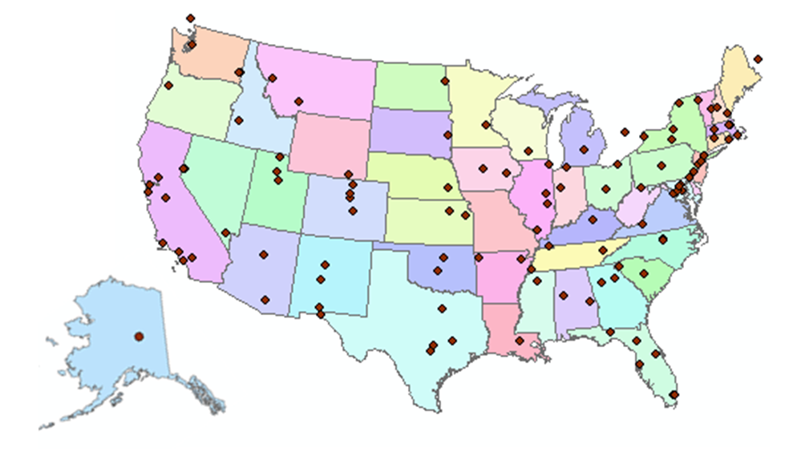
Consortium of Universities for the Advancement of Hydrologic Science, Inc
125 Universities are members ….
…. supported by NSF

Slide 25
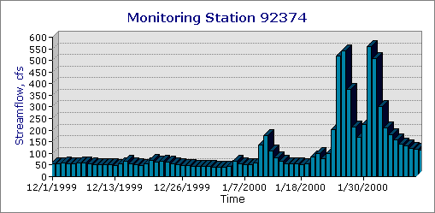
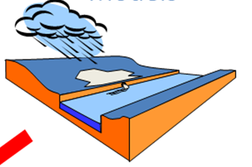
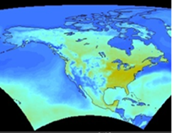
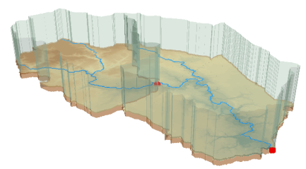
CUAHSI Hydrologic Information System
Observations
Weather and Climate
Modeling
GIS
Remote Sensing
Access and Integrate water data across water disciplines ….
…. and data types

Slide 26
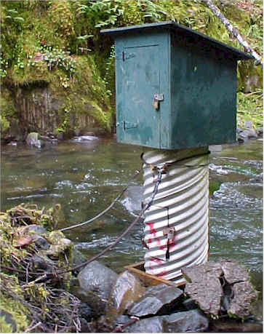
Point Water Observations Time Series
A point location in space
A series of values in time

Slide 27
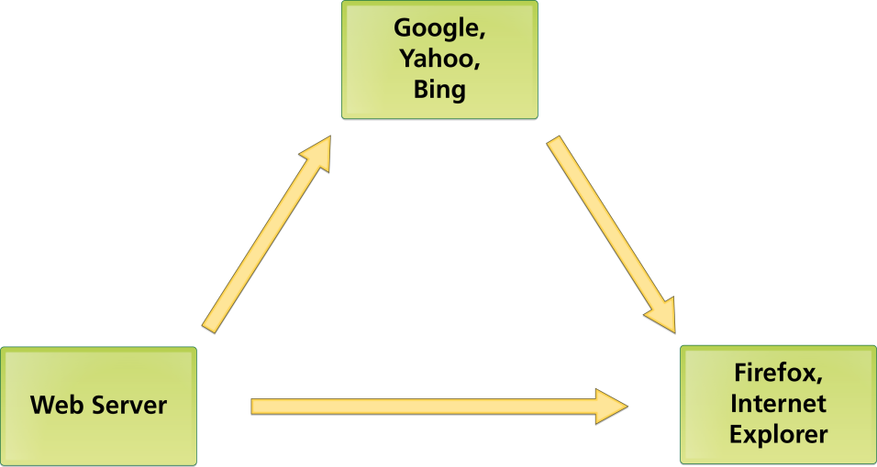
Three Basic Internet Components: Catalog, Server, User Linked by HTML
Catalog
HTML
Server
User

Slide 28
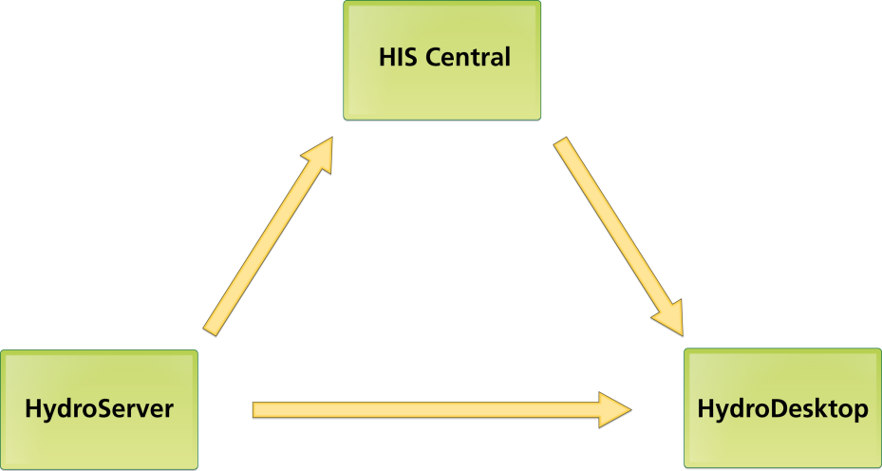
CUAHSI HIS Components Linked by WaterML
Catalog
WaterML
Server
User

Slide 29
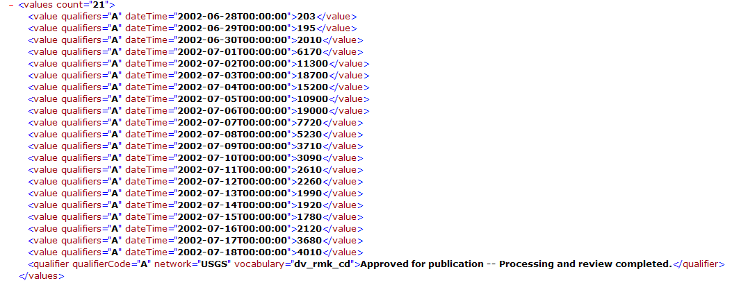
WaterML as a Web Language
Discharge of the San Marcos River at Luling, TX June 28 - July 18, 2002
USGS Streamflow data in WaterML language

Slide 30
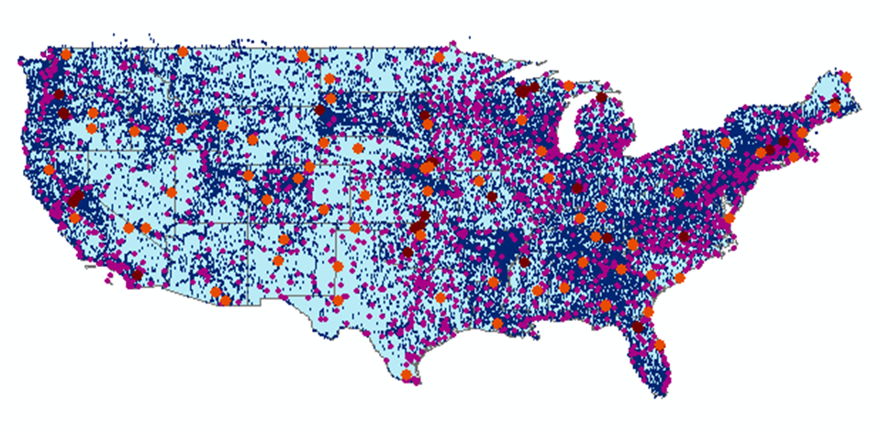
CUAHSI Water Data Services
66 public services
18,000 variables
1.9 million sites
23 million series
5.1 billion data values
And growing
The largest water data catalog in the world
maintained at the San Diego Supercomputer Center

Slide 31
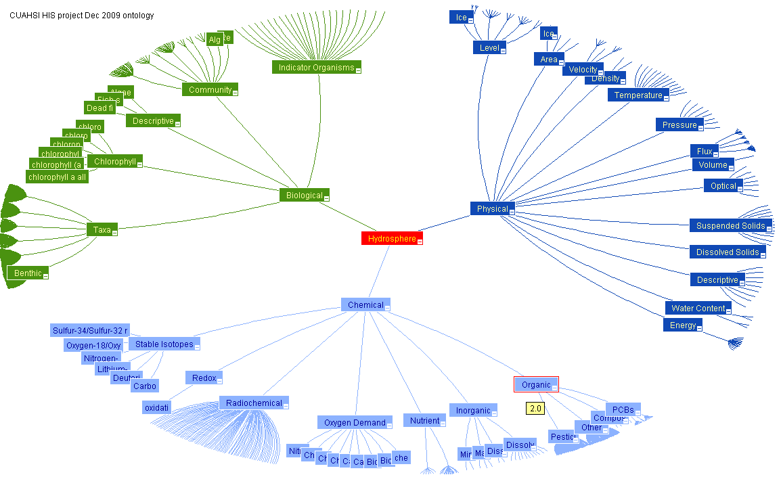
Working Towards Common Semantics Using an Ontology to Reconcile Meanings of Variables
A hierarchy of concepts
Match variables to leaf concepts
Physical
Hydrosphere
Chemical
Biological
Uses EPA Substance Registry System for Chemistry
http://test.hydroseek.net/ontology/Ontology_heirarchy.html

Slide 32
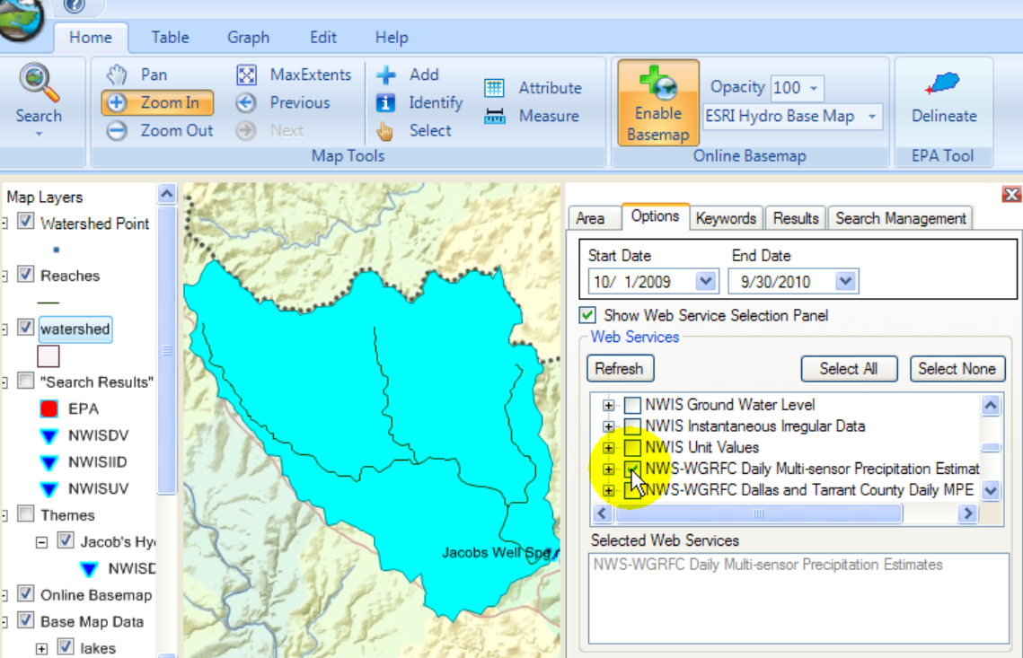
HydroDesktop Desktop Hydrologic Information System
Metadata
Catalog
Data

Slide 33
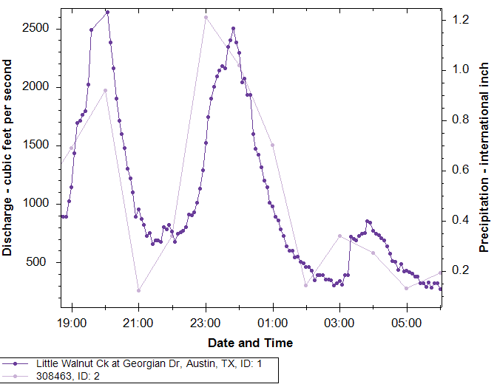
Watershed, Rainfall, Streamflow
Rainfall
Streamflow
Little Walnut Creek at Georgian Dr,
Austin, Texas

Slide 34
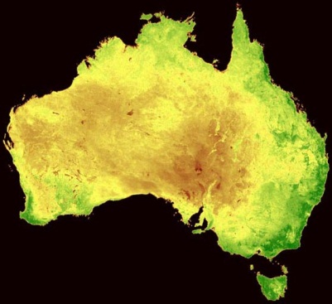
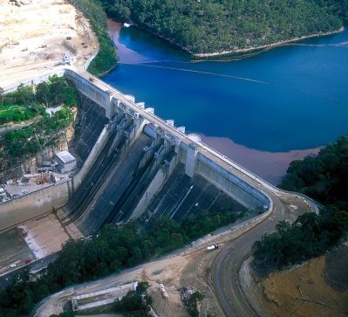
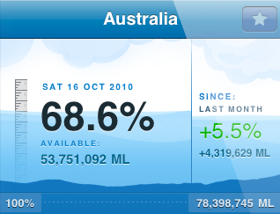
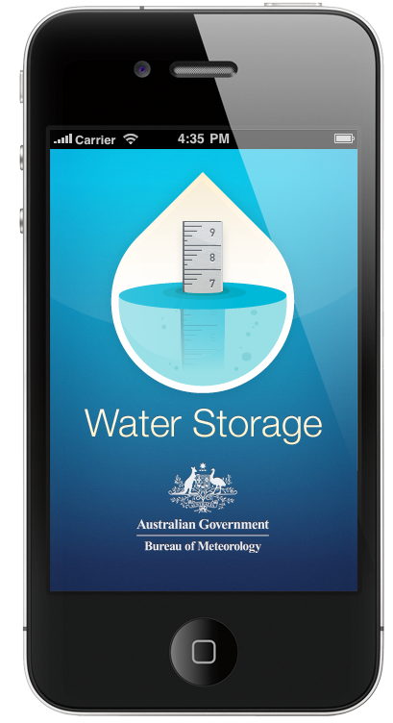
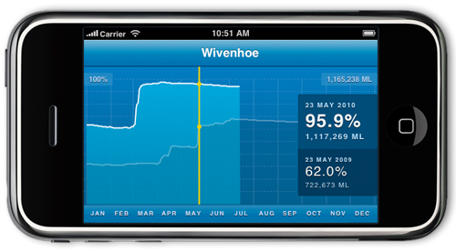
Australian Water Resources Information System iPhone App for Water Storage
National View
Summarizes the current volume of water in reservoir storage and its change over time
Regional View
http://itunes.apple.com/au/app/water-storage/id380627384

Slide 35
How do we combine knowledge with data?
How do we combine knowledge with data?
Digital textbook that has imbedded services with maps and data for any location on earth
…. How can we build an educational mission in water resources engineering?

Slide 36
How do we build a global water information community?
A challenge for the 21st Century!

