Slide 1
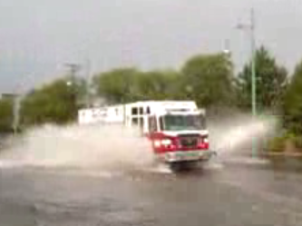
Situational Awareness for Flash Flooding
Presented to the Capital Area Council of Governments
Austin, 5 May 2011
By David R. Maidment and Fernando Salas
Director, Center for Research in Water Resources
Cockrell School of Engineering
University of Texas at Austin

Slide 2
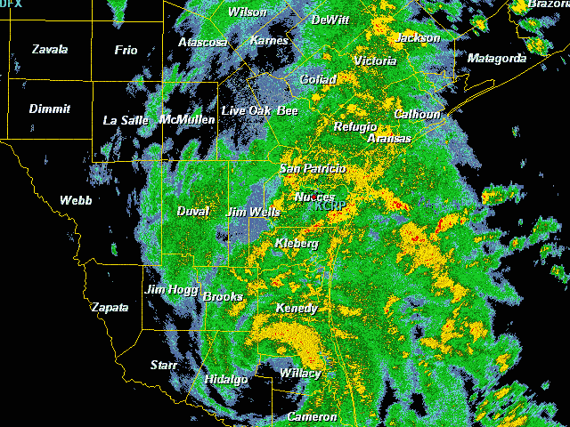
Tropical Storm Hermine,
Sept 7-8, 2010

Slide 3
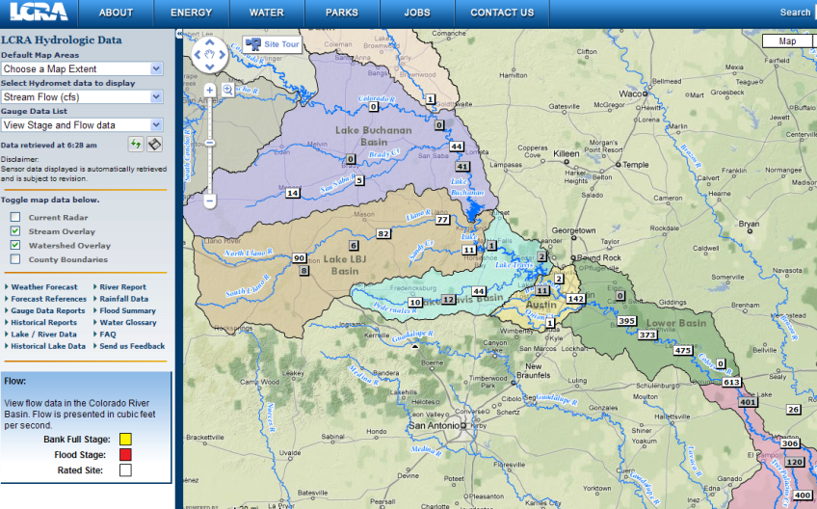
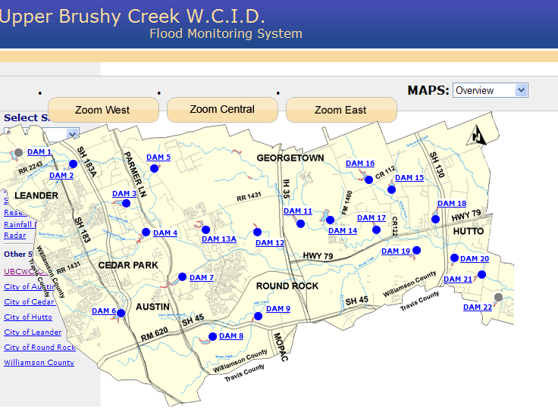
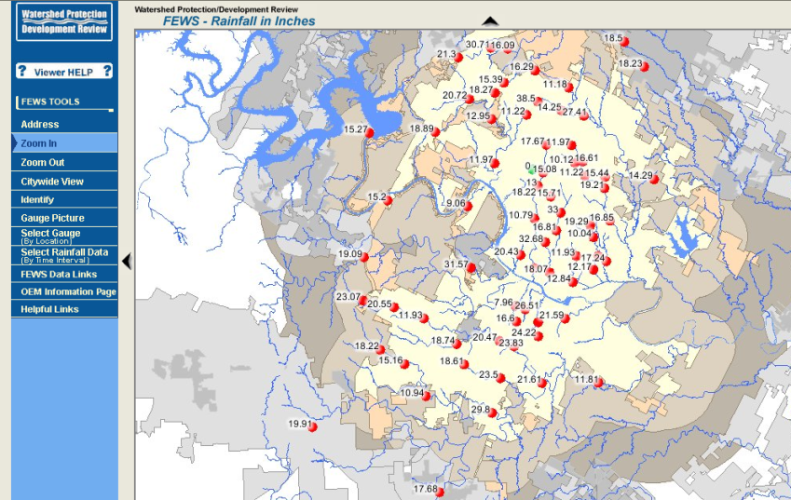
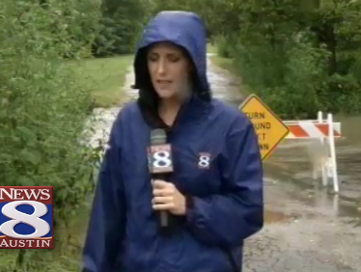
Local Information during Tropical Storm Hermine
(7-8 Sept 2010)
Upper Brushy Creek (Round Rock)
LCRA
Bring data together into one system
http://hydromet.lcra.org
http://ubcwcid.org/Overview/Overview.aspx?id=1
TV
City of Austin
http://coagis1.ci.austin.tx.us/website/COAViewer_fews/viewer.htm

Slide 4
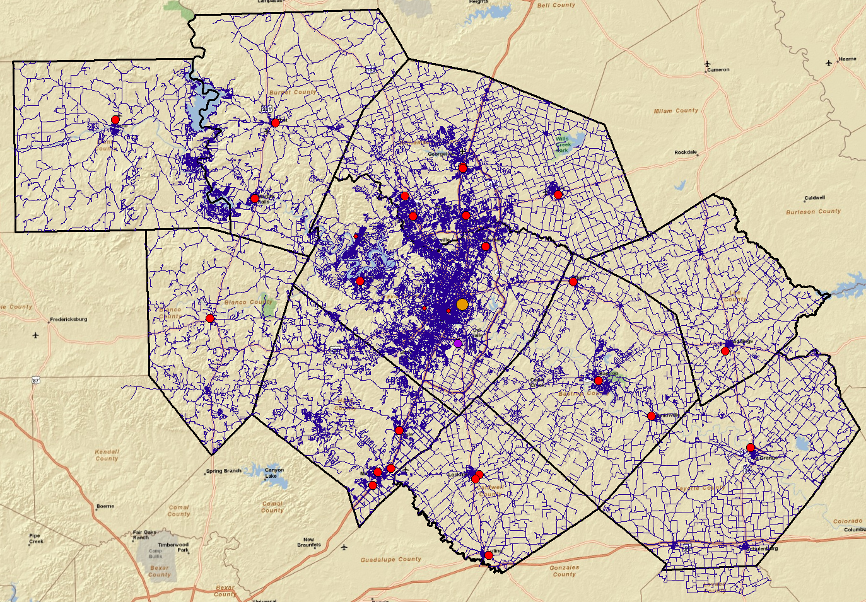
Emergency Response System (CAPCOG)

Slide 5
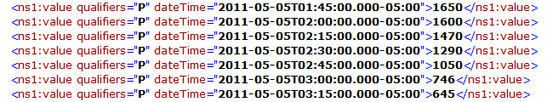
WaterML web services:
Colorado River at Austin
I accessed this WaterML service at 4:15AM
http://waterservices.usgs.gov/nwis/iv?sites=08158000&period=P7D&parameterCd=00060
And got back these flow data from USGS which are up to 3:15AM Central time

Slide 6
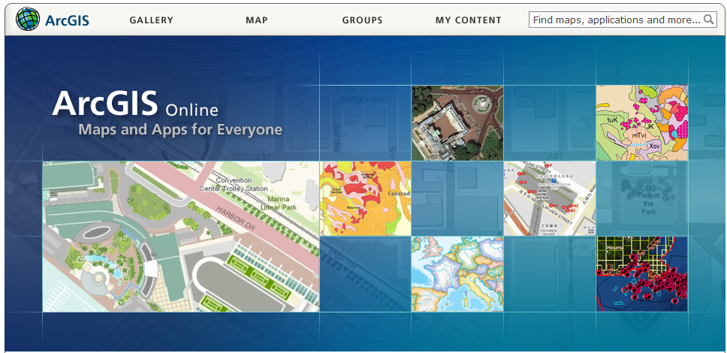
ArcGIS Online
GIS on the web – online map services
http://www.arcgis.com

Slide 7
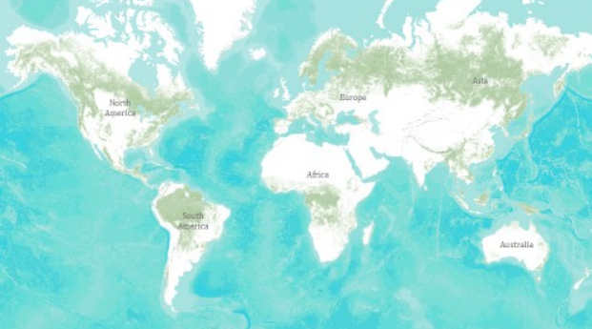
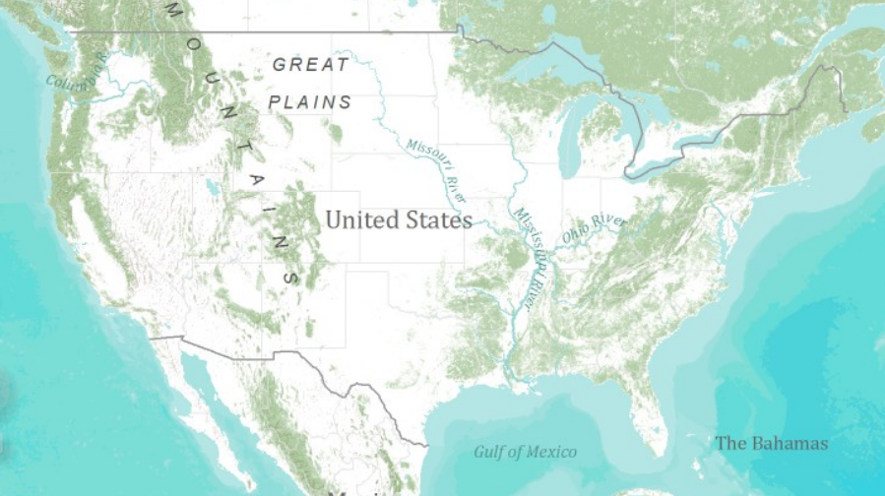
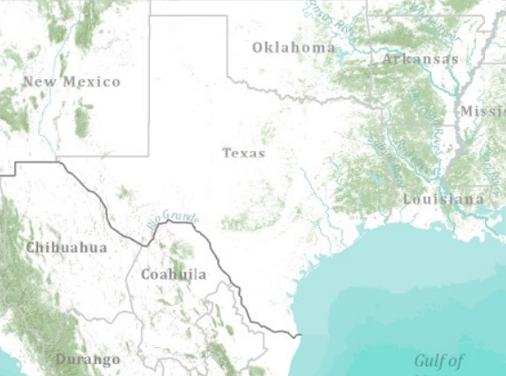
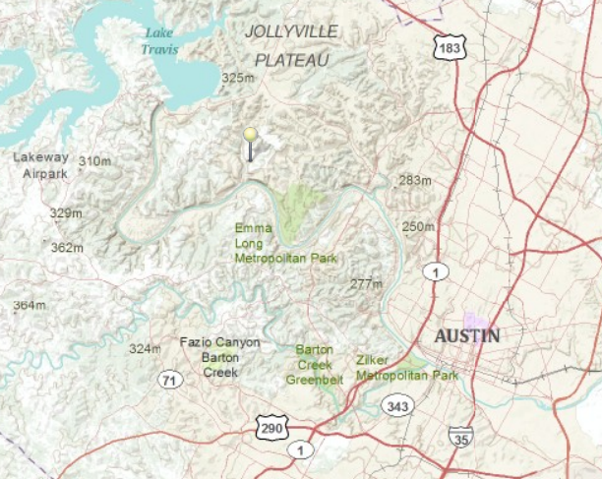
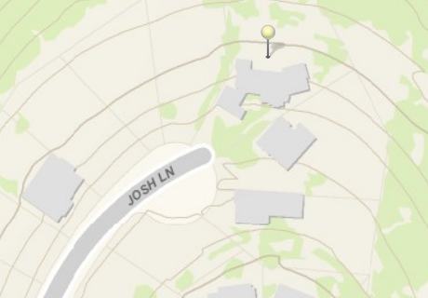
Topographic Base Map in ArcGIS Online
World
United States
Texas
Austin
Home

Slide 8
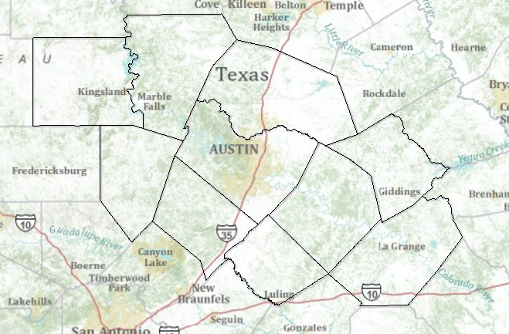
Topographic Base Map Service
http://explorer.arcgis.com/?open=c50ba5510cfa4663ae417eb4a56cc336

Slide 9
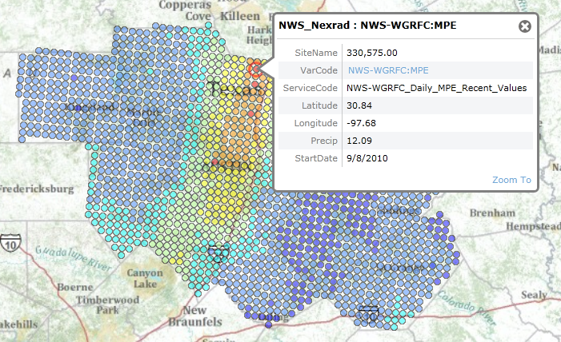
Precipitation Web Service: NWS Nexrad

Slide 10
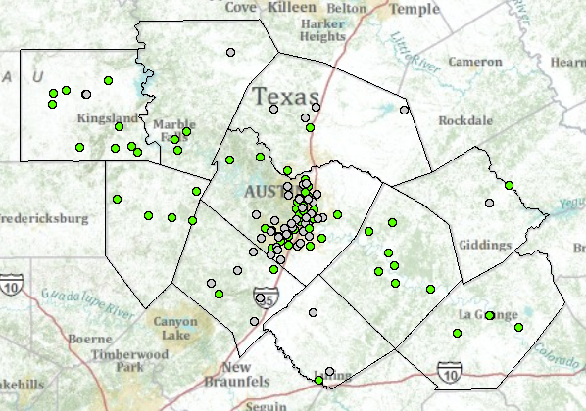
River Gage Web Services
USGS, LCRA and City of Austin
Gages whose flood stage heights are undefined as yet

Slide 11
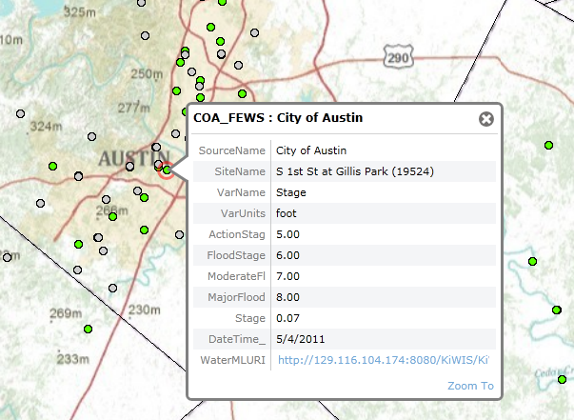
River Stage Web Service: City of Austin

Slide 12
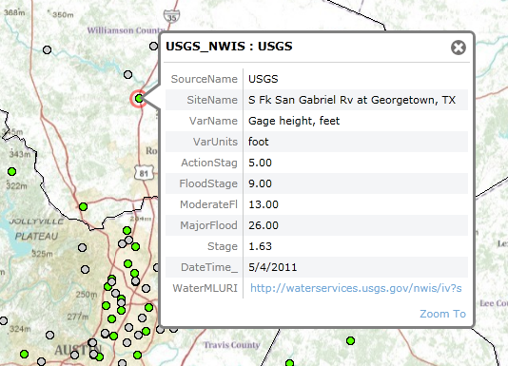
River Stage Web Service: USGS

Slide 13
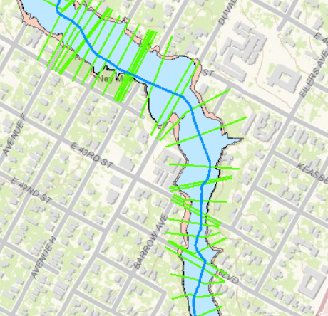
River Channel Data Services
http://explorer.arcgis.com/?open=ad7c4dbe299a458ca52b9caa725a2d4d

Slide 14


IBM is collaborating with UT….
…. to help build a Smarter Planet

Slide 15
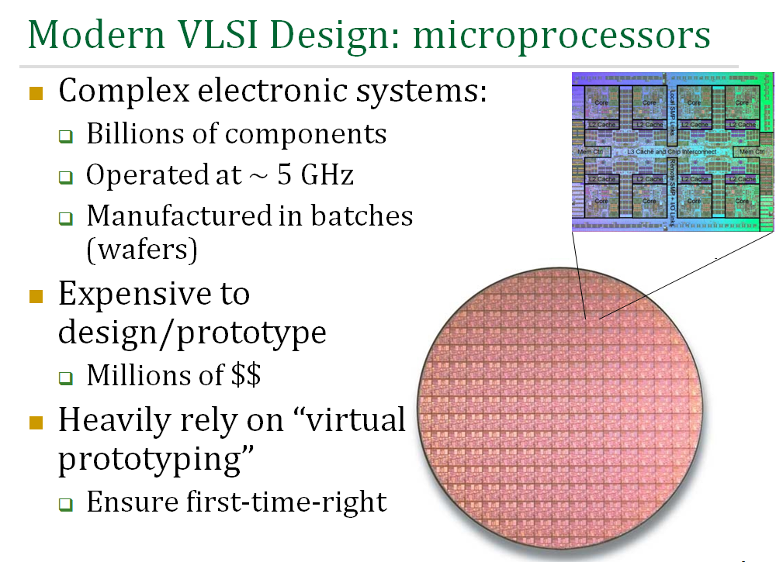

Slide 16
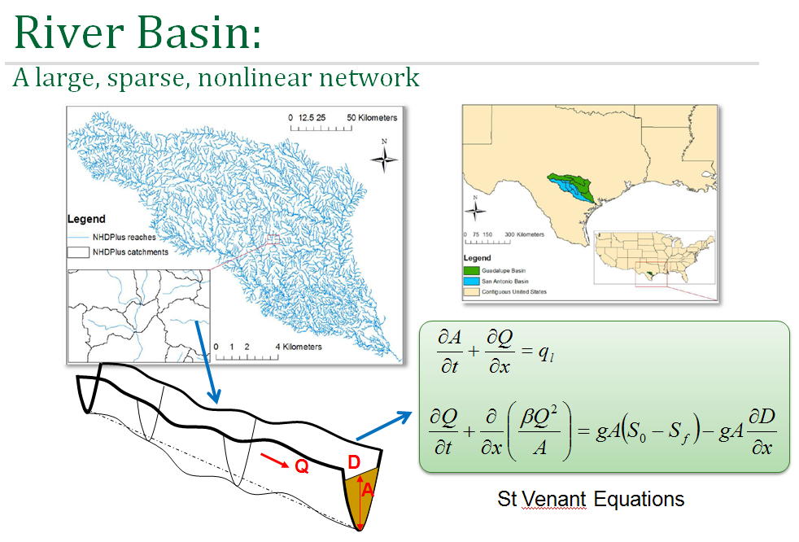
VLSI simulation models for electric circuit design…..
….. adapted to apply to river networks

Slide 17
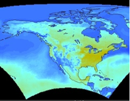



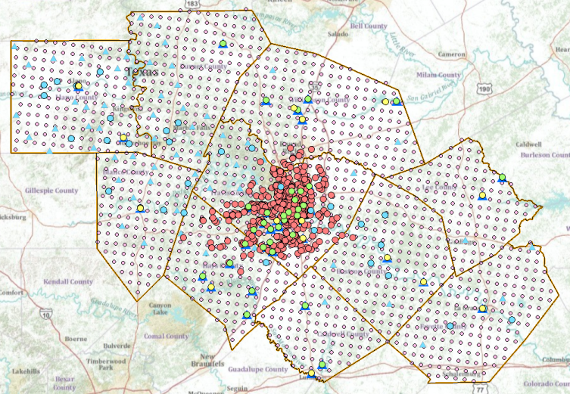



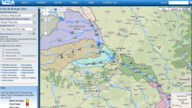





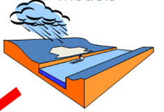
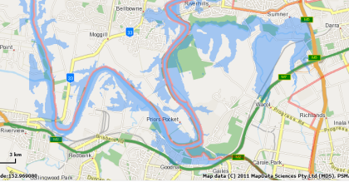
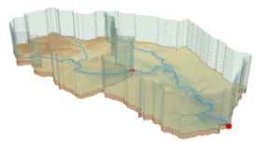
Web Services HUB
Inputs
Outputs
Web Services HUB
Observation
Data
Services
(WaterML)
Observation
Data
Services
(WaterML)
USGS
LCRA
COA
Channel
Data
Services
(WFS)
NWS
Mapping
Services
(WFS)
AHPS
Data
Services
(WFS)
Modeling
Services
Mapping
Services
(WFS)
Models
Maps

Slide 18








We would like to work with CAPCOG
Possible next steps:
Identify/confirm constituents
Map out initial use cases
Finalize architecture
Identify funding avenues

