Slide 1
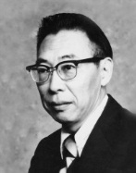
Ven Te Chow Scholar, Teacher, Author, Friend
Presented by David Maidment Center for Water and the Environment University of Texas at Austin
Celebration of the 100th anniversary
of the birth of Ven Te Chow
Shanghai Jiao Tong University 2 November 2019
Acknowledgements: Drs Ximing Cai and Marcelo Garcia, University of Illinois at Urbana-Champaign;
Prof. Yixin Xhao, Ms Rong Zhang, Shanghai Jiao Tong University.
Notes:
How do we answer the question of how many people are going to be impacted, especially if large areas of the state are not covered by LIDAR or National Flood Hazard Layer? The researchers developed a process called Height Above Nearest Drainage or HAND.

Slide 2
Thank you for this invitation It is an honor for me to speak at the Alma Mater of my academic advisor, Dr Ven Te Chow…

Slide 3
Dr Chow as a Scholar A seeker for knowledge …

Slide 4
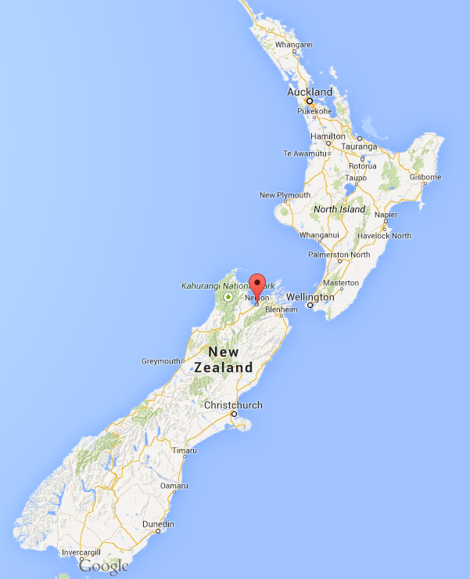
My Introduction to Ven Te Chow…
In the summer of 1971 I was a hydrology intern of the New Zealand Ministry of Works and Development
In the Nelson field office we had three books
One was the Handbook of Applied Hydrology
Nelson

Slide 5
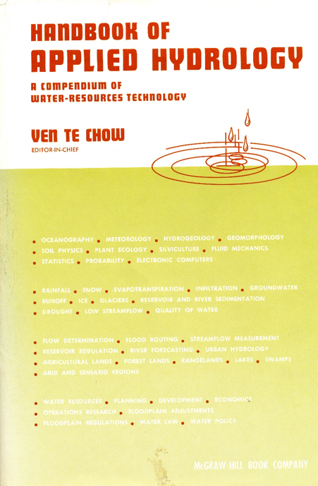
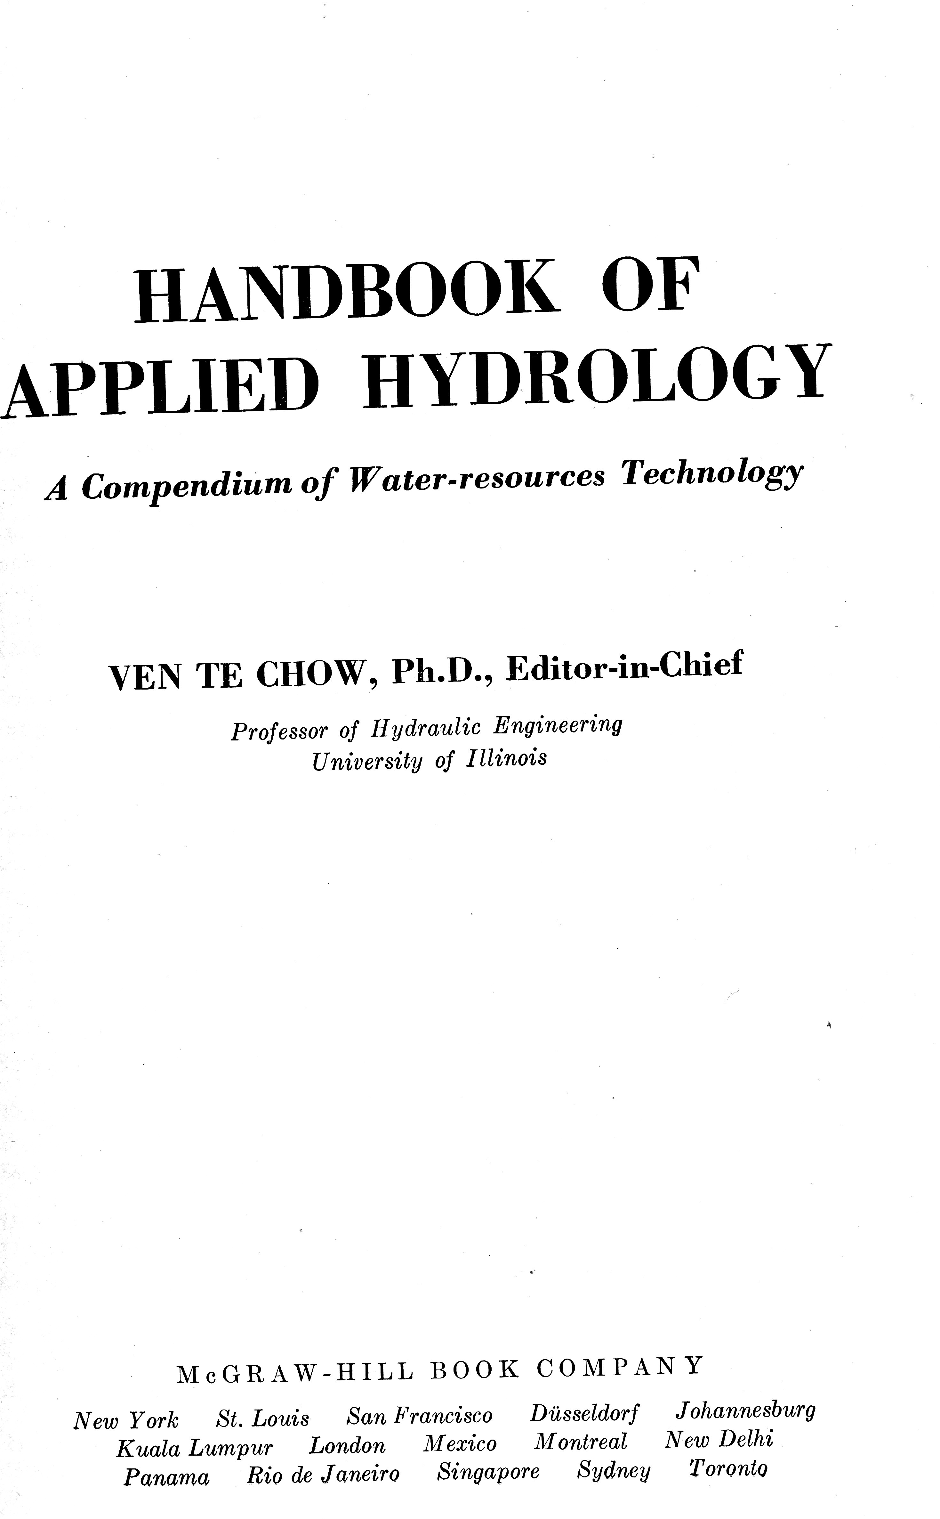
Published in 1964
When Dr Chow was
45 years old

Slide 6
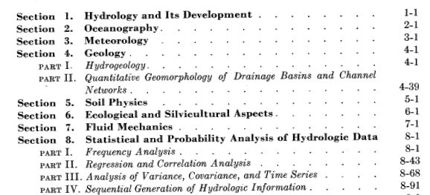
Ch. 1-8: Sciences supporting hydrology
(363 pages)

Slide 7
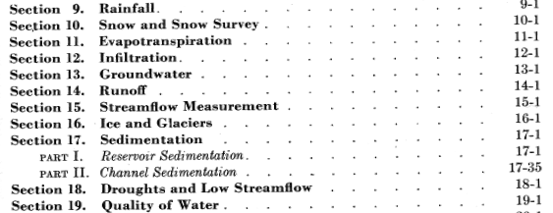
Ch. 9-19: Phases of Hydrologic Cycle
(505 pages)

Slide 8
Ch. 20-24: Practice and Application of Hydrology
(273 pages)

Slide 9
Ch. 25 — 29 Water Resources Planning
(263 pages)

Slide 10
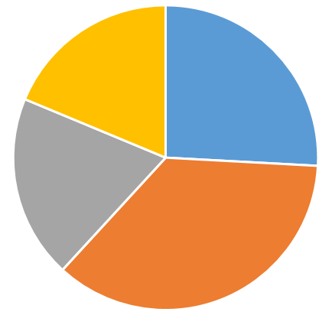
Makeup of “Handbook of Applied Hydrology” – 1400 pages
Water resources planning
and management
(20%)
Supporting
Sciences
(25%)
Practice and Application
of hydrology
(20%)
Phases of
Hydrologic Cycle
(35%)

Slide 11
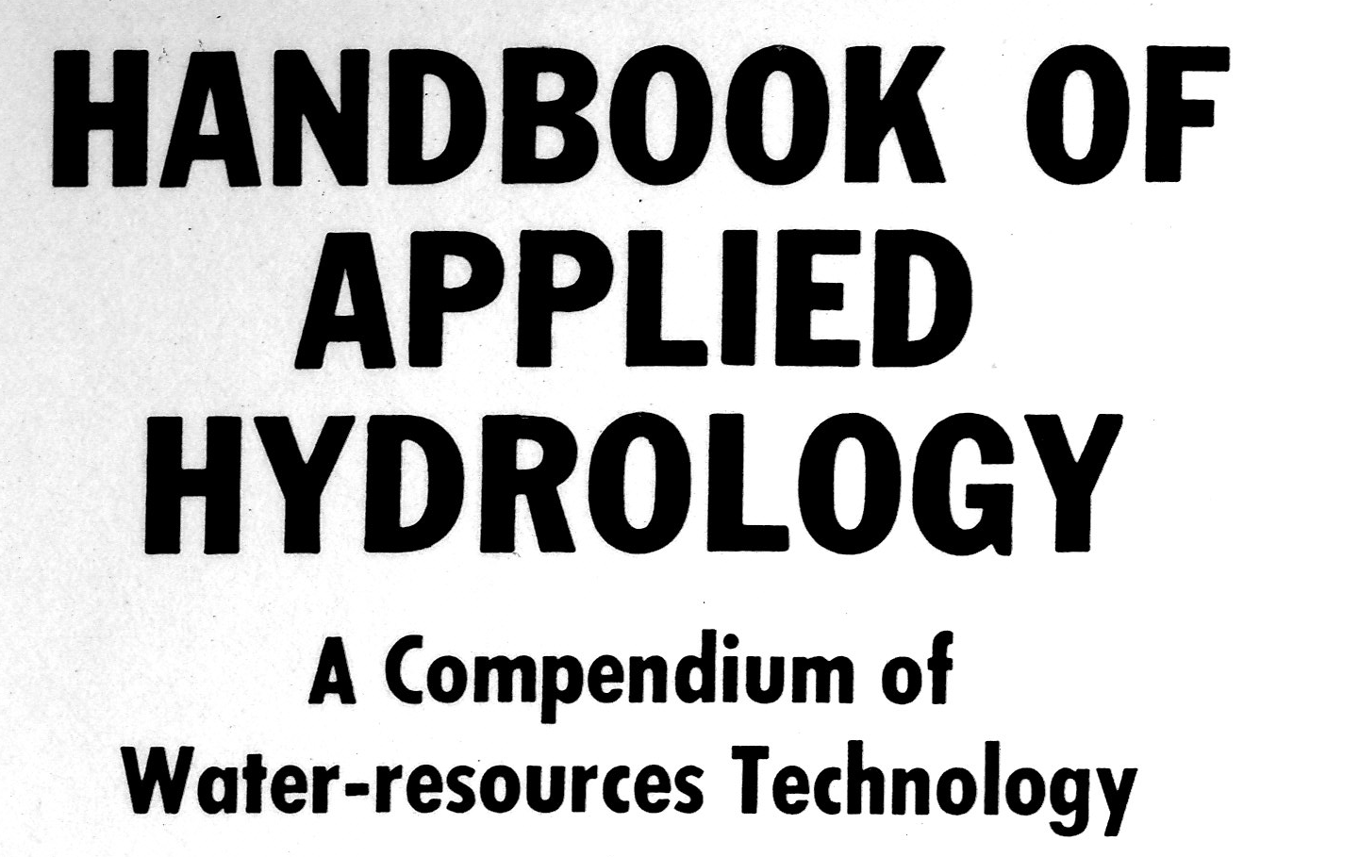
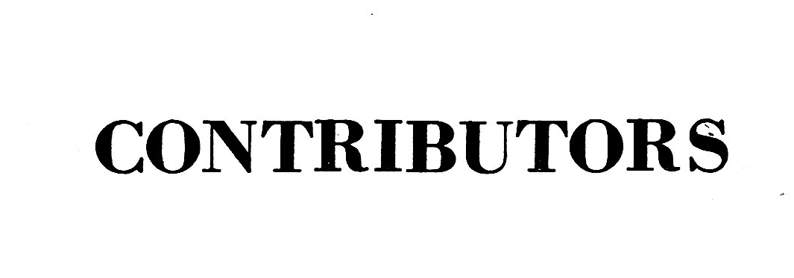
He edited the whole Handbook ....
… and wrote all these sections himself!
These are the subjects in which he was most interested

Slide 12
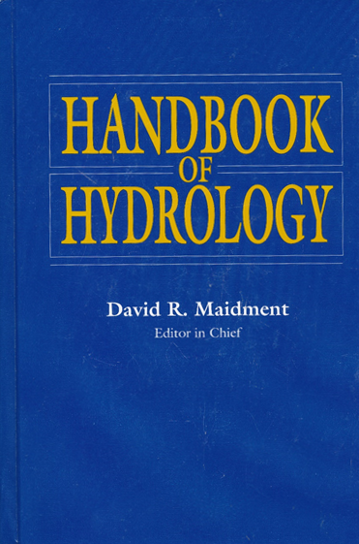
A generation later I edited a Handbook of Hydrology …
… and dedicated it to Dr Chow
1964
1993

Slide 13
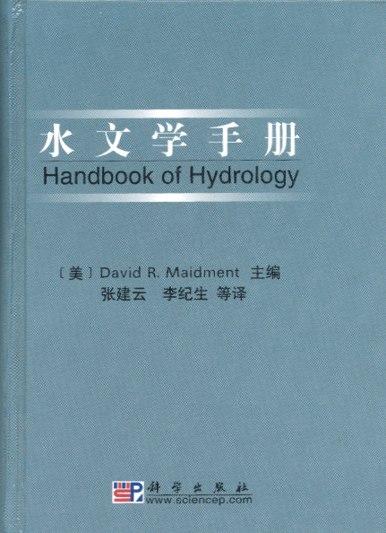
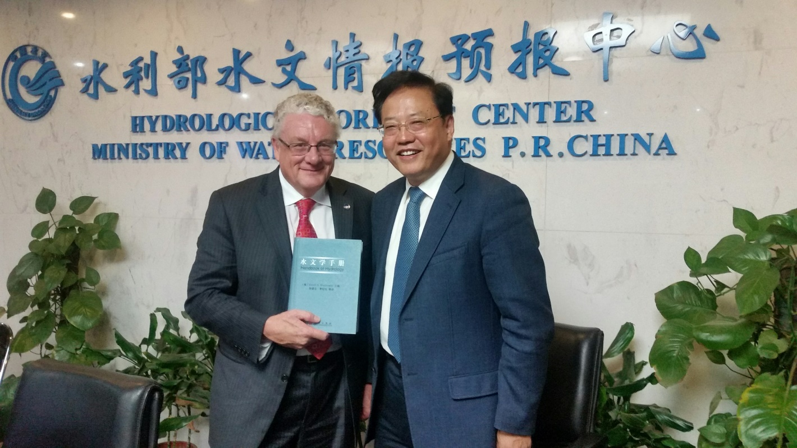
It was translated into Chinese
by Prof Jian Yun Zhang, now at Nanjing Hydraulic Research Institute
McGraw-Hill
1993
Chinese translation
2002

Slide 14
Dr Chow as a Teacher A conveyor of knowledge …

Slide 15
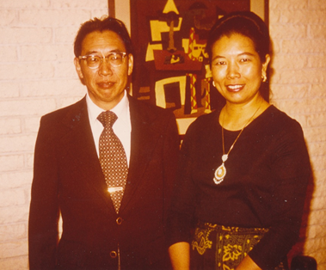
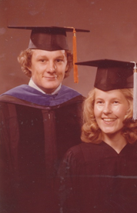
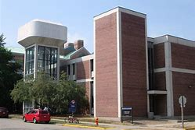
I became a Student at the University of Illinois in 1972
Dr Chow was my academic advisor
Ven Te Chow
and his wife, Lora Chow
Hydrosystems Laboratory
David: MS in Civil Engineering, 1974
PhD in Civil Engineering, 1976
Helen: MS in Science Education, 1975

Slide 16
My first memories of Illinois …
I vividly recall my first days on campus at Illinois, mixing with the international graduate student community.
I remember my first visit to the Hydrosystems Laboratory, sitting in Dr Chow’s office in a little chair next to his desk.
I was just 22 years old. In a flash, my world had been transformed from a quiet life in a small country very far away, to mixing in a global community at the forefront of learning.
It was a unique, life-changing experience, one that I’ll never forget.
Hydrosystems Laboratory

Slide 17
My Class Notes from CE 450 Hydrologic Systems
Taught by Dr Chow
Fall Semester 1972

Slide 18
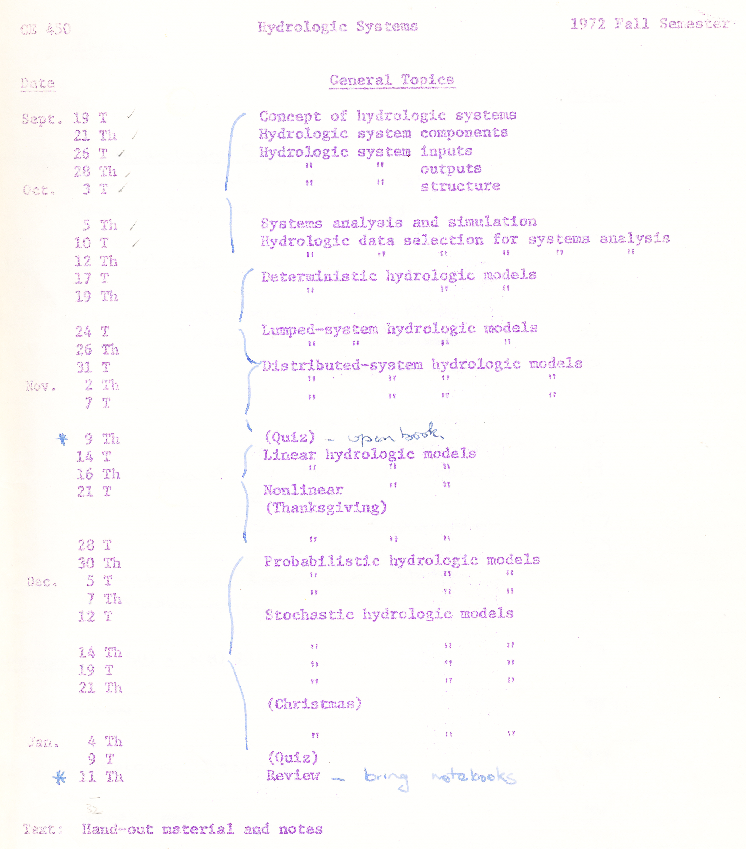
Course Topics for CE 450 Hydrologic Systems
Rainfall Watershed Streamflow
Structure
Inputs
Outputs
Concept of Hydrologic Systems
Components, inputs, outputs, structure
Systems analysis and simulation
Hydrologic data collection
Deterministic hydrologic models
Lumped system models
Distributed system models
Linear and Nonlinear hydrologic models
Stochastic hydrologic models
Space, Time and Uncertainty

Slide 19
A Homework Problem
I(t)
Transfer function
O = φ(I)
Input, I(t)
Output, O(t)
Storage
S(t)
O(t)
dS/dt = I – O (Continuity Equation)
S = KO (linear reservoir)
for t = 0, O = 0.
Derive the transfer function φ relating I and O

Slide 20
My Solution ….

Slide 21
…. completion of the Solution
Dr Chow’s check mark for correct!
$$O\left(t\right)=I(t)\left(1−e^{−t/K}\right)$$

Slide 22
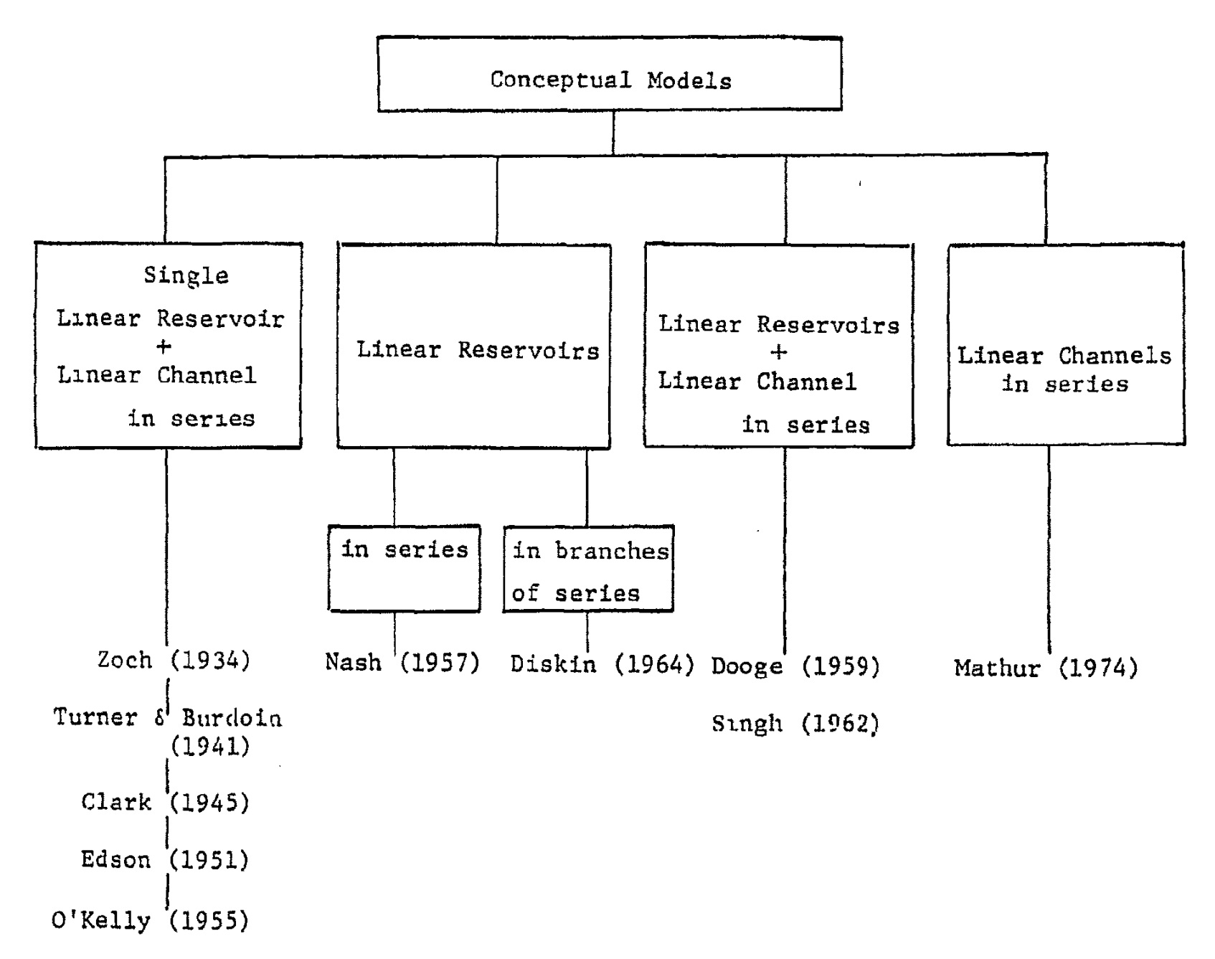
Dr Chow called these “Conceptual Models”
“Most natural hydrologic phenomena are so complex
that they are beyond human comprehension,
or that exact laws concerning such phenomena
have not yet been discovered.
“Before such laws can ever be found,
complicated hydrologic phenomena
can only be approximated by modeling”
V.T. Chow Freeman Memorial Lecture Boston Society of Civil Engineers
17 February 1972

Slide 23
Some Characteristics of Dr Chow
Suggestive rather than directive – when he asked for something, he always left you with an alternative choice should you wish to make it
Meticulously careful – every small detail mattered, even the smoothness of a box around a graph
His wife, Lora Chow, once asked him: “What do you think is the secret of your success?”
He responded: “Perhaps because I worked harder than others.”

Slide 24
Dr Chow as an Author A writer of knowledge …

Slide 25
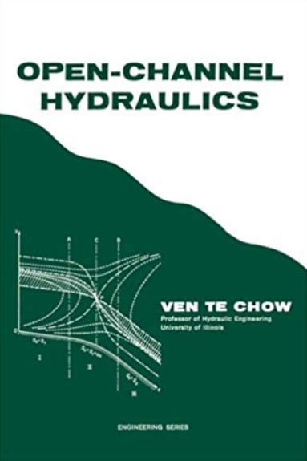
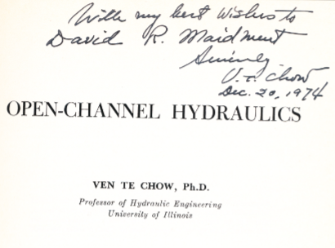
Open-Channel Hydraulics (published in 1959)

Slide 26
Open-Channel Hydraulics
Basic Principles
Uniform flow
Gradually varied flow
Rapidly Varied Flow
Unsteady flow
Start with basic principles for
flow not changing in space or time
and then increase the complication
for spatially and temporally varying flows
Very clear, logical progression of ideas

Slide 27
Comprehensive Knowledge of the Subject
“The book is the outgrowth of the author’s
20 years of experience as a student,
teacher, engineer, researcher and
consultant in the field of hydraulic
engineering.”
This book was published in 1959 so Dr Chow
is here including his experience at
Shanghai Jiao Tong University
“Special thanks are due to … Dr Steponas Kolupaila ….
[who] helped in interpreting and collecting information
from the hydraulic literature written in Russian, Polish,
Lithuanian, and several other languages which were
unfamiliar to the author.”
Dr Chow collected knowledge globally

Slide 28
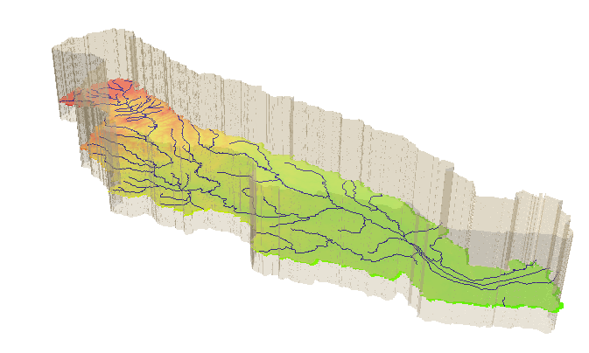
Applied Hydrology
Dr Chow was working on this book at the time of his death in 1981
I was then an Assistant Professor at the University of Texas at Austin
His wife, Lora, asked me to bring the book to completion
I asked a colleague, Larry W. Mays, to help me do this
The book was published in 1988 and is still used today
Watershed

Slide 29
Watershed as a Hydrologic System
Take a watershed and extrude it vertically into the atmosphere and subsurface, Applied Hydrology, p.7- 8
A hydrologic system is “a structure or volume in space surrounded by a boundary, that accepts water and other inputs, operates on them internally, and produces them as outputs”

Slide 30
Dr Chow as a Friend What was he like as a person…

Slide 31
The Chows: Ven at the office, and Lora at home

Slide 32
The Daughters: Margo and Marana

Slide 33
Playing Croquet at the Chow Home
From Left:
Dong Hee Kim
Ven Te Chow David Maidment
Jeff Armbruster

Slide 34
My wife and I with the Chows
David Maidment, Helen Maidment, Lora Chow, Ven Te Chow

Slide 35
Saying Farewell, June 1976
Charles Morris (later at University of Missouri, Rolla), Sue Ellen Morris, Helen Maidment, Philippa Walsh, Cricket Organek, John Organek, Lora Chow, Ven Te Chow

Slide 36
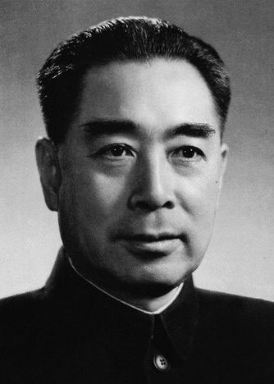
Return to China
Sometime around 1974, Dr Chow returned to China for the first time since he left in 1948
He talked with me about the impressions of his trip
He spoke of seeing a movie of a massive construction project with vast teams of workers
He was very proud that his surname, Chow, is Zhou in Chinese, as for Zhou En Lai
He returned to Shanghai Jiao Tong University and saw once again
testing machines working in the Civil Engineering Laboratory
that he had helped to disassemble and bury the parts
during the Japanese occupation of China

Slide 37
Final Year …
He had heart trouble during 1980
I visited him in Champaign-Urbana during the Spring of 1981, and he was visibly weakened
He died on 30 July 1981 in Champaign at the age of 61
Great loss of accumulated wisdom
His wife said – “his books were still open on his desk – it was like a movie, just stopped”

Slide 38
Memorial Tribute from the US National Academy of Engineering
“Dr Chow was respected and loved by his close academic associates and a generation of students from throughout the world who came to study with him.
“It was in these associations that his warm personality and his unfailing patience and humor were most apparent.”
Dr Chow was elected to the US National Academy of Engineering in 1973.
He was very proud of this.
His membership certificate hung in a prominent place in his office.

