Slide 1
Hurricane Harvey: A call for new data, science and services
David R. Maidment
Center for Water and Environment University of Texas at Austin
Dirksen Senate Office Building, Washington DC, 25 September 2017
Acknowledgements: Texas Division of Emergency Management, Chief Nim Kidd, Jeff Newbold,
Michael Ouimet, Warren Weidler, Jeanette Chamorro; ESRI, Kisters, TACC; from UT Austin: Paola
Passalacqua, Harry Evans, Xing Zheng, David Arctur, Erika Boghici, Lukas Godbout, Jeff Zheng

Slide 2
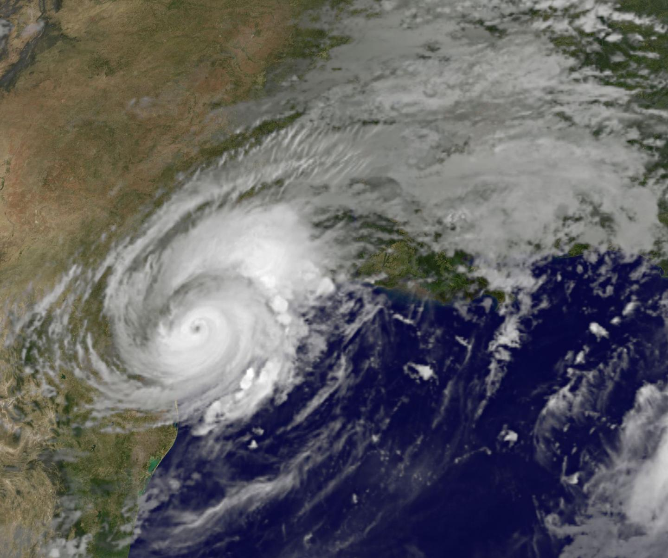
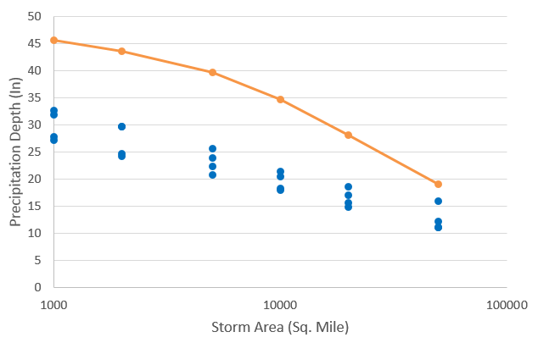
Hurricane Harvey Precipitation
Harvey 2-day precipitation was the worst recorded storm in US history
Harvey 3-day Precipitation averaged 5 inches more than previous storms
Harvey 5-day Precipitation averaged 11 inches more than previous storms
Data Sources: NWS River Forecast Centers; Applied Weather Associates, Inc., NASA.
Analysis: John Nielsen-Gammon and Brent McRoberts, Texas A&M University

Slide 3
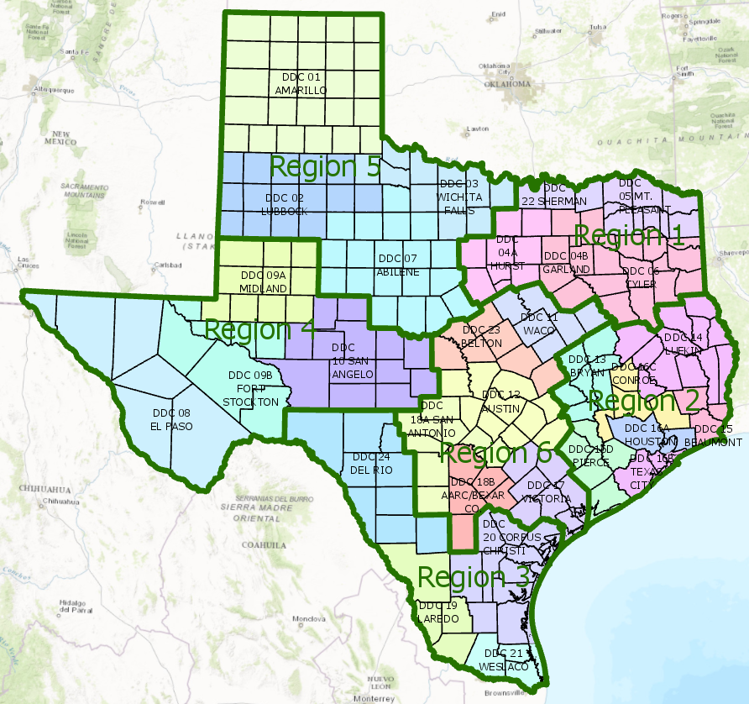
Texas Division of Emergency Management
State Operations Center
Regional Coordinators
Disaster Districts
Counties
Chief Nim Kidd Director, TDEM

Slide 4
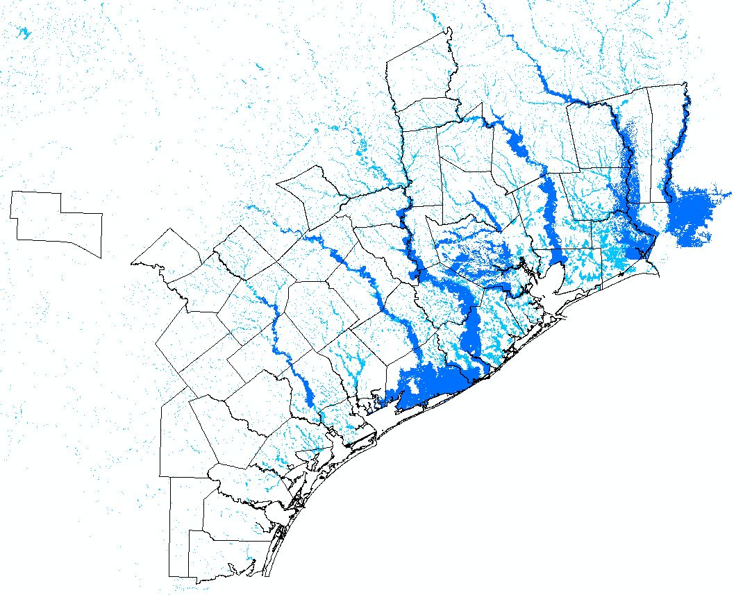
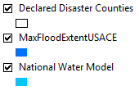
Maximum Flood Inundation Extent from Hurricane Harvey
First regional scale map of
flooding in impacted zone
Responded to a request by
Governor for estimate of the
total flooded area
“Dear Director Uccellini:
The Texas Division of Emergency Management requests the mobilization of the National Water Center to assist with flood inundation mapping in response to Hurricane Harvey. “
-- Chief Kidd; Sunday, August 27, 2017

Slide 5
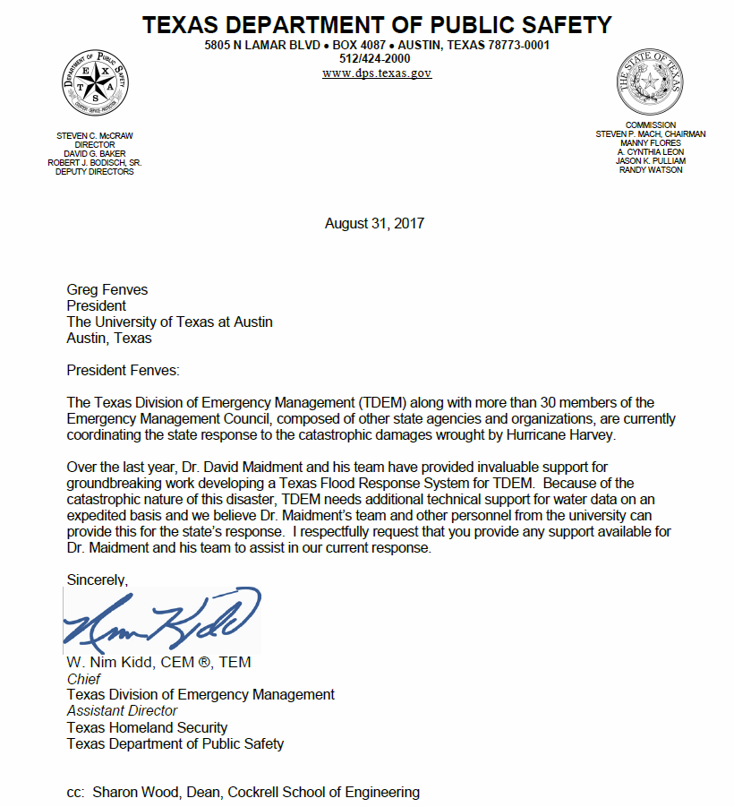
Letter from Chief Kidd to President Fenves, UT Austin
“Over the last year, Dr. David Maidment and his team have provided invaluable support for groundbreaking work developing a Texas Flood Response System for TDEM.
Because of the catastrophic nature of this disaster, TDEM needs additional technical support for water data on an expedited basis and we believe Dr. Maidment’s team and other personnel from the university can provide this for the state’s response.”
Thursday, August 31
Notes:
This slide could be a good transition to ask the philosophical question Do we have the water resources science and water resources data (observations) that this unprecedented challenge requires?
National

Slide 6
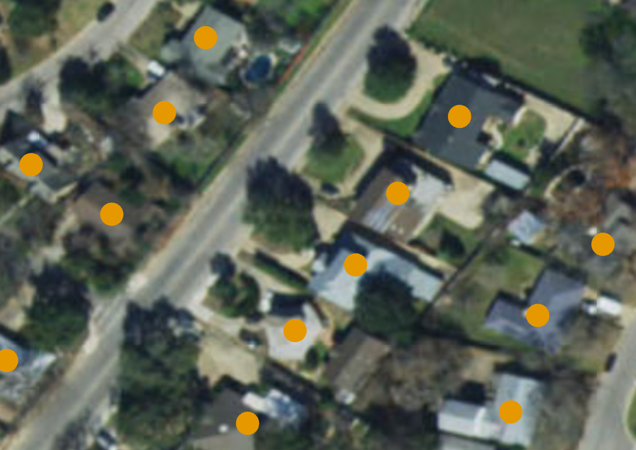
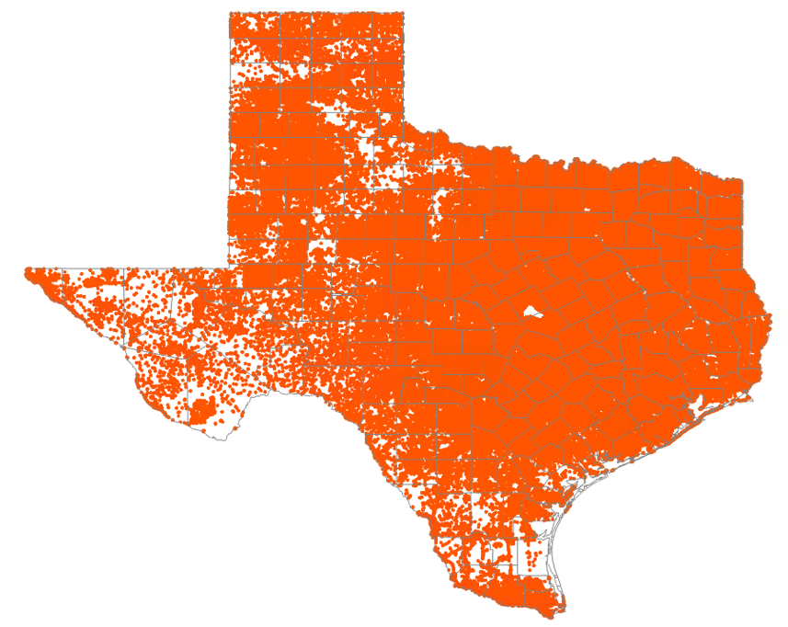
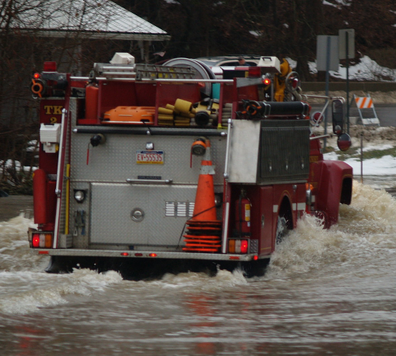
Texas Address Points
9.2 million points
Point on every building
used for dispatching
emergency response
vehicles by 911 systems
Data compiled by UT Austin
from Emergency
Communications Districts
Notes:
Over the summer we collected all 8.7million address points across Texas. Dr. David Arctur has assembled all the data and done some quality checks. When you have this much data from hundreds of sources, there are always some inconsistencies. However, in my opinion, for public safety this strategic snapshot is a good starting point for describing overall impact to a region or district.

Slide 7
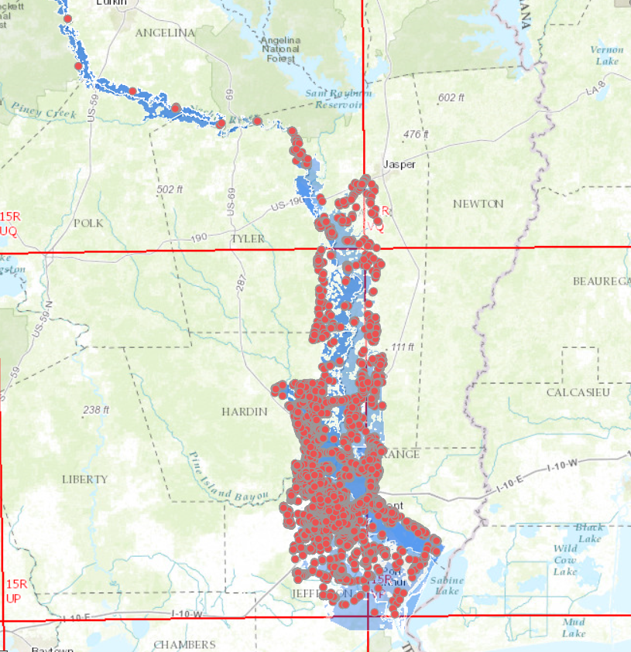
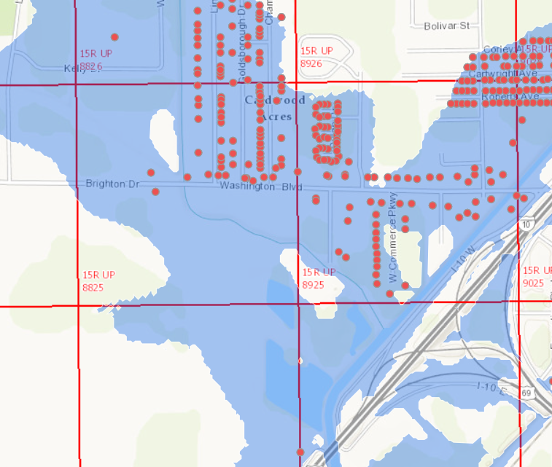
Inundation Maps for Search and Rescue
US National Grid
used for Search
and Rescue
Experimental product, not confirmed by local observation
Observations from the U.S. Geological Survey
Guidance from NOAA and the National Water Center
Forecasting by NWS West Gulf River Forecast Center
Inundation Mapping by US Army Corps of Engineers
Overlay on Address Points by University of Texas at Austin

Slide 8
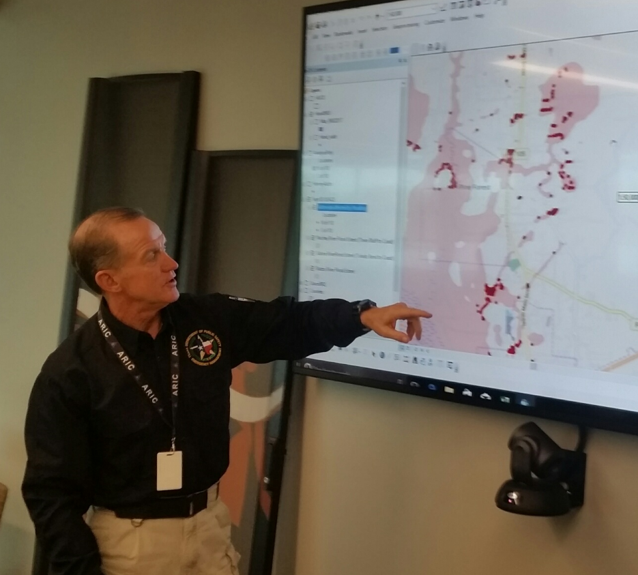
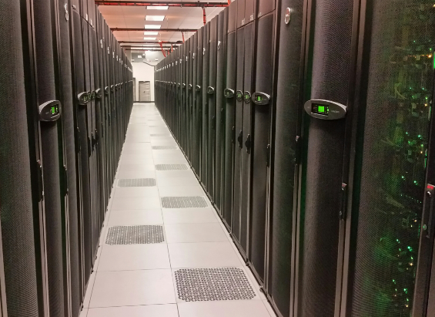
Goal: Real-Time Flood Inundation Mapping for Texas at Local Scale

Slide 9
National Water Center Innovators Program
Successful partnership between federal water agencies and the academic community to accelerate Research to Operations
Summer Institutes for graduate students at National Water Center in 2015, 2016, 2017, involved 105 students from 49 universities
Establishes a community of practice around the National Water Model and the National Water Center.
Annual cycle of innovation, research and assessment spanning USGS, USACE, NOAA and the academic community
Notes:
This could be broadened to a slide that discuss requirements from the operational community in terms of data and models, to the research community to support the continuous evolution of research to operations and operations to research.

Slide 10
Conclusions
Harvey was an unprecedented and devastating storm
Real-time inundation maps are required now more than ever
Flood predictive capability is within grasp at National Water Center
Continued investment in rainfall prediction is needed
Observational capability is woefully inadequate requiring renewed investments in USGS stream gages and other networks
Academic community can make a significant contribution
Research to operations spans federal and research communities
Computational support in development and processing
Summer Institute research at National Water Center

