Slide 1

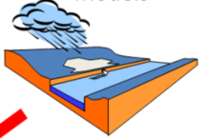
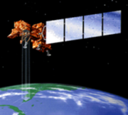
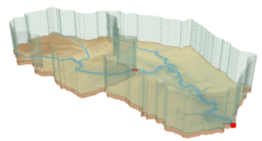
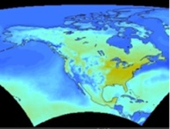
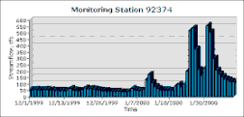
Water Web Services
David R. Maidment
Center for Research in Water Resources
University of Texas at Austin
Open Waters Symposium
Delft, the Netherlands
April 18, 2011

Slide 2
Water Web Services
Water Data Services
Regional Applications

Slide 3
Water Web Services
Water Data Services
Regional Applications

Slide 4
Acknowledgements
Stefano Nativi
  “Crossing the Digital Divide” – searching across catalogs of time series and grid information
David Lemon
  Co-Chair of OGC/WMO Hydrology Domain Working Group – WaterML2 specification
Dan Ames
  HydroDesktop as a prototype Hydrologic Information System

Slide 5
Framing the Problem
We have a region in which hydrologic data are collected by many agencies
  National
  Regional
  Local
We want to discover these data and access them in a consistent way as if this were one data system
We want to connect hydrologic data and models
Different levels of government with distributed responsibilities

Slide 6

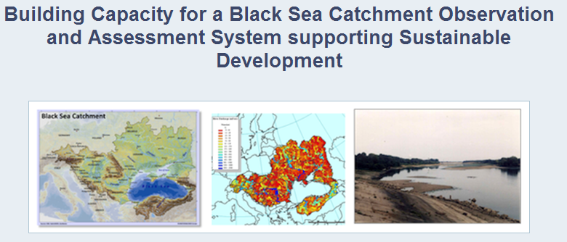
An Example – Black Sea Project
http://envirogrids.net

Slide 7




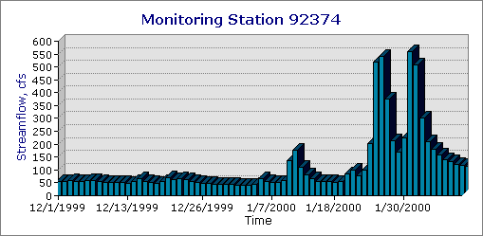
A Virtual Observatory for Watersheds
Accessing and synthesizing data and models ……
Modeling
Remote Sensing
Weather and Climate
Monitoring
Watershed
…… doing this in “the cloud”

Slide 8
How the web works
Catalog
(Google)
Catalog harvest
Search
Web Server
(CNN.com)
Access
Browser
(Firefox)
HTML – web language for text and pictures

Slide 9
Services-Oriented Architecture for Water Data
Catalog
Service registration
Search
Catalog harvest
Server
Data access
User
WaterML – web language for water data

Slide 10
Some terms and definitions
Web Service: A web service allows for information to be exchanged computer-to-computer over the internet
Portal: A one-stop shop that pulls together information from various sources and provides it to the user in a seamless fashion using a web site
Catalog: Like a library card-catalog, these provide summary level information on what data are available at the various sources
Exchange Schema: An agreed-upon data sharing format via which data owners publish data (e.g. WaterML)
Source: Dwane Young, Western States Water Council
Notes:
In order to understand what I’d talk about, these are some basic terms that need to be defined. The key term that needs to be understood is the idea of a web service. The best way to describe a web service is to relate it to something that they may already be familiar with. The best example I’ve been able to come up with is describing the ‘Weather Bug’ web service. A lot of people have interacted with this type of service. They have a little application that’s running on their computer that required a ‘Input parameter’, in this case a zip code. The application uses that to query another computer out on the internet. That computer returns to your computer a file that has all the information about the weather for your zip code. The application reads that file and turns it into a nice little icon that says that it’s raining and 42 degrees. The user never needs to know that this application is going out there and doing this, and doesn’t need to re-enter their information or interact with a web site or anything. It all happens in the back-ground as computer-to-computer communication.

Slide 11
What is a “services-oriented architecture”?
Networks of computers connected through the web …….
Everything is a service
  Data, models, visualization, ……
A service receives requests and provides responses using web standards (WSDL)
It uses customized web languages
  HTML (HyperText Markup Language) for text and pictures
  WaterML for water time series (CUAHSI/OGC)
  GML for geospatial coverages (OGC)
….. supporting a wide range of users

Slide 12
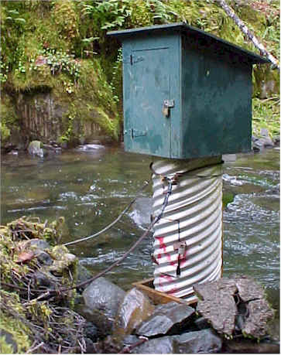
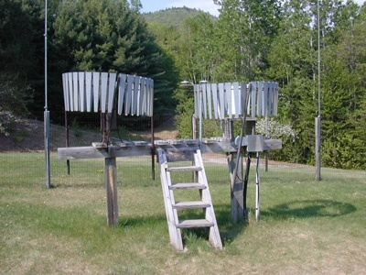
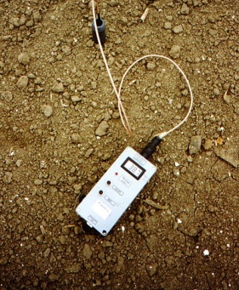
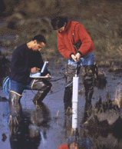
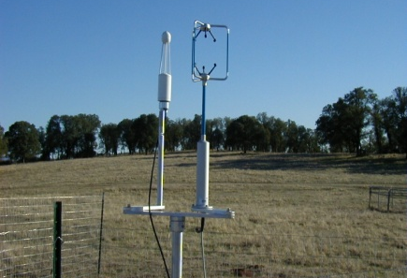
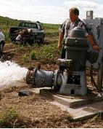
We Collect Lots of Water Data
Water quantity
Rainfall
Soil water
Water quality
Meteorology
Groundwater

Slide 13
The Data are Collected by Many Organizations
Water Districts
Federal Agencies
River Authorities
State Agencies
Cities
Universities
…. and the data are continuously accumulating

Slide 14
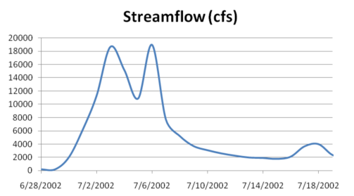
The Data have a Common Structure
A point location in space
A series of values in time
Gaging – regular time series
Sampling – irregular time series
Notes:
These data are recorded over time to monitor a hydrologic process or property.

Slide 15
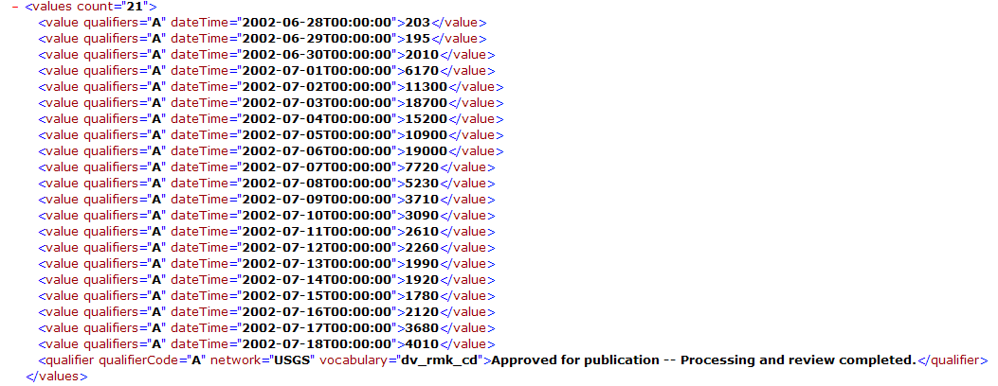
They can be expressed in WaterML
Discharge of the San Marcos River at Luling, TX June 28 - July 18, 2002
USGS Streamflow data in WaterML language
The USGS now publishes its time series data as WaterML web services

Slide 16
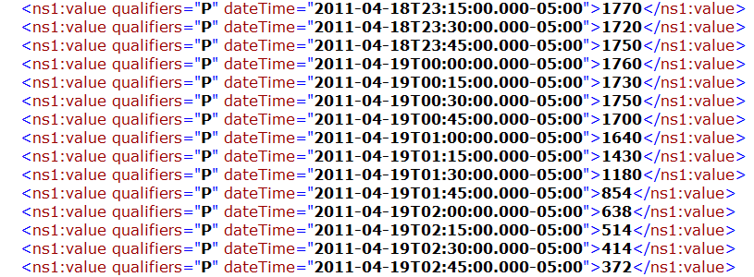
Colorado River at Austin
I accessed this WaterML service from Swansea at 10:30 AM this morning
(4:30AM Central Time)
http://waterservices.usgs.gov/nwis/iv?sites=08158000&period=P7D&parameterCd=00060
And got back these flow data from USGS which are up to 2:45 AM Central time
USGS maintains this real-time WaterML service 24/7/365 at 22,000 sites in US

Slide 17
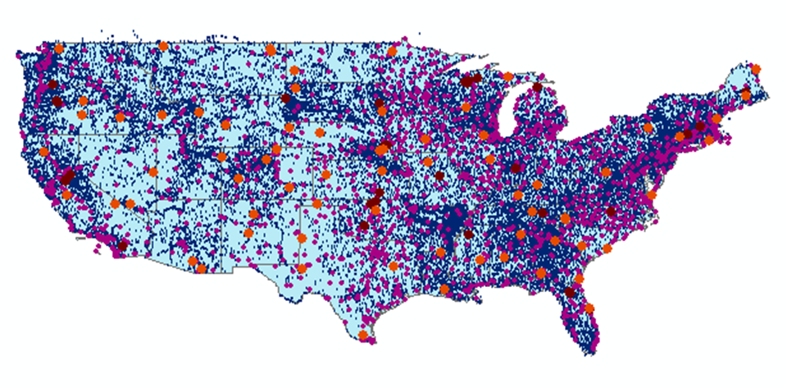
CUAHSI Water Data Services Catalog
69 public services
18,000 variables
1.9 million sites
23 million series
5.1 billion data values
And growing
The largest water data
catalog in the world
maintained at the San Diego Supercomputer Center

Slide 18
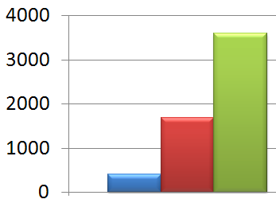
Web Services Data Requests per Day
Observations Networks Indexed at HIS Central
2008 2009 2010

Slide 19



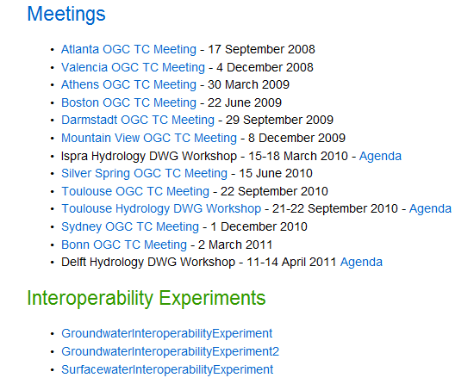
OGC/WMO Hydrology Domain Working Group
Design of WaterML 2.0 and testing in Interoperability Experiments

Slide 20
Water Web Services
Water Data Services
Regional Applications

Slide 21
Catalog Services for the Web (CS/W)
An OGC standard for cataloging a list of web services
  Provides a single URL reference point for all services from an organization https://hydroportal.crwr.utexas.edu/geoportal/csw/......
  Enables searching of underlying Web Feature Services using the “who, what, when, where” approach
Start
Select Region
(where)
Select Time Period
(when)
Select Service(s)
(who)
Select Keyword(s)
(what)
Filter Results
Save Theme
End

Slide 22
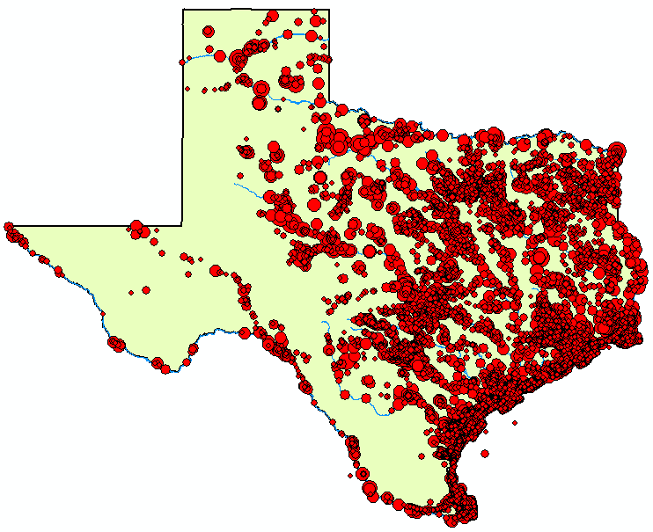
Web Services Stack for Time Series
OGC Catalog Service for the Web with standard metadata: ISO, Dublin Core, ..
Who, What?
Catalog
Time
Series
Services
Where, When?
Metadata
OGC Web Feature Service
Data
Get the data
WaterML or OGC WaterML2

Slide 23
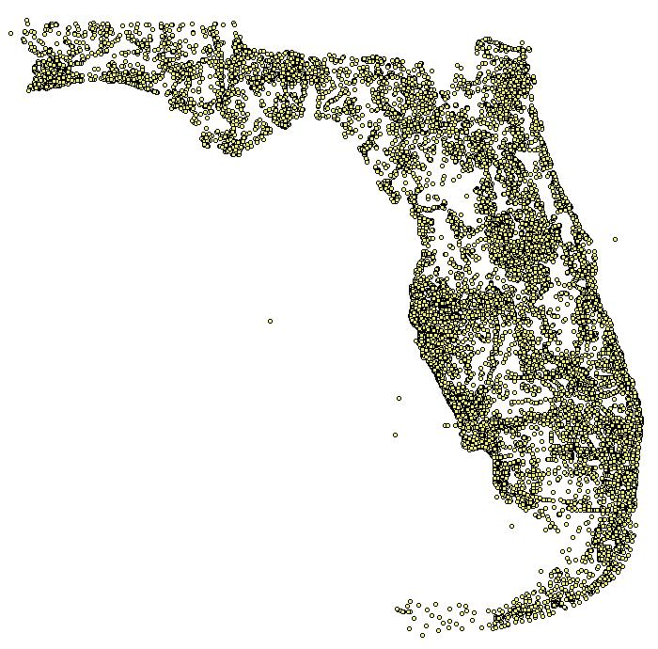
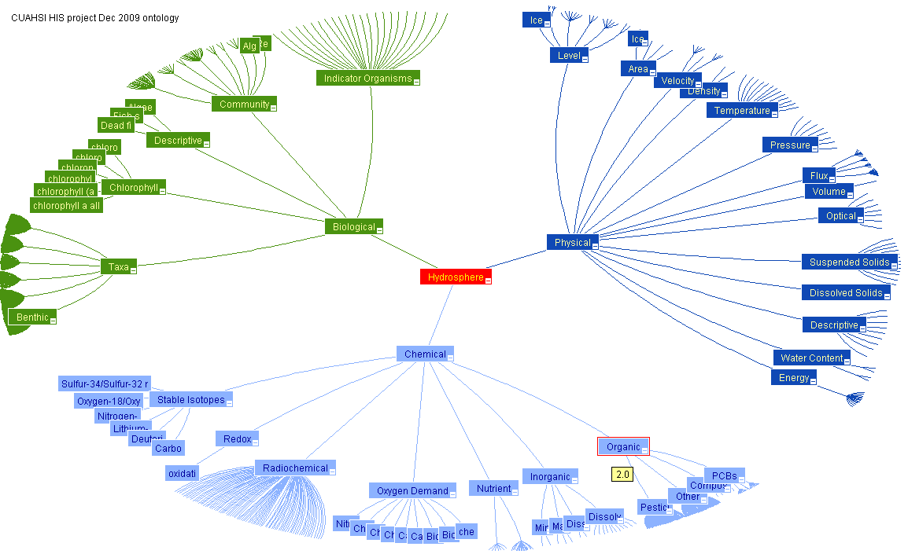
Semantic Integration using an Ontology of Concepts
Nutrients in Florida
Ontology of Concepts
Physical
Hydrosphere
Chemical
EPA SRS
Biological
http://his.cuahsi.org/ontologyfiles.html

Slide 24
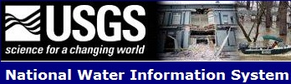
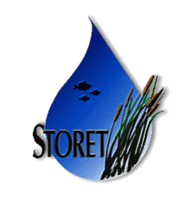


Water Agency Service Stacks
Each agency maintains its own data and metadata
NWIS
Storet
NCDC
State
TWDB
MetaCatalog is a listing of the URL addresses of all the agency catalogs
All linked via a Metacatalog
Notes:
The Federal Government already supports Catalog Services for the Web through Geodata.gov and is moving to Data.Gov and a new initiative called the Geoplatform (requested by OMB in 2011). Cataloging water observations data under this system is a straightforward extension of what is already being done to federate the federal government’s geospatial data layers. State water observations data systems like that coming from the Texas Water Development Board can be federated and searched along with the federal water observations data services

Slide 25
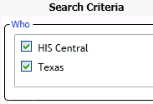
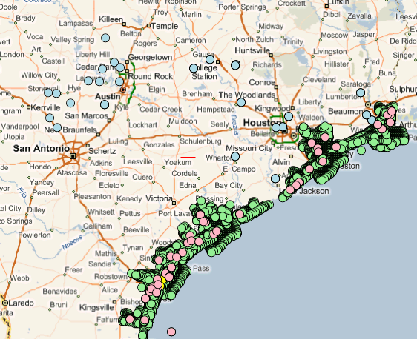
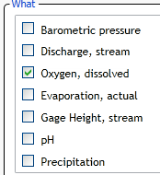
Searching Federal and State Data
(Federal)
(State)
USGS Daily Values
Texas TWDB
Texas Agencies
A single search accesses federal water data from a catalog at HIS Central ….
…. and state water data from a catalog in Austin, Texas

Slide 26
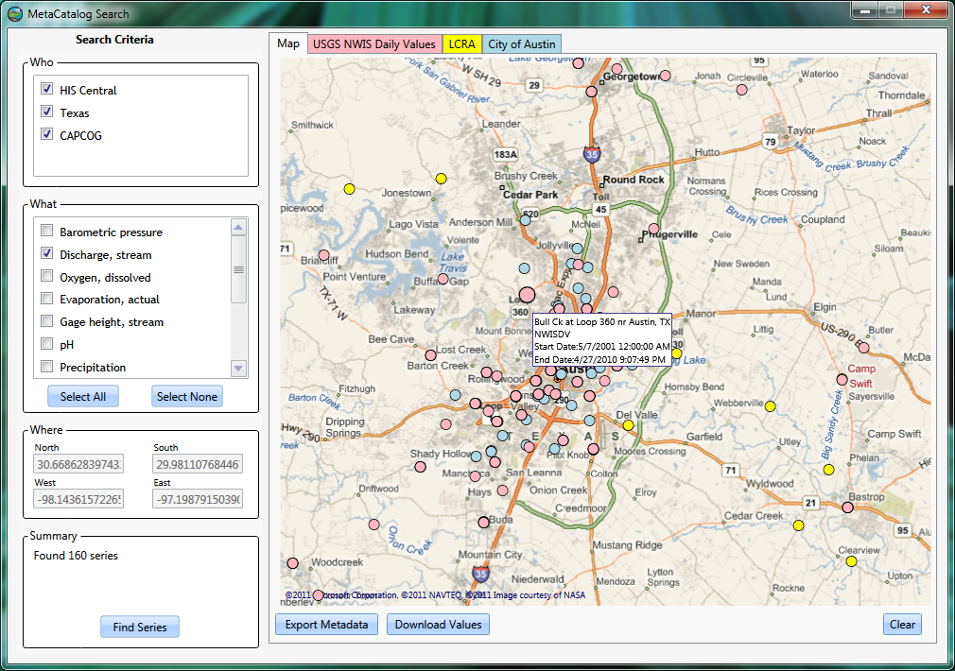
Searching Search Federal, State and Local Data

Slide 27
A Virtual Observatory for Watersheds
Accessing and synthesizing data and models ……
Modeling
Remote Sensing
Weather and Climate
Monitoring
Watershed
…… doing this in “the cloud”

Slide 28
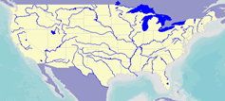

Web Services Stack for Climate Grids
OGC Catalog Service for the Web with standard metadata: ISO, Dublin Core, ..
Who, What?
Catalog
Grid
Data
Services
Where, When?
Metadata
OGC Web Feature Service
Data
Get the data
“Crossing the Digital Divide”
OGC Web Coverage Service or netCDF

Slide 29
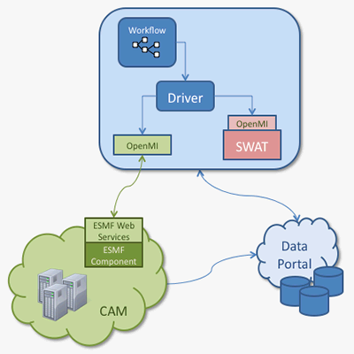
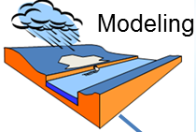
Linking SWAT with Climate Models
Jon Goodall, University of South Carolina
Cecelia DeLuca, NOAA/NCAR
WaterML
More information: http://www.earthsystemcurator.org/projects/openmi.shtml

Slide 30
Conclusions
Sharing water data regionally using WaterML and OGC web services is practical at any scale
Each organization stores its own data and metadata in a catalog
A metacatalog or listing of the catalogs can be searched as if it were a single data system
WaterML can also be used to link climate and hydrologic modeling services

