Slide 1

Flood Modeling Tools for Response and Alerting
David Maidment, University of Texas, and Jack Dangermond, ESRI
Presented at FEMA, Washington DC
4 September 2014

Slide 2
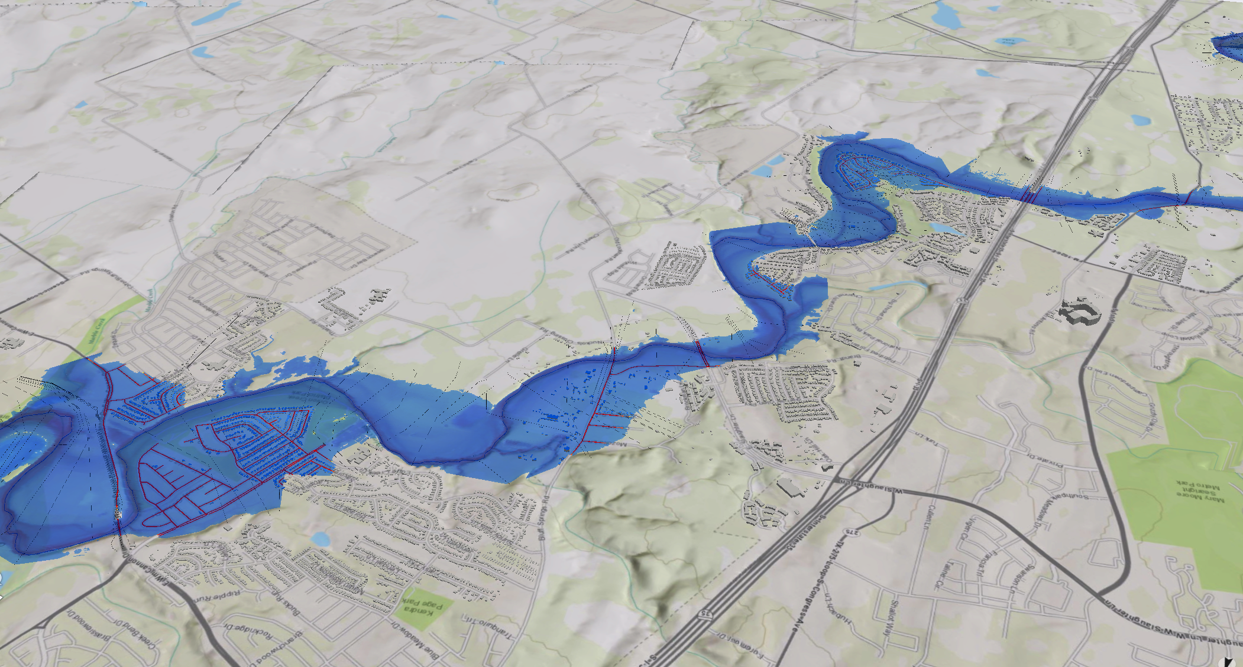
Improving Water Forecasts
Using new modeling methodology:
  Localizes water forecasts to
  specific geographies
  Integrate with National Response Framework
  Works for both Flood and Drought
Challenges
Making this timely and consistent nationally
Loss of base information from USGS gauges

Slide 3
Major Transitions in Geospatial Info
Paper maps to digital data
  National Spatial Data Infrastructure development
  Started in 1990’s
  Took more than a decade to complete
Digital data to web services
  Started several years ago
  Will take years to complete
Maps
Data
Services

Slide 4
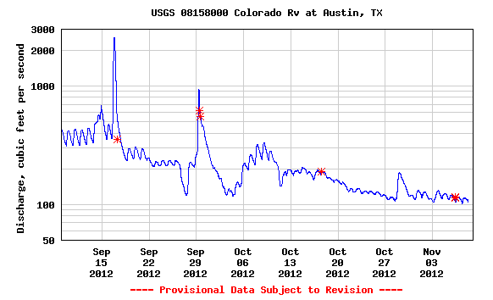

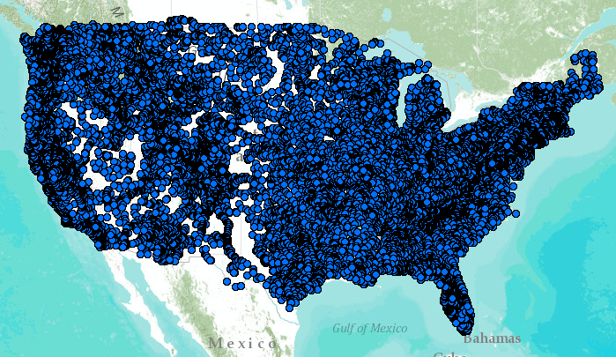
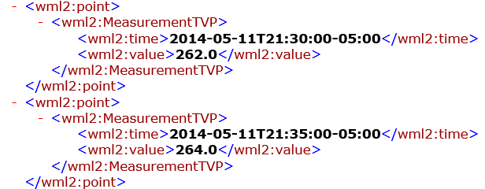
WaterML Web Services – CUAHSI, USGS, OGC, WMO …..
Water time series data on the internet
24/7/365 service
For daily and real-time data
. . . Operational water web services system for the United States
http://waterservices.usgs.gov/nwis/iv/?format=waterml,2.0&sites=08158000&period=P1D&parameterCd=00060

Slide 5
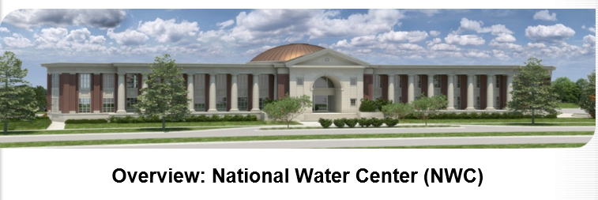

Located on Tuscaloosa Campus of University of Alabama
Operated by National Weather Service to support IWRSS partners (NWS, USGS, Corps of Engineers, FEMA)

Slide 6
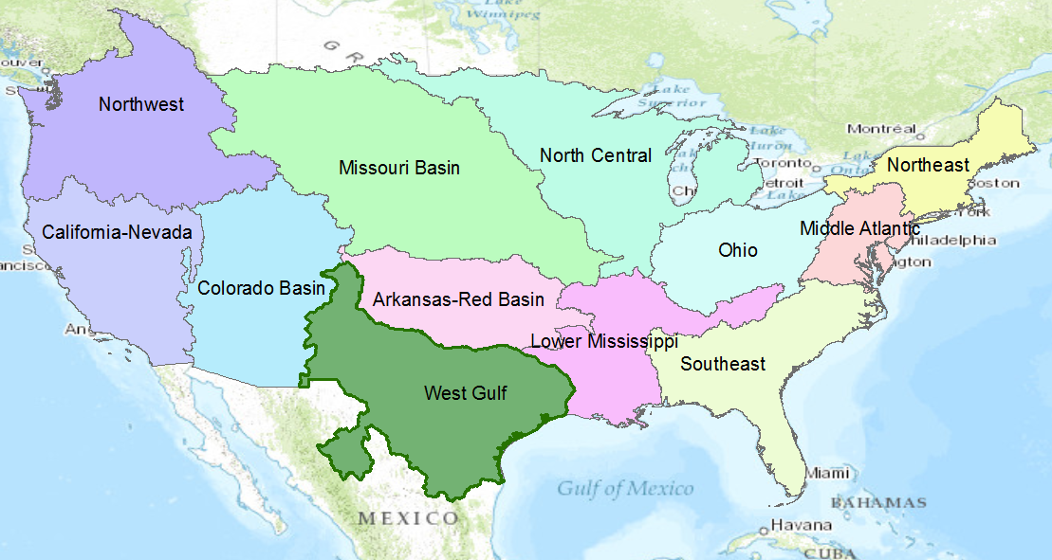
NWS River Forecast Centers
Perform precipitation, runoff and river flow simulation and forecasting for five days ahead, updated daily, more frequently during floods

Slide 7
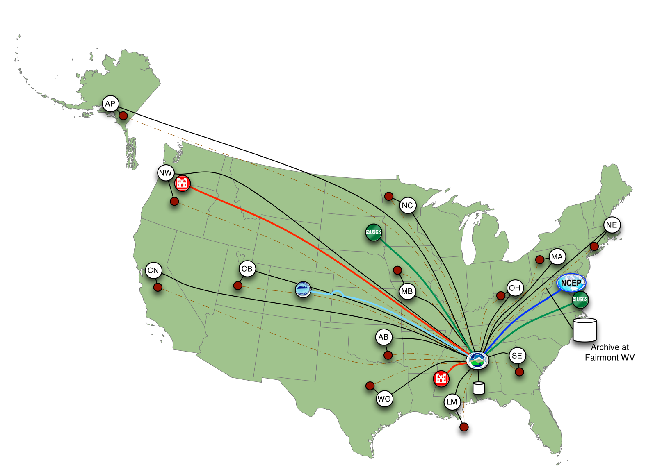
Nationally Synthesize Operations of Regional River Forecast Centers
….hub for national open water data infrastructure

Slide 8

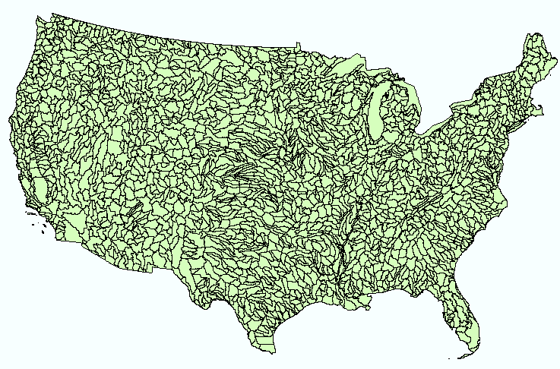
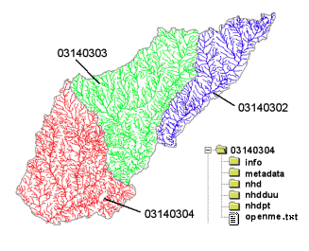
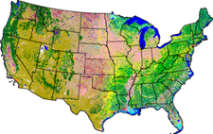
NHDPlus
Geospatial base for Open Water Data Infrastructure
NHDPlus
(built 2004-2014)
National Elevation Dataset
Watershed Boundary Dataset
National Hydrography Dataset
National Land Cover Dataset
3 million catchments average area 3 km²,
reach length 2 km

Slide 9
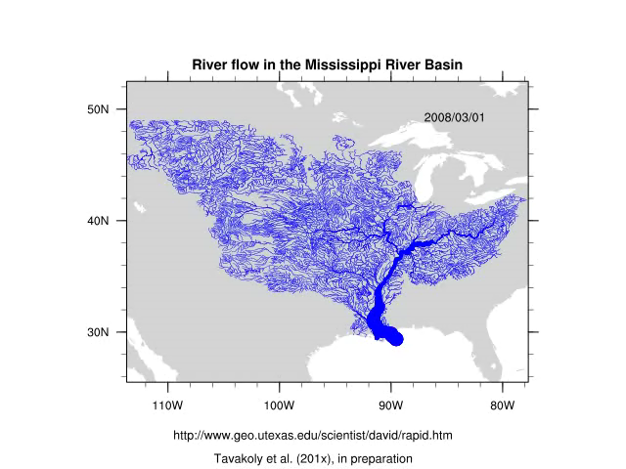
Rapid Model for flow on NHDPlus
March to May 2008, 3 hour time steps
David et al. (2011) DOI: 10.1175/2011JHM1345.1
GIS data describes 1.2 million river reaches . . .
. . . simulate flow in each reach in each time step

Slide 10
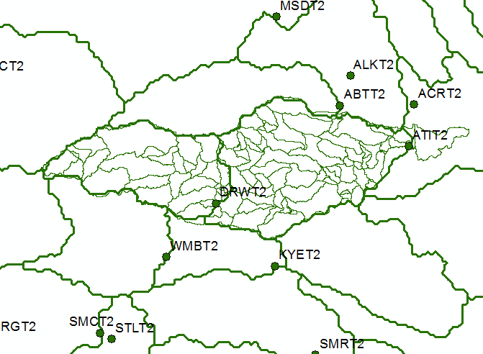
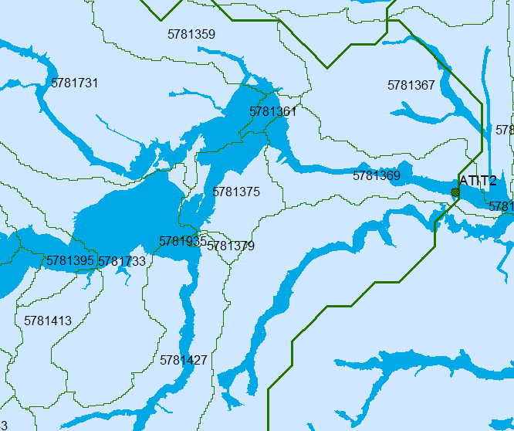
Linking NWS Flood Forecasts to FEMA National Flood Hazard Layer through NHDPlus
National Weather Service
River Forecast Subbasins
National Flood Hazard Layer
NHDPlus Catchments
The FEMA National Flood Hazard Layer is intersected with the NHDPlus Catchments to
form “NHDPlus Flood Warning Zones”. The downscaled NWS flow forecast for each zone
is used to assess flood risk. If flood risk is high, a warning is sent to all cell phones in this zone.

Slide 11









National Flood Interoperability Experiment: Connect National Scale Flood Modeling with Local emergency planning and response
How can near-real-time hydrologic simulations at high spatial resolution, covering the nation, be carried out using the NHDPlus or next generation hydro-fabric (e.g. data structure for hillslope, watershed scales)?
How can this lead to improved emergency response and community resilience?
How can an improved interoperability framework support the first two goals and lead to sustained innovation in the research to operations process?
Slide: Ed Clark, NWS

Slide 12
How can FEMA help?
Sensor to Map
Information model for open water data infrastructure
Challenges
Making this timely and consistent nationally
Loss of base information from USGS gauges

Slide 13
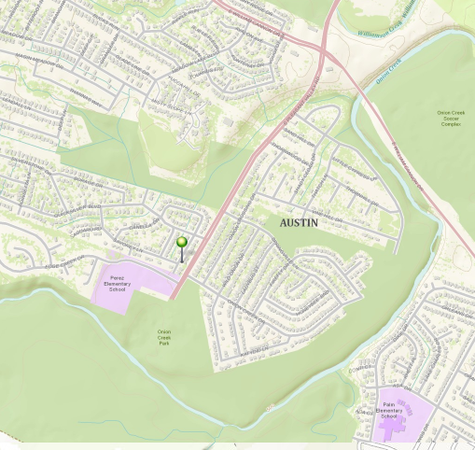
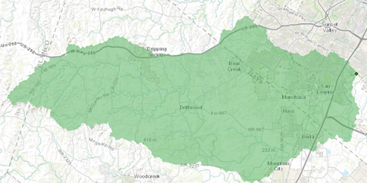
Halloween Flood, Onion Creek, Austin, Texas, October 2013
Upstream watershed 280 mi²
(larger than the City of Austin)
A flooded home location
Watershed delineated using
ESRI terrain services
Massive flash flood arrived at 5AM without warning …
… 5 people drowned and 700 homes flooded

Slide 14
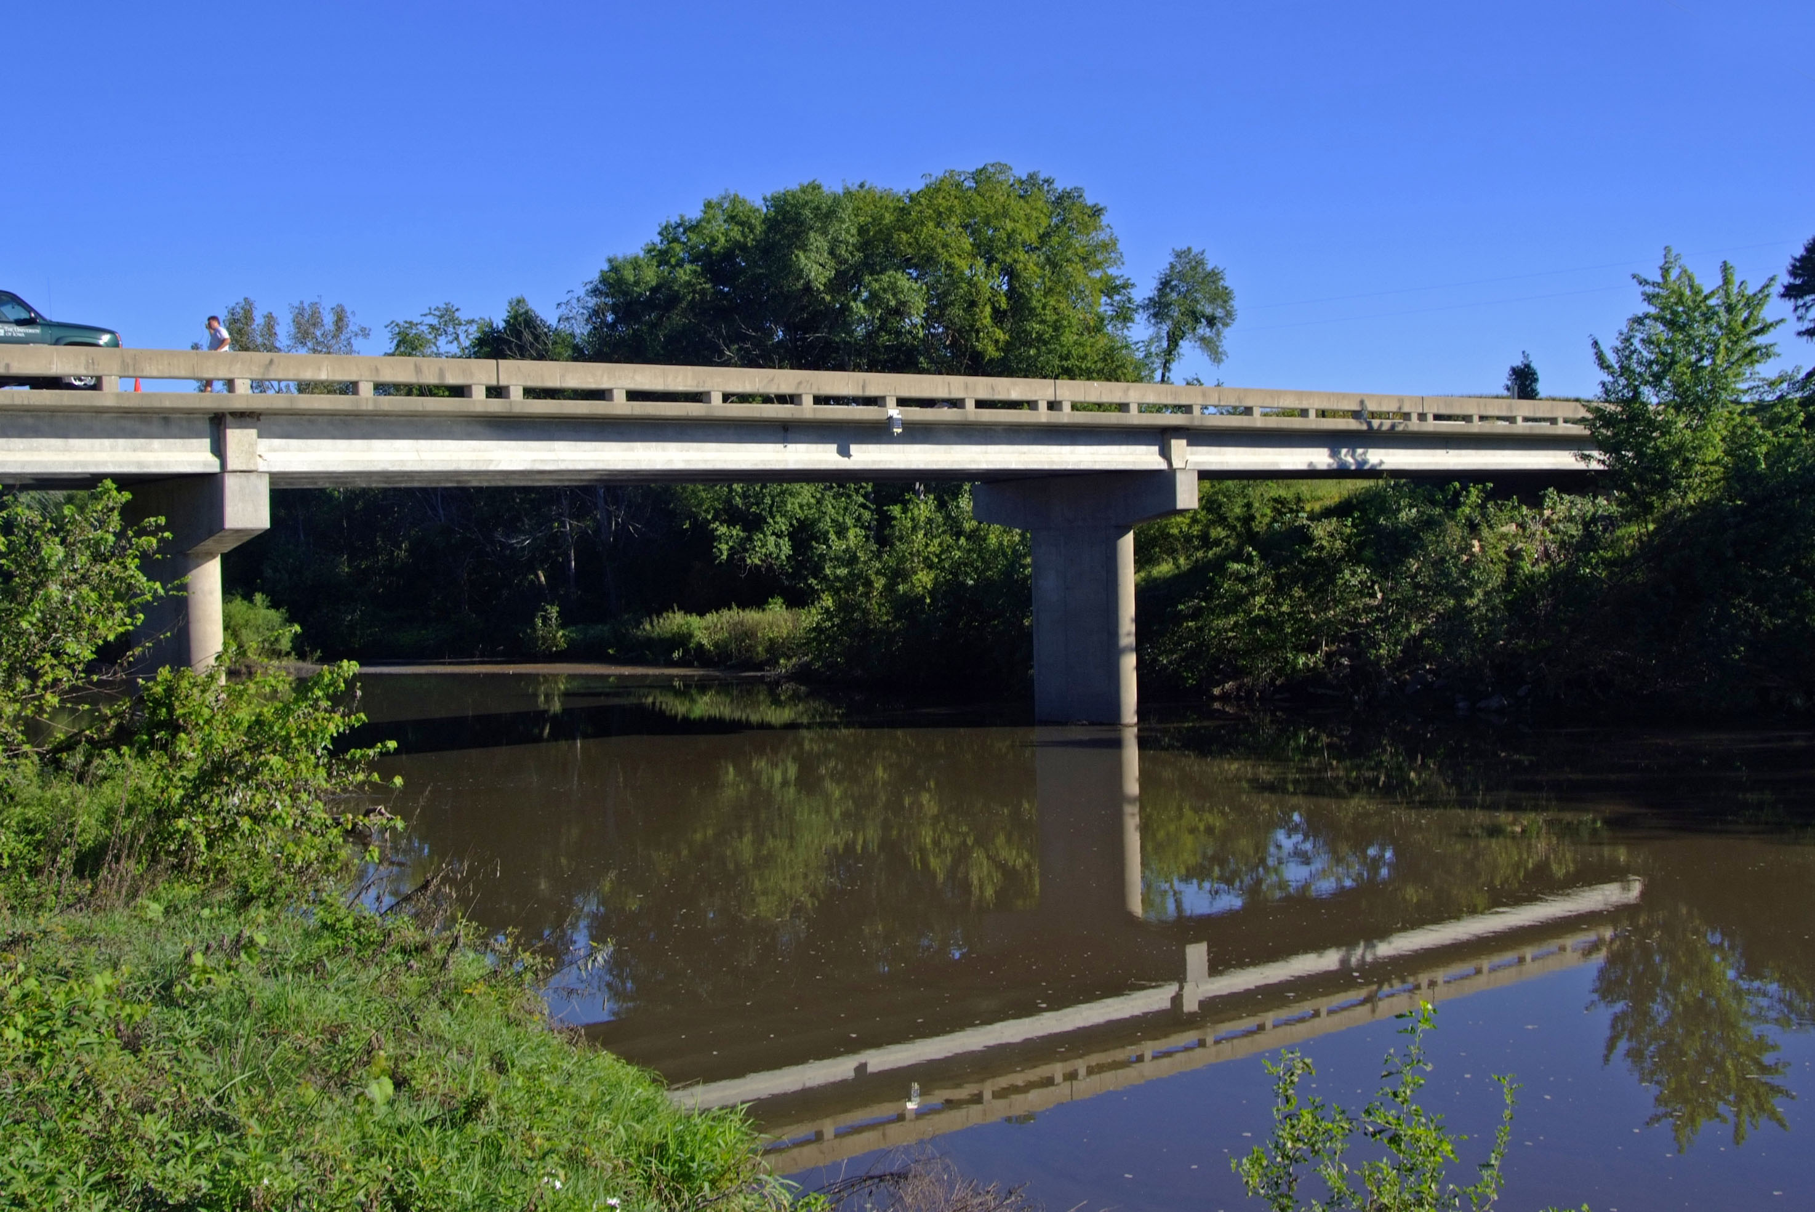

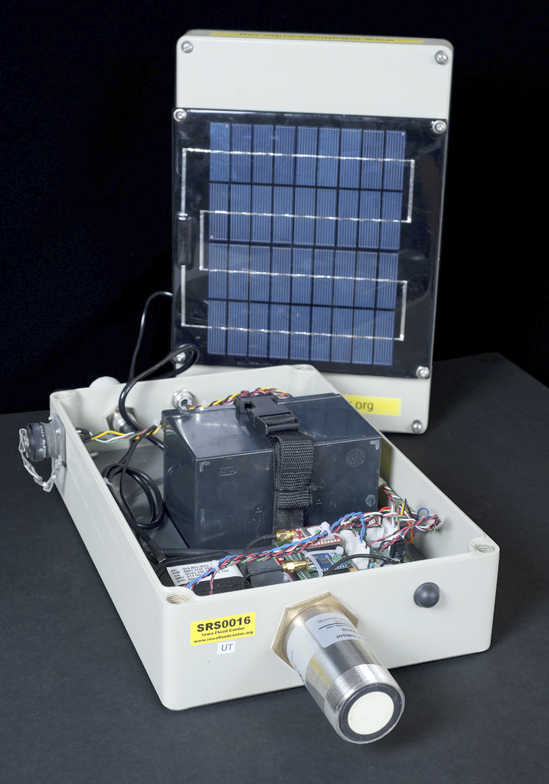
Augment USGS gage network with water elevation sensors on bridges ($3000 per site)
University of Iowa

Slide 15
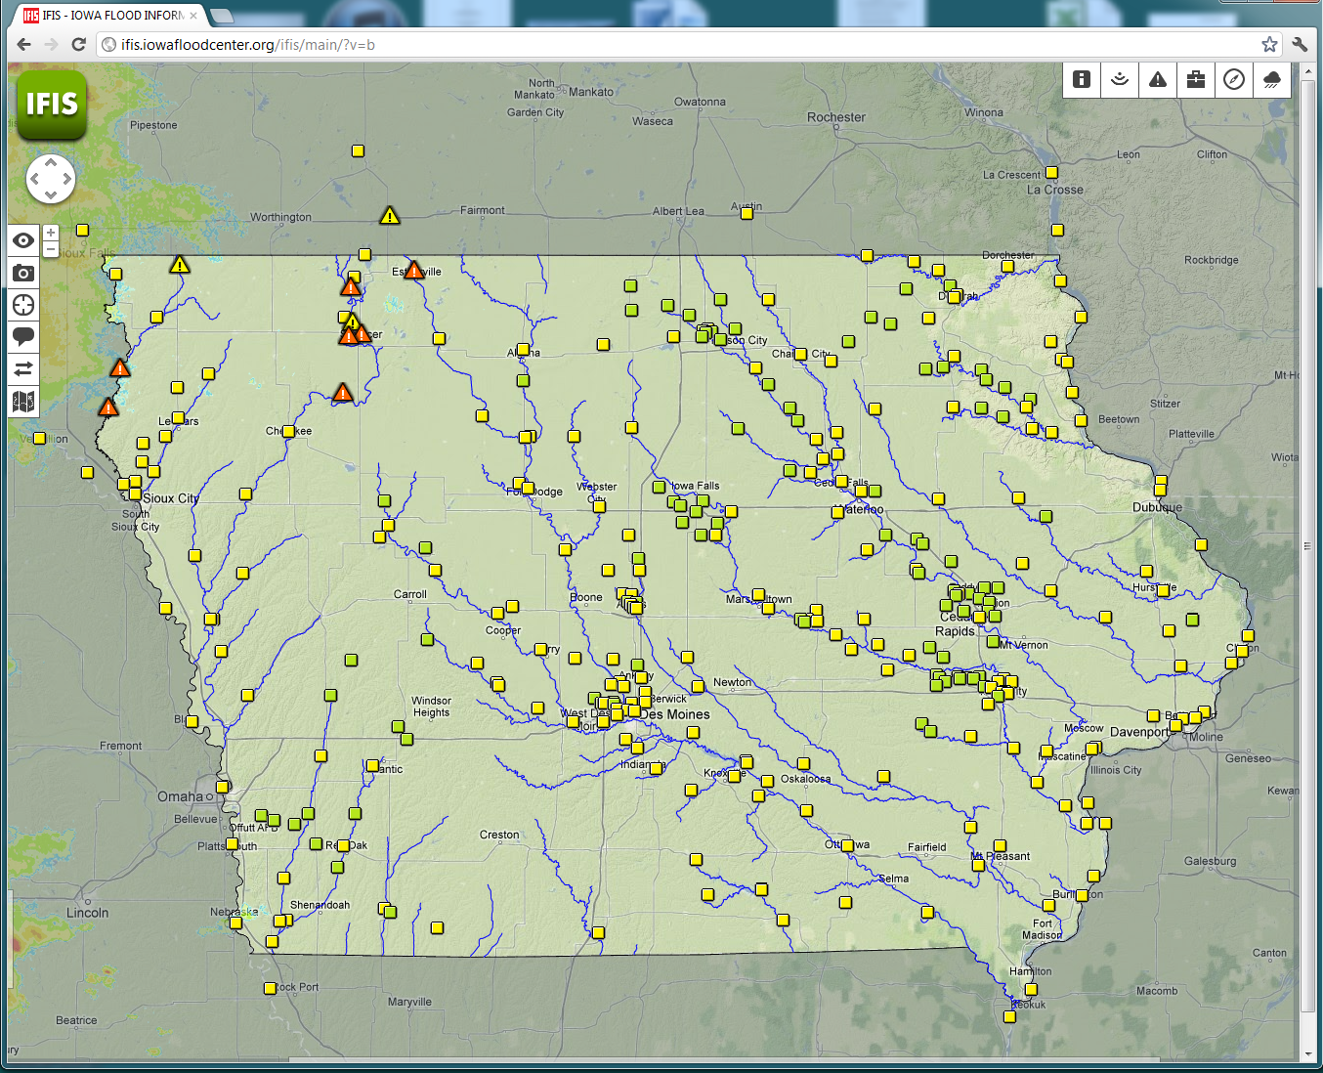
Iowa has 180 of these sensors are already deployed
Plans for 70 more
Extend this modal across the nation …
… develop a National Flood Sensor Network

Slide 16
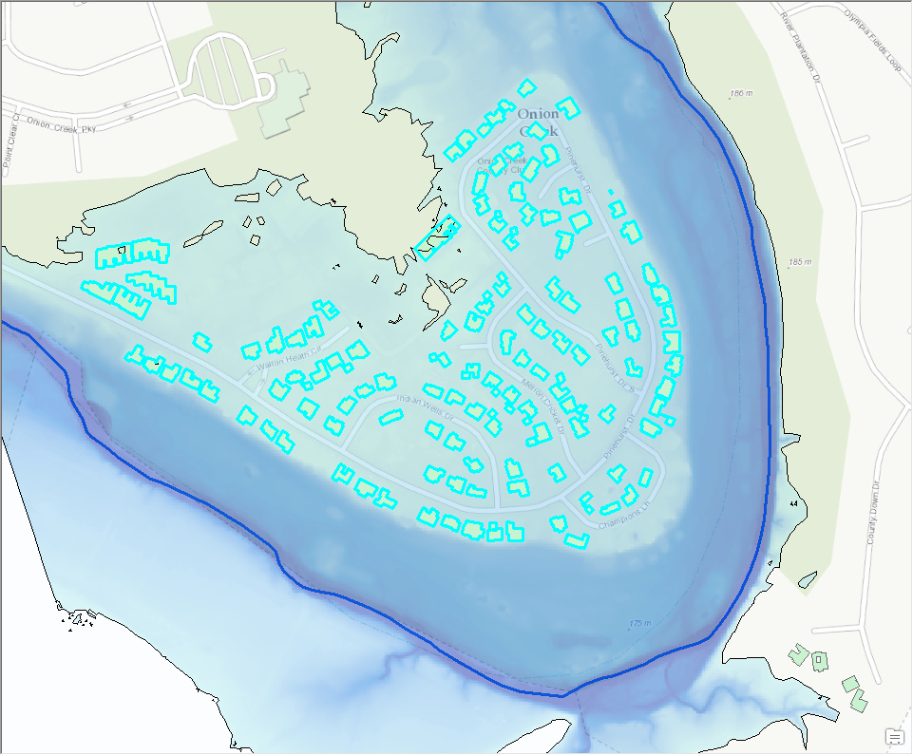
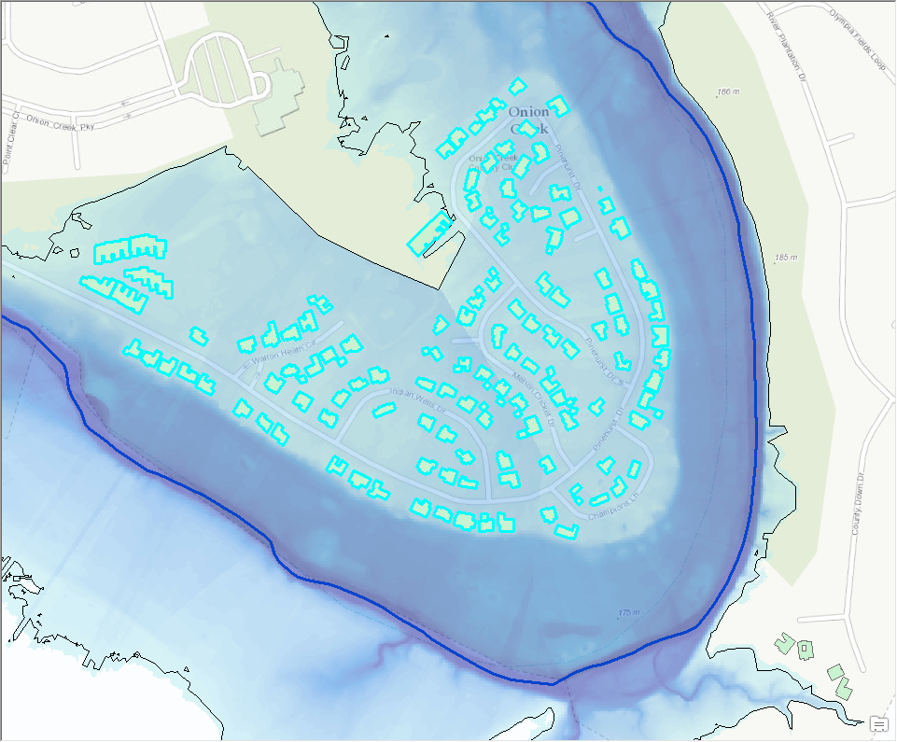
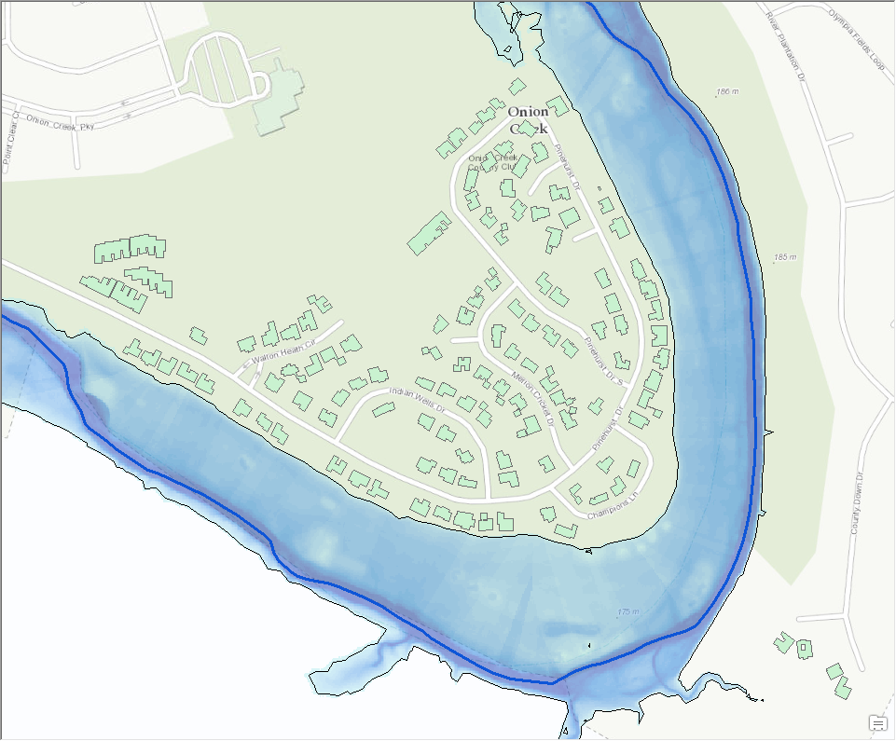
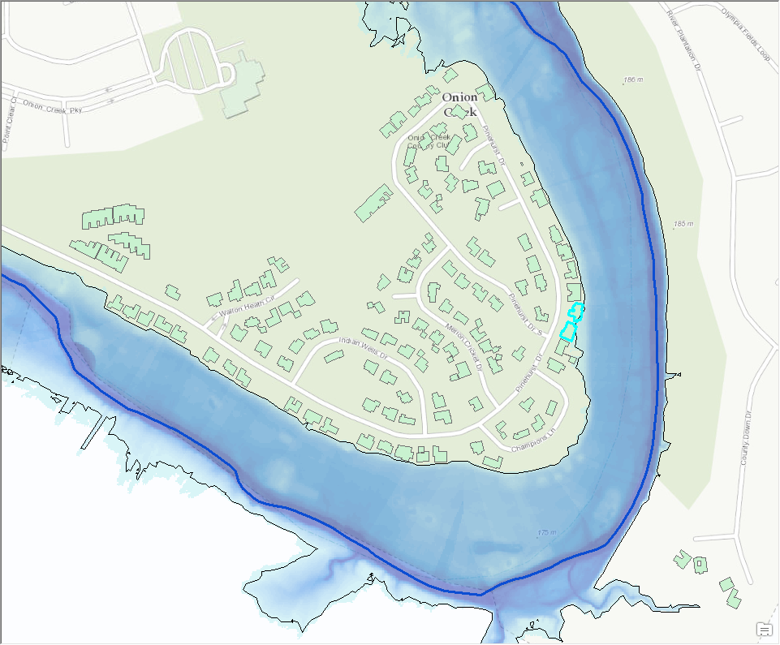
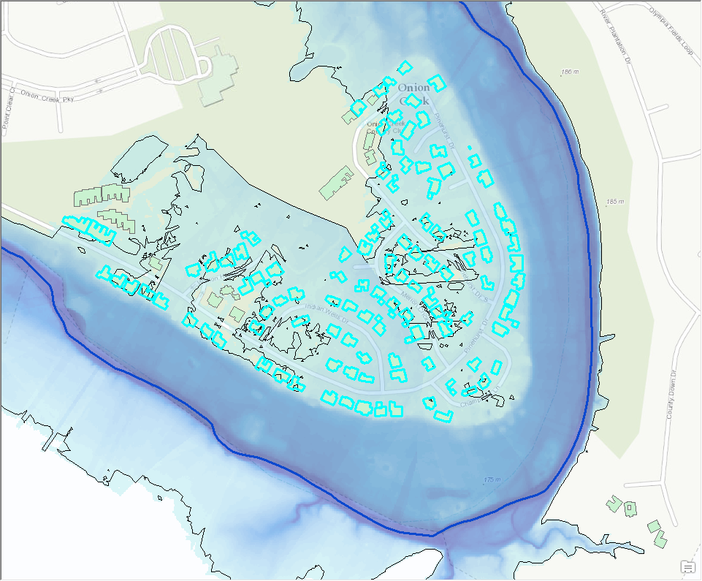
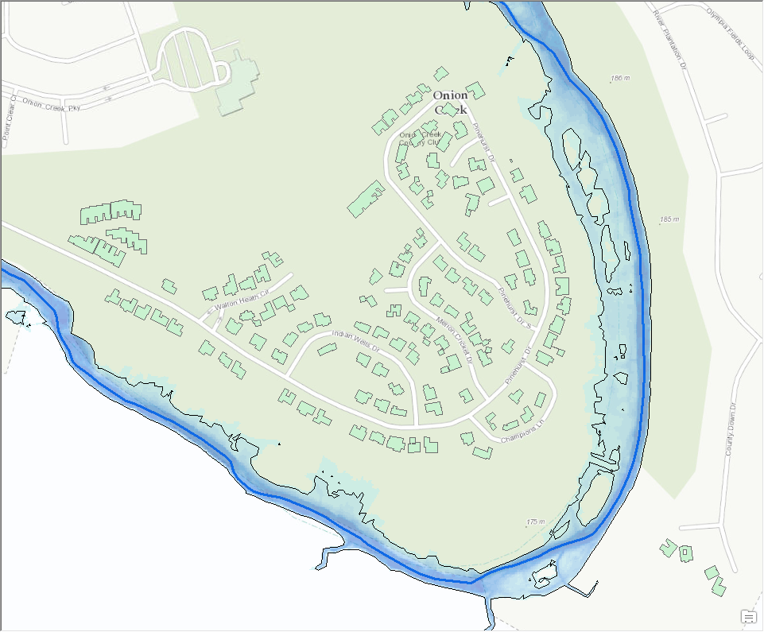
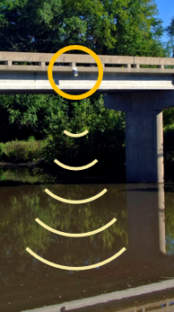
Onion Creek – elevation-indexed flood mapping
Sensor to Map

Slide 17




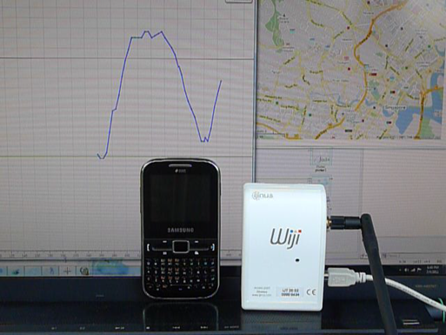




Sensor to Cellphone
Hydroinformatic challenges⎥ Ph.Gourbesville

Slide 18
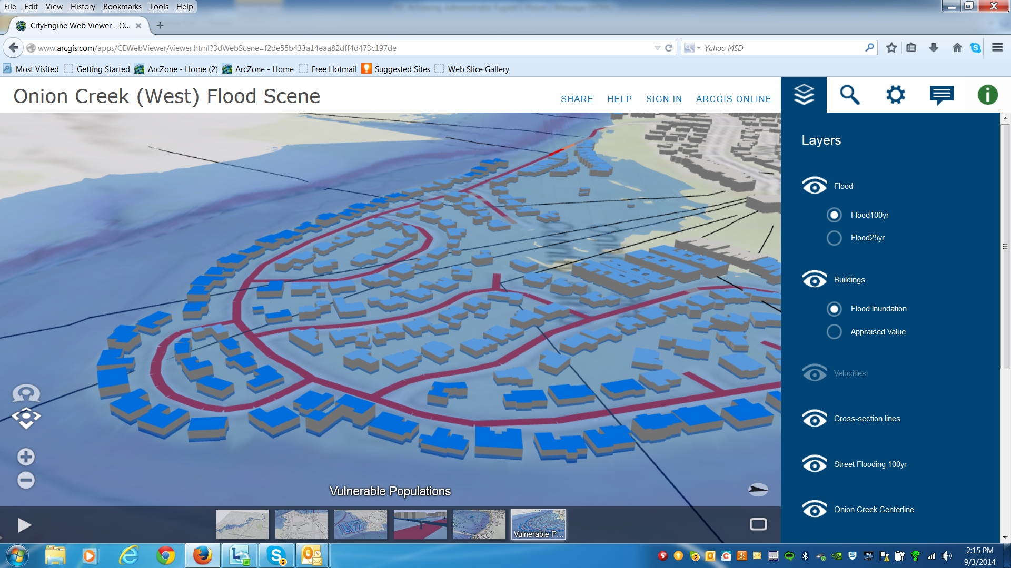

Slide 19
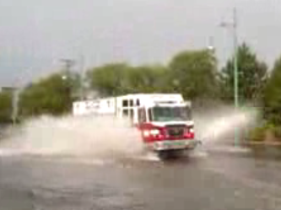
Onion Creek – wide area flood response planning
Proactive rather than reactive

Slide 20
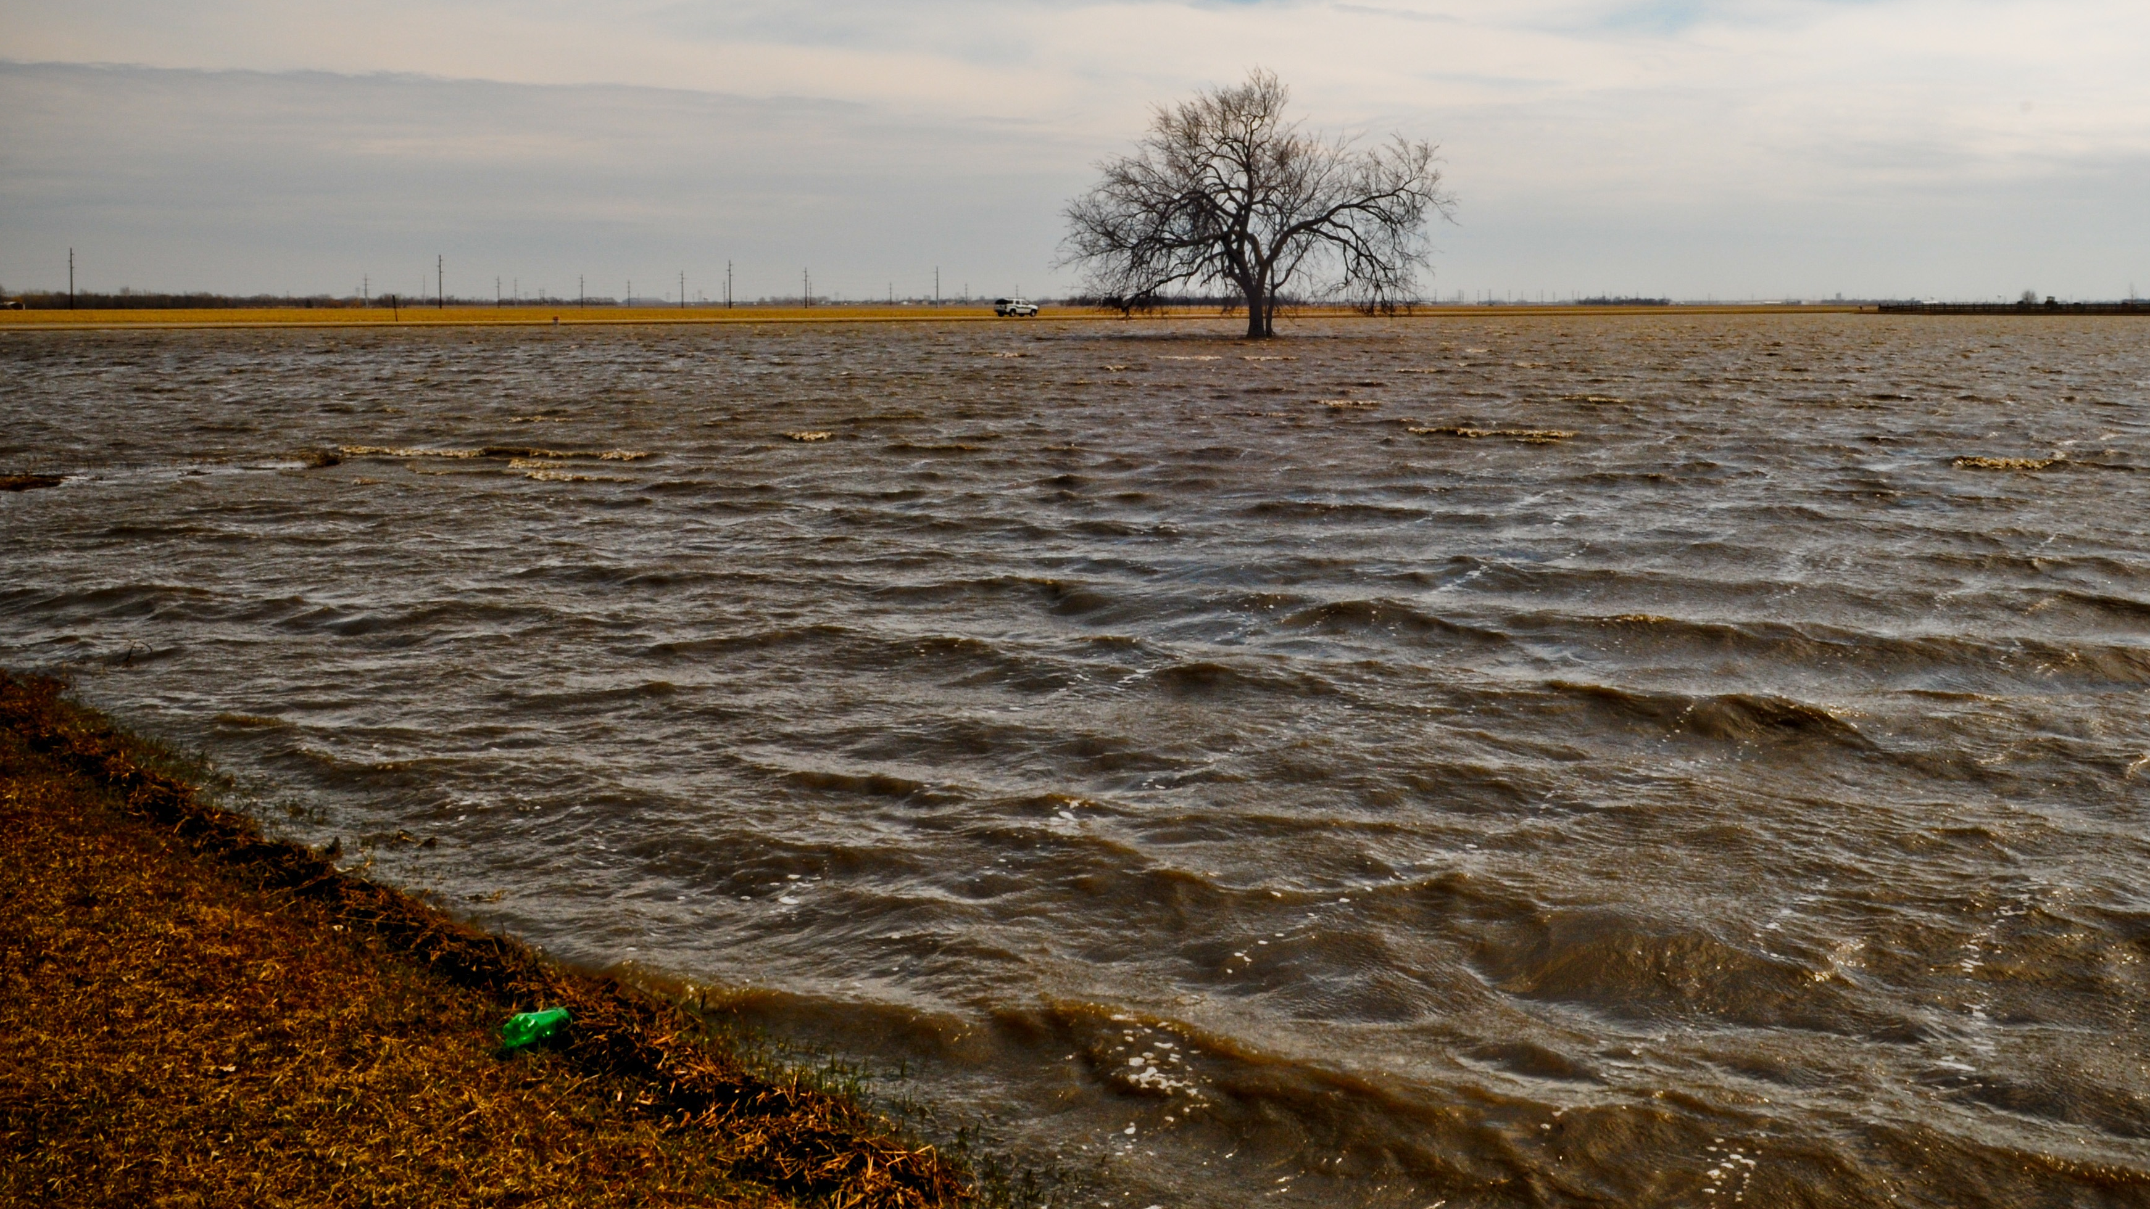
Sharing Concepts For…
Improving flood preparedness and response
Improving National
Flood Forecasts
Modernizing Flood Response Planning
& Damage Assessment
Localizing flood levels to specific geographies
Re-Factoring
HAZUS platform
Geo-targeted Messaging (IPAWS)
Local Authorities Response
  Planning
  Mitigation
  Response

Slide 21
Enhancing flood response system
Integrating advanced modeling into HAZUS
NEXRAD
NWS
River Forecast
Impact
Assessment
HAZUS
Localize Forecast
(RAPID or other)
IPAWS
Local
Alerts
Stream
Flow
Process
Geospatial
Database
GeoProcessing
Local
Applications
Planning
Mitigation
Response
Stream
Gages
Create
Flood Data
Model
Stream Flows

Slide 22
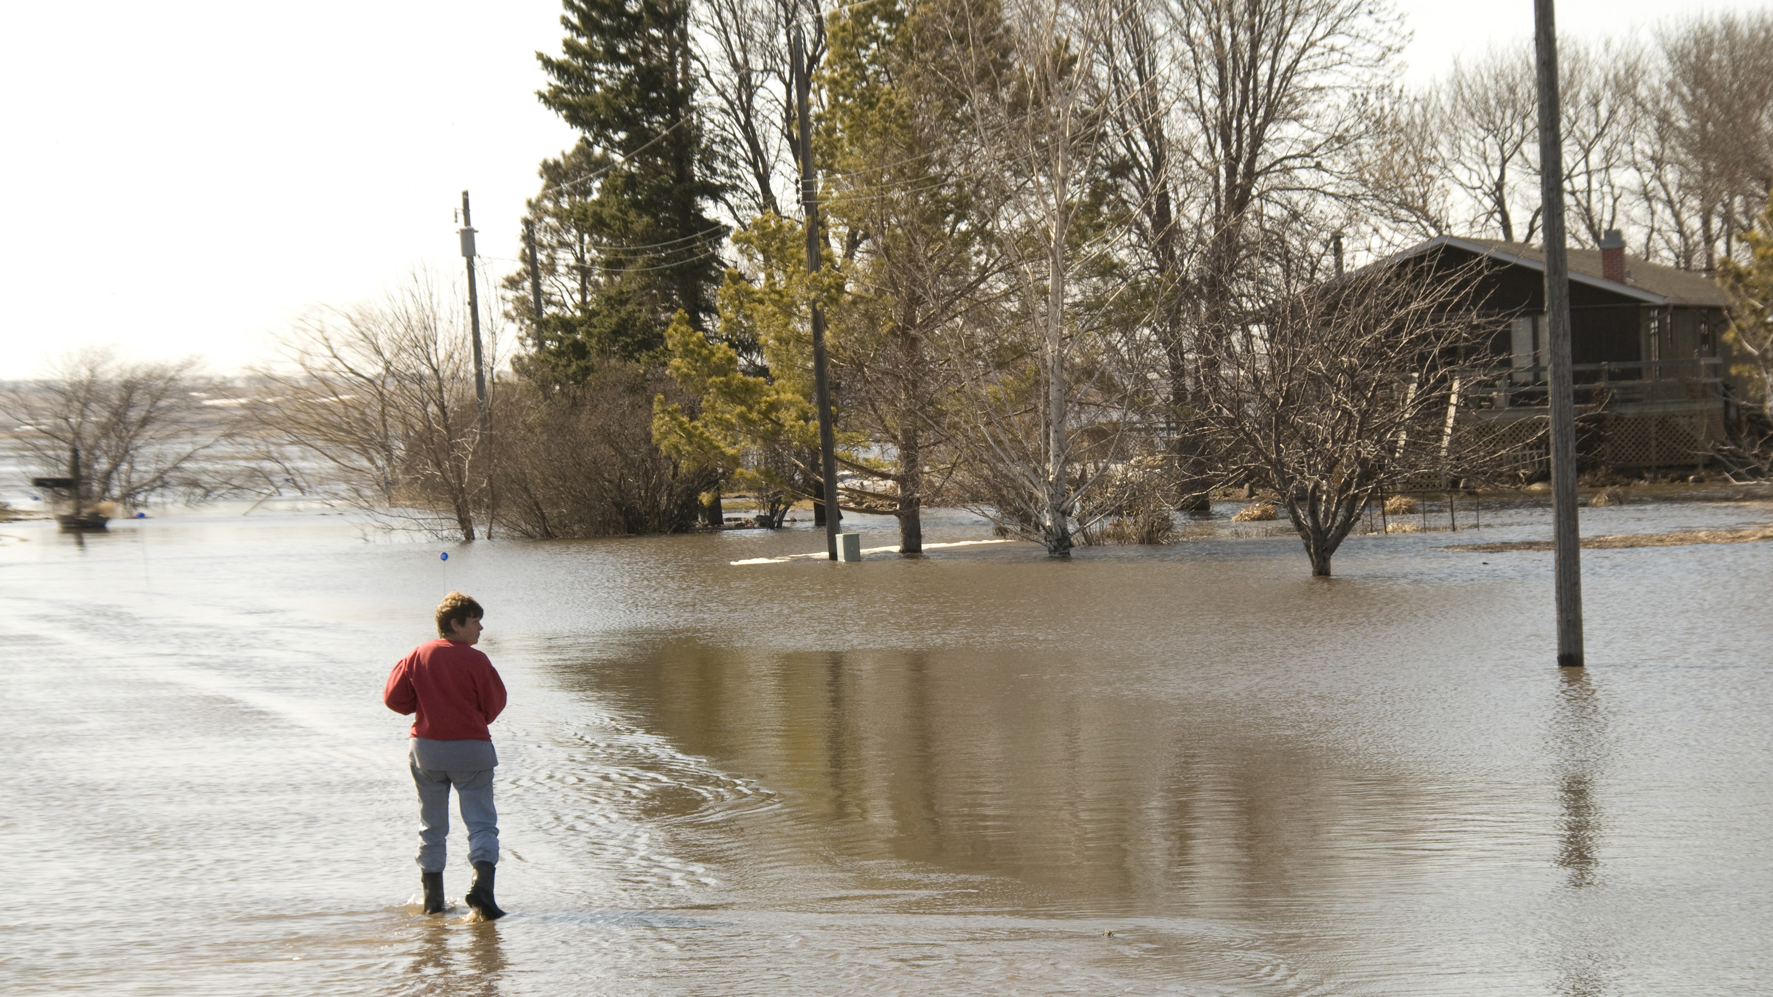
Recommendations
Partner early in HAZUS modernization
Support integration of flood models
(with UT and National Water Center)
  Pilot Project in Austin leveraging Preparedness grant
Partner with GIS template development
  Exercise and integrate with NFR

