Slide 1
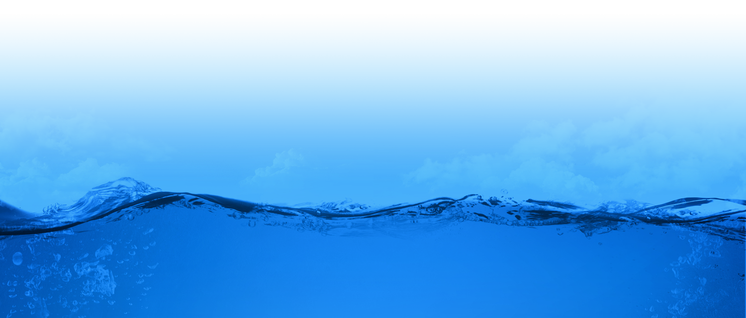
GEOSS and Water Science
David R. Maidment
Center for Research in Water Resources
University of Texas at Austin
Presented to GEOSS Future Products Workshop
Silver Spring, MD | 26 March 2013
Acknowledgements: David Arctur, Martina Bussettini, Cedric David, Amaree Israngkura,
Steve Kopp, Barbara Minsker, Matt Rodell, Fernando Salas, Jochen Schmidt, Bill Teng

Slide 2
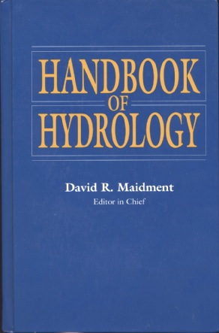
How is new knowledge discovered?
After completing a Handbook of Hydrology, I asked myself the question: how is new knowledge discovered in hydrology?
Deduction from existing knowledge
By deduction from existing knowledge
By experiment in a laboratory
By observation of the natural environment
Experiment in a laboratory
Observation of the natural environment
Notes:
After completing a Handbook of Hydrology, I asked myself the question: how is new knowledge discovered in hydrology?
<Click> to show answers
By deduction from existing knowledge
By experiment in a laboratory
By observation of the natural environment

Slide 3
Deduction – Isaac Newton
“The ancients divided mechanics into two parts; the rational, which proceeds accurately by demonstration; and the practical.
It occurs that mechanics is so distinguished from geometry, that what is perfectly accurate is called geometrical, what is less so, is called mechanical. Yet the errors do not come from the art but from those who practice the art.
In this sense rational mechanics will be the science of motions resulting from any forces whatsoever, and of the forces required to produce any motions, accurately proposed and demonstrated.”
Isaac Newton
Trinity College, Cambridge
8 May, 1686

Slide 4
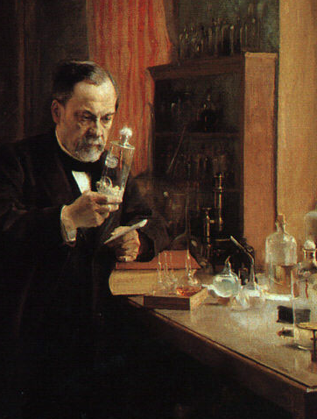
Experiment – Louis Pasteur
Experiment is the classical path of laboratory science – a simplified view of the natural world is replicated under controlled conditions
Pasteur showed that microorganisms cause disease and discovered vaccination
a foundation of scientific medicine
Laboratory experiments are more for microscale than the macroscale
hard to conduct at the global scale
Experiment – a simplified view of the natural world is replicated under controlled conditions
Pasteur showed that microorganisms cause disease and discovered vaccination
a foundation of scientific medicine
Laboratory experiments are more for microscale than the macroscale
hard to conduct at the global scale
Notes:
Experiment is the classical path of laboratory science – a simplified view of the natural world is replicated under controlled conditions
Pasteur showed that microorganisms cause disease and discovered vaccination
a foundation of scientific medicine
Laboratory experiments are more for microscale than the macroscale
hard to conduct at the global scale

Slide 5
Observation – Charles Darwin
“When on board H.M.S. Beagle, as naturalist, I was much struck with certain facts in the distribution of the inhabitants of South America, and in the geological relations of the present to the past inhabitants of that continent. These facts seemed to me to throw some light on the origin of species -- that mystery of mysteries, as it has been called by one of our greatest philosophers. On my return home, it occurred to me, in 1837, that something might perhaps be made out on this question by patiently accumulating and reflecting on all sorts of facts which could possibly have any bearing on it.
I can here give only the general conclusions at which I have arrived, with a few facts in illustration, but which, I hope, in most cases will suffice.”
Published 24 November,1859
Most accessible book of great
scientific imagination ever written

Slide 6
Observation – the heart of GEOSS
GRACE gravity anomaly map of the earth

Slide 7
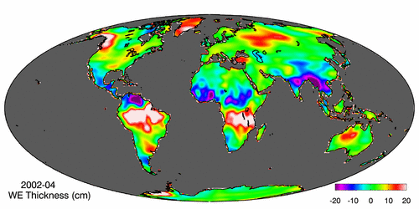
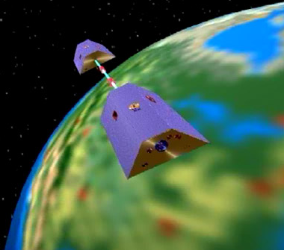
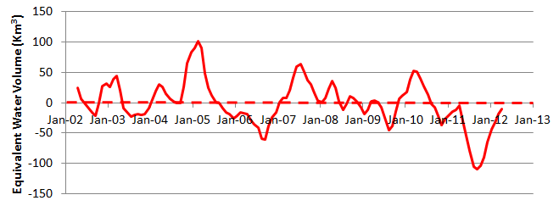
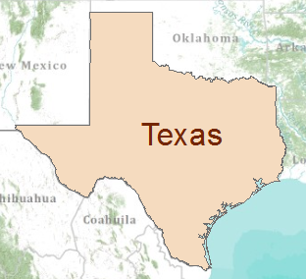
Water Observation – from satellites Measuring the gravity anomaly (GRACE)
Normal
In 2011 Texas lost 100 Km³ of water
Global processes . . .
. . . Local consequences
Global processes . . . . . . Local consequences

Slide 8
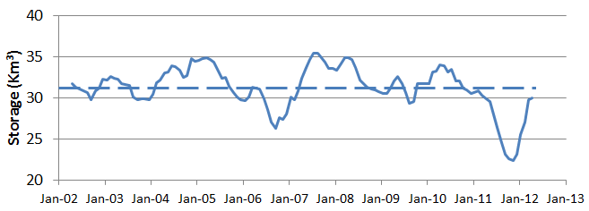
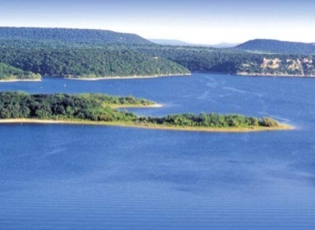
GRACE and Texas Reservoir Water Storage
GRACE
Normal
In 2011, Texas lost 100 Km³ of water overall
Surface Water
Reservoirs
Normal
In 2011, Texas lost 9 Km³ of water from reservoirs

Slide 9
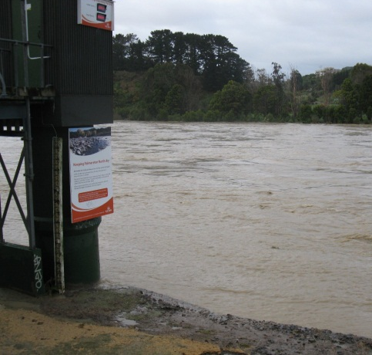
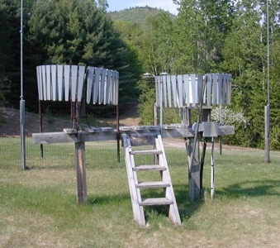
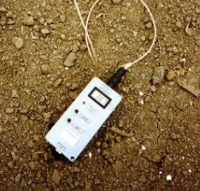
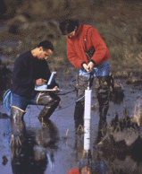
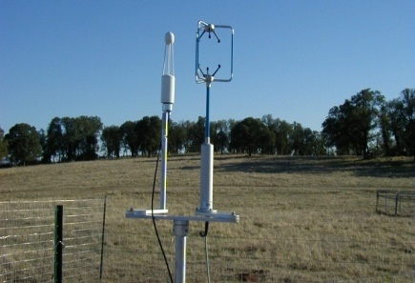
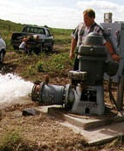
Water Observation – In Situ
Time series data at point locations
Water Quantity
Rainfall
Soil Water
Water Quality
Meteorology
Groundwater

Slide 10
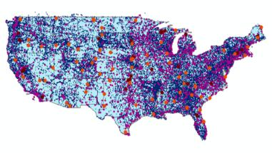
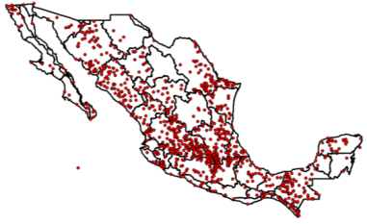
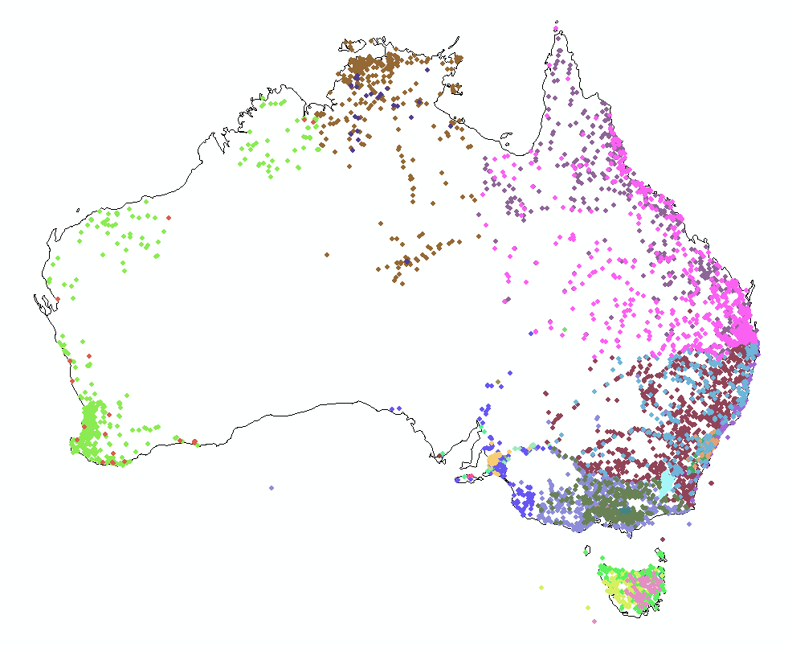
Every Country Collects These Data
We need
Global Water
Data Integration
United States
Mexico
Australia

Slide 11
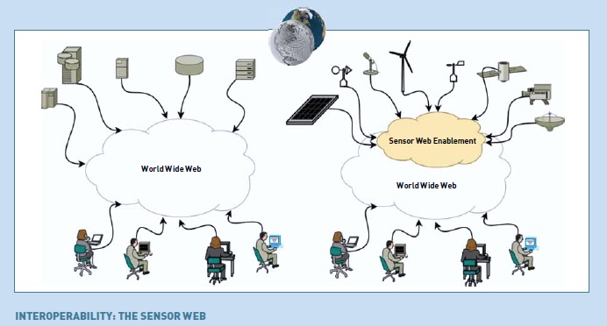
Observation in GEOSS – Sensor Web

Slide 12
Deduction in GEOSS – Model Web
Deduction is the classical path of mathematical physics:
Given a set of axioms
Then by a logical process
Derive a new principle or equation
Computer Modeling is a modern equivalent that says:
Given a set of input data
Then using an algorithm
Derive a computational result
Model Web is interconnection on the internet of computer models and data: Model as a Service
Sensor Web and Model Web are important for the advancement of science

Slide 13
Connecting the Sensor Web and Model Web
Deduction
Observation
Model Web
Sensor Web
Contribution of GEOSS to Science

Slide 14
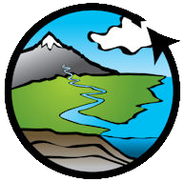
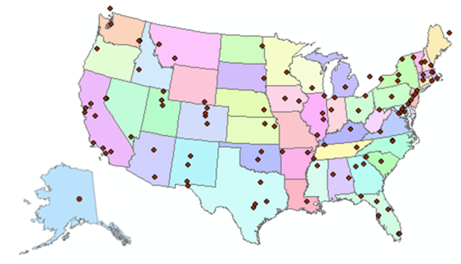
Consortium of Universities for the Advancement of Hydrologic Science, Inc.
www.cuahsi.org
CUAHSI
A consortium representing 125 US universities
Dr. Richard Hooper, President and CEO
Supported by the National Science Foundation Earth Science Division
Advances hydrologic science in nation’s universities
Includes a Hydrologic Information System project
Invented WaterML language for water resources time series
Building an academic prototype system

Slide 15
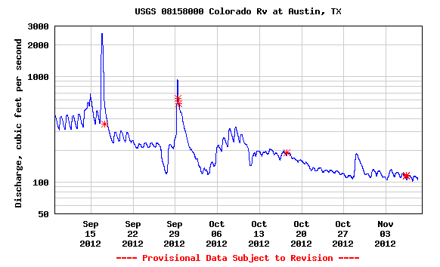
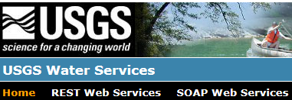
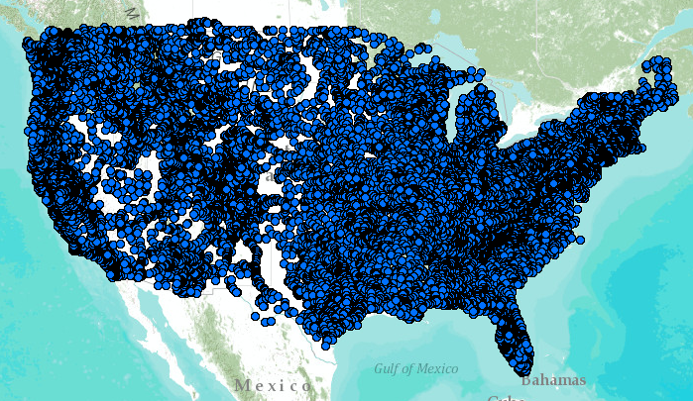
WaterML – the US Geological Survey
Water time series data on the internet
24/7/365 service
For daily and real-time data
. . . Operational water web services system for the United States
http://waterservices.usgs.gov/nwis/iv?sites=08158000&period=P1D&parameterCd=00060

Slide 16
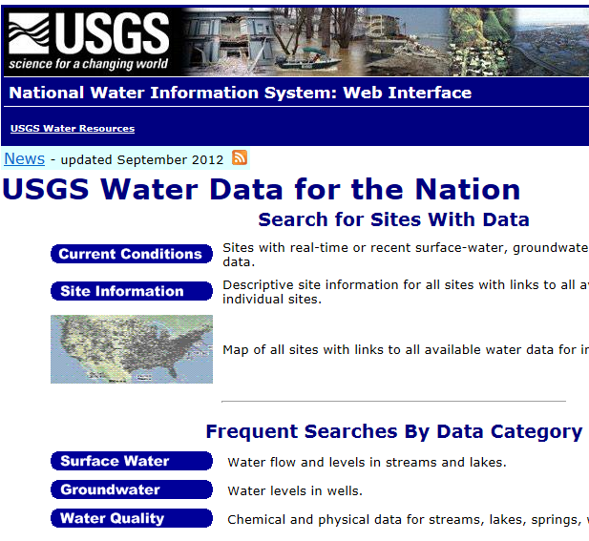
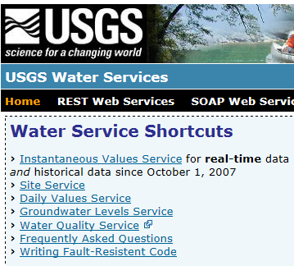
Web Pages and Web Services
Web pages deliver text and images
http://water.usgs.gov
Web services deliver data encoded in XML
http://waterservices.usgs.gov/

Slide 17
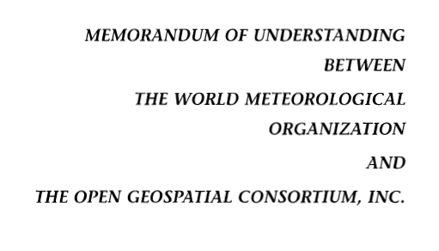
OGC/WMO Hydrology Domain Working Group
4-Year International Effort – WaterML
A time series for one variable at one location
Hydrology Domain Working Group formed
OGC observer at WMO Congress on Hydrology
Technical Meetings Each 3 Months Four Interoperability Experiments
(Surface water, groundwater, forecasting)
Annual week-long workshops
Involvement by many countries
November 2009
Acknowledgements: OGC, WMO, GRDC, CUAHSI, BoM/CSIRO, USGS, GSC, Kisters, …….
2008
2009
2010
2011
2012
Notes:
(1) A four-year international effort has been undertaken to reconcile WaterML with international standards;
(2) This effort was initiated with the establishment of an Hydrology Domain Working Group by the Open Geospatial Consortium in September 2008;
(3) An OGC representative attended the WMO Congress of the Commission for Hydrology in 2008
(4) A formal agreement between Secretary General of WMO and President of OGC in 2009 to jointly develop standards for hydrology, climatology, oceanography and climatology;
(5) The joint OGC/WMO Hydrology Domain Working Group was supported by a large work effort, annual week-long workshops, four interoperability experiments for surface and groundwater data exchange, and participation by many countries;
(6) In June 2012, the OGC voted to adopt the revised version, WaterML2 as an international standard for exchange of water resources time series (the first such public standard that has existed);
(7) This Congress to the WMO Commission for Hydrology to whom I am speaking is considering WaterML2 for adoption as an official standard by WMO

Slide 18
GEOSS Water Services proposed for AIP- 6
GEOSS
WMO
Catalogs
Implementation
OGC
WMO
Standards
GIS
Water
Resources
Domains
Maps and time series . . .
. . . interoperability of connected systems

Slide 19
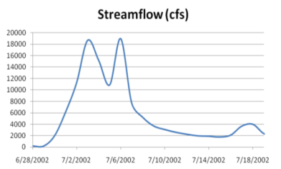
Web Services Stack
For Time Series
Catalog Service for the Web with standard metadata: ISO, FGDC, ANZLIC, Dublin Core
Who?
What?
Catalog (CSW)
Time Series Services
Where? When?
Metadata (WFS)
Data (WaterML2)
CSW = OGC Catalog Service for the Web
WFS = OGC Web Feature Service for Maps
Access
Data
Existing OGC Data Services are Adequate . . .
. . . Need to Be Customized for Water Information

Slide 20
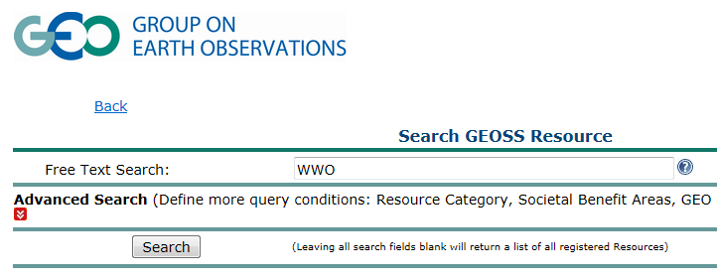
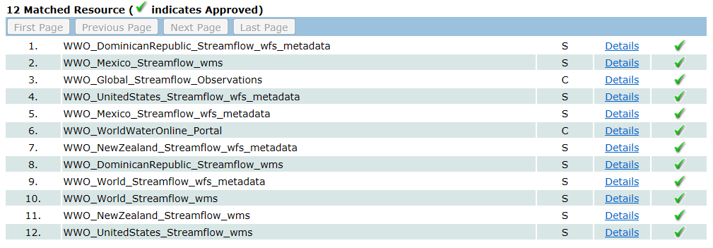
Searching GEOSS Portal
Search for water information
Find streamflow maps for countries
Streamflow map for the Dominican Republic
http://geossregistries.info/geosspub/resource_search_ns.jsp

Slide 21
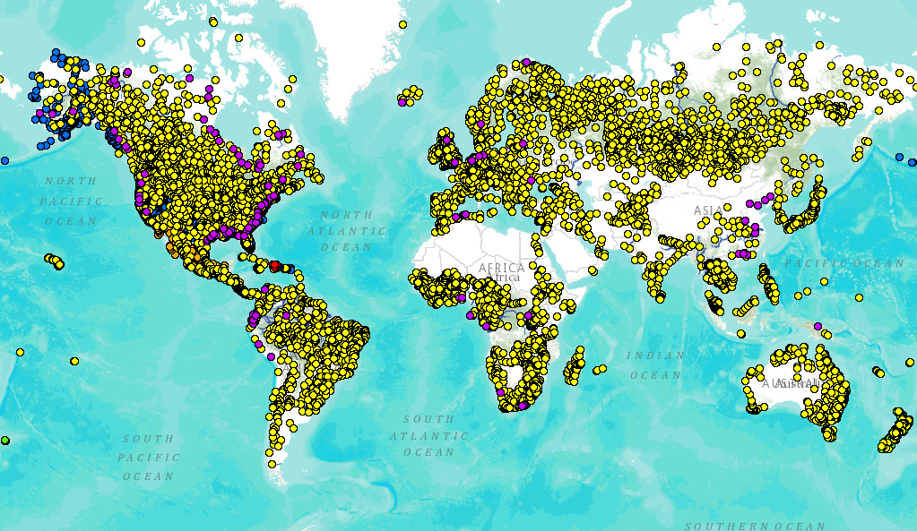
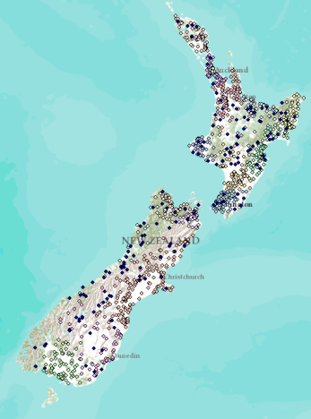
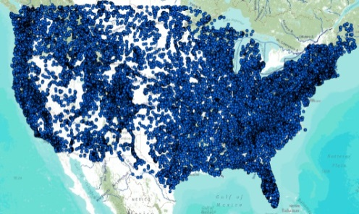
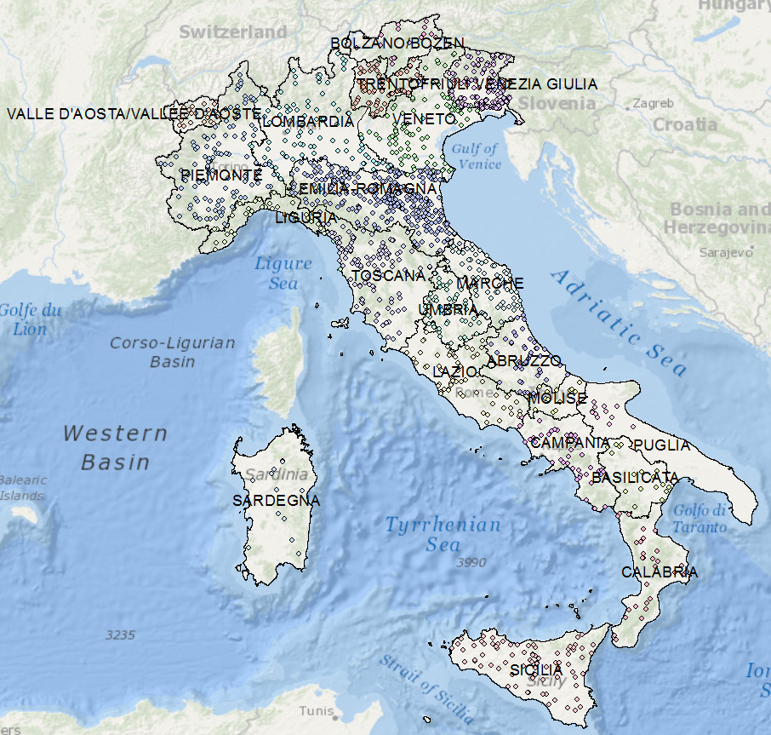
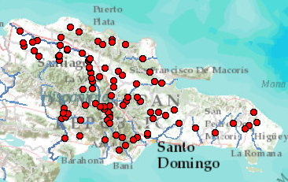
Global Streamflow Services
Global Runoff Data Centre
New Zealand
USA
Italy
Dominican Republic
Building a national system federating regions . . .
. . . builds a global system federating countries
http://www.arcgis.com/home/webmap/viewer.html?webmap=87ab07e2aba840828033e80b15fd6727

Slide 22
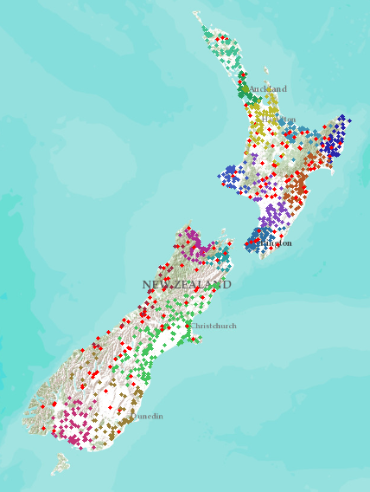
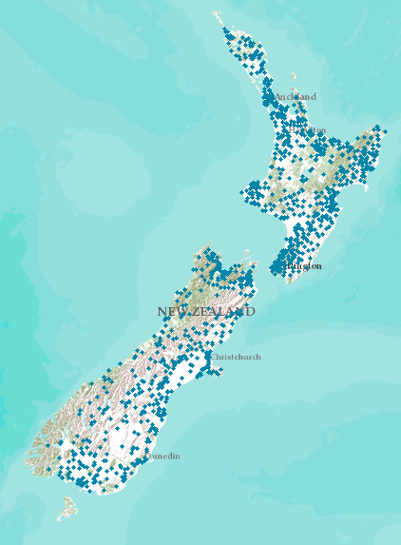
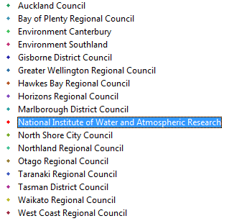
New Zealand – 16 regions
New Zealand Water Information System
NIWA operates about 20% of 1300 hydrometric stations
Regional authorities operate about 80% of stations.
Develop a federated hydrological information infrastructure . . .
. . . linking nationally and regionally collected data

Slide 23
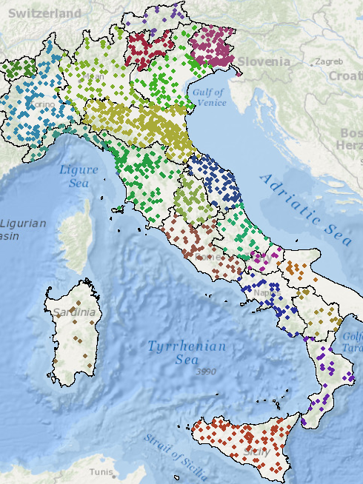
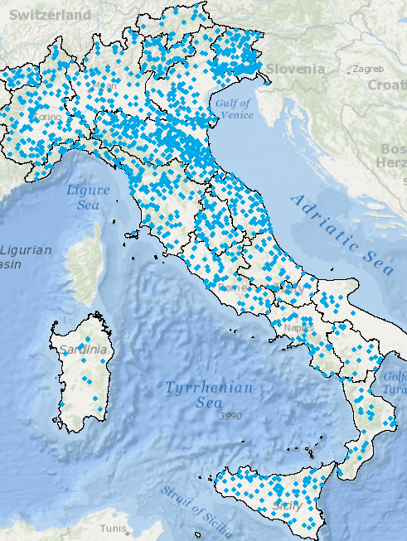
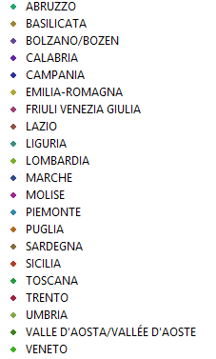
Italy – 21 regions
Italian Water Information System
National Institute for Environmental Protection and Research (ISPRA)
Regional authorities operate 100% of hydrometric stations
Linking observations data within countries. . .
. . . is same challenge as linking observations data between countries

Slide 24
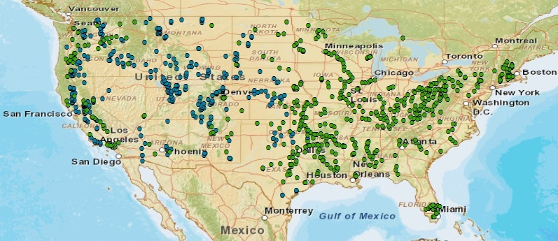
United States – surface water reservoirs
Information distributed across district and field offices
(608)
(348)
United States also needs a federated water information system. . .
. . . across water agencies and levels of government

Slide 25
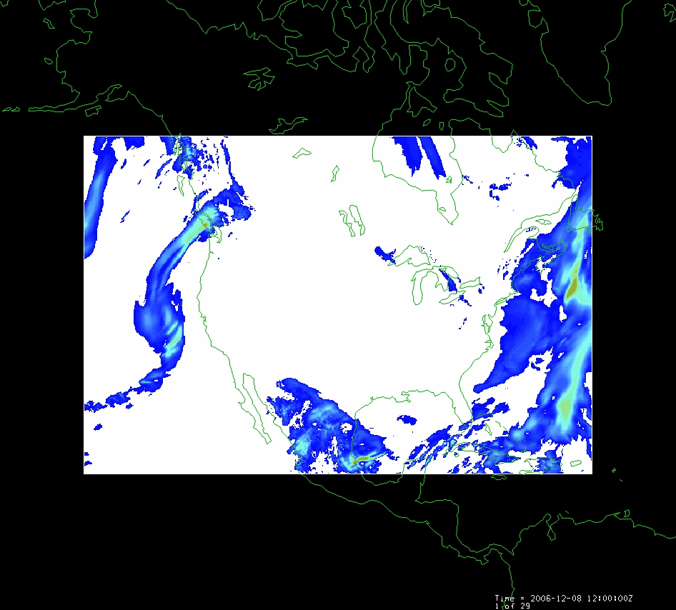
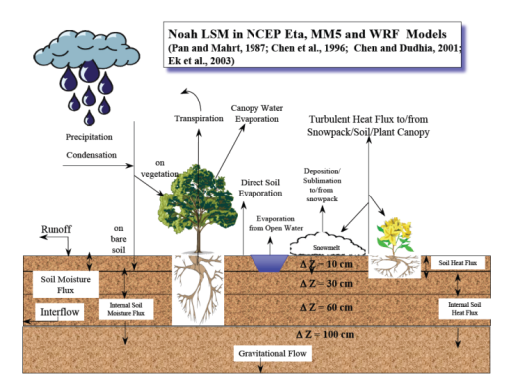
Land Data Assimilation System (LDAS)
Forcing:
Radiation
Precipitation
Surface climate
Evaporation
Soil Moisture
Runoff
Recharge
Observations Datasets, Numerical Weather Model
Soil
Vegetation
Terrain
1979 to present
Domain | Space | Time
North America | 1/8 degree | 1 hour
Global | 1/4 degree | 3 hours
Land Surface Model
Deduction:
Given these forcing and land surface conditions
Then, using a land surface simulation model
Derive surface moisture and energy balance

Slide 26
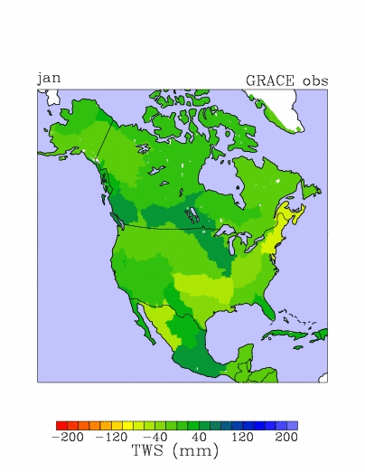
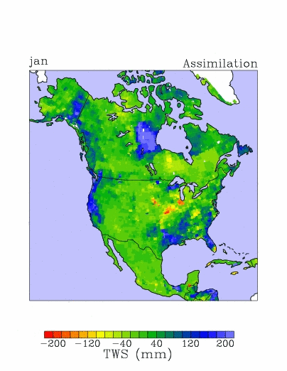
Total water storage in 2003
GRACE Observations
LDAS Assimilation
Updated from Zaitchik, Rodell, and Reichle, J. Hydromet., 2008.

Slide 27
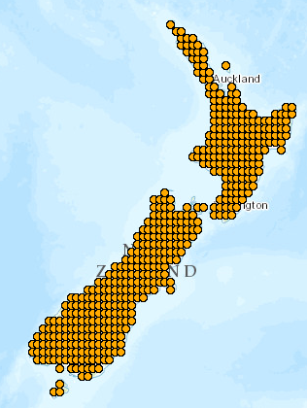
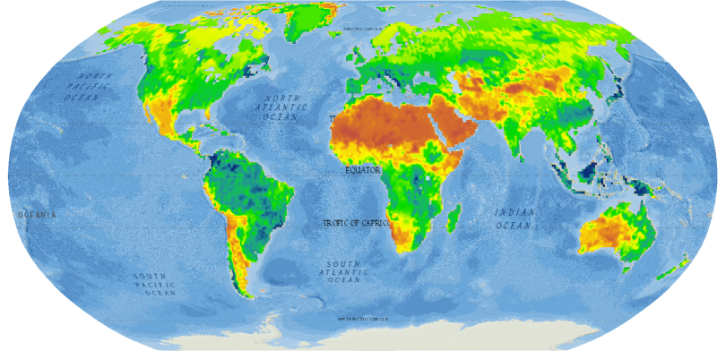
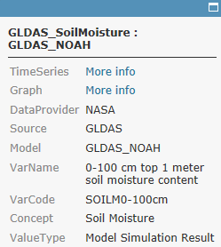
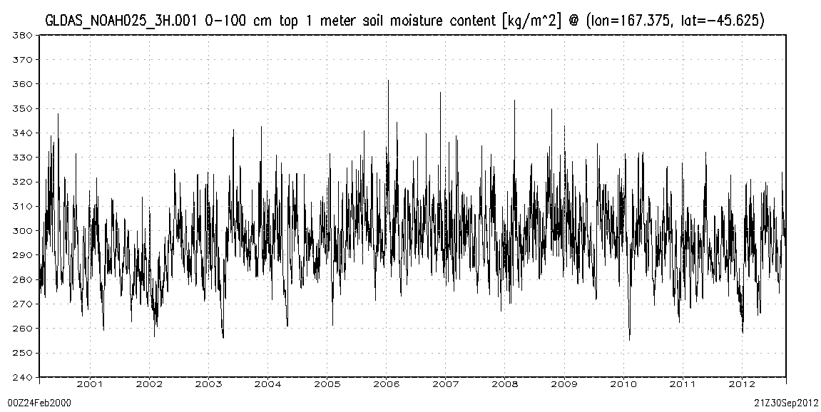
World Soil Moisture
from the NASA Global Land Data Assimilation System (GLDAS)
http://www.arcgis.com/home/webmap/viewer.html?webmap=7d6cefdf3f324b55b08c136654e91612
Charts show 3-hourly variation (37,000 values) of soil water content of the top 1m of soil from 2000 to 2012
Popup on point links to data and chart
New Zealand
A very wet region with little seasonality
A dryer region with significant seasonality

Slide 28
River Flow – Model as a Service
Observations Datasets, Numerical Weather Model
Land Surface Model
RAPID River Flow Model
Automated workflow at Univ. of Illinois uses LDAS data from NASA to run river model at Univ. of Texas

Slide 29
Flow in the Mississippi River Basin
RAPID model, March-May 2008, 3 hour time steps
GIS data describes 1.2 million river reaches . . .
. . . simulate flow in each reach in each time step

Slide 30
Global Water Maps
Model Web
Sensor Web
Describe a water property over a domain of space and time
History
Current conditions
Forecasts
Water Property
Precipitation
Evaporation
Soil Moisture
Streamflow
Groundwater
Reservoirs
Past
Present
Future

Slide 31
Conclusions
GEOSS Common Infrastructure
valuable for synthesizing water observations within countries as well as between countries
GEOSS Water Services
index global water observations and model information distributed in space and time
There is a golden opportunity to make progress!

