Slide 1
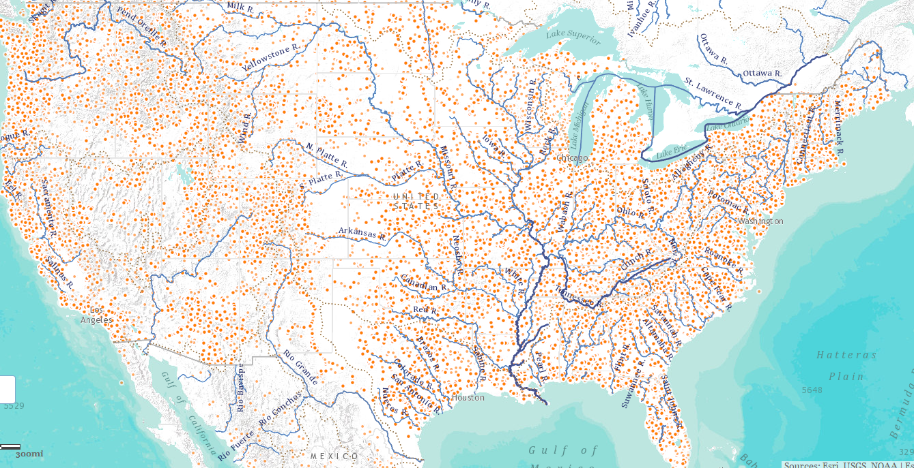
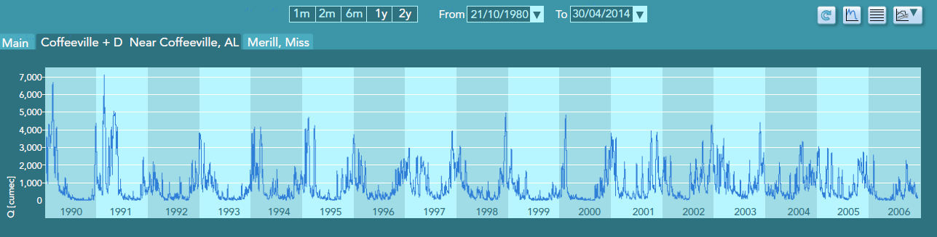
Developments in
Water Information Sharing
David R. Maidment,
University of Texas at Austin
11th International Conference on HydroInformatics
City College of New York
New York CIty
17 August 2014

Slide 2
Three Important Developments
Open Water Data Initiative
National Water Center
National Flood Interoperability Experiment
Acknowledgments: David Arctur, Cedric David, Stephen Jackson, Fernando Salas, Ahmad Tavakoly, Tim Whiteaker, (UT Austin); Nate Booth, Al Rea (USGS); Ed Clark (NWS), Microsoft Research Connections (Kristin Tolle), ESRI, Kisters.
This presentation has been edited slightly from the form in which it was originally presented

Slide 3
Three Important Developments
Open Water Data Initiative
National Water Center
National Flood Interoperability Experiment

Slide 4
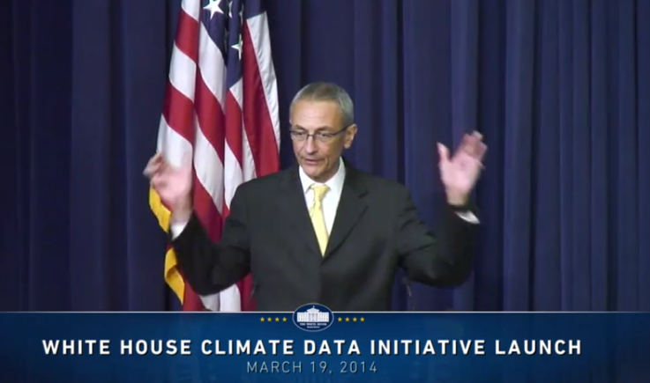
President’s Climate Data Initiative
John Podesta, Counsellor to the President, White House, March 19, 2014
https://www.youtube.com/watch?v=pfe5oRdsCp0&feature=youtu.be&t=7s

Slide 5
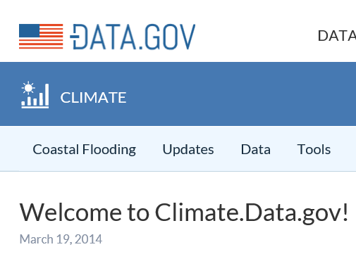
Goals of Climate Data Initiative
Prepare for climate change
Make government data accessible
Engage private sector
  ESRI, Microsoft, Google, Intel ….
Engage communities
  Chesapeake, New Orleans, World Bank, …
Why not a Water Data Initiative?

Slide 6
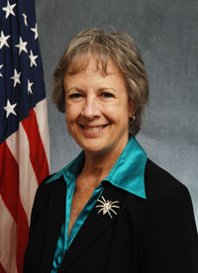

Open Water Data Initiative
Subcommittee on Spatial Water Data will lead this effort
This reports to both FGDC and ACWI
Anne Castle, Asst Secretary for Water and Science, Dept of Interior
Chair

Slide 7
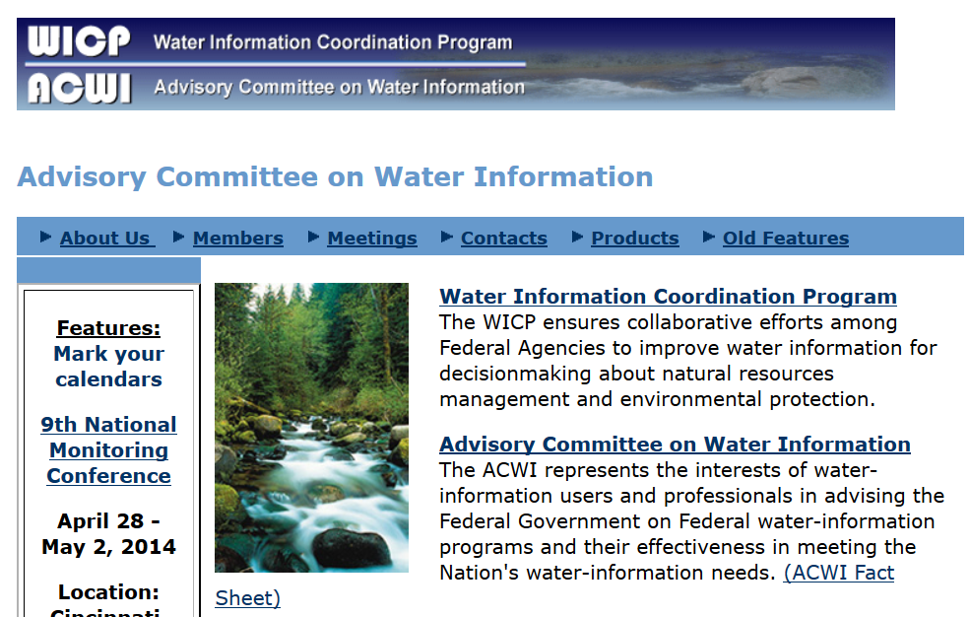
ACWI – Advisory Committee on Water Information
Established in 1991

Slide 8
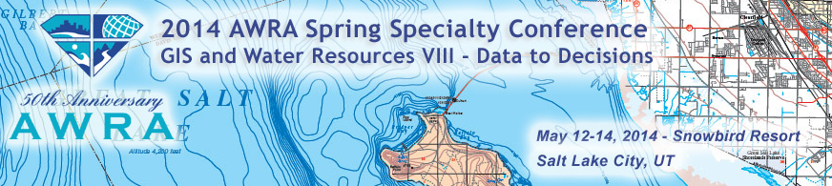
Collaboration with the American Water Resources Association
AWRA support for Open Water Data Initiative
  Featured Collection of articles in Journal of AWRA
  New AWRA Technology Committee
  Special track at AWRA National meeting in Tysons Corner, VA, Nov 6, 2014

Slide 9
Major Transitions in Geospatial Info
Paper maps to digital data
  National Spatial Data Infrastructure development
  Started in 1990’s
  Took more than a decade to complete
Digital data to web services
  Started several years ago
  Will take years to complete
Maps
Data
Services

Slide 10
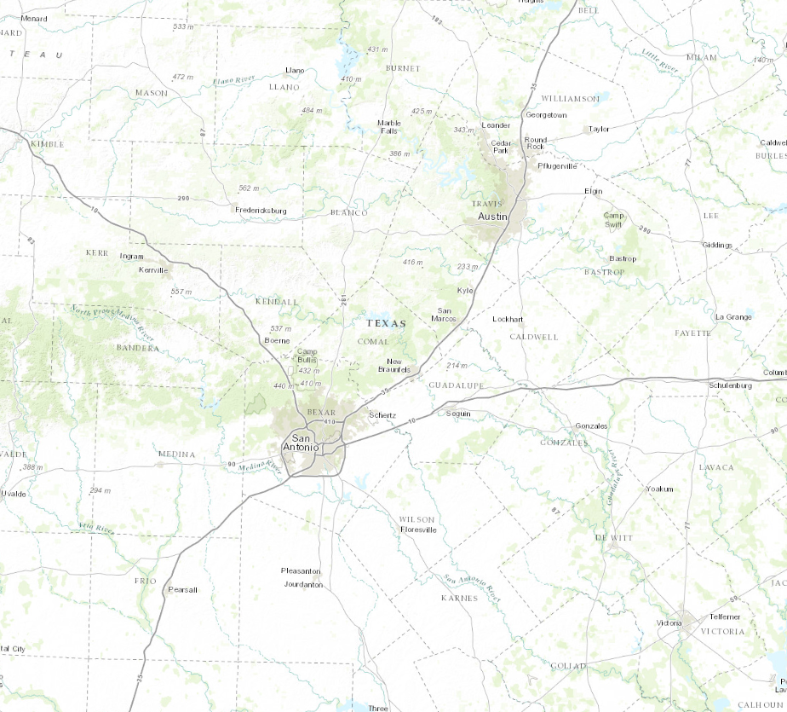
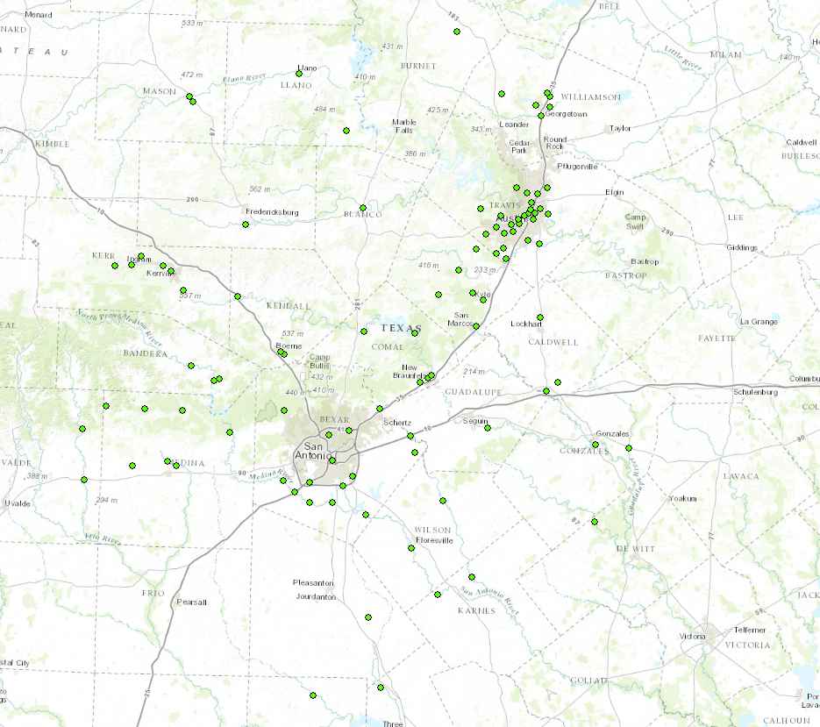
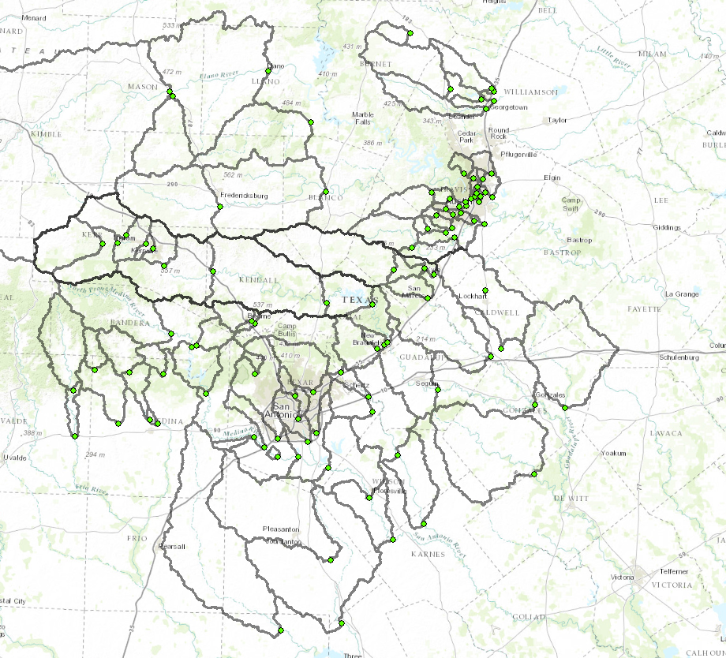
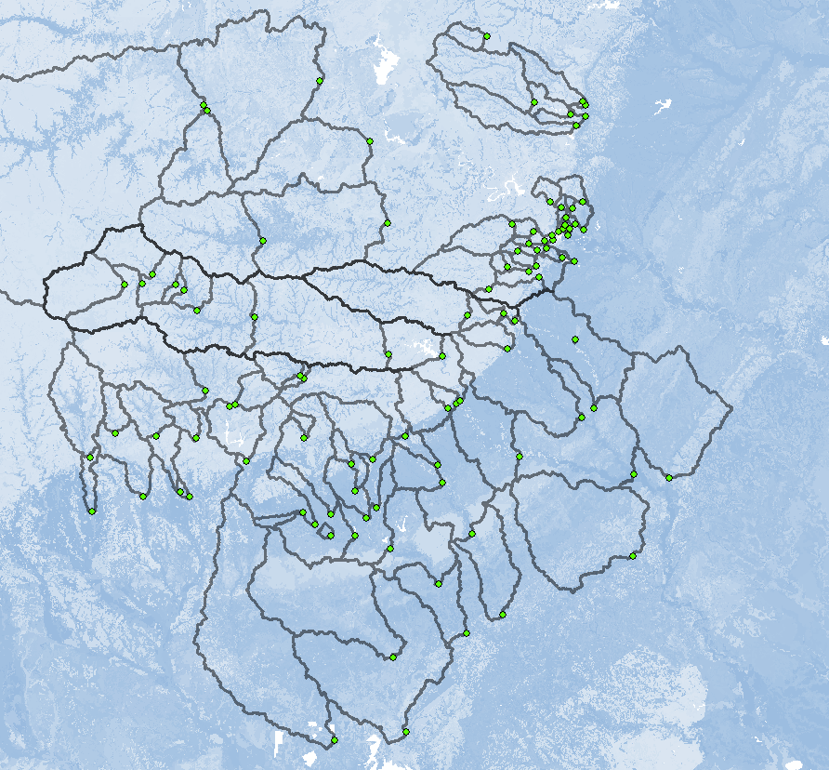
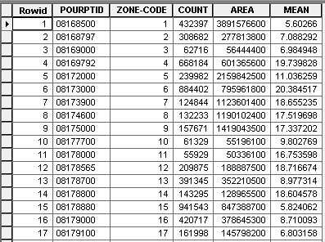
Geospatial Services
Goal:
Calculate average available water storage for a set of contributing areas
Analysis to define watershed properties done entirely with web services and functions
Remote Data & Tools:
Basemap
Stream Gages
Digital Elevation Model
Watershed Delineation Tool
Soil Available Moisture Map
Soil Statistics by Watershed

Slide 11
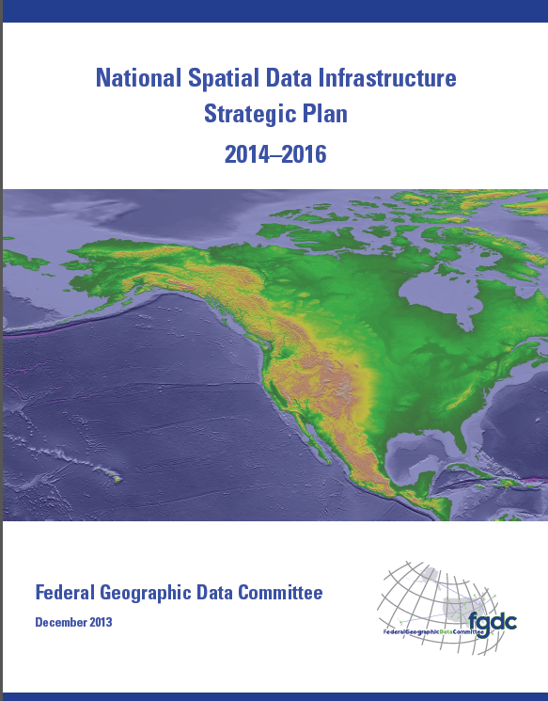
National Spatial Data Infrastructure (NSDI)
Desired Future State of NSDI
Create network of resources and services
Facilitate discovery, access and application of resources
Leverage shared standard-based services
Develop core set of information layers that interface with nonspatial data
Use real-time data feeds and sensor webs

Slide 12
Open Water Data Initiative
Open Water Web (applications)
National Water
Data Infrastructure
Water
Pollution
Ecological
Integrity
Flood
Drought
Concept: Nate Booth, USGS

Slide 13
National Water Data Infrastructure (NWDI)
A thematically organized set of water information data layers
Authoritative for the nation
Assembled from best available sources
Made freely available through water information services.

Slide 14
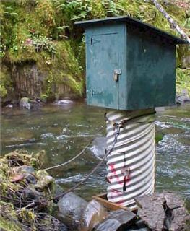
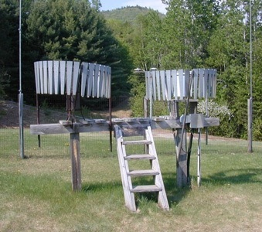
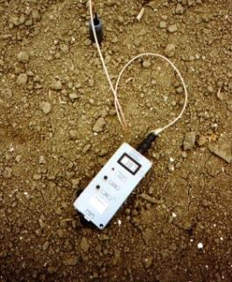
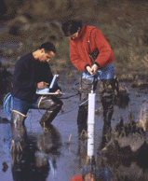
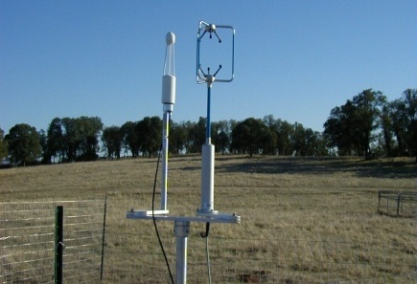
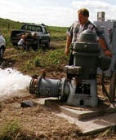
Hydrologic Measurement
Water Quantity
Rainfall
Soil Water
Water Quality
Meteorology
Groundwater
Time series data at point locations

Slide 15


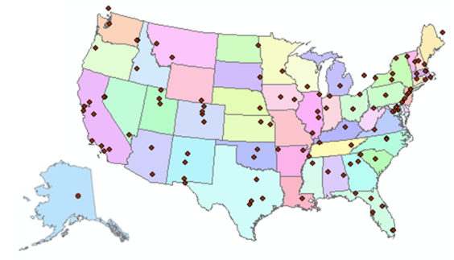
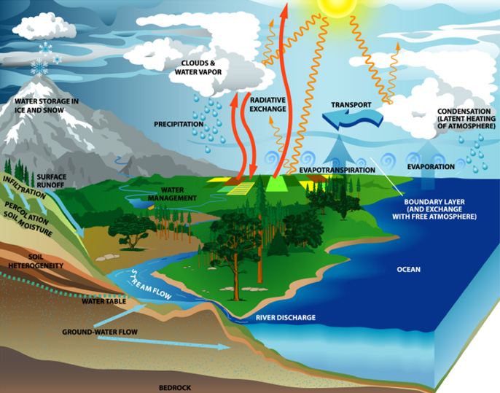
Consortium of Universities for the Advancement of Hydrologic Science, Inc.
www.cuahsi.org
CUAHSI
A consortium representing 125 US universities
Dr. Richard Hooper, President and CEO
Supported by the National Science Foundation Earth Science Division
Advances hydrologic science in nation’s universities
Includes a Hydrologic Information System project
Designed the WaterML language

Slide 16
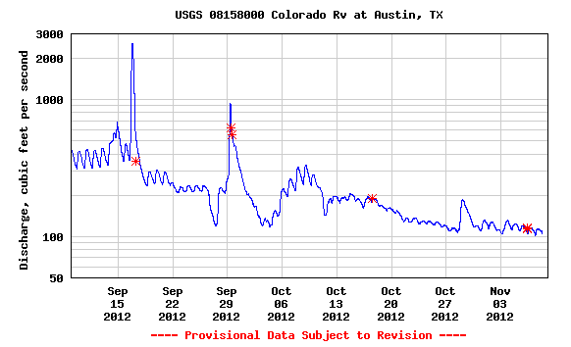

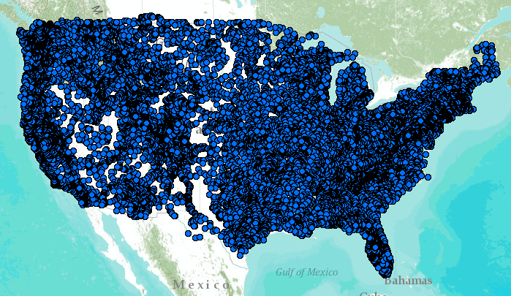
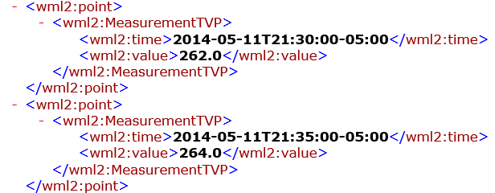
WaterML Web Services – CUAHSI, USGS, OGC, WMO …..
Water time series data on the internet
24/7/365 service
For daily and real-time data
. . . Operational water web services system for the United States
http://waterservices.usgs.gov/nwis/iv/?format=waterml,2.0&sites=08158000&period=P1D&parameterCd=00060

Slide 17
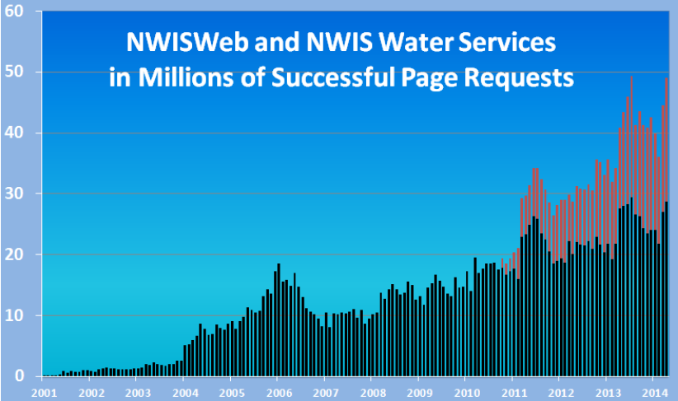
Water Data Distribution by US Geological Survey
Web service requests (millions/month)
Web page requests (millions/month)

Slide 18
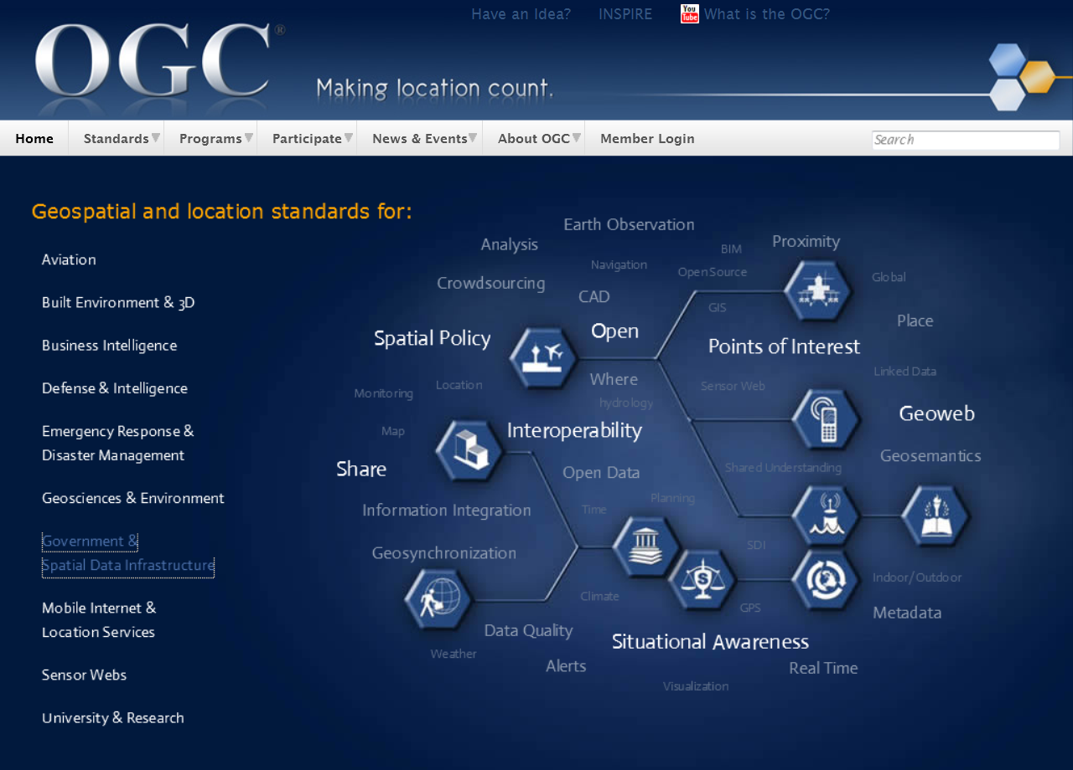
Open Geospatial Consortium
More than 400 companies and agencies globally
Internet standards for
Map services
Observation services
Catalog services

Slide 19

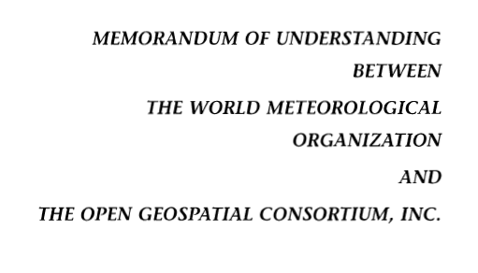
OGC/WMO Hydrology Domain Working Group
4-Year International Effort – WaterML
A time series for one variable at one location
Hydrology Domain Working Group formed
OGC at WMO Commission for Hydrology
Technical Meetings Each 3 Months
Four Interoperability Experiments
(Surface water, groundwater, forecasting)
Annual week-long workshops
Involvement by many countries
November 2009
Acknowledgements: OGC, WMO, GRDC, NWS, CUAHSI, BoM/CSIRO, USGS, GSC, Kisters, …….
2008
2009
2010
2011
2012
Notes:
(1) A four-year international effort has been undertaken to reconcile WaterML with international standards;
(2) This effort was initiated with the establishment of an Hydrology Domain Working Group by the Open Geospatial Consortium in September 2008;
(3) An OGC representative attended the WMO Congress of the Commission for Hydrology in 2008
(4) A formal agreement between Secretary General of WMO and President of OGC in 2009 to jointly develop standards for hydrology, climatology, oceanography and climatology;
(5) The joint OGC/WMO Hydrology Domain Working Group was supported by a large work effort, annual week-long workshops, four interoperability experiments for surface and groundwater data exchange, and participation by many countries;
(6) In June 2012, the OGC voted to adopt the revised version, WaterML2 as an international standard for exchange of water resources time series (the first such public standard that has existed);
(7) This Congress to the WMO Commission for Hydrology to whom I am speaking is considering WaterML2 for adoption as an official standard by WMO

Slide 20

WMO is adopting WaterML
WMO Executive Council has asked its Commission for Basic Systems to lead adoption of WATERML2 as a WMO standard and also its adoption by the International Standards Organisation (ISO)
Repackage WaterML2 as TimeSeriesML to be used for all forms of time series, not just for water

Slide 21
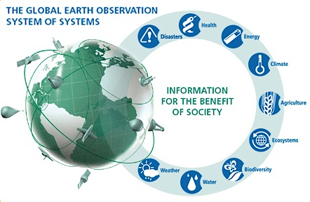
GEOSS – Global Earth Observation System of Systems
Group on Earth Observations (GEO) . . .
. . . located with WMO in Geneva

Slide 22
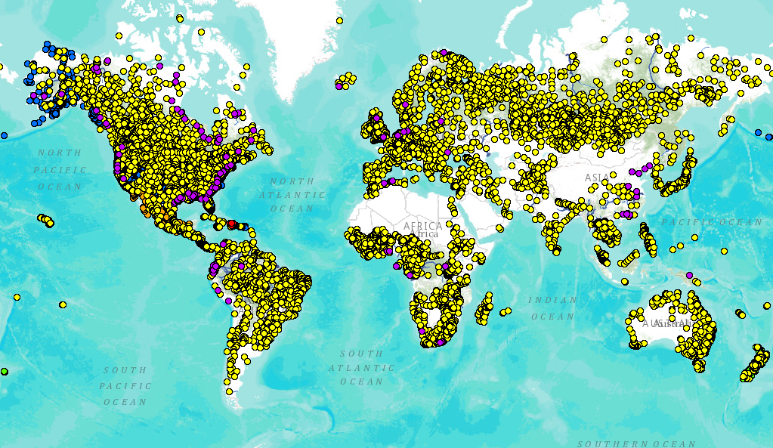
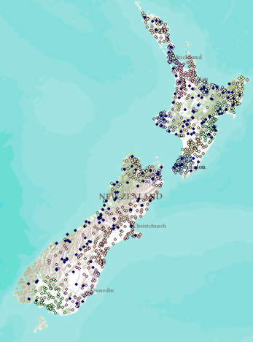
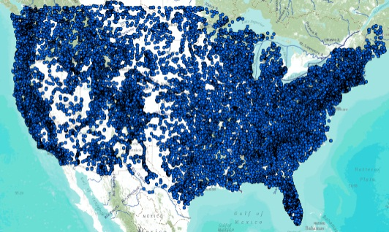
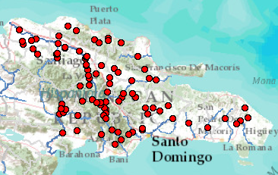
Global Streamflow Services
Building a national system federating regions . . .
. . . builds a global system federating countries
Global Runoff Data Centre
New Zealand
USA
Dominican Republic
http://www.arcgis.com/home/webmap/viewer.html?webmap=87ab07e2aba840828033e80b15fd6727

Slide 23
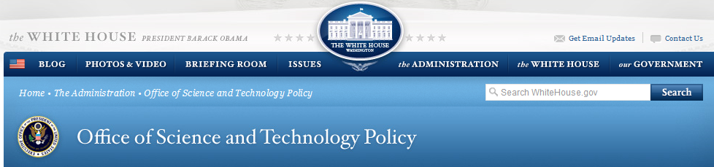

Committee on Environmental, Natural Resources, and Sustainability (CENRS)
“WaterML: Water Markup Language (ML) is an informatics initiative of the CENRS Subcommittee on Water Availability and Quality that provides a systematic way to access water information from point observation sites.” (p.21)
WaterML is the first OGC standard endorsed by the Executive Office of the President
http://www.whitehouse.gov/sites/default/files/microsites/ostp/nstc_2013_earthobsstrategy.pdf

Slide 24
Three Important Developments
Open Water Data Initiative
National Water Center
National Flood Interoperability Experiment

Slide 25
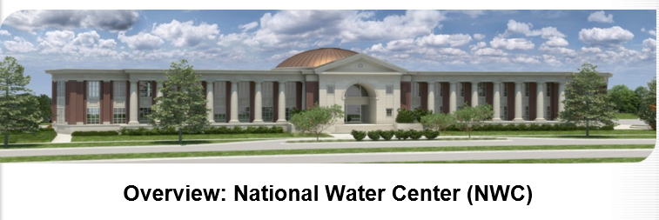

Located on Tuscaloosa Campus of University of Alabama
Operated by National Weather Service to support IWRSS partners (NWS, USGS, Corps of Engineers, FEMA)

Slide 26
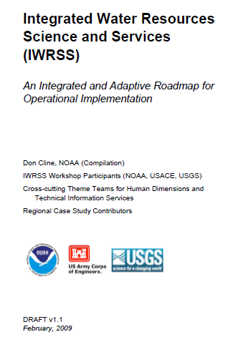
Integrated Water Resources Science and Services (IWRSS)
Aligns multiple agencies with complimentary water-related missions to:
Integrate services and service delivery
Improve river and flood forecasts
Provide new summit-to-sea water resources analyses and forecasts
Enable more effective use of resources
Roadmap Document
(February 2009)
Purpose, Scope, Vision and Goals
Cross-Cutting Themes
National and Regional
Operations and Business Concepts
Slide: Ed Clark, NWS
http://www.nohrsc.noaa.gov/~cline/IWRSS/IWRSS_ROADMAP_v1.0.pdf
26

Slide 27
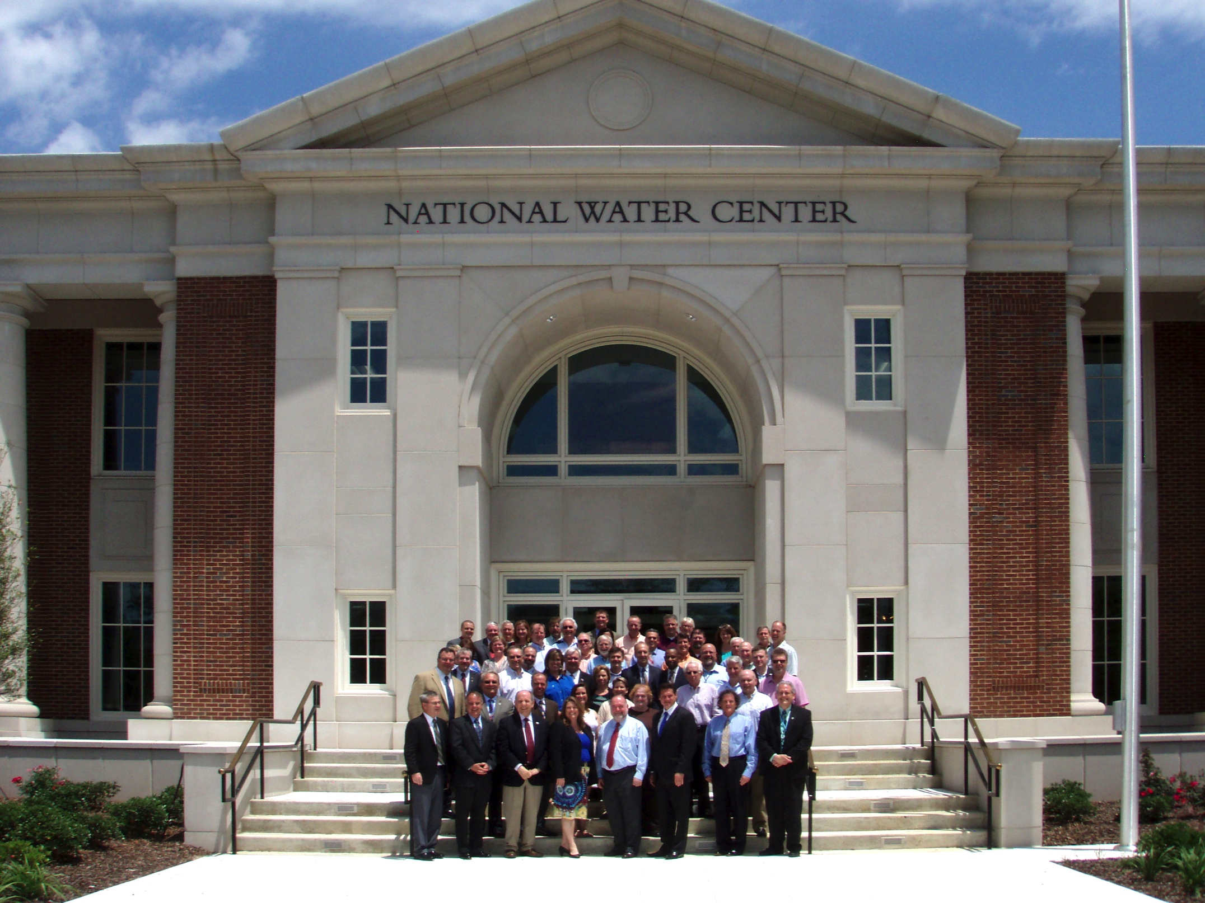
Inaugural Meeting – May, 2014

Slide 28
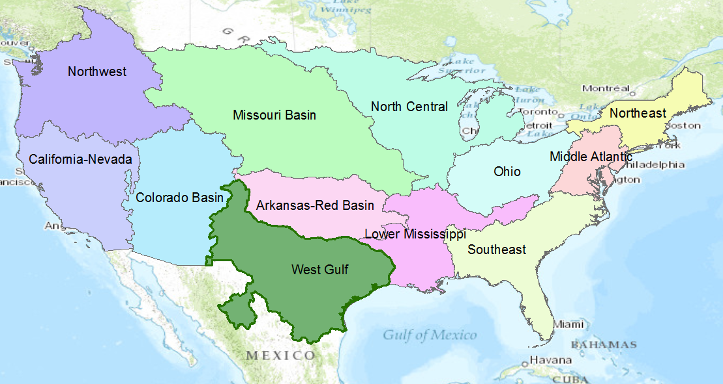
NWS River Forecast Centers
Perform precipitation, runoff and river flow simulation and forecasting for five days ahead, updated daily, more frequently during floods

Slide 29
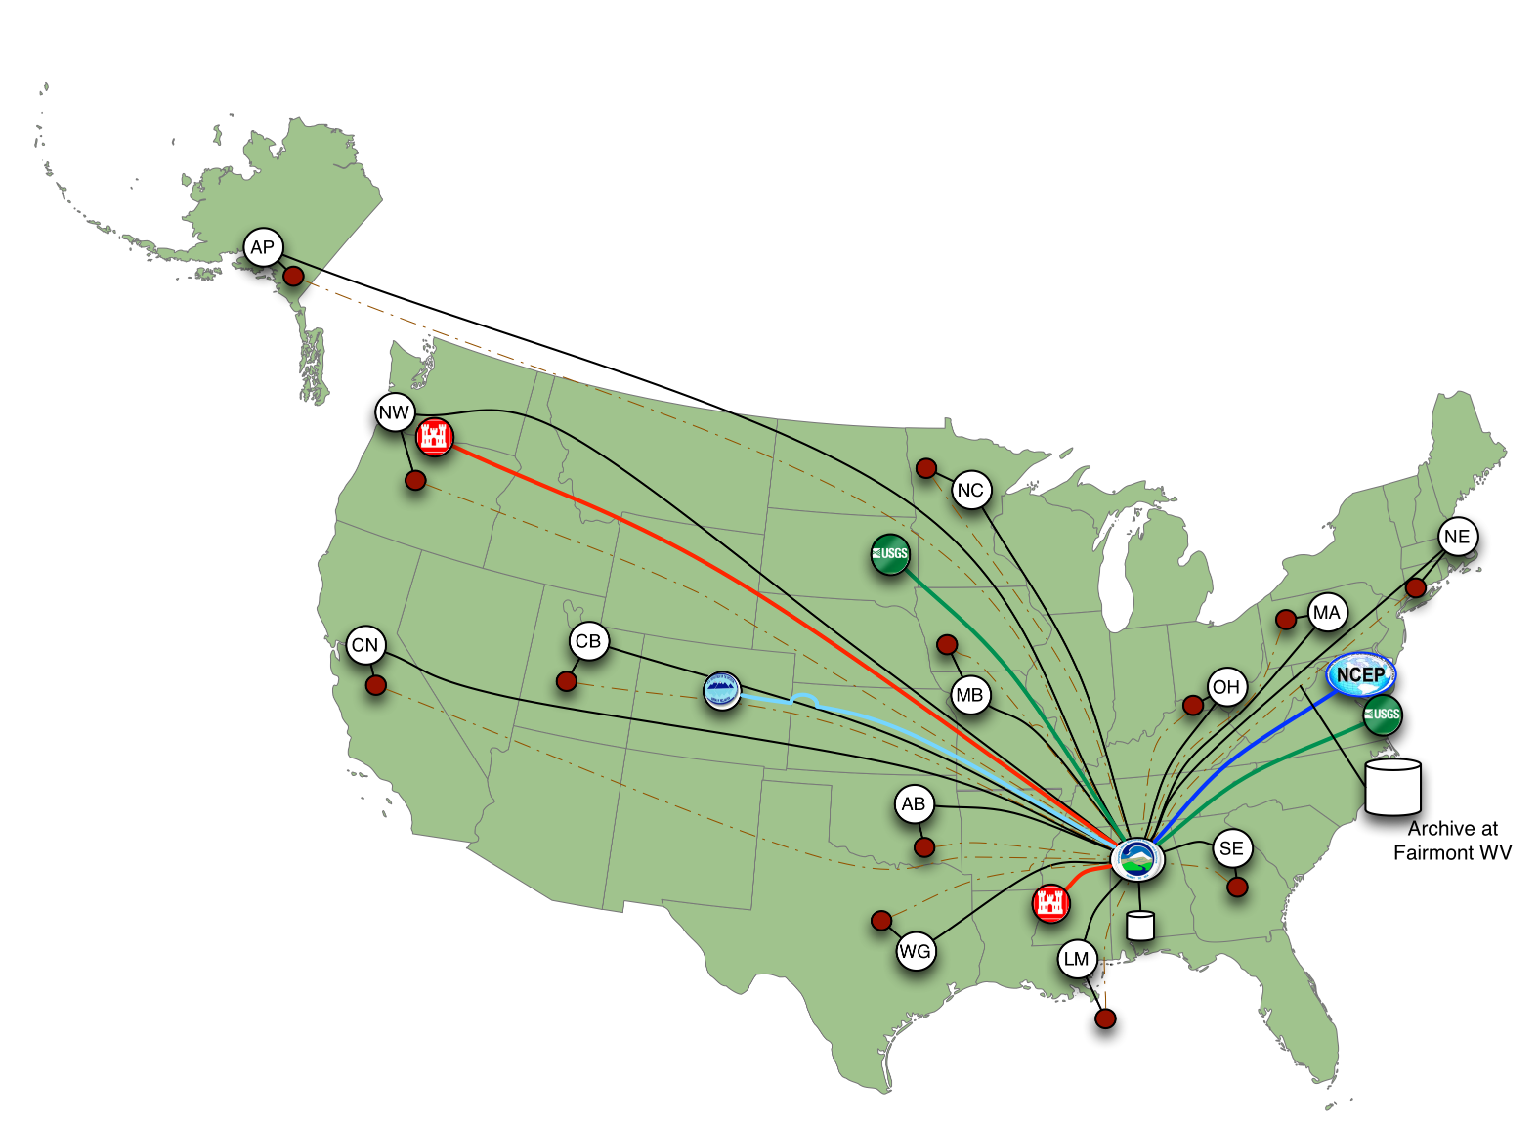
Nationally Synthesize Operations of Regional River Forecast Centers

Slide 30
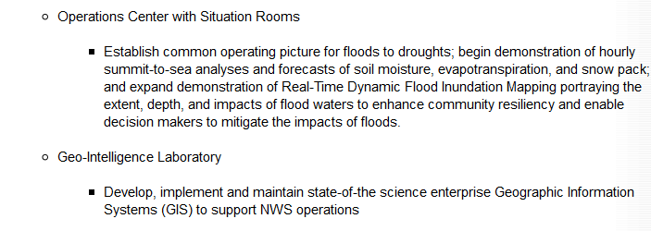
Temporal information
Geospatial information
Open Water Data Infrastructure

Slide 31
Transformative Research (NSF)
Transformative research involves ideas, discoveries, or tools that radically change our understanding of an important existing scientific or engineering concept or educational practice or leads to the creation of a new paradigm or field of science, engineering, or education. Such research challenges current understanding or provides pathways to new frontiers.
http://www.nsf.gov/about/transformative_research/definition.jsp
How to move from evolutionary change
to transformative change?

Slide 32
Three Important Developments
Open Water Data Initiative
National Water Center
National Flood Interoperability Experiment

Slide 33
National Flood Interoperability Experiment (NFIE)
Will be led by the academic community in collaboration with the IWRSS partners through the National Water Center
Run from September 2014 to August 2015
  Preparatory phase to May 2015
  Summer Institute at the National Water Center, June to August 2015
Serves a use case in flooding for the Open Water Data Initiative

Slide 34









NFIE Goal: Connect National Scale Flood Modeling with Local emergency planning and response
How can near-real-time hydrologic simulations at high spatial resolution, covering the nation, be carried out using the NHDPlus or next generation hydro-fabric (e.g. data structure for hillslope, watershed scales)?
How can this lead to improved emergency response and community resilience?
How can an improved interoperability framework support the first two goals and lead to sustained innovation in the research to operations process?
Slide: Ed Clark, NWS

Slide 35
National Flood Interoperability Experiment: Project Elements
The National Flood Interoperability Experiment will be a transformational community-initiative between the private sector, academia and the federal agencies to:
Demonstrate an initial set of data services for water resources information using community adopted standards (existing and new)
Demonstrate a prototype real-time flood simulation and mapping system built from existing cutting edge tools and techniques
Prototype a project-based interdisciplinary educational model for emerging hydrologists, engineers, computer scientists and data architects (semester curriculum and Summer Institute)
Slide: Ed Clark, NWS
(pre-decisional)

Slide 36
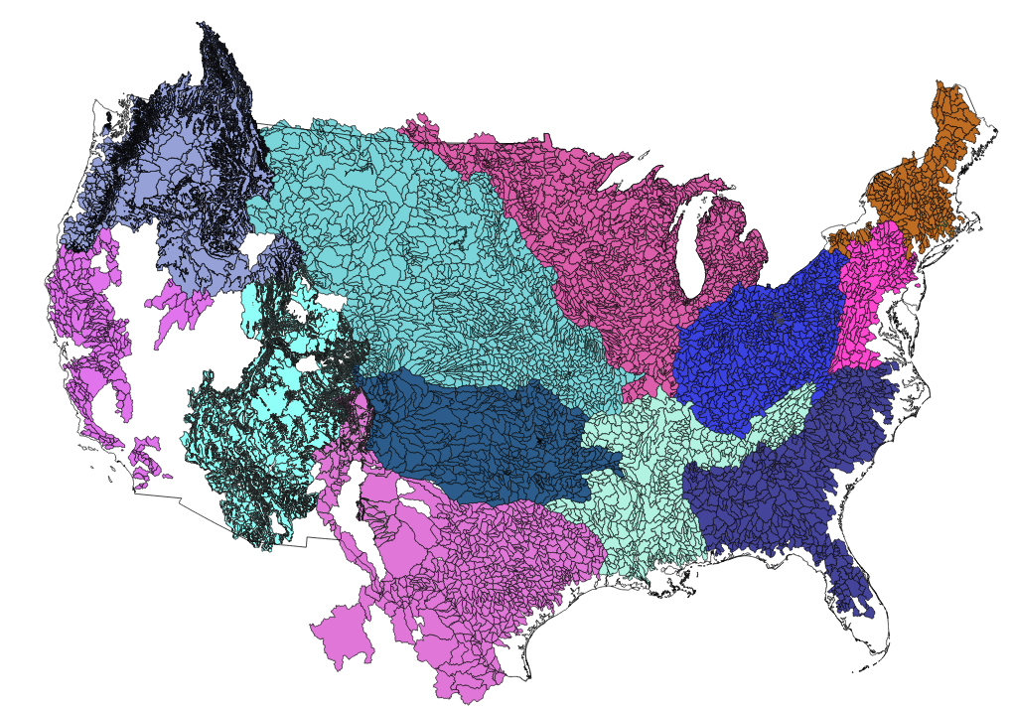
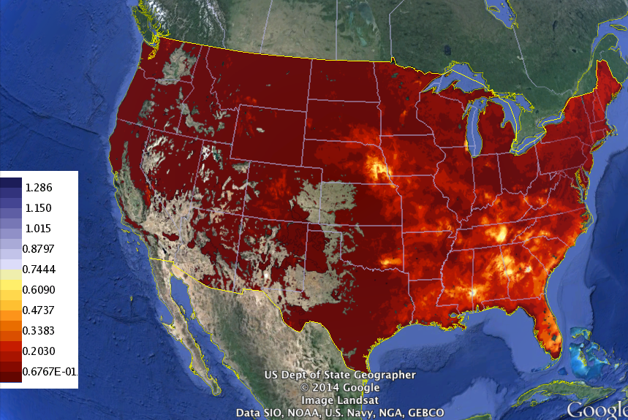
Develop NWS Experimental Data Services
Experimental distributed model (SAC-HTET)
NWS CHPS Modeling Units: 12 CONUS RFCs
PI-XML to WaterML2
XMRG to NetCDF
Export Data elements from the simulation workflow including:
INFW – Inflow to the “Channel”
Mean Areal Precipitation (MAP)
Reservoir Outflow (QINE)
Data Services – local runoff
Slide: Ed Clark, NWS
(pre-decisional)

Slide 37
NFIE: Proposed Timeline
Summer Institute capstone
Fall NFIE Meeting
Flash Flood Summit at the NWC
Spring NFIE Meeting
NWC IOC
Hydro Domain Working Group
Summer Institute
Aug ‘14
Sep
Mid-Oct
Jan ’15
Mar
May
Jun
Summer Institute
Fall Semester
Spring Semester
Subcommittee on Spatial Water Data and Open Water Data Initiative
Slide: Ed Clark, NWS
(pre-decisional)

Slide 38
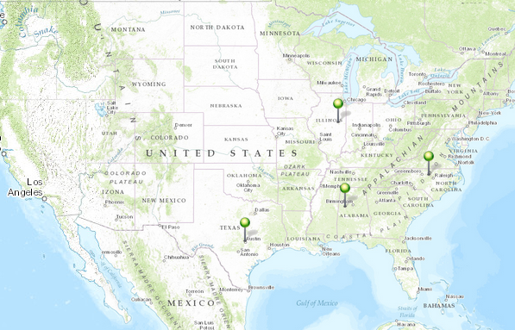
NFIE Academic Centers
University of Illinois
(Modeling)
University of North Carolina
(Data)
University of Texas
(Interoperability)
University of Alabama
(Emergency Response)

Slide 39
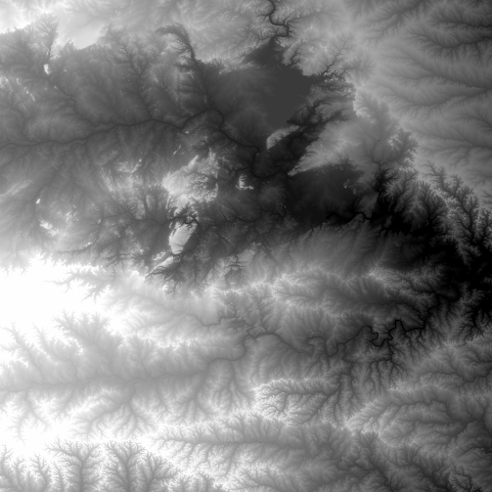
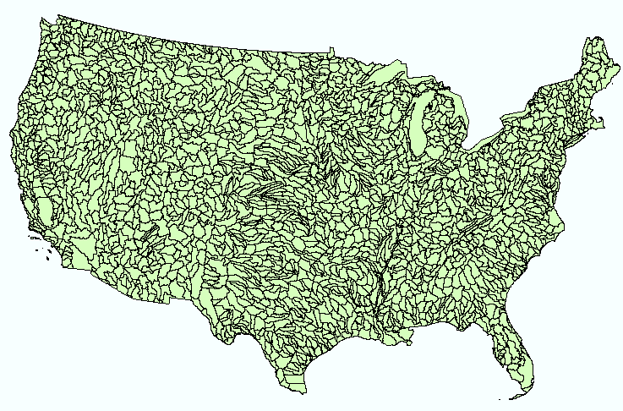
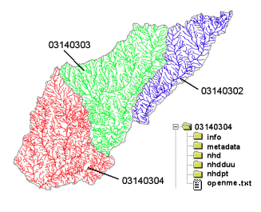
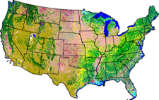
NHDPlus
Geospatial base for National Water Data Infrastructure
NHDPlus
(built 2004-2014)
National Elevation Dataset
Watershed Boundary Dataset
National Hydrography Dataset
National Land Cover Dataset
3 million catchments average area 3 km²,
reach length 2 km

Slide 40
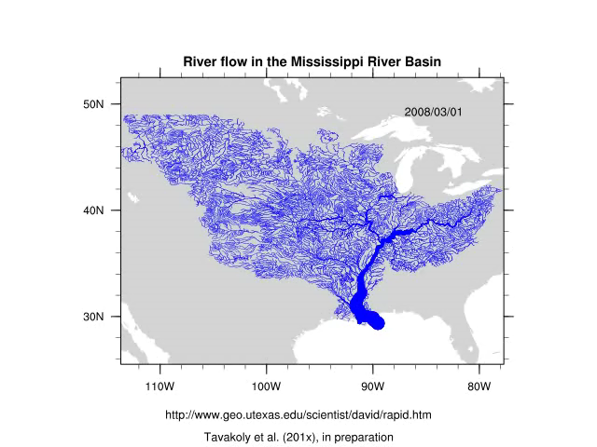
Rapid Model for flow on NHDPlus
March to May 2008, 3 hour time steps
David et al. (2011) DOI: 10.1175/2011JHM1345.1
GIS data describes 1.2 million river reaches . . .
. . . simulate flow in each reach in each time step

Slide 41
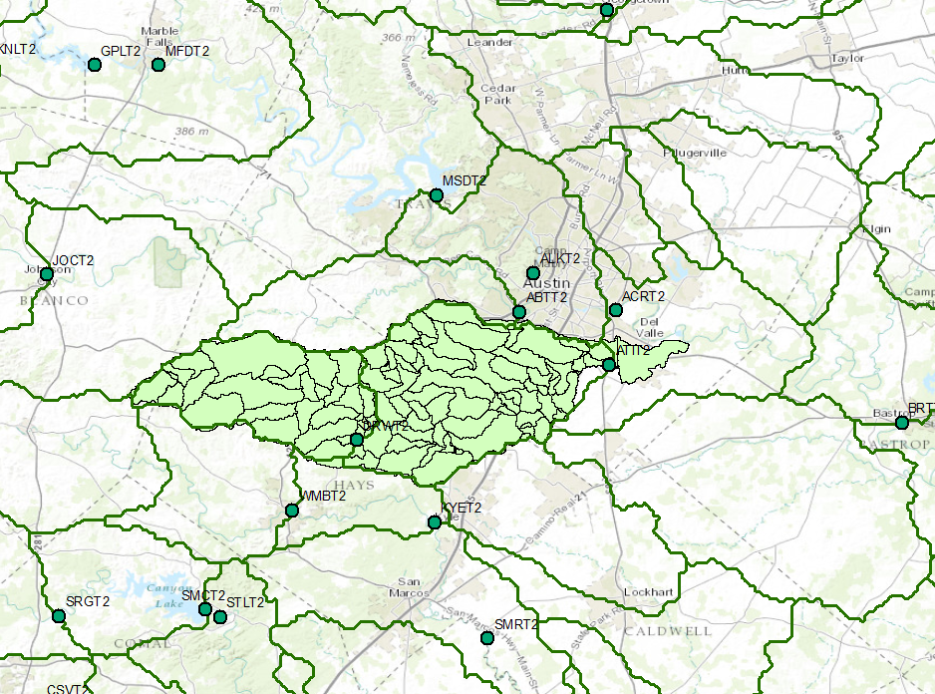
“Dynamic Downscaling” of NWS River Forecasts to NHDPlus
NHDPlus
NWS River Forecast Center basins

Slide 42
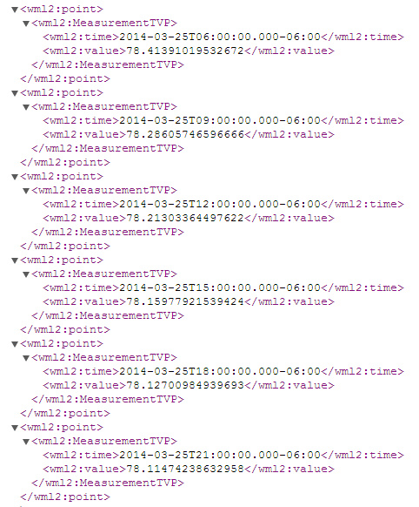
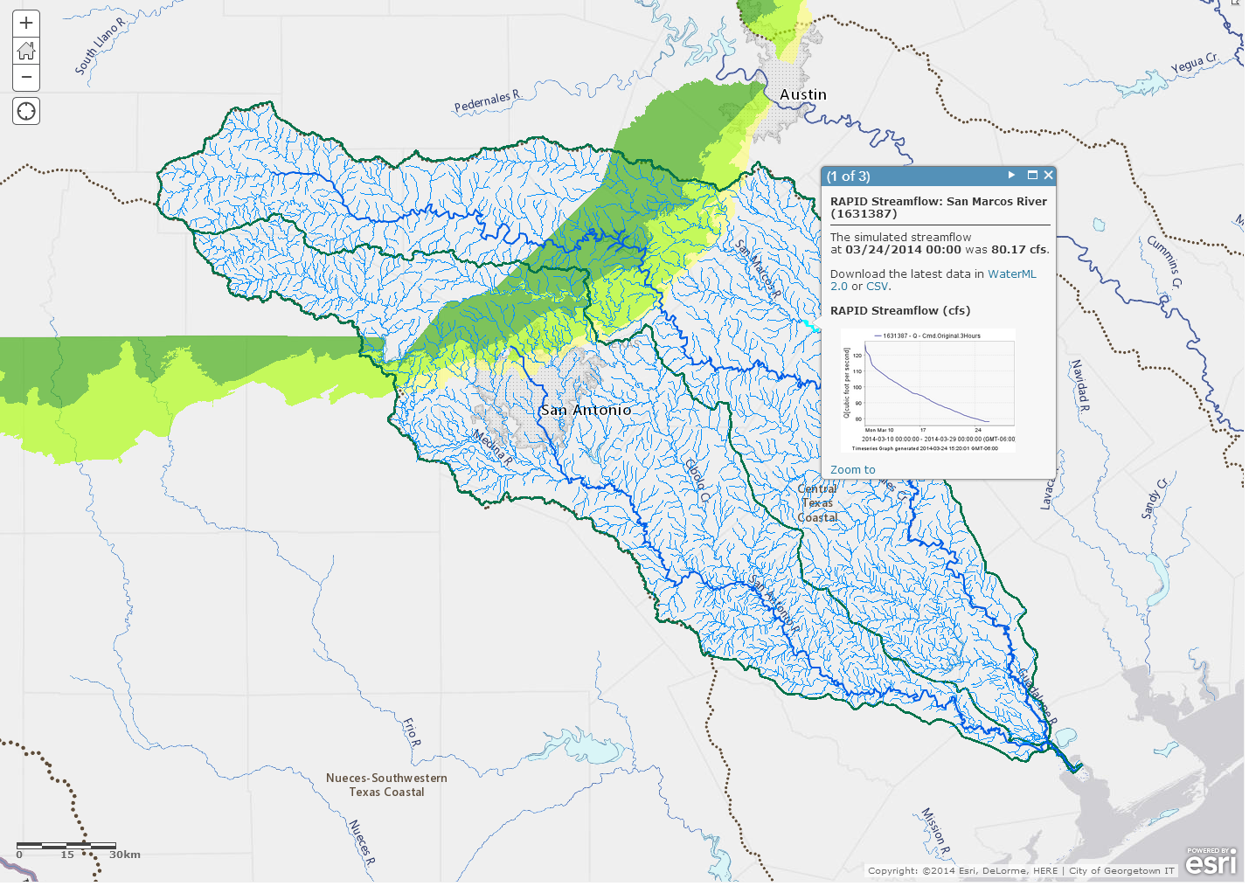


Water Map and Data Services
RAPID Streamflow Calculations – 47 NWS River Forecast basins downscaled to 5,175 NHDPlus catchments in San Antonio and Guadalupe basins
Map Service
Data Service
https://ut-austin.maps.arcgis.com/home/webmap/viewer.html?webmap=d107aa9260534ddbb96db302e3643a93

Slide 43

Integration of Map and Data Services
Web
Viewer
Amazon Cloud (Map Services)
MS Azure Cloud (Data Services)

Slide 44
Flood hydrology and response
Flood Inundation Maps
Flood hydrology and hydraulic data, models, forecasts
Flood emergency response planning and action
Forecast the flood elevation
Determine and plan for flood impact

Slide 45


Halloween Flood, Onion Creek, Austin, Texas, October 2013
Upstream watershed 280 mi²
(larger than the City of Austin)
A flooded home location
Watershed delineated using
ESRI terrain services

Slide 46

FEMA Flood Hazard Zone

Slide 47

Real-Time Flood Inundation Mapping (USGS/NWS)
http://water.weather.gov/ahps2/inundation/inundation_google.php?gage=atit2

Slide 48


Mitigation and Response Flood Levels
(FEMA)
(NWS)
Mitigation (ft above NAVD88)
Response (Stage Height, ft)
500 yr
490.34
200 yr
487.88
100 yr
484.82
50 yr
481.24
25 yr
477.09
10 yr
471.01
5 yr
466.62
Major Flood Stage: 24
Moderate Flood Stage: 20
2 yr
460.30
Flood Stage: 17
Action Stage: 15

Slide 49



National Flood Interoperability Experiment
Data Framework
Time Series
(WaterML2 and .csv)
Multidimensional Arrays
(WCS and netCDF)
Temporal
Hydrology
(RFC Basins,
NHDPlus Catchments)
Hydraulics
(National Flood Hazard Layer,
Flood Inundation Map Libraries)
Geospatial

Slide 50


RiverML: Modular River Data Format
Terrain Processing Software
(ArcGIS, AutoCAD, etc.)
Hydrologic Calculation Software
(HEC-HMS, PondPack, etc.)
Hydraulic Calculation Software
(HEC-RAS, MIKE Flood HD, etc)

Slide 51





Flood Modeling: Geometry and Flow
RiverML – a language for communicating river channel and flood inundation map information

Slide 52


  HY_Features as a theoretical framework (Irina Dornblut)
The AU Hydrological Geo Fabric (AHGF) experience – CSIRO, BoM
Read more: http://www.bom.gov.au/water/geofabric/index.shtml , https://wiki.csiro.au/display/SIRF/The+SIRF+API
See also: Atkinson, R.: Linked data and vocabularies (5^{th,} HDWG Meeting New York, 11-15 August 2014)

Slide 53
HydroShare
Follow-on project to CUAHSI Hydrologic Information System that supports hydrologic data sharing
Led by David Tarboton of Utah State University and Ray Idazsak of RENCI, University of North Carolina
Includes a large data repository at RENCI
Will be used to construct a Open River Morphology Database to support the National Flood Interoperability Experiment

Slide 54
Conclusions
A remarkable convergence has occurred in water information sharing
  Geospatial data (NHDPlus) and services
  Temporal data services (WaterML2)
  Organizational framework (IWRSS, Open Water Data Initiative)
  National Water Center and National Flood Interoperability Experiment
A National Water Data Infrastructure will be built over the next 10 years
This will support water modeling in all areas

