Slide 1
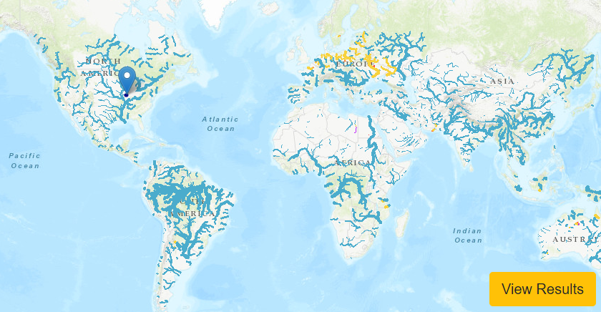
A Decade of Innovation: from National Water Model to Global Impact
Presented by
David R. Maidment
Center for Water and the Environment
University of Texas at Austin
Presented to:
IHE-Delft Institute for Water Education
19 April 2024
Acknowledgments: NOAA National Weather Service, US Geological Survey, Texas Department of Transportation, ESRI, KISTERS, colleagues and students at University of Texas at Austin

Slide 2
A Decade of Innovation
“Most people overestimate what they can do in one year and underestimate what they can do in ten years.” ― Bill Gates
Where were we 10 years ago?
Where are we now?
Where could we be 10 years from now?
What role could IHE-Delft play?

Slide 3
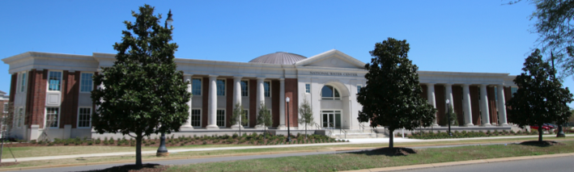
Itinerary for May 2014
National Water Center, opened 13 May 2014 in Tuscaloosa, AL
David Maidment, Jim Nelson
National Water Center
Tuscaloosa, Alabama
ECMWF
Reading, England

Slide 4
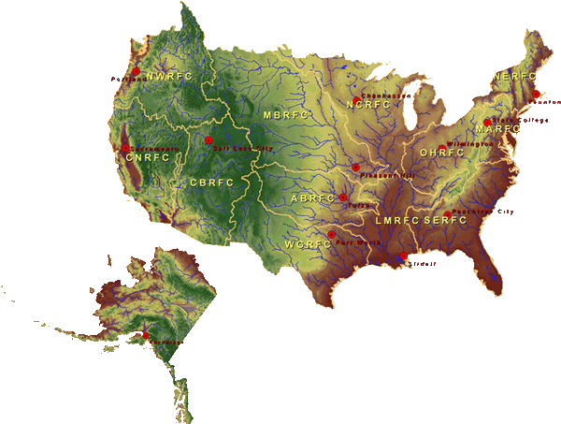
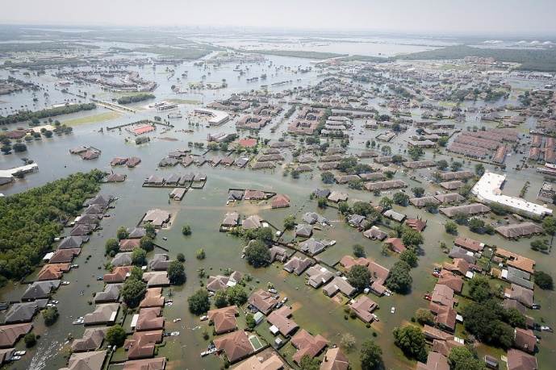
National Flood Forecasting
National Water Center
Established in 2014 in Tuscaloosa, AL

Slide 5
Transformative Research
Transformative research challenges current understanding or provides pathways to new frontiers in science and engineering. It involves ideas, discoveries or tools that do one or both of the following:
Radically change understanding of an important existing concept in science, engineering or education.
Lead to the creation of a new paradigm or field of science, engineering or education.
https://new.nsf.gov/funding/learn/research-types/transformative-research#definition
Can we move from evolutionary change to transformative change?

Slide 6
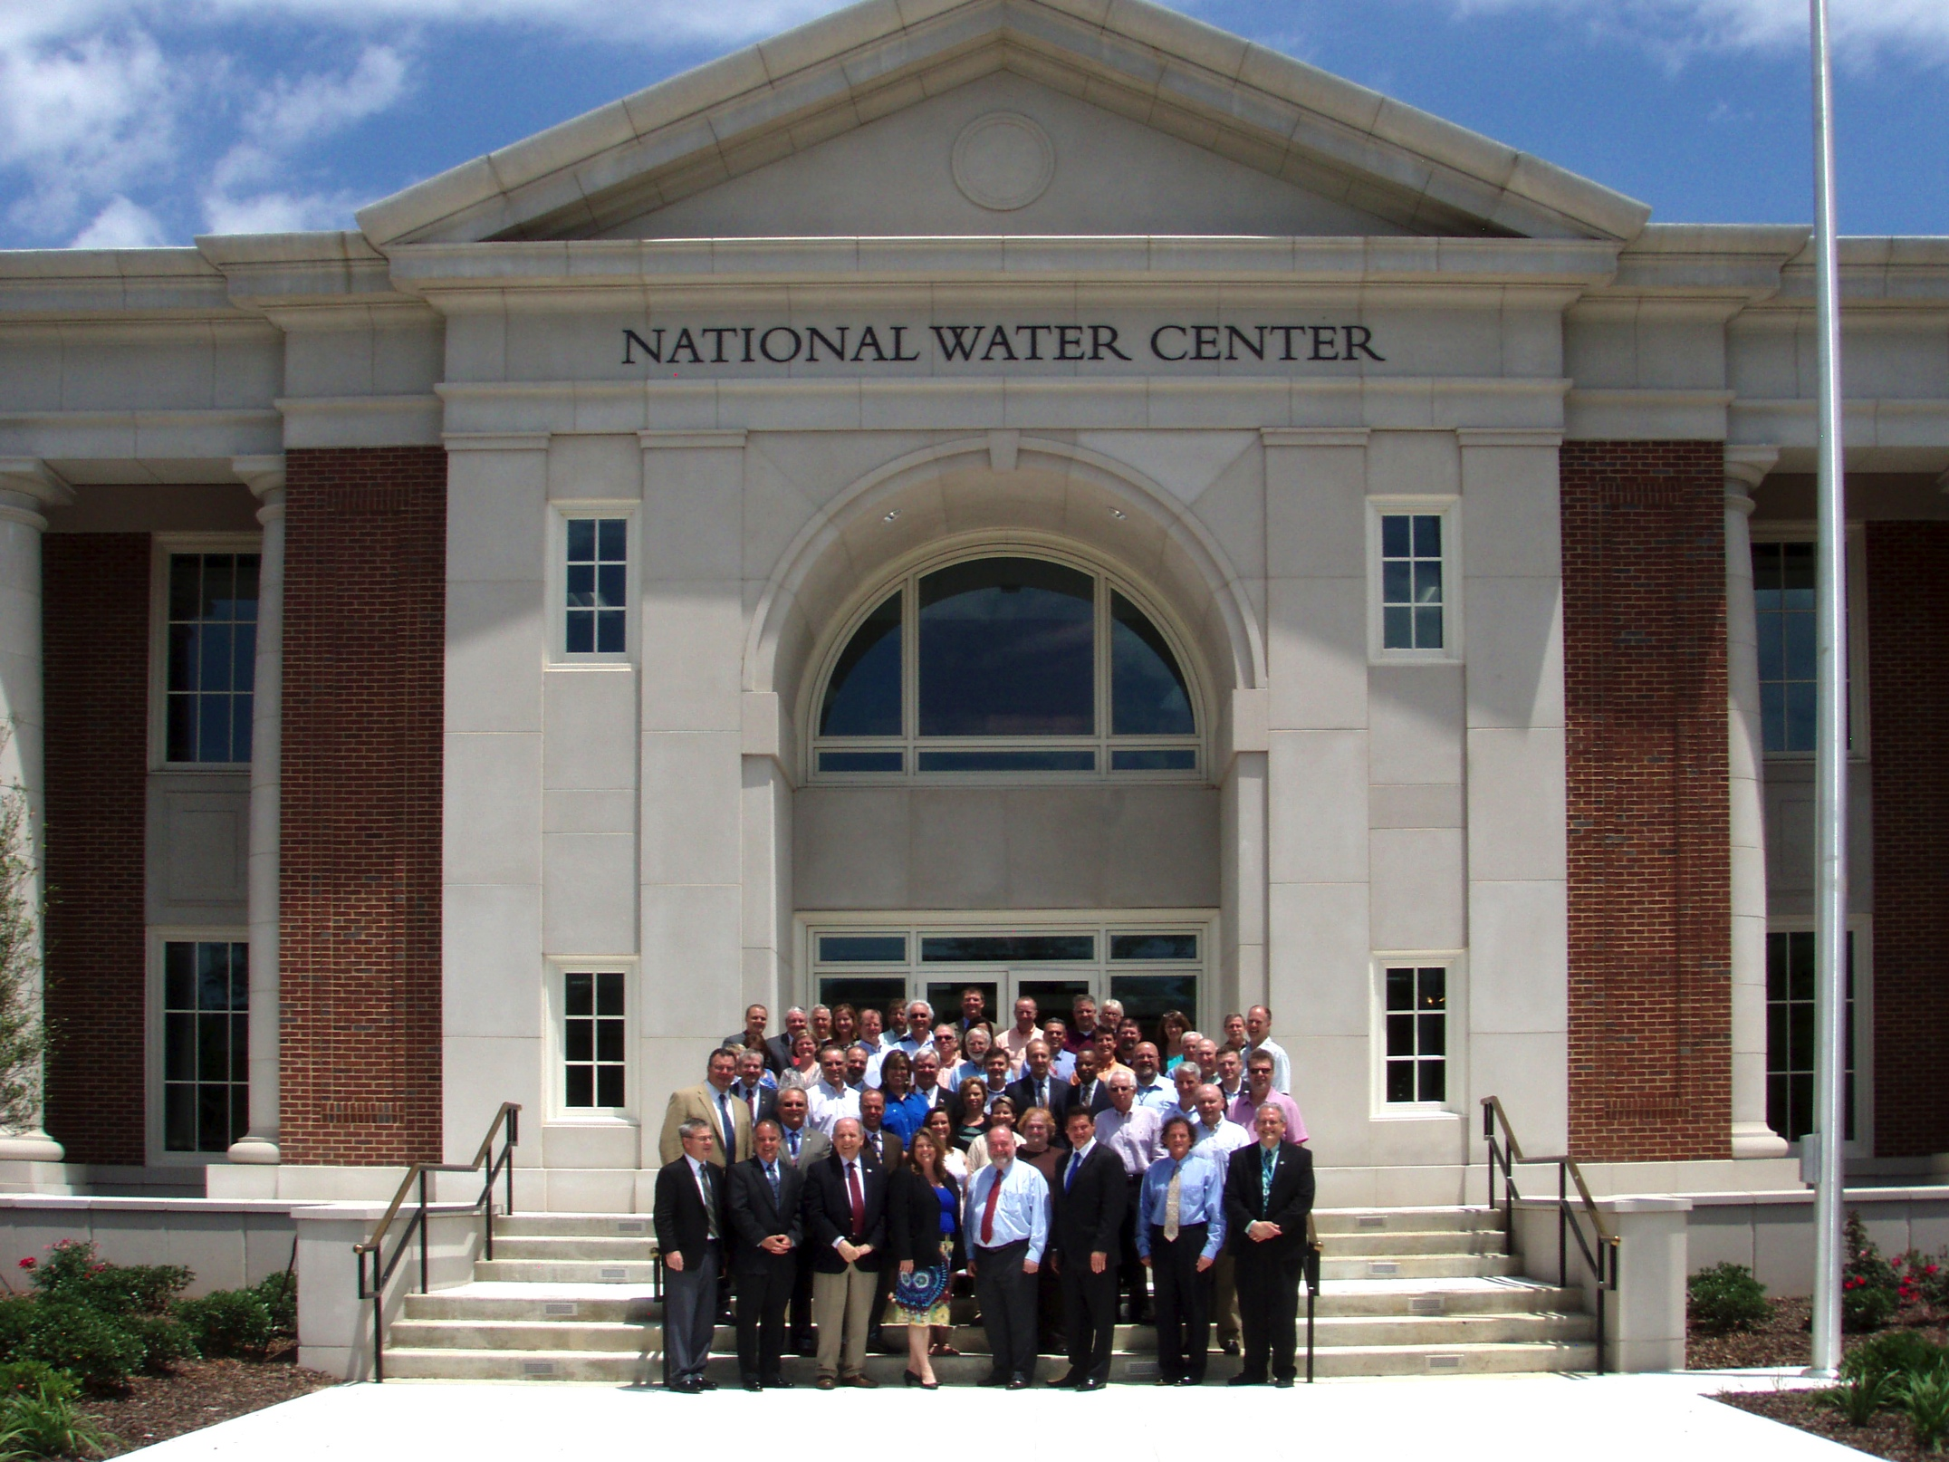
I proposed: Bring in the academic community and rapidly prototype
a new national flood forecasting system in one year … this has led to annual Summer Institutes for graduate student research
Inaugural Meeting – May, 2014

Slide 7
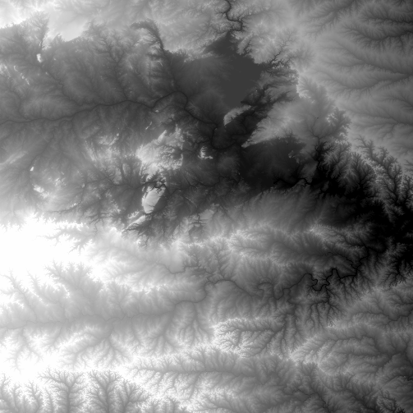
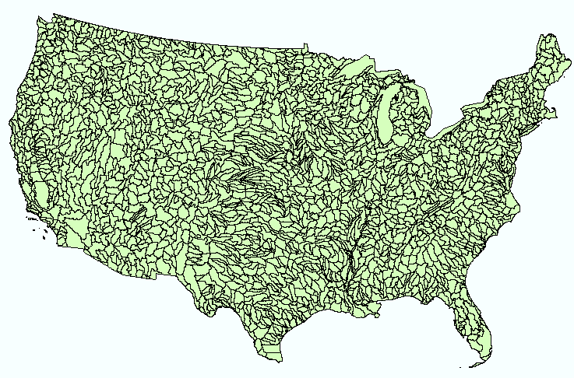
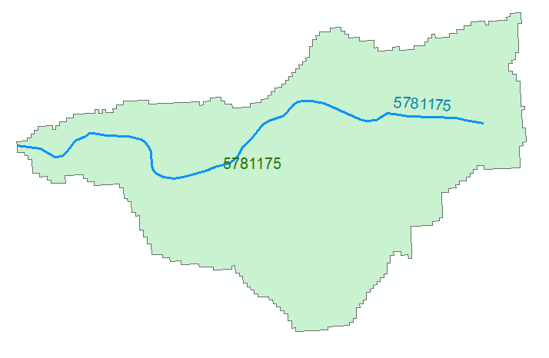
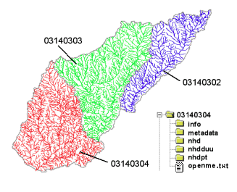
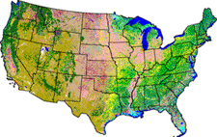
Geographic Information Systems
Foundation for a National Flood Forecasting for the United States
NHDPlus Dataset
2.7 million reach catchments in US
average area 3.0 km²
reach length 1.9 km
Uniquely labelled
National Elevation Dataset
Watershed Boundary Dataset
National Hydrography Dataset
National Land Cover Dataset
20 years to complete and integrate national data sets

Slide 8
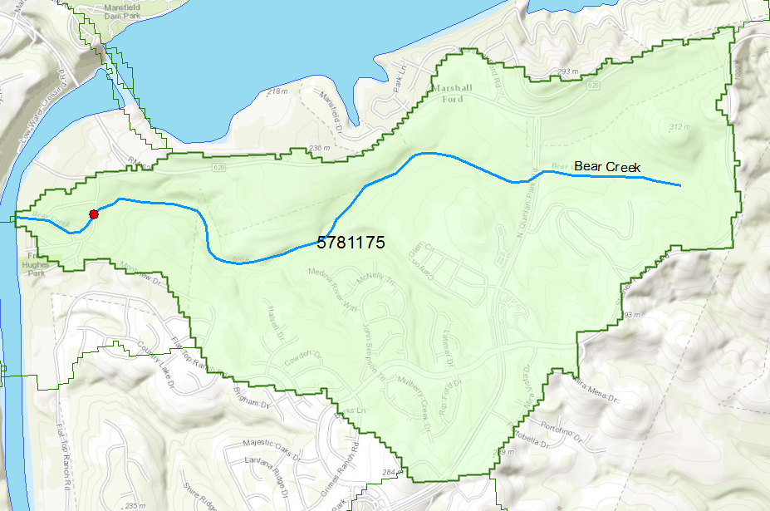
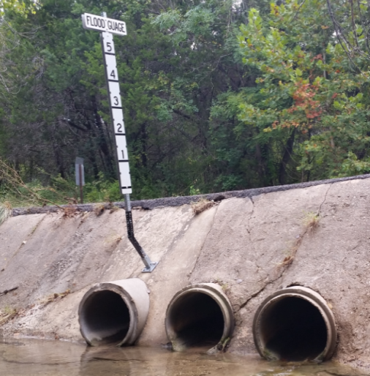
Flood Information for Bear Creek at Fritz Hughes Park Rd, Austin, Texas
National Hydrography Dataset Plus
catchment for Bear Creek
Low water crossing at
3400 Fritz Hughes Park Rd

Slide 9
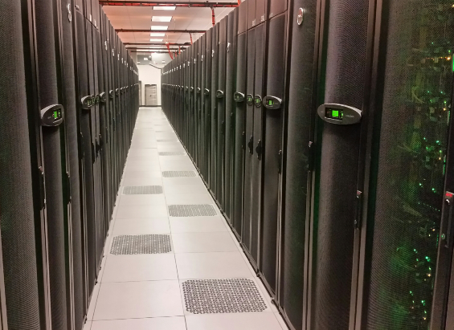
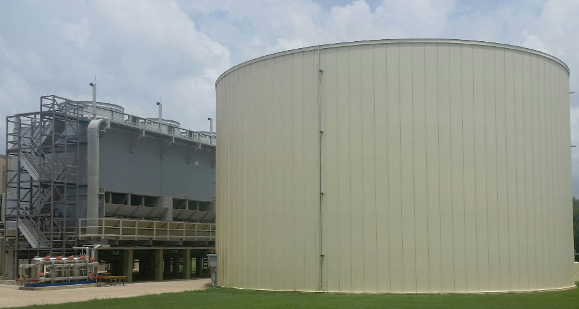
Texas Advanced Computing Center at UT Austin used to build prototype of National Water Model
1.2 million gallon cooling tank
Largest academic supercomputer in the United States in 2014

Slide 10
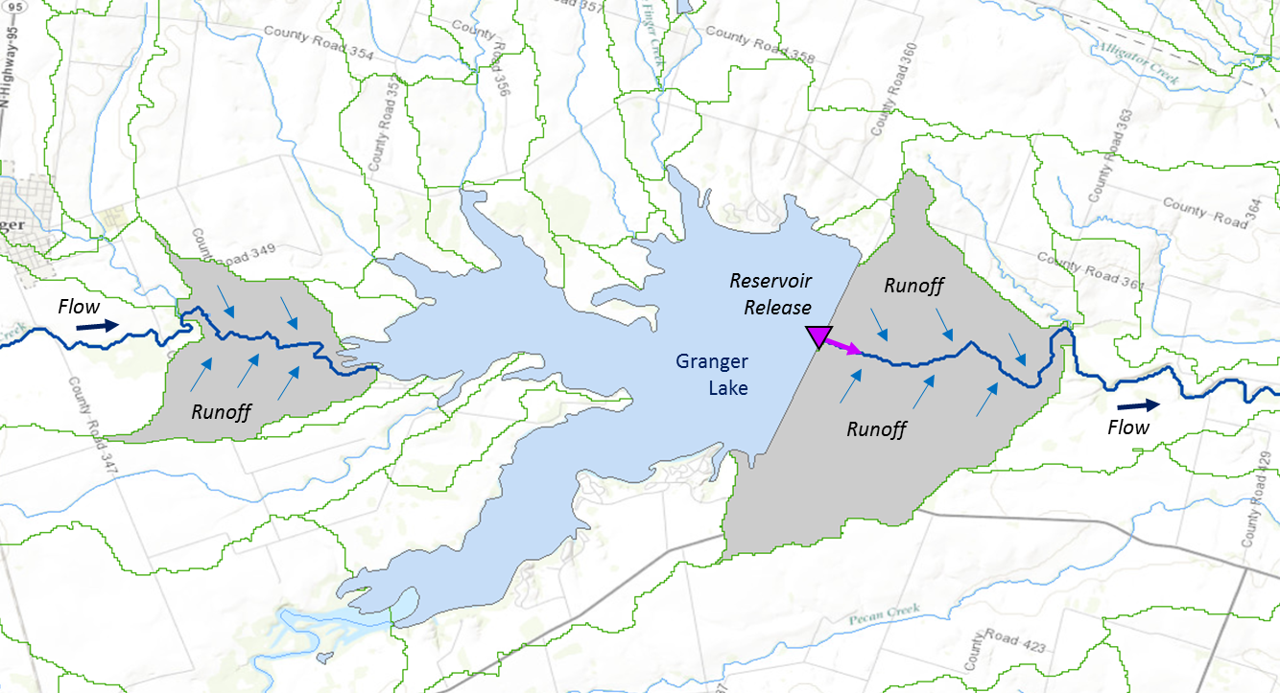
Muskingum
Method
RAPID River Routing Model
River Application for Parallel ComputatIon of Discharge
S_{prism} = KQ
S_{wedge} = KX (I – Q)
Routing of flow through the river network
Forcing: Runoff and reservoir releases
NHDPlus Catchment
Flow
Weather modeling on square grid cells
Hydrologic modeling on catchments and streams
Legend
Dam
Junction
Catchment
Model Creator: Cedric David
http://rapid-hub.org/

Slide 11
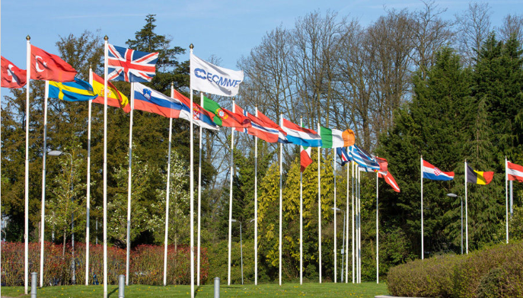
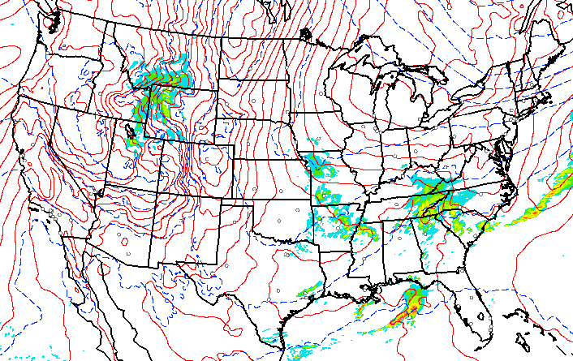
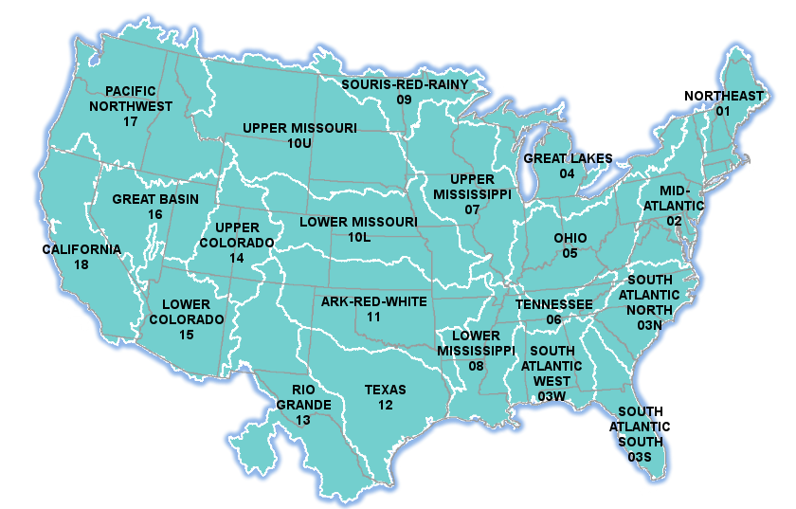
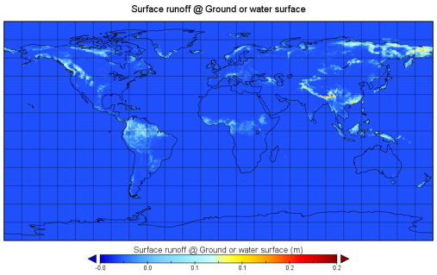
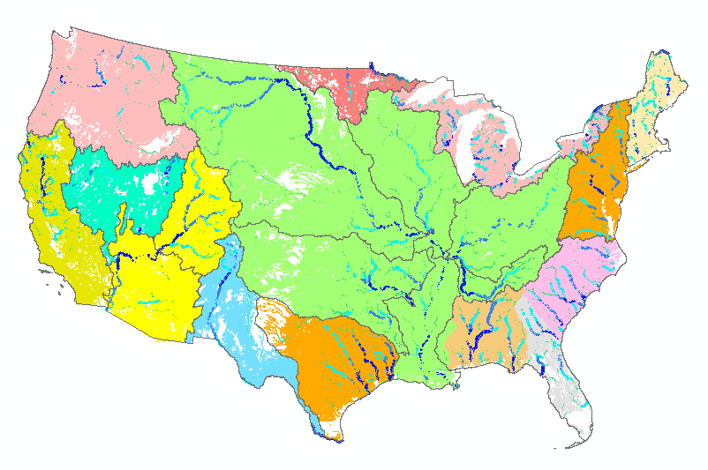
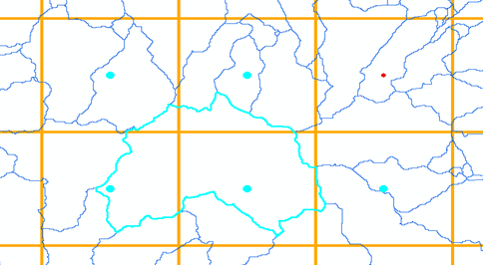
Leveraging US and European Weather Forecasting
2015 Summer Institute at National Water Center
HRRR
United
States
Europe
Forcing
NHDPlus
to RAPID
WRF-Hydro
ECMWF
TACC
Grid to
catchment

Slide 12
Operational by National Weather Service in August 2016

Slide 13
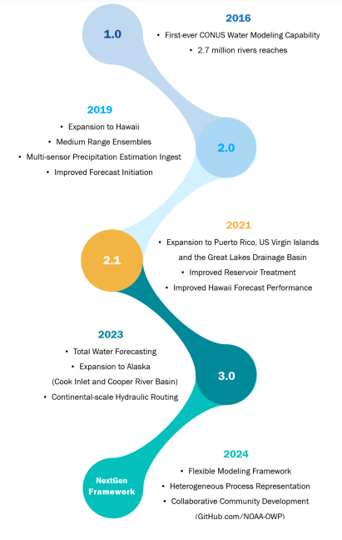
National Water Model – 2024
Water forecast like weather 24/7/365
2016
Initial CONUS Water Model
Four model outputs for forecast discharge:
Assimilation (Current conditions)
Short Range Forecast (18 hours ahead)
Medium Range (10 days ahead)
Long Range Forecast (30 days ahead)
Versions
2019
Includes Hawaii
Medium Range Forecast
2021
Includes Puerto Rico …
Improved performance
2023
Includes part of Alaska
Combines riverine and coastal
Future
Next Generation
Modeling Framework
Water flow forecasts on 5.2 million km
of streams and rivers in US

Slide 14
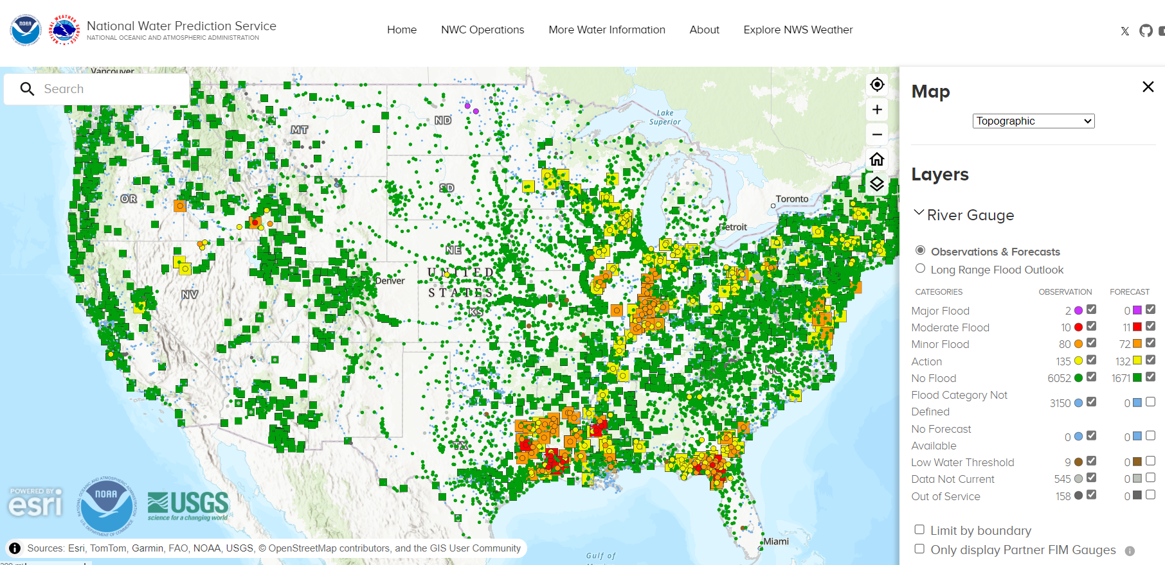
US National Water Prediction Service https://water.noaa.gov

Slide 15
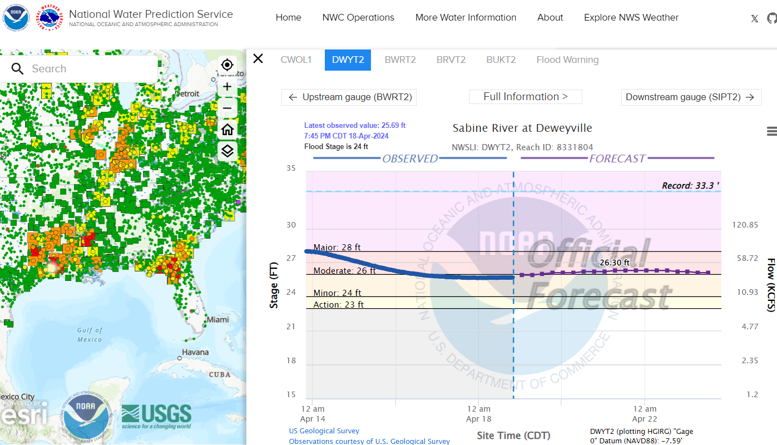
US National Water Prediction Service Sabine River at Deweyville, Texas

Slide 16
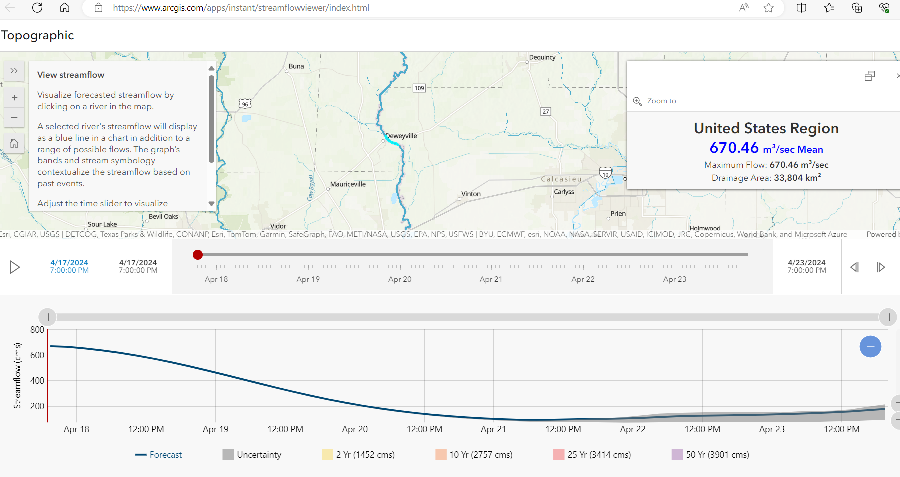
Global Streamflow and Flood Forecasting System (GEOGLOWS) Sabine River at Deweyville, Texas
https://www.geoglows.org
Rendered as an ESRI Map Application

Slide 17
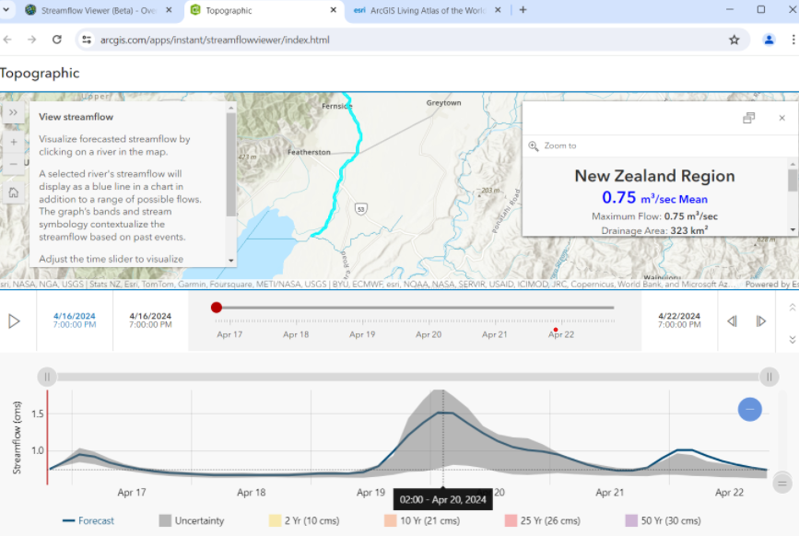
Global Streamflow and Flood Forecasting System (GEOGLOWS) Tauherenikau River at Featherston, New Zealand

Slide 18
Development of Hydrology
in the Last 10 Years
Real-Time
Hydrology
Weather
Water flow is now like weather: forecast everywhere at local spatial scale all the time
Historical
Hydrology
Climate
Can we move from evolutionary change to transformative change? Yes!

Slide 19
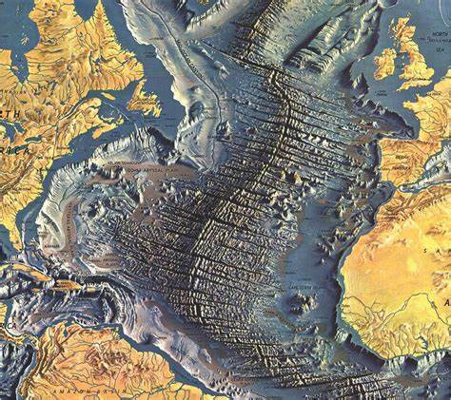
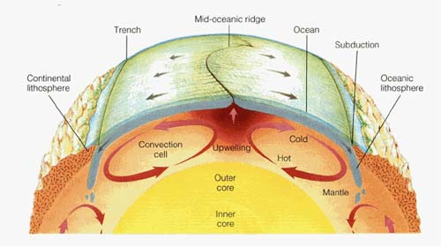
Development of Plate Tectonics
A magic period in Geology: 1962-1967
Discovered by mapping
the topography and
magnetism of the
ocean floor
“While conceptual innovation was an important part of the development of plate tectonics, the stories told here strongly suggest that the most powerful driving force was data.”
Image: National Geographic Maps
Image: City University of New York
Four scientific teams
Cambridge, Lamont Doherty, Scripps, Princeton

Slide 20
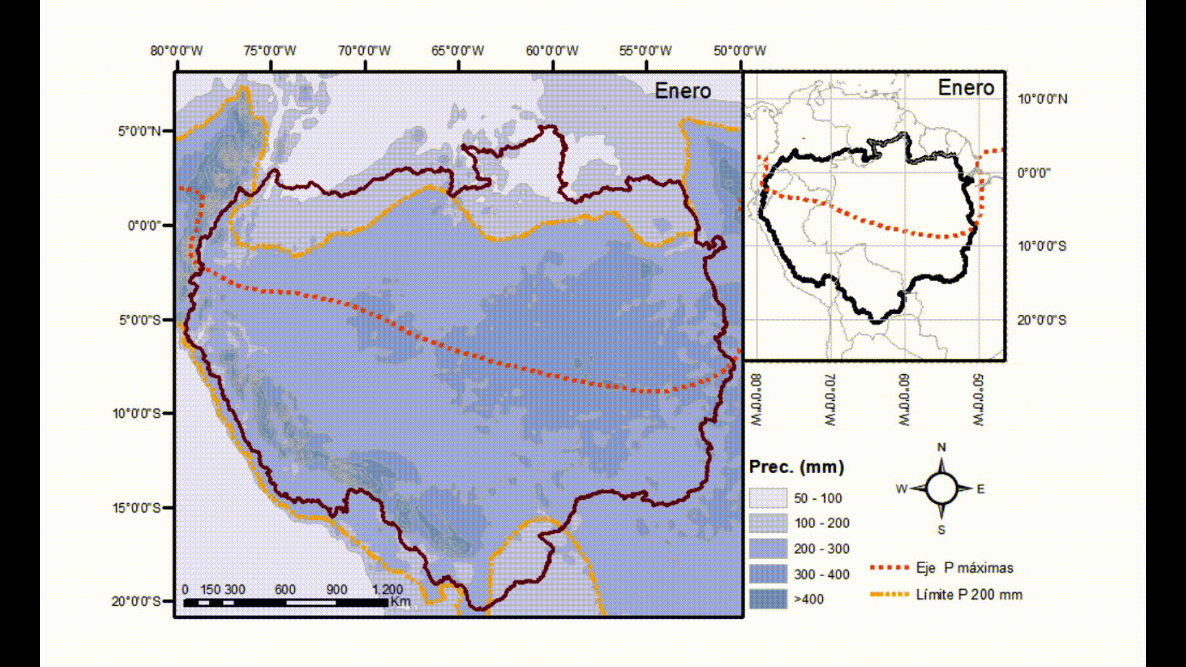
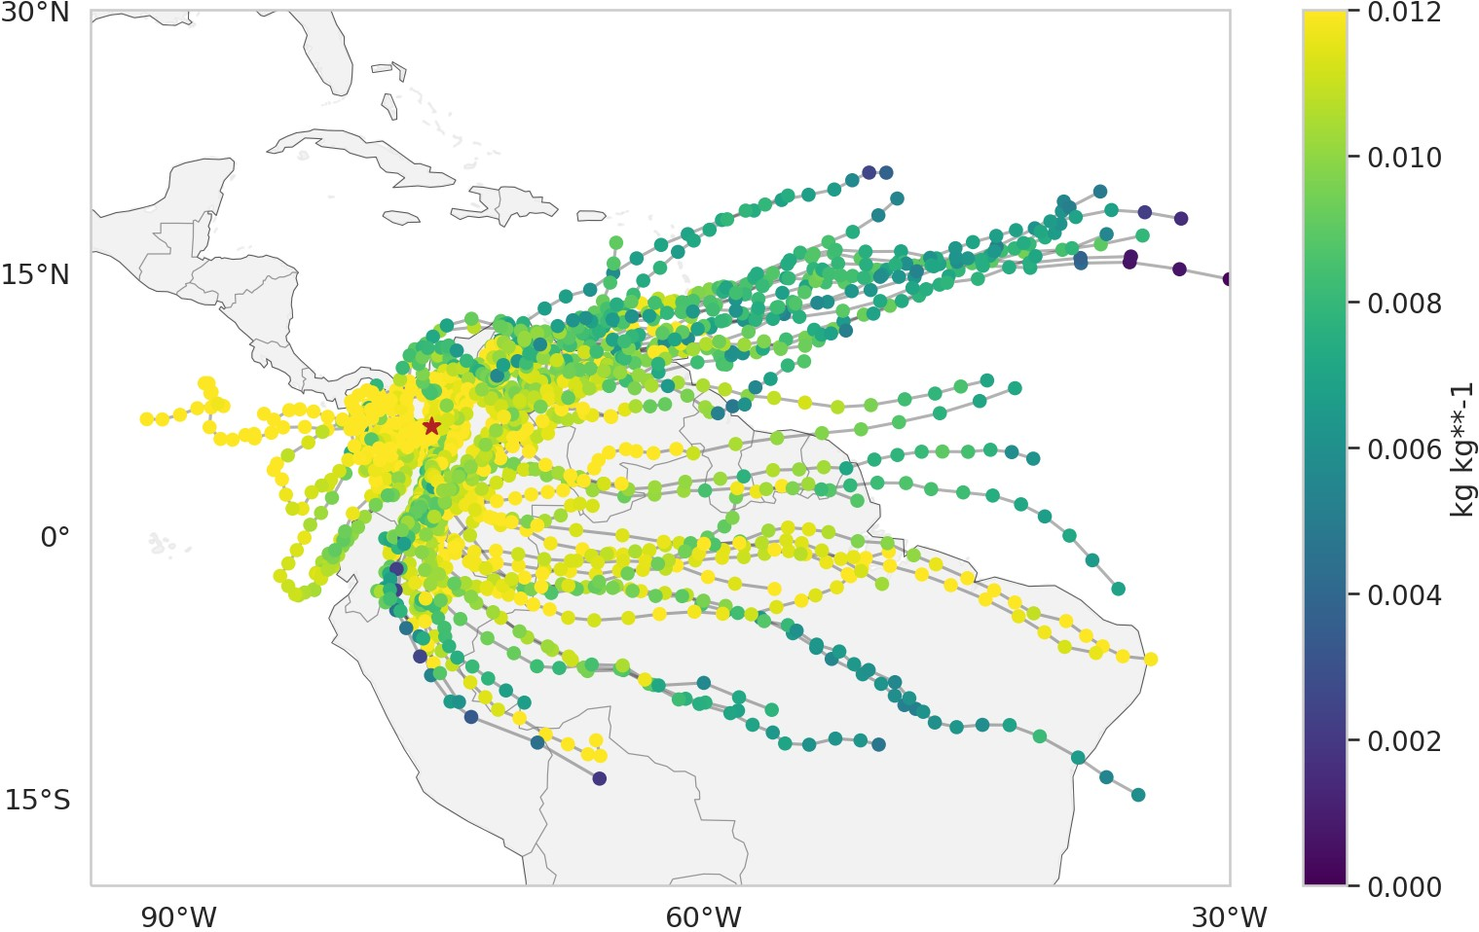
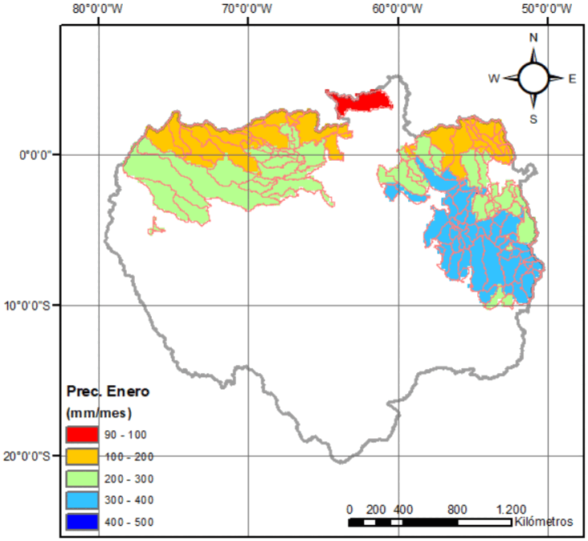
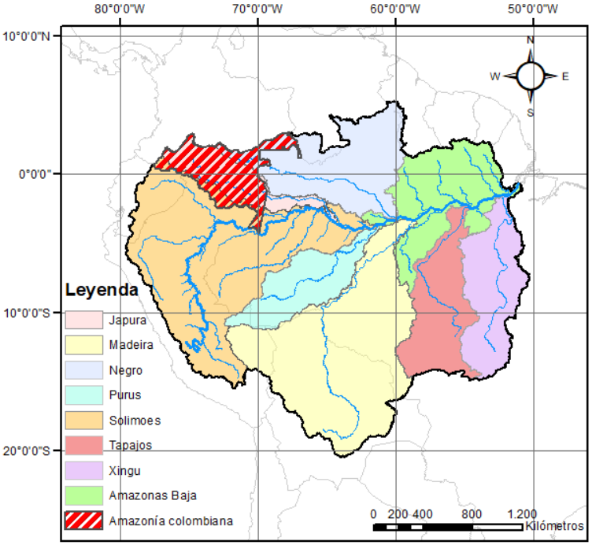
Water vapor transport and its importance in the local hydrological seasonality

Slide 21
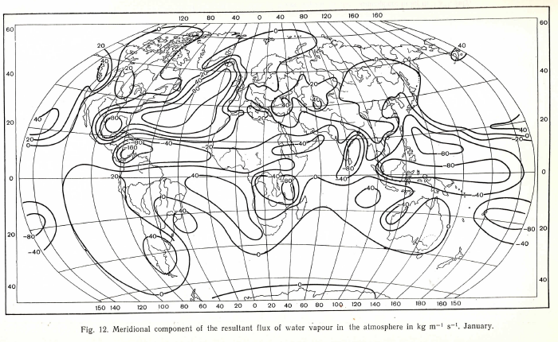
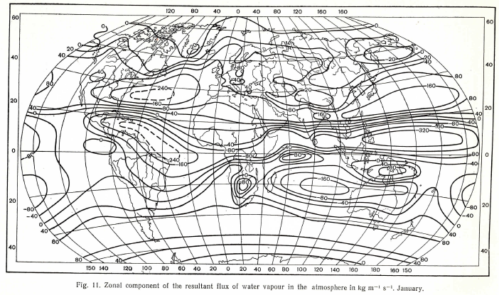
World Water Balance Study done for the International Hydrological Decade (1965-1974)
Quantified the time-averaged World Water Balance
Meridional atmospheric
water flux
1978
Zonal atmospheric
water flux

Slide 22
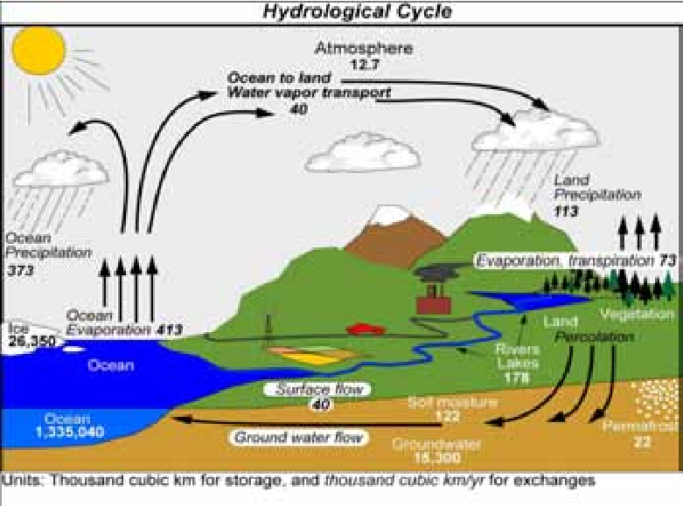
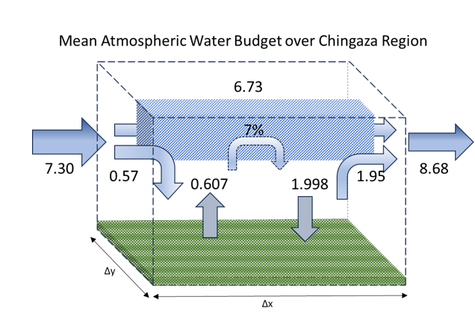
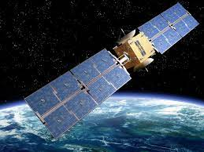
Goal for the Next Decade: Close the Global Hydrological Cycle Quantify the time-varying world water balance
Atmospheric water balance
Water storage
Soil
Groundwater
Oceans
Surface water balance
Image: Paolo Ceci

