Slide 1
Water Web Services
By David R. Maidment
Center for Research in Water Resources
University of Texas at Austin
Web Services HUB
USGS
LCRA
COA
NWS
NDFD
Kisters North America User Conference
Sacramento, CA, Sept 12, 2011

Slide 2
Water Web Services
Situational awareness for flash flooding
Web services for water and geospatial data
Demo of KiWIS for the CAPCOG area (Matt Ables)
Computing in the Cloud

Slide 3
Water Web Services
Situational awareness for flash flooding
Web services for water and geospatial data
Demo of KiWIS for the CAPCOG area (Matt Ables)
Computing in the Cloud

Slide 4
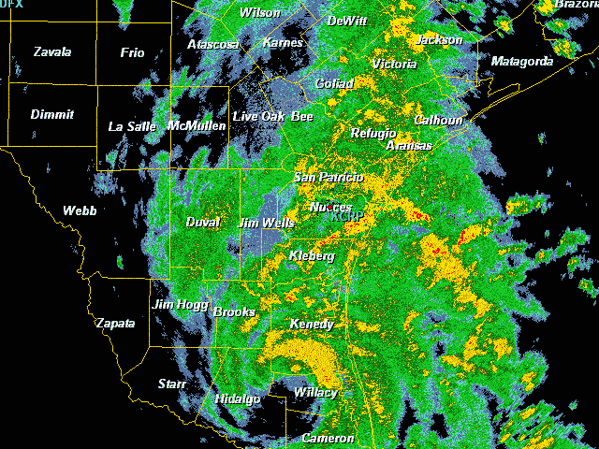
Tropical Storm Hermine, Sept 7-8, 2010

Slide 5
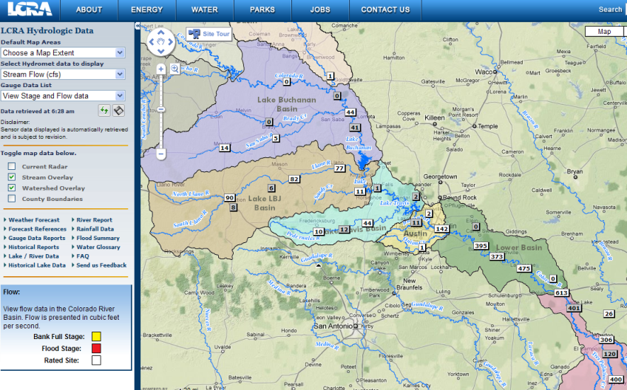
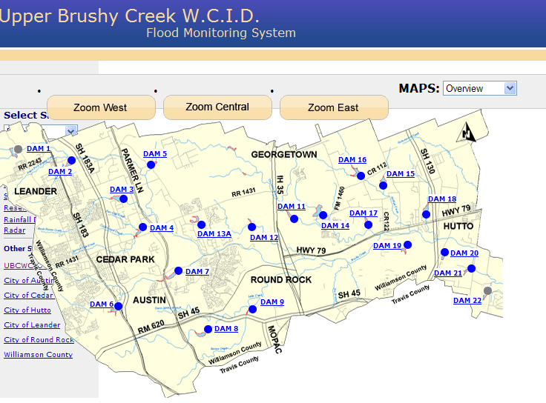
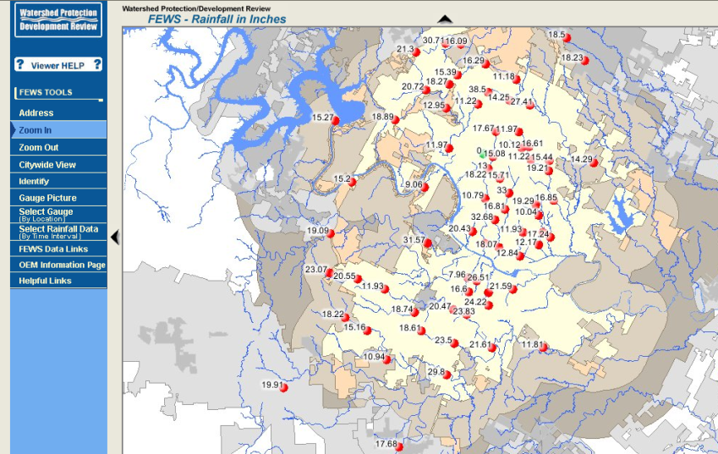
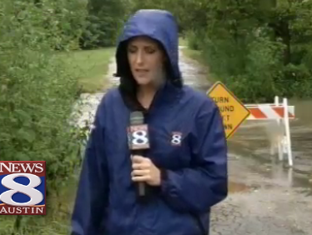
Local Information during Tropical Storm Hermine (7-8 Sept 2010)
Upper Brushy Creek (Round Rock)
LCRA
Bring data together into one system
http://hydromet.lcra.org
http://ubcwcid.org/Overview/Overview.aspx?id=1
TV
City of Austin
http://coagis1.ci.austin.tx.us/website/COAViewer_fews/viewer.htm

Slide 6
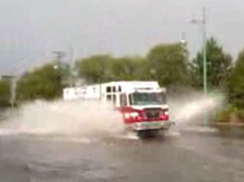
Emergency Response and Flooding
They want to be the rescuers not the rescued!

Slide 7
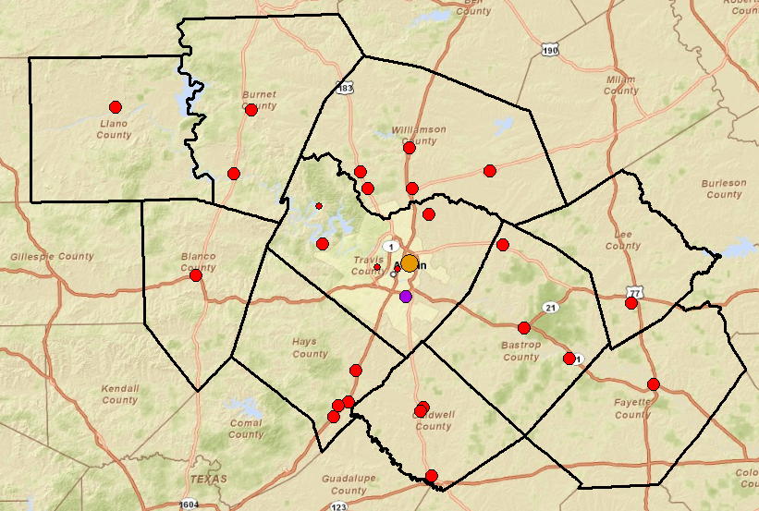
Public Safety Answering Points in the CAPCOG region (Capital Area Council of Governments)

Slide 8
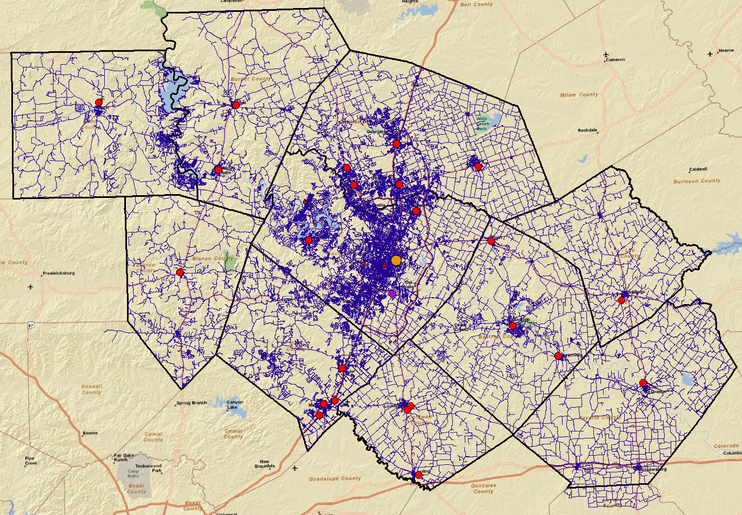
Emergency calls are referenced on the road and street network

Slide 9
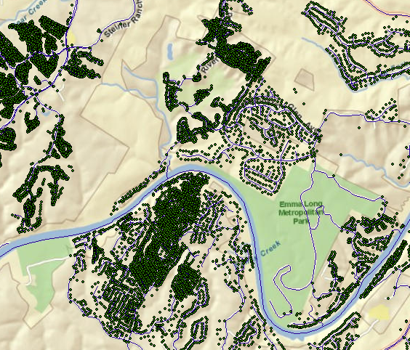
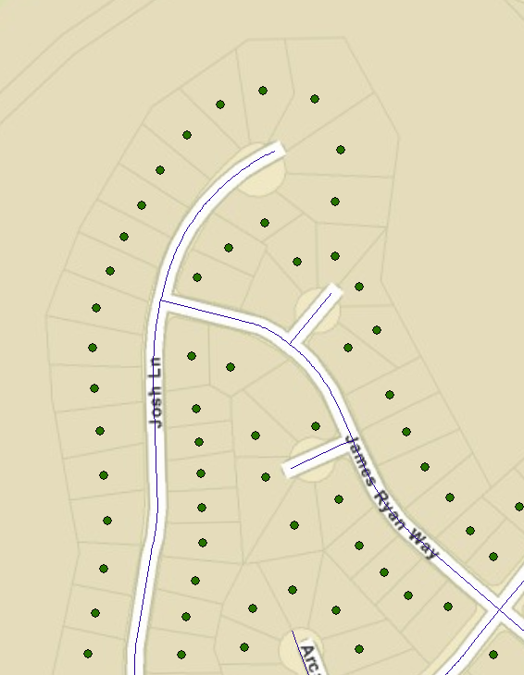
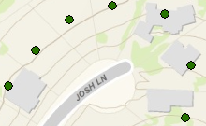
Address points locate individual homes and buildings
Address points and building footprints
There are 687,000 address points in the CAPCOG region
Address point is the center of a legal lot and is referenced to a location on the road network

Slide 10
How 911 calls are handled now
71% of emergency calls are made from cell phones
PSAP = Public Safety Answering Point
Slide from: John Brosowsky Product Development Director, GeoComm

Slide 11
ESInet – Emergency Services Internet Network
Next Generation 911
Geographic location by coordinates
Slide from: John Brosowsky Product Development Director, GeoComm

Slide 12
Water Web Services
Situational awareness for flash flooding
Web services for water and geospatial data
Demo of KiWIS for the CAPCOG area (Matt Ables)
Computing in the Cloud

Slide 13
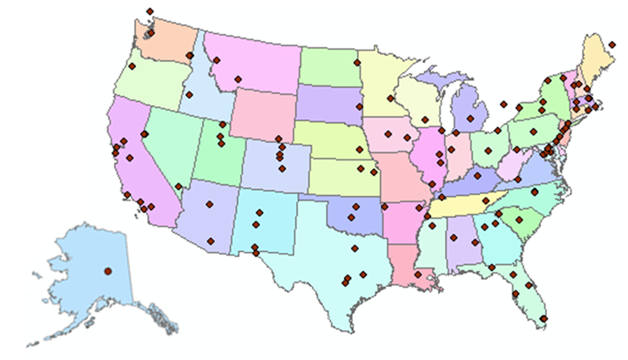
http://www.cuahsi.org
CUAHSI is a consortium representing 125 US universities
Supported by the National Science Foundation Earth Science Division
Advances hydrologic science in nation’s universities
Includes a Hydrologic Information System project

Slide 14
How the web works
Catalog (Google)
Catalog harvest
Search
Web Server
(CNN.com)
Access
Browser
(Firefox)
HTML – web language for text and pictures

Slide 15
Services-Oriented Architecture for Water Data
Catalog
Service registration
Search
Catalog harvest
Server
Data access
User
WaterML – web language for water data

Slide 16
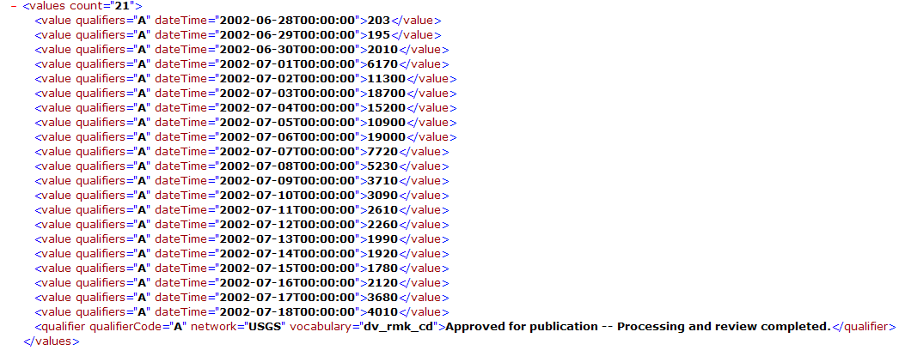
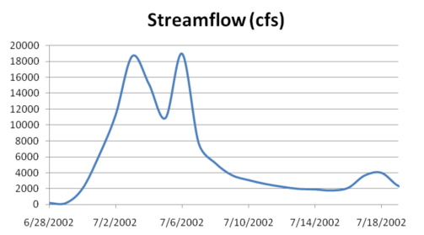
WaterML as a Web Language
Discharge of the San Marcos River at Luling, TX June 28 - July 18, 2002
USGS Streamflow data in WaterML language
The USGS now publishes its time series data as WaterML web services

Slide 17
Colorado River at Austin
I accessed this WaterML service from USGS at 9:08AM Central time this morning
http://waterservices.usgs.gov/nwis/iv?sites=08158000&period=P7D&parameterCd=00060
And got back these flow data from USGS which are up to 8:45AM Central time
These services operate 24/7/365 at all USGS real-time sites in the United States

Slide 18
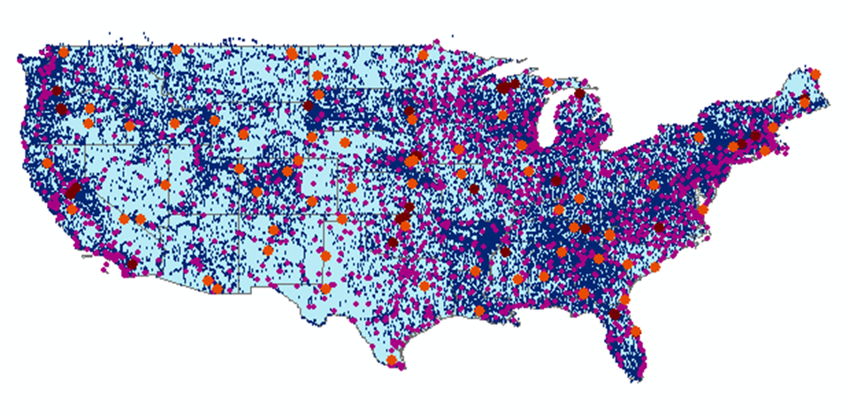
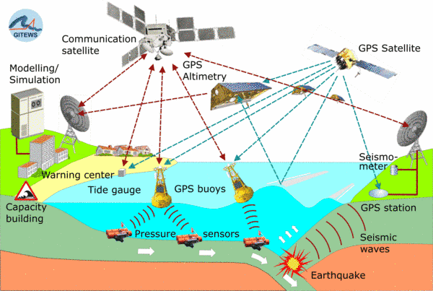
Open Geospatial Consortium Web Service Standards
Map Services
Web Map Service (WMS)
Web Feature Service (WFS)
Web Coverage Service (WCS)
Catalog Services for the Web (CS/W)
Observation Services
Observations and Measurements Model
Sensor Web Enablement (SWE)
Sensor Observation Service (SOS)

Slide 19
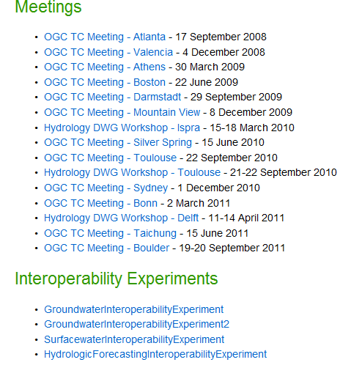
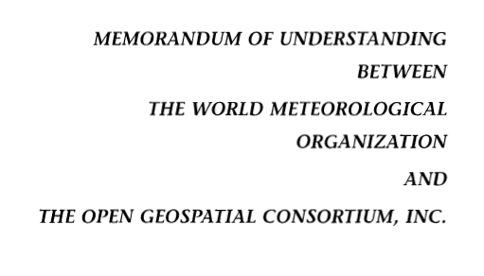
Jointly with World Meteorological Organization
Evolving WaterML into an International Standard
Meets every 3 months
Teleconferences most weeks
November 2009
Hydrology, Meteorology, Climatology, and Oceanography
WaterML Version 2 Standards Working Group established
Vote for adoption later this year or early next year

Slide 20
Slide: Christian Michl, Kisters

Slide 21
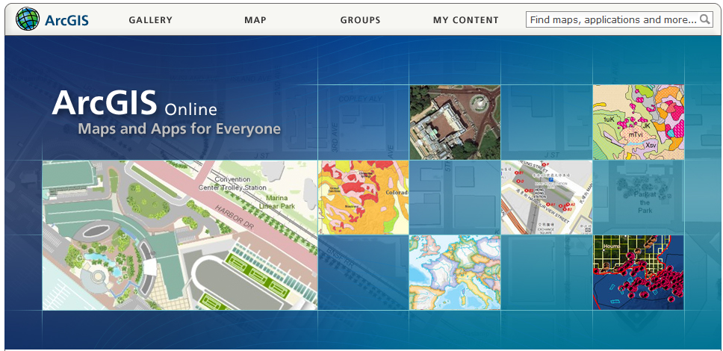
ArcGIS Online
GIS on the web – online map services
http://www.arcgis.com

Slide 22
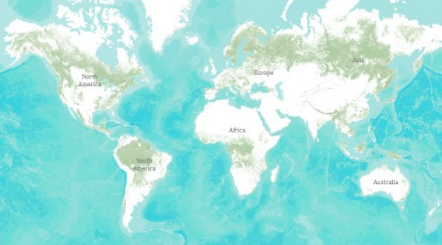
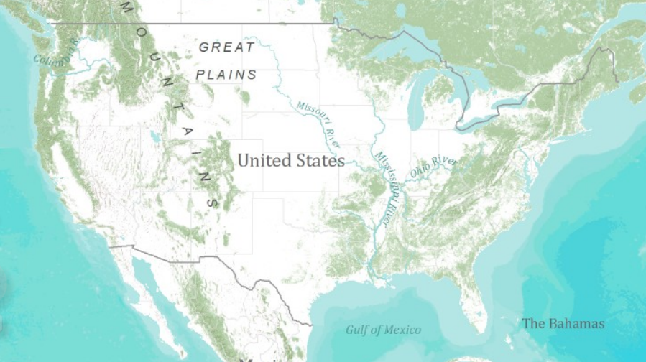
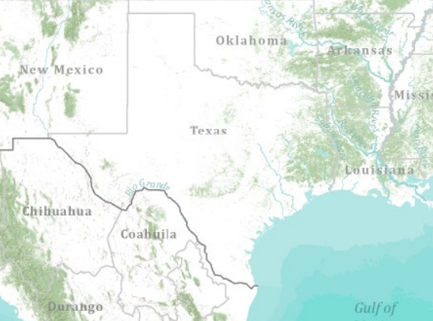
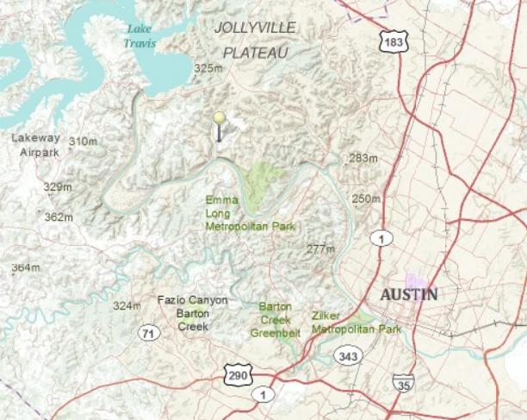
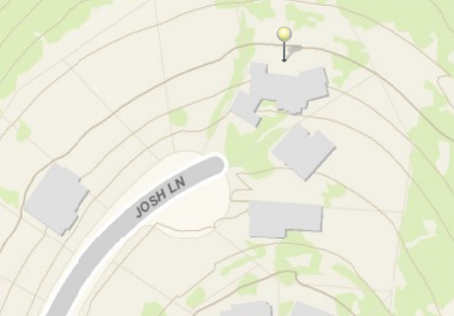
Topographic Base Map in ArcGIS Online
World
United States
Texas
Austin
Home

Slide 23
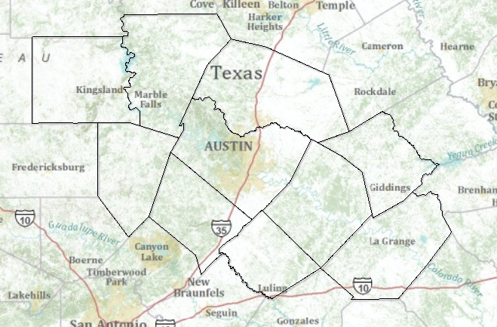
Topographic Base Map Service
http://explorer.arcgis.com/?open=c50ba5510cfa4663ae417eb4a56cc336

Slide 24
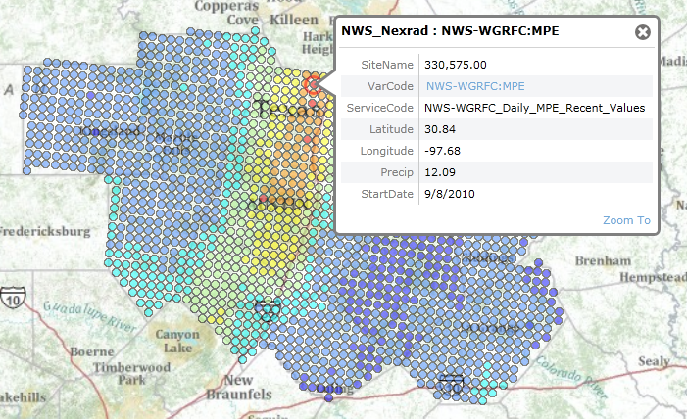
Precipitation Web Service: NWS Nexrad

Slide 25
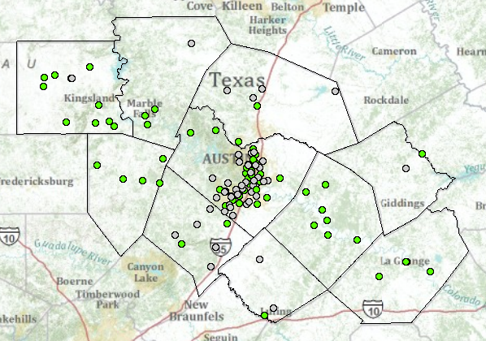
River Gage Web Services
LCRA and City of Austin
USGS

Slide 26
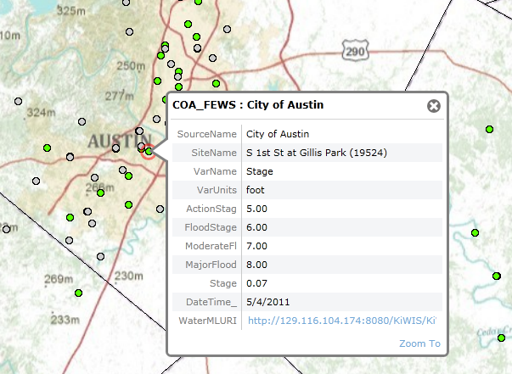
River Stage Web Service: City of Austin

Slide 27
River Stage Web Service: USGS

Slide 28
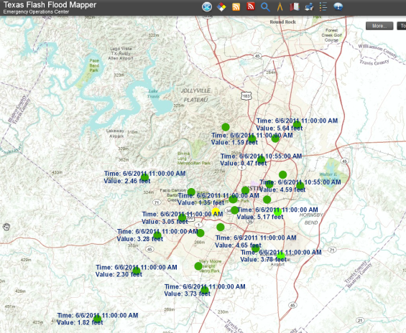
Real-Time Observations Map Layer
Real-Time WaterML service
Map Query Layer
Query Script to acquire observations
Output Map Layer for results
Output Map Service
Viewing System
http://waterservices.usgs.gov/nwis/iv?sites=08158000&period=P1D&parameterCd=00065
Stage Height Map Service (USGS and City of Austin) http://129.116.104.176/ArcGIS/rest/services/RealTime/COA_REALTIME/MapServer
NEXRAD Map Service http://129.116.104.176/ArcGIS/rest/services/RealTime/COA_NEXRAD/MapServer
Continually updating
Common Operating Picture Viewer:
http://129.116.104.176/PublicSafetyCOP/index.html

Slide 29
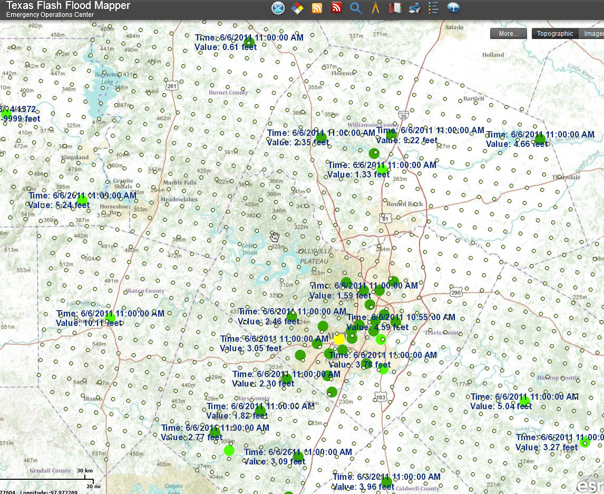
ESRI Public Safety Situational Awareness Viewer
Continuously updated maps of rainfall and stage height from multiple web services

Slide 30
IBM is collaborating with UT….
…. to help build a Smarter Planet

Slide 31
Solve 100 million equations simultaneously each night

Slide 32
VLSI simulation models for electric circuit design…..
….. adapted to apply to river networks

Slide 33
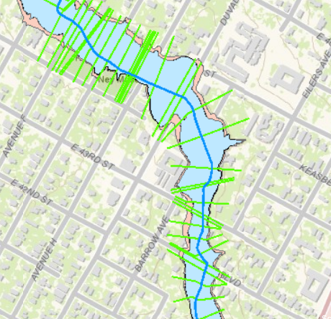
Flood Mapping Services
http://explorer.arcgis.com/?open=ad7c4dbe299a458ca52b9caa725a2d4d

Slide 34
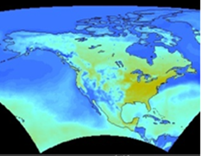
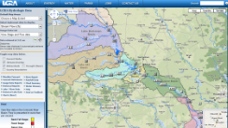
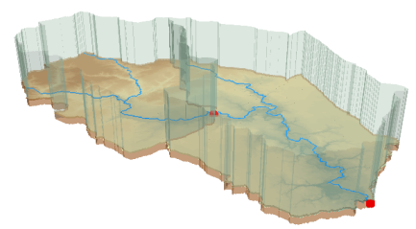
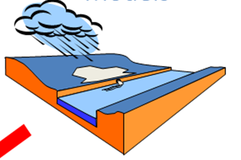
Web Services HUB
Inputs
Outputs
Web Services HUB
Data
Services
(WaterML)
USGS
Data
Services
(WaterML)
LCRA
Wiski/Hydstra and ArcGIS Server
COA
Mapping
Services
NWS
Mapping
Services
NDFD
Data and Mapping
Services
Modeling
Services
Flood Mapping
Services
Models
Maps

Slide 35
Water Web Services
Situational awareness for flash flooding
Web services for water and geospatial data
Demo of KiWIS for the CAPCOG area (Matt Ables)
Computing in the Cloud

Slide 36
Water Web Services
Situational awareness for flash flooding
Web services for water and geospatial data
Demo of KiWIS for the CAPCOG area (Matt Ables)
Computing in the Cloud

Slide 37
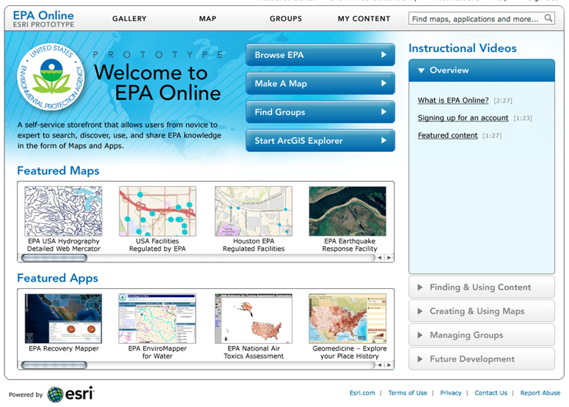
EPA Online

Slide 40
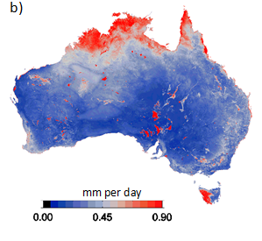
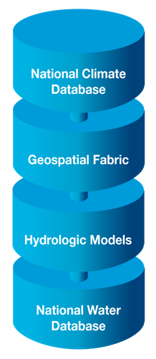
Australian Water Resources Information System
Uncertainty of Evaporation Estimation
Image: Albert van Dijk

Slide 41
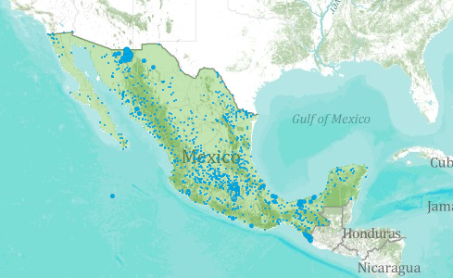
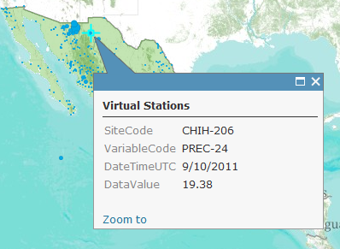
World Water Online A continually updated Real-Time Rainfall Map for Mexico
http://www.arcgis.com/home/webmap/viewer.html?services=ba0450587baf439ea8c899c3161daebb

Slide 42
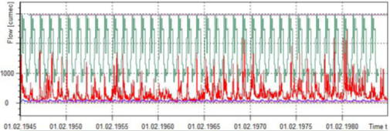
Linking Geographic Information Systems and Water Resources
Water
Resources
GIS
Map
Time Series

Slide 43
Conclusions
WaterML Web services are real now
WISKI and Hydstra manage information from networks of observation sites
With the addition of KiWIS, they can manage information from networks of networks
Modeling and mapping services are emerging
A web services “hub” is being engineered
The hub can live in “the cloud” and may become global in extent

