Slide 1
Towards a National Water Model for New Zealand
David R. Maidment
Center for Water and Environment
University of Texas at Austin
Presented to Local Government New Zealand Freshwater 2017 Conference
Wellington, New Zealand | 30 May 2017
Acknowledgements: US National Weather Service, US academic colleagues and students,
Open Geospatial Consortium, Horizons Regional Council, NIWA, Kisters.

Slide 2
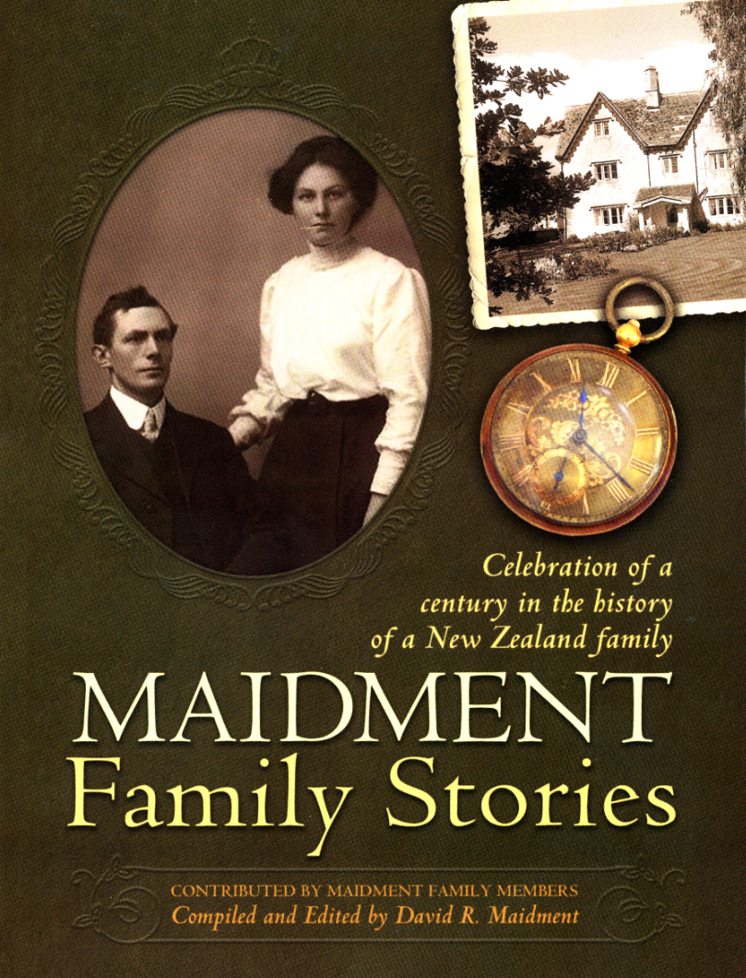
Per Capita Income of New Zealand 1870-2010
Constant $ per capita
(relative scale)
$4 – Now
$2 – Me
$1– My father
Source: Maddison Project, http://www.ggdc.net/maddison/maddison-project/data.htm

Slide 3

Population Distribution of New Zealand
2015: 4.6 million
1915: 1 million
0.6
0.5
0.5
4.0
Almost all population growth during last century
has been in towns and cities

Slide 4
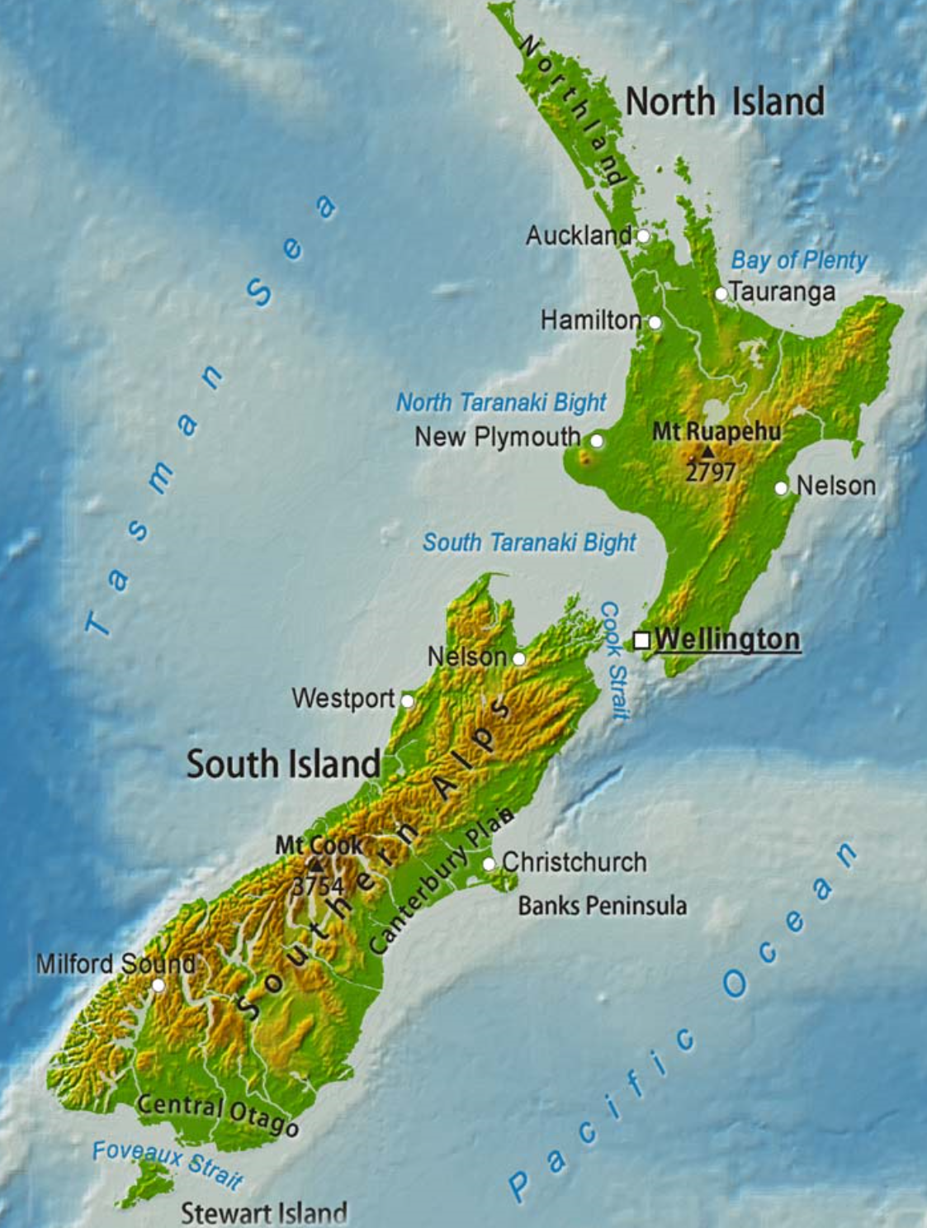
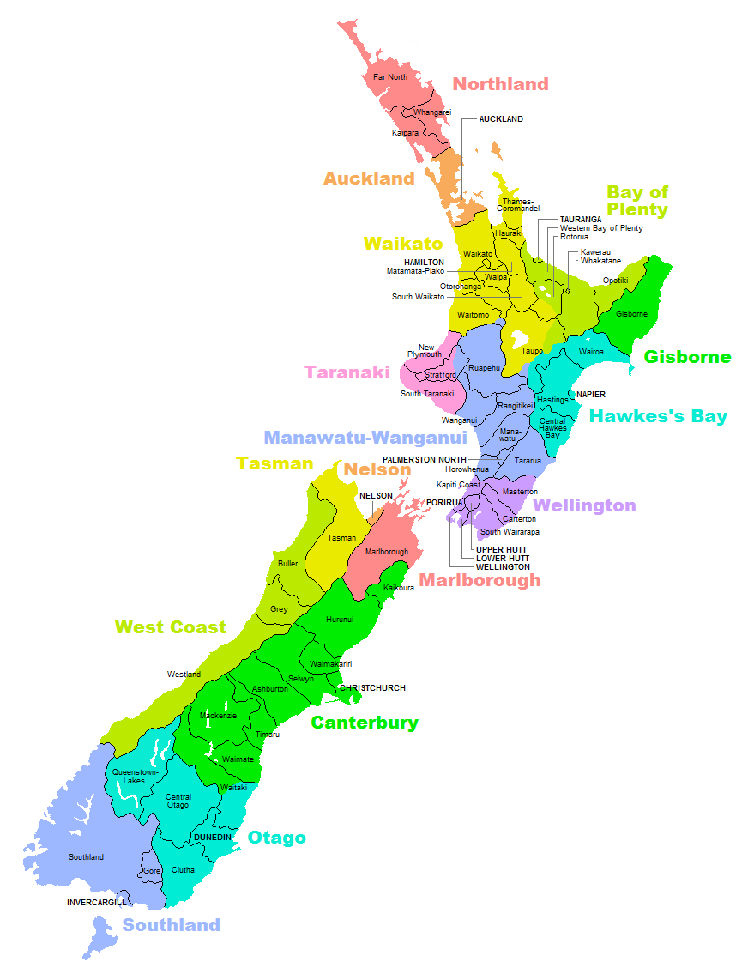
Progress in 100 years
(Population x 4.6) X (Per Capita Income x 4) = Economy x 18
Natural environment of New Zealand supports 4.6 times the population
and 18 times the economy that it did 100 years ago

Slide 5
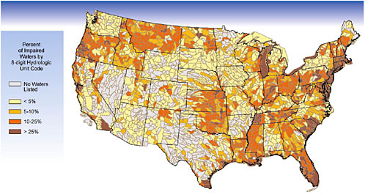
Impaired Water Bodies of the United States
Defined by Clean Water Act which protects “beneficial uses”: fishing, swimming, aquatic life, drinking water supply,..
Federal law implemented by States in different ways
https://www.nap.edu/openbook/0309082951/xhtml/images/p2000a440g288001.jpg

Slide 6
Clean Water Act Methodology
Applies only to surface water (not groundwater)
Streams, rivers, water bodies split into “water quality segments”
Acceptable water quality standard defined for each beneficial use
Annual sampling program to measure water quality
“Impairment” if pollution exceeds standard
List of “impaired water bodies” compiled
“Total Maximum Daily Load” defined for each impairment
Implementation plan developed to achieve TMDL

Slide 7
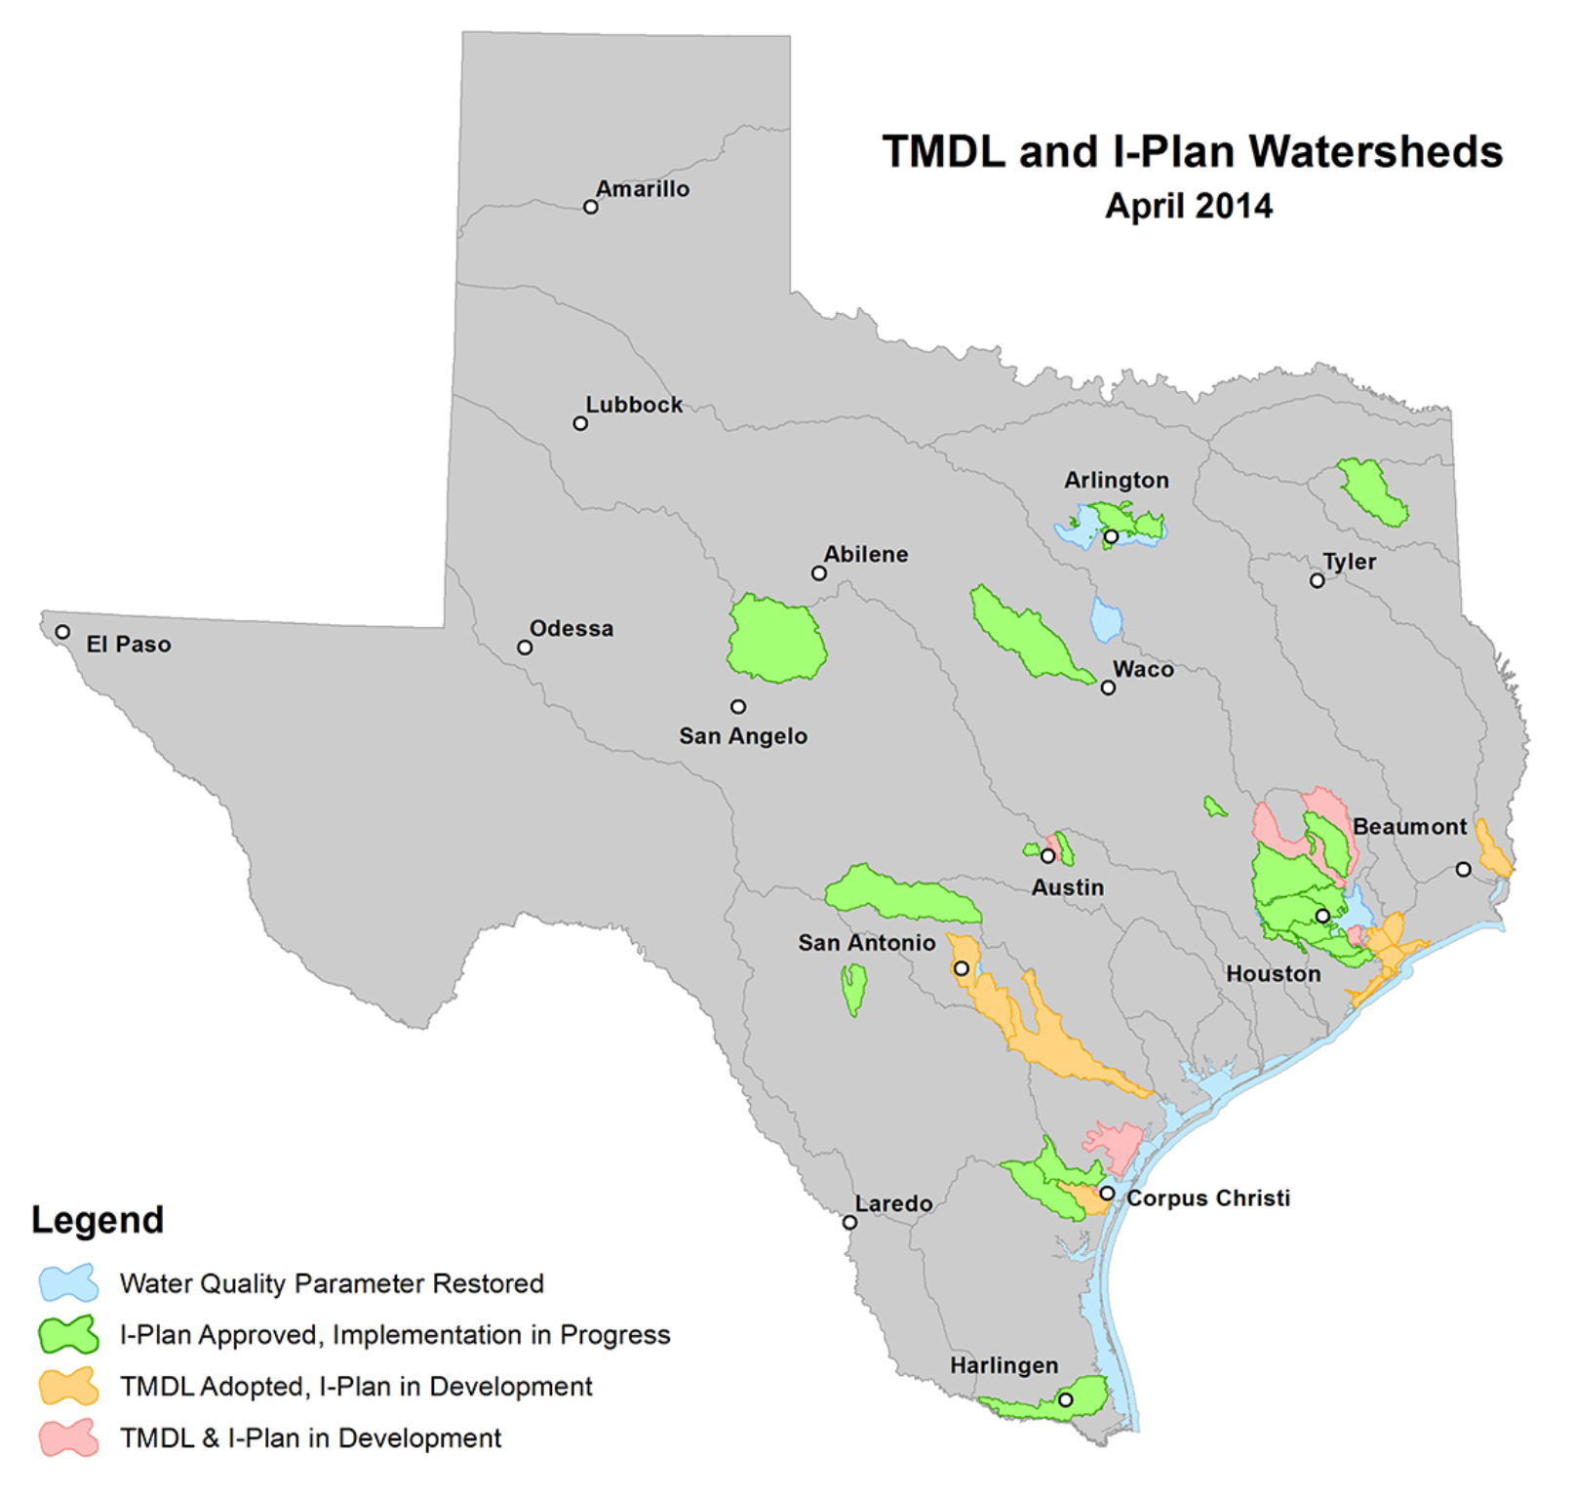
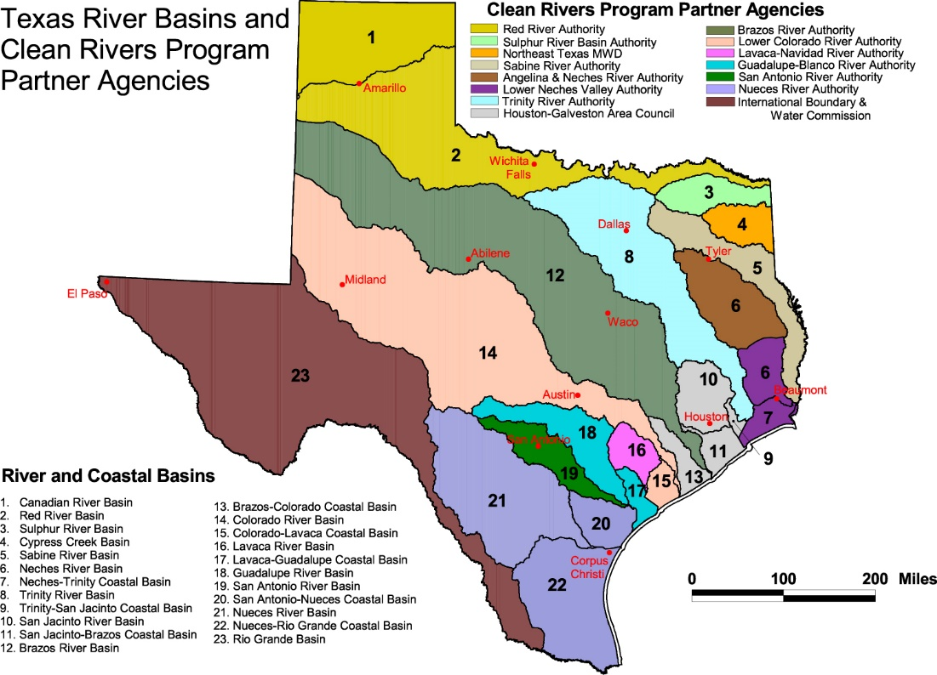
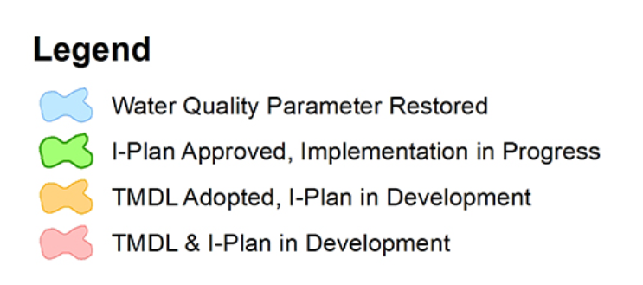
Clean Water Act in Texas
Impaired Water Bodies
and Stages of Improvement
Data collected by
Clean Rivers Program
Administered by
Texas Commission
for Environmental Quality
4.
3.
2.
1.

Slide 8
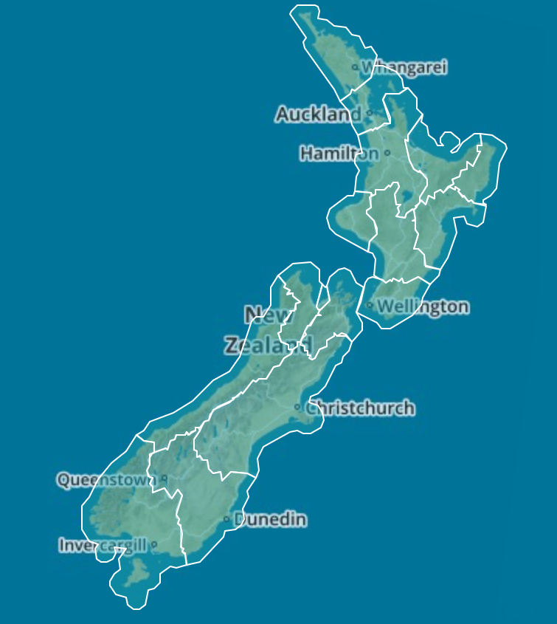



Land Air Water Aotearoa
LAWA is like Clean Rivers Program

Slide 9
Towards a Global Water
Information System
David R. Maidment
Center for Research in Water Resources
University of Texas at Austin
Acknowledge Leadership of Horizons Regional Council
Michael McCartney, Jeff Watson, Brent Watson, Sean Hodges
Presented to New Zealand Hydrological Society
Palmerston North, New Zealand | 22 February 2013
Adapted from a presentation to 14th Congress of the WMO Commission for Hydrology
Geneva, Switzerland | 9 November 2012

Slide 10


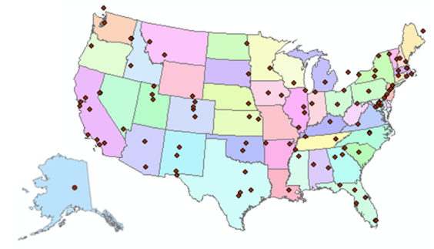
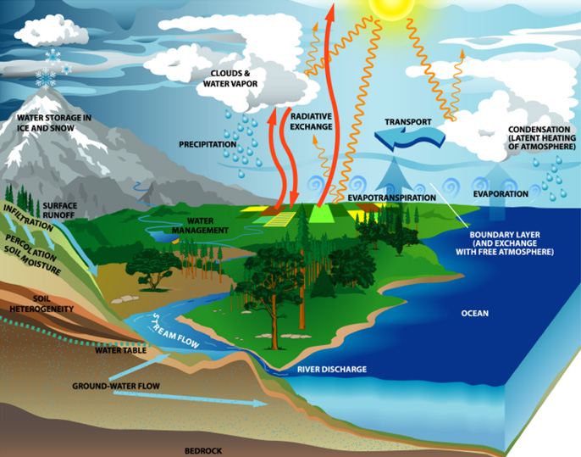
Consortium of Universities for the Advancement of Hydrologic Science, Inc.
www.cuahsi.org
CUAHSI
A consortium representing 125 US universities
Supported by the National Science Foundation Earth Science Division
Advances hydrologic science in nation’s universities
Includes a Hydrologic Information System project
Invented WaterML language for water resources time series
Building an academic prototype system

Slide 11
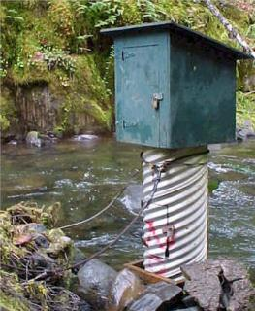
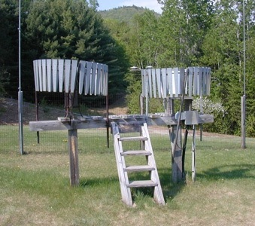
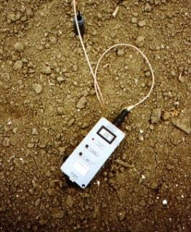
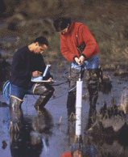
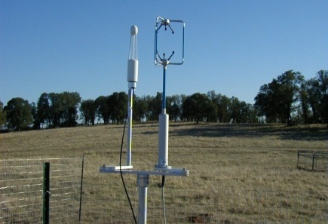
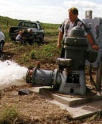
Hydrologic Measurement
Water Quantity
Rainfall
Soil Water
Water Quality
Meteorology
Groundwater
Time series data at point locations

Slide 12
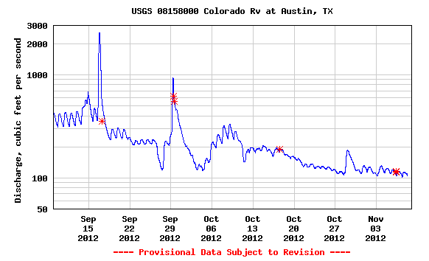
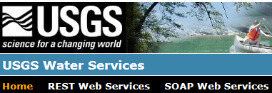
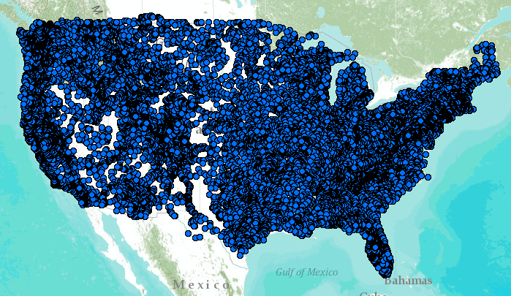
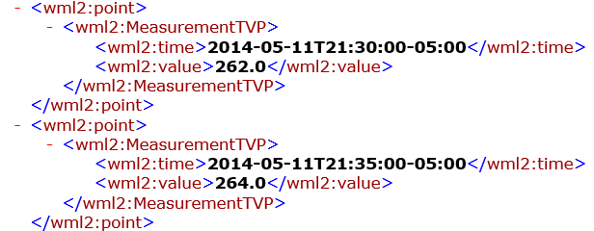
WaterML2 Web Services – US Geological Survey…..
Water time series data on the internet
24/7/365 service
For daily and real-time data
. . . Operational water web services system for the United States
http://waterservices.usgs.gov/nwis/iv/?format=waterml,2.0&sites=08158000&period=P1D&parameterCd=00060

Slide 13
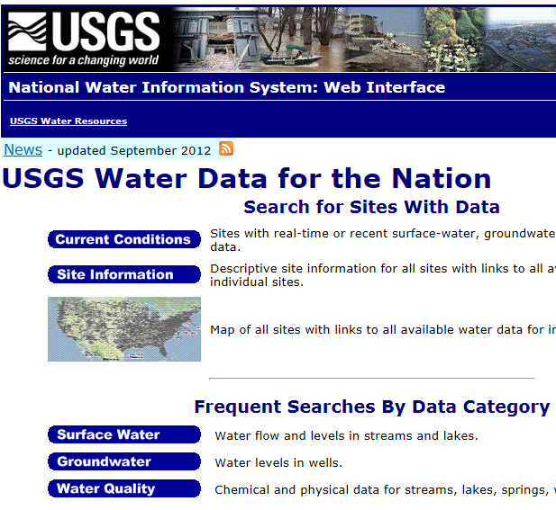
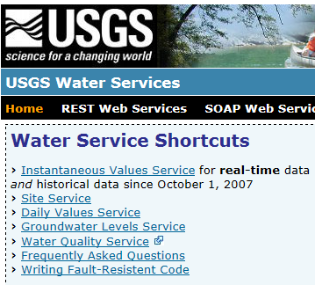
Web Pages and Web Services
Web pages deliver text and images
Web services deliver data encoded in XML
http://water.usgs.gov/
http://waterservices.usgs.gov/

Slide 14
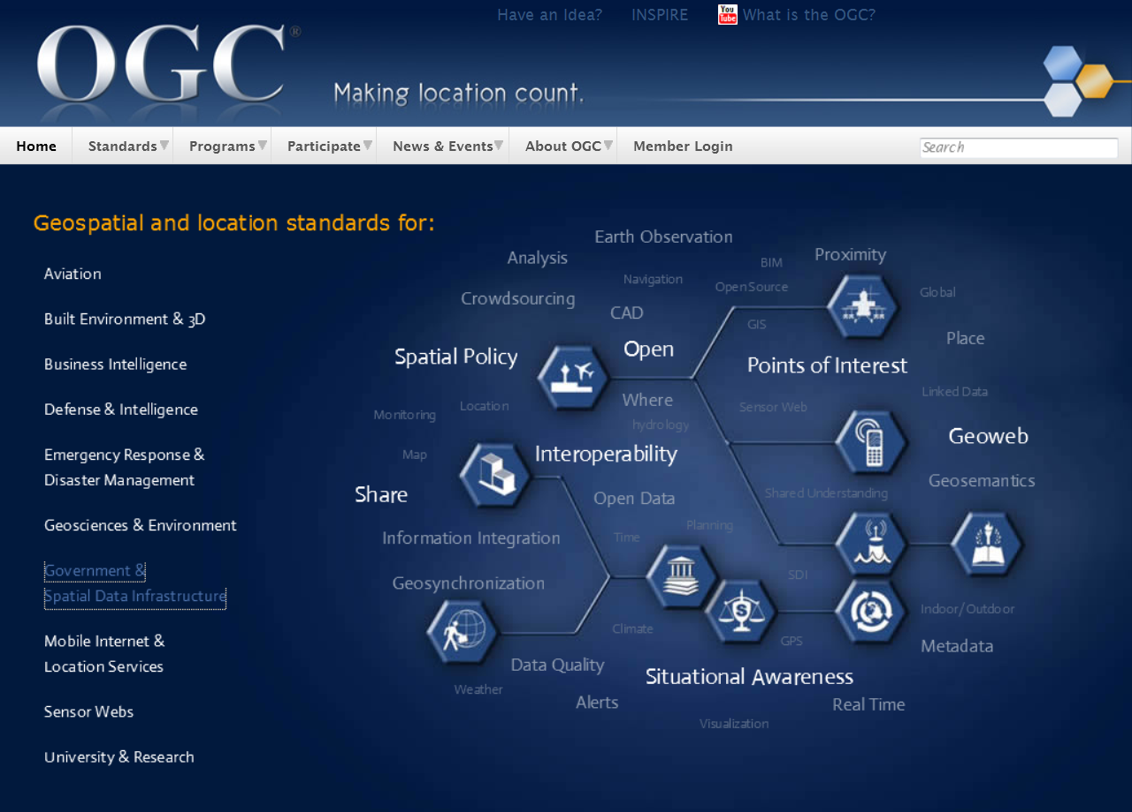
Open Geospatial Consortium
More than 400 companies and agencies globally
. . . Internet data standards for maps and observational data

Slide 15


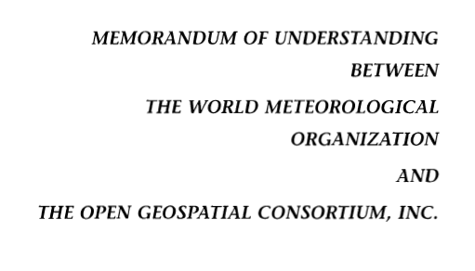

OGC/WMO Hydrology Domain Working Group
12-year effort to define international water data standards
A time series for one variable at one location
Research started by CUAHSI in United States
Technical Meetings Each 3 Months
Four Interoperability Experiments
(Surface water, groundwater, forecasting)
Annual week-long workshops
Involvement by many countries
Adoption
2004
2008
2010
2012
2016
Notes:
(1) A four-year international effort has been undertaken to reconcile WaterML with international standards;
(2) This effort was initiated with the establishment of an Hydrology Domain Working Group by the Open Geospatial Consortium in September 2008;
(3) An OGC representative attended the WMO Congress of the Commission for Hydrology in 2008
(4) A formal agreement between Secretary General of WMO and President of OGC in 2009 to jointly develop standards for hydrology, climatology, oceanography and climatology;
(5) The joint OGC/WMO Hydrology Domain Working Group was supported by a large work effort, annual week-long workshops, four interoperability experiments for surface and groundwater data exchange, and participation by many countries;
(6) In June 2012, the OGC voted to adopt the revised version, WaterML2 as an international standard for exchange of water resources time series (the first such public standard that has existed);
(7) This Congress to the WMO Commission for Hydrology to whom I am speaking is considering WaterML2 for adoption as an official standard by WMO

Slide 16

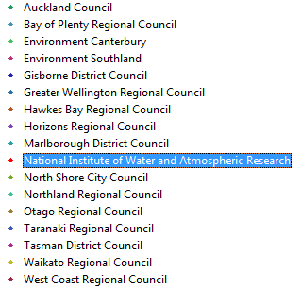
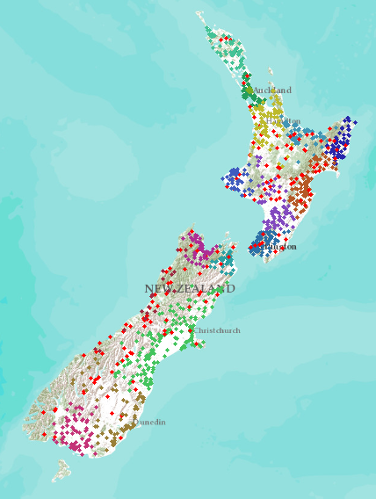
New Zealand – 16 regions
NIWA operates about 20% of 1300 hydrometric stations
Regional authorities operate about 80% of stations
Develop a federated hydrological information infrastructure . . .
. . . linking nationally and regionally collected data

Slide 17
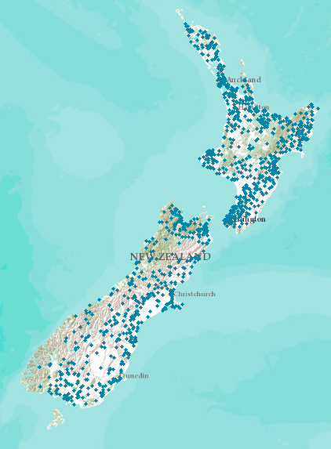
Proposed New Zealand Water Information System
NIWA operates about 20% of 1300 hydrometric stations
Regional authorities operate about 80% of stations
New Zealand
Water Information System
Develop a federated hydrological information infrastructure . . .
. . . linking nationally and regionally collected data

Slide 18
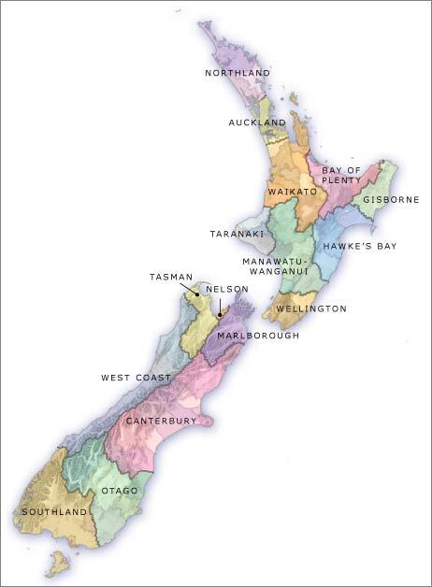

Current State of Play for NZ – all Done!
Local Government
National - CRIs
16
3
SOS2/WaterML2
now
SOS2/WaterML2
now
SOS = Sensor Observation Service
Slide: Brent Watson, HRC

Slide 19
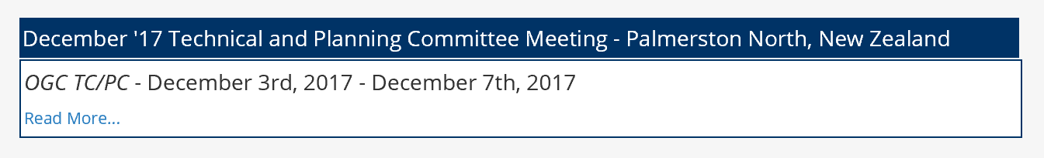

Data Sharing using Open Standards in LAWA
National synthesis without centralizing the data
Each region maintains its own data
Data are accessed through “web services”
Common language for water: WaterML2
Open Geospatial Consortium standards
All information “looks the same” to user
A tremendous technological achievement for New Zealand!!!
Credit: LAEMG, especially Horizons Regional Council
Michael McCartney, Jeff Watson, Brent Watson, Sean Hodges
NIWA, Landcare, Kisters, Hilltop, 52North

Slide 20
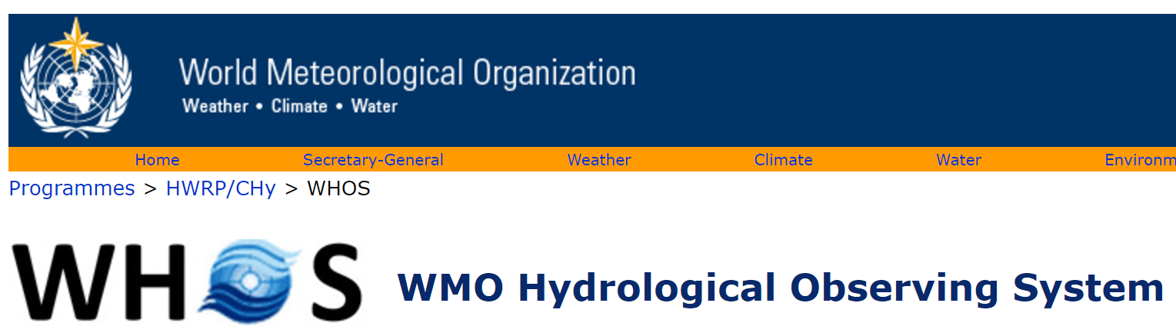
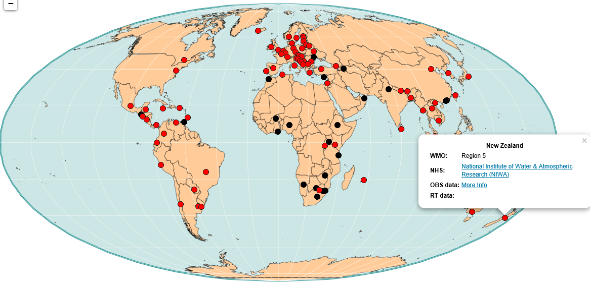
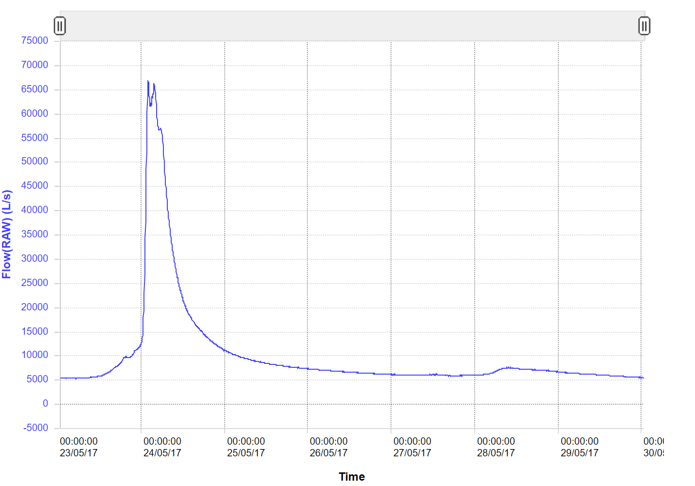
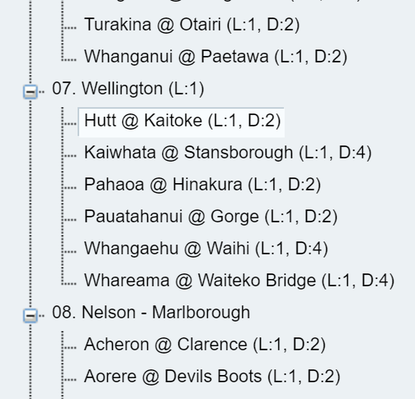
NIWA
New Zealand data globally accessible
Current Flow Data for the Hutt River at Kaitoke
30 May 2017
http://www.wmo.int/pages/prog/hwrp/chy/whos/

Slide 21
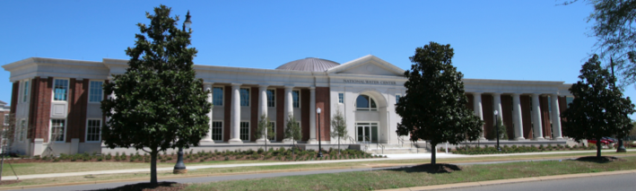
An Opportunity
New National Water Center established on the Tuscaloosa campus of University of Alabama by the National Weather Service and federal agency partners
Has a mission to assess hydrology in a new way at the continental scale for the United States

Slide 22
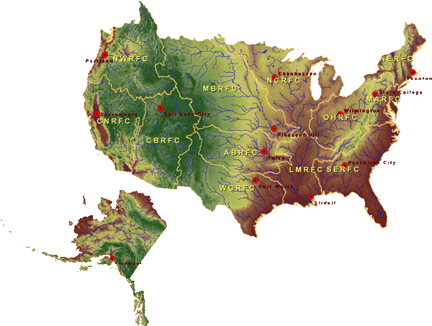

Centralized Water Model and Forecasting
National Water Center
Notes:
TRANSITION INTO METHODS
FY15 PROJECT HAS FOUR CORE COMPONENTS
RFC archive
Model evaluation service
Modeling testbed
Centralized modeling demonstration

Slide 23
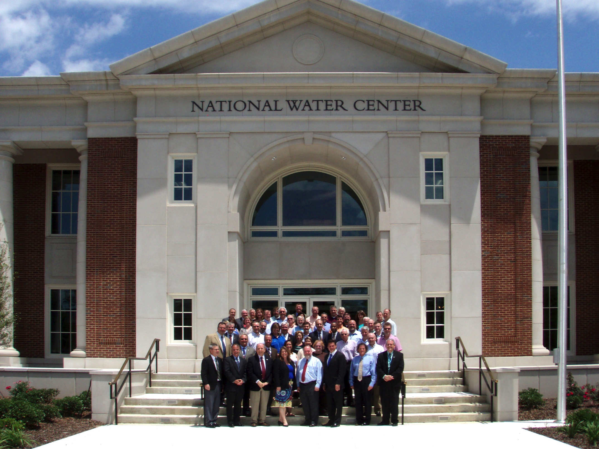
This meeting led to an engagement between the academic community of the United States and the National Weather Service to help build the National Water Model
Inaugural Meeting – May, 2014

Slide 24
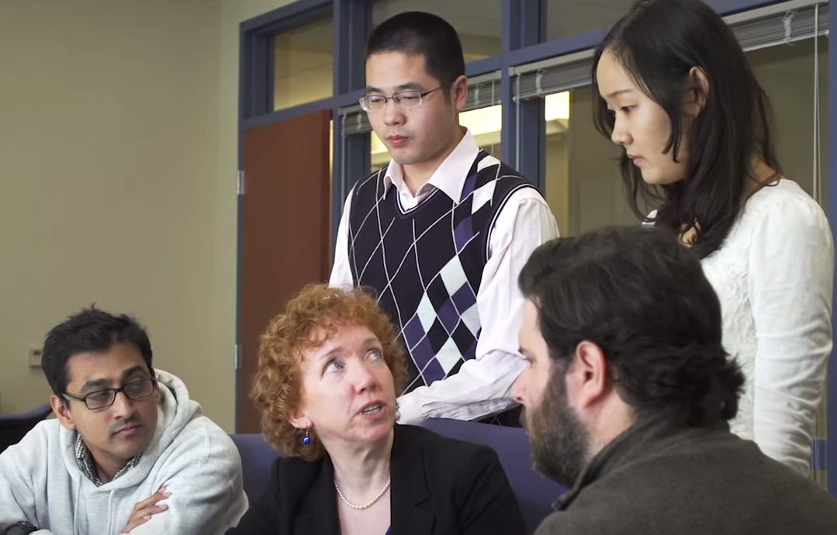

National Flood Interoperability Experiment
Partnership between National Weather Service and the academic community
Includes Summer Institutes for 35-40 graduate students at the National Water Center, June-July in 2015, 2016, 2017, ….

Slide 25
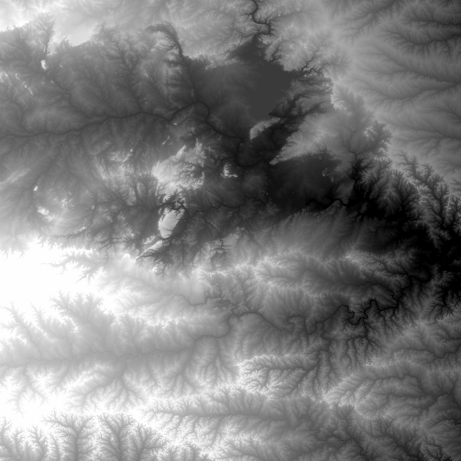
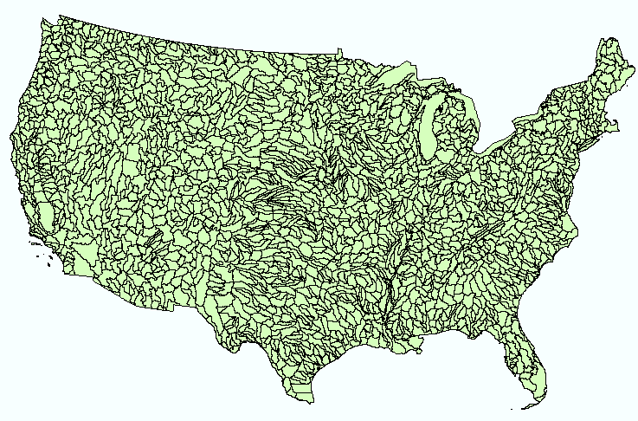
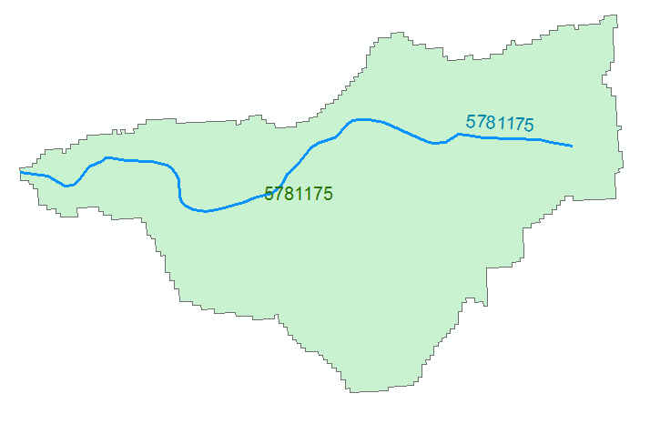
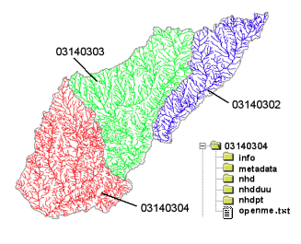
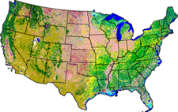
NHDPlus Version 2.1
Foundation for a Geospatial Hydrologic Framework for the United States
NHDPlus
2.7 million reach catchments in US
average area 3 km²
reach length 2 km
Uniquely labelled
National Elevation Dataset
Watershed Boundary Dataset
National Hydrography Dataset
National Land Cover Dataset

Slide 26
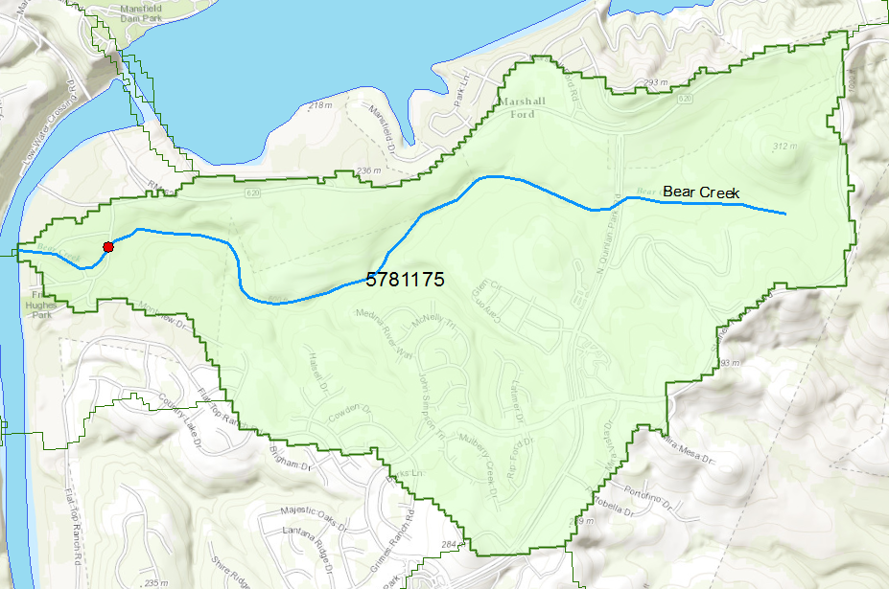
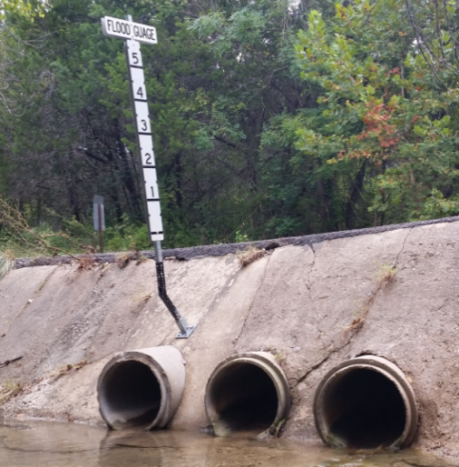
Flood Information for Fritz Hughes Park Rd
National Hydrography Dataset Plus
catchment for Bear Creek
(area = 5.71 km²)
Low water crossing at
3400 Fritz Hughes Park Rd

Slide 27

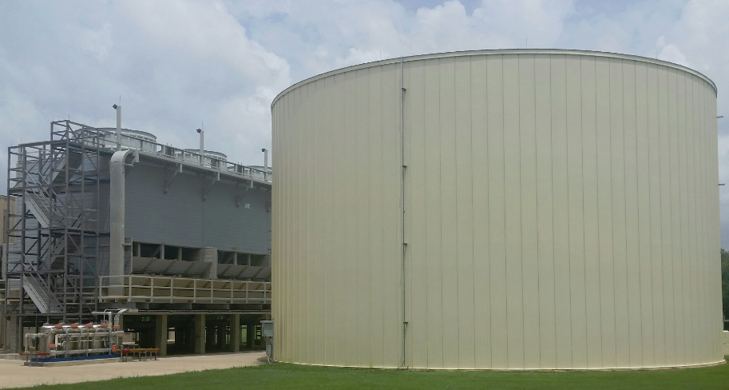
Stampede
1.2 million gallon cooling tank
500,000 processors operating in parallel

Slide 28
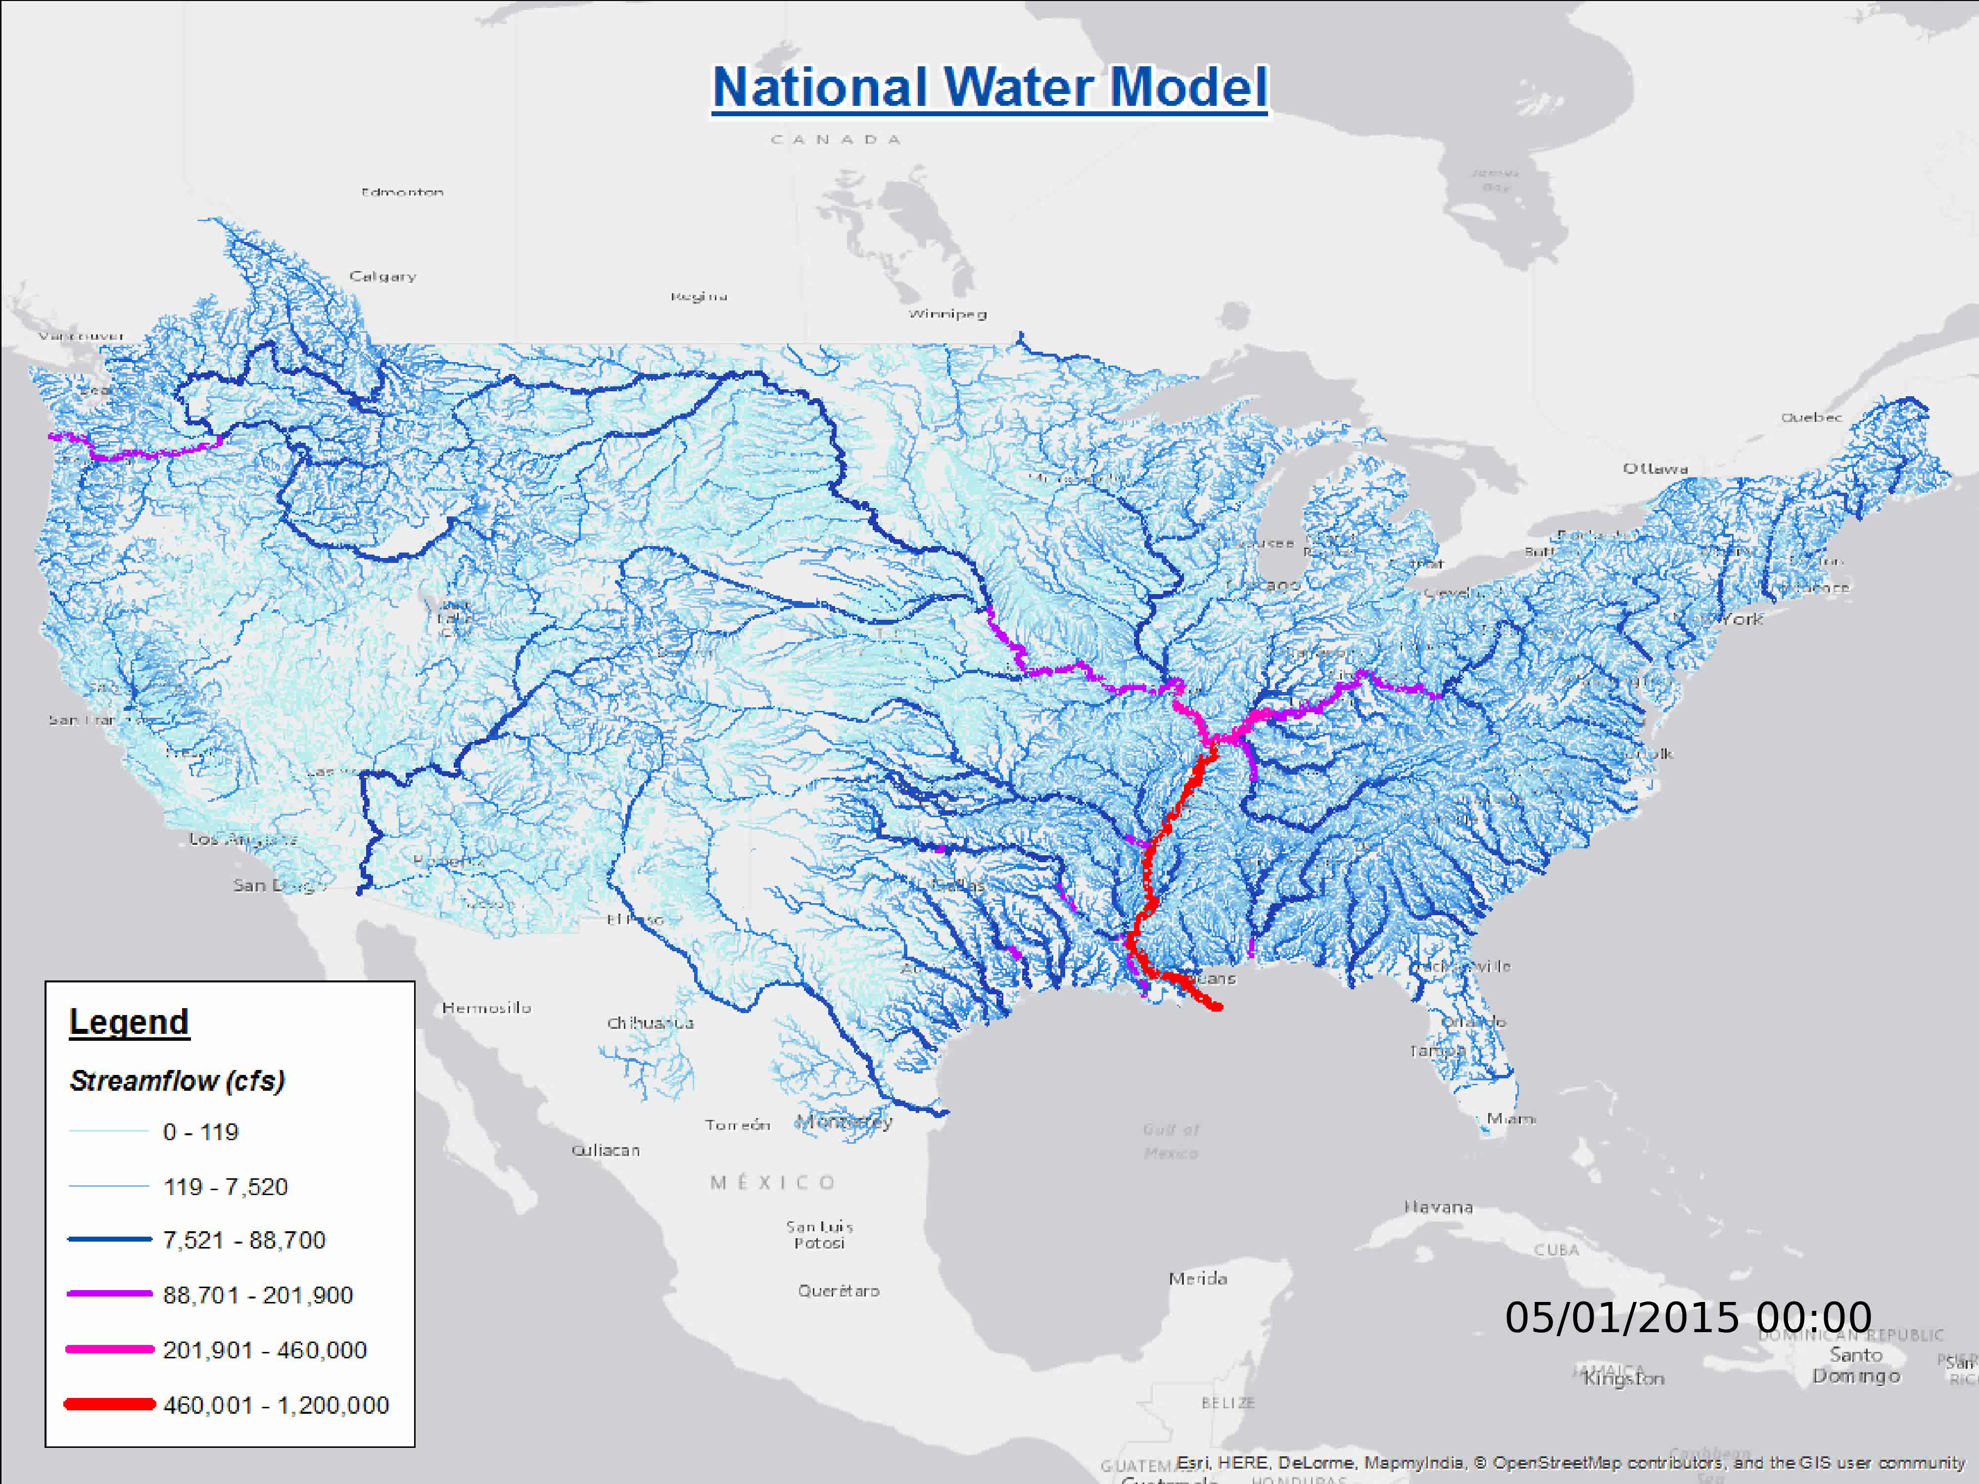
Operational on 16 August 2016
2.7 million reaches covering 5.2 million Km of streams and rivers

Slide 29

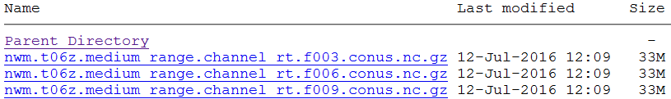
National Water Forecasting
Now
Analysis
Best estimate of current conditions
Short Range
Hourly for 18 hours ahead
Medium Range
6 Hourly for 10 days ahead
Long Range
Daily for 30 days ahead
Ensemble of 4 forecasts each 6 hours (24 forecasts total)
Operational with publicly accessible forecasts as of 16 August 2016
ftp://ftpprd.ncep.noaa.gov/pub/data/nccf/com/nwm/prod/

Slide 30
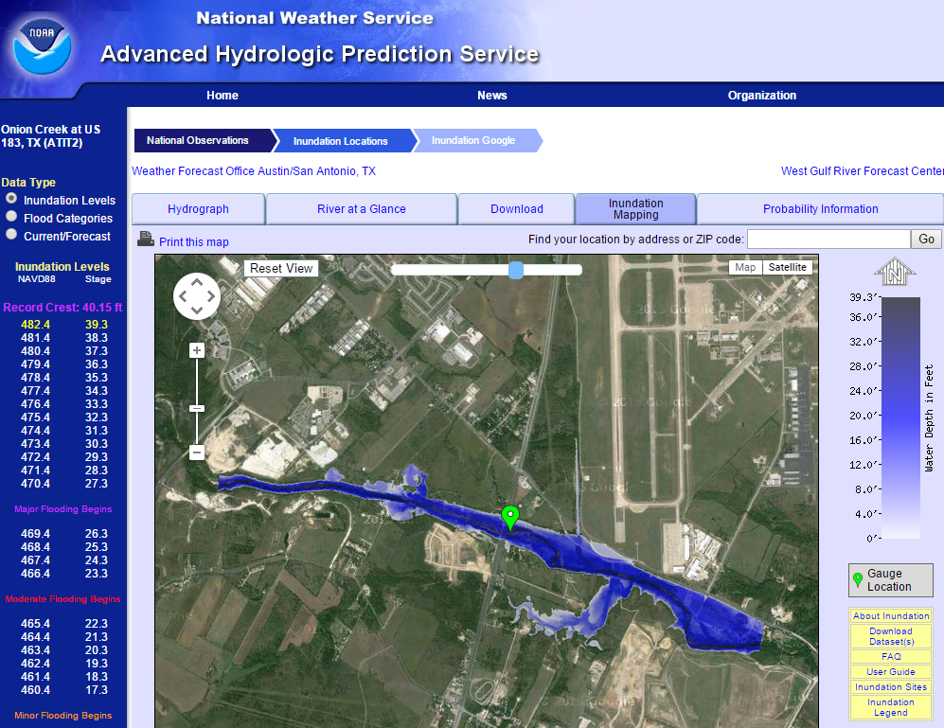
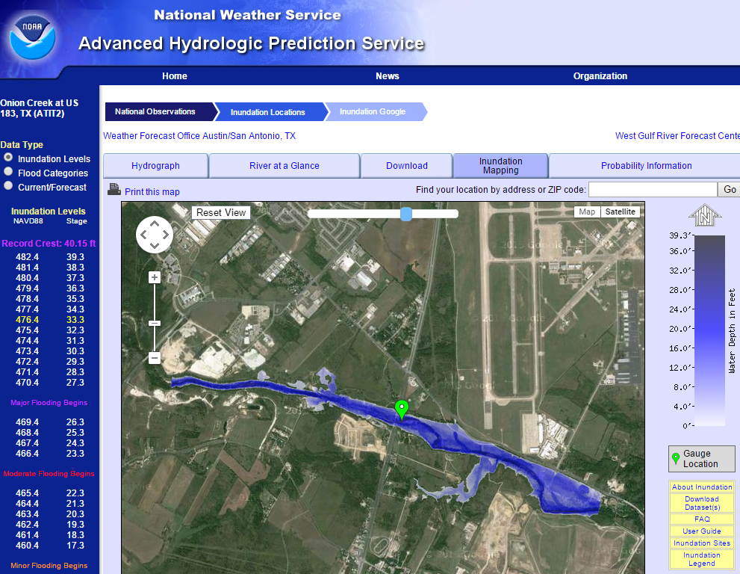
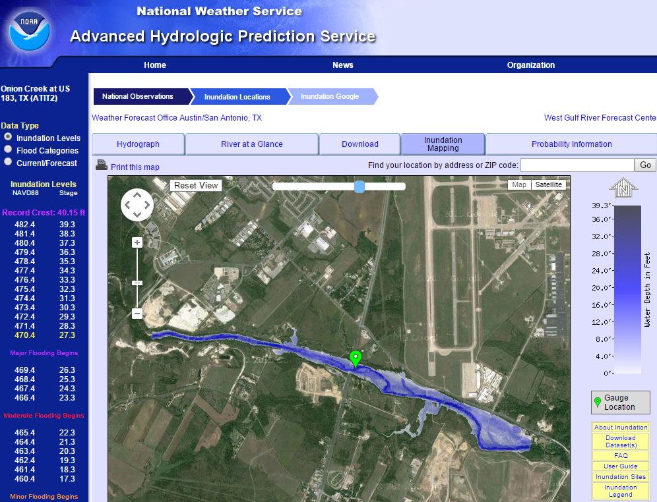


Real-Time Flood Inundation Mapping
Onion Creek at Highway 183
http://water.weather.gov/ahps2/inundation/inundation_google.php?gage=atit2

Slide 31
Method for Determining Flood Risk:
Height Above Nearest Drainage (HAND)
Flooding occurs when Water Depth is greater than HAND
Flood
HAND
Normal
Notes:
How do we answer the question of how many people are going to be impacted, especially if large areas of the state are not covered by LIDAR or National Flood Hazard Layer? The researchers developed a process called Height Above Nearest Drainage or HAND.

Slide 32




Continental-Scale Flood Inundation Mapping
Catchments and Flowlines
Height Above Nearest
Drainage (HAND)
(relative elevation of land
surface cell above cell in
stream to which it flows)
Digital Elevation Model

Slide 33

Groundwater Model for Continental US
250 m cells horizontal
1 km total depth
1 billion computational cells
Being developed now
Source: Reed Maxwell
Colorado School of Mines

Slide 34



Core Observation Networks
Precipitation
Streamflow
Groundwater

Slide 35

Digital River Network of New Zealand
Version 3 (DN3) -- NIWA, Christchurch
LIDAR-based
Waituna
Improvements started in Southland, done for most of North Island by June 2017,
for all of North and South Islands by June 2018

Slide 36






World Soil Moisture from the NASA Global Land Data Assimilation System (GLDAS)
Charts show 3-hourly variation at 37,000 locations of soil water content of the top 1m of soil
Popup on point links to data and chart
New Zealand
¼ x ¼ degree grid
A very wet region with little seasonality
A dryer region with significant seasonality

Slide 37




Australian Water and Climate Summer Institute, Australian National University, Dec 2016 – Jan2017
U. Melb Otago U. ANU

Slide 38
Conclusions
NZ has grown: 4.6 x population and 18 x economy in 100 years
NZ water quality challenges
  Balance between national and local government
  Balance between agriculture and environment
US has Clean Water Act to ensure swimming, fishing, ..
NZ has LAWA -- a real-time federated database of water data
In US Water has become like weather,
forecast everywhere at local scale, updated hourly
US National Water Model is just for surface water
but groundwater may be added later
Great Achievement!!!!
Could a real-time National Water Model be developed for New Zealand?

