Slide 1
National Flood Interoperability Experiment (NFIE)
Prepared by David R. Maidment
Center for Research in Water Resources
University of Texas at Austin
Presented at the Engineering Research and Development Center, US Army Corps of Engineers,
Vicksburg, MS
20 March 2015

Slide 2
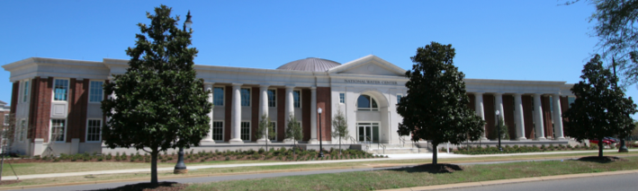
The Opportunity…
New National Water Center established on the Tuscaloosa campus of University of Alabama by the National Weather Service and federal agency partners
Has a mission to assess hydrology in a new way at the continental scale for the United States

Slide 3
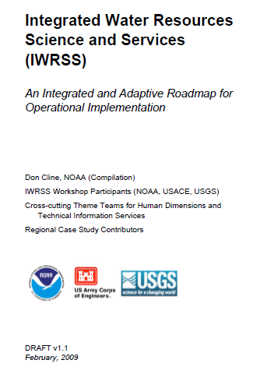
Integrated Water Resources Science and Services (IWRSS)
Aligns multiple agencies with complimentary water-related missions to:
Integrate services and service delivery
Improve river and flood forecasts
Provide new summit-to-sea water resources analyses and forecasts
Enable more effective use of resources
Roadmap Document
(February 2009)
Purpose, Scope, Vision and Goals
Cross-Cutting Themes
National and Regional
Operations and Business Concepts
Slide: Ed Clark, NWS
http://www.nohrsc.noaa.gov/~cline/IWRSS/IWRSS_ROADMAP_v1.0.pdf
3

Slide 4
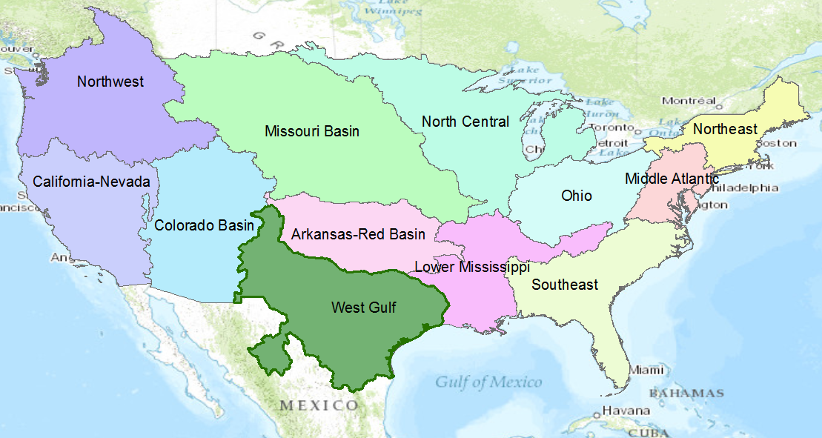
NWS River Forecast Centers
Perform precipitation, runoff and river flow simulation and forecasting for five days ahead, updated daily, more frequently during floods

Slide 5
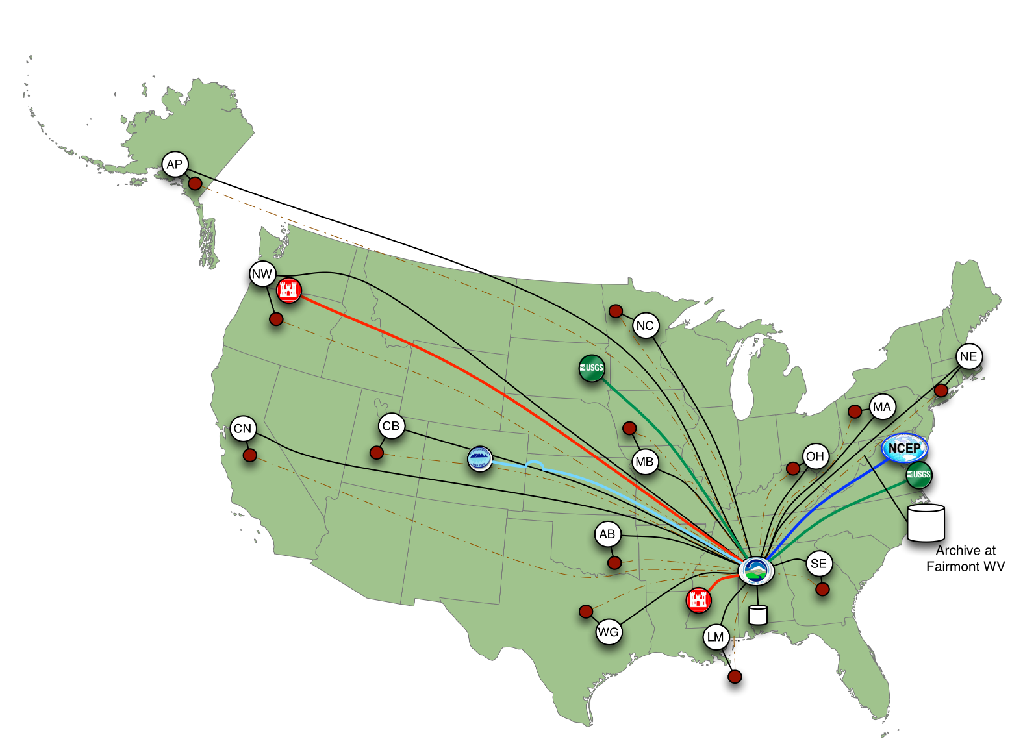
Nationally Synthesize Operations of Regional River Forecast Centers

Slide 6

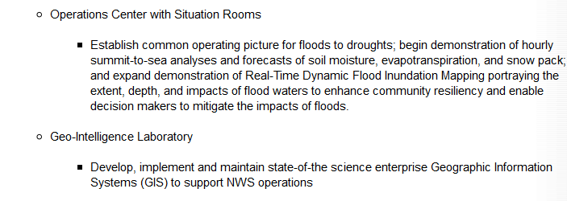
Temporal information
Geospatial information
National Water Data Infrastructure

Slide 7
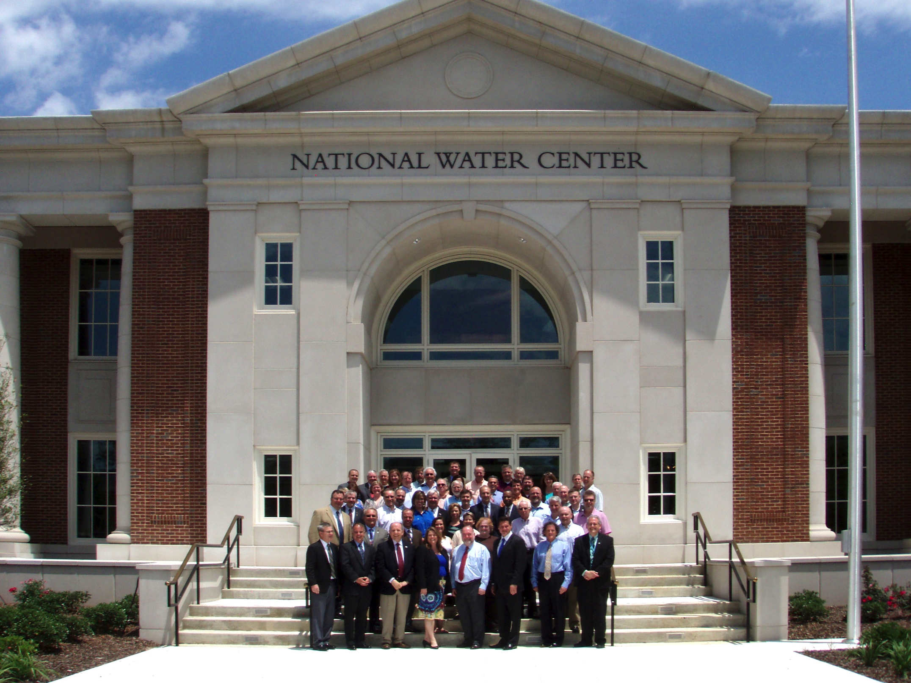
Inaugural Meeting – May, 2014

Slide 8
Transformative Research (NSF)
Transformative research involves ideas, discoveries, or tools that radically change our understanding of an important existing scientific or engineering concept or educational practice or leads to the creation of a new paradigm or field of science, engineering, or education. Such research challenges current understanding or provides pathways to new frontiers.
http://www.nsf.gov/about/transformative_research/definition.jsp
How to move from evolutionary change
to transformative change?

Slide 9


Partnership with the academic community …
National Weather Service has joined with CUAHSI to conduct a one-year National Flood Interoperability Experiment (NFIE)
Includes a Summer Institute for students and faculty at the National Water Center, June 1 to July 17, 2015

Slide 10
NFIE Summer Institute
Runs from June 1 to July 17
  Kickoff Event, week of June 1
  Capstone conference July 15-17
48 graduate students and post-docs from 15 Universities: Alabama, Texas (Arlington, Austin), Utah State, SUNY Syracuse, BYU, Colorado (Boulder), Illinois (Urbana-Champaign), Purdue, Oklahoma, Iowa, Michigan State, Arizona, Alaska (Fairbanks), Tufts

Slide 11
Goal of the Experiment …
Close the gap between National Flood Forecasting and Local Emergency Response
Demonstrate forecasting of flood impacts at “stream and street level”
National
Weather and Hydrology
National Weather Service and federal agencies
National Water Center
River Flooding and Emergency Response
Local, State and Regional Agencies
Citizens
Local

Slide 12
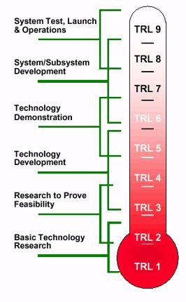
Technical Readiness Levels
The NFIE is a research effort
It will not create an operational system
It will not produce public forecast information
NFIE
http://en.wikipedia.org/wiki/Technology_readiness_level

Slide 13
NFIE Conceptual Framework…
NFIE-Geo: National geospatial framework for hydrology
NFIE-Response: Wide area planning for flood emergency response
NFIE-Hydro: National high spatial resolution hydrologic forecasting
NFIE-River: River channel information and real-time flood inundation mapping
NFIE-Services: Web services for flood information

Slide 14
NFIE Continental scale…
NFIE-Geo: National geospatial framework for hydrology
NFIE-Response: Wide area planning for flood emergency response
NFIE-Hydro: National high spatial resolution hydrologic forecasting
NFIE-River: River channel information and real-time flood inundation mapping
NFIE-Services: Web services for flood information

Slide 15

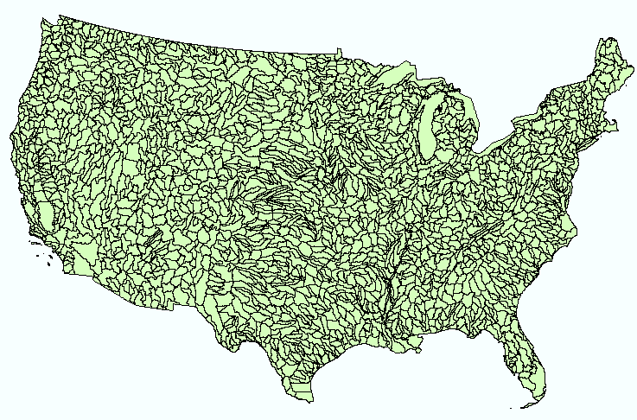
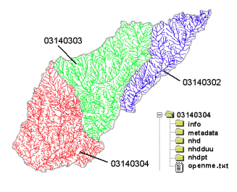
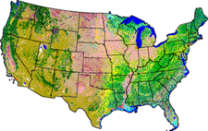
NHDPlus Version 2
Geospatial foundation for a national water data infrastructure
NHDPlus
2.67 million reach catchments in US
average area 3 km²
reach length 2 km
National Elevation Dataset
Watershed Boundary Dataset
National Hydrography Dataset
National Land Cover Dataset

Slide 16


Open Water Data Initiative
Subcommittee on Spatial Water Data leads this effort
Al Rea (USGS) and Ed Clark (NWS) are co-chairs
This reports to both FGDC and ACWI
Sponsoring a series of “experiments” with water information services
NFIE is one of these experiments
Anne Castle, Former Asst Secretary for Water and Science, Dept of Interior
Chair

Slide 17
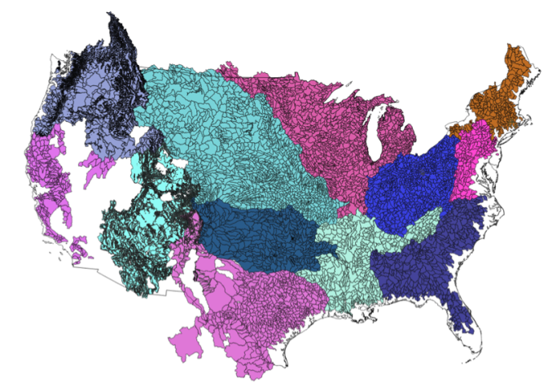


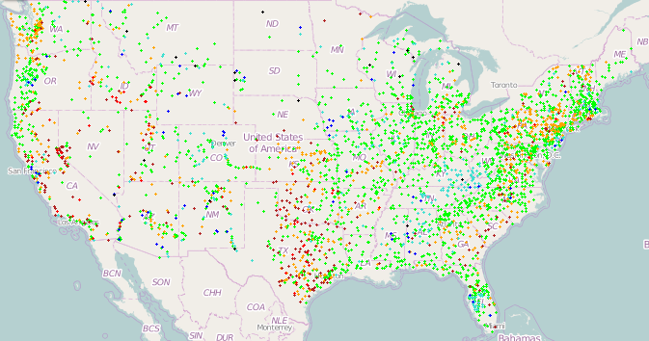
NFIE-Geo for National Flood Interoperability Experiment
Enhanced geospatial database for a national water data infrastructure
NWS Basins and
Forecast Points
USGS Water Watch
Points
National Flood
Hazard Layer
Feature classes:
Subwatershed (HUC12)
Catchment
Flowline
Waterbody
Dam
NFIE-Geo
9 feature classes
5 from NHDPlus
4 from IWRSS
NHDPlus

Slide 18
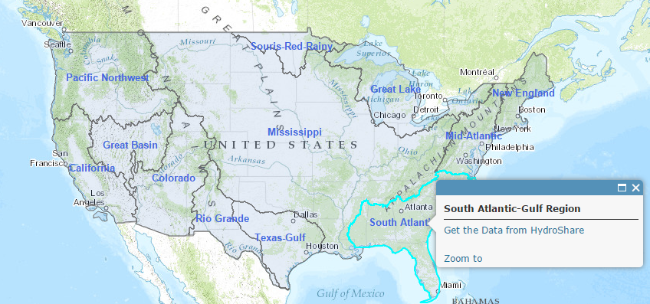
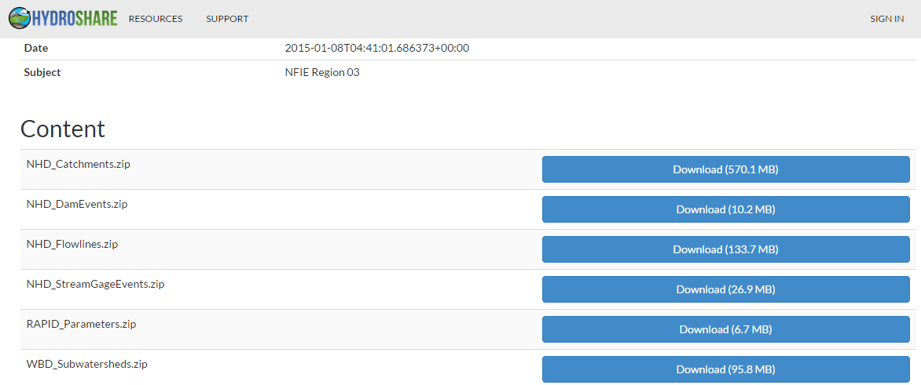
NFIE-Geo in HydroShare
https://www.arcgis.com/home/webmap/viewer.html?webmap=2c30160429984a59873f26b9d118dbfe
David Tarboton, Utah State Univ
and Ray Idaszak, RENCI

Slide 19
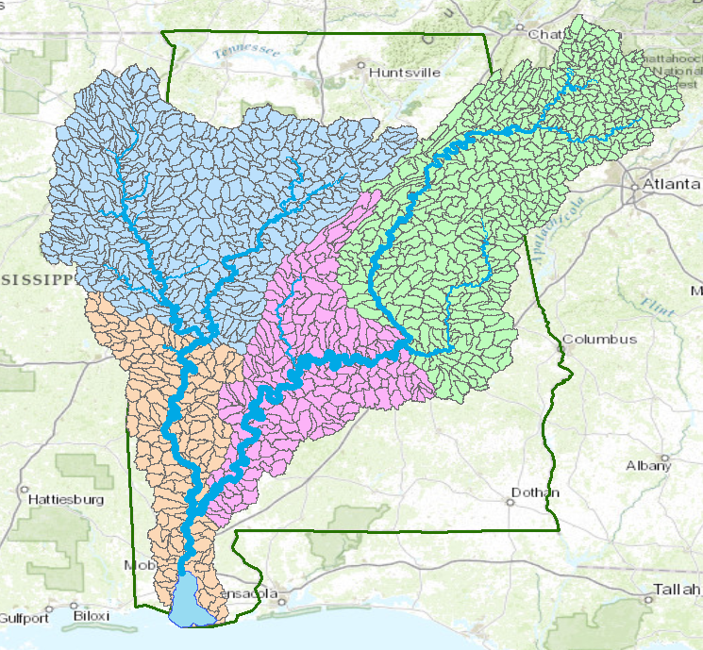
Mobile-Alabama River System
Black Warrior River
Coosa River
Cahaba River
TombigbeeRiver
Alabama River
Mobile River
Mobile Bay

Slide 20
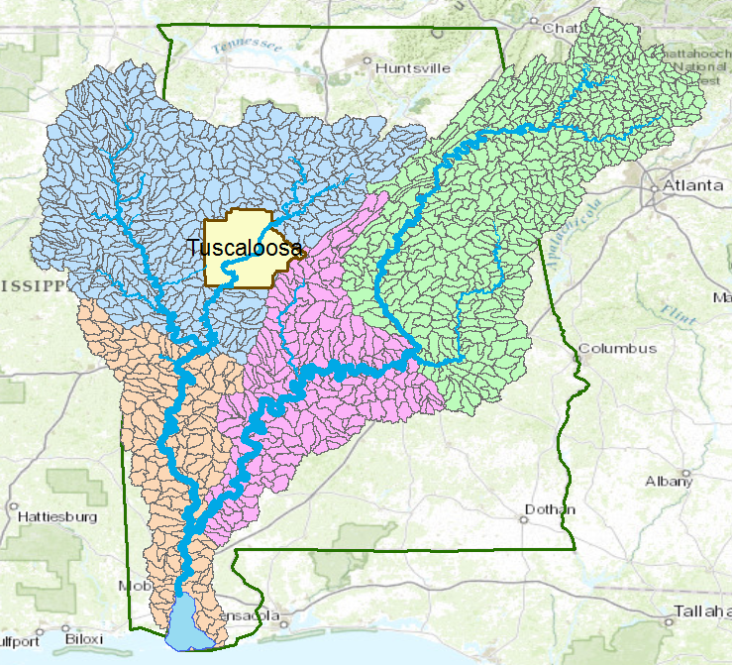
Tuscaloosa County
Black Warrior River

Slide 21
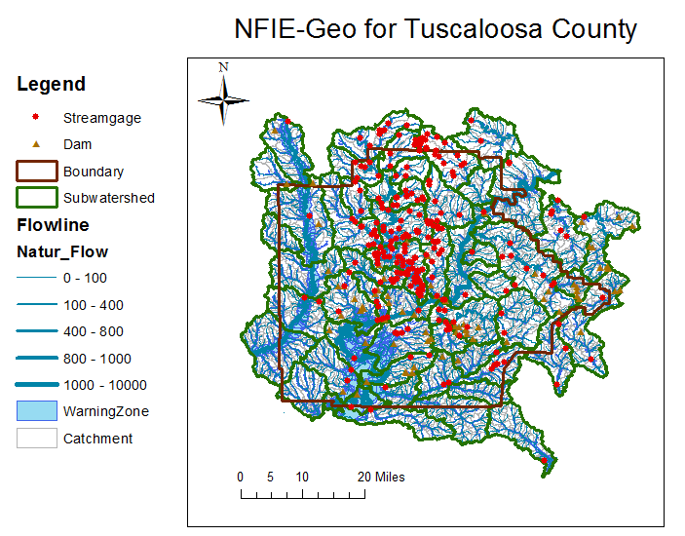
NFIE-Geo for a county….
County subset of national geospatial data layers
http://www.caee.utexas.edu/prof/maidment/CE397Flood/Assignment2/NFIEGeo.pdf

Slide 22
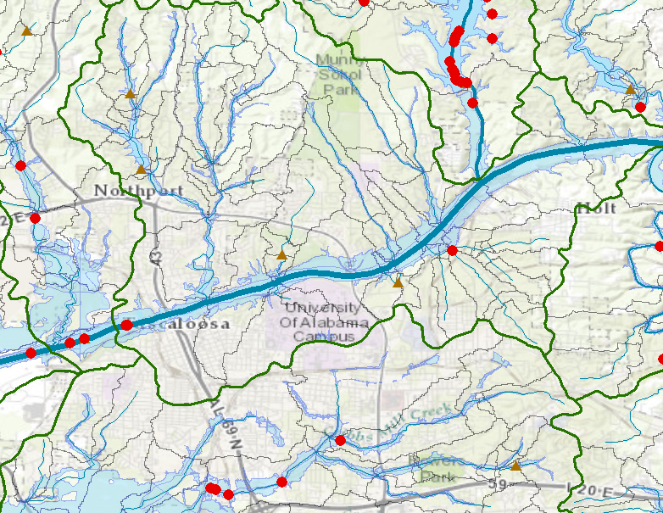
NFIE-Geo around University of Alabama Campus
Black Warrior River

Slide 23
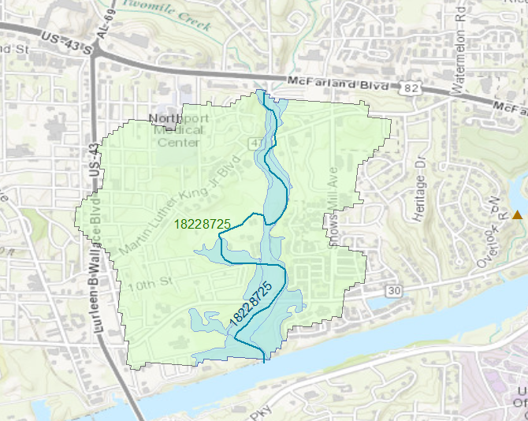
Catchment 18228725

Slide 24
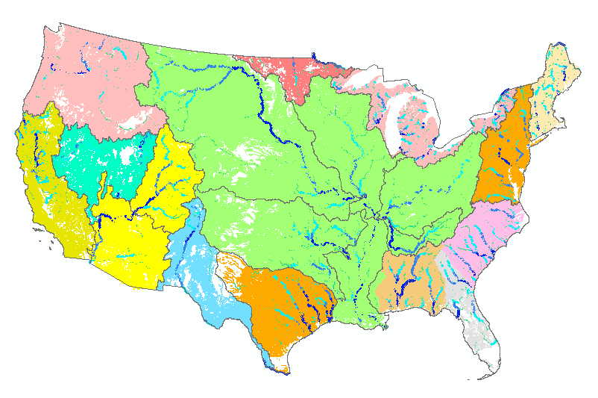
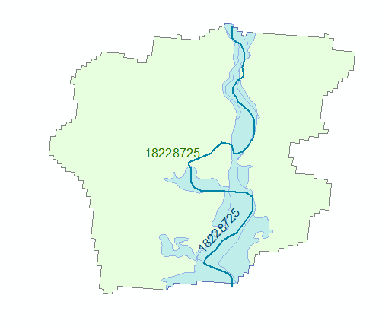
Geo to Hydro…
High spatial resolution hydrologic modeling at continental scale
Built upon NFIE-Geo: A national geospatial framework for hydrology
  Continental landscape divided into 2.67 million local catchments, each containing a single stream reach
  Stream reaches connect to form a national stream network
2.67 million catchments
Average area 3 km²
Average reach length 2 km

Slide 25
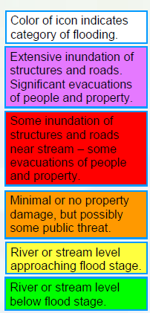
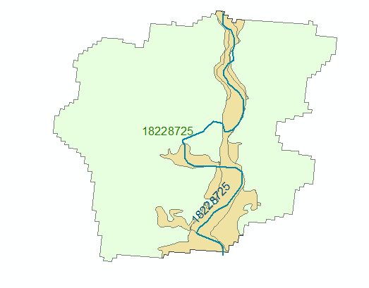
Flood risk zones…
Each catchment has a flood hazard zone defined from FEMA flood data
Probabilistic forecast from NFIE-Hydro defines flood risk
Color the zones according to risk

Slide 26
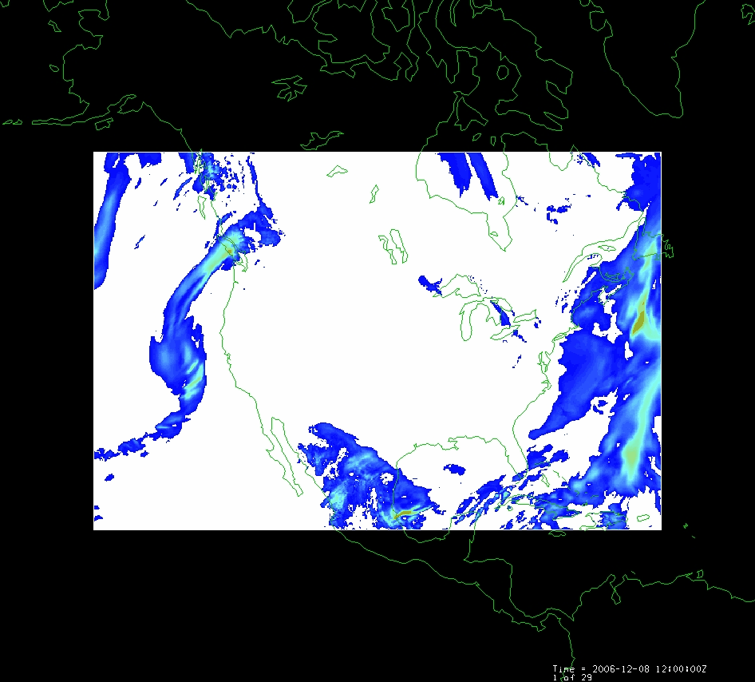
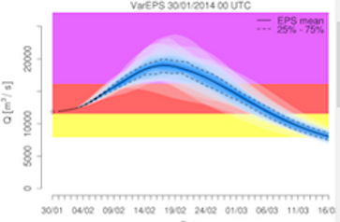
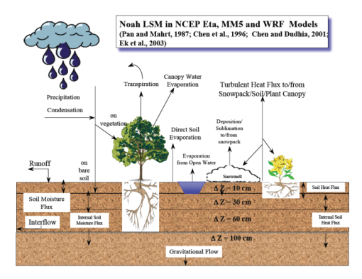
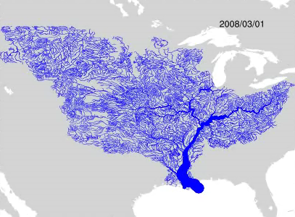
NFIE-Hydro Forecasting Model…
Weather model and forecasts (HRRR)
Probabilistic flood forecasts
Catchment-level forecasts
Weather
Precipitation
Streamflow
Runoff
Land-Atmosphere Model (WRF-Hydro)
RAPID flow routing (for continental US)

Slide 27
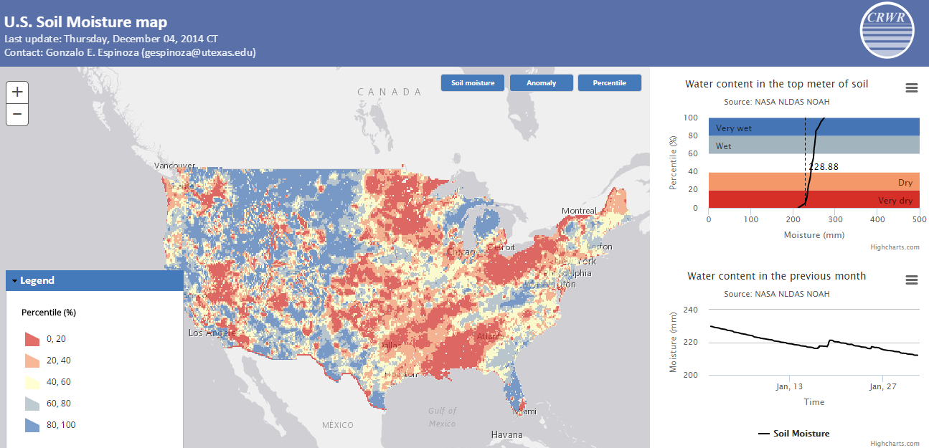
Soil Moisture Percentile Map
Current value expressed as a percentile based on historical data [1979 to present] on this calendar day at this spatial point
Compare present soil moisture with past conditions
http://statsnldas.azurewebsites.net/

Slide 28
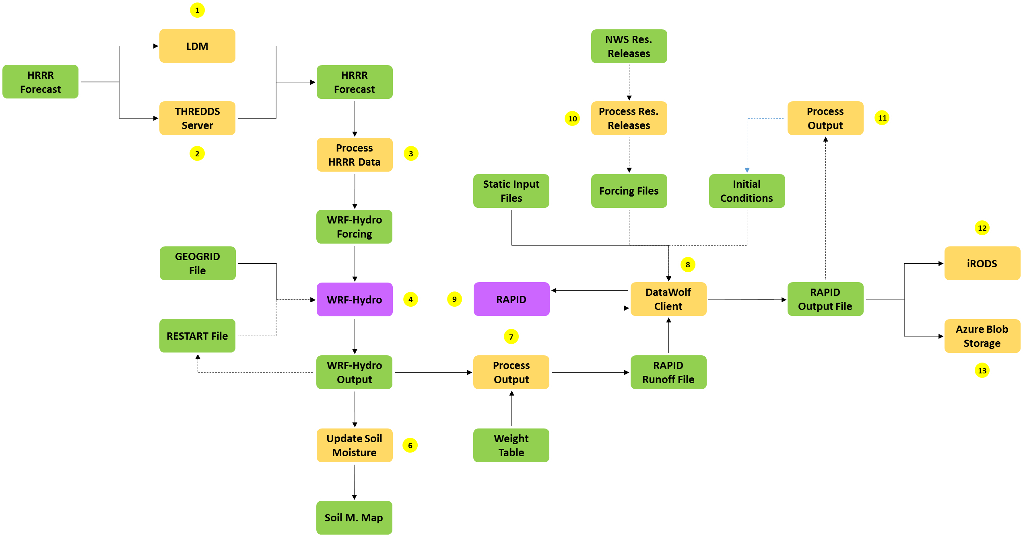
NFIE-Hydro Workflow
Implemented in Microsoft Azure

Slide 29
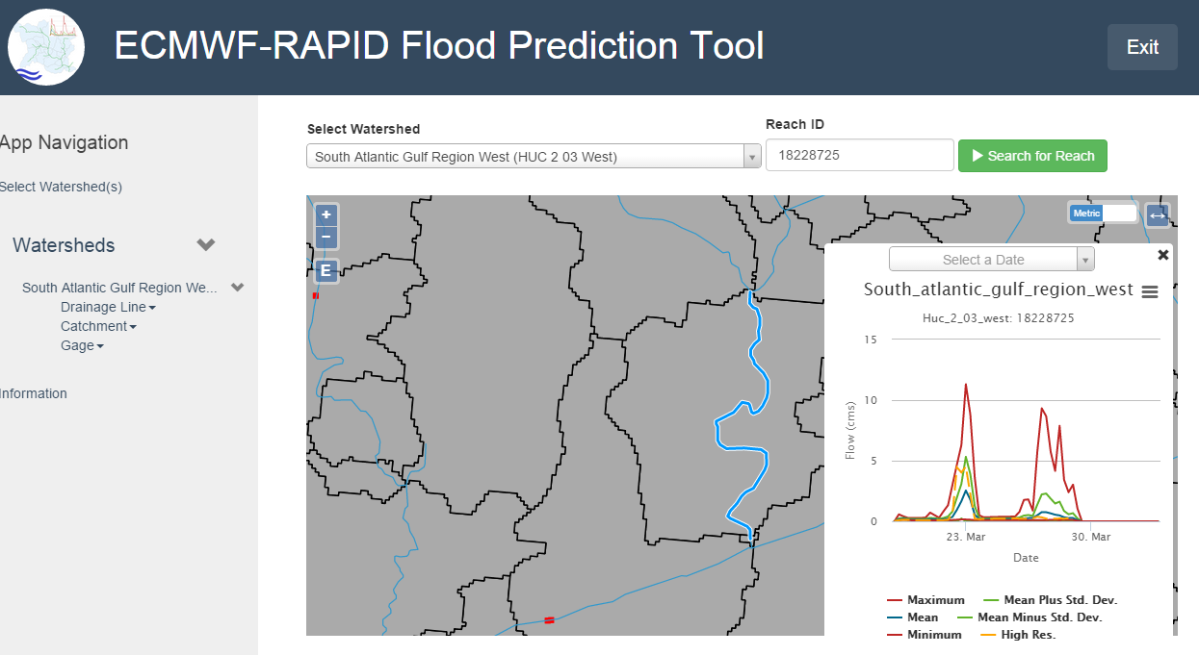
Tethys Application ….
Catchment
18228725
Brigham Young University
http://demo.tethys.ci-water.org/

Slide 30
NFIE Regional and Local scale…
NFIE-Geo: National geospatial framework for hydrology
NFIE-Response: Wide area planning for flood emergency response
NFIE-Hydro: National high spatial resolution hydrologic forecasting
NFIE-River: River channel information and real-time flood inundation mapping
NFIE-Services: Web services for flood information

Slide 31
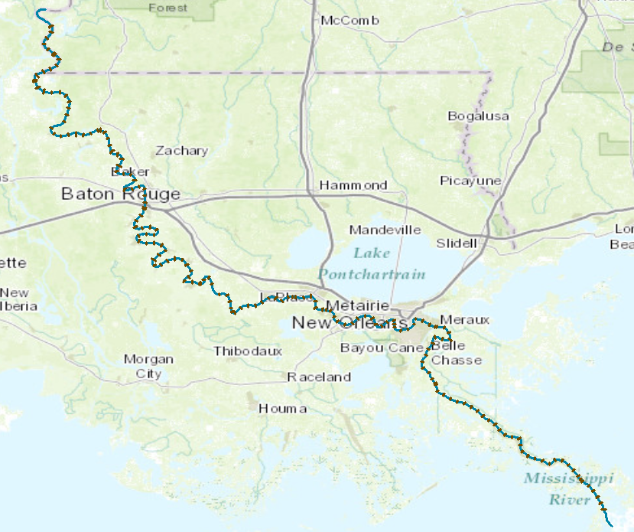
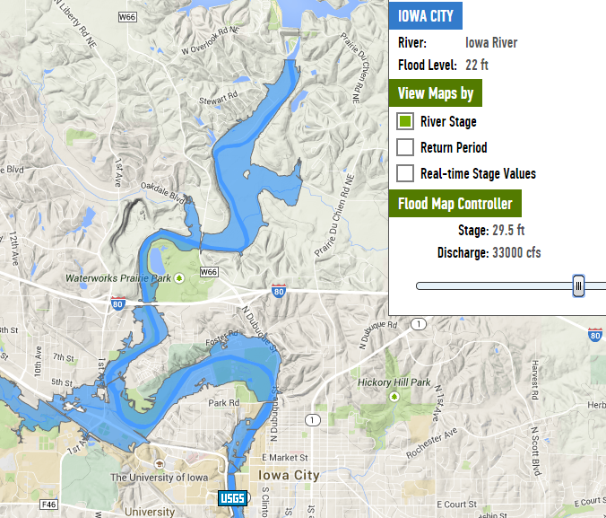

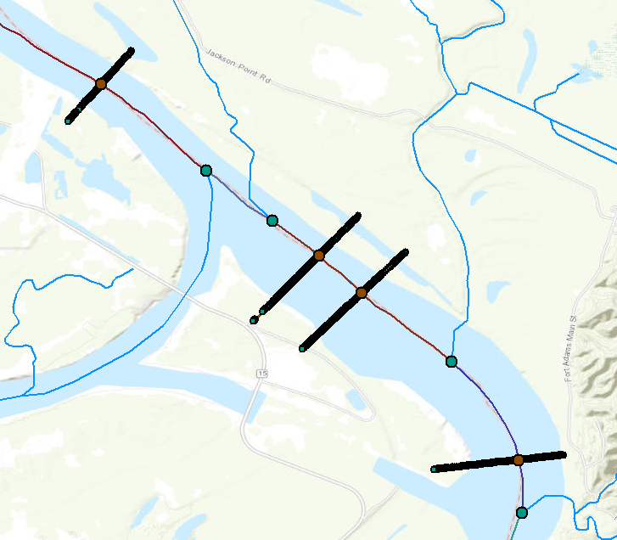
NFIE-River…
NFIE-River: Dynamic flood modeling, forecasting and inundation mapping in space and time
Requires LIDAR terrain data so can only be done for particular regions
Iowa Flood Information System

Slide 32
CrossSections on Lower Mississippi River
173 cross-sections over 543 km, or 3.1 km between cross-sections, on average
41,479 cross-section points (x,y,z) of bed elevation, or 240 points per cross-section, on average

Slide 33
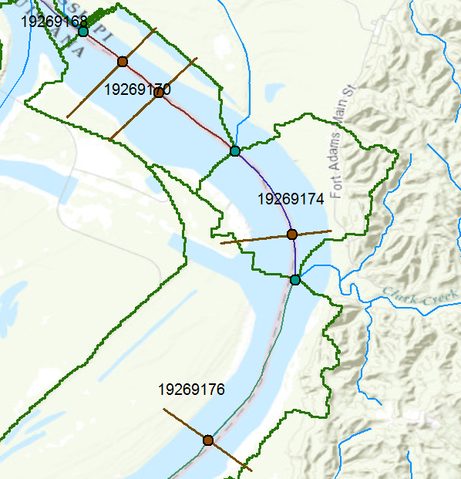
NFIE-Hydro and NFIE-River
Tributary inflow
Junction
XSIntersect
Catchment inflow

Slide 34
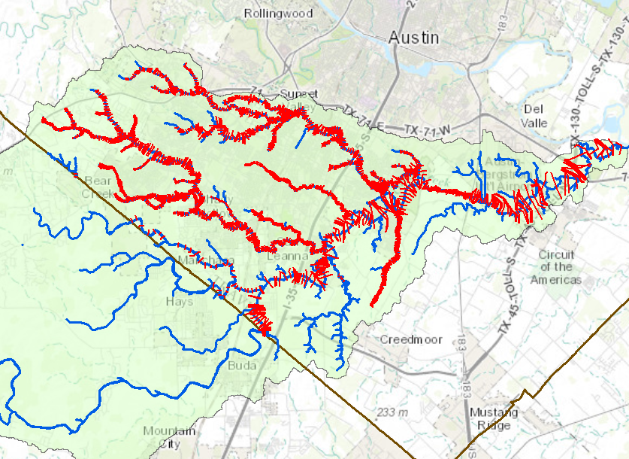
Cross-sections from HEC-RAS models
We need a national repository -- use HydroShare
Onion Creek watershed
Map: Xing Zheng
Data Source: City of Austin
Travis County
Hayes County

Slide 35
North Carolina Floodplain Mapping Program HEC- RAS Models
  5 Recurrence Intervals: 10, 25, 50, 100, 500
  300,000 cross-sections
  Each cross-section has a rating curve
Slide: Ken Ashe, NCFMP

Slide 36
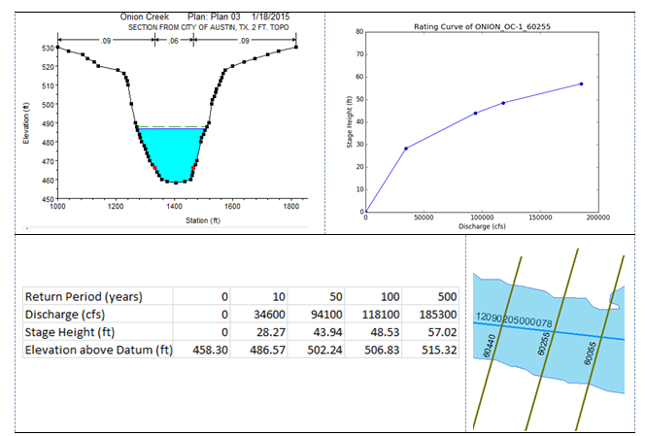
Return Period – Discharge – Stage Height – Water Surface Elevation

Slide 37
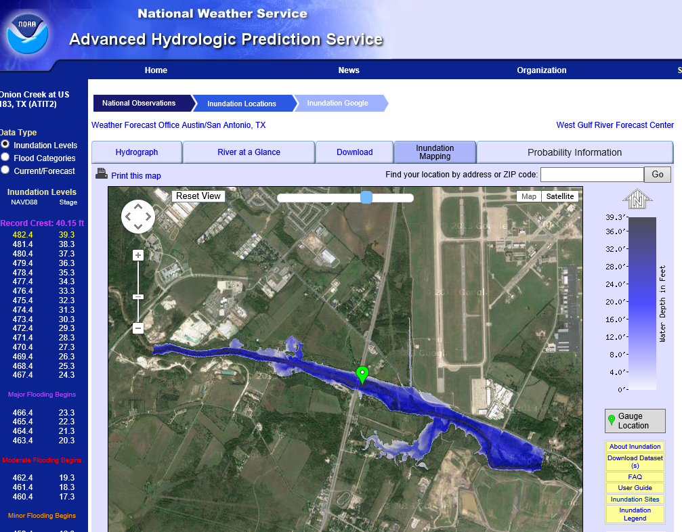
Real-Time Flood Inundation Mapping (USGS/NWS)
http://water.weather.gov/ahps2/inundation/inundation_google.php?gage=atit2

Slide 38
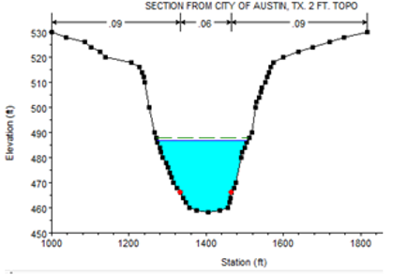

NFIE-River Advances …
River Cross-Sections and Ratings Template
Hydraulic modeling on large rivers
  Mississippi
  Tar Basin (NC)
  Mobile-Alabama
  Iowa ….
River-Coast interaction
SPRNT Modeling for St Venant Equations
(like electricity flow in computer chips)

Slide 39
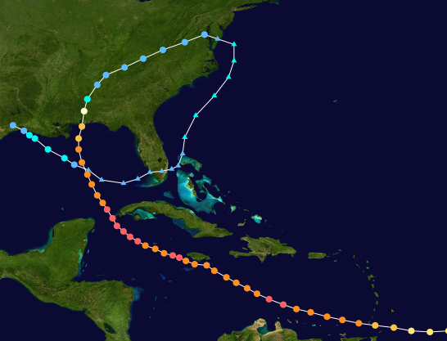
Hurricane Ivan, September 2004
The most expensive disaster in the history of Alabama

Slide 40
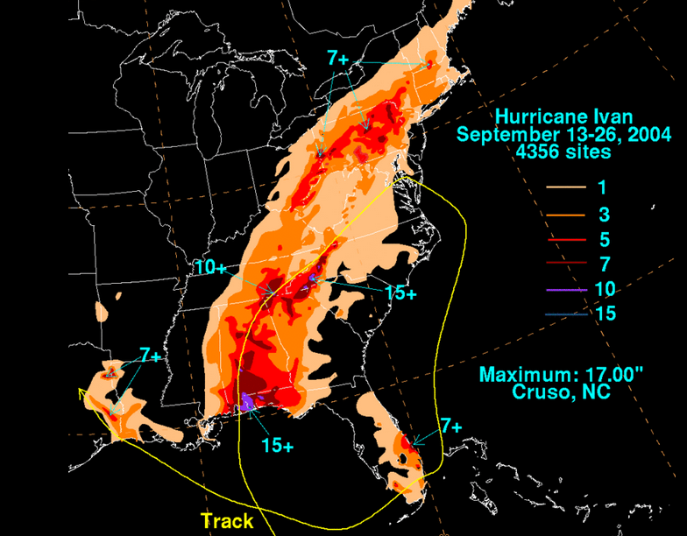
Hurricane Ivan as a case study
http://en.wikipedia.org/wiki/Hurricane_Ivan#Alabama

Slide 41
NWS River Forecast Centers
No River Forecast
Notes:
THERE’S A MAJOR GEOGRAPHIC GAP – WE DON’T FORECAST ALONG THE COAST

Slide 42
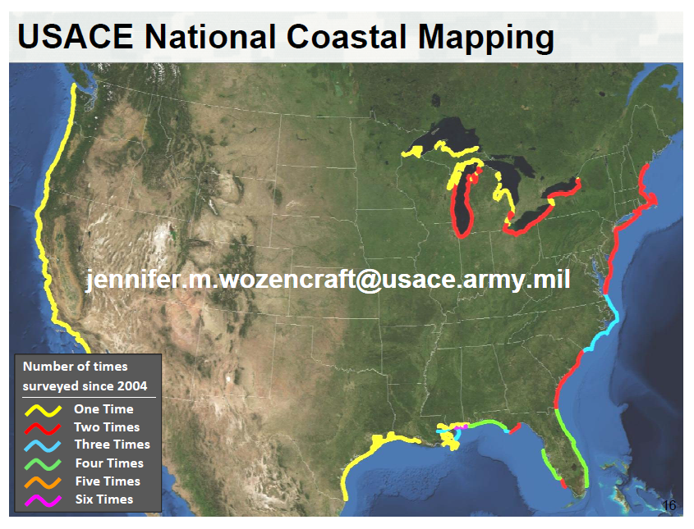

Slide 43
Severe Flooding in Mobile during Ivan
Black Warrior River
Case study for river-coastal interaction

Slide 44
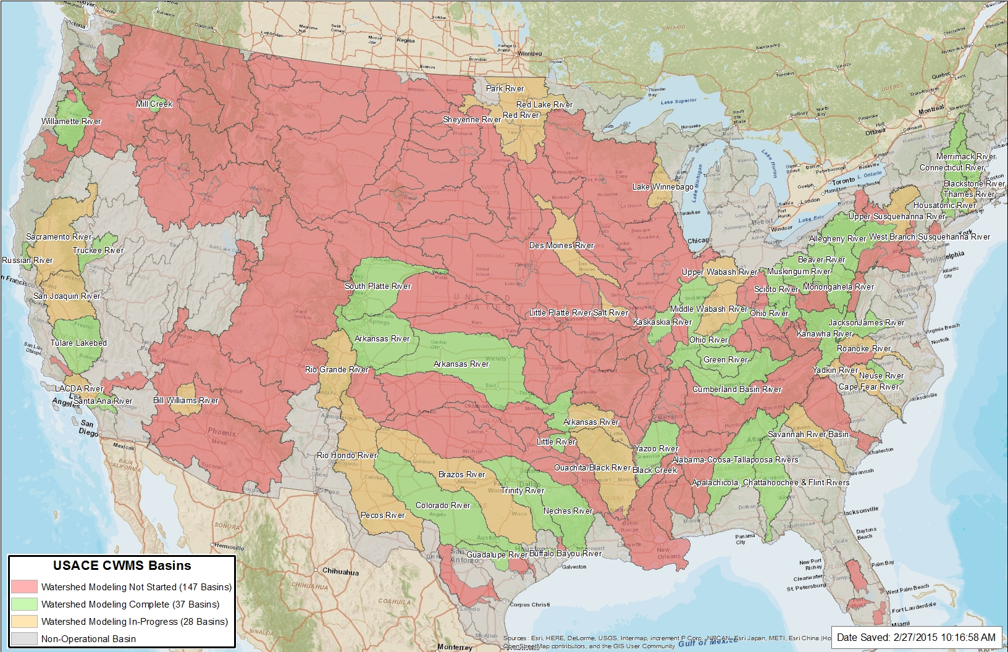
Corps of Engineers Modeling, Mapping and Consequences program
Source: R. Simrall, USACE

Slide 45
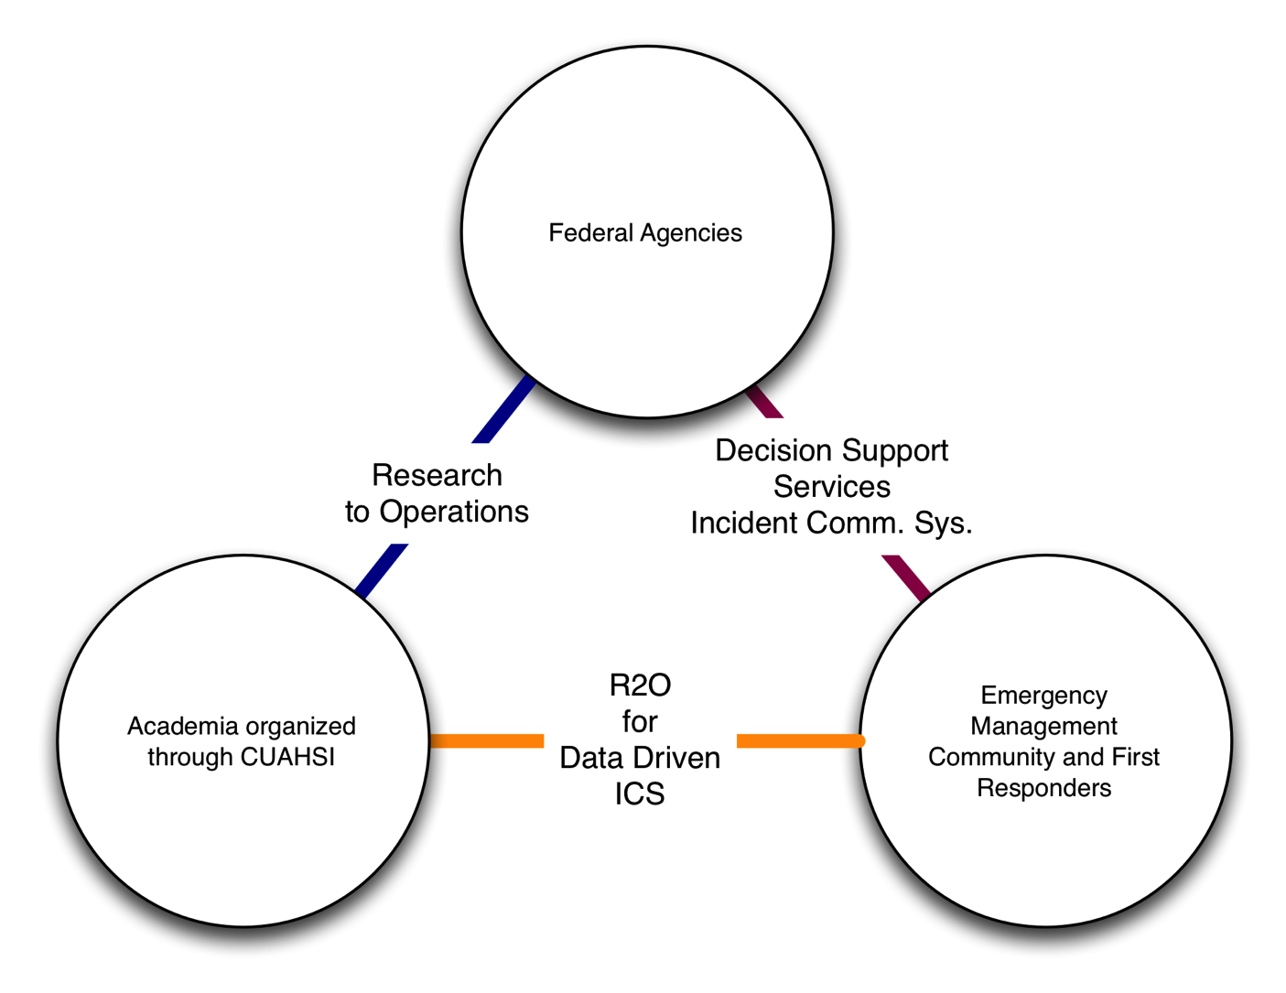
NFIE-Response…

Slide 46


Flood Emergency Response…
NFIE-Response: Work with the first response community to define flood strategy and tactics
https://www.youtube.com/watch?v=ympaR6YUxiA&feature=youtube

Slide 47
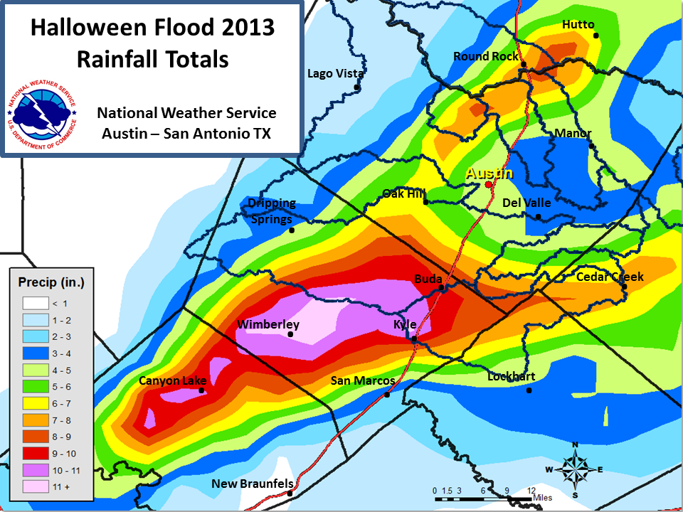
Actual Rainfall Totals
Onion Creek watershed

Slide 48
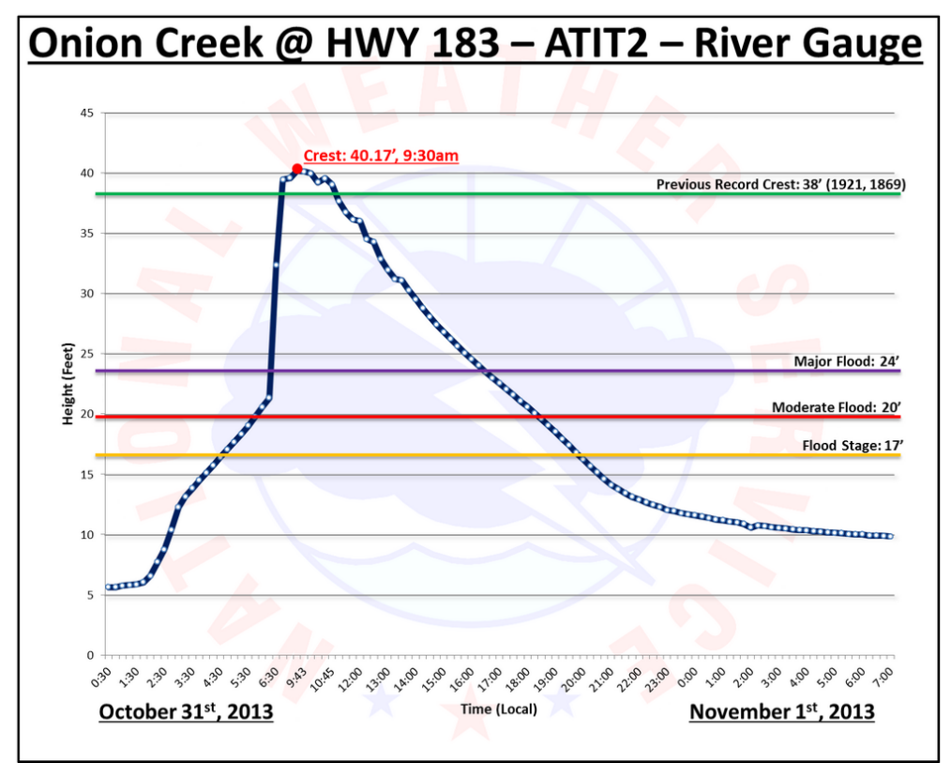

Slide 49
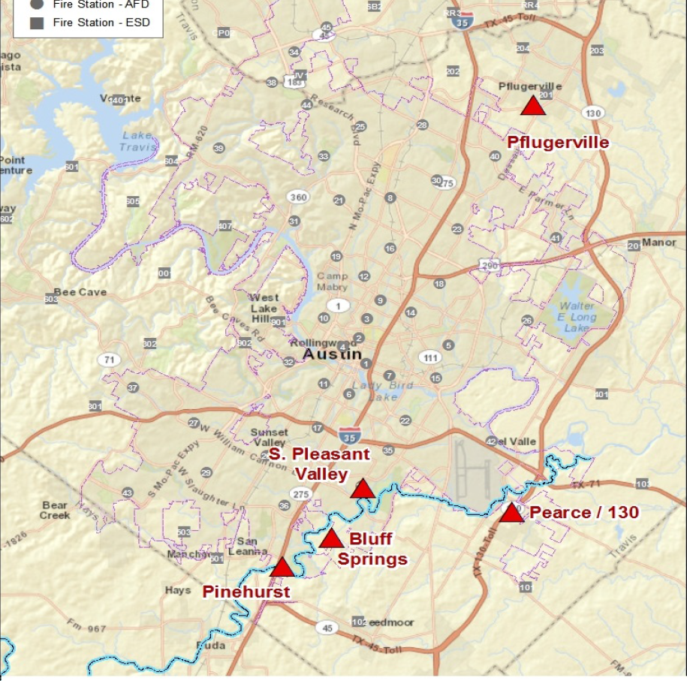
11:30PM, Oct 30
Incident Command Locations
6.00AM, Oct 31
4.25AM, Oct 31
5.50AM, Oct 31

Slide 50
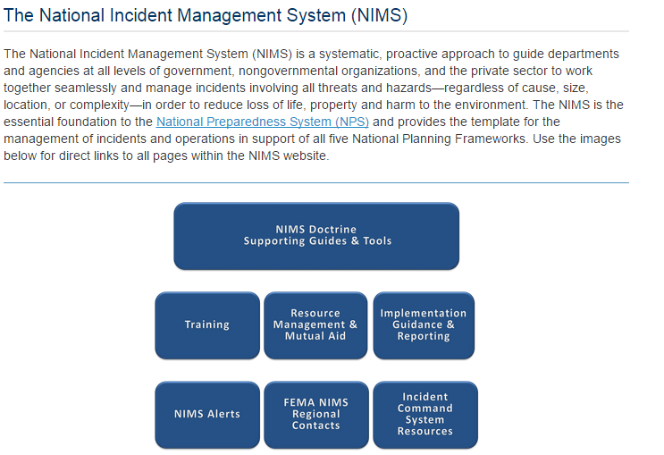

Slide 51
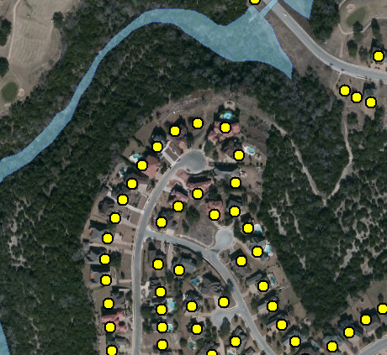


Address Points -- used for directing emergency response vehicles
All legal residences have an address point
Established when the lot is legally platted and registered with the county

Slide 52
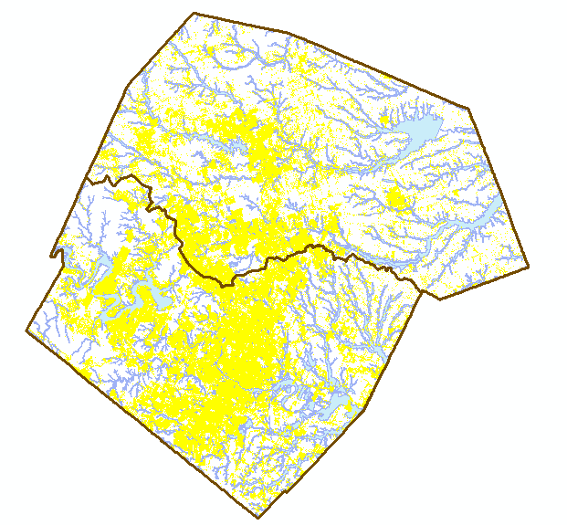
Address Points and the Flood Hazard Zone
Williamson County
495,000 Address points in the two counties
How many points are in the flood hazard zone?
Where are the high flood risk areas in these counties?
Austin, Texas
Travis County

Slide 53
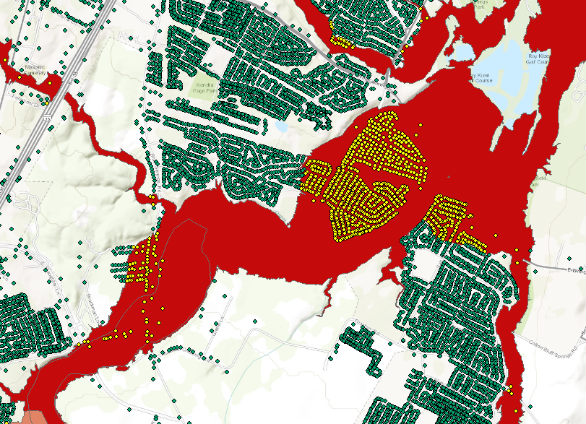

Address Points and the Floodplain

Slide 54



Intersection of Streams and Roads
5517 intersection points in Travis and Williamson Counties
Both datasets at 24K resolution
Data: Xing Zheng

Slide 55

Tuscaloosa as a case study for local flood emergency response
Start with NFIE-Geo for Tuscaloosa County
Wide Area Flood Planning
Interact with local emergency response community
Real-time flood mapping and response

Slide 56
Transformative for the nation…
Forecasts produced by
  Current system – 3600 locations
  NFIE system – 2.67 million locations
New Information to help emergency managers save lives and keep people safe
700 times more
Current
Proposed

Slide 57
Flood Emergency Response…
NFIE-Response: Work with the first response community to define flood strategy and tactics
https://www.youtube.com/watch?v=ympaR6YUxiA&feature=youtube

