Slide 1
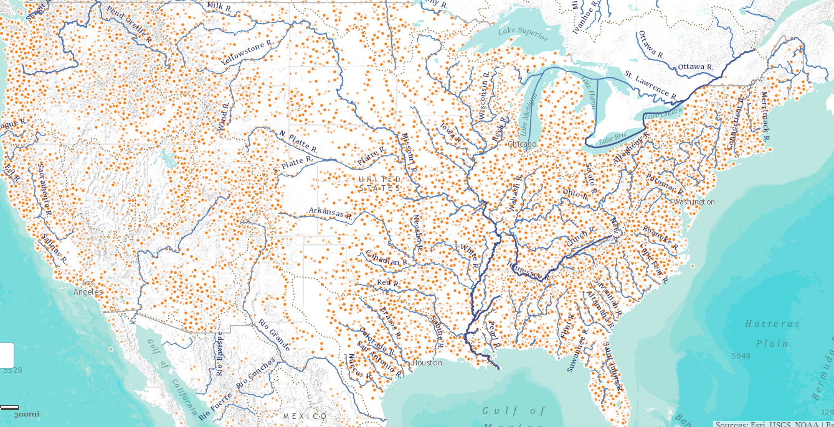
National Flood Interoperability Experiment
National Science Foundation
Arlington, VA
24 July 2014

Slide 2
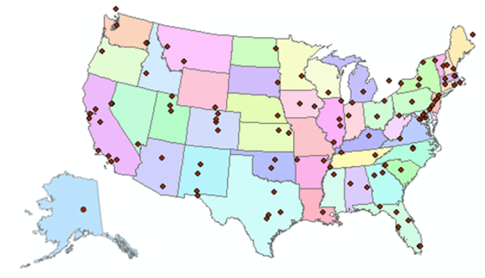
Consortium of Universities for the Advancement of Hydrologic Science, Inc.
www.cuahsi.org
CUAHSI
A consortium representing 125 US universities
Dr. Richard Hooper, President and CEO
Supported by the National Science Foundation Earth Science Division
Advances hydrologic science in nation’s universities
Includes a Hydrologic Information System project
Invented WaterML language for water resources time series
Building an academic prototype system

Slide 3
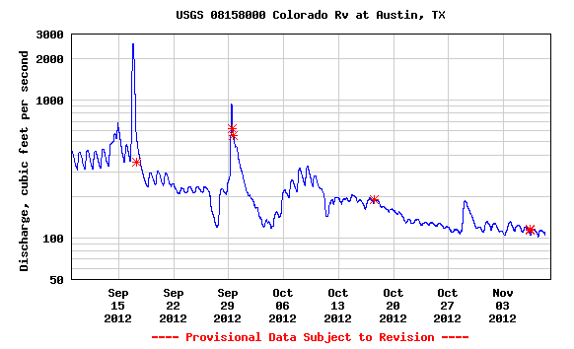
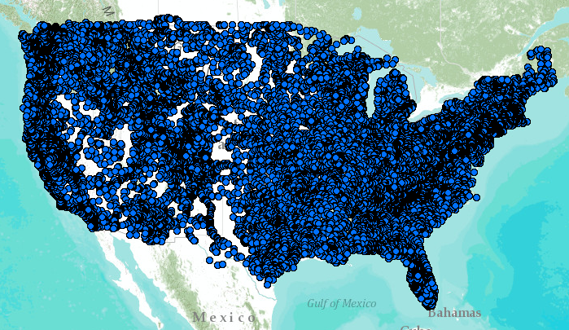
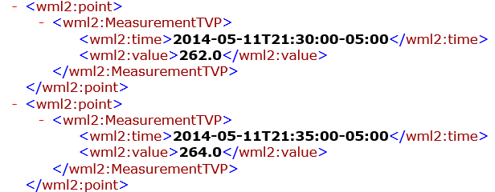
WaterML Web Services – CUAHSI, USGS, OGC, WMO …..
Water time series data on the internet
24/7/365 service
For daily and real-time data
. . . Operational water web services system for the United States
http://waterservices.usgs.gov/nwis/iv/?format=waterml,2.0&sites=08158000&period=P1D&parameterCd=00060

Slide 4
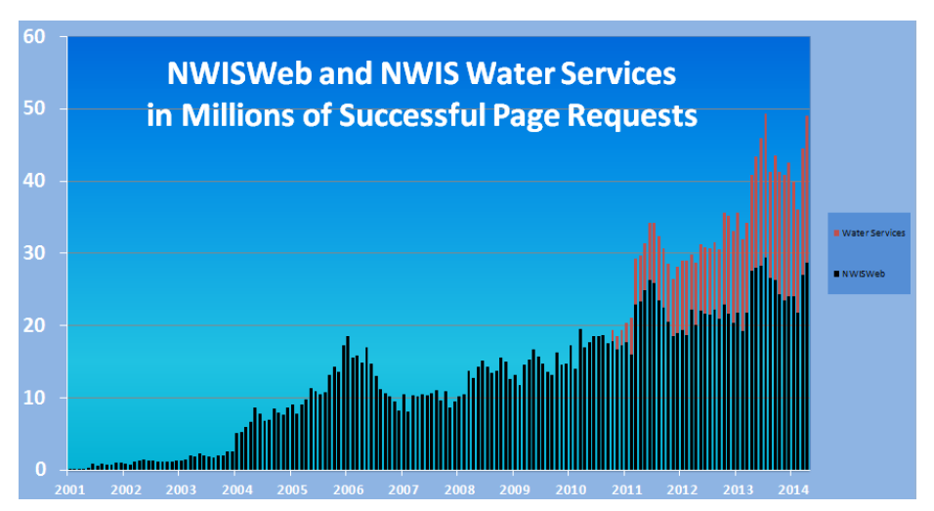

Slide 5
Open Geospatial Consortium
More than 400 companies and agencies globally
Internet standards for
Map services
Observation services
Catalog services
. . . Internet data standards for maps and observational data

Slide 6
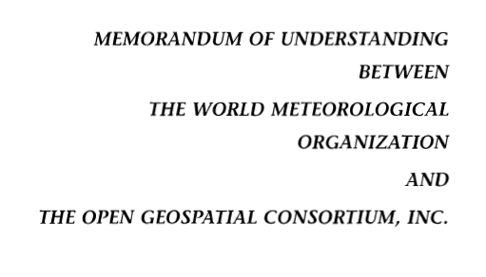
OGC/WMO Hydrology Domain Working Group
4-Year International Effort – WaterML
A time series for one variable at one location
Hydrology Domain Working Group formed
OGC at WMO Commission for Hydrology
Technical Meetings Each 3 Months Four Interoperability Experiments
(Surface water, groundwater, forecasting)
Annual week-long workshops
Involvement by many countries
November 2009
Acknowledgements: OGC, WMO, GRDC, NWS, CUAHSI, BoM/CSIRO, USGS, GSC, Kisters, …….
2008
2009
2010
2011
2012
Notes:
(1) A four-year international effort has been undertaken to reconcile WaterML with international standards;
(2) This effort was initiated with the establishment of an Hydrology Domain Working Group by the Open Geospatial Consortium in September 2008;
(3) An OGC representative attended the WMO Congress of the Commission for Hydrology in 2008
(4) A formal agreement between Secretary General of WMO and President of OGC in 2009 to jointly develop standards for hydrology, climatology, oceanography and climatology;
(5) The joint OGC/WMO Hydrology Domain Working Group was supported by a large work effort, annual week-long workshops, four interoperability experiments for surface and groundwater data exchange, and participation by many countries;
(6) In June 2012, the OGC voted to adopt the revised version, WaterML2 as an international standard for exchange of water resources time series (the first such public standard that has existed);
(7) This Congress to the WMO Commission for Hydrology to whom I am speaking is considering WaterML2 for adoption as an official standard by WMO

Slide 7
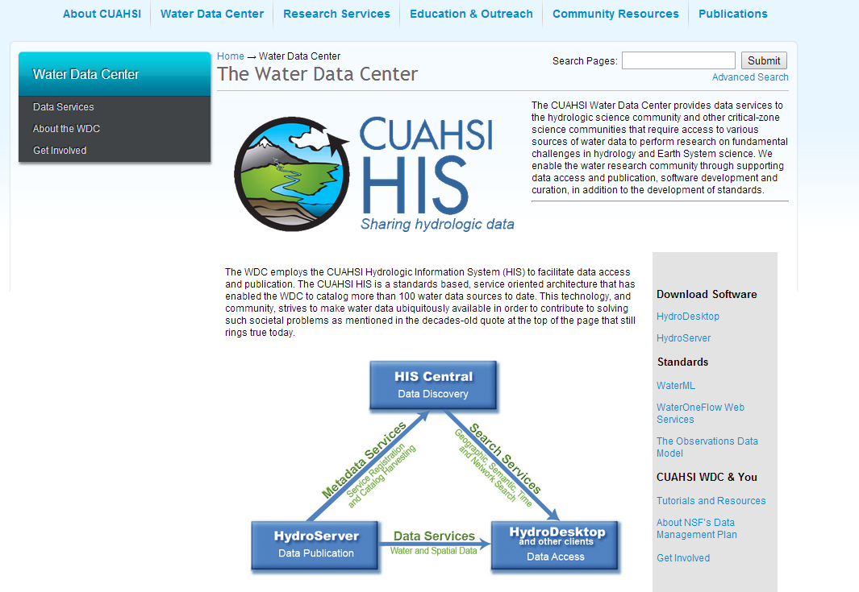
CUAHSI Water Data Center

Slide 8
Committee on Environmental, Natural Resources, and Sustainability (CENRS)
“WaterML: Water Markup Language (ML) is an informatics initiative of the CENRS Subcommittee on Water Availability and Quality that provides a systematic way to access water information from point observation sites.” (p.21)
WaterML is the first OGC standard endorsed by the Executive Office of the President
http://www.whitehouse.gov/sites/default/files/microsites/ostp/nstc_2013_earthobsstrategy.pdf

Slide 9
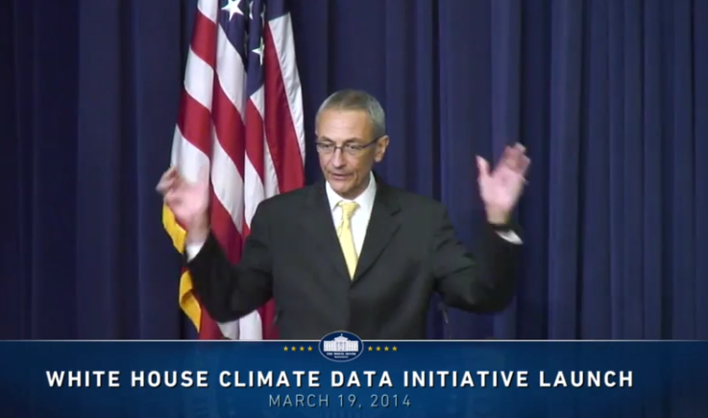
President’s Climate Data Initiative
John Podesta, Counsellor to the President, White House, March 19, 2014
https://www.youtube.com/watch?v=pfe5oRdsCp0&feature=youtu.be&t=7s

Slide 10
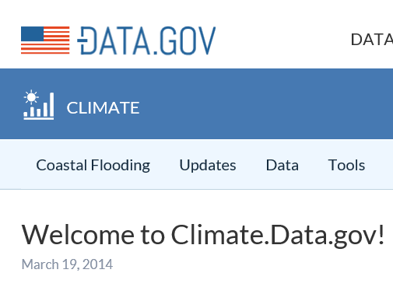
Goals of Climate Data Initiative
Prepare for climate change
Make government data accessible
Engage private sector
ESRI, Microsoft, Google, Intel ….
Engage communities
Chesapeake, New Orleans, World Bank, …
Why not Water.Data.gov?
Build an Open Water Data Initiative

Slide 11
Anne Castle, Asst Secretary for Water and Science, Dept of Interior
“Today we have unprecedented opportunities to use science and technology to create a better understanding of one of our most precious resources – water”
“I am committed to working with you to do that”
Chair

Slide 13
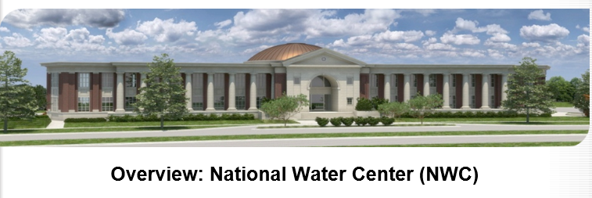
Common Operating Picture for Water Resources
Geo-Intelligence Laboratory
Science and software studio
Systems proving ground
Distance learning
Center opened on 13 May 2014

Slide 14
National Flood Interoperability Experiment (NFIE): Connecting national flood forecasting with local flood emergency response
Will be led by the academic community coordinated by CUAHSI in collaboration with the IWRSS partners (NWS, USGS, Corps of Engineers, FEMA) through the National Water Center
Run from September 2014 to August 2015
Preparatory phase to May 2015
Summer Institute at the National Water Center to bring things together June to August 2015
Goals:
Improved high spatial resolution, near-real-time flood forecasting using the NHDPlus spatial framework or next generation geofabric;
Improved flood emergency response and community resilience;
Improved interoperability framework to accomplish (1) and (2).

Slide 15
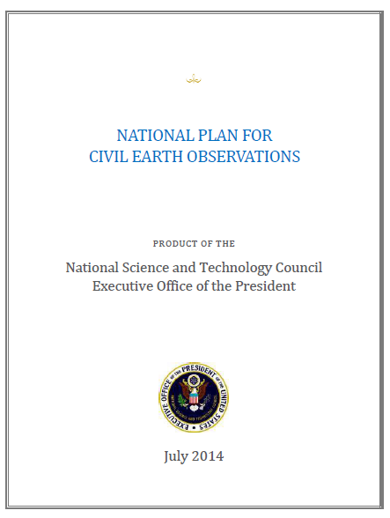
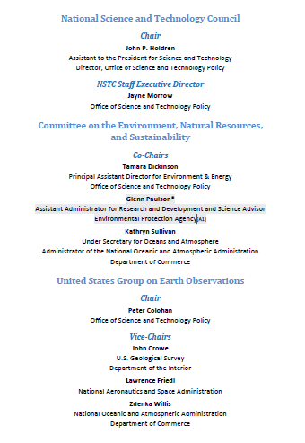
National Plan for Civil Earth Observations (Office of Science and Technology Policy, July 2014)

Slide 16
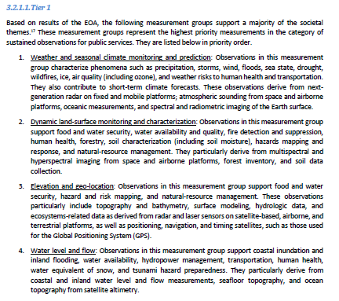
Highest Priority Observations
Weather and Seasonal Climate Monitoring and Prediction
Dynamic land-surface monitoring and characterization
Elevation and Geo-Location
Water level and flow
Science goal: Link these four sources of observations to help predict floods and assess their impact on people

Slide 17
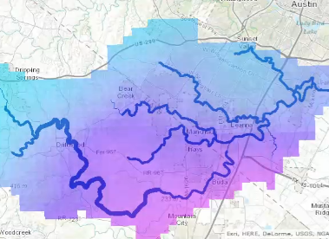
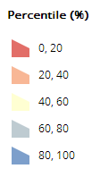
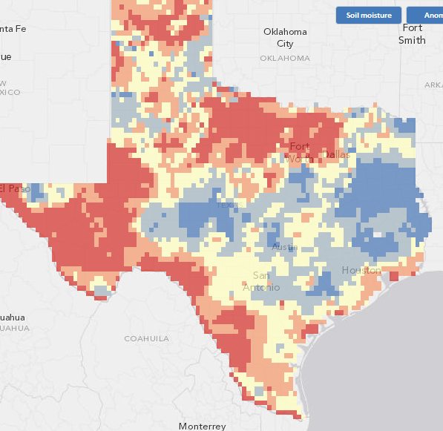
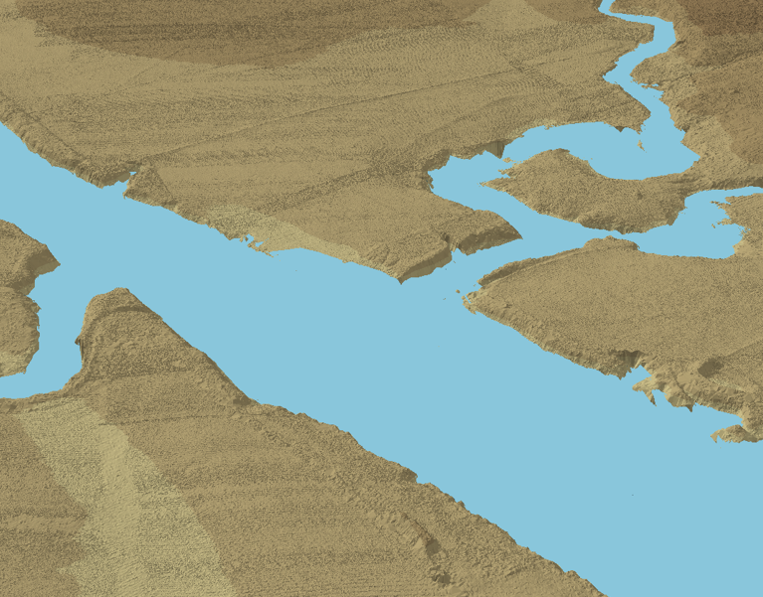
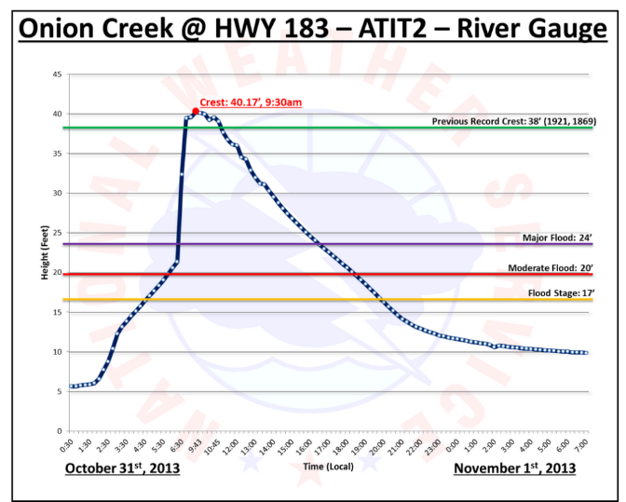
Flood observations and modeling
Nexrad rainfall and flood runoff
Soil moisture
Flood water level
Flood inundation on LIDAR terrain

Slide 18
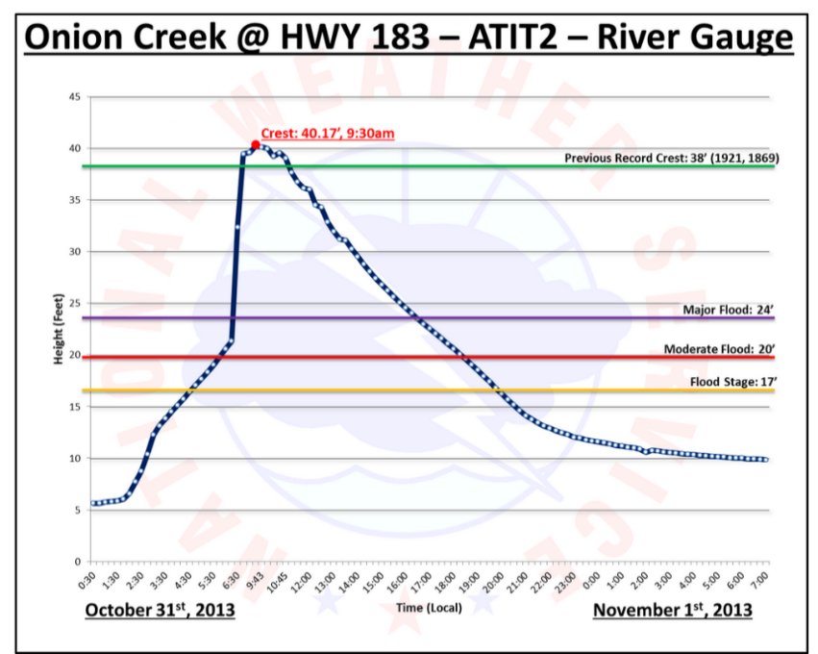
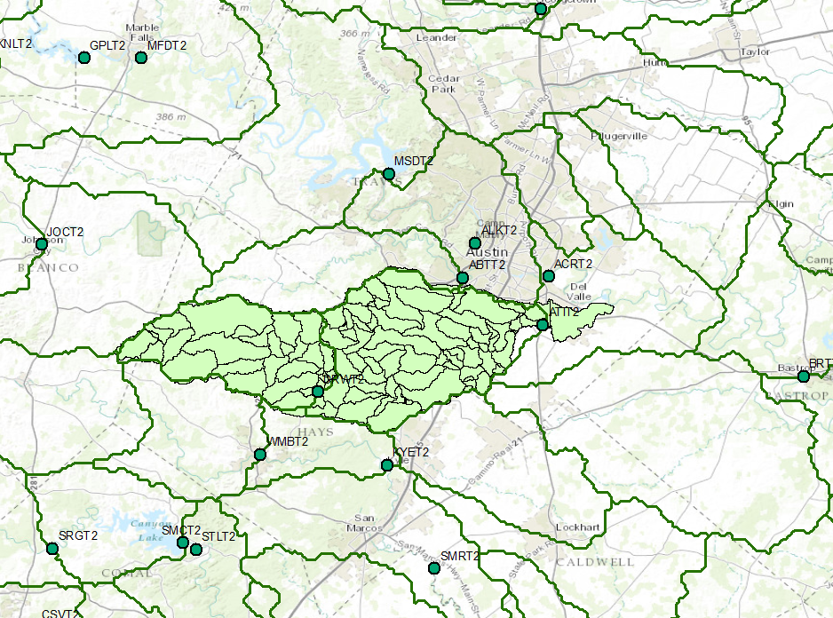
National and Local Flood Modeling
City of Austin (NHDPlus)
NWS River Forecast Center

Slide 19
Flow in the Mississippi Basin
RAPID model, 3 hour time steps
David et al. (2011) DOI: 10.1175/2011JHM1345.1
GIS data describes 5,175 river reaches . . .
. . . simulate flow in each reach in each time step

Slide 20
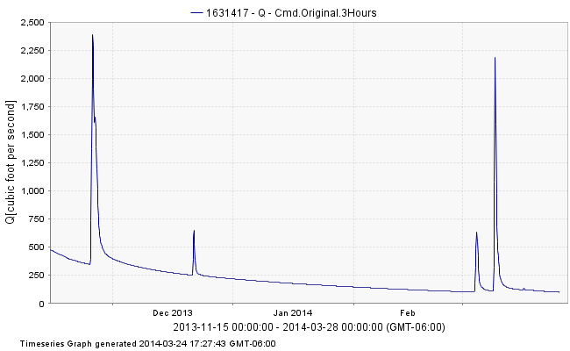
Water Operations Model RAPID Streamflow Calculations – 5,175 NHDPlus river reaches
Map Service
Data Service
https://ut-austin.maps.arcgis.com/home/webmap/viewer.html?webmap=d107aa9260534ddbb96db302e3643a93

Slide 21
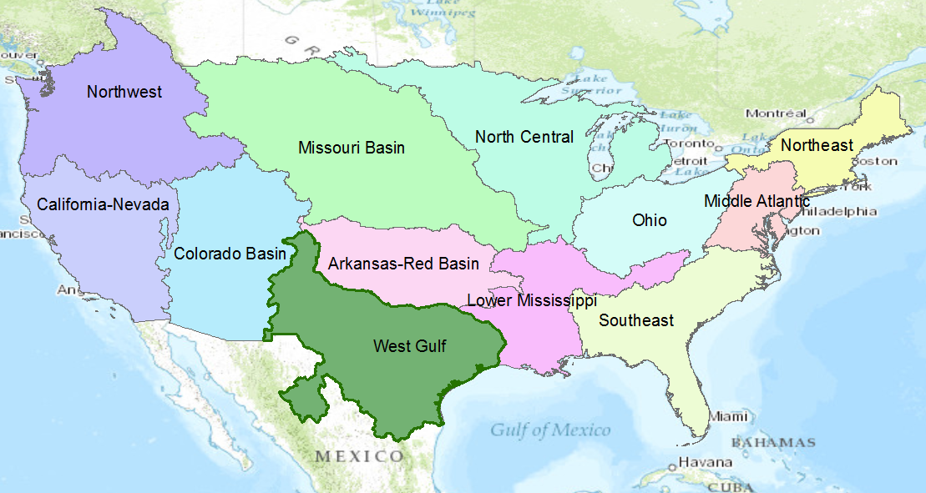
River Forecast Centers

Slide 22
Flood hydrology and response
Flood Inundation Map Library
Flood hydrology and hydraulic data, models, forecasts
Flood emergency response planning and action
Forecast the flood elevation
Determine and plan for flood impact

Slide 23
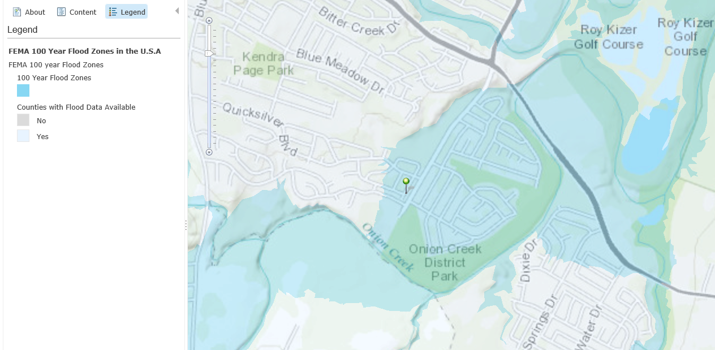
FEMA Flood Hazard Zone

Slide 24
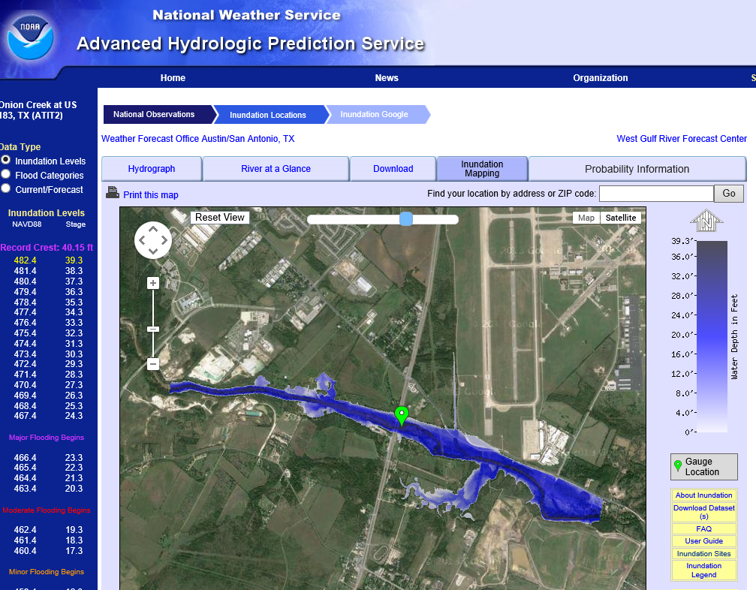
Real-Time Flood Inundation Mapping on Onion Creek (USGS/NWS)
Gage at Highway 183
http://water.weather.gov/ahps2/inundation/inundation_google.php?gage=atit2

Slide 25
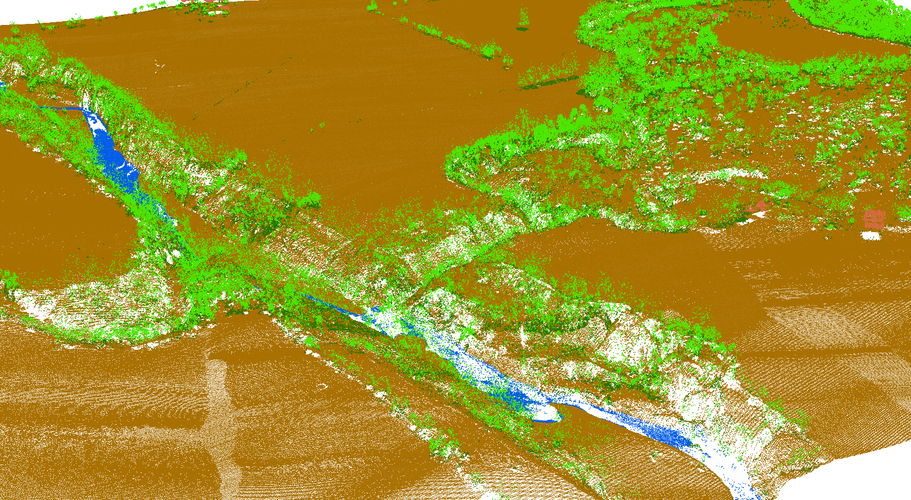
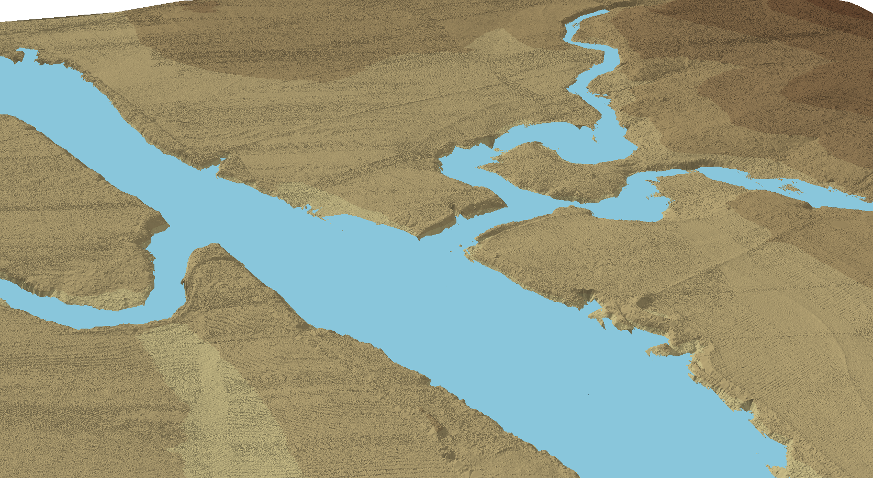
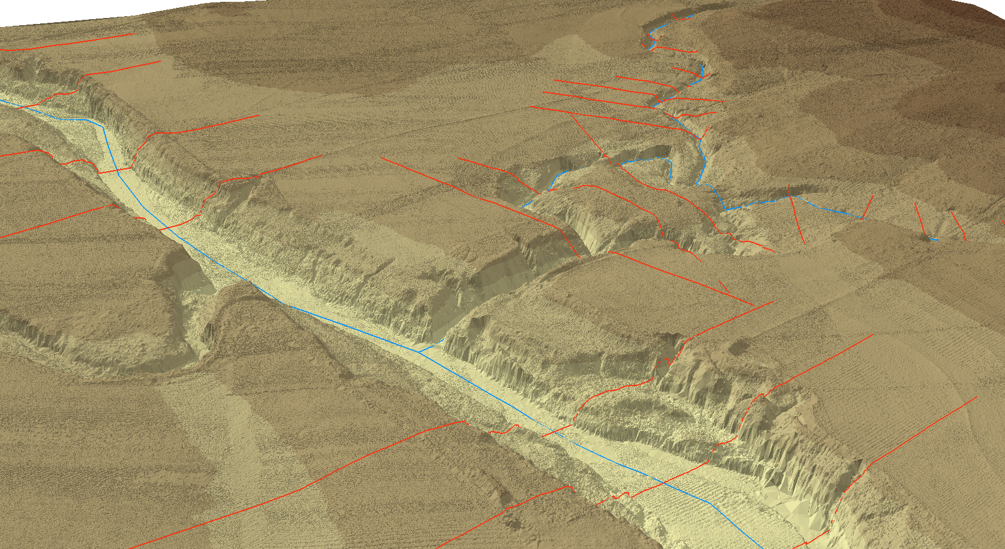
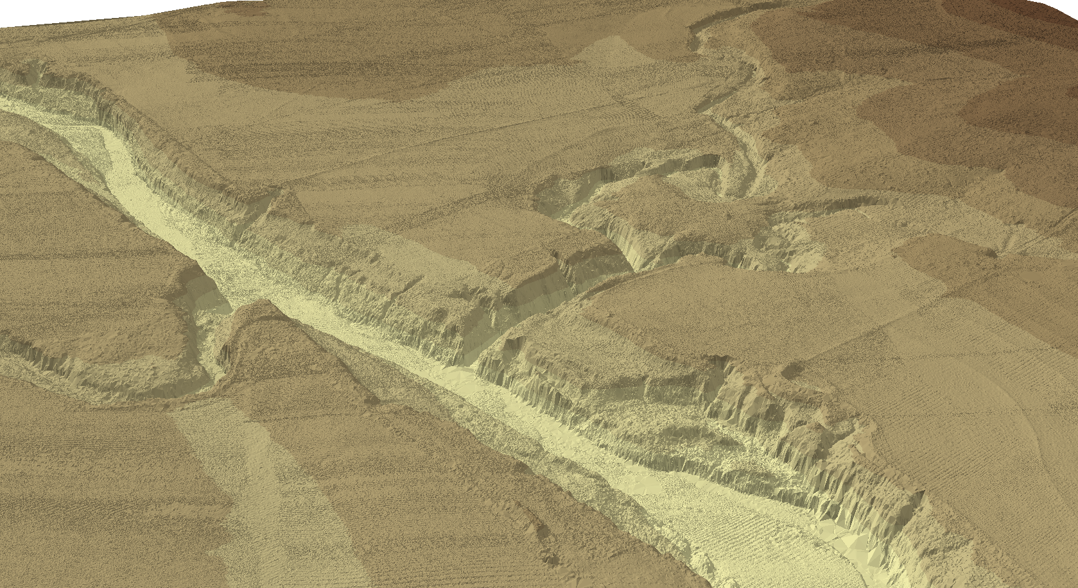
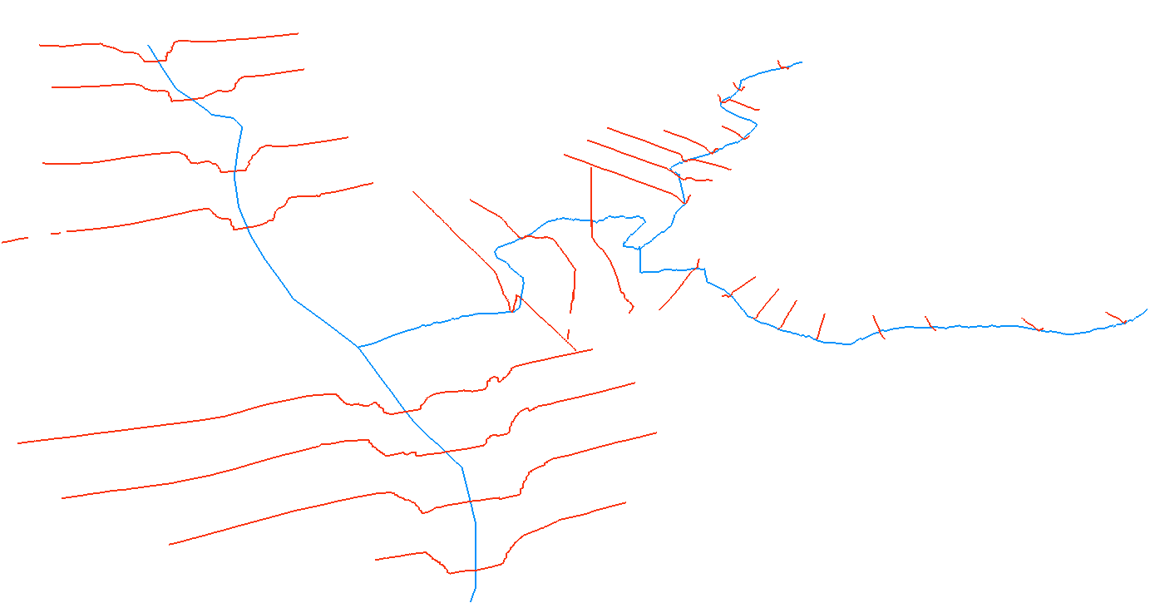
Flood Modeling: Geometry and Flow
RiverML – a language for communicating river channel and flood inundation map information

Slide 26
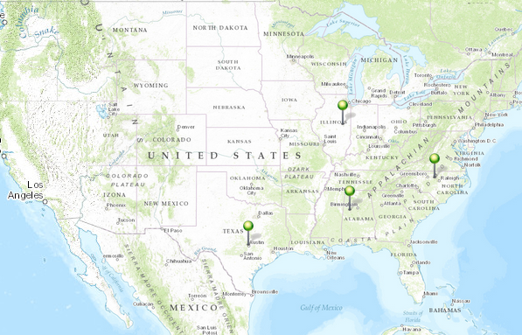
NFIE Academic Centers
University of Illinois
(Modeling)
University of North Carolina
(Data)
University of Texas
(Interoperability)
University of Alabama
(Emergency Response)

Slide 27
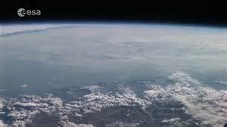
Map Projection
Projected Coordinate Systems (X, Y)
Albers Equal Area
State Plane
Universal Transverse Mercator
(X₁, Y₁)
(X₂, Y₂)
(X₃, Y₃)
Geographic Coordinate
System
Earth Datum
(Latitude, Longitude)
(φ, λ)
Global Positioning
Systems

Slide 28
Earth Cube: Information Projection
Specific Information Technical Framworks
(All Discrete in space and time to some degree)
Water Time Series
Remote Sensing
Gridded simulation Models
(v,t)
(v₁ , … , x, y)
(v₁ , v₂ , v₃ … , x, y, z, t)
Real Earth
(Continuous in space
and time)
Open
Information
Standards

