Slide 1
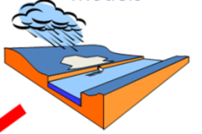
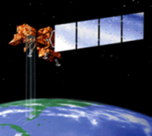
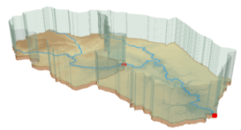
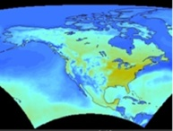
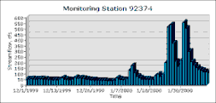
CUAHSI Hydrologic Information System and the Virtual Observatory
David R. Maidment
Center for Research in Water Resources
University of Texas at Austin
NSF-NERC Workshop
Washington DC
March 1, 2010

Slide 2
CUAHSI Hydrologic Information System and the Virtual Observatory
The cloud and web services
CUAHSI water data services
Building water data networks
Ways of using water data services

Slide 3
CUAHSI Hydrologic Information System and the Virtual Observatory
The cloud and web services
CUAHSI water data services
Building water data networks
Ways of using water data services

Slide 4
HIS Team and Collaborators
University of Texas at Austin – David Maidment, Tim Whiteaker, James Seppi, Fernando Salas
San Diego Supercomputer Center – Ilya Zaslavsky, David Valentine, Tom Whitenack, Matt Rodriguez
Utah State University – David Tarboton, Jeff Horsburgh, Kim Schreuders, Justin Berger
University of South Carolina – Jon Goodall, Anthony Castronova
Idaho State University – Dan Ames, Ted Dunsford, Jiri Kadlec

Slide 5
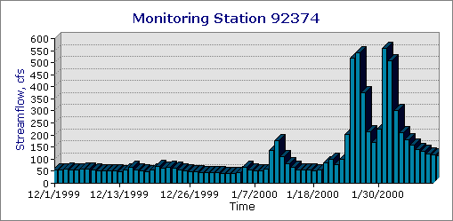
A Virtual Observatory for Catchments
Accessing and synthesizing data and models ……
Modeling
Remote Sensing
Weather and Climate
Monitoring
Catchment
…… doing this in “the cloud”

Slide 6
What is “the cloud”? Networks of computers connected through the web …….
Everything is a service
Data, models, visualization, ……
A service receives requests and provides responses using web standards (WSDL)
It uses customized web languages
HTML (HyperText Markup Language) for text and pictures
WaterML for water time series (CUAHSI)
GML for geospatial coverages (OGC)
….. supporting a wide range of users

Slide 7
How does the internet work?
This is how it got started …..
Web servers
Text, Pictures
in HTML
Mosaic browser
…..this is how it works now
Google, Yahoo, Bing
Catalog
Three key components linked by services and a common language
Metadata harvesting
Search Services
Web servers
Text, Pictures
in HTML
Firefox, Internet Explorer
Server
User

Slide 8
What has CUAHSI Done?
Taken the internet services model …..
Catalog
Server
User
…..and implemented it for water observations data
HIS Central
Metadata harvesting
Search Services
HydroServer, Agency Servers
Time series data
in WaterML
HydroExcel, HydroDesktop, ...

Slide 9
CUAHSI Hydrologic Information System and the Virtual Observatory
The cloud and web services
CUAHSI water data services
Building water data networks
Ways of using water data services

Slide 10
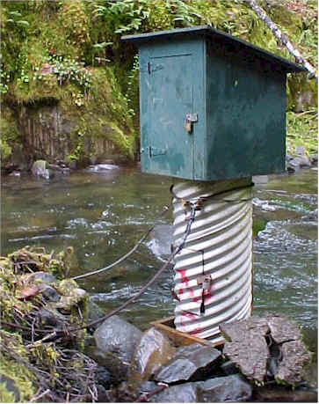
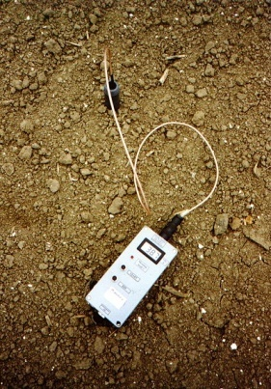
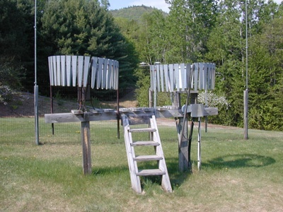
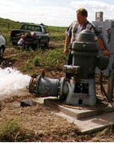
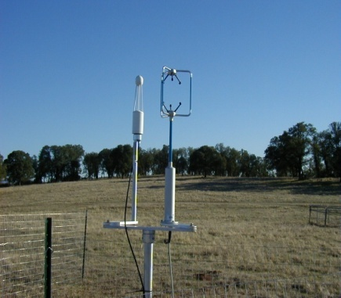
Water Observations Data
Water quantity
Soil water
Rainfall
Water quality
Groundwater
Meteorology

Slide 11
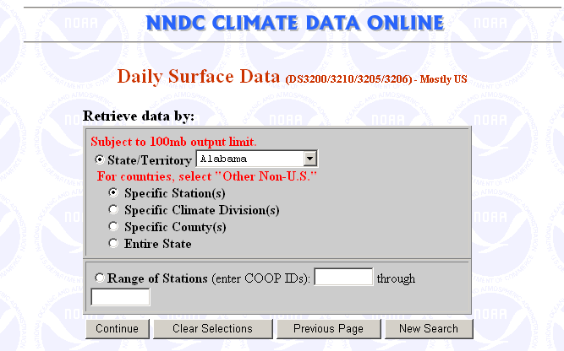
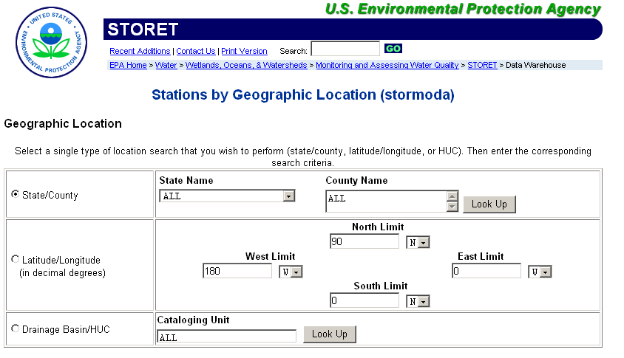
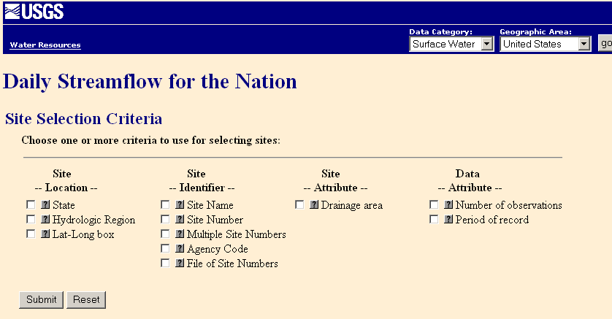
Water Data Web Sites

Slide 12
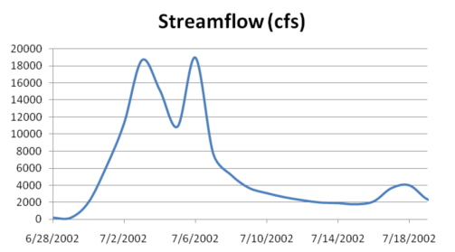
Point Water Observations Time Series
A point location in space
A series of values in time

Slide 13
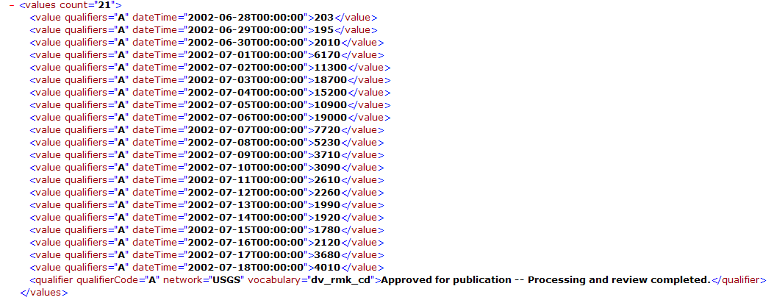
WaterML as a Web Language
Discharge of the San Marcos River at Luling, TX June 28 - July 18, 2002
Streamflow data in WaterML language
The US Geological Survey and other water agencies in the US have adopted WaterML

Slide 14
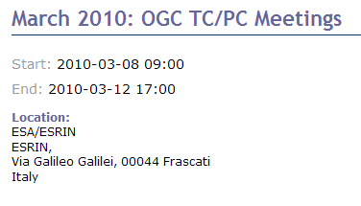
International Standardization of WaterML
OGC/WMO Hydrology Domain Working Group
(formed in December 2008)
Design of WaterML 2.0 and testing in Interoperability Experiments
OpenMI conceptual model should be included
Meets 4 times per year (2 in Europe, 2 in US)
+ Hydrology Workshop
at JRC, Ispra

Slide 15
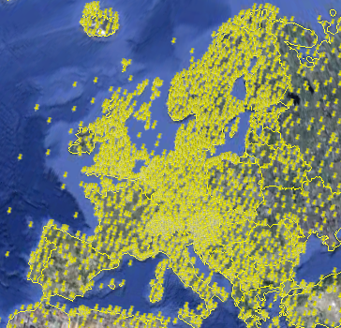
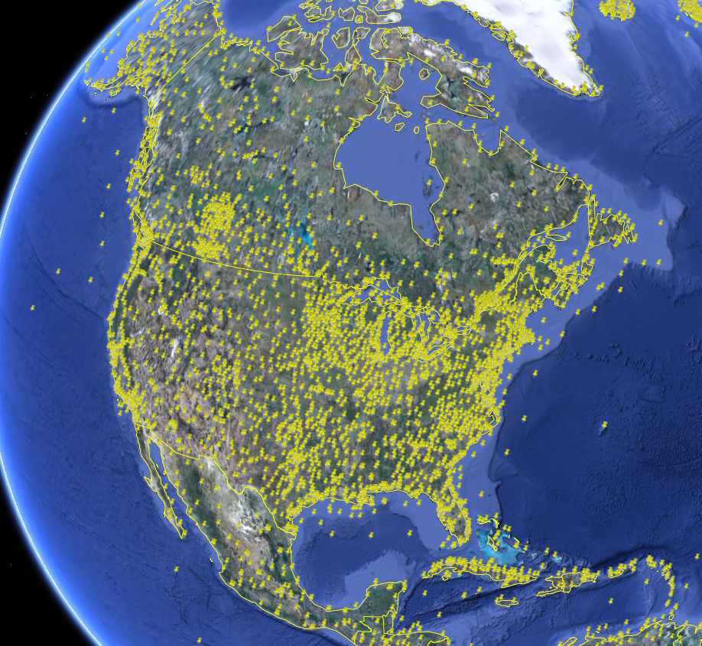
NCDC Integrated Station Hourly Data
Hourly weather data up to 36 hours ago
13,628 sites across globe
34 variables
Published by National Climate Data Center and populated with weather observations from national weather services
http://water.sdsc.edu/wateroneflow/NCDC/ISH_1_0.asmx?WSDL

Slide 16
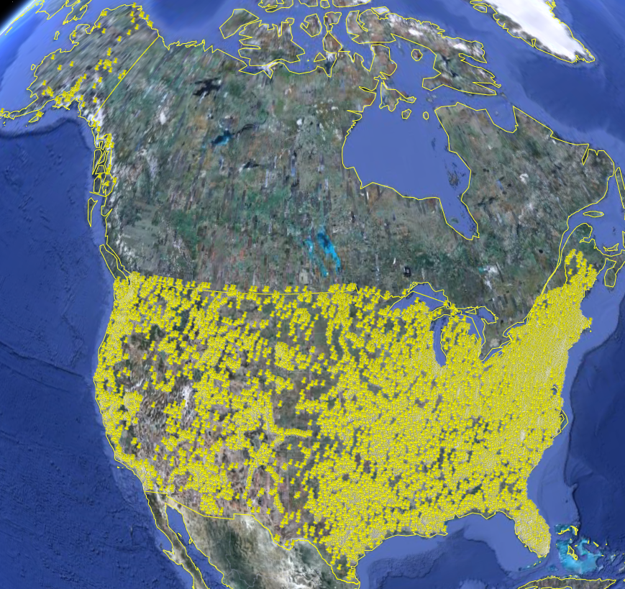
USGS Instantaneous Data
Real time, instantaneous data over the last 60 days
11188 sites, nationally for the US
80 variables
Published by USGS National Water Information System

Slide 17
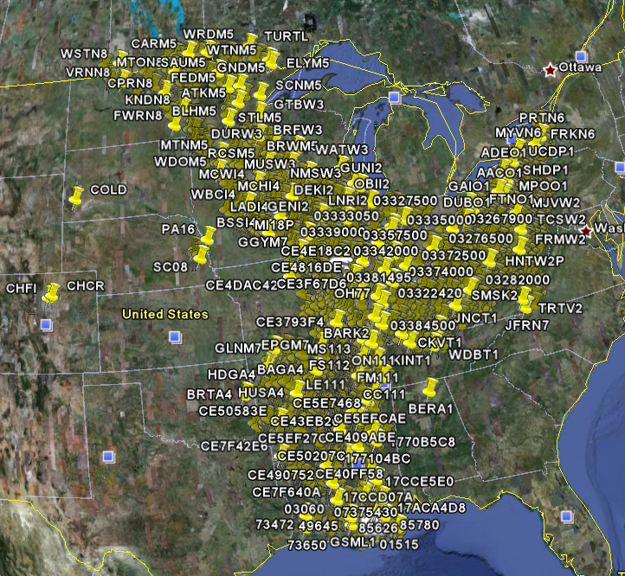
Corps of Engineers Water Observations
Time series at Corps gages
2210 sites, mainly in Mississippi Basin
80 variables
4954 series
Published by Corps of Engineers, Rock Island District to support their WaterML plugin to HEC-DSS
http://www2.mvr.usace.army.mil/watercontrol/SOAP/WaterML_SOAP.cfc?wsdl

Slide 18
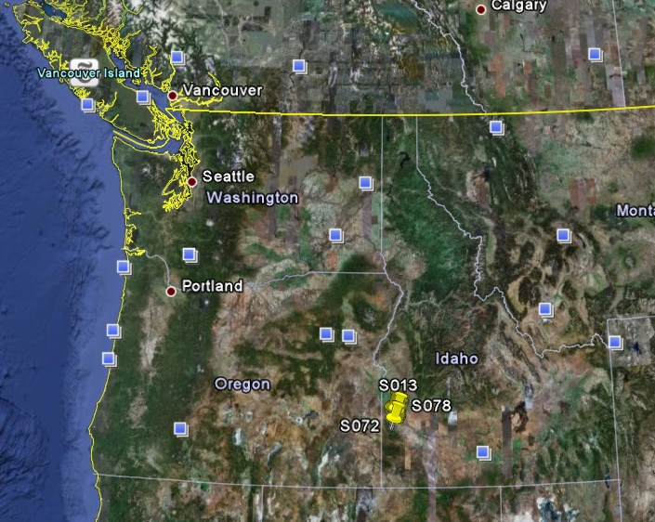
Reynolds Creek Experimental Watershed
1 data service
84 sites
65 variables
372 series
17.8 million data
Published by USDA-ARS as part of an Idaho Waters project
http://idahowaters.uidaho.edu/RCEW_ODWS/cuahsi_1_0.asmx?WSDL

Slide 19
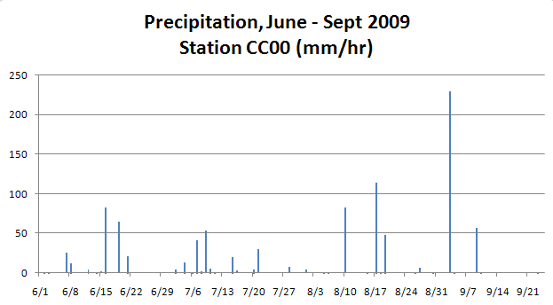
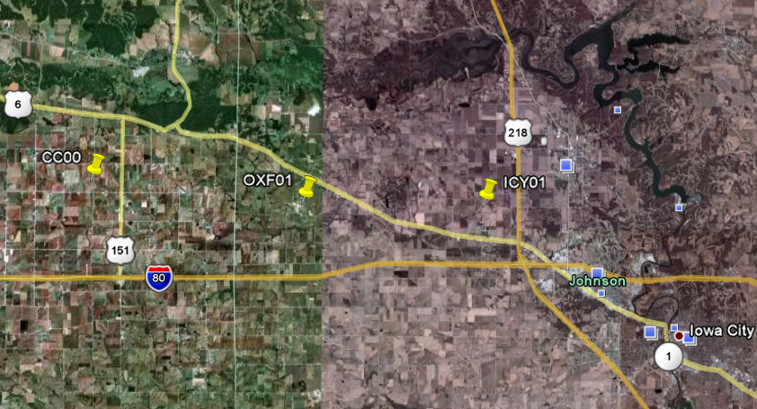
Iowa Tipping Bucket Raingages
Data Manager:
Nick Arnold, IIHR

Slide 20
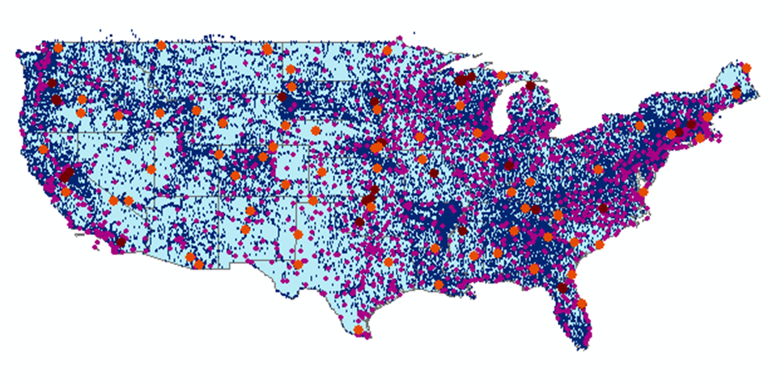
The CUAHSI Water Data Catalog
47 services
15,000 variables
1.8 million sites
9 million series
4.3 billion data Values
. . . All the data is accessible in WaterML

Slide 21
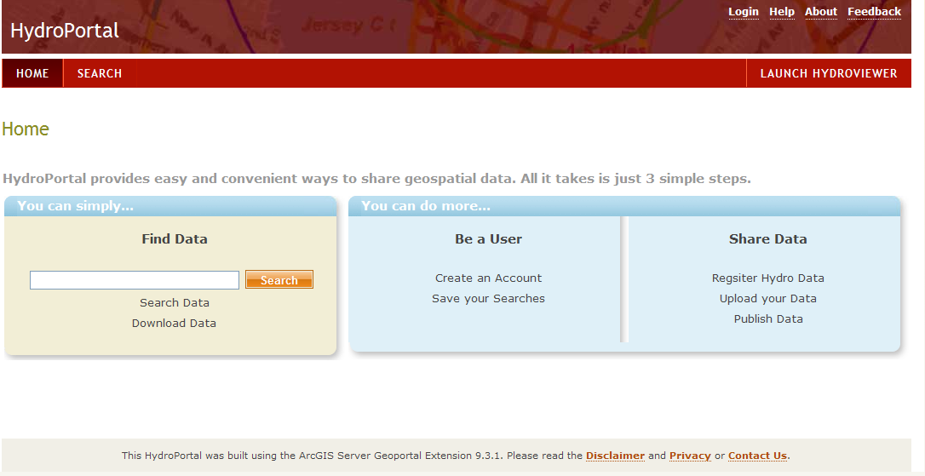
Hydro Portal: Interconnection of data portals based on the OGC Catalog Services for the Web standard
Customization of ArcGIS GeoPortal Extension 9.3.1 for WaterML web services data

Slide 22
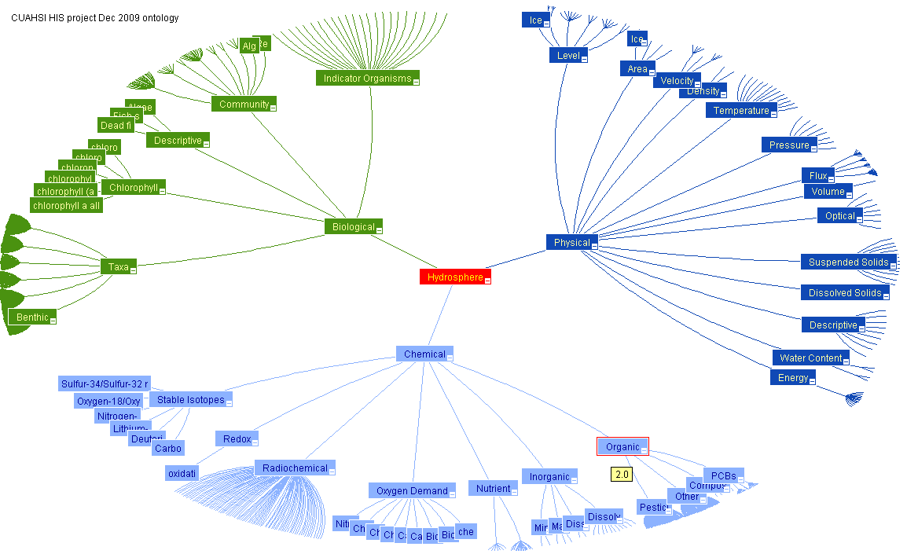
Working Towards Common Semantics Using an Ontology to Reconcile Meanings of Variables
A hierarchy of concepts
Match variables to leaf concepts
Physical
Hydrosphere
Chemical
Biological
Uses EPA Substance Registry System for Chemistry
http://test.hydroseek.net/ontology/Ontology_heirarchy.html

Slide 23
CUAHSI Hydrologic Information System and the Virtual Observatory
The cloud and web services
CUAHSI water data services
Building water data networks
Ways of using water data services

Slide 24
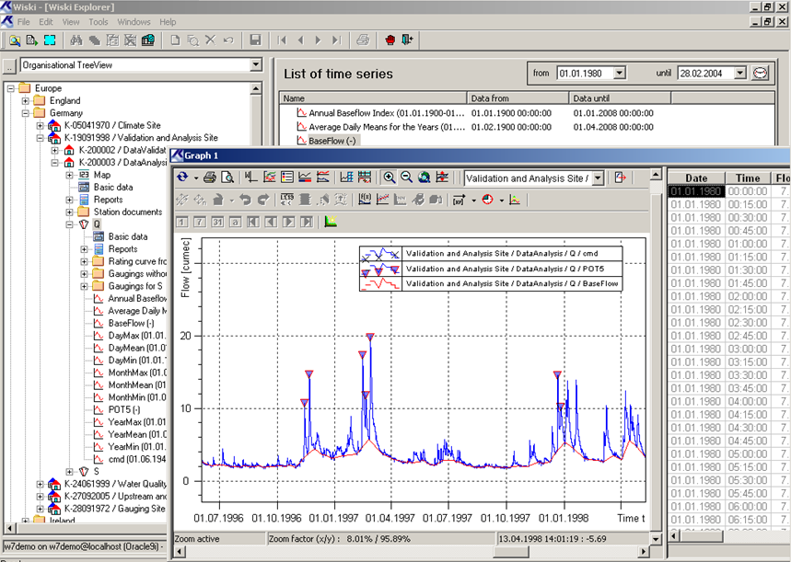
WISKI Water Data Management System from the Kisters company based in Aachen, Germany
Kisters has adopted the CUAHSI model for water data services

Slide 25
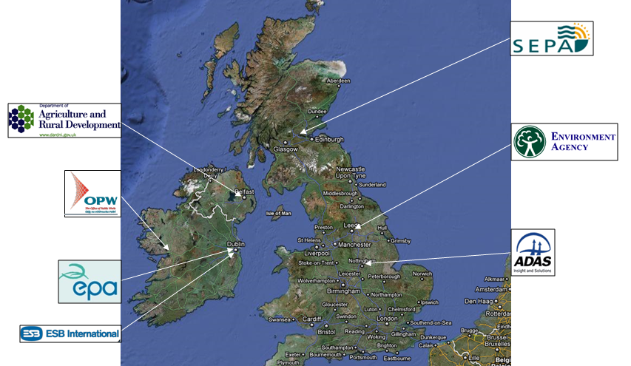
WISKI Data Systems in the UK and Ireland
The technology to implement CUAHSI water data services in the UK is already deployed….

Slide 26
WISKI Data Systems in the UK and Ireland
Surface water: 7696 Rainfall: 13236 Groundwater: 20184 Effluent sites: 3658 Water quality: 237 Areal: 257 (for calculation of areal rainfall) Secondary gauging sites: 43 (for summarizing gaugings) Reservoirs: 239
46,000 sites

Slide 27
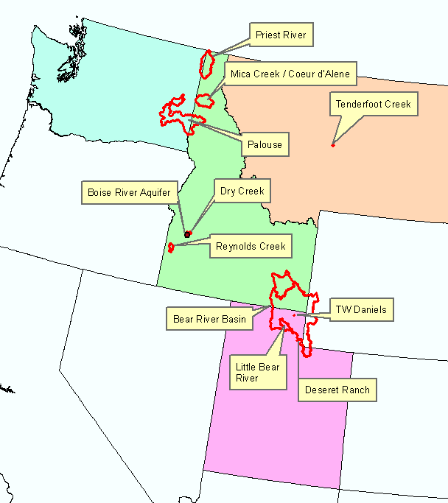
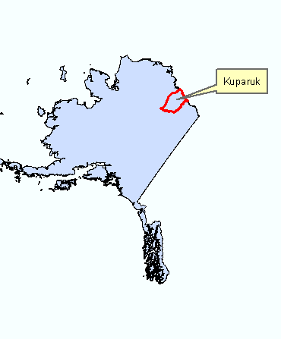
ICEWATER
Inland Northwest Research Alliance (INRA) Water Research Consortium - coalition of eight universities working in cooperation with the US Department of Energy
Boise State University
Idaho State University
Montana State University
University of Alaska Fairbanks
University of Idaho
University of Montana
Utah State University
Washington State University
ICEWATER – INRA Constellation of Experimental WATERsheds
http://www.inra.org/
http://icewater.inra.org/

Slide 28
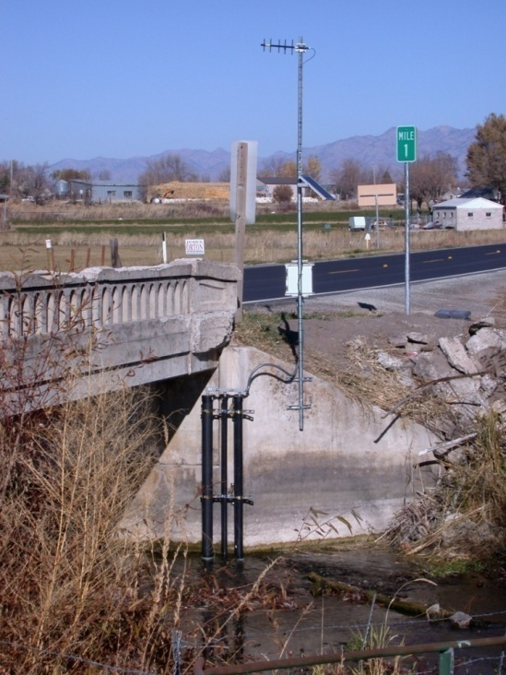
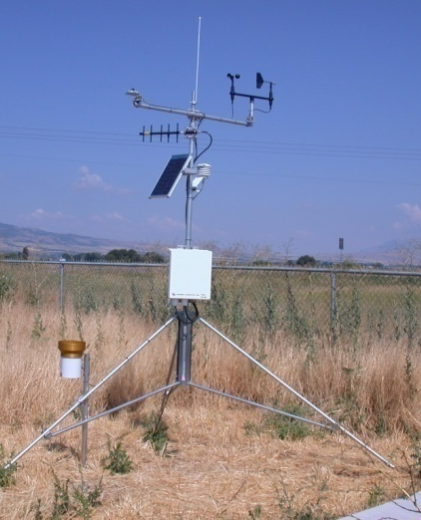
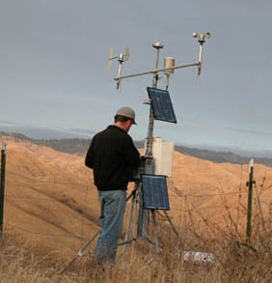
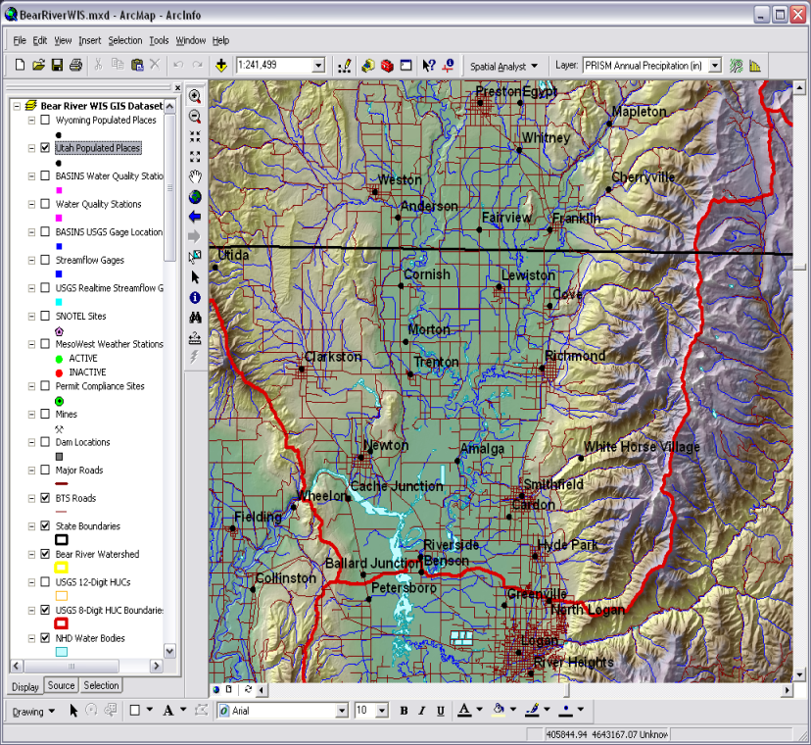
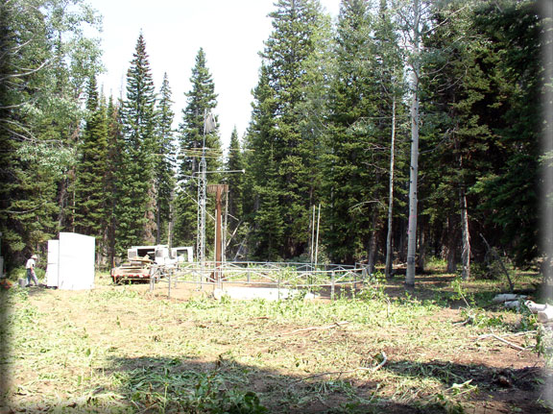
ICEWATER Data
Point Observations
Stream gages
Water quality sampling
Weather stations
Soil moisture
Snow monitoring
Groundwater level/quality
Spatially Distributed Data
Land use/cover
Terrain
Hydrography

Slide 29
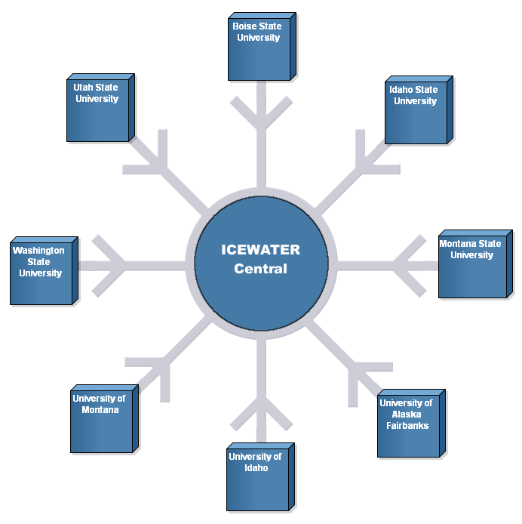
ICEWATER CI Architecture
Each University establishes a HydroServer node
A central portal provides support services

Slide 31
CUAHSI Hydrologic Information System and the Virtual Observatory
The cloud and web services
CUAHSI water data services
Building water data networks
Ways of using water data services

Slide 32
How do you access WaterML web services?
HIS Central
Metadata harvesting
Search Services
Users
HydroServer, Agency Servers
Time series data
in WaterML
HydroExcel, HydroDesktop, ...

Slide 33
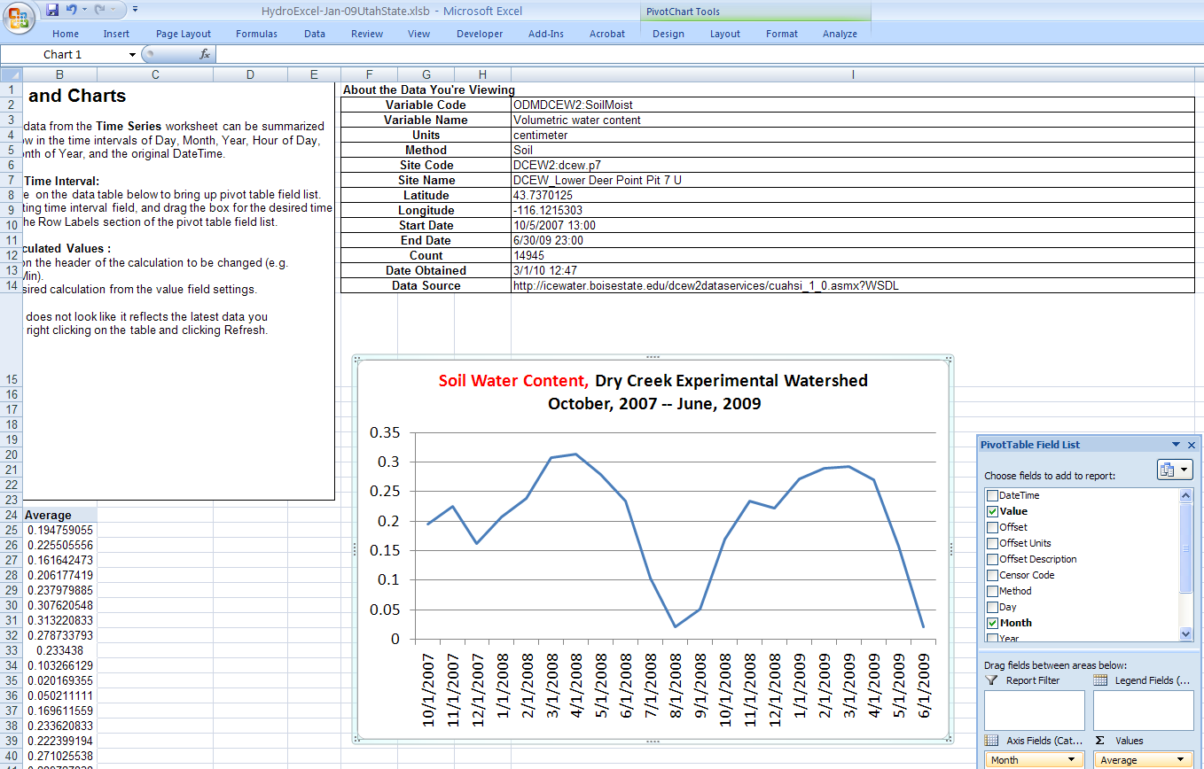
HydroExcel – one series at a time Soil water data from Dry Creek Watershed

Slide 34
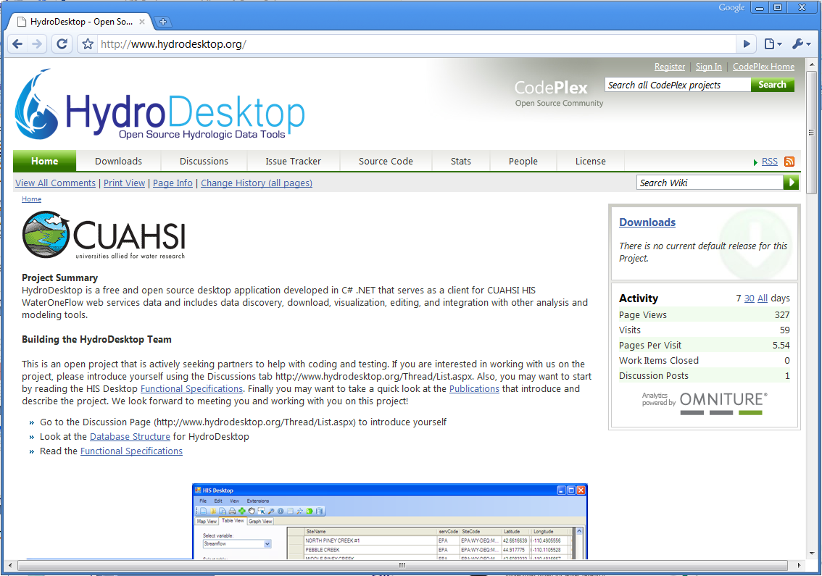
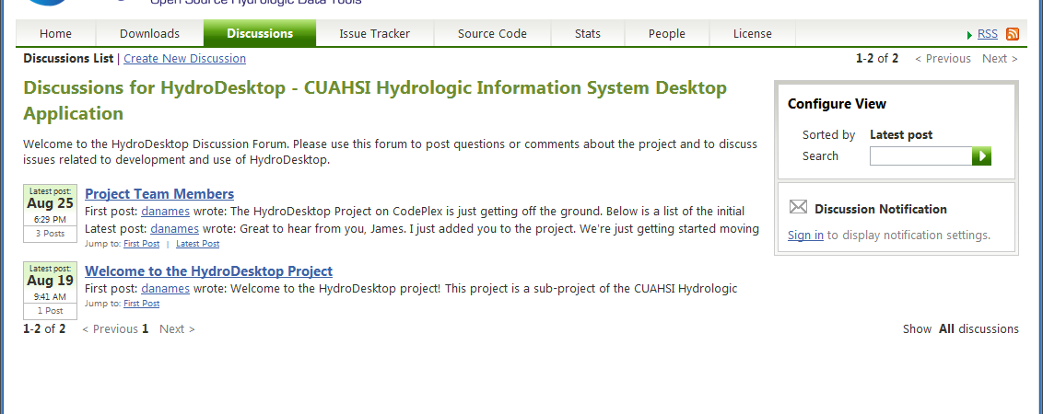
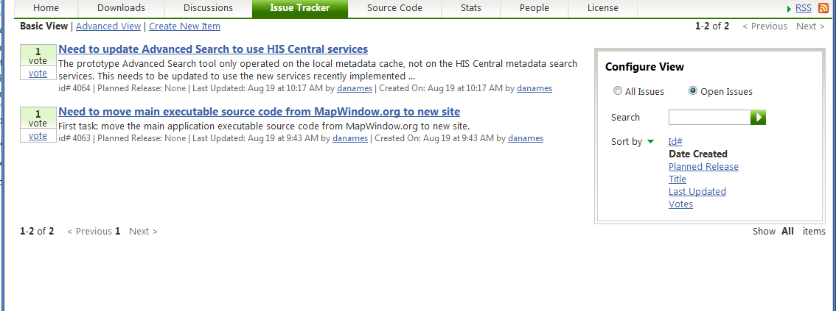
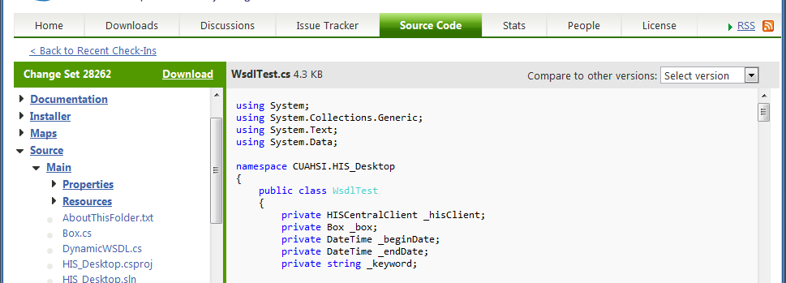
HydroDesktop – an Open Source HIS
A web-based collaborative software design and development environment was set up on CodePlex.com. This site includes a discussion forum, wiki, source code repository and versioning system, and bug/issue tracking system.
http://www.HydroDesktop.org
Notes:
HydroDesktop development is following the open source model and is housed at the Microsoft CodePlex web site. The project can be accessed through the link:www.hydrodesktop.org and is open for public participation in the project. The collaborative development portal includes a project WIKI with information about the project, a Downloads page for current installers and releases of the software, a Discussion Forum for open discussions and questions about the project, an Issue tracker for managing bugs, features, and issues. Also direct access to source code is available for anyone (authorized users are invited to contribute source code directly to the project). HydroDesktop is licensed under the BSD open source license which allows it to be used in commercial, non-commercial, academic, government or other settings as needed.

Slide 35
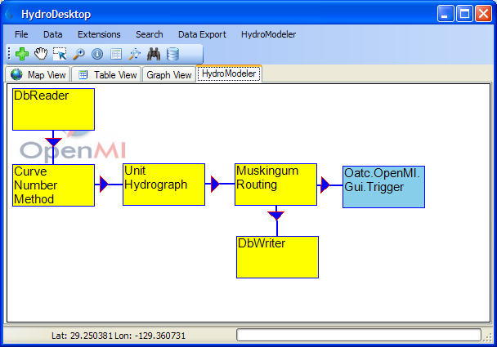
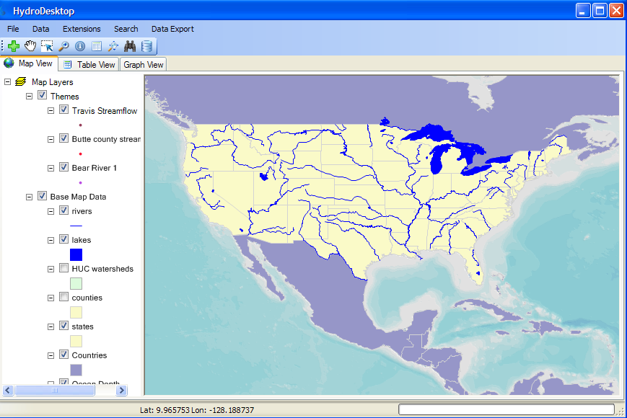
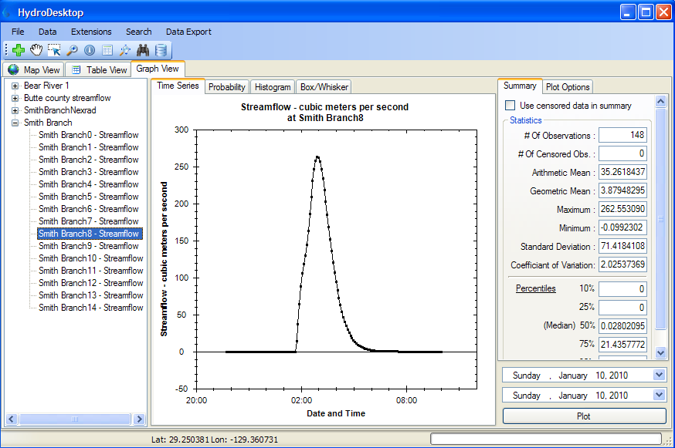
HydroDesktop A Hydrologic Information System integrates space, time and modeling
OpenMI
MapWindow
SQLite
http://www.hydrodesktop.org – an open source software development

Slide 36
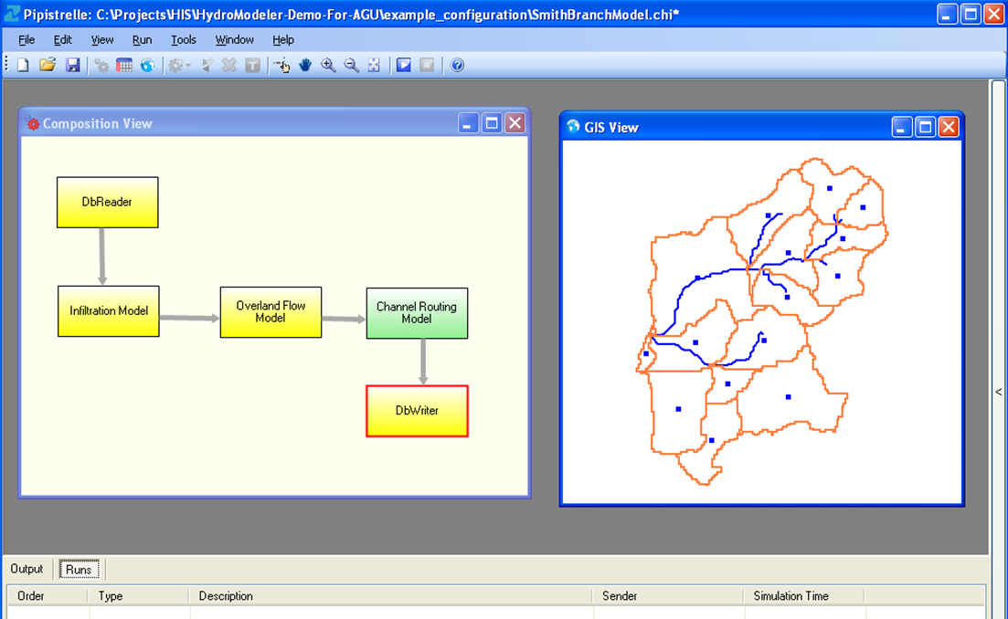
Pipistrelle : OpenMI Model Compositions Developed at Hydraulic Research Wallingford
Map Window
Database reader
CUAHSI Components
Database writer

Slide 41
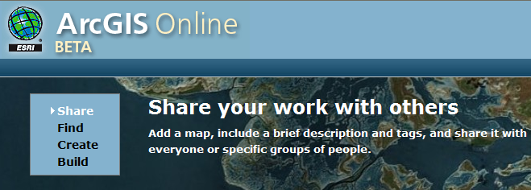
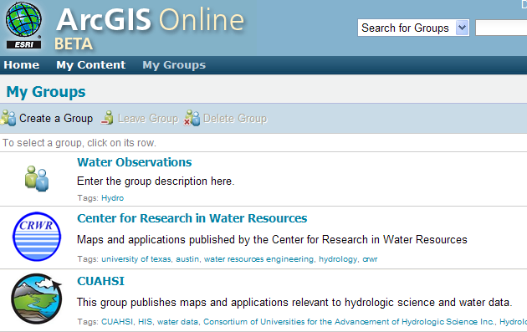
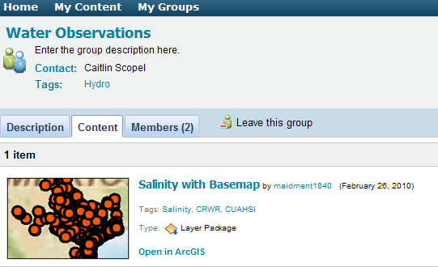
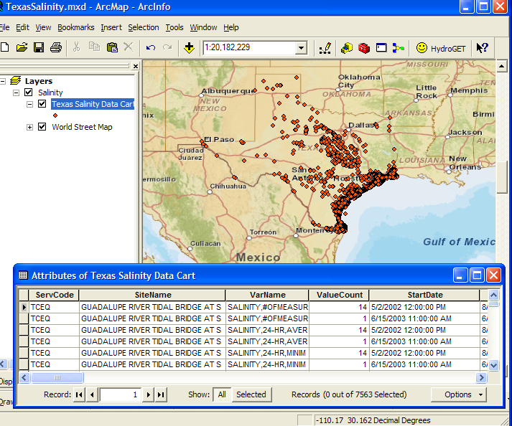
A Social Networking System for Sharing Geospatial Data

Slide 42
A Question…
Once you have a cloud…..
…..what is the telescope you use to view it?

Slide 43
Some parting thoughts…..
The Virtual Observatory is a great idea!
WaterML is a standard for sharing water observations data
We in CUAHSI HIS would be happy to collaborate with the VO team
We would like to learn from what you do

