Slide 1

Flood Inundation Mapping
David R. Maidment
Center for Research in Water Resources
University of Texas at Austin
National Water Center, 16 May 2015
Acknowledgements: UT Austin Colleagues and Students, National Weather Service, NCAR
City of Austin, ESRI, Kisters, Microsoft Research, Yan Liu, David Tarboton
This research is supported in part by NSF EarthCube grant 1343785

Slide 2
Goal of the NFIE
Close the gap between National Flood Forecasting and Local Flood Emergency Response
Demonstrate forecasting of flood impacts at “stream and street level”
National
Weather and Hydrology
National Weather Service and federal agencies
National Water Center
River Flooding and Emergency Response
Local, State and Regional Agencies,
Citizens
Local

Slide 3
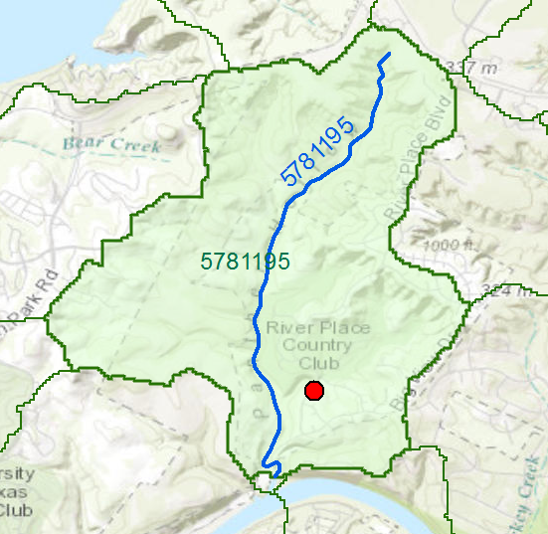
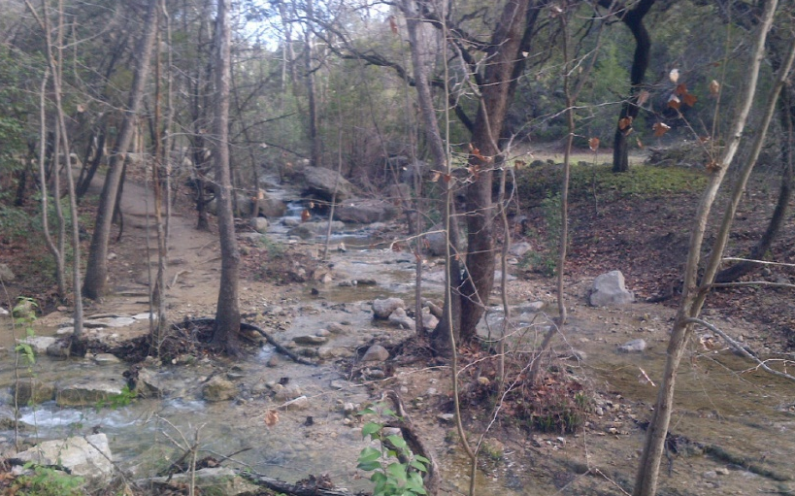

My Home Catchment and Address Point
My Stream
Area = 4.2 square miles
Length = 3.3 miles
Panther Creek

Slide 4
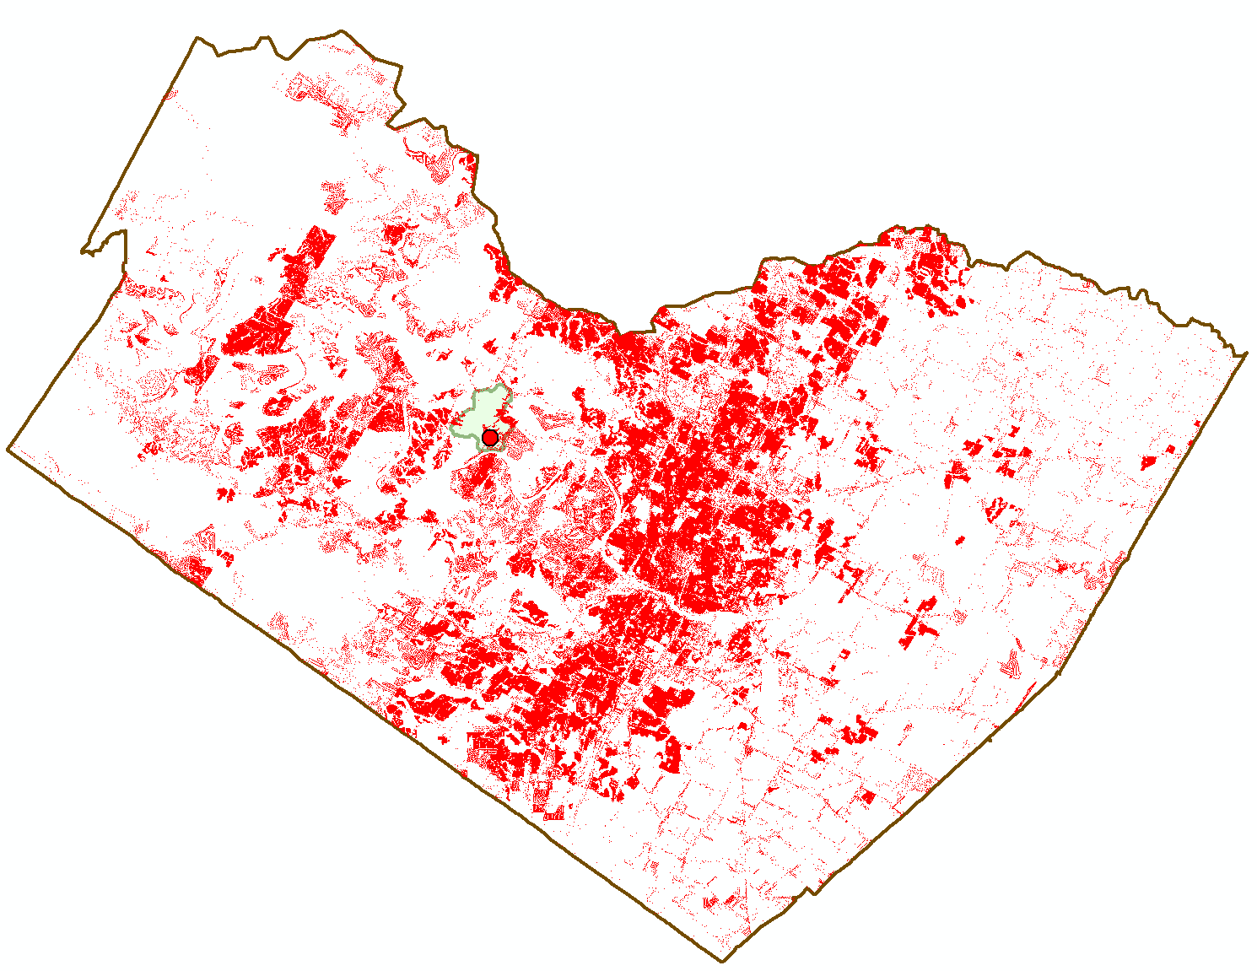
Address Points in Travis County (355,000)
8 million for Texas
100 million for US

Slide 5

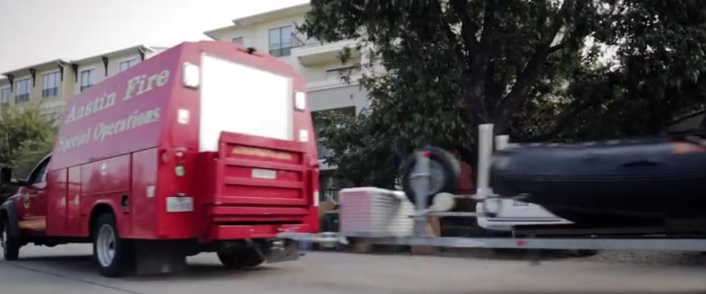
Connecting with Local Decision Makers
Harry Evans, former Chief of Staff of Austin Fire Department
Work with the first response community to define flood strategy for stream reaches
https://www.youtube.com/watch?v=ympaR6YUxiA&feature=youtube

Slide 6
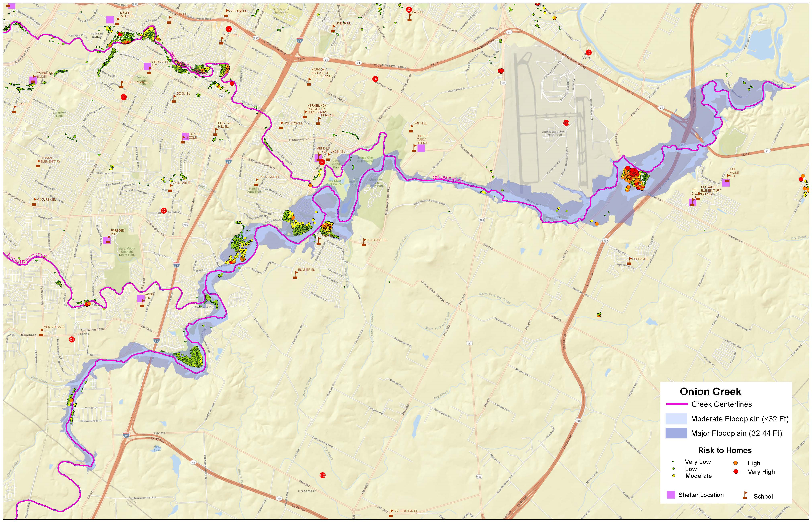
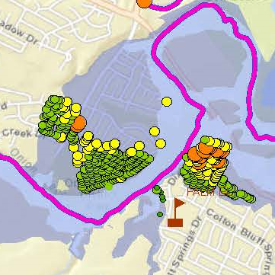
Strategic Overview Map
One area of risk

Slide 7
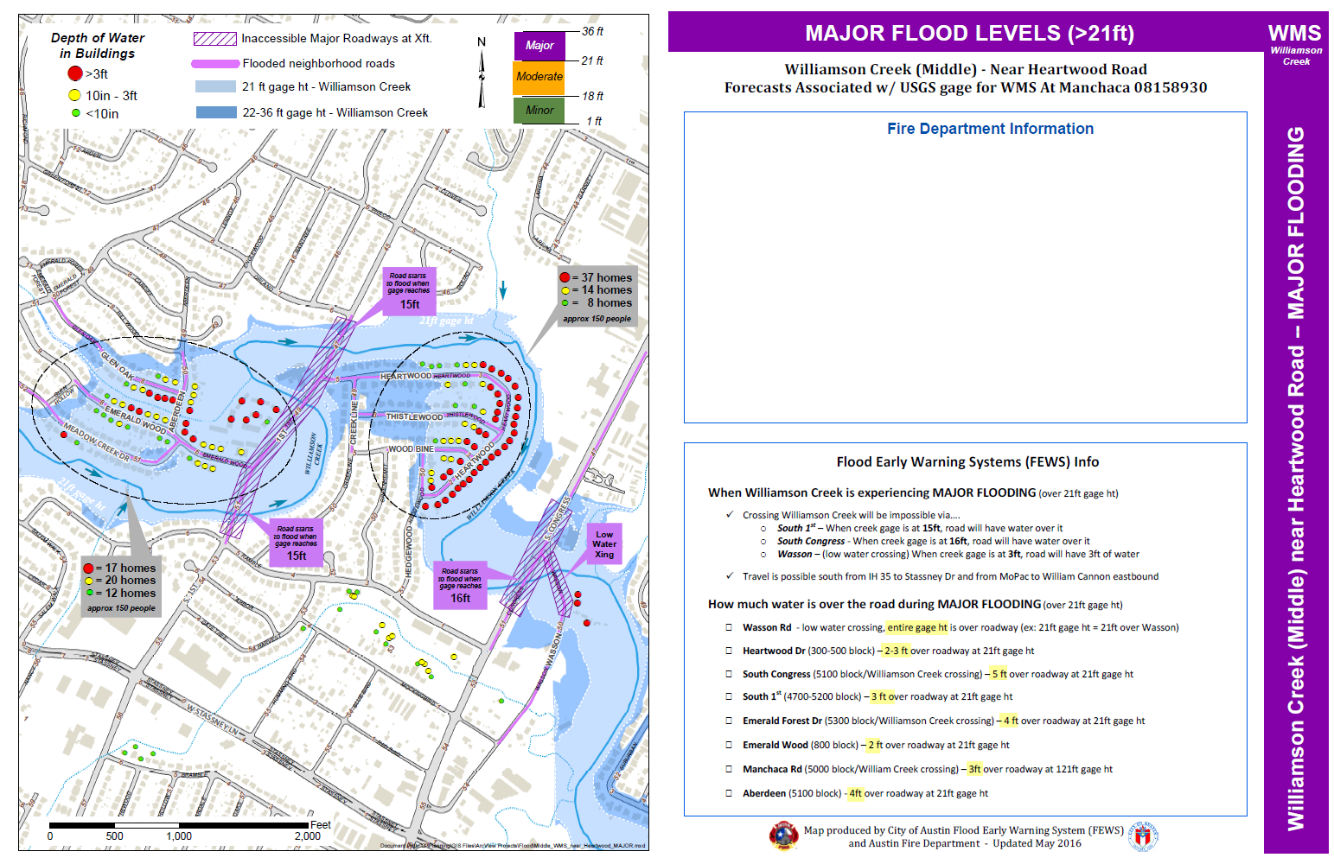
Flood Preplanning Map (Minor, Moderate, Major Floods)
Address Points used for reference

Slide 8
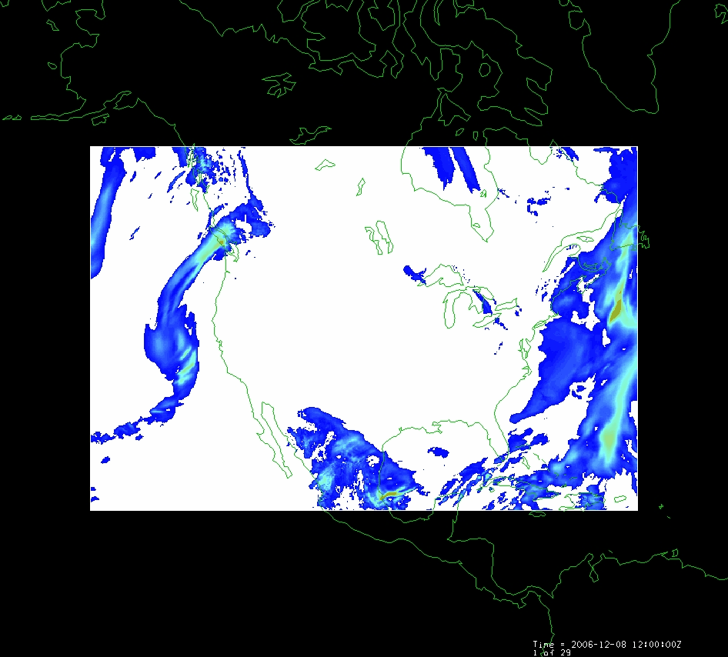
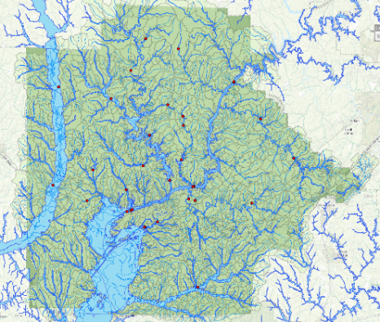
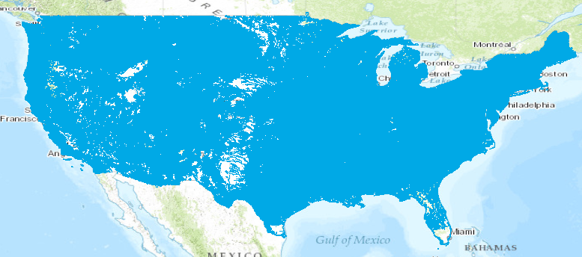
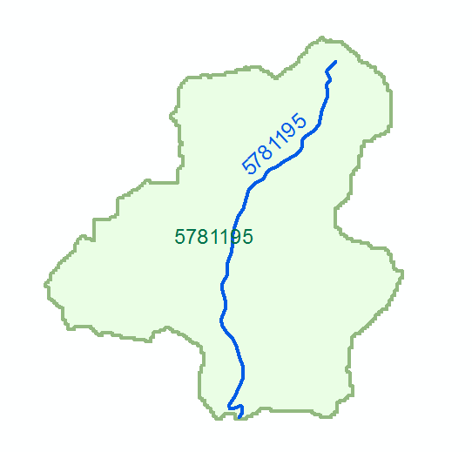
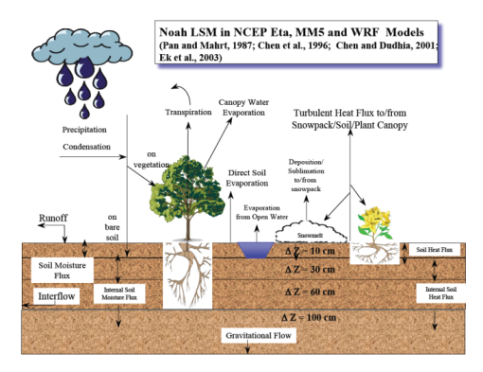
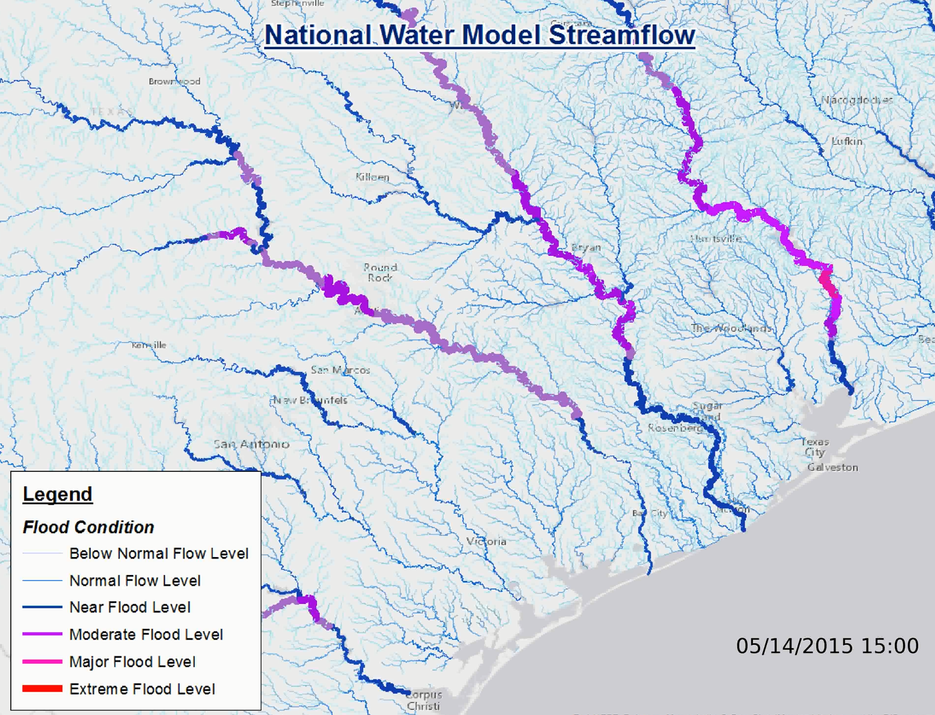
Continental Scale Flood Inundation and Impacts
Meteorology
Mapping and Impacts
2.7 million catchments
Hydrology
Hydraulics

Slide 9
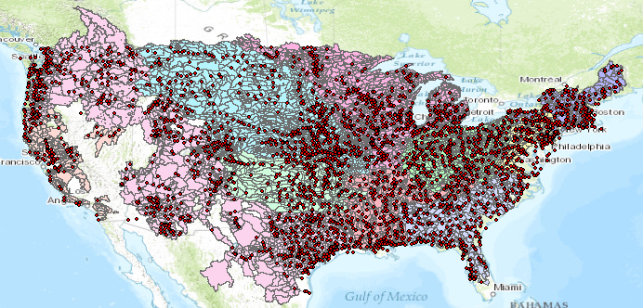
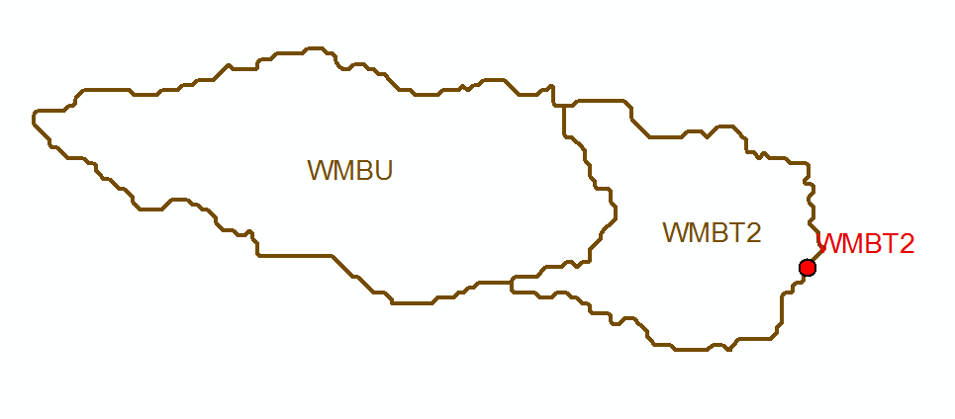
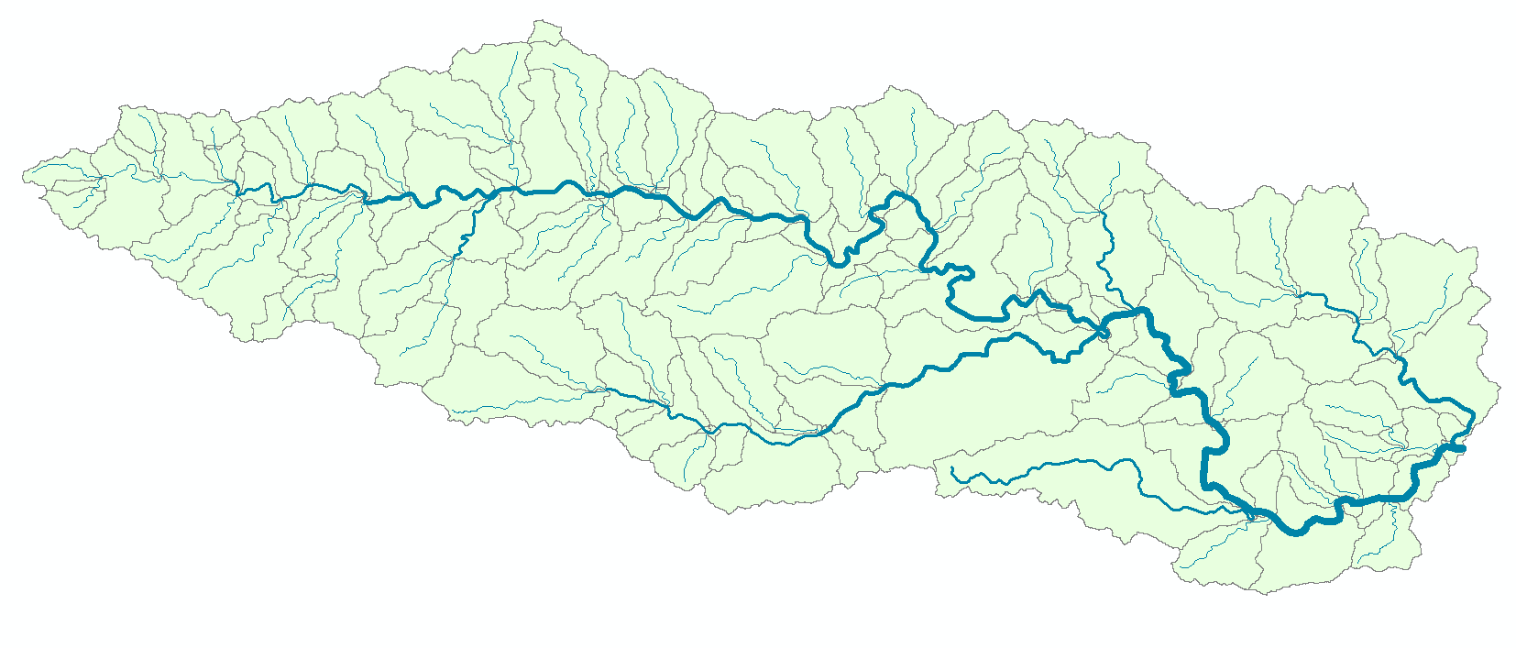
Flow Continuum Model – a national stream network, atmosphere to oceans, coast to coast
Blanco River at Wimberley
Current: 6600 basins and 3600 forecast points
Two basins and one forecast point
Watershed Hydrology – basins and outlet points
Basin ~ 400 Sq Mile
becomes
NFIE: 2.7 million stream reaches and catchments
Continental Hydrology – network flow continuum
Reach Catchment ~ 1 Sq Mile
130 Catchments and Flowlines
uniquely labelled
A national flow network

Slide 10
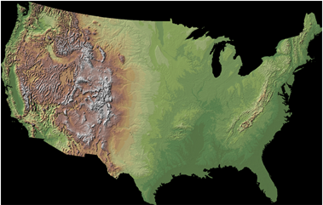
Experiment for 2016:
Combine hydrography and elevation to define river channel geometry and flood inundation extent for 5 million km of stream reaches over continental US
National Hydrography Dataset
National Elevation Dataset
Use the CyberGIS computing facility
at the University of Illinois at Urbana-Champaign

Slide 11
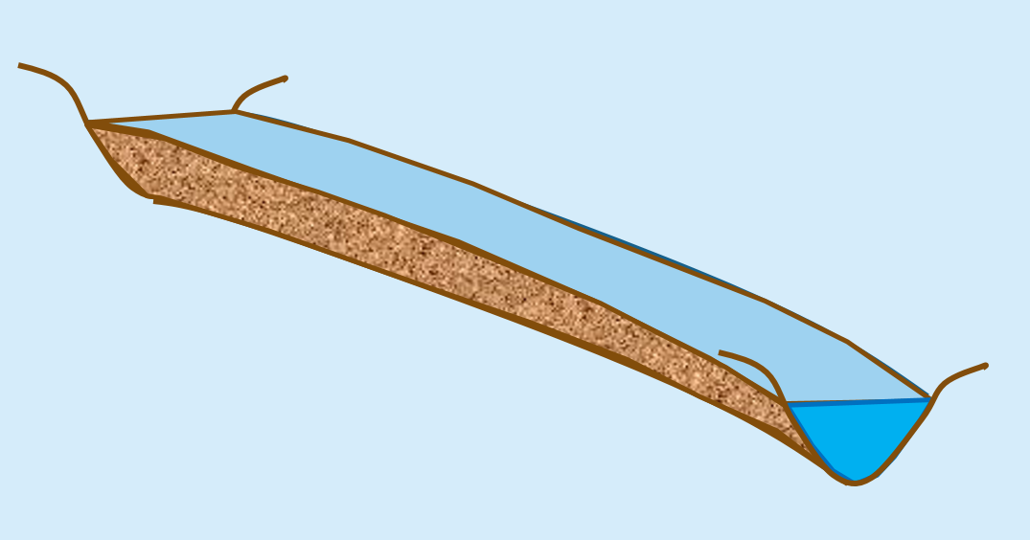

Elevation-Indexed Flood Response Mapping
Take blue line network, raise it and
flood it out, continue for increments
of elevation
Riverine
Mapping
Elevation-indexed flood
inundation mapping
Treat these
in a common way
Coastal
Mapping
Flood water surface elevation
modeling and forecasting
Inundation map library for each NHDPlus Reach
for coastal and riverine reaches

Slide 12
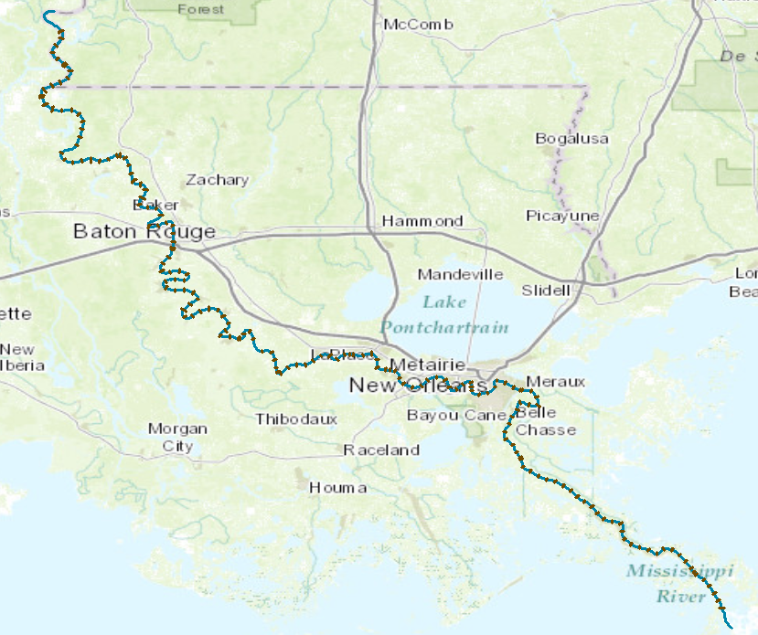
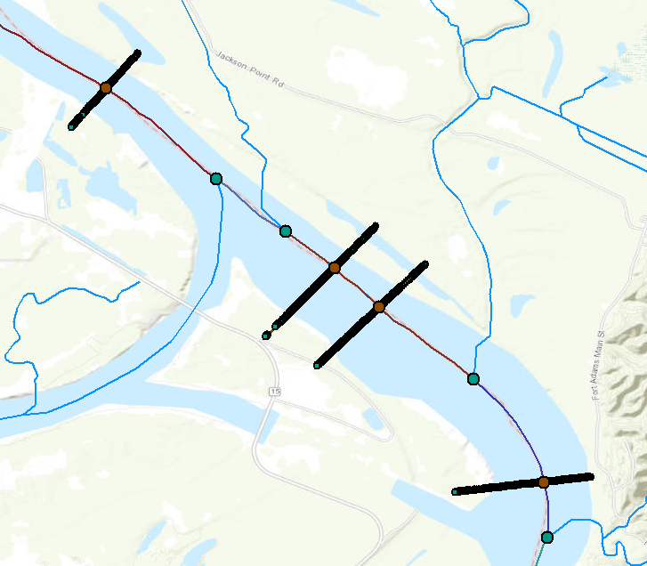
Cross-Sections on Lower Mississippi River for Hydraulic River Routing
173 cross-sections over 543 km, or 3.1 km between cross-sections, on average
41,479 cross-section points (x,y,z) of bed elevation, or 240 points per cross-section, on average

Slide 13
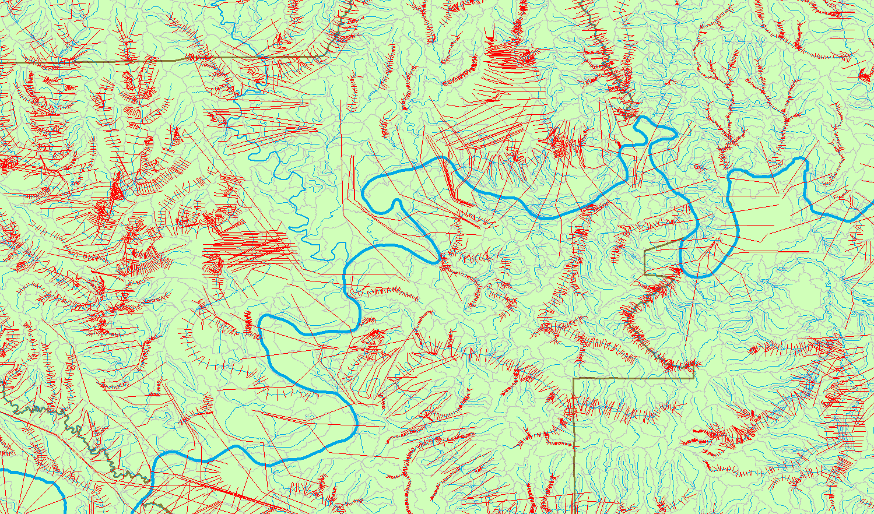
Cross-Sections for Alabama Rivers compiled in NFIE-I
Conclusion: Many studies done independently have lots of overlaps and gaps

Slide 14
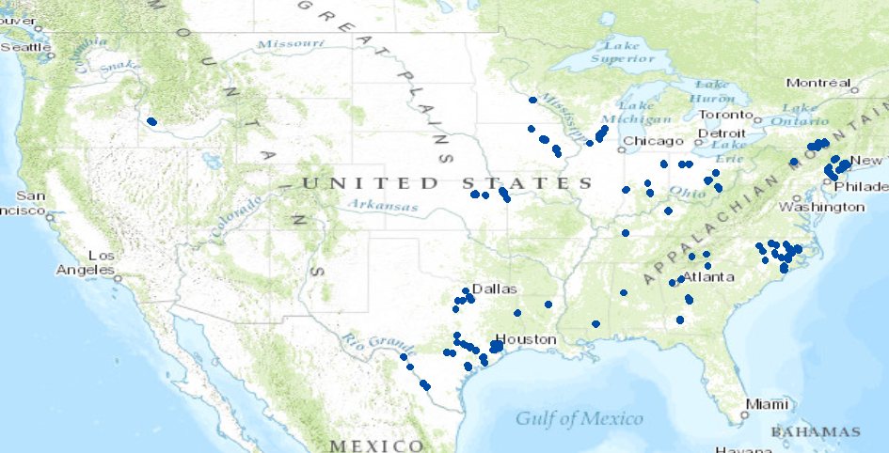
NWS Flood Inundation Maps for the US (130 in total)
33 maps in Texas (one quarter of total)

Slide 15
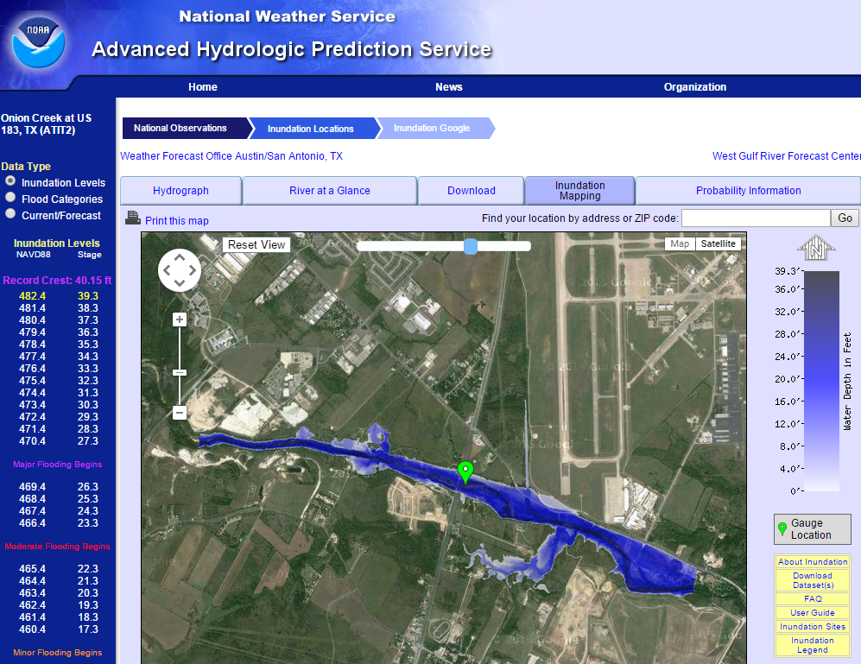
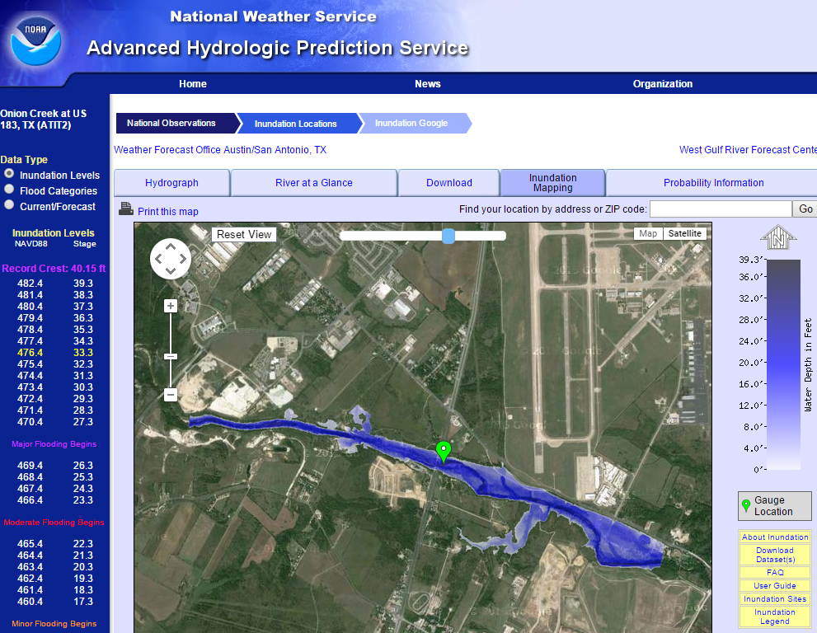
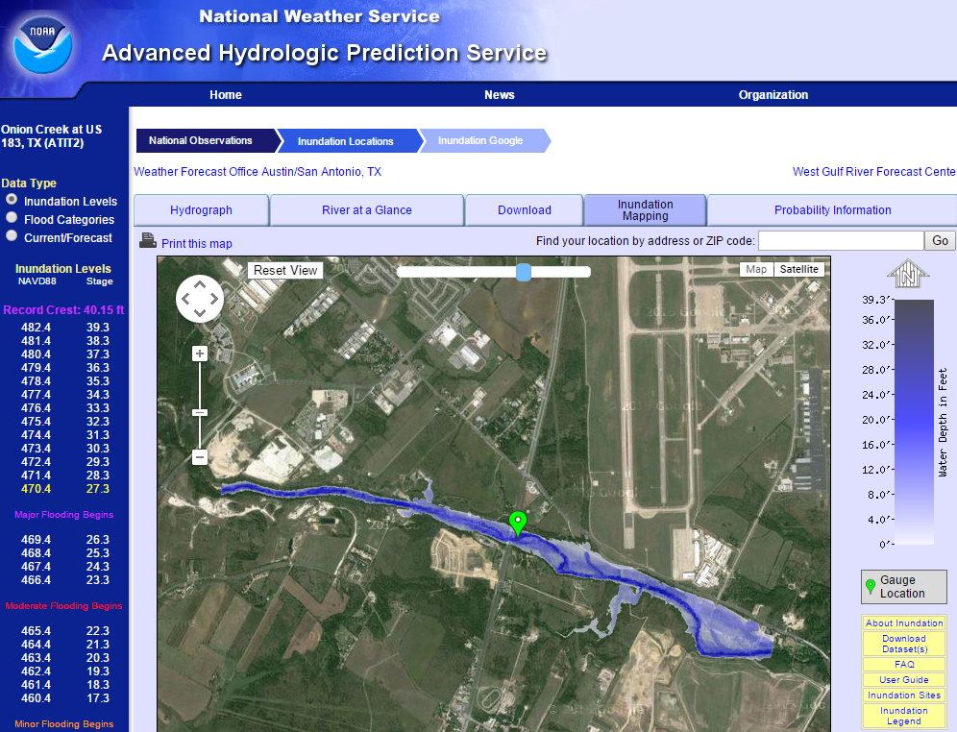

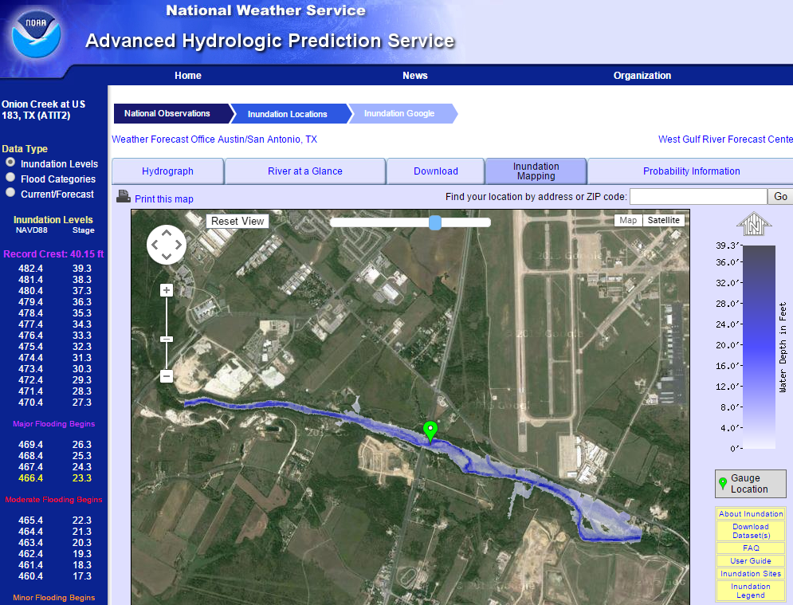
Real-Time Flood Inundation Mapping (USGS/NWS)
http://water.weather.gov/ahps2/inundation/inundation_google.php?gage=atit2

Slide 16
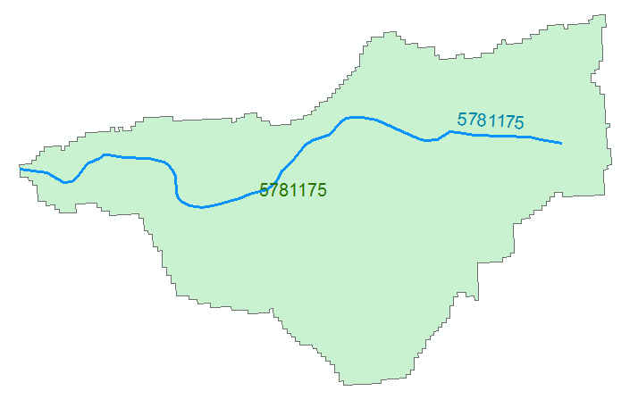



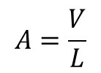
Reach Hydraulic Parameters
Comid | y | A | R | P | T | V | Ab | As
5781175 | 3
5781175 | 4
A_{s}
Surface Area
Wetted Bed Area
L
V
Volume
A_{b}
T
$$A=\frac{V}{L}$$
Cross Section Area
Depth
y
A
P
P$=\frac{Ab}{L}$
Wetted Perimeter
T$=\frac{As}{L}$
Top Width
R$=\frac{A}{P}$
Hydraulic Radius

Slide 17
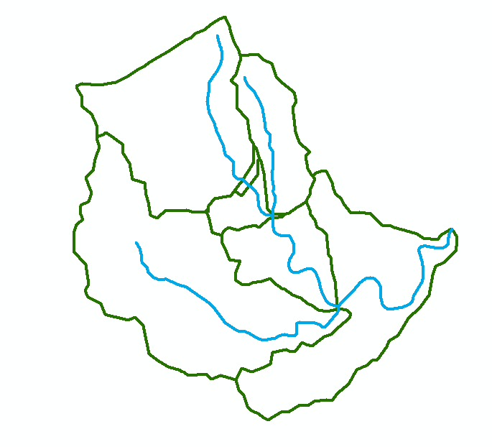
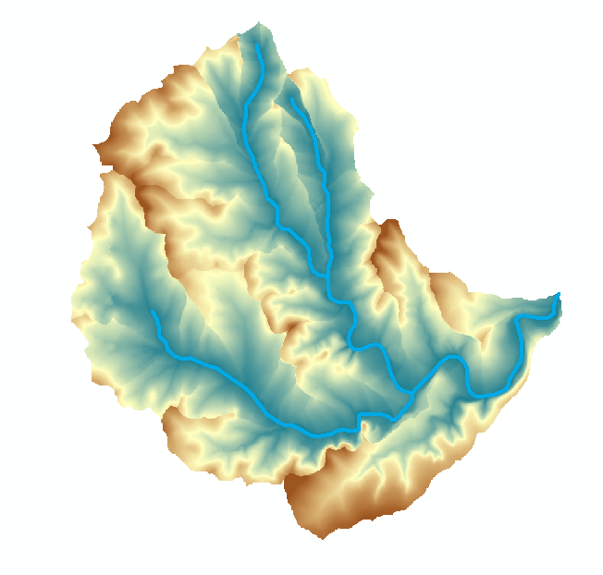
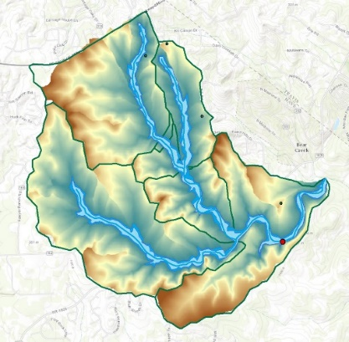

Flood Inundation Mapping – NHDPlus-HAND Method
Water surface elevation
h = z + y
y
NHDPlus
h
z
Geodetic datum
Catchments and Flowlines
Height Above Nearest
Drainage (HAND)
(relative elevation of land
surface cell above cell in
NHDPlus stream to which it flows)
Inundation map
Height above
drainage < 15 ft)
Digital Elevation Model

Slide 18
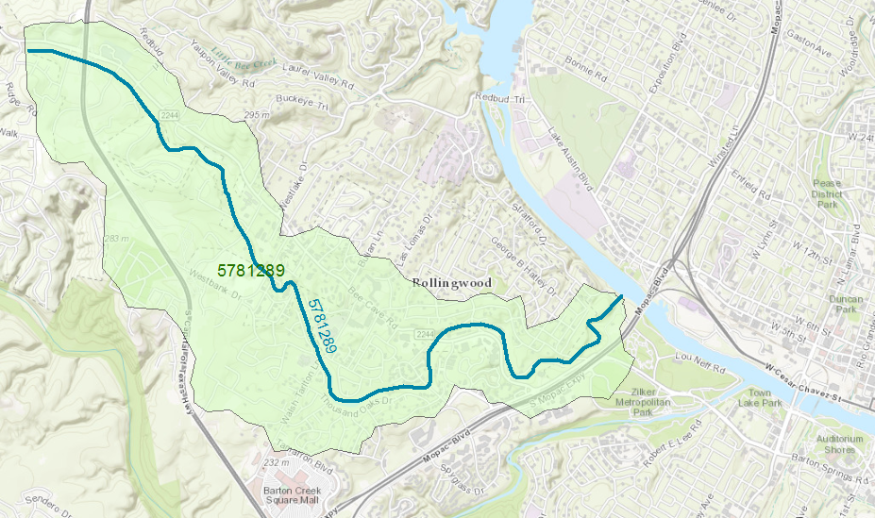
Reach Catchment 5781289
Eanes Creek, Rollingwood, Texas
Drainage area = 3.13 mi²
Reach Length = 4.3 miles

Slide 19
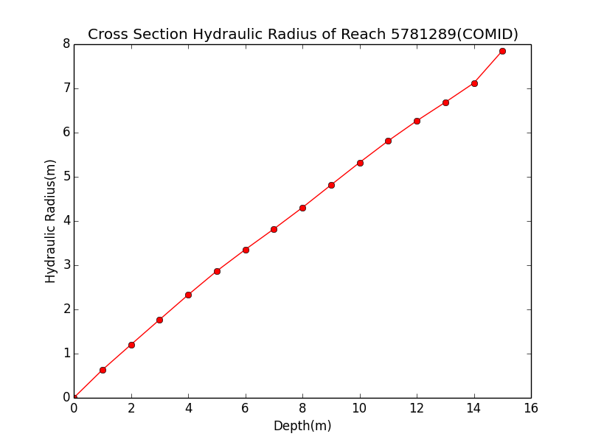
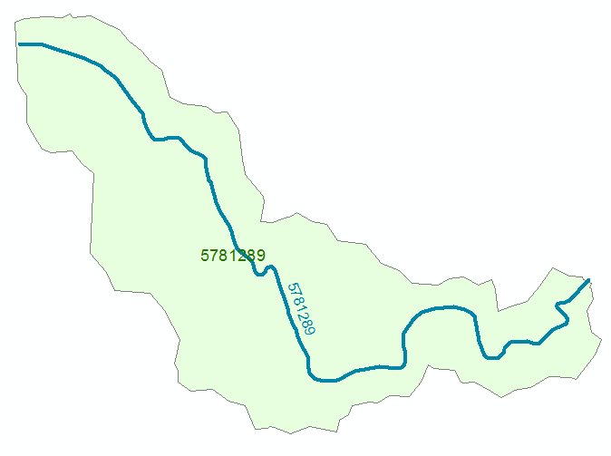
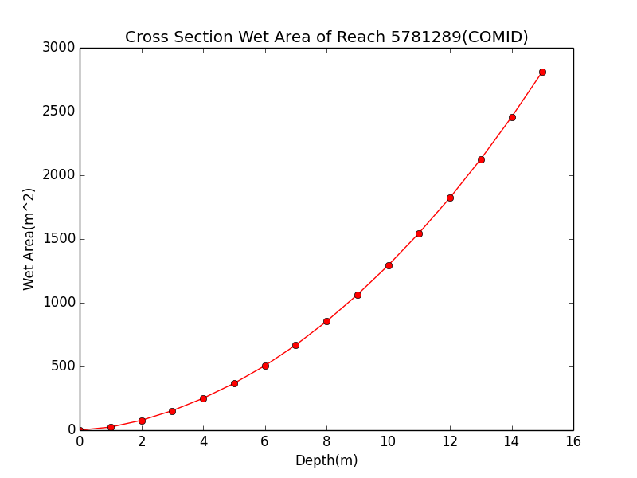

Discharge Computation
Hydraulic Radius, R
Flood Discharge, Q (cfs)
$$Q=\frac{1.49}{n}AR^{2/3}S_{o}^{1/2}$$
Flood Depth, h (ft)
Crossection Area, A
n = 0.035 Manning roughness of channel
S_{o} = 0.0163 Bed slope

Slide 20

Rating Curve for Eanes Creek
Flood Depth, y (ft)
$$Q=\frac{1.49}{n}AR^{2/3}S_{o}^{1/2}$$
Forecast Discharge, Q, from National Water Model

Slide 21

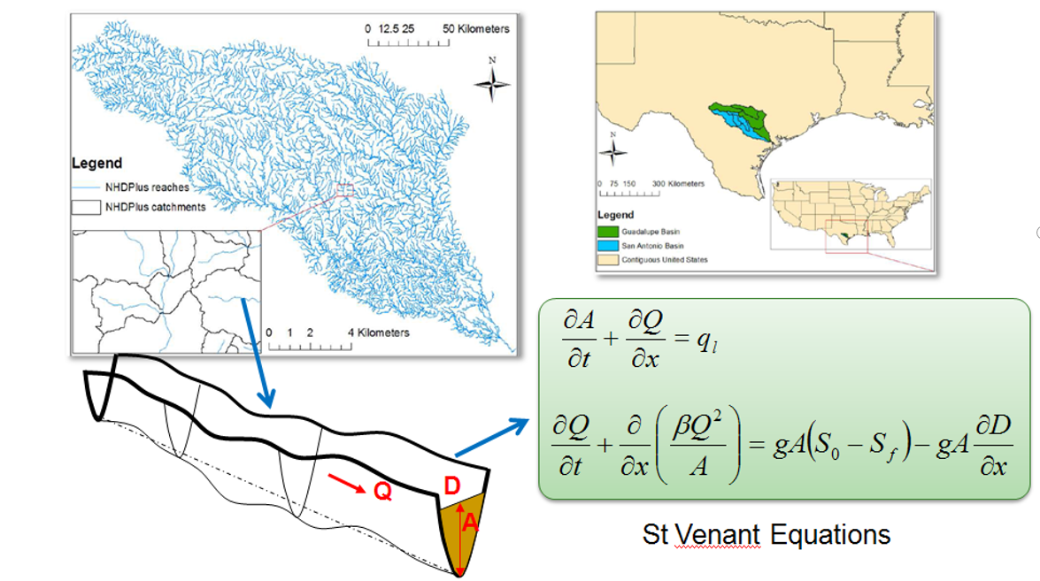


SPRNT Model – flow and water depth on large networks
Open source code in Github
Very Large Scale Integrated (VLSI) design of computer chips – solve 100 million equations each night to check on effects of design changes on electricity flow in chip
Dynamic wave routing
Compute water flow by analogy with electricity flow in chips

Slide 22
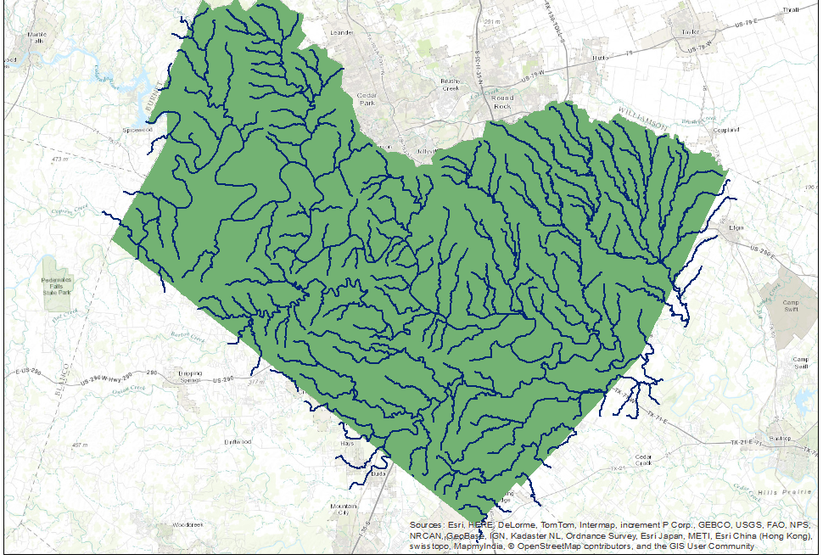
Rating the Landscape using SPRNT
Total 540 flowlines in Travis County.
Catchment Area: 2942.76 km²
Rainfall
Rainfall increased in uniform
increments of 1 mm/hr
Flow reaches equilibrium
in Travis County in 200 hours
Mannings “n” = 0.05
Time

Slide 23
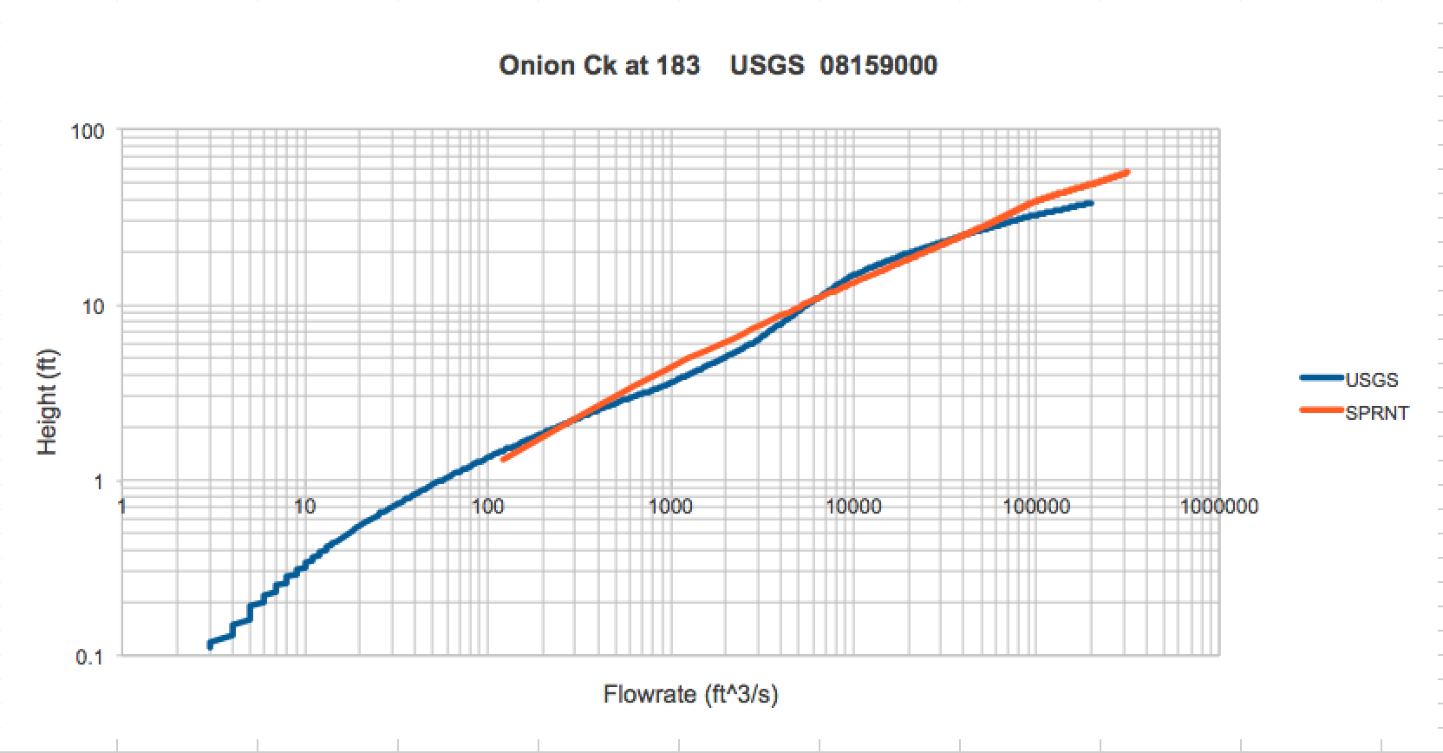
Rating Curves for Stream Gages in
Travis County
USGS Rating
SPRNT

Slide 24
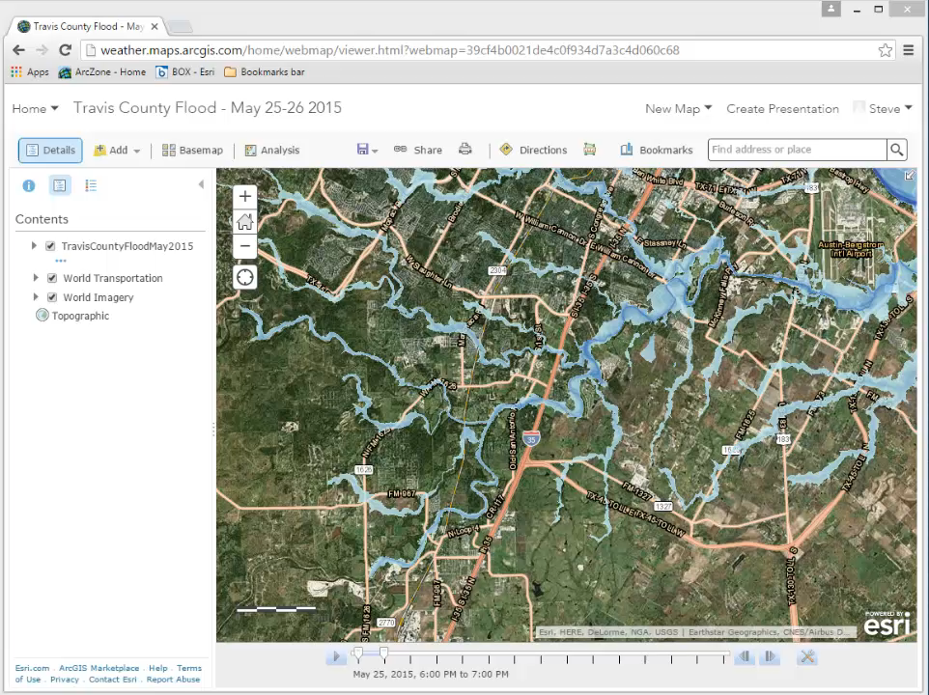
ESRI Geospatial Image Services for Flood Inundation Mapping

Slide 25
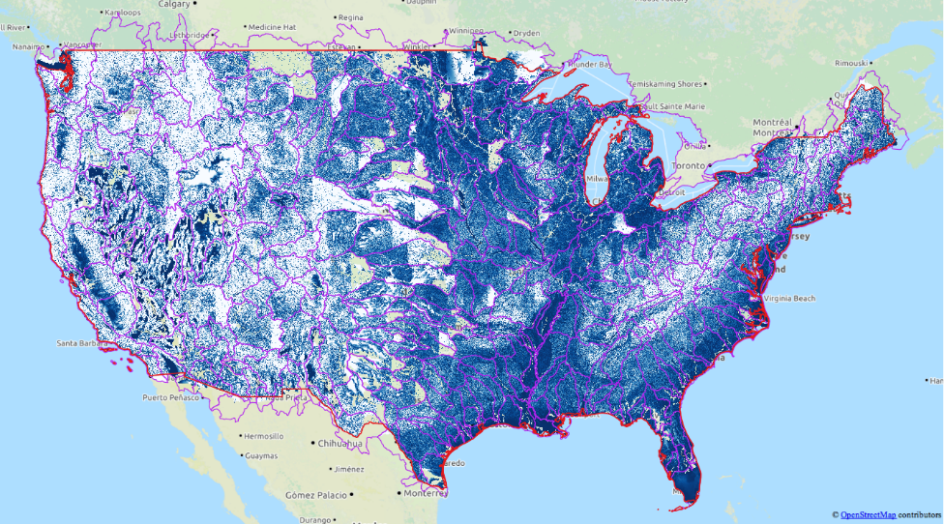
Continental-Scale Flood Inundation Mapping
Catchments and Flowlines
Height Above Nearest
Drainage (HAND)
(relative elevation of land
surface cell above cell in
stream to which it flows)
Digital Elevation Model

Slide 26


NHDPlus-HAND Raster – Version 0.1
Computed at the CyberGIS facility, University of Illinois at Urbana-Champaign, by Yan Liu and colleagues
using software developed by David Tarboton and colleagues at Utah State University
April 15, 2016

Slide 27
Real-Time Flood Inundation Mapping
Existing
Proposed
 | Existing | Proposed | Ratio
Number of Mapped Reaches | 130 | 2691344
Total Mapped Length (Km) | 2256 | 5192824 | 2302
Average Reach Length (Km) | 17.4 | 1.93 | 0.11
Total Mapped Length (Mile) | 1402 | 3226671 | 2302
Average Reach Length (Mile) | 10.8 | 1.20 | 0.11

Slide 28
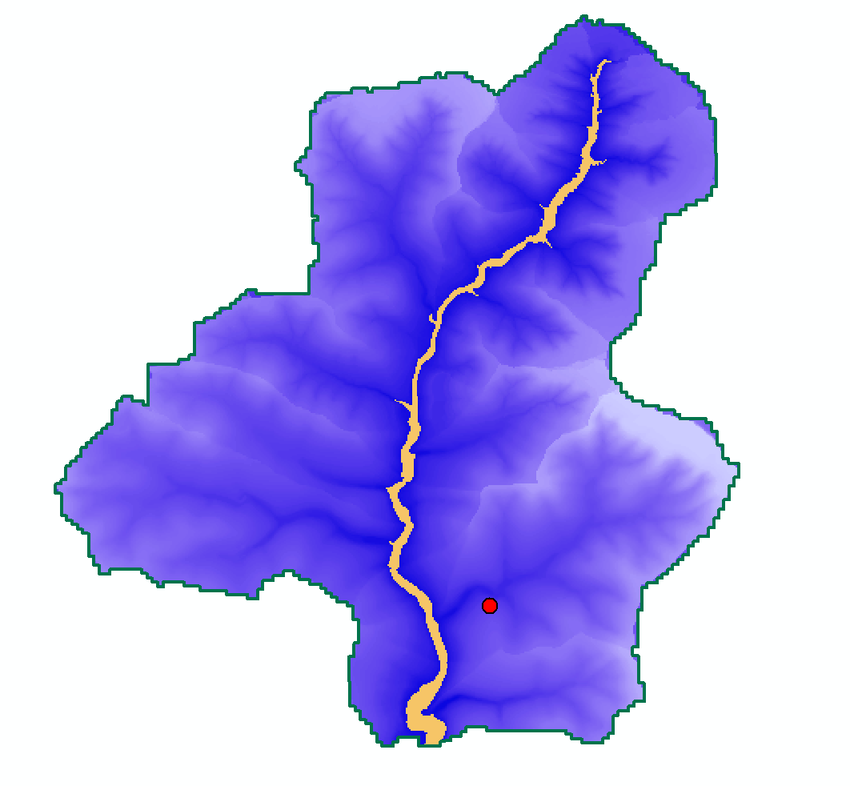
Height Above Nearest Drainage at my Home
HAND < 5 m

Slide 29
Principles for Flood Inundation Mapping
Continental flow network continuum
Top down not bottom up
Separate modeling from mapping
Terrain continuum rather than cross-sections
Stream bed as stage height datum
Height Above Nearest Drainage for inundation
Geospatial image services for mapping
Address Points to connect with Emergency Response

