Slide 1
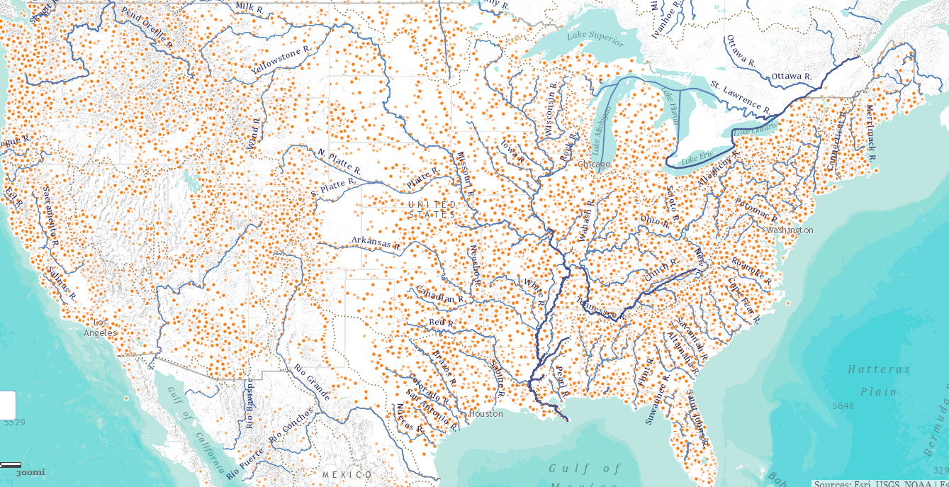
National Water Data Infrastructure
David R. Maidment,
University of Texas at Austin
NWS National Water Center Opening
Tuscaloosa, Alabama
13 May 2014

Slide 2
Transformative Research (NSF)
Transformative research involves ideas, discoveries, or tools that radically change our understanding of an important existing scientific or engineering concept or educational practice or leads to the creation of a new paradigm or field of science, engineering, or education. Such research challenges current understanding or provides pathways to new frontiers.
http://www.nsf.gov/about/transformative_research/definition.jsp
How to move from evolutionary change to transformative change?

Slide 3
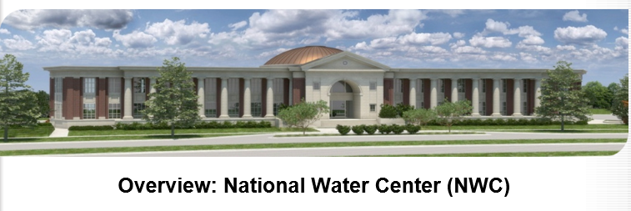
Common Operating Picture for Water Resources
Geo-Intelligence Laboratory
Science and software studio
Systems proving ground
Distance learning

Slide 4
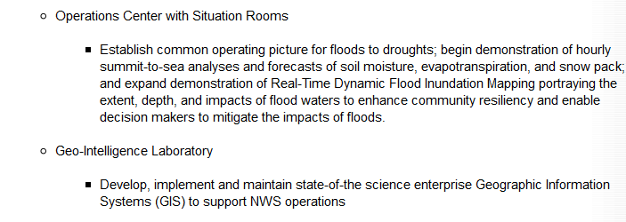
Temporal information
Geospatial information
National Water Data Infrastructure

Slide 5
Major Transitions in Geospatial Info
Paper maps to digital data
National Spatial Data Infrastructure development
Started in 1990’s
Took more than a decade to complete
Digital data to web services
Started several years ago
Will take years to complete
Maps
Data
Services

Slide 6
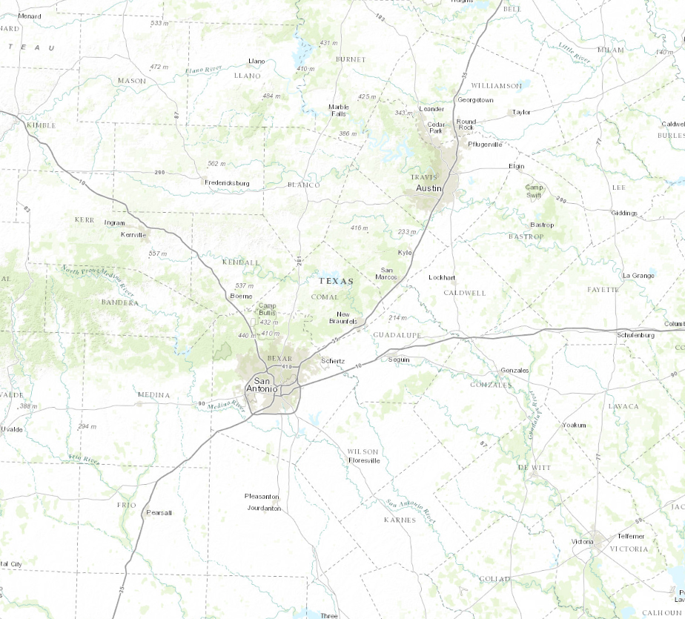
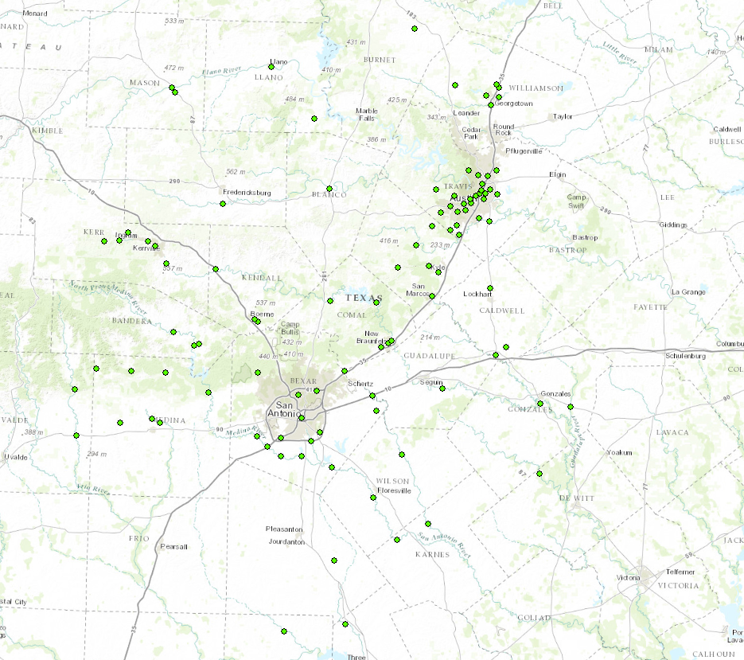
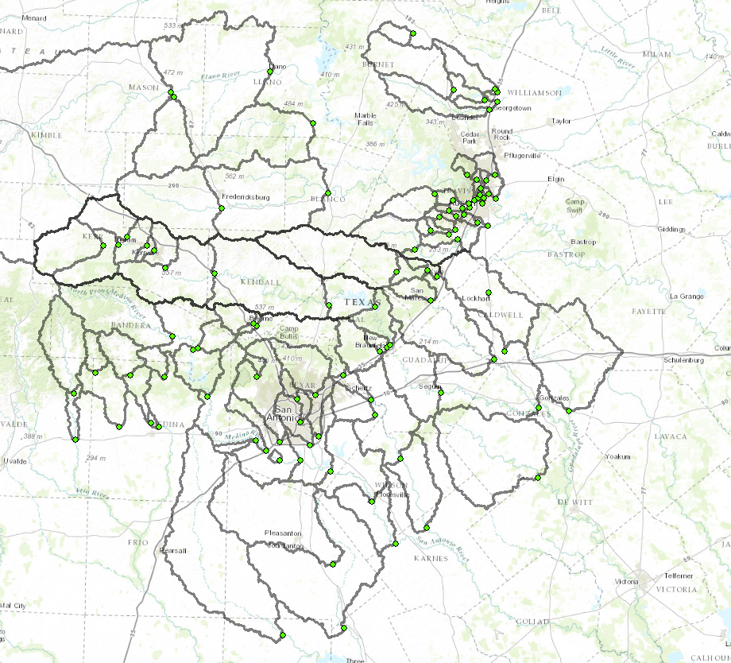
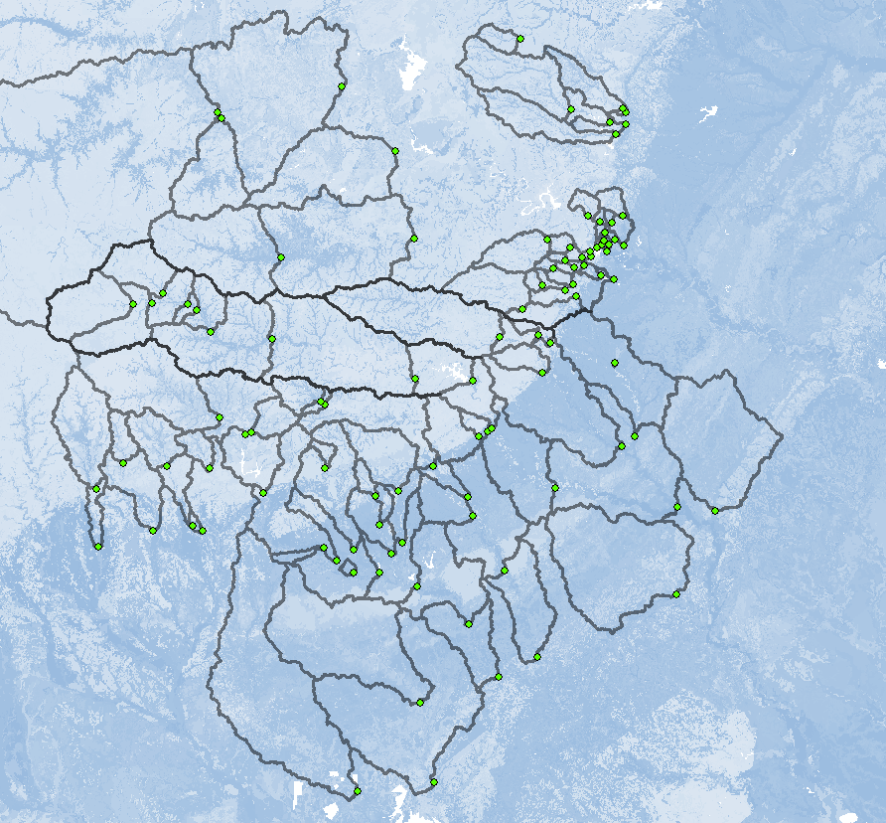
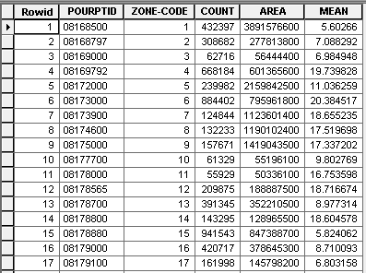
Geospatial Services
Goal:
Calculate average available water storage for a set of contributing areas
Key to Geospatial Services:
Standardized & Machine-Readable Formats
Remote Data & Tools:
Basemap
Stream Gages
Digital Elevation Model
Watershed Delineation Tool
Soil Available Moisture Map
Soil Statistics by Watershed

Slide 7
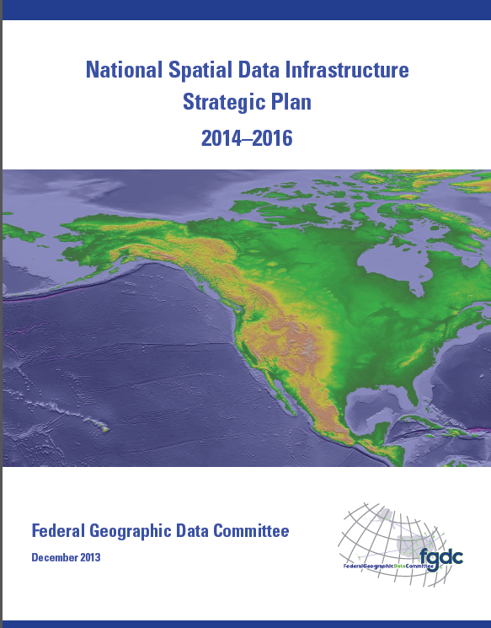
National Spatial Data Infrastructure (NSDI)
Desired Future State of NSDI
Create network of resources and services
Facilitate discovery, access and application of resources
Leverage shared standard-based services
Develop core set of information layers that interface with nonspatial data
Use real-time data feeds and sensor webs

Slide 8
National Water Data Infrastructure (NWDI)
A thematically organized set of water information data layers
Authoritative for the nation
Assembled from best available sources
Made freely available through water information services.

Slide 9
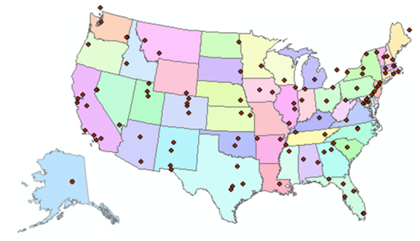
Consortium of Universities for the Advancement of Hydrologic Science, Inc.
www.cuahsi.org
CUAHSI
A consortium representing 125 US universities
Dr. Richard Hooper, President and CEO
Supported by the National Science Foundation Earth Science Division
Advances hydrologic science in nation’s universities
Includes a Hydrologic Information System project
Invented WaterML language for water resources time series
Building an academic prototype system

Slide 10
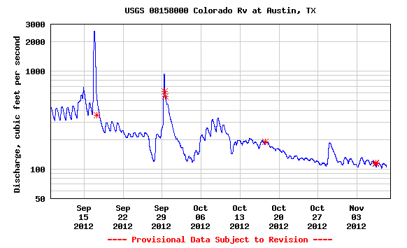
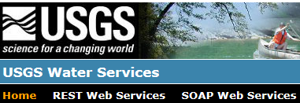
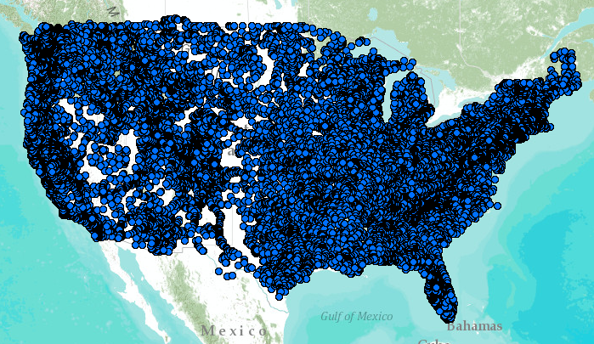
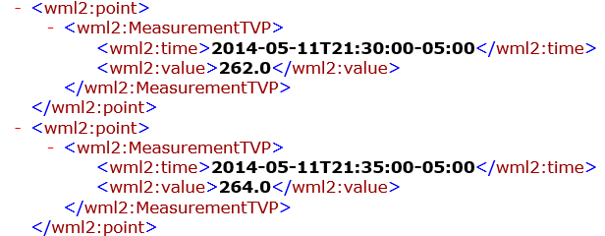
WaterML – the US Geological Survey
Water time series data on the internet
24/7/365 service
For daily and real-time data
. . . Operational water web services system for the United States
http://waterservices.usgs.gov/nwis/iv/?format=waterml,2.0&sites=08158000&period=P1D&parameterCd=00060

Slide 11
Open Geospatial Consortium
More than 400 companies and agencies globally
Internet standards for
Map services
Observation services
Catalog services
. . . Internet data standards for maps and observational data

Slide 12
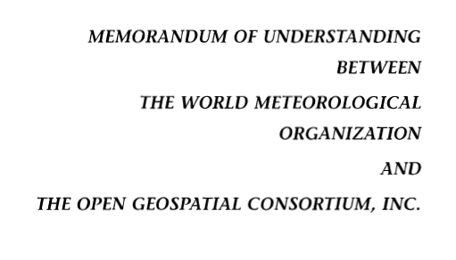
OGC/WMO Hydrology Domain Working Group
4-Year International Effort – WaterML
A time series for one variable at one location
Hydrology Domain Working Group formed
OGC observer at CHy-13
Technical Meetings Each 3 Months Four Interoperability Experiments
(Surface water, groundwater, forecasting)
Annual week-long workshops
Involvement by many countries
November 2009
Acknowledgements: OGC, WMO, GRDC, NWS, CUAHSI, BoM/CSIRO, USGS, GSC, Kisters, …….
2008
2009
2010
2011
2012
Notes:
(1) A four-year international effort has been undertaken to reconcile WaterML with international standards;
(2) This effort was initiated with the establishment of an Hydrology Domain Working Group by the Open Geospatial Consortium in September 2008;
(3) An OGC representative attended the WMO Congress of the Commission for Hydrology in 2008
(4) A formal agreement between Secretary General of WMO and President of OGC in 2009 to jointly develop standards for hydrology, climatology, oceanography and climatology;
(5) The joint OGC/WMO Hydrology Domain Working Group was supported by a large work effort, annual week-long workshops, four interoperability experiments for surface and groundwater data exchange, and participation by many countries;
(6) In June 2012, the OGC voted to adopt the revised version, WaterML2 as an international standard for exchange of water resources time series (the first such public standard that has existed);
(7) This Congress to the WMO Commission for Hydrology to whom I am speaking is considering WaterML2 for adoption as an official standard by WMO

Slide 13
Committee on Environmental, Natural Resources, and Sustainability (CENRS)
“WaterML: Water Markup Language (ML) is an informatics initiative of the CENRS Subcommittee on Water Availability and Quality that provides a systematic way to access water information from point observation sites.” (p.21)
WaterML is the first OGC standard endorsed by the Executive Office of the President
http://www.whitehouse.gov/sites/default/files/microsites/ostp/nstc_2013_earthobsstrategy.pdf

Slide 14
ACWI – Advisory Committee on Water Information
Established in 1991

Slide 15
Anne Castle, Asst Secretary for Water and Science, Dept of Interior
“Today we have unprecedented opportunities to use science and technology to create a better understanding of one of our most precious resources – water”
“I am committed to working with you to do that”
Chair

Slide 16
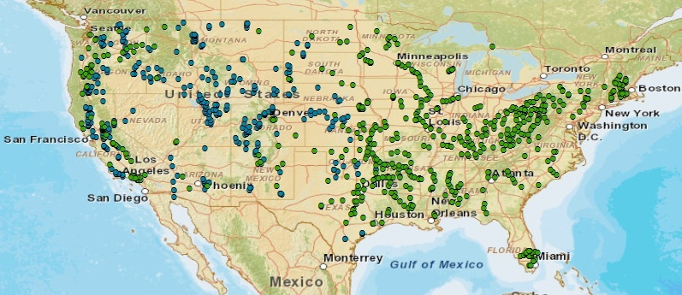
A Key Data Layer in the NWDI: Corps and USBR Reservoirs
(608)
Lower Colorado Region will be the first in USBR to publish its data
(348)

Slide 17
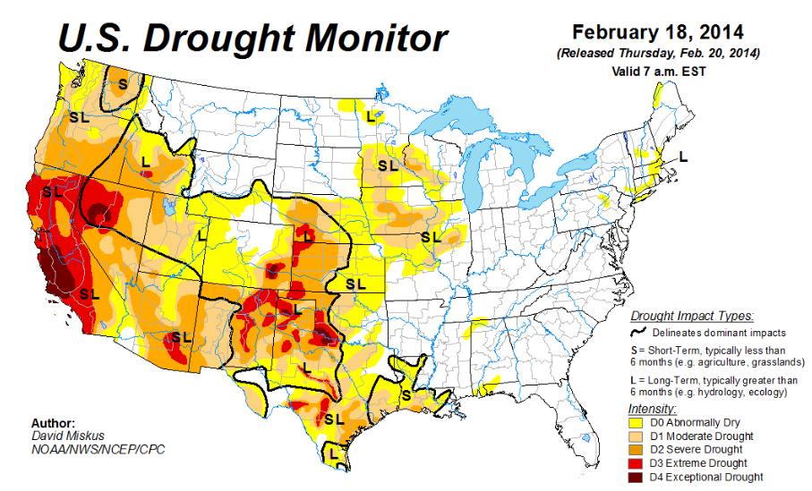
Drought and Reservoirs – regional response over large areas

Slide 18
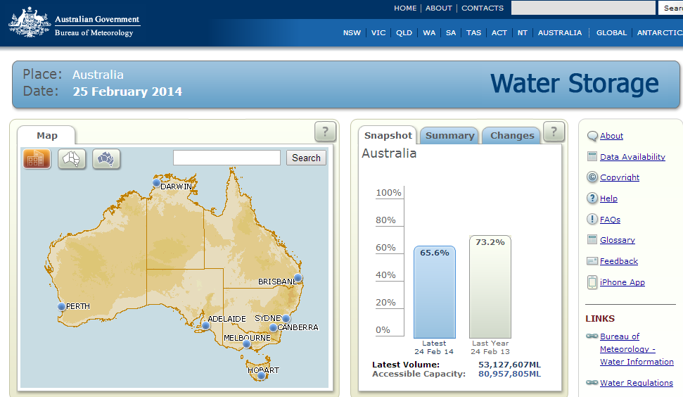
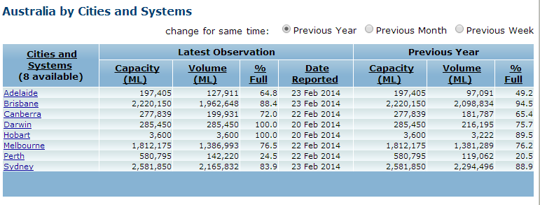
Reservoir Data from Australia (Comparison with previous year)

Slide 19
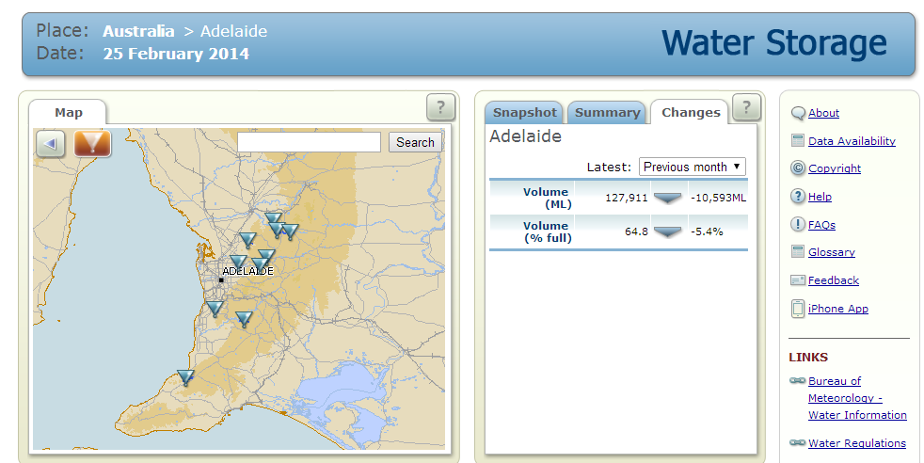
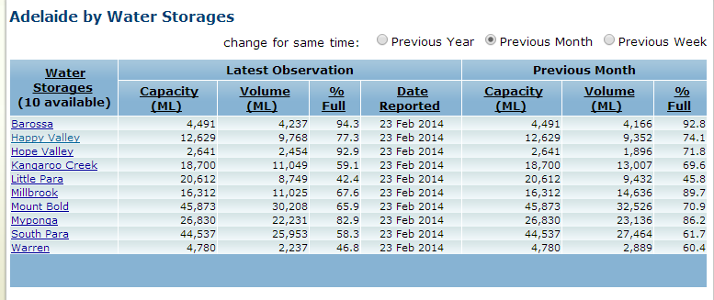
Reservoir Data for Adelaide (Comparison with previous month)

Slide 20
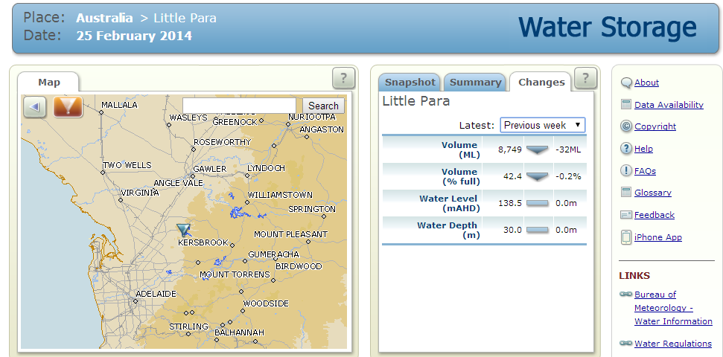
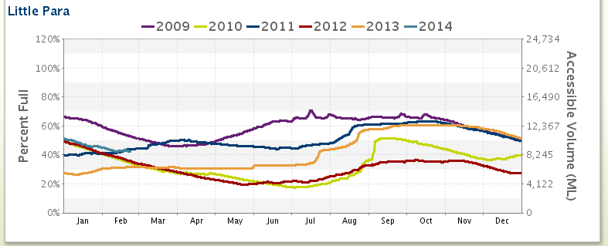
Little Para Reservoir Data (Comparison with previous week)

Slide 21
Slide: Hector Guerrero, NWS, San Angelo

Slide 22
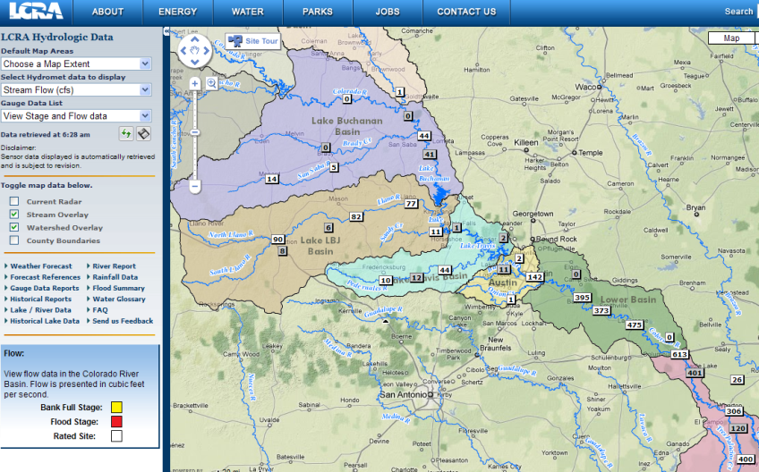
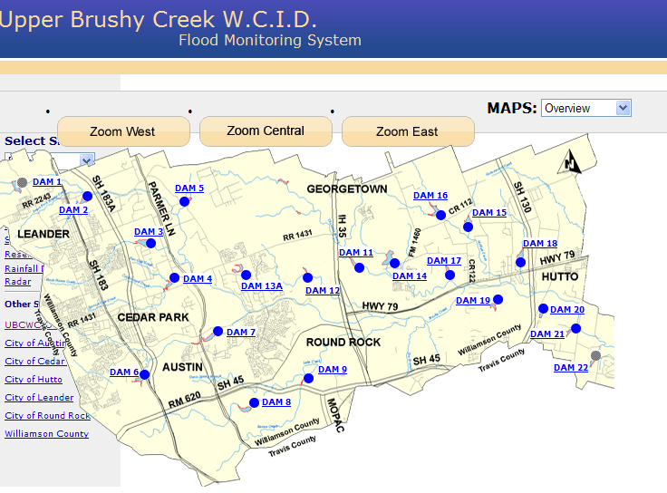
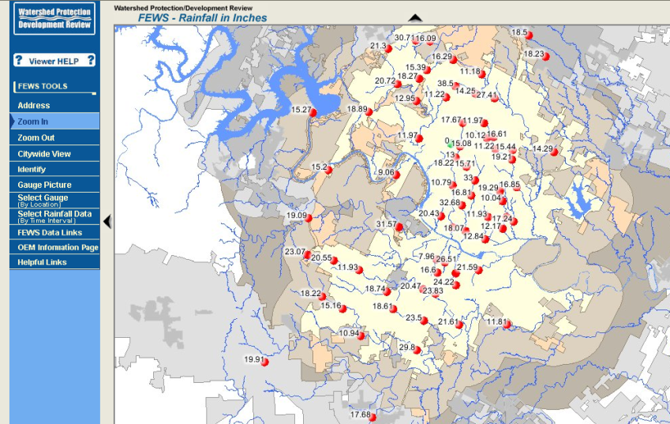
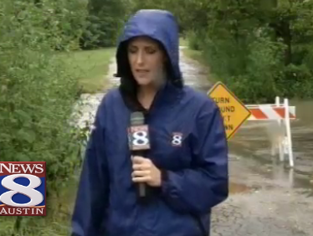
Local Information during Tropical Storm Hermine (8 Sept 2010)
Upper Brushy Creek (Round Rock)
LCRA
http://hydromet.lcra.org
http://ubcwcid.org/Overview/Overview.aspx?id=1
TV
City of Austin
http://coagis1.ci.austin.tx.us/website/COAViewer_fews/viewer.htm

Slide 23
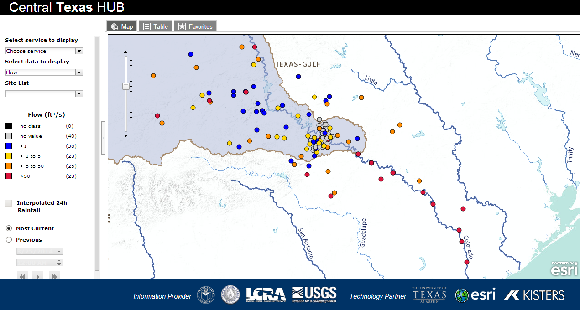
“System of Systems” for Water Data

Slide 24
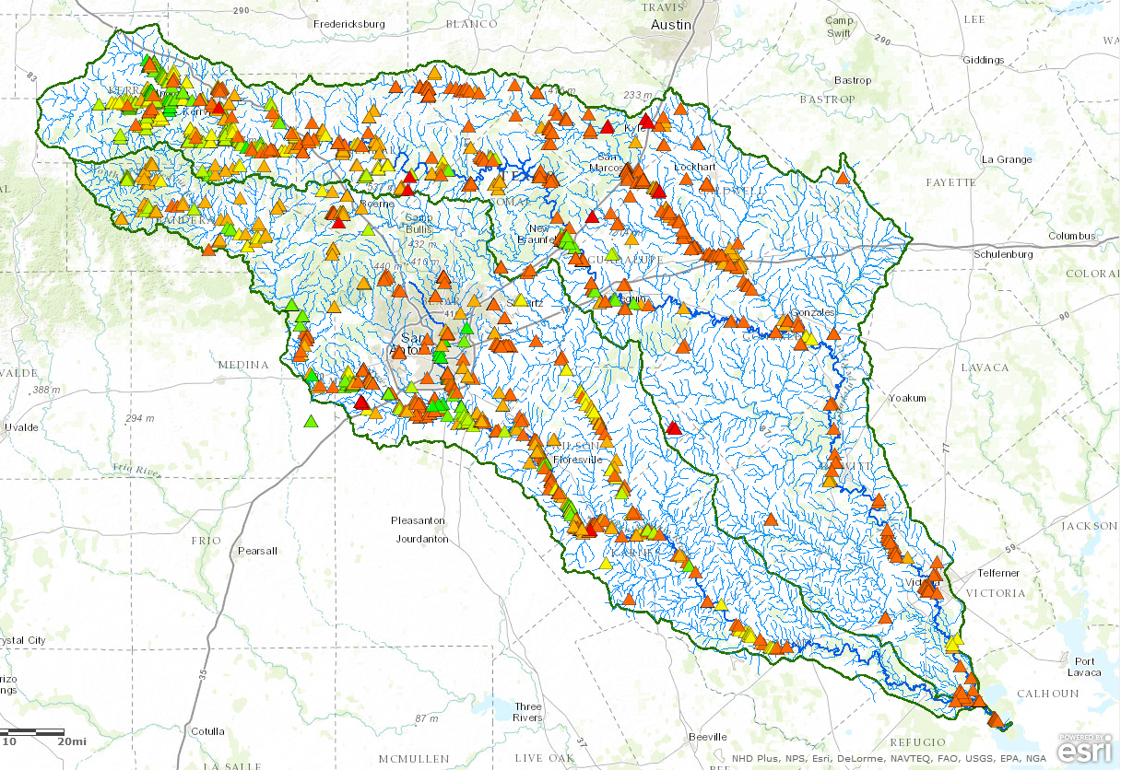
TCEQ Watermaster Operations Approx. 750 water rights
Priority Date

Slide 25
Water Operations Model San Antonio/Guadalupe Basins
Map Services – geospatial context
Data Services – historical context

Slide 26
Water Operations Model USGS Streamflow Observations – 36 gages
Map Service
Data Service

Slide 27
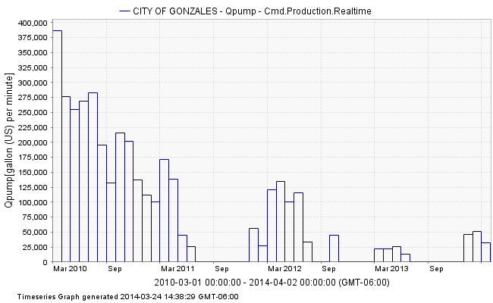
Water Operations Model TCEQ Water Rights Observations – 750 water right holders
Map Service
Data Service

Slide 28
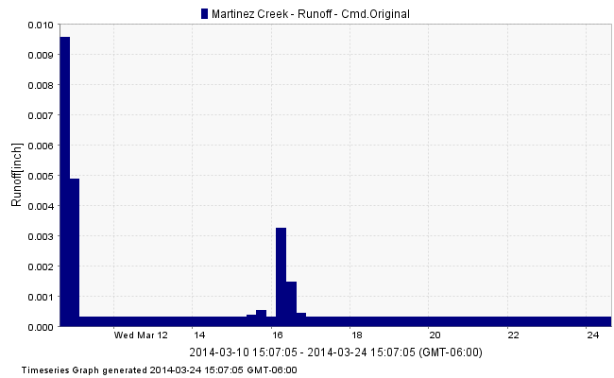
Water Operations Model NWS Surface Runoff Calculations – 47 forecast points
Map Service
Data Service

Slide 29
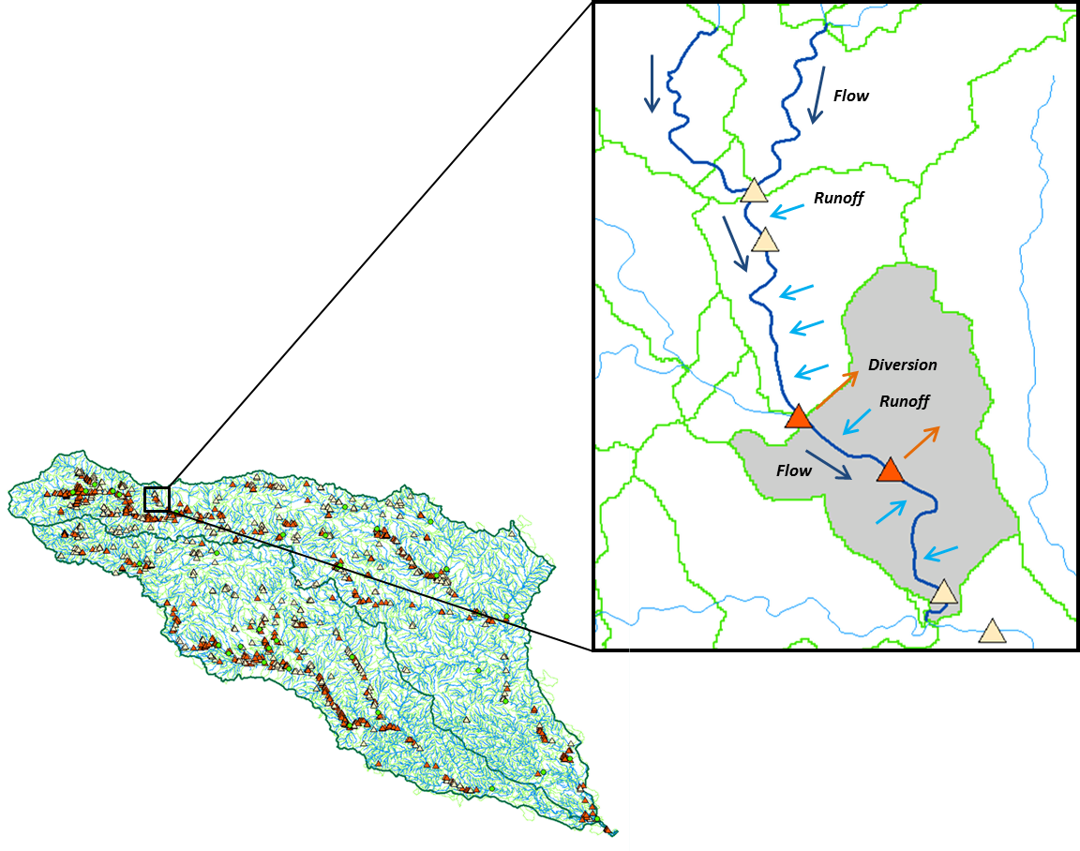
Water Operations Model Computational modeling unit –NHDPlus Catchments

Slide 30
Water Operations Model Disaggregation of NWS forecasts to NHDPlus catchments
Legend
NHDPlus Catchment
NWS Subbasin

Slide 31
Flow in the San Antonio/Guadalupe Basin
RAPID model, 3 hour time steps
http://www.ucchm.org/david/rapid.htm
David et al. (2011) DOI: 10.1175/2011JHM1345.1
GIS data describes 5,175 river reaches . . .
. . . simulate flow in each reach in each time step

Slide 32
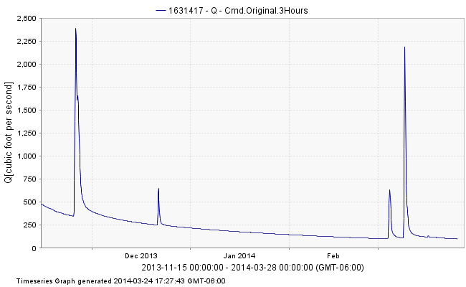
Water Operations Model RAPID Streamflow Calculations – 5,175 NHDPlus river reaches
Map Service
Data Service
https://ut-austin.maps.arcgis.com/home/webmap/viewer.html?webmap=d107aa9260534ddbb96db302e3643a93

Slide 33
Integration of Map and Data Services
Water Master
Amazon Cloud (Map Services)
MS Azure Cloud (Data Services)

Slide 34
Flow in the Mississippi Basin
RAPID model, 3 hour time steps
David et al. (2011) DOI: 10.1175/2011JHM1345.1
GIS data describes 5,175 river reaches . . .
. . . simulate flow in each reach in each time step

Slide 35
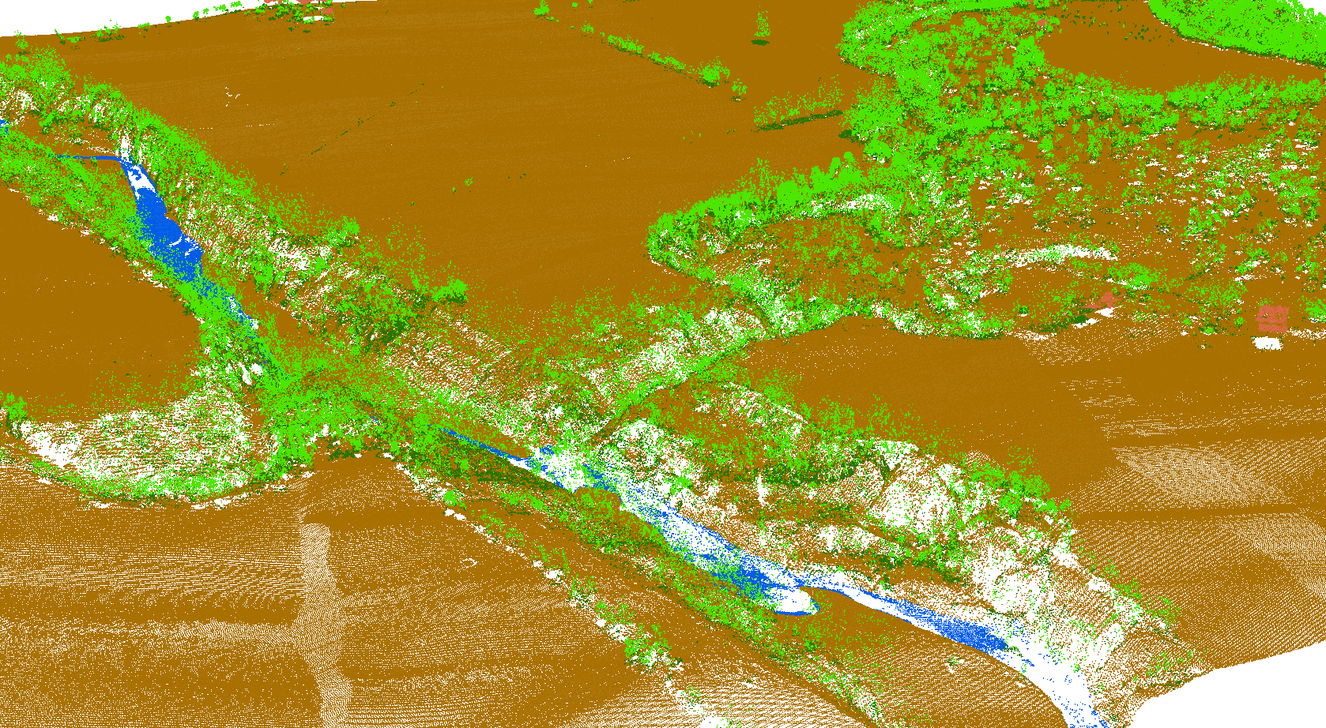
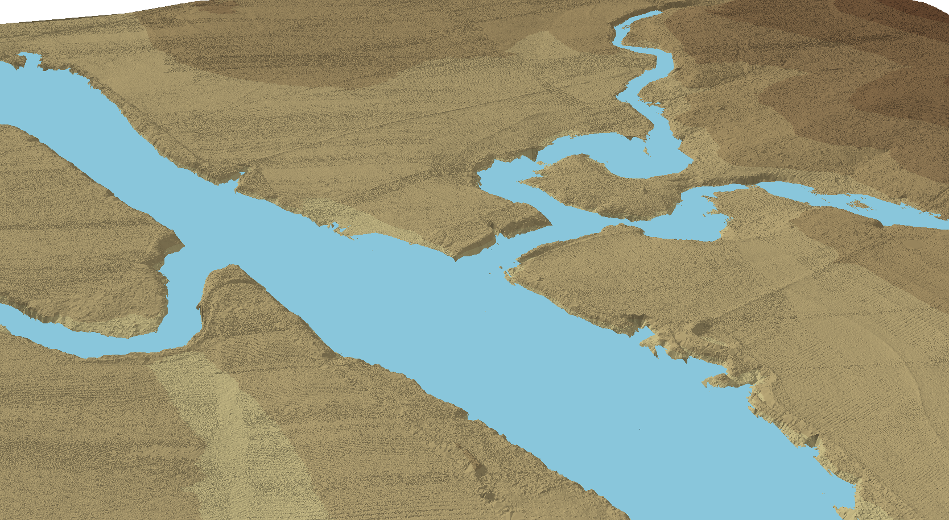
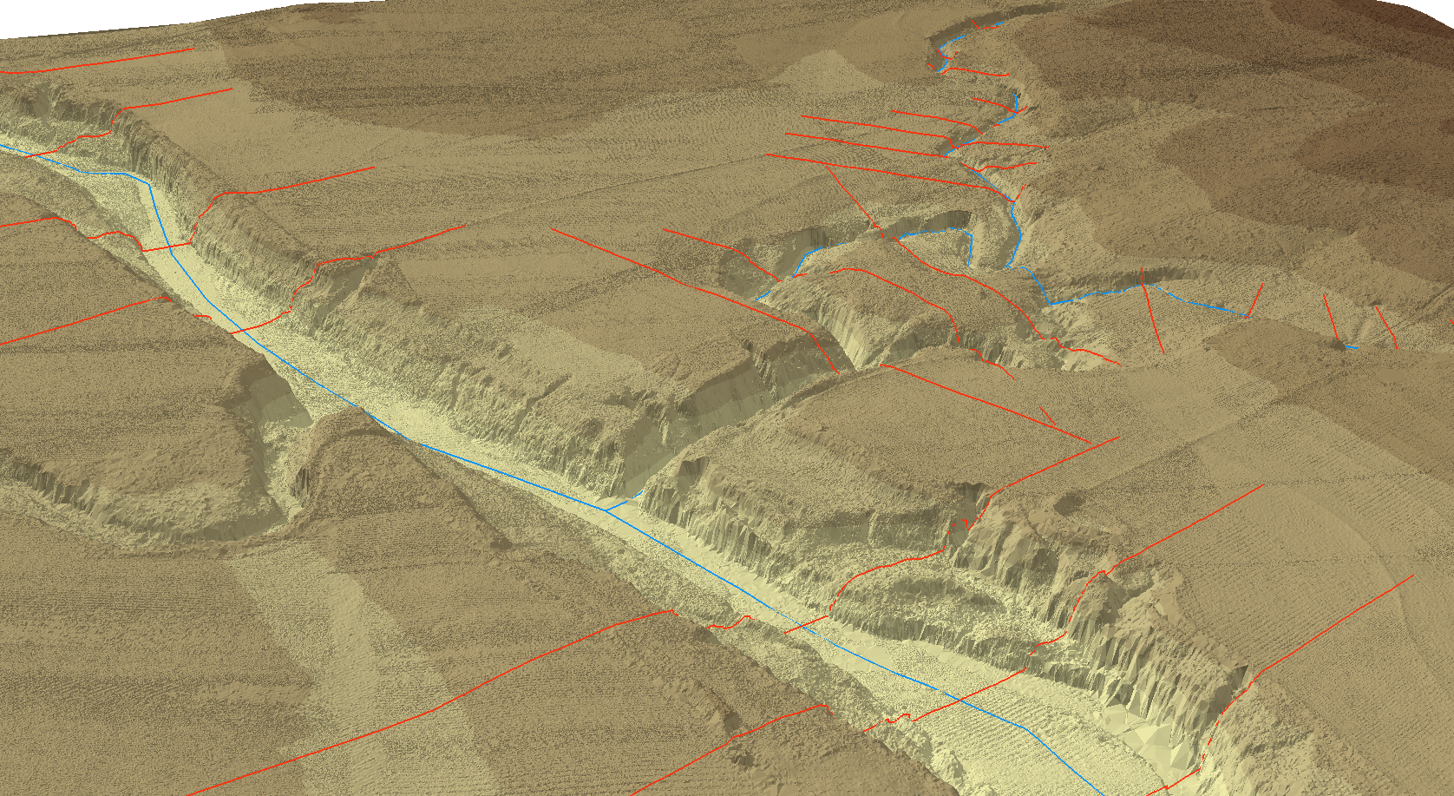
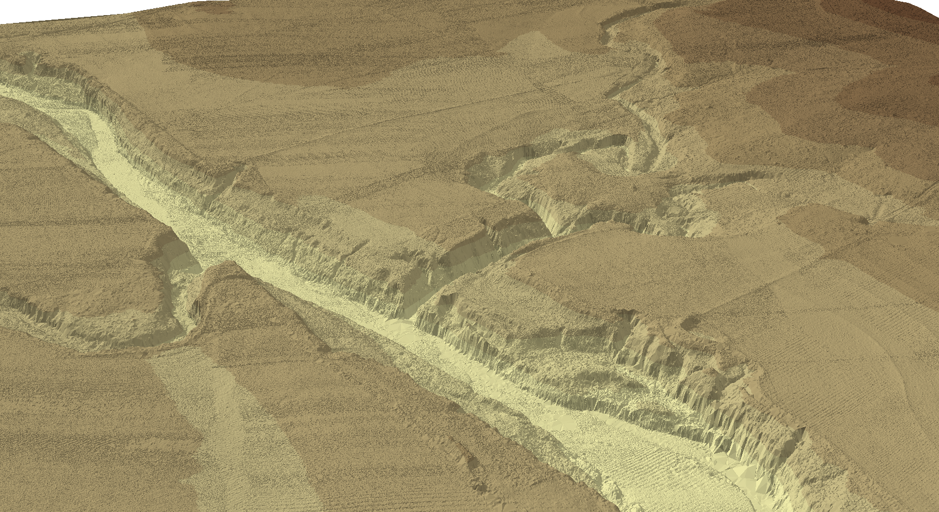
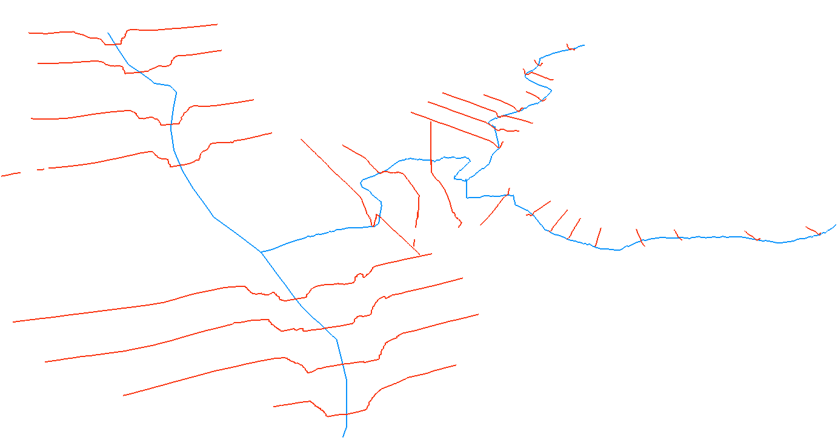
Flood Modeling: Geometry and Flow
Convert High Density Raw Data
to
Simplified Meaningful Relationships

Slide 36
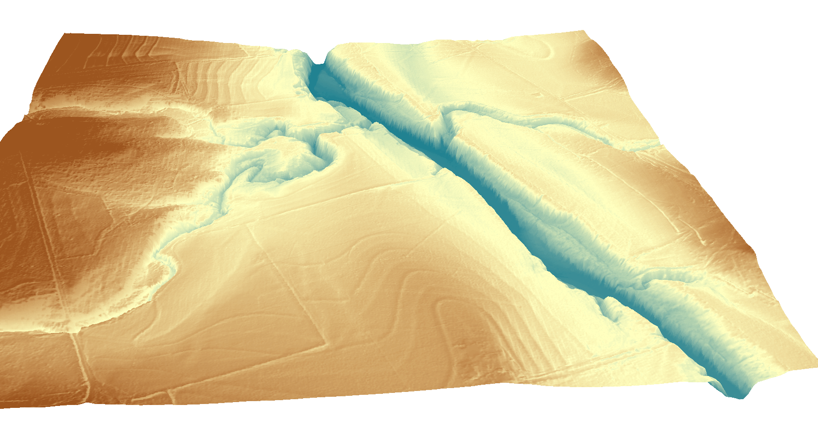
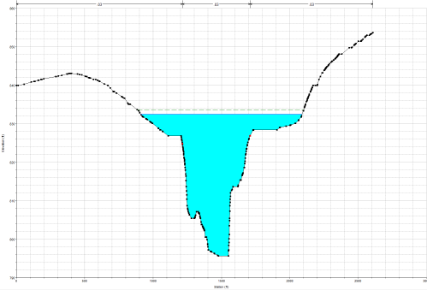
RiverML: Modular River Data Format
Terrain Processing Software
(ArcGIS, AutoCAD, etc.)
Hydrologic Calculation Software
(HEC-HMS, PondPack, etc.)
Hydraulic Calculation Software
(HEC-RAS, MIKE Flood HD, etc)

Slide 37
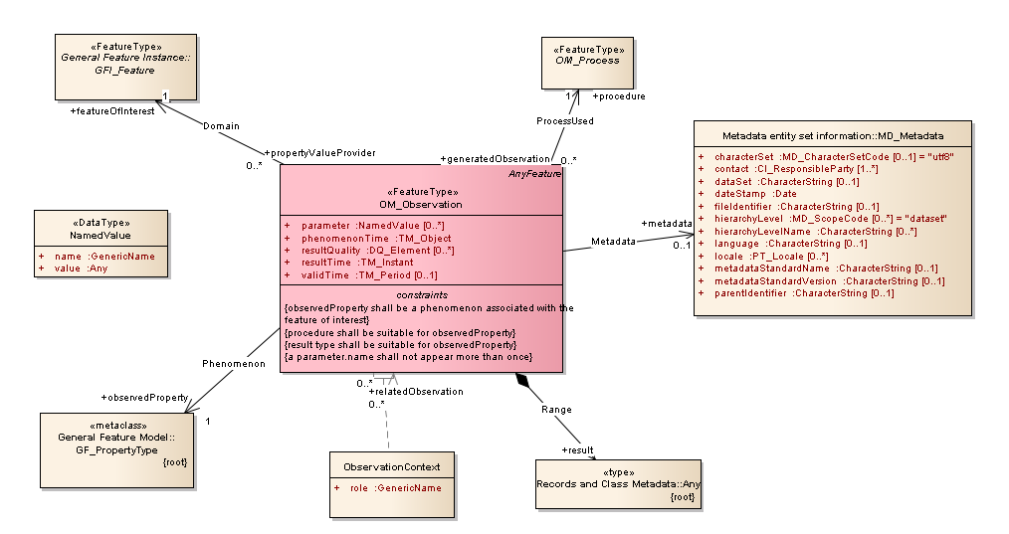
OGC Observations Information Model
Observations & Measurements Model (O&M):
A Feature of Interest has a Property that is measured by a Process that produces a Result

Slide 38
OGC/WMO Hydrology Domain Working Group
WaterML2 standard for time series approved in 2012
Ratings and Gagings standardization ongoing now within the Hydrology Domain Working Group (driven by requirements for IWRSS)
RiverML initiated at Quebec HDWG meeting in 2013
Next workshop in New York in August 2014
NWS participation is very welcome!

Slide 39
AWRA support for National Water Data Infrastructure
Featured Collection of articles in Journal of AWRA
New Technology Committee Special track at AWRA National meeting in Tysons Corner, VA, Nov 2014
National Weather Service participation is very welcome

Slide 40
National Water Data Infrastructure (NWDI)
A thematically organized set of water information data layers
Authoritative for the nation
Assembled from best available sources
Made freely available through water information services.

Slide 41
Conclusions
The National Water Center could be an anchor organization in the development of a National Water Data Infrastructure
This will involve shared map and water data and modeling services across organizations, levels of government, and the private sector
Open Geospatial Consortium standards e.g. WaterML are an important foundation for this shared services infrastructure
Bon Voyage with your new Center!

