Slide 1
Towards a Global Water Information System
David R. Maidment
Center for Research in Water Resources
University of Texas at Austin
Presented to New Zealand Hydrological Society
Palmerston North, New Zealand | 22 February 2013
Adapted from a presentation to 14th Congress of the WMO Commission for Hydrology
Geneva, Switzerland | 9 November 2012

Slide 2
WMO Guide to Hydrological Practices
Guide to Hydrological Practices
Volume I
Hydrology – From Measurement to Hydrological Information
Science and Measurement
Chapter 10
Data Storage, Access, and Dissemination
Guide to Hydrological Practices
Volume II
Management of Water Resources and Application of Hydrological Practices
Application and
Management
Guide to Hydrological Practices . . .
. . . WMO recommendations for National Hydrological Surveys

Slide 3
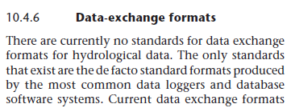
Volume 1, Chapter 10
Guide to Hydrological Practices
Volume I
Hydrology – From Measurement to Hydrological Information
Science and Measurement
Published in 2008
Last section of the last chapter of Volume I . . .
. . . this lecture provides an update since 2008

Slide 4
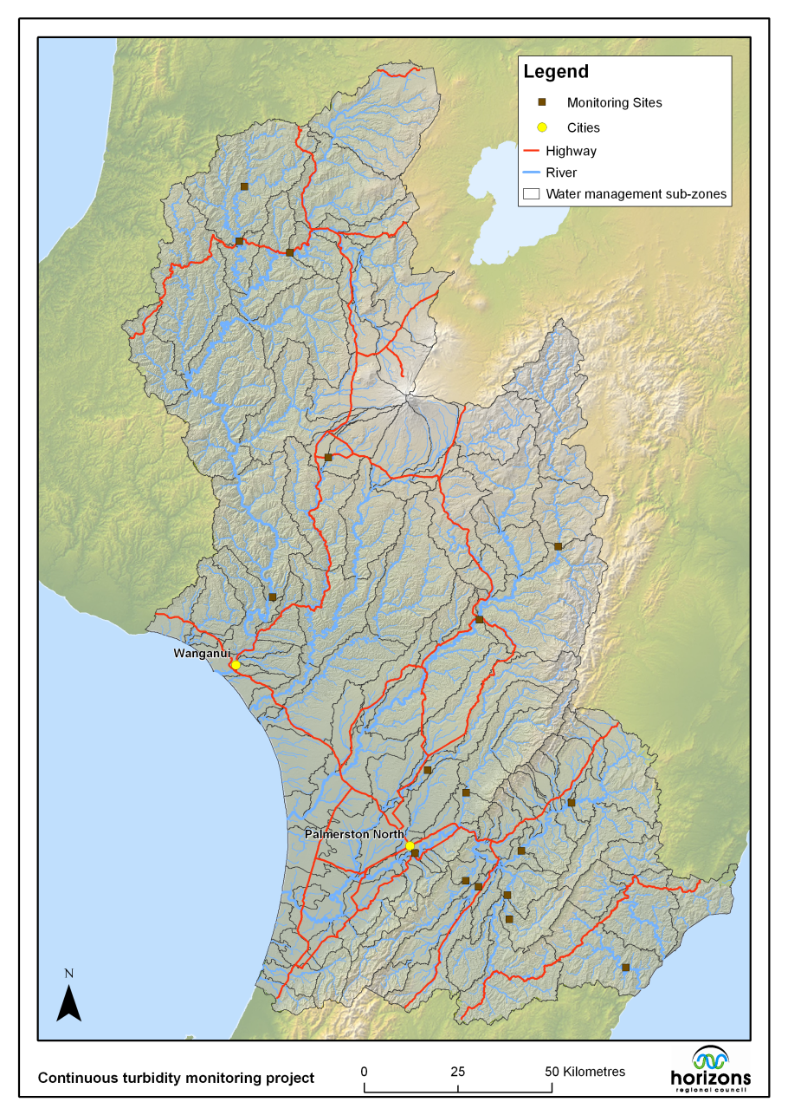
Horizons Regional Council does all of this
Guide to Hydrological Practices
Volume I
Hydrology – From Measurement to Hydrological Information
Guide to Hydrological Practices
Volume II
Management of Water Resources and Application of Hydrological Practices
HRC covers all functions
Flooding
Drought
Water quality
Ecological integrity
Does its own measurement . . .
. . . translates data into action

Slide 5
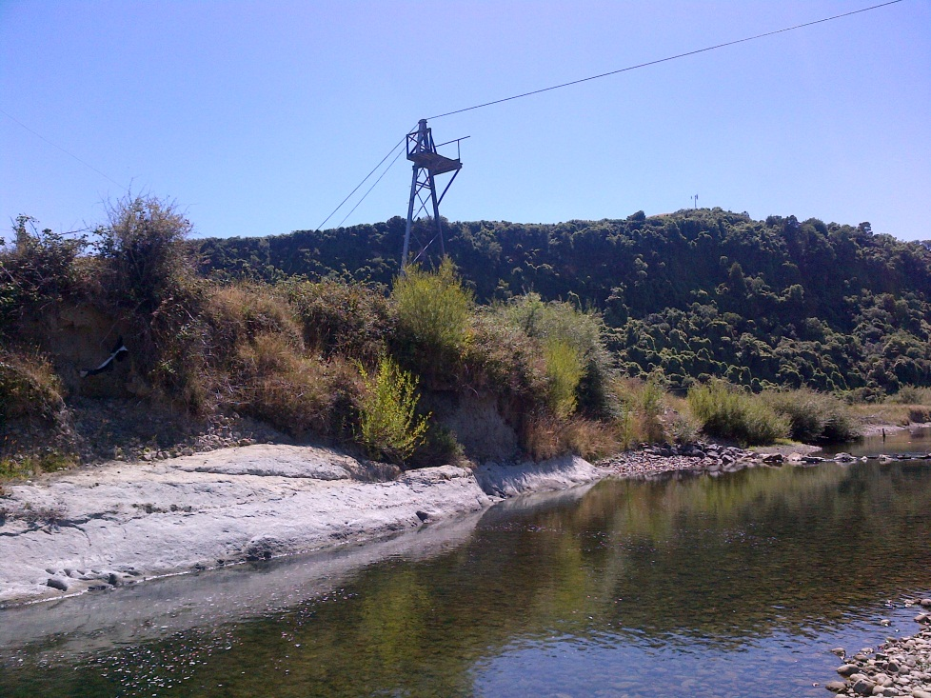
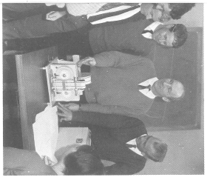
“Hoppy” Hopkins
A pioneer of hydrological measurement in New Zealand
Operated a hydrological field party from Palmerston North for many years
Mangatainoka River at Suspension Bridge
Hoppy was the first person who
saw something in me as a teacher
“Tell the field technicians what they
need to know about hydraulics””

Slide 6
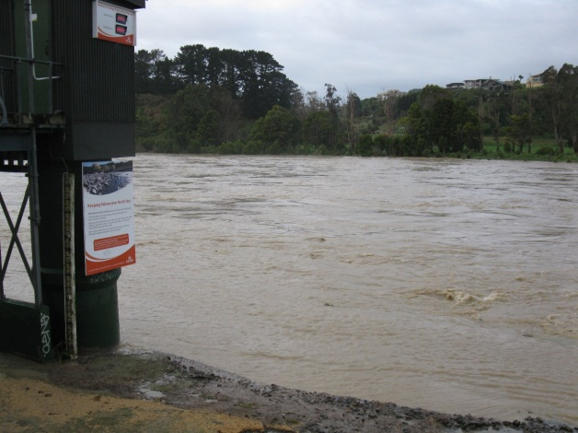
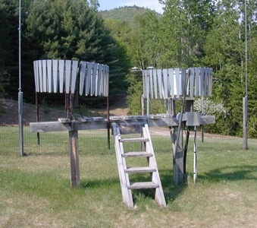
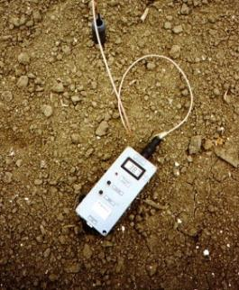
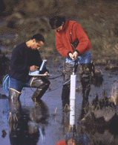
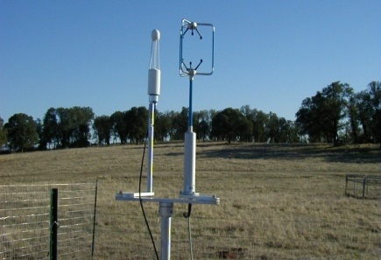
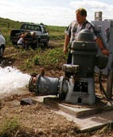
Hydrological Measurement
Water Quantity
Rainfall
Soil Water
Water Quality
Meteorology
Groundwater
Time series data at point locations

Slide 7
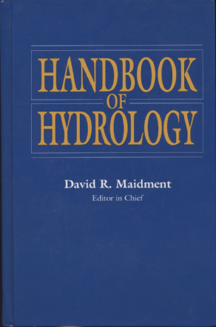
How is new knowledge discovered?
After completing the Handbook of Hydrology in 1993, I asked myself the question: how is new knowledge discovered in hydrology?
By deduction from existing knowledge
By experiment in a laboratory
By observation of the natural environment

Slide 8
Conclusion for Hydrology
Deduction and experiment are important, but hydrology is primarily an observational science

Slide 9
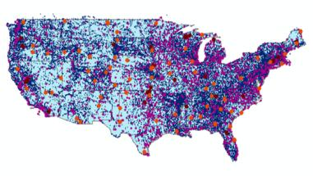
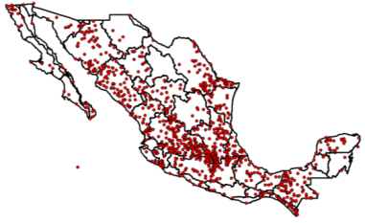
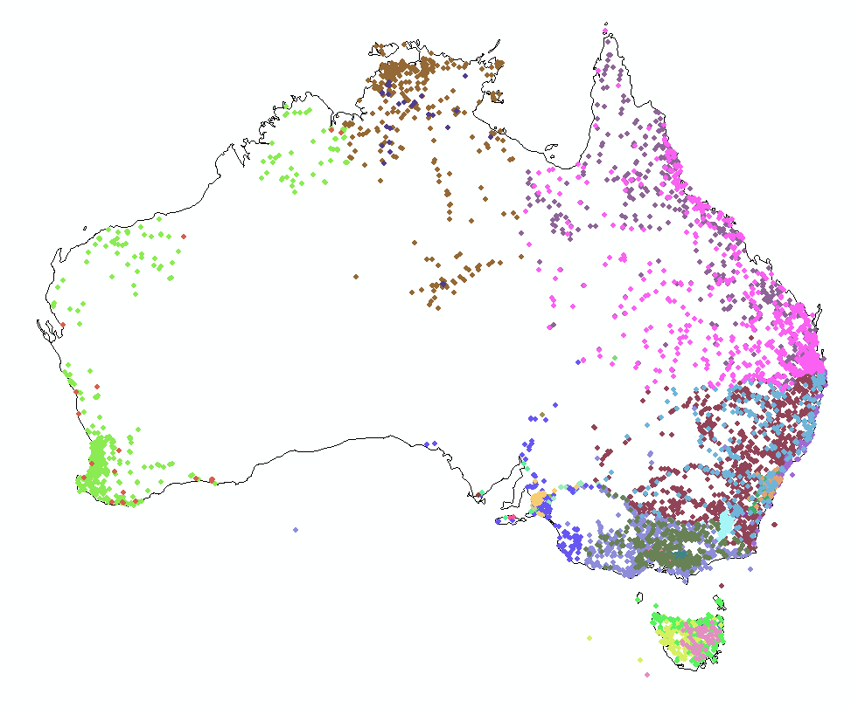
Every Country Collects These Data
WMO does
Global Water
Data Integration
United States
Mexico
Australia
Many kinds of hydrological measurements . . .
. . . this presentation focuses on streamflow

Slide 10
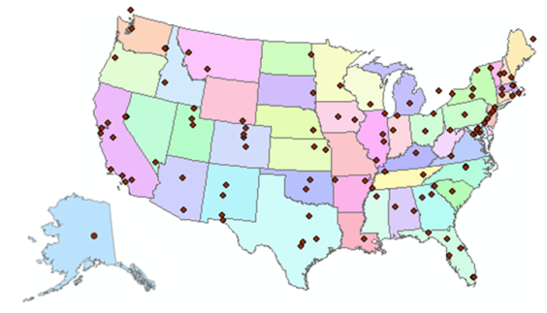
Consortium of Universities for the Advancement of Hydrologic Science, Inc.
www.cuahsi.org
CUAHSI
A consortium representing 125 US universities
Dr. Richard Hooper, President and CEO
Supported by the National Science Foundation Earth Science Division
Advances hydrologic science in nation’s universities
Includes a Hydrologic Information System project
Invented WaterML language for water resources time series
Building an academic prototype system

Slide 11
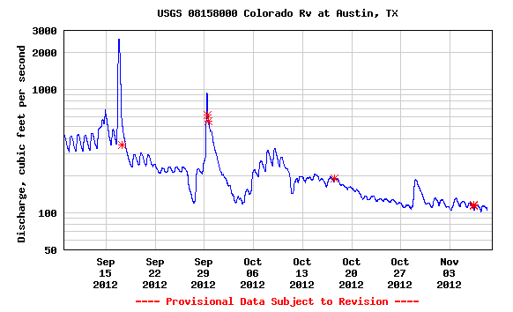
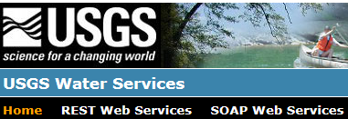
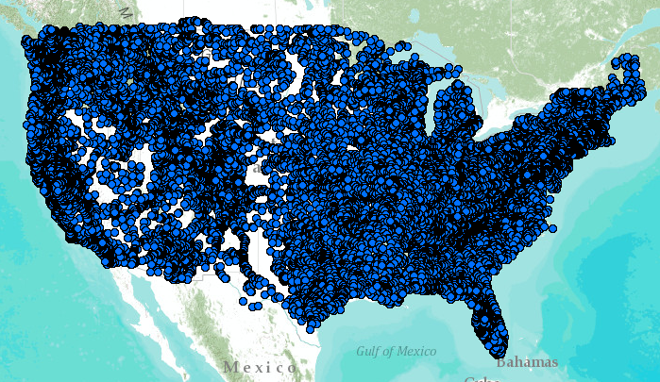
WaterML – the US Geological Survey
Water time series data on the internet
Measurement Standards
Map Standards
24/7/365 service
For daily and real-time data
. . . Operational water web services system for the United States
http://waterservices.usgs.gov/nwis/iv?sites=08158000&period=P1D&parameterCd=00060

Slide 12
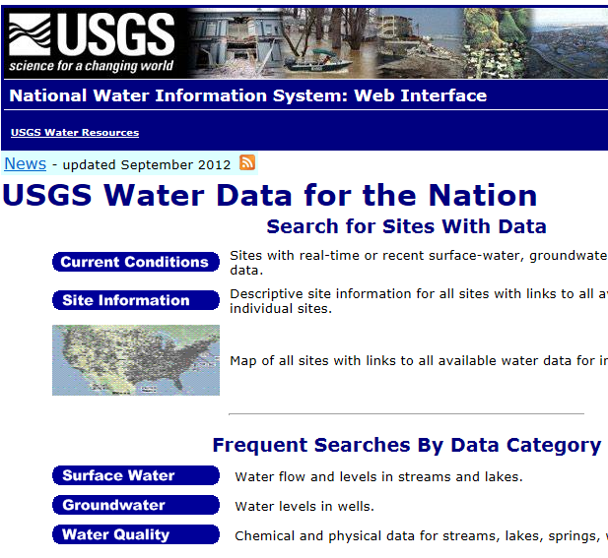
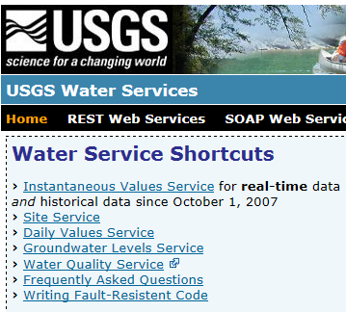
Web Pages and Web Services
Web pages deliver text and images
Web services deliver data encoded in XML
http://water.usgs.gov/
http://waterservices.usgs.gov/

Slide 13
Open Geospatial Consortium
More than 400 companies and agencies globally
. . . Internet data standards for maps and observational data

Slide 14
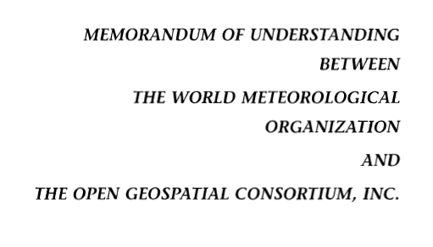
OGC/WMO Hydrology Domain Working Group
4-Year International Effort – WaterML
A time series for one variable at one location
Hydrology Domain Working Group formed
OGC observer at CHy-13
Technical Meetings Each 3 Months Four Interoperability Experiments
(Surface water, groundwater, forecasting)
Annual week-long workshops
Involvement by many countries
November 2009
Acknowledgements: OGC, WMO, GRDC, CUAHSI, BoM/CSIRO, USGS, GSC, Kisters, …….
2008
2009
2010
2011
2012
Notes:
(1) A four-year international effort has been undertaken to reconcile WaterML with international standards;
(2) This effort was initiated with the establishment of an Hydrology Domain Working Group by the Open Geospatial Consortium in September 2008;
(3) An OGC representative attended the WMO Congress of the Commission for Hydrology in 2008
(4) A formal agreement between Secretary General of WMO and President of OGC in 2009 to jointly develop standards for hydrology, climatology, oceanography and climatology;
(5) The joint OGC/WMO Hydrology Domain Working Group was supported by a large work effort, annual week-long workshops, four interoperability experiments for surface and groundwater data exchange, and participation by many countries;
(6) In June 2012, the OGC voted to adopt the revised version, WaterML2 as an international standard for exchange of water resources time series (the first such public standard that has existed);
(7) This Congress to the WMO Commission for Hydrology to whom I am speaking is considering WaterML2 for adoption as an official standard by WMO

Slide 15
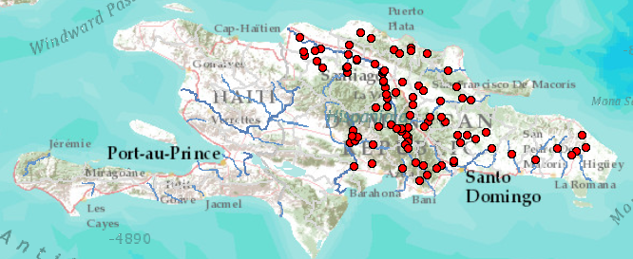
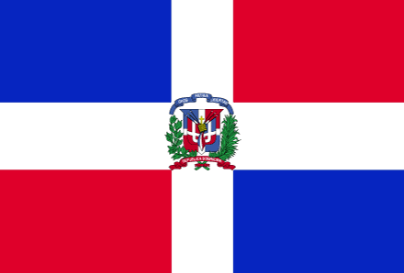
Dominican Republic – An Example
INDRHI (Instituto Nacional de Recursos Hidráulicos) data . . .
. . . converted to WaterML web services at BYU

Slide 16
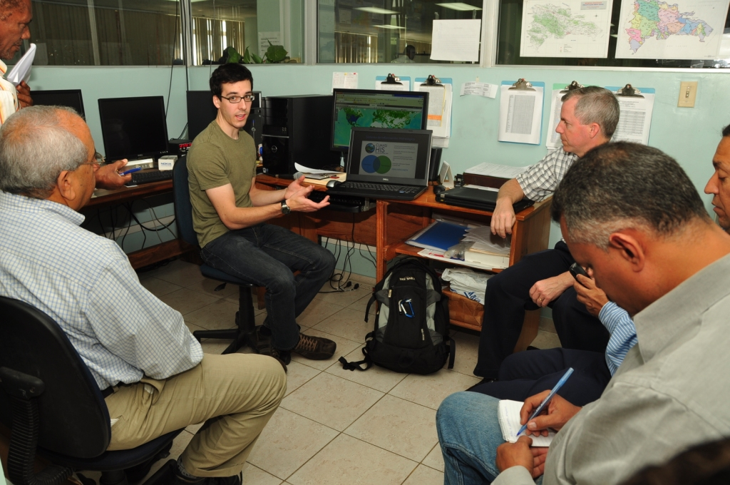
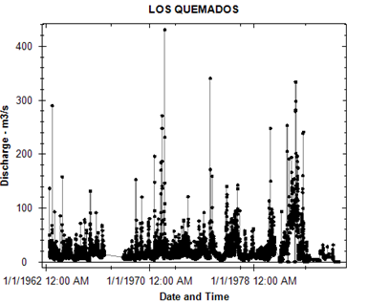
A Voluntary Project Using Free Software
Graduate student and faculty member from BYU . . .
. . . collaborating with technical staff at INDRHI

Slide 17
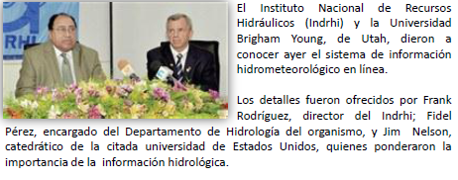
Press Conference for “Online” System
Frank Rodríguez, Director of INDRHI . . .
. . . Jim Nelson, Professor from BYU

Slide 18
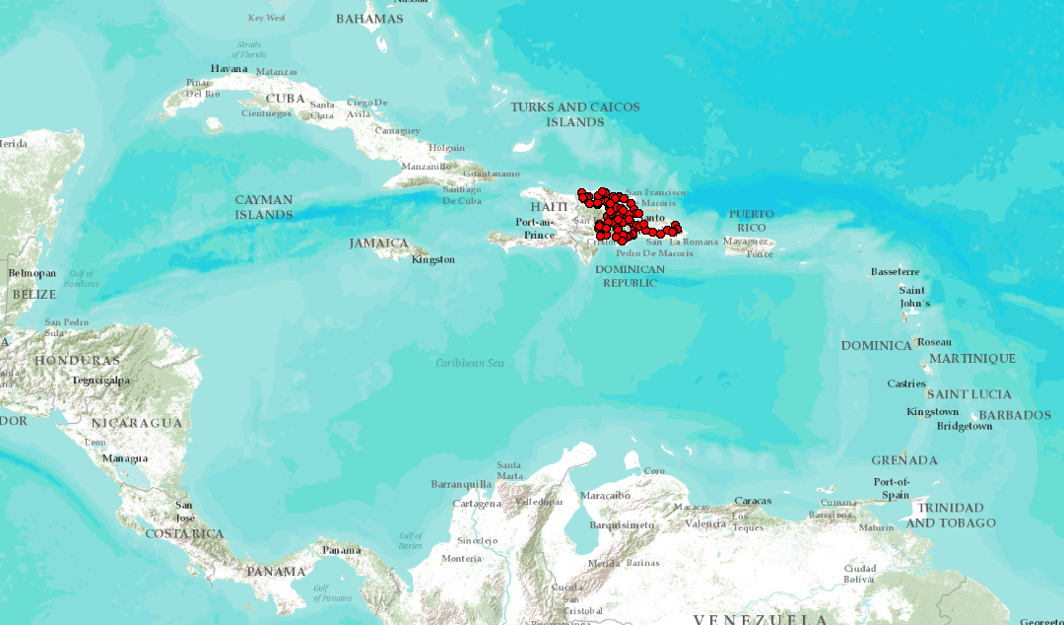
A Leader for the Caribbean Region
INDRHI would like to use their experience as a guide for neighboring countries. . .
. . . perhaps an activity for the CHy-14 Data Operations and Management theme?

Slide 19
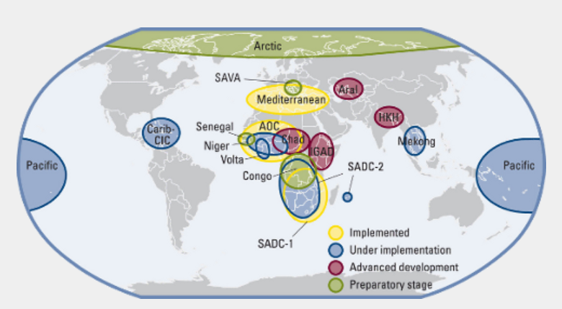
World Hydrological Cycle Observing System
Some projects implemented . . .
. . . Some in development

Slide 20
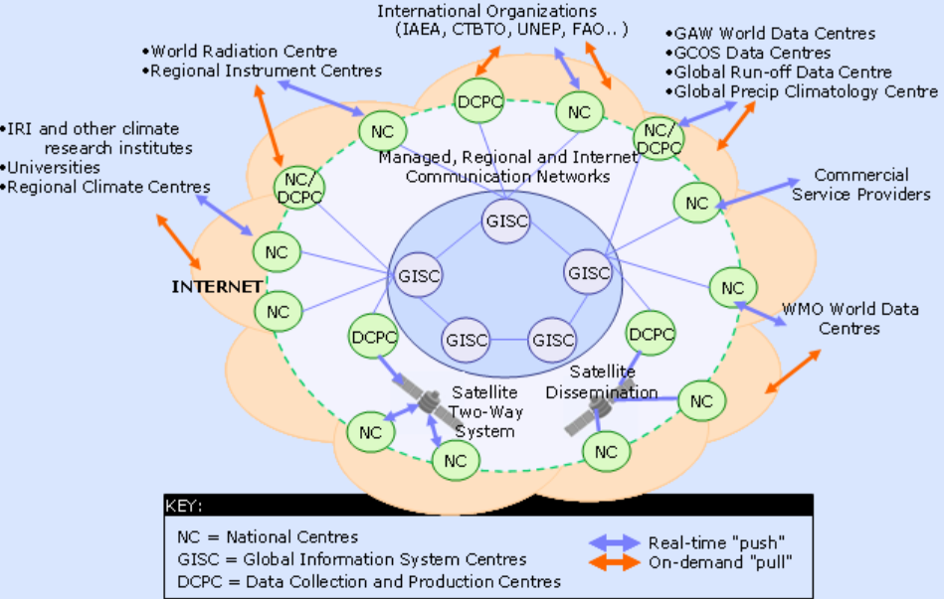
WIS – WMO Information System
Ingests data from National Centers . . .
. . . synthesized globally through communication networks

Slide 21
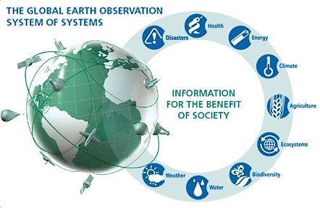
GEOSS – Global Earth Observation System of Systems
Group on Earth Observations (GEO) . . .
. . . located with WMO in Geneva

Slide 22
Geospatial and Temporal Water Data
GEOSS
WIS
Catalogs
Implementation
OGC
WMO
Standards
GIS
Water
Resources
Domains
Maps and time series . . .
. . . interoperability of connected systems

Slide 23
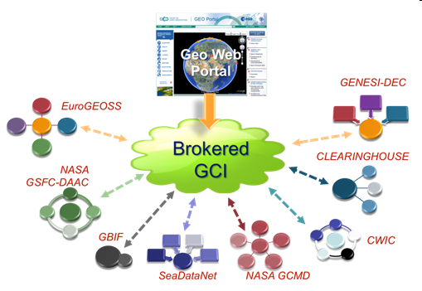
GEOSS and WIS – A Brokered Connection
GEOSS
WIS
Link water observations data . . .
. . . with many other kinds of observational data

Slide 24
Three Categories of Water Services
Catalog
Enable search, discovery, and selection of data
Time Series Services
Metadata
Describe specific collections of data
Catalog
Data
Convey the data
Metadata
Data
A time series data service for one variable at one location . . .
. . . describe and catalog networks of observation sites

Slide 25
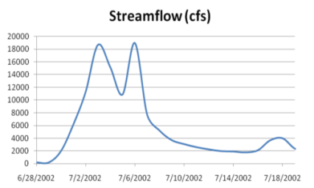
Web Services Stack for Time Series
Catalog Service for the Web with standard metadata: ISO, FGDC, ANZLIC, Dublin Core
Who?
What?
Catalog (CSW)
Time Series Services
Where? When?
Metadata (WFS)
Data (WaterML2)
CSW = OGC Catalog Service for the Web
WFS = OGC Web Feature Service for Maps
Access
Data
Existing OGC Data Services are Adequate . . .
. . . Need to Be Customized for Water Information

Slide 26
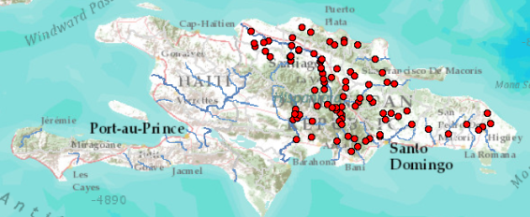
Dominican Republic, GEOSS, and WMO
Volunteered Information
Authoritative information
Catalog
Metadata
Data
WMO Information System. . .
. . . INDRHI – Dominican Republic

Slide 27
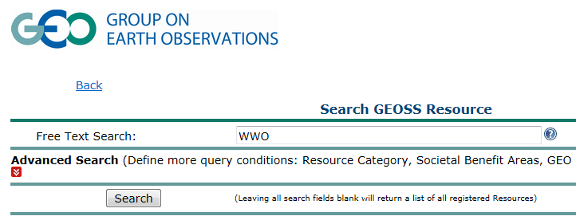
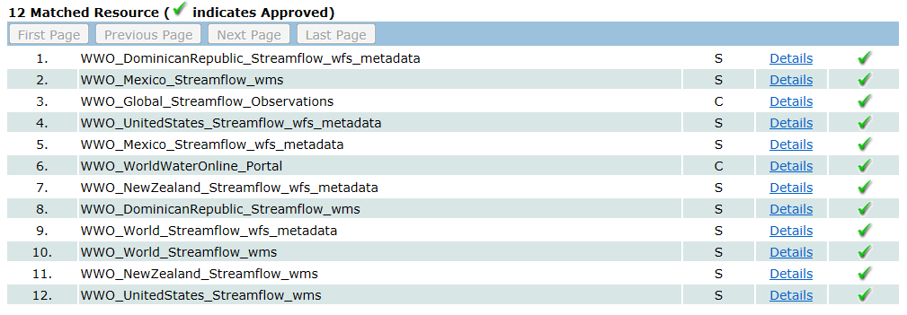
Searching GEOSS Portal
Search for water information
Find streamflow maps for countries
Streamflow map for the Dominican Republic
http://geossregistries.info/geosspub/resource_search_ns.jsp

Slide 28
National Service Stacks – Globally Federated
USA
Dominican Republic
Australia
New Zealand
Catalog
GEOSS
WIS
Metadata
Data
GEOSS Indexes Geospatial Data . . .
. . . WIS Indexes Observational Data

Slide 29
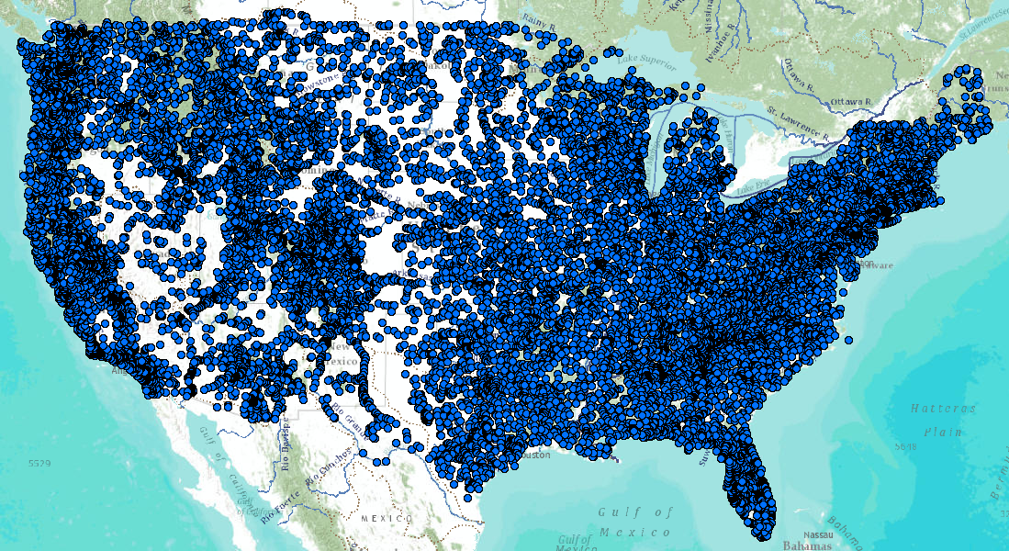
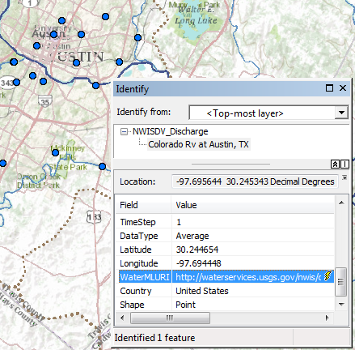
United States Services Stack
Catalog
Metadata
Data
Web Feature Service for Observation Metadata
Colorado River
at Austin, Texas
WaterML time series service for data
An attribute of each mapped observation point . . .
. . . is a web link to the WaterML data service

Slide 30
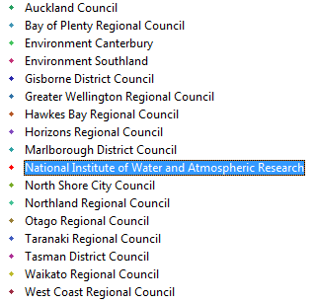
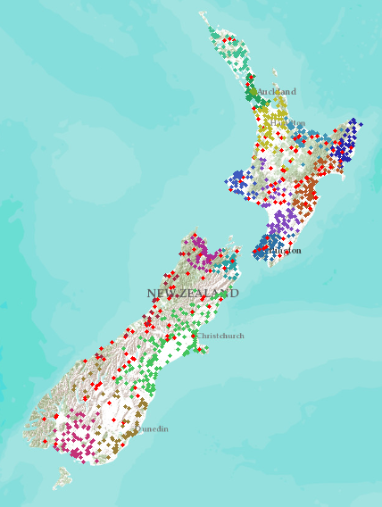
New Zealand – 16 regions
NIWA operates about 20% of 1300 hydrometric stations Regional authorities operate about 80% of stations
Develop a federated hydrological information infrastructure . . .
. . . linking nationally and regionally collected data

Slide 31
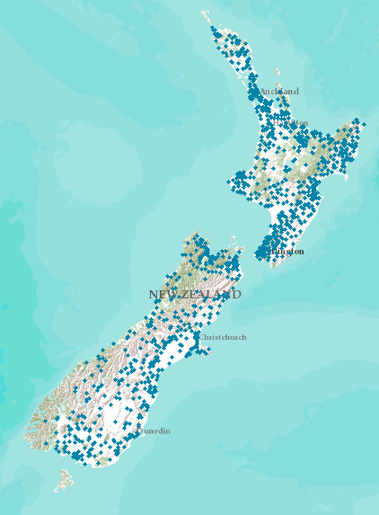
New Zealand – 16 regions
NIWA operates about 20% of 1300 hydrometric stations Regional authorities operate about 80% of stations
New Zealand
Water Information System
Develop a federated hydrological information infrastructure . . .
. . . linking nationally and regionally collected data

Slide 32
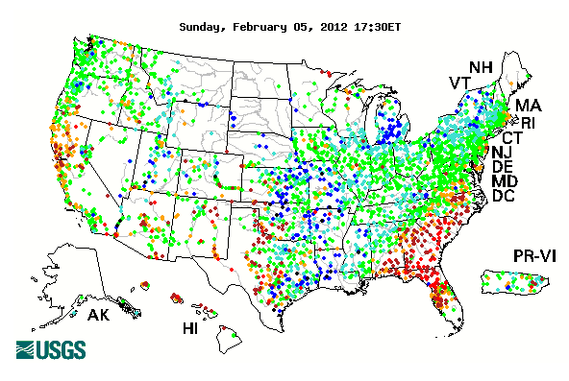
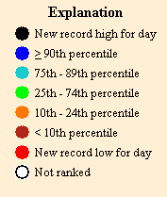
USGS Water Watch: Feb 5, 2012
Current streamflow as a percentage of historical flow on this day
Real-time and historical data services

Slide 33
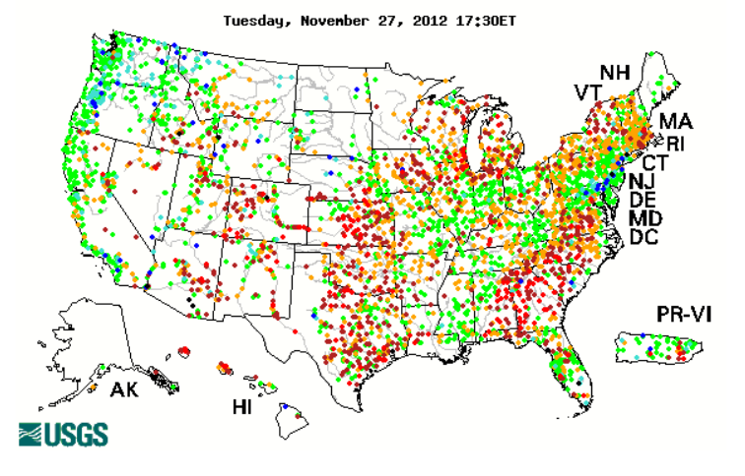
USGS Water Watch: November 27, 2012
Current streamflow as a percentage of historical flow on this day
Real-time and historical data services

Slide 34
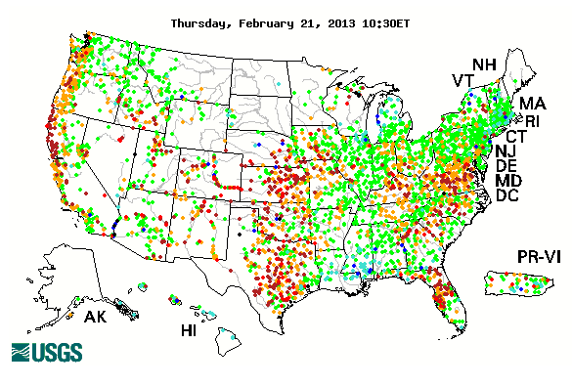
USGS Water Watch: February 21, 2013
Current streamflow as a percentage of historical flow on this day
Real-time and historical data services

Slide 35
Develop a Water Watch Map for New Zealand?
Current streamflow as a percentage of historical flow on this day
Real-time and historical data services

Slide 36
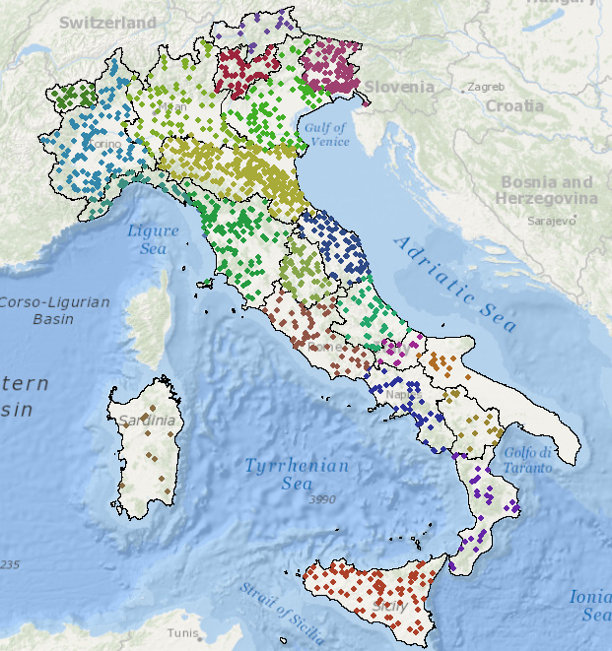
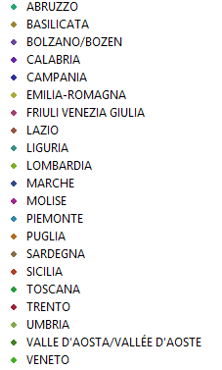
Italy – 22 regions
National Institute for Environmental Protection and Research (ISPRA)
ISPRA is the NIWA of Italy ….
….Hydrometric measurement was regionalized in 2002

Slide 37
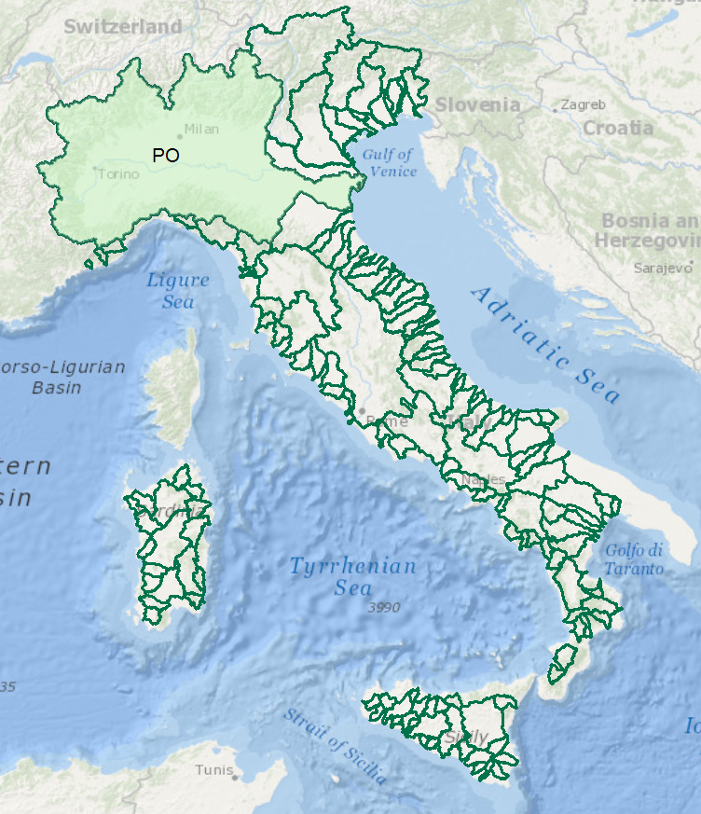
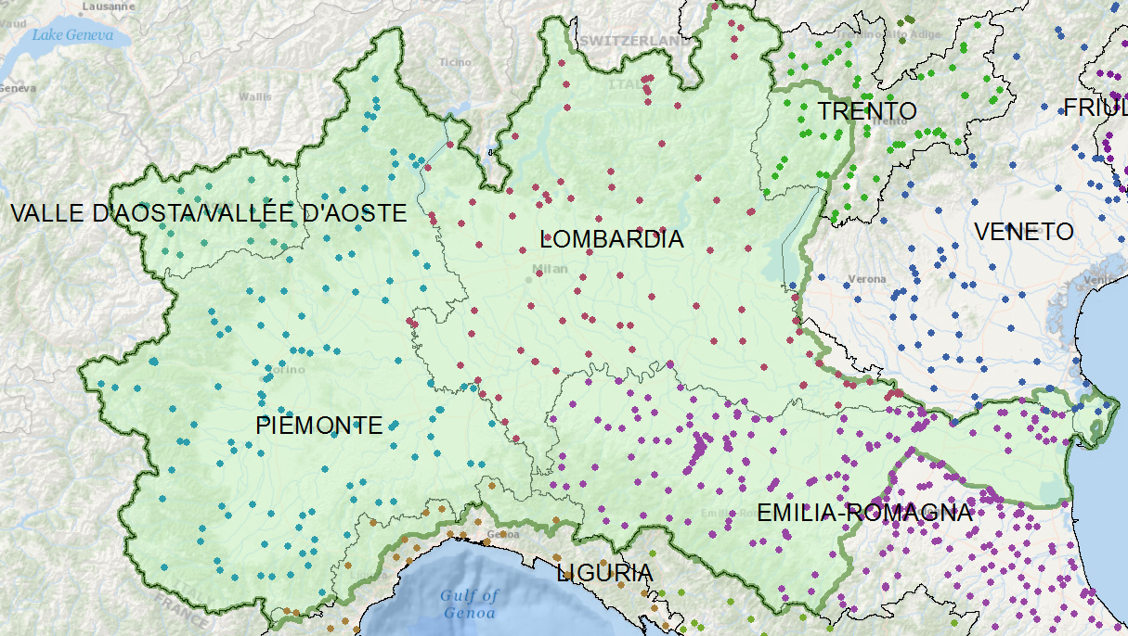
Italy – River Basins
Data for the Po River basin is managed by seven different regional authorities
One of these regions is Emilio-Romagna . . .
. . . they have fedeated the data for the Po Basin

Slide 38
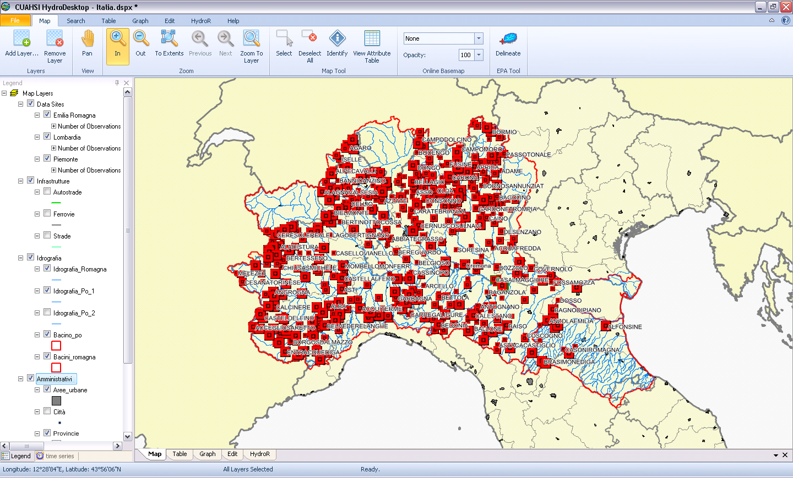
Prototype HIS for the Po Basin
Developed by Silvano Pecora (ARPA Emilio-Romagna)
Water data services published using CUAHSI Hydroserver ….
….. and ingested into CUAHSI Hydrodesktop

Slide 39
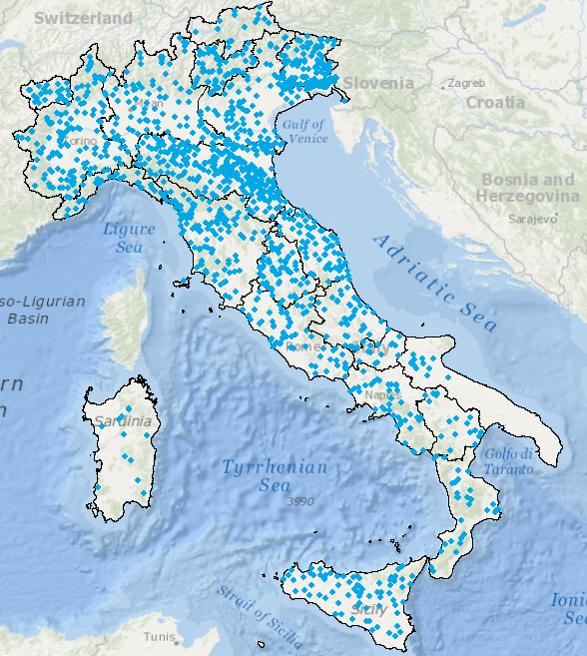
Italian example – instructive for New Zealand?
Regional
National
Martina Bussettini
Silvano Pecora
Jochen Schmidt is the Martina Bussettini of New Zealand. . .
. . . who is the Silvano Pecora?

Slide 40
European Flood Awareness System (EFAS)
Silvano Pecora participates from the Po Basin. . .
. . . may join in GEOSS Architecture Implementation Pilot 6 in 2013

Slide 41
European Flood Awareness System (EFAS)
Silvano Pecora participates from the Po Basin. . .
. . . may join in GEOSS Architecture Implementation Pilot 6 in 2013

Slide 42
Global Data Centers – Precipitation and Runoff
Collect data from National Hydrological Surveys….
…. using water web services in the future

Slide 43
Global Streamflow Services
Building a national system federating regions . . .
. . . builds a global system federating countries
Global Runoff Data Centre
New Zealand
USA
Italy
Dominican Republic
http://www.arcgis.com/home/webmap/viewer.html?webmap=87ab07e2aba840828033e80b15fd6727

Slide 44
In the Future: World Water Online
Bring together water information for the whole earth
All spatial scales: global, national, regional, local
Both geospatial and temporal information
Linking data and modeling
Everything on the web
. . . a transformation of our world!
An initiative of the University of Texas at Austin . . .
. . . in collaboration with commercial and open source partners

Slide 45
Scales of Application
My house, My well, My ranch
River Basin, Aquifer
Landscape
World
Global
Assessment
Water and Climate
National
Accounting
How much water?
Regional
Management
Solving water problems
Local
Personal
How does this affect me?
A scale-independent information model for maps and observations . . .
. . . more detail as focus narrows

Slide 46
World Hydro Overlay Map
World
United States
Texas
My Home
My Stream

Slide 47
Watershed of My Stream Esri Base Map and Delineation Services
My Stream
My Watershed
Panther Hollow
My home
Delineate the watershed of any stream or river anywhere on earth

Slide 48
Congo River Basin Global river mapping and watershed delineation
World Hydro Overlay Map
River Basin Delineation
Delineate a watershed from any point on a river

Slide 49
World Watershed Explorer – Congo Basin
Watershed characteristics . . .
. . . precipitation, soils, land cover, population

Slide 50
Manawatu River at Teachers College Global river mapping and watershed delineation on the web
Gage Site
Watershed of this Gage Site
Delineate a watershed from any point on a river

Slide 51
Runoff Estimation on the Web Probabilistic Rational Method
Fitzherbert St Bridge
Q = CIA
Delineate a watershed from any point on a river and compute the flood design discharge

Slide 52
Flow in the Mississippi River Basin RAPID model, March-May 2008, 3 hour time steps
GIS data describes 1.2 million river reaches . . .
. . . simulate flow in each reach in each time step

Slide 53
Central Texas Hub A synthesis of water observation networks
http://www.centraltexashub.org/wiskiweb.htm

Slide 54
Active Water Management in Texas
Data and modeling services from many sources. . .
. . . linked in a web maps
http://bit.ly/WVSkdX

Slide 55
World Water Online Hydrology on the web
Watersheds
Global to Local
Maps
Models
Observations
Open Information systems include both commercial and
open source software linked by open standards

Slide 56
World Water Online Linking people everywhere with water data, maps, and models

