Slide 1
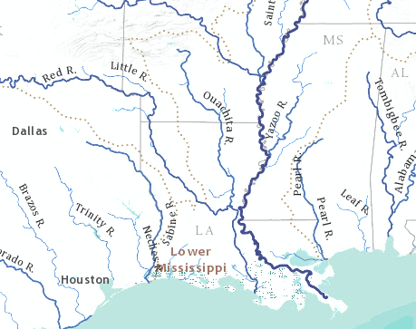
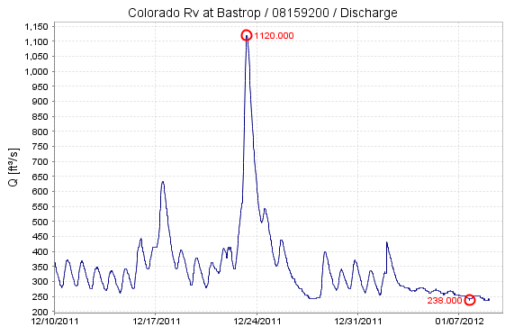
The Future of HydroInformatics for Managing Water
By David R. Maidment
Center for Research in Water Resources
University of Texas at Austin
Williams Memorial Lecture
University of Nebraska, Lincoln, 25 January 2012

Slide 2
World Water Online
Bring together water information for the whole earth
All spatial scales: global, regional, local
Both geospatial and temporal information
Linking data and modeling
Everything on the web
…. a transformation of our world!

Slide 3
One Year Ago: A Democratic Revolution in Egypt
…. empowered by internet technologies

Slide 4
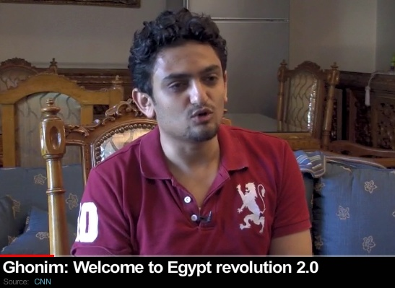
Wael Ghonim: Sparked the Revolution
“If you want to free a society, give them the internet”
…. a revolution sparked by a computer system administrator!

Slide 5
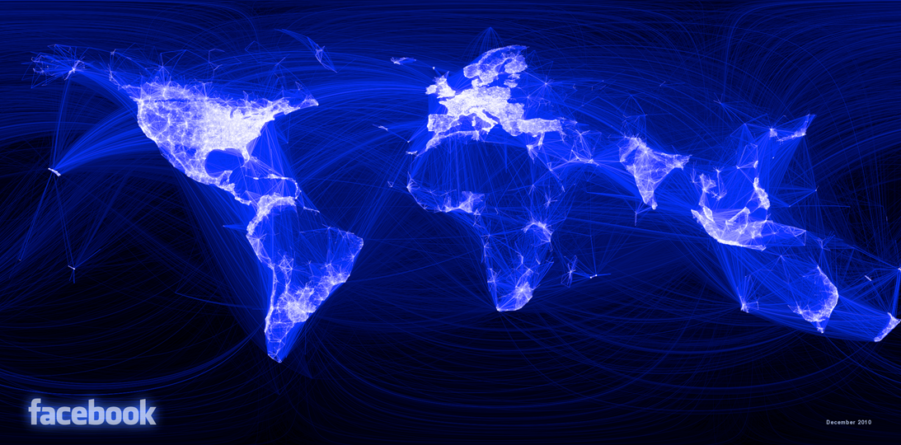
Visualizing Friendship – Facebook Connections
People are empowered by being connected
http://www.facebook.com/notes/facebook-engineering/visualizing-friendships/469716398919

Slide 6
iPad Book Reader
Information gains mobility when it is electronic

Slide 7
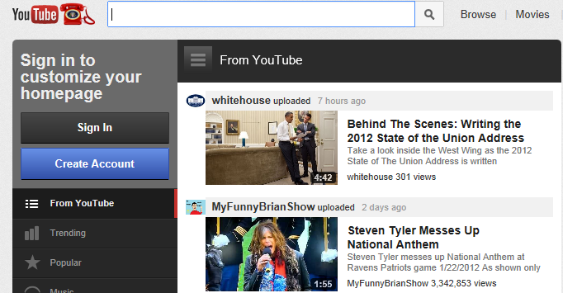
YouTube
Visual information is compelling
800 million users …..
…. upload 10 years of video every day

Slide 8
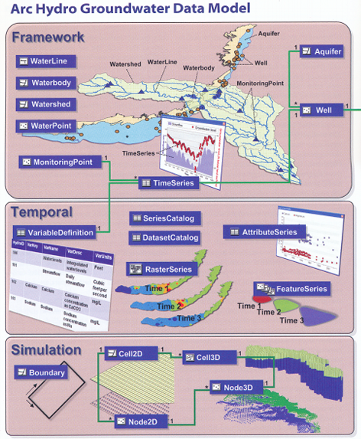
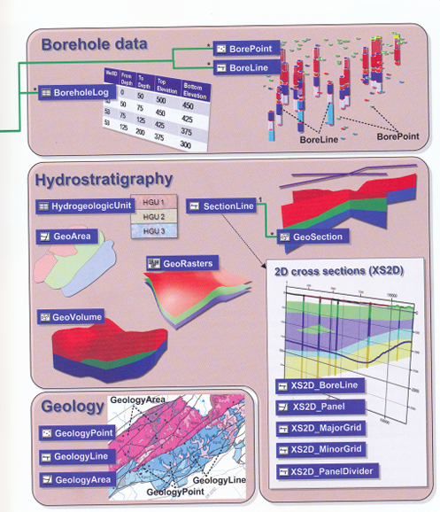
Arc Hydro Groundwater
Information is more useful when it is organized
…. a geographic data model for groundwater

Slide 9
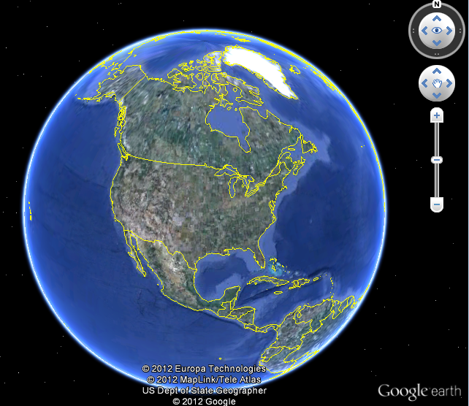
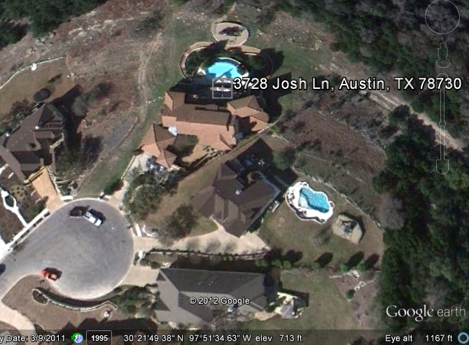
Google Earth
Information that is global and personal
…. fly to anwhere on earth

Slide 10
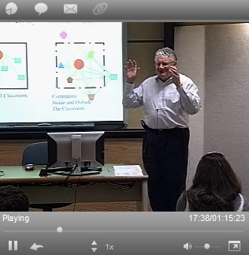
University Without Walls
Information is more valuable when it is accessible
Traditional Classroom
Community
Inside and Outside
The Classroom
Lectures on streaming video

Slide 11
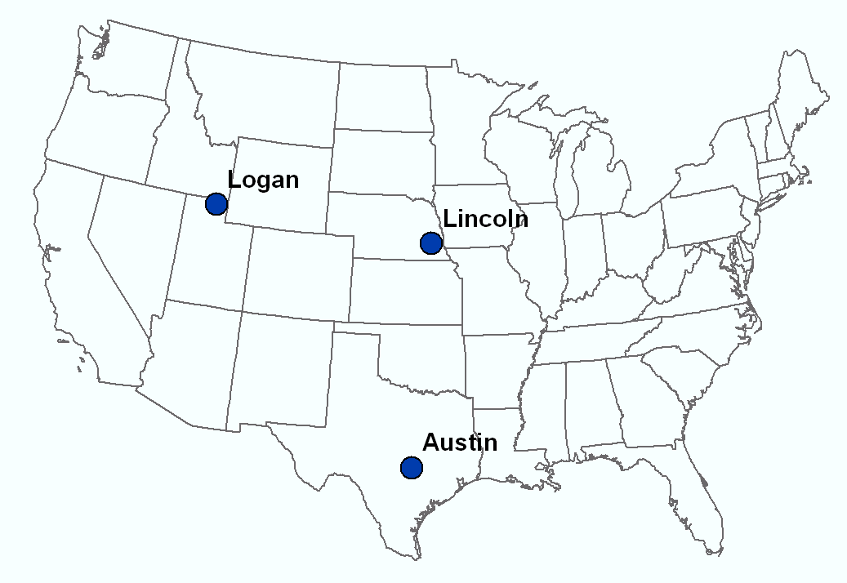
Video Connected Classroom
Dr David Tarboton
Students at Utah State University
Dr Ayse Irmak Students at University of Nebraska - Lincoln
Dr David Maidment Students at UT Austin
…. GIS in Water Resources class taught each Fall

Slide 12
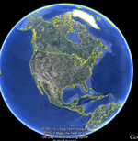
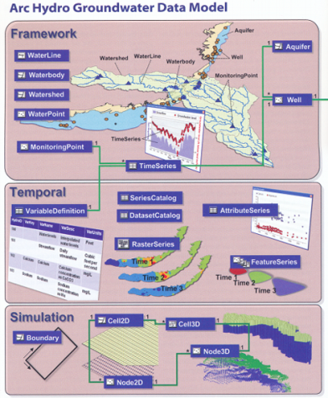
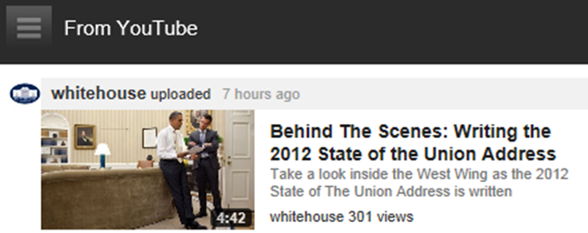
A World of Information is Opening …..
Mobile
Global
Connected
Accessible
Visual
Organized
…. How can we achieve this in water resources?

Slide 13
We need a new GIS definition
“All capabilities aside, GIS is an incredibly difficult program to use . . .”
“. . . Many who would like to use GIS open the program on their computers expecting a map to materialize before their eyes. But this is not the case. GIS itself is devoid of data — everything, from the data points to the maps, must be supplied by the user.”
Yale Daily News, Oct 21, 2011
We must overcome the status quo

Slide 14
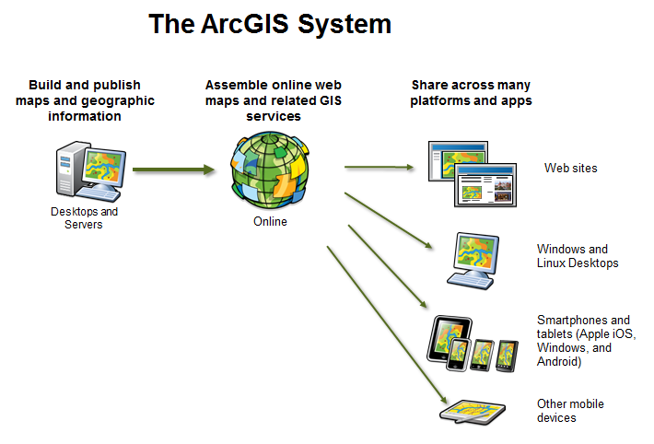
What ESRI is doing
Maps and Apps
on the webl

Slide 15
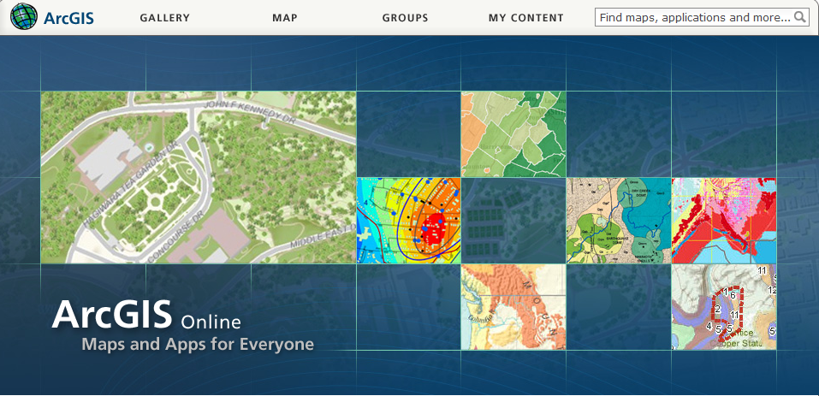
ArcGIS Online
…. is making map information globally and freely accessible

Slide 16
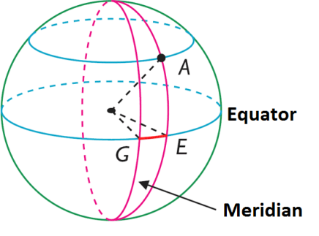
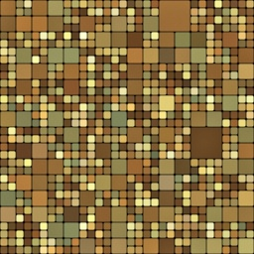
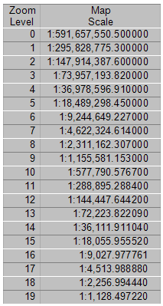
Map Scales for Image Tiles
Decimal Degree Pixel
20 Zoom Levels
1 Pixel = 1.40624 °
~ 4.9km at Equator
1 Pixel = 0.00549 °
~ 612m at Equator
1 Pixel = 0.000003 °
~ 30cm at Equator

Slide 17
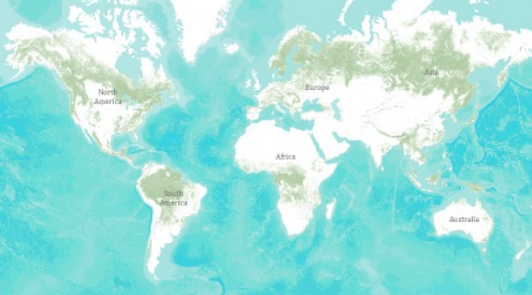
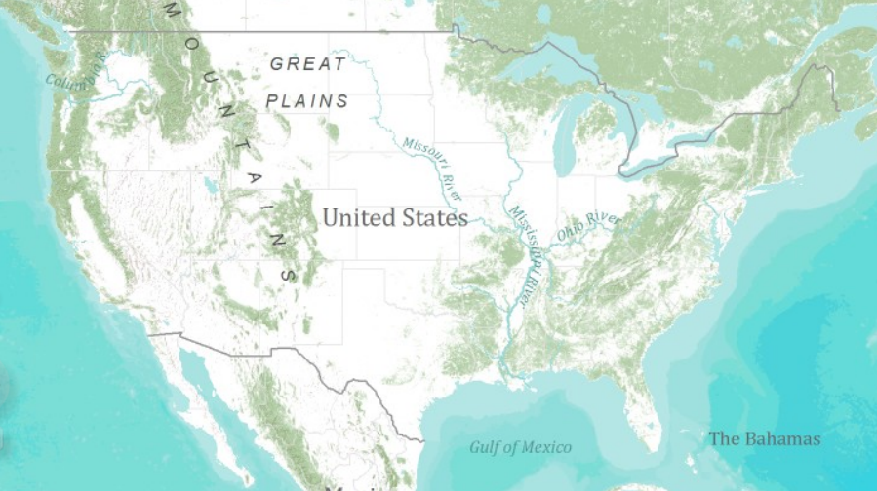
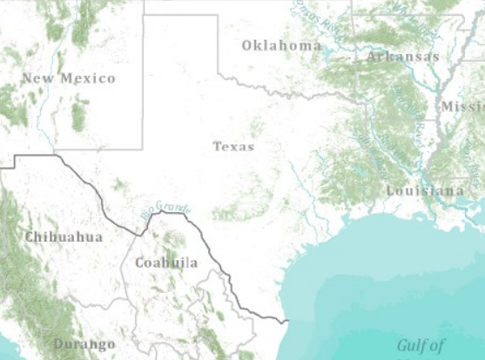
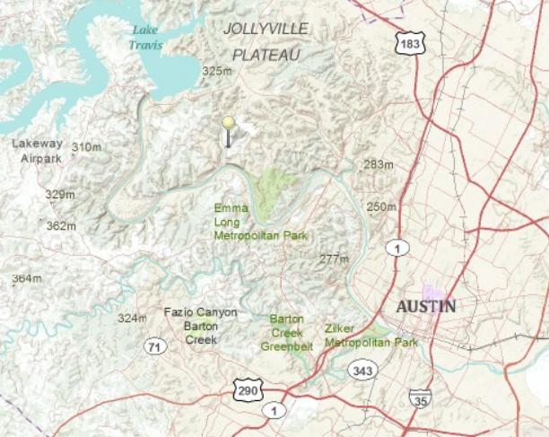
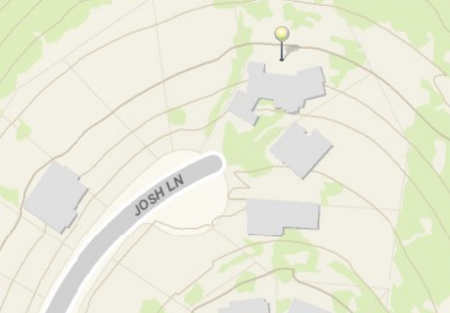
Global Topographic Basemap in ArcGIS Online
Information contributed by many cities and countries
World
United States
Texas
Austin
Home
ArcGIS Online Topo Map
Tiled base map synthesizing information across map scales

Slide 18
Scales of HydroInformatics
Global, National
Assessment
How much water?
Landscape
Management
Solving water problems
Regional, State
River Basin, Aquifer
Local, Personal
My house, my well, my ranch
Engineering
How does this
affect me?

Slide 19
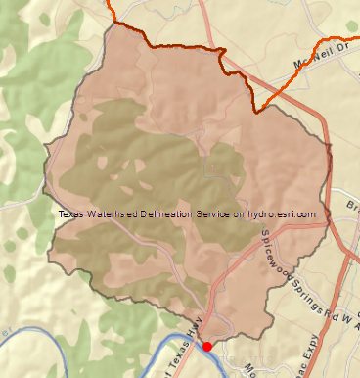
A Connected System Over all Spatial Scales
Watershed Analysis
River Mapping
Observations

Slide 20
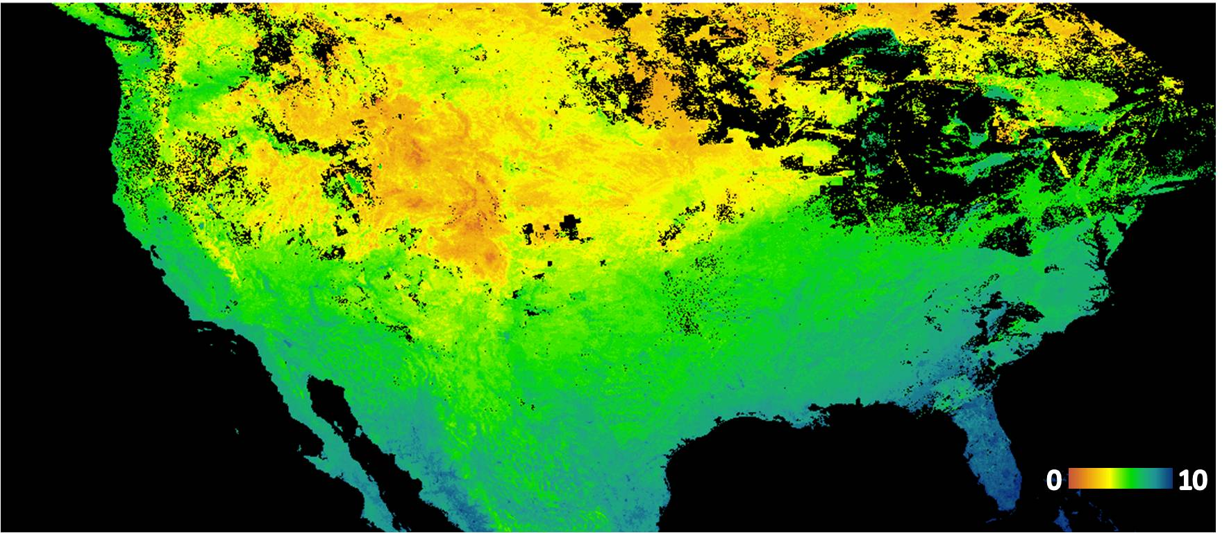
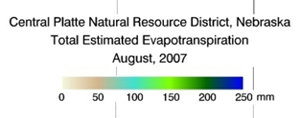
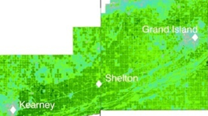
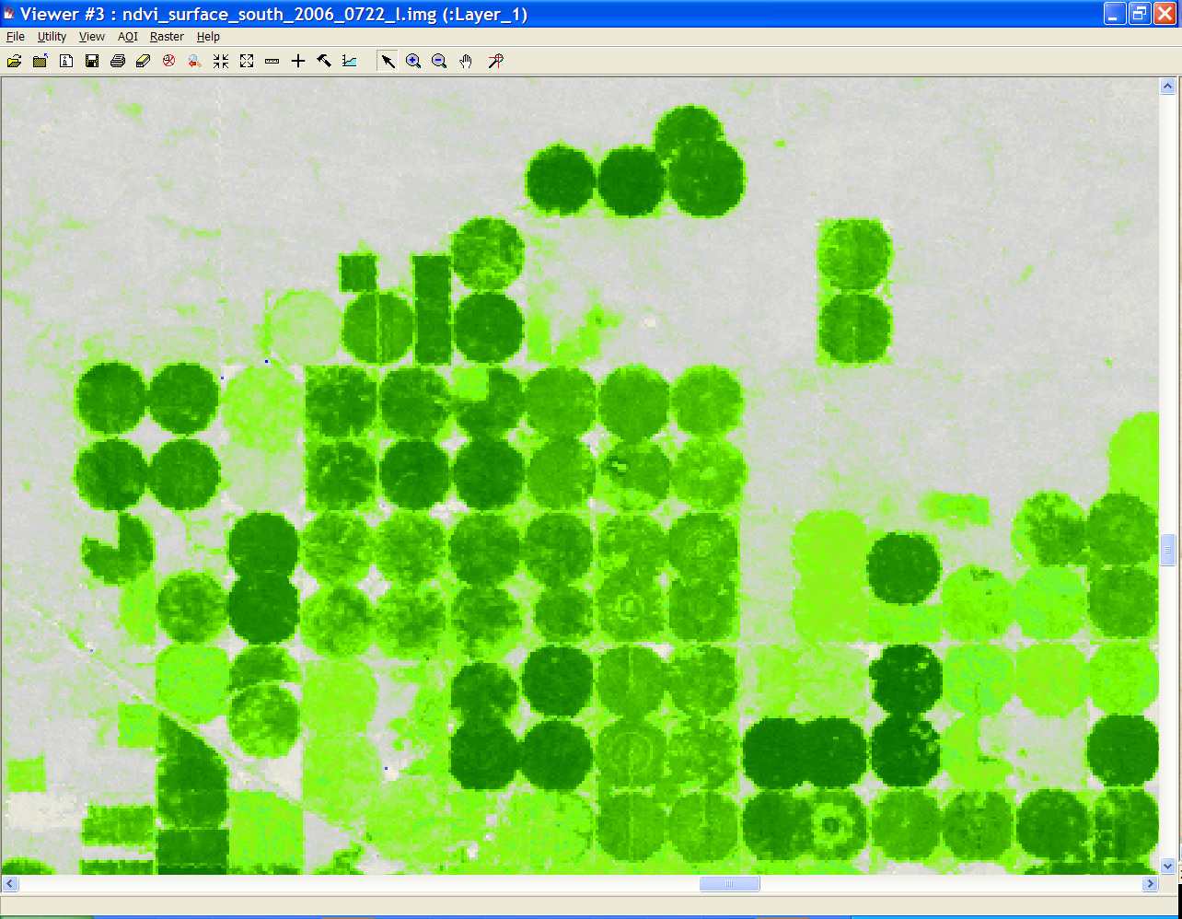
Mapping Evapotranspiration using Remote Sensing
United States
Irrigated Fields
Images from Ayse Irmak

Slide 22
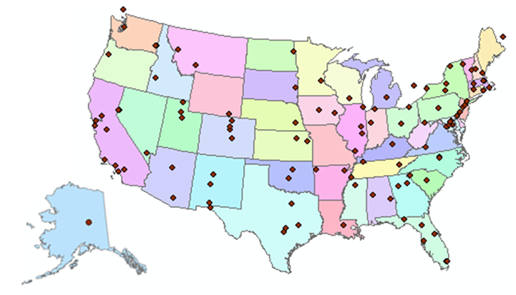
http://www.cuahsi.org
CUAHSI is a consortium representing 125 US universities
Supported by the National Science Foundation Earth Science Division
Advances hydrologic science in nation’s universities
Includes a Hydrologic Information System project

Slide 23
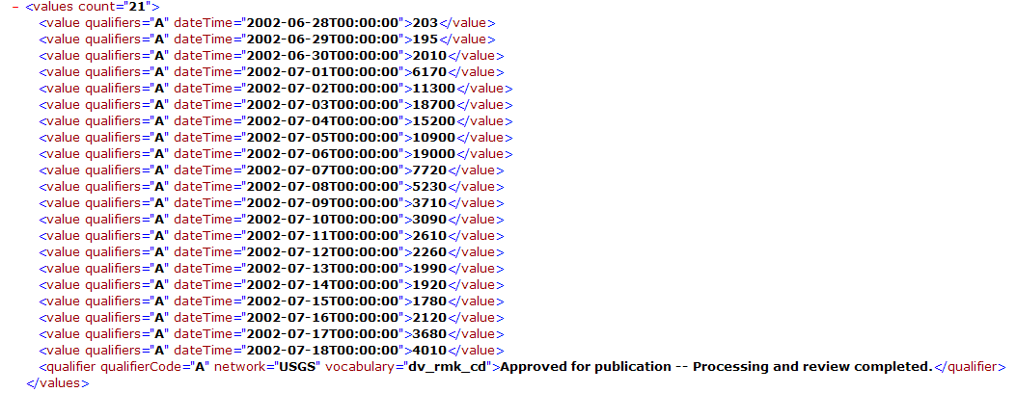
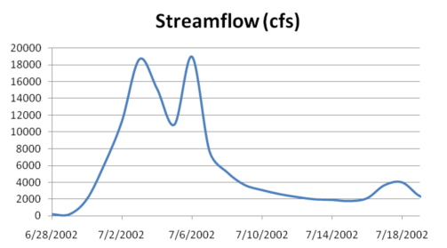
WaterML as a Web Language
Discharge of the San Marcos River at Luling, TX June 28 - July 18, 2002
USGS Streamflow data in WaterML language
The USGS now publishes its time series data as WaterML web services

Slide 24
Colorado River at Austin
I accessed this WaterML service from USGS at 9PM
http://waterservices.usgs.gov/nwis/iv?sites=08158000&period=P7D&parameterCd=00060
And got back these flow data from USGS which are up to 8PM Central time

Slide 25
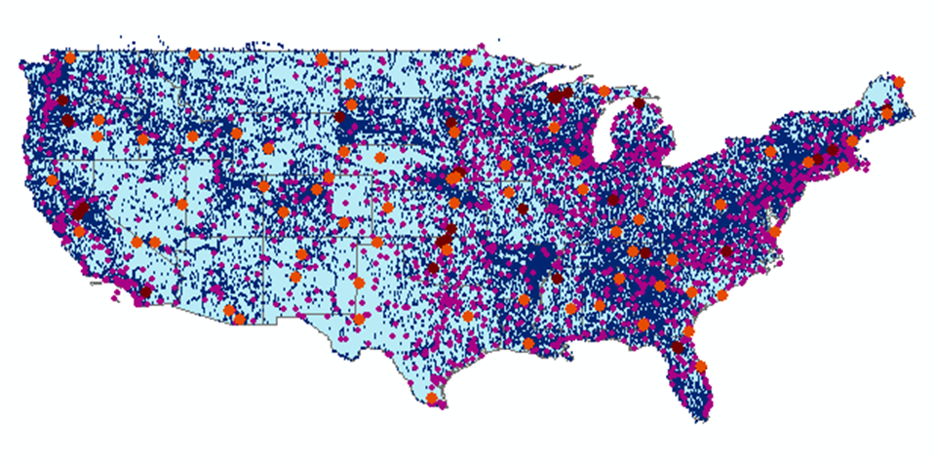
CUAHSI Water Data Services Catalog
66 public services
18,000 variables
1.9 million sites
23 million series
5.1 billion data values
And growing
A national water data catalog
maintained at the San Diego Supercomputer Center

Slide 26
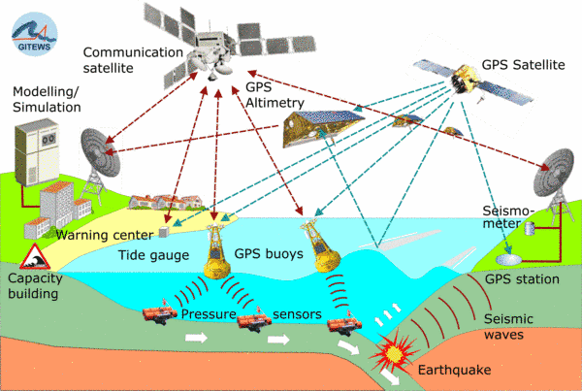
Open Geospatial Consortium Web Service Standards
Map Services
Web Map Service (WMS)
Web Feature Service (WFS)
Web Coverage Service (WCS)
Catalog Services for the Web (CS/W)
Observation Services
Observations and Measurements Model
Sensor Web Enablement (SWE)
Sensor Observation Service (SOS)

Slide 27
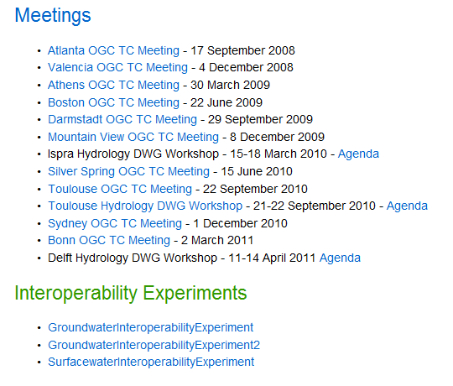
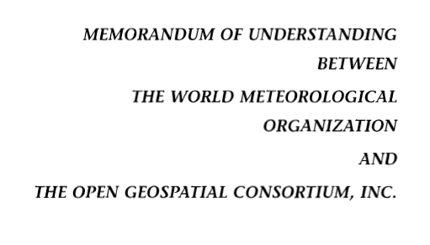
Jointly with World Meteorological Organization
Evolving WaterML into an International Standard
Meets every 3 months
Teleconferences most weeks
November 2009
Hydrology, Meteorology, Climatology, and Oceanography
WaterML Version 2 standard proposed
Vote for adoption later this year

Slide 28
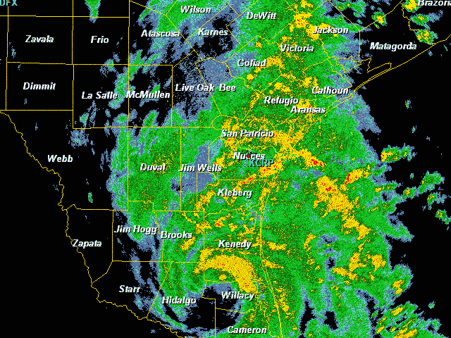
Tropical Storm Hermine in Texas Sept 7-8, 2010

Slide 29
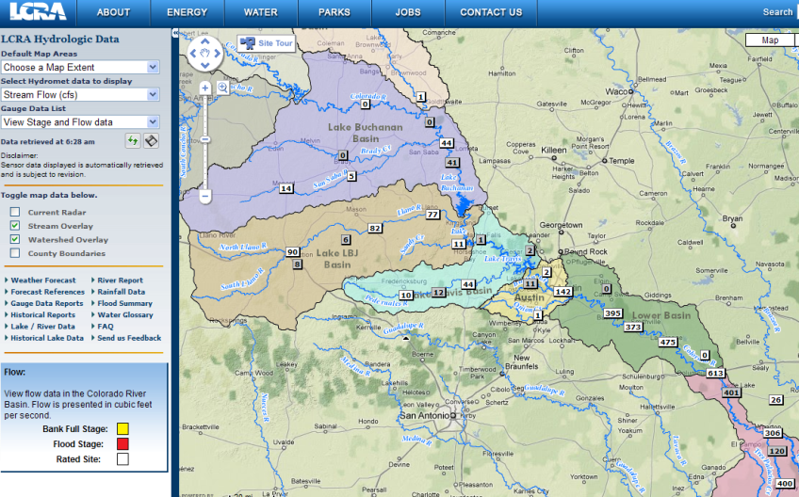
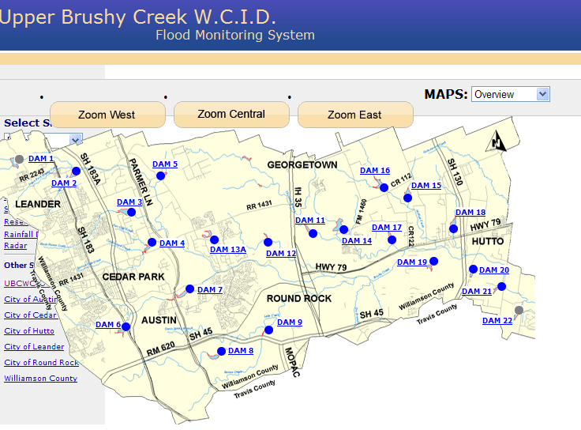
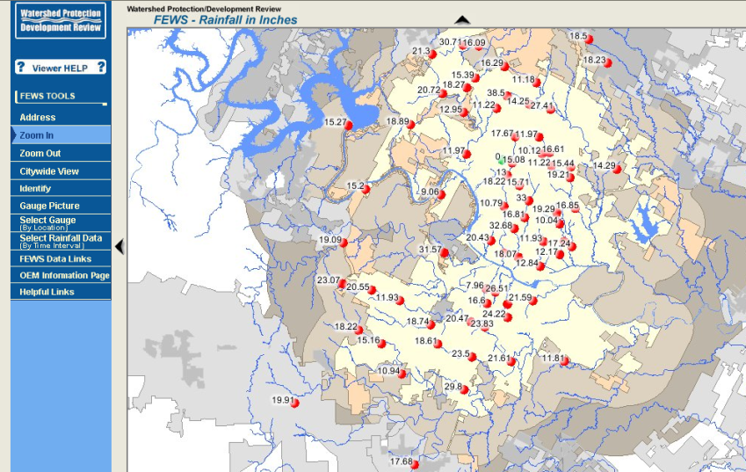
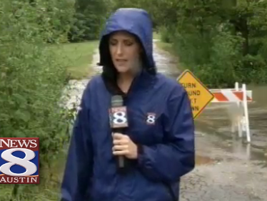
Bring data together into one system
Upper Brushy Creek (Round Rock)
LCRA
http://hydromet.lcra.org
http://ubcwcid.org/Overview/Overview.aspx?id=1
TV
City of Austin
http://coagis1.ci.austin.tx.us/website/COAViewer_fews/viewer.htm

Slide 30
Observations Data in Central Texas
USGS
LCRA
COA
NWS
AHPS

Slide 31
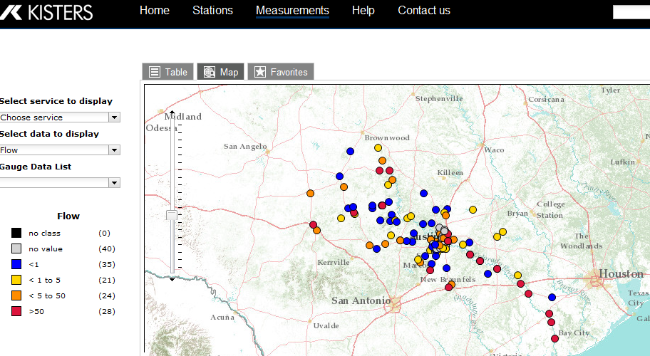
Central Texas Hub
http://crwr-wisk01.crwr.utexas.edu/static/
Thematic mapping of streamflow
A “network of networks”

Slide 32
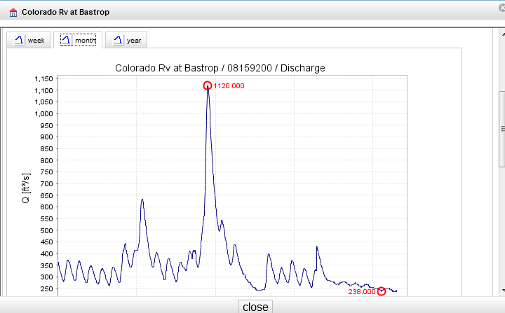
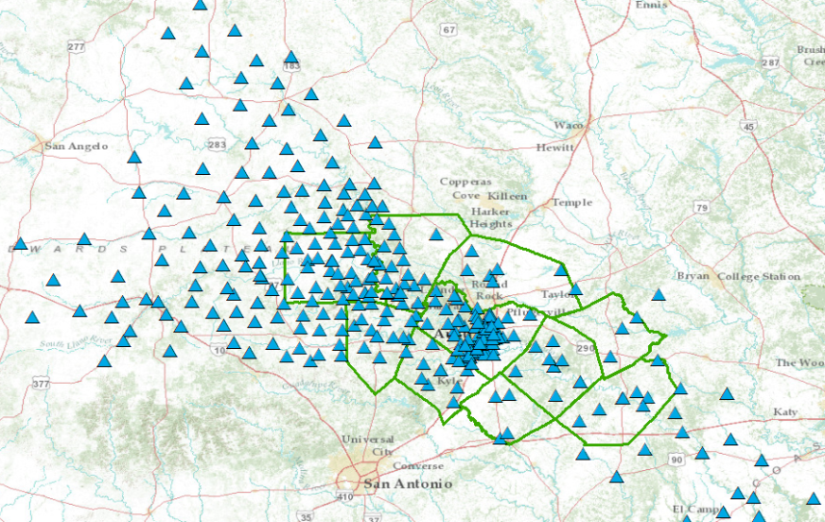
Runoff Data Services for Central Texas
http://129.116.104.174:8080/KiWIS/
SOS

Slide 33
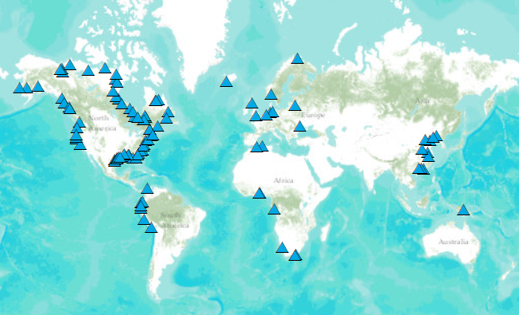
Global Runoff Data Services
SOS
http://kiwis.kisters.de/

Slide 34
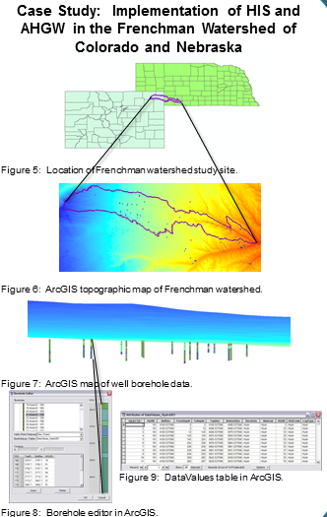
Arc Hydro Groundwater
…. a geographic data model for groundwater

Slide 35
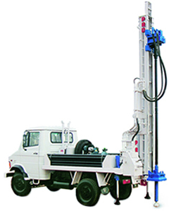
Automated Well Permitting
Calibrated regional model is imported to ArcGIS as a “baseline” model
Candidate wells are added to baseline model using well package.
Impact of new well is analyzed using MODFLOW and/or SEAWAT
Notes:
Just an overview of the general well-permitting process. The baseline model is a calibrated regional model used by the agency for impact analysis.
http://westonengineering.com/P7100029.JPG

Slide 36
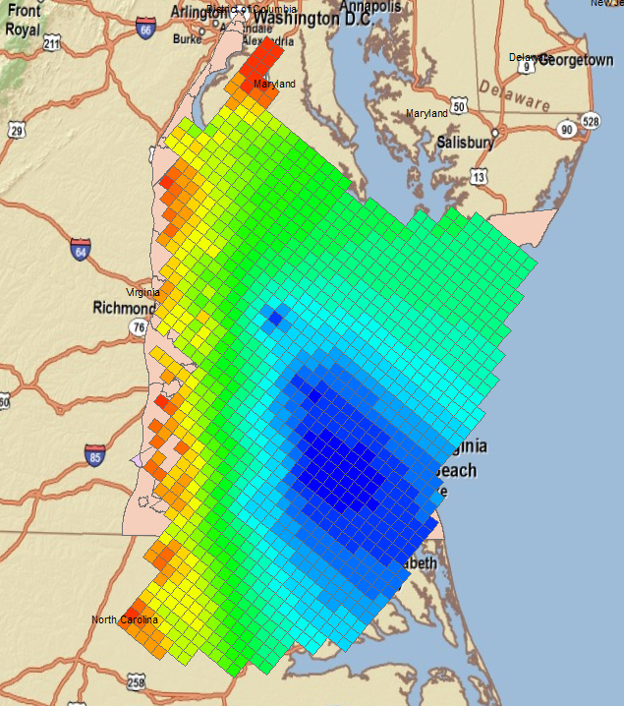
Case Study #1 – Virginia DEQ
Virginia Coastal Plain Model (VCPM)
10-layer MODFLOW model used to analyze impacts of candidate wells
Criteria based on state law
Potentiometric surface cannot fall below a critical surface (80% drawdown)
Area of Impact defined by drawdown = 1 ft
Heads for layer 8
Notes:
We have an ongoing contract to do modeling services for the VA-DEQ in support of their well-permitting program. They use a RASA MODFLOW model for the coastal plane region (shown in slide). The permitting process is based on VA state law. The wells are mainly in deep confined aquifers. They can’t let the potentiometric surface to draw down below an elevation called the “critical surface” (80% drawdown between pre-pumping conditions and top of confined aquifer). Also, we compute an “area of impact” defined by the region with drawdown >= 1 ft. The are of impact cannot include any neighboring wells, or a mitigation plan must be developed.

Slide 37
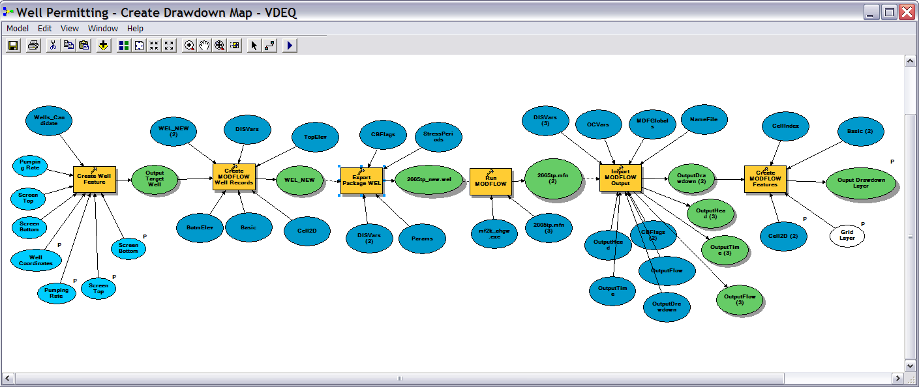
Well Permitting Workflow
Create new well → update well table → export well package file → run MODFLOW → import solution → build drawdown map layer
Notes:
Well permit analysis (impact of a proposed well or change in pumping rate) was traditionally done by manually modifying the model, running the model, and manually analyzing the changes to the model. Using AHGW tools, we developed a series of workflows that fully automated the process.

Slide 38
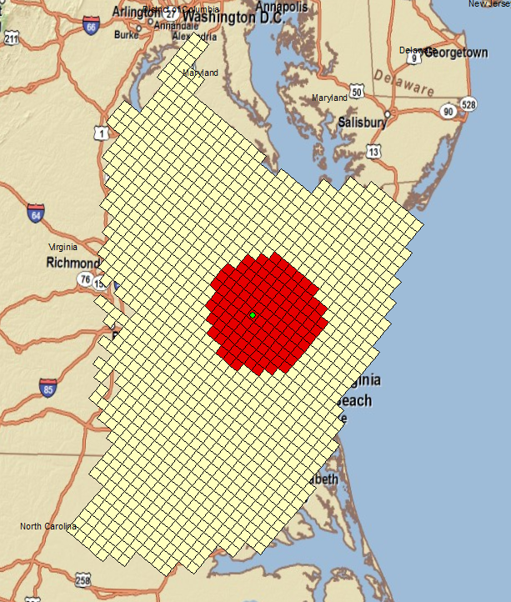
Products
Area of Impact Cells
Area of Impact Contour
Notes:
Screenshots from a sample run using the automated workflow. Green dot is new well. Red cells are where drawdown > 1 ft. Corresponding contour shown on the right. Yellow dots are existing wells.

Slide 39
GIS Products
Notes:
While the previous slide was just a hypothetical run, this slide shows some actual maps generated from our process that were included in the modeling reports.

Slide 40
Utah State Division of Water Rights
Notes:
While the VA-DEQ is in production mode, it is not web-based. I currently have two students working on a web-based system for the Utah Division of Water Rights. You can test a prototype of the web interface here:
http://utahdwr.groups.et.byu.net/app/ (runs best in Chrome)
The maps shown using Google Earth, but the calculations are done using AHGW on Arc Server. The model shown here is the Northern Utah County Model. With this model, they are primarily concerned with drawdown and change in flow to springs feeding Utah Lake. With this run, I analyzed two wells and the drawdown contours are shown. The dots by the lake are the springs, simulated as Drains in MODFLOW. You can click on each drain symbol to see the change in flow to the spring. Or you can click on the polygon surrounding the springs to get the total change in flow for all springs.
It takes about ten minutes to run now, but we think we should be able to get it down to a minute or so.
You can also toggle on all sorts of map layers related to the model and water rights in Utah, much of which is pulled off of a Utah DWR server. The state is thrilled with how this has worked out and they want to start using it right away. We are in the process of applying it to other models used by the DWR in different locations in the state.

Slide 41
MODFLOW Parameters
Notes:
Same map with the hydraulic conductivity of model layer 1 being displayed.

Slide 42
World Water Online
Bring together water information for the whole earth
All spatial scales: global, regional, local
Both geospatial and temporal information
Linking data and modeling
Everything on the web
…. a transformation of our world!

