Slide 1

National Flood Interoperability Experiment
David R. Maidment
Center for Research in Water Resources
University of Texas at Austin
Water Summer, Open Geospatial Consortium Technical Committee Meeting
Boulder, CO| 3 June 2015
Acknowledgements: David Arctur, Ed Clark, Fernando Salas, Marcelo Somos Valenzuela,
Andy Ernest, Sagy Cohen, Sarah Praskievicz, David Gochis, Kristin Tolle, Cedric David

Slide 2
National Flood Interoperability Experiment
The Bad News ….
The Good News ….
Where do we go from here?

Slide 3
National Flood Interoperability Experiment
The Bad News ….
The Good News ….
Where do we go from here?

Slide 4
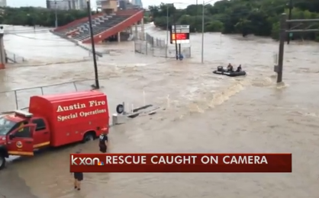
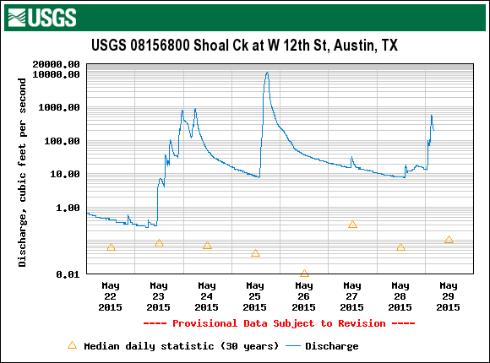
Flood Disaster in Texas
Swift water rescue
Enough rain to cover entire state in 8” of water
70 Texas counties declared flood disaster areas by the state
23 flood deaths, other people are still missing

Slide 5
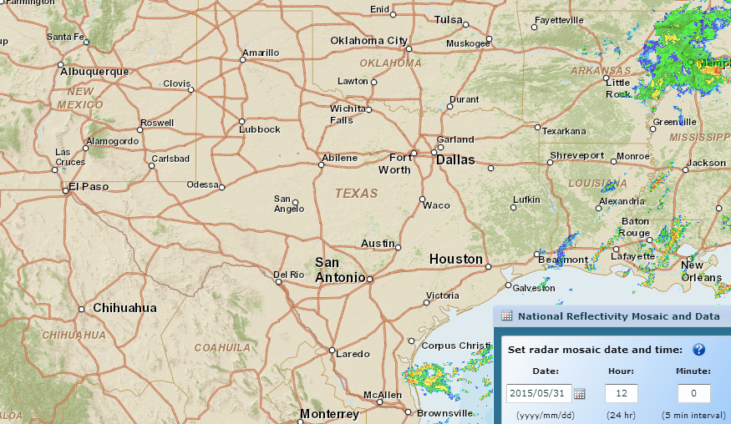
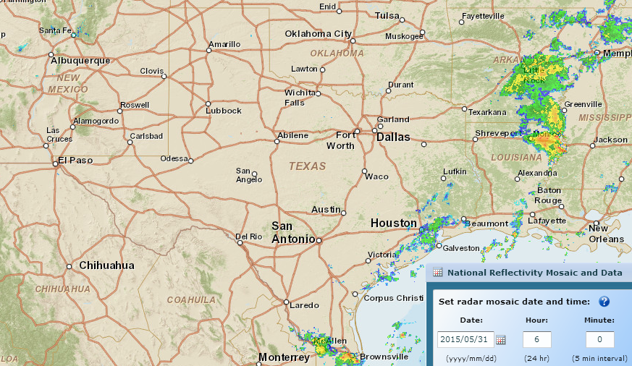
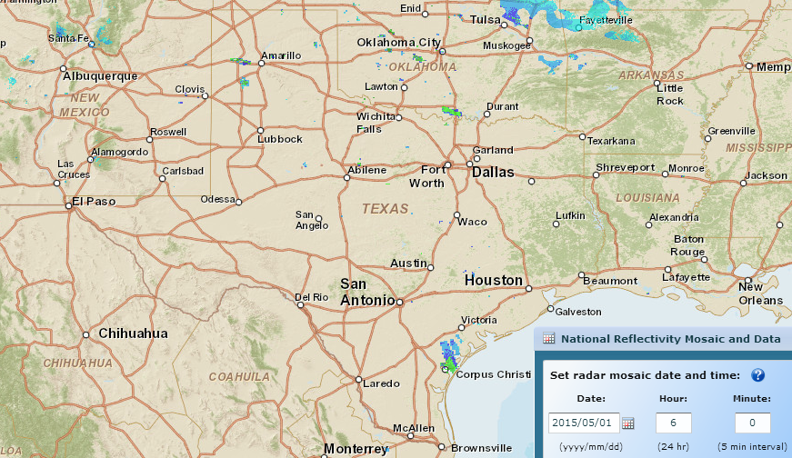
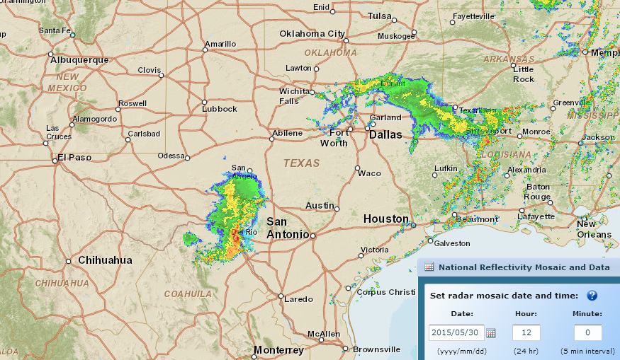
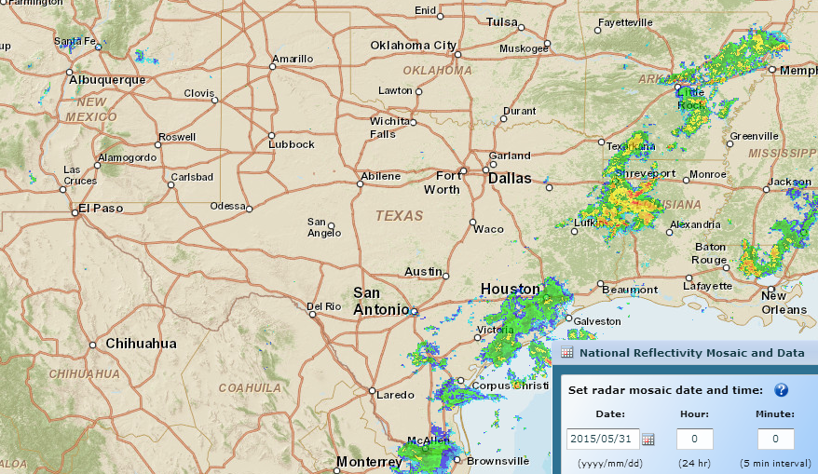
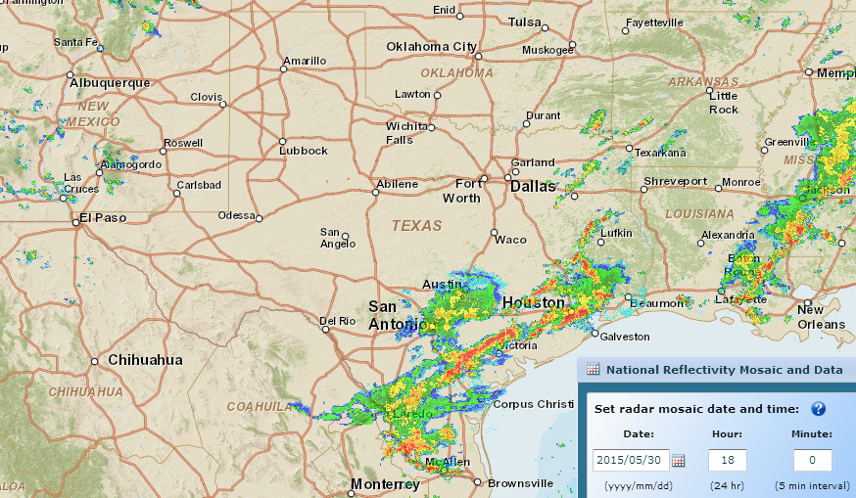
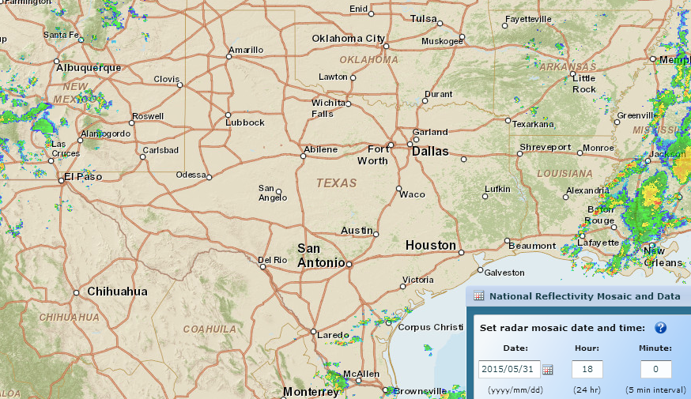
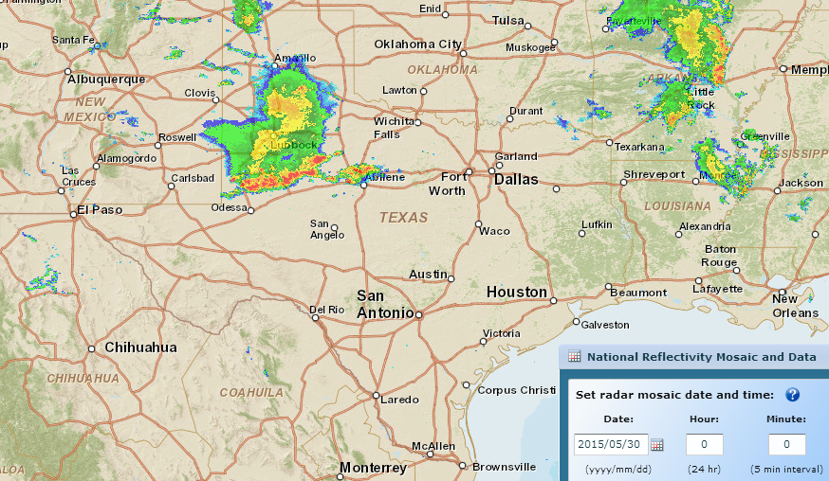
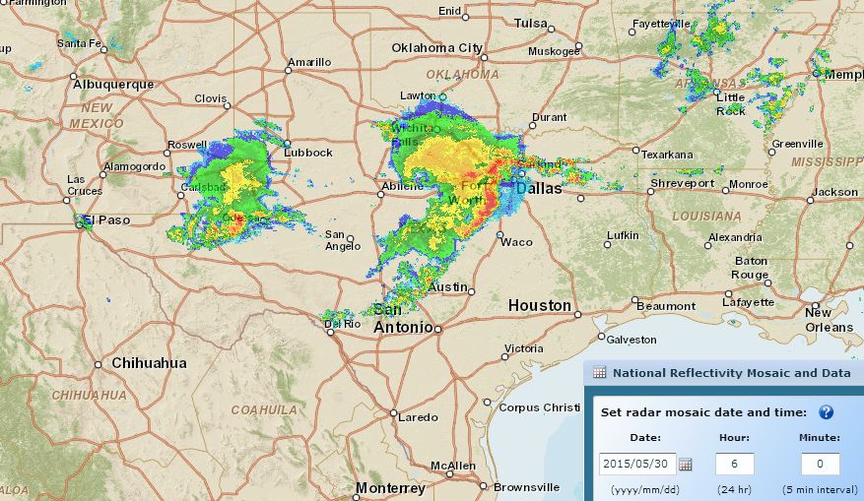
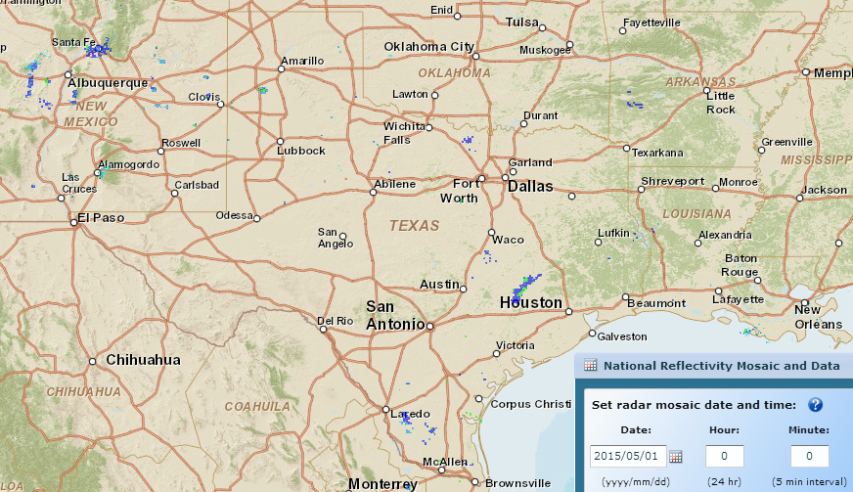
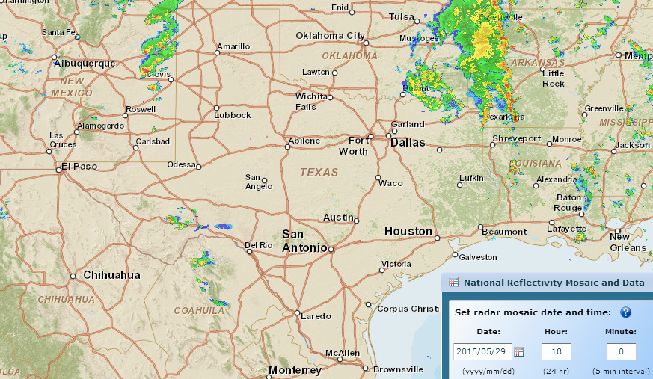
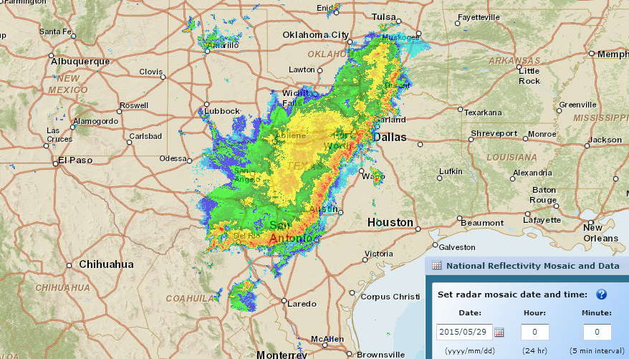
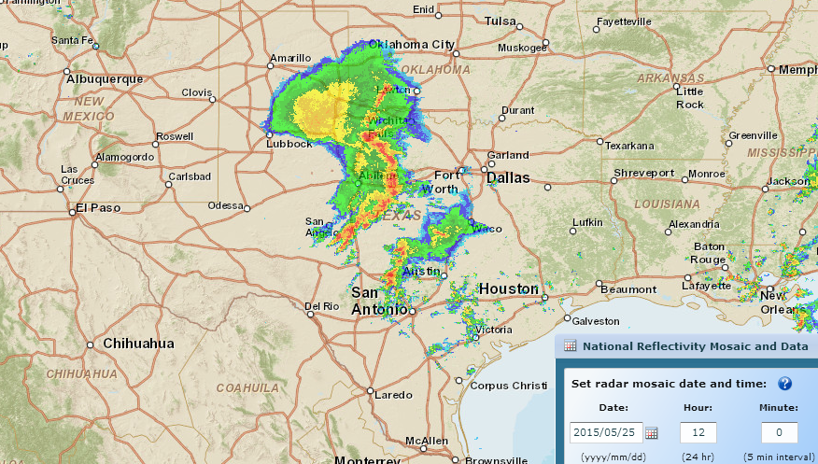
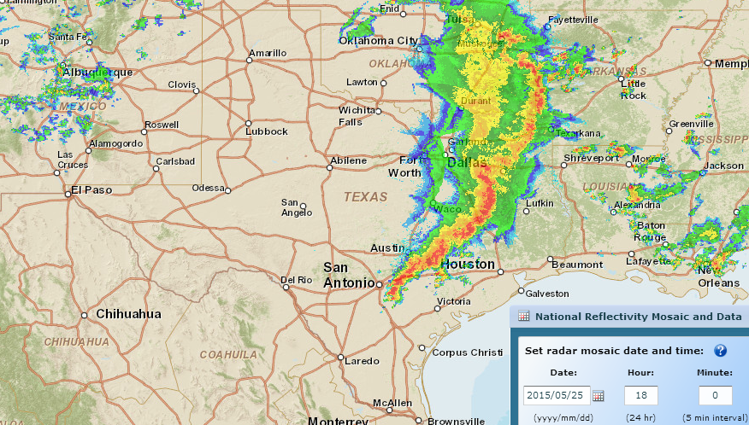
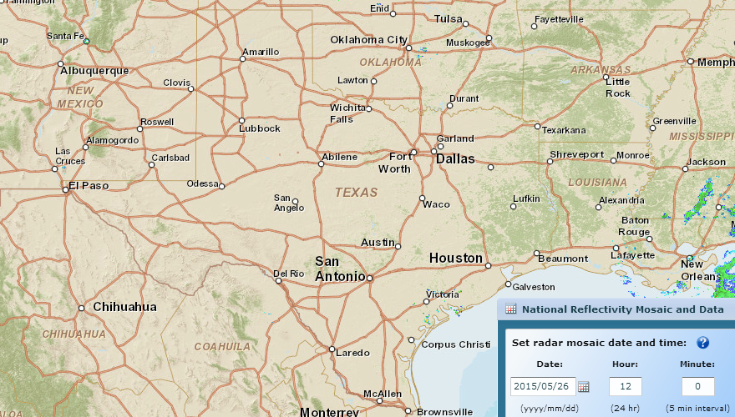
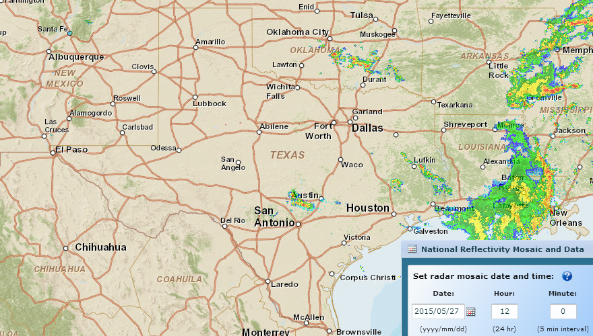
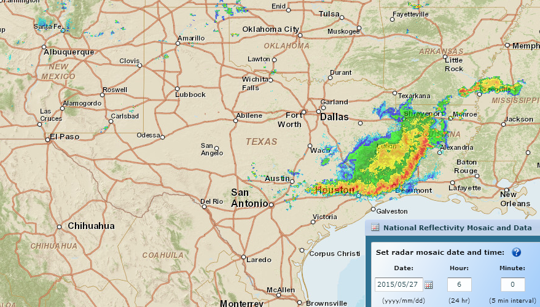
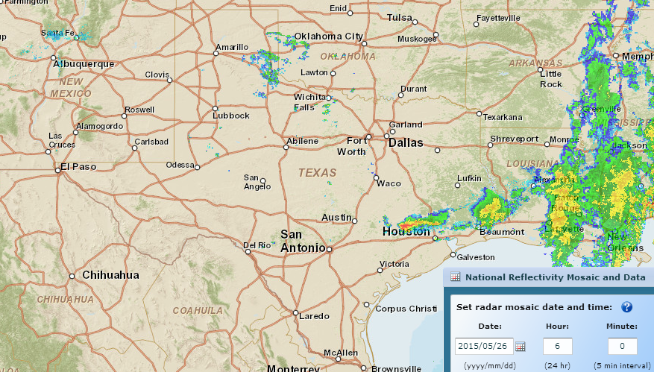
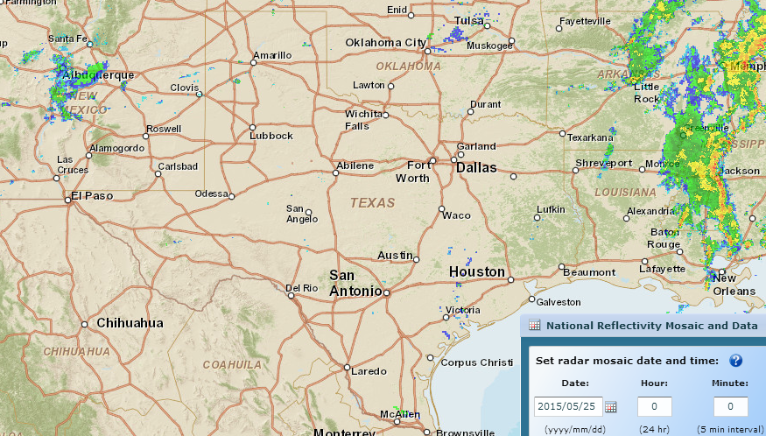
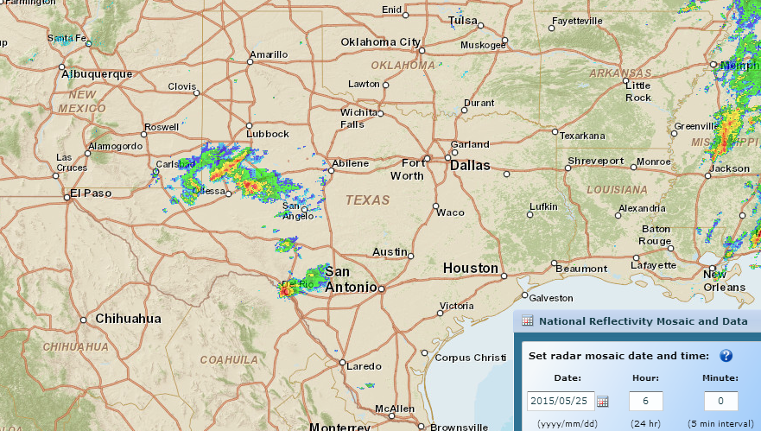
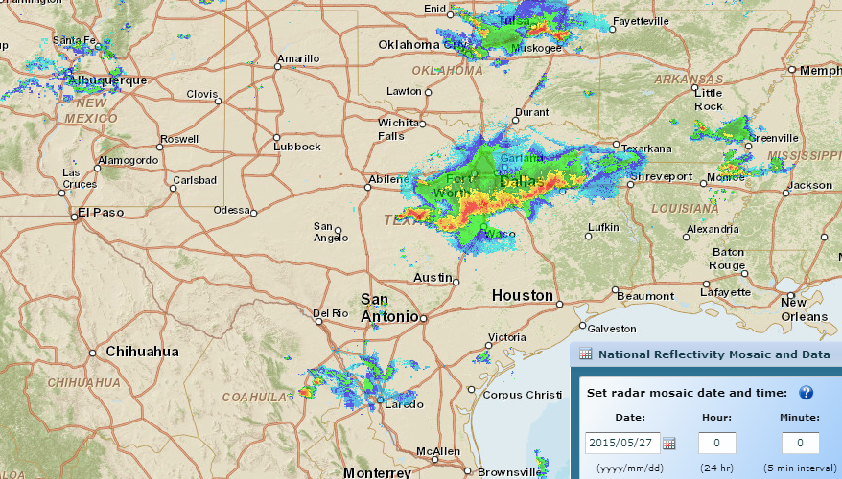
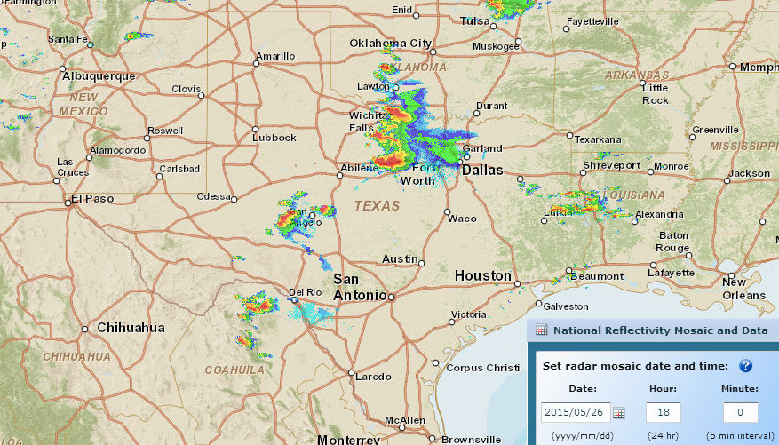
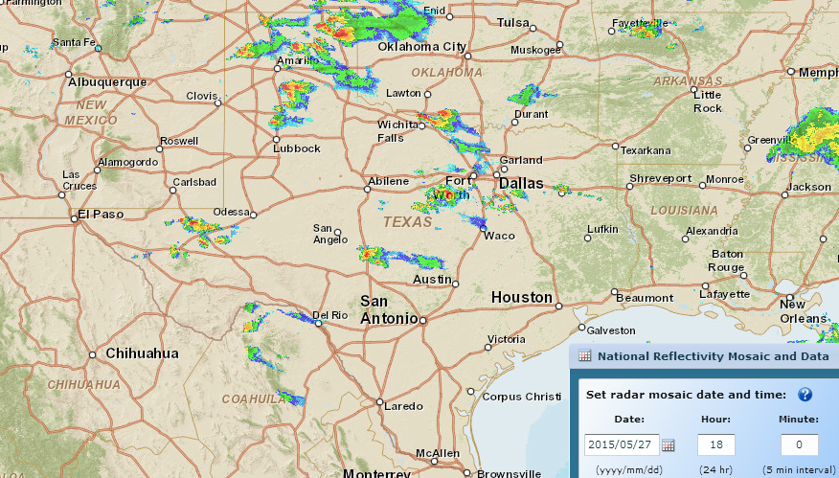
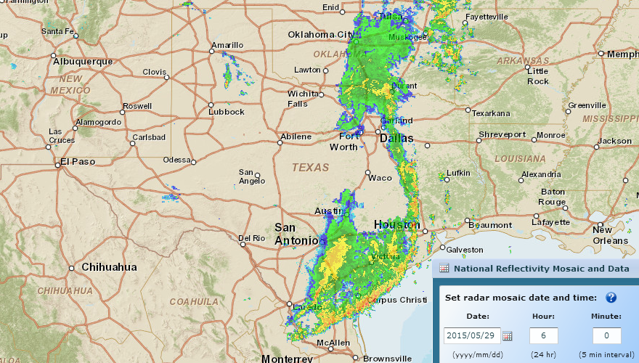
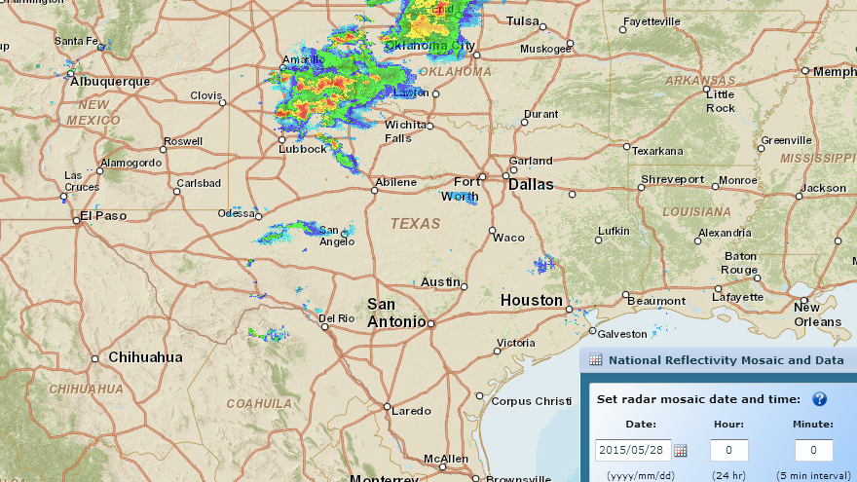
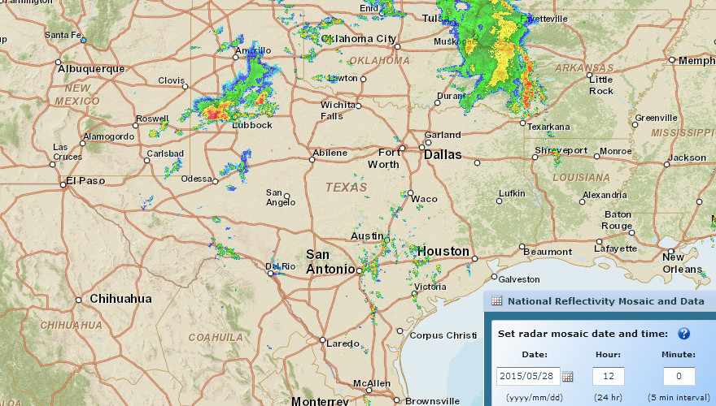
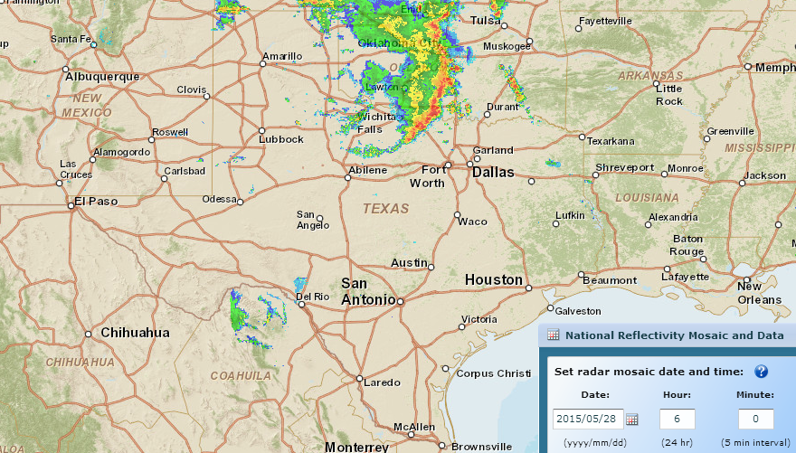
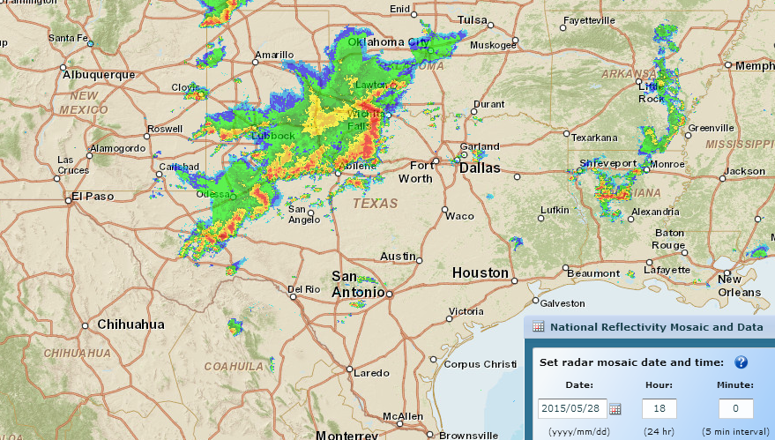
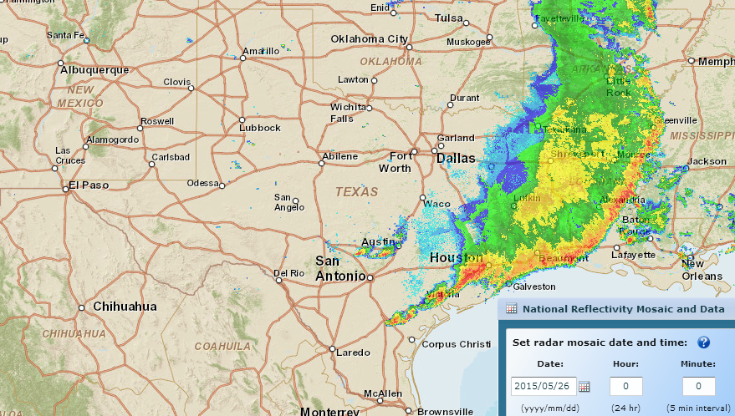
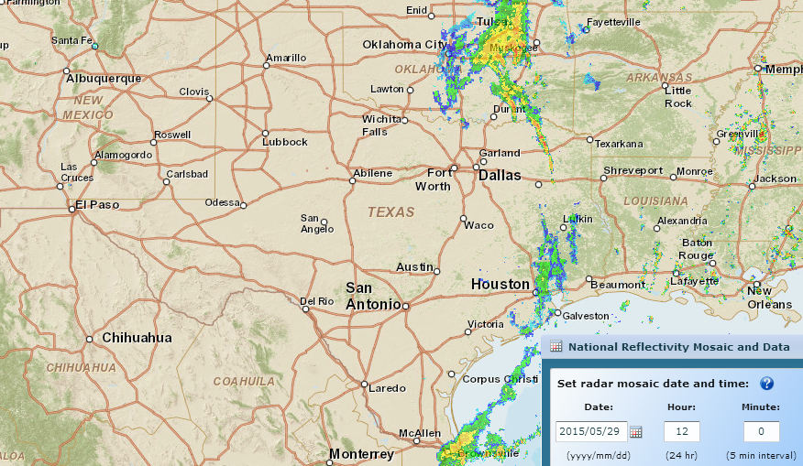
Storm Rainfall during last week ….
http://gis.ncdc.noaa.gov/map/viewer/#app=cdo&cfg=radar&theme=radar&display=nexrad
Where are the corresponding flood maps on the ground?
Sunday, Midnight
Tuesday, 6 PM
Monday, 6PM
Wednesday, 6 AM
Wednesday, Midnight
Tuesday, noon
Monday, 6AM
Thursday, 6 AM
Thursday, noon
Monday,Midnight
Wednesday, noon
Tuesday, Midnight
Tuesday 6 AM
Thursday, 6 PM
Wednesday, 6 PM
Thursday, Midnight
Monday, noon
Sunday, Midnight
Friday, 6 AM
Sunday, 6 PM
Friday, 6 PM
Friday, midnight
Saturday, 6 AM
Monday, 6 AM
Saturday, Midnight
Saturday, 6 PM
Saturday, noon
Friday, noon
Sunday, 6 AM
Sunday, noon

Slide 6
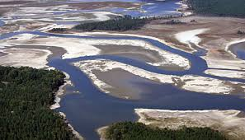
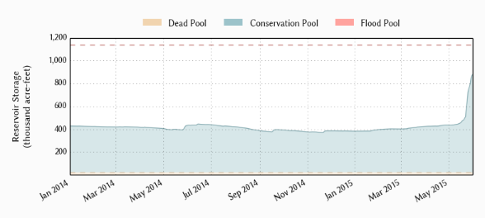
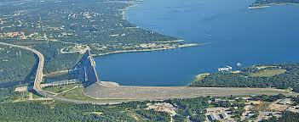
Drought to Deluge!
Lake Travis near Austin, Texas, has been in drought for the last four years
Reservoir storage doubled in last 10 days
How can this happen?

Slide 7
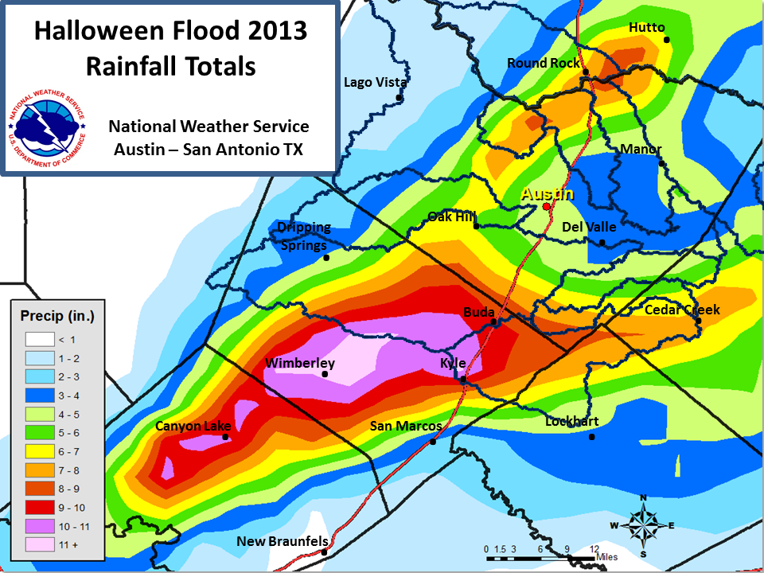

Slide 8
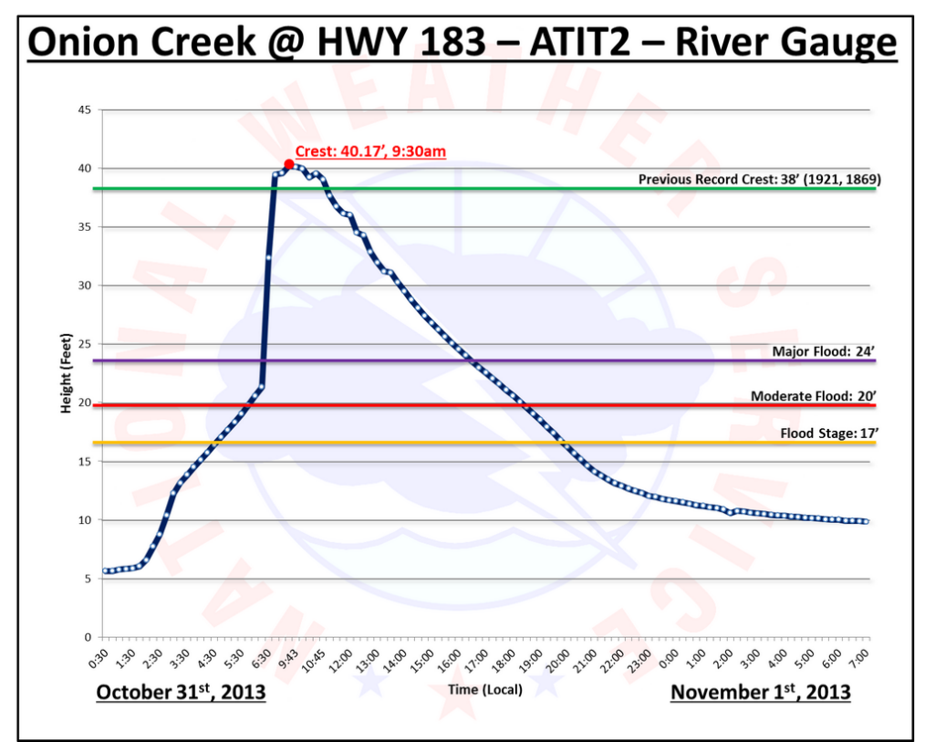

Slide 9
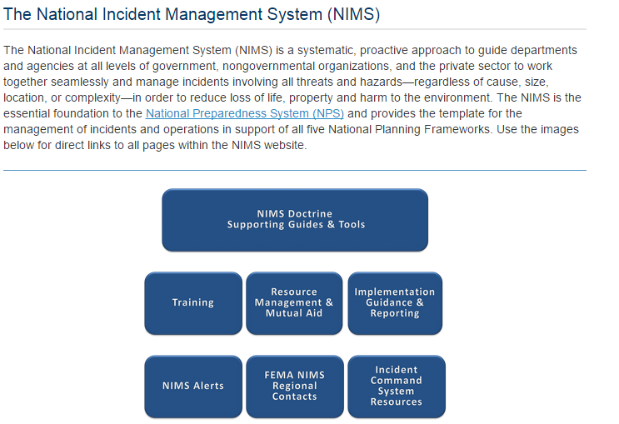

Slide 10
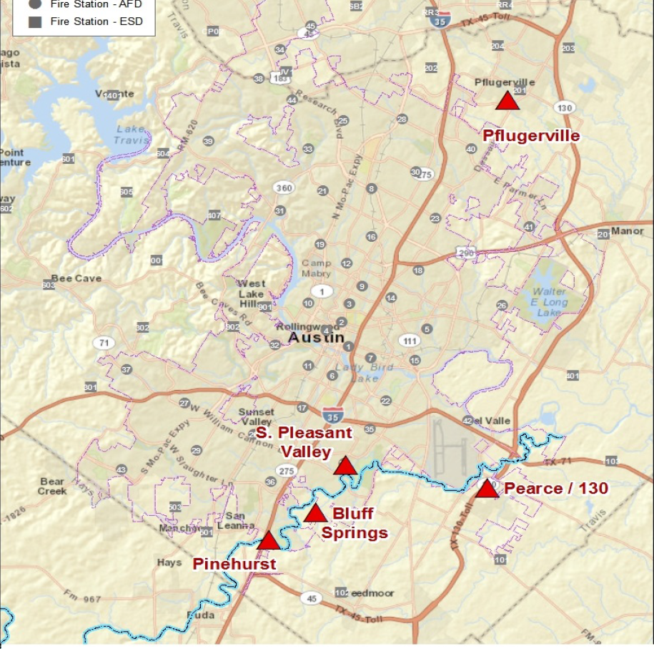
Incident Command Locations
11:30PM, Oct 30
6.00AM, Oct 31
4.25AM, Oct 31
5.50AM, Oct 31

Slide 11
National Flood Interoperability Experiment
The Bad News ….
The Good News ….
Where do we go from here?

Slide 12

Transforming the
National Weather Service’s Water Services
Edward Clark
National Weather Service, NOAA
Notes:
OUTLINE:
NEW MISSION FOCUS
TECHNICAL APPROACH
SCALE IMPLICATIONS
NATIONAL WATER CENTER (Organization, Functions, Staffing, Initial Activities, Design Tour)
SUMMARY

Slide 13
National Academy of Sciences Report
Weather Services for the Nation: Second to None
Assessment of the NWS Hydrology Program
Three inter-related issues:
  inadequate state of NWS hydrologic science
  inefficient function and structure of the NWS’s hydrologic forecasting operations, and
  lack of expertise, skills and training needed to support a modern hydrologic program
Recommendations:
  Improve pathways to accelerate research to operations
  Improve RFC operational workflow to reflect state of the art science
  Implement consistent framework to assess hydrologic prediction skill
  National Water Center test-bed for hydrologic prediction
  Enhance core competencies of hydrologic workforce
Notes:
NAS IS TELLING US WE NEED TO CHANGE

Slide 14
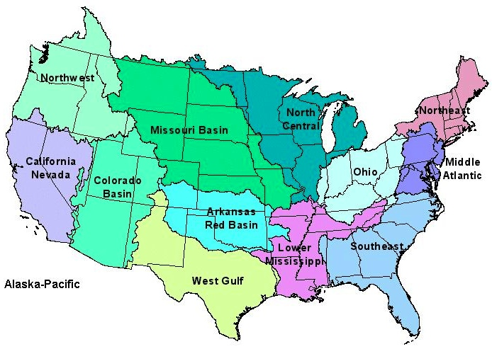
NWS River Forecast Centers (RFCs)
  Prepare river and flood forecasts using models based on average basin characteristics
  Provide forecast guidance to Weather Forecast Offices (WFOs)
  Issue daily stage and streamflow forecasts, rainfall and drought data and information, and flash flood guidance
  Work with water managers and other Federal Agencies
14
Notes:
RFC Summary

Slide 15
NWS River Forecast Centers
No River Forecast
Notes:
THERE’S A MAJOR GEOGRAPHIC GAP – WE DON’T FORECAST ALONG THE COAST

Slide 16
NWS River Forecast Centers
Seattle
Boston
New York
City
San
Francisco
Baltimore
Washington
Los Angeles
Charleston
Savannah
New Orleans
Jacksonville
Houston
12 Coastal Cities: 20 Million People
Notes:
>50% of U.S. population live within 50 miles of the coast
60% of GDP generated in coastal counties
Aging infrastructure, expensive to upgrade/replace
Rise in LOSSES of at least $1B insured damages per event
Runoff from land-falling rain often a major contribution to coastal inundation

Slide 17
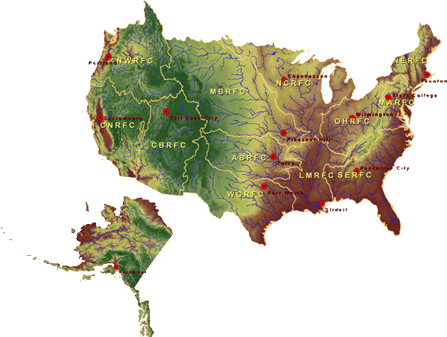

National Water Center
FY15 Centralized Water Forecasting
Centralized Data Archive – all RFC data
Modeling Evaluation Service
  RFC and NWC modeling and forecasts
Modeling Testbed – new NWC capabilities
Centralized Water Forecasting Demonstration
Notes:
TRANSITION INTO METHODS
FY15 PROJECT HAS FOUR CORE COMPONENTS
RFC archive
Model evaluation service
Modeling testbed
Centralized modeling demonstration

Slide 18
Stakeholder Priorities
Flooding
Water Quality
Water Availability
Drought
Climate Change
Need integrated understanding of near- and long-term outlook and risks
Actionable Water Intelligence
Notes:
The message was loud and clear:
While flooding remains a high priority, most stakeholders are concerned about the full gamut of water
They need more, and better integrated water prediction information
They need actionable WATER INTELLIGENCE
<< CLICK ONCE TO REVEAL LIST >>

Slide 19
WATER PREDICTION (NHD Plus)
+
GeoINTELLIGENCE
“Street Level” Water Prediction and
Impact-Based Decision Support

Slide 20
Hydrography, AHPS Forecast Points

Slide 21
Hydrography, AHPS Forecast Points
NCRFC
MBRFC
OHRFC
ABRFC
LMRFC
1000 km

Slide 22
NATIONAL INFRASTRUCTURE
Hospitals, EMS & Fire Stations
Full Resolution National Hydrography Dataset NHD+
Springfield, MO
AHPS Forecast Point
James River at Galena, MO
150 km

Slide 23
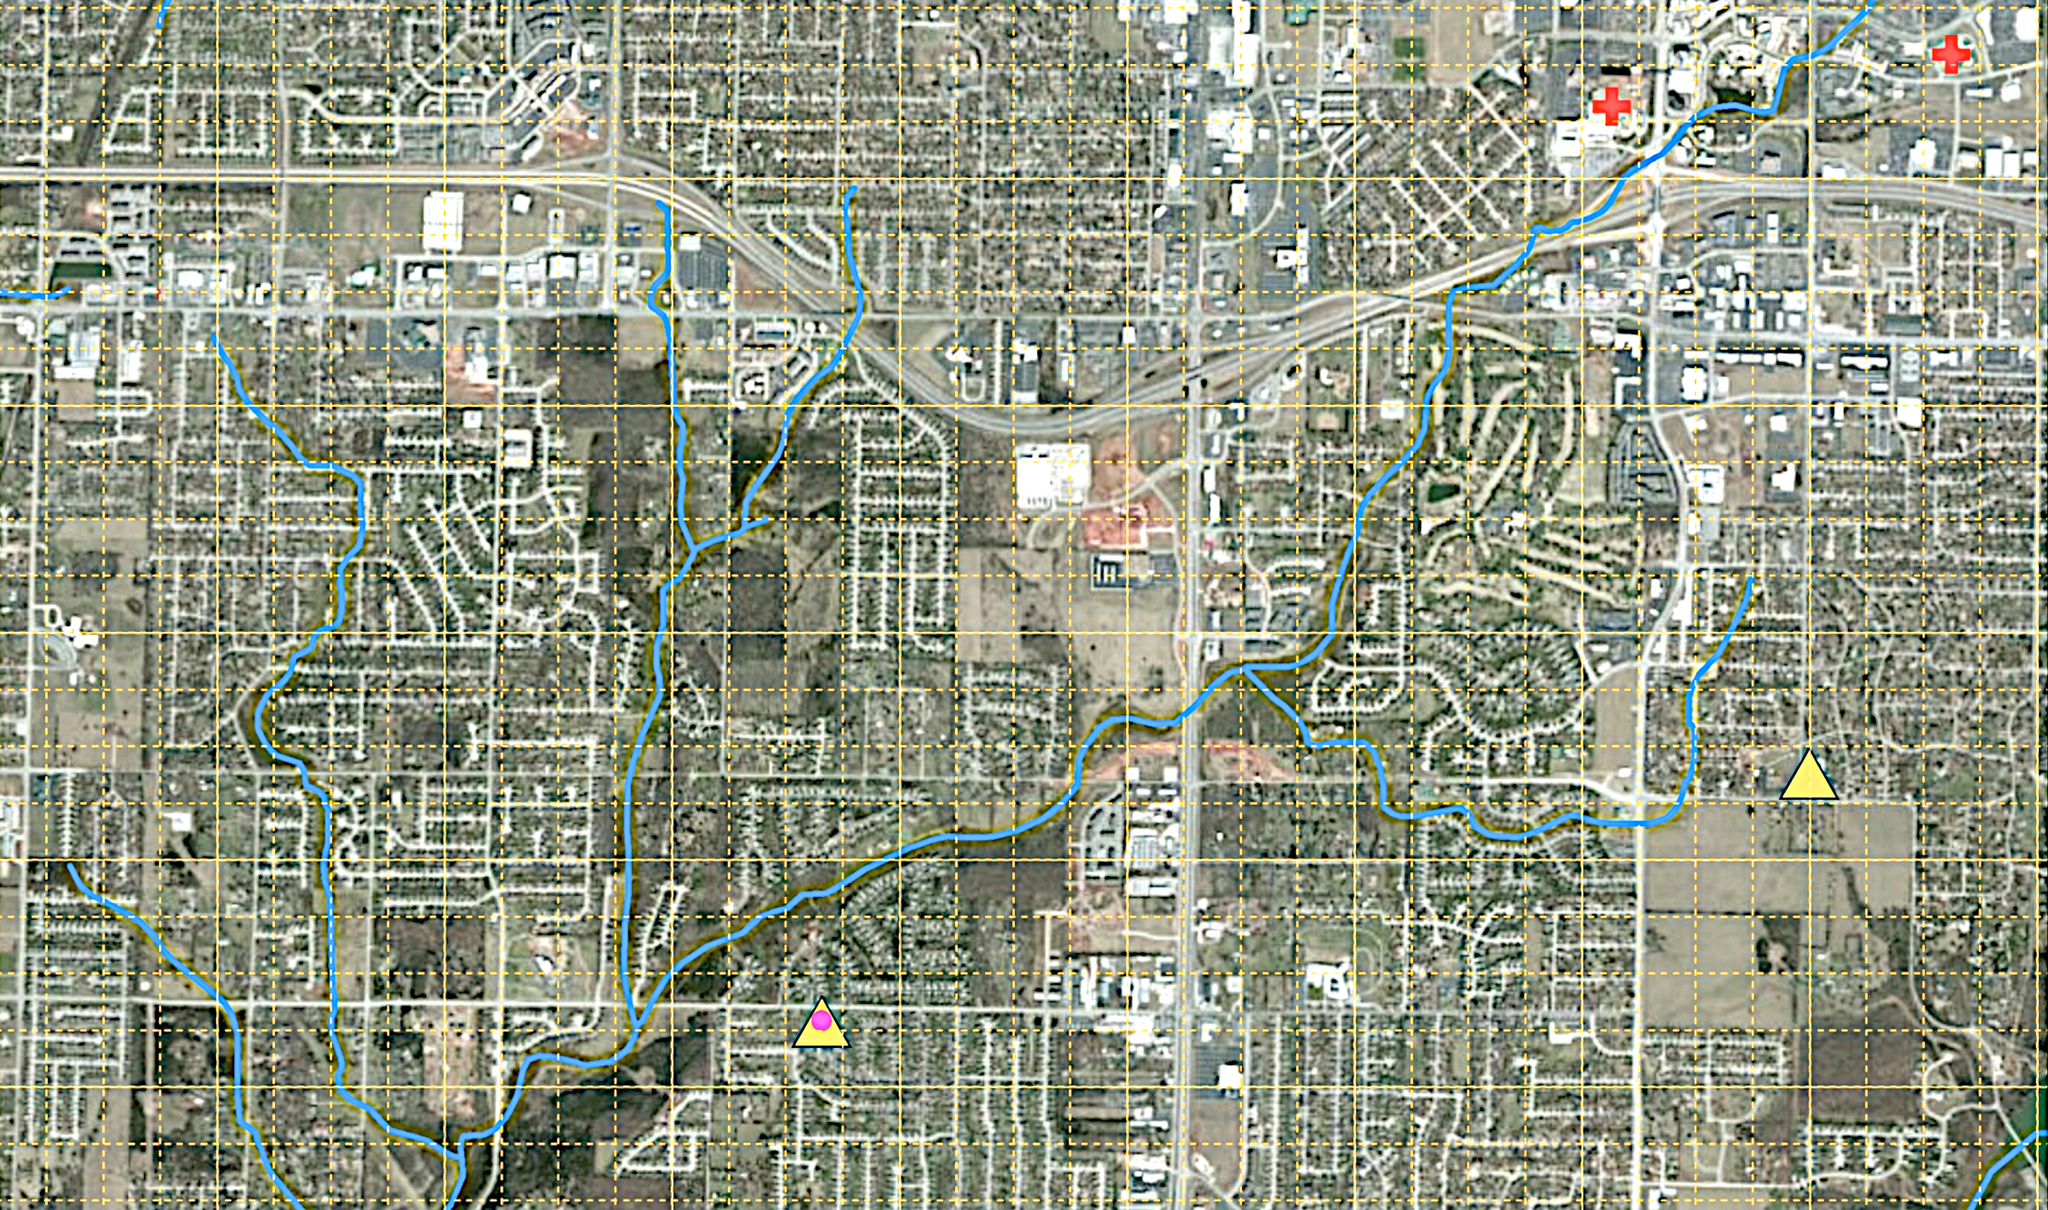
NATIONAL INFRASTRUCTURE
Hospitals, EMS & Fire Stations
Workman Branch
Ward Branch
18 km

Slide 24
NATIONAL INFRASTRUCTURE
Emergency Services
HOSPITALS
PHARMACIES
EMS STATIONS
FIRE STATIONS

Slide 25
NATIONAL INFRASTRUCTURE
Electric Power Grid

Slide 26
NWS Water Prediction
TODAY
TOMORROW
Approximately 6000 forecast locations at points
Driven by large catchment “lumped” modeling
Requires:
  Precipitation and Air Temperature (averaged over watershed)
  Reservoir Information
  River Network Topology
  Hydraulic modeling for large channels
  Stream Gage Data
  General Impacts near Gages
  Local servers and storage
Approximately 2,700,000 forecast stream reaches
Driven by high/hyper resolution Earth System modeling
Requires:
  Full high-resolution meteorological suite
  Reservoir Information
  Stream Network Topology
  Hydraulic modeling for small channels
  High Resolution Terrain Data
  Land Cover Change Data
  Stream Gage Data (enhanced)
  Reach-based Inundation Mapping and Impacts
  Centralized high-performance computing
Notes:
Comparison of today and tomorrow – orders of magnitude more ‘complex’ prediction paradigm – mainly in data density

Slide 27
Transforming the
National Weather Service’s Water Services
Edward Clark
National Weather Service, NOAA
End of Slides by Edward Clark
Notes:
OUTLINE:
NEW MISSION FOCUS
TECHNICAL APPROACH
SCALE IMPLICATIONS
NATIONAL WATER CENTER (Organization, Functions, Staffing, Initial Activities, Design Tour)
SUMMARY

Slide 28
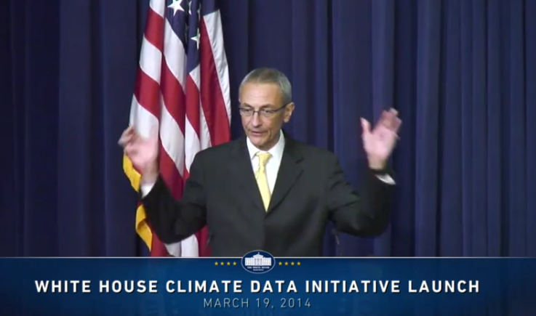
President’s Climate Data Initiative
John Podesta, Counsellor to the President, White House, March 19, 2014
https://www.youtube.com/watch?v=pfe5oRdsCp0&feature=youtu.be&t=7s

Slide 29
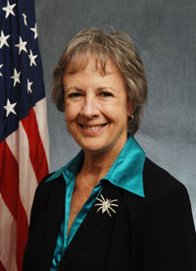

Open Water Data Initiative
Subcommittee on Spatial Water Data leads this effort
This reports to both FGDC and ACWI
Sponsoring a series of “experiments” with water information services
National Flood Interoperability Experiment
Anne Castle, Former Asst Secretary for Water and Science, Dept of Interior
Chair

Slide 30
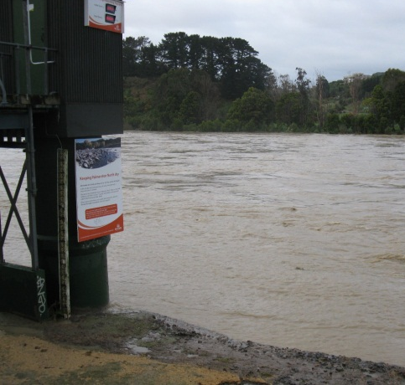
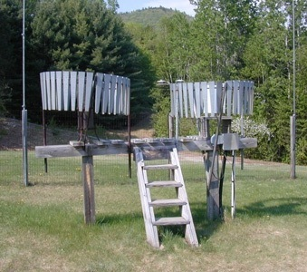
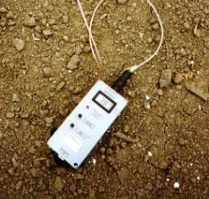
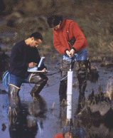
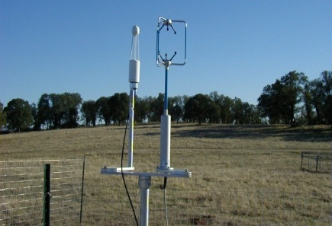
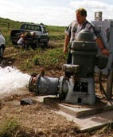
Water Observation – In Situ
Time series data at point locations
Water Quantity
Rainfall
Soil Water
Water Quality
Meteorology
Groundwater

Slide 31




Consortium of Universities for the Advancement of Hydrologic Science, Inc.
www.cuahsi.org
CUAHSI
A consortium representing 125 US universities
Dr. Richard Hooper, President and CEO
Supported by the National Science Foundation Earth Science Division
Advances hydrologic science in nation’s universities
Includes a Hydrologic Information System project
Invented WaterML language for water resources time series
Building an academic prototype system

Slide 32




WaterML Web Services – CUAHSI, USGS, OGC, WMO …..
Water time series data on the internet
24/7/365 service
For daily and real-time data
. . . Operational water web services system for the United States
http://waterservices.usgs.gov/nwis/iv/?format=waterml,2.0&sites=08158000&period=P1D&parameterCd=00060

Slide 33


Web Pages and Web Services
Web pages deliver text and images
http://water.usgs.gov
Web services deliver data encoded in XML
http://waterservices.usgs.gov/

Slide 34

NWISWeb and NWIS Water Services
Water Service Requests
Requests per month
Web Page Requests

Slide 35


WaterML – an international standard for time series
Acknowledgements: OGC, WMO, GRDC, CUAHSI, BoM/CSIRO, USGS, GSC, Kisters, …….
TimeSeriesML being
processed for adoption
by OGC and WMO for all
forms of time series
CUAHSI Hydrologic Information System project
starts working on WaterML
November 2009
Adopted and endorsed by
Executive Office of the President
USGS adopts
WaterML
Technical Meetings Each 3 Months
Four Interoperability Experiments
(Surface water, groundwater, forecasting)
Annual week-long workshops
Involvement by many countries
2005
2007
2009
2011
2013
2015
Notes:
(1) A four-year international effort has been undertaken to reconcile WaterML with international standards;
(2) This effort was initiated with the establishment of an Hydrology Domain Working Group by the Open Geospatial Consortium in September 2008;
(3) An OGC representative attended the WMO Congress of the Commission for Hydrology in 2008
(4) A formal agreement between Secretary General of WMO and President of OGC in 2009 to jointly develop standards for hydrology, climatology, oceanography and climatology;
(5) The joint OGC/WMO Hydrology Domain Working Group was supported by a large work effort, annual week-long workshops, four interoperability experiments for surface and groundwater data exchange, and participation by many countries;
(6) In June 2012, the OGC voted to adopt the revised version, WaterML2 as an international standard for exchange of water resources time series (the first such public standard that has existed);
(7) This Congress to the WMO Commission for Hydrology to whom I am speaking is considering WaterML2 for adoption as an official standard by WMO

Slide 36
National Flood Interoperability Experiment
The Bad News ….
The Good News ….
Where do we go from here?

Slide 37

Inaugural Meeting – May, 2014

Slide 38
Transformative Research (NSF)
Transformative research involves ideas, discoveries, or tools that radically change our understanding of an important existing scientific or engineering concept or educational practice or leads to the creation of a new paradigm or field of science, engineering, or education. Such research challenges current understanding or provides pathways to new frontiers.
http://www.nsf.gov/about/transformative_research/definition.jsp
How to move from evolutionary change
to transformative change?

Slide 39


Partnership with the academic community (Interagency Agreement between NSF and NOAA)
National Weather Service has joined with CUAHSI to conduct a one-year National Flood Interoperability Experiment (NFIE)
Includes a Summer Institute for students and faculty at the National Water Center, June 1 to July 17, 2015

Slide 40

NFIE Summer Institute
Runs from June 1 to July 17
  Kickoff Event, week of June 1
  Capstone conference July 15-17
46 graduate students and post-docs from 19 Universities: Alabama, Texas (Arlington, Austin), Utah State, SUNY Syracuse, BYU, Colorado (Boulder), Illinois (Urbana-Champaign), Purdue, Oklahoma, Iowa, Michigan State, Arizona, Alaska (Fairbanks), Tufts, Sweden, China, Korea, Netherlands

Slide 41
Goal of the Experiment …
Close the gap between National Flood Forecasting and Local Emergency Response
Demonstrate forecasting of flood impacts at “stream and street level”
National
Weather and Hydrology
National Weather Service and federal agencies
National Water Center
River Flooding and Emergency Response
Local, State and Regional Agencies
Citizens
Local

Slide 42

Technical Readiness Levels
The NFIE is a research effort
It will not create an operational system
It will not produce public forecast information
NFIE
http://en.wikipedia.org/wiki/Technology_readiness_level

Slide 43
NFIE Conceptual Framework…
NFIE-Geo: National geospatial framework for hydrology
NFIE-Response: Wide area planning for flood emergency response
NFIE-Hydro: National high spatial resolution hydrologic forecasting
NFIE-River: River channel information and real-time flood inundation mapping
NFIE-Services: Web services for flood information

Slide 44
NFIE Continental scale…
NFIE-Geo: National geospatial framework for hydrology
NFIE-Response: Wide area planning for flood emergency response
NFIE-Hydro: National high spatial resolution hydrologic forecasting
NFIE-River: River channel information and real-time flood inundation mapping
NFIE-Services: Web services for flood information

Slide 45




NHDPlus Version 2
Geospatial foundation for a national water data infrastructure
NHDPlus
2.67 million reach catchments in US
average area 3 km²
reach length 2 km
National Elevation Dataset
Watershed Boundary Dataset
National Hydrography Dataset
National Land Cover Dataset

Slide 46




NFIE-Geo for National Flood Interoperability Experiment
Enhanced geospatial database for a national water data infrastructure
NWS Basins and
Forecast Points
USGS Water Watch
Points
National Flood
Hazard Layer
Feature classes:
Subwatershed (HUC12)
Catchment
Flowline
Waterbody
Streamgage
NFIE-Geo
9 feature classes
5 from NHDPlus
4 from IWRSS
NHDPlus

Slide 47


NFIE-Geo in HydroShare
https://www.arcgis.com/home/webmap/viewer.html?webmap=2c30160429984a59873f26b9d118dbfe
David Tarboton, Utah State Univ
and Ray Idaszak, RENCI

Slide 48

NFIE-Geo for Mobile-Alabama River System
Black Warrior River
Coosa River
Cahaba River
TombigbeeRiver
Alabama River
Mobile River
Mobile Bay

Slide 49

Tuscaloosa County
Black Warrior River

Slide 50

NFIE-Geo for a county….
County subset of national geospatial data layers
http://www.caee.utexas.edu/prof/maidment/CE397Flood/Assignment2/NFIEGeo.pdf

Slide 51

NFIE-Geo around University of Alabama Campus
Black Warrior River

Slide 52

Catchment 18228725

Slide 53


Geo to Hydro…
High spatial resolution hydrologic modeling at continental scale
Built upon NFIE-Geo: A national geospatial framework for hydrology
  Continental landscape divided into 2.67 million local catchments, each containing a single stream reach
  Stream reaches connect to form a national stream network
2.67 million catchments
Average area 3 km²
Average reach length 2 km

Slide 54




NFIE-Hydro Forecasting Model
Computed for the continental US in 10 minutes at Texas Advanced Computing Center
Weather model and forecasts (HRRR)
Probabilistic flood forecasts
Catchment-level forecasts
Weather
Precipitation
Streamflow
Runoff
Land-Atmosphere Model (NOAH-MP)
RAPID flow routing (for continental US)

Slide 55


Flood risk zones…
Each catchment has a flood hazard zone defined from FEMA flood data
Probabilistic forecast from NFIE-Hydro defines flood risk
Color the zones according to risk

Slide 56

Tethys Application …. ECMWF-RAPID
Catchment
18228725
Brigham Young University
http://demo.tethys.ci-water.org/apps/erfp-tool/

Slide 57

NFIE-Hydro Workflow
Implemented in Microsoft Azure

Slide 58

Soil Moisture Percentile Map
Current value expressed as a percentile based on historical data [1979 to present] on this calendar day at this spatial point
Compare present soil moisture with past conditions
Slide: Gonzalo Espinoza
http://statsnldas.azurewebsites.net/

Slide 59
NFIE Regional and Local scale…
NFIE-Geo: National geospatial framework for hydrology
NFIE-Response: Wide area planning for flood emergency response
NFIE-Hydro: National high spatial resolution hydrologic forecasting
NFIE-River: River channel information and real-time flood inundation mapping
NFIE-Services: Web services for flood information

Slide 60




NFIE-River…
NFIE-River: Dynamic flood modeling, forecasting and inundation mapping in space and time
Requires LIDAR terrain data so can only be done for particular regions
Iowa Flood Information System

Slide 61

Case Study: North Carolina
Cross Section Dataset
17637 Cross Sections
Slide: Xing Zheng

Slide 62

Return Period – Discharge – Stage Height – Water Surface Elevation

Slide 63

Real-Time Flood Inundation Mapping (USGS/NWS)
http://water.weather.gov/ahps2/inundation/inundation_google.php?gage=atit2

Slide 64
NWS River Forecast Centers
No River Forecast
Notes:
THERE’S A MAJOR GEOGRAPHIC GAP – WE DON’T FORECAST ALONG THE COAST

Slide 65


Slide 66

Hurricane Ivan, September 2004
The most expensive disaster in the history of Alabama

Slide 67

Hurricane Ivan as a case study
http://en.wikipedia.org/wiki/Hurricane_Ivan#Alabama

Slide 68
Severe Flooding in Mobile during Ivan
Black Warrior River
Case study for river-coastal interaction

Slide 69

NFIE-Response

Slide 70



Address Points -- used for directing emergency response vehicles
All legal residences have an address point
Established when the lot is legally platted and registered with the county

Slide 71

Address Points and the Flood Hazard Zone
Williamson County
495,000 Address points in the two counties
How many points are in the flood hazard zone?
Where are the high flood risk areas in these counties?
Austin, Texas
Travis County

Slide 72


Address Points and the Floodplain

Slide 73
Transformative for the nation
Forecasts produced by
  Current system – 3600 locations
  NFIE system – 2.67 million locations
New Information to help emergency managers save lives and keep people safe
700 times more
Proposed in NFIE
Current

Slide 74


Connecting with Local Decision Makers
Work with the first response community to define flood strategy and tactics
https://www.youtube.com/watch?v=ympaR6YUxiA&feature=youtube

