Slide 1
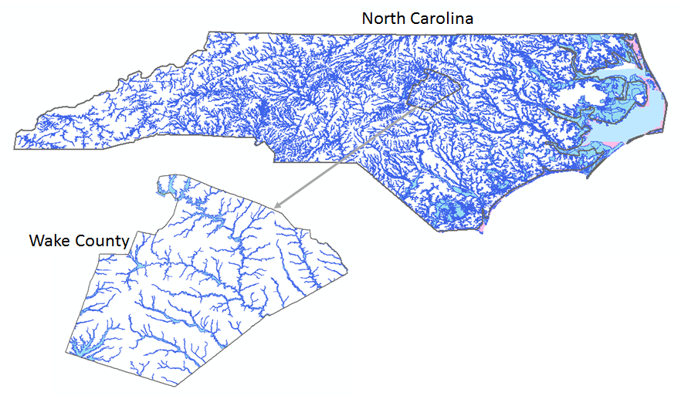
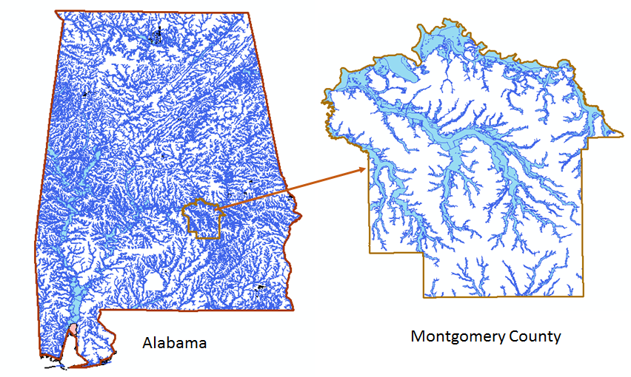
National Flood Interoperability Experiment for North Carolina and Alabama
David R. Maidment,
University of Texas at Austin
Presented at RENCI, University of North Carolina, Chapel Hill, NC, 16 January 2015

Slide 2
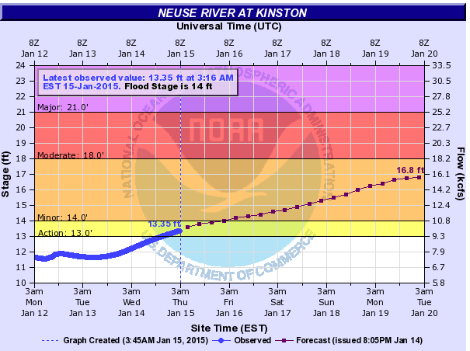
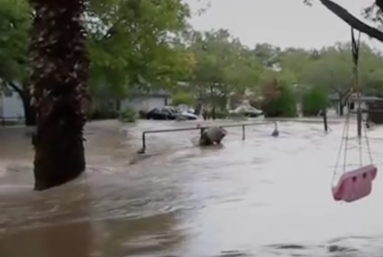
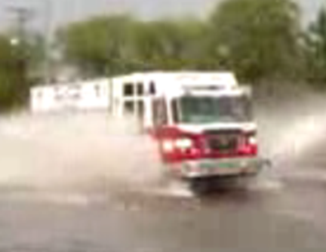
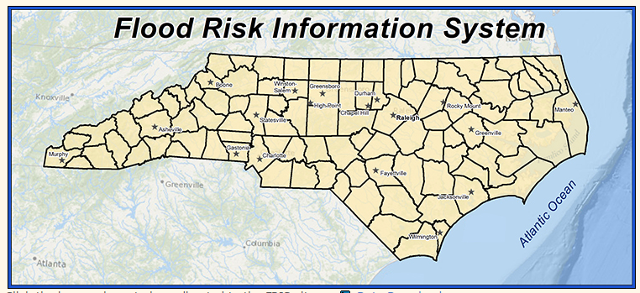
Building a stronger flood support system for citizens
National Weather Service
Citizens
Local and State Flood Managers
First Response Community

Slide 3


Located on Tuscaloosa Campus of University of Alabama
Operated by National Weather Service to support IWRSS partners (NWS, USGS, Corps of Engineers, FEMA)

Slide 4
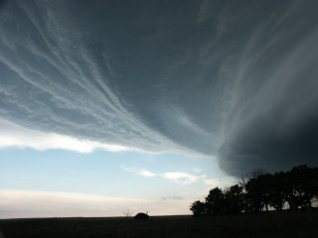
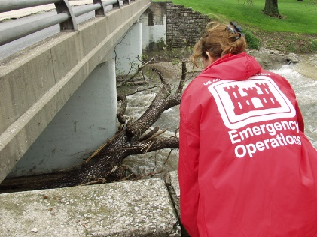

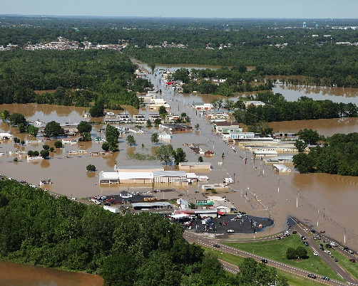


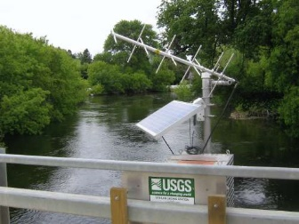

Linkages among federal agencies for flood response
Atmosphere
Stream
Street
Data

Slide 5
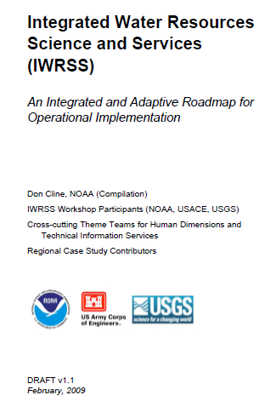
Integrated Water Resources Science and Services (IWRSS)
Aligns multiple agencies with complimentary water-related missions to:
Integrate services and service delivery
Improve river and flood forecasts
Provide new summit-to-sea water resources analyses and forecasts
Enable more effective use of resources
Roadmap Document
(February 2009)
Purpose, Scope, Vision and Goals
Cross-Cutting Themes
National and Regional
Operations and Business Concepts
Slide: Ed Clark, NWS
http://www.nohrsc.noaa.gov/~cline/IWRSS/IWRSS_ROADMAP_v1.0.pdf
5

Slide 6
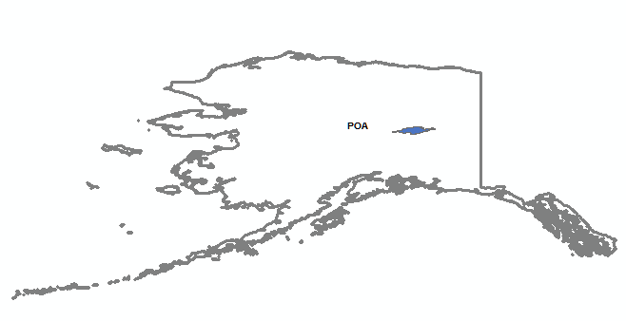
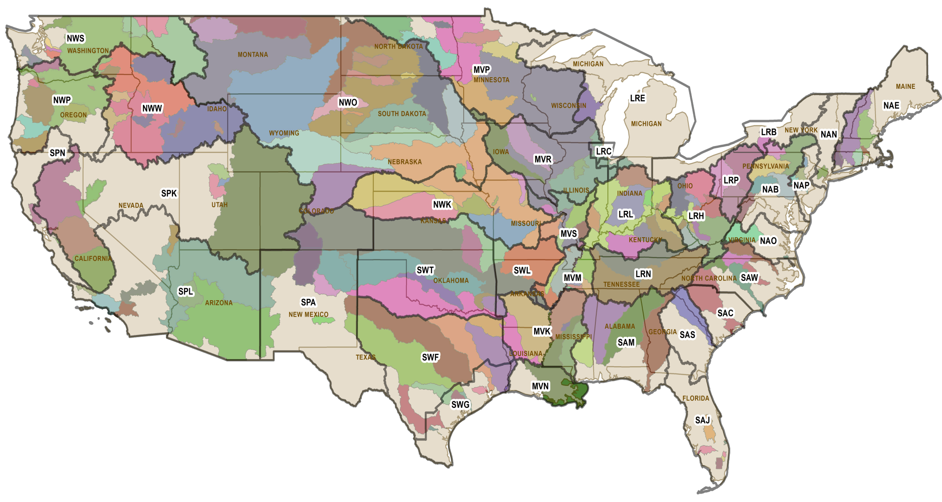


















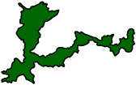



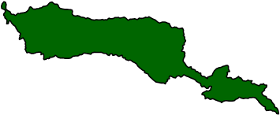

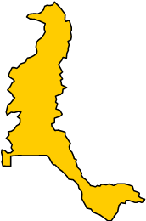















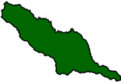



CWMS Implementation
Chena
River
Park
River
Red Lake
River
Mill Creek
Willamette
River
Sheyenne
River
Red
River
Connecticut River
West Branch Susquehanna
River
Upper
Wabash River
Beaver
River
Genessee
River
Sacramento River
Des Moines River
Iowa
River
Muskingum
River
Merrimack
River
Lower
Wabash River
Allegheny
River
Thames River
Russian River
Truckee River
South Platte
River
Little Platte
River
Scioto
River
Upper Susquehanna
River
Kaskaskia
River
Ohio River
Monongahela
River
Housatonic River
San Joaquin River
Arkansas River
Kanawha River
Arkansas River
Green River
Jackson James River
Tulare
Lakebed
Cumberland River
Yadkin
River
Roanoke River
Rio Grande River
Red River
Arkansas River
Yazoo
River
Neuse
River
Bill Williams
River
Cape Fear
River
LACDA
River
Trinity River
ACT
Santa Ana
River
Pecos River
Colorado River
Neches River
Black Creek
ACF
Rio Hondo River
Legend
Guadalupe River
Little
River
Ouachita/Black River
Buffalo
Bayou
Watersheds Completed (17 basins)
Watersheds In Progress (33 basins)
FY15 Watersheds (13 basins)
Updated 22 Sep 2014

Slide 7
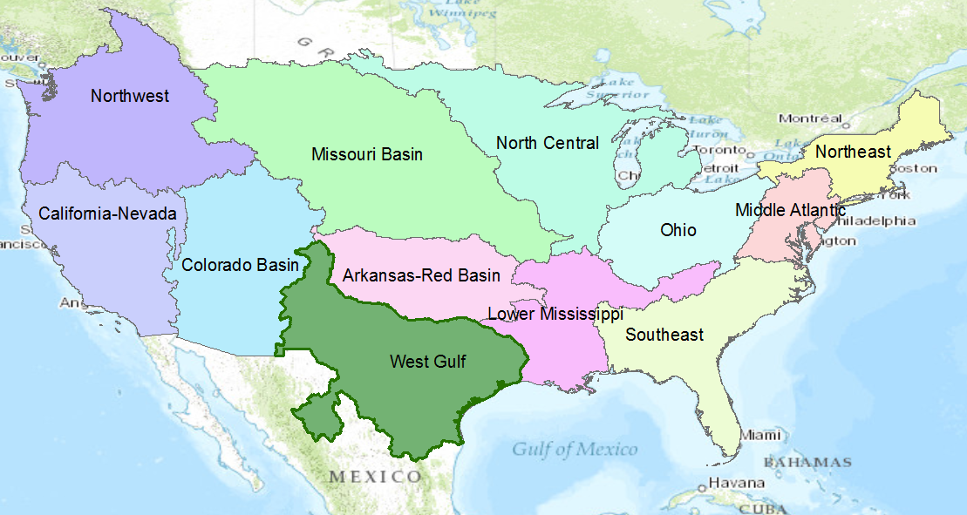
NWS River Forecast Centers
Perform precipitation, runoff and river flow simulation and forecasting for five days ahead, updated daily, more frequently during floods

Slide 8
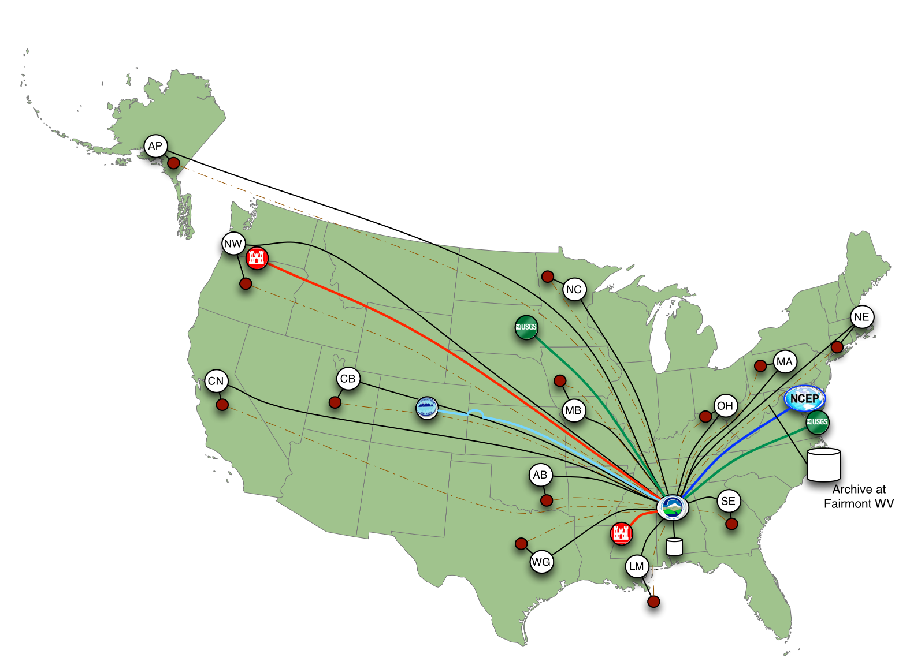
Nationally Synthesize Operations of Regional River Forecast Centers

Slide 9
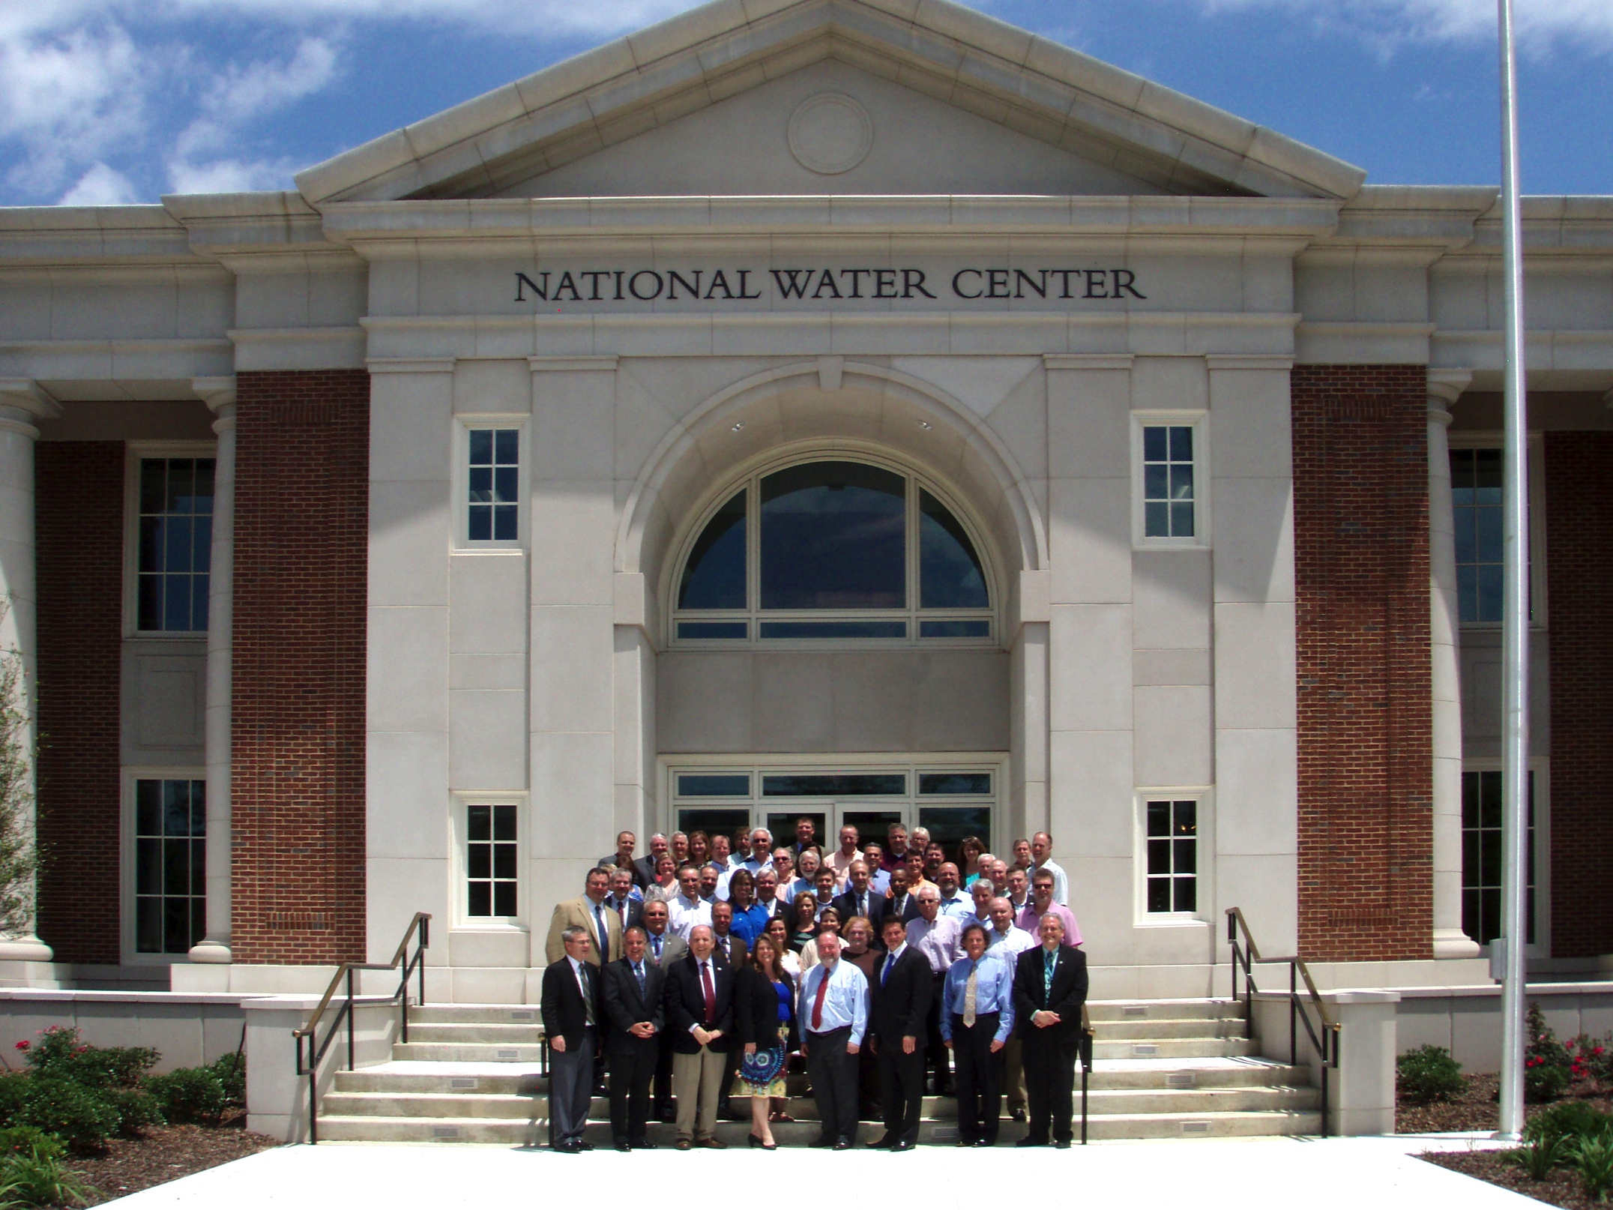
Inaugural Meeting – May, 2014

Slide 10
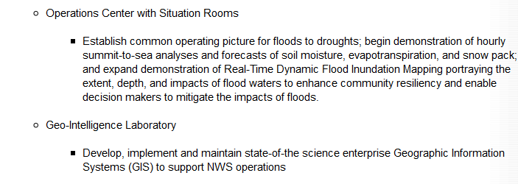
Temporal information
Geospatial information
National Water Data Infrastructure

Slide 11
Transformative Research (NSF)
Transformative research involves ideas, discoveries, or tools that radically change our understanding of an important existing scientific or engineering concept or educational practice or leads to the creation of a new paradigm or field of science, engineering, or education. Such research challenges current understanding or provides pathways to new frontiers.
http://www.nsf.gov/about/transformative_research/definition.jsp
How to move from evolutionary change
to transformative change?

Slide 12
National Flood Interoperability Experiment (NFIE)
Will be led by the academic community coordinated by CUAHSI in collaboration with the IWRSS partners through the National Water Center
Run from September 2014 to August 2015
  Preparatory phase to May 2015
  Summer Institute at the National Water Center, June 1 to July 17 2015

Slide 13









NFIE Goal: Connect National Scale Flood Modeling with Local emergency planning and response
How can near-real-time hydrologic simulations at high spatial resolution, covering the nation, be carried out using the NHDPlus or next generation hydro-fabric (e.g. data structure for hillslope, watershed scales)?
How can this lead to improved emergency response and community resilience?
How can an improved interoperability framework support the first two goals and lead to sustained innovation in the research to operations process?
Slide: Ed Clark, NWS

Slide 14
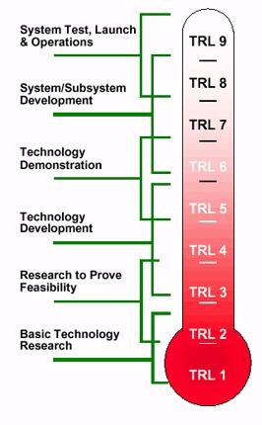
Technical Readiness Levels
The NFIE is a research effort
It will not create an operational system
It will not produce public forecast information
NFIE
http://en.wikipedia.org/wiki/Technology_readiness_level

Slide 15
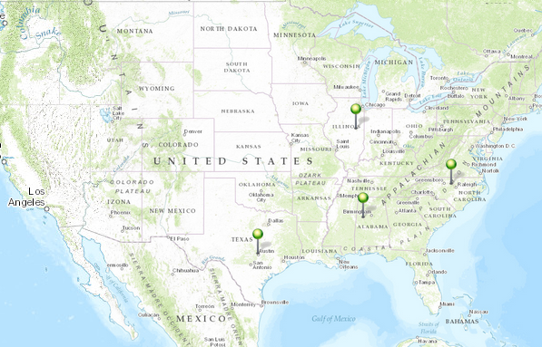
NFIE Academic Centers (as at present)
University of Illinois
(Subsetting)
University of North Carolina
(GIS Data)
University of Texas
(Real-time forecasting)
University of Alabama
(Summer Institute )

Slide 16
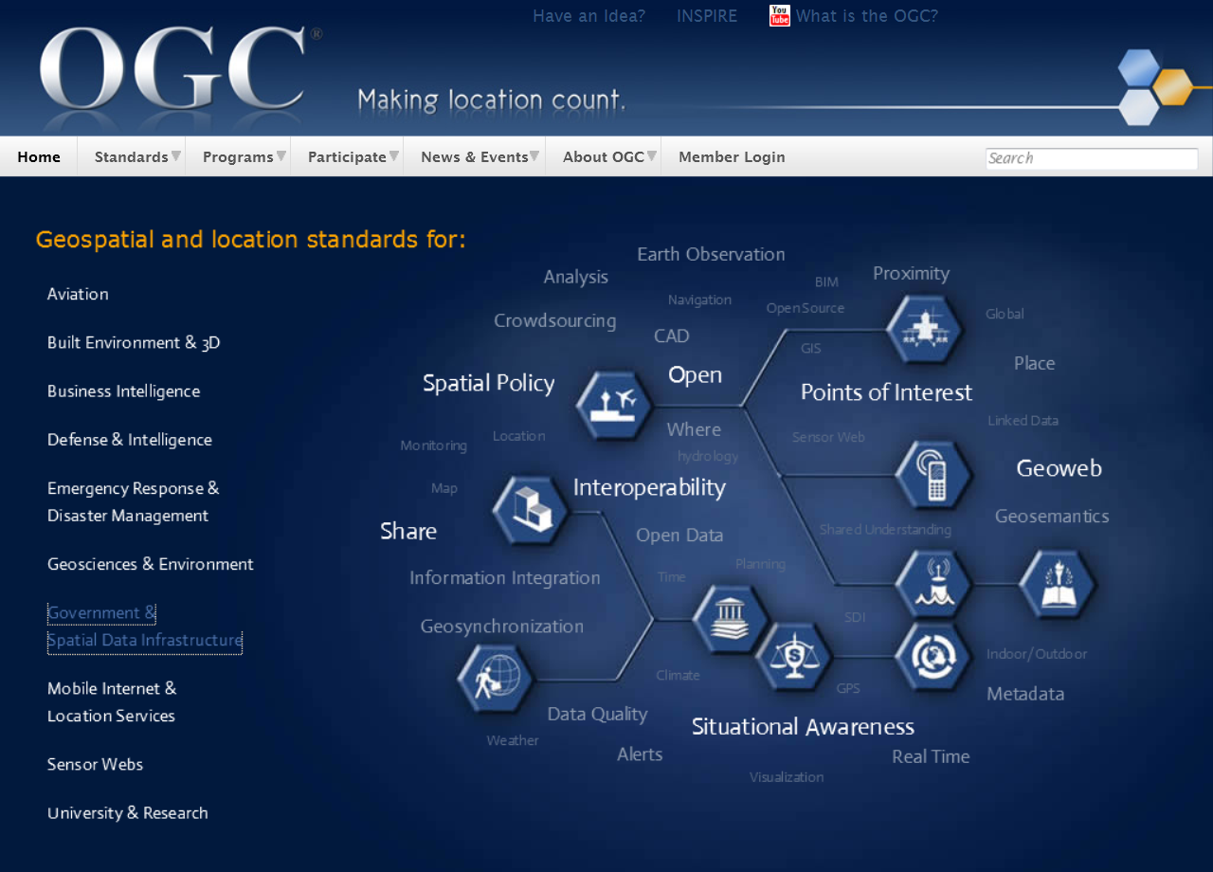
Open Geospatial Consortium
More than 400 companies and agencies globally
Internet standards for
Map services
Observation services
Catalog services

Slide 17
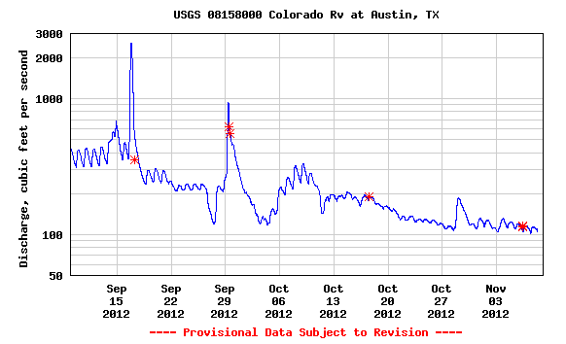

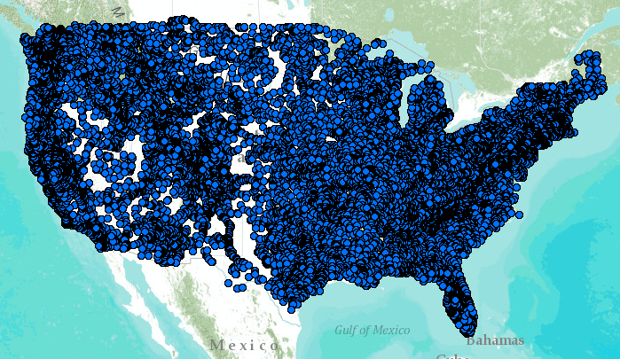
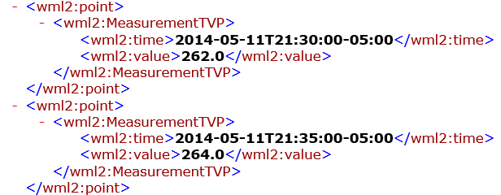
WaterML Web Services – CUAHSI, USGS, OGC, WMO …..
Water time series data on the internet
24/7/365 service
For daily and real-time data
. . . Operational water web services system for the United States
http://waterservices.usgs.gov/nwis/iv/?format=waterml,2.0&sites=08158000&period=P1D&parameterCd=00060

Slide 18
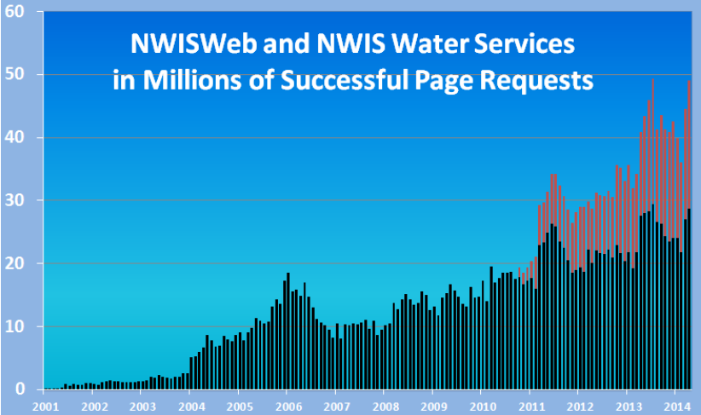
Water Data Distribution by US Geological Survey
Web service requests (millions/month)
Web page requests (millions/month)

Slide 19
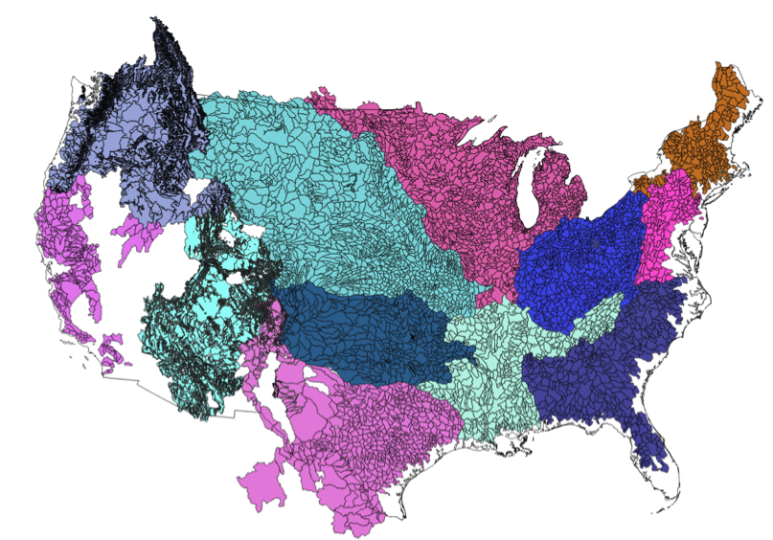
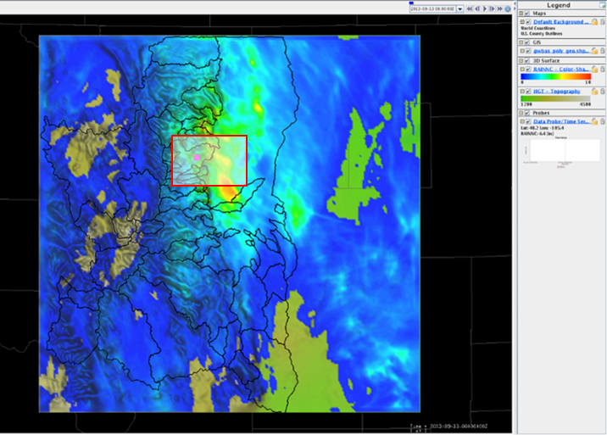
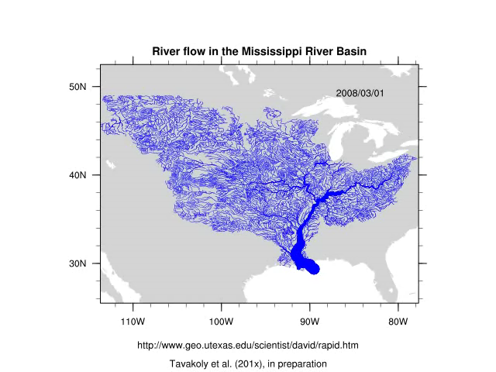
Develop NWS Experimental Data Services
Experimental WRF-Hydro ¹
NWS CHPS Modeling Units: RFCs
Export Data elements from the simulation& forecast workflow including:
Inflow to the Channel (INFW)
Mean Areal Precipitation (MAP)
Streamflow (QINE)
PI-XML to WaterML2²
netCDF
to
NHD+
Data Services – local runoff
¹Responsibility of NCAR

Slide 20
NFIE: NWS Project ‘Elements’ or Functional Requirements
Acquire data from 13 CHPS Instances
  Establish hosting system – central FEWS data server at UoA³
  Develop and implement extraction workflow (Based on WGRFC Export example)
  Develop and implement transmission capability – SFTP to UoA
Serve (make data available) constituent CHPS elements
  Publish geospatial--topology relationship corresponding to the time-series identifiers in CHPS extracted data sets¹ (metadata)
  Data reformatting to WaterML2²
  Provide access to CHPS data and metadata sets (data service)¹
  Develop data service monitoring capability (TBD via NWC)
Support Data Service through Aug 2015.
  Monitor & maintain
¹on going through OWDI
² Via UoA FEWS-WaterML2-SOAP service
³Note that RGB code for UoA is not available

Slide 21

National Spatial Data Infrastructure
Desired Future State of NSDI
Create network of resources and services
Facilitate discovery, access and application of resources
Leverage shared standard-based services
Develop core set of information layers that interface with nonspatial data
Use real-time data feeds and sensor webs

Slide 22


Open Water Data Initiative
Subcommittee on Spatial Water Data leads this effort
Al Rea (USGS) and Ed Clark (NWS) are co-chairs
This reports to both FGDC and ACWI
Sponsoring a series of “experiments” with water information services
NFIE is one of these experiments
Anne Castle, Former Asst Secretary for Water and Science, Dept of Interior
Chair

Slide 23
Open Water Data Components
Open Water Web (applications)
Open Water
Data Infrastructure
Water
Pollution
Ecological
Integrity
Flood
Drought
Concept: Nate Booth, USGS

Slide 24
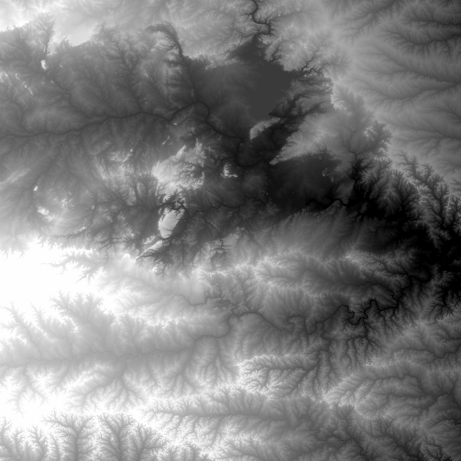
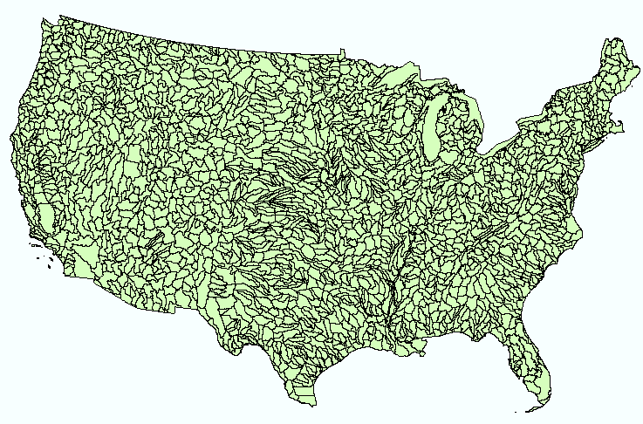
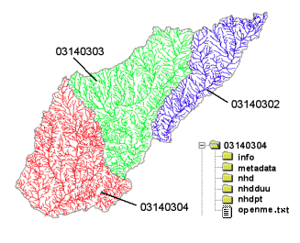
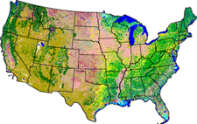
NHDPlus Version 2
Geospatial foundation for a national water data infrastructure
NHDPlus
(built 2004-2014)
National Elevation Dataset
Watershed Boundary Dataset
National Hydrography Dataset
National Land Cover Dataset
2.67 million catchments average area 3 km²,
reach length 2 km

Slide 25
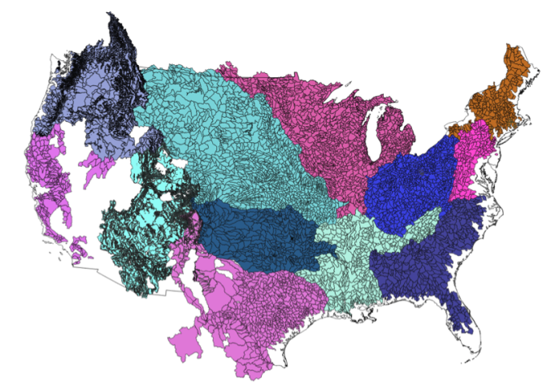

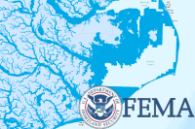
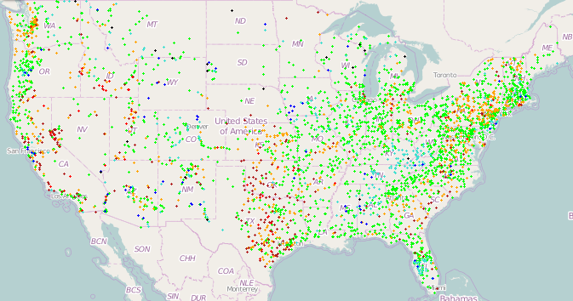
NFIE-Geo for National Flood Interoperability Experiment
Enhanced geospatial database for a national water data infrastructure
NWS Basins and
Forecast Points
USGS Water Watch
Points
National Flood
Hazard Layer
Feature classes:
Subwatershed
Catchment
Flowline
Waterbody
Dam
NFIE-Geo
9 feature classes
5 from NHDPlus
4 from IWRSS
NHDPlus

Slide 26
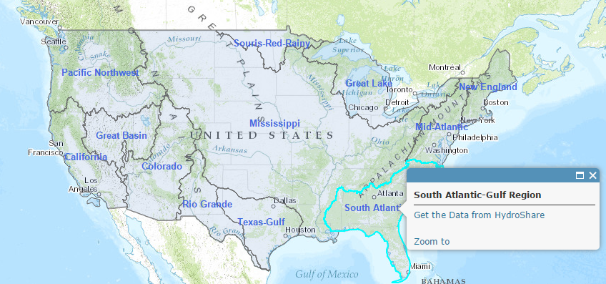
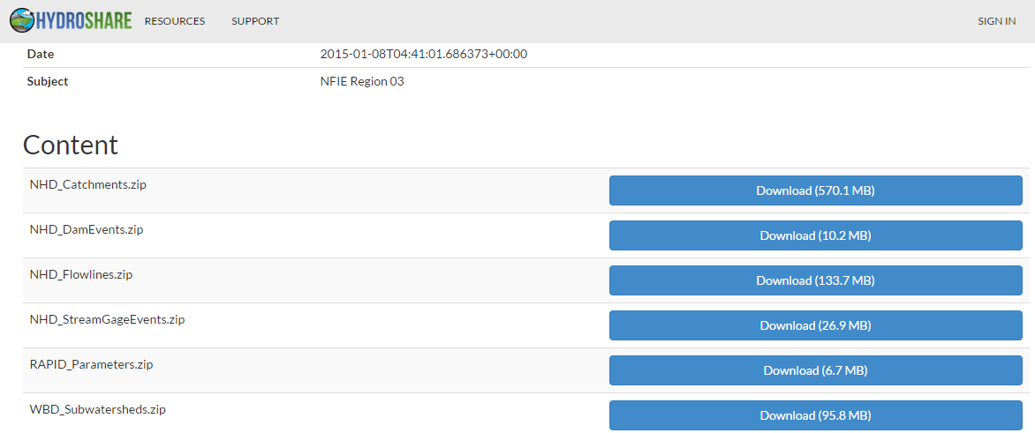
NFIE-Geo in HydroShare
https://www.arcgis.com/home/webmap/viewer.html?webmap=2c30160429984a59873f26b9d118dbfe

Slide 27

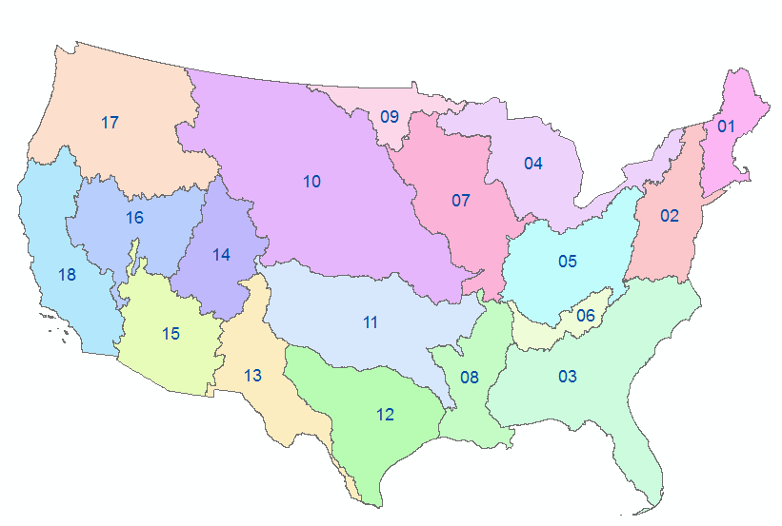


NFIE-Geo as Data Packages in Geoplatform
Enhanced geospatial database for a national water data infrastructure
A data package for each
USGS Water Resource Region
Can this be published in the Geoplatform?
NHDPlus

Slide 28
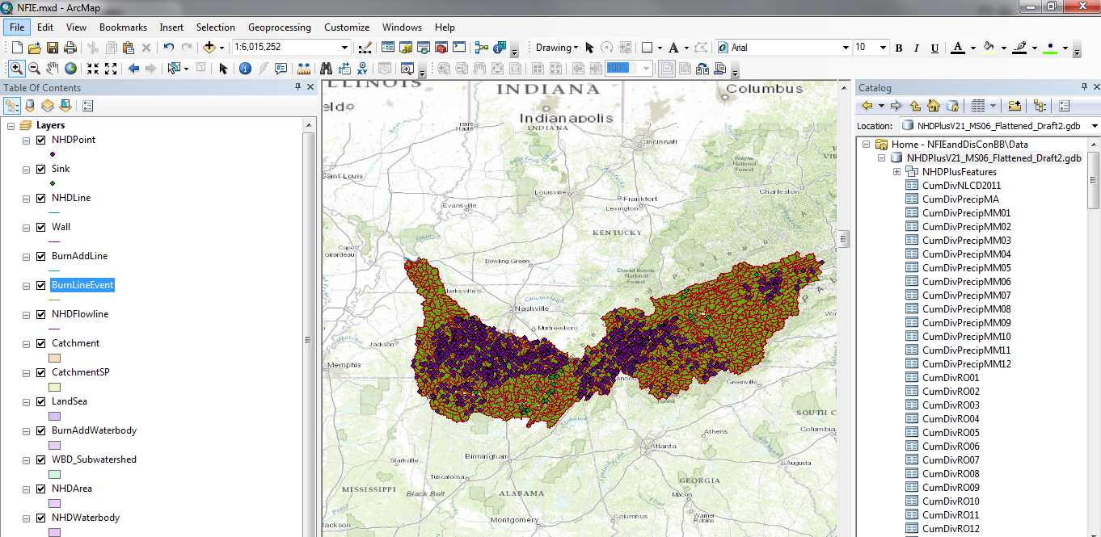
Layers and geographic coverage of the flattened NHD plus geodatabase

Slide 29
Rapid Model for flow on NHDPlus
March to May 2008, 3 hour time steps
David et al. (2011) DOI: 10.1175/2011JHM1345.1
GIS data describes 1.2 million river reaches . . .
. . . simulate flow in each reach in each time step

Slide 30

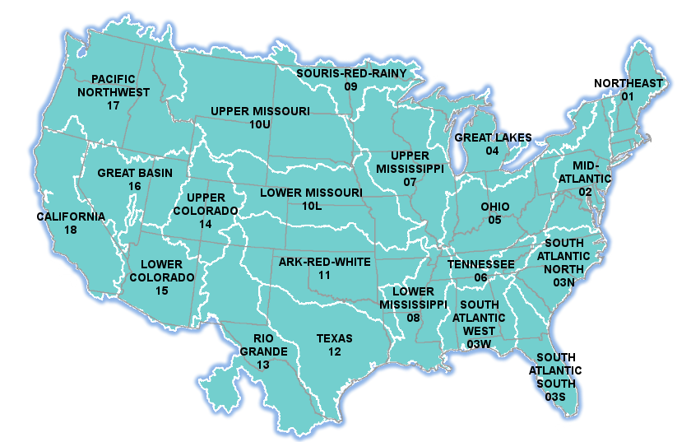

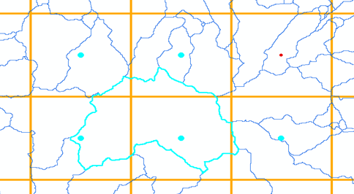
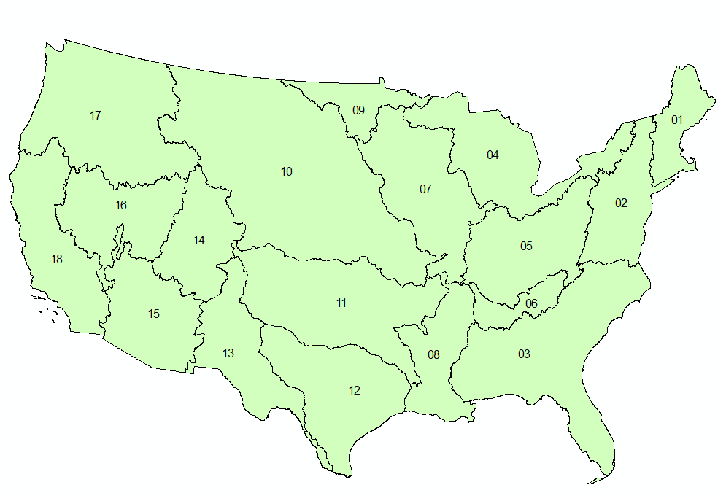
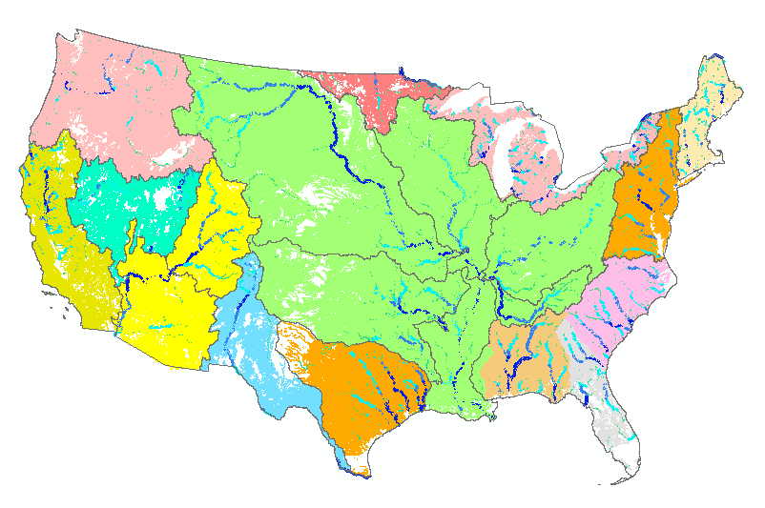
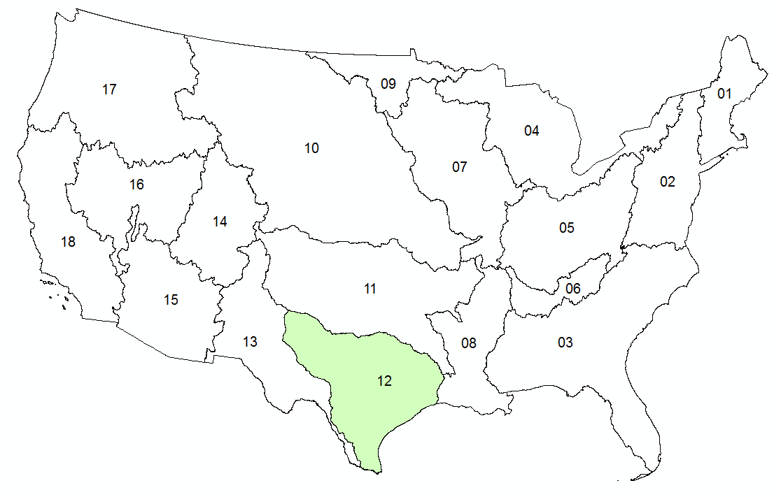

NFIE Hydro: Computing Flows
Pending
Completed
NWS River Forecasts
WRF-Hydro Model
NHDPlus to
RAPID Conversion
Grid to Catchment Linking
Forecast services
NFIE-Hydro

Slide 31

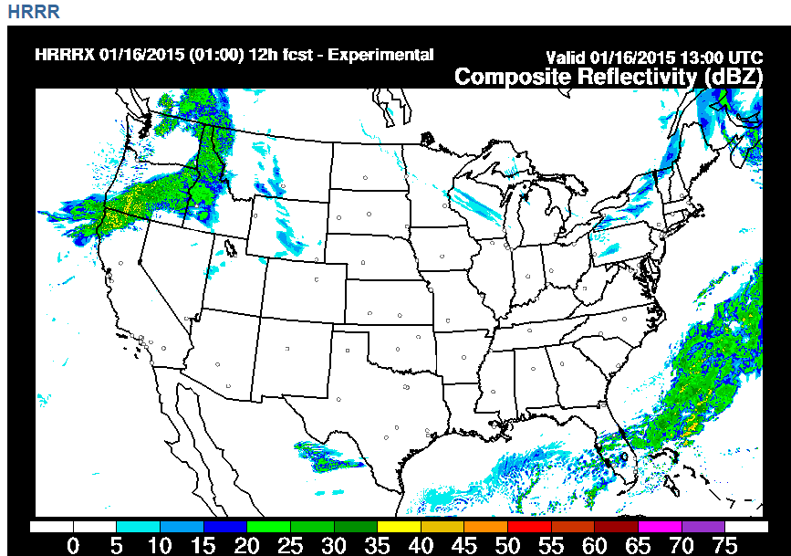
Rainfall Forecast (15 hours ahead)
Forecast the flood before the rain begins

Slide 32
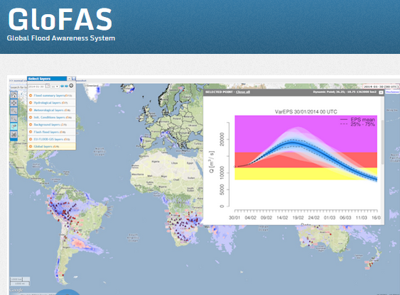
European Center for Medium Range Weather Forecasting and European Joint Research Commission
15 Day ahead forecast ensemble (50 hydrographs) at each location

Slide 33
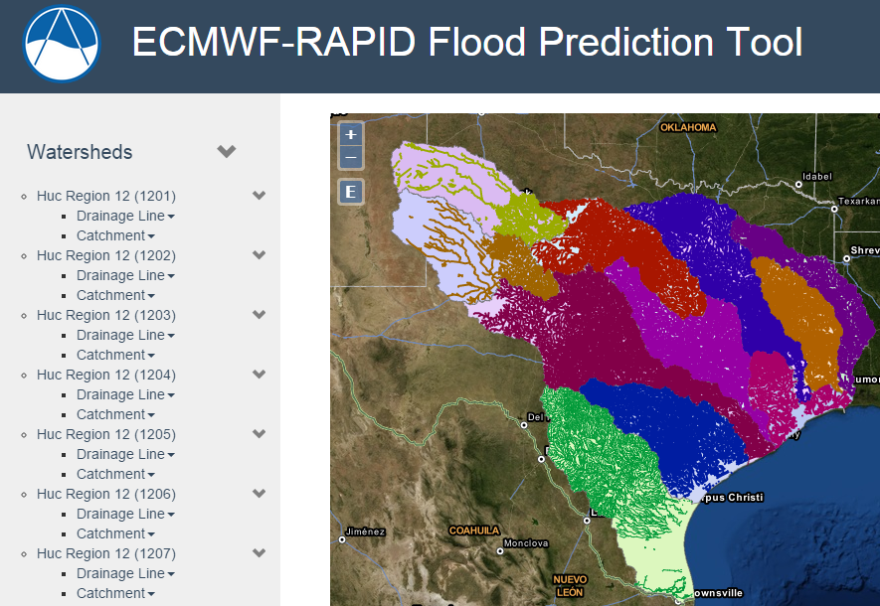
Hydrologic Forecasting for the Texas-Gulf Region
(from Brigham Young University)
(67,313 NHDPlus reaches)
Source: Jim Nelson, BYU
http://demo.tethys.ci-water.org/

Slide 34

Ensemble Flow Forecast for Reach Catchment 5592208 made on Jan 13, 2015 (15 day horizon)
Weather information source: European Center for Medium Range Weather Forecasting (ECMWF). Summary statistics compiled from 50 forecast hydrographs
Source: Jim Nelson, BYU

Slide 35



Land Data Assimilation System (LDAS)
Forcing:
Radiation
Precipitation
Surface climate
Evaporation
Soil Moisture
Runoff
Recharge
Observations Datasets, Numerical Weather Model
Soil
Vegetation
Terrain
1979 to present
Domain | Space | Time
North America | 1/8 degree | 1 hour
Global | 1/4 degree | 3 hours
Land Surface Model
Deduction:
Given these forcing and land surface conditions
Then, using a land surface simulation model
Derive surface moisture and energy balance

Slide 36


NASA Data Rod
Soil Moisture
North American Land Data Assimilation System
Time

Slide 37

Soil Moisture Map (mm water in top 1 m of soil from NASA Land Data Assimilation System)
Map is created each day using NASA services
http://statsnldas.azurewebsites.net/

Slide 38

Soil Moisture Anomaly Map
(current value – mean for calendar day at each spatial point)
Map is created each day using NASA services
http://statsnldas.azurewebsites.net/

Slide 39

Soil Moisture Percentile Map
(current value expressed as a percentile based on historical data [1979 to present] on this calendar day at this spatial point
http://statsnldas.azurewebsites.net/

Slide 40


National Flood Hazard Layer (NFHL)
North Carolina
Wake County
At present, this is a static map for one design flood frequency
What if it were a dynamic map varying in space and time as a storm and flood occur?
http://msc.fema.gov/portal

Slide 41

NFHL for Wake County

Slide 42

Wake County:HUC12 Subwatersheds
46 Subwatersheds

Slide 43

Wake County: NHDPlus Flowlines

Slide 44

Wake County: NHDPlus Catchments
3423 Catchments

Slide 45


Crabtree Creek Subwatershed
87 NHDPlus Catchments

Slide 46



Crabtree Creek Subwatershed
Dam
87 Catchments

Slide 47

Catchment and Flood Risk Zone
There are 2.67 million NHDPlus Catchments in the continental US
Average area 3 km², average length 2 km
This is the elementary flood risk area for flood warning and planning in this catchment
Each catchment has one flow line.
They have the same COMID number which is unique across the nation
The flowline has an associated Flood Hazard Area

Slide 48

NWS River Forecast Basins

Slide 49

NWS River Forecast subbasins in NC
141 Subasins

Slide 50

NWS Forecast Basins and Points in Wake County
Crabtree Creek
Neuse River

Slide 51


Flood Forecast Frameworks
326 NFIE Forecast Catchments in this NWS Forecast Subbasin
NWS Forecast Subbasin CRBN7
NFIE Forecast Catchment 8783667

Slide 52
Forecasting and flood risk assessment
Forecast discharge on the flow line
Assess the flood risk on flood zone

Slide 53



Flood Risk Condition Status
When Flood Risk Condition is High: Action to Evacuate or Shelter in Place is taken
Normal
Medium
High

Slide 54


FEMA Flood Hazard Layer
Alabama
Montgomery County
http://msc.fema.gov/portal

Slide 55


Subwatersheds and Flowlines
HUC12 Subwatersheds (38)
NHDPlus Flowlines
Hydrology and Wide Area Flood Planning
Flood forecasting

Slide 56



NHDPlus Catchments and Flowlines
NHDPlus Catchments (3200)
NHDPlus Flowlines
Each Catchment has a single Flowline.
Both have the same COMID identifier (21686606)
that is unique in the nation

Slide 57


National Weather Service River Forecast Center Subbasins (140)
Catoma Creek Forecast Subbasin

Slide 58





Flood Hazard Response Unit
National Flood Hazard Layer in Catchment 21686606
Use Ensemble Flood Forecast to assign Flood Risk Condition
Condition 1: Normal
Condition 2: Warning
Condition 3: Action
Evacuation or Shelter in Place

Slide 59

Forecast Catchments in NWS RFC Subbasin CATA1
The present NWS Forecast System is focused on large streams and rivers
Forecast for NHD Catchment 21686606 is equivalent to NWS CATA1 Forecast point
Forecasts produced on NHDPlus provide local stream level information
1 RFC Subbasin =
9 NHDPlus Subwatersheds
790 NHDPlus Catchments
(90 Catchments/Subwatershed)
NWS is providing web service for CATA1:
Precipitation and Runoff on Subbasin
Streamflow at Forecast Point
These can be used for comparison and adjustment of detailed spatial forecasts

Slide 60

Travis-Williamson Flood Plan

Slide 61


Link with the First Response Community
Harry Evans, Chief of Staff Austin Fire Department
Responsible for flood emergency response in Austin
https://www.youtube.com/watch?v=ympaR6YUxiA&feature=youtube

Slide 62



Address Points -- used for directing emergency response vehicles
All legal residences have an address point
Established when the lot is legally platted and registered with the county

Slide 63

Address Points and the Flood Hazard Zone
Williamson County
495,000 Address points in the two counties
How many points are in the flood hazard zone?
Where are the high flood risk areas in these counties?
Travis County

Slide 64


Address Points and the Floodplain

Slide 65



Address Points in the Floodplain
Address Points in Floodplain of Onion Creek
Floodpoints

Slide 66


Address Points in Floodplain of a Subwatershed
Number of Address Points in the Floodplain
A total of 12,052 address points are in the floodplain out of 495,468 in the study region (2.5%)

Slide 67


Address Points and Roads in Floodplain of Onion Creek

Slide 68


Length of Roads in Floodplain of a Subwatershed
Length of Roads in Floodplain (Km)
A total of 711 km of roads are in the floodplain out of 14,732 km in the study region (4.8%)

Slide 69
Flood hydrology and response
Flood Inundation Maps
Flood hydrology and hydraulic data, models, forecasts
Flood emergency response planning and action
Forecast the flood elevation
Determine and plan for flood impact

Slide 70


Mitigation and Response Flood Levels
(FEMA)
(NWS)
Mitigation (ft above NAVD88)
Response (Stage Height, ft)
500 yr
490.34
200 yr
487.88
100 yr
484.82
50 yr
481.24
25 yr
477.09
10 yr
471.01
5 yr
466.62
Major Flood Stage: 24
Moderate Flood Stage: 20
2 yr
460.30
Flood Stage: 17
Action Stage: 15

Slide 71

Real-Time Flood Inundation Mapping (USGS/NWS)
http://water.weather.gov/ahps2/inundation/inundation_google.php?gage=atit2

Slide 72

Another Gage up here
Gage is here
Another Gage down here…
Slide: Ken Ashe, NCFMP

Slide 73
Problem
Traditional FIMAN Libraries are “spatially limited”
Most extend
  1 mile US
  1 mile DS
Traditional Mapping Methods
  Develop a model (if none exists)
  Model each scenario (trail and error / rating curves)
  Map the results from the model
  Store each scenario in a library (database with a series of stacked polygons)
Slide: Ken Ashe, NCFMP

Slide 74


Stream Gages Gives Real Time Discharge AND Stage and thus Recurrence Interval
USGS: ~ 200 Gages in NC
NC: ~30 gage
Slide: Ken Ashe, NCFMP

Slide 75
NCFMP HEC- RAS Models
  5 Recurrence Intervals: 10, 25, 50, 100, 500
  300,000 cross-sections
  Each cross-section has a rating curve
Slide: Ken Ashe, NCFMP

Slide 76

Our cross-sections give the ability to interpolate RI between gages expanding the real time information from ~200 locations to 10s of thousands to 100s of thousand of locations
Slide: Ken Ashe, NCFMP

Slide 77














NATIONAL FLOOD INUNDATION AND WARNING SYSTEM
CONCEPTUAL FRAMEWORK
SOURCE INTELLIGENCE
HAZARD IDENTIFICATION
IMPACT / RISK ASSESSMENT
1) REAL-TIME
MODELING
2) REAL-TIME
MAPPING
LAND
Coastal
ECOLOGICAL
RESPONSE MANAGEMENT
ALERTS
END VISION
EMS
NWS
TV
Radio
SMS
Google Public Alerts
EFFICIENT RESPONSE
PREDICTIVE
AGRICULTURE
CI/KR
Financial Consequences
Receptors
Population / Demographic Impacts
Mitigation
Riverine
Option 1
Current and Predictive Modeling of Discharge and Surge Elevations
STRUCTURES
CI/KR
NEXRAD
If x + y, then …
PUBLIC AWARENESS
SOCIETAL
DISSEMINATION
CI/KR
Financial Consequences
Receptors
Population / Demographic Impacts
Mitigation
Current
Future
Elevation
Depth
Velocity
Road Impacts
Building Impacts
Option 2
Economics
Rainfall
North Carolina
“NEXFIM-NC” Solution
OBSERVED
River Stage
FLOOD HAZARD MAPPING AND RISK DATABASES
Building Footprints
First Floor Elevation
Conflated Parcel Data / Risk Attributes
Depth / Damage Curves
Building Addresses
Population / Demographic Data
Probability Rasters
CI/KR Data
Coastal / Tidal
Slide: Ken Ashe, NCFMP

Slide 78
There is a pattern here
National level flood forecasting system being produced at National Water Center
State level support for floodplain mapping, data and models
Local level engagement for flood emergency response
  Propose NFIE-North Carolina and NFIE-Alabama as state level test cases for the NFIE

