Slide 1
Standards and Interoperability in Geospatial Water Information
David R. Maidment
Center for Research in Water Resources
University of Texas at Austin
Presented to Geospatial World Forum
Rotterdam, the Netherlands |16 May 2013
Acknowledgements: David Arctur, Fernando Salas

Slide 2
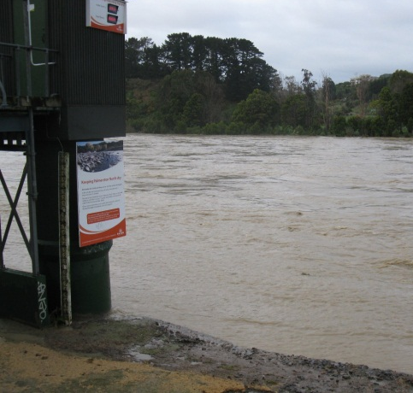
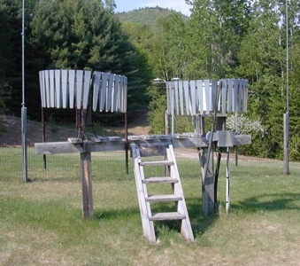
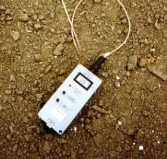
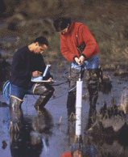
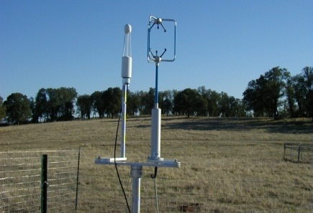
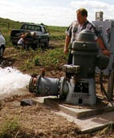
Water Observation – In Situ
Time series data at point locations
Water Quantity
Rainfall
Soil Water
Water Quality
Meteorology
Groundwater

Slide 3
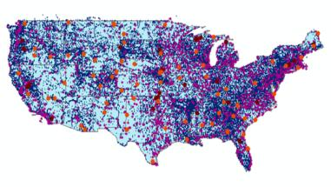
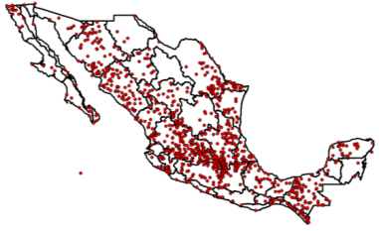
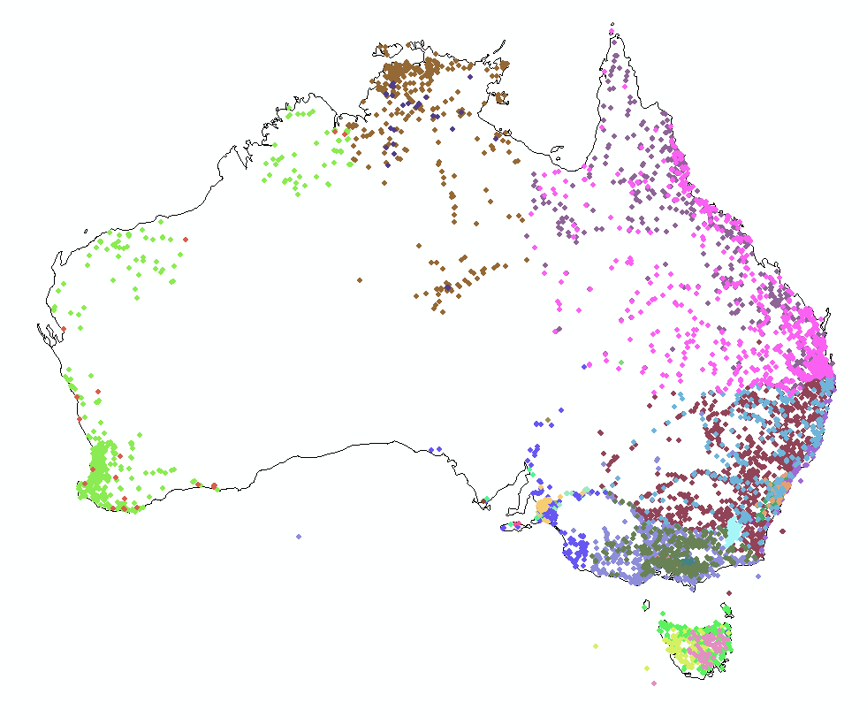
Every Country Collects These Data
We need
Global Water
Data Integration
United States
Mexico
Australia

Slide 4
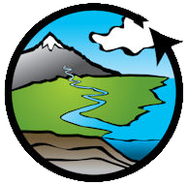
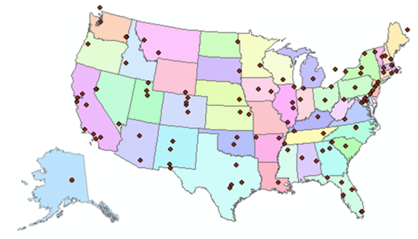
Consortium of Universities for the Advancement of Hydrologic Science, Inc.
www.cuahsi.org
CUAHSI
A consortium representing 125 US universities
Dr. Richard Hooper, President and CEO
Supported by the National Science Foundation Earth Science Division
Advances hydrologic science in nation’s universities
Includes a Hydrologic Information System project
Invented WaterML language for water resources time series
Building an academic prototype system

Slide 5
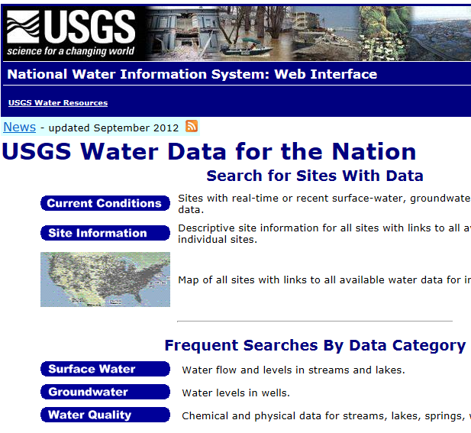
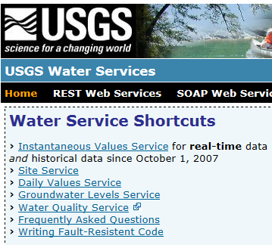
Web Pages and Web Services
Web pages deliver text and images
http://water.usgs.gov
Web services deliver data encoded in XML
http://waterservices.usgs.gov/

Slide 6
WMO Guide to Hydrological Practices
Guide to Hydrological Practices
Volume I
Hydrology – From Measurement to Hydrological Information
Science and Measurement
Chapter 10
Data Storage, Access, and Dissemination
Guide to Hydrological Practices
Volume II
Management of Water Resources and Application of Hydrological Practices
Application and
Management
Guide to Hydrological Practices . . .
. . . WMO recommendations for National Hydrological Surveys

Slide 7
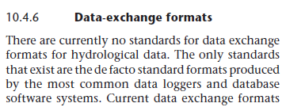
Volume 1, Chapter 10
Guide to Hydrological Practices
Volume I
Hydrology – From Measurement to Hydrological Information
Science and Measurement
Published in 2008
Last section of the last chapter of Volume I …
… this lecture provides an update since 2008

Slide 8
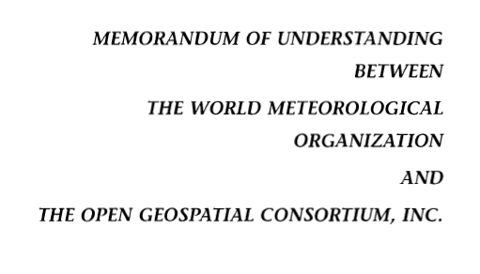
OGC/WMO Hydrology Domain Working Group
4-Year International Effort – WaterML2
A time series for one variable at one location
Hydrology Domain Working Group formed
OGC at WMO Commission on Hydrology
Technical Meetings Each 3 Months Four Interoperability Experiments
(Surface water, groundwater, forecasting)
Annual week-long workshops
Involvement by many countries
November 2009
Acknowledgements: OGC, WMO, GRDC, CUAHSI, BoM/CSIRO, USGS, GSC, Kisters, …….
2008
2009
2010
2011
2012
Notes:
(1) A four-year international effort has been undertaken to reconcile WaterML with international standards;
(2) This effort was initiated with the establishment of an Hydrology Domain Working Group by the Open Geospatial Consortium in September 2008;
(3) An OGC representative attended the WMO Congress of the Commission for Hydrology in 2008
(4) A formal agreement between Secretary General of WMO and President of OGC in 2009 to jointly develop standards for hydrology, climatology, oceanography and climatology;
(5) The joint OGC/WMO Hydrology Domain Working Group was supported by a large work effort, annual week-long workshops, four interoperability experiments for surface and groundwater data exchange, and participation by many countries;
(6) In June 2012, the OGC voted to adopt the revised version, WaterML2 as an international standard for exchange of water resources time series (the first such public standard that has existed);
(7) This Congress to the WMO Commission for Hydrology to whom I am speaking is considering WaterML2 for adoption as an official standard by WMO

Slide 9
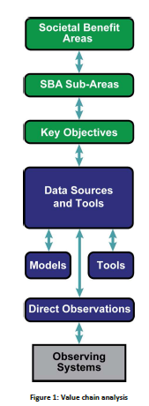
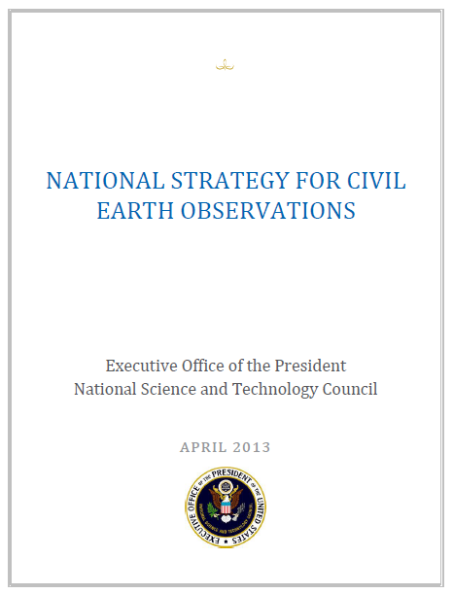
Committee on Environmental, Natural Resources, and Sustainability (CENRS)
“WaterML: Water Markup Language (ML) is an informatics initiative of the CENRS Subcommittee on Water Availability and Quality that provides a systematic way to access water information from point observation sites.” (p.21)
http://www.whitehouse.gov/sites/default/files/microsites/ostp/nstc_2013_earthobsstrategy.pdf

Slide 10
Geospatial and Temporal Water Data
GEOSS
WIS
Catalogues
Implementation
OGC
WMO
Standards
GIS
Water
Resources
Domains
Maps and Time Series . . .
. . . Interoperability of Connected Systems

Slide 11
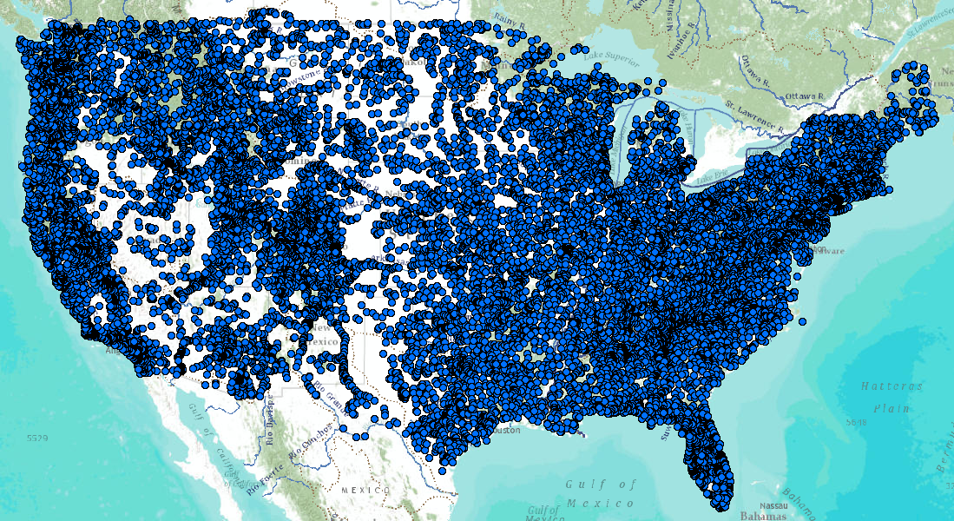
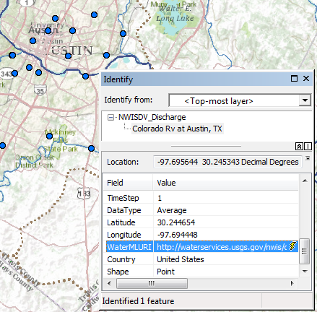
United States Services Stack
Catalog
Metadata
Data
Web Feature Service for Observation Metadata
Colorado River
at Austin, Texas
WaterML time series service for data
An attribute of each mapped observation point. . .
. . . is a web link to the WaterML data service

Slide 12
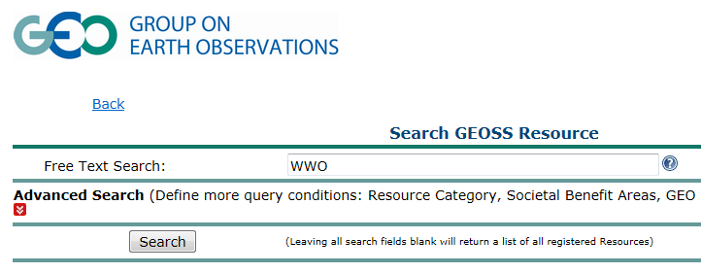
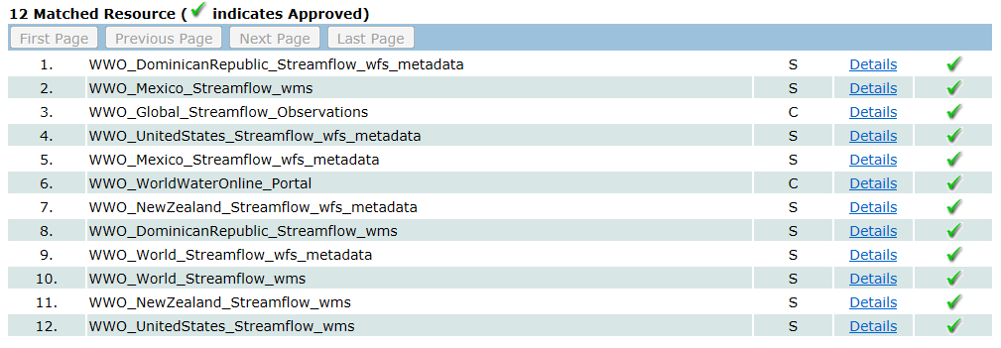
Searching GEOSS Portal
Search for water information
Find streamflow maps for countries
http://geossregistries.info/geosspub/resource_search_ns.jsp

Slide 13
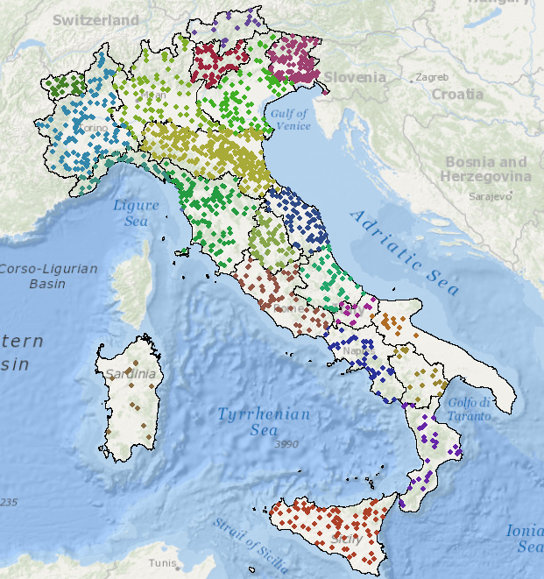
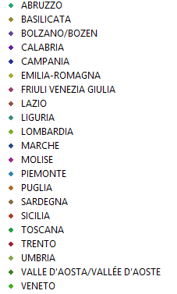
Italy – 22 regions
National Institute for Environmental Protection and Research (ISPRA)
ISPRA is the NIWA of Italy ….
….Hydrometric measurement was regionalized in 2002

Slide 14
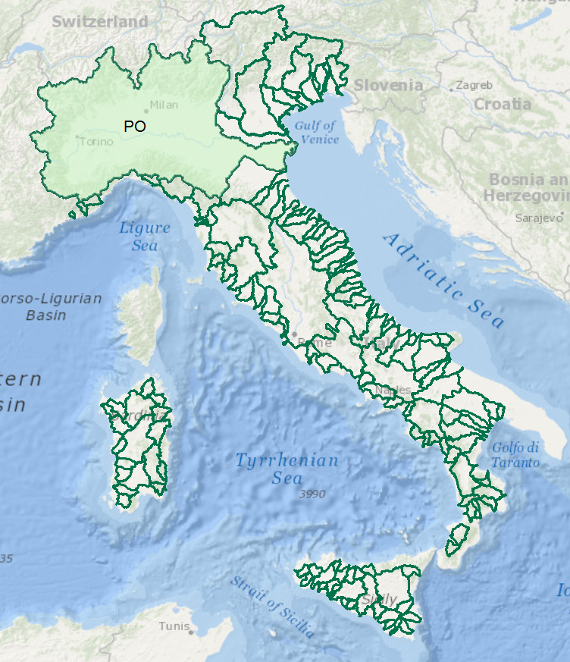
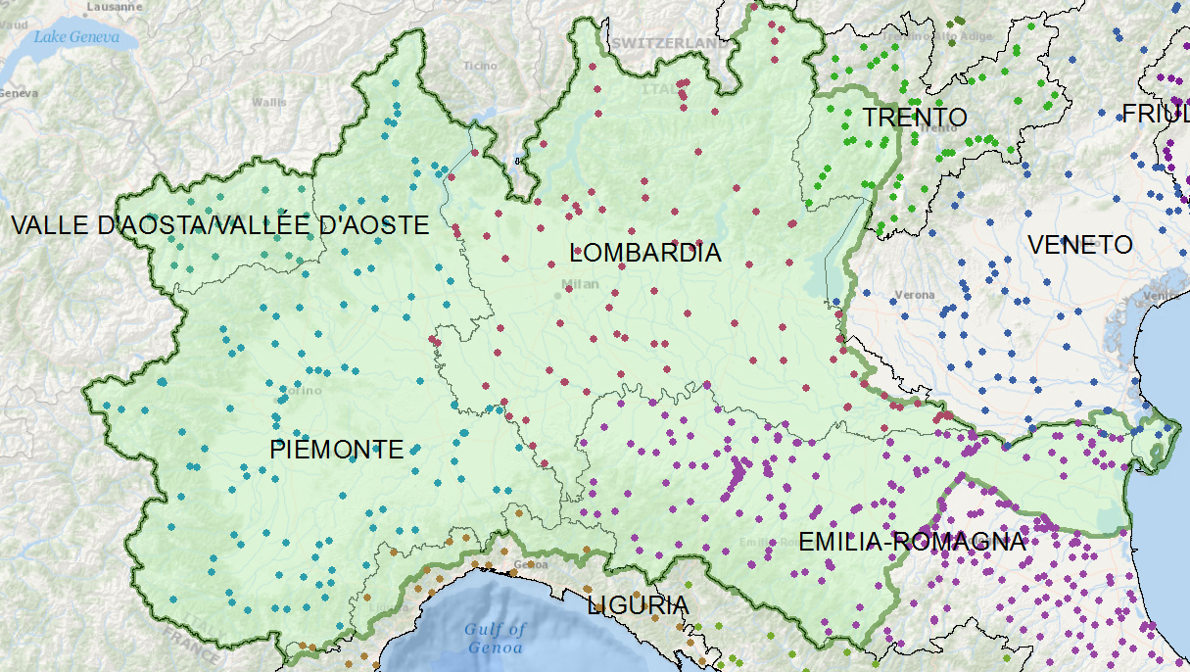
Italy – River Basins
Data for the Po River basin is managed by seven different regional authorities
One of these regions is Emilio-Romagna . . .
. . . they have fedeated the data for the Po Basin

Slide 15
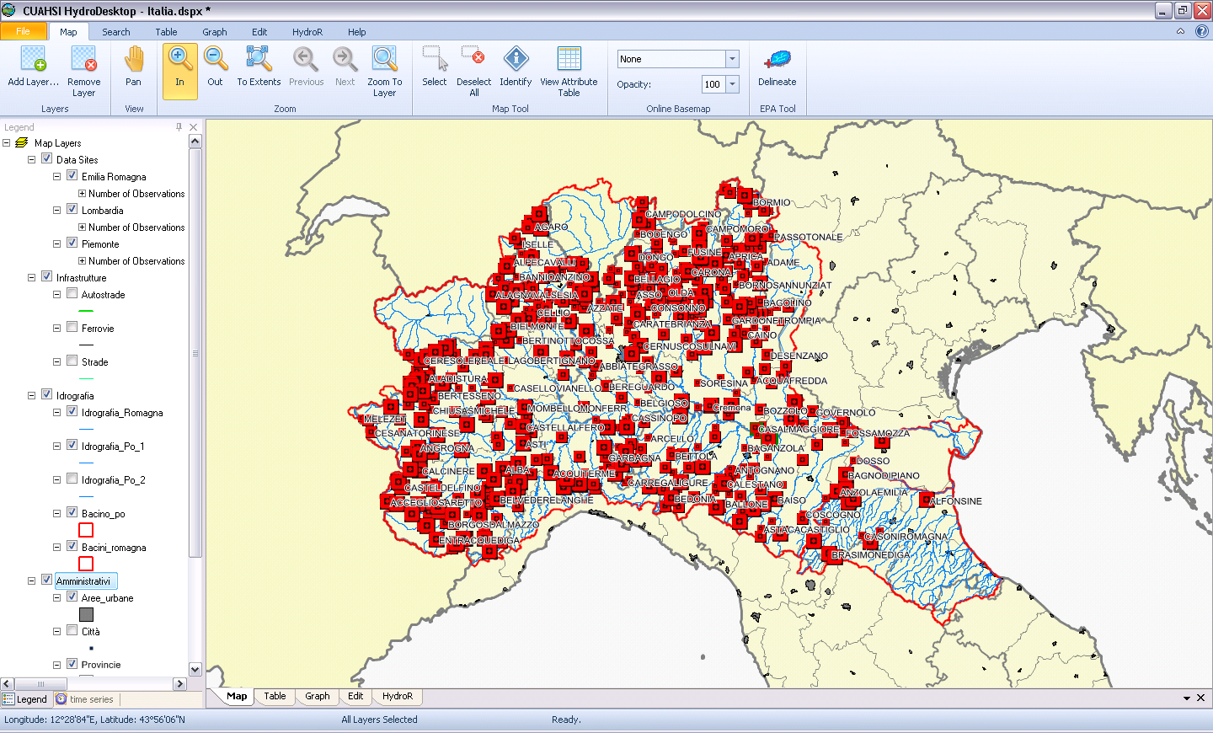
Prototype HIS for the Po Basin
Developed by Silvano Pecora (ARPA Emilio-Romagna)
Water data services published using CUAHSI Hydroserver ….
….. and ingested into CUAHSI Hydrodesktop

Slide 16
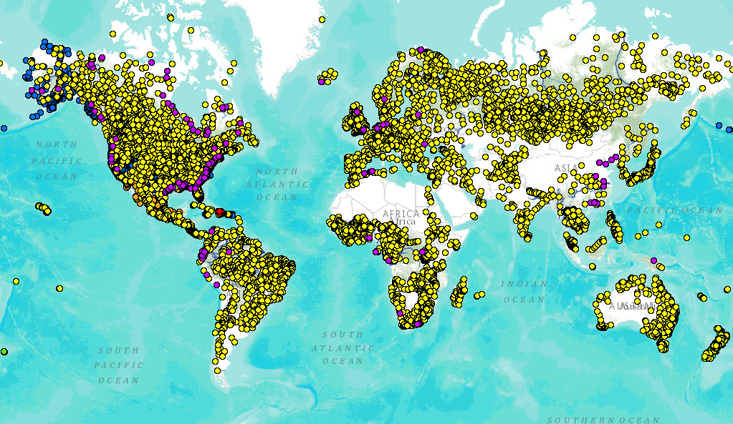
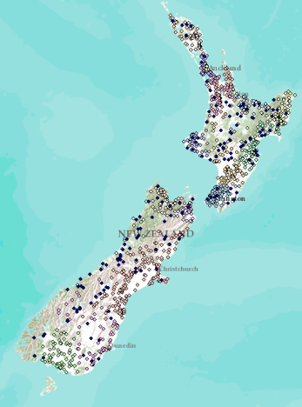
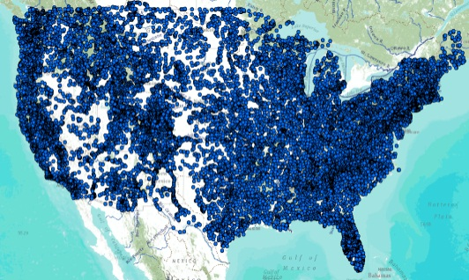
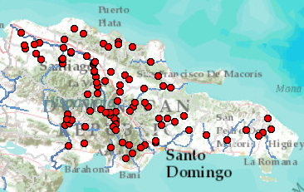
Global Streamflow Services
Building a national system federating regions. . .
. . . builds a global system federating countries
Global Runoff Data Centre
New Zealand
USA
Dominican Republic
http://www.arcgis.com/home/webmap/viewer.html?webmap=87ab07e2aba840828033e80b15fd6727

Slide 17
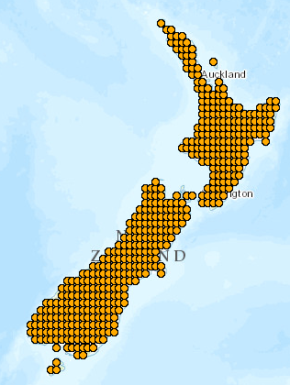
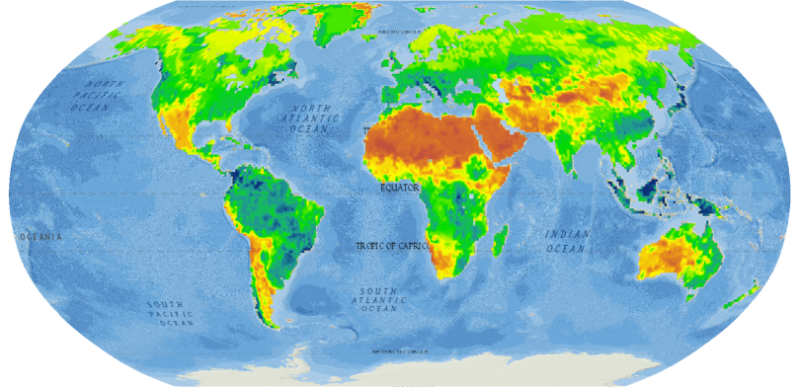
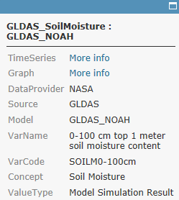
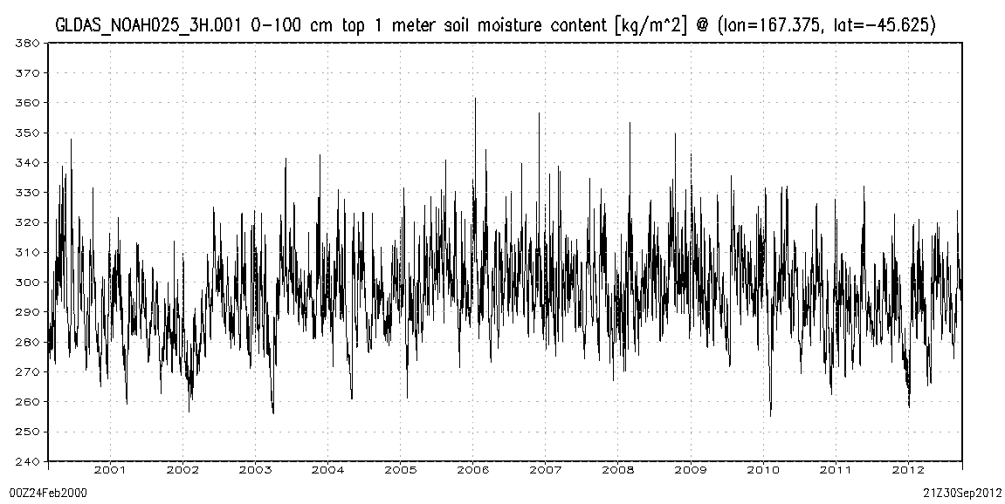
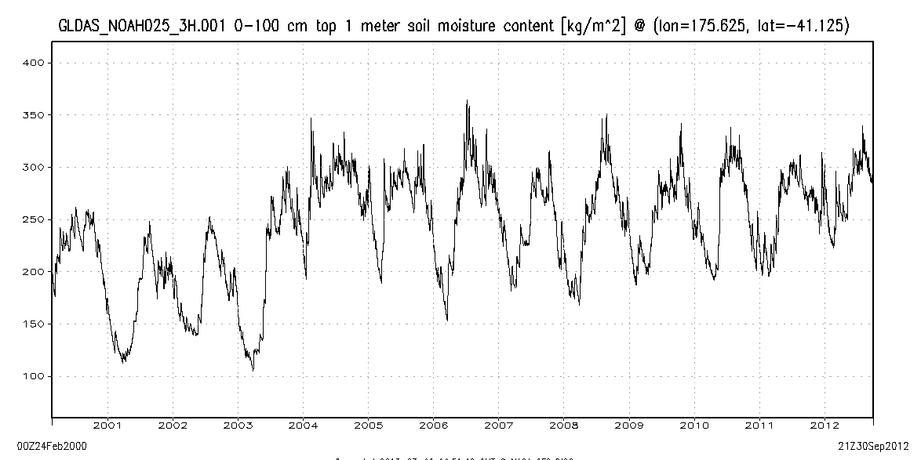
World Soil Moisture
from the NASA Global Land Data Assimilation System (GLDAS)
http://www.arcgis.com/home/webmap/viewer.html?webmap=7d6cefdf3f324b55b08c136654e91612
Charts show 3-hourly variation (37,000 values) of soil water content of the top 1m of soil from 2000 to 2012
Popup on point links to data and chart
New Zealand
A very wet region with little seasonality
A dryer region with significant seasonality

Slide 18
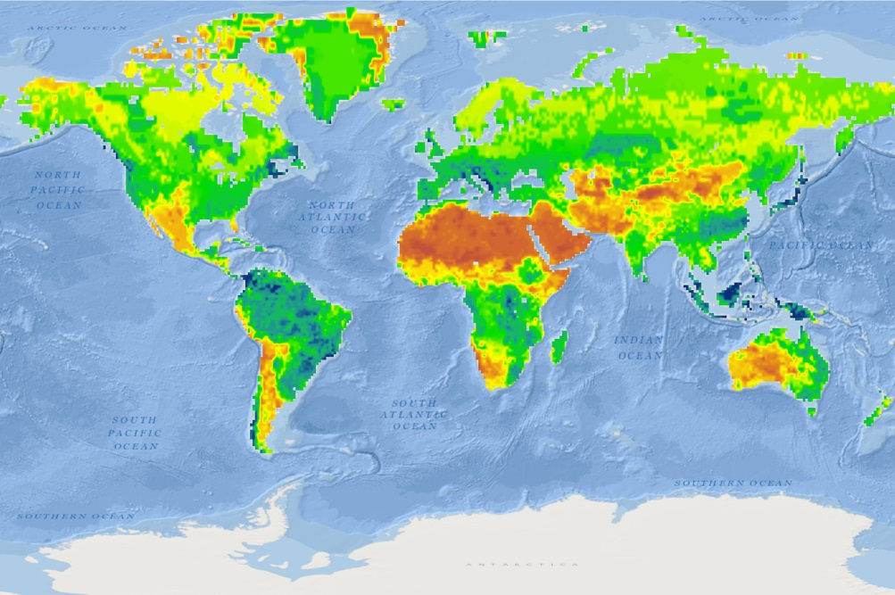
Global Water Maps
Model Web
Sensor Web
Describe a water property over a domain of space and time
History
Current conditions
Forecasts
Water Property
Precipitation
Evaporation
Soil Moisture
Streamflow
Groundwater
Reservoirs
Past
Present
Future

