Slide 1
A Services-Oriented Architecture for Water Data in the United States
Presented by David R. Maidment
Center for Research in Water Resources
University of Texas at Austin
To the FGDC Subcommittee on Spatial Water Data
October 28, 2010

Slide 2
A Services-Oriented Architecture for Water Data in the United States
Water web services in EPA and the USGS
Water web services in CUAHSI
How to move forward in the future

Slide 3
A Services-Oriented Architecture for Water Data in the United States
Water web services in EPA and the USGS
Water web services in CUAHSI
How to move forward in the future

Slide 4
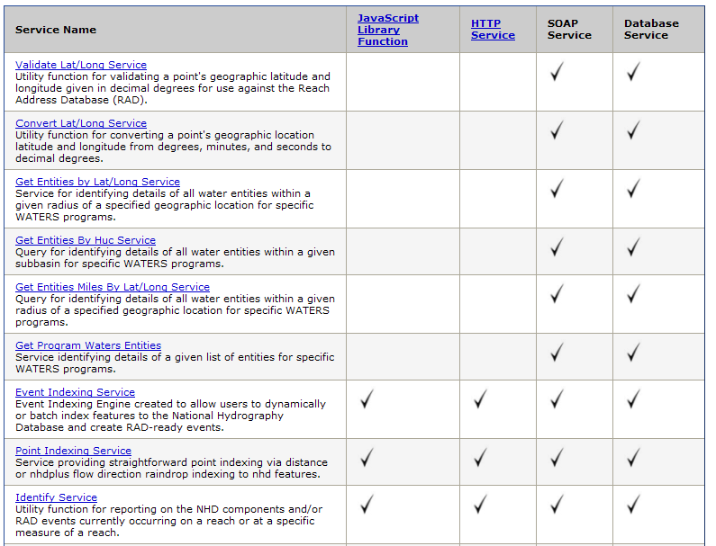
Geospatial Water Web Services from EPA

Slide 5
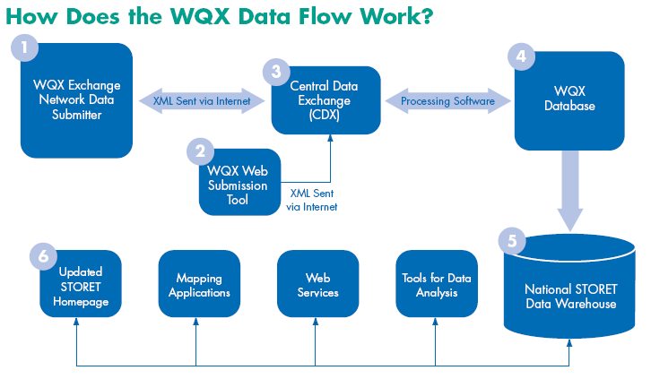
WQX and STORET
Observational Water Web Services from EPA
The Water Quality Exchange (WQX) is a new framework that makes it easier for States, Tribes, and others to submit and share water quality monitoring data over the Internet. States, Tribes and other organizations can now submit data directly to the publicly-accessible STORET Data Warehouse using the WQX framework.

Slide 6
Organizations have Activities that collect Monitoring data which produce Results

Slide 7
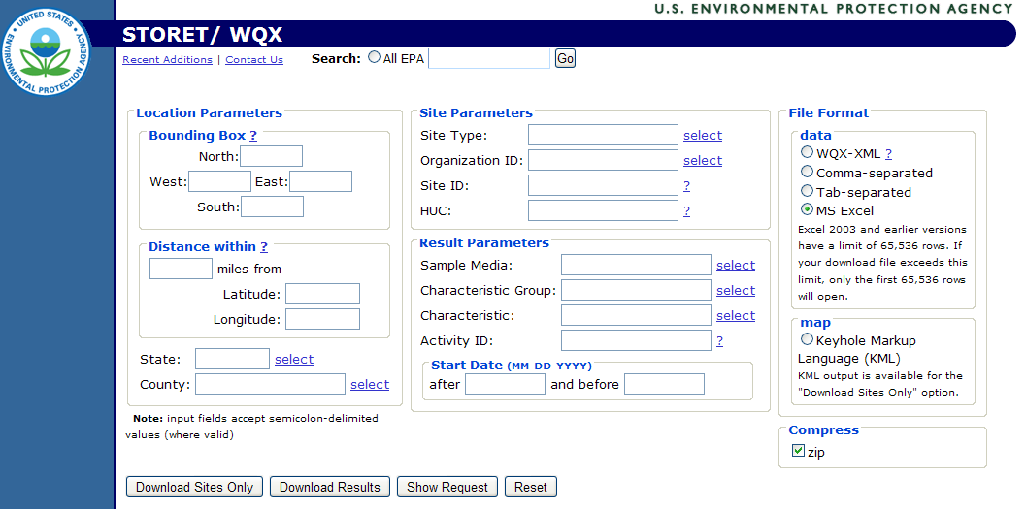
EPA Water Quality Web Services Portal
There is no “Download Series” function here
http://storetnwis.epa.gov/storetqw/portal.html

Slide 8
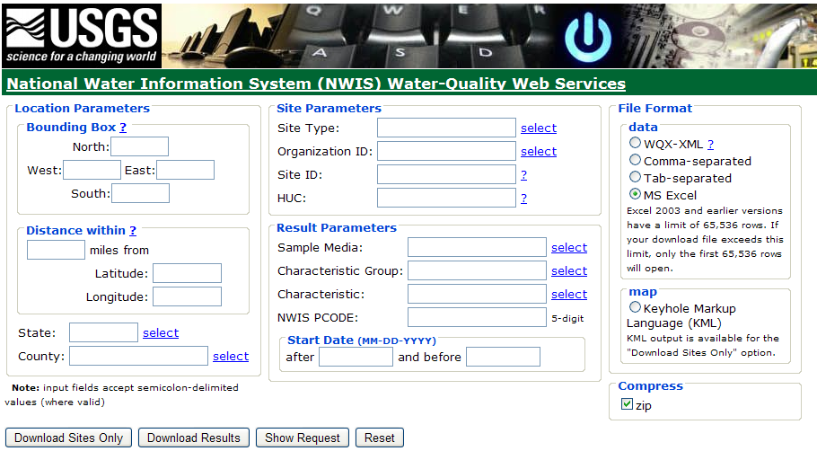
USGS Water Quality Web Services Portal
http://qwwebservices.usgs.gov/portal.html

Slide 9
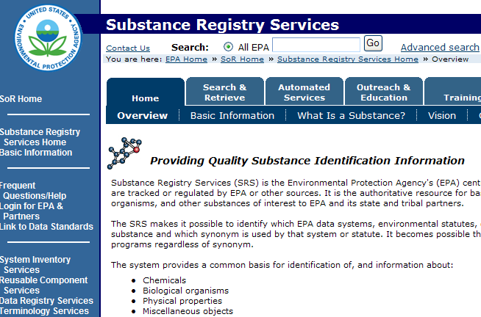
Semantic Mediation between two data systems

Slide 10
USGS Water Databases
USGS has four water observations databases:
NWIS Instantaneous Irregular Data (NWISIID).This is the one linked to EPA through WQX
NWIS Daily Values (NWISDV) – daily data from gaging sites through time
NWIS Unit Values (NWISUV) – instantaneous measurements at gages through time (e.g. 15 min)
NWIS Groundwater (NWISGW) – irregular measurements at groundwater wells

Slide 11
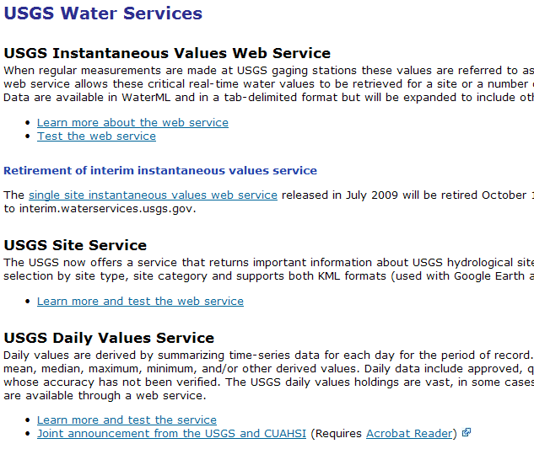
USGS WaterML Time Series Web Services
From NWIS Unit Values Database
From all four Databases
From NWIS Daily Values Database
One observation site can have data in several water web services

Slide 12
CUAHSI Network-Observations Model
NWIS Daily Values
Data Service
NWIS Sites
Network
GetSites
San Marcos River at Luling, Tx
GetSiteInfo
Sites
Discharge, stage
(Daily or instantaneous)
GetVariableInfo
Variables
GetValues
Observation
18,700 cfs, 3 July 2002
{Value, Time, Qualifier}
A data source operates an observation network
A network is a set of observation sites
A site is a point location where one or more variables are measured
A variable is a property describing the flow or quality of water
A value is an observation of a variable at a particular time
A qualifier is a symbol that provides additional information about the value

Slide 13
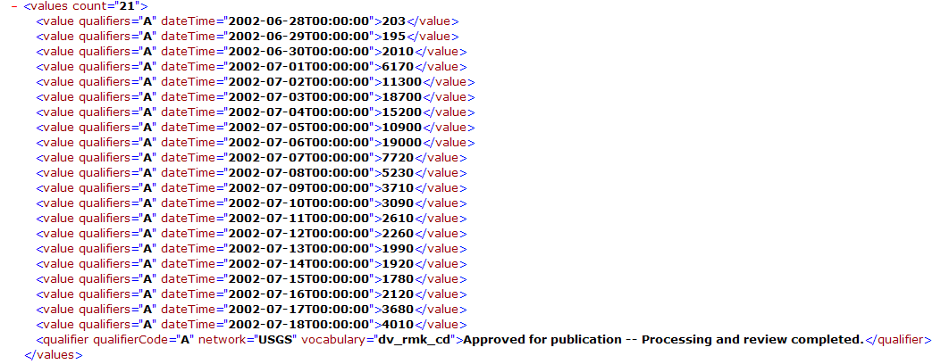
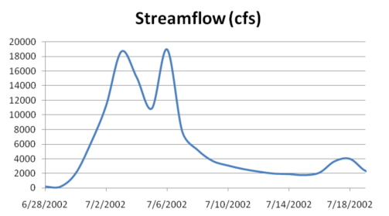
WaterML as a Web Language
Discharge of the San Marcos River at Luling, TX June 28 - July 18, 2002
USGS Streamflow data in WaterML language
This is the WaterML GetValues response from NWIS Daily Values

Slide 14
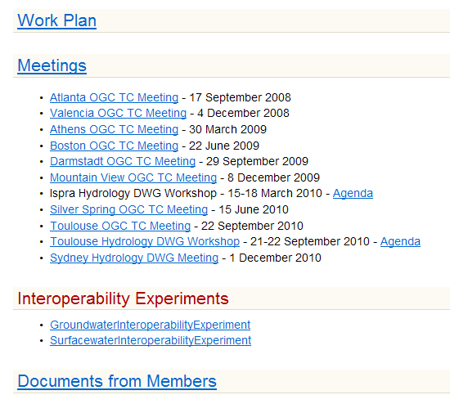
Jointly with World Meteorological Organization
Evolving WaterML into an International Standard
Meets every 3 months
Teleconferences most weeks
WaterML Version 2 standard to be proposed
Vote for adoption 3-6 months later

Slide 15
Summary of USGS-EPA Activities
A services-oriented architecture for water information has been created
Water quality data are treated as collections of results
Physical hydrology data are treated as time series
Geospatial site information is common to all services
Geospatial data services for NHD, NHDPlus, exist
Why bring this together – an example requirement is for TMDL ……

Slide 16
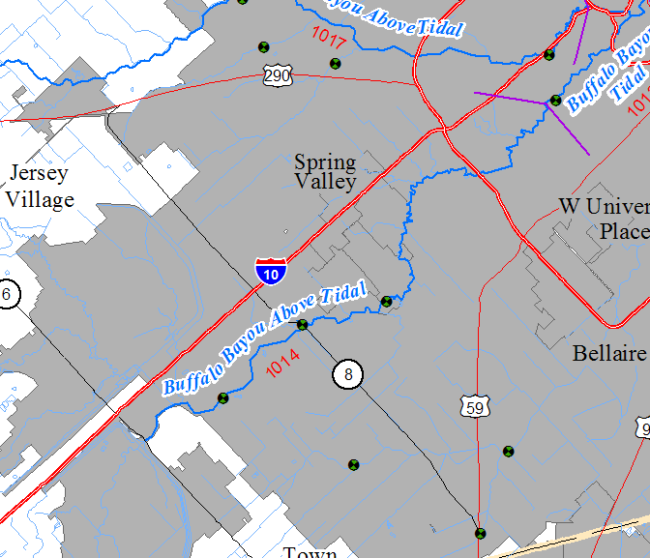
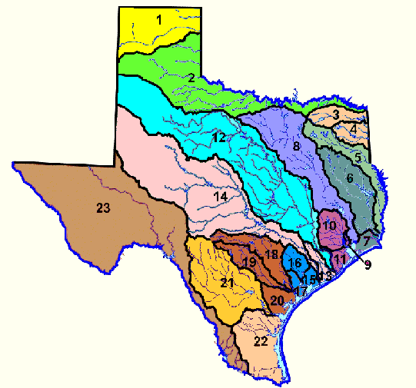
TMDL analysis of Buffalo Bayou
TCEQ Water Quality Management Segment 1014
Buffalo Bayou above Tidal
USGS Site 08073500
Buffalo Bayou nr Addicks, Tx

Slide 17
Acknowledgement
The load duration curve spreadsheet described in this presentation was developed by Stephanie L. Johnson as part of her PhD studies at the University of Texas at Austin. It is described in the following Journal AWRA paper:

Slide 18
Load Duration Curve Spreadsheet
Developed by Stephanie Johnson
Supported by two WaterML web services
One which extracts bacteria data from the TCEQ water quality archive for segment 1014 (C)
Another which extracts streamflow data from NWIS for station 08073500 (Q)
http://www.caee.utexas.edu/prof/maidment/meetings/EPACincinnatiSept28/LDCurve.xlsm

Slide 19
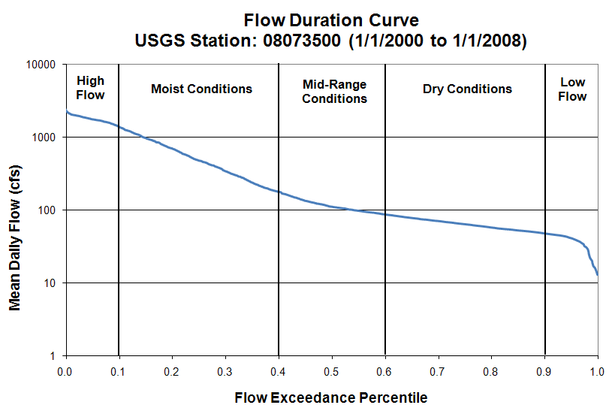
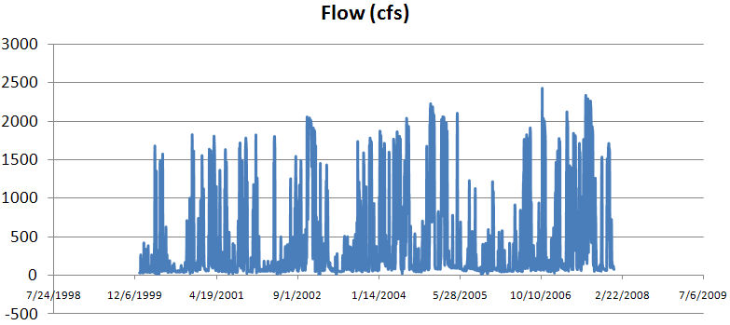
Time Series, Q

Slide 20
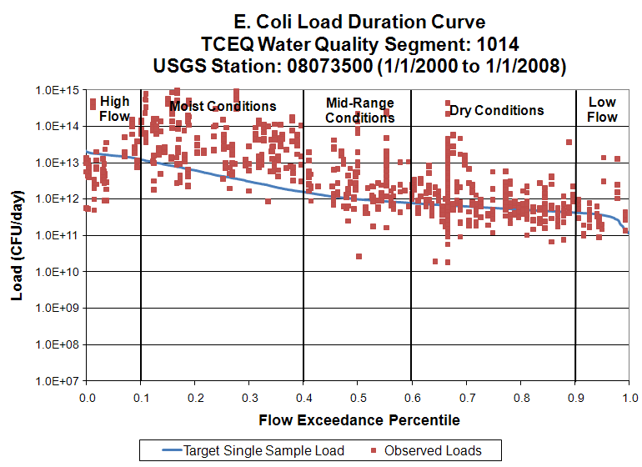
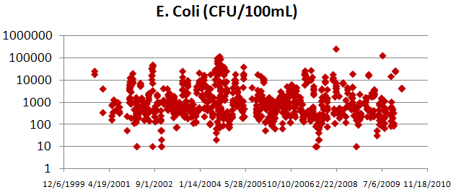
Load L = QC
Time Series, C

Slide 21
Bacterical TMDL Summary
A management segment is located geospatially
It is characterized by water quality observations, C (t)
A flow station or model for flow, Q (t)
A load computation, L(t) =Q(t)*C(t)
Time Series, C (t)
Time Series, Q (t)
We need time series data services for Q(t) and C(t) – a consistent data language between physical hydrology and water quality

Slide 22
A Services-Oriented Architecture for Water Data in the United States
Water web services in EPA and the USGS
Water web services in CUAHSI
How to move forward in the future

Slide 23
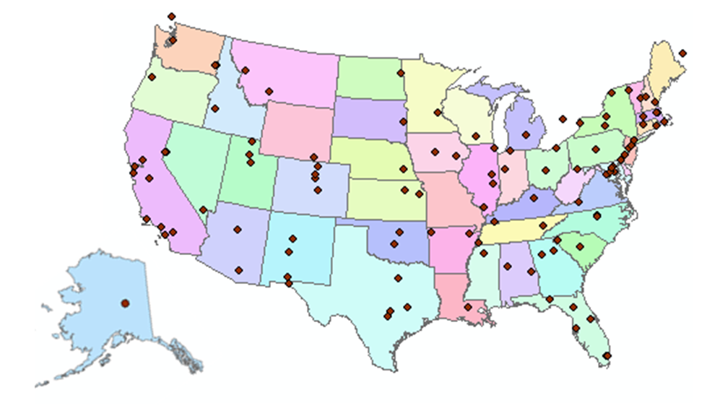
CUAHSI Has been Working on All These Challenges
Building a Hydrologic Information system
CUAHSI is a Consortium of more than 120 Universities . . .
. . .Supported by NSF

Slide 24
CUAHSI HIS Team and Collaborators
University of Texas at Austin – David Maidment, Tim Whiteaker, James Seppi, Fernando Salas, Harish Sangireddy, Jingqi Dong
San Diego Supercomputer Center – Ilya Zaslavsky, David Valentine, Tom Whitenack, Matt Rodriguez
Utah State University – David Tarboton, Jeff Horsburgh, Kim Schreuders, Justin Berger
University of South Carolina – Jon Goodall, Anthony Castronova
Idaho State University – Dan Ames, Ted Dunsford, Jiri Kadlec
CUAHSI Program Office – Rick Hooper, Yoori Choi

Slide 25
What is a “services-oriented architecture”? Networks of computers connected through the web …….
Everything is a service
Data, models, visualization, ……
A service receives requests and provides responses using web standards (WSDL)
It uses customized web languages
HTML (HyperText Markup Language) for text and pictures
WaterML for water time series (CUAHSI)
GML for geospatial coverages (OGC)
….. supporting a wide range of users

Slide 26
How does the internet work?
This is how it got started …..
Web servers
Text, Pictures
in HTML
Mosaic browser
…..this is how it works now
Google, Yahoo, Bing
Catalog
Three key components linked by services and a common language
Metadata harvesting
Search Services
HTML
Web servers
Text, Pictures
Firefox, Internet Explorer
Server
User

Slide 27
What has CUAHSI Done?
Taken the internet services model …..
Catalog
Server
User
…..and implemented it for water observations data
HIS Central
Metadata harvesting
Search Services
WaterML
HydroServer, Agency Servers
Time series data
HydroExcel, HydroDesktop, ...

Slide 28
WaterML and WQX
WaterML
Designed for individual users to obtain one time series from one location for one variable from a data service
Supports data consumers
WQX
Designed for organizations to input water quality data sets into STORET and share data sets that they have collected
Supports data providers
CUAHSI has built a translator that converts WQX to WaterML

Slide 29
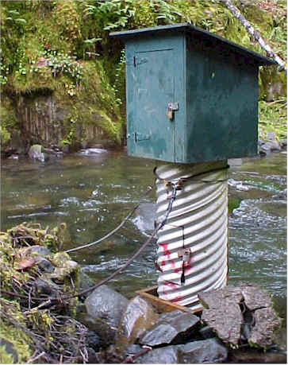
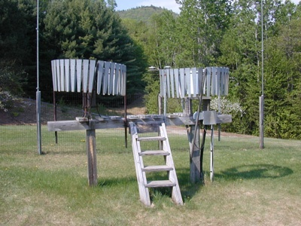
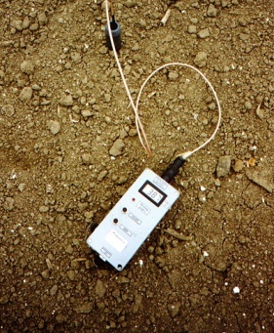
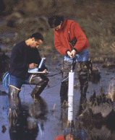
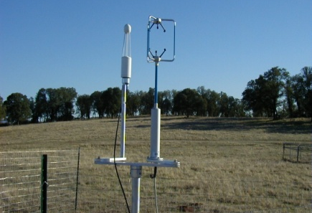
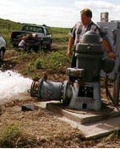
This System Integrates Many Types of Water Observations Data
Water quantity
Rainfall
Soil water
Water quality
Meteorology
Groundwater

Slide 30
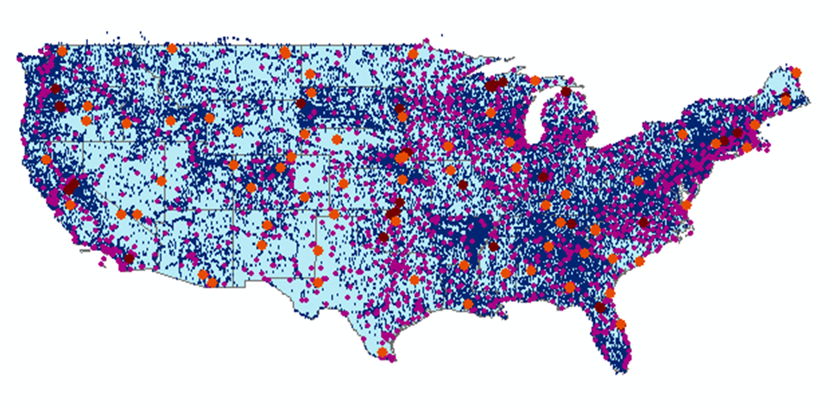
CUAHSI Water Data Services
Map Integrating NWIS, STORET, & Climatic Sites
55 public services
15,400+ variables
1.8+ million sites
23.3 million series
4.7 billion data values
And growing
The largest water data catalog in the world

Slide 31
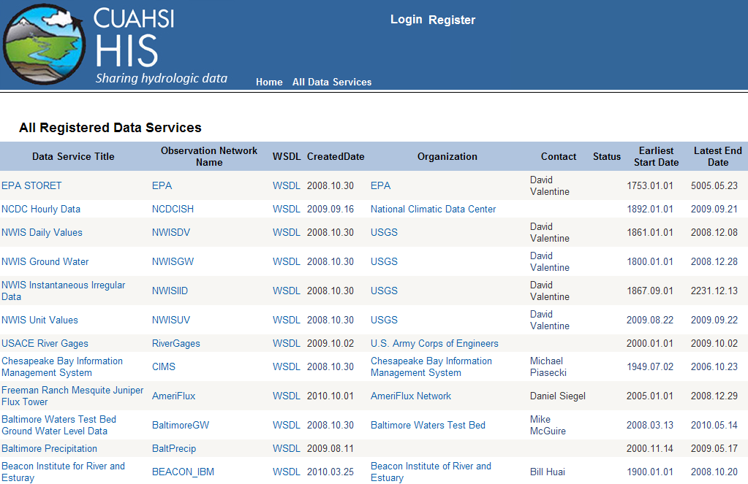
WaterML Services at HIS Central
USGS, EPA, NCDC data are published as WaterML time series

Slide 32
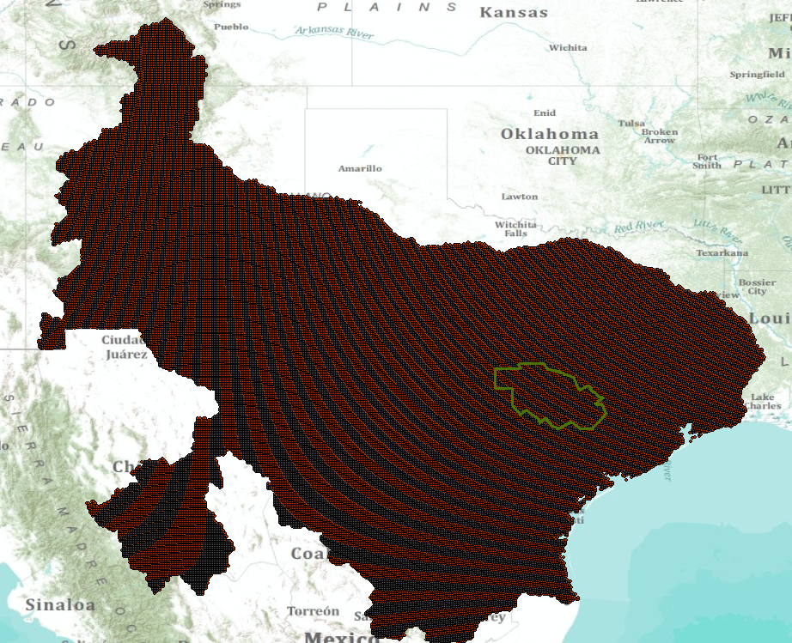
Multisensor Precipitation Estimate (MPE) West Gulf River Forecast Center
UT Arlington is publishing these data as CUAHSI WaterML web services.
NWS is providing continuous updates
An emerging development – NWS data in WaterML

Slide 33
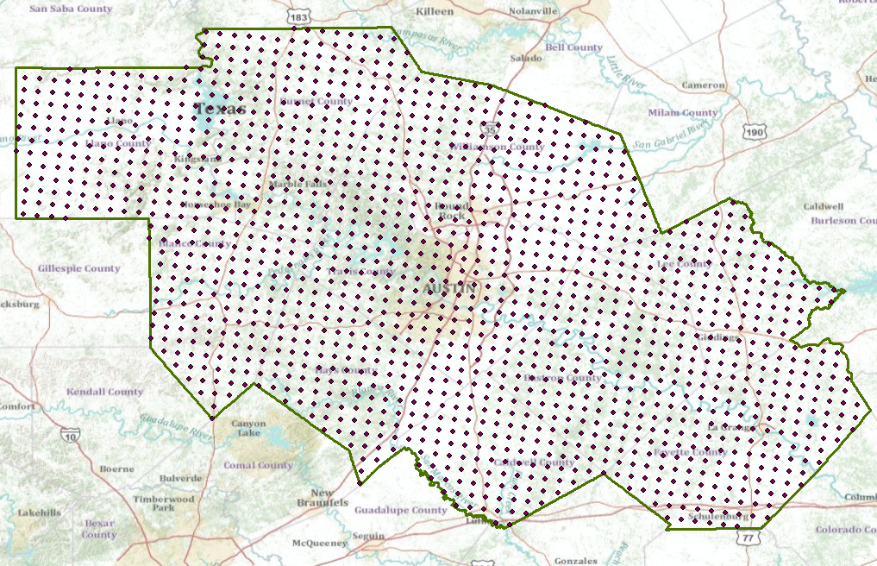
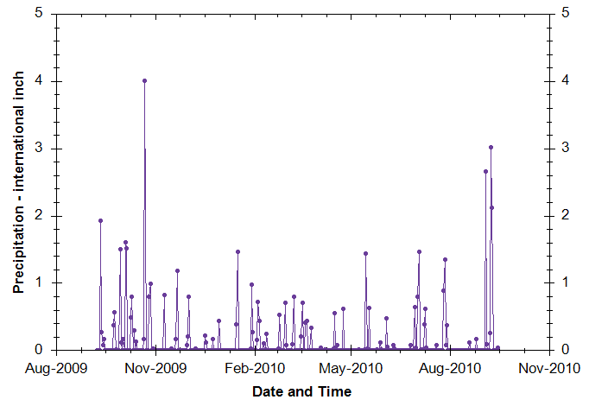
MPE Rainfall Time Series in WaterML

Slide 34
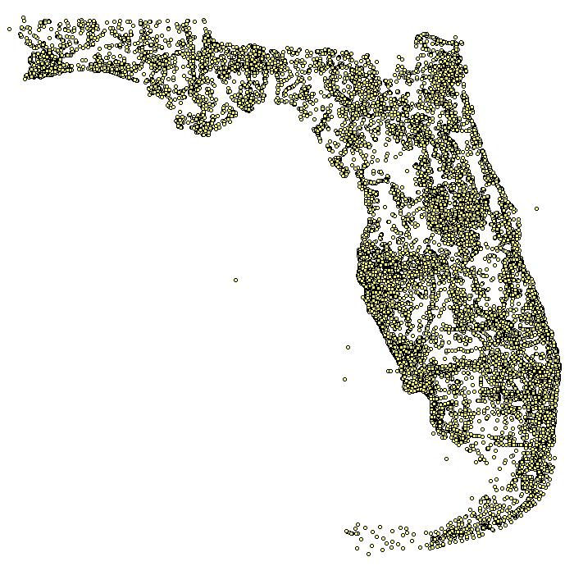
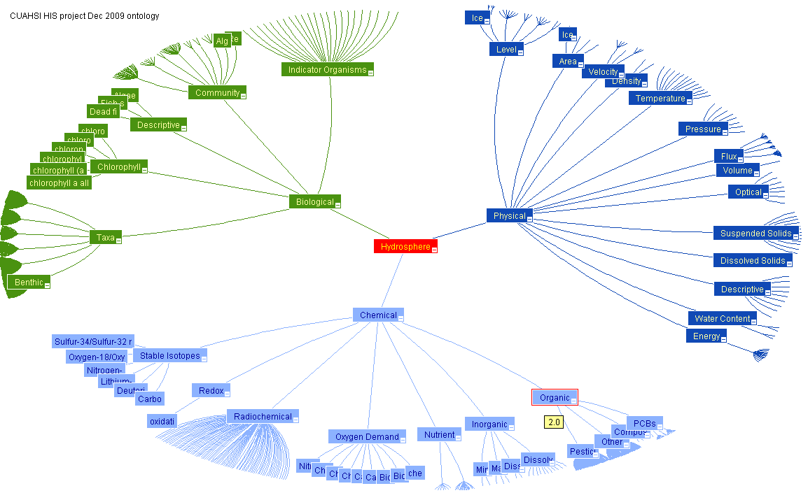
Semantic Integration using an Ontology of Concepts
Nutrients in Florida
Ontology of Concepts
Physical
Hydrosphere
Chemical
EPA SRS
Biological
http://his.cuahsi.org/ontologyfiles.html

Slide 35
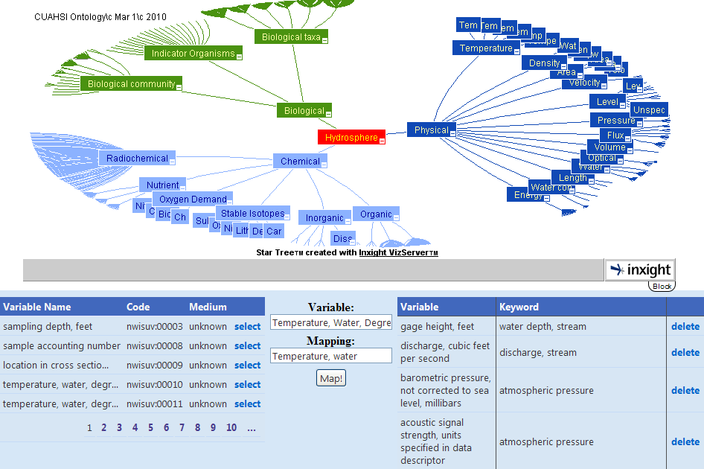
HydroTagger
Each Variable is connected to a corresponding Concept
http://water.sdsc.edu/hiscentral/startree.aspx
Notes:
These concepts are maintained in the HIS ontology. When people register their web service with HIS Central, they match the variables in their database to the concepts in the ontology. When users search for a keyword like “Nitrogen” in applications like HydroSeek, the software figures out what variables from the web service match that ontology concept and then constructs the appropriate queries for data.
From Tim Whiteaker

Slide 36
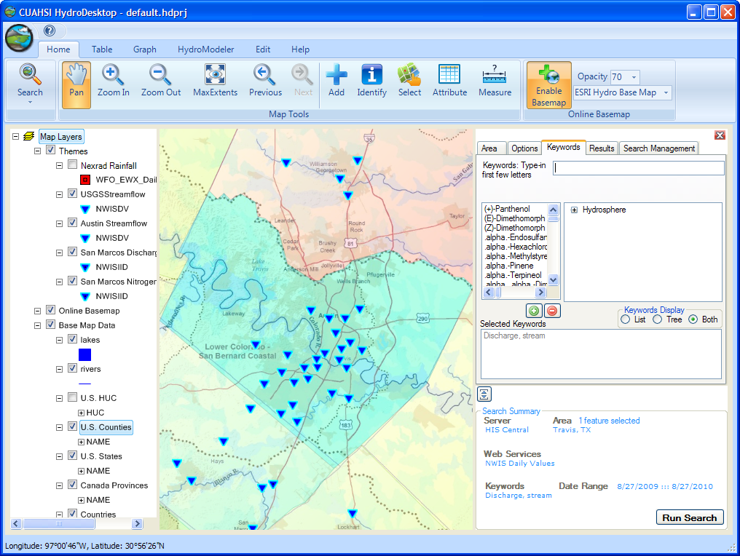
CUAHSI HydroDesktop http://www.hydrodesktop.org

Slide 37
Search Mechanism in HydroDesktop
Start
Select Region (where)
Select Time Period
(when)
Select Service(s)
(who)
Select Keyword(s)
(what)
Filter Results
Save Theme
End
“Who, What, When, Where” model…….

Slide 38
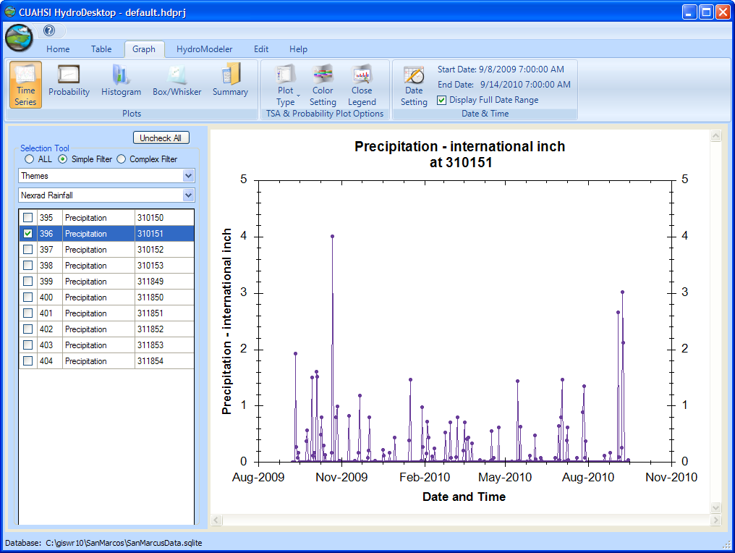
A Hydrologic Information System Searching and Graphing Time Series

Slide 39
What has CUAHSI Learned?
We have built a very large scale prototype services-oriented architecture for water observations data – WaterML rocks!!
Metadata is centralized at San Diego Supercomputer Center, data are distributed at water agencies and universities
Transferring metadata for USGS and EPA web services to San Diego Supercomputer Center is very laborious
This is also true for large state water data systems
Concept tagging needs to be done at the source
We need to work towards a distributed metadata and data system…..

Slide 40
A Services-Oriented Architecture for Water Data in the United States
Water web services in EPA and the USGS
Water web services in CUAHSI
How to move forward in the future
Acknowledgment: This part of the presentations is based in part on a paper “Integrating Water Resources Information using GIS and the Web” I wrote with Jack Dangermond, President of ESRI, for the AWRA GIS in Water Resources Conference in Orlando, FL, in March 2010
http://www.ce.utexas.edu/prof/maidment/esri/paper/final/AWRAKeynote.pdf

Slide 41
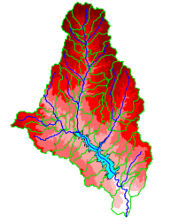
A Key Challenge
Integrating GIS and Water Resources Observations Data
Geography and GIS provide the Framework
Time Series Data
GIS
Water Environment
(Watersheds, streams, gages, sampling points)
The Water Itself
(Flow, water level concentraton)
. . . Relevant at all Scales

Slide 42
Web Services are Interesting . . .
Users Can Interact with a Network of Services
……as a Collective Whole
Web Pages
Web Services
. . .Collaborative and Integrative Interaction

Slide 43
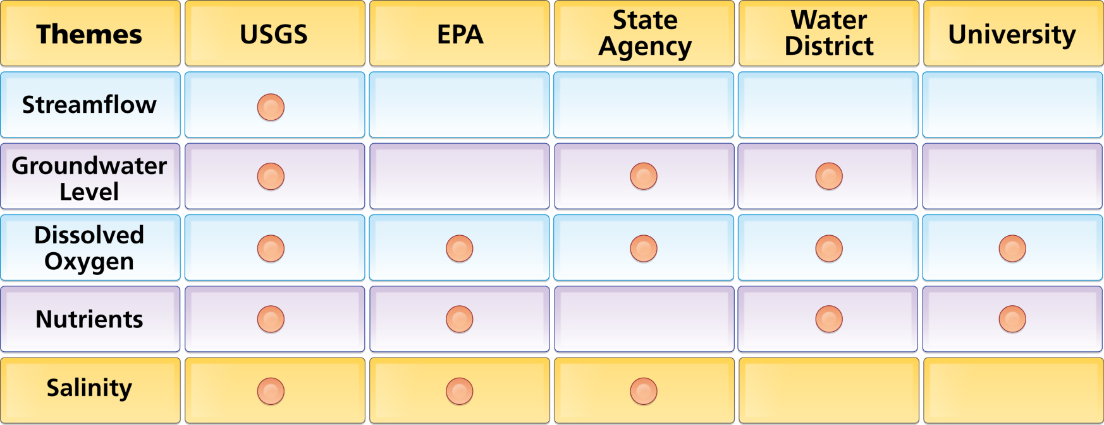
Organize Water Data Into “Themes”
Integrating Water Data Services From Multiple Agencies
WaterML
WaterML
WaterML
WaterML
WaterML
. . . Across Groups of Organizations

Slide 44
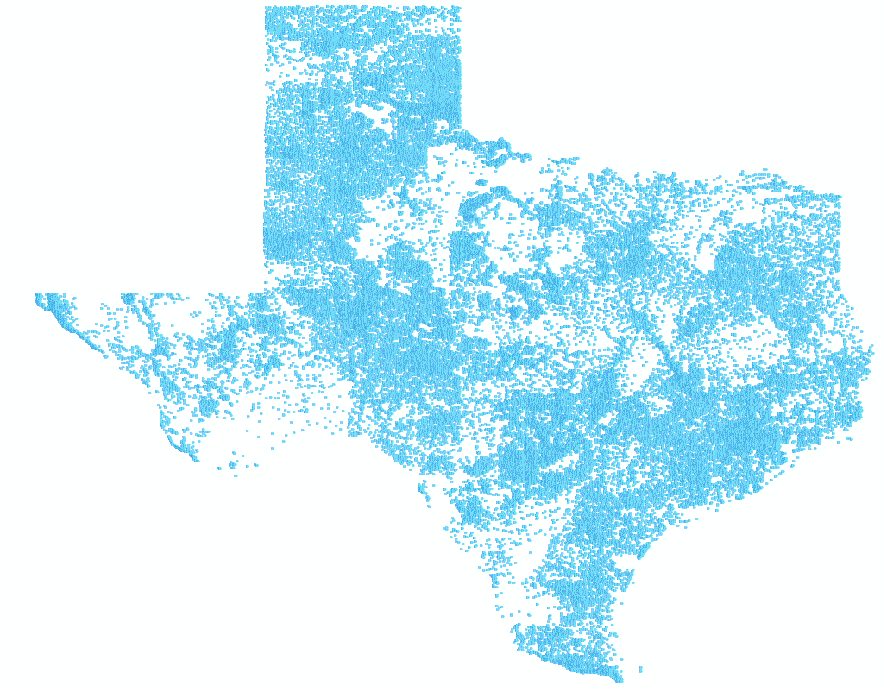
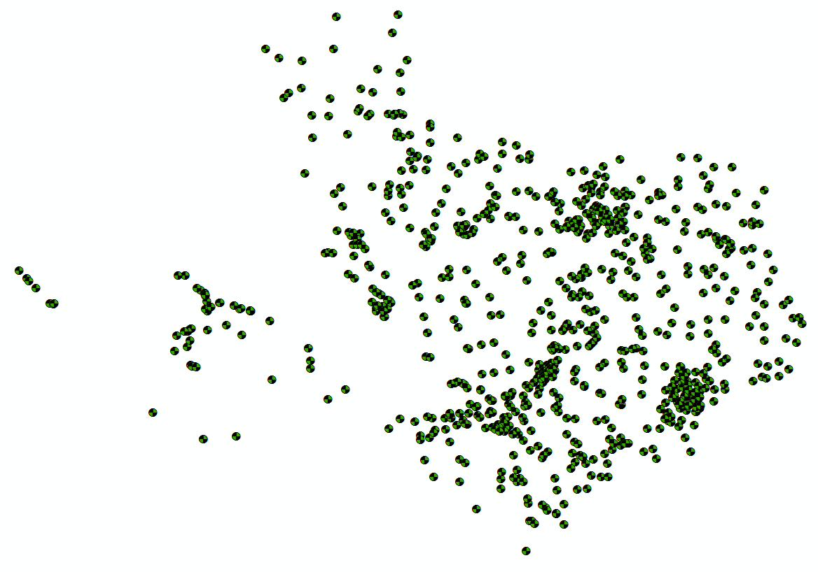
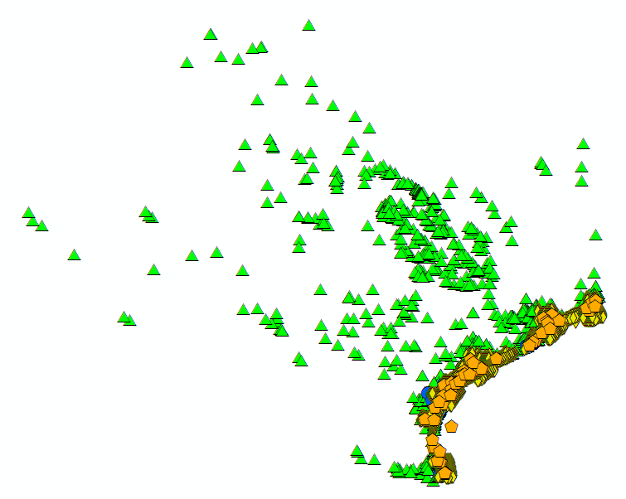
Bringing Water Into GIS Thematic Maps of Water Observations as GIS Layers
Groundwater
Streamflow
Bacteria

Slide 45
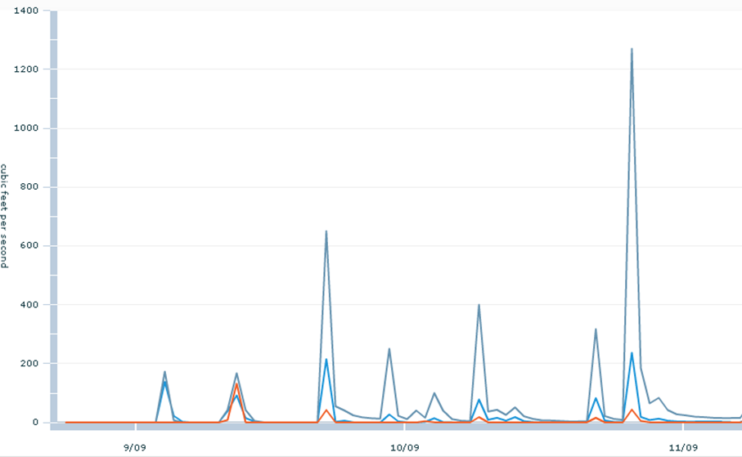
Time Series as Themes
A time series is like a feature
Theme – a collection of time series describing a subject and region
Streamflow data provided as WaterML data services by USGS

Slide 46
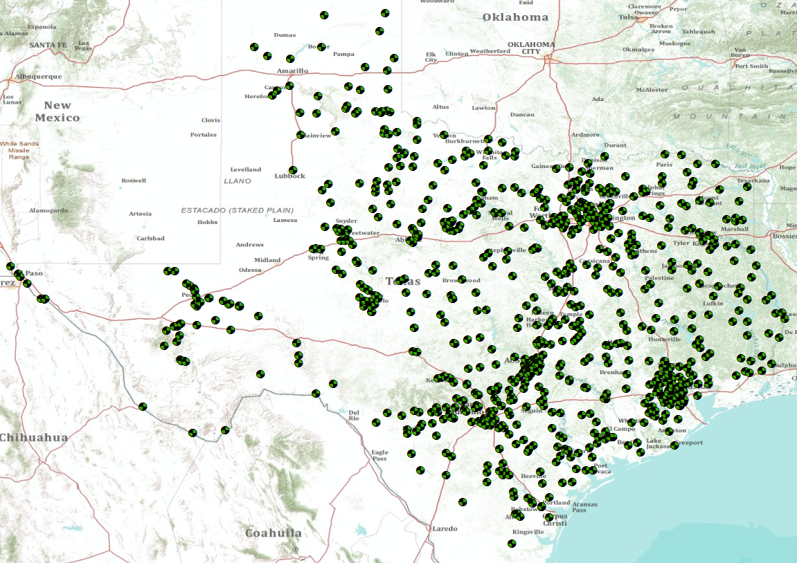
Plotting Data on Cached Base Maps

Slide 47
Each Observations Map has a Data Cart An attribute table for time series metadata

Slide 48
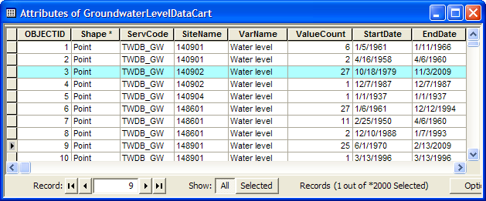
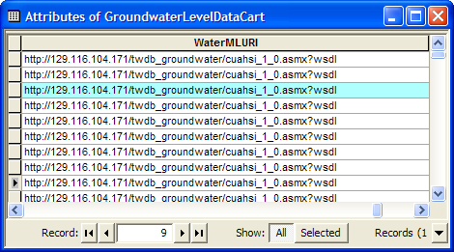
Data Cart: A Record for Each Time Series One variable measured by one organization at one location over a period of time
A record describes each time series ….
…. and links to its WaterML web service
Data Cart Specification:
http://www.caee.utexas.edu/prof/maidment/CUAHSI/DataCart/Spec_2010-06-07.docx

Slide 49
WaterML Web Service Delivers Data
Same format for all water observations data sources

Slide 50
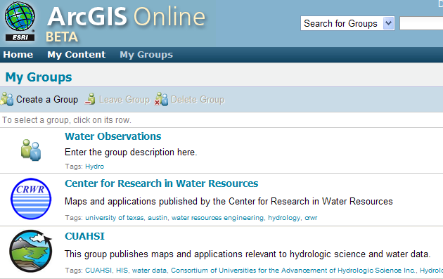
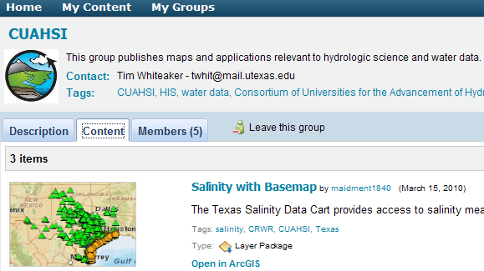
Data Carts are Published & Easily Discovered
Map and Data are encapsulated in a "Layer Package"
Information Shared within a Group . . .
. . . or Provided for Public Access

Slide 51
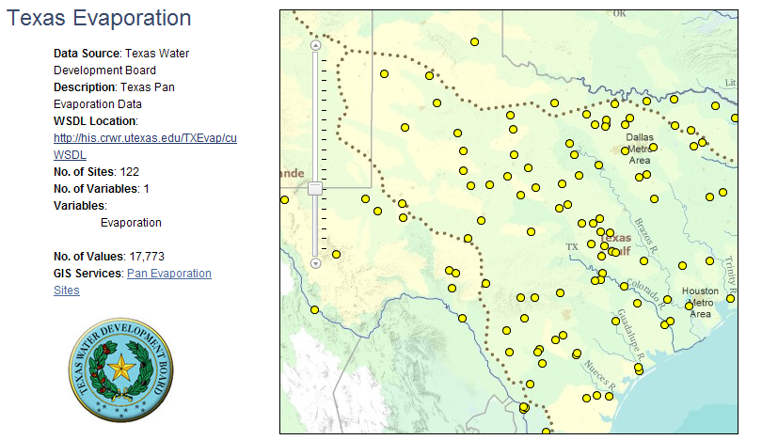
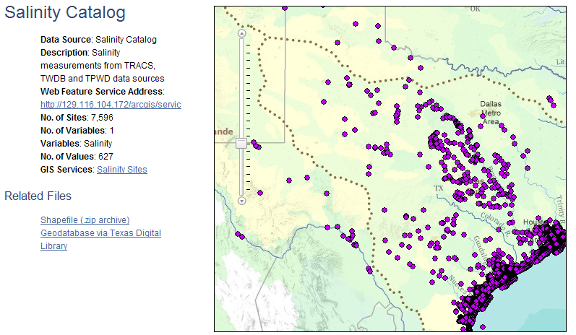
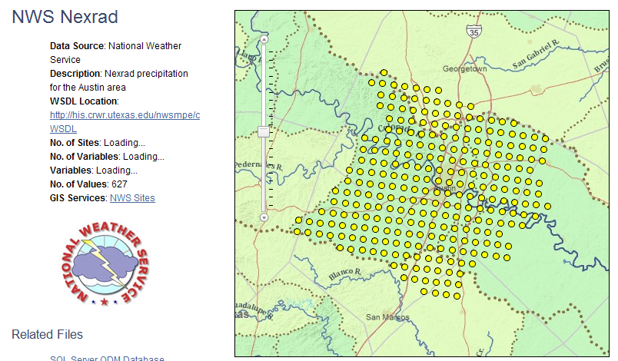
Data Carts as Web Feature Services
Water time series are thematically classified and published in data carts as OGC Web Feature Services (WFS)
One record and feature for each time series
A theme is a collection of time series
One WFS for each theme

Slide 52
Catalog Services for the Web (CS/W)
An OGC standard for cataloging a list of web services
Provides a single URL reference point for all services from an organization https://hydroportal.crwr.utexas.edu/geoportal/csw/......
Enables searching of underlying Web Feature Services using the “who, what, when, where” approach
Start
Select Region (where)
Select Time Period
(when)
Select Service(s)
(who)
Select Keyword(s)
(what)
Filter Results
Save Theme
End

Slide 53
A possible theme-series model
HydroCatalog
(CSW)
Registers services and service
Descriptions
Service metadata passing with
WFS:GetCapabilities
Searches the catalog for services with
CSW:GetRecords
(XML)
Gets the series metadata with
WFS:GetFeature
Gets the data with
SOS:GetObservations
(WaterML 2.0)
HydroServer
(SOS, WFS)
HydroDesktop
Based as much as possible on existing OGC standards and software tools

Slide 54
Simple Example Client using CSW server and DataCart WFS services.
1) Query CRWR’s GeoPortal CSW endpoint to find DataCart WFS services.
This is done via CSW:GetRecords, using a filter to
find services with the word “DataCart” in their Abstract field

Slide 55
Make a Query: “Who, What, When, Where”
2) Query each returned DataCart WFS service.
This is done via WFS:GetCapabilities to get the service titles and layer names (required for GetFeatures).
Start
Select Region (where)
Select Time Period
(when)
Select Service(s)
(who)
Select Keyword(s)
(what)
Filter Results
Save Theme
End

Slide 56
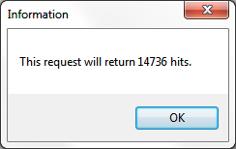
Find Number of Series that Satisfy the Query
3) Call WFS:GetFeature on each DataCart WFS service.
Can specify the result type as “hits” to just get the number of features that will be returned
Modify the query if necessary to get a manageable number of series …..

Slide 57
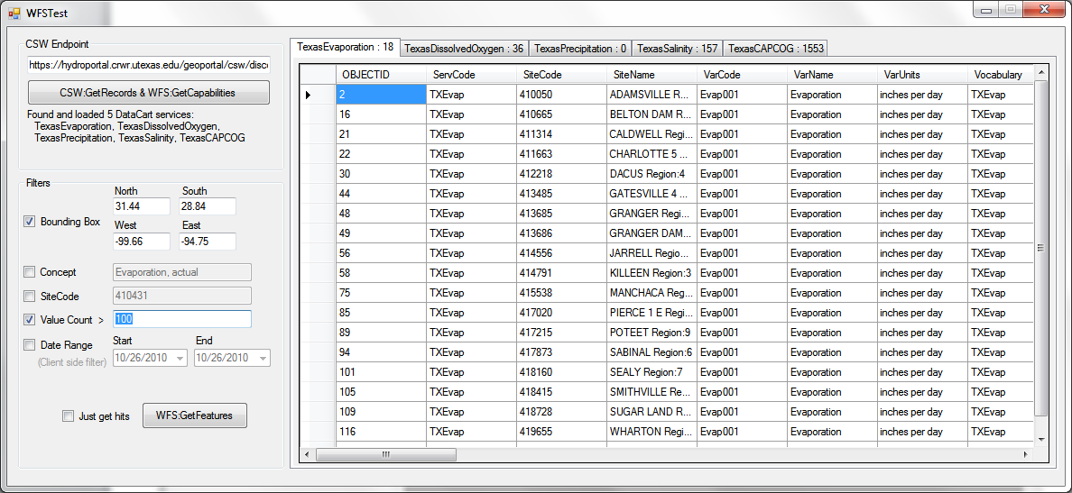
Get Metadata for Each Time Series
4) Call WFS:GetFeature on each DataCart WFS service.
Can specify filters to limit the returned features to a given spatial extent or to those that match a certain attribute (such as number of values).

Slide 58
Store the Metadata and Use it to Access Data
5) Export the Data Cart to a .csv file
Can specify filters to limit the returned features to a given spatial extent or to those that match a certain attribute (such as number of values).

Slide 59
Data Access Workflow
Query for matching Services from HydroCatalog
OGC Catalog Services for the Web
Get Services
A national water portal?
Narrow
Query for matching Series from each HydroServer
OGC Web Feature Service
Get Series
Metadata in space
Narrow
Get Values from each HydroServer
WaterML and future
OGC WaterML2 standard
Get Values
Observations in time
Narrow
Produce the final Theme
Better water science!!

Slide 60
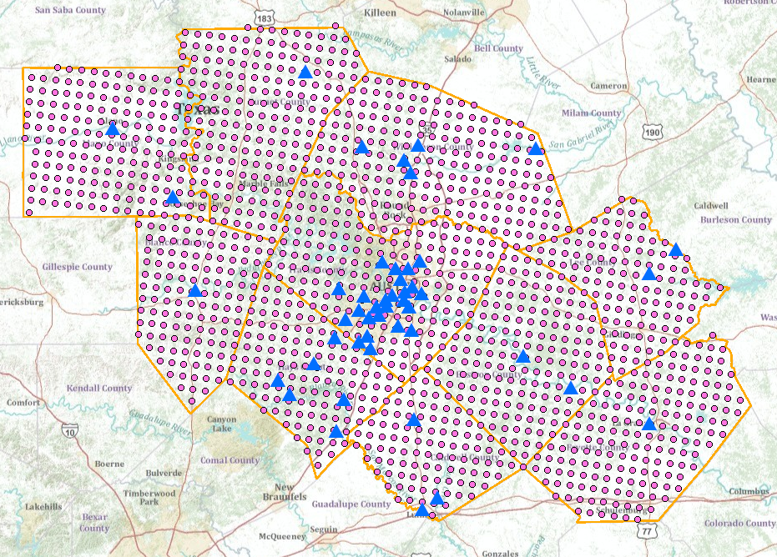
Nexrad Rainfall and USGS gages in the CAPCOG region
http://129.116.104.176/ArcGIS/rest/services/capcogaustin/capcog/MapServer
A Web Feature Service in space
USGS and NWS data both in WaterML

Slide 61
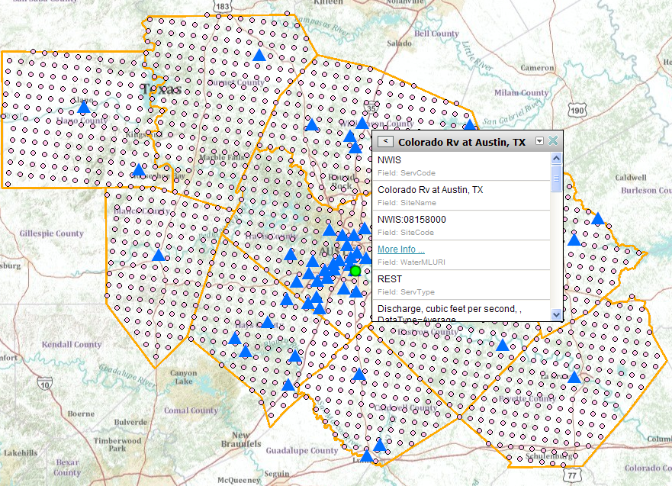
USGS REST service
http://waterservices.usgs.gov/nwis/iv?sites=08158000&period=P7D&parameterCd=00060
A WaterML service in time

Slide 62
Conclusions
USGS, EPA and other water agencies are investing in water web services
CUAHSI research has produced a framework that supports national water observations data synthesis
Each data source needs to host its own water data and metadata
Integration is through map metadata and time series data services
A national water ontology is needed to make this work – NSF has just funded a new 3-year study for this led by Rick Hooper, President of CUAHSI

Slide 63
Next Steps
Agreement about
The web services structure presented
A place for the national portal to register the water web services catalogs (CS/W addresses)
The specification of the data cart
http://www.caee.utexas.edu/prof/maidment/CUAHSI/DataCart/Spec_2010-06-07.docx
The current hydrologic ontology
http://his.cuahsi.org/ontologyfiles.html
http://water.sdsc.edu/hiscentral/startree.aspx

