Slide 1
Water Data Sharing
Presented by David R. Maidment
Leader, CUAHSI Hydrologic Information System
and Director, Center for Research in Water Resources, University of Texas at Austin
Presented to
Subcommittee on Water Availability and Quality
Office of Science and Technology Policy
White House Conference Center, Jan 19, 2011

Slide 2
Water Data Sharing
Water data sharing using web services
Adapting OGC web service standards
Applications of water data sharing

Slide 3
Water Data Sharing
Water data sharing using web services
Adapting OGC web service standards
Applications of water data sharing

Slide 4
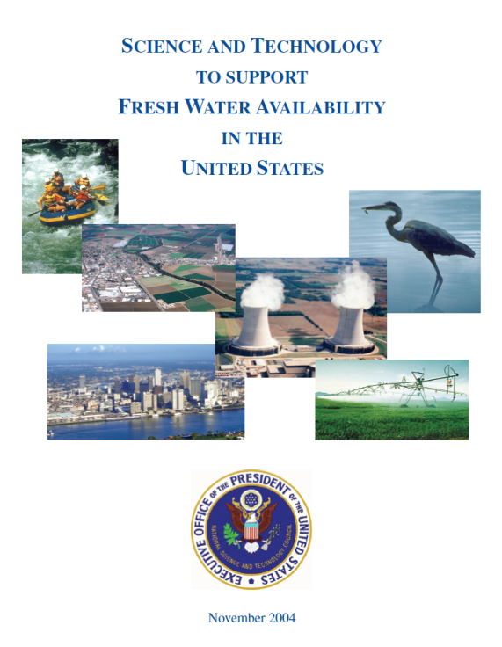
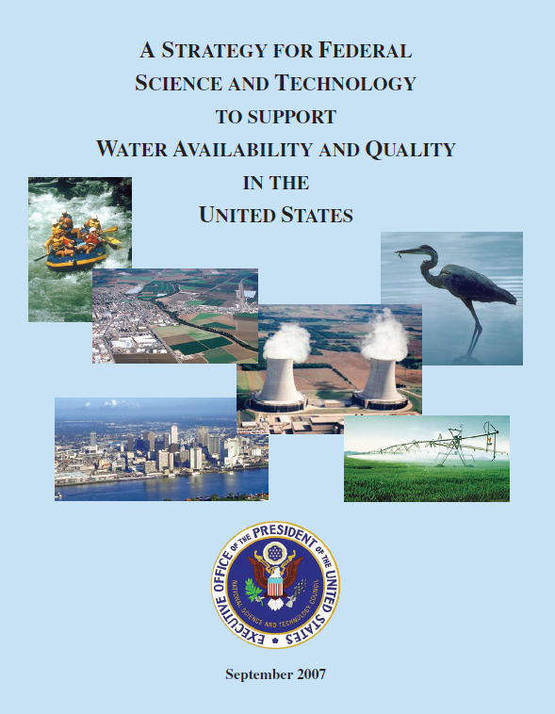
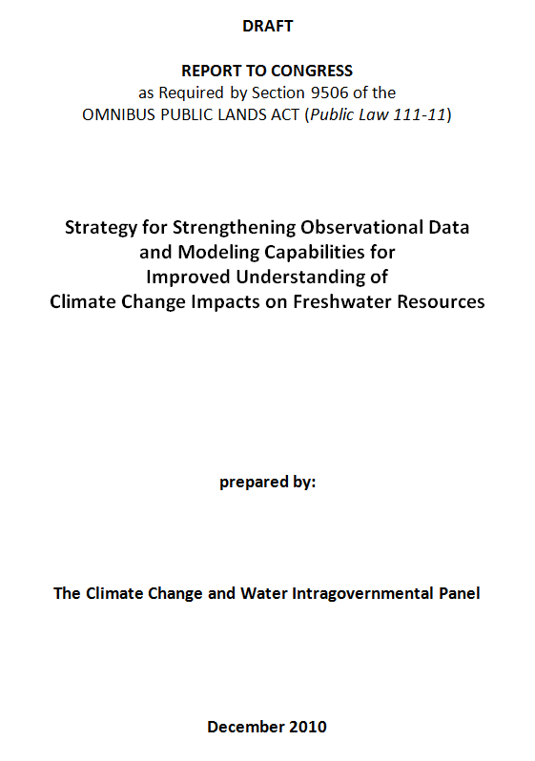
Subcommittee on Water Availability and Quality (SWAQ)
Supports the Office of Science and Technology Policy, Executive Office of the President
2010 Draft Report
2004 Report
2007 Report
To provide guidance concerning the science and technology needed …..
….. to assure the availability and quality of water resources of the United States

Slide 5
Omnibus Public Lands Act (Public Law 111-11) Sec. 9506 “Climate Change and Water Intragovernmental Panel”
(c) Review Elements
(3) “To establish data management and communication protocols and standards to increase the quality and efficiency by which each Federal agency acquires and reports data;
(4) To consider options for the establishment of a data portal to enhance access to water resource data;
This presentation addresses these topics ….
…. from the viewpoint of the CUAHSI Hydrologic Information System
http://www.blm.gov/pgdata/etc/medialib/blm/wo/Law_Enforcement/nlcs.Par.9712.File.dat/PublicLaw111-11.pdf

Slide 6
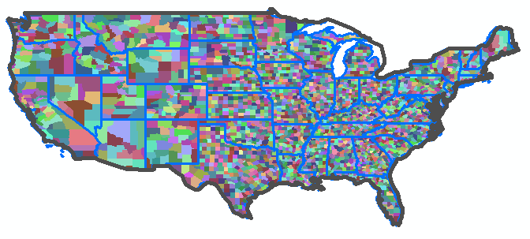
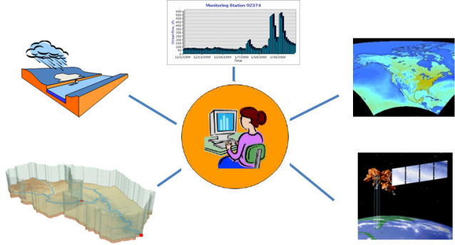
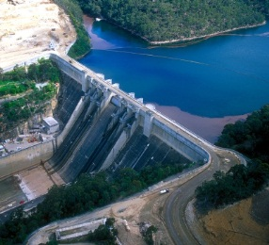
Challenges and Opportunities
To share water data across agencies and across levels of government
To share water data across water disciplines and data types
To use data to link water science and water management

Slide 7
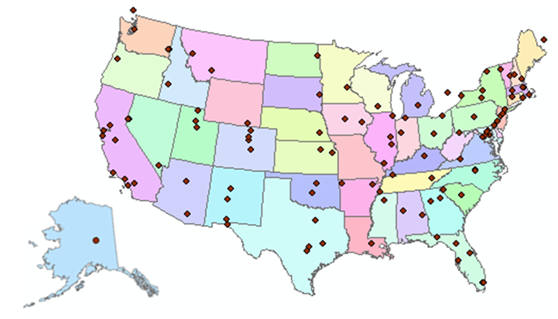
http://www.cuahsi.org
CUAHSI is a consortium representing 125 US universities
Supported by the National Science Foundation Earth Science Division
Advances hydrologic science in nation’s universities
Includes a Hydrologic Information System project

Slide 8
http://his.cuahsi.org/
CUAHSI HIS Team:
University of Texas at Austin
San Diego Supercomputer Center
Utah State University
University of South Carolina
Idaho State University
CUAHSI Program Office
We have been working on water data sharing since 2004

Slide 9
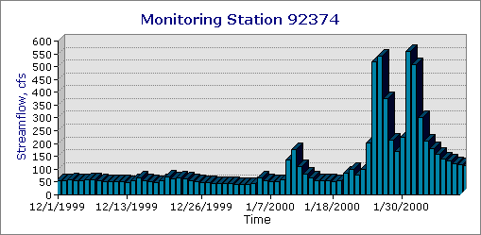
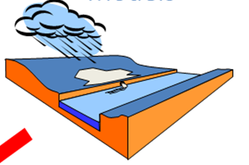
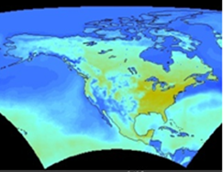
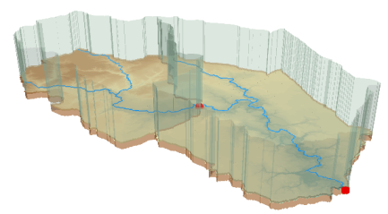
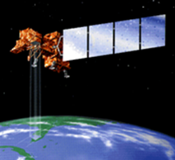
CUAHSI Hydrologic Information System
Observations
Weather and Climate
Modeling
GIS
Remote Sensing
Focus
Access and Integrate water data across water disciplines ….
…. and data types

Slide 10
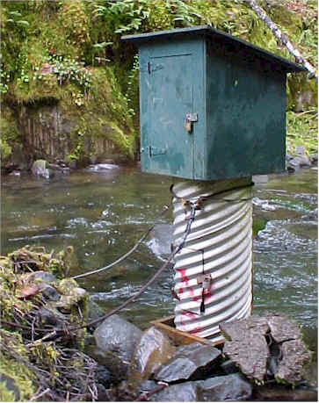
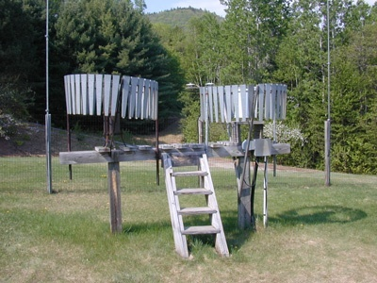
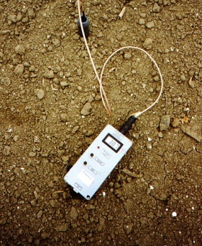
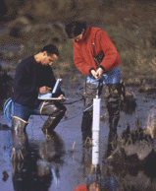
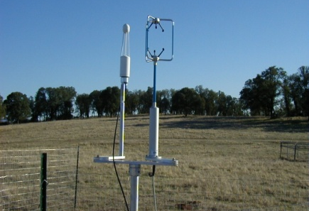
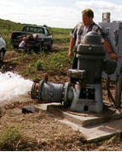
This system integrates data from many water disciplines
Water quantity
Rainfall
Soil water
Water quality
Meteorology
Groundwater

Slide 11
CUAHSI Network-Observations Model
NWIS Daily Values
Data Service
NWIS Sites
Network
GetSites
San Marcos River at Luling, Tx
GetSiteInfo
Sites
Discharge, stage
(Daily or instantaneous)
GetVariableInfo
Variables
GetValues
Observation
18,700 cfs, 3 July 2002
{Value, Time, Qualifier}
A data source operates an observation network
A network is a set of observation sites
A site is a point location where one or more variables are measured
A variable is a property describing the flow or quality of water
A value is an observation of a variable at a particular time
A qualifier is a symbol that provides additional information about the value

Slide 12
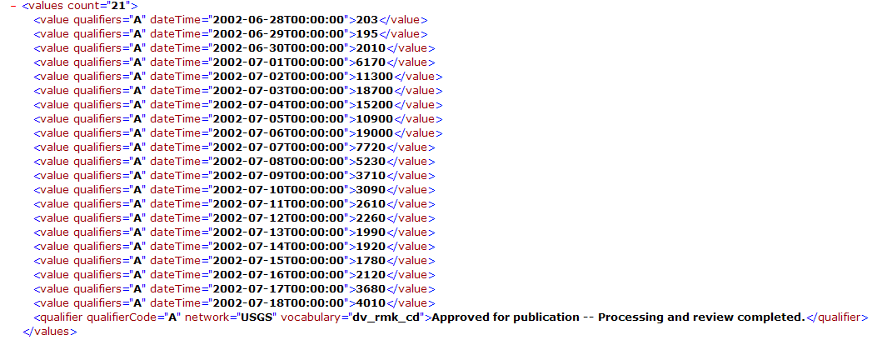
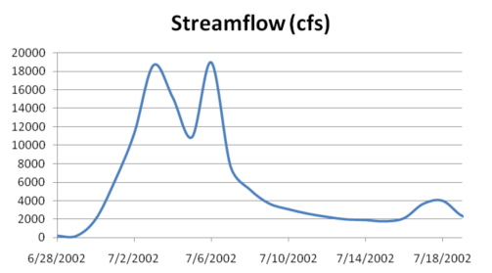
WaterML as a Web Language
Discharge of the San Marcos River at Luling, TX June 28 - July 18, 2002
USGS Streamflow data in WaterML language
This is the WaterML GetValues response from NWIS Daily Values

Slide 13
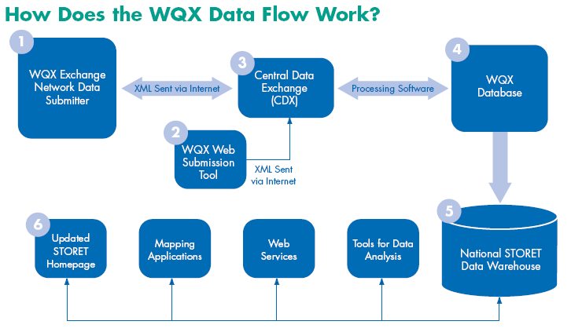
WQX and STORET
Observational Water Web Services from EPA
The Water Quality Exchange (WQX) is a new framework that makes it easier for States, Tribes, and others to submit and share water quality monitoring data over the Internet. States, Tribes and other organizations can now submit data directly to the publicly-accessible STORET Data Warehouse using the WQX framework.

Slide 14
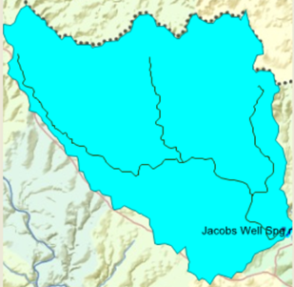
Geospatial Water Web Services from EPA
Automated watershed delineation anywhere in the continental US

Slide 15
What is a “services-oriented architecture”? Networks of computers connected through the web …….
Everything is a service
Data, models, visualization, ……
A service receives requests and provides responses using web standards (WSDL)
It uses customized web languages
HTML (HyperText Markup Language) for text and pictures
WaterML for water time series (CUAHSI)
WQX for water quality (EPA)
GML for geospatial coverages (OGC)
….. supporting a wide range of users

Slide 16
How does the internet work?
This is how it got started …..
Web servers
Text, Pictures
in HTML
Mosaic browser
…..this is how it works now
Google, Yahoo, Bing
Catalog
Three key components linked by services and a common language
Metadata harvesting
Search Services
HTML
Web servers
Text, Pictures
Firefox, Internet Explorer
Server
User

Slide 17
What has CUAHSI Done?
Taken the internet services model …..
Catalog
Server
User
…..and implemented it for water observations data
HIS Central
Metadata harvesting
Search Services
WaterML
HydroServer, Agency Servers
Time series data
HydroExcel, HydroDesktop, ...

Slide 18
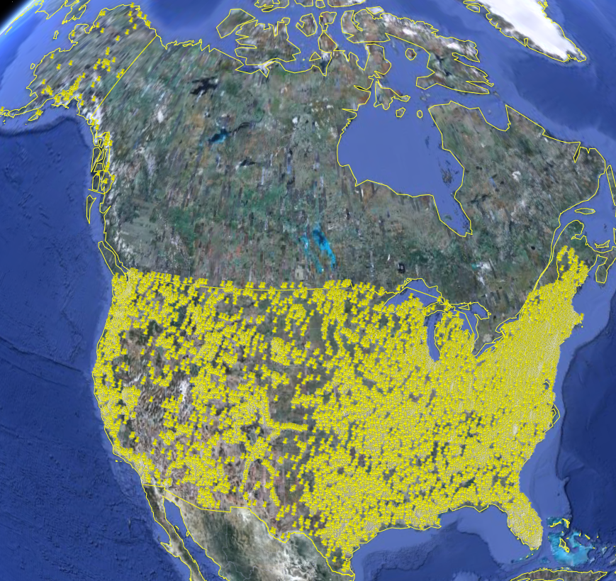
USGS Instantaneous Data
Real time, instantaneous data over the last 120 days
11188 sites, nationally for the US
80 variables
24/7/365 availability
Published by USGS National Water Information System

Slide 19
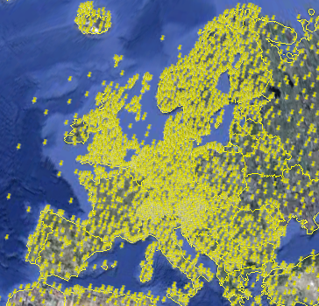
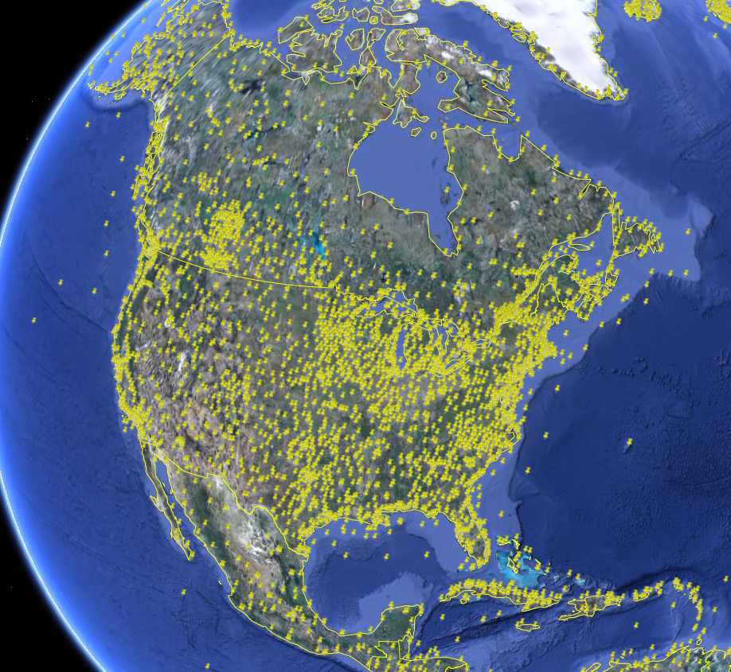
NCDC Integrated Station Hourly Data
Hourly weather data up to 36 hours ago
13,628 sites across globe
34 variables
Published by National Climate Data Center and populated with weather observations from national weather services
http://water.sdsc.edu/wateroneflow/NCDC/ISH_1_0.asmx?WSDL

Slide 20
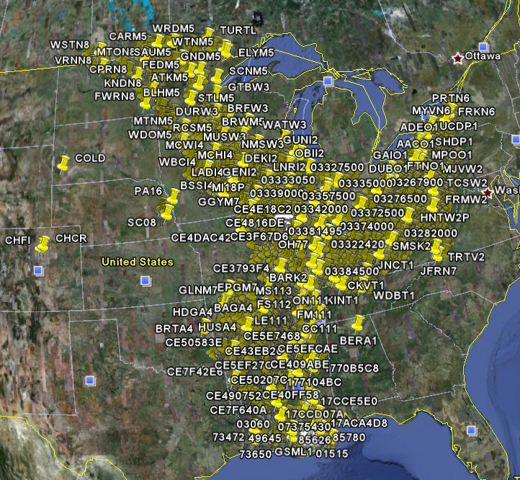
Corps of Engineers Water Observations
Time series at Corps gages
2210 sites, mainly in Mississippi Basin
80 variables
4954 series
Published by Corps of Engineers, Rock Island District to support their WaterML plugin to HEC-DSS
http://www2.mvr.usace.army.mil/watercontrol/SOAP/WaterML_SOAP.cfc?wsdl

Slide 21
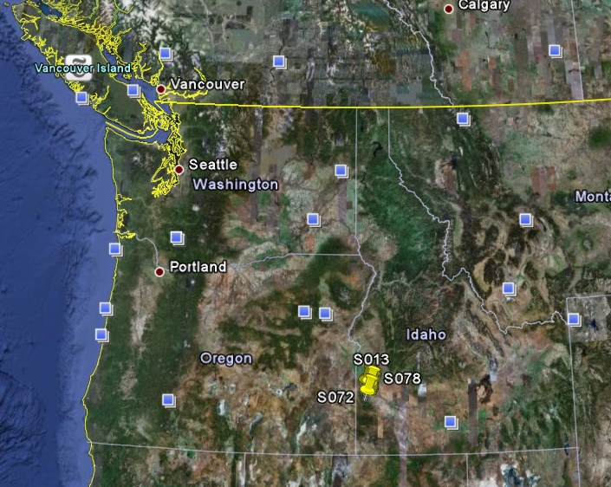
Reynolds Creek Experimental Watershed
1 data service
84 sites
65 variables
372 series
17.8 million data
Published by USDA-ARS as part of an Idaho Waters project
http://idahowaters.uidaho.edu/RCEW_ODWS/cuahsi_1_0.asmx?WSDL

Slide 22
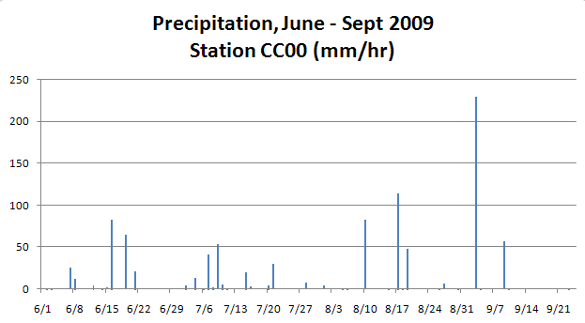
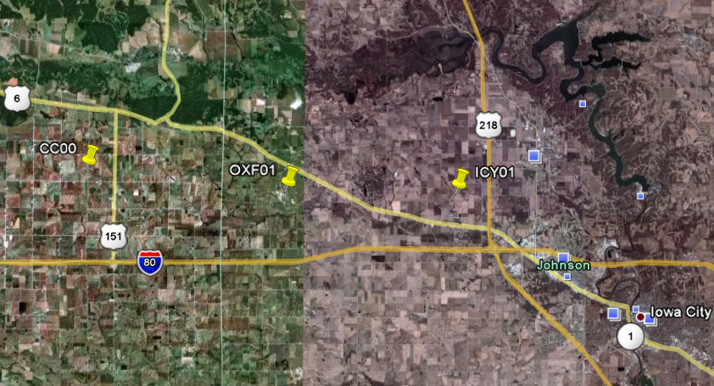
Iowa Tipping Bucket Raingages
Data Manager:
Nick Arnold, IIHR

Slide 23
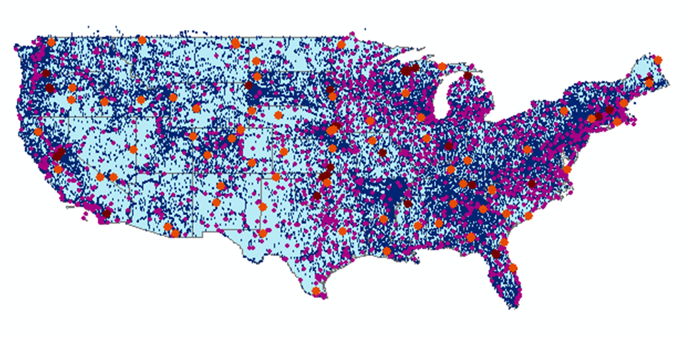
CUAHSI Water Data Services
66 public services
18,000 variables
1.9 million sites
23 million series
5.1 billion data values
And growing
The largest water data catalog in the world
maintained at the San Diego Supercomputer Center

Slide 24
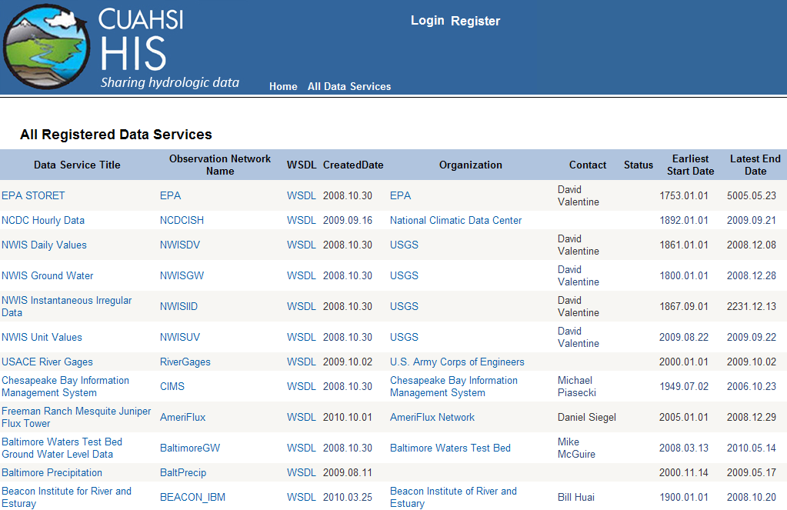
WaterML Services at HIS Central
USGS, EPA, NCDC, USACE data as WaterML time series

Slide 25
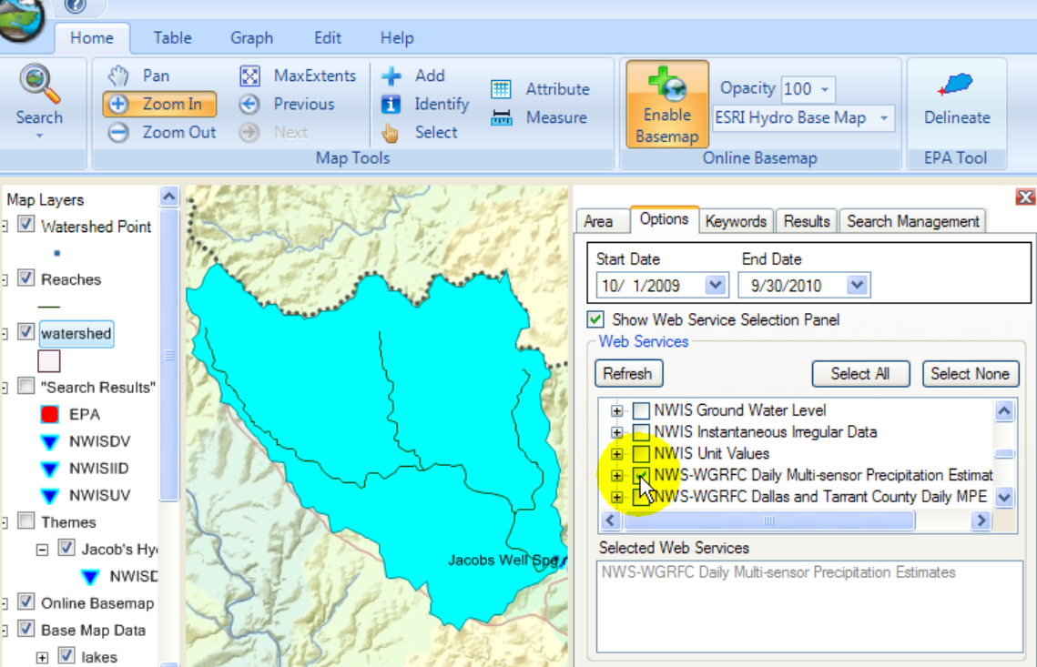
HydroDesktop Desktop Hydrologic Information System
Metadata
Catalog
Data

Slide 26
What have we learned?
We have custom-built a very large scale services-oriented architecture and a sophisticated user interface to it
A much simpler and more general pattern has emerged based on existing Open Geospatial Consortium (OGC) information exchange standards and extensions to them
We have exposed a very large volume of information
It needs to be carefully organized to be most useful

Slide 27
Water Data Sharing
Water data sharing using web services
Adapting OGC web service standards
Applications of water data sharing

Slide 28
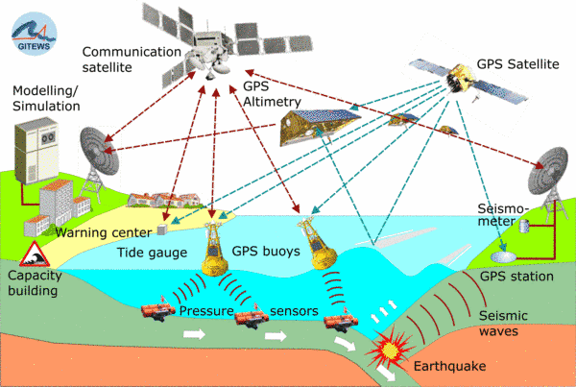
Open Geospatial Consortium Web Service Standards
Map Services
Web Map Service (WMS)
Web Feature Service (WFS)
Web Coverage Service (WCS)
Catalog Services for the Web (CS/W)
Observation Services
Observations and Measurements Model
Sensor Web Enablement (SWE)
Sensor Observation Service (SOS)
These standards have been developed over the past 10 years ….
…. by 400 companies and agencies working within the OGC

Slide 29
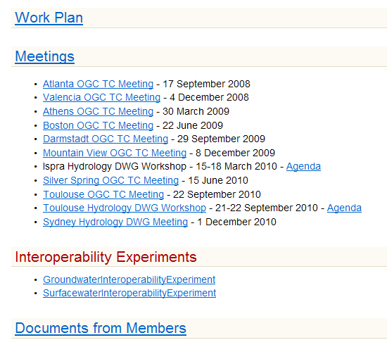
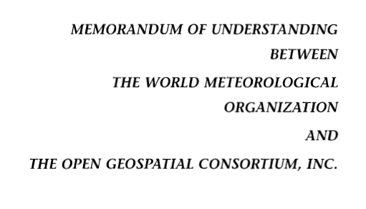
Jointly with World Meteorological Organization
Evolving WaterML into an International Standard
Meets every 3 months
Teleconferences most weeks
November 2009
Hydrology, Meteorology, Climatology, and Oceanography
WaterML Version 2 standard being proposed
Notes:
The Hydrology Domain Working Group was initiated by the Open Geospatial Consortium in September 2008. The OGC has about 400 companies and agencies that have developed the most widely used standards for conveying geospatial information on the internet (Web Mapping Service, Web Feature Service, Web Coverage Service, Catalog Services for the Web, Sensor Observation Service). In November 2009, OGC and WMO agreed to collaborate to provide information data exchange standards in hydrology, climatology, oceanography and meteorology – there are now two working groups – the OGC/WMO Joint Hydrology Domain Working Group and a similar Met-Oceans Working Group. HDWG is proposing a new standard for WaterML in December 2010 that is a customization of the OGC Sensor Observation Services’ Get Observations function adapted for conveying time series through the internet (WaterML2). The technical specification for the “service stack” will be presented and peer-reviewed through the Hydrology Domain Working Group.

Slide 30
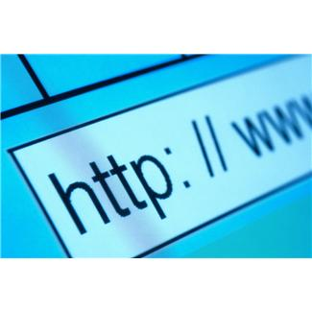
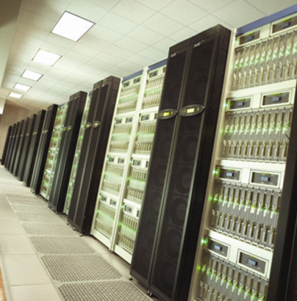
Services-Oriented Architecture for Water Data
Catalogs
Metadata
Search
Data
Users
Servers

Slide 31
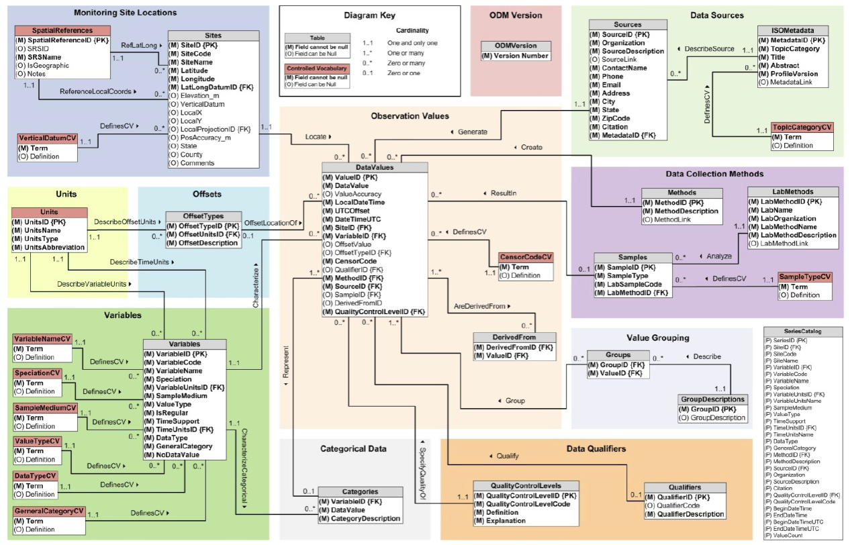
Building a Services Stack Using OGC Web Service Standards
Catalog Services – which list water web services
OGC Catalog Services for the Web
Metadata Services – which define a set of variables over a domain of space and time
OGC Web Feature Service
Data Services – which convey the data values
Currently WaterML 1.1
Future OGC Sensor Observation Service (WaterML2)
Catalog
Services
Metadata
Data
ODM Database
Notes:
There are three kinds of services: Catalogs that describe metadata services and define their domains in space; Metadata services whose records describe one variable from one source over a domain of space and time and provide a service call to access the data; Data services which enable downloading of the data. An ODM database can have a “stack” of these services mounted over it to provide tiered access to its information (and to allow public/private access to some time series if necessary).

Slide 32
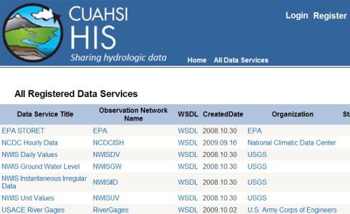
Federation of Catalog Services A MetaCatalog at CUAHSI Program Office, Boston
CS/W
HIS
Central
CS/W
CS/W
CS/W
Texas
USU
Notes:
Using OGC Catalog Services for the web a “Metacatalog” can be built at the CUAHSI Program Office by installing the ESRI Geoportal Software (now an open source software program) and registering CS/W endpoints in it from individual CUAHSI data collections, including HIS Central. The CUAHSI Metacatalog provides a single URL address that allows search across all CUAHSI collections. The metadata and data for those collections stay at the individual universities or are ingested into HIS Central and accessed from there.

Slide 33
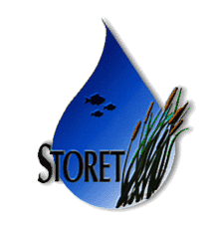
Water Agency Service Stacks Each agency maintains its own data and metadata
Federal
Geodata.gov, Data.gov, Geoplatform
NWIS
(Uses Catalog Services for Web in Geoportal)
Storet
State
NCDC
TWDB
A water data portal for the nation could be built ….
….. as a metacatalog linking the catalogs from these stacks
Notes:
The Federal Government already supports Catalog Services for the Web through Geodata.gov and is moving to Data.Gov and a new initiative called the Geoplatform (requested by OMB in 2011). Cataloging water observations data under this system is a straightforward extension of what is already being done to federate the federal government’s geospatial data layers. State water observations data systems like that coming from the Texas Water Development Board can be federated and searched along with the federal water observations data services

Slide 34
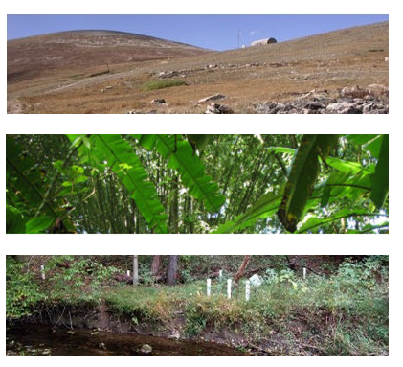
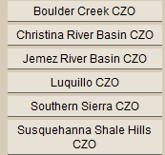
CZO
Data
Services
Catalog
Metadata
Data
Academic water science data from NSF projects can be accessed ….
…. in the same way as water science data from federal agencies

Slide 35
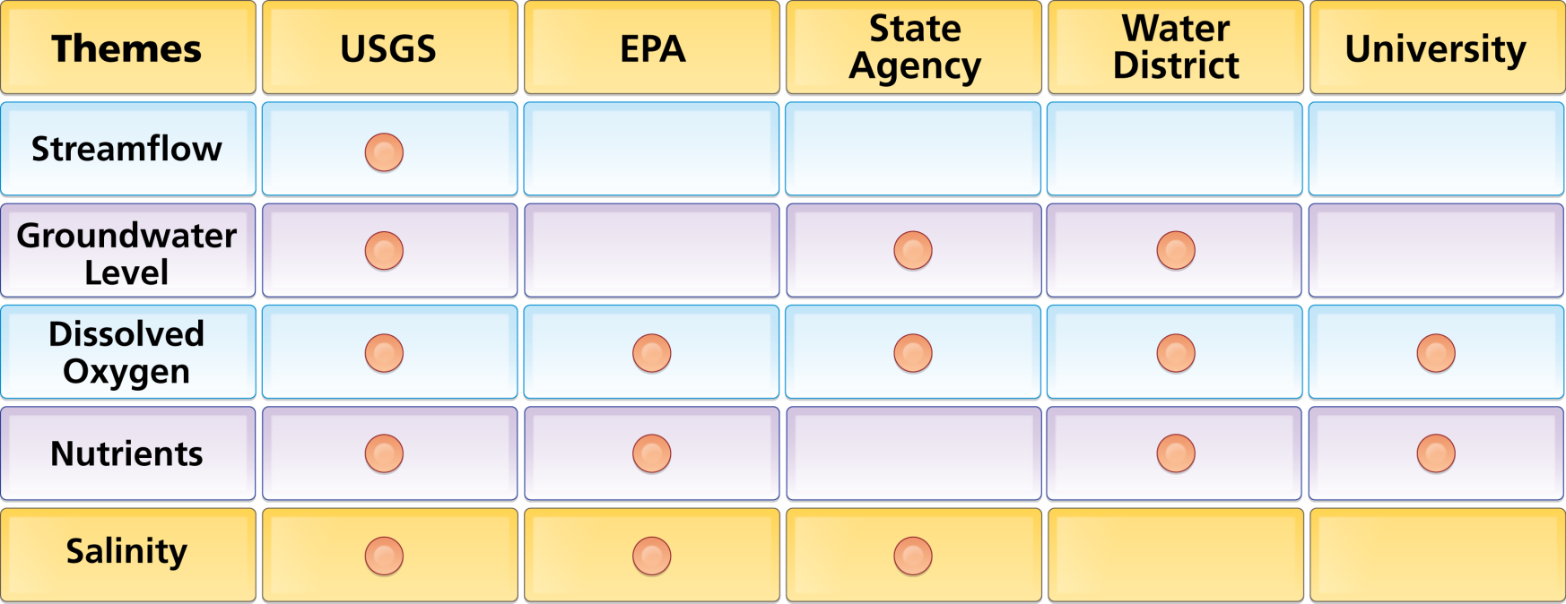
Organize Water Data Into “Themes”
Integrating Water Data Services From Multiple Sources
WaterML
WaterML
WaterML
WaterML
WaterML
. . . Across Groups of Organizations

Slide 36
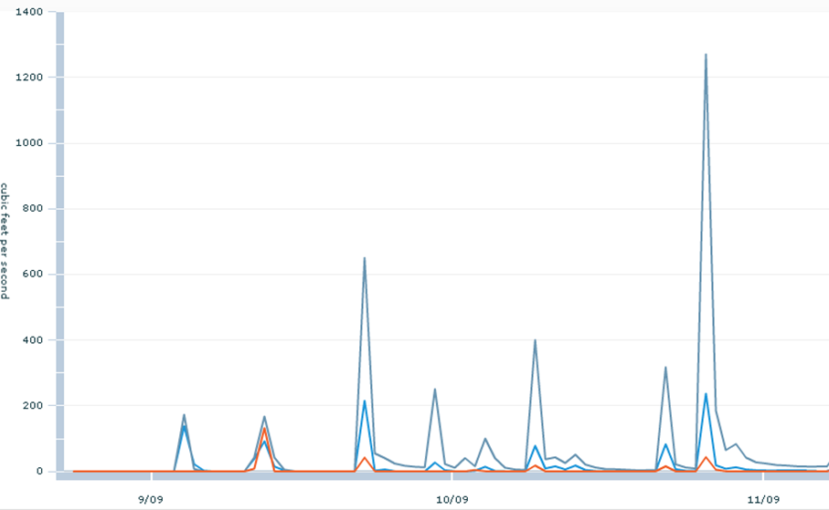
Time Series as Themes
A time series is like a feature
Theme – a collection of time series describing a subject and region
Streamflow data provided as WaterML data services by USGS

Slide 37
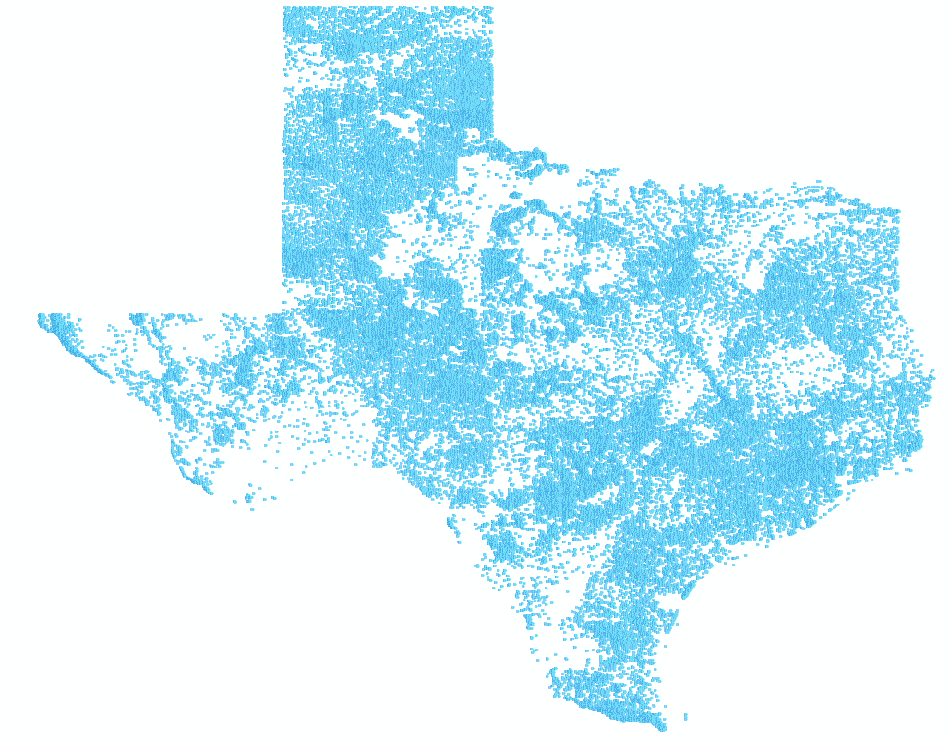
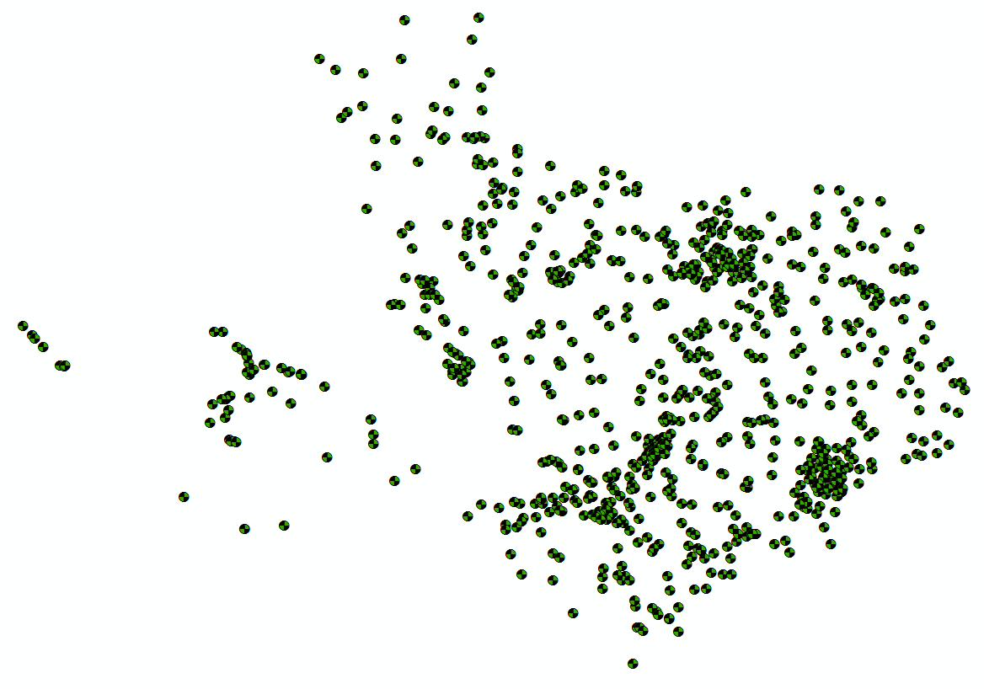
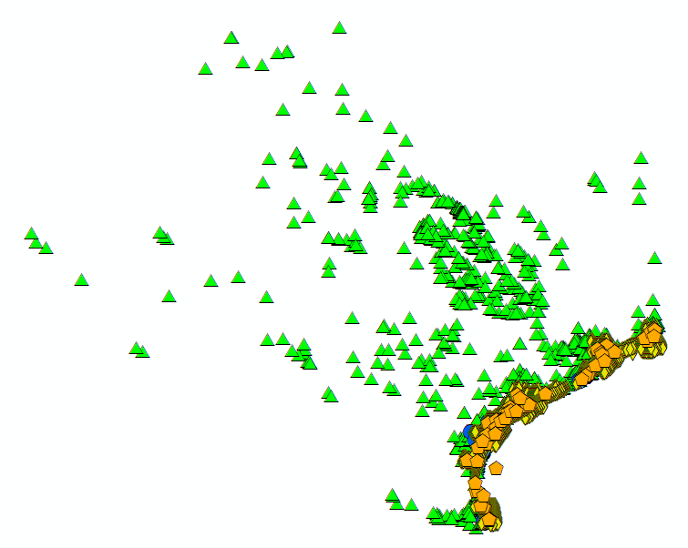
Bringing Water Into GIS Thematic Maps of Water Observations as GIS Layers
Groundwater
Streamflow
Dissolved Oxygen

Slide 38
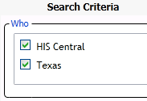
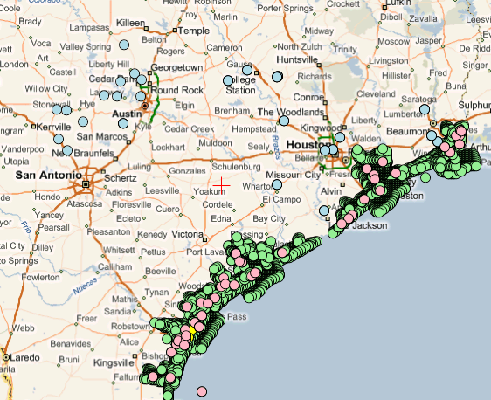
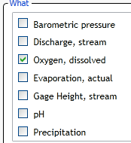
Searching Federal and State Data
(Federal)
(State)
USGS Daily Values
Texas TWDB
Texas TCEQ & TPWD
A single search accesses federal water data from a catalog at HIS Central ….
…. and state water data from a catalog in Austin, Texas

Slide 39
Water Data Sharing
Water data sharing using web services
Adapting OGC web service standards
Applications of water data sharing

Slide 40
Australian Water Resources Information System iPhone App for Water Storage
National View
Summarizes the current volume of water in reservoir storage and its change over time
Regional View
http://itunes.apple.com/au/app/water-storage/id380627384

Slide 41
Corps and USBR Reservoirs Surface water storage is a critical element of water resources sustainability under climate change
(608)
No centralized database exists.
Data are compiled by
Corps District Offices and USBR Field Offices
(348)
Use water web services to track water storage volume ….
…. for the nation and for river basins

Slide 42
Multisensor Precipitation Estimate (MPE) West Gulf River Forecast Center
Exported by NWS to CUAHSI Observations Data Model and WaterML web services at University of Texas at Arlington
Capital Area Council of Governments (CAPCOG)

Slide 43
Situational Awareness for Flash Flooding in the CAPCOG region
National Weather Service,
USGS, Corps of Engineers
Combines federal, river authority, city and water district data ….
…. to support real-time flood emergency response

Slide 44
Rainfall in Cypress Creek Watershed Drainage area – 38 Sq. Mi.
“Virtual Rain Gages”— Nexrad Radar Rainfall points
Time Series of Rainfall
Data obtained via WaterML web service from NWS and UT Arlington

Slide 45
Crossing the Digital Divide
Discrete spatial objects with time series
Continuous space-time arrays
Weather and Climate
Observations
Remote Sensing
GIS
These are two very different data worlds
Notes:
Discrete spatial objects (GIS) and associated time series are two different data worlds that CUAHSI HIS has connected. We still need to connect with continuous space-time arrays of weather and climate and remote sensing information. That is complicated by that information being in binary files of various formats. Unidata’s THREDDS server is providing a common way of accessing such information

Slide 46
Modeling and Remote Sensing
NASA WaterML Web Services
HydroDesktop
Data publication (NLDAS² precipitation, temperature, soil moisture)

Slide 47
NASA Hydrologic Data Access from HydroDesktop (an example)¹
Other HydroServer
Other HydroServer
Data publication (NLDAS² precipitation, temperature, soil moisture)
HIS Central
NASA GES DISC HydroServer
GetSites, GetSiteInfo, GetVariableInfo, GetValues
HydroServers with precipitation data
Data served in WaterML
Search for precipitation data
Site Info
Location=123
Begin date-time
End date-time
…
Site ID: 123
HydroDesktop
Variables
Precipitation hourly total
2-m above ground temperature
0-10 cm layer 1 soil moisture content
GDS Info
GrADS Data Server (GDS)
Precipitation Values
Location=123
Time 1 Value 1
Time 2 Value 2
Time 3 Value 3
…
Tan star – surface point of interest
Red circle – nearest NLDAS grid box
Site ID: 123
S4PA Archive
¹Courtesy NASA Goddard Earth Sciences Data and Information Services Center and Hydrological Sciences Branch
²NLDAS (North American Land Data Assimilation System) is a collaboration among NOAA, NASA, Princeton Univ., Univ. of Washington, and others.

Slide 48
Working Towards Common Semantics Using an Ontology to Reconcile Meanings of Variables
A hierarchy of concepts
Match variables to leaf concepts
Physical
Hydrosphere
Chemical
Biological
Uses EPA Substance Registry System for Chemistry
http://test.hydroseek.net/ontology/Ontology_heirarchy.html

Slide 49
Catalog Services Searched Using a Common Ontology
Discrete spatial objects with time series
Continuous space-time arrays
Weather and Climate
Observations
Remote Sensing
GIS
NSF is supporting a new 3-year ontology project ….
…. led by Richard Hooper, President of CUAHSI
Notes:
The CUAHSI HydroServer publishes GIS and time series data, all of which can be accessed through a Catalog Services for the Web as OGC web services. Unidata THREDDS server performs a similar function for continuous space-time arrays. Over the past several months, an experiment between CUAHSI and Unidata has shown that these service stacks can be made interoperable (paper on this at AGU by Maidment et al). This means that in HydroDesktop of the future, a user will be able to search for all kinds of data and download them. This requires a common ontology so that the search is meaningful over multiple subject domains. NSF has recently funded a project to Hooper, Zaslavsky and Piasecki to build a stronger ontology for this purpose.

Slide 50
Slide from Jack Dangermond, President of ESRI

Slide 51
A multiscale hydro base map showing National Hydrography Dataset ….
…. and properties of the Watershed Boundary Dataset

Slide 52
A Water Data Portal is part of the federal government’s strategy for data sharing
Another part is the Geospatial Platform

Slide 53
Coordination with ACWI and FGDC through their Subcommittee for Spatial Water Data
ACWI Subcommittees
Hydrology
Groundwater
Sedimentation
Monitoring Water Quality
Sustainable water (use)
Spatial Water Data
FGDC Subcommittees
Cadastral
Marine and Coastal
Transportation
Vegetation
Wetlands
Spatial Water Data
The ACWI/FGDC Subcommittee on Spatial Water Data ….
…. supports the CUAHSI/OGC strategy for water data sharing

Slide 54
Challenges and Opportunities
To share water data across agencies and across levels of government
To share water data across water disciplines and data types
To use data to link water science and water management

Slide 55
Conclusions
We have an extraordinary opportunity to share water data
Across agencies and levels of government
Across water disciplines and data types
Linking water science and water management
The internet provides us with the pathway but leadership from SWAQ and OSTP is needed to articulate the science and technology strategy

