Slide 1
Drought and Water Resources:
Texas and San Angelo
David R. Maidment
Center for Research in Water Resources
University of Texas at Austin
A presentation made for Texas Exes
San Angelo, Texas
27 March 2013

Slide 2

Facing Drought in Texas
Texas population increased by 4.3 million in the last 10 years
  430,000 people per year
  1180 people per day
  An Oklahoma in 9 years
We have a Texas Water Plan but little money to implement it
Legislature is debating House Bill 4 today
The clock is ticking …..

Slide 3

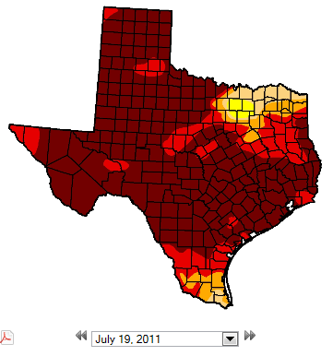
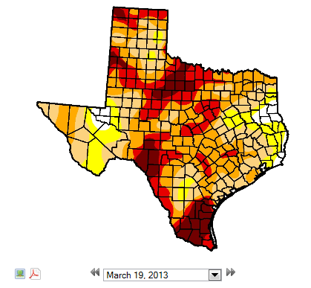
Drought in Texas – US Drought Monitor
In 2011, Texas and Oklahoma had the hottest summer
ever recorded in the history of the United States
Texas 99% in drought
75% in D4
Texas 96% in drought
10% in D4
July 2011
March 2013
http://droughtmonitor.unl.edu/

Slide 4
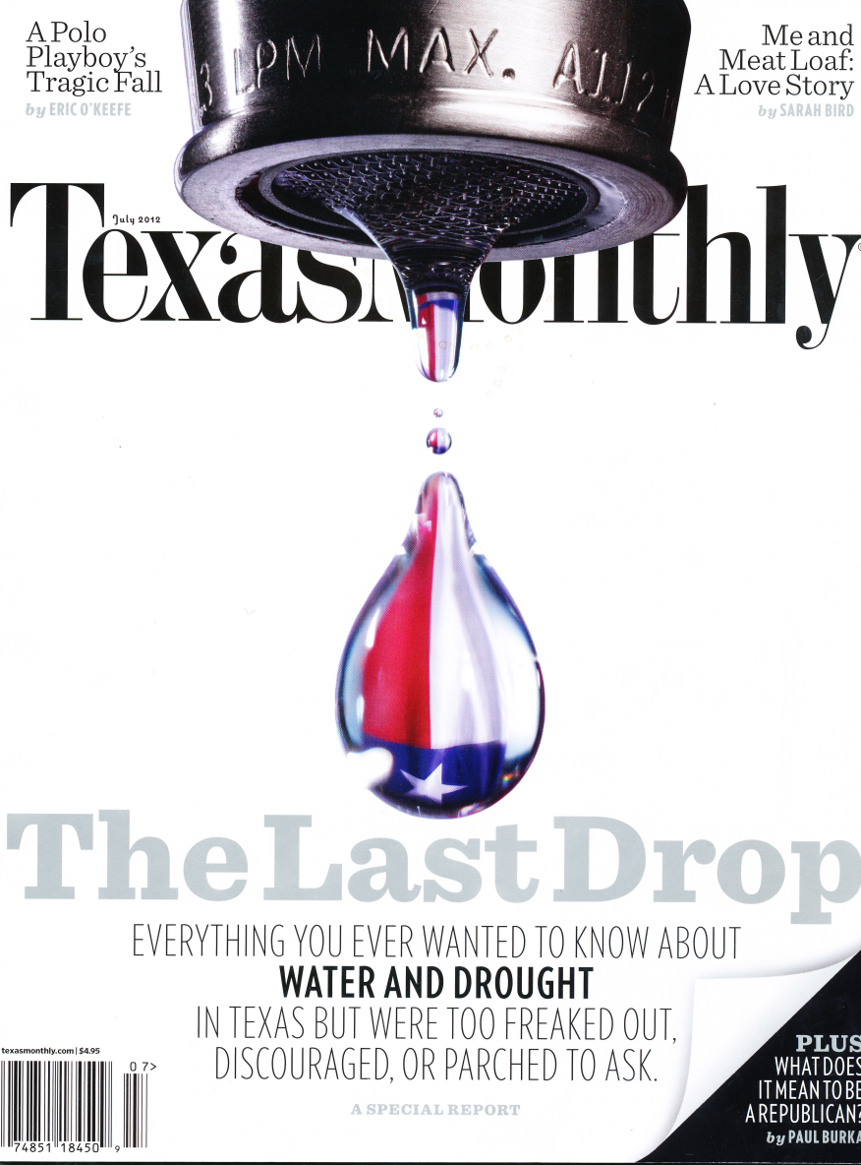
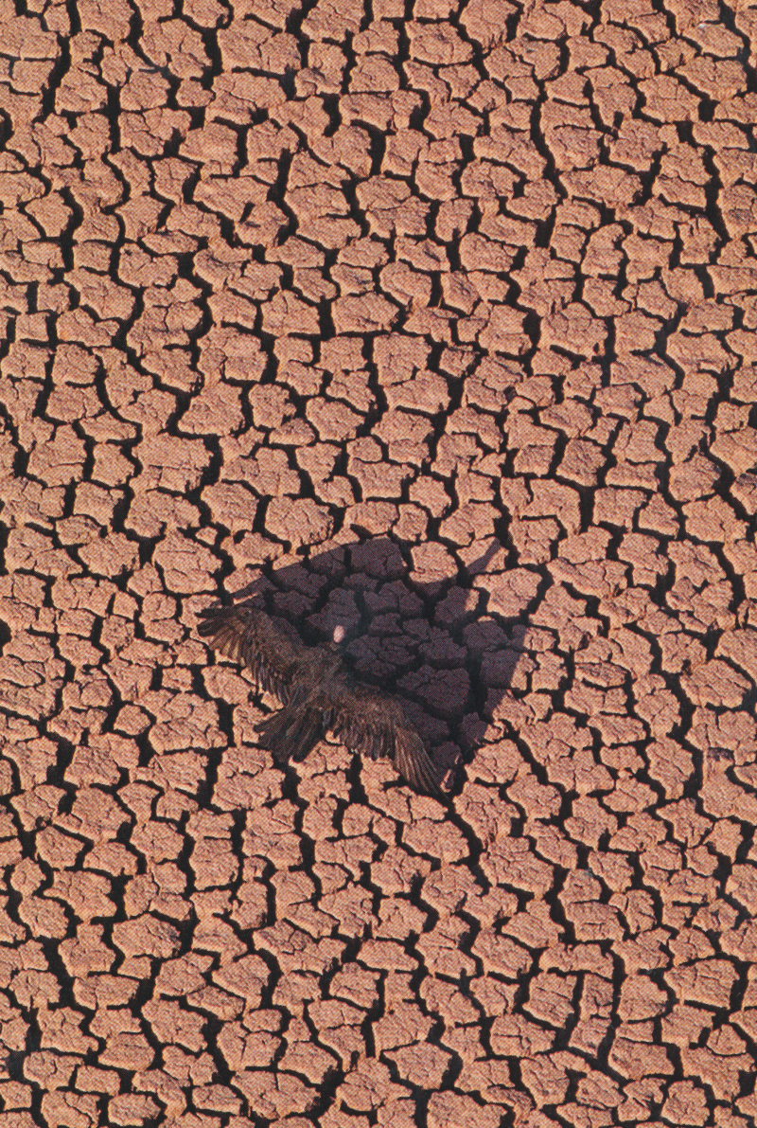
Texas Monthly Drought Special Report
July 2012

Slide 5
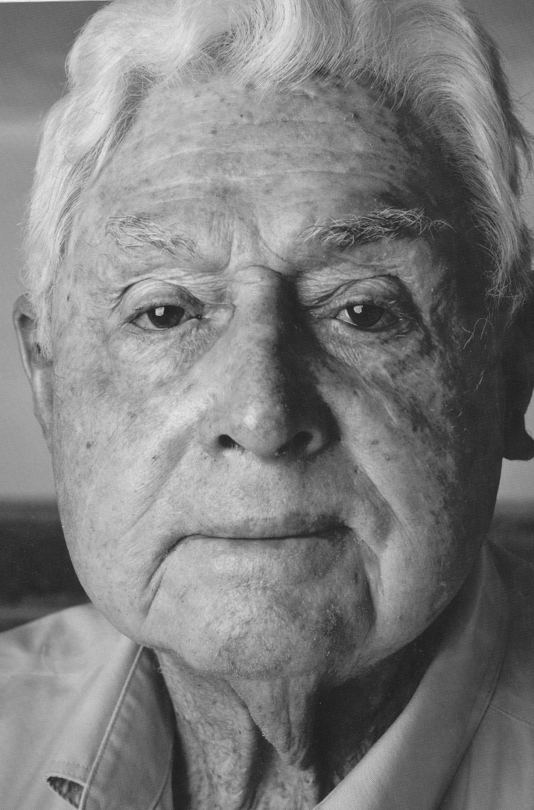
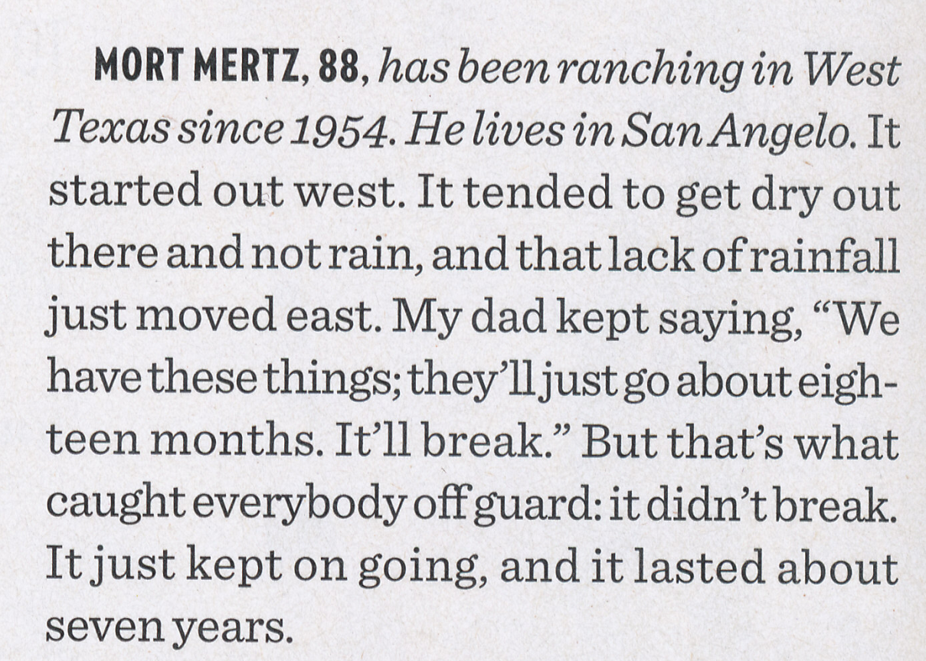
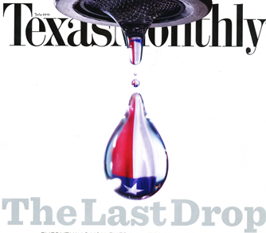
Mort Mertz – Drought of the 1950’s
(1950-1957)

Slide 6

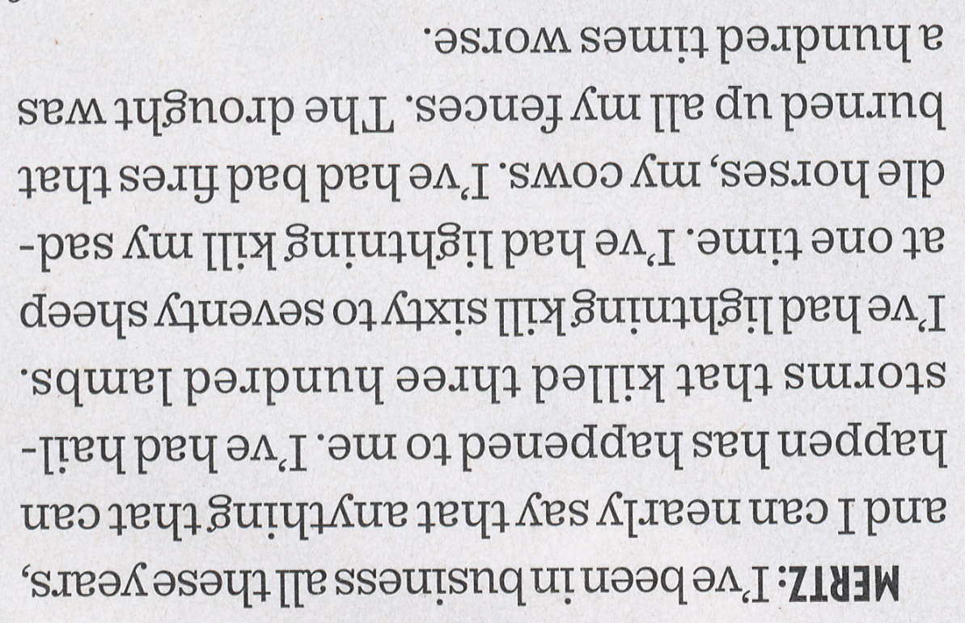
San Angelo – Epicenter of the 1950’s Drought
“If you don’t notice this ad,
The drouth is really hurting!”

Slide 7
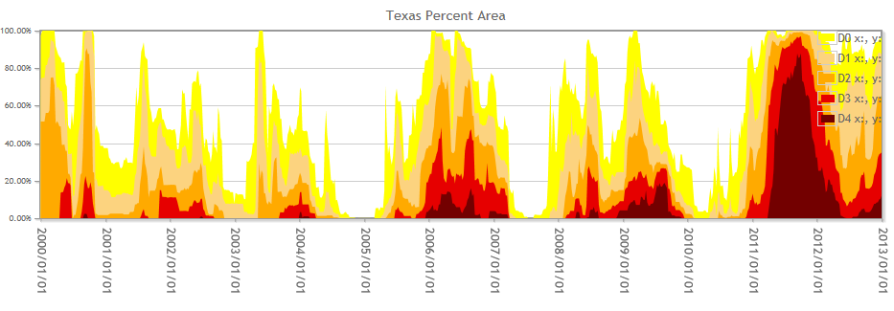
Trends in Drought Severity in Texas
2000
2002
2004
2006
2009
2011

Slide 8
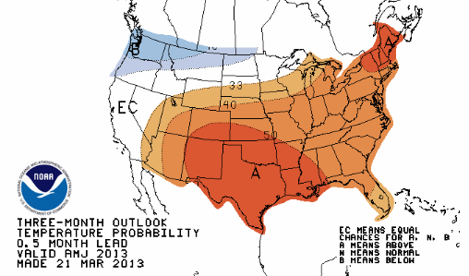
Temperature Outlook for Next Three Months
A means Above normal
with 50% probability

Slide 9
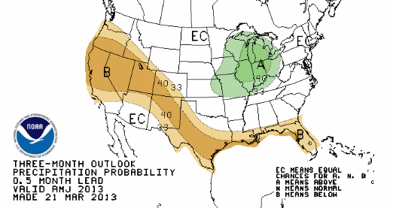
Precipitation Outlook for Next Three Months
B means Below normal
with 40% probability

Slide 10
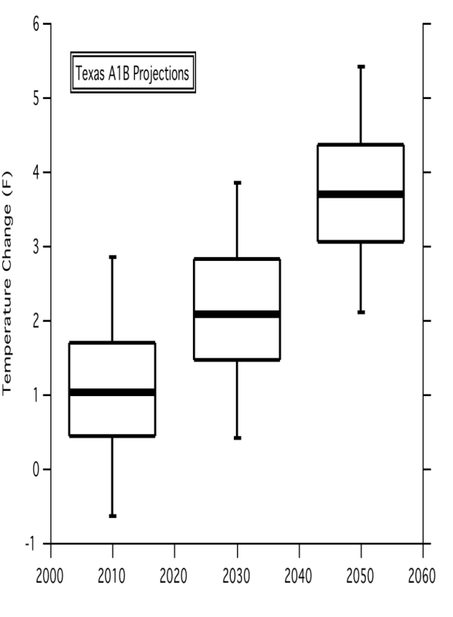
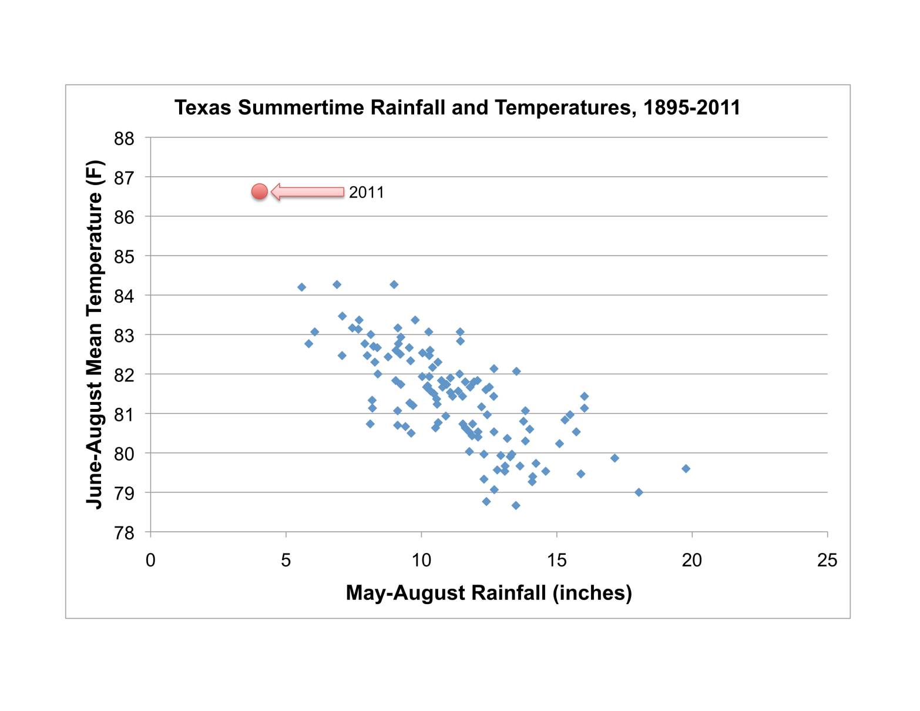
What does the longer-term future hold?
As temperatures rise, rain decreases….
Temperature is expected to rise…
whether due to natural variations or anthropogenic causes
John Nielson-Gammon, 2012; Danny Reible, 2013

Slide 11
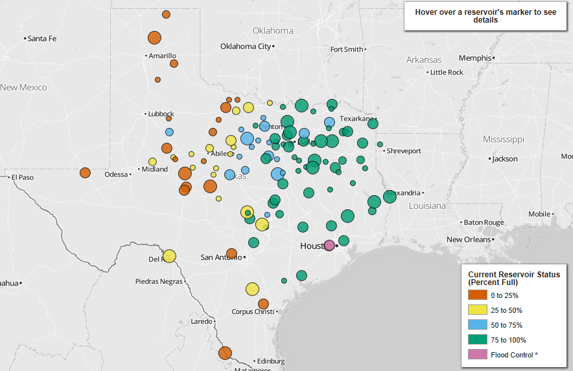
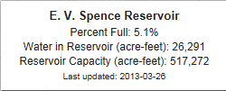
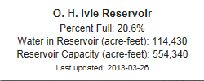
Reservoir Levels
(Dec 17, 2012)
West Texas is in a more sustained drought
http://www.texastribune.org/library/data/texas-reservoir-levels/
Notes:
West Texas is chronically short of water – reservoirs are either dry or are drying up. Cities are building access to groundwater well fields as fast as possible. East Texas has relatively abundant water resources.

Slide 12
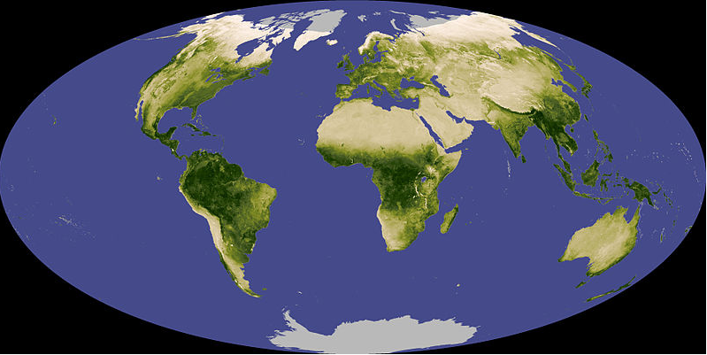
Normalized Difference Vegetation Index (NDVI)
A measure (0-1) of the greenness of the land surface derived from remote sensing
Vegetative vigor is limited by soil moisture

Slide 13

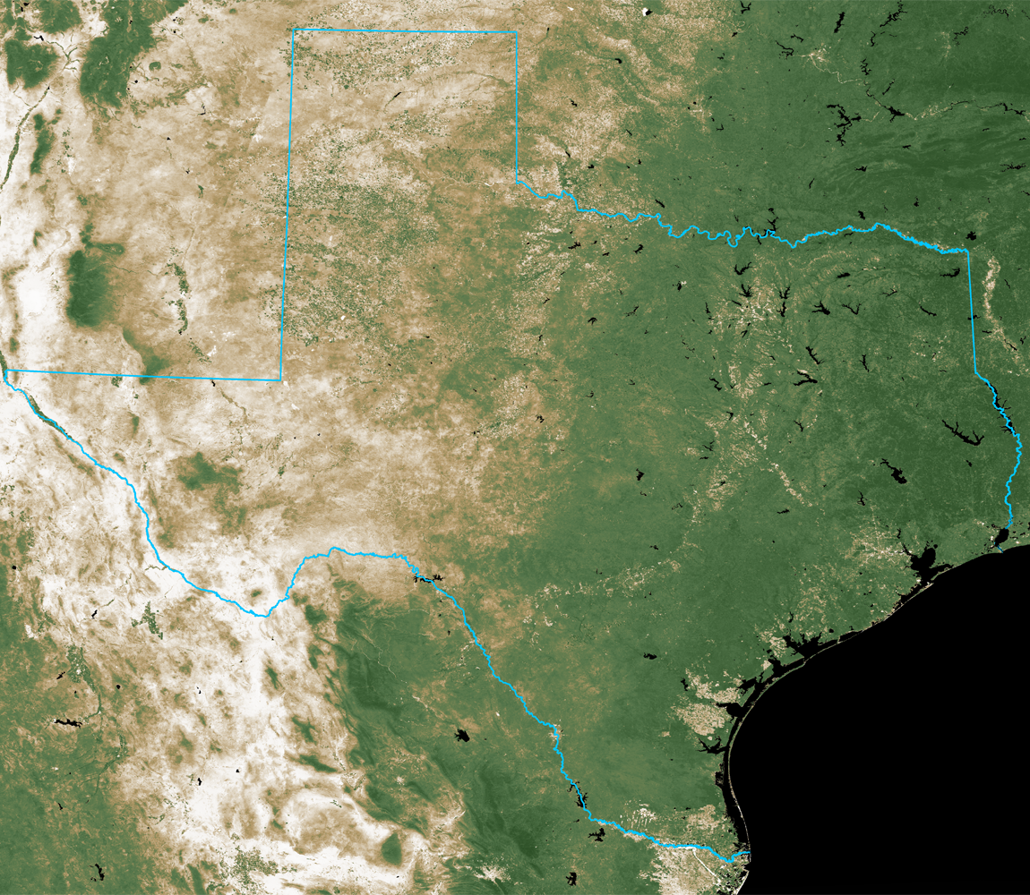
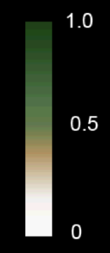
NDVI on September 30, 2010
Normalized Difference
Vegetation Index
September 30, 2010
Source: 16-day cycle MODIS
UT Center for Space Research

Slide 14
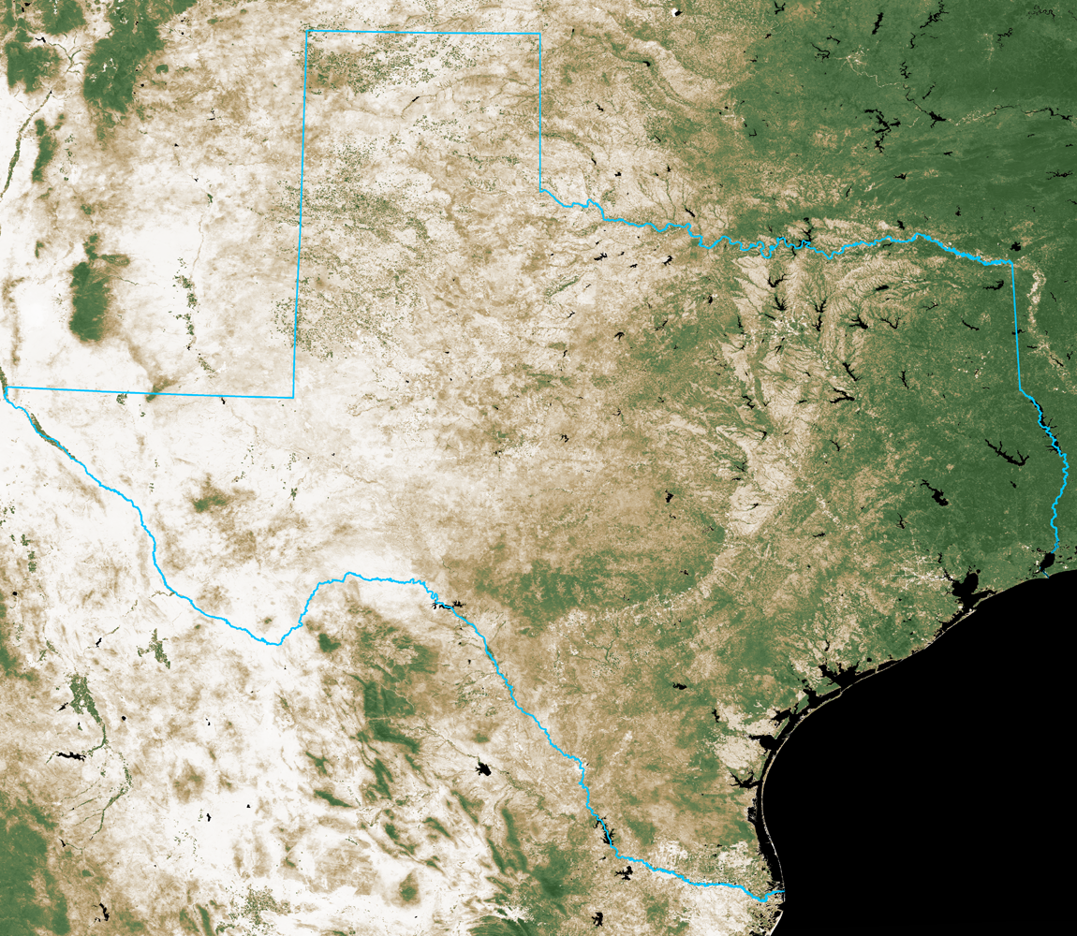
NDVI on September 30, 2011
Normalized Difference
Vegetation Index
September 30, 2011
Source: 16-day cycle MODIS
UT Center for Space Research

Slide 15
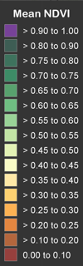
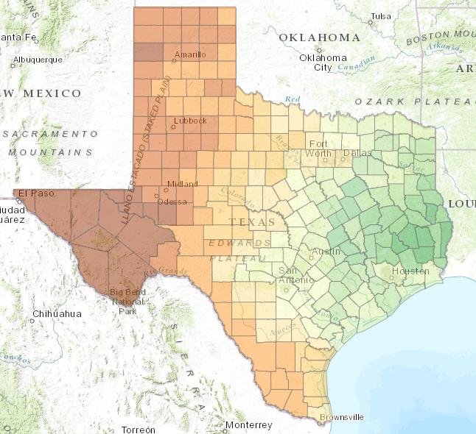
Most Recent NDVI Map
http://magic.csr.utexas.edu/ndvi/flexviewer/

Slide 16
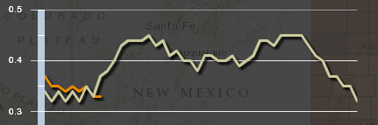
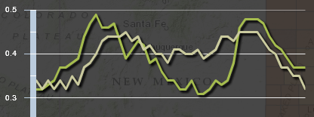
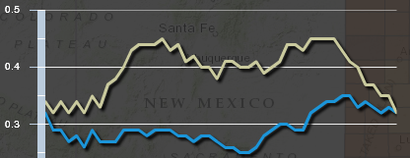
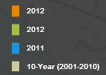

NDVI in
Tom
Green
County
2013
2012
2011

Slide 17
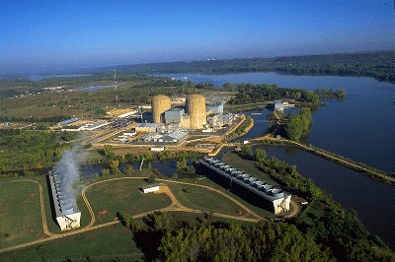
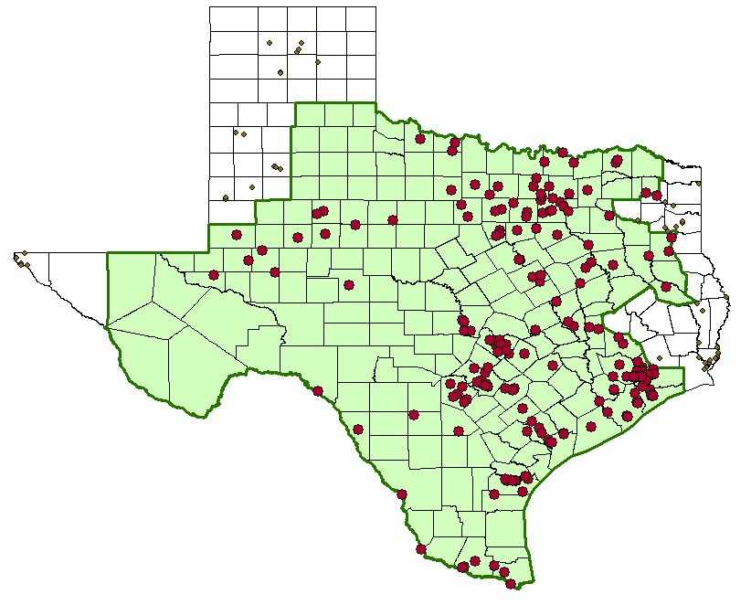
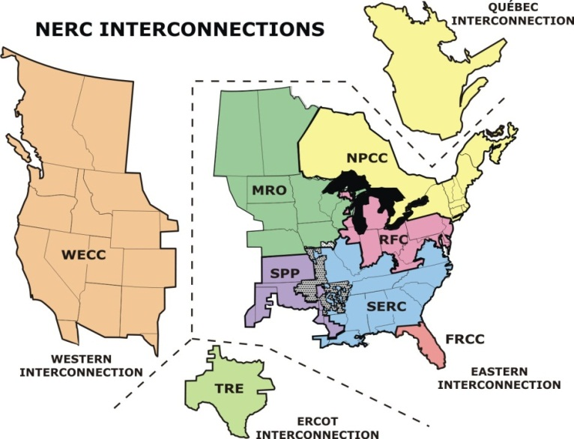
Water and Electric Power Generation
Water flow, level and temperature issues
ERCOT Power Pool

Slide 18
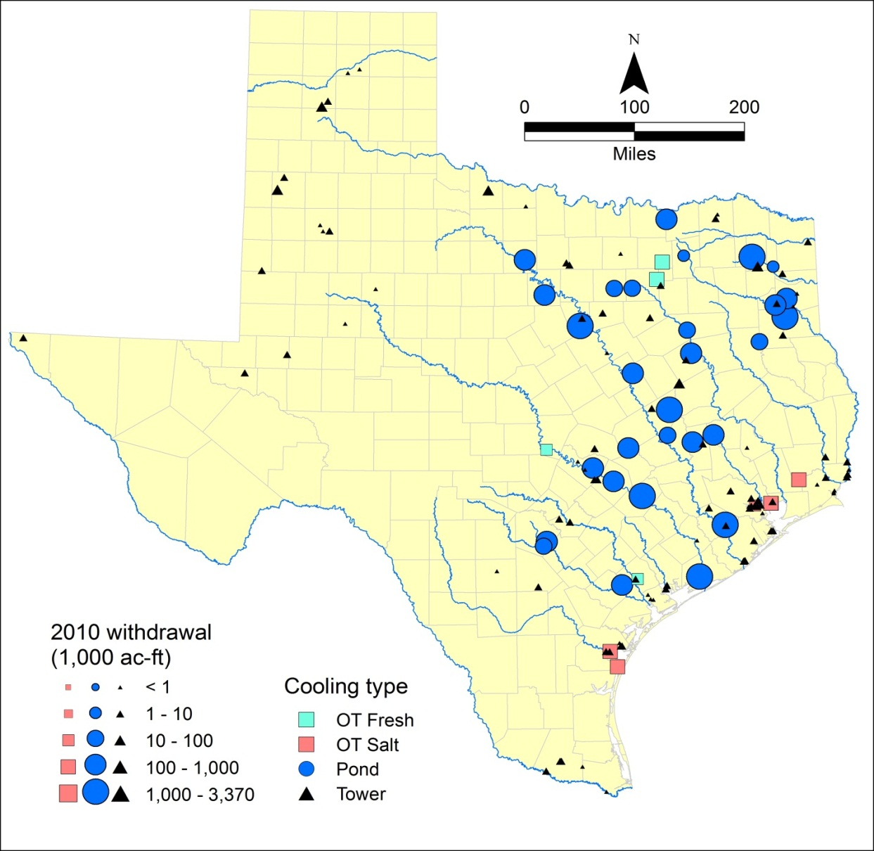

Electrical supply is NOT resilient to drought
Power supply in195 counties isolated from rest of US
41% of TX water withdrawals for electricity
77% of water is surface water
3000 MW at risk if drought had not eased in early 2012
Notes:
Our power supply is threatened by the possibility of low water conditions inhibiting access to cooling water at some power plants. This could lead to rolling blackouts in Texas (as were being warned by ERCOT in Spring 2012)

Slide 19
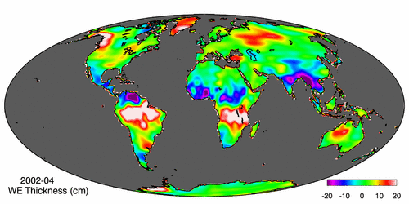
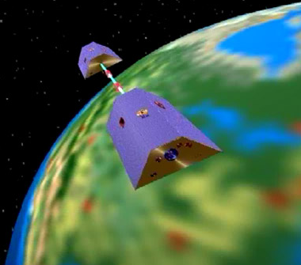
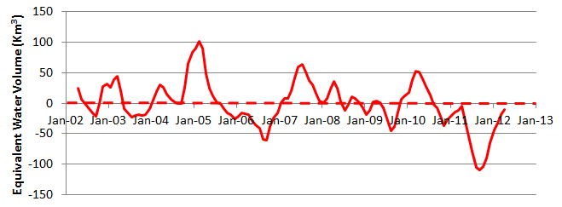
Measuring Gravity Anomaly from Space (GRACE)
Force of gravity responds to changes in water volume
Water is really heavy!
Gravity Anomaly of Texas, 2002 – 2012
Normal
In 2011, we lost 100 Km³ of water or 70 Lake Travis’s

Slide 20
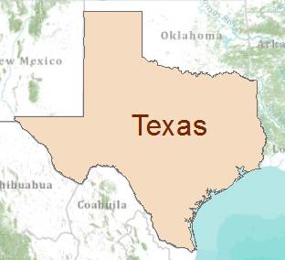
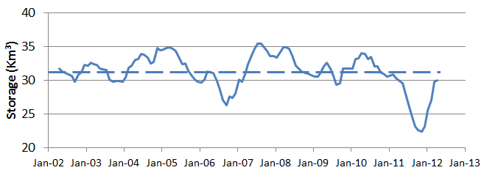
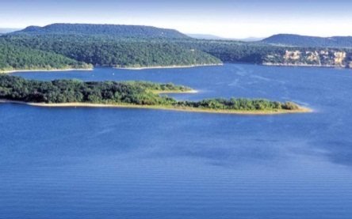
GRACE and Texas Reservoir Water Storage
Surface water reservoir storage is closely correlated with the GRACE data
Grace Satellites
Normal
In 2011 we lost 100 Km³ of water overall
Surface Water Reservoirs
Normal
In 2011 we lost 9 Km³ of water from reservoirs

Slide 21
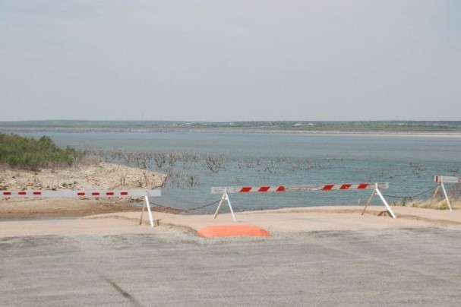
O.H. Ivie Reservoir
  Owned and operated by the Colorado River Municipal Water District
  Purpose: Water Supply
  Supplies: Odessa, Big Spring, Snyder, Midland, Abilene, San Angelo, Ballinger
  Storage Capacity: 554,339 acre-feet
  Current Storage: 114,000 acre-feet
  2011 Change in Storage: - 82,000 acre-feet
  (12,000 acre-feet to San Angelo)
M. Bewley

Slide 22
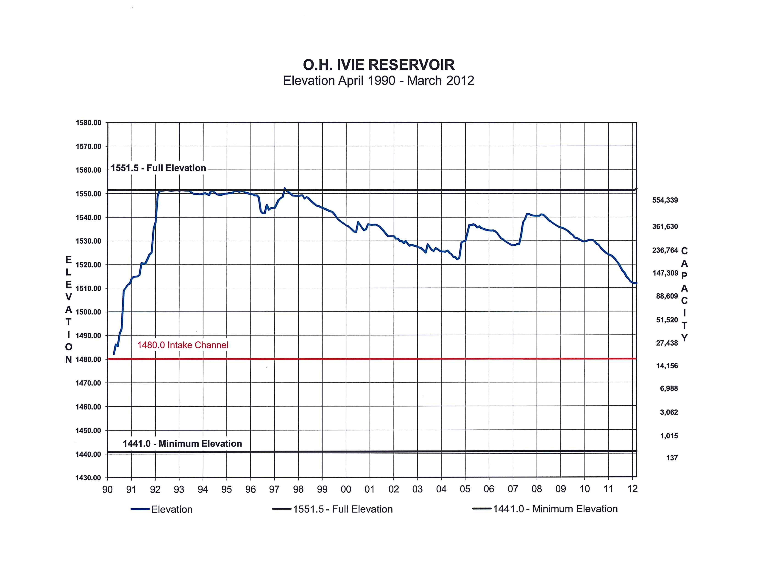
Drought in West Texas is chronic
1990’s
2000’s

Slide 23
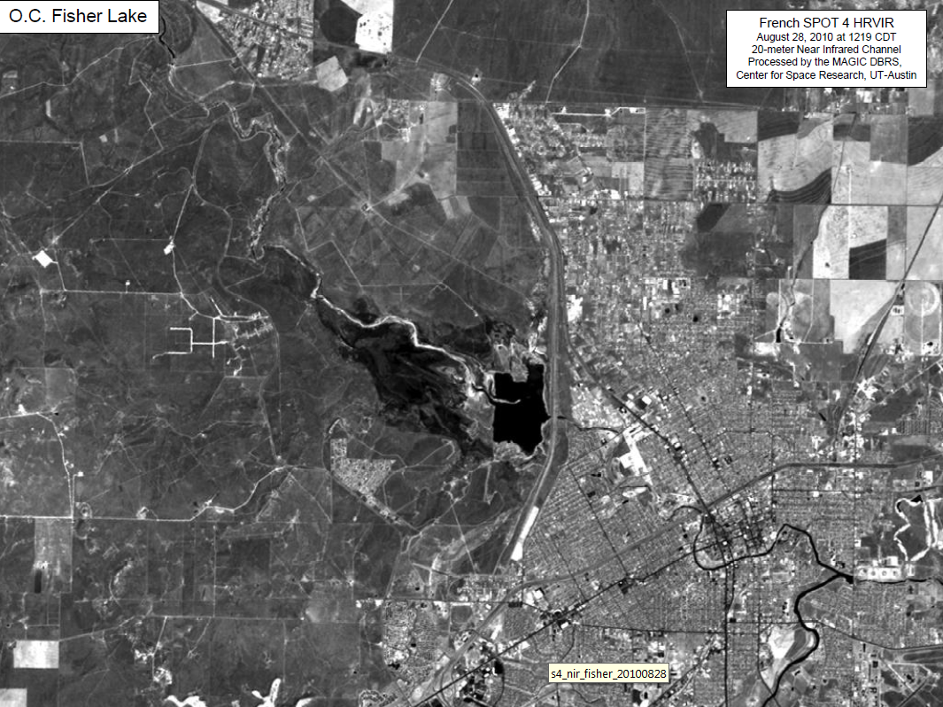
Lake O.C. Fisher, August 2010

Slide 24
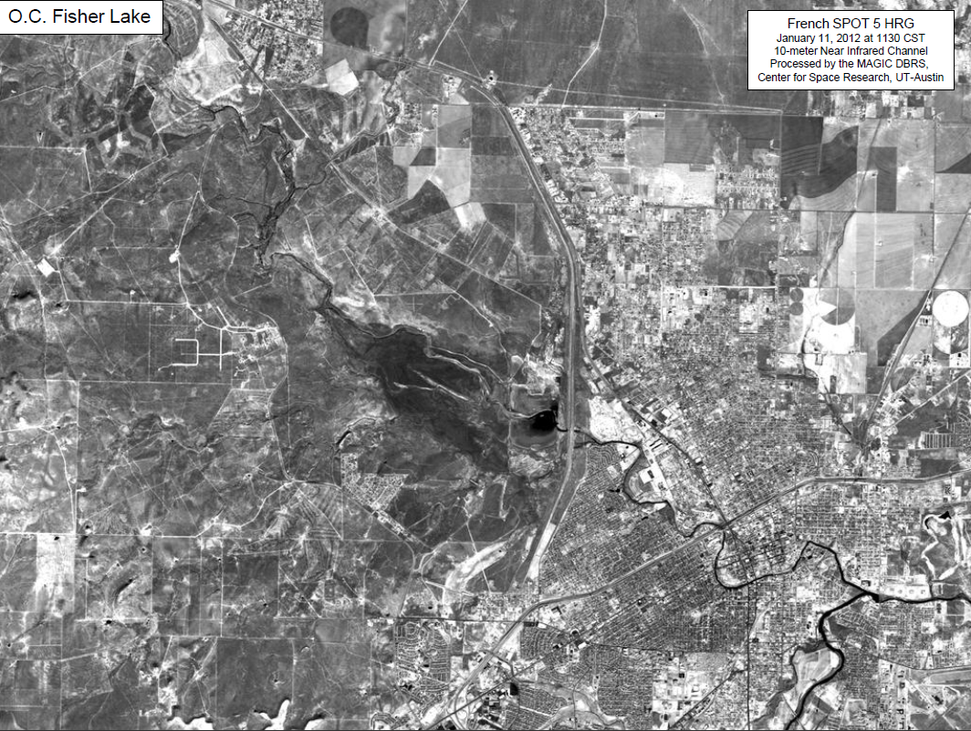
Lake O.C. Fisher, Jan 2012

Slide 25
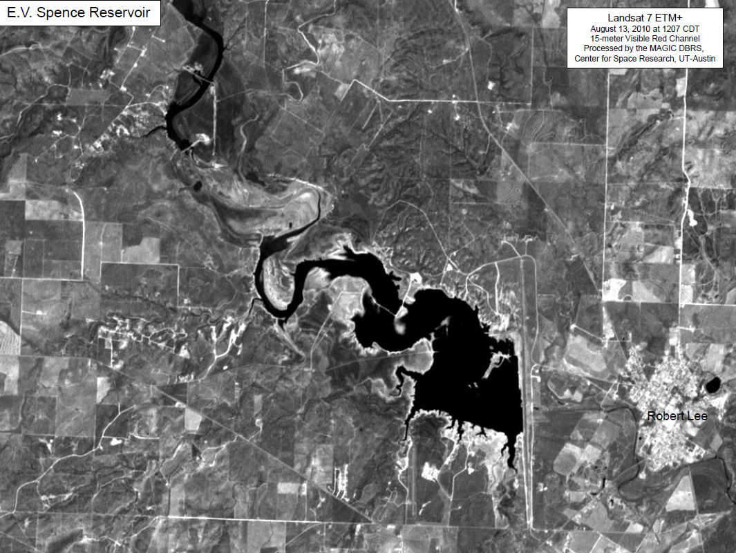
Lake E.V. Spence, August 2010

Slide 26
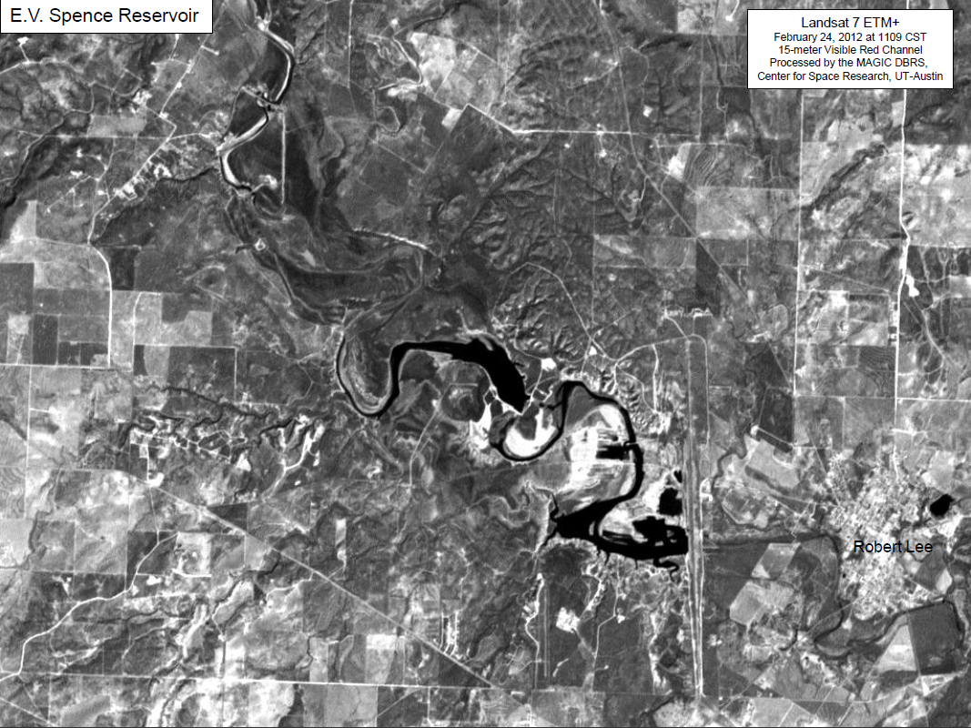
Lake E.V. Spence, Jan 2012

Slide 27
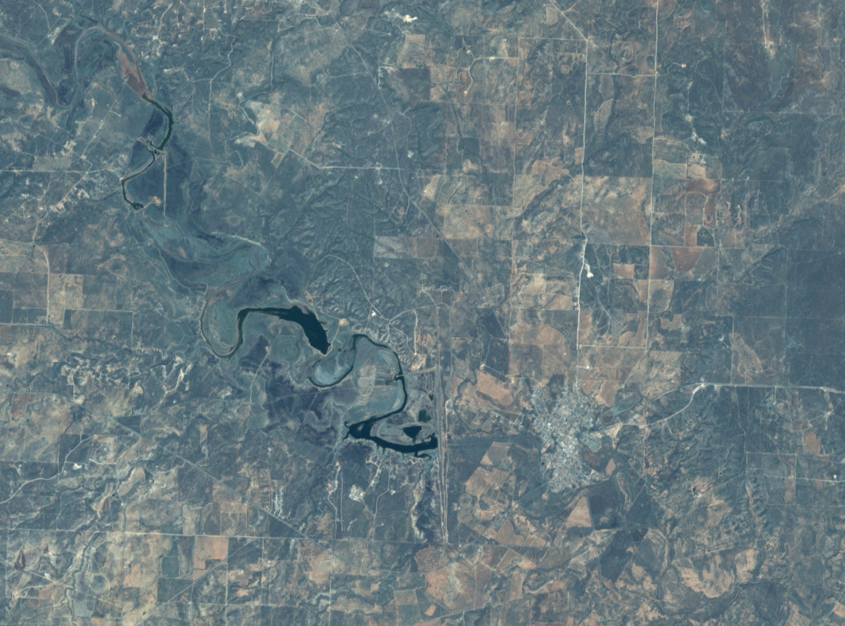
Lake E.V. Spence, Sept 2012
Landsat 7 ETM+
September 19, 2012 at 1210 CDT
15-meter Pan/Visible Color
Processed by the MAGIC DBRS,
Center for Space Research, UT-Austin
Robert Lee
Lake E.V. Spence

Slide 28
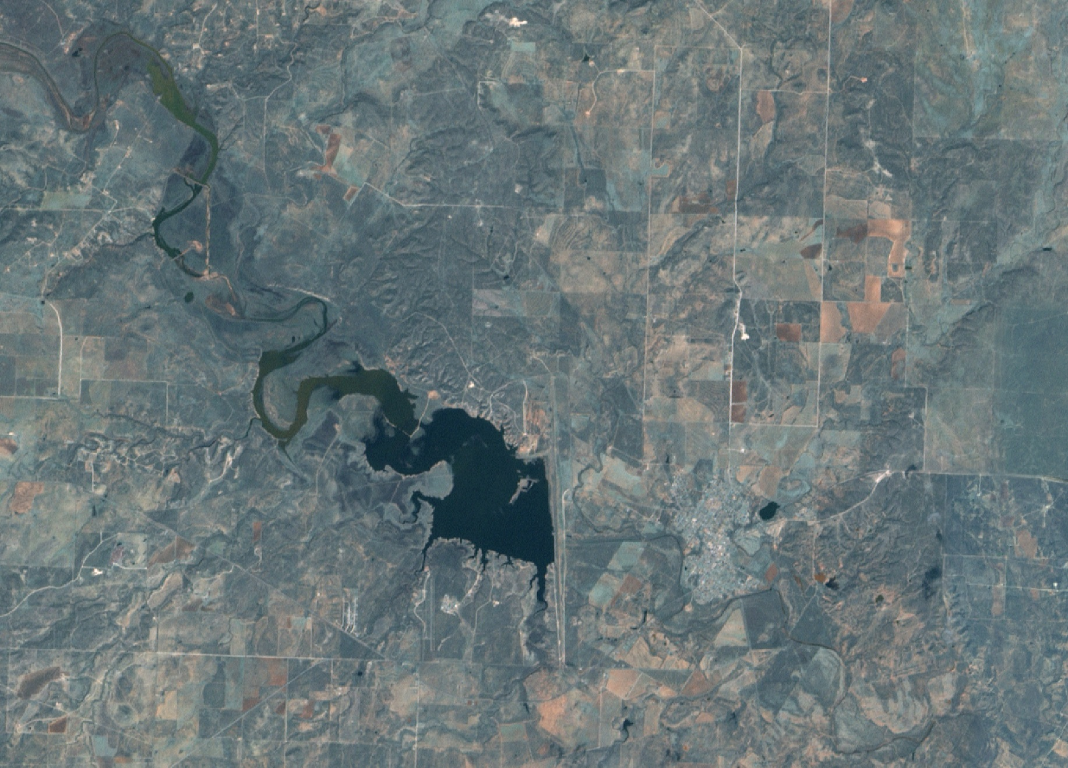
Lake E.V. Spence, Oct 2012
Landsat 7 ETM+
October 21, 2012 at 1211 CDT
15-meter Pan/Visible Color
Processed by the MAGIC DBRS,
Center for Space Research, UT-Austin
Rainfall on September 29, 2012
Robert Lee
Lake E.V. Spence

Slide 29
Reservoirs
Odessa
Midland
San Angelo

Slide 30
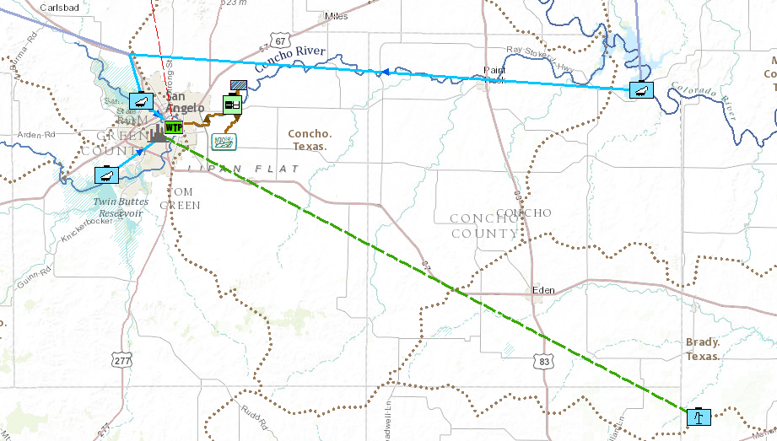
San Angelo Water Supply Sources
Regional pipeline (CRMWD)
O.C. Fisher
Reservoir
Wastewater
reuse for irrigation
O.H. Ivie
Reservoir
City of
San Angelo
Twin Buttes
Reservoir
Pipeline Under Construction
Hickory Underground
Water District

Slide 31
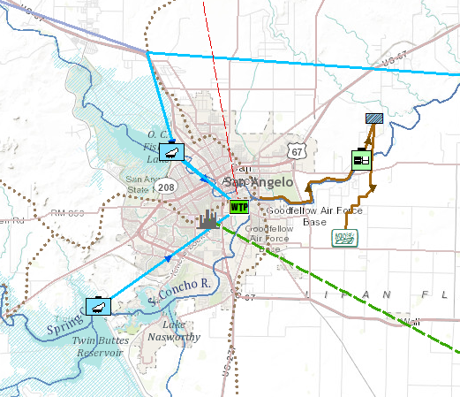
San Angelo Water Infrastructure
Pipeline from O.H. Ivie
O.C. Fisher
Reservoir
Wastewater Treatment Plant
Water Treatment Plant
Lipan Flats
irrigation area
Twin Buttes
Reservoir

Slide 32
San Angelo Water Demand

Slide 33
San Angelo Water Demand
San Angelo has a contract for 15,000 acre-ft per year from O.H. Ivie (13.4 MGD)
which was reduced to 12,000 acre-feet in 2011
“Seasonal Load” of 4 MGD (30% of total volume)
10 MGD
“Base Load” of 10 MGD (70% of total volume)

Slide 34
Water Demand and Supply
Groundwater supply could support much of the base load
Supplement that with surface water from lakes
9 MGD
With banking
6 MGD
Groundwater Supply

Slide 35
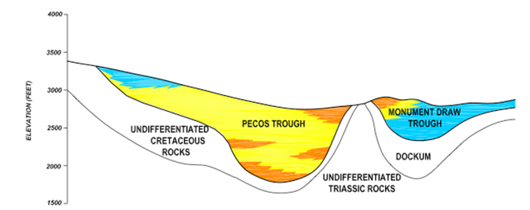
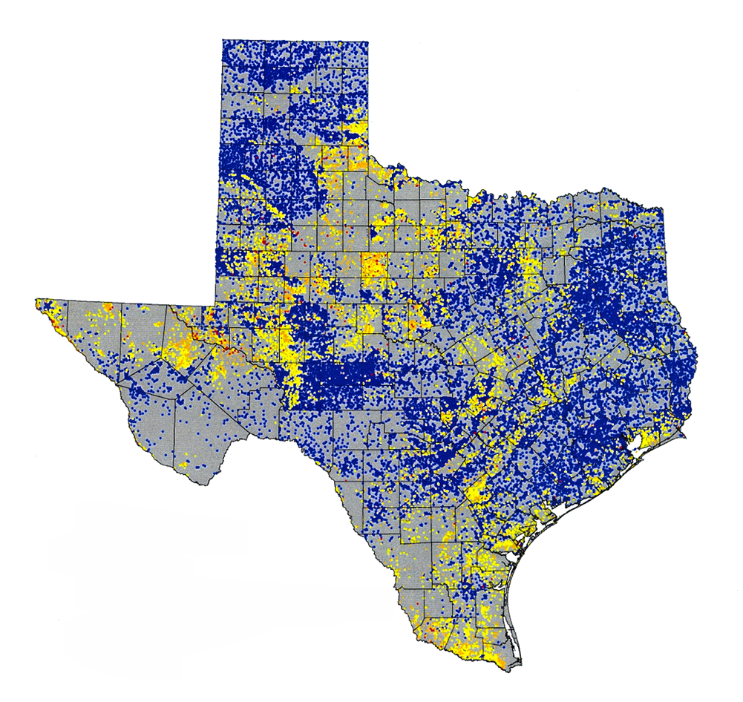
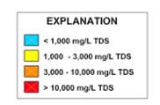
Saline Groundwaters of Texas
Pecos Alluvium

Slide 36
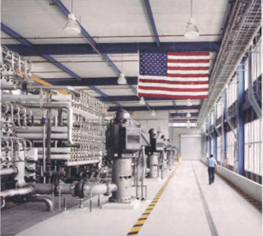


Largest inland desalination plant in the world
Kay Bailey Hutchinson Plant in El Paso
(27.5 MGD)

Slide 37
Conclusions
Drought is a fact of life in Texas
  Especially prevalent in West Texas
The Drought of 2011 continues and we do not know when it will end
Surface water supplies are significantly diminished
Groundwater supply is needed but quality is a challenge
Texas is going to invest $billions in water development

