Slide 1
Water Availability During the Drought
David R. Maidment Center for Research in Water Resources University of Texas at Austin

Slide 2
Water Availability during the Drought
Drought Technology Steering Committee
Water balance of Texas
Drought in West Texas
Texas water and climate model

Slide 3
Water Availability during the Drought
Drought Technology Steering Committee
Water balance of Texas
Drought in West Texas
Texas water and climate model

Slide 4
Drought Forum, Feb 13, 2012
State water agencies and academic speakers
Formed a Drought Technology Steering Committee to continue dialog
TWDB, TCEQ, TPWD, TDEM
UT Austin, TAMU – College Station, Texas Tech
Acknowledgements: Brenner Brown, Kathy Alexander, David Bradsby, Mike Bewley, Byron Tapley, Himanshu Save, Gordon Wells, Teresa Howard, Johnnie Sullivan, Zong-Liang Yang, Xitian Cai, Jay Banner, Eric James, Charlie Kreitler, Cedric David, Dharhas Pothina
http://www.texasdroughtinfo.org

Slide 5
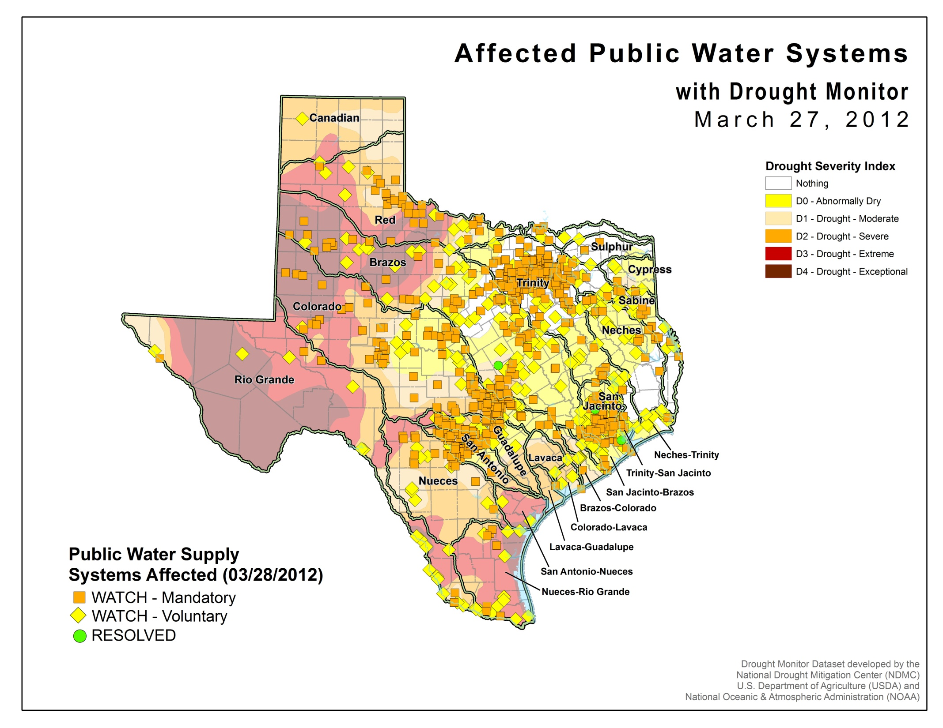
About 1000 water systems
600 Groundwater
400 Surface water

Slide 6
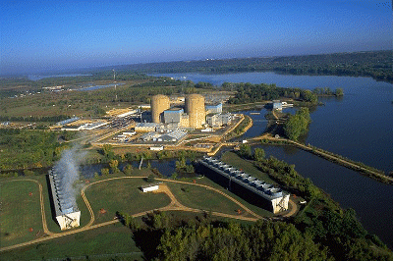
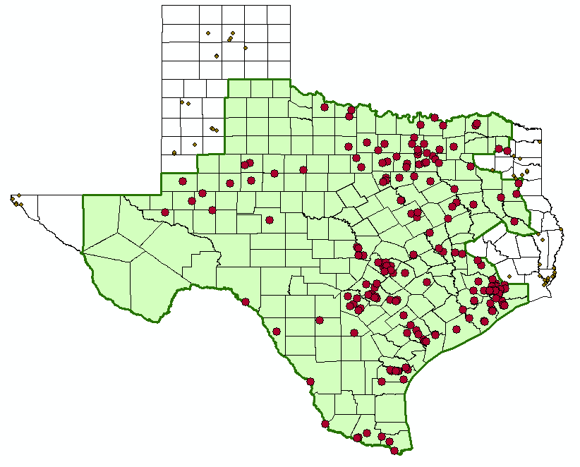
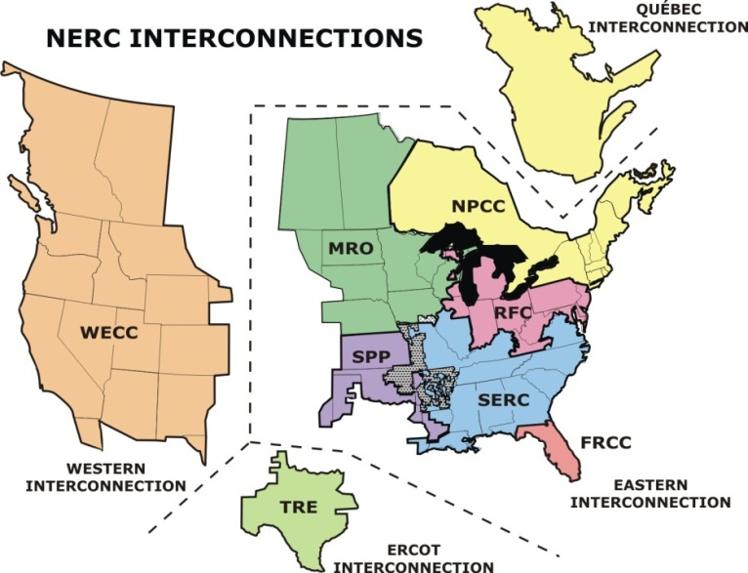
Water and Electric Power Generation
Water flow, level and temperature issues
ERCOT Power Pool

Slide 7
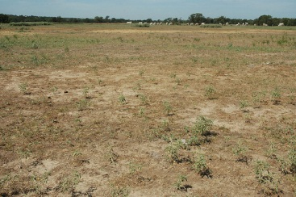
Impact on Agriculture
Pasture in Burleson County
Source: Texas Agrilife

Slide 8
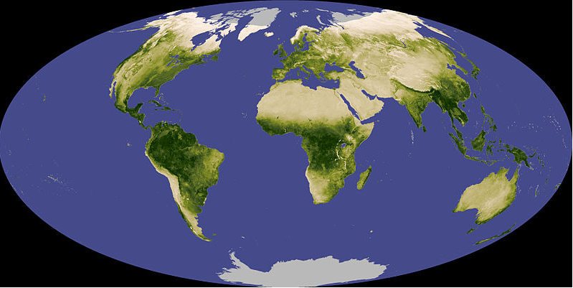
Normalized Difference Vegetation Index (NDVI)
A measure (0-1) of the greenness of the land surface derived from remote sensing
Vegetative vigor is limited by soil moisture

Slide 9
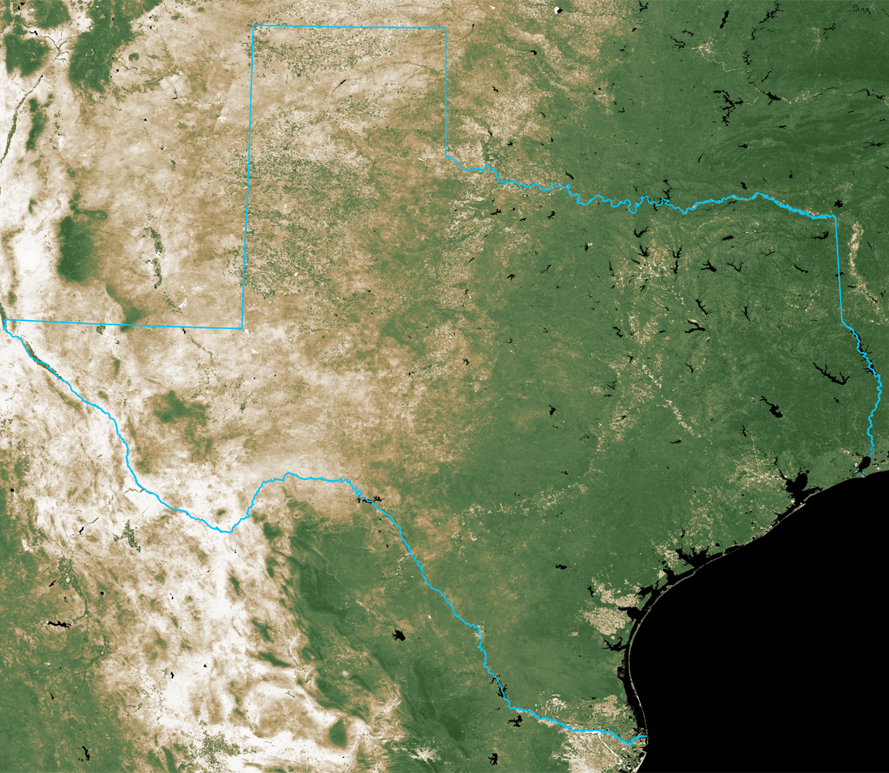
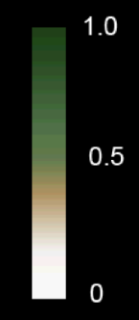
NDVI on September 30, 2010
Normalized Difference
Vegetation Index
September 30, 2010
Source: 16-day cycle MODIS
UT Center for Space Research

Slide 10
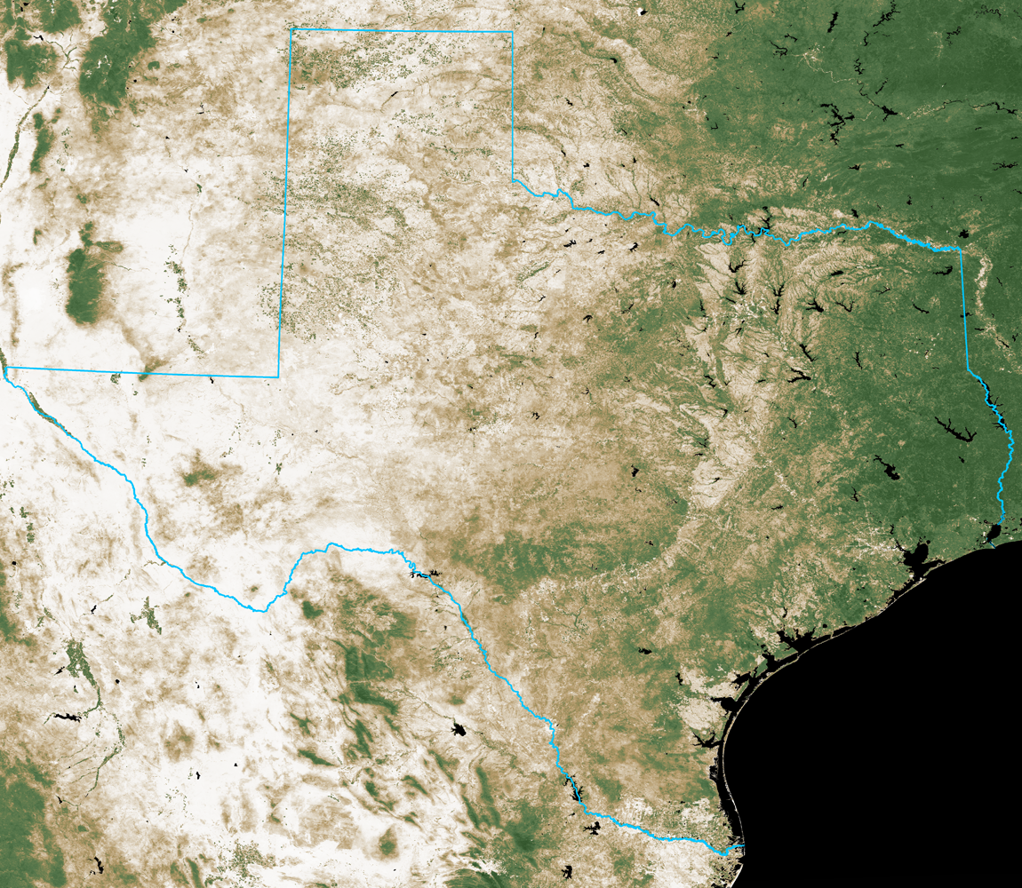
NDVI on September 30, 2011
Normalized Difference
Vegetation Index
September 30, 2011
Source: 16-day cycle MODIS
UT Center for Space Research

Slide 11
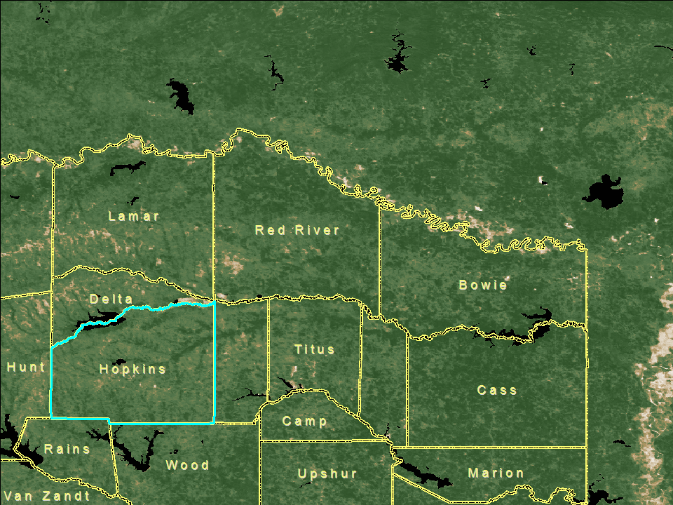
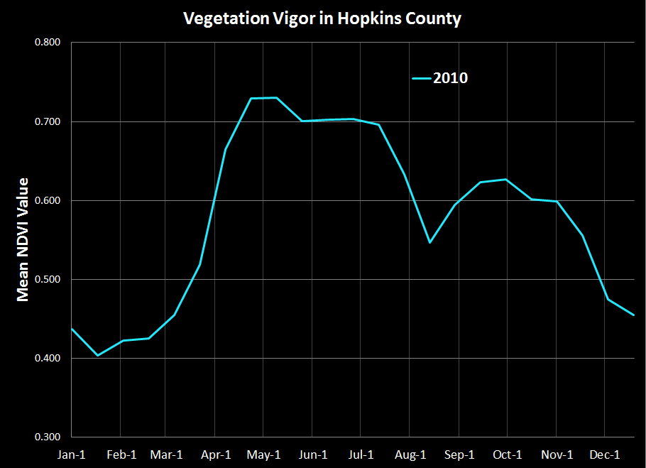
September 30
2010
September 30
2010

Slide 12
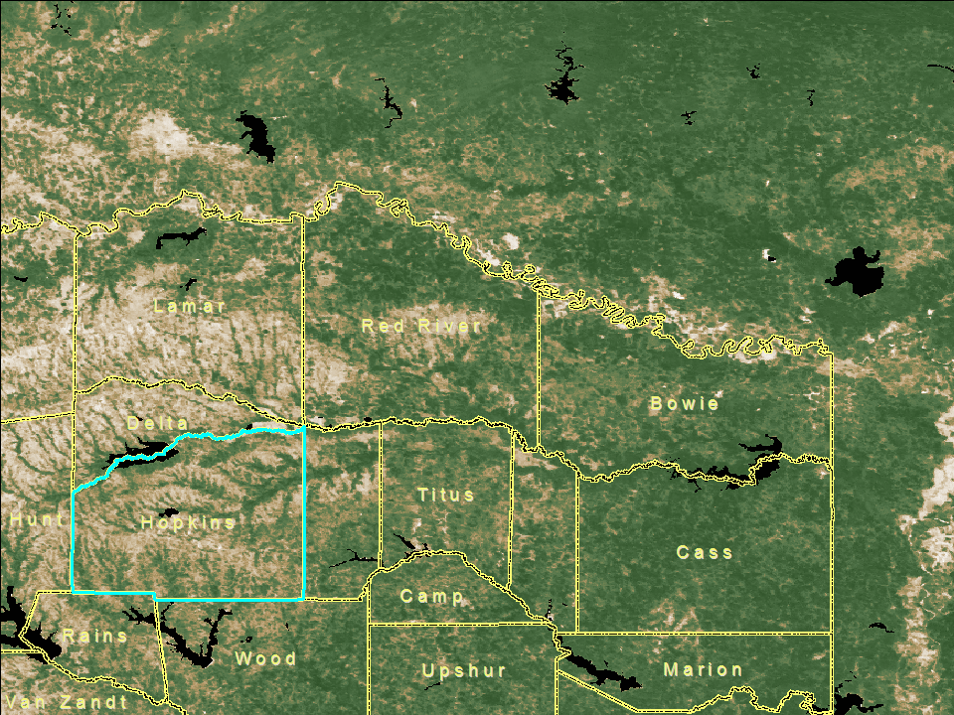
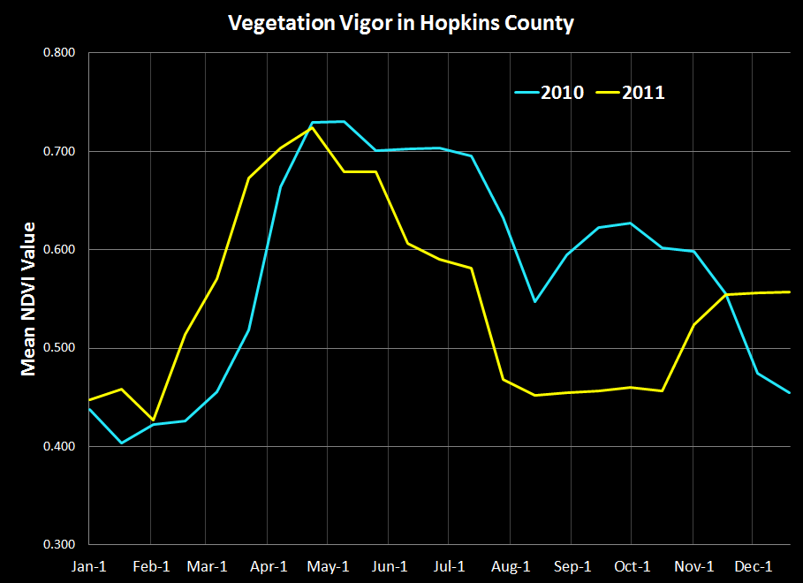
September 30
2011
September 30
2011

Slide 13
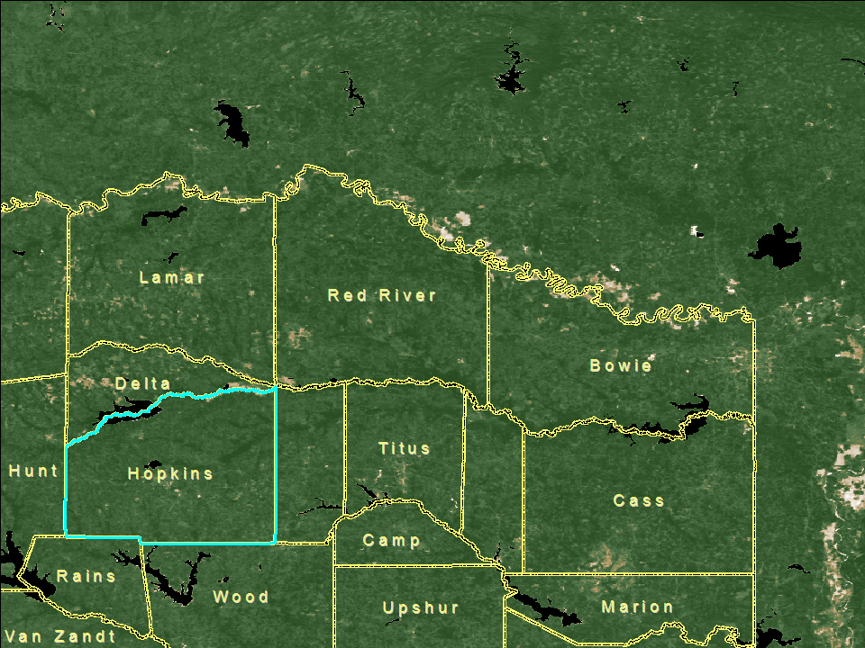
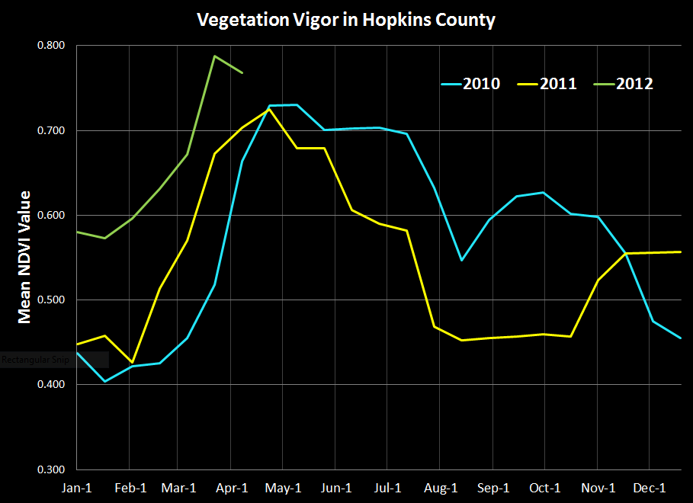
April 6
2012
April 6
2012

Slide 14
Water Availability during the Drought
Drought Technology Steering Committee
Water balance of Texas
Drought in West Texas
Texas water and climate model

Slide 15
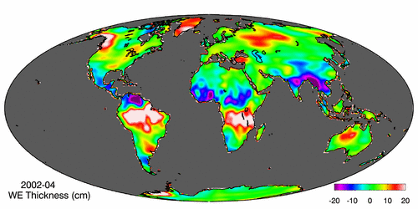
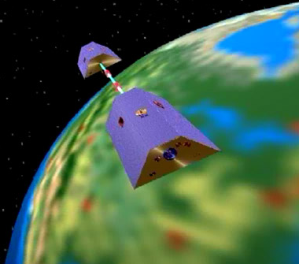
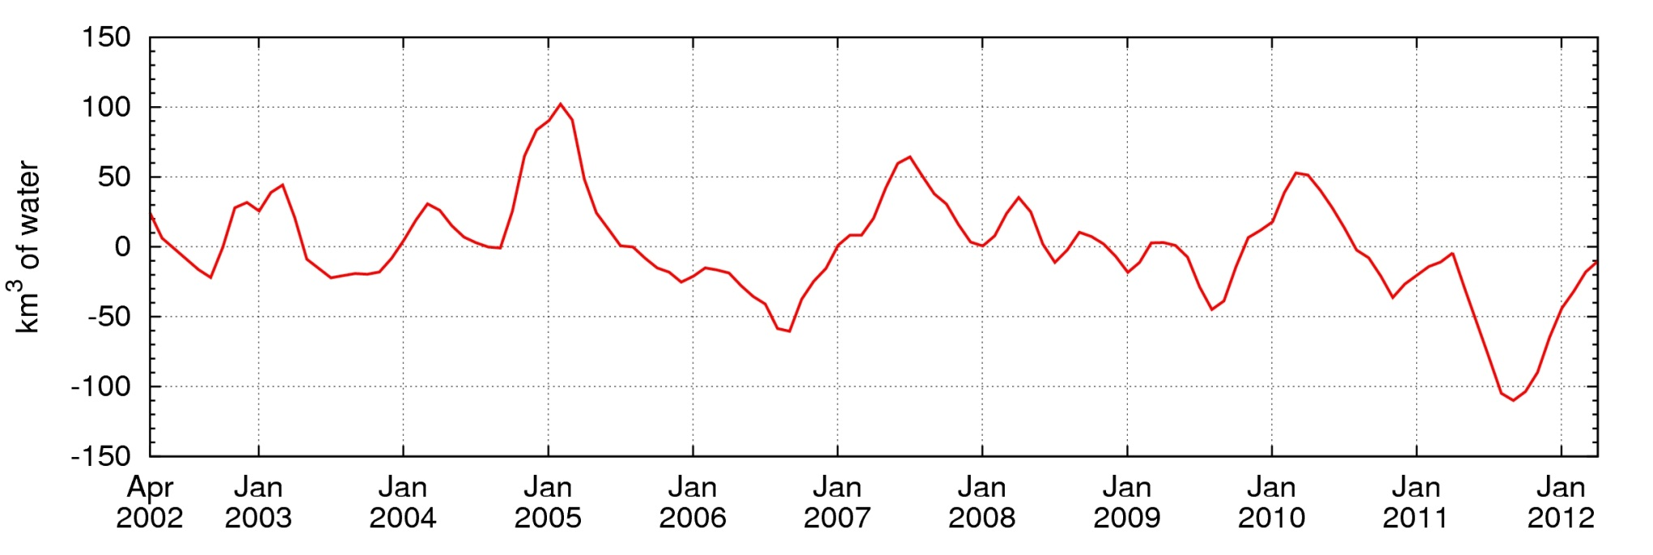
Measuring Gravity Anomaly from Space (GRACE) Force of gravity responds to changes in water volume Water is really heavy!
Gravity Anomaly of Texas, 2002 – 2012
Normal
In 2011, we lost 100 Km³ of water or 70 Lake Travis’s

Slide 16
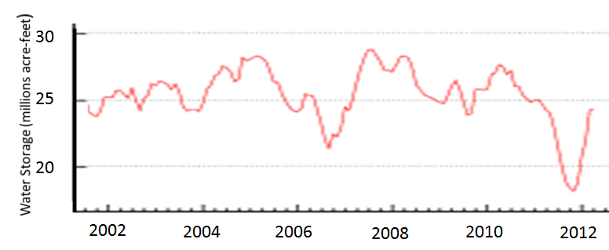
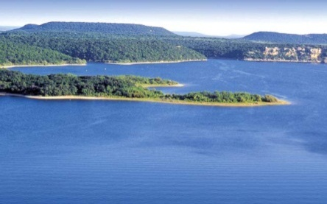
GRACE and Texas Reservoir Water Storage
Most water loss in drought is coming from soil water and shallow groundwater
Grace Satellites
In 2011 we lost 100 Km³ of water overall
Texas Reservoirs
In 2011 we lost 9 Km³ of water from reservoirs
http://midgewater.twdb.texas.gov/Reservoirs/TWC/plothtm/State.htm

Slide 17
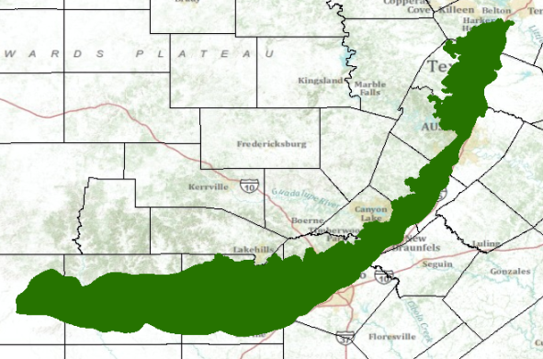
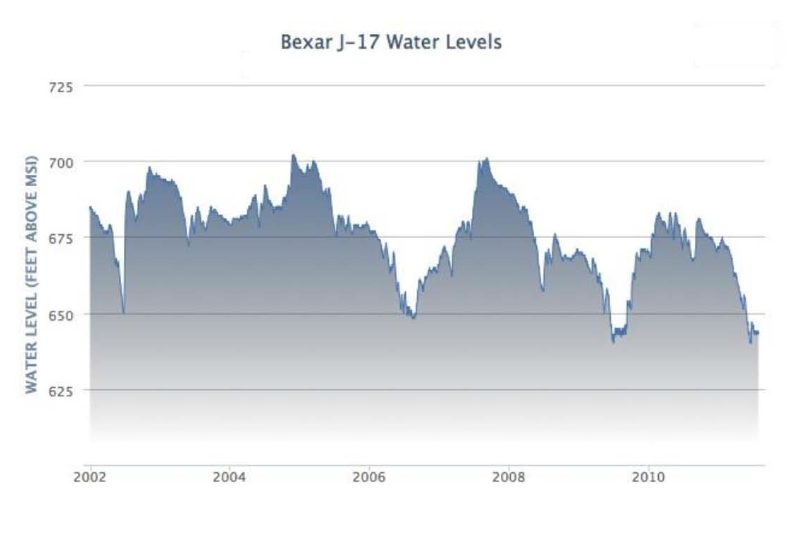
GRACE and Edwards Aquifer Levels
The shallow groundwater system is reacting to drought like surface reservoirs
Grace Satellites
Gravity Anomaly of Texas, 2002 – 2012
Texas Drought
2011
Texas Drought
2005-2006
J-17 well
Edwards Aquifer

Slide 18
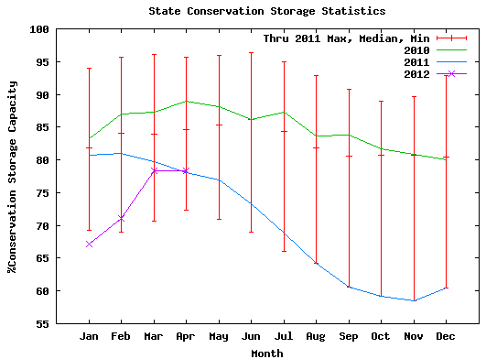
Surface Water Reservoir Storage
Surface water reservoirs total 50 Km³ of capacity and were 58% full at lowest point
Minimum in 2011, 58%

Slide 19
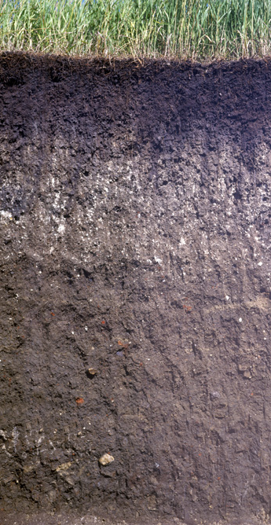
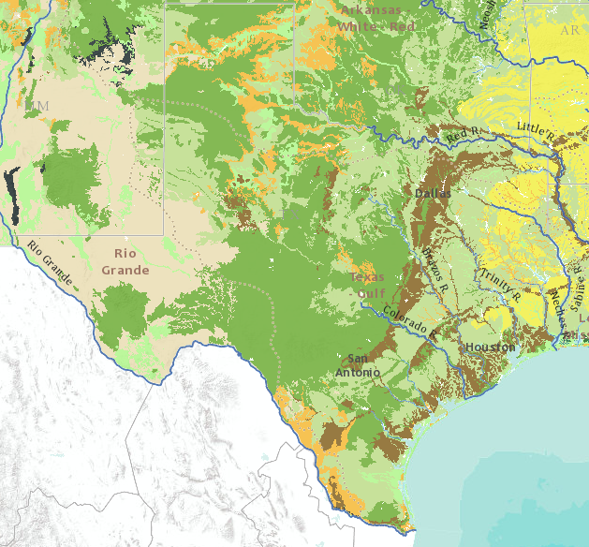
Soil Water In Texas
Soil water system has 78 Km³ of water storage capacity in top 1m of soil
Soil Wetness Index
Saturated
100
Soil Air
Oven Dry
Soil Water
0
Solid Particles
Soil Texture Map
First meter of Texas soil contains 11 cm of soil water and soil air

Slide 20
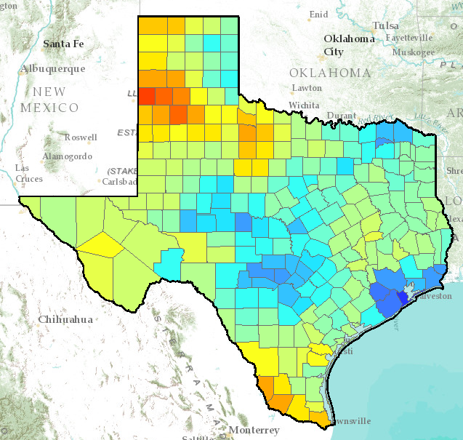
Texas Soil Wetness Index
On 12 May 2012, soil water storage in first meter of soil was 47% full, which is equivalent to 37 Km³ of water volume, or 5 cm of water uniformly distributed over Texas
% soil water capacity
http://www.arcgis.com/home/webmap/viewer.html?services=35849a2d508540f194d17380d0830266

Slide 21
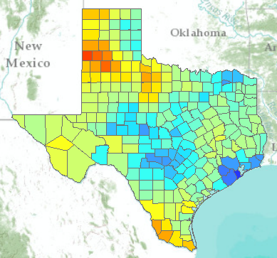
Soil Wetness Index, Travis County, January 2011 - May 2012
Effect of Spring Rains

Slide 22
Texas Soil Wetness Index (2011-2012)

Slide 23
Summary Water Balance of Texas
Overall changes in Texas water storage can be measured from space by the GRACE satellites
In 2011 drought we lost 100 Km³ of water (70 Lake Travis’s)
About 9 Km³ from surface water reservoirs
Approximately 15 Km³ from the soil water system
About three quarters from shallow groundwater
We have regained most of this lost water
We need county level metrics of water availability for better drought management

Slide 24
Water Availability during the Drought
Drought Technology Steering Committee
Water balance of Texas
Drought in West Texas
Texas water and climate model

Slide 25
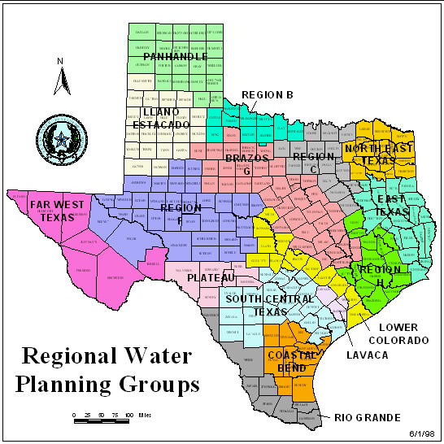
Drought in West Texas

Slide 26
Reservoirs
Odessa
Midland
San Angelo

Slide 27
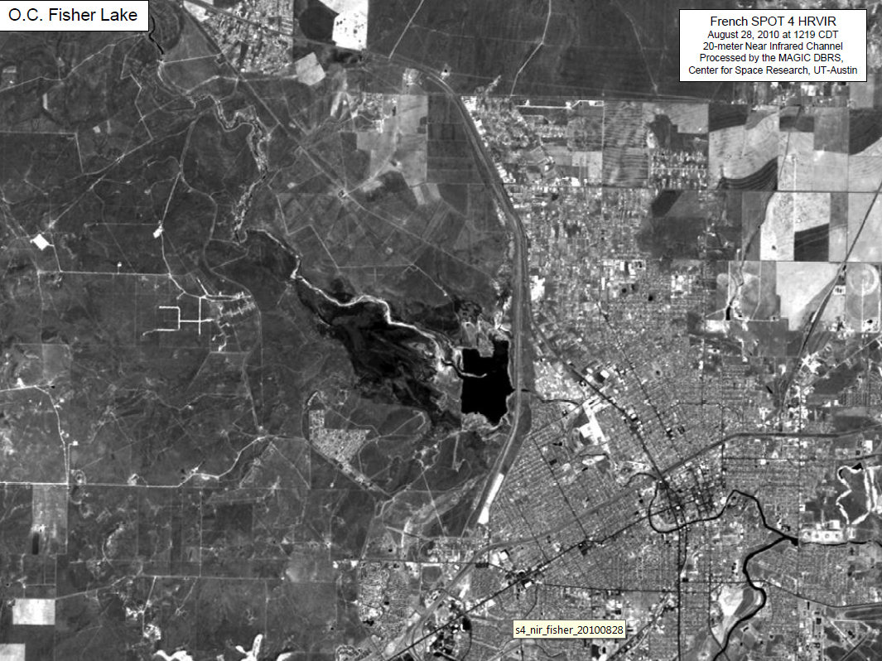
Lake O.C. Fisher, August 2010

Slide 28
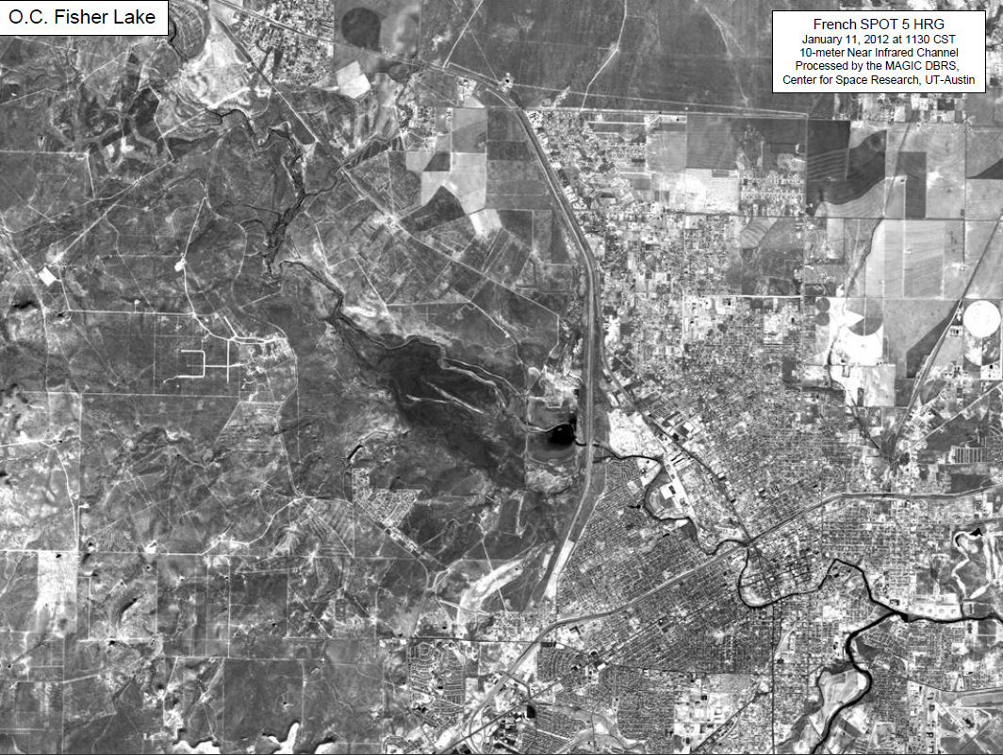
Lake O.C. Fisher, Jan 2012

Slide 29
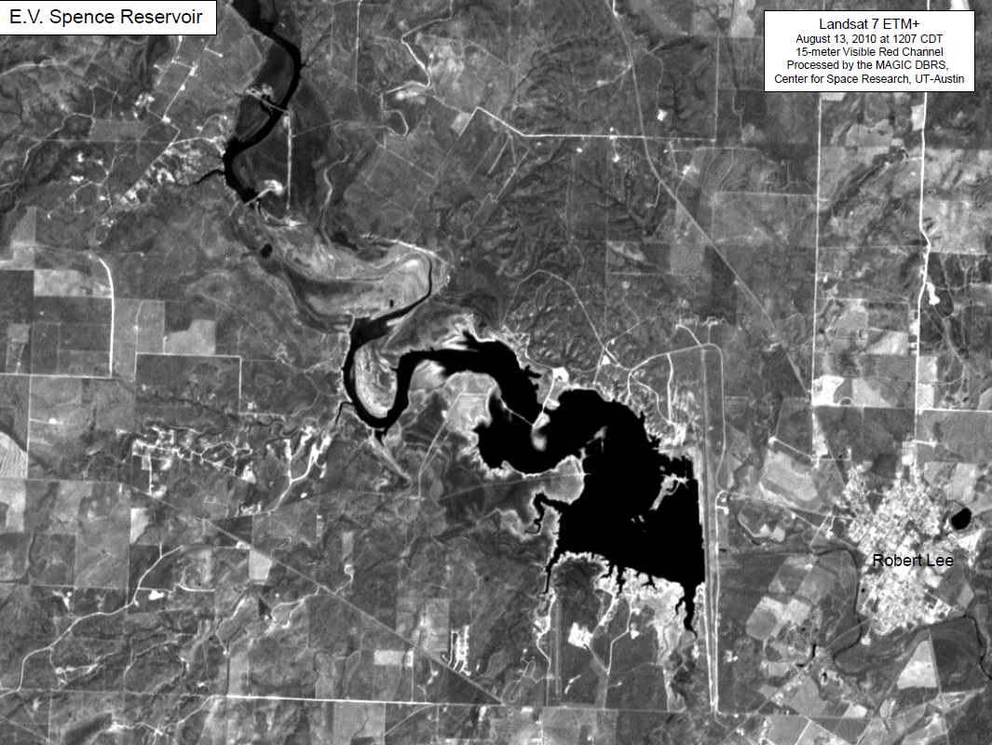
Lake E.V. Spence, August 2010

Slide 30
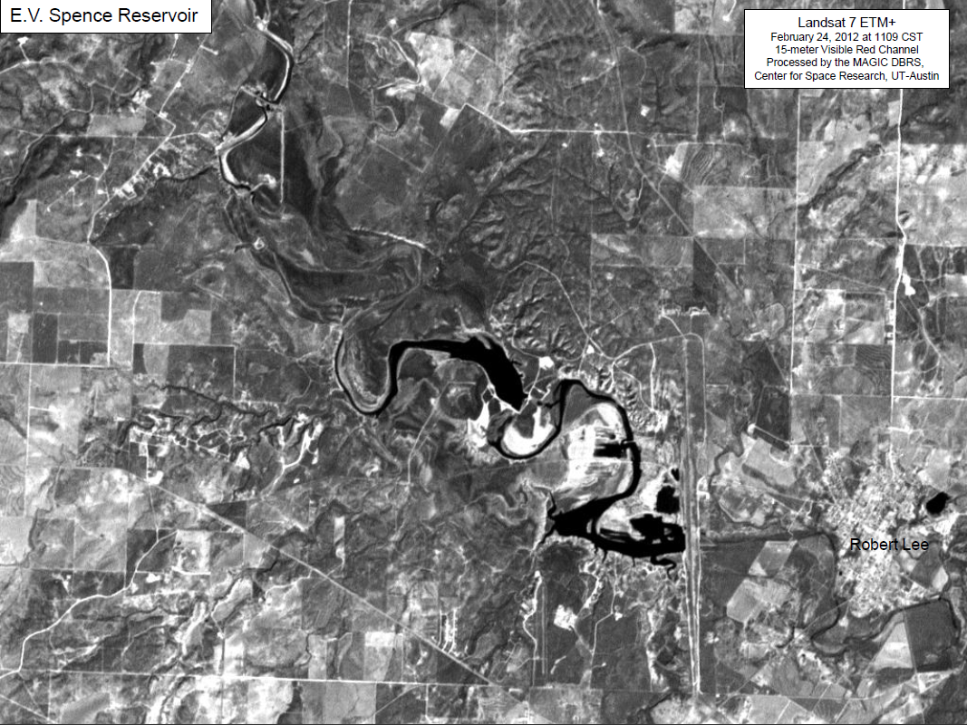
Lake E.V. Spence, Jan 2012

Slide 31
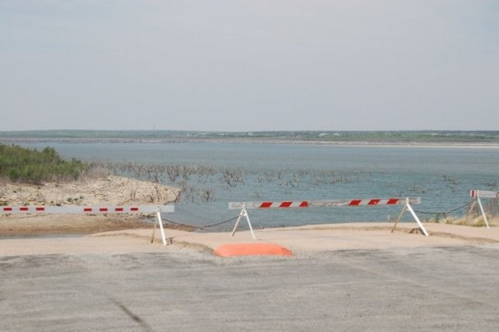
O.H. Ivie Reservoir
Owned and operated by the Colorado River Municipal Water District
Purpose: Water Supply
Supplies: Odessa, Big Spring, Snyder, Midland, Abilene, San Angelo, Ballinger
Storage Capacity: 554,339 acre-feet
Current Storage: 98,400 acre-feet
2011 Change in Storage: -81,820 acre-feet
M. Bewley

Slide 32
Drought in West Texas is chronic

Slide 33
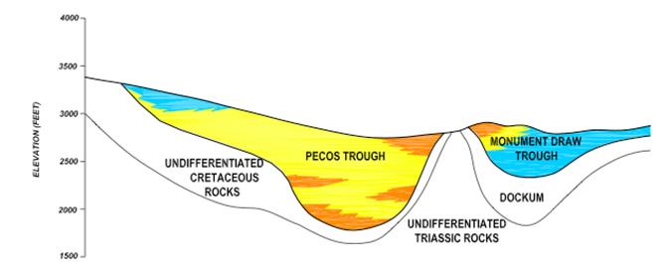
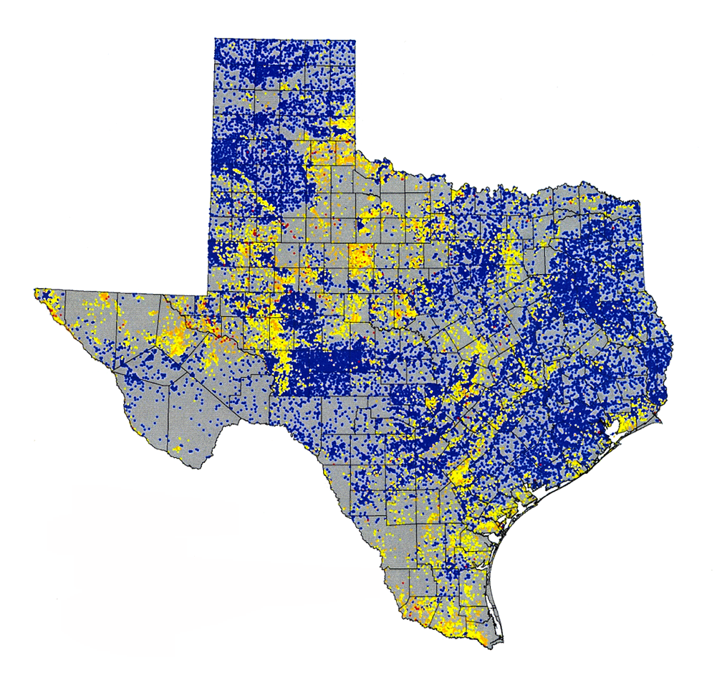
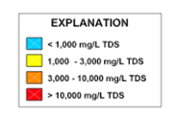
Saline Groundwaters of Texas
Pecos Alluvium

Slide 34
Water Availability during the Drought
Drought Technology Steering Committee
Water balance of Texas
Drought in West Texas
Texas water and climate model

Slide 35
Texas Water and Climate Model
Last severe drought in 1996 led to Senate Bill 1 in 1997 and SB2, SB3 later
Great improvement in long term water planning (10 to 50 years in future)
The 2011 drought exposed
We don’t have synthesized situational awareness of current condition of our water system state-wide
We need to be able to see ahead 6-18 months for rational water decision making

Slide 36
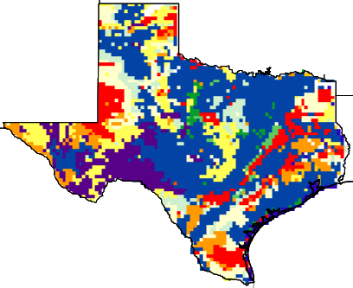
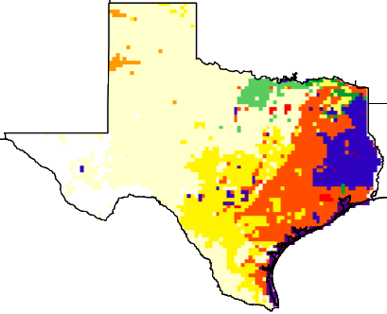
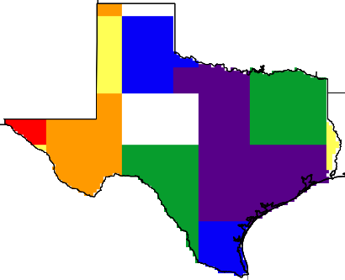
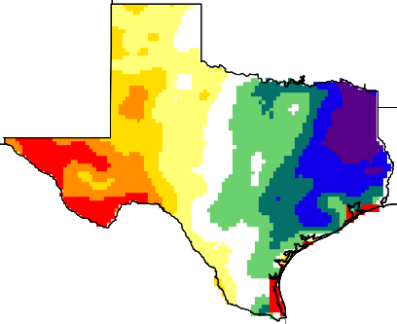
Calculate the Soil Water Balance of Texas
Land surface features
NLDAS atmospheric forcing
Soil
type
Temperature
Precipitation
Wind speed
Specific humidity
Surface pressure
Downward SW radiation
Downward LW radiation
Noah-MP land surface model
Land
cover
Soil
color
Green
vegetation fraction
Surface runoff
Sub-surface runoff
Soil moisture
Evapotranspiration
Water table ……
Model output

Slide 37
RAPID River Flow Model

Slide 38
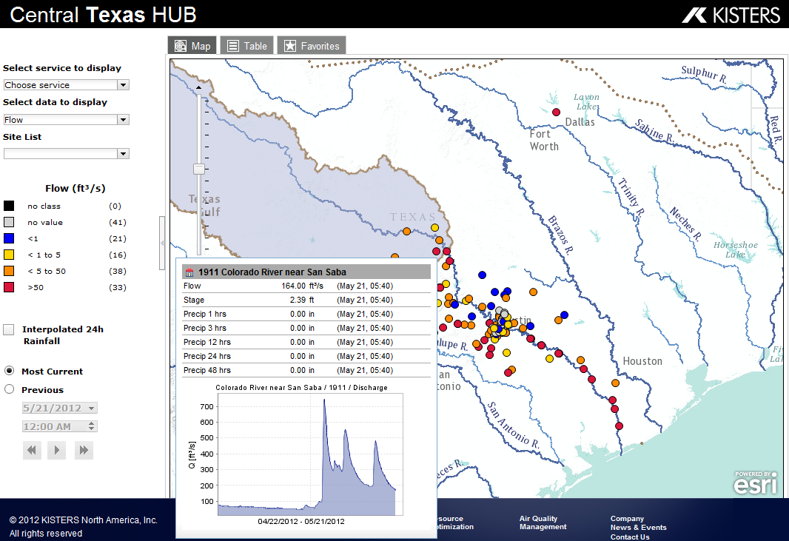
Synthesized Real-Time Water Models, Observations, Maps and Graphs
http://www.CentralTexasHub.org

Slide 39
Conclusions
GRACE Satellites can directly measure overall change in water storage in Texas
In 2011, we lost 100 Km³ of water, but conditions have returned to nearly normal
County-based metrics are needed to quantify drought severity and its spatial patterns
Surface water storage is almost gone in West Texas – switching to groundwater supply
We need a Texas Water and Climate Model

