Slide 1
Wide Area Flood Plan
By David R. Maidment
Center for Research in Water Resources
University of Texas at Austin
Presented to the Texas Flash Flood Coalition
University of Texas
12 November 2014
This presentation has been edited from the form in which it was originally given

Slide 2
Wide Area Flood Plan
A Wide Area Flood Plan enhances flood emergency response for communities
Linked to new flood forecast procedures being developed at the National Water Center in the National Flood Interoperability Experiment
Develop this plan for Travis and Williamson Counties in one year
Engage the Texas Flash Flood Coalition to guide the development of the effort
Have quarterly meetings of the TFFC to review progress and provide feedback
Use the discussion at this meeting to set the direction and identify leadership from the community

Slide 3
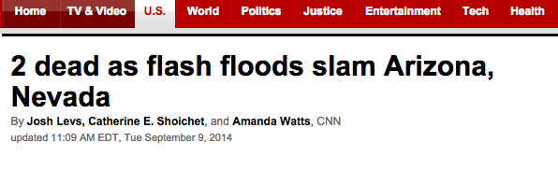
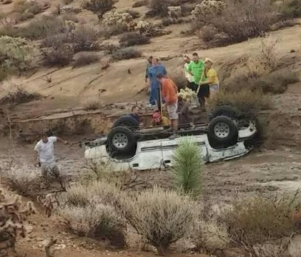
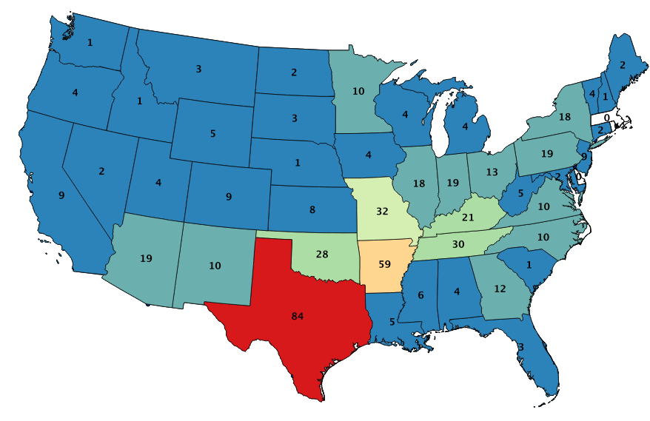
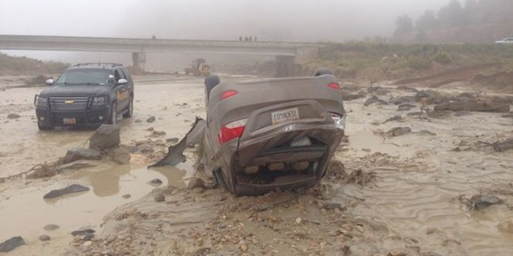
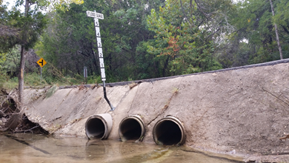
Why – People
On average, more people die annually from flooding than from
any other form of natural disaster
84
Low water crossing
Spatial Distribution of
Flood Fatalities 2007-2013
(source: NWS StormDat)

Slide 4


Located on Tuscaloosa Campus of University of Alabama
Operated by National Weather Service to support IWRSS partners (NWS, USGS, Corps of Engineers, FEMA)

Slide 5
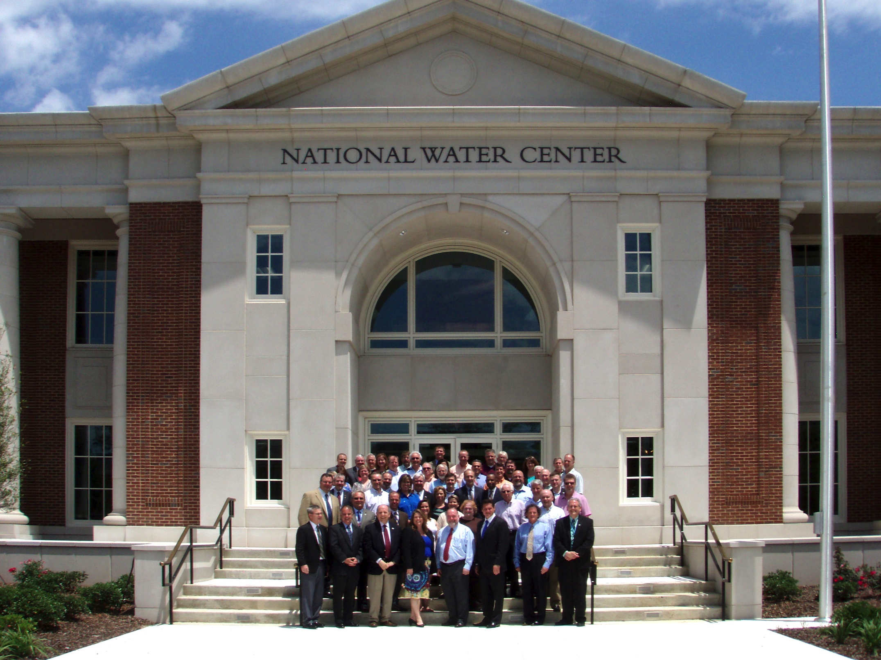
Inaugural Meeting – May, 2014

Slide 6
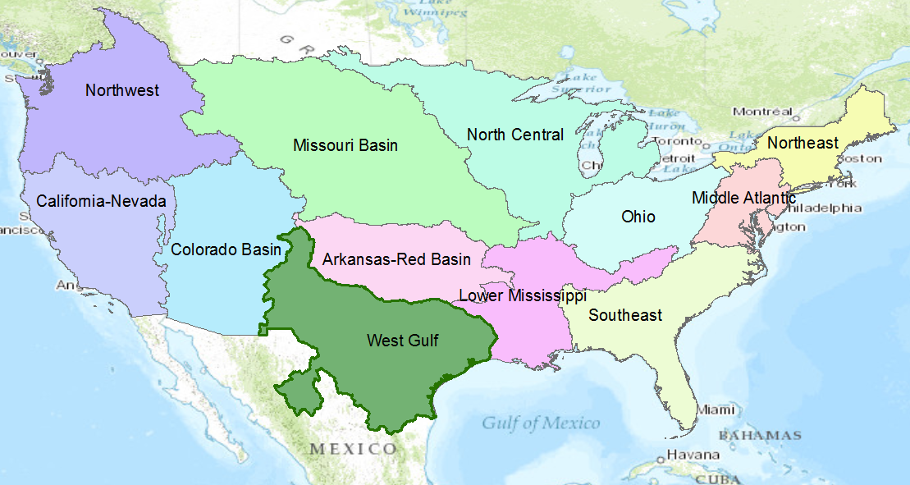
NWS River Forecast Centers
Perform precipitation, runoff and river flow simulation and forecasting for five days ahead, updated daily, more frequently during floods

Slide 7
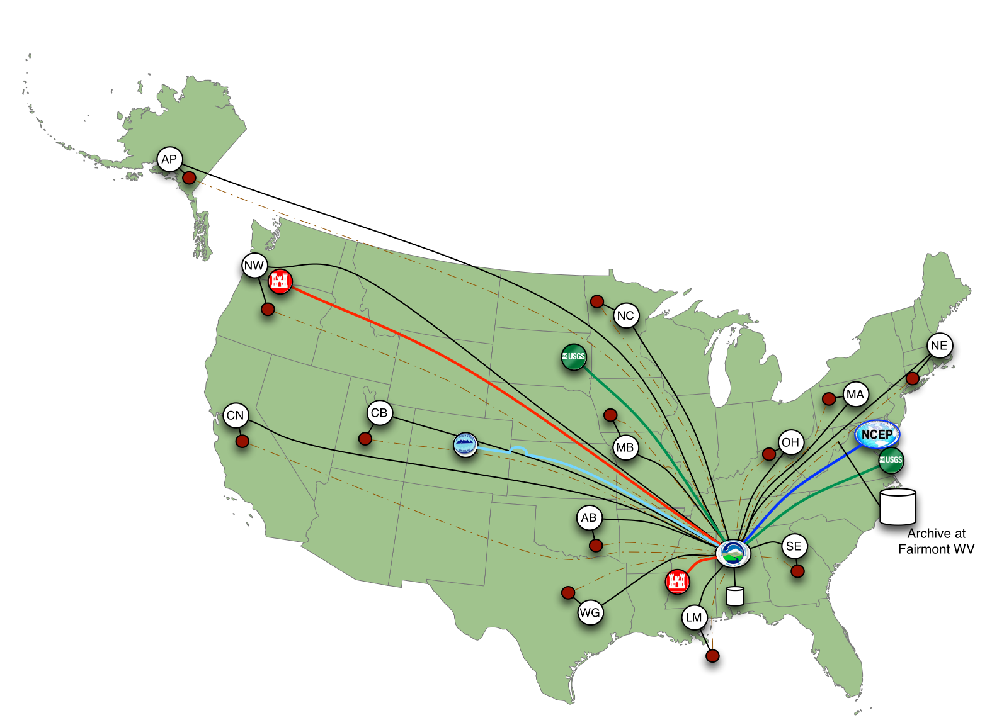
Nationally Synthesize Operations of Regional River Forecast Centers

Slide 8
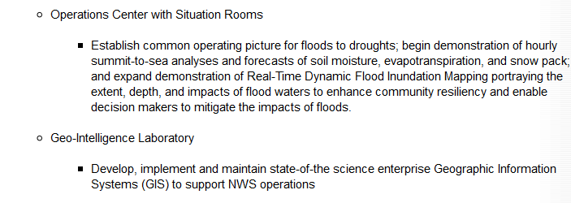
Temporal information
Geospatial information
Open Water Data Infrastructure

Slide 9
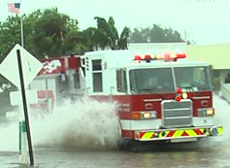



Goals
National Flood Interoperability Experiment
Close the gap between national flood forecasting
and local emergency response
  Impact at the street level
Create real-time flood information services
  Shared among organizations, geographies, people
Engage academic community through the National Water Center
  Innovation for transformative change

Slide 10
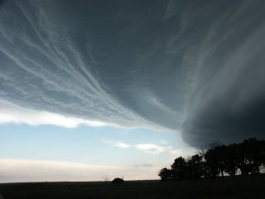
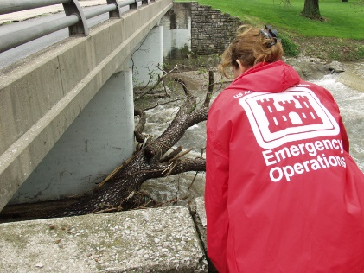

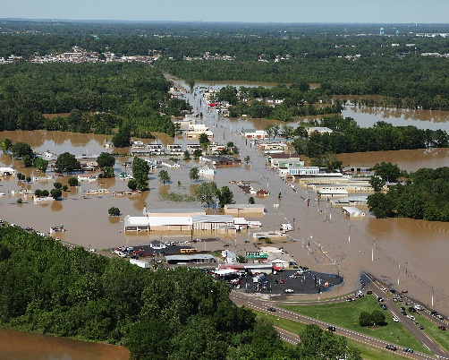


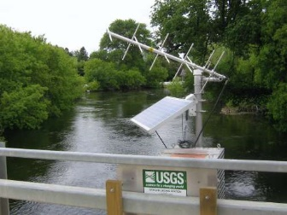

Linkages among federal agencies for flood response
Atmosphere
Stream
Data
Street

Slide 11

President’s Climate Data Initiative
John Podesta, Counsellor to the President, White House, March 19, 2014
https://www.youtube.com/watch?v=pfe5oRdsCp0&feature=youtu.be&t=7s

Slide 12
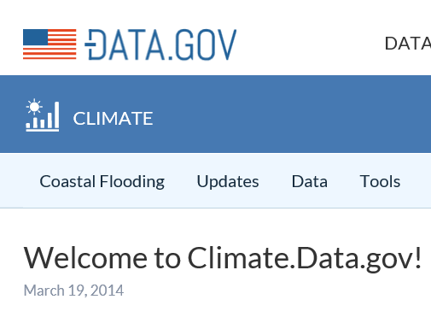
Goals of Climate Data Initiative
Prepare for climate change
Make government data accessible
Engage private sector
  ESRI, Microsoft, Google, Intel ….
Engage communities
  Chesapeake, New Orleans, World Bank, …
Why not a Water Data Initiative?

Slide 13


Open Water Data Initiative
Subcommittee on Spatial Water Data will lead this effort
This reports to both FGDC and ACWI
Anne Castle, Asst Secretary for Water and Science, Dept of Interior
Chair

Slide 14
Open Water Data Initiative
Open Water Web (applications)
National Water
Data Infrastructure
Water
Pollution
Ecological
Integrity
Flood
Drought
Concept: Nate Booth, USGS

Slide 15
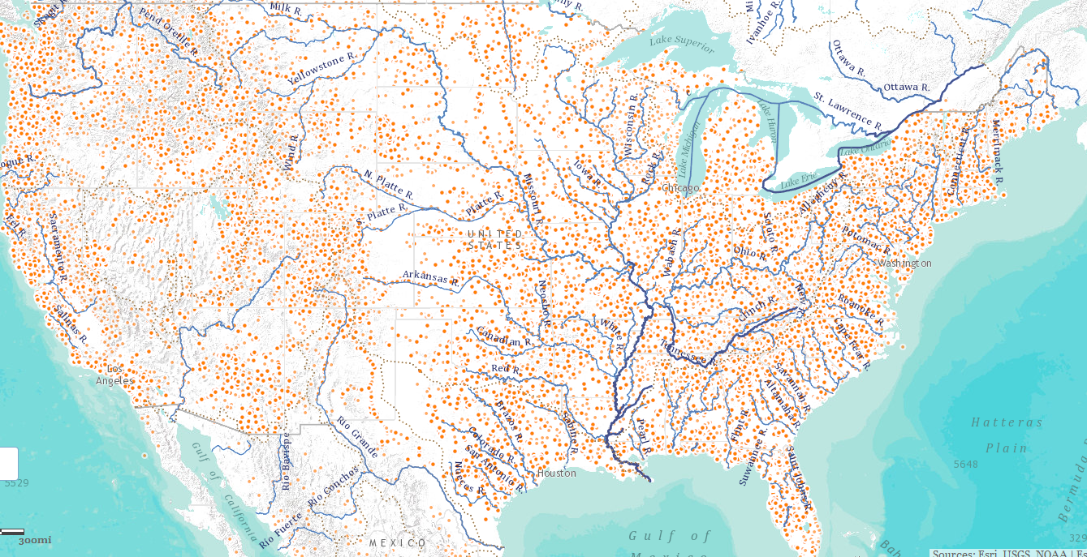
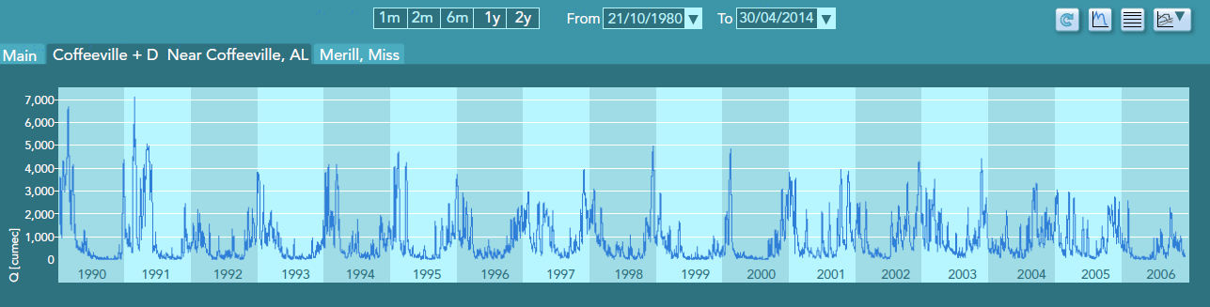
National Water Data Infrastructure (NWDI)
A thematically organized set of water information data layers
Authoritative for the nation
Assembled from best available sources
Made freely available through water information services.

Slide 16
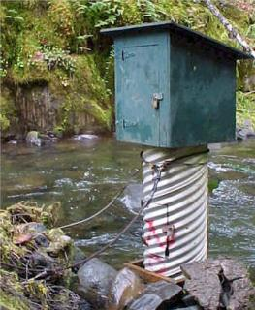
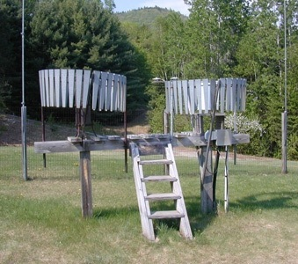
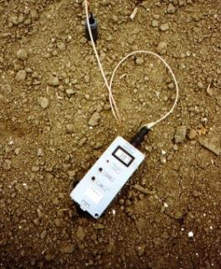
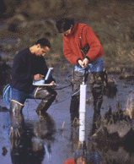
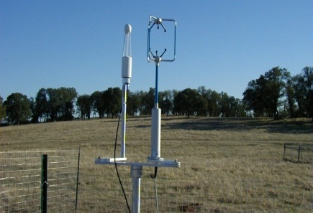
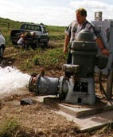
Hydrologic Measurement
Water Quantity
Rainfall
Soil Water
Water Quality
Meteorology
Groundwater
Time series data at point locations

Slide 17


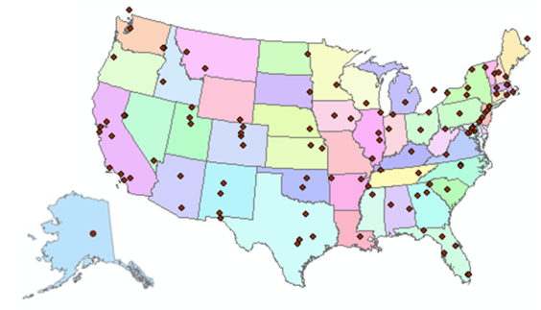
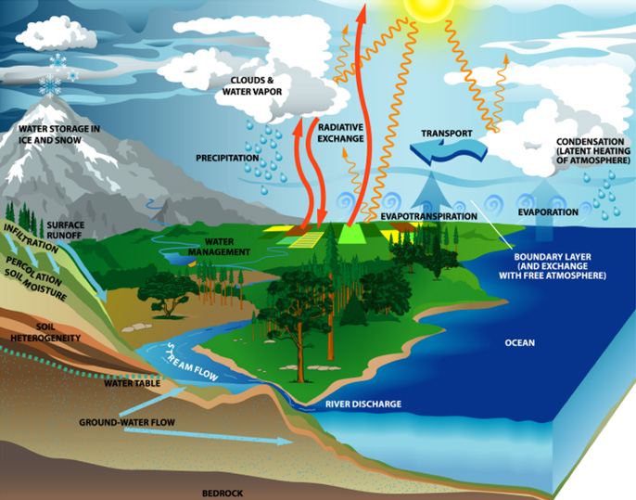
Consortium of Universities for the Advancement of Hydrologic Science, Inc.
www.cuahsi.org
CUAHSI
A consortium representing 125 US universities
Dr. Richard Hooper, President and CEO
Supported by the National Science Foundation Earth Science Division
Advances hydrologic science in nation’s universities
Includes a Hydrologic Information System project
Designed the WaterML language

Slide 18
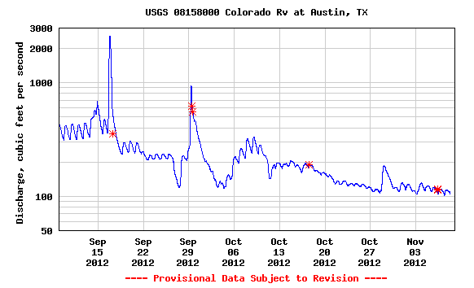

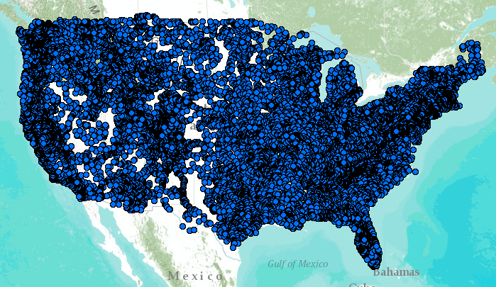
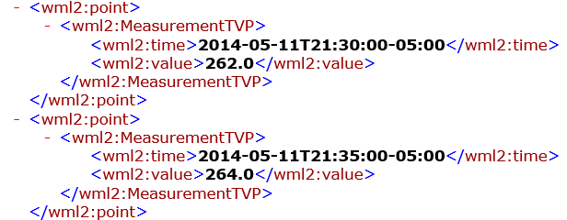
WaterML Web Services – CUAHSI, USGS, OGC, WMO …..
Water time series data on the internet
24/7/365 service
For daily and real-time data
. . . Operational water web services system for the United States
http://waterservices.usgs.gov/nwis/iv/?format=waterml,2.0&sites=08158000&period=P1D&parameterCd=00060

Slide 19
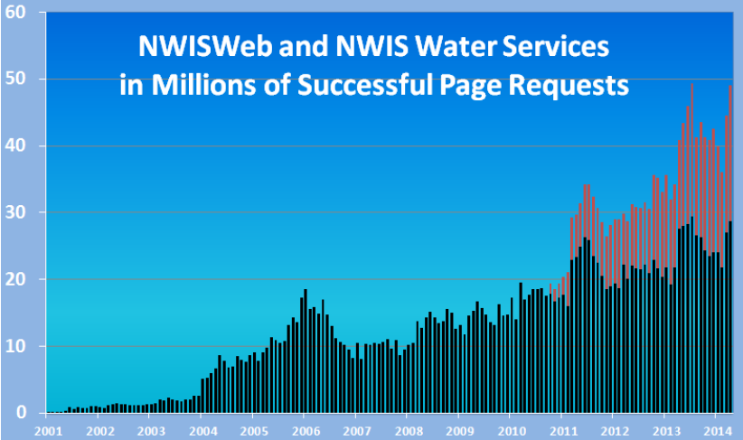
Water Data Distribution by US Geological Survey
Web service requests (millions/month)
Web page requests (millions/month)

Slide 20
Goals
National Flood Interoperability Experiment
Close the gap between national flood forecasting
and local emergency response
  Impact at the street level
Create real-time flood information services
  Shared among organizations, geographies, people
Engage academic community through the National Water Center
  Innovation for transformative change

Slide 21
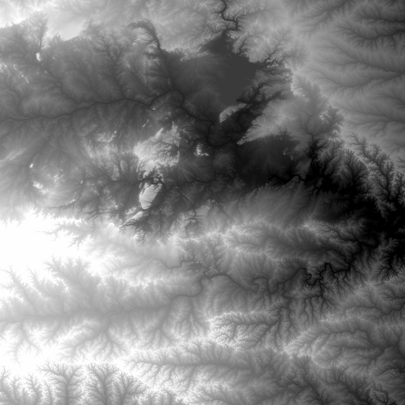
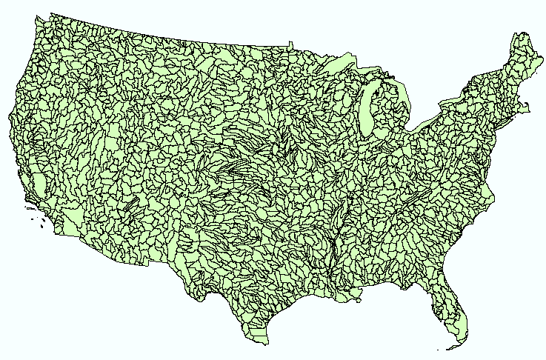
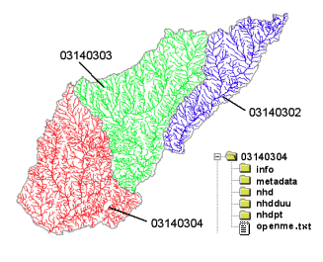
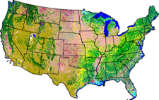
NHDPlus
Geospatial base for National Water Data Infrastructure
NHDPlus
(built 2004-2014)
National Elevation Dataset
Watershed Boundary Dataset
National Hydrography Dataset
National Land Cover Dataset
3 million catchments average area 3 km²,
reach length 2 km

Slide 22
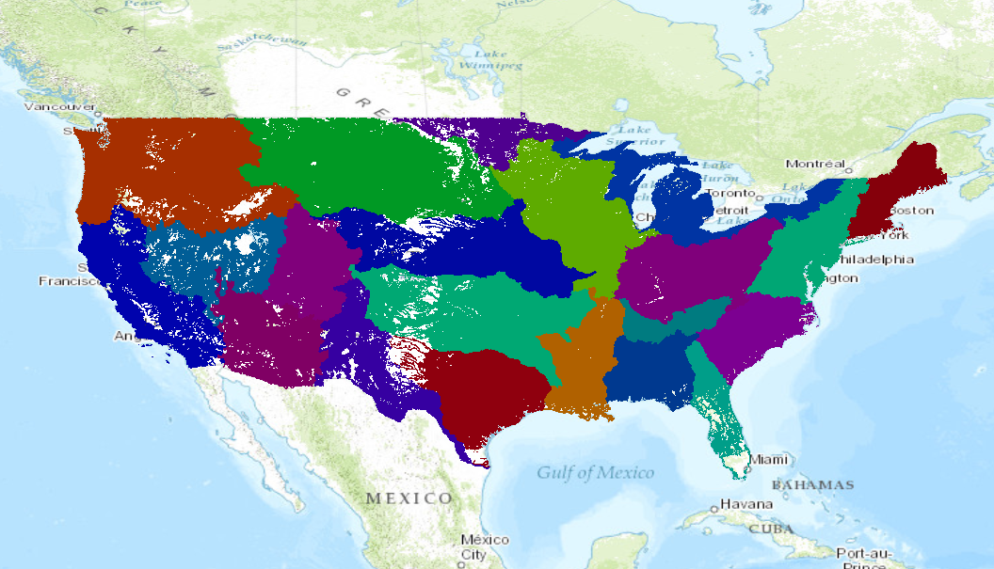
Spatial Coverage of NFIE-Hydro
Built on top of the NHDPlus
2.67 million catchments, average area 3 km², average length 2 km

Slide 23
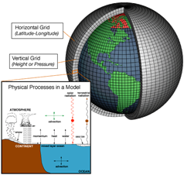
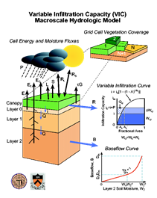
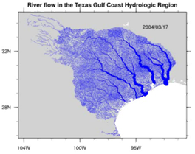
Modelling the terrestrial water cycle
Rivers
Lidar, surveys and river routing models
Streamflow, water level, fish etc.
Atmosphere
Observation datasets and numerical weather models
Precipitation, temperature, solar radiation etc.
Land Surface
Remote sensing and land surface models
Evaporation, soil moisture, surface runoff etc.

Slide 24
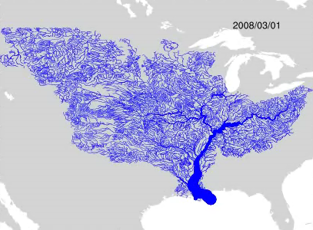
Why – Technology
Build a national high spatial resolution, near real-time river and stream model
River flow in the Mississippi River Basin
Use Weather Research and Forecasting Hydro model (WRF-Hydro)
(from NCAR)
Like this but for
whole continental US
Link to current
NWS River Forecasts
Build on NHDPlus
(from EPA and USGS)
using RAPID river model
Source: http://rapid-hub.org/

Slide 25
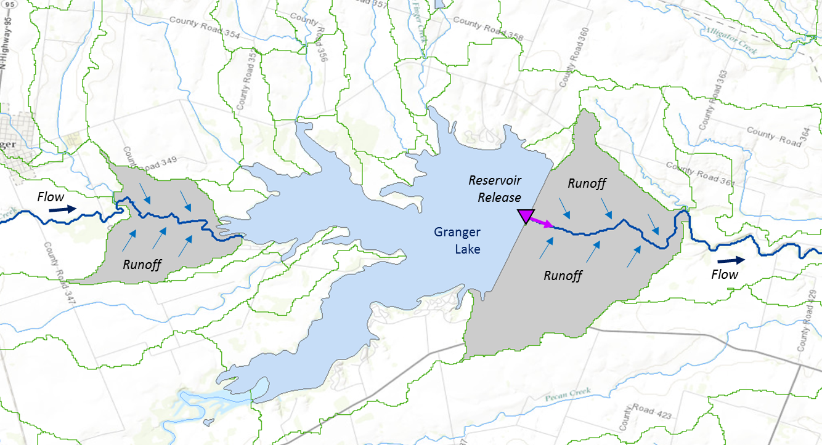
Muskingum
Method
RAPID River Routing Model
River Application for Parallel ComputatIon of Discharge
S_{prism} = KQ
S_{wedge} = KX (I – Q)
Computational Unit for Rivers
Forcing: Runoff and reservoir releases
Flow
Legend
Dam
Junction
Catchment

Slide 26
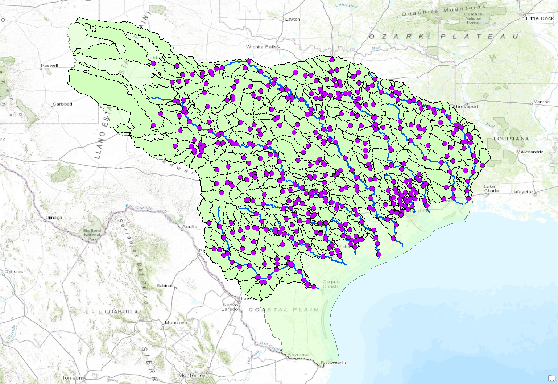


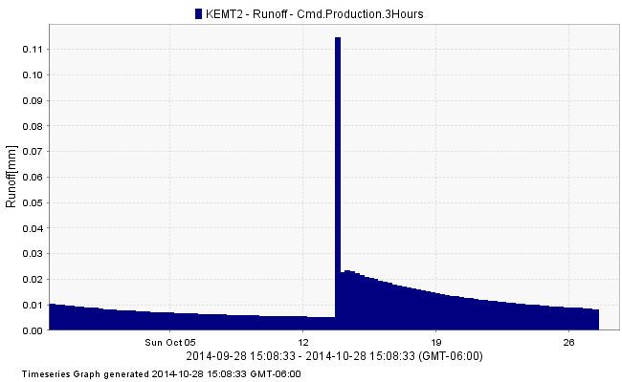
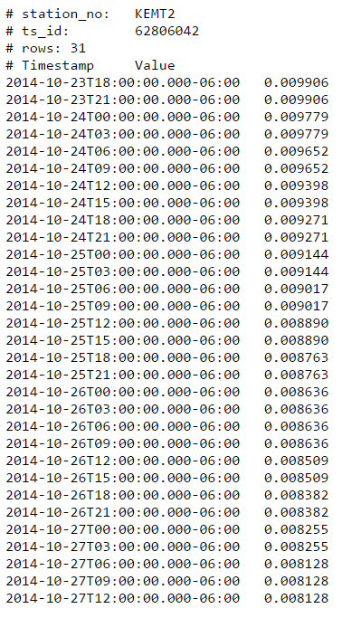
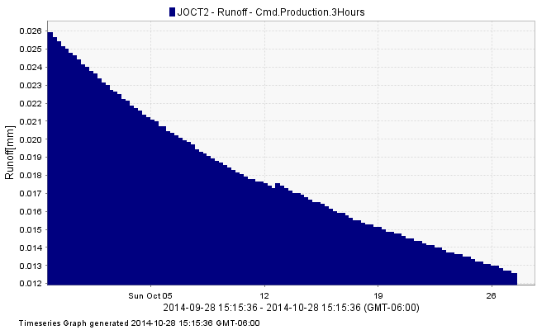
NWS Forecast Services
KEMT2
Surface runoff in
mm per unit area
JOCT2
Web services provide data in csv, ascii, WaterML etc.
http://wwokiweb01.cloudapp.net:8080/KiWIS/KiWIS?datasource=0&service=kisters&type=queryServices&request=getTimeseriesValues&format=ascii&ts_id=62806042&period=p5d&metadata=true&md_returnfields=station_no,ts_id

Slide 27
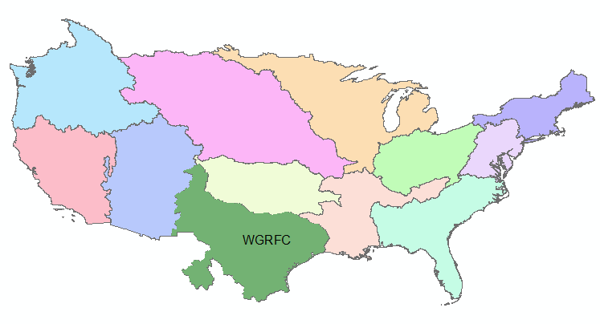
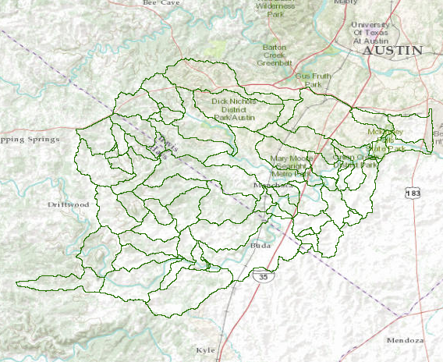
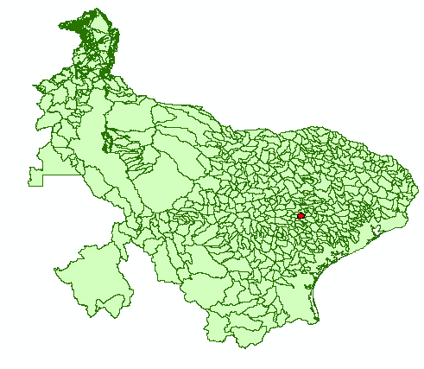
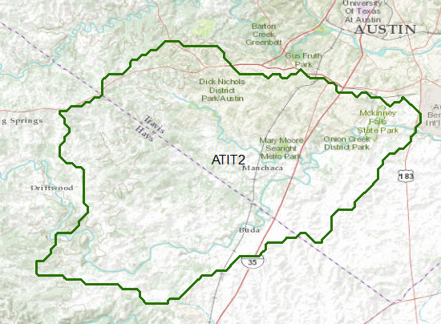
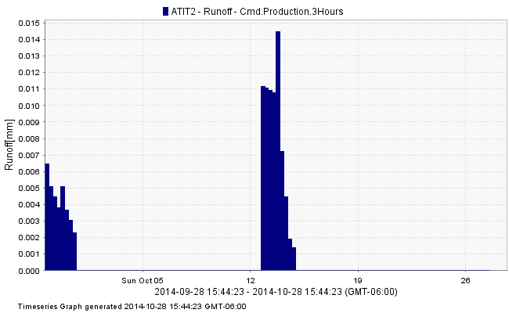
Dynamic Downscaling of NWS Forecasts
NWS Forecast Basin to NHDPlus Catchment
NWS River Forecast Centers
NHDPlus
Catchments
Azure
Wiski
NWS Forecast
Subbasin ATIT2
Forecast Subbasins for
West Gulf River Forecast Center

Slide 28
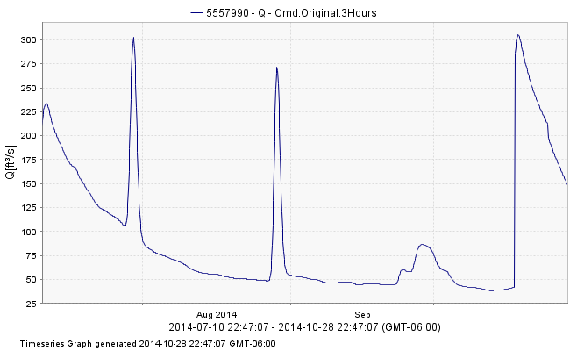
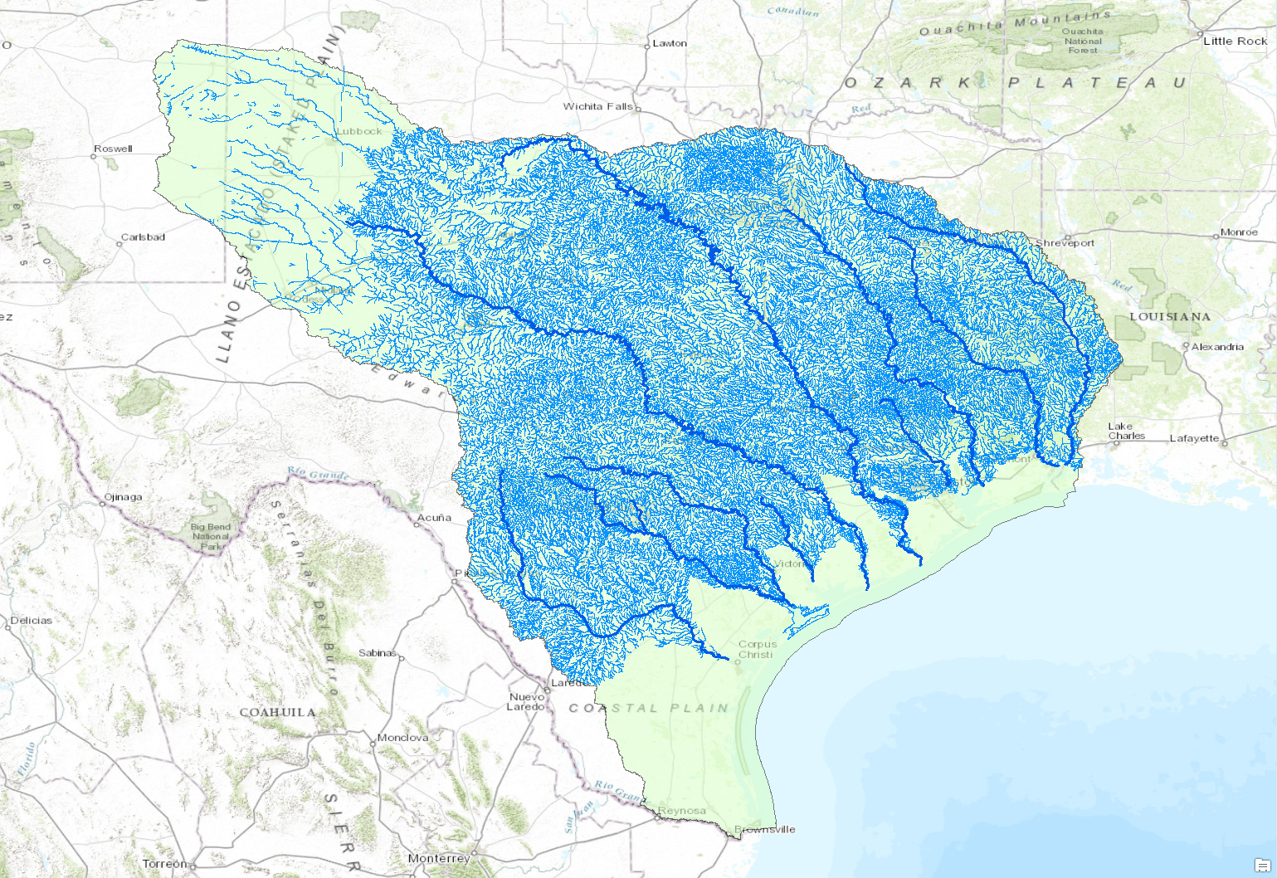


NWS West Gulf Region
COMID
5557990
Streamflow in cfs
COMID
5586778
Web services provide data in csv, ascii, WaterML etc.
http://wwokiweb01.cloudapp.net:8080/KiWIS/KiWIS?datasource=0&service=kisters&type=queryServices&request=getTimeseriesValues&format=ascii&ts_id=58261042&period=p10d&metadata=true&md_returnfields=station_no,ts_id

Slide 29


West Gulf River Flow Animation
World Wide Telescope

Slide 30


Ensemble Flood
Forecasting
Flood Water Elevation
Time

Slide 31

Percentile Maps of Soil Moisture
http://texassoilmoisture.azurewebsites.net/

Slide 32


HUC-10 Watersheds and Rivers in Travis and Williamson Counties
San Gabriel River
Brushy Creek
Pedernales River
Barton Creek
Colorado River
Onion Creek

Slide 33


City Jurisdiction
Austin

Slide 34

100-year floodplain for Travis and Williamson Counties
13% ( > 1/8) of the land is in the 100-year floodplain

Slide 35

HUC-10 Watersheds for City of Austin-Colorado River
19 Watersheds: Prioritize and Rank in Order of Importance

Slide 36


HUC-12 Subwatersheds in City of Austin-Colorado River HUC-10
Use these Units for Wide Area Flood Planning

Slide 37


Eanes Creek Model
Upstream
Slide:
Tomas Rodriguez
City of Austin
Downstream

Slide 38

75 m² Model Resolution
Eanes Creek Model
CAD Report Rcvd 02:11
Slide:
Tomas Rodriguez
City of Austin

Slide 39


NHDPlus Catchments in Lake Austin-Town Lake HUC12 Subwatershed
Flood forecasting operates at this level. Each catchment has one stream reach.
A flow forecast is made for that stream reach

Slide 40

Eanes Creek – Flood Response Mapping and Planning
Catchment 5781289

Slide 41


Eanes Creek Floodplain
Identify buildings at flood risk

Slide 42

Eanes Creek Transportation
Bee Cave Rd (FM 2244)
Identify streets with flood risk

Slide 43

Eanes Creek Jurisdiction
West Lake Hills
Austin
Rollingwood
Austin

Slide 44

Cells of US National Grid
Each 1km x 1km
5596 cells

Slide 45

US National Grid Cells in Eanes Creek

Slide 46

NHDPlus Catchments in Travis and Williamson Counties
Dry Creek
1020 Catchments and Stream Reaches

Slide 47

How to connect gridded input runoff data (WRFHydro) to NHDplus network
209

Slide 48





Upper Brushy Creek Water Control & Improvement District
Ruth Haberman, General Manager, UBCWCID

Slide 49
JURISDICTIONAL BOUNDARIES

Slide 50
DRAINAGE AREAS

Slide 51


Upper Brushy Flood Geodatabase

Slide 52

Upper Brushy Flood Geodatabase
Subwatersheds

Slide 53

Upper Brushy Flood Geodatabase
Floodplain

Slide 54

Upper Brushy Flood Geodatabase
FlowLines

Slide 55

Upper Brushy Flood Geodatabase
Catchments

Slide 56




Upper Brushy Flood Geodatabase
Each Catchment has one FlowLine
3.62 km
6.23 km²
This identifier, 5671589,
is unique for the whole United States
There are 2.6 million of these catchments

Slide 57

Upper Brushy Flood Geodatabase
US National Grid

Slide 58

Upper Brushy Flood Geodatabase
Transportation

Slide 59

Upper Brushy Flood Geodatabase
Address Points

Slide 60

Upper Brushy Flood Geodatabase
A National Grid Cell

Slide 61

National Grid Cells and Catchments
Cells are 1x1 km, hence smaller than catchments.
Clip floodplain so that there is a piece in each cell

Slide 62


4km mesh for WRF-Hydro
Austin watershed region
USGS Water Resource Region 12

Slide 63

Case Study
RAPID Model is built for all the NHDPlus reaches in Travis and Williamson County. The simulation results are published on the Internet using web service
Williamson
Travis
http://wwokiweb01.cloudapp.net:8080/KiWIS/KiWIS?service=kisters&type=queryServices&request=getTimeseriesList&datasource=0&format=ascii&&timeseriesgroup_id=146856&returnfields=station_name,parametertype_name,coverage&dateformat=yyyy-MM-dd%20HH:mm:ss

Slide 64
HEC Software
Data Collection
Modeling
Database
HMS
ResSim
(Hydrology)
(Storage)
FIA
RAS
(Hydraulics)
Modeling
(Damages)
Data
Visualization
Information dissemination

Slide 65
Current Progress
Workflow for connecting the NFIE with HEC-RAS model in Upper Brushy Creek
NWS Forecasts Data
…
Flood Inundation Map
RAPID Model
Flood Velocity Map
Flow data for
every NHD reach
at a 3-hour interval
HEC-RAS
Rating Curve
Web Service
HEC DSS File

Slide 66


Unsteady Simulation in HEC-RAS
North Fork of Brushy Creek Tributary1
Flow Data
Geometry Data

Slide 67


Unsteady Simulation Results using HEC-RAS

Slide 68
Wide Area Flood Plan
A Wide Area Flood Plan enhances flood emergency response for communities
Linked to new flood forecast procedures being developed at the National Water Center in the National Flood Interoperability Experiment
Develop this plan for Travis and Williamson Counties in one year
Engage the Texas Flash Flood Coalition to guide the development of the effort
Have quarterly meetings of the TFFC to review progress and provide feedback
Use the discussion at this meeting to set the direction and identify leadership from the community

