Slide 1

National Flood Interoperability Experiment in Texas
David R. Maidment
Center for Research in Water Resources
University of Texas at Austin
Texas Floodplain Management Association
San Antonio, TX| 11 June 2015
Acknowledgements: Ed Clark, Fernando Salas, Marcelo Somos Valenzuela, Andy Ernest
ESRI, Kisters, Microsoft Research

Slide 2

Thank you!

Slide 3
National Flood Interoperability Experiment
The Bad News ….
The Good News ….
Where to go from here ….

Slide 4
National Flood Interoperability Experiment
The Bad News ….
The Good News ….
Where to go from here ….

Slide 5
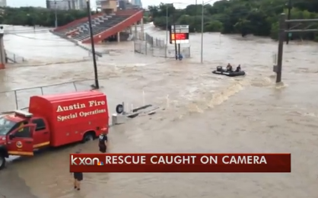
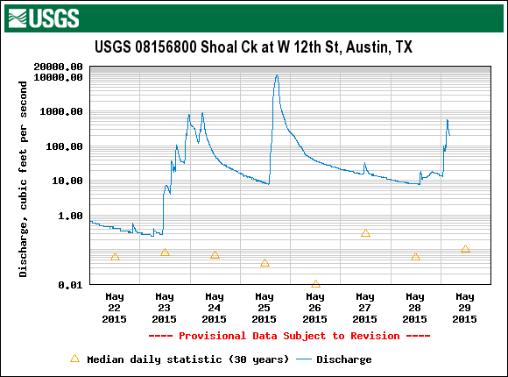
Flood Disaster in Texas
Swift water rescue
Enough rain to cover entire state in 8” of water
70 Texas counties declared flood disaster areas by the state
28 flood deaths, other people are still missing

Slide 6
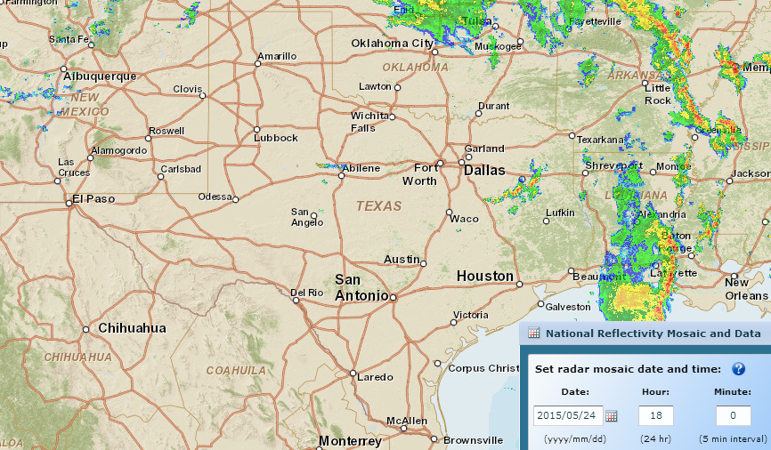
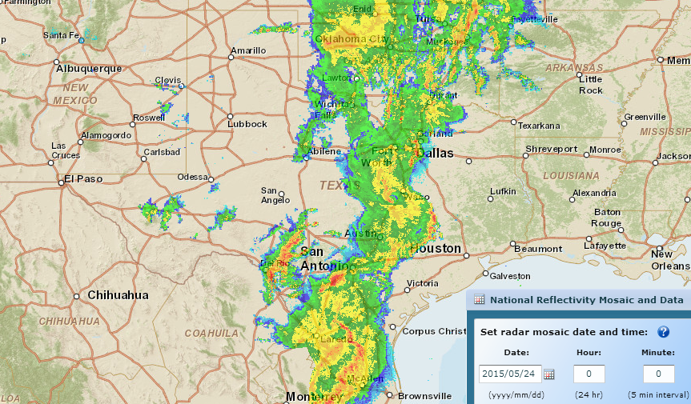
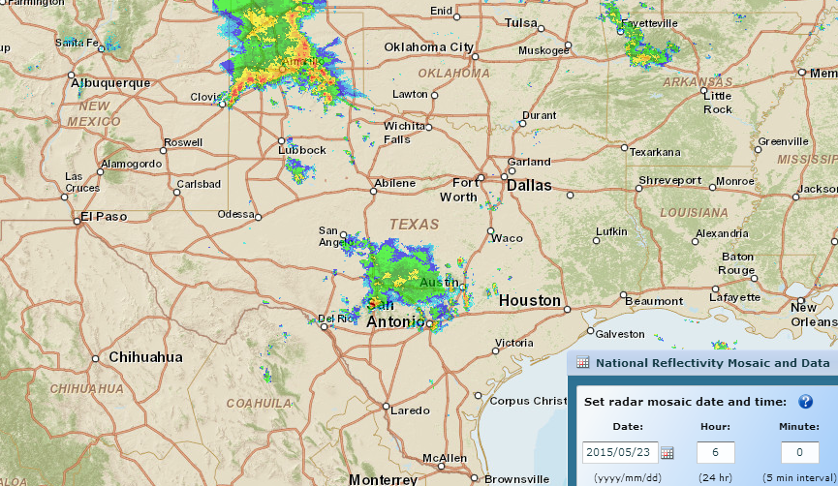
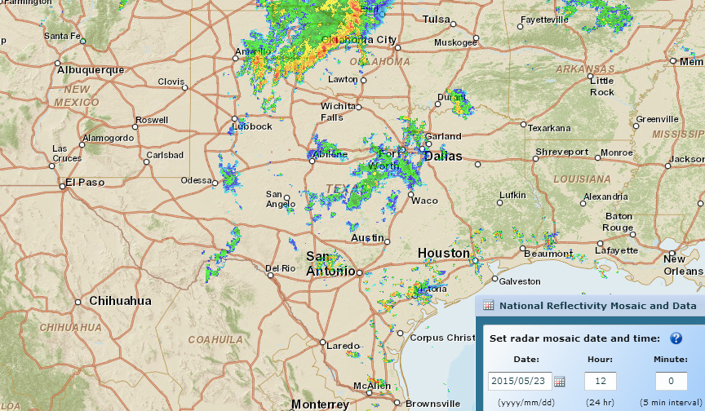
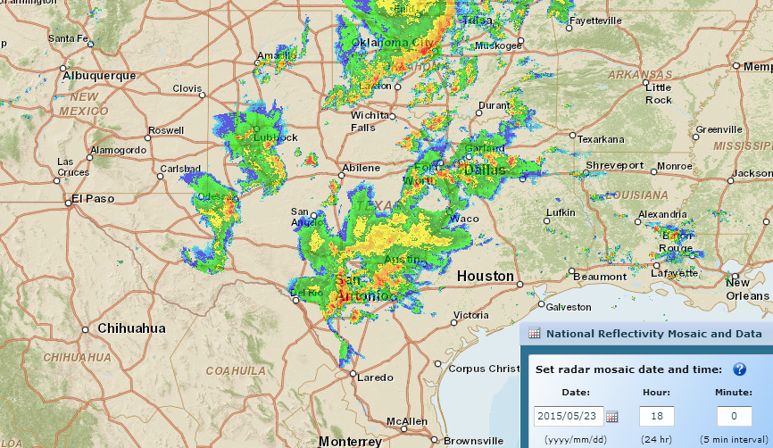
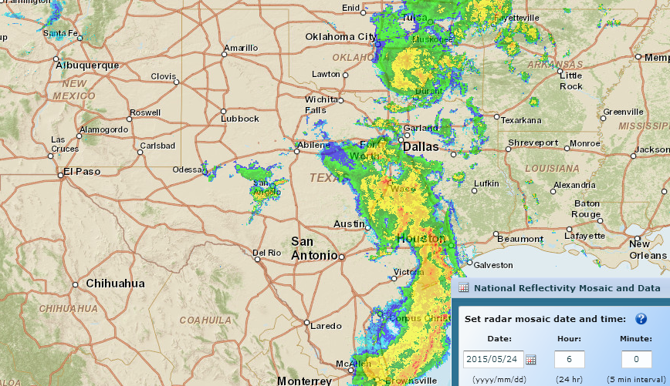
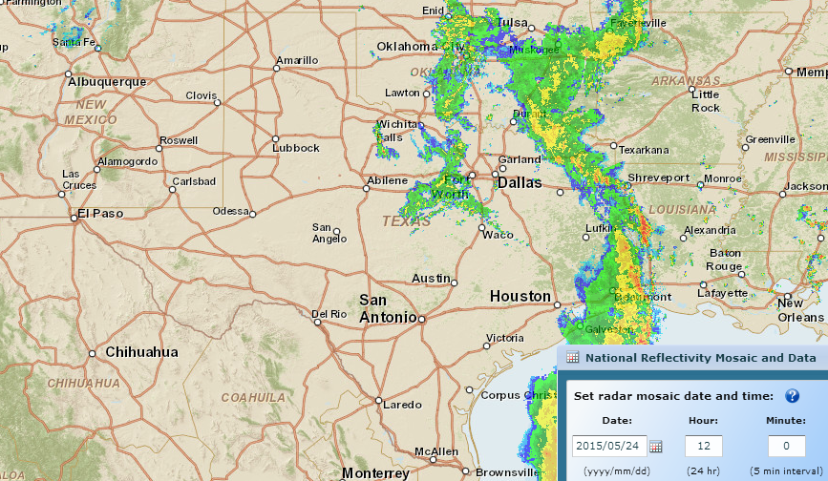
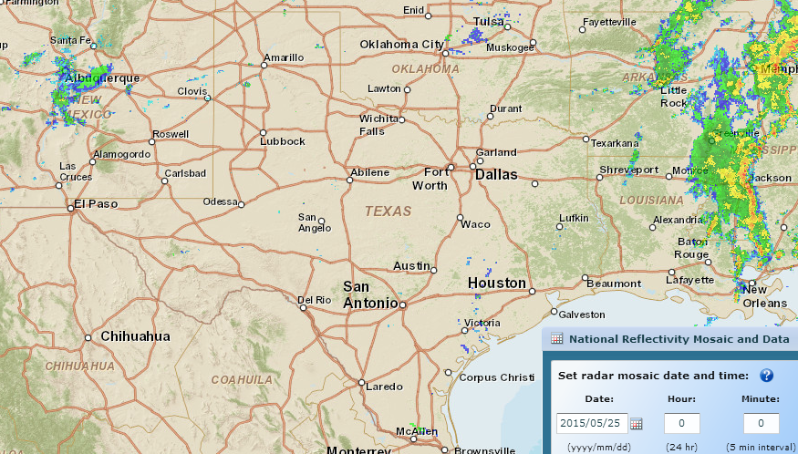
Storm Rainfall during Memorial Day Weekend
http://gis.ncdc.noaa.gov/map/viewer/#app=cdo&cfg=radar&theme=radar&display=nexrad
Where are the corresponding flood maps on the ground?
Sunday, May 24, Midnight
Sunday, May 24, 6 PM
Sunday, May 24, 6 AM
Saturday, May 23, 6 AM
Saturday, May 23, Midnight
Sunday, May 24, noon
Saturday, May 23, noon
Saturday, May 23, 6 PM

Slide 7
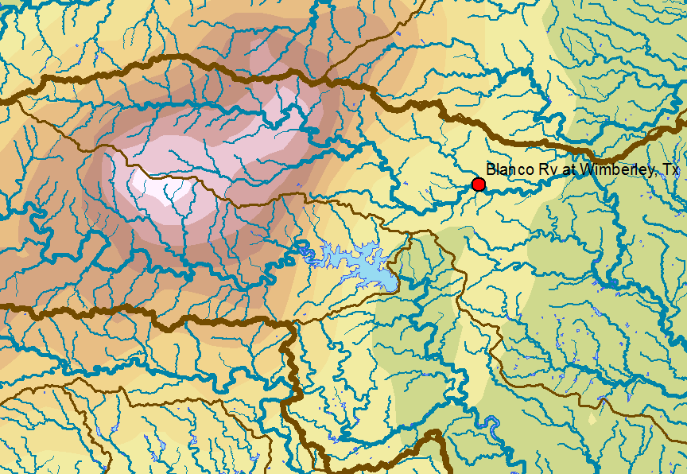

Memorial Day Weekend Precipitation
Total Precip.
(inches)

Slide 8
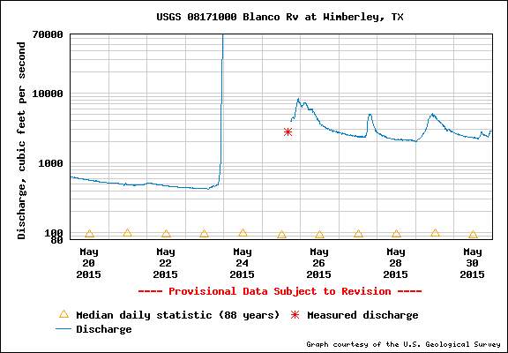
Flow in Blanco River at Wimberley
40 ft wall of water overwhelmed the gage

Slide 9
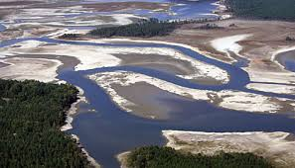
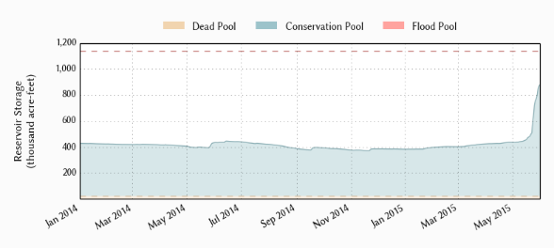
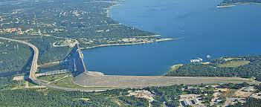
Drought to Deluge!
Lake Travis near Austin, Texas, has been in drought for the last four years
Reservoir storage doubled in 10 days
How can this happen?

Slide 10
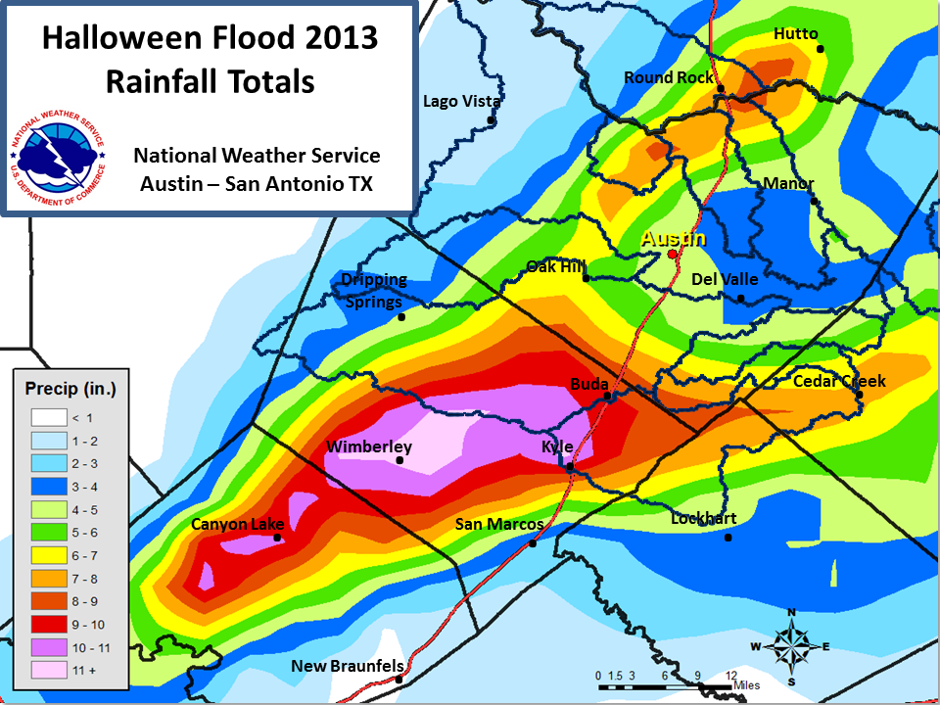

Slide 11
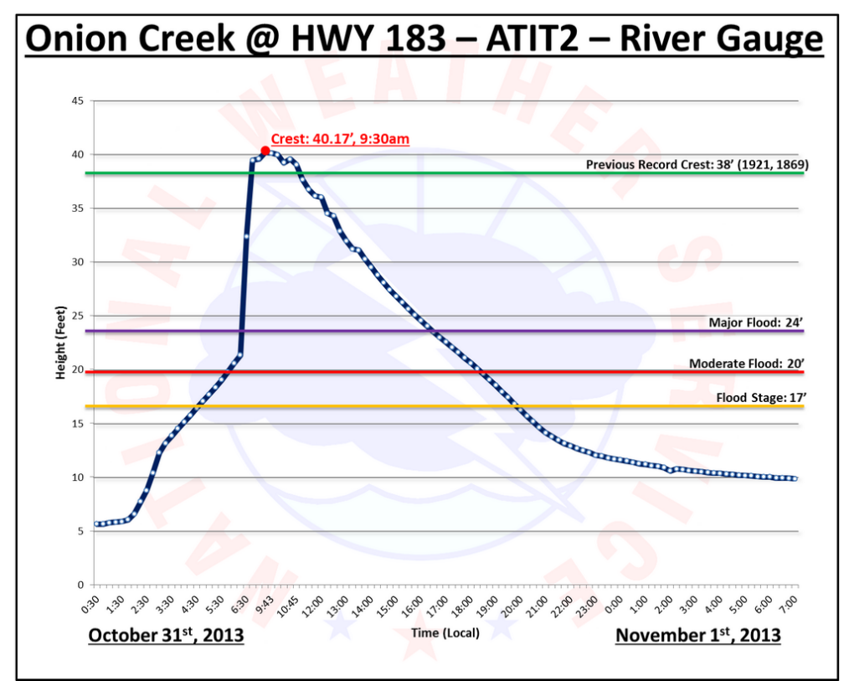

Slide 12
National Flood Interoperability Experiment
The Bad News ….
The Good News ….
Where to go from here

Slide 13

Transforming the
National Weather Service’s Water Services
Edward Clark
National Weather Service, NOAA
(adapted slightly)
Notes:
OUTLINE:
NEW MISSION FOCUS
TECHNICAL APPROACH
SCALE IMPLICATIONS
NATIONAL WATER CENTER (Organization, Functions, Staffing, Initial Activities, Design Tour)
SUMMARY

Slide 14

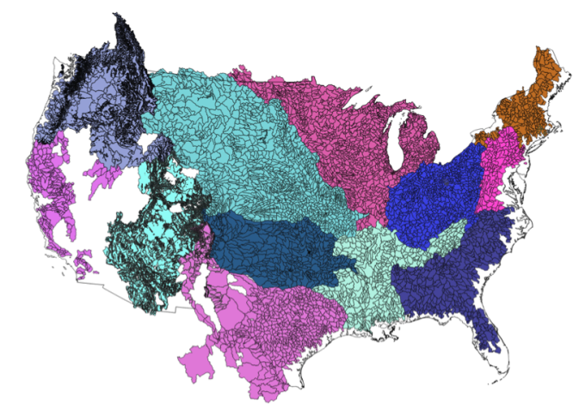
NWS River Forecast Centers (RFCs)
  Prepare river and flood forecasts using models based on average basin characteristics
  Provide forecast guidance to Weather Forecast Offices (WFOs)
  Issue daily stage and streamflow forecasts, rainfall and drought data and information, and flash flood guidance
  Work with water managers and other Federal Agencies
6000 sub-basins in continental US
14
Notes:
RFC Summary

Slide 15
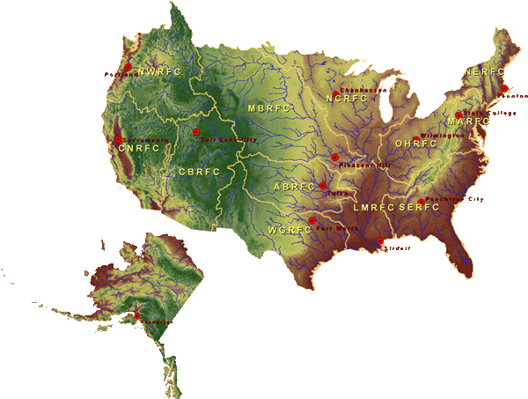

National Water Center
FY15 Centralized Water Forecasting
Centralized Data Archive – all RFC data
Modeling Evaluation Service
  RFC and NWC modeling and forecasts
Modeling Testbed – new NWC capabilities
Centralized Water Forecasting Demonstration
Notes:
TRANSITION INTO METHODS
FY15 PROJECT HAS FOUR CORE COMPONENTS
RFC archive
Model evaluation service
Modeling testbed
Centralized modeling demonstration

Slide 16
Stakeholder Priorities
Flooding
Water Quality
Water Availability
Drought
Climate Change
Need integrated understanding of near- and long-term outlook and risks
Actionable Water Intelligence
Notes:
The message was loud and clear:
While flooding remains a high priority, most stakeholders are concerned about the full gamut of water
They need more, and better integrated water prediction information
They need actionable WATER INTELLIGENCE
<< CLICK ONCE TO REVEAL LIST >>

Slide 17
WATER PREDICTION (NHD Plus)
+
GeoINTELLIGENCE
“Street Level” Water Prediction and
Impact-Based Decision Support

Slide 18
Hydrography, AHPS Forecast Points

Slide 19
Hydrography, AHPS Forecast Points
NCRFC
MBRFC
OHRFC
ABRFC
LMRFC
1000 km

Slide 20
NATIONAL INFRASTRUCTURE
Hospitals, EMS & Fire Stations
Full Resolution National Hydrography Dataset NHD+
Springfield, MO
AHPS Forecast Point
James River at Galena, MO
150 km

Slide 21
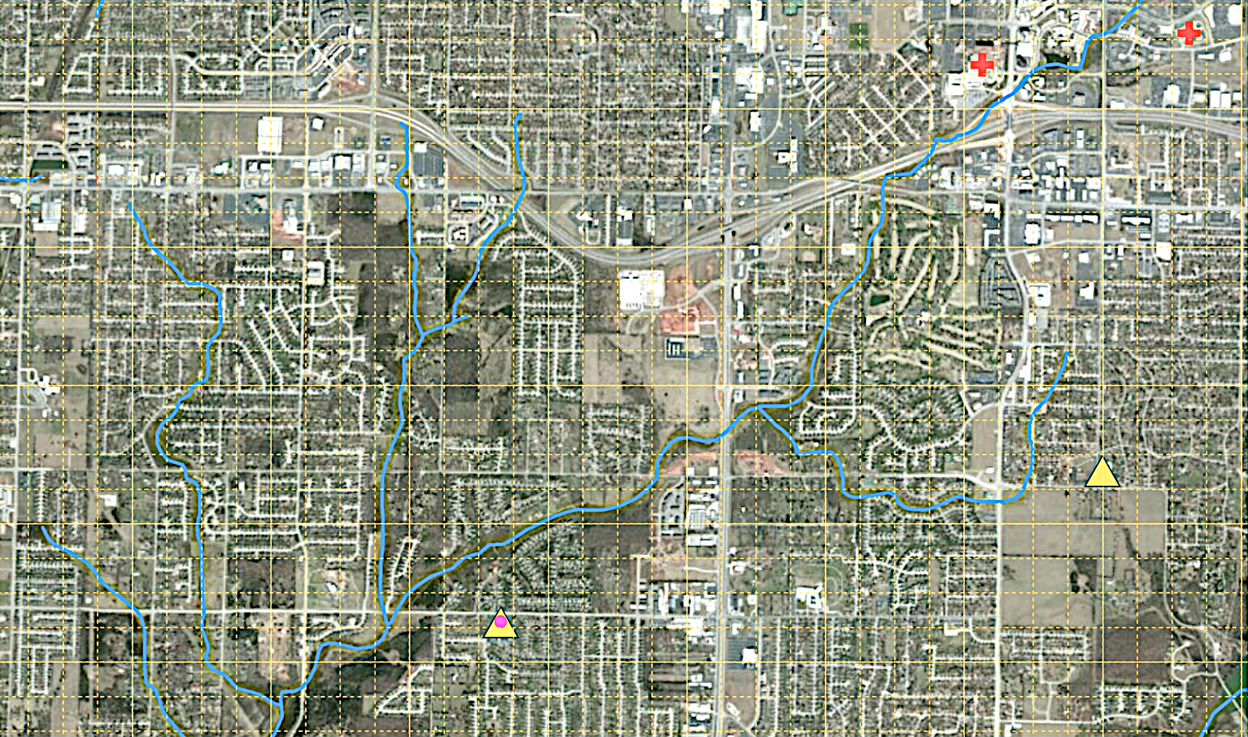
High Spatial Resolution Forecasting at Stream and Street Level
Workman Branch
Ward Branch
18 km

Slide 22
NWS Water Prediction
TODAY
TOMORROW
Approximately 6000 forecast locations at points
Driven by large catchment “lumped” modeling
Requires:
  Precipitation and Air Temperature (averaged over watershed)
  Reservoir Information
  River Network Topology
  Hydraulic modeling for large channels
  Stream Gage Data
  General Impacts near Gages
  Local servers and storage
Approximately 2,700,000 forecast stream reaches
Driven by high/hyper resolution Earth System modeling
Requires:
  Full high-resolution meteorological suite
  Reservoir Information
  Stream Network Topology
  Hydraulic modeling for small channels
  High Resolution Terrain Data
  Land Cover Change Data
  Stream Gage Data (enhanced)
  Reach-based Inundation Mapping and Impacts
  Centralized high-performance computing
Notes:
Comparison of today and tomorrow – orders of magnitude more ‘complex’ prediction paradigm – mainly in data density

Slide 23
Transforming the
National Weather Service’s Water Services
Edward Clark
National Weather Service, NOAA
End of Slides by Edward Clark
Notes:
OUTLINE:
NEW MISSION FOCUS
TECHNICAL APPROACH
SCALE IMPLICATIONS
NATIONAL WATER CENTER (Organization, Functions, Staffing, Initial Activities, Design Tour)
SUMMARY

Slide 24
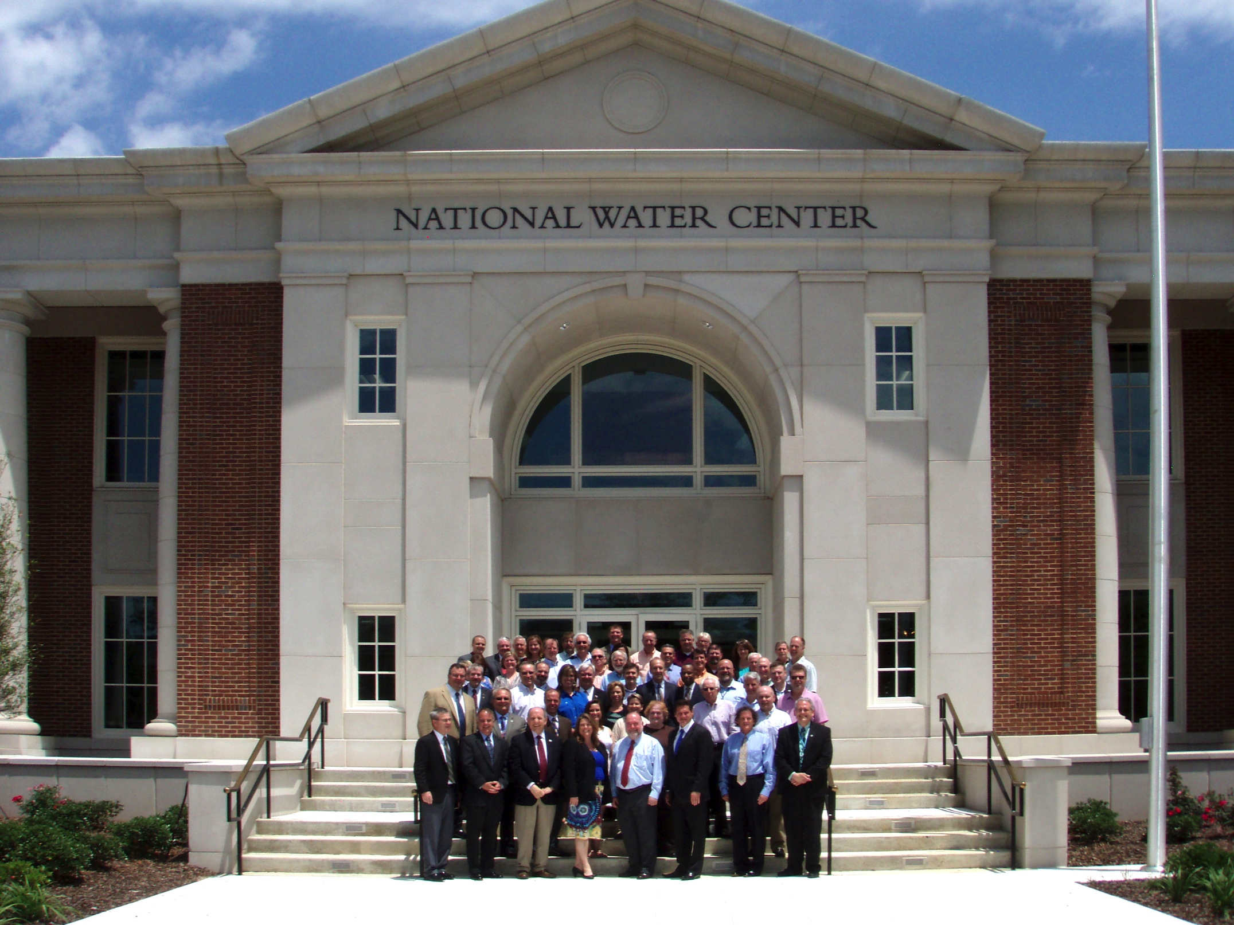
Inaugural Meeting – May, 2014

Slide 25
Transformative Research (NSF)
Transformative research involves ideas, discoveries, or tools that radically change our understanding of an important existing scientific or engineering concept or educational practice or leads to the creation of a new paradigm or field of science, engineering, or education. Such research challenges current understanding or provides pathways to new frontiers.
http://www.nsf.gov/about/transformative_research/definition.jsp
How to move from evolutionary change
to transformative change?

Slide 26


Partnership with the academic community (Interagency Agreement between NSF and NOAA)
National Weather Service has joined with CUAHSI to conduct a one-year National Flood Interoperability Experiment (NFIE)
Includes a Summer Institute for students and faculty at the National Water Center, June 1 to July 17, 2015

Slide 27
Goal of the Experiment …
Close the gap between National Flood Forecasting and Local Emergency Response
Demonstrate forecasting of flood impacts at “stream and street level”
National
Weather and Hydrology
National Weather Service and federal agencies
National Water Center
River Flooding and Emergency Response
Local, State and Regional Agencies
Citizens
Local

Slide 28
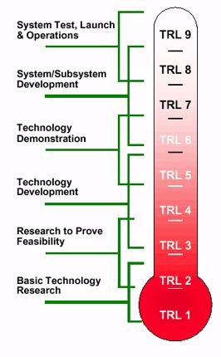
Technical Readiness Levels
The NFIE is a research effort
It will not create an operational system
It will not produce public forecast information
NFIE
http://en.wikipedia.org/wiki/Technology_readiness_level

Slide 29
NFIE Conceptual Framework…
NFIE-Geo: National geospatial framework for hydrology
NFIE-Response: Wide area planning for flood emergency response
NFIE-Hydro: National high spatial resolution hydrologic forecasting
NFIE-River: River channel information and real-time flood inundation mapping
NFIE-Services: Web services for flood information

Slide 30
NFIE Continental scale…
NFIE-Geo: National geospatial framework for hydrology
NFIE-Response: Wide area planning for flood emergency response
NFIE-Hydro: National high spatial resolution hydrologic forecasting
NFIE-River: River channel information and real-time flood inundation mapping
NFIE-Services: Web services for flood information

Slide 31
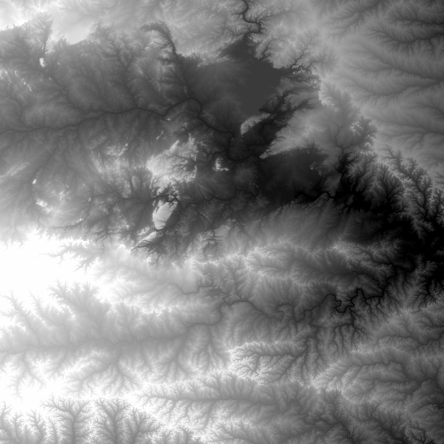
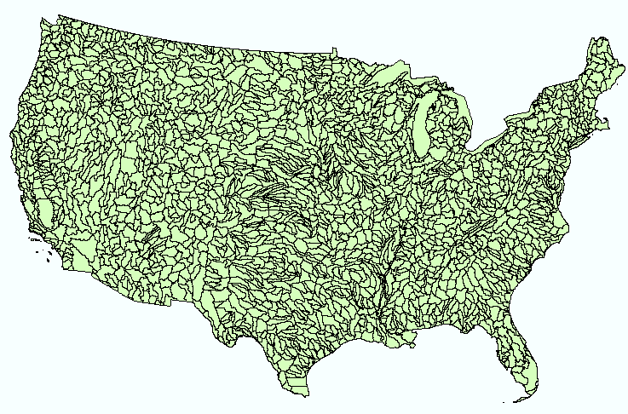
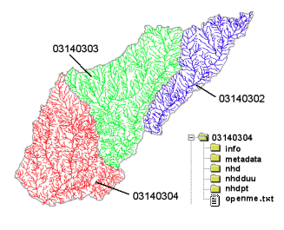
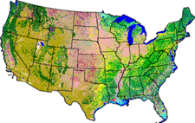
NHDPlus Version 2
Geospatial foundation for a national water data infrastructure
NHDPlus
2.67 million reach catchments in US
average area 3 km²
reach length 2 km
National Elevation Dataset
Watershed Boundary Dataset
National Hydrography Dataset
National Land Cover Dataset

Slide 32
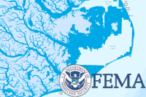
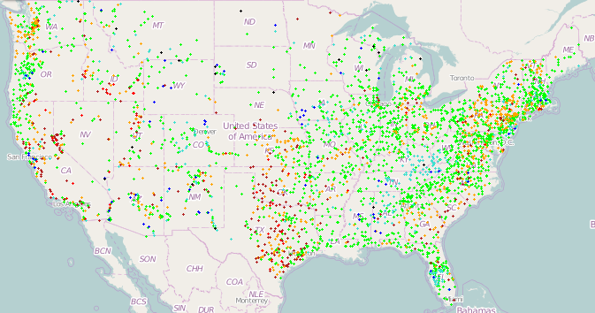
NFIE-Geo for National Flood Interoperability Experiment
Enhanced geospatial database for a national water data infrastructure
NWS Basins and
Forecast Points
USGS Water Watch
Points
National Flood
Hazard Layer
Feature classes:
Subwatershed (HUC12)
Catchment
Flowline
Waterbody
Streamgage
NFIE-Geo
9 feature classes
5 from NHDPlus
4 from IWRSS
NHDPlus

Slide 33
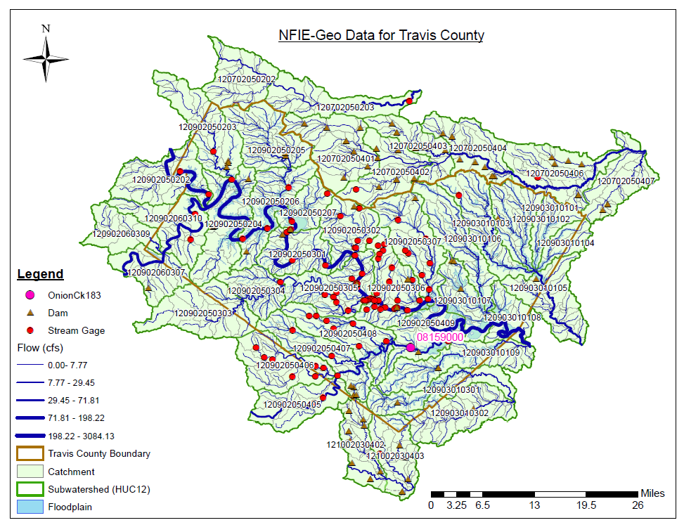
NFIE-Geo for Travis county
County subset of national geospatial data layers
Map courtesy of Cyndi Castro
UT Austin
http://www.caee.utexas.edu/prof/maidment/CE397Flood/Assignment2/NFIEGeo.pdf

Slide 34
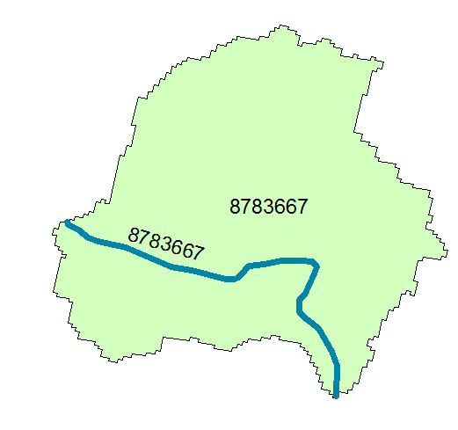
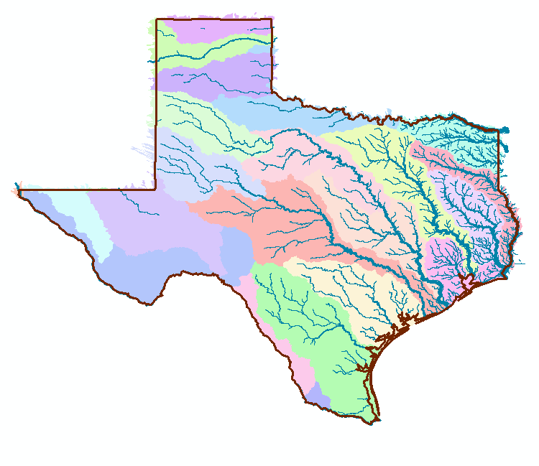
NFIE-Geo for Texas
NHDPlus reach catchment
Uniquely labeled across nation
102,000 NHDPlus reach catchments for Texas
Average area 7.1 km²
Average reach length 3 km

Slide 35
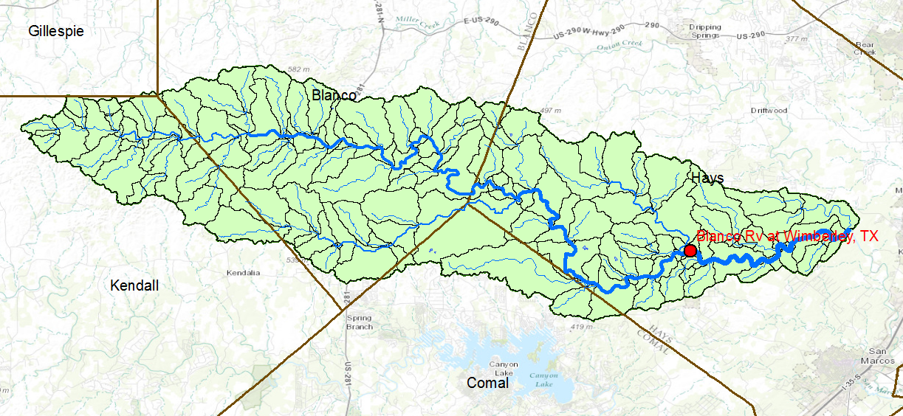
NFIE-Geo for the Blanco Basin
NHDPlus Reach Catchments = 158
of which 129 are upstream of Wimberley
Average area = 6.73 Km²
Average reach length = 3.13 Km

Slide 36

Stampede
500,000 processors operating in parallel

Slide 37
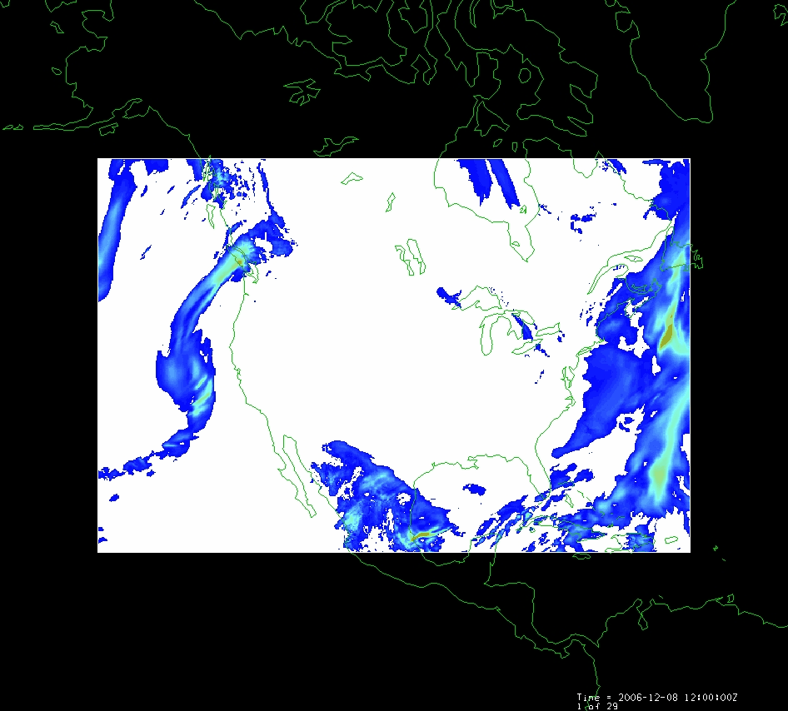
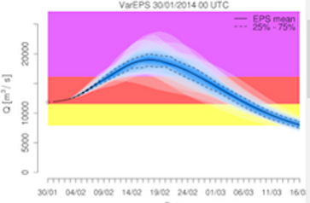
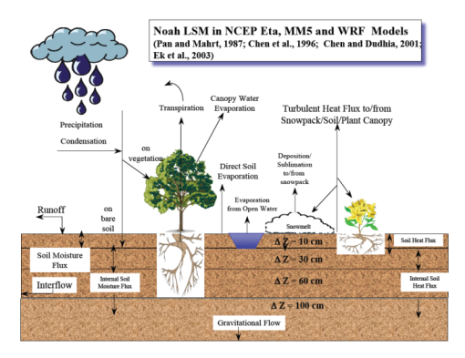
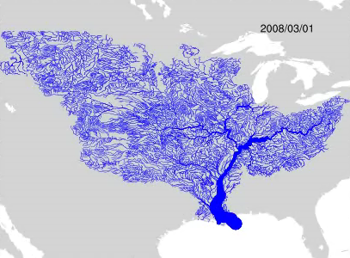
NFIE-Hydro Forecasting Model
Computed for the continental US in 10 minutes at Texas Advanced Computing Center
Weather model and forecasts (HRRR)
Probabilistic flood forecasts
Catchment-level forecasts
Weather
Precipitation
Streamflow
Runoff
Land-Atmosphere Model (NOAH-MP)
RAPID flow routing (for continental US)

Slide 38
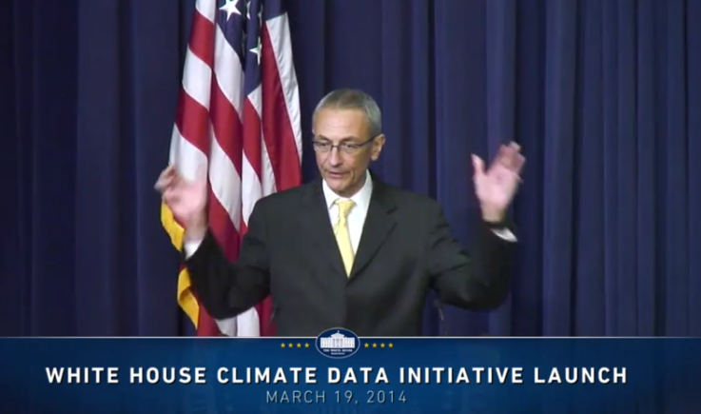
President’s Climate Data Initiative
John Podesta, Counsellor to the President, White House, March 19, 2014
https://www.youtube.com/watch?v=pfe5oRdsCp0&feature=youtu.be&t=7s

Slide 39
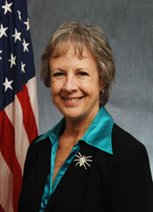

Open Water Data Initiative
Subcommittee on Spatial Water Data leads this effort
This reports to both FGDC and ACWI
Sponsoring a series of “experiments” with water information services
National Flood Interoperability Experiment
Anne Castle, Former Asst Secretary for Water and Science, Dept of Interior
Chair

Slide 40
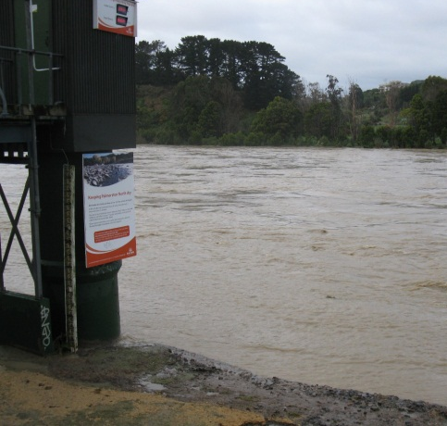
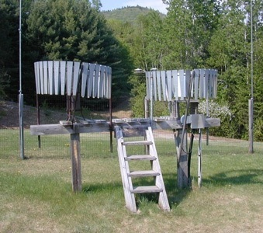
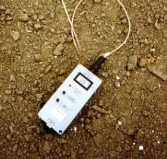
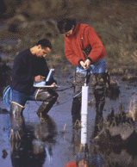
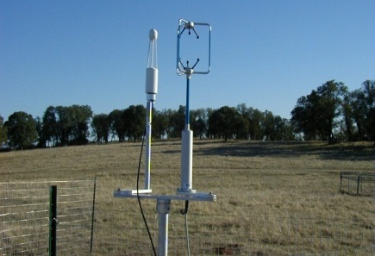
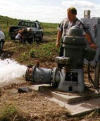
Water Observation – In Situ
Time series data at point locations
Water Quantity
Rainfall
Soil Water
Water Quality
Meteorology
Groundwater

Slide 41


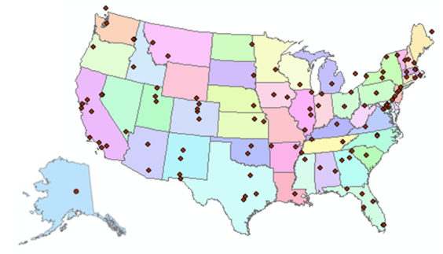
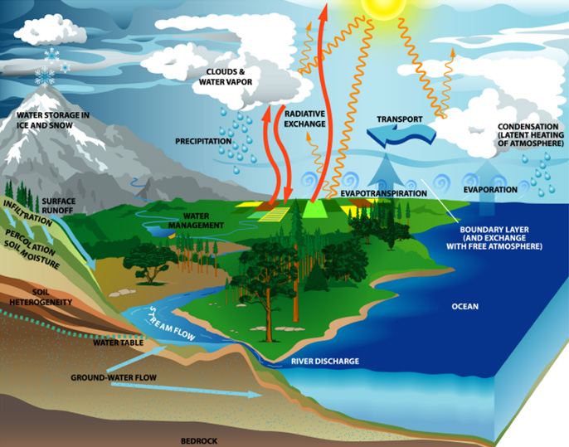
Consortium of Universities for the Advancement of Hydrologic Science, Inc.
www.cuahsi.org
CUAHSI
A consortium representing 125 US universities
Dr. Richard Hooper, President and CEO
Supported by the National Science Foundation Earth Science Division
Advances hydrologic science in nation’s universities
Includes a Hydrologic Information System project
Invented WaterML language for water resources time series
Building an academic prototype system

Slide 42
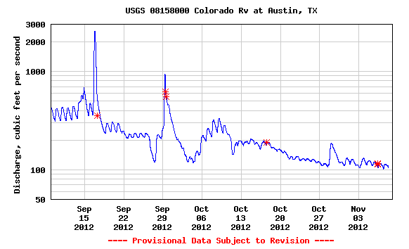

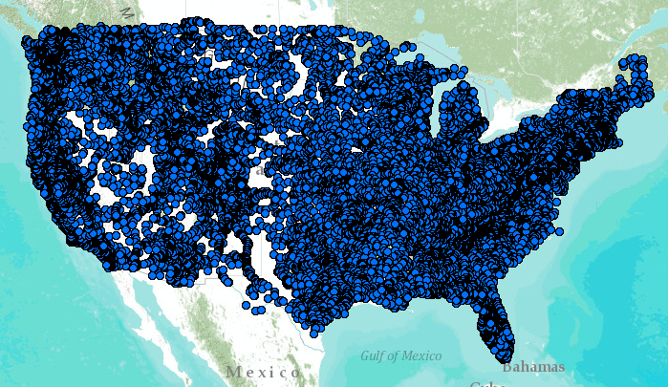
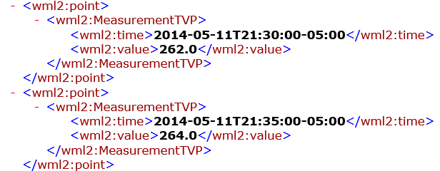
WaterML Web Services – CUAHSI, USGS, OGC, WMO …..
Water time series data on the internet
24/7/365 service
For daily and real-time data
. . . Operational water web services system for the United States
http://waterservices.usgs.gov/nwis/iv/?format=waterml,2.0&sites=08158000&period=P1D&parameterCd=00060

Slide 43
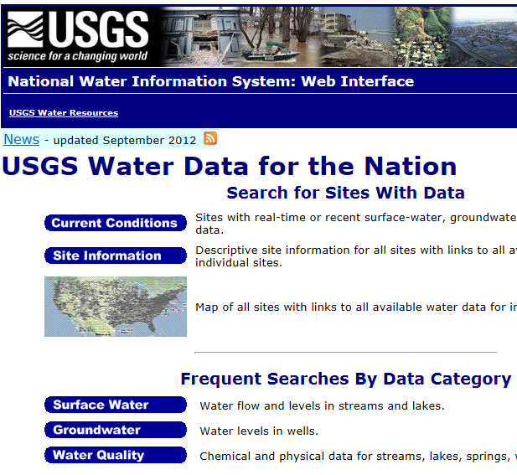

Web Pages and Web Services
Web pages deliver text and images
http://water.usgs.gov
Web services deliver data encoded in XML
http://waterservices.usgs.gov/

Slide 44

NWISWeb and NWIS Water Services
Water Service Requests
Requests per month
Web Page Requests

Slide 45


WaterML – an international standard for time series
We need to adopt this for all our observation networks in Texas
Acknowledgements: OGC, WMO, GRDC, CUAHSI, BoM/CSIRO, USGS, GSC, Kisters, …….
TimeSeriesML being
processed for adoption
by OGC and WMO for all
forms of time series
CUAHSI Hydrologic Information System project
starts working on WaterML
November 2009
Adopted and endorsed by
Executive Office of the President
USGS adopts
WaterML
Technical Meetings Each 3 Months
Four Interoperability Experiments
(Surface water, groundwater, forecasting)
Annual week-long workshops
Involvement by many countries
2005
2007
2009
2011
2013
2015
Notes:
(1) A four-year international effort has been undertaken to reconcile WaterML with international standards;
(2) This effort was initiated with the establishment of an Hydrology Domain Working Group by the Open Geospatial Consortium in September 2008;
(3) An OGC representative attended the WMO Congress of the Commission for Hydrology in 2008
(4) A formal agreement between Secretary General of WMO and President of OGC in 2009 to jointly develop standards for hydrology, climatology, oceanography and climatology;
(5) The joint OGC/WMO Hydrology Domain Working Group was supported by a large work effort, annual week-long workshops, four interoperability experiments for surface and groundwater data exchange, and participation by many countries;
(6) In June 2012, the OGC voted to adopt the revised version, WaterML2 as an international standard for exchange of water resources time series (the first such public standard that has existed);
(7) This Congress to the WMO Commission for Hydrology to whom I am speaking is considering WaterML2 for adoption as an official standard by WMO

Slide 46
National – Local Communication
Close the gap between National Flood Forecasting and Local Emergency Response
Local observations are needed to calibrate and adjust a national model in real-time
National
Weather and Hydrology
National Weather Service and federal agencies
National Water Center
WaterML Web Services
River Flooding and Emergency Response
Local, State and Regional Agencies
Citizens
Local

Slide 47
National Flood Interoperability Experiment
The Bad News ….
The Good News ….
Where to go from here ….

Slide 48
NFIE Regional and Local scale…
NFIE-Geo: National geospatial framework for hydrology
NFIE-Response: Wide area planning for flood emergency response
NFIE-Hydro: National high spatial resolution hydrologic forecasting
NFIE-River: River channel information and real-time flood inundation mapping
NFIE-Services: Web services for flood information

Slide 49




NFIE-River…
NFIE-River: Dynamic flood modeling, forecasting and inundation mapping in space and time
Requires LIDAR terrain data so can only be done for particular regions
Iowa Flood Information System

Slide 50

Real-Time Flood Inundation Mapping (USGS/NWS)
http://water.weather.gov/ahps2/inundation/inundation_google.php?gage=atit2

Slide 51







Elevation-indexed flood mapping
Center Points of Reaches
Travis County
Map sequence for each point

Slide 52

NFIE Case Study: North Carolina
HEC-RAS Cross Section Dataset
17637 Cross Sections
Slide: Xing Zheng
We need to do this for Texas

Slide 53

Return Period – Discharge – Stage Height – Water Surface Elevation

Slide 54


Solve 100 million equations each night
to check the effects of design changes
made during the day

Slide 55


SPRNT model adapts VLSI design to computation of flow in large river networks

Slide 56



Install water level sensors on the back of bridges ($3000 per site)
University of Iowa
Notes:
Point to make here is the need for physically based models given the dynamic and complex nature of rainfall.

Slide 57

Iowa has 250 of these sensors already deployed
We should adopt this approach in Texas

Slide 58

NFIE-Response

Slide 59



Address Points -- used for directing emergency response vehicles
All legal residences have an address point
Established when the lot is legally platted and registered with the county

Slide 60

Address Points and the Flood Hazard Zone
Williamson County
495,000 Address points in the two counties
How many points are in the flood hazard zone?
Where are the high flood risk areas in these counties?
Austin, Texas
Travis County
We need to compile all these data across Texas

Slide 61


Address Points and the Floodplain

Slide 62


Connecting with Local Decision Makers
Work with the first response community to define flood strategy and tactics
https://www.youtube.com/watch?v=ympaR6YUxiA&feature=youtube

Slide 63

Transformative for the nation
Forecasts produced by
  Current system – 6000 locations
  NFIE system – 2.67 million locations
New Information to help emergency managers save lives and keep people safe
400 times more
Proposed in NFIE
Current

Slide 64
We need your help
Adopt WaterML2 water data services framework
Compile cross-sections into a statewide system so we can do proper modeling of hydraulics of large river networks
Densify our observation network with water level sensors
Compile Address Points as a service across Texas
Can TFMA collaborate with UT and other Tx Universities to make all this real for our state?

