Slide 1
Texas Water Resources and Rainwater Harvesting
David R. Maidment Center for Research in Water Resources University of Texas at Austin
A presentation made for Texas Rainwater Catchment Association San Marcos, Texas
11 May 2013

Slide 2
Facing Drought in Texas
Texas population increased by 4.3 million in the last 10 years
430,000 people per year
1180 people per day
An Oklahoma in 9 years
We have a Texas Water Plan but little money to implement it
Legislature is debating water funding
The clock is ticking …..

Slide 3
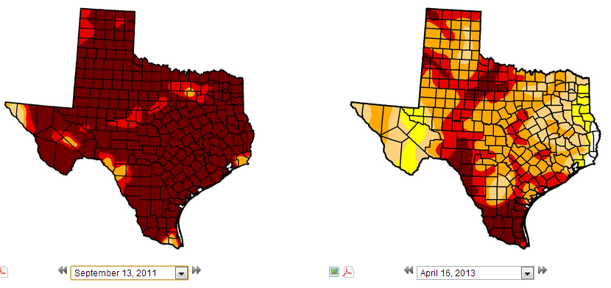
Drought in Texas – US Drought Monitor
In 2011, Texas and Oklahoma had the hottest summer
ever recorded in the history of the United States
Texas 99% in drought
87% in D4
Texas 98% in drought
12% in D4
September 2011
April 2013
http://droughtmonitor.unl.edu/

Slide 4
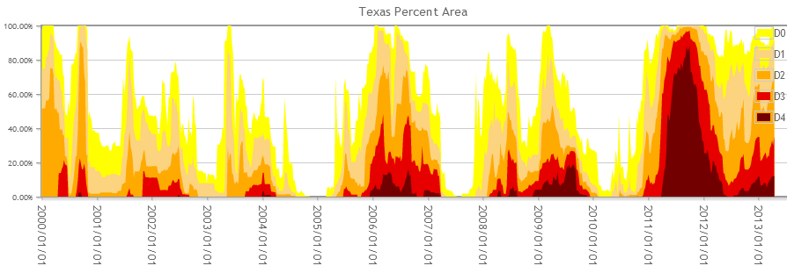
Trends in Drought Severity in Texas
2000
2002
2004
2006
2009
2011

Slide 5
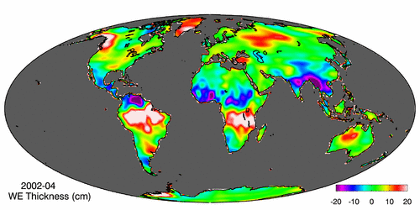
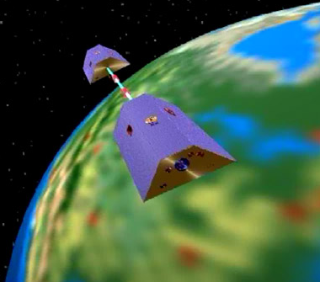
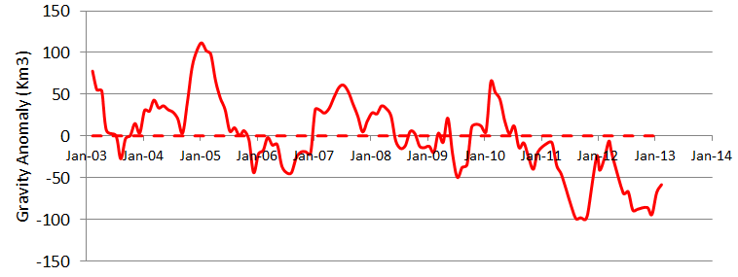
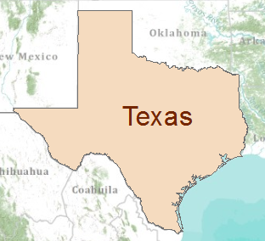
Gravity Recovery and Climate Experiment (GRACE) Force of gravity responds to changes in water volume Water is really heavy!
Gravity Anomaly of Texas, 2003 – 2013
Normal
At peak drought, Texas had a 100 Km³ water deficit
(equivalent to 70 Lake Travis’s)

Slide 6
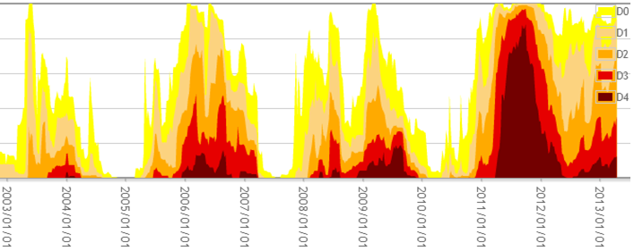
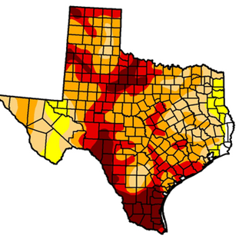
Drought and GRACE
US Drought Monitor is closely correlated with the GRACE data
US Drought
Monitor
Percent of Area in Drought
GRACE
September
2011
At peak drought, Texas had a 100 Km³ water deficit
(equivalent to 70 Lake Travis’s)

Slide 7
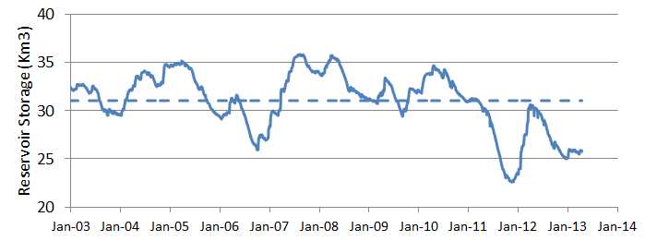
GRACE and Texas Reservoir Water Storage
Surface water reservoir storage is closely correlated with the GRACE data
Grace Satellites
Normal
At peak drought, Texas had a 100 Km³ total water deficit
(equivalent to 70 Lake Travis’s)
Surface Water Reservoirs
90% of the water deficit is in soil water and groundwater
Normal
and an 8.4 Km³ deficit in reservoir water storage

Slide 8
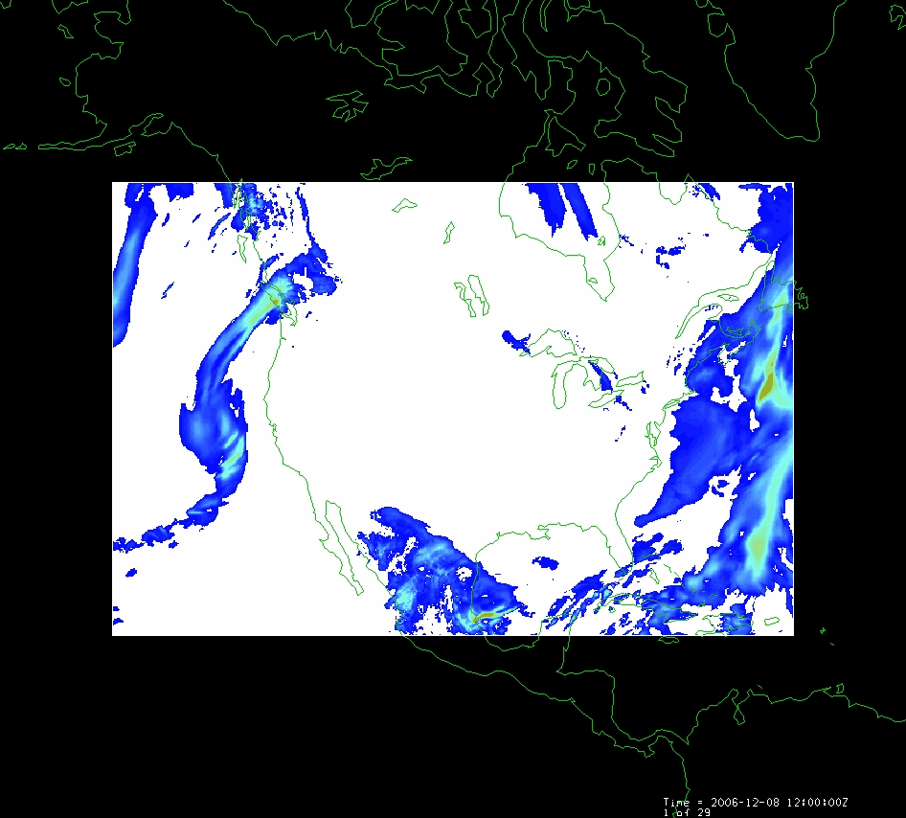
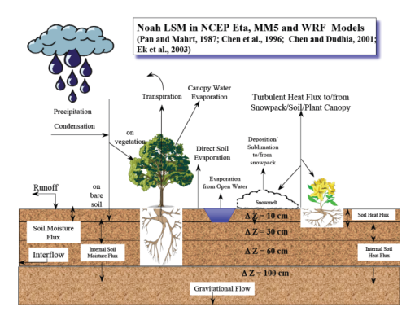
LDAS – Land Data Assimilation System
Forcing:
Radiation
Precipitation
Surface climate
Evaporation
Soil Moisture
Runoff
Recharge
Observations Datasets, Numerical Weather Model
Soil
Vegetation
Terrain
1979 to present
Domain | Space | Time
North America | 1/8 degree | 1 hour
Global | 1/4 degree | 3 hours
Land Surface Model
Deduction:
Given these forcing and land surface conditions
Then, using a land surface simulation model
Derive surface moisture and energy balance

Slide 9
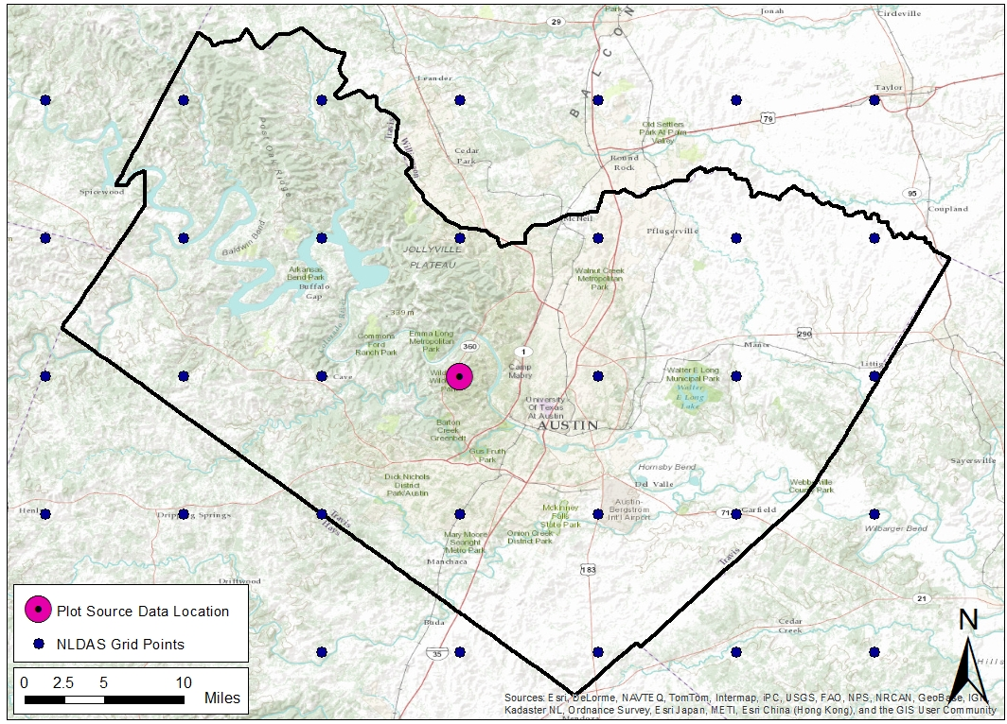
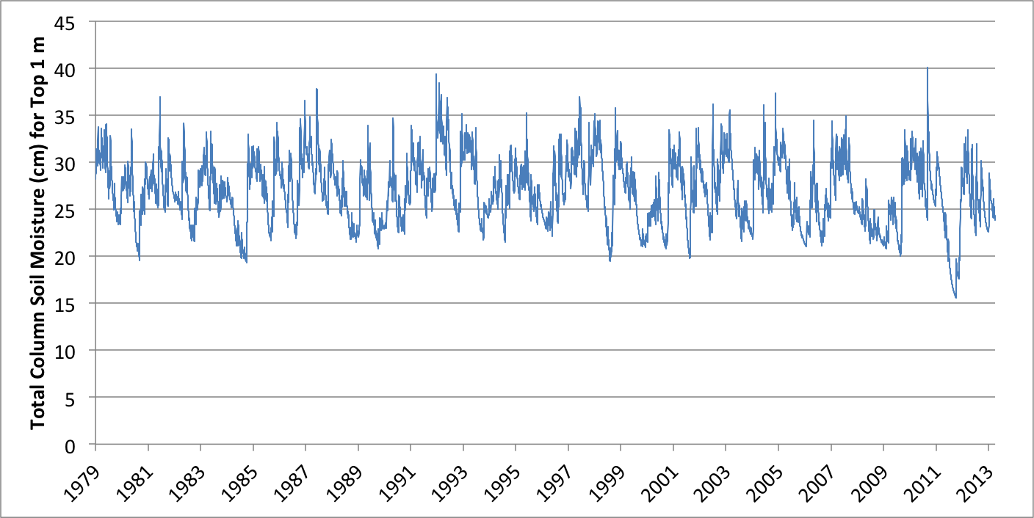
LDAS “Data Rods” project
Time series at every point

Slide 10
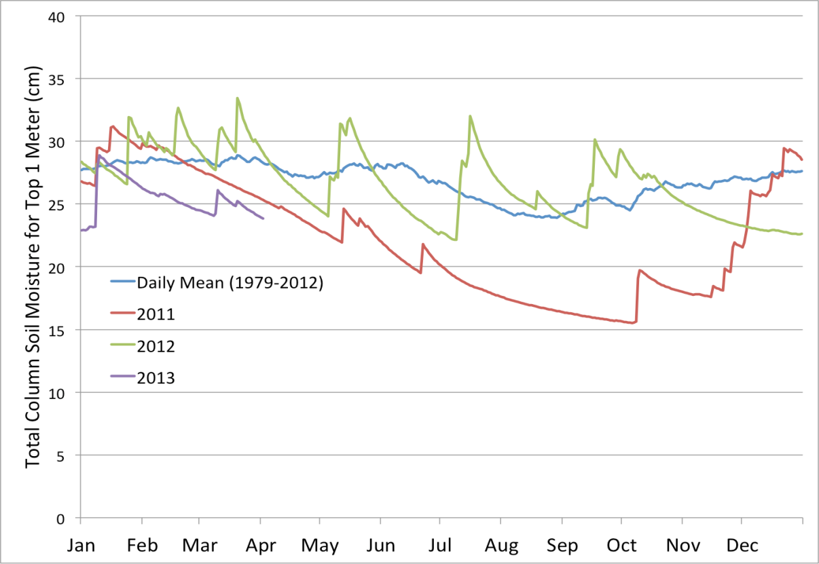
Current Soil Moisture Conditions
Time series at every point

Slide 11
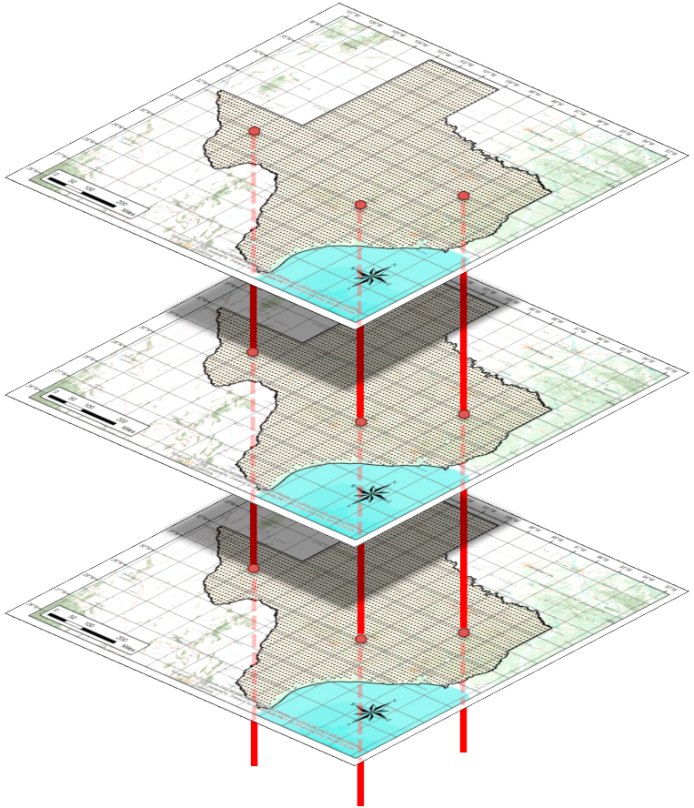
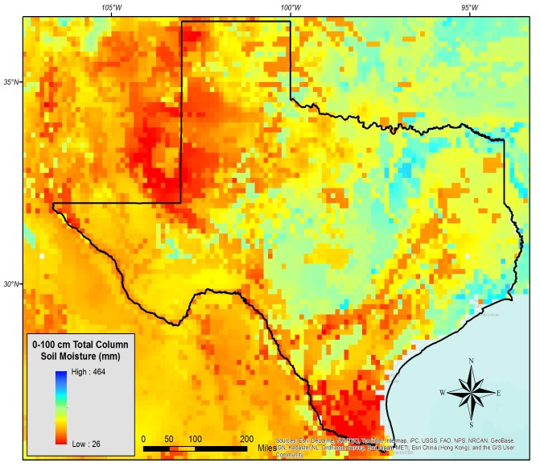
“Data Rods” for Texas
2012
2011
2010
April 25, 2013
Soil moisture
in top 1m of soil

Slide 12
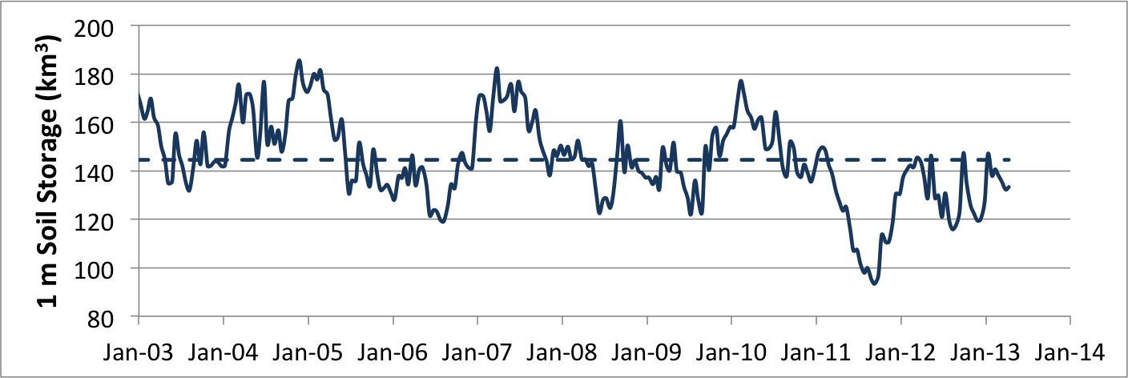
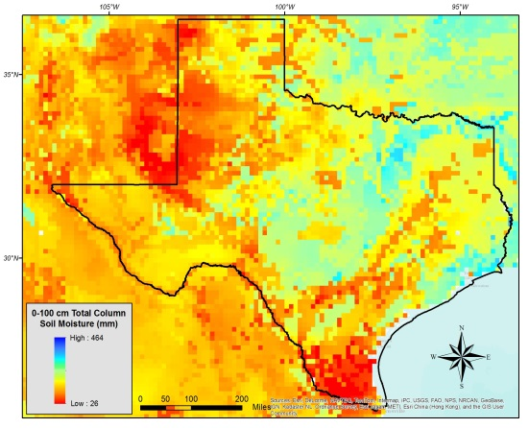
GRACE and Texas Soil Water Storage
Surface water reservoir storage is closely correlated with the GRACE data
Grace Satellites
Normal
Texas had a 100 Km³ total water deficit
Soil Water in top 1m
Normal
and an 8.4 Km³ deficit in reservoir water storage
Of this 45 Km³ is in top 1 m of soil

Slide 13
Texas Monthly Drought Special Report July 2012

Slide 14
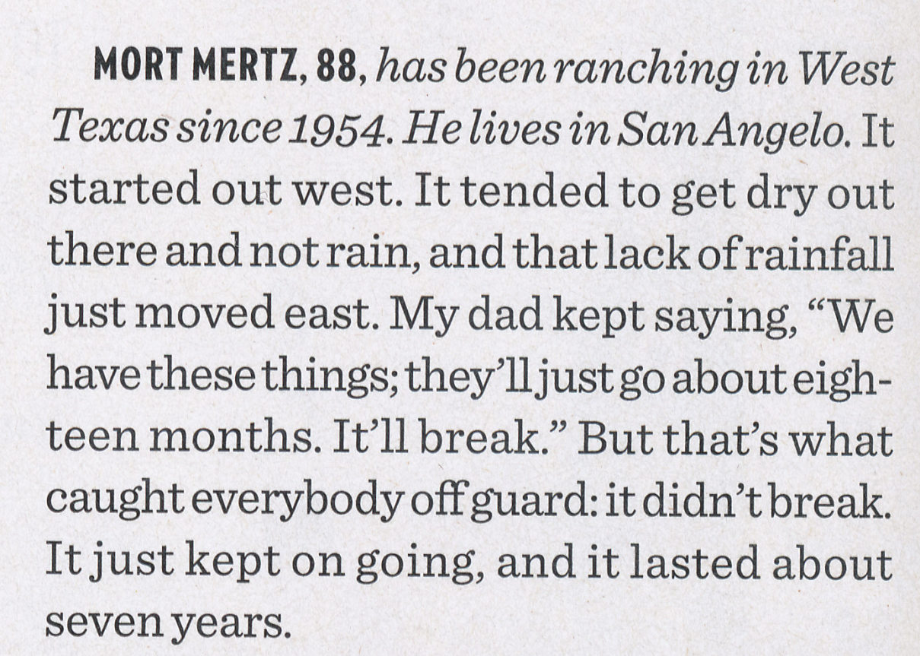
Mort Mertz – Drought of the 1950’s (1950-1957)

Slide 15
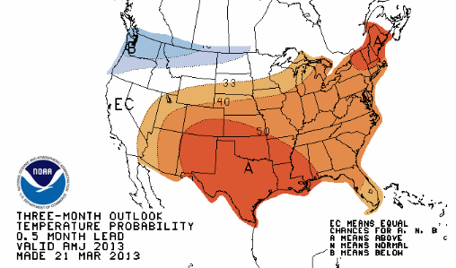
Temperature Outlook for Next Three Months
A means Above normal
with 50% probability

Slide 16
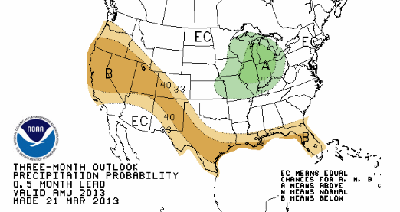
Precipitation Outlook for Next Three Months
B means Below normal
with 40% probability

Slide 17
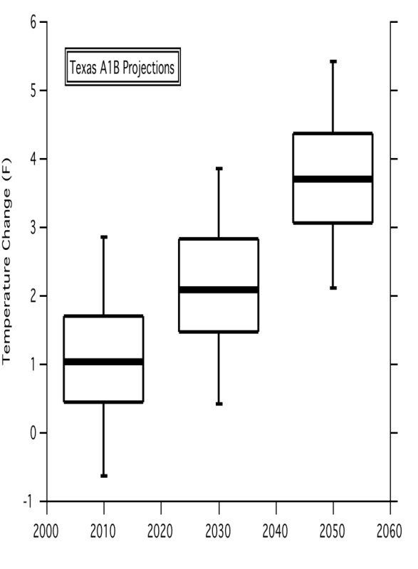
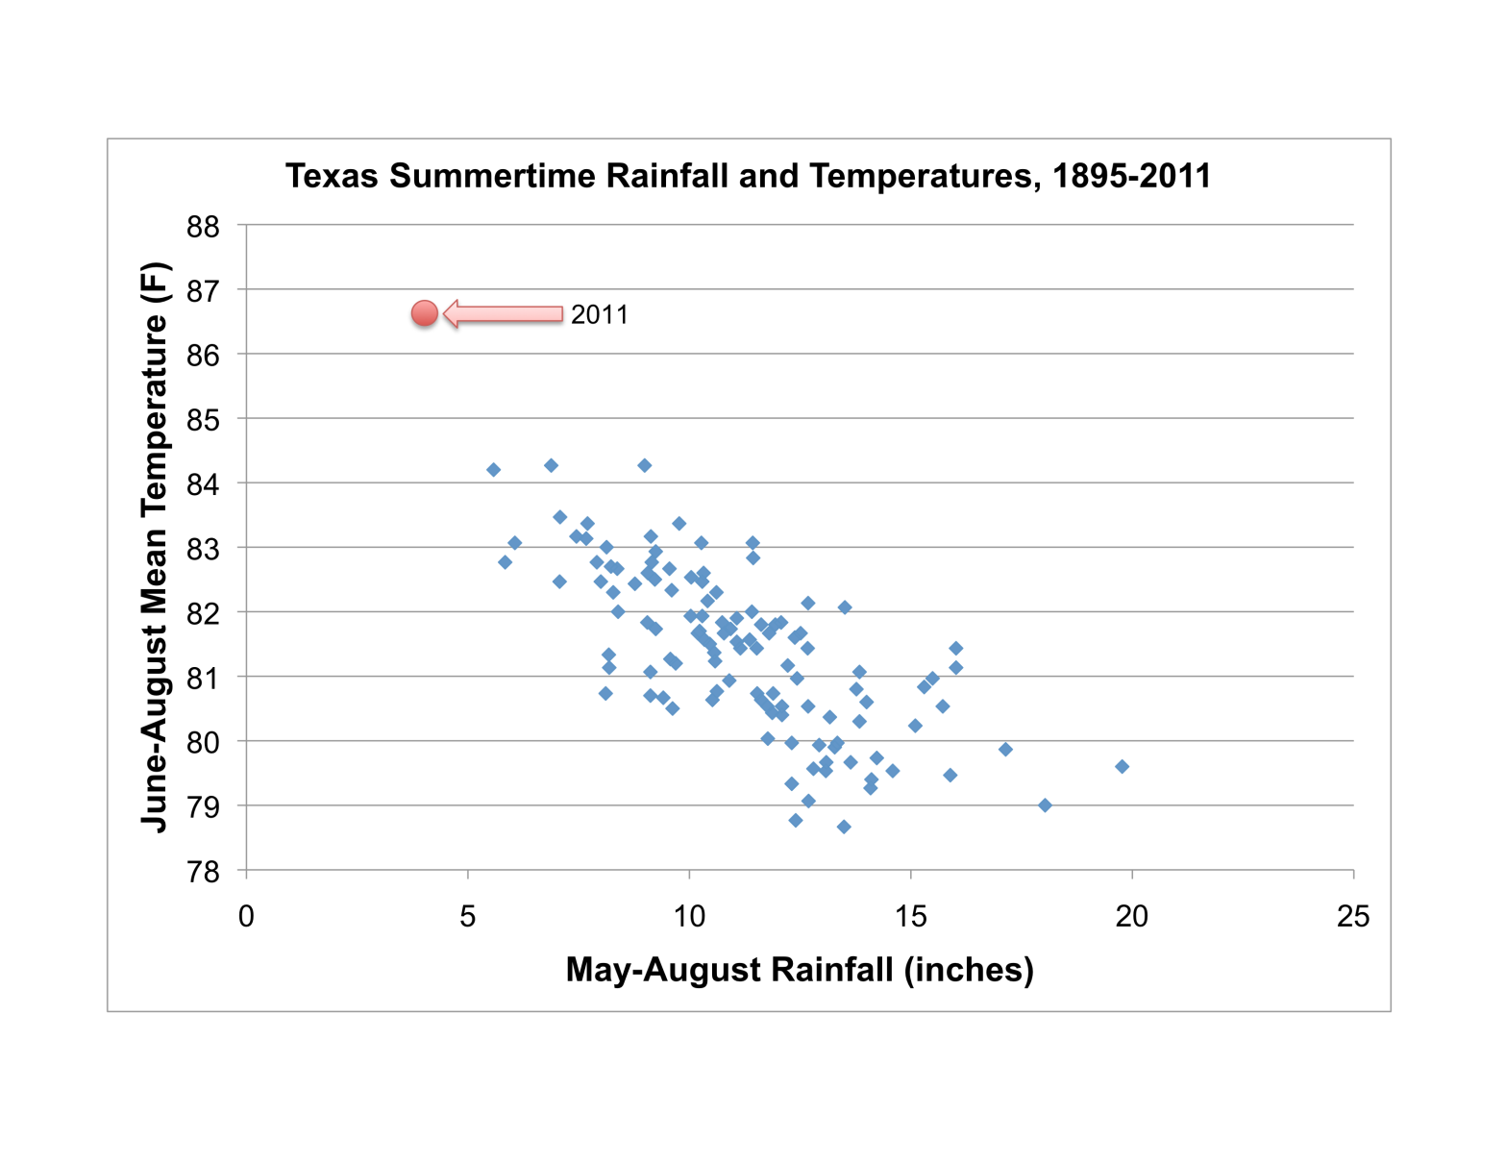
What does the longer-term future hold?
As temperatures rise, rain decreases….
Temperature is expected to rise…
whether due to natural variations or anthropogenic causes
John Nielson-Gammon, 2012; Danny Reible, 2013

Slide 18
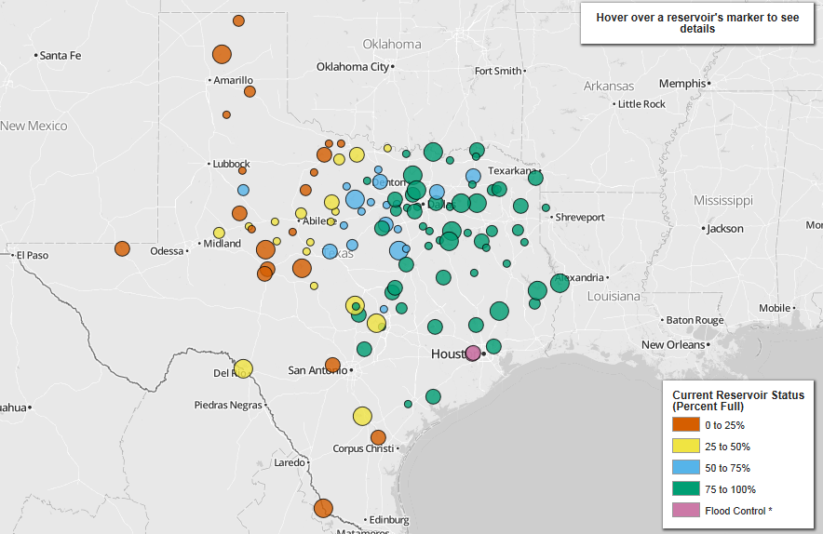
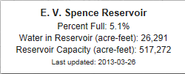
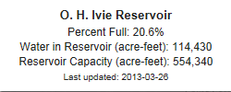
Reservoir Levels (Dec 17, 2012)
West Texas is in a more sustained drought
http://www.texastribune.org/library/data/texas-reservoir-levels/
Notes:
West Texas is chronically short of water – reservoirs are either dry or are drying up. Cities are building access to groundwater well fields as fast as possible. East Texas has relatively abundant water resources.

Slide 19
Normalized Difference Vegetation Index (NDVI)
A measure (0-1) of the greenness of the land surface derived from remote sensing
Vegetative vigor is limited by soil moisture

Slide 20
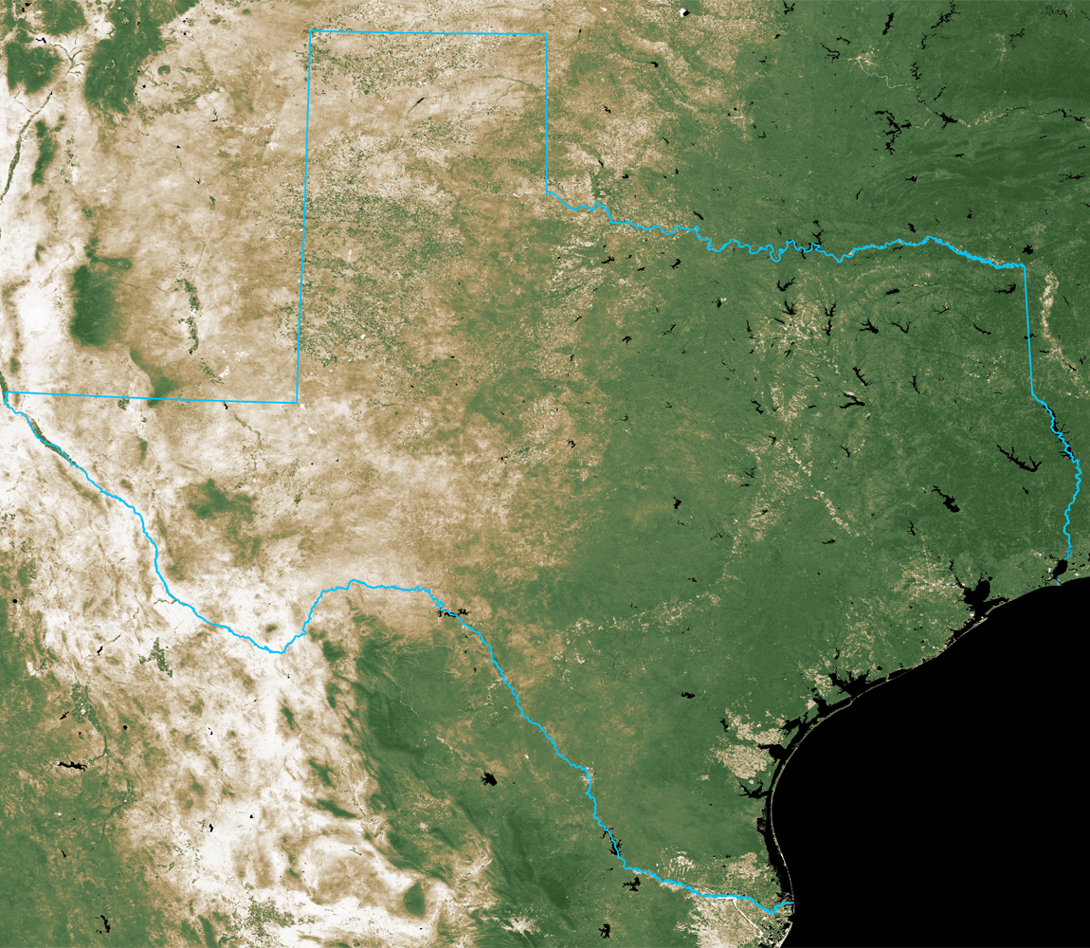
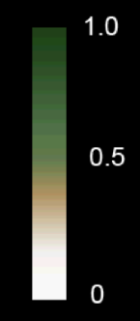
NDVI on September 30, 2010
Normalized Difference
Vegetation Index
September 30, 2010
Source: 16-day cycle MODIS
UT Center for Space Research

Slide 21
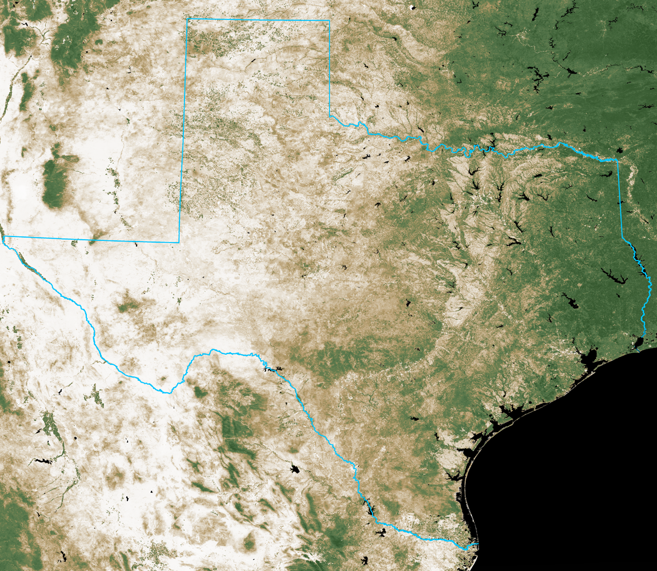
NDVI on September 30, 2011
Normalized Difference
Vegetation Index
September 30, 2011
Source: 16-day cycle MODIS
UT Center for Space Research

Slide 22
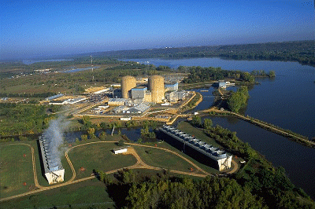
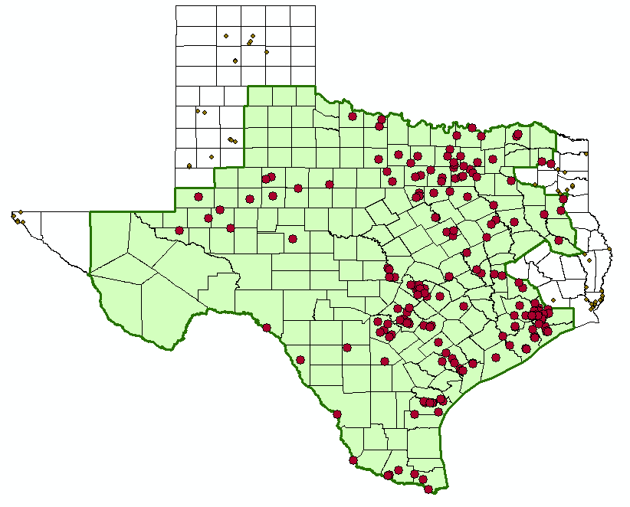
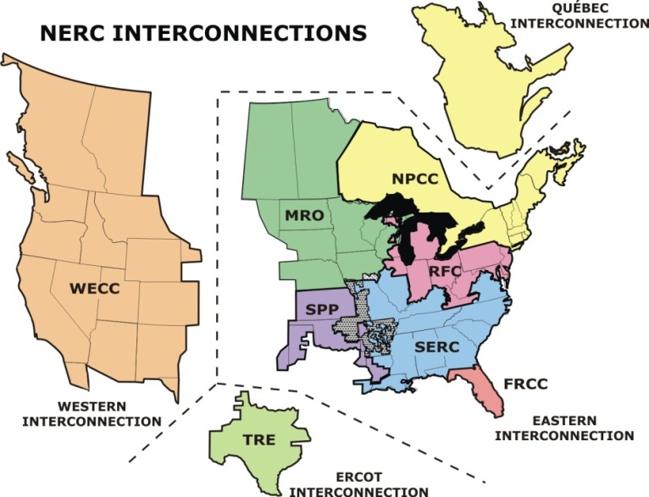
Water and Electric Power Generation
Water flow, level and temperature issues
ERCOT Power Pool

Slide 23
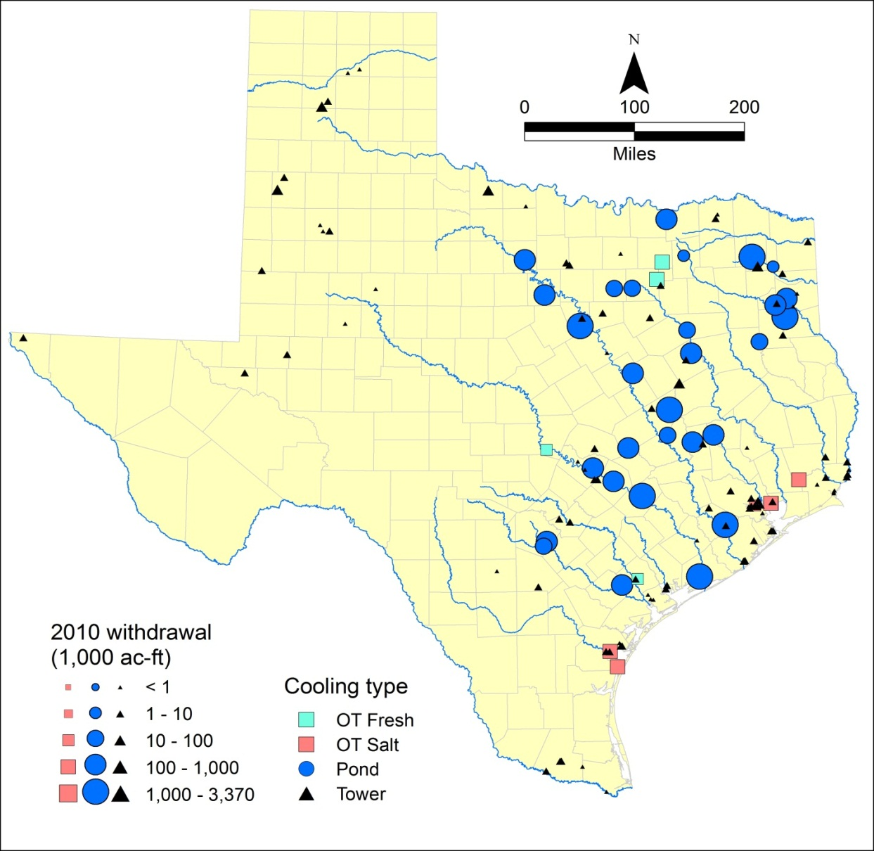
Electrical supply is NOT resilient to drought
Power supply in195 counties isolated from rest of US
41% of TX water withdrawals for electricity
77% of water is surface water
3000 MW at risk if drought had not eased in early 2012
Notes:
Our power supply is threatened by the possibility of low water conditions inhibiting access to cooling water at some power plants. This could lead to rolling blackouts in Texas (as were being warned by ERCOT in Spring 2012)

Slide 24
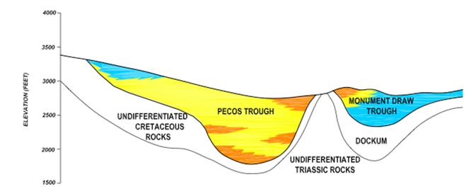
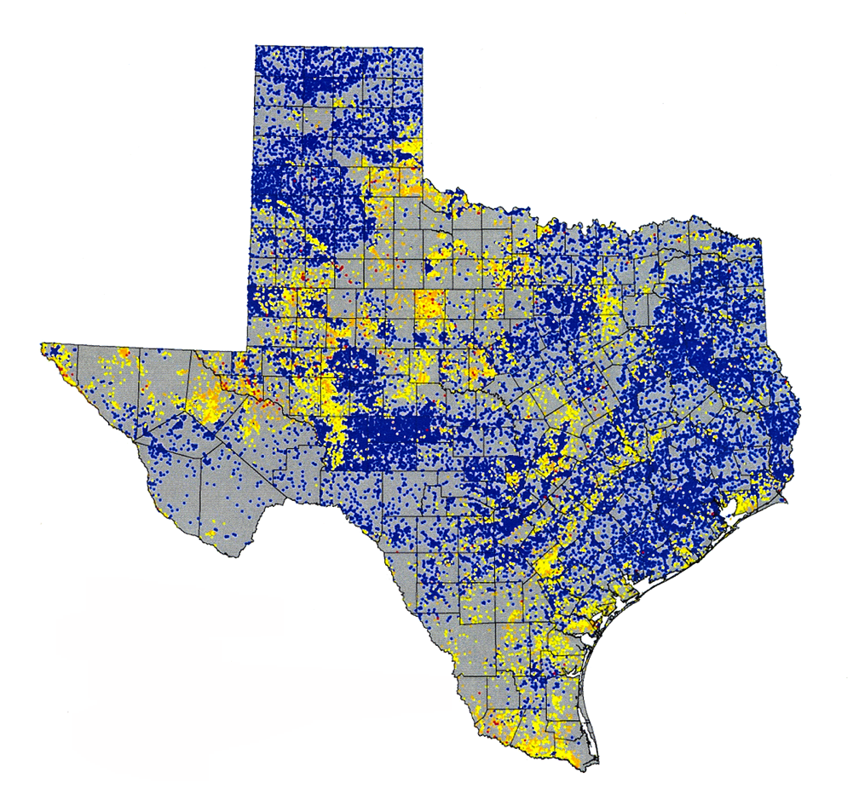
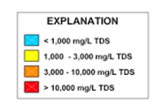
Saline Groundwaters of Texas
Pecos Alluvium

Slide 25
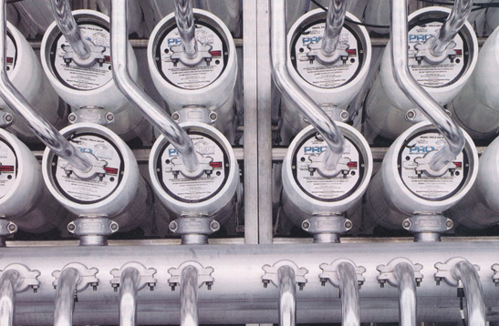
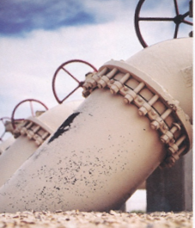
Largest inland desalination plant in the world Kay Bailey Hutchinson Plant in El Paso (27.5 MGD)

Slide 26
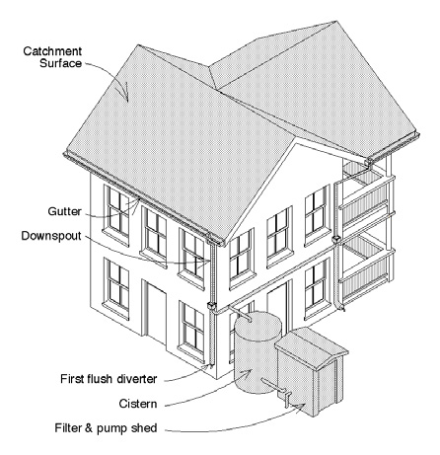
Rainwater harvesting system components
Basic unit
Roof
Conveyance system
Storage system
Distribution system
More complex unit (in addition to components in basic unit)
Pump and pressure tank
Filtration system
Disinfection system
Slide: Sanjeev Kalaswad

Slide 27
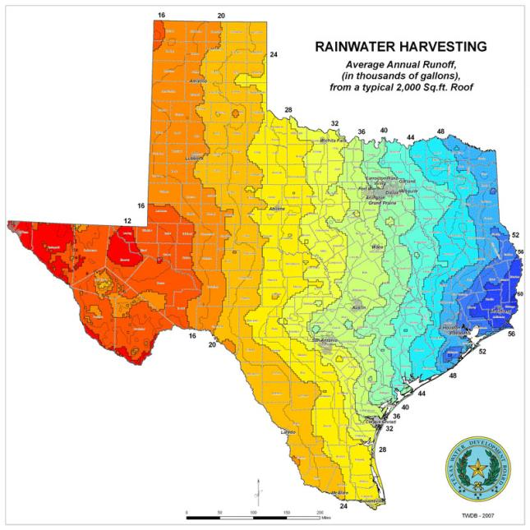
How much rainwater can we collect?
Or, an approximate volume can be estimated using the rainwater harvesting runoff map (left)
Example:
For a 2,000 square foot roof in:
Hays County ( )
About 36,000 gallons of rainwater can be collected annually
Slide: Sanjeev Kalaswad

Slide 28
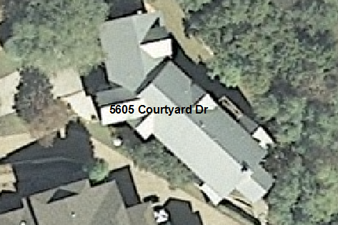
Estimating Roof Surface Area
ArcGIS 10
6 inch orthoimage available from CapCOG
2761 ft²

Slide 29
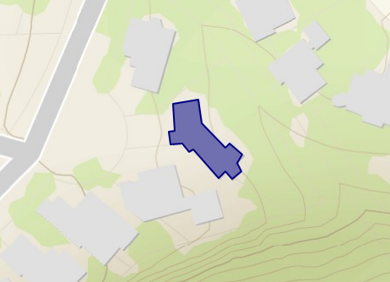
Estimating Roof Surface Area
ArcGIS Explorer
Free online version
2568 ft²
~200 ft² difference
Less resolution?
User error?

Slide 30
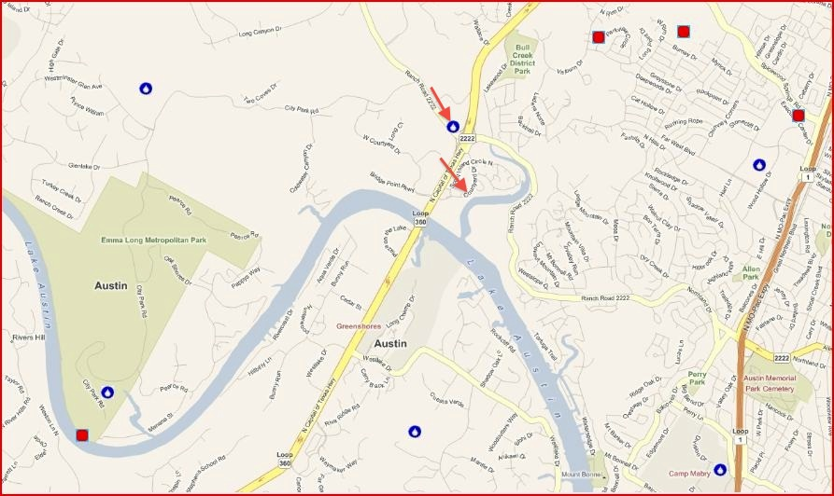
Finding Precipitation Data
Hydro Desktop – free and open source
Identified 6 gauges with robust data close to house
NOAA’s National Weather Service West Gulf River Forecast Center

Slide 31
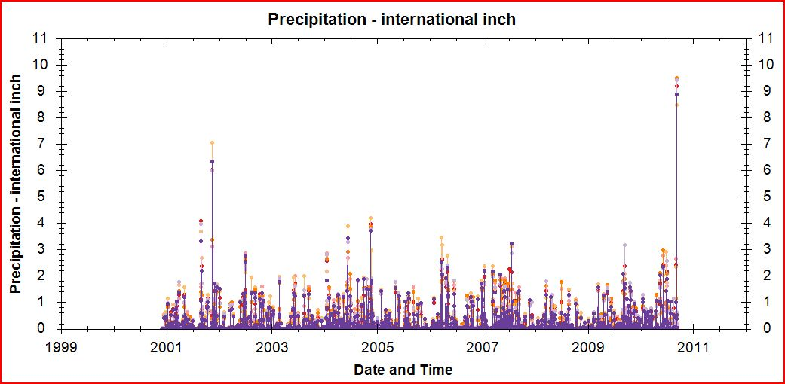
Assessing Precipitation Data
Histogram with data from all 6 sites
Rainfall localized, but gauges have similar spikes

Slide 32
3D Model of UT Campus in Google Earth Data from City of Austin
“Egg shell” of NHB building – built from aerial images
ftp://ftp.ci.austin.tx.us/GIS-Data/Regional/coa_gis.html

Slide 33
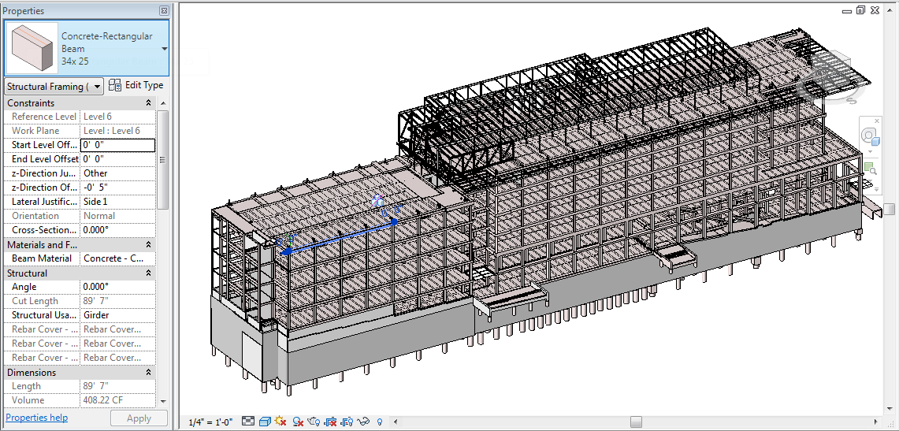
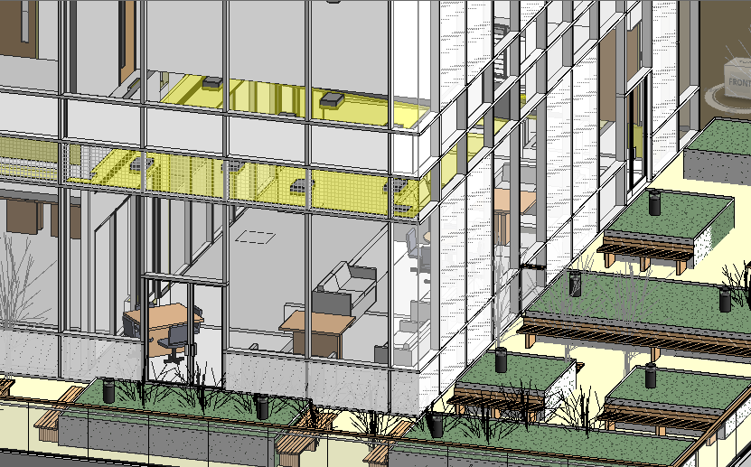
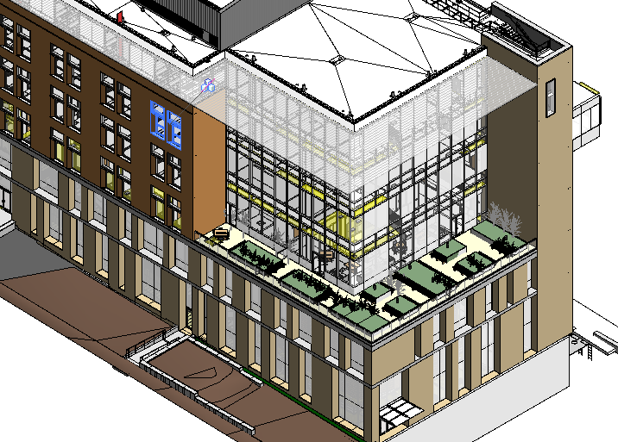
BIM of UT Norman Hackerman Building Data from Beck Construction and UT-Austin
Curtain Wall
Steel Structure
Exterior Enclosure
Mechanical, Electrical, Plumbing and Fire Protection

Slide 34
Rainwater Harvesting using 3D roofs in Corpus Christi, Texas
By Tongren Zhu Dec. 20th,2012

Slide 35
Rainwater Harvesting
Rainwater harvesting is the accumulation and storage of rainwater for reuse before it reaches the aquifer.
Definition
Including water for garden, water for livestock, water for irrigation, cleaning of bathrooms as in first flush, etc.
Uses
Provide sufficient water supply, serve as a valuable stormwater management tool.
Benefit

Slide 36
Project Area
237 buildings in total
All commercial buildings in downtown
With field value of roof areaXY, facade area, reletive height, roof slope etc.
Will look into potential of rainwater for toilet use

Slide 37
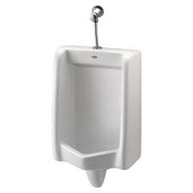
Calculation of Toilet Water Needs
Toilet: 6L(1.6 gallon) per flush
Urinal: 3.8L(1 gallon) per flush
Lavatory Faucet: 5.7L(1.5 gallon) per minute
Assume 10 hours in the office per day
For male, use toilet 1 time, use urinal 4 times, 21.2L/(cap-day)
For female, use toilet 5 times,30L/(cap-day)
For one capita, 25.6L/day. We use 30L/day here.
30L/(Cap-d)

Slide 38
Month Toilet Water Needs in Each Building

Slide 39
Conclusions
Drought is a fact of life in Texas
Especially prevalent in West Texas
The Drought of 2011 continues and we do not know when it will end
Surface water supplies are significantly diminished
Rainwater harvesting is an important water source
GIS and new water web services technologies can help with design.

