Slide 1
Web Services for Water Data in Texas
Presented by David R. Maidment
Director, Center for Research in Water Resources, University of Texas at Austin
Presented to
Texas Water Conservation Association
67th Annual Convention
Austin, Texas, March 4, 2011

Slide 2
Web Services for Water Data in Texas
The vision – a unified view of water data in Texas
Making it happen – web services
Making it useful – rapid, authoritative information
Next steps …..

Slide 3
Web Services for Water Data in Texas
The vision – a unified view of water data in Texas
Making it happen – web services
Making it useful – rapid, authoritative information
Next steps …..

Slide 4
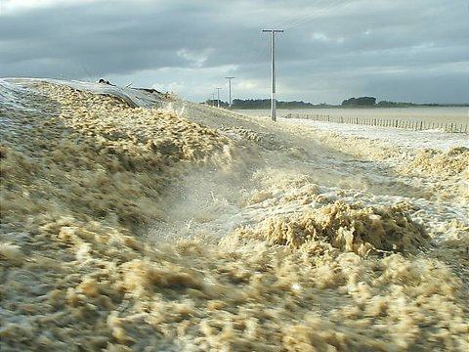
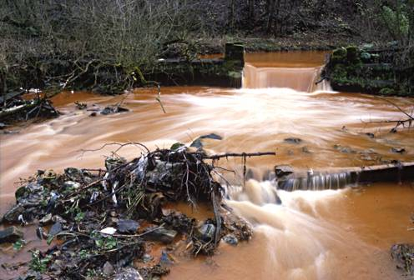
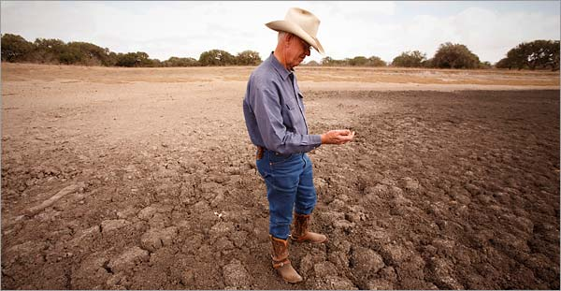
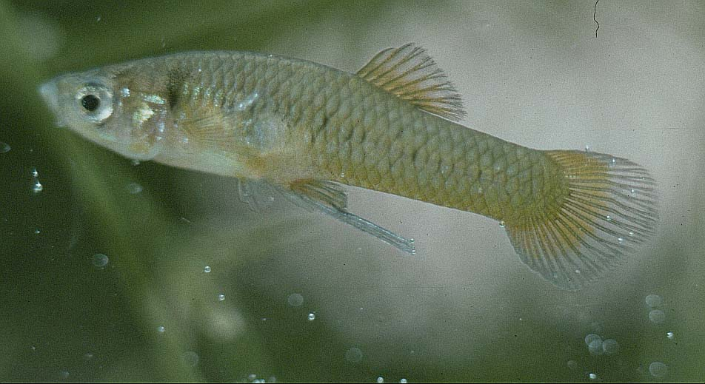
Four water problems to be solved
Too much water
(flooding)
Dirty water
(water quality)
Not enough water
(droughts)
Environmental Issues
(aquatic life)
Notes:
There are four basic problems to be solved in natural water systems:
Flooding – how to characterize and mitigate floods
Droughts – how to assess water availability and define water supply
Dirty water – how to assess water quality assessment and calculate Total Maximum Daily Load estimates
Environmental Issues – how to ensure that there is enough water quantity and quality to support aquatic life?

Slide 5
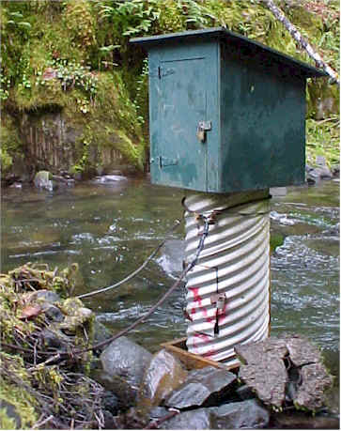
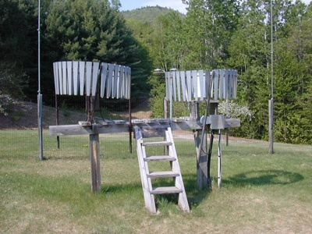
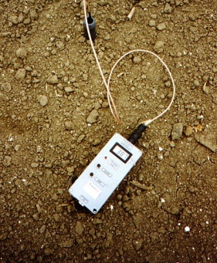
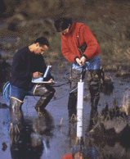
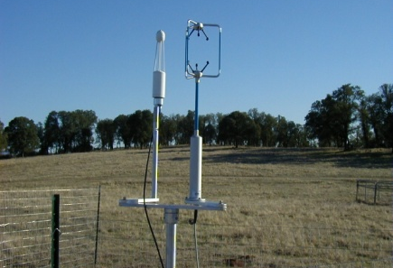
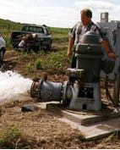
We Collect Lots of Water Data
Water quantity
Rainfall
Soil water
Water quality
Meteorology
Groundwater

Slide 6
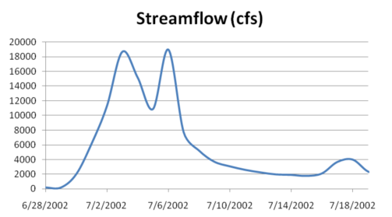
The Data have a Common Structure
A point location in space
A series of values in time
Gaging – regular time series
Sampling – irregular time series
Notes:
These data are recorded over time to monitor a hydrologic process or property.

Slide 7
The Data are Collected by Many Organizations
Water Districts
Federal Agencies
River Authorities
State Agencies
Cities
Universities
…. and the data are continuously accumulating

Slide 8
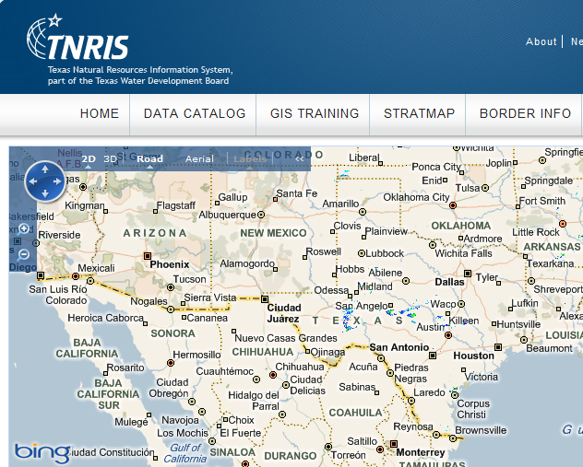
We have a GIS data repository
… but nothing equivalent for water data

Slide 9
Web Services for Water Data in Texas
The vision – a unified view of water data in Texas
Making it happen – web services
Making it useful – rapid, authoritative information
Next steps …..

Slide 10
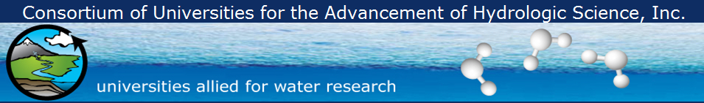
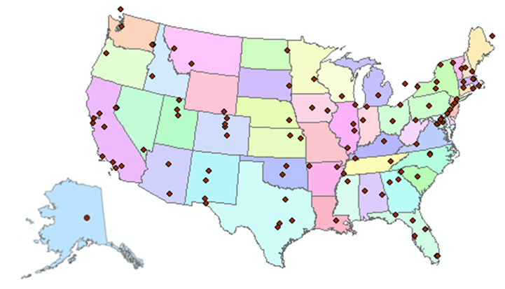
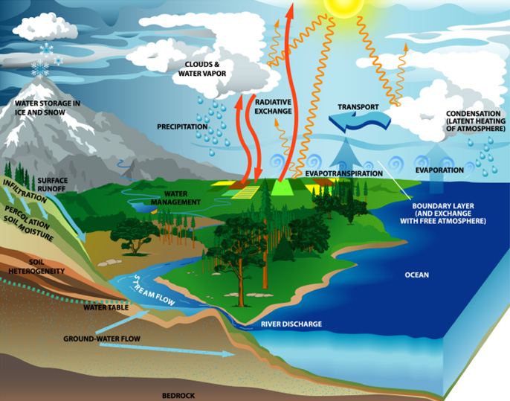
http://www.cuahsi.org
CUAHSI is a consortium representing 125 US universities
Supported by the National Science Foundation Earth Science Division
Advances hydrologic science in nation’s universities
Includes a Hydrologic Information System project

Slide 11
How the web works
Catalog
(Google)
Catalog harvest
Search
Web Server
(CNN.com)
Access
Browser
(Firefox)
HTML – web language for text and pictures

Slide 12
Services-Oriented Architecture for Water Data
Catalog
Service registration
Search
Catalog harvest
Server
Data access
User
WaterML – web language for water data

Slide 13
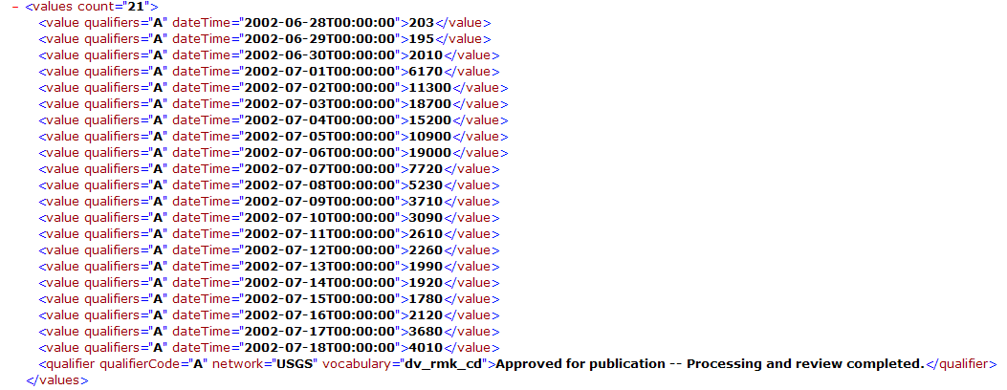
WaterML as a Web Language
Discharge of the San Marcos River at Luling, TX June 28 - July 18, 2002
USGS Streamflow data in WaterML language
The USGS now publishes its time series data as WaterML web services

Slide 14
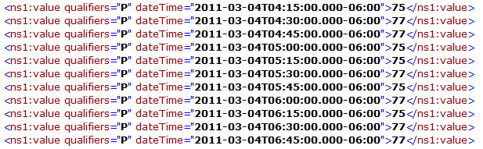
Colorado River at Austin
I accessed this WaterML service from USGS at 7:23AM this morning
http://waterservices.usgs.gov/nwis/iv?sites=08158000&period=P7D&parameterCd=00060
And got back these flow data from USGS which are up to 6:45AM Central time

Slide 15
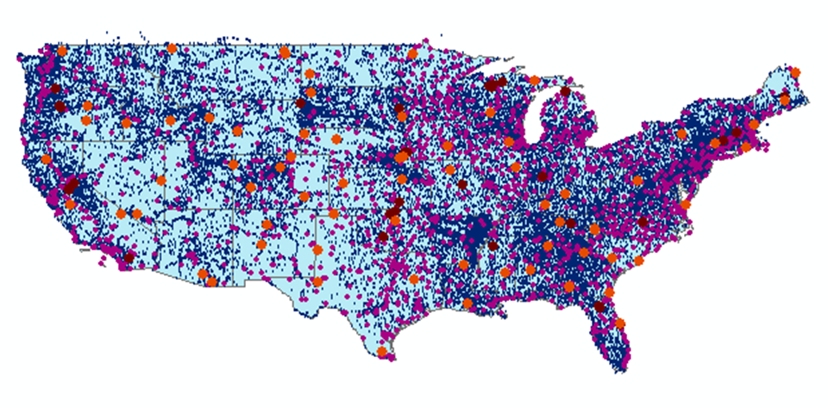
CUAHSI Water Data Services Catalog
66 public services
18,000 variables
1.9 million sites
23 million series
5.1 billion data values
And growing
The largest water data
catalog in the world
maintained at the San Diego Supercomputer Center

Slide 16
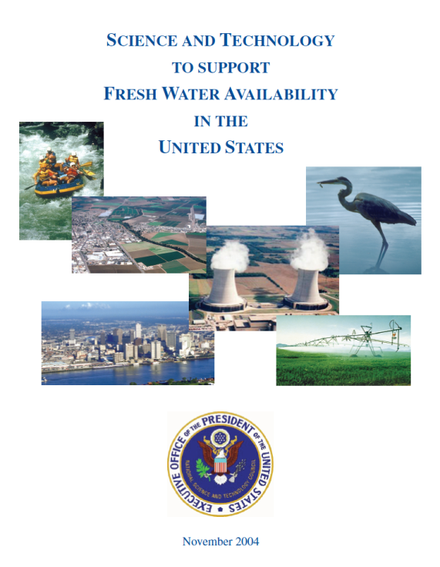
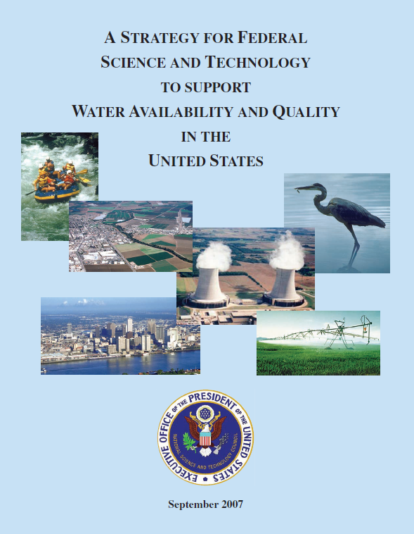
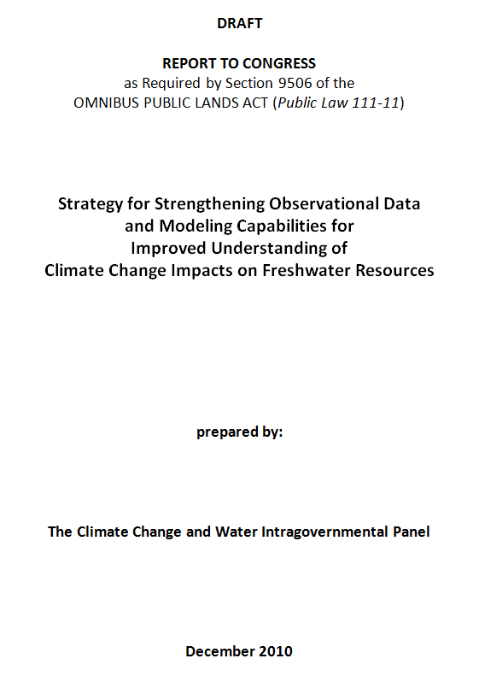
Subcommittee on Water Availability and Quality (SWAQ)
Supports the Office of Science and Technology Policy, Executive Office of the President
2010 Draft Report
2004 Report
2007 Report
To provide guidance concerning the science and technology needed …..
….. to assure the availability and quality of water resources of the United States

Slide 17
Omnibus Public Lands Act (Public Law 111-11)
Sec. 9506 “Climate Change and Water Intragovernmental Panel”
(c) Review Elements
  (3) “To establish data management and communication protocols and standards to increase the quality and efficiency by which each Federal agency acquires and reports data;
  (4) To consider options for the establishment of a data portal to enhance access to water resource data;
The Federal government has a mandate for water data sharing

Slide 18
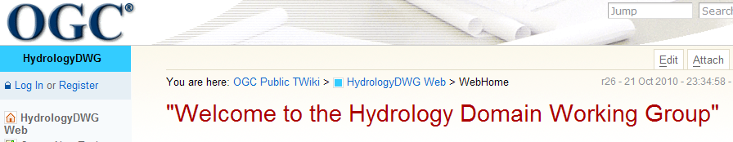
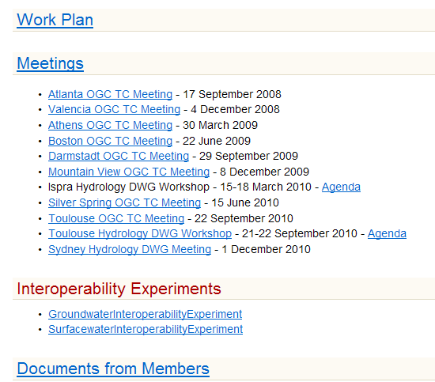
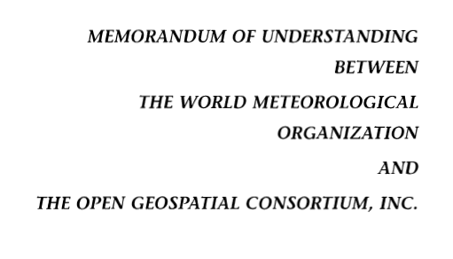
Jointly with World Meteorological Organization
Evolving WaterML into an International Standard
Meets every 3 months
Teleconferences most weeks
November 2009
Hydrology, Meteorology, Climatology, and Oceanography
WaterML Version 2 standard being proposed
Notes:
The Hydrology Domain Working Group was initiated by the Open Geospatial Consortium in September 2008. The OGC has about 400 companies and agencies that have developed the most widely used standards for conveying geospatial information on the internet (Web Mapping Service, Web Feature Service, Web Coverage Service, Catalog Services for the Web, Sensor Observation Service). In November 2009, OGC and WMO agreed to collaborate to provide information data exchange standards in hydrology, climatology, oceanography and meteorology – there are now two working groups – the OGC/WMO Joint Hydrology Domain Working Group and a similar Met-Oceans Working Group. HDWG is proposing a new standard for WaterML in December 2010 that is a customization of the OGC Sensor Observation Services’ Get Observations function adapted for conveying time series through the internet (WaterML2). The technical specification for the “service stack” will be presented and peer-reviewed through the Hydrology Domain Working Group.

Slide 19




Water Agency Service Stacks
Each agency maintains its own data and metadata
NWIS
Storet
State
NCDC
TWDB
A water data portal for the Texas is being built ….
….. as a metacatalog linking the catalogs from these stacks
Notes:
The Federal Government already supports Catalog Services for the Web through Geodata.gov and is moving to Data.Gov and a new initiative called the Geoplatform (requested by OMB in 2011). Cataloging water observations data under this system is a straightforward extension of what is already being done to federate the federal government’s geospatial data layers. State water observations data systems like that coming from the Texas Water Development Board can be federated and searched along with the federal water observations data services

Slide 20
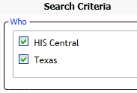
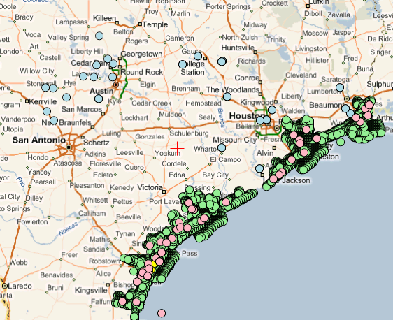
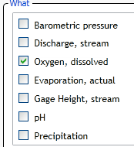
Searching Federal and State Data
(Federal)
(State)
USGS Daily Values
Texas TWDB
Texas TCEQ & TPWD
A single search accesses federal water data from a catalog at HIS Central ….
…. and state water data from a catalog in Austin, Texas

Slide 21
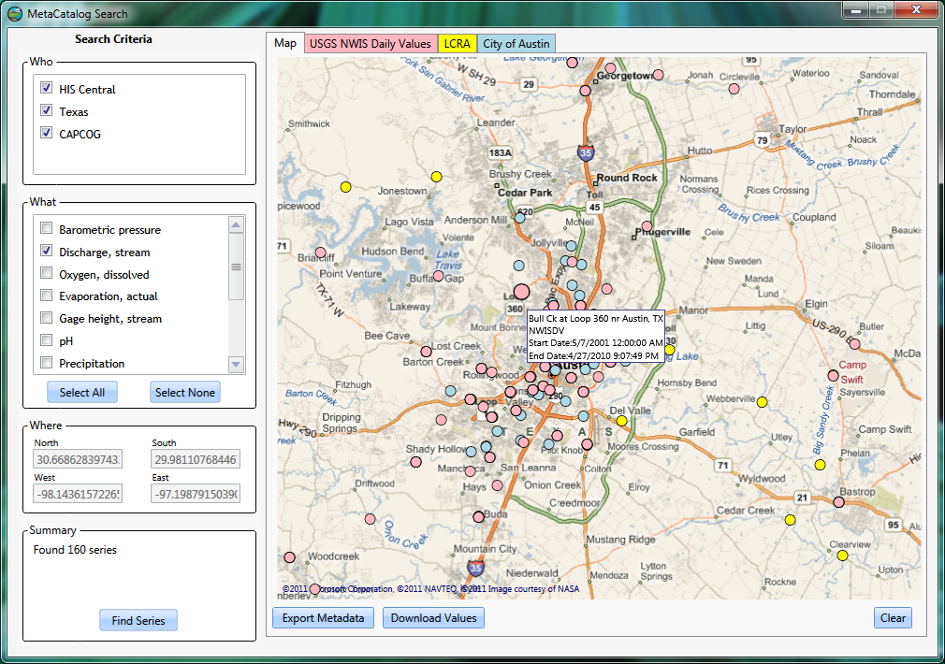
Searching USGS, LCRA and City of Austin data

Slide 22
Web Services for Water Data in Texas
The vision – a unified view of water data in Texas
Making it happen – web services
Making it useful – rapid, authoritative information
Next steps …..

Slide 23
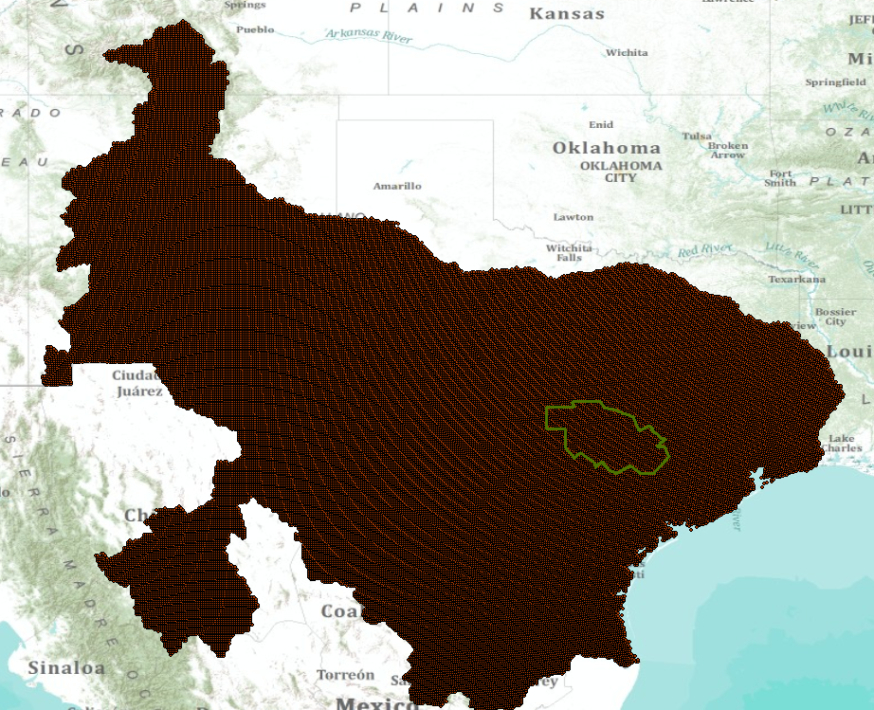
Multisensor Precipitation Estimate (MPE) West Gulf River Forecast Center
Exported by NWS to CUAHSI Observations Data Model and WaterML web services at University of Texas at Arlington
Capital Area Council of Governments (CAPCOG)

Slide 24
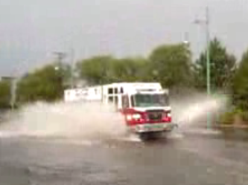
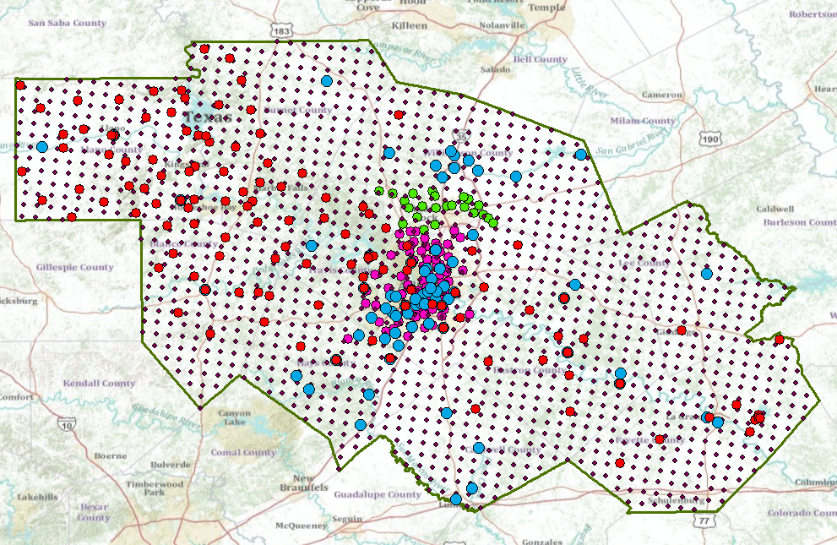
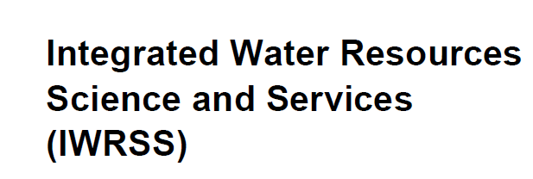
Situational Awareness for Flash Flooding in the CAPCOG region
National Weather Service,
USGS, Corps of Engineers
Combines federal, river authority, city and water district data ….
…. to support real-time flood emergency response

Slide 25
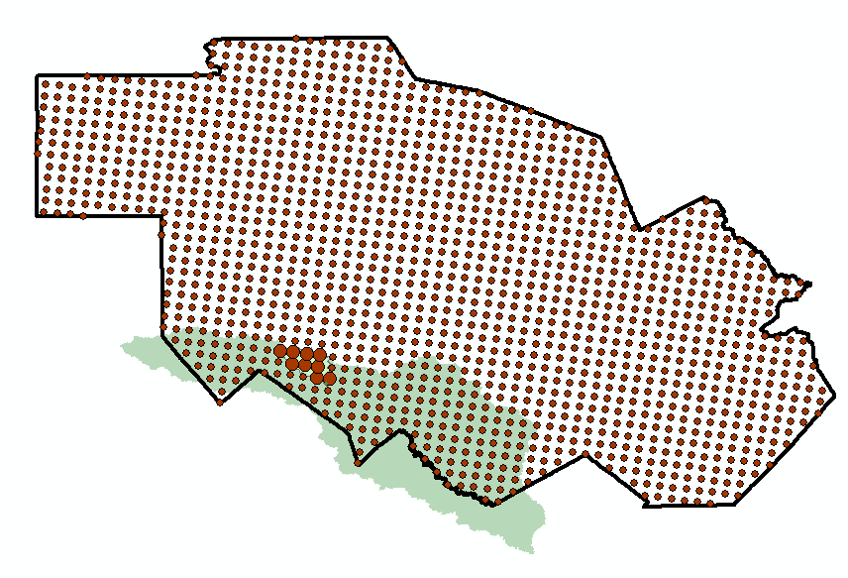
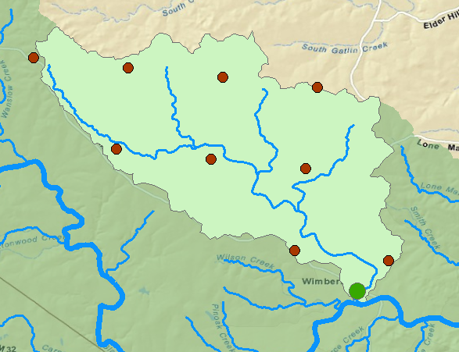
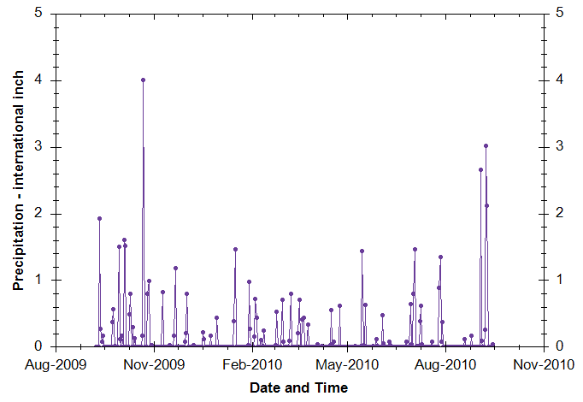
Rainfall in Cypress Creek Watershed
Drainage area – 38 Sq. Mi.
“Virtual Rain Gages”— Nexrad Radar Rainfall points
Time Series of Rainfall
Data obtained via WaterML web service from NWS and UT Arlington

Slide 26
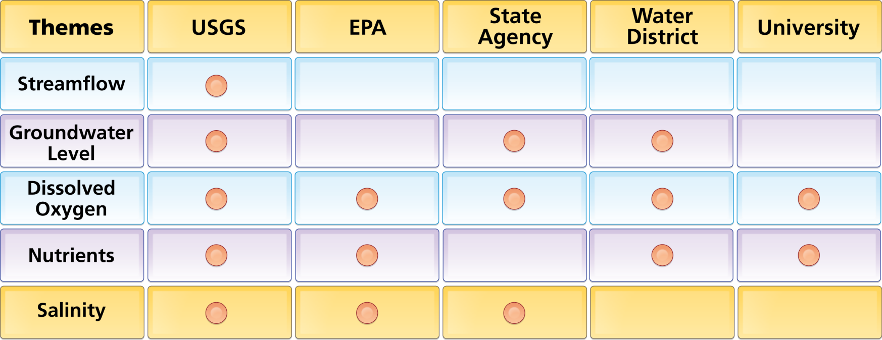
Organize Water Data Into “Themes”
Integrating Water Data Services From Multiple Sources
WaterML
WaterML
WaterML
WaterML
WaterML
. . . Across Groups of Organizations

Slide 27
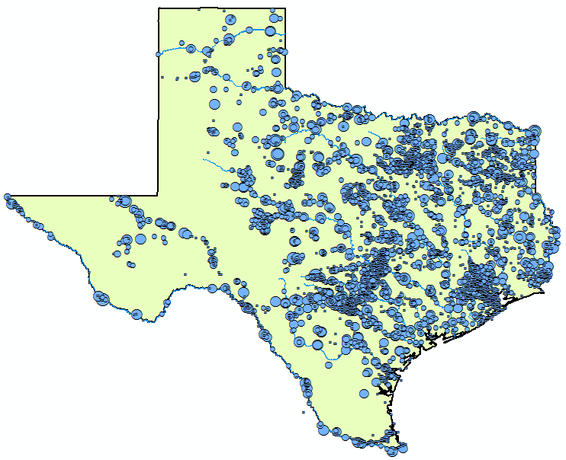

Streamflow Data Services
2 services
7 variables
4,363 sites
11,484 series
9,493,968 records
Notes:
Here’s an example showing where streamflow is measured in Texas from two different services (i.e., data providers).

Slide 28
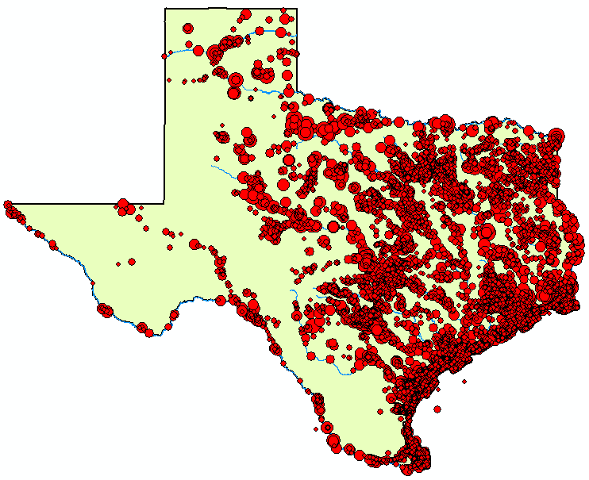
Water
Temperature Data Services
6 services
11 variables
11,158 sites
22,953 series
1,546,841 records

Slide 29
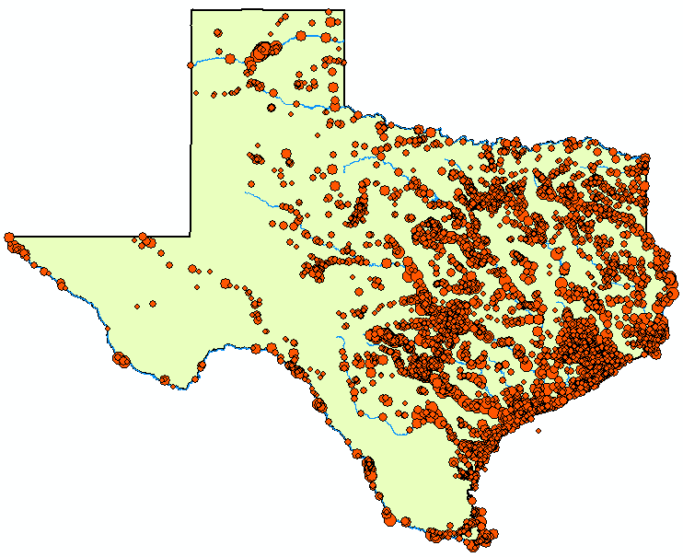
Bacteria Data Services
1 service
21 variables
4,801 sites
15,483 series
297,849 records

Slide 30
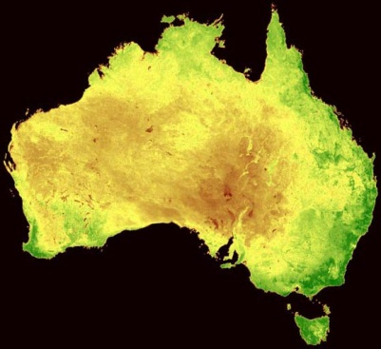
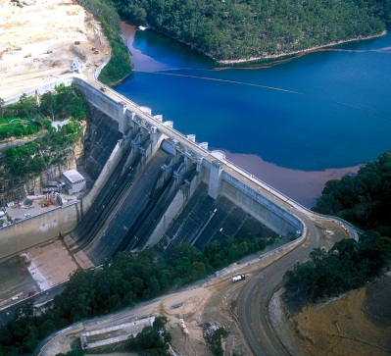
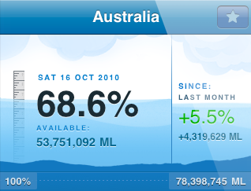
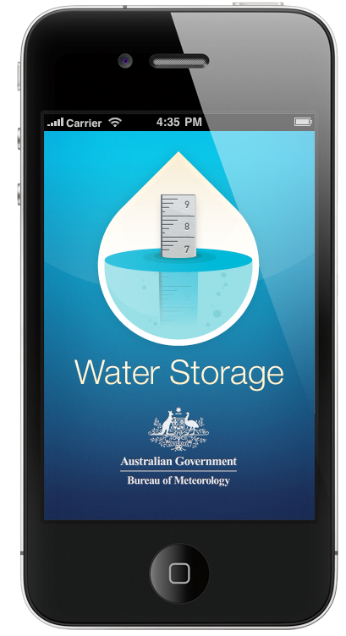
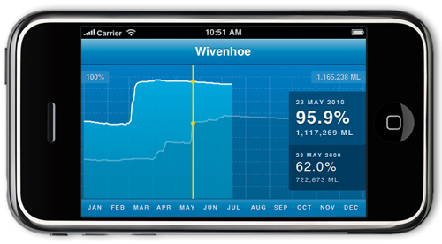
Australian Water Resources Information System iPhone App for Water Storage
National View
Summarizes the current volume of water in reservoir storage and its change over time
Regional View
http://itunes.apple.com/au/app/water-storage/id380627384

Slide 31
Conclusions
Public, open source standards for water data are emerging for the first time (WaterML)
We can use these to build an integrated view of water data in Texas like what we have for GIS data
There is commitment at the international, national and state level to this process
We invite your participation!

