Slide 1
Integrated Water Resources Science and Systems (IWRSS) for Texas
David R. Maidment Center for Research in Water Resources University of Texas at Austin
IWRSS Coordination Meeting Texas Water Development Board
Austin, August 2, 2012

Slide 2
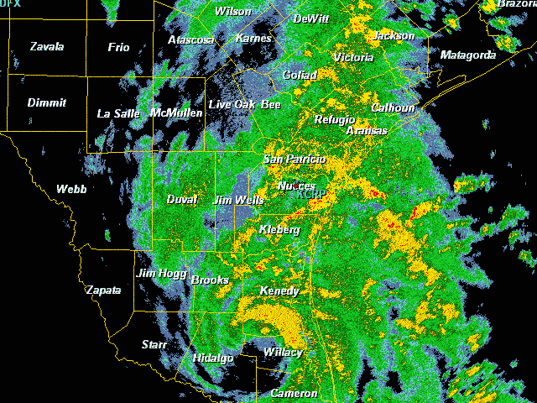
Tropical Storm Hermine, Sept 7-8, 2010

Slide 3
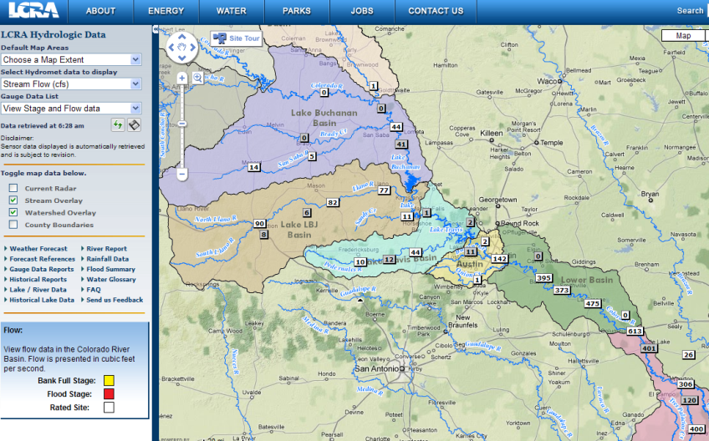
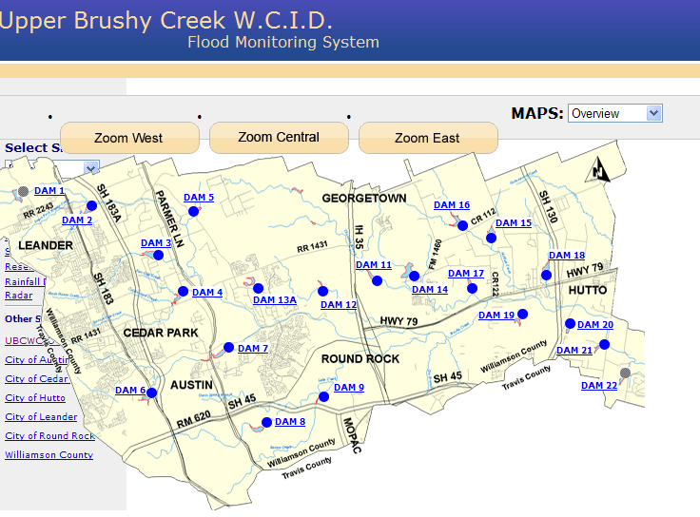
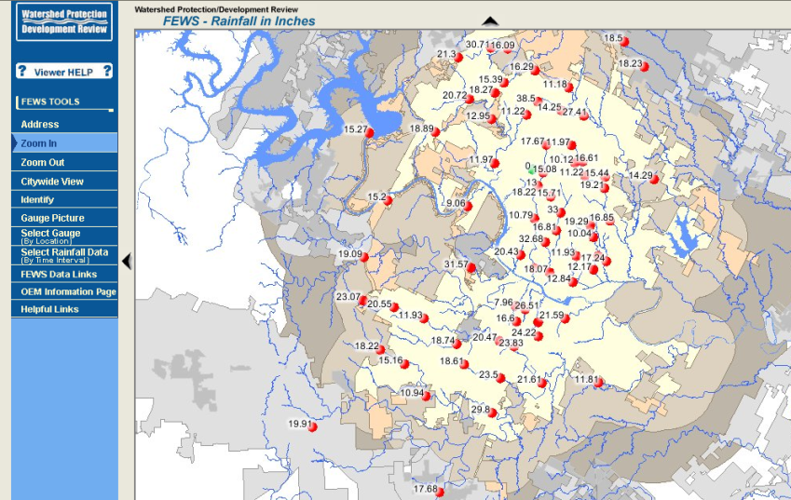
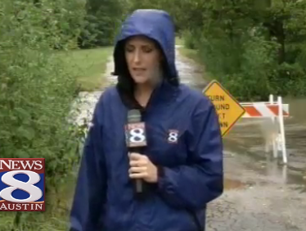
Local Information during Tropical Storm Hermine (7-8 Sept 2010)
Upper Brushy Creek (Round Rock)
LCRA
Bring data together into one system
http://hydromet.lcra.org
http://ubcwcid.org/Overview/Overview.aspx?id=1
TV
City of Austin
http://coagis1.ci.austin.tx.us/website/COAViewer_fews/viewer.htm

Slide 4
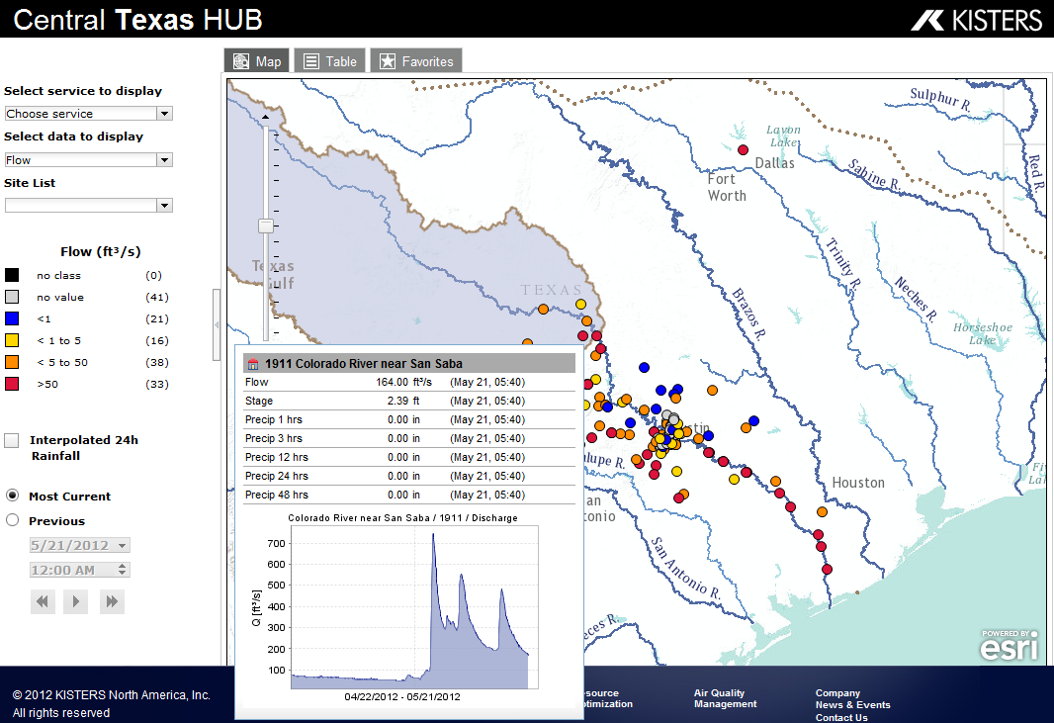
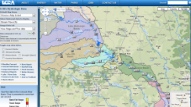
Web Services Hub for Texas Real-Time Water Data, Models and Maps
Inputs
Outputs
Data
Services
(WaterML)
Data
Services
(WaterML)
Mapping
Services
Mapping
Services
Data and Mapping
Services
Modeling
Services
Mapping
Services
Models
Maps

Slide 5
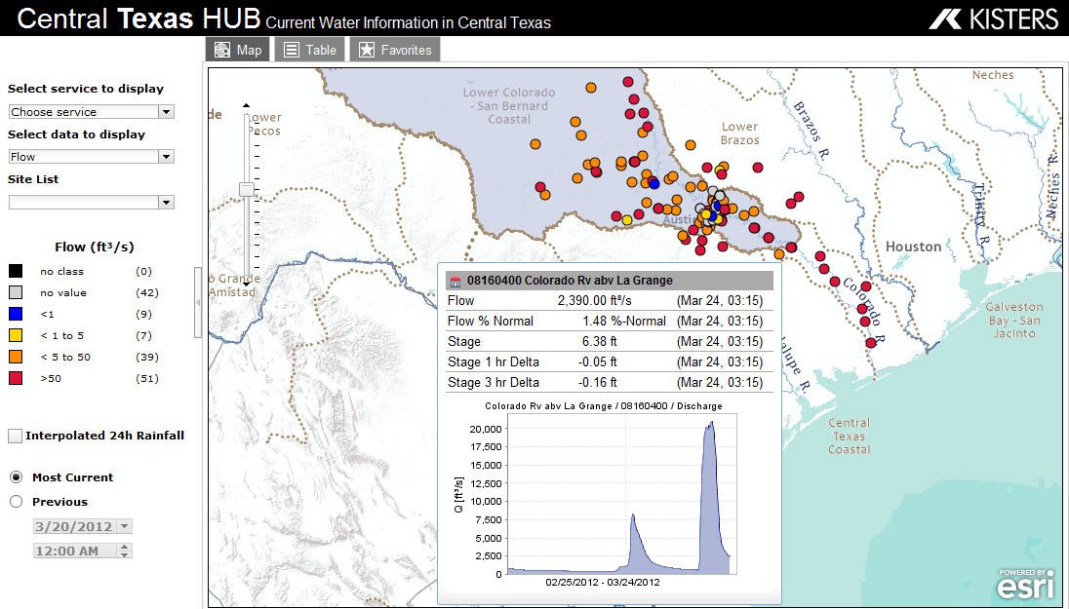
Water Web Services – WaterML and WaterML2
Instantaneous machine to machine communication
http://waterservices.usgs.gov/nwis/iv?sites=08158000&period=P1D&parameterCd=00060
Obtained at 9:03AM
Water web services “hub” ….
…. synthesis of water observation networks

Slide 7
Aggregated content and social networking

Slide 8
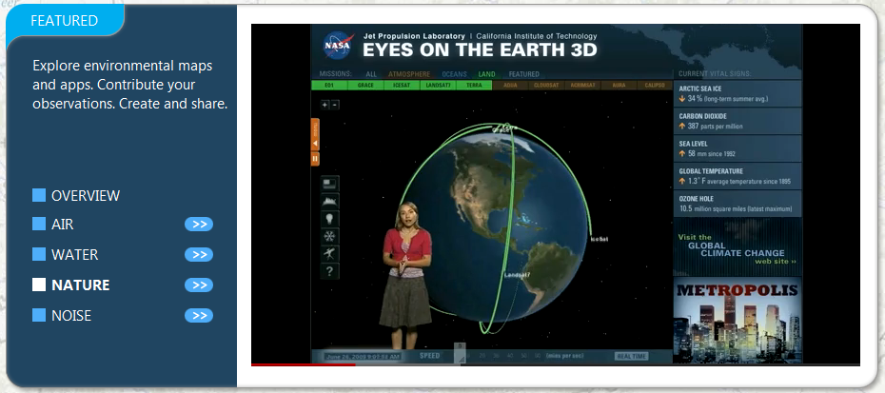
http://www.eyeonearth.org
European Environment Agency synthesis platform ……
…. a reskinned version of ArcGIS Online

Slide 10
Observations data in ArcGIS Online

Slide 11
Drought Forum, Feb 13, 2012
State water agencies and academic speakers
Formed a Drought Technology Steering Committee to continue dialog
TWDB, TCEQ, TPWD, TDEM
UT Austin, TAMU – College Station, Texas Tech
Acknowledgements: Brenner Brown, Kathy Alexander, David Bradsby, Mike Bewley, Byron Tapley, Himanshu Save, Gordon Wells, Teresa Howard, Johnnie Sullivan, Zong-Liang Yang, Xitian Cai, Jay Banner, Eric James, Charlie Kreitler, Cedric David, Dharhas Pothina
http://www.texasdroughtinfo.org

Slide 12
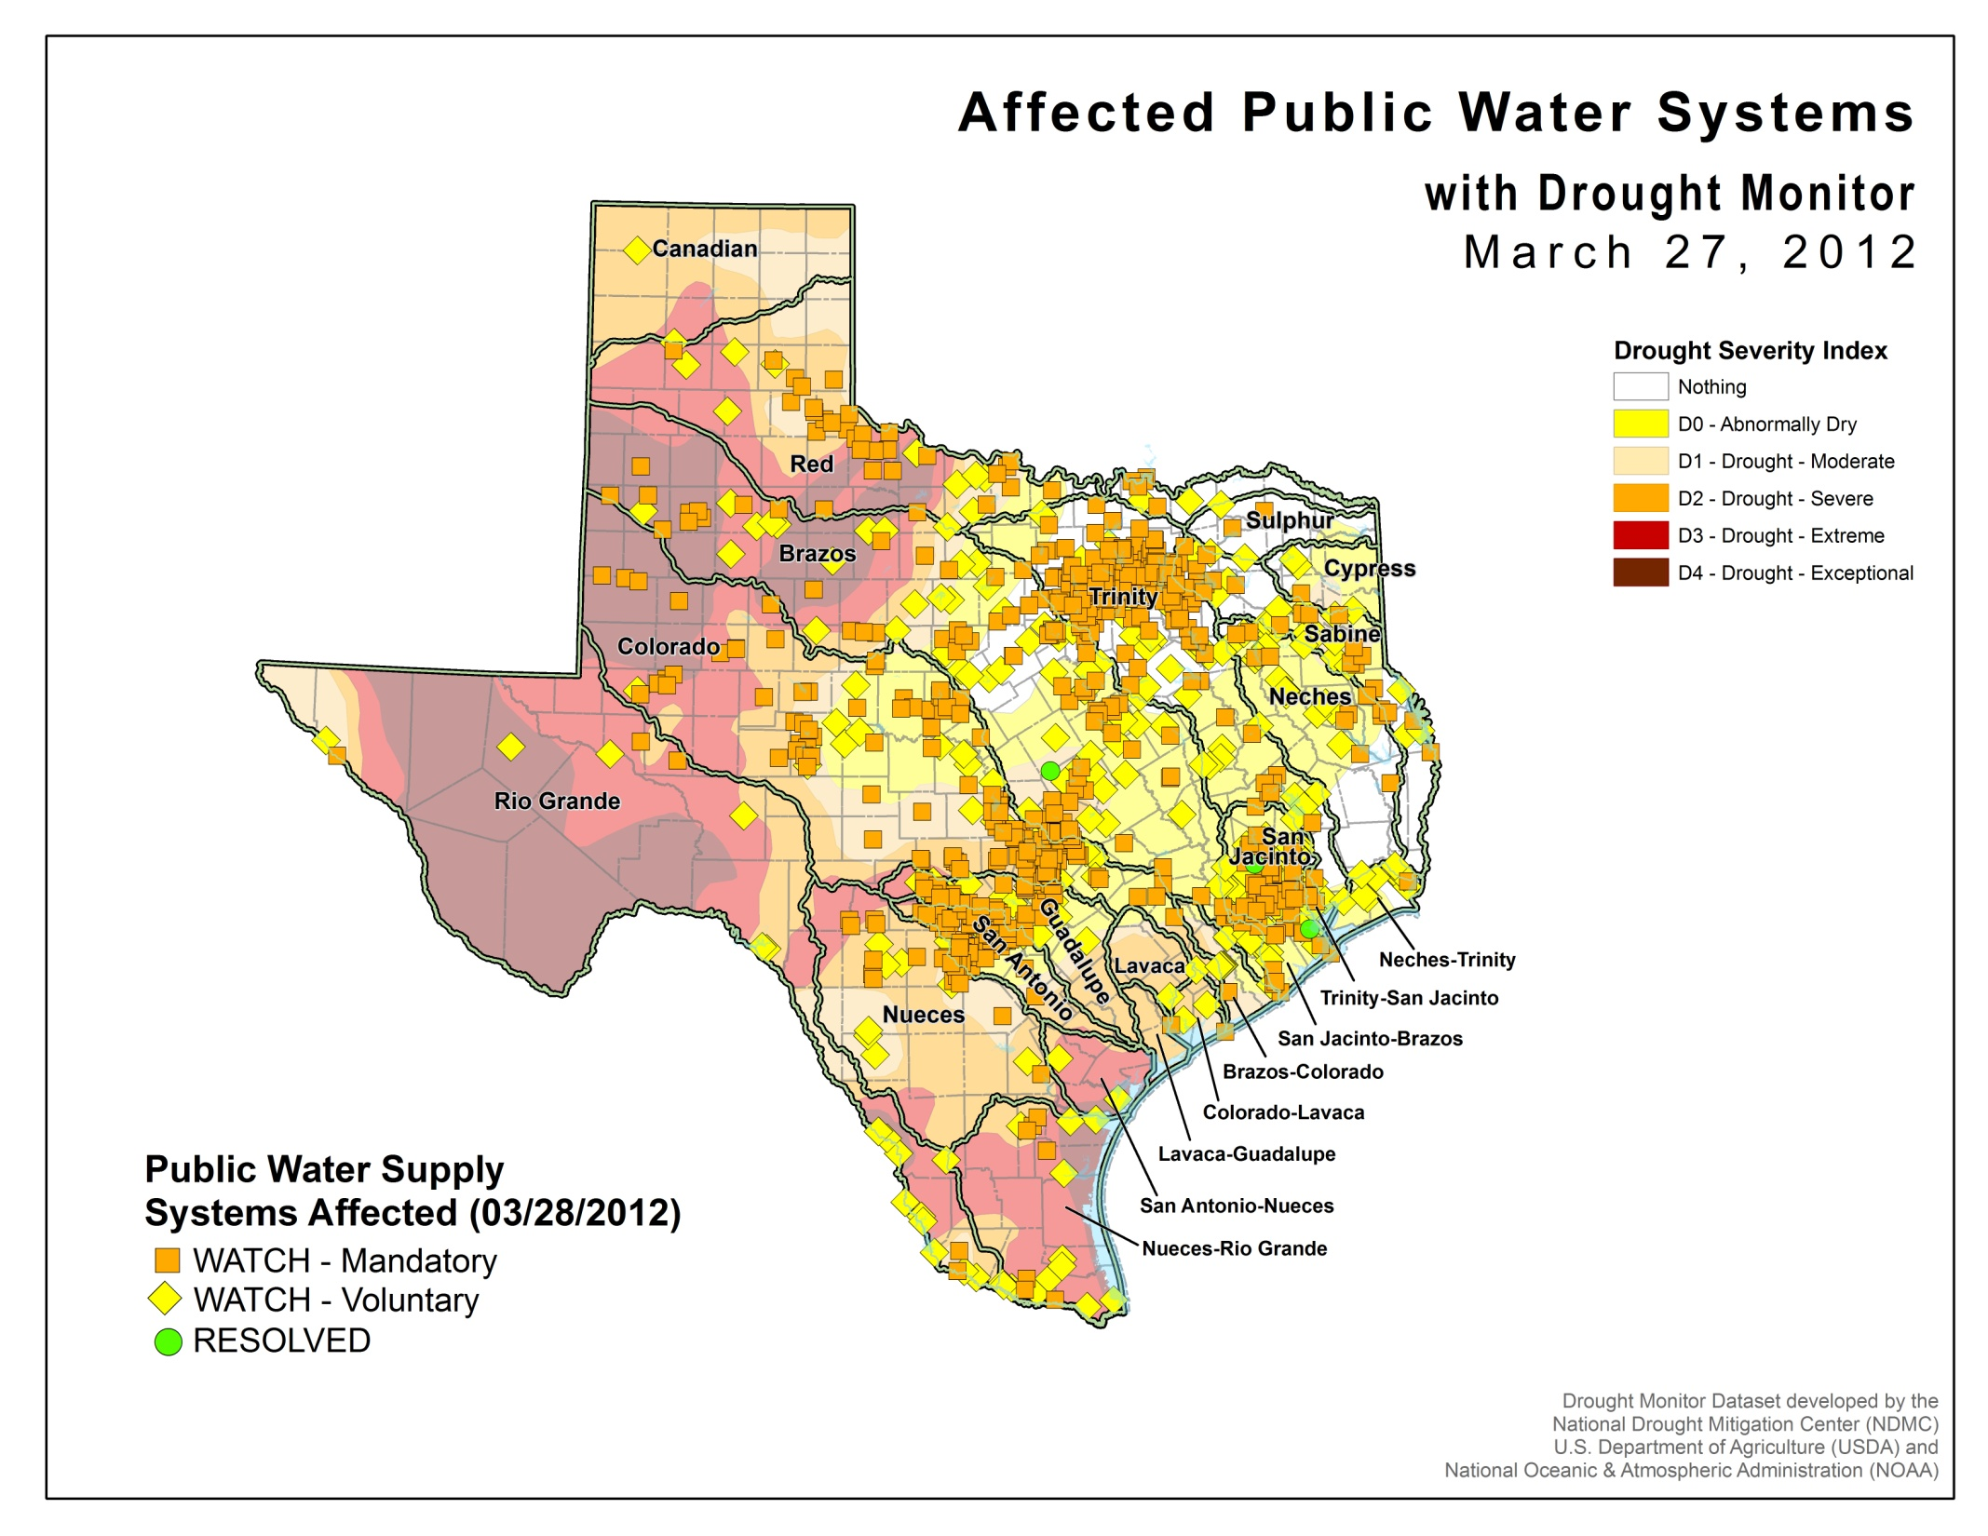
About 1000 water systems
600 Groundwater
400 Surface water

Slide 13
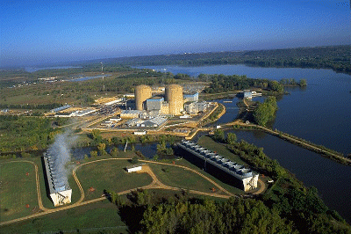
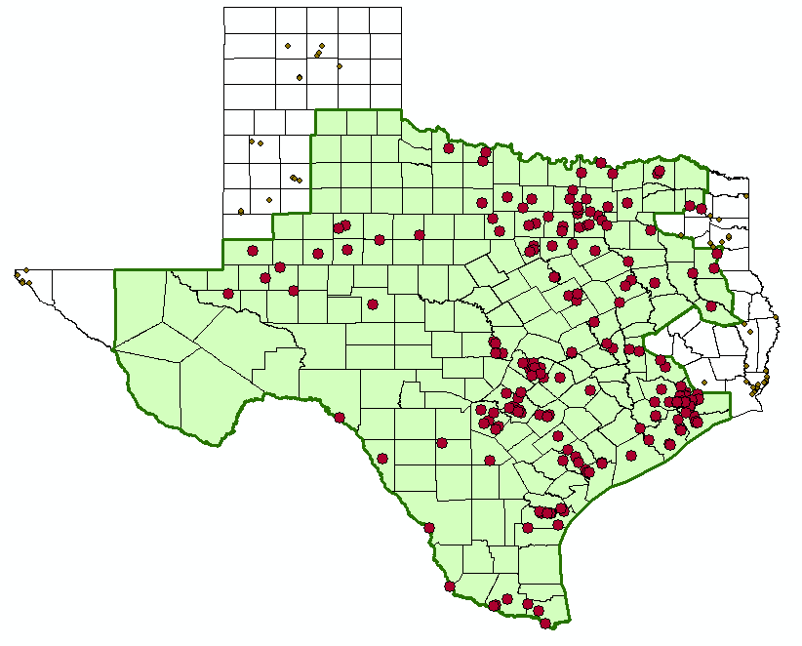
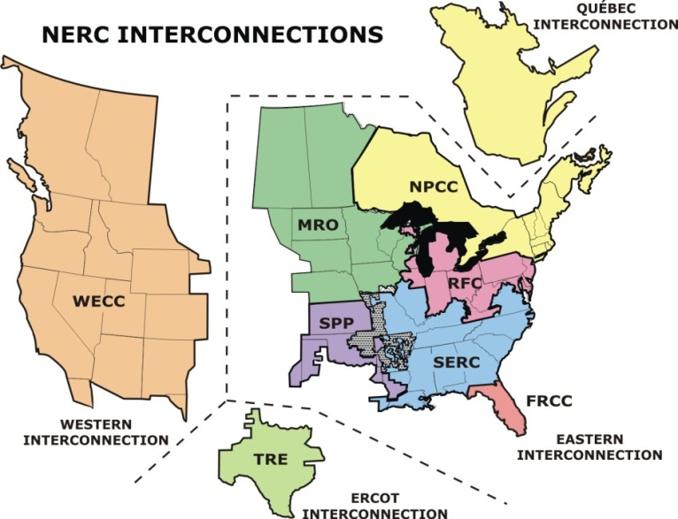
Water and Electric Power Generation
Water flow, level and temperature issues
ERCOT Power Pool

Slide 14
Facing Drought in Texas
Texas population increased by 4.3 million in the last 10 years
430,000 people per year
1180 people per day
We have a Texas Water Plan but little money to implement it
The clock is ticking …..

Slide 15
Drought Technology
Water Cycle
Atmosphere
Impacts
Economic Development
Public Water Supply
Agricultural Production
Electric Power Generation
Ecological Integrity
Soil Water
Surface Water
Groundwater
Observations – Modeling – Assessment – Prediction
Notes:
The intent of the Drought Technology Steering Committee is to bring the best available science and technology to bear on quantifying the storage and flow of water in Texas, and the impacts of water shortage on key water functions in the state.

Slide 16
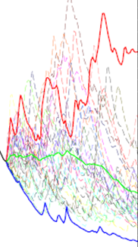
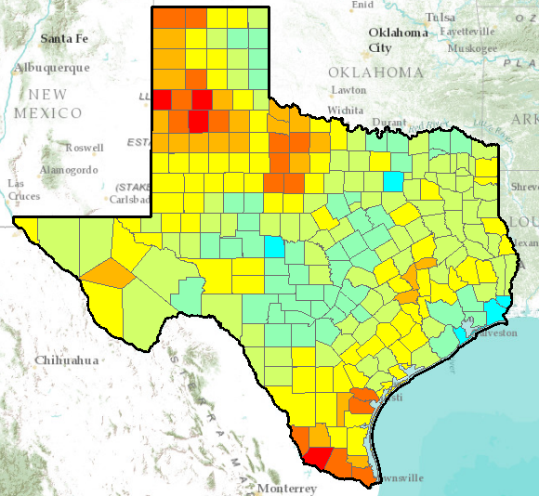
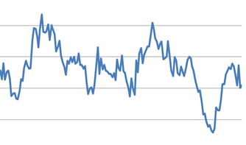
Texas Water and Climate Model
Improve our state-wide, real-time situational awareness of water conditions
Statistics from past
Current situation
Short-term predictions

Slide 17
Water Information Hub for Texas
Government
Public
Water Information Hub
Water Institutions
Industries

