Slide 1
Water Data and Modeling Services
David R. Maidment Center for Research in Water Resources University of Texas at Austin
Presentation made at Water Institute of Texas First Symposium on Emerging Water Issues
University of Texas at San Antonio 4 October 2013

Slide 2
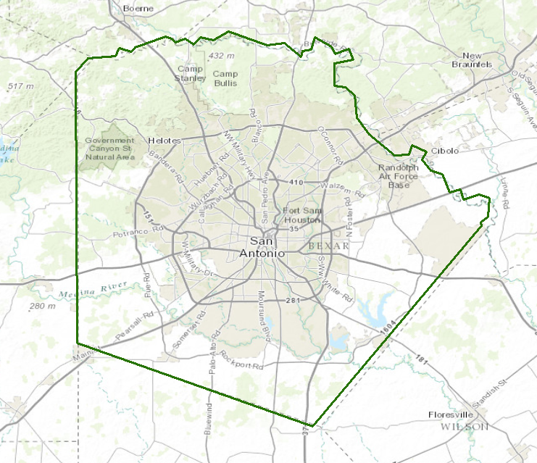
Water in Bexar County
How much water is there in Bexar County today?
Is this trending up or down?
At what rate is water entering? Leaving?
How is the present compared to the past?
Think about water like a bank account

Slide 3
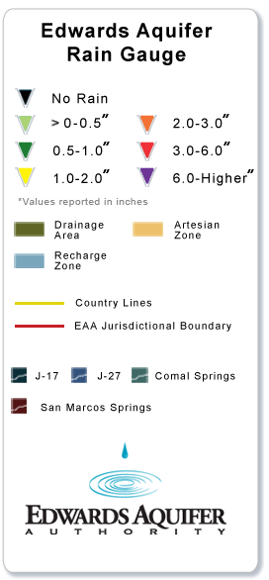
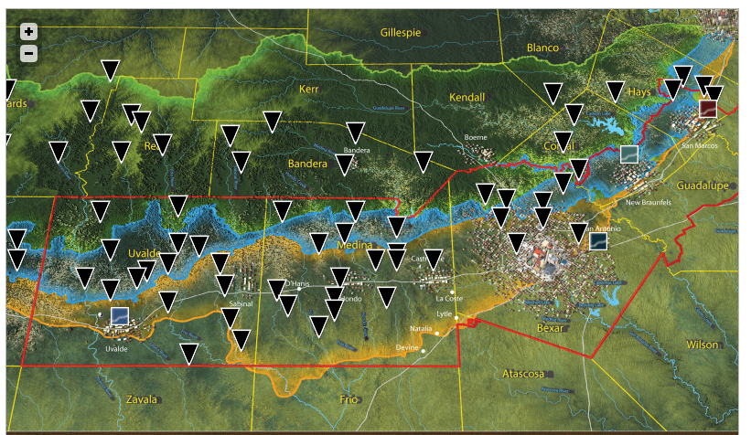
Input to the “Water Bank Account”
http://www.edwardsaquifer.org/aquifer-data-and-maps/calibrated-rain-maps/rain-gauge-network

Slide 4
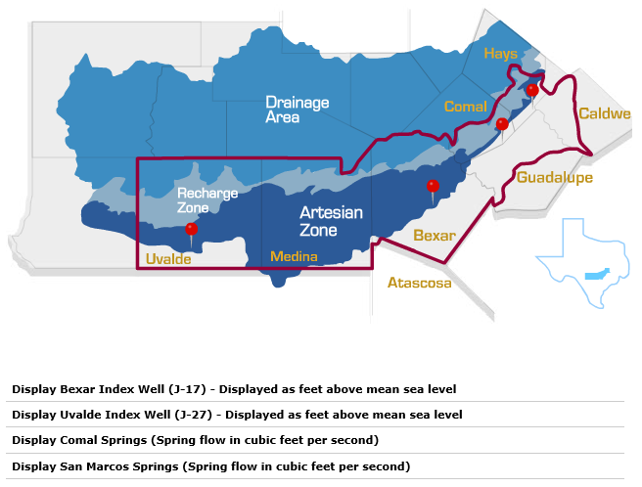
Critical Indicators for the Edwards Aquifer
Storage
Outflow

Slide 5
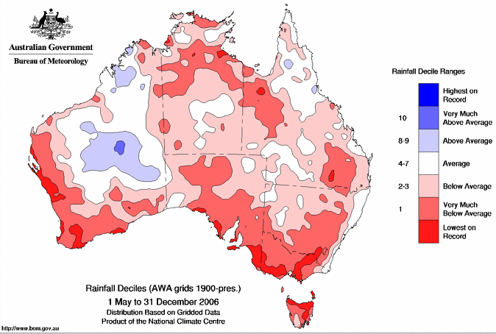
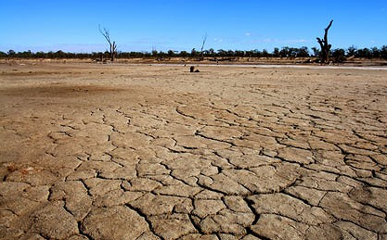
Great Australian Drought of 2000’s

Slide 6
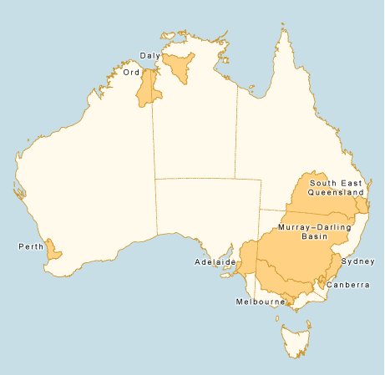
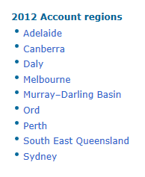
Australian National Water Account

Slide 7
Australian Water Resources Information System (AWRIS)
Slide: Rob Vertessy

Slide 8
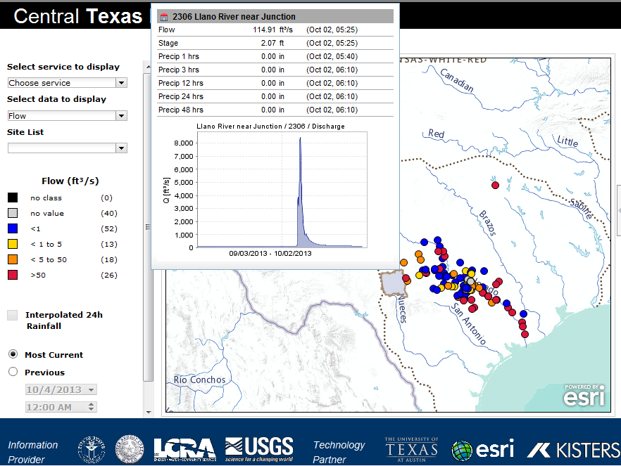
Central Texas Hub
http://www.centraltexashub.org/wiskiweb.htm
Continuously updated regional view of water resources

Slide 9
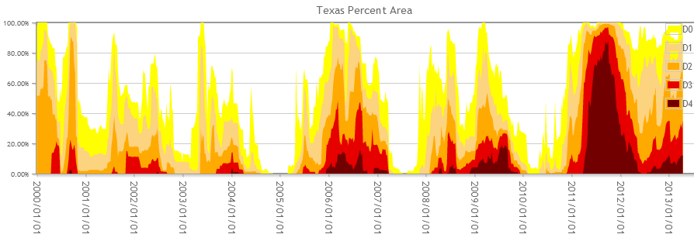
Trends in Drought Severity in Texas
2000
2002
2004
2006
2009
2011

Slide 10
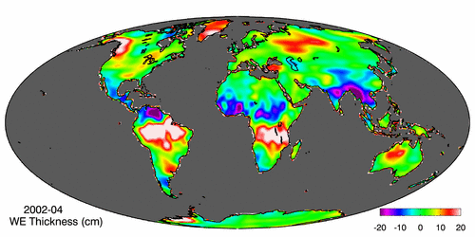
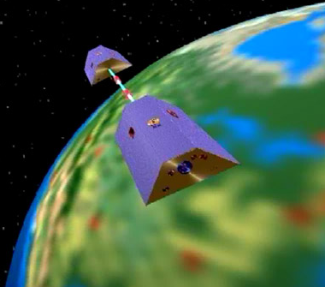
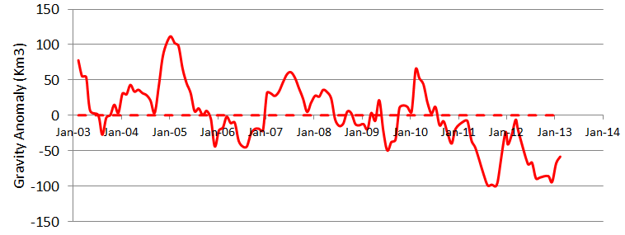
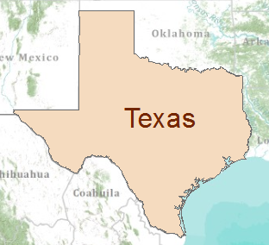
Gravity Recovery and Climate Experiment (GRACE) Force of gravity responds to changes in water volume Water is really heavy!
Gravity Anomaly of Texas, 2003 – 2013
Normal
At peak drought, Texas had a 100 Km³ water deficit
(equivalent to 70 Lake Travis’s)

Slide 11
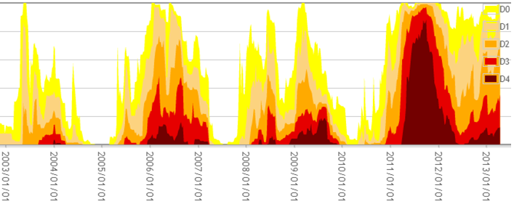
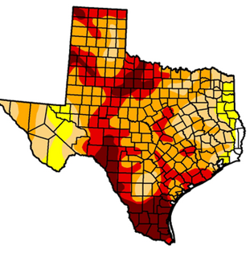
Drought and GRACE
US Drought Monitor is closely correlated with the GRACE data
US Drought
Monitor
Percent of Area in Drought
GRACE
September
2011
At peak drought, Texas had a 100 Km³ water deficit
(equivalent to 70 Lake Travis’s)

Slide 12
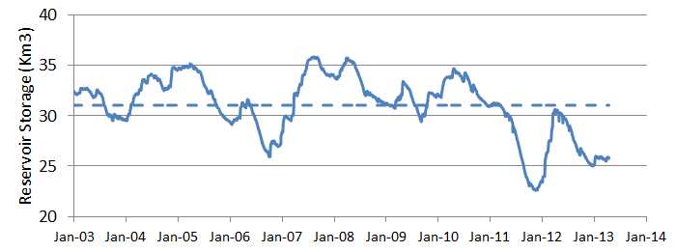
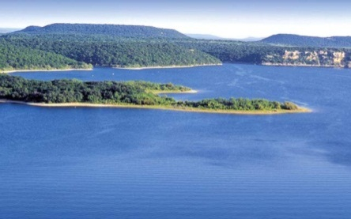
GRACE and Texas Reservoir Water Storage
Surface water reservoir storage is closely correlated with the GRACE data
Grace Satellites
Normal
At peak drought, Texas had a 100 Km³ total water deficit
(equivalent to 70 Lake Travis’s)
Surface Water Reservoirs
90% of the water deficit is in soil water and groundwater
Normal
and an 8.4 Km³ deficit in reservoir water storage

Slide 13
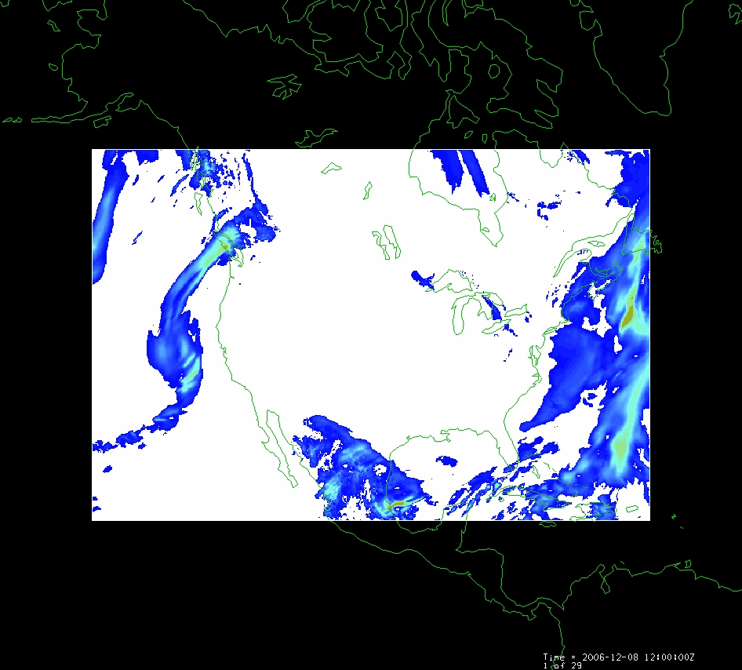
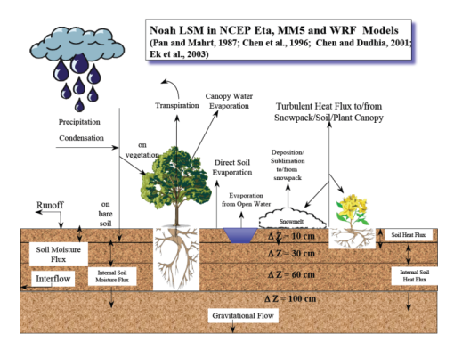
LDAS – Land Data Assimilation System
Forcing:
Radiation
Precipitation
Surface climate
Evaporation
Soil Moisture
Runoff
Recharge
Observations Datasets, Numerical Weather Model
Soil
Vegetation
Terrain
1979 to present
Domain | Space | Time
North America | 1/8 degree | 1 hour
Global | 1/4 degree | 3 hours
Land Surface Model
Deduction:
Given these forcing and land surface conditions
Then, using a land surface simulation model
Derive surface moisture and energy balance

Slide 14
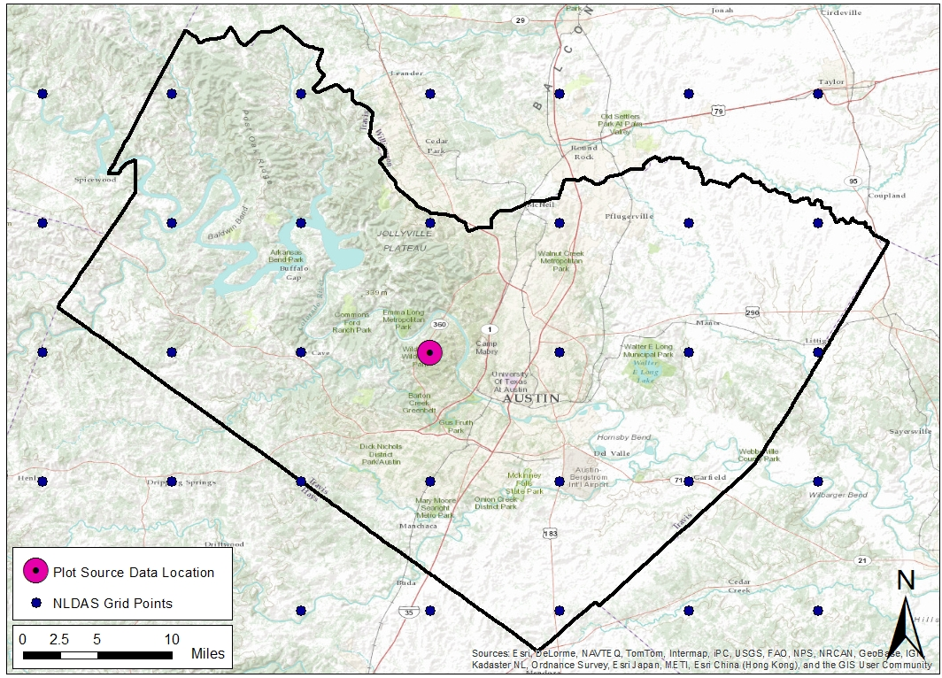
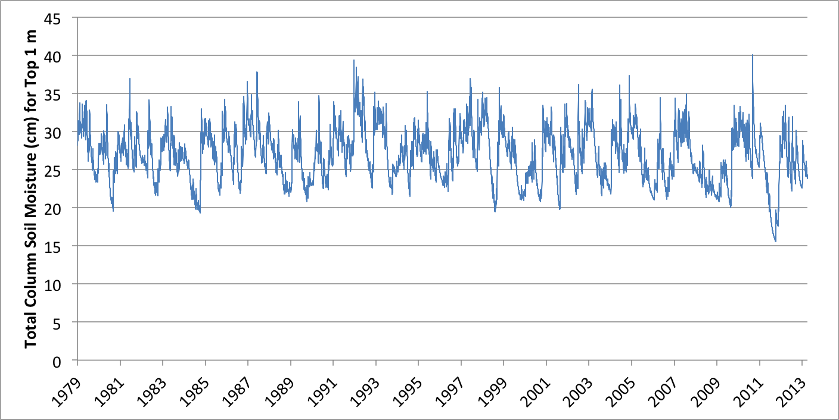
LDAS “Data Rods” project
Time series at every point

Slide 15
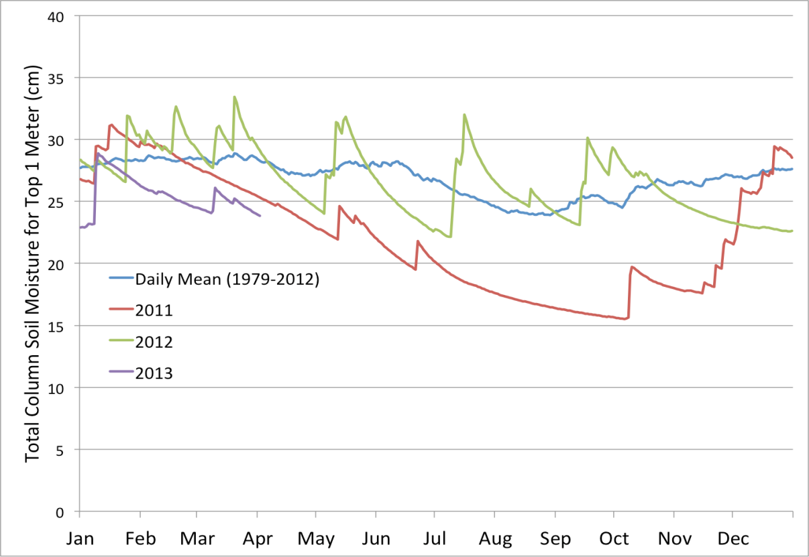
Current Soil Moisture Conditions
Time series at every point

Slide 16
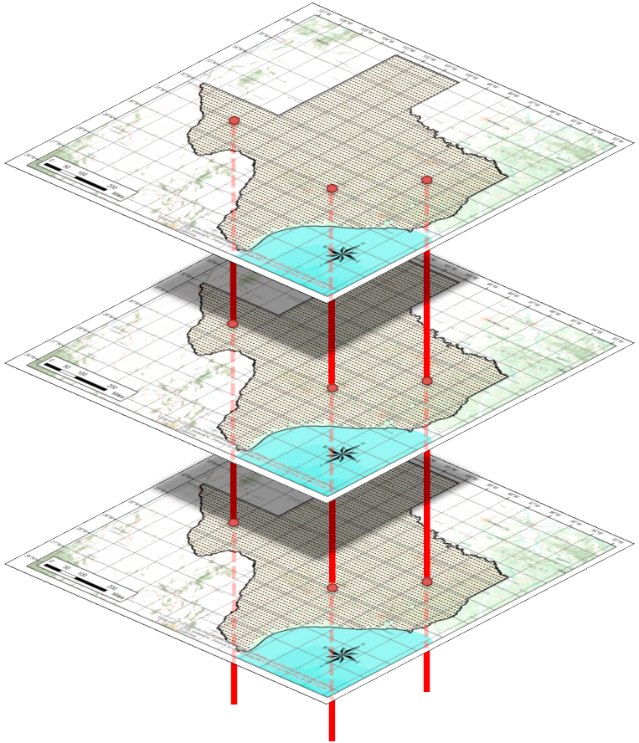
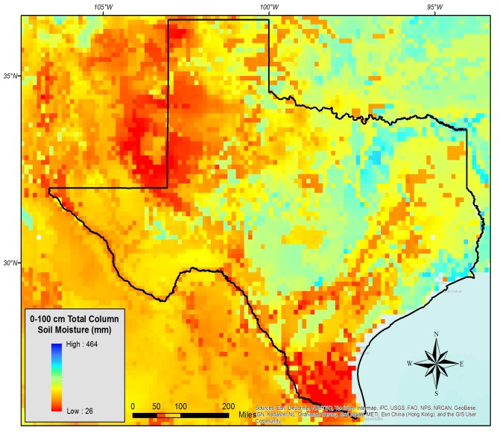
“Data Rods” for Texas
2012
2011
2010
April 25, 2013
Soil moisture
in top 1m of soil

Slide 17
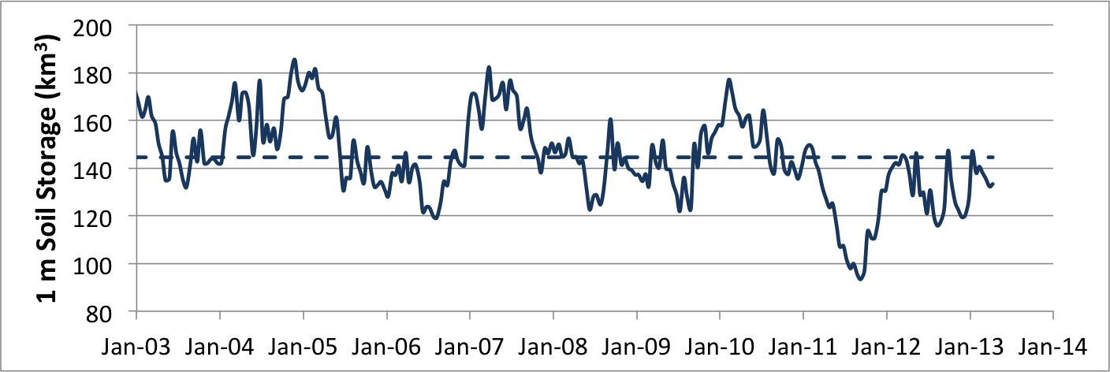
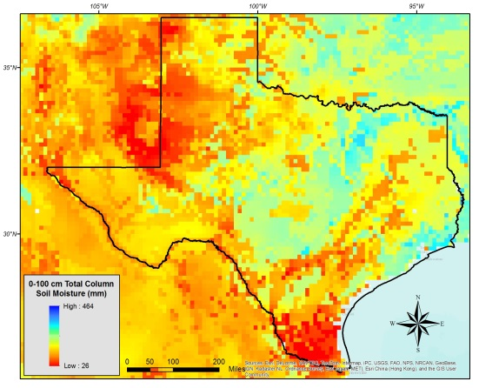
GRACE and Texas Soil Water Storage
Soil water reservoir storage is closely correlated with the GRACE data
Grace Satellites
Normal
Texas had a 100 Km³ total water deficit
Soil Water in top 1m
Normal
and an 8.4 Km³ deficit in reservoir water storage
Of this 45 Km³ is in top 1 m of soil

Slide 18
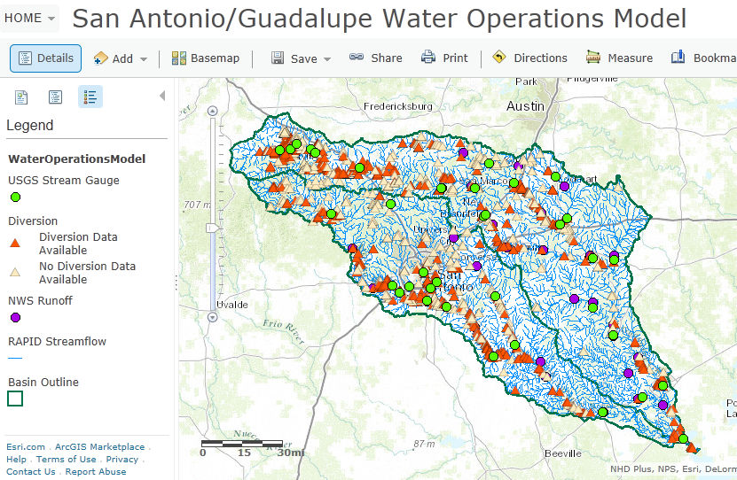
Real-Time Water Operations
https://ut-austin.maps.arcgis.com/home/webmap/viewer.html?webmap=d107aa9260534ddbb96db302e3643a93

Slide 19
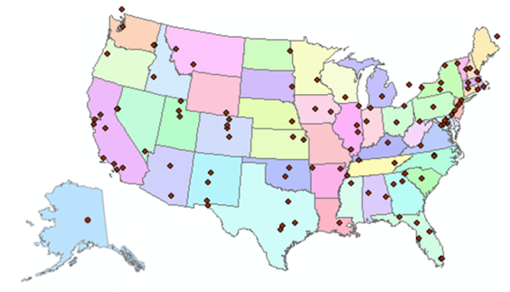
Consortium of Universities for the Advancement of Hydrologic Science, Inc.
www.cuahsi.org
CUAHSI
A consortium representing 125 US universities
Dr. Richard Hooper, President and CEO
Supported by the National Science Foundation Earth Science Division
Advances hydrologic science in nation’s universities
Includes a Hydrologic Information System project
Invented WaterML language for water resources time series
Building an academic prototype system

Slide 20
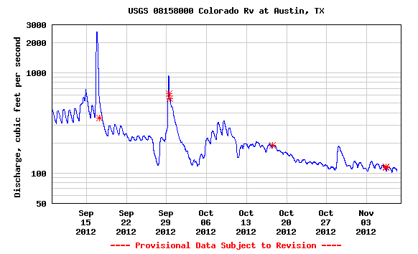
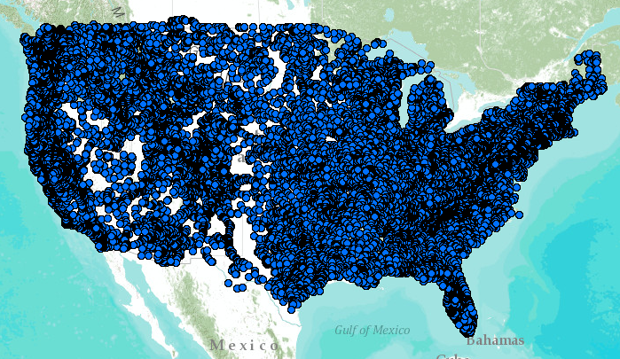
WaterML – the US Geological Survey
Water time series data on the internet
24/7/365 service
For daily and real-time data
. . . Operational water web services system for the United States
http://waterservices.usgs.gov/nwis/iv?sites=08158000&period=P1D&parameterCd=00060

Slide 21
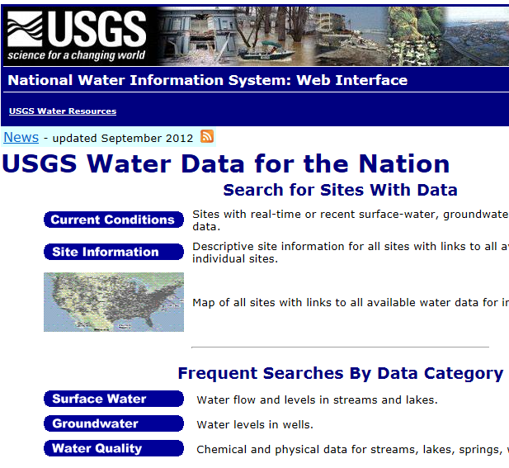
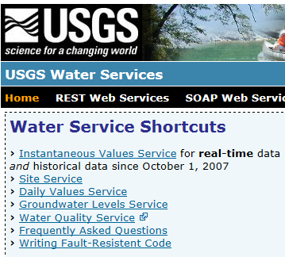
Web Pages and Web Services
Web pages deliver text and images
http://water.usgs.gov
Web services deliver data encoded in XML
http://waterservices.usgs.gov/

Slide 22
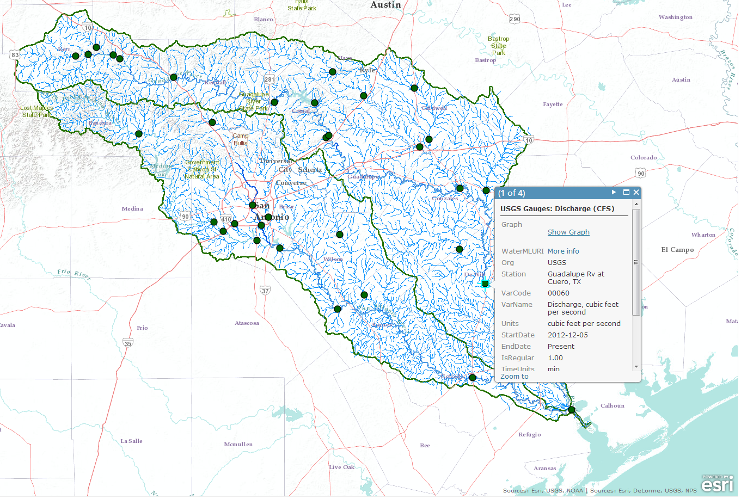
Map and Data Services for USGS Water Observations
Map Service
Data Service
ArcGIS Online Map
http://bit.ly/13KKQyi

Slide 23
Map and Data Services for TCEQ Water Diversions
Map Service
Data Service

Slide 24
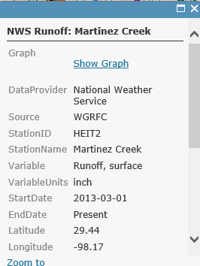
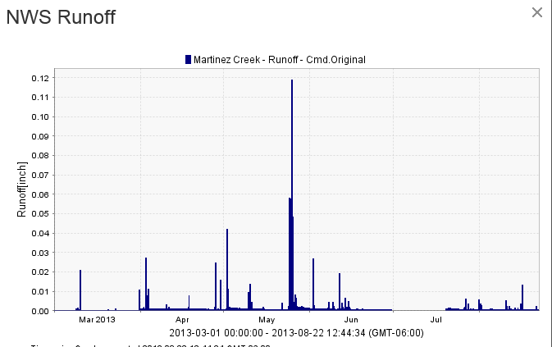
Map and Data Services for NWS River Forecasts
Map Service
Data Service
Legend
NWS Subbasin Outlet Point

Slide 25
Transform NWS data from 47 forecast points to 5500 NHDPlus Catchments and River Reaches
Legend
NHDPlus Catchment
NWS Subbasin

Slide 26
Add in the TCEQ river diversions in each Catchment
Flow
Runoff
Diversion
Runoff
Flow

Slide 27
Map and Data Services for RAPID Water Flow Simulations
Map Service
Data Service
Model as a Service at University of Illinois (supported by MS Research)

Slide 28
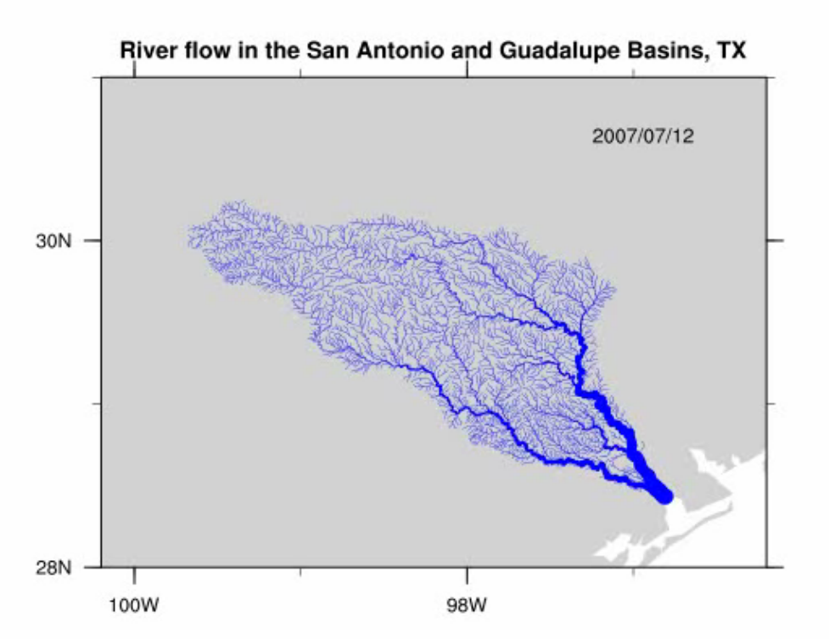
Rapid River Flow Model (parallel computing, model as a service)
http://www.ucchm.org/david/rapid.htm

Slide 29
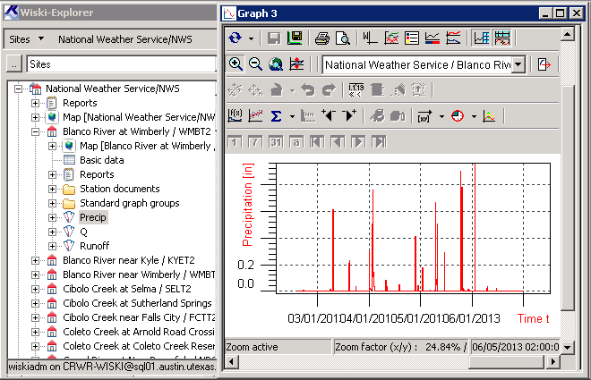
WISKI Time Series Data System (KISTERS)

Slide 30
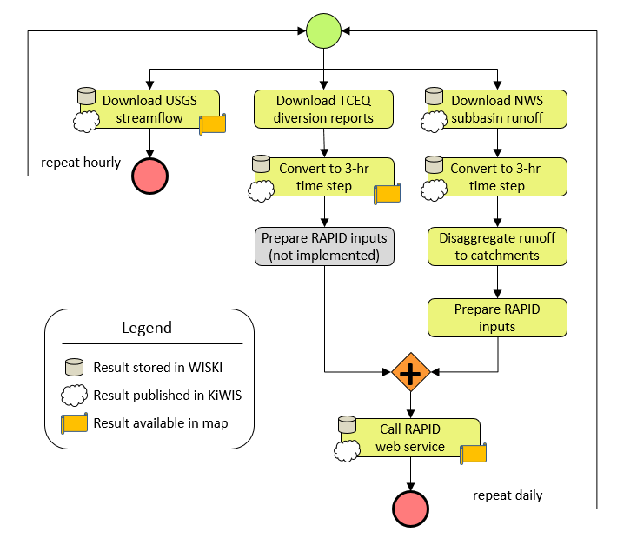
Daily Workflow

Slide 31
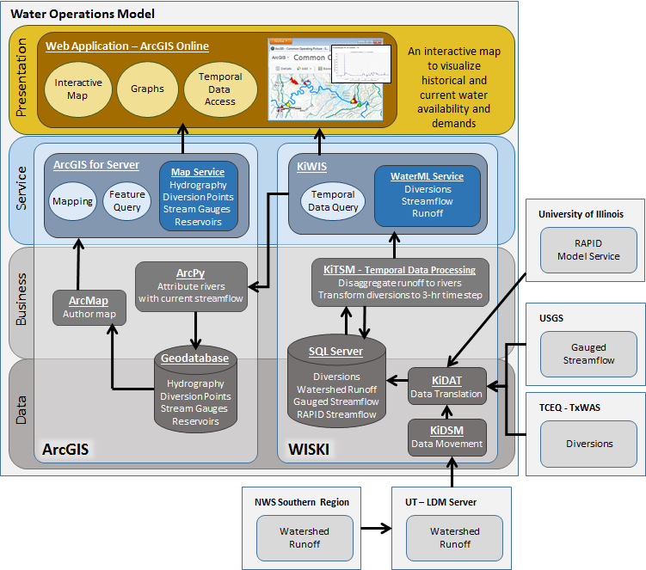
Water Operations Model

Slide 32
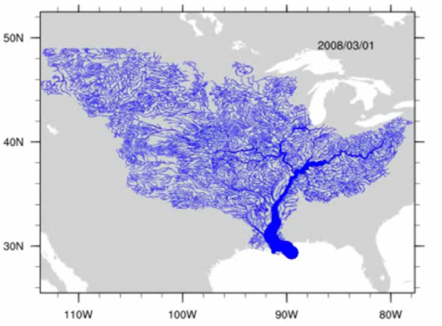
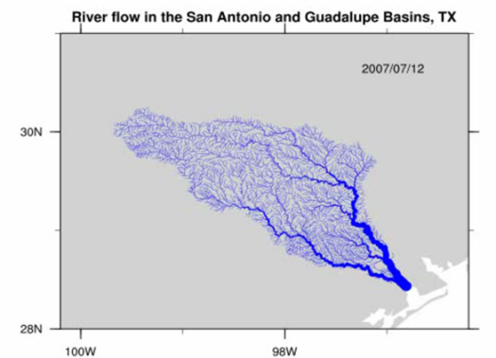
River Flow – Model as a Service
Observations Datasets, Numerical Weather Model
Land Surface Model
RAPID River Flow Model
Automated workflow at Univ. of Illinois uses LDAS data from NASA to run river model at Univ. of Texas

Slide 33
Conclusions
Some things we could do for Texas
Texas Water Accounts
Systematic tracking of total water storage and flow by regions
Natural flow and human usage
Texas Water Resource Information System
Continuously updated, synoptic-scale picture of the water conditions of our state
Web-linked water data and modeling services from many sources

