Slide 1


UT System and Water
David R. Maidment,
Dept of Civil, Architectural and Environmental Engineering
University of Texas at Austin
18 October 2013

Slide 2

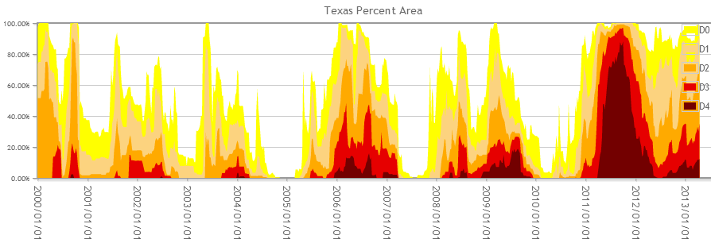
Trends in Drought Severity in Texas
2000
2002
2004
2006
2009
2011

Slide 3
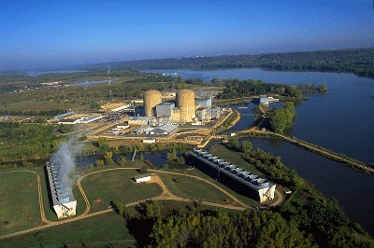
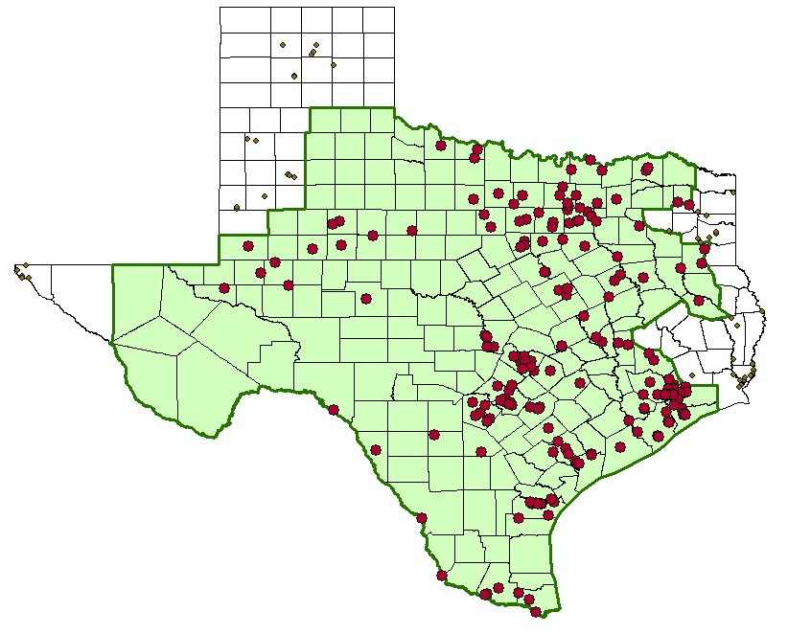
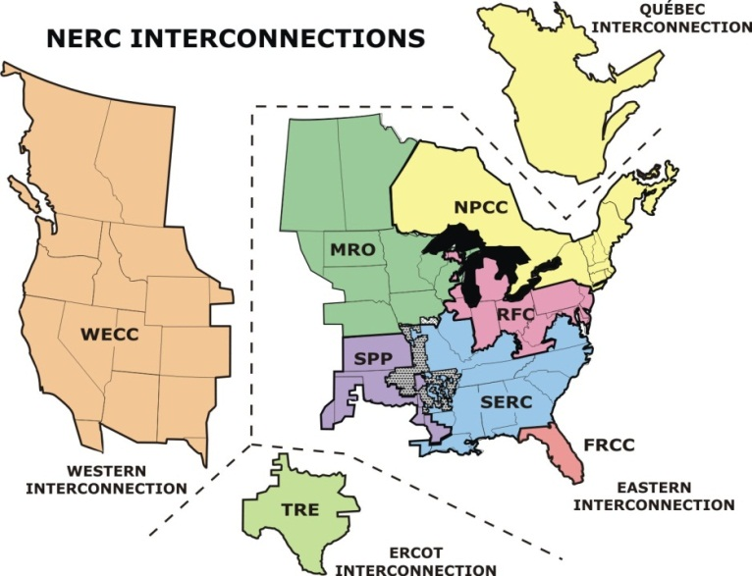
Water and Electric Power Generation
Water flow, level and temperature issues
ERCOT Power Pool

Slide 4
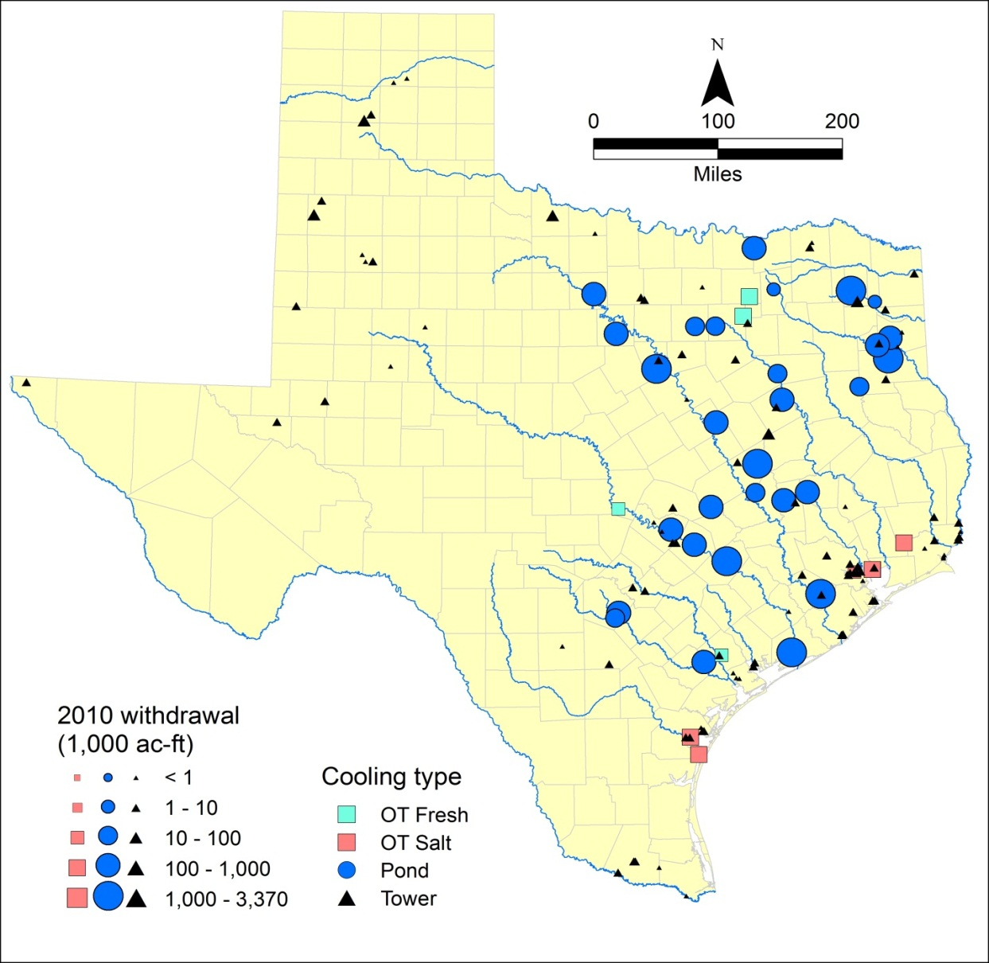

Electrical supply is NOT resilient to drought
Power supply in195 counties isolated from rest of US
41% of TX water withdrawals for electricity
77% of water is surface water
3000 MW at risk if drought had not eased in early 2012
Notes:
Our power supply is threatened by the possibility of low water conditions inhibiting access to cooling water at some power plants. This could lead to rolling blackouts in Texas (as were being warned by ERCOT in Spring 2012)

Slide 5


Water Supply Planning for Texas
Dan Hardin, Interim Deputy Executive Administrator
Water Resources Planning and Information

Slide 6
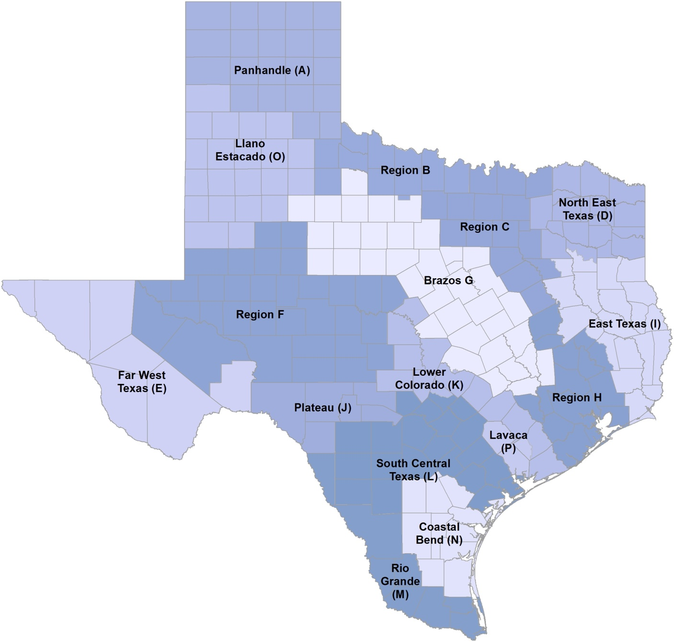
Regional Water Planning
Statutory interests:
Public
Counties
Municipalities
Electric-generating utilities
River authorities
Industries
Agriculture
Environment
Small businesses
Water districts
Water utilities
Groundwater management areas

Slide 7
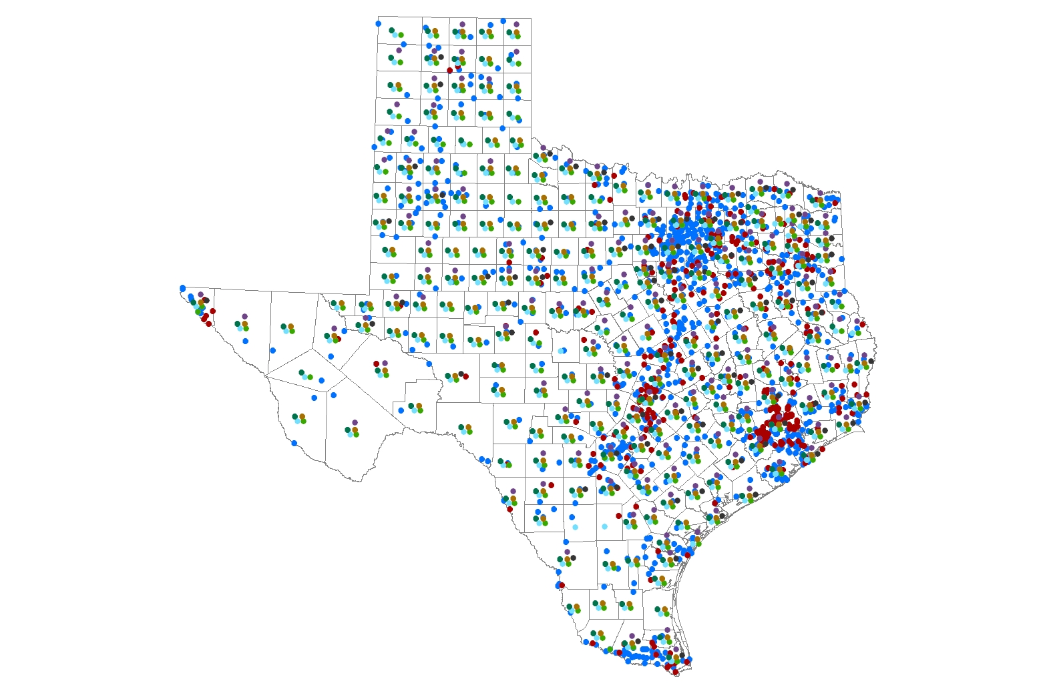
Planning for Water User Groups
Cities: 971 (>500 pop)
Utilities: 362
County-Others: 254
Manufacturing: 174
Steam-Electric: 85
Livestock: 254
Mining: 229
Irrigation: 239

Slide 8
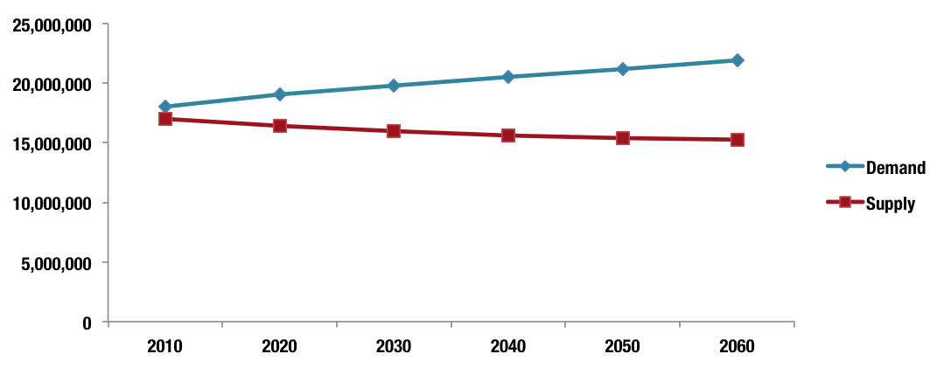
Projected Water Demands and Existing Supplies

Slide 9
Strategies – The Big Picture
Conservation and reuse – Meeting needs by making more efficient use of what we have
  34% of volume, 12% of capital costs
Other surface water – Developing infrastructure to transport/access supplies already developed.
  34% of volume, 45% of total capital costs
New supply development – reservoirs, groundwater development, desalination, and others
  32% of volume, 43% of total capital costs

Slide 10
Water Data and Modeling Services
David R. Maidment
Center for Research in Water Resources
University of Texas at Austin
Presentation made at Water Institute of Texas
First Symposium on Emerging Water Issues
University of Texas at San Antonio
4 October 2013

Slide 11
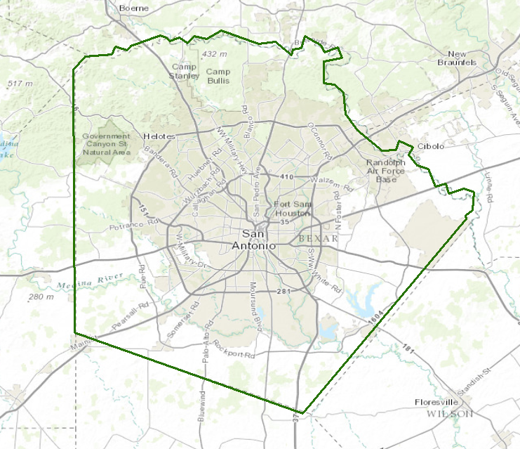
Water in Bexar County
How much water is there in Bexar County today?
Is this trending up or down?
At what rate is water entering? Leaving?
How is the present compared to the past?
Think about water like a bank account

Slide 12
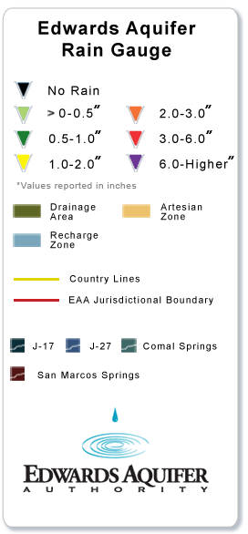

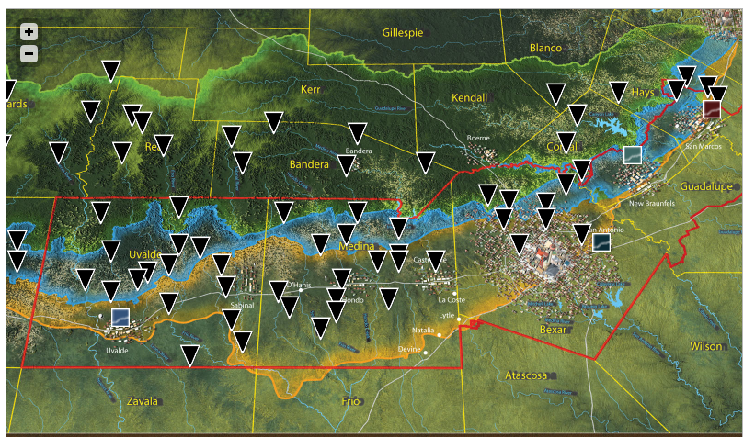
Input to the “Water Bank Account”
http://www.edwardsaquifer.org/aquifer-data-and-maps/calibrated-rain-maps/rain-gauge-network

Slide 13
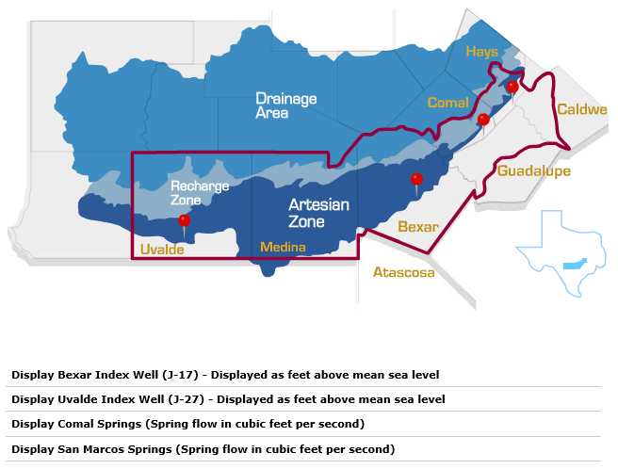
Critical Indicators for the Edwards Aquifer
Storage
Outflow

Slide 14


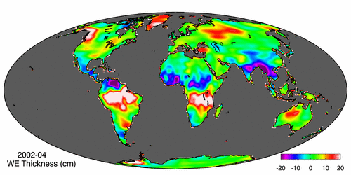
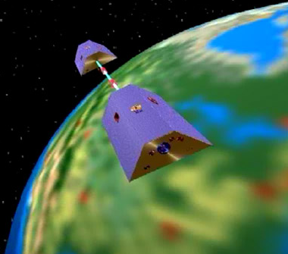
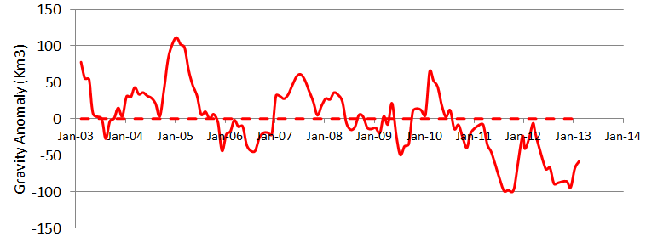
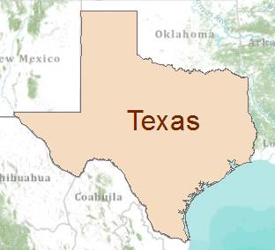
Gravity Recovery and Climate Experiment (GRACE)
Force of gravity responds to changes in water volume
Water is really heavy!
Gravity Anomaly of Texas, 2003 – 2013
Normal
At peak drought, Texas had a 100 Km³ water deficit
(equivalent to 70 Lake Travis’s)

Slide 15


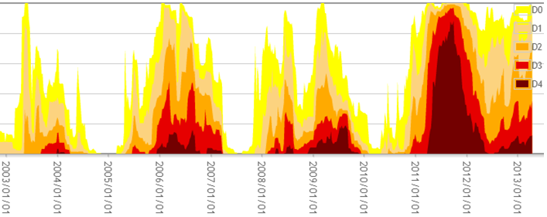
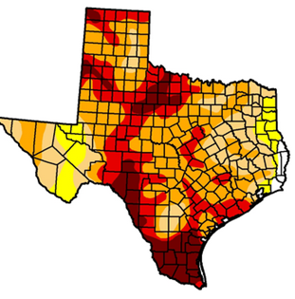

Drought and GRACE
US Drought Monitor is closely correlated with the GRACE data
US Drought
Monitor
Percent of Area in Drought
GRACE
September
2011
At peak drought, Texas had a 100 Km³ water deficit
(equivalent to 70 Lake Travis’s)

Slide 16
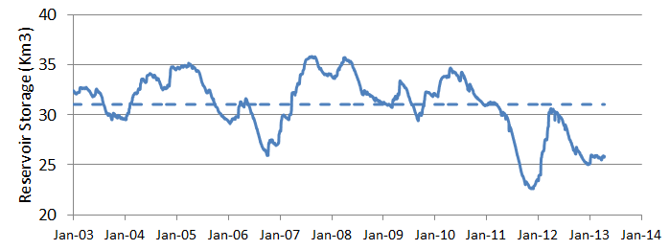
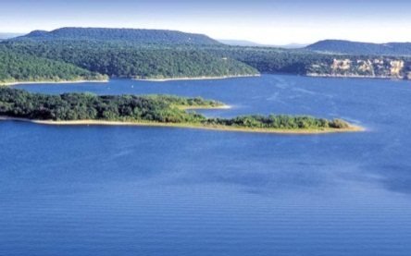
GRACE and Texas Reservoir Water Storage
Surface water reservoir storage is closely correlated with the GRACE data
Grace Satellites
Normal
At peak drought, Texas had a 100 Km³ total water deficit
(equivalent to 70 Lake Travis’s)
Surface Water Reservoirs
90% of the water deficit is in soil water and groundwater
Normal
and an 8.4 Km³ deficit in reservoir water storage

Slide 17
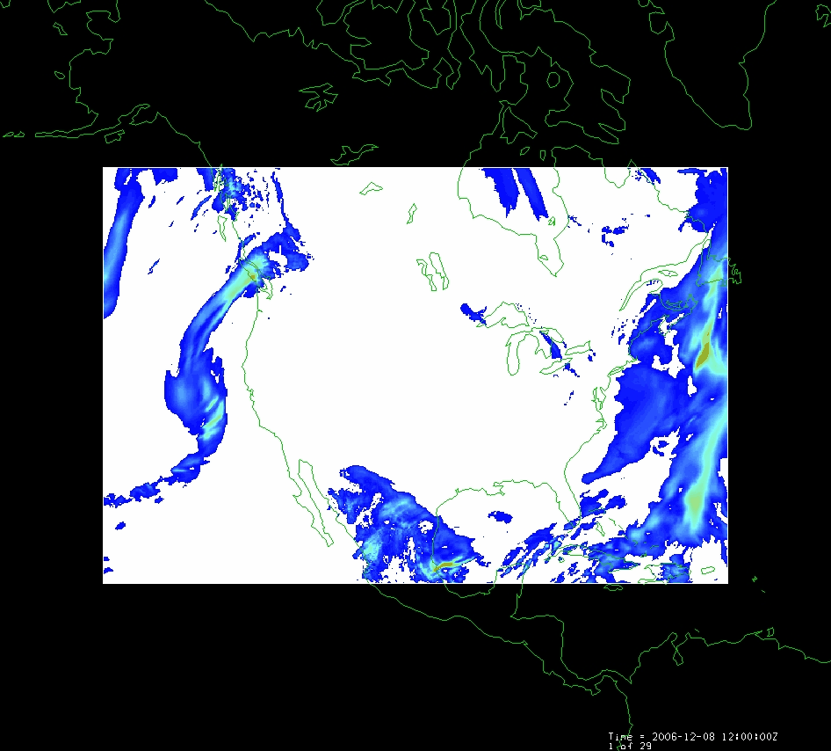

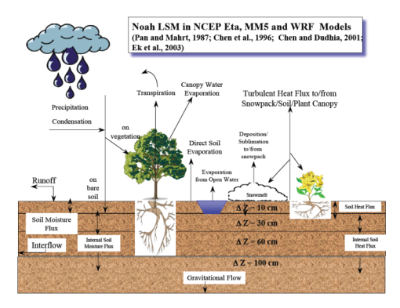
LDAS – Land Data Assimilation System
Forcing:
Radiation
Precipitation
Surface climate
Evaporation
Soil Moisture
Runoff
Recharge
Observations Datasets, Numerical Weather Model
Soil
Vegetation
Terrain
1979 to present
Domain | Space | Time
North America | 1/8 degree | 1 hour
Global | 1/4 degree | 3 hours
Land Surface Model
Deduction:
Given these forcing and land surface conditions
Then, using a land surface simulation model
Derive surface moisture and energy balance

Slide 18
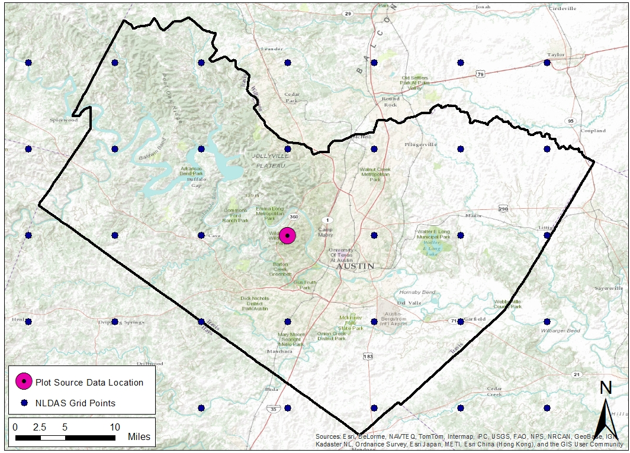
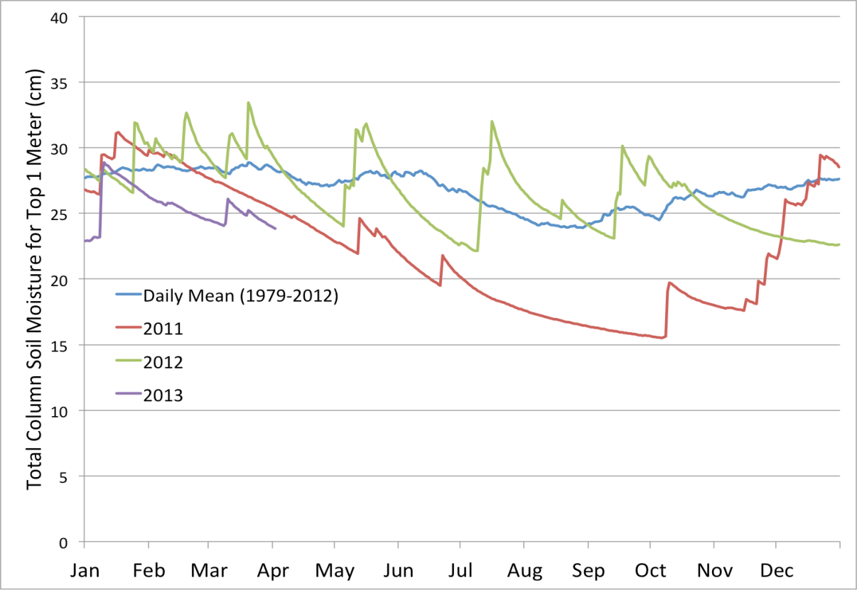
Current Soil Moisture Conditions
Time series at every point

Slide 19
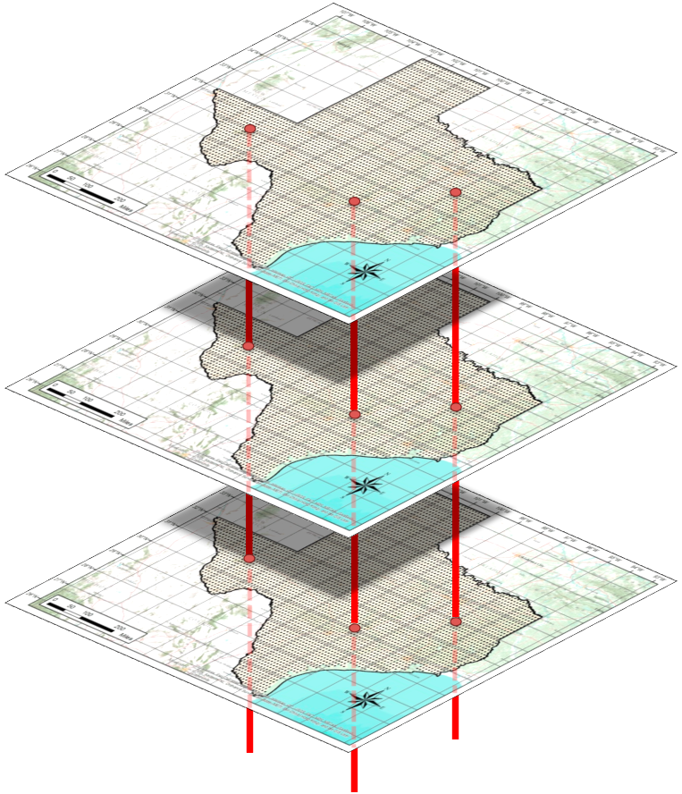
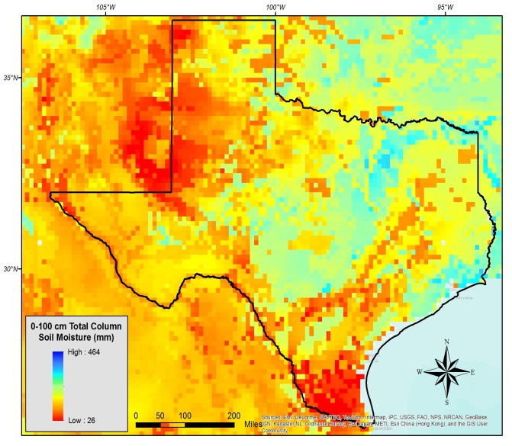
“Data Rods” for Texas
2012
2011
2010
April 25, 2013
Soil moisture
in top 1m of soil

Slide 20
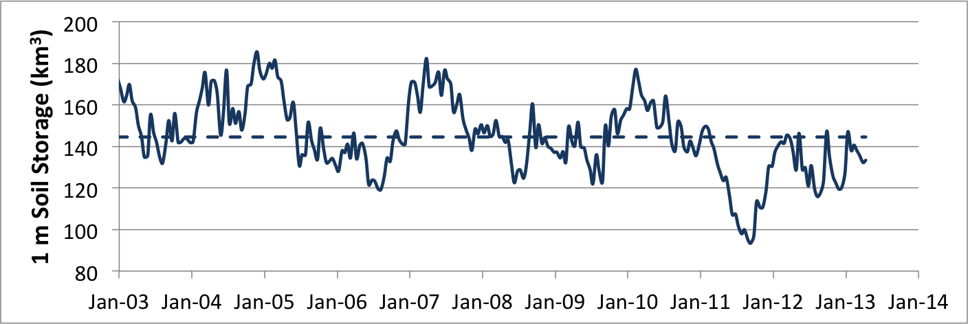
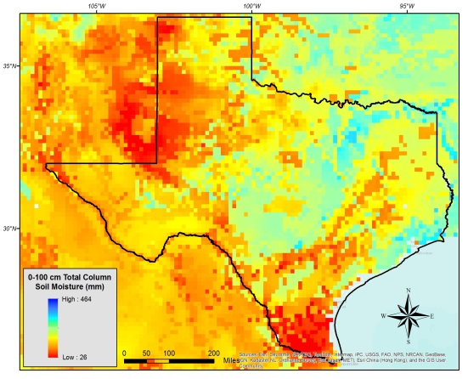
GRACE and Texas Soil Water Storage
Soil water reservoir storage is closely correlated with the GRACE data
Grace Satellites
Normal
Texas had a 100 Km³ total water deficit
Soil Water in top 1m
Very large uncertainty
Normal
and an 8.4 Km³ deficit in reservoir water storage
Of this 45 Km³ is in top 1 m of soil

Slide 21
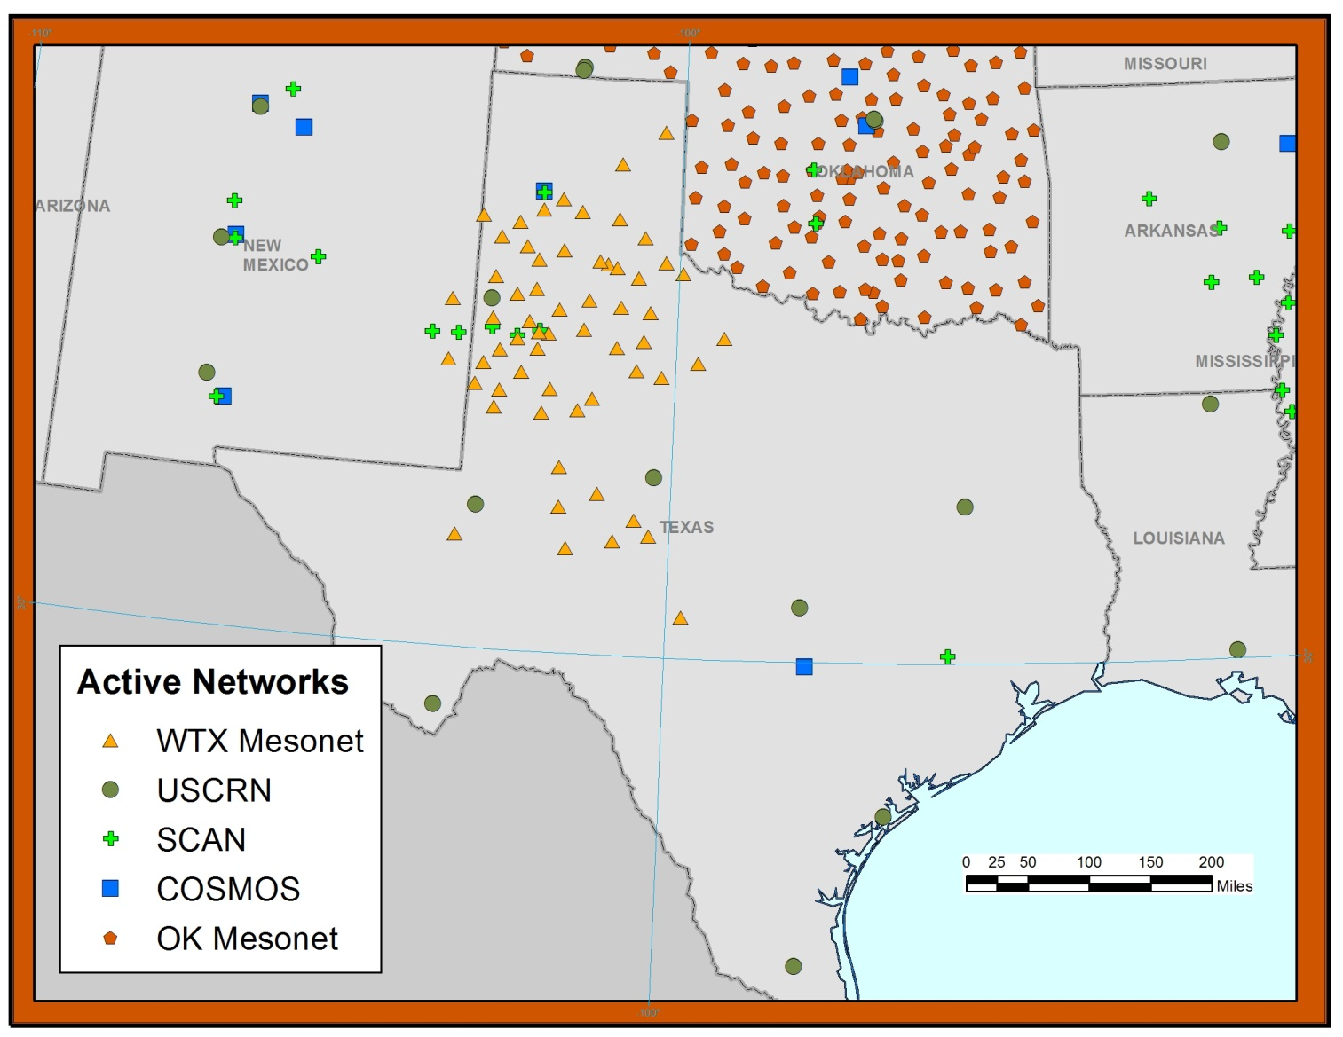
Monitoring soil moisture in Texas
Soil moisture data is sparse across much of Texas

Slide 22
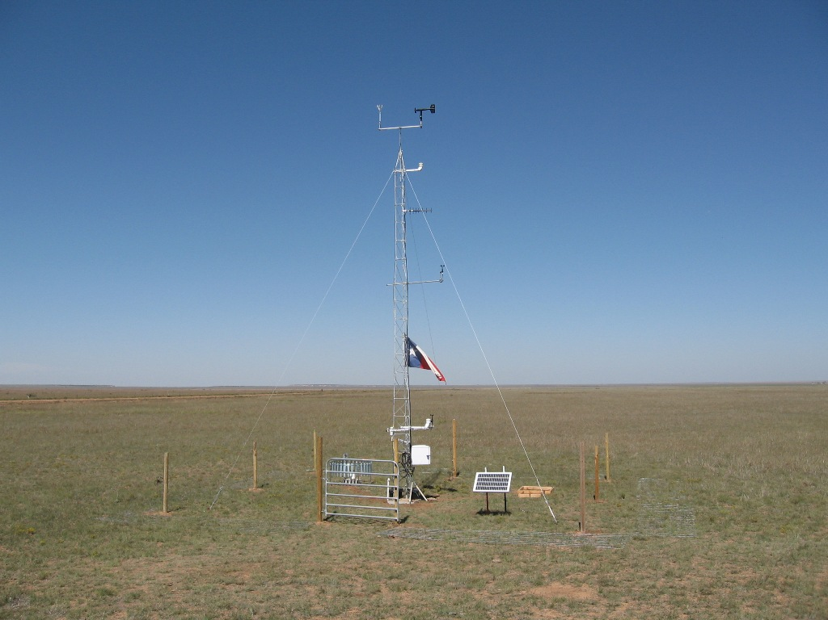
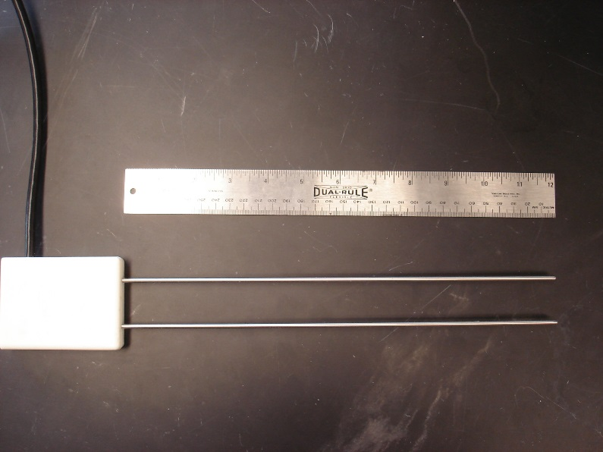
Mesonet Station for Climate and Soil Moisture
Climate Measurement
Soil Moisture Measurement

Slide 23


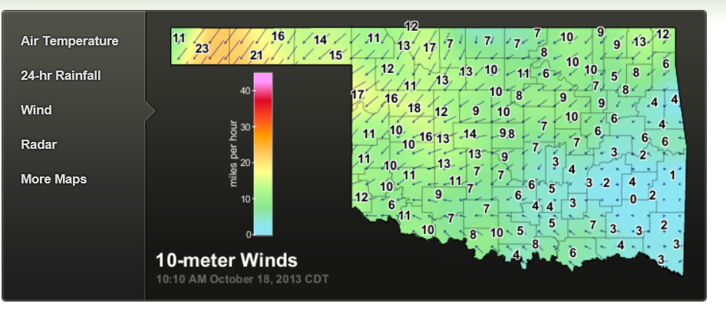
Texas Tech
Oklahoma

Slide 24
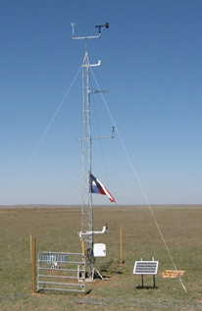
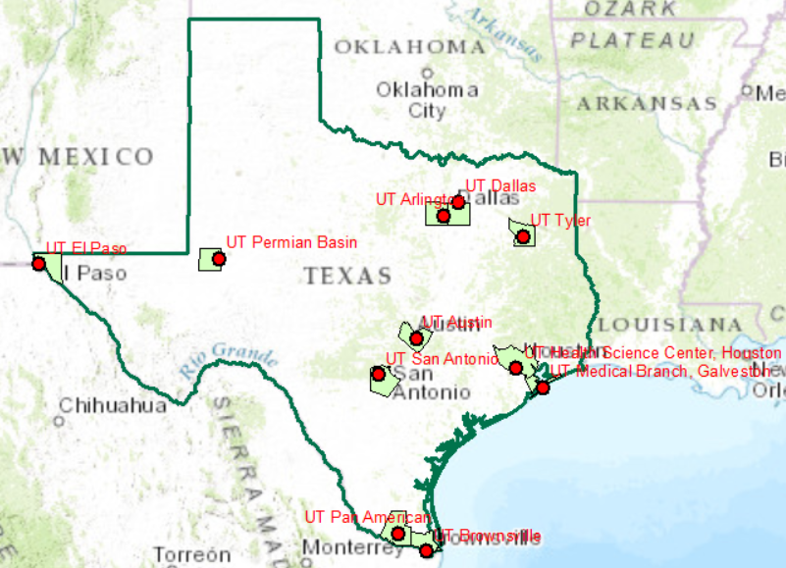
UT System WaterNet
Focus on Water

Slide 25
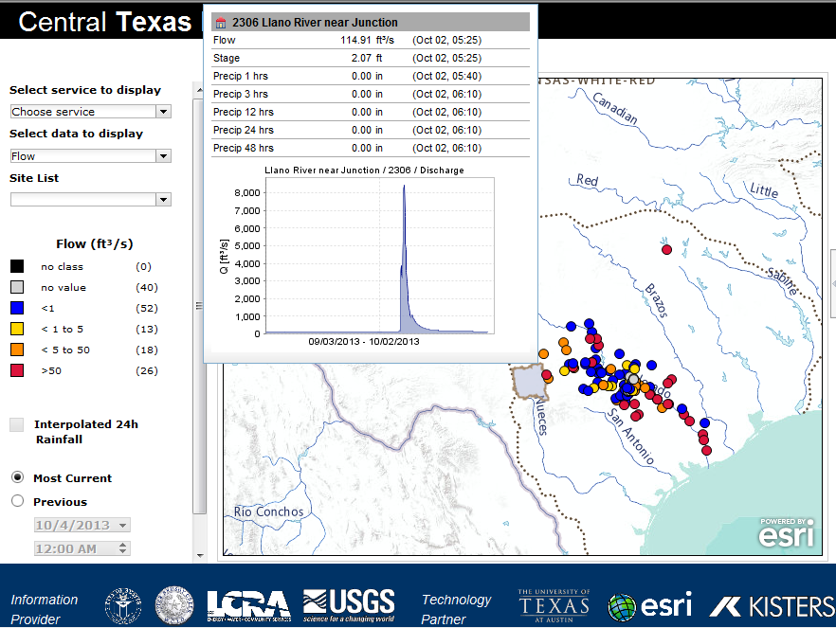
Central Texas Hub
http://www.centraltexashub.org/wiskiweb.htm
Continuously updated regional view of water resources

Slide 26
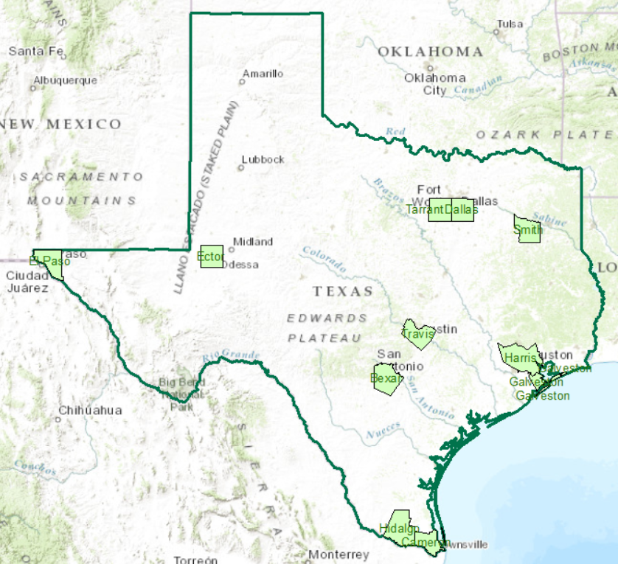
Water in Counties
How much water do we have?
  Atmosphere
  Surface
  Vegetation
  Soil
  Groundwater
  Infrastructure
How is this changing with time?
How much do we need for sustainability?

Slide 27
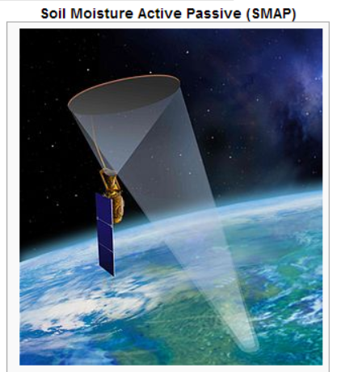
NASA SMAP Mission
Due for Launch in October 2014
Provides soil moisture measurement by both active and passive sensing
Needs ground truthing of information to be accurate

Slide 28
UT System Partnership with Nasa
There already exists a Strategic Partnership between UT Austin and NASA Jet Propulsion Lab
Extend this to NASA as a whole to make Texas an “Exemplar State” in using space-based measurement of water

Slide 29


With Drought Comes Opportunity…
Robert E. Mace, Ph.D., P.G.
Texas Water Development Board
presented to
Water Forum III: Drought and Other Extreme Weather Events
hosted by
Center for Integrated Earth System Science
October 14, 2013

Slide 30
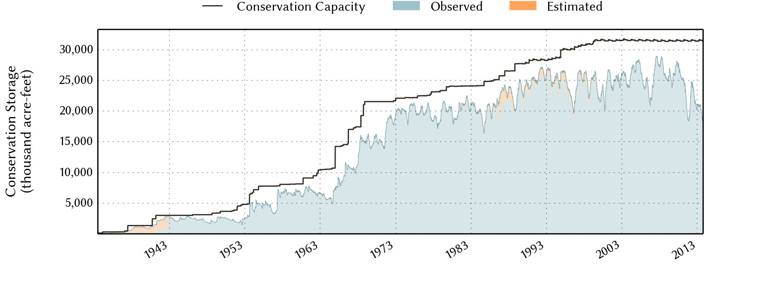
Statewide Storage
currently 59% full
October 11, 2013

Slide 31
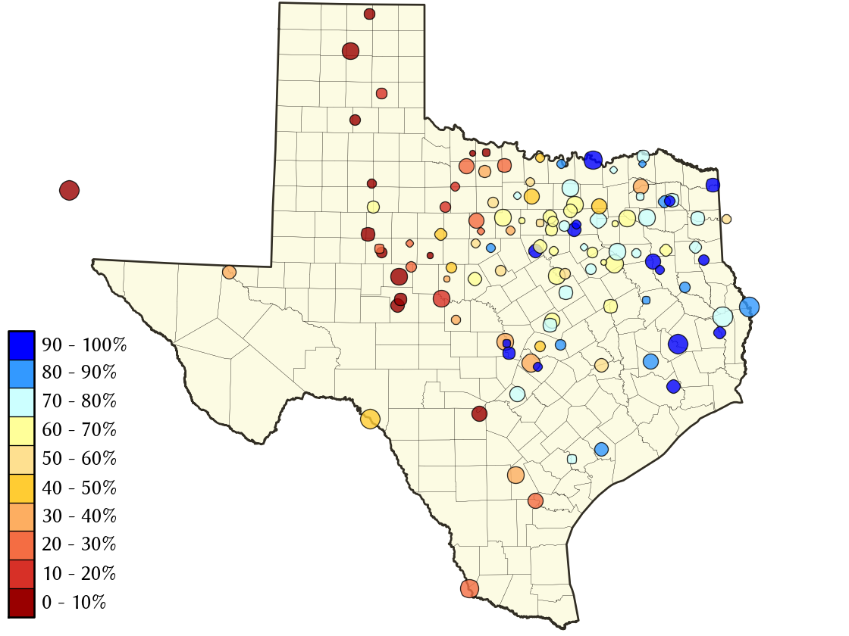
Storage
Statewide

Slide 32
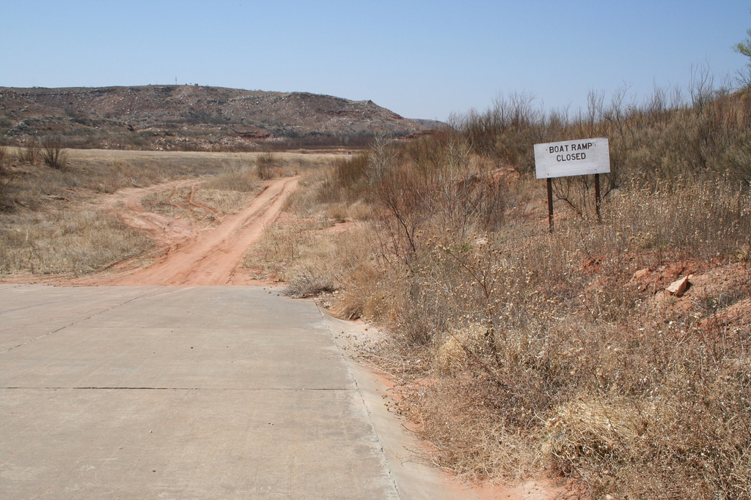
Lake Meredith…

Slide 33
Lake
Meredith
Notes:
Although the current drought started in the fall of last year, Lake Meredith seems to be suffering from a longer drought that started in the 1990s.
Officially, the conservation storage, the volume of water available for use, is currently zero.
For your back pocket: Folks don’t fully understand what the cause is. Likely to be due to several issues: less runoff, impacts of groundwater pumping, less inflow from New Mexico.

Slide 34

Opportunity
for research…

Slide 35
Texas residential water use
outdoor use
31%
indoor use
69%

Slide 36
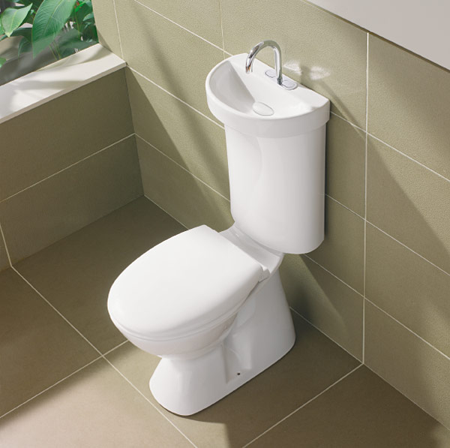
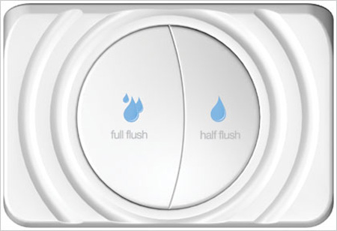
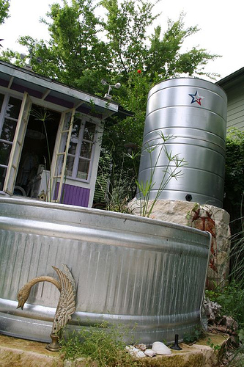
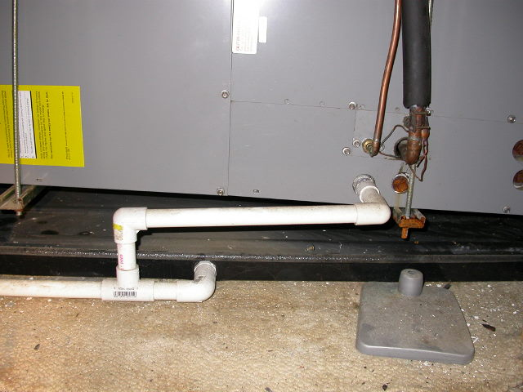
Advanced conservation

Slide 37

Smarter Cities – capture air conditioning condensation water
33 million gallons a year

Slide 38
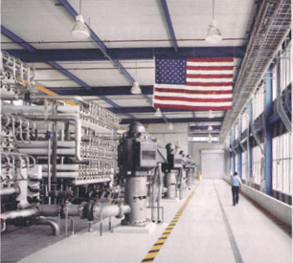
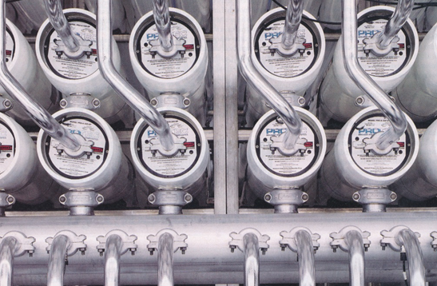
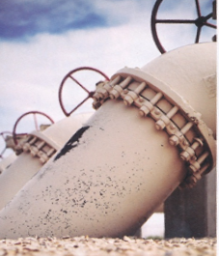
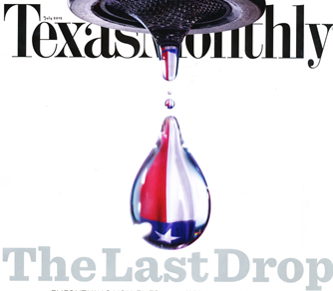
Largest inland desalination plant in the world
Kay Bailey Hutchinson Plant in El Paso
(27.5 MGD)

Slide 39
UWERL?
water...
Urban Water Efficiency Research Laboratory?
Testing facility similar to Pike Powers Laboratory & Center for Commercialization?
Testing facility for new water technologies?
Water tech incubators?

Slide 40

Carlos Rubinstein, TWDB Chairman

Slide 41
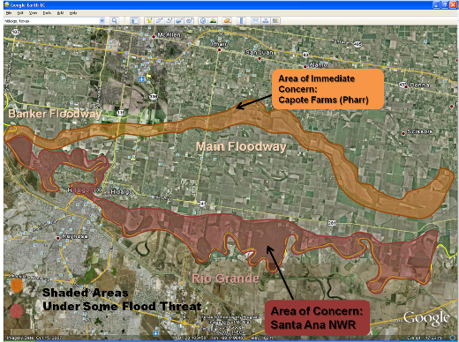
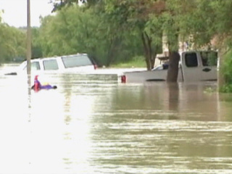
Flooding in the Rio Grande Valley

Slide 42


LIDAR data collection for flood mapping
Frequent Rainfalls (hurricanes + floods)
Very flat region (5 to 6 m above sea level)
A vast network for irrigation
Brownsville/Matamoros

Slide 43

Digital Campus
Digital model of UT-Austin Campus to support research and education

Slide 44

Drainage Patterns at UT-Austin

Slide 45


Vehicle-based LIDAR collection at UT-Austin
Mandli Communications

Slide 46


Flood Modeling

Slide 47
UT System WaterNet
Water and climate measurement system for UT System institutions
Focus on water sustainability for campus and surrounding region
Partnership with NASA – Texas as “Exemplar State” for space-based water measurement
Water data “hubs” at UT system campuses

Slide 48

Texas Water Development Board
A key partner on the state side for this initiative
Carlos Rubinstein, Chairman, TWDB
Focus on “smarter cities” for water

Slide 49

Flooding
Study flooding using LIDAR data on a “Digital Campus”
Focus on the Rio Grande Valley
Building up knowledge infrastructure to address flooding there

