Slide 1
Delivering on National Water Information Needs
David R. Maidment
Director, Center for Research in Water Resources
University of Texas at Austin
WIRADA Science Symposium
Melbourne, Australia
4 August 2011

Slide 2
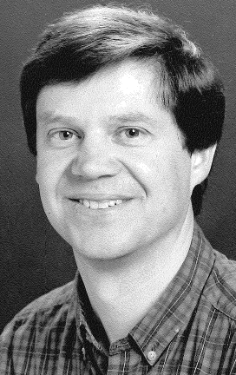
In Memory of Ian Moore, 1951-1993
Welcome to Aussie Hydro
A pioneer of digital characterization of the landscape for hydrology
Worked at Australian National University and the University of Minnesota
He would have been so happy with WIRADA!

Slide 3
Questions
What is the most exciting trend or opportunity?
How does WIRADA research measure up?
What research or technological breakthrough is required to secure our intended outcomes?
From Greg Ayers: “In looking forward to the remaining two years of the alliance agreement, ….. examine the remaining research challenges and ….. inject fresh ideas and shape research directions”

Slide 4
The Premise of WIRADA
Sound water management is based on sound science and data
Bureau of Meteorology
What science foundations are needed to make this structure strong?
Implementation
Requirements
Research and Development
CSIRO
Maidment’s First Law of Information System Development:
Anybody can be complicated.
It takes real insight to be simple.

Slide 5
Our Journey Begins….. Melbourne Cup Day, November 2006
I was in Canberra doing a seminar jointly with Rob Vertessy about geospatial data for water
The Prime Minister met on this day in Canberra with the Premiers of all the States to confront the drought
The country was in crisis
The drought was already severe and its ultimate magnitude and duration were unknown
Action was needed!!!

Slide 6
What was the state of water knowledge in Australia at that time?
Science – Rich – a real legacy of historical investment in CSIRO, ANU and elsewhere
Modeling – Rich – CRC’s for Catchment Hydrology and eWater, and elsewhere
Information – Limited
250m DEM
No consistent digital blue line stream hydrography (ouch!!)
37 separate stream gaging networks
AWRIS and WIRADA were prompted by these and other deficiencies in information

Slide 7
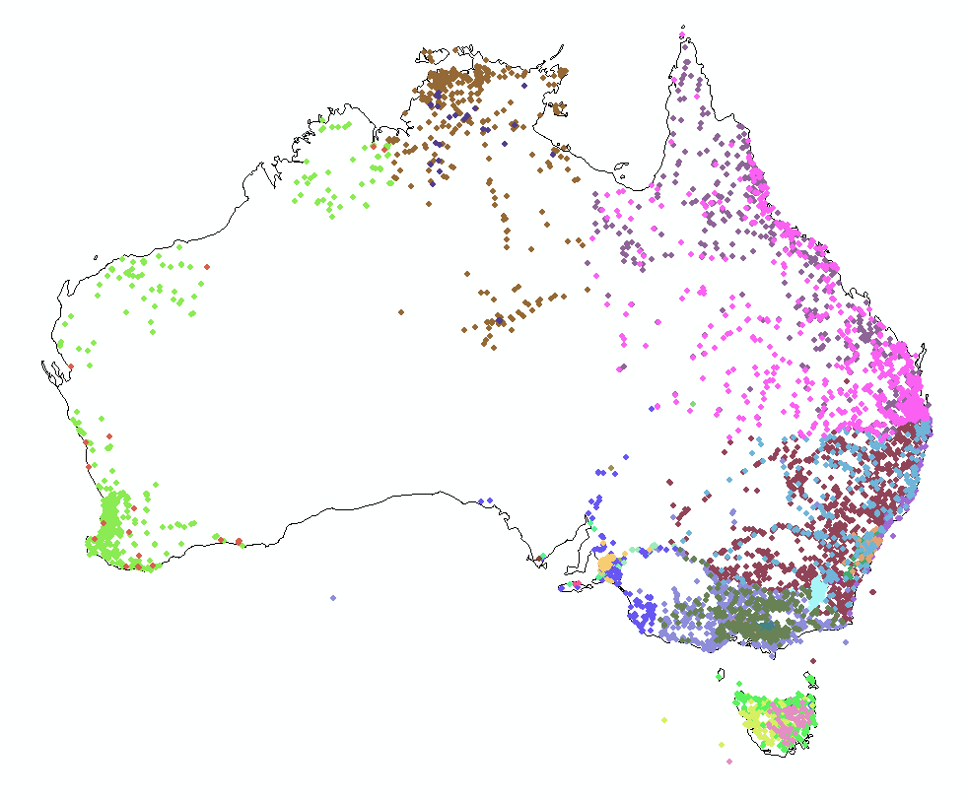
River Gage Networks
9079 gages in 37 networks
Average = 245 gages/network

Slide 8
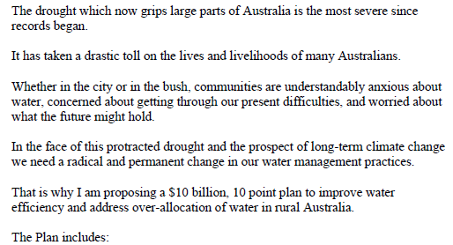
Some months pass…. then comes (Jan 2007)
An announcement by the Prime Minister of Australia
http://www.nalwt.gov.au/files/national_plan_for_water_security.pdf

Slide 9
Australian Water Resources Information System (AWRIS)
Slide: Rob Vertessy

Slide 10
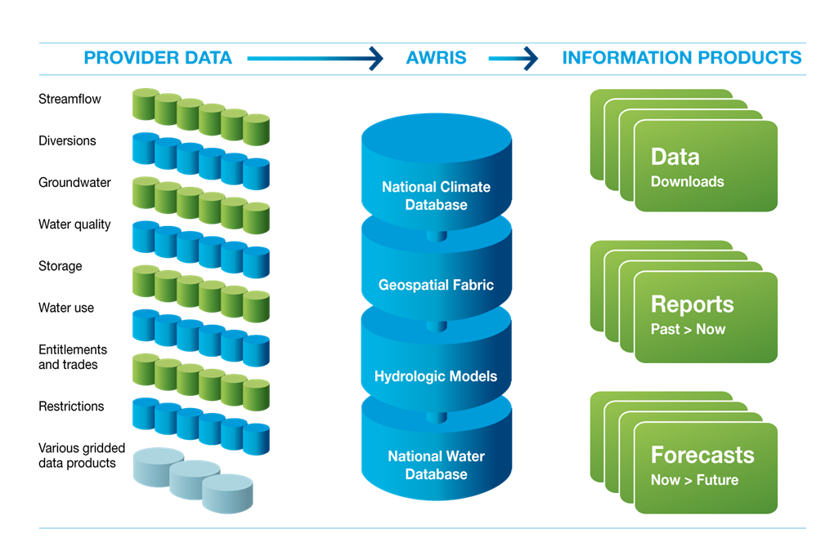
Components of AWRIS
Slide: Rob Vertessy, BoM
Notes:
10
10
AWRIS on a page.

Slide 11
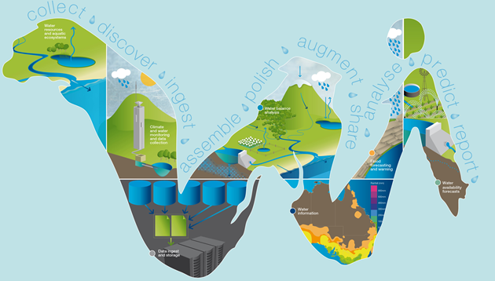
WIRADA (2008-2013) Water Information Research and Development Alliance
CSIRO research program to support the AWRIS development being done by the Bureau of Meteorology
Slide: Rob Vertessy, BoM

Slide 12
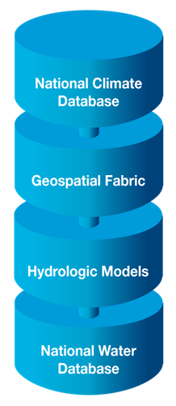
Three years in ….. What is the state of Water Information now?
Progress has been made in each of these four components
They are very different to one another
The challenge now is how to link them

Slide 13
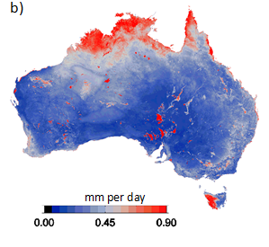
Australian National Climate Database
This is a core competency of the BoM
Augment with evaporation derived from remote sensing
Std Dev of 8 methods of estimating evaporation
Image: Albert van Dijk, CSIRO

Slide 14
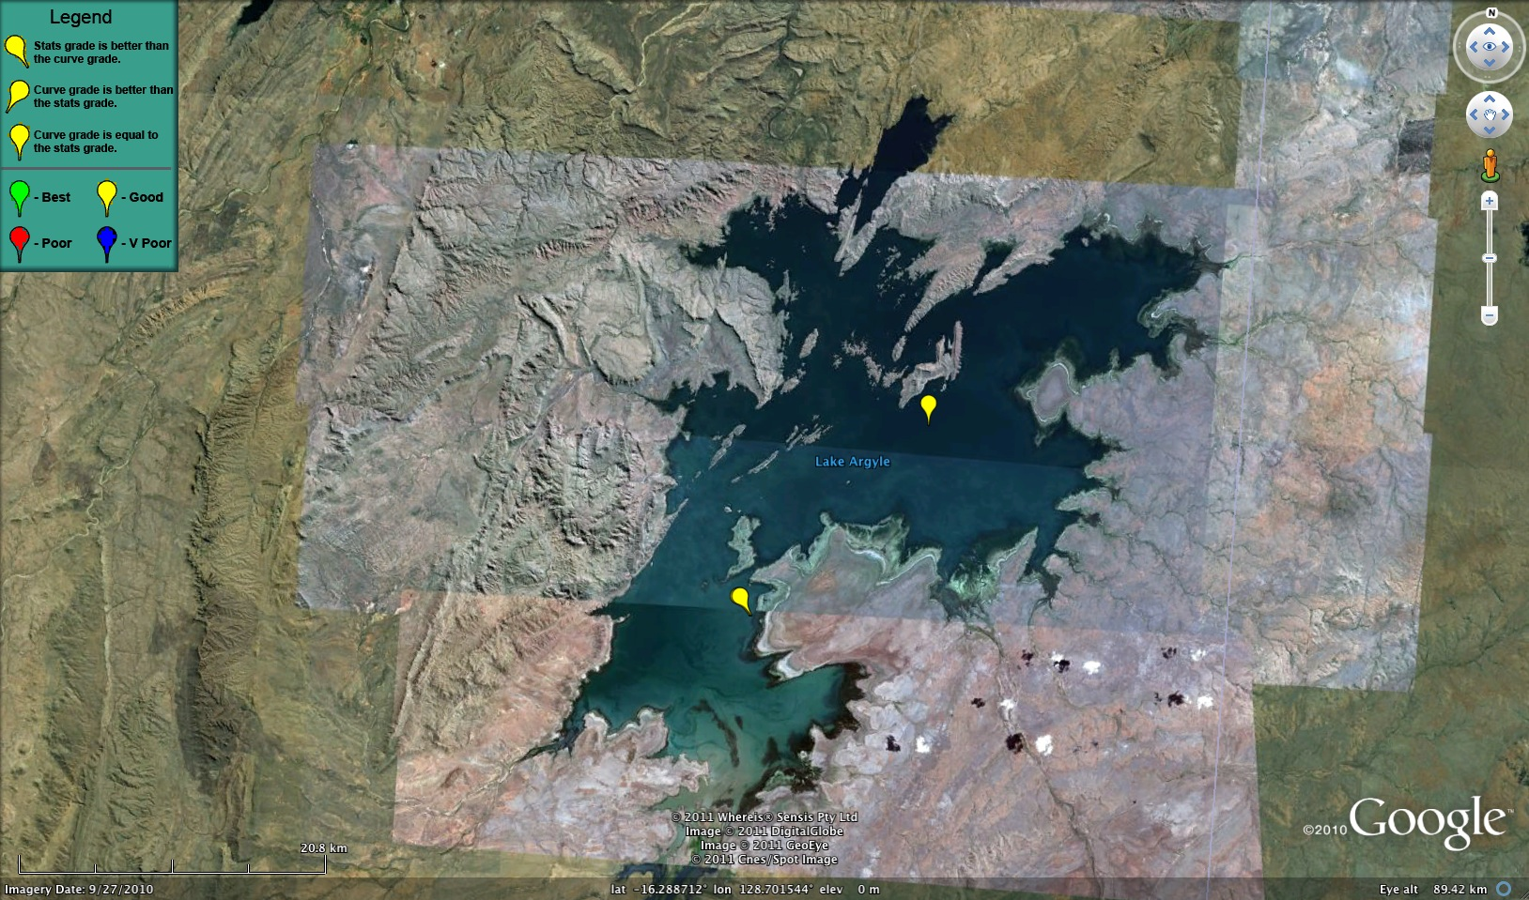
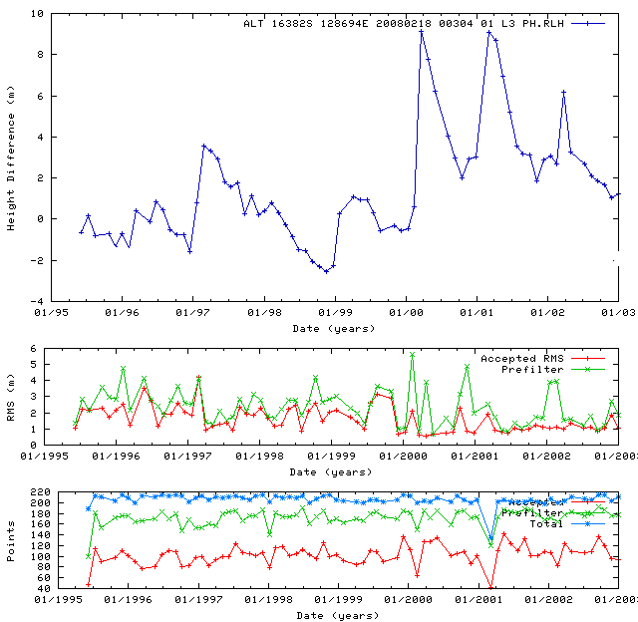
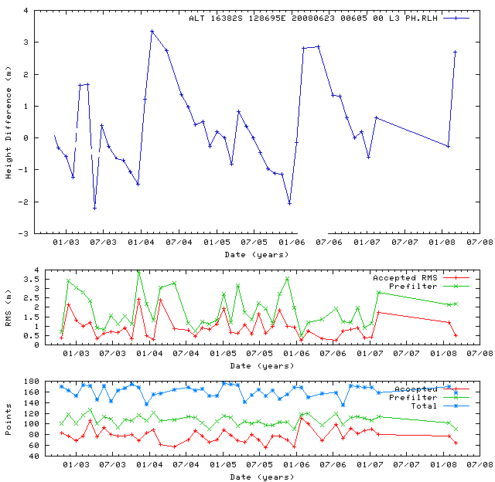
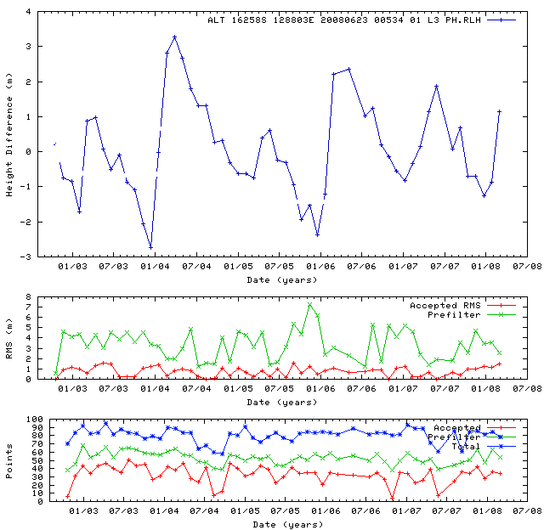
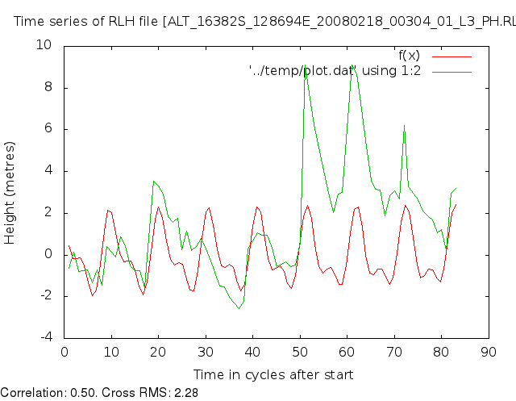
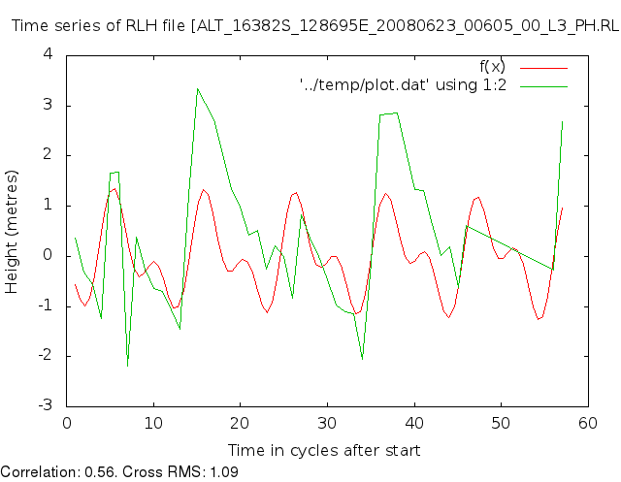
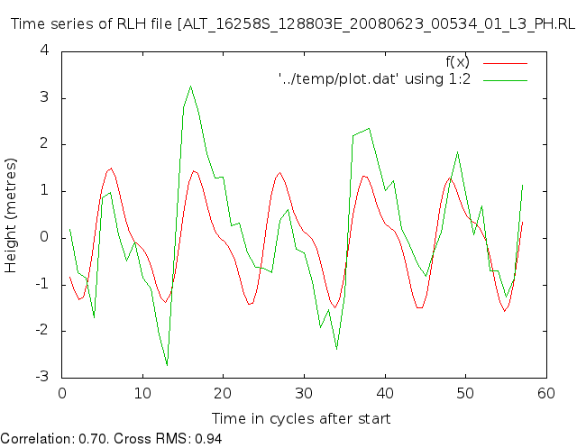
Lake Argyll – Remote Sensing as Time Series!
Lake timeseries plus statistics and curve-fiting analysis.
Slide: Philippa Berry, DeMontfort University

Slide 15
Australian Hydrological Geospatial Fabric
Four key constructs
Cell to cell water movement on DEMs
Line to Line water movement on networks
Area flows to line (connect land and water systems – Reach Catchments)
Area flows to point on line (Contracted Nodes and Catchments)

Slide 17
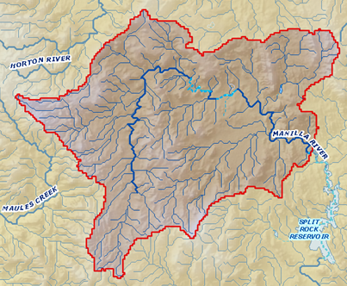
United States Experience with DEM Improvement
1990’s
5%
Error in delineated watershed area
0.5%
2000’s
1 arcsec: 30 m
3 arcsec: 90 m
DEM Cell Size

Slide 18
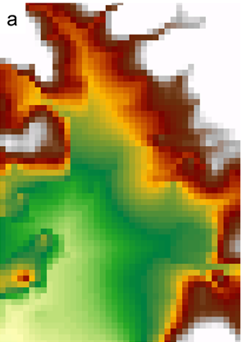
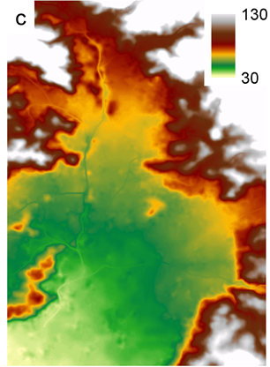
National Elevation Dataset for Australia
Existing
New
9 Arc Second – 250 m
1 Arc Second – 30 m
1 cell
81 cells
Two orders of magnitude improvement! Wow!
Images: John Gallant, CSIRO

Slide 19
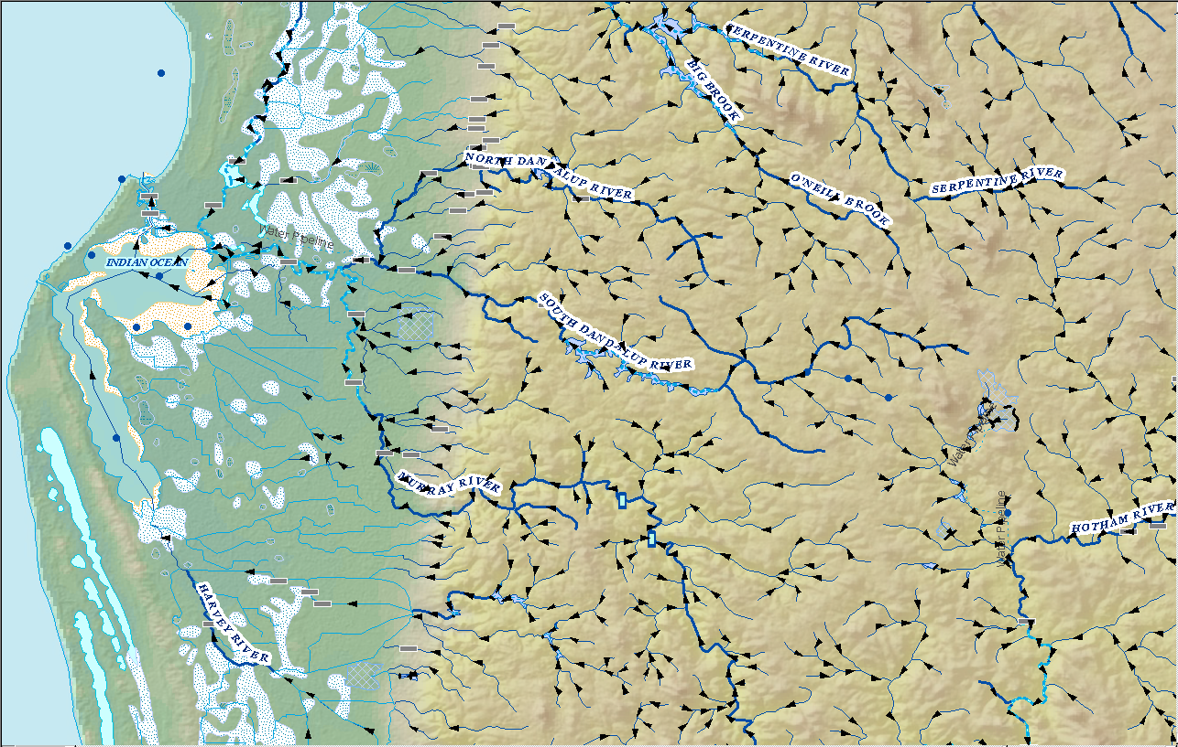
National River Network for Australia
Line flows to Line
Geometric Network
Geometry model: Where am I? (x,y coordinates)
Logical model: Who am I connected to? (topology)
Addressing model: Where are things on me? (linear referencing)
Image: Elizabeth McDonald, BoM

Slide 20
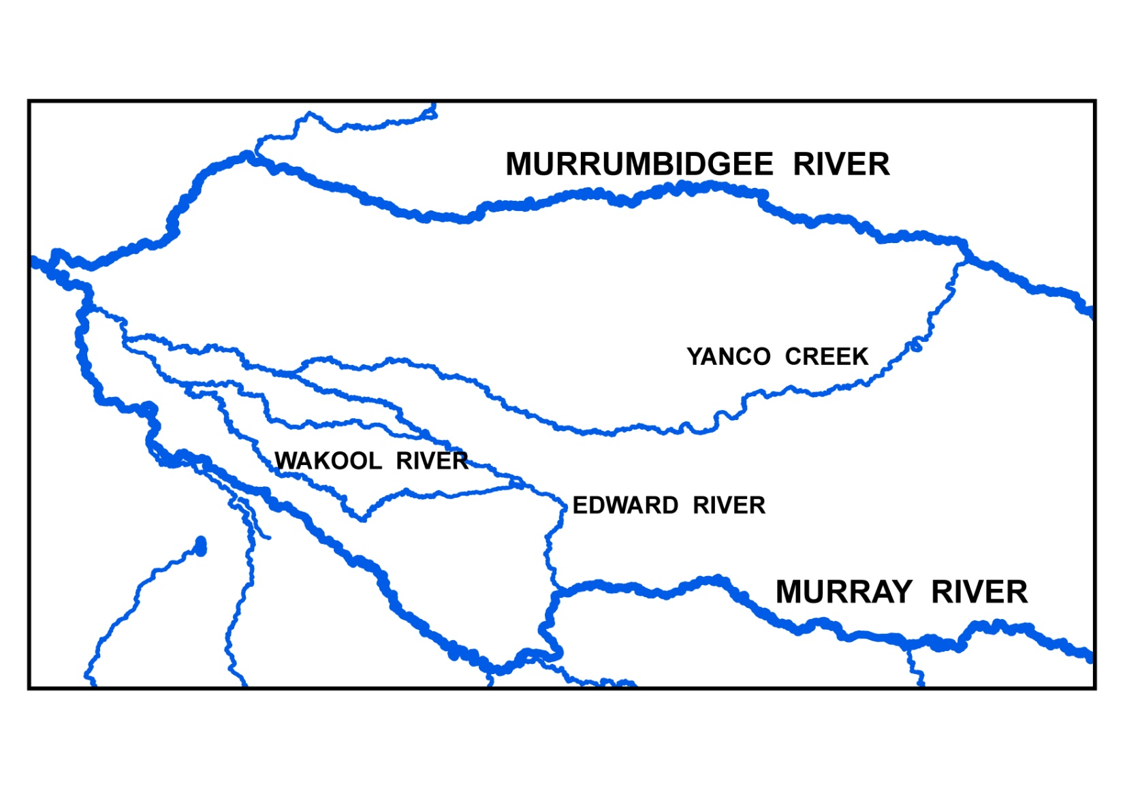
A challenge: those messy Aussie rivers have lots of loops and branches
Image: Michael Hutchinson, ANU

Slide 21
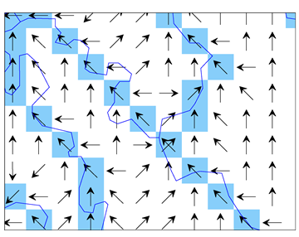
A fundamental innovation: Connecting the Cell to Cell and Line to Line Models
Flow divergences have multiple flow directions on a single DEM cell
Cell flows to Cell
Image and Research: Janet Stein, ANU

Slide 22
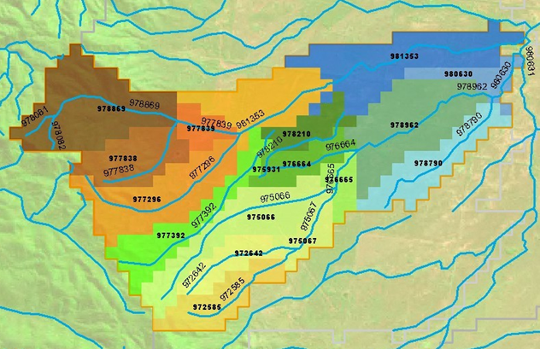
Reach Catchments Every stream reach has a local drainage area
Area flows to Line
Image: Elizabeth McDonald, BoM
Fundamental connection between the water and land systems

Slide 23
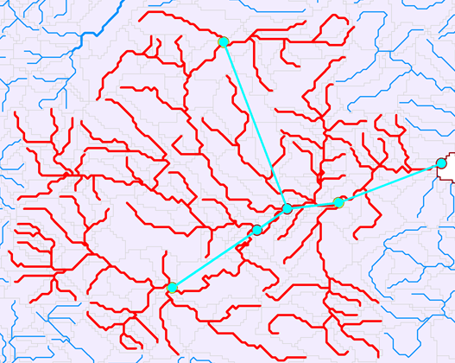
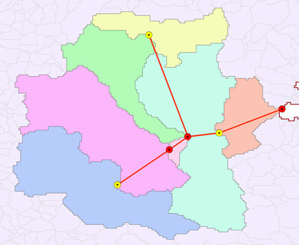
Contracted Nodes and Catchments
A standardized tessellation of the landscape – one chosen among the infinite number of tessellations possible
Contracted Nodes
Contracted Catchments
Area flows to a point on a line
Contracted nodes persist through successive versions of the geofabric
Images: Elizabeth McDonald, BoM

Slide 24
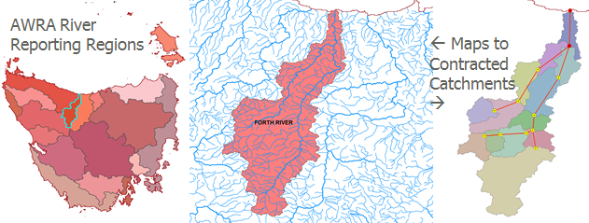
AWRA River Reporting Regions
Aggregate contracted catchments to form reporting regions
Images: Elizabeth McDonald, BoM

Slide 25
Geofabric Summary
I’ve used test versions of these data – they work!
This enables water management to be built on a digital landscape rather than paper maps
Huge implications for all forms of water management in Australia
Large institutional and cultural change required to fully achieve benefits

Slide 26
Geofabric Recommendation
The Geofabric team has Version 1 out, and Version 2 is due out in a few months
You’ve largely solved the special problems that pertain to Australian conditions
I suggest taking the foot off the gas pedal and stepping back a bit for a “mid-course review”
Ask experienced developers and users of comparable geofabrics from the US, UK, New Zealand …. for their review and input (and vacuum up their free tools!)
The question is not now how best to produce the geofabric, it is how best to use it.

Slide 27
Hydrologic Models
“I’m in hydrology heaven ……”
Long historical experience with catchment hydrology modeling in Australia (CRC for Catchment Hydrology)
AWRIS requires a transition to landscape hydrology modeling
AWRA-L; AWRA-R, AWRA-G

Slide 28
Slide: Neil Viney, CSIRO

Slide 29
What I was thinking about on the plane
I was asked to address “Delivering on National Water Information Needs”
In hydrology, we’ve always thought of national information as being built up from state and local information
Question: to what degree is national hydrologic modeling informed by global information?
Answer: Yes, for climate drivers

Slide 30
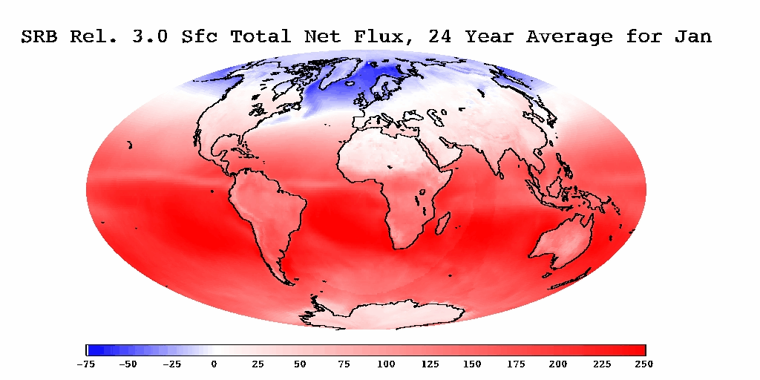
W/m²
http://gewex-srb.larc.nasa.gov/

Slide 31
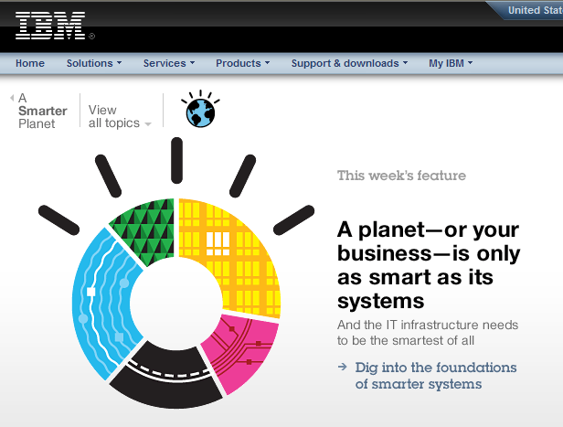
IBM is collaborating with UT….
…. to help build a Smarter Planet

Slide 32
Solve 100 million equations simultaneously!

Slide 33
3500 reaches
VLSI simulation models for electric circuit design…..
….. model right on top of the river geofabric

Slide 34
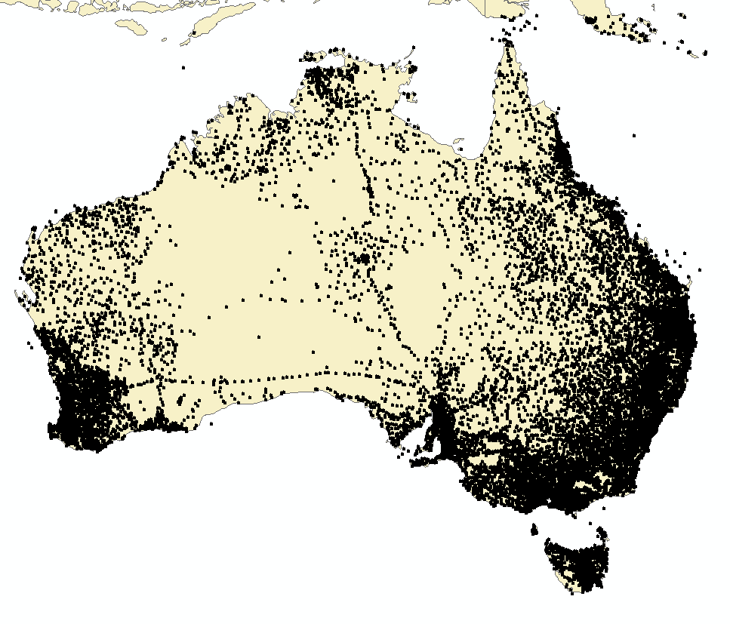
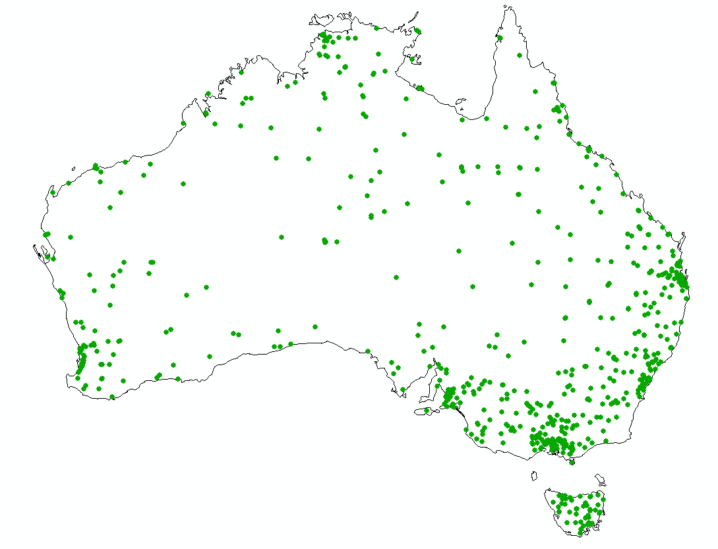
Assembly of lots and lots of time series from more than 200 organizations
Rain gages
River gages
A network of networks
Reservoir levels
Groundwater levels
Evaporation gages
Water Pumpage
Diversions

Slide 35
Slide: Brett Anderson, BoM

Slide 36
Slide: Brett Anderson, BoM

Slide 37
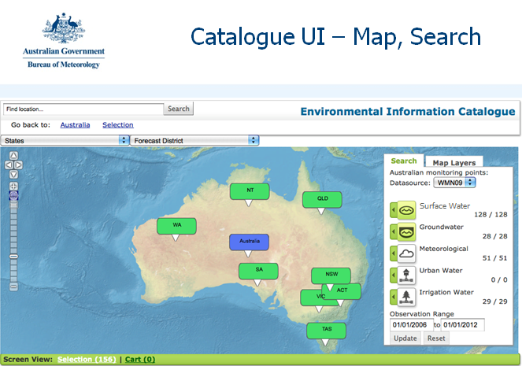
Slide: Brett Anderson, BoM

Slide 38
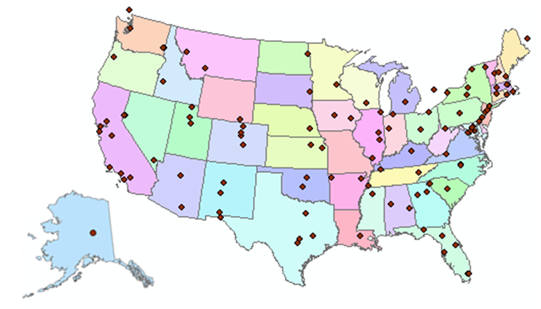
http://www.cuahsi.org
CUAHSI is a consortium representing 125 US universities
Supported by the National Science Foundation Earth Science Division
Advances hydrologic science in nation’s universities
Includes a Hydrologic Information System project

Slide 39
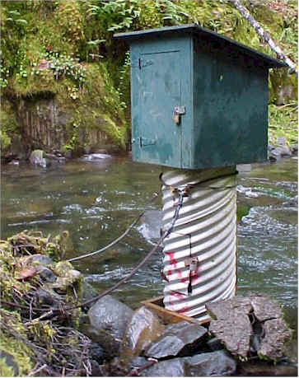
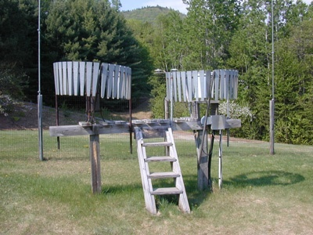
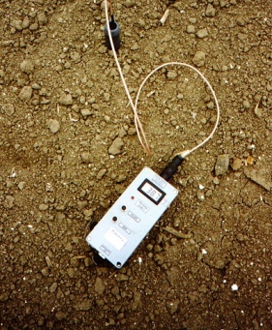
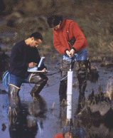
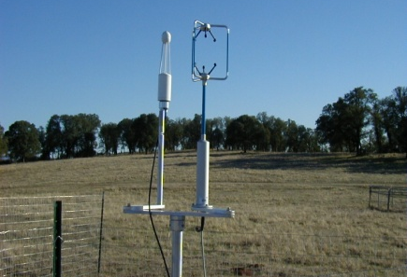
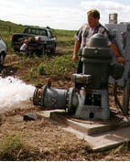
We Collect Lots of Water Data
Water quantity
Rainfall
Soil water
Water quality
Meteorology
Groundwater

Slide 40
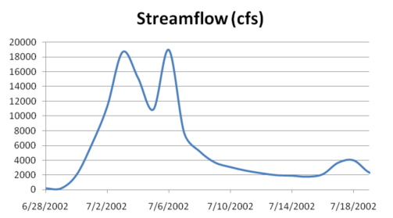
The Data have a Common Structure
A point location in space
A series of values in time
Gaging – regular time series
Sampling – irregular time series
Notes:
These data are recorded over time to monitor a hydrologic process or property.

Slide 41
The Data are Collected by Many Organizations
Water Districts
Federal Agencies
River Authorities
State Agencies
Cities
Universities
…. and the data are continuously accumulating

Slide 42
How the web works
Catalog (Google)
Catalog harvest
Search
Web Server
(CNN.com)
Access
Browser
(Firefox)
HTML – web language for text and pictures

Slide 43
Services-Oriented Architecture for Water Data
Catalog
Service registration
Search
Catalog harvest
Server
Data access
User
WaterML – web language for water data

Slide 44
Some terms and definitions
Web Service: A web service allows for information to be exchanged computer-to-computer over the internet
Portal: A one-stop shop that pulls together information from various sources and provides it to the user in a seamless fashion using a web site
Catalog: Like a library card-catalog, these provide summary level information on what data are available at the various sources
Exchange Schema: An agreed-upon data sharing format via which data owners publish data (e.g. WaterML)
Source: Dwane Young, Western States Water Council
Notes:
In order to understand what I’d talk about, these are some basic terms that need to be defined. The key term that needs to be understood is the idea of a web service. The best way to describe a web service is to relate it to something that they may already be familiar with. The best example I’ve been able to come up with is describing the ‘Weather Bug’ web service. A lot of people have interacted with this type of service. They have a little application that’s running on their computer that required a ‘Input parameter’, in this case a zip code. The application uses that to query another computer out on the internet. That computer returns to your computer a file that has all the information about the weather for your zip code. The application reads that file and turns it into a nice little icon that says that it’s raining and 42 degrees. The user never needs to know that this application is going out there and doing this, and doesn’t need to re-enter their information or interact with a web site or anything. It all happens in the back-ground as computer-to-computer communication.

Slide 45
What is a “services-oriented architecture”? Networks of computers connected through the web …….
Everything is a service
Data, models, visualization, ……
A service receives requests and provides responses using web standards (WSDL)
It uses customized web languages
HTML (HyperText Markup Language) for text and pictures
WaterML for water time series (CUAHSI/OGC)
GML for geospatial coverages (OGC)
….. supporting a wide range of users

Slide 46
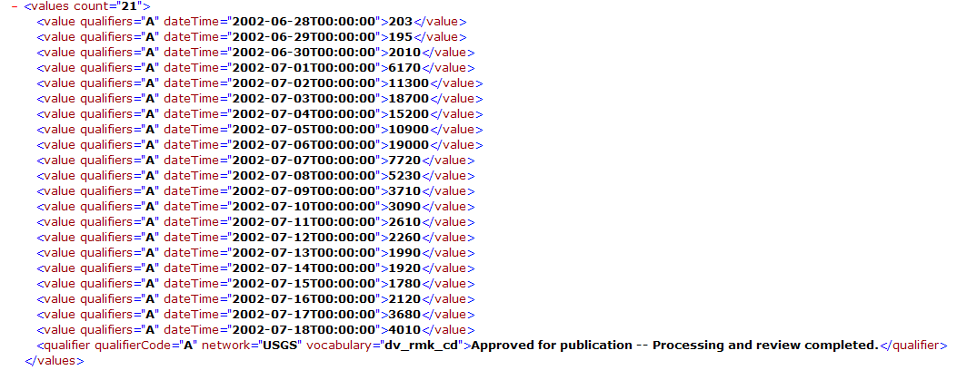
WaterML as a Web Language
Discharge of the San Marcos River at Luling, TX June 28 - July 18, 2002
USGS Streamflow data in WaterML language
The USGS now publishes its time series data as WaterML web services

Slide 47
Colorado River at Austin
I accessed this WaterML service from USGS at 3:10AM this morning
http://waterservices.usgs.gov/nwis/iv?sites=08158000&period=P7D&parameterCd=00060
And got back these flow data from USGS which are up to 1:45AM Melbourne time (UTC +10:00)
USGS has real-time WaterML services for about 22,000 sites available 24/7/365

Slide 48
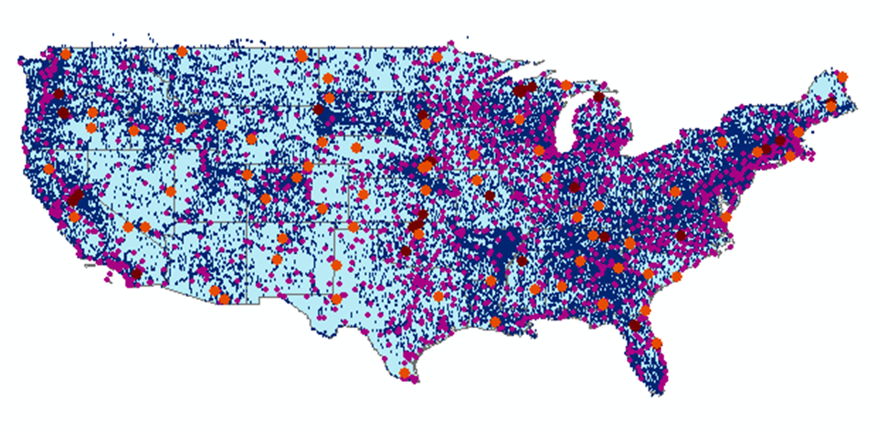
CUAHSI Water Data Services Catalog
All the data comes out in WaterML
69 public services
18,000 variables
1.9 million sites
23 million series
5.1 billion data values
And growing
The largest water data catalog in the world
maintained at the San Diego Supercomputer Center

Slide 49
Point Observations Information Model
Niagara Peninsula Conservation Authority
Information is transmitted through the internet in WaterML as web services
Data Source
Water Quality
Network
GetSites
BA001
Sites
GetSiteInfo
Total Phosphorus
Variables
GetVariableInfo
GetValues
0.89 mg/L, 20 April 2009
Values
{Value, Time, Metadata}
A data source operates an observation network
A network is a set of observation sites
A site is a point location where one or more variables are measured
A variable is a property describing the flow or quality of water
A value is an observation of a variable at a particular time
A metadata quantity provides additional information about the value

Slide 50
BoM Rain Gage Network
An observation network
= one web service
24,343 rain gages

Slide 51
River Gage Networks
A network of observation networks
= a collection of web services
9079 gages in 37 networks
Average = 245 gages/network

Slide 52
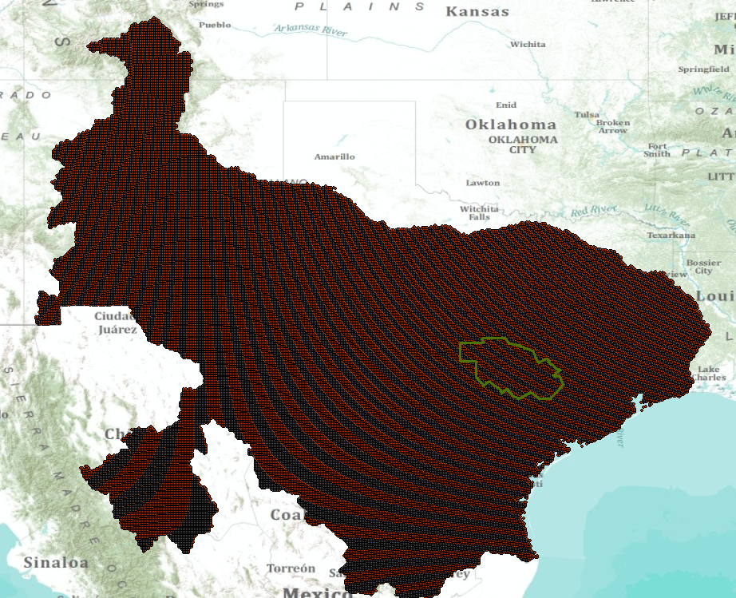
Multisensor Precipitation Estimate (MPE) West Gulf River Forecast Center
Exported by NWS to CUAHSI Observations Data Model and WaterML web services at University of Texas at Arlington
Capital Area Council of Governments (CAPCOG)

Slide 53
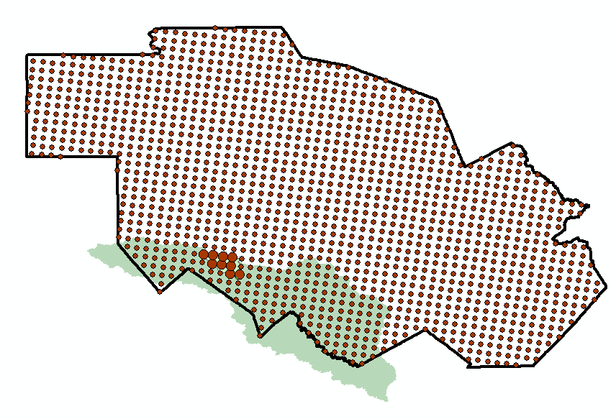
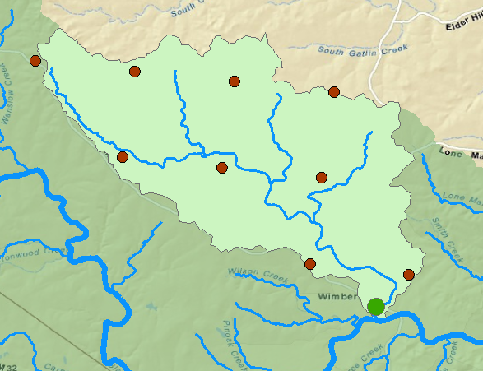
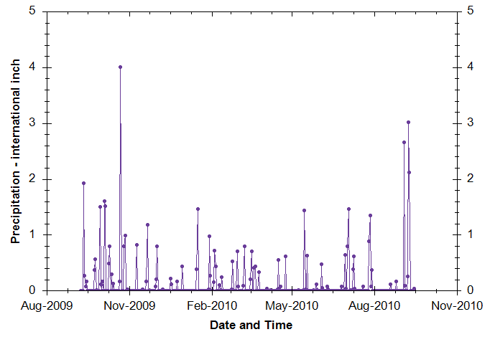
Rainfall in Cypress Creek Watershed Drainage area – 38 Sq. Mi.
“Virtual Rain Gages”— Nexrad Radar Rainfall points
A Virtual Observation Network and web services
Time Series of Rainfall
Data obtained via WaterML web service from NWS and UT Arlington

Slide 54
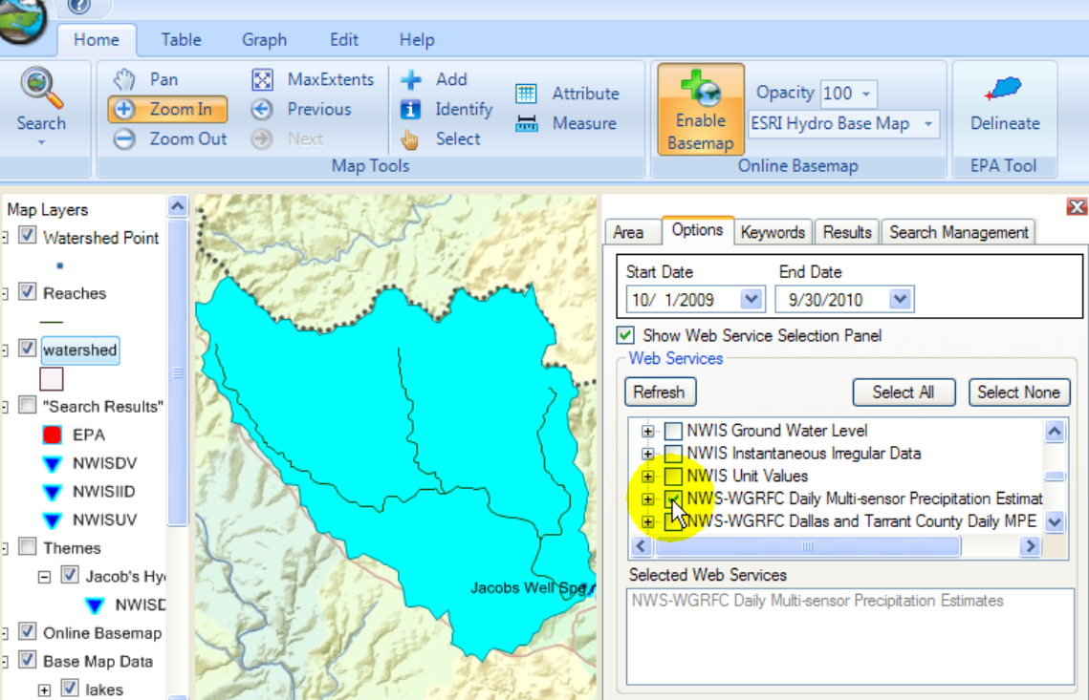
HydroDesktop – Desktop HIS
Metadata
Catalog
Data

Slide 55
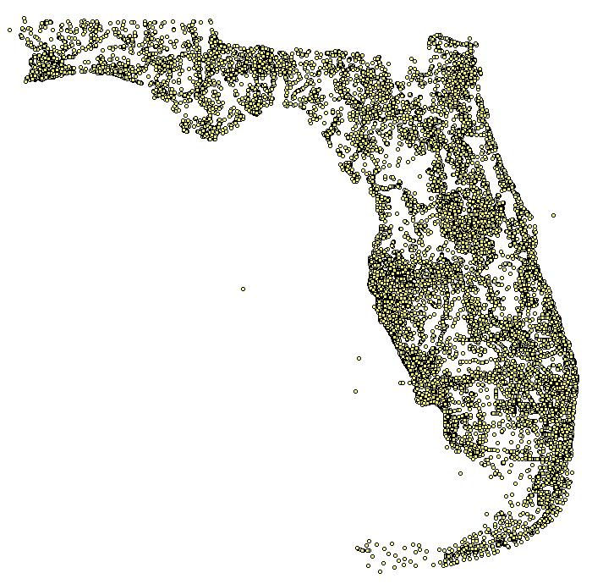
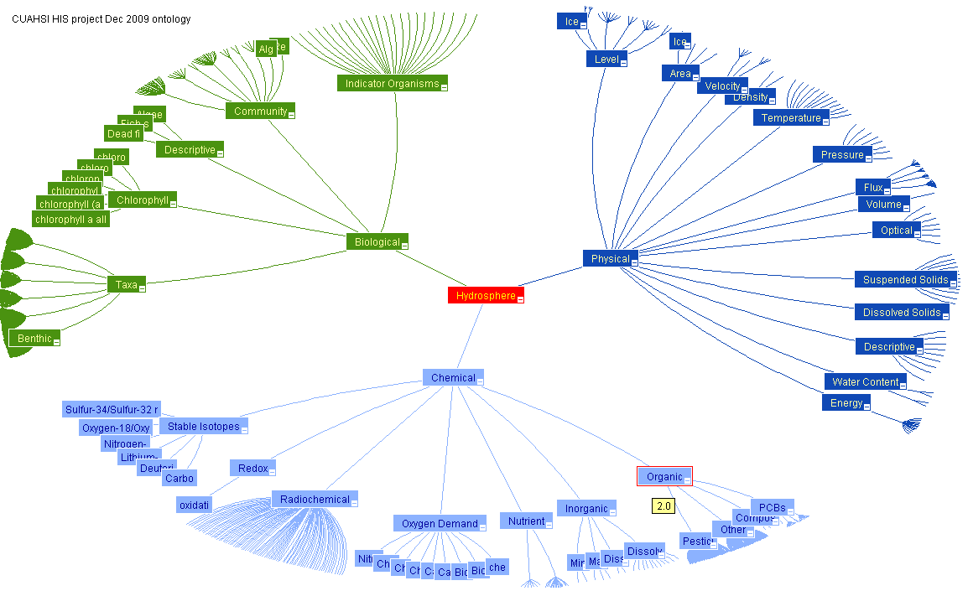
Semantic Integration using an Ontology of Concepts
Nutrients in Florida
Ontology of Concepts
Physical
Hydrosphere
Chemical
EPA SRS
Biological
http://his.cuahsi.org/ontologyfiles.html

Slide 56
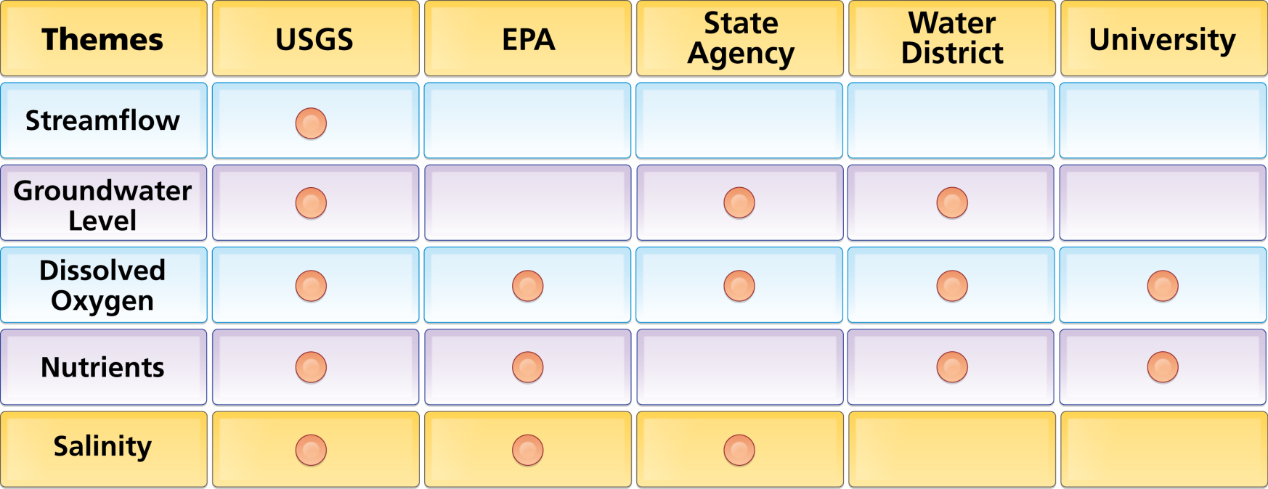
Organize Water Data Into “Themes”
Integrating Water Data Services From Multiple Sources
WaterML
WaterML
WaterML
WaterML
WaterML
. . . Across Groups of Organizations

Slide 57
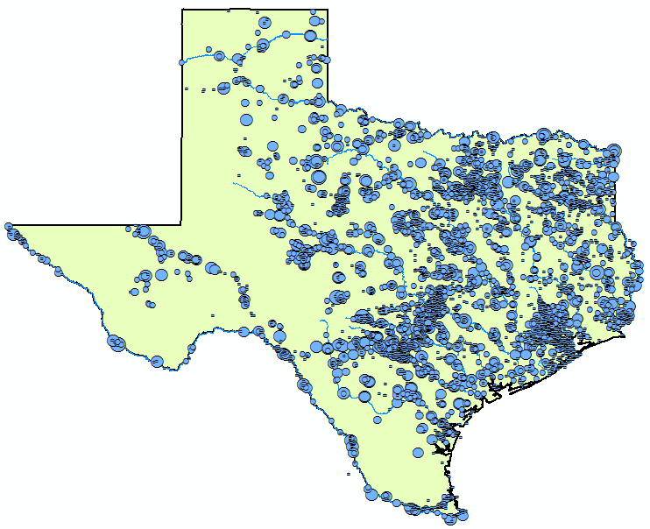
Streamflow Data Services
2 services
7 variables
4,363 sites
11,484 series
9,493,968 records
Notes:
Here’s an example showing where streamflow is measured in Texas from two different services (i.e., data providers).

Slide 58
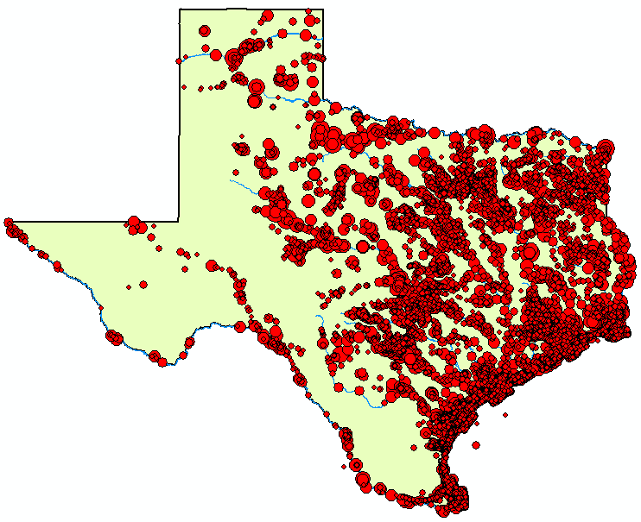
Water
Temperature Data Services
6 services
11 variables
11,158 sites
22,953 series
1,546,841 records

Slide 59
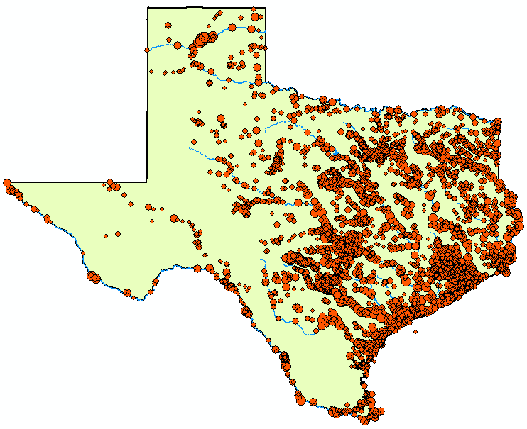
Bacteria Data Services
1 service
21 variables
4,801 sites
15,483 series
297,849 records

Slide 60
WOFpy
Water One Flow web services in Python
Easy, low cost way to create water web services
Delivers both WaterML1 and WaterML2
https://github.com/swtools/WOFpy

Slide 61
Open Geospatial Consortium Web Service Standards
Map Services
Web Map Service (WMS)
Web Feature Service (WFS)
Web Coverage Service (WCS)
Catalog Services for the Web (CS/W)
Observation Services
Observations and Measurements Model
Sensor Web Enablement (SWE)
Sensor Observation Service (SOS)

Slide 62
Jointly with World Meteorological Organization
Evolving WaterML into an International Standard
Meets every 3 months
Teleconferences most weeks
November 2009
Hydrology, Meteorology, Climatology, and Oceanography
WaterML Version 2 standard proposed
Vote for adoption later this year or early next year

Slide 63
Catalog Services for the Web (CS/W)
An OGC standard for cataloging web services
Provides a single URL reference point for all services from an organization https://hydroportal.crwr.utexas.edu/geoportal/csw/......
Enables searching of underlying Web Feature Services using the “who, what, when, where” approach
Start
Select Region (where)
Select Time Period
(when)
Select Service(s)
(who)
Select Keyword(s)
(what)
Filter Results
Save Theme
End

Slide 64
Web Services Stack for Time Series
OGC Catalog Service for the Web with standard metadata: ISO, Dublin Core, ..
Who, What?
Catalog
Time
Series
Services
Where, When?
Metadata
OGC Web Feature Service
Data
Get the data
WaterML or OGC WaterML2

Slide 65
Water Agency Service Stacks Each agency maintains its own data and metadata
NWIS
Storet
NCDC
State
TWDB
MetaCatalog is a listing of the URL addresses of all the agency catalogs
All linked via a Metacatalog
Notes:
The Federal Government already supports Catalog Services for the Web through Geodata.gov and is moving to Data.Gov and a new initiative called the Geoplatform (requested by OMB in 2011). Cataloging water observations data under this system is a straightforward extension of what is already being done to federate the federal government’s geospatial data layers. State water observations data systems like that coming from the Texas Water Development Board can be federated and searched along with the federal water observations data services

Slide 66
Searching Federal and State Data
(Federal)
(State)
USGS Daily Values
Texas TWDB
Texas Agencies
A single search accesses federal water data from a catalog at HIS Central ….
…. and state water data from a catalog in Austin, Texas

Slide 67
Searching Search Federal, State and Local Data

Slide 68
Build this on top of a Services-Oriented Architecture
Slide: Brett Anderson, BoM

Slide 69
Bringing it all Together: the Services “Hub”
Progress has been made in each of these four components
They are very different to one another
The challenge now is how to link them

Slide 70
Slide: Rob Vertessy

Slide 71
Tropical Storm Hermine, Sept 7-8, 2010

Slide 72
Local Information during Tropical Storm Hermine (7-8 Sept 2010)
Upper Brushy Creek (Round Rock)
LCRA
Bring data together into one system
http://hydromet.lcra.org
http://ubcwcid.org/Overview/Overview.aspx?id=1
TV
City of Austin
http://coagis1.ci.austin.tx.us/website/COAViewer_fews/viewer.htm

Slide 73
Situational Awareness for Flash Flooding in the CAPCOG region
National Weather Service,
USGS, Corps of Engineers
Combines federal, river authority, city and water district data ….
…. to support real-time flood emergency response

Slide 74
Web Services HUB
Inputs
Outputs
Web Services HUB
Observation
Data
Services
(WaterML)
Observation
Data
Services
(WaterML)
USGS
LCRA
COA
Channel
Data
Services
(WFS)
NWS
Mapping
Services
(WFS)
AHPS
Data
Services
(WFS)
Modeling
Services
Mapping
Services
(WFS)
Models
Maps

Slide 75
Build this on top of a Services-Oriented Architecture
Slide: Brett Anderson, BoM

Slide 76
Build this on top of a Services-Oriented Architecture
Slide: Rob Vertessy, BoM

Slide 77
Slide: Rob Vertessy, BoM
Build this on top of a Services-Oriented Architecture

Slide 78
And then you get real-time situational awareness
Slide: Rob Vertessy, BoM

Slide 79
Questions and Answers
What is the most exciting trend or opportunity?
WIRADA has a global impact
How does WIRADA research measure up?
Excellently – Geofabric, Water Web Services
What research or technological breakthrough is required to secure our intended outcomes?
A web services hub
From Greg Ayers: “In looking forward to the remaining two years of the alliance agreement, ….. examine the remaining research challenges and ….. inject fresh ideas and shape research directions”

