Slide 1
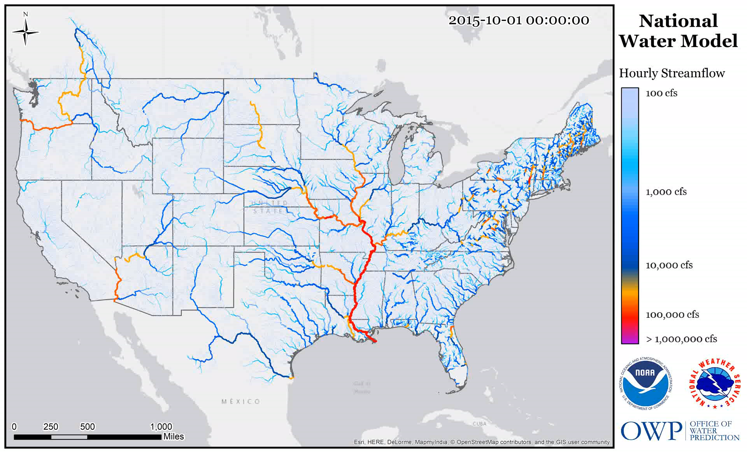

Flood Impact on the Road Transportation System
Presented by David R. Maidment
Center for Water and the Environment
University of Texas at Austin
Water Science and Technology Board
National Academies of Science, Engineering and Medicine
Washington DC
14 November 2024
Acknowledgement: This research is supported by the Texas Department of Transportation (TxDOT)
and the Cooperative Institute for Research to Operations in Hydrology (CIROH)

Slide 2
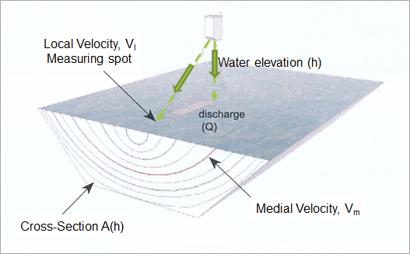
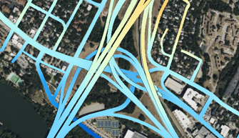
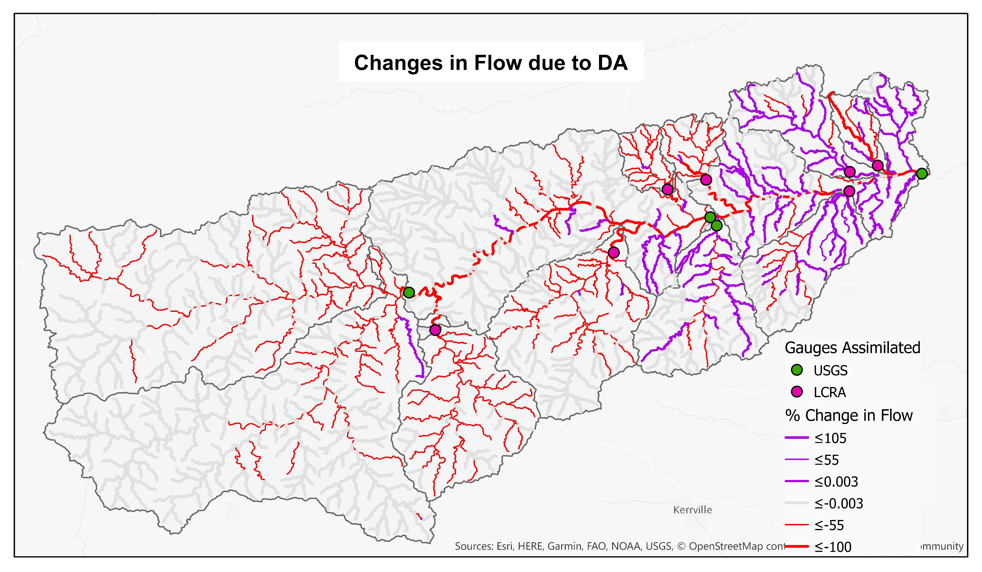
Flood Impact on the Road Transportation System
Three innovations:
Streamflow measurement using velocimetry
Road Elevation Model
Data Assimilation to link measurements
and forecasting

Slide 3
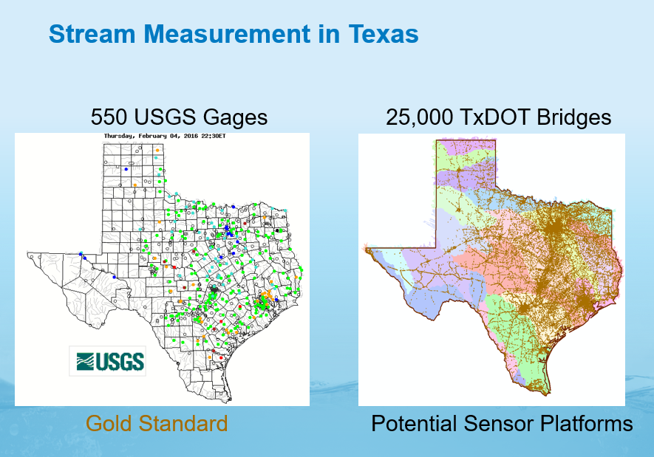

(Slides presented to TxDOT in 2016)

Slide 4
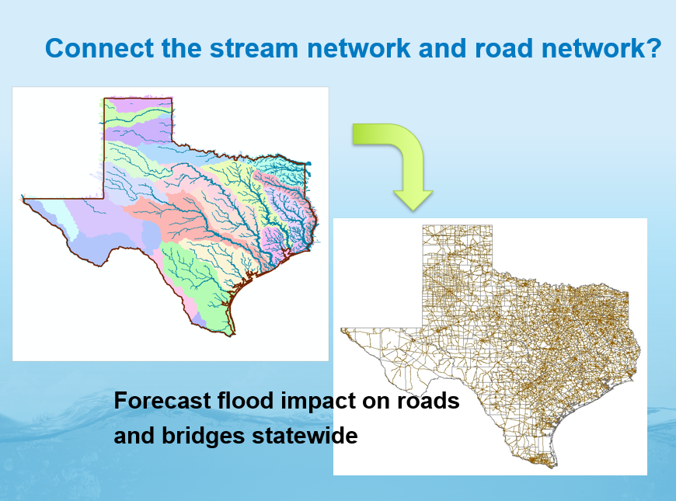
Densified forecasting requires densified measurement

Slide 5
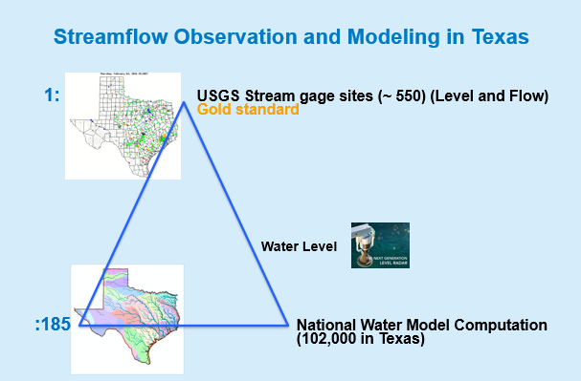
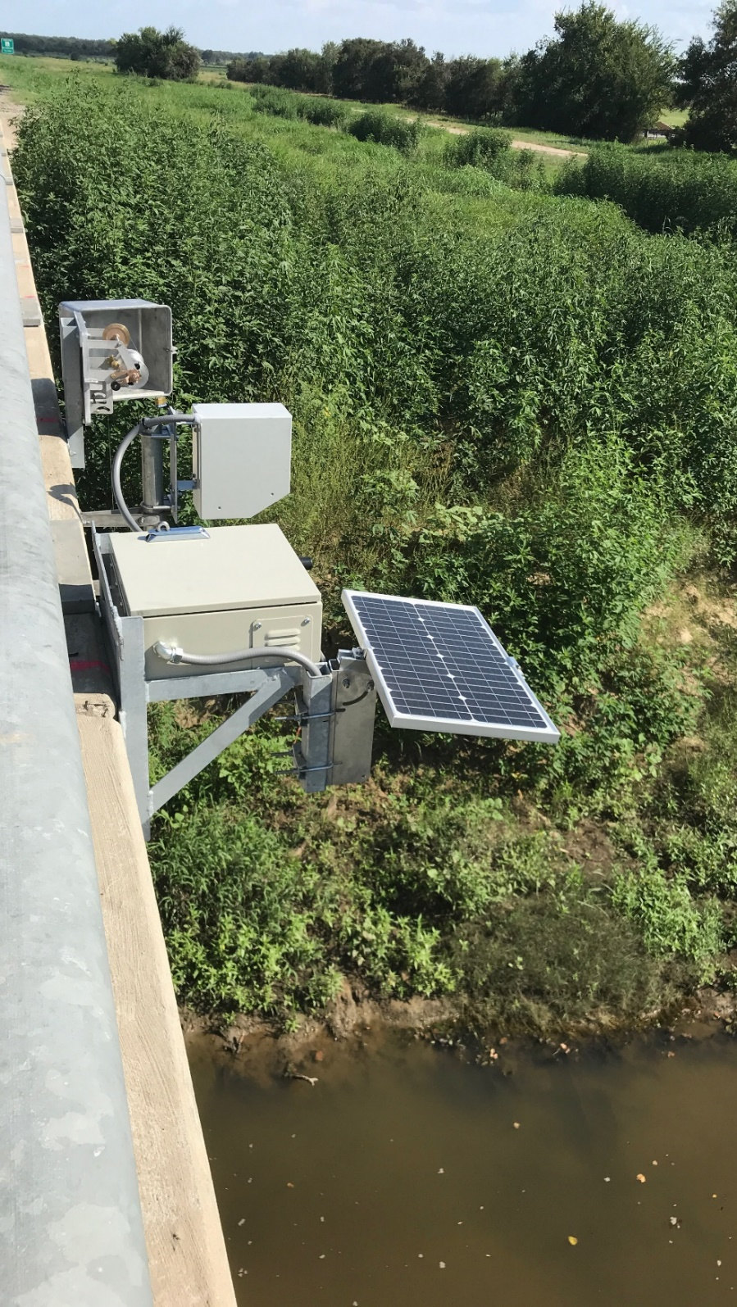
A new kind of flood gauge
Water Level and Surface Velocity
TxDOT Decision

Slide 6
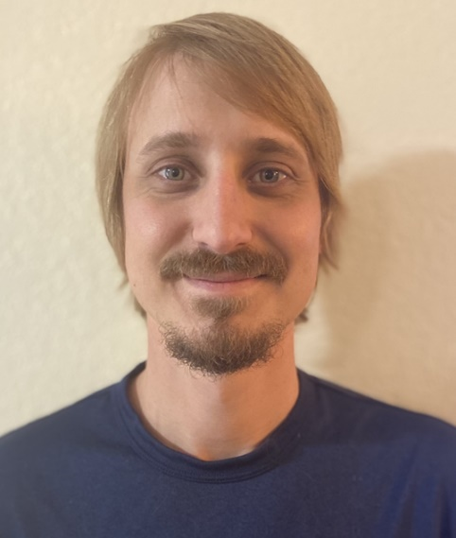
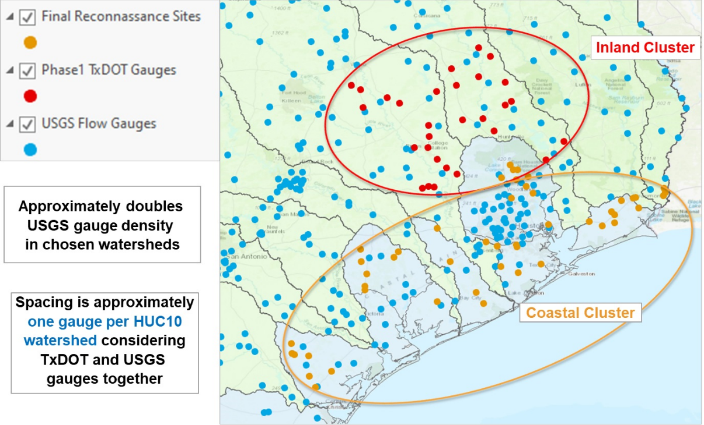
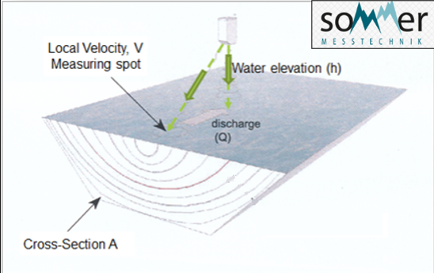

80 RQ-30 Radar Stream Gauges for TxDOT
Fast forward to 2024 ….
Scott Grzyb, USGS

Slide 7
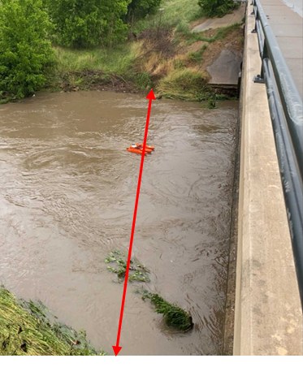
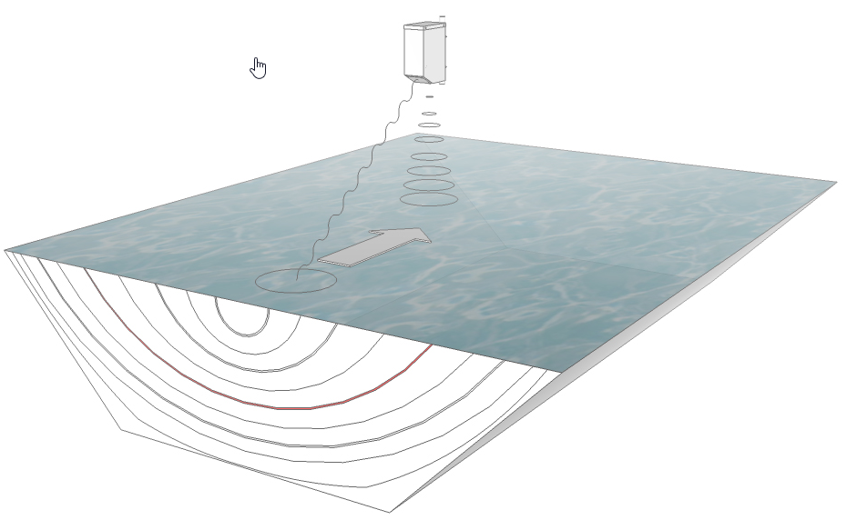
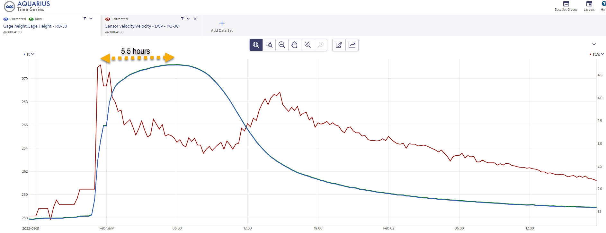
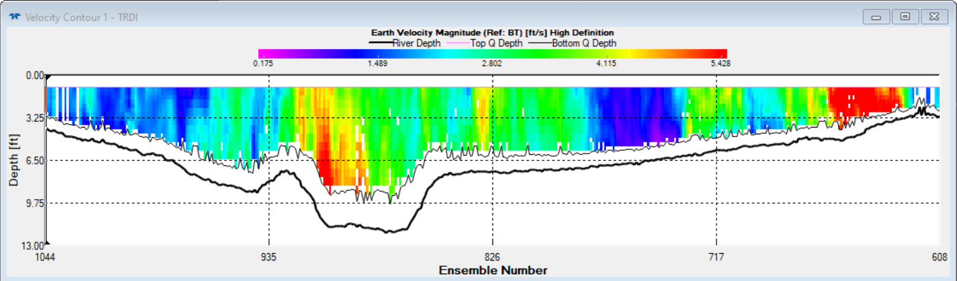
Stream gauging with Velocimetry
V_{s}
h
RQ-30 measures surface velocity, V_{s}
and elevation h in time at one point
ADCP measures velocity distribution
in space across stream cross-section
V_{s}
h
Discharge, Q = Cross-section area, A * average velocity, V
= A * surface velocity, V_{s} * k-factor

Slide 8
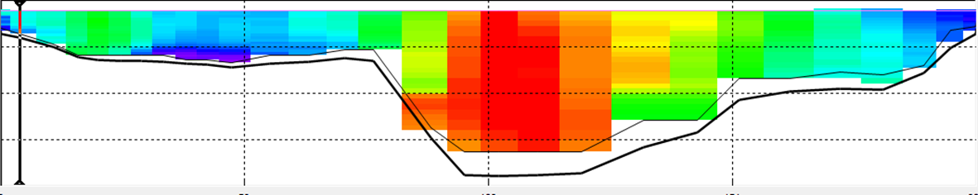

Linking RQ-30 Surface Velocity through time with ADCP Velocity in Cross-Section
Depth
Calibration
Relative
Velocity
Distribution
Cell values are the ratio of the cell velocity
to the surface velocity at the RQ-30 measurement point
Distance from Left Bank

Slide 9
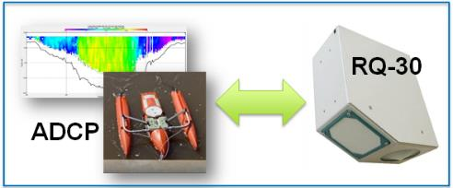
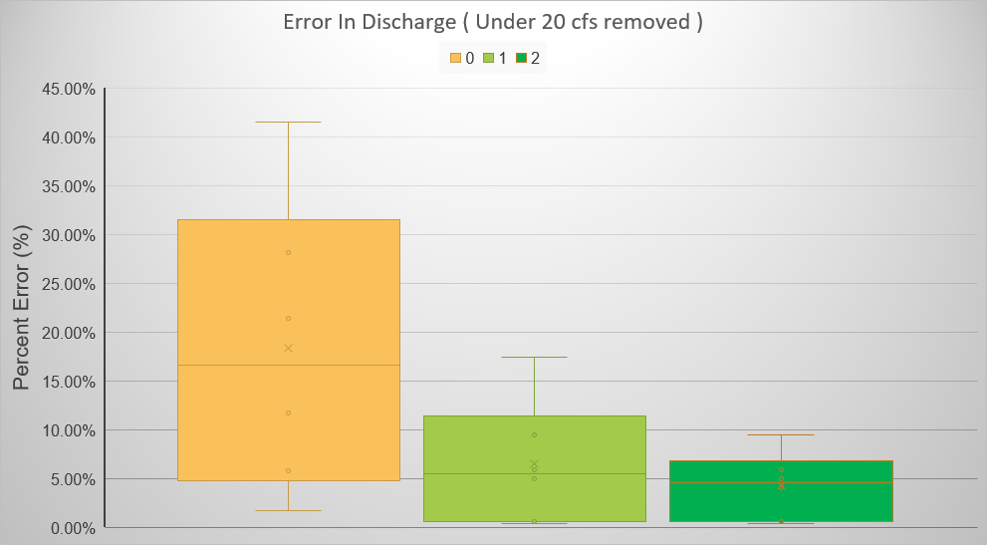
Calibrating the RQ-30 Gauge using Acoustic Doppler Current Profiler (ADCP)
Measurement Number
No ADCP
Measurements
One ADCP
Measurement
Two ADCP
Measurements
081111110 – New Year Ck at FM 1155 nr Chappel Hill, TX

Slide 10
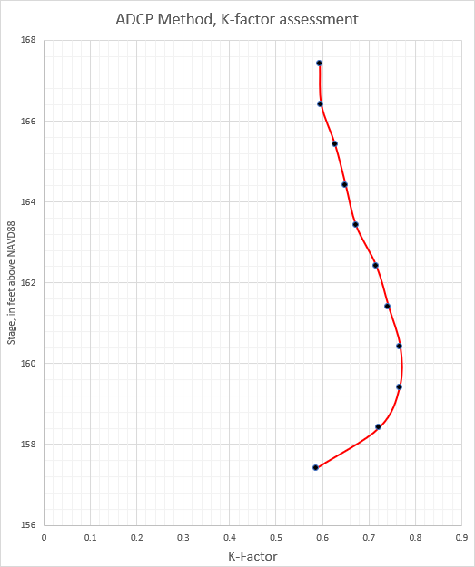
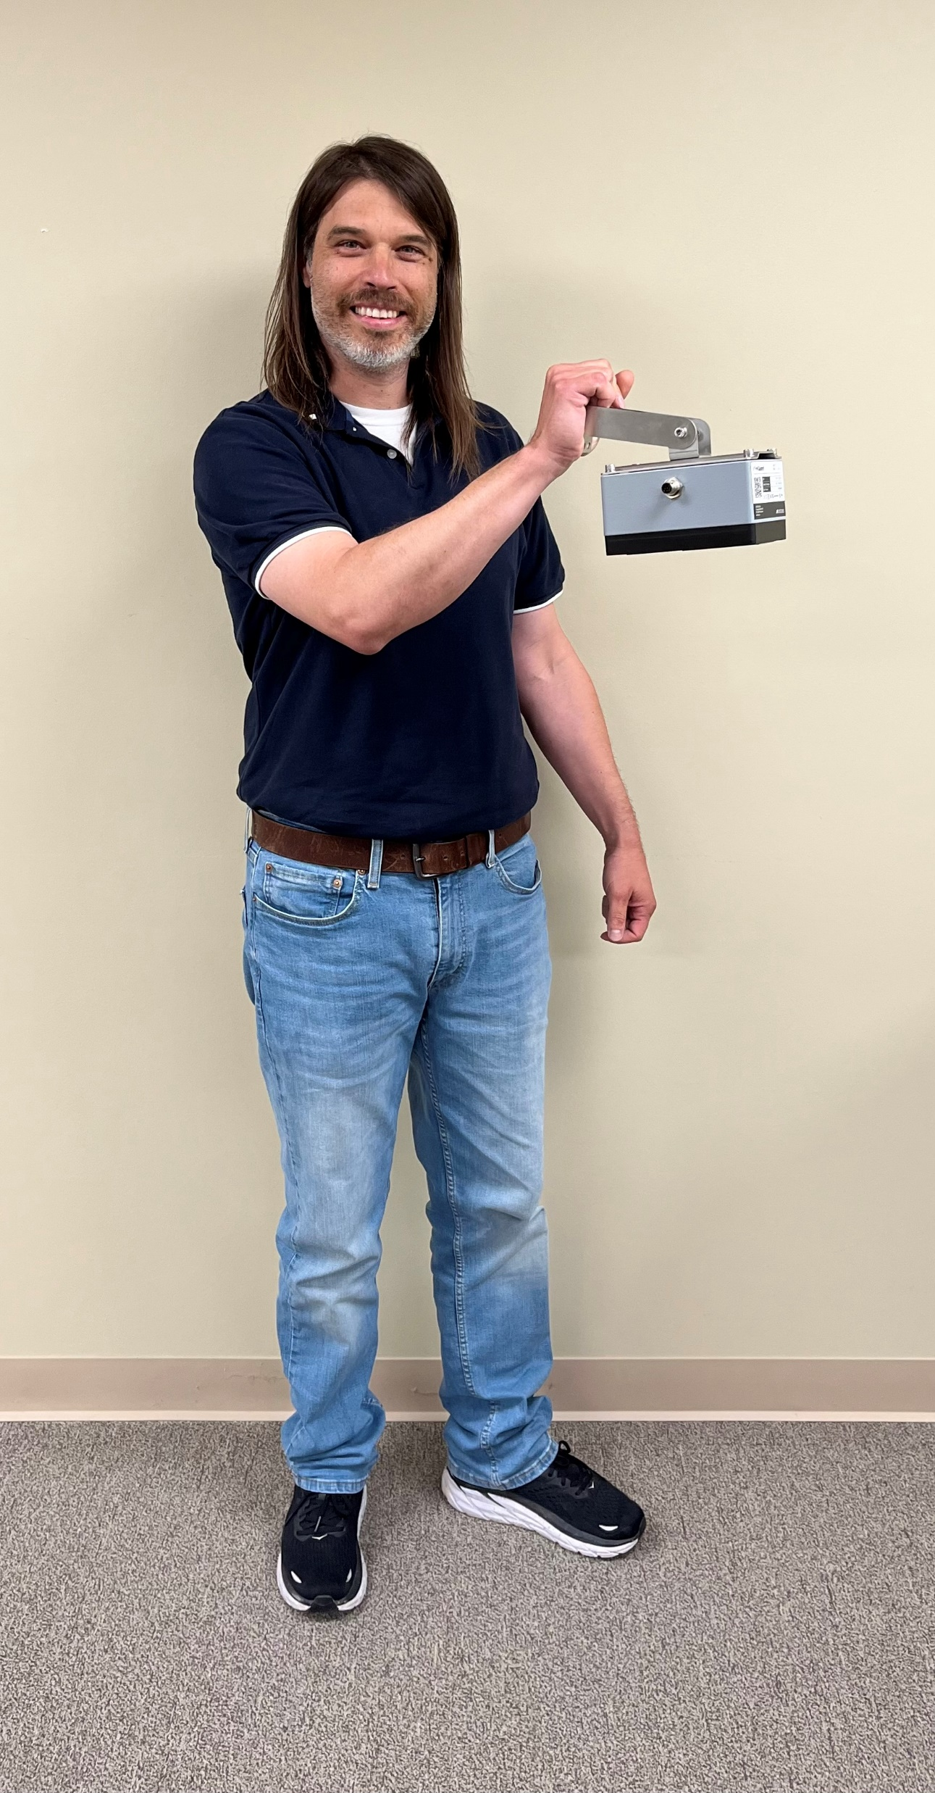
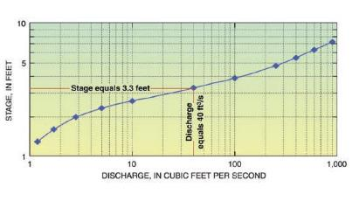
Evolution in Discharge Measurement
ADCP Deconstruction
New Streamflow Sensor
(being tested in 2025)
USGS Stage-Discharge Rating
Stage height
k-factor to adjust
surface velocity
to get mean velocity
Numerous Measurements
1 - 2 Measurements
No need for roughness
Jody Avant, USGS

Slide 11
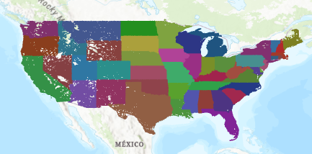
All Roads Network of Linear Referenced Data (ARNOLD)
Used by the states to report condition of roadways to the federal government
All 2D road lines
Route labeling varies from state to state

Slide 12


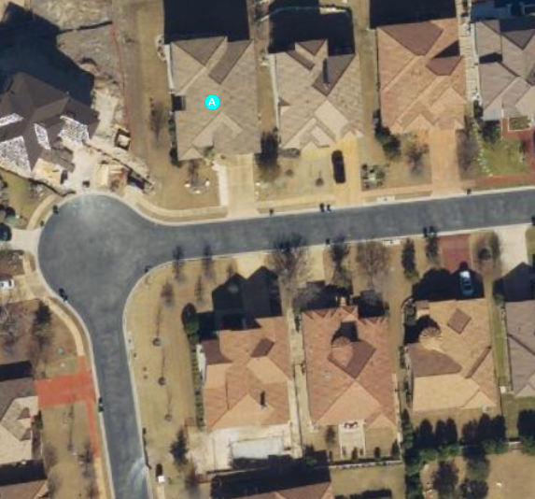
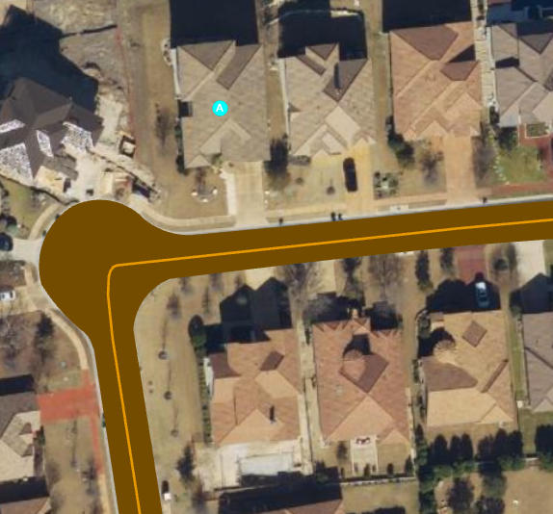
Ecopia Roads at my Home
TNRIS 6” Imagery licensed by TxDOT
Ecopia Polygons and Centerlines

Slide 13

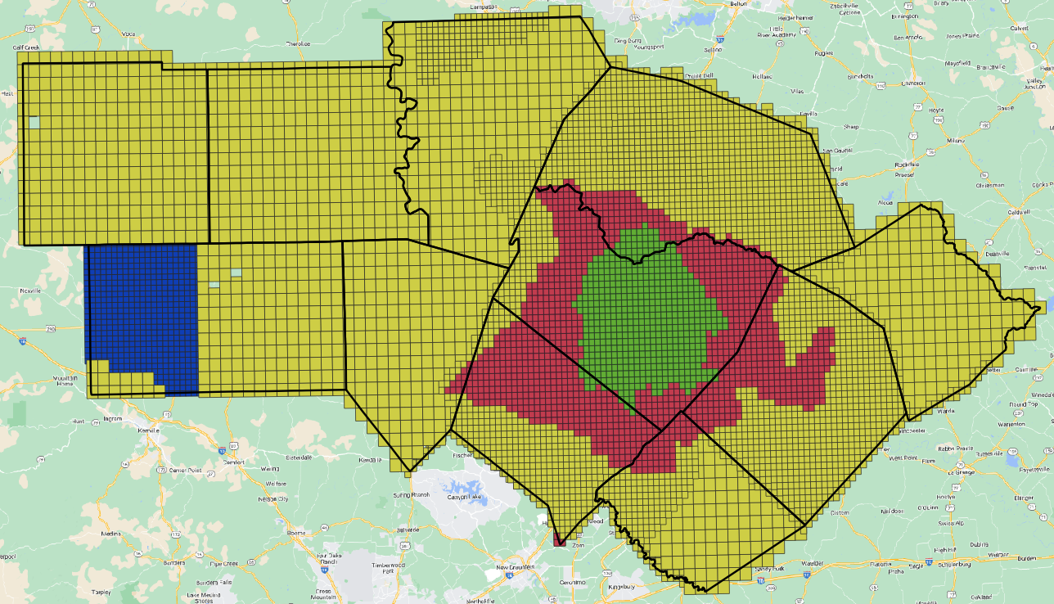
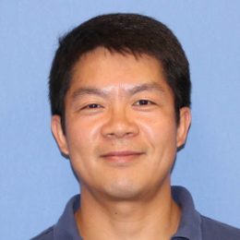
LIDAR Data Collections TxDOT Austin District
10,012 tiles
1.5 TB of data
Yan Liu
Overlay these on Ecopia Road Polygons
and extract the most recent LIDAR points
Roads are 1.6% of the landscape here

Slide 14
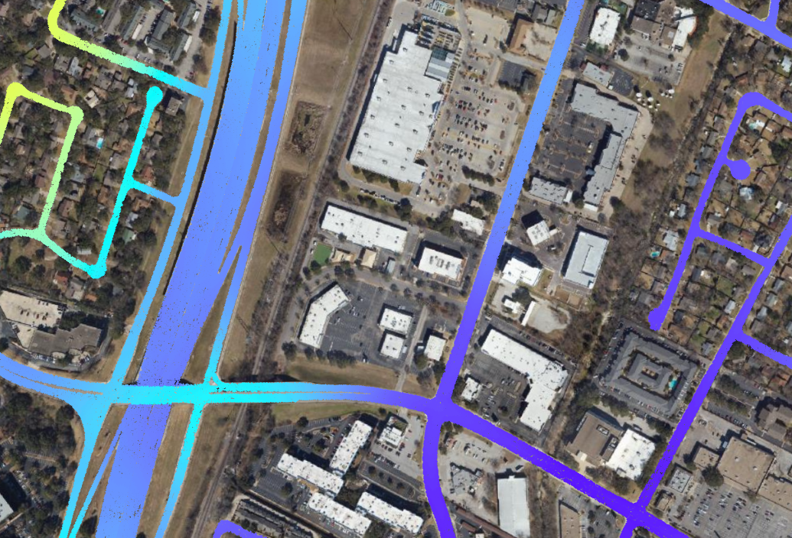

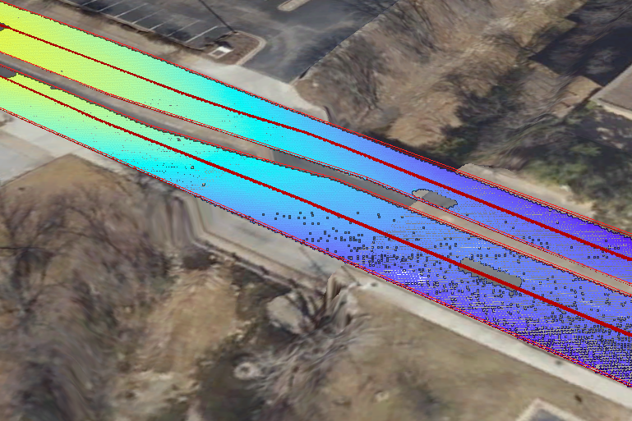
Road Elevation Model: LIDAR points plus 3D Road Polygon and Centerline
Elevation Points
3D Road Polygon and Centerline
Mopac
Shoal
Creek
Anderson Lane
On average, 20 LIDAR
points per square meter of road surface in this data collection

Slide 15
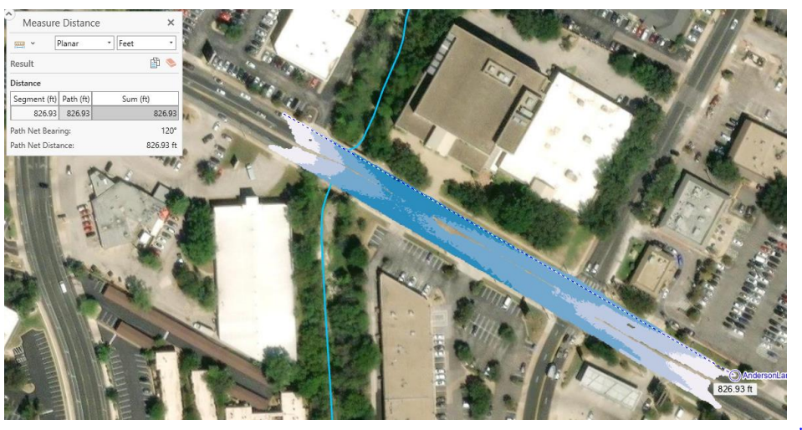
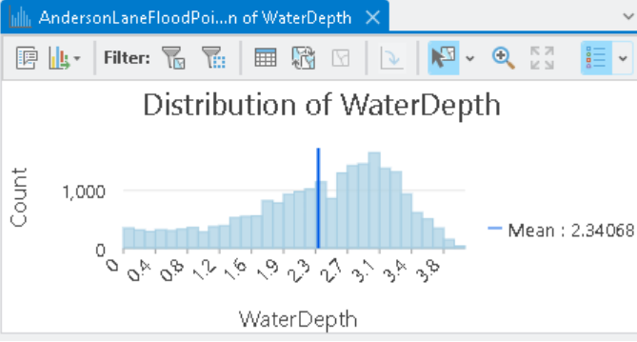
Road Inundation Map using LIDAR Points
Anderson Lane at Shoal Creek in Austin, Texas

Slide 16
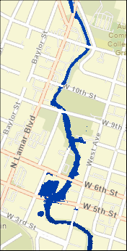
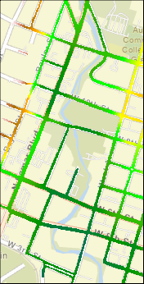
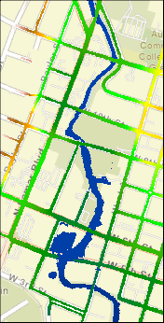
Flood Inundation Mapping with Hydraulic Models
water surface
elevation
road elevation
road flooding

Slide 17



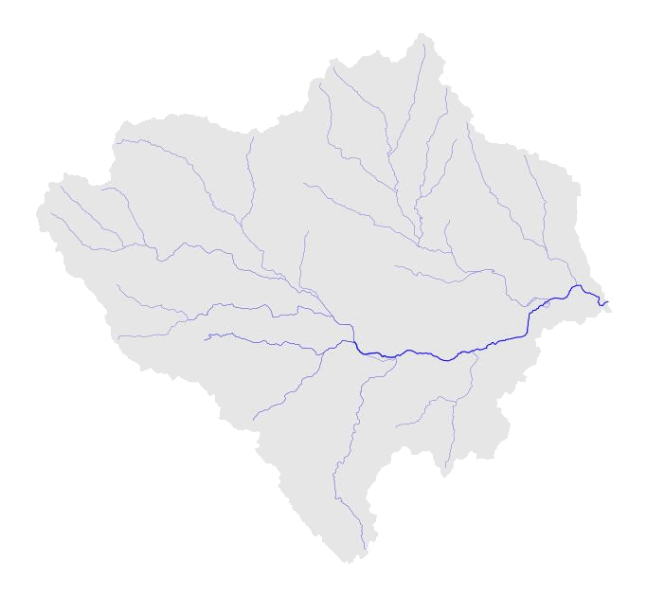
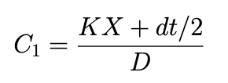
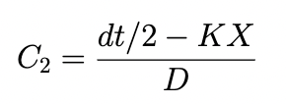
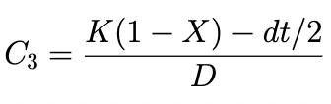
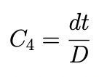

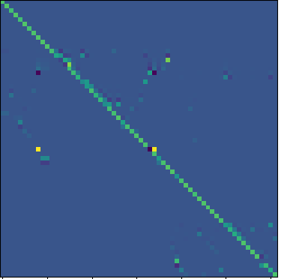
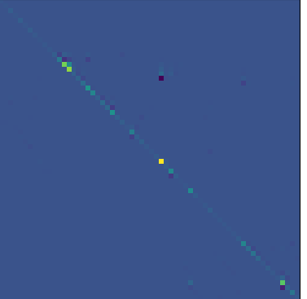
Data Assimilation Combines Measurements and Forecasting
Muskingum routing scheme:
Matt Bartos, UT Austin and Jeil Oh
State-space simulation
State-space Muskingum Method (matrix form):
=
Q^{t}
+
q^{t}
Q^{t+1}
A
B
Allows us to rapidly simulate multiple forecasts and their probability distributions!

Slide 18
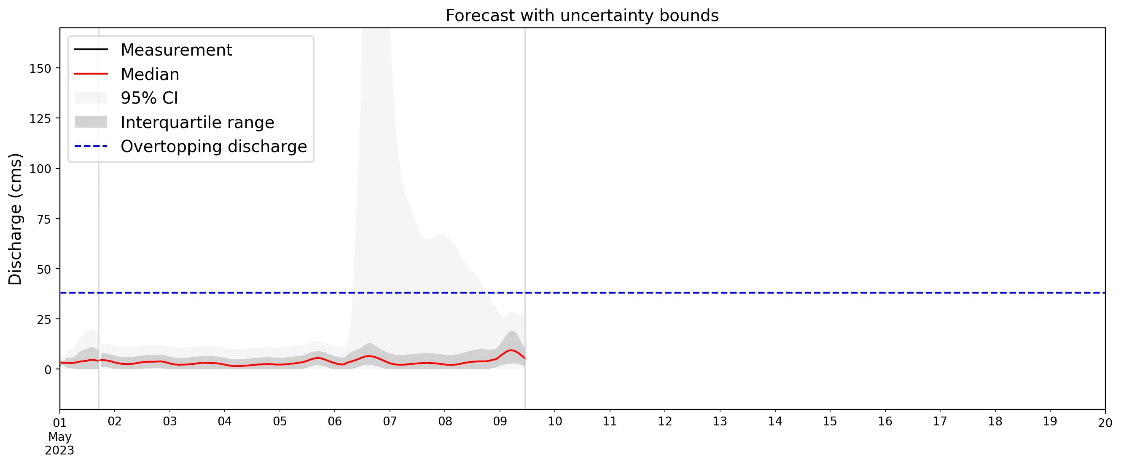







Adding uncertainty to the model, we get probabilistic forecasts
state-space Muskingum model for flood forecast i
Random vectors:
$$x_{i}^{t+Δt}=Ax_{i}^{t}+Bu_{i}^{t}+w_{i}^{t}$$
$$w_{i}^{t}\sim 𝒩(0, Q_{i})$$
Input uncertainty
$$y_{i}^{t+Δt}=Cx_{i}^{t+Δt}+v_{i}^{t+Δt}$$
$$v_{i}^{t}\sim 𝒩(0, R_{i})$$
Measurement uncertainty
probability distribution of states of model member i
$$x_{i}^{t+Δt}\sim 𝒩(μ_{i}^{t+Δt},Σ_{i}^{t+Δt})$$
Mean:
$$μ_{i}^{t+Δt}=Ax_{i}^{t}+Bu_{i}^{t}$$
Covariance:
$$Σ_{i}^{t+Δt}=AΣ_{i}^{t}A^{T}+Q_{i}$$
total probability distribution over all models obtained through kernel density estimation

Slide 19
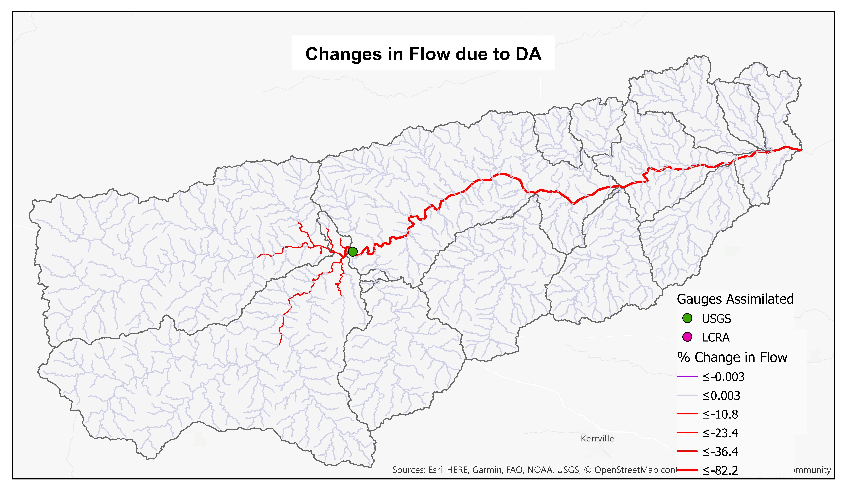
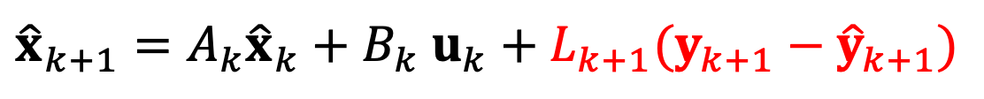
Kalman Filter applies a ‘correction’ to the runoff input at every timestep
$${\hat{x}}_{k+1}=A_{k}{\hat{x}}_{k}+B_{k} u_{k}+L_{k+1}(y_{k+1}−{\hat{y}}_{k+1})$$
(open-loop model)
(correction)
11 gauges
1 gauge

Slide 20
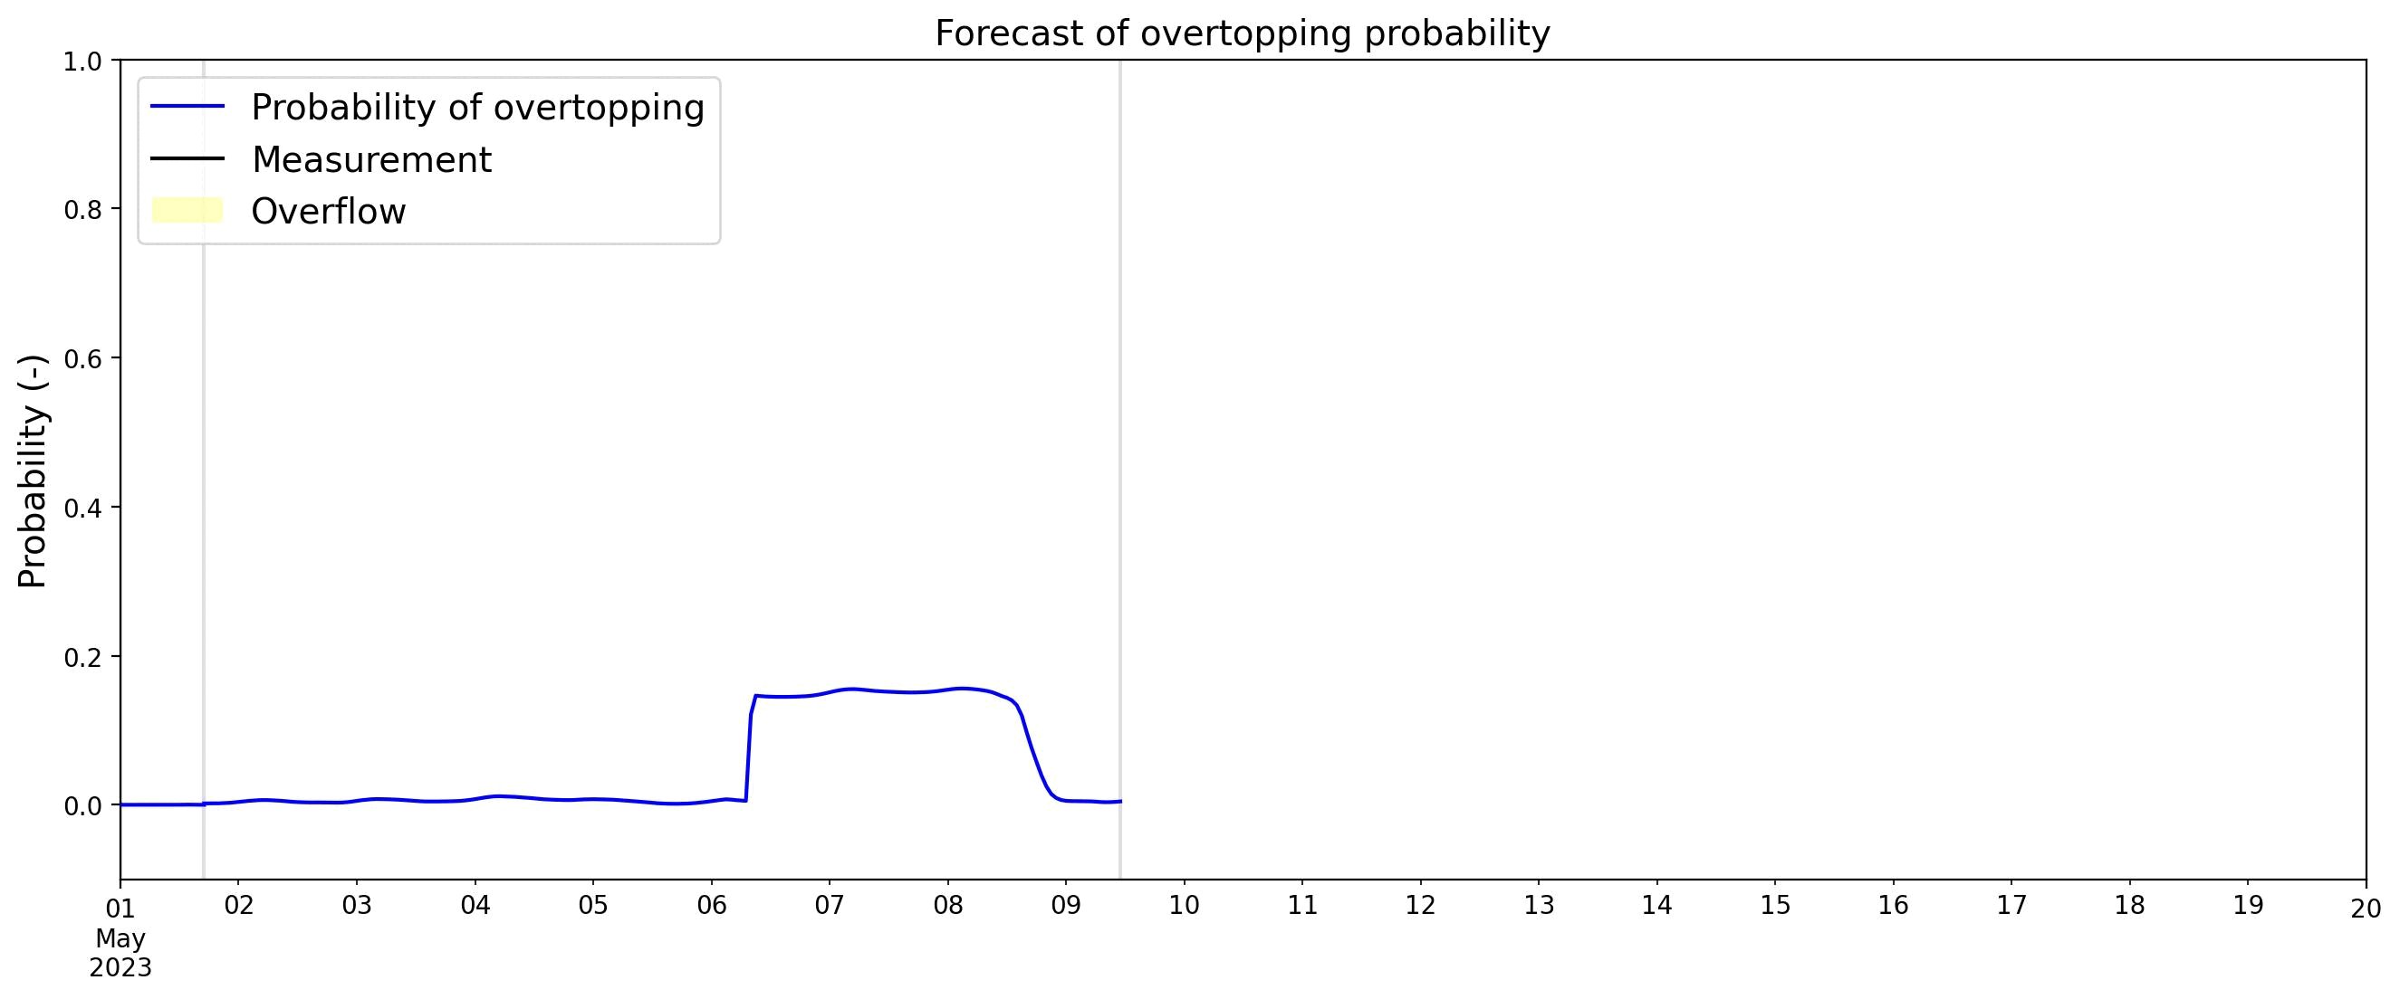
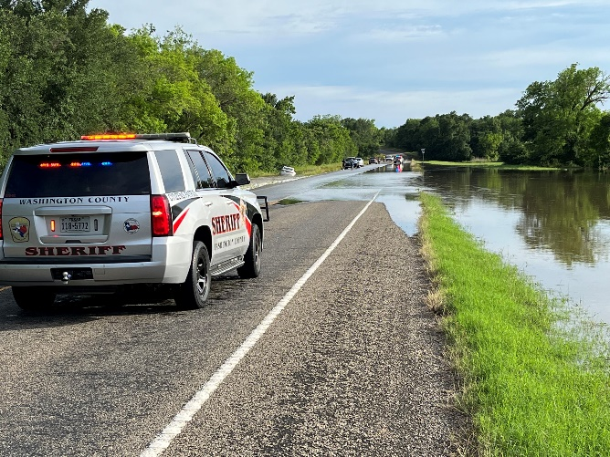
Forecast of Probability of Road Overtopping
081111110 – New Year Ck at FM 1155 nr Chappel Hill, TX
1
Probability
0
May, 2023

Slide 21
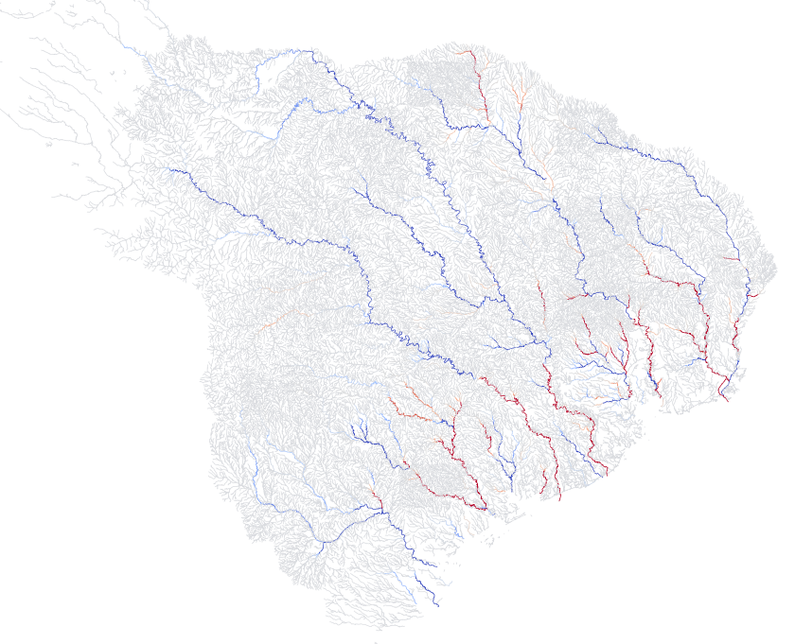
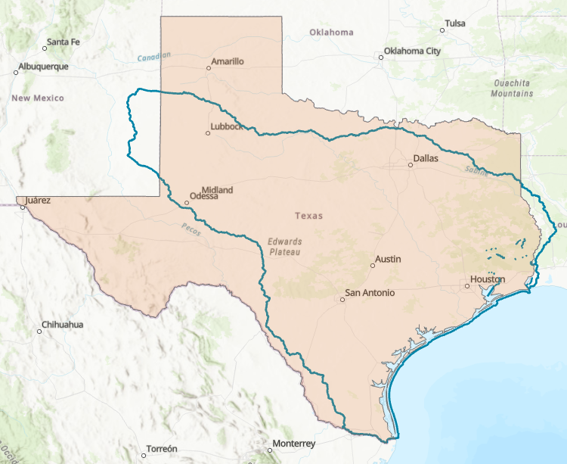
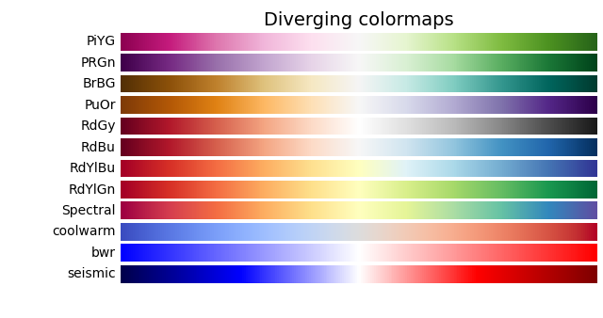
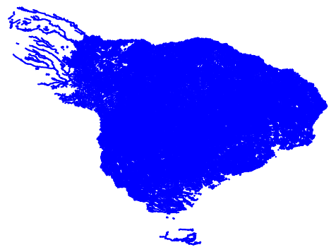
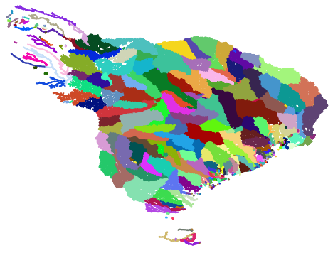
Scaling Data Assimilation to Multiple River Basins
Data assimilation based on
Kalman Filtering extended to entire
USGS water resource region 12
(70,000 stream reaches)
Positive correction
Scaling facilitated by new parallelization scheme using HUC8 units.
USGS water resource region 12
Negative correction

Slide 22
Flood Impact on the Road Transportation System
Three innovations:
Streamflow measurement using velocimetry
Road Elevation Model
Data Assimilation to link measurements
and forecasting

