Slide 1
HydroShare for River Channels
Presentation made to the HydroShare Research team 16 April 2013
Stephen Jackson
David Maidment
Tim Whiteaker
Center for Research in Water Resources
University of Texas at Austin

Slide 2
HydroShare
HydroShare is an National Science Foundation project linking cyberinfructure and hydrology in association with the Consortium of Universities for the Advancement of Hydrologic Science, Inc (CUAHSI)
The goals of this project are to:
develop sustainable cyberinfrastructure for better access to data and models;
to enable the hydrologic and other communities to collaborate and combine data and models from multiple sources, and to thus transform the way hydrologic knowledge is created and applied;
provide new opportunities for information integration at a scale that was previously inconceivable to hydrology researchers.
http://www.cuahsi.org/HydroShare.aspx

Slide 3
HydroShare – Channel
From the NSF project proposal: “As an exemplar for advancing data access, we will establish a national repository within HydroShare for river channel cross section data: a new data type not presently supported by CUAHSI HIS. Since 2003, the United States has spent more than $2 billion on digital flood map modernization. A great deal of river channel cross-section, morphology and hydraulic modeling data has been developed to support this mapping and some of that could be repurposed to advance water science. This repository will include a mechanism for voluntary submission of information and it will provide access to this data in a standard way such that it is easy to run hydraulic models that use this data on either local or HPC environments.”

Slide 4
HydroShare Resources
A first description of the types of data being stored in HydroShare are:
Point Observations: These include time series of Hydrologic observations that conform to either the Observations Data Model (ODM) (e.g., a set of time series in a database) or WaterML (a single time series) format.
Feature Data Sets: These include points, lines, or polygons with their associated attributes that conform to the ESRI shapefile data model/format.
Raster Data Sets: Raster datasets are georeferenced grids containing datasets such as land cover, elevation, elevation derivatives, etc. The initial target format for HydroShare will be the GeoTIFF format, which is a TIFF based interchange format for raster imagery.
Multidimensional Space/Time Data Sets: These include continuous space/time grids with with the initial target being Unidata/OGC’s NetCDF format.
Geochemistry/Sample-Based Observations: These include water quality and/or solid earth or other samples that may conform to the ODM 2 data model.

Slide 5
HydroShare Channel
Arc Hydro channel model
River Channel Morphology Model (Venkatesh Merwade)
HEC-GeoRAS
Floodplain mapping
SPRINT
St Venant equation computation on large networks

Slide 6
HydroShare Channel
Arc Hydro channel model
River Channel Morphology Model (Venkatesh Merwade)
HEC-GeoRAS
Floodplain mapping
SPRINT
St Venant equation computation on large networks

Slide 7
Arc Hydro Data Model
Drainage System
Hydro Network
Flow
Time
Time Series
Hydrography
Channel System

Slide 8
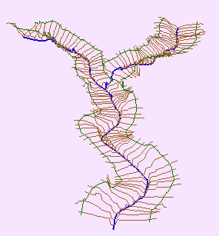
Channel Cross-Section
Direction of Flow
Channel
Cross-Section
Notes:
Before we get into detail let’s quickly define a channel and a cross-section. A river of stream Channel is a conduit or water course carrying water flow under gravity.
A Cross-Section refers to the section of a channel taken normal to the direction of the flow.

Slide 9
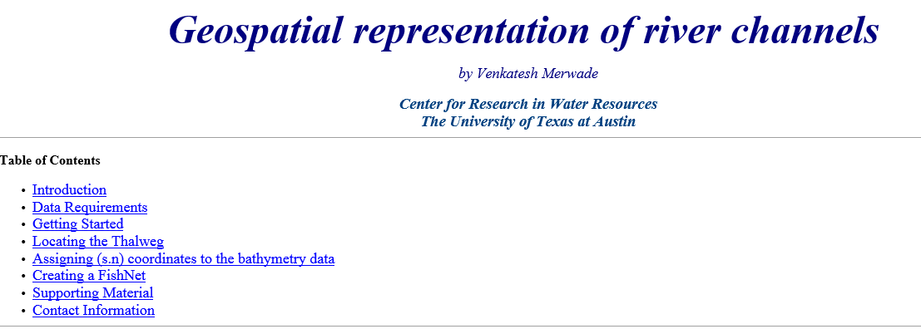
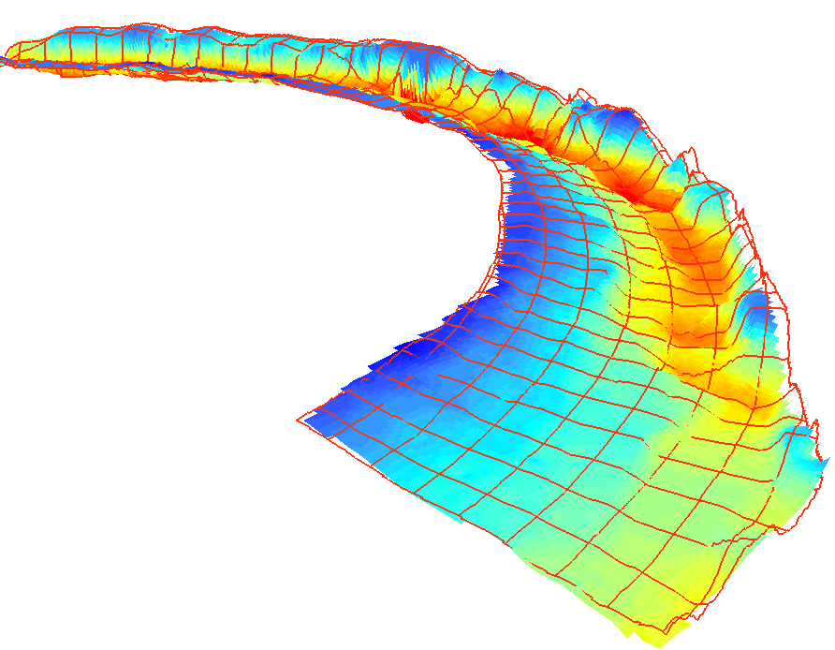
River Channel Morphology Model

Slide 10
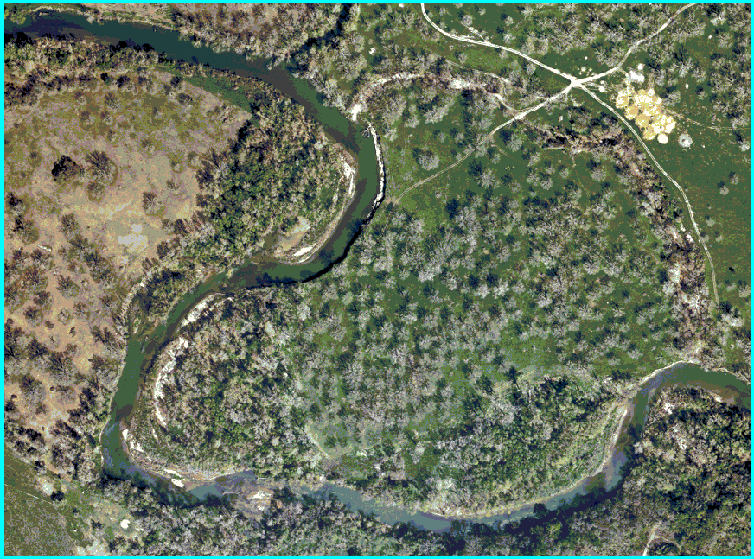
Study Area (Guadalupe river near Seguin, TX)
1/2 meter Digital Ortho Photography

Slide 11
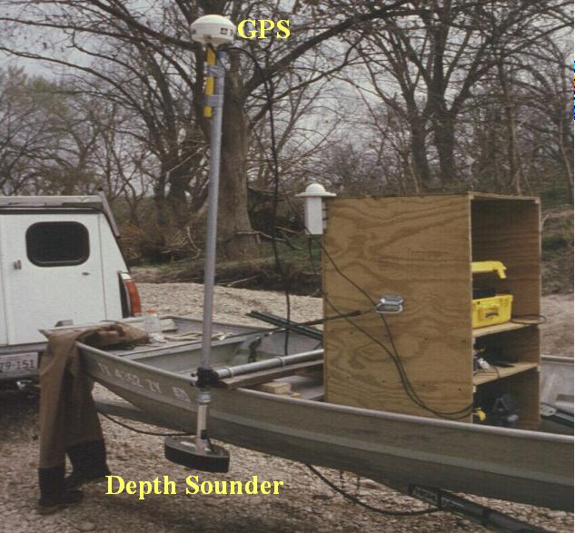
Boat setup for data collection

Slide 12
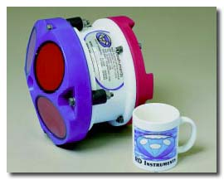
Accoustic Doppler Current Profiler
Provides full profiles of water velocity and direction in the ocean, rivers, and lakes. Also used for discharge, scour and river bed topography.

Slide 13
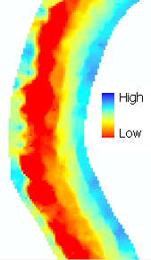
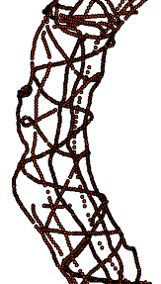
Data analysis
Centerline/Thalweg
Cross-sections
ProfileLines
Start with points
Create surface from points
Extract all the necessary information
How do we do this…….

Slide 14
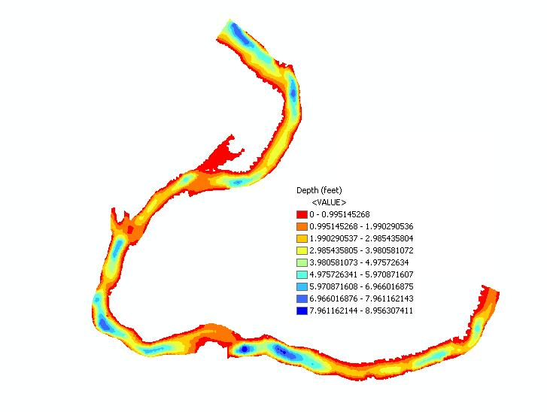
Interpolation
Points are interpolated in ArcMap to produce a continuous surface.

Slide 15
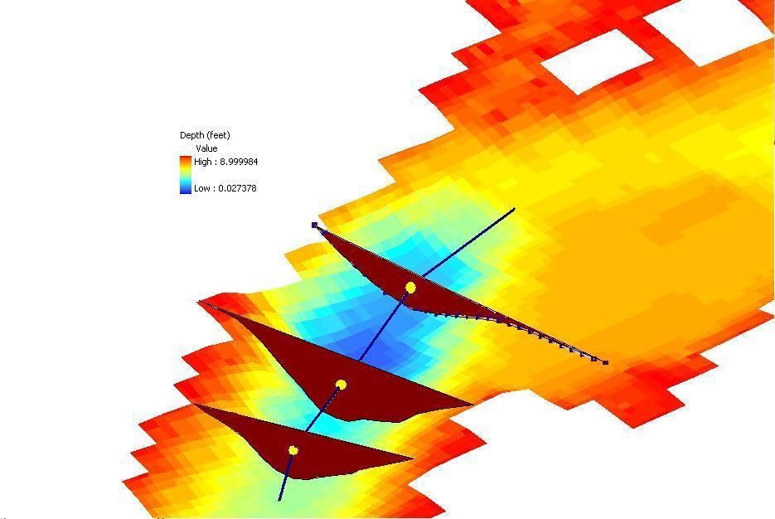
Centerline
Define the centerline along the thalweg of the channel

Slide 16
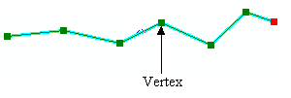
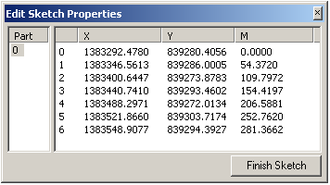
Measure in ArcGIS
Measures are assigned in meters
54.37
154.41
0
281.36
A PolylineM can store m-values at each vertex along with x and y coordinates.

Slide 17
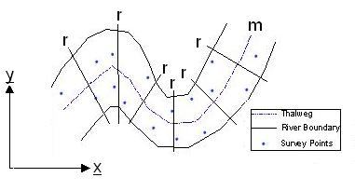
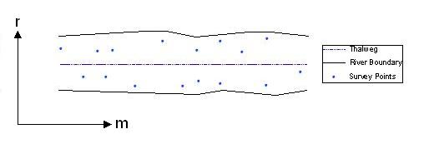
Coordinate Transformation
m is measure along the centerline
r is distance across the river from the centerline
Sinuous river becomes straight when transformed into (m,r) co-ordinates.

Slide 18
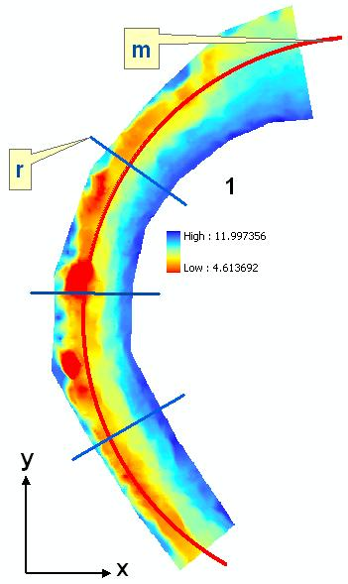
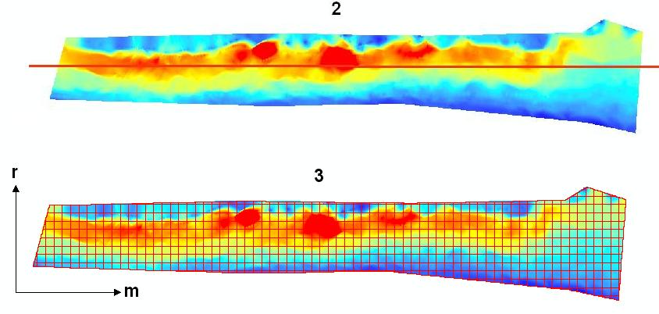
Coordinate Transformation
Straightened river
Profile line and cross-sections
Sinuous river

Slide 19
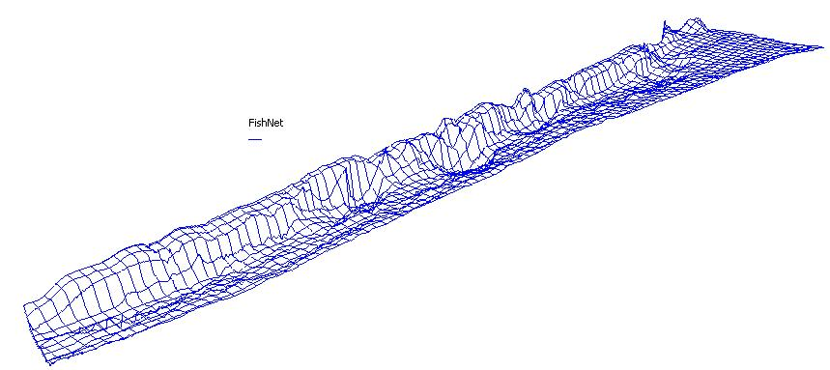
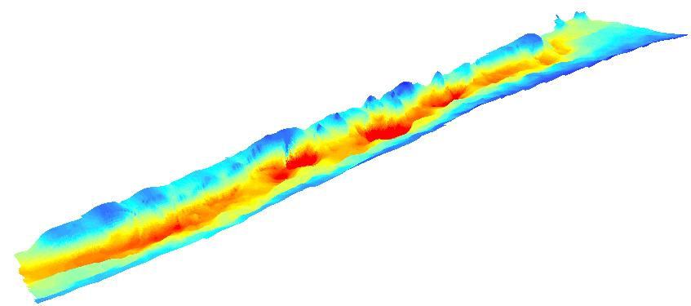
Straightened River in 3D

Slide 20
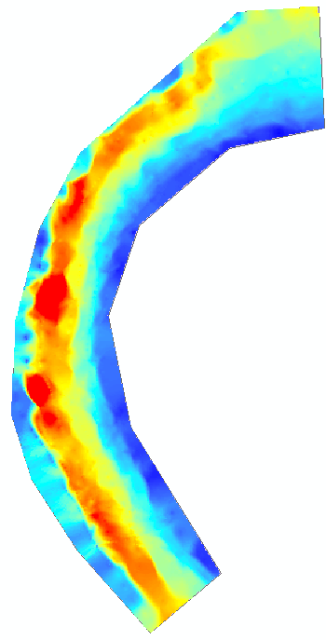
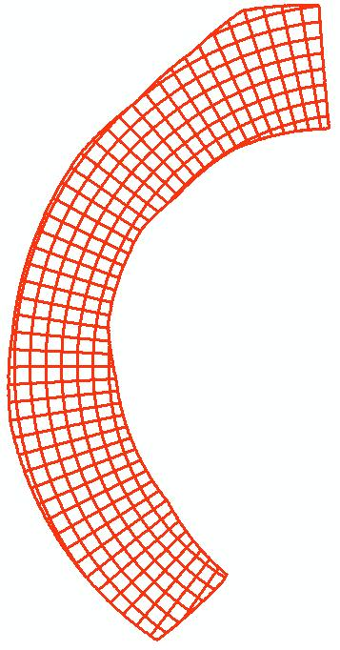
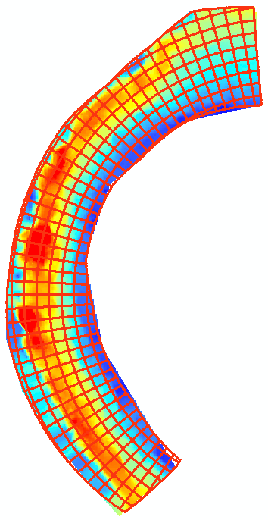
Data back to x,y coordinates
Original river in X,Y
Profile lines and cross-sections in (x,y) created using FishNet in (m,r).

Slide 21
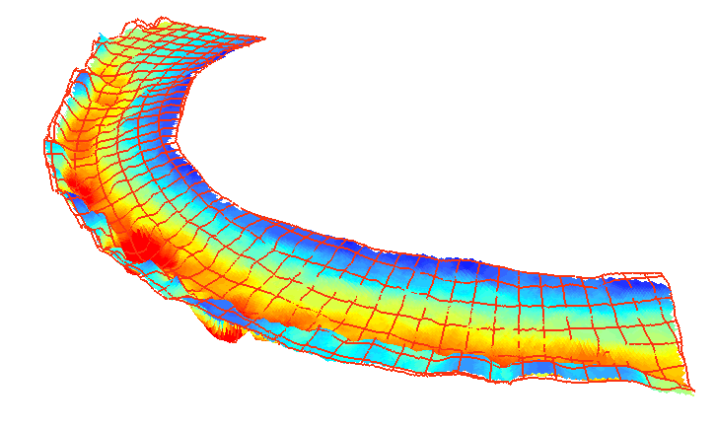
Profile Lines and Cross Sections in 3D
Each point has five dimensions: x, y, z, r, m
Geographic (x, y, z)
Hydraulic (r, m, z)

Slide 22
HydroShare Channel
Arc Hydro channel model
River Channel Morphology Model (Venkatesh Merwade)
HEC-GeoRAS
Floodplain mapping
SPRINT
St Venant equation computation on large networks

Slide 23
HEC-GeoRAS

Slide 24
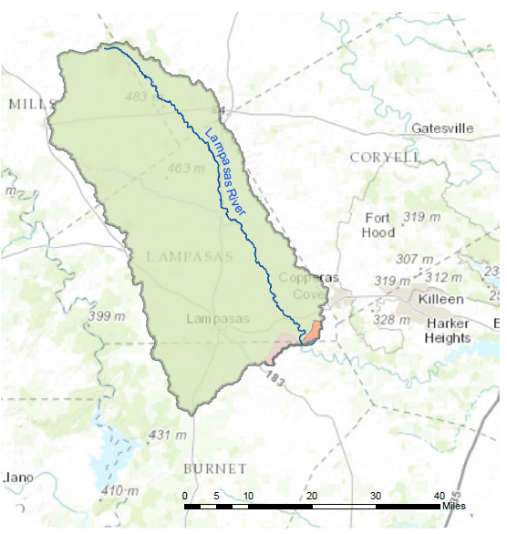
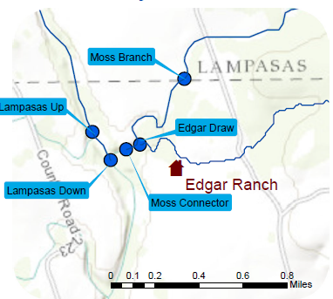
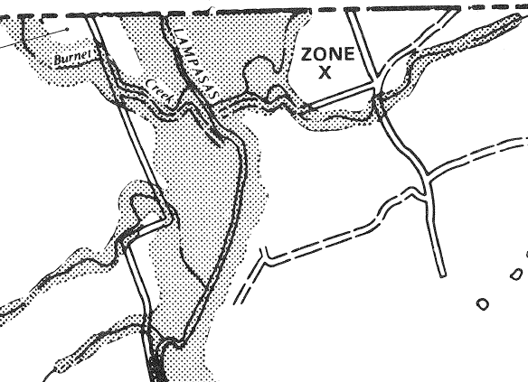
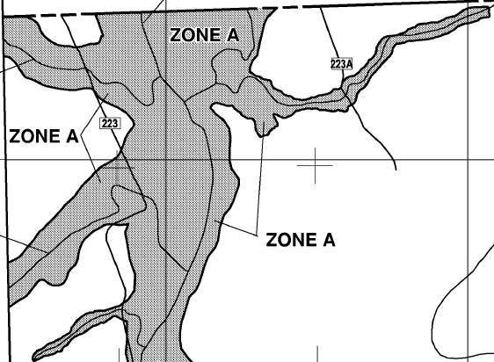
Edgar Ranch: Case Study
Edgar Ranch
1990 FEMA Floodplain
2012 FEMA Floodplain

Slide 25
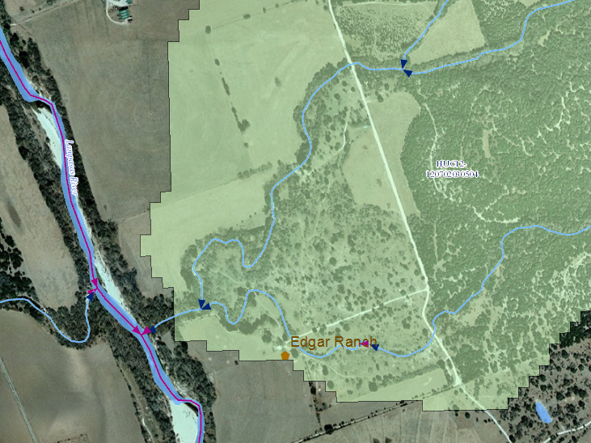
Local Streams
Moss Branch
100K NHD
Edgar Draw
24K NHD

Slide 26
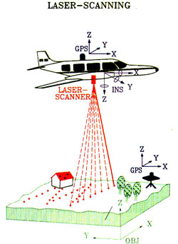
LIDAR
Light Detection and Ranging
Light pulse (laser) mounted on fixed wing aircraft or helicopter
Multi-return technology
Multiple measurements per pulse
“Penetrating” ability
Average spacing, 1.4m to 0.25m

Slide 27
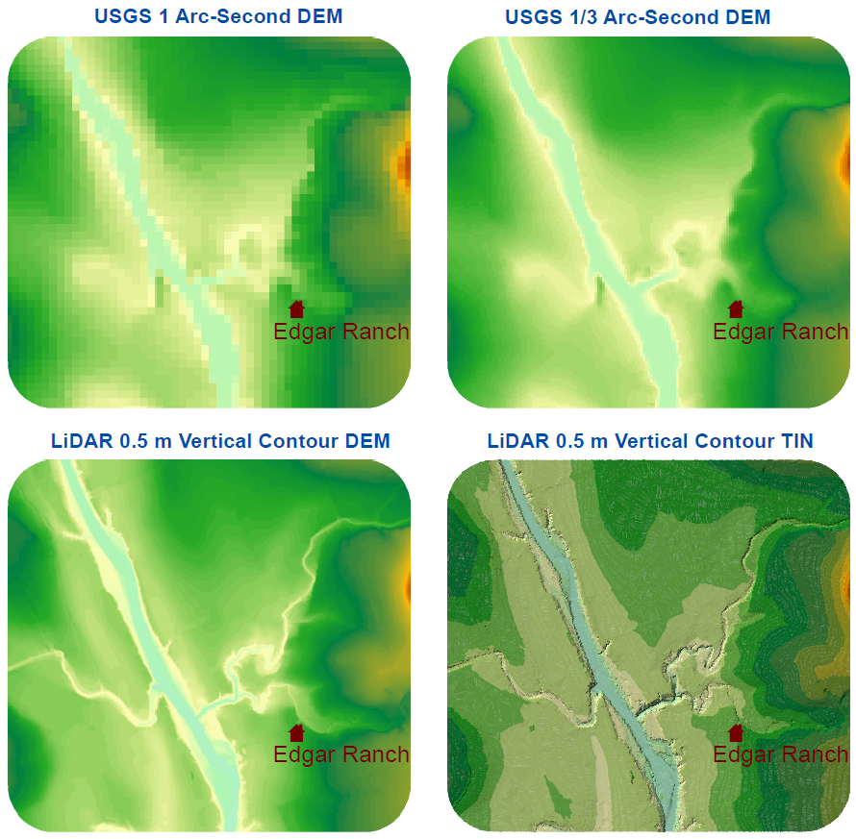
Terrain Comparison

Slide 28
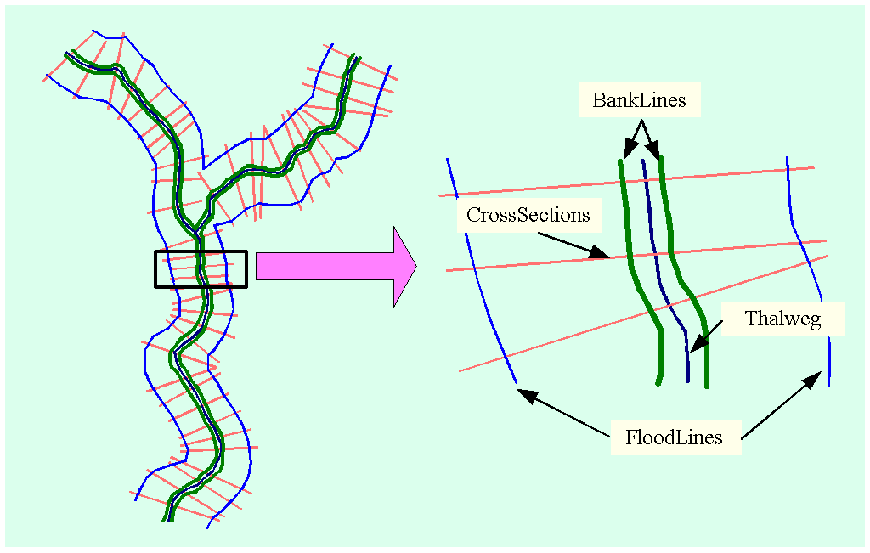
Channel ProfileLines in HEC-GeoRAS
Notes:
It is important to relate other features such as embankments and the extent of inundation with the main channel itself and see everything as an integrated system rather than as individual components. An embankment profile provides useful information regarding breaches or identifies the location of possible overspilling. Historical flood extent information is very useful for checking the validity of a flood model. These longitudinal view of channel features are stored as ProfileLines in this model. These are linear features. Currently five different features are supported such as Thalweg, left and right banks, left and right flood lines. ProfileLines and CrossSections are linked through Channel_ID.

Slide 29
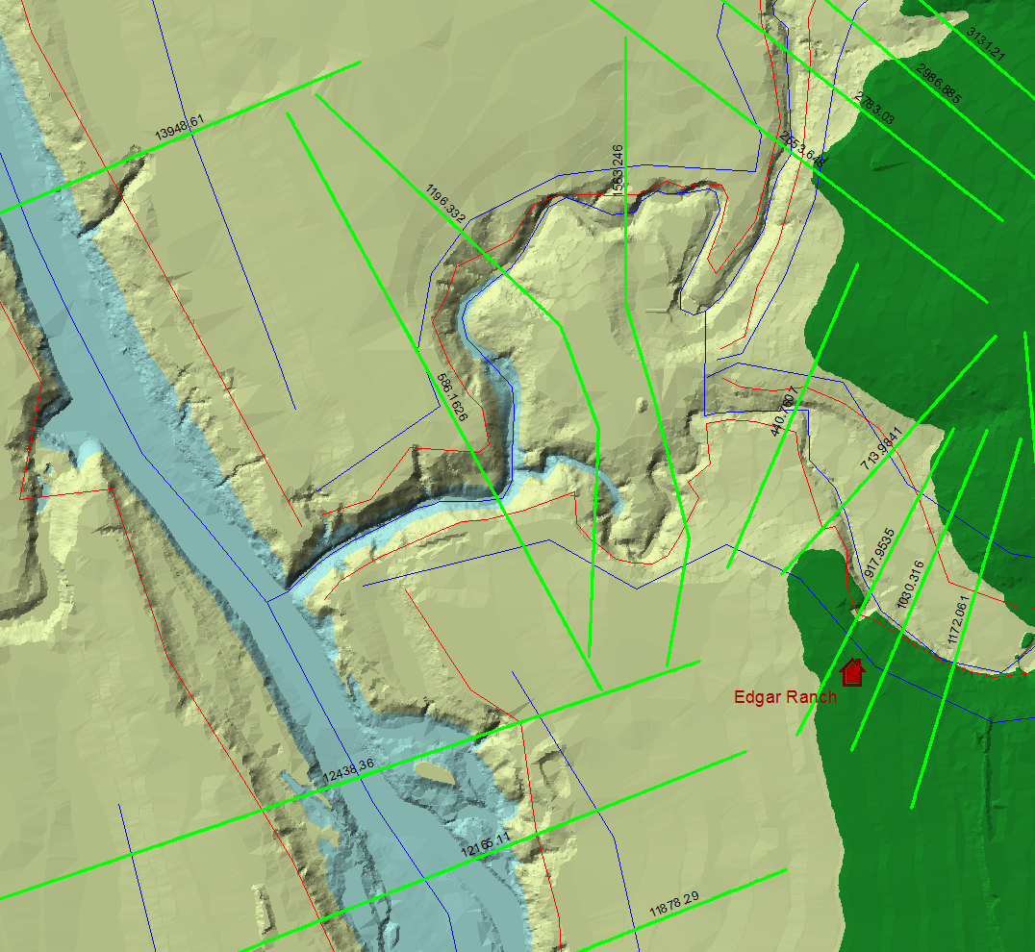
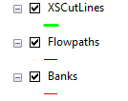
HEC-GeoRAS Model – Input to RAS
Cross Section Geometry and Attributes as Shapefiles

Slide 30
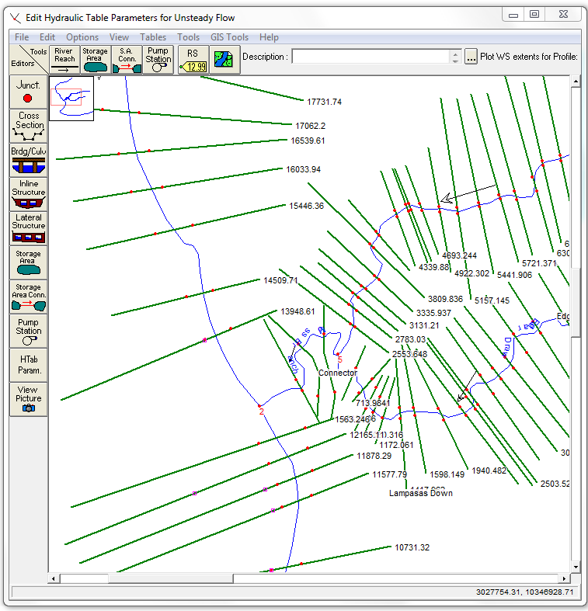
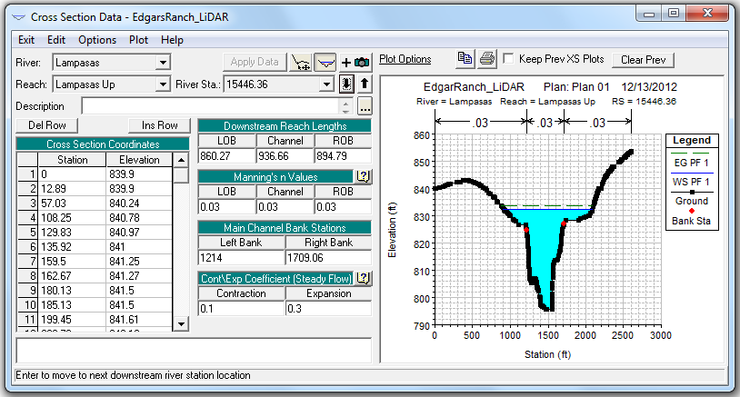
HEC-RAS Model – Computes Water Surface Elevation given the Discharge
Cross Section Data
Georeferenced Cross Sections

Slide 31
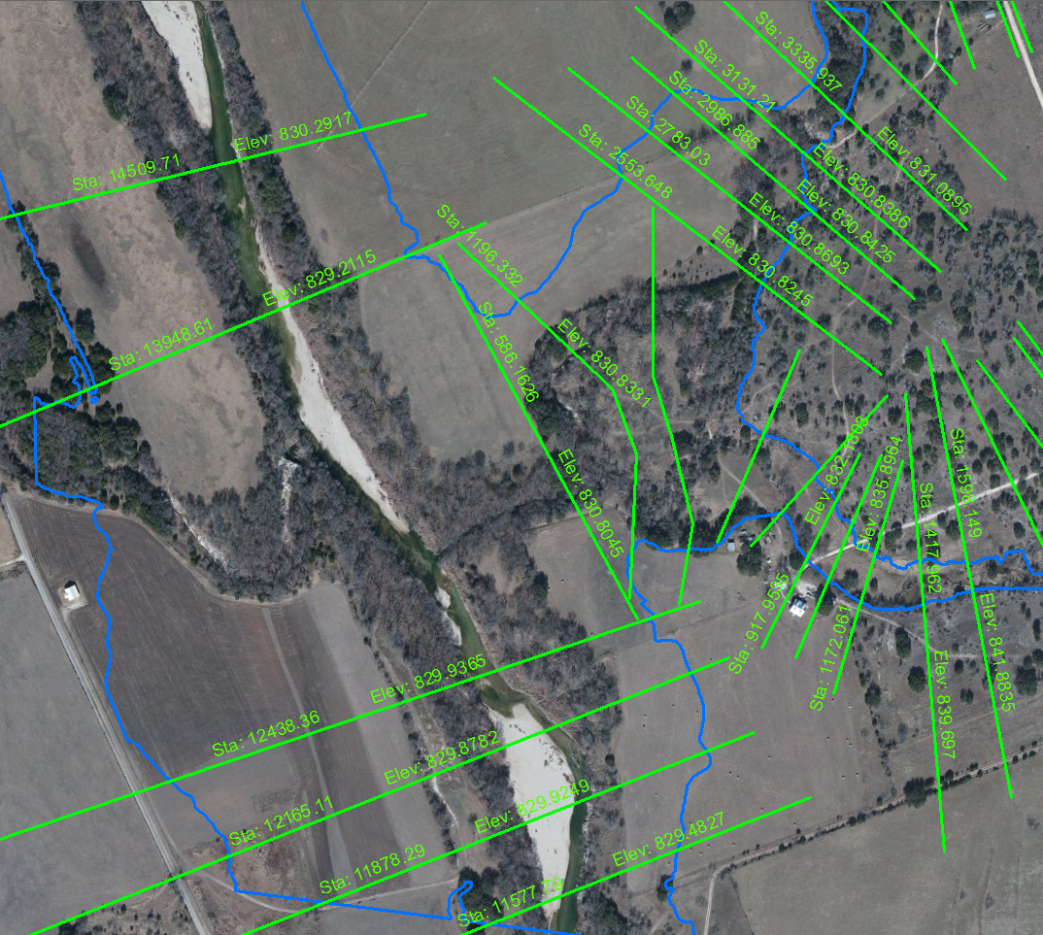
Floodplain Results – Output from RAS in HEC-GeoRAS
Floodplain Results as both Cross Section and Polygon Shapefiles

Slide 32
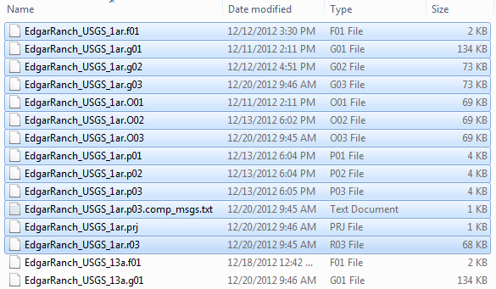
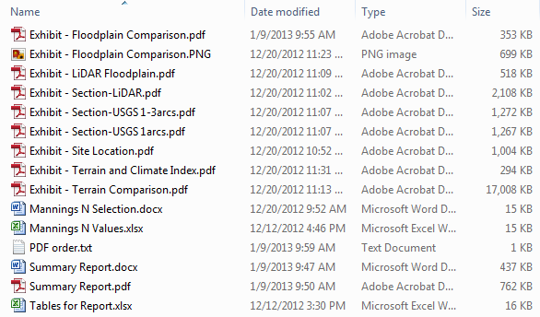
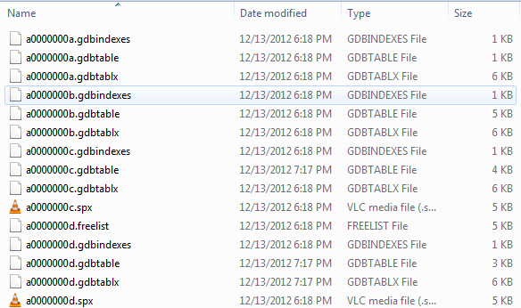
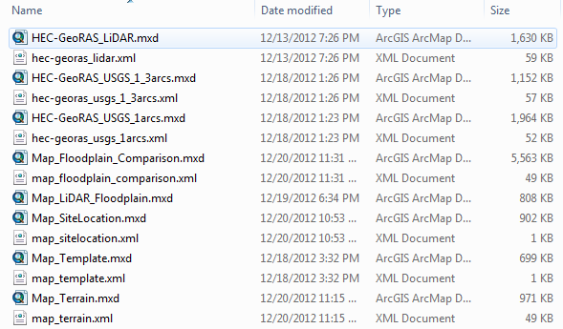
Project File Structure
HEC-RAS Model
Reports and Supplemental Files
Geodatabases (shapefiles and terrain)
Map Files

Slide 33
TINs based on Z-tolerance (Erin Atkinson)
“Sta/Elev” = number of vertices in the cross-section
Z-tol = 0.00’
Sta/Elev = 1792
Z-tol = 0.25’
Sta/Elev = 541
Z-tol = 0.50’
Sta/Elev = 223
Z-tol = 0.75’
Sta/Elev = 156
Z-tol = 1.00’
Sta/Elev = 110

Slide 34
Profile Comparisons – smoothed profiles give nearly the same result

Slide 35
HydroShare Channel
Arc Hydro channel model
River Channel Morphology Model (Venkatesh Merwade)
HEC-GeoRAS
Floodplain mapping
SPRINT
St Venant equation computation on large networks

Slide 37
VLSI simulation models for electric circuit design…..
….. adapted to apply to river networks

Slide 38
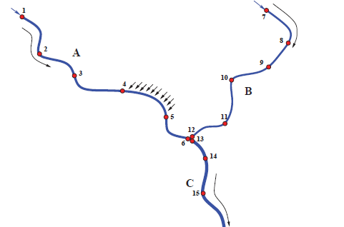
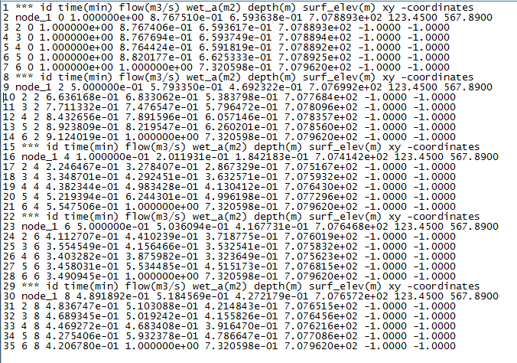
SPRINT
SPRINT (Simulation Program for RIver NeTworks) is an high performance river network simulator developed at IBM Research Austin. It provides fully dynamic solutions to large scale St Venant equations, from large networks of river branches.
Network of Nodes
SPRINT Output
(Water Depth at each node at each time step)

Slide 39
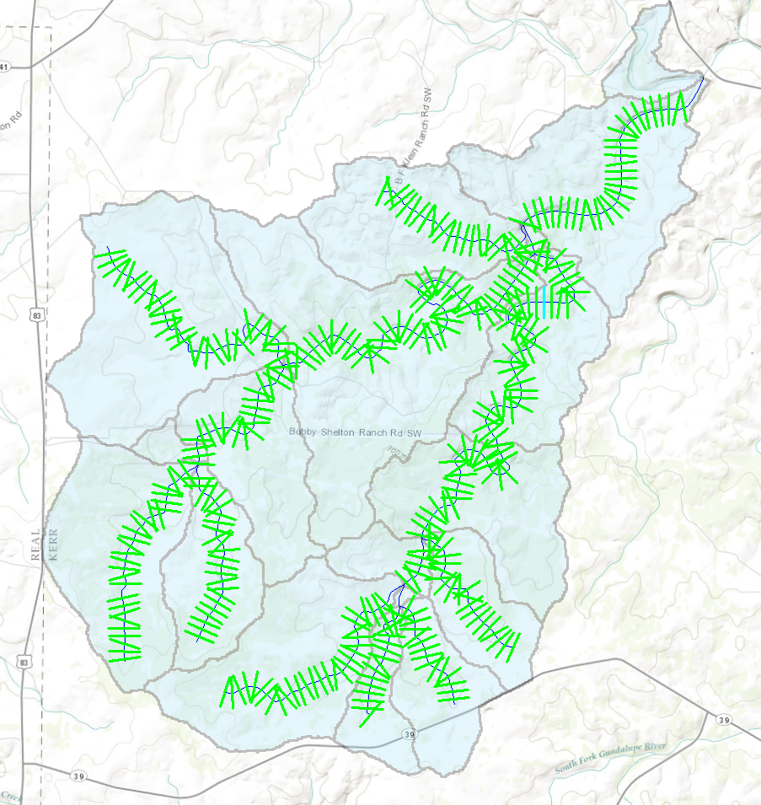
Merging HEC-GeoRAS and SPRINT
Combine Strengths
HEC-GeoRAS
Network Creation
Cross Section Generation
Elevation and Attribute Extraction
Georeferencing
Visual Representation
SPRINT
Dynamic WSEL Modeling of very large networks
Regional HEC-GeoRAS Model with Automated Cross Sections

Slide 40
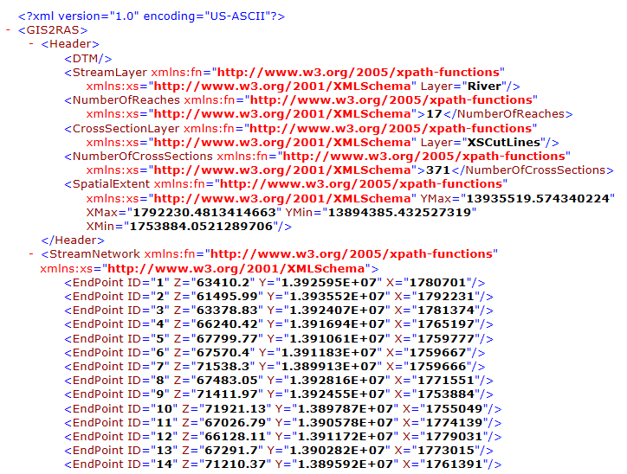
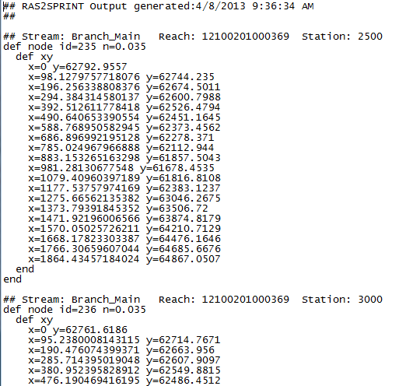
HEC-GeoRAS to SPRINT
Conversion
Script
(Under
Development)
HEC-GeoRAS Geometry Output (XML)
SPRINT Geometry Input (txt)
Channel System

Slide 41
Discussion
How far do we want to go?
Cross-sections and a stream center line?
Cross-section and profile line mesh?
DEM data for channel and floodplain surface?
TIN data for channel and floodplain surface?
What coordinate systems do we want to support?
Do we do “smoothed” flow mesh or “rough” information interpreted directly from LIDAR?
Do we add hydraulic geometry?
Functions interrelating Q, V, h, A, R, n
Do we seek to extend NHD to 3D?
Build 3D channels around existing or modified flow centerlines
Is this for academic use only or do we solicit data and collaboration from government and industry?

Slide 42
Tentative Conclusions
Take small, simple steps to achieve progress
Really two separate problems
Storing a project scale database about river channels in a small area in HydroShare
Developing a landscape-scale representation for river channels
The XML interchange between HEC-RAS and HEC-GeoRAS is a channel description similar in concept to WaterML1.0 for time series data
This could be developed into an OGC-compliant language called RiverML to facilitate exchange of river channel information

