Slide 1
HydroShare Channel
Stephen Jackson, David Maidment and David Arctur
2 July 2013
Presentation to HydroShare Research Team

Slide 2
HydroShare Channel
From the NSF project proposal: “As an exemplar for advancing data access, we will establish a national repository within HydroShare for river channel cross section data: a new data type not presently supported by CUAHSI HIS. Since 2003, the United States has spent more than $2 billion on digital flood map modernization. A great deal of river channel cross-section, morphology and hydraulic modeling data has been developed to support this mapping and some of that could be repurposed to advance water science. This repository will include a mechanism for voluntary submission of information and it will provide access to this data in a standard way such that it is easy to run hydraulic models that use this data on either local or HPC environments.”

Slide 3
Tentative Conclusions – 16 April 2013
Take small, simple steps to achieve progress
Really two separate problems
  Storing a project scale database about river channels in a small area in HydroShare
  Developing a landscape-scale representation for river channels
The XML interchange between HEC-RAS and HEC-GeoRAS is a channel description similar in concept to WaterML1.0 for time series data
This could be developed into an OGC-compliant language called RiverML to facilitate exchange of river channel information

Slide 4
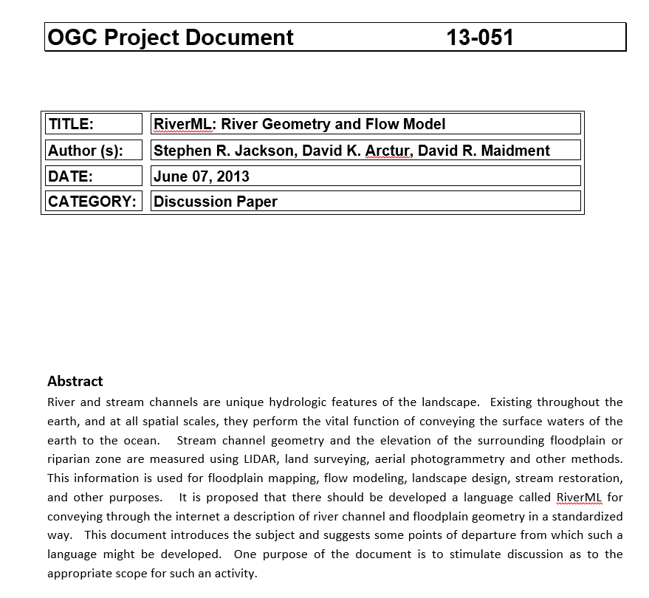
RiverML Discussion Paper
Produced for discussion at the Quebec meeting of the OGC/WMO Hydrology Domain Working Group
June 7, 2013
http://external.opengis.org/twiki_public/pub/HydrologyDWG/QuebecWorkshop2013/RiverML_Version_0.3.docx

Slide 5
WMO – OGC
Hydrology Domain Working Group
4th Annual Workshop
Workshop Highlights
Quebec City, Canada
17 – 21 June 2013

Slide 6
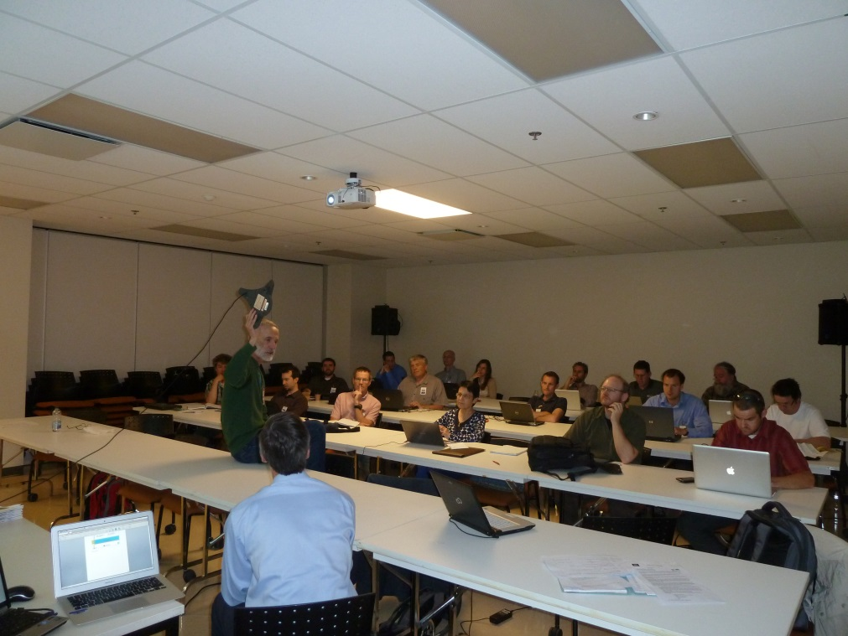
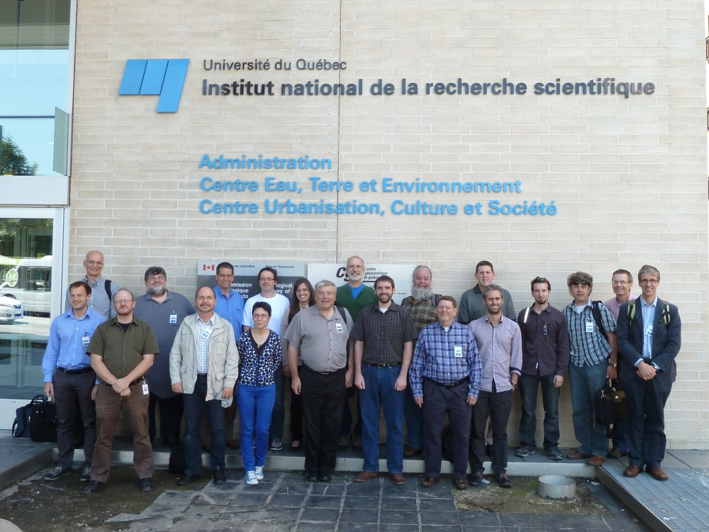
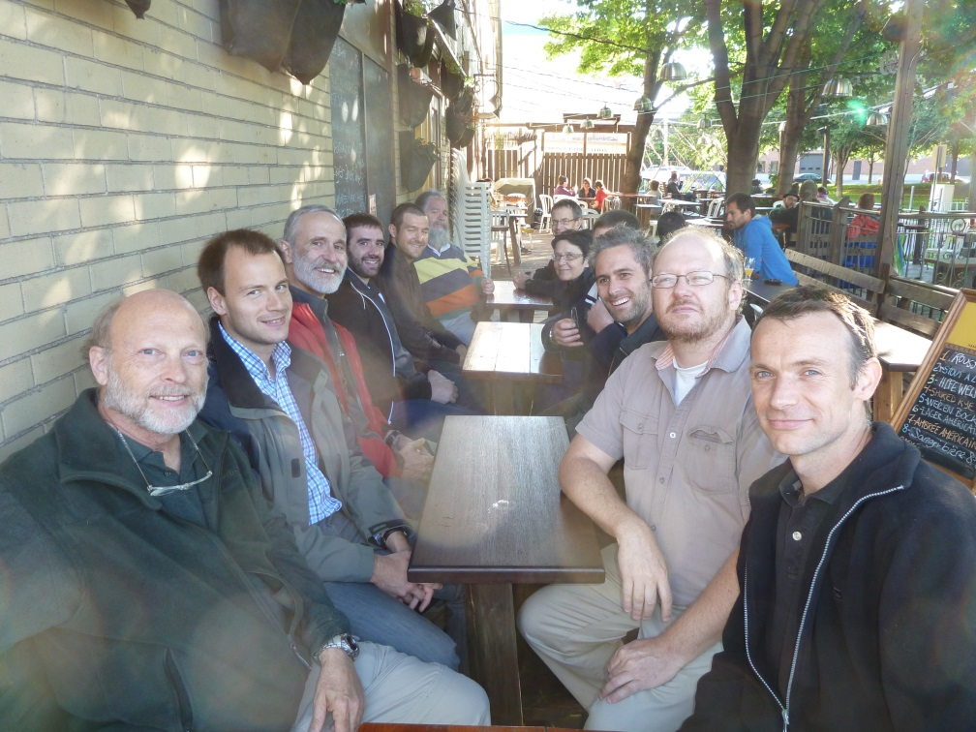
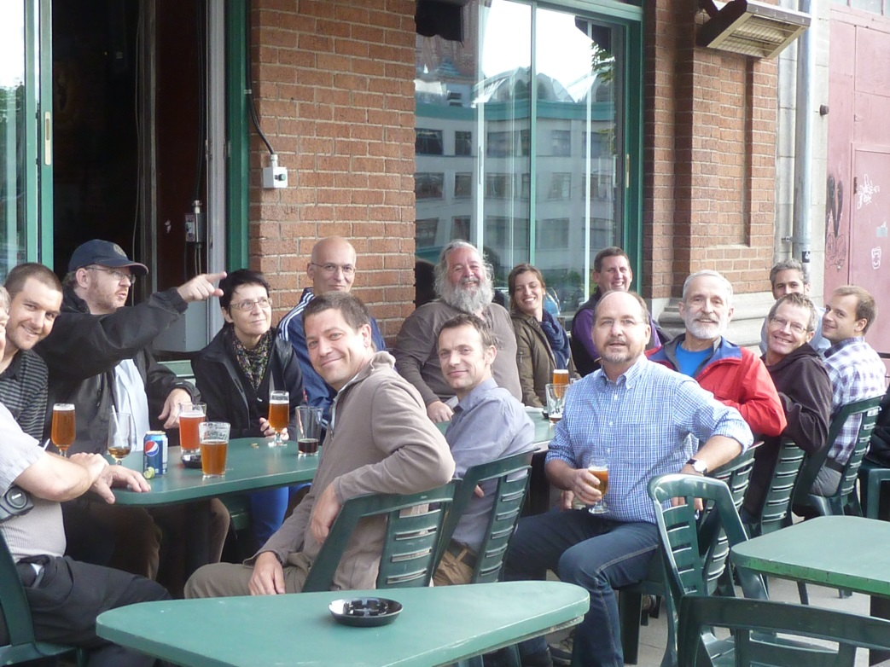

Slide 7
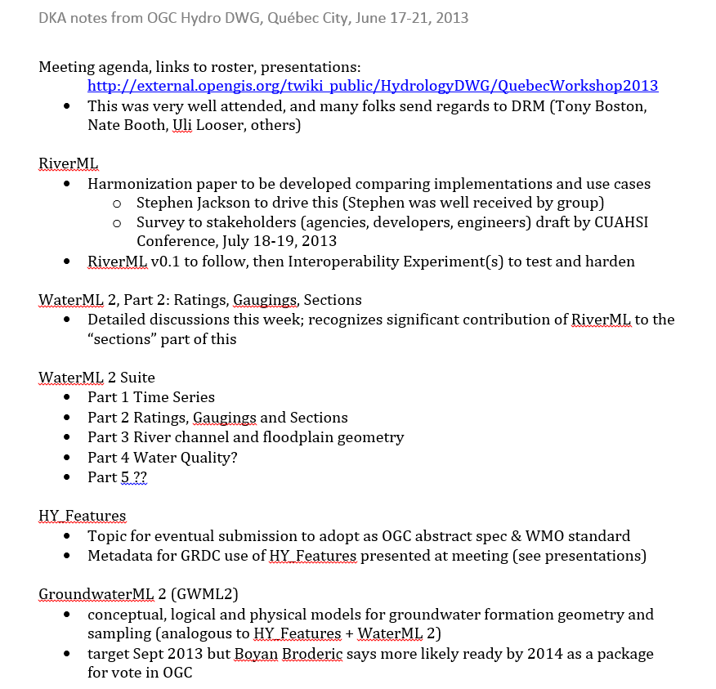
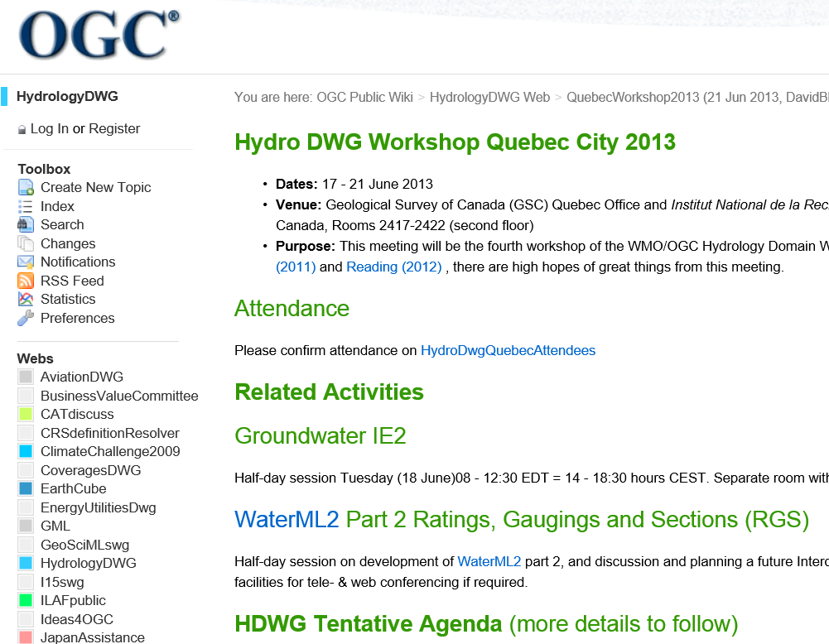
HDWG Workshop
Notes from David Arctur
http://external.opengis.org/twiki_public/HydrologyDWG/QuebecWorkshop2013

Slide 8
RiverML Roadmap
Gather Data
  CUAHSI Survey
  Software Inventory
Harmonization Paper
  Identify community goals for RiverML
  Identify common input/output parameters
  Describe approach for a harmonized core conceptual model (UML)
RiverML 1.0 UML/XML
  Focus on 1D Inundation Mapping Use Case
  Demonstrate plausible information structure
Hydroshare User Interface (RiverML 1.0)
  Demonstrate a plausible implementation
OGC Interoperability Experiment (RiverML 1.0)
  Organize a larger scale test of RiverML with multiple agency/industry participants
OGC Standards Working Group (RiverML 2.0)
  Modify based on results of Interoperability Experiment
  Expand to additional Use Cases
  Create rigorous design ready for OGC adoption
July 2013 to June 2014
2014 - 2015
2015 - 2016

Slide 9
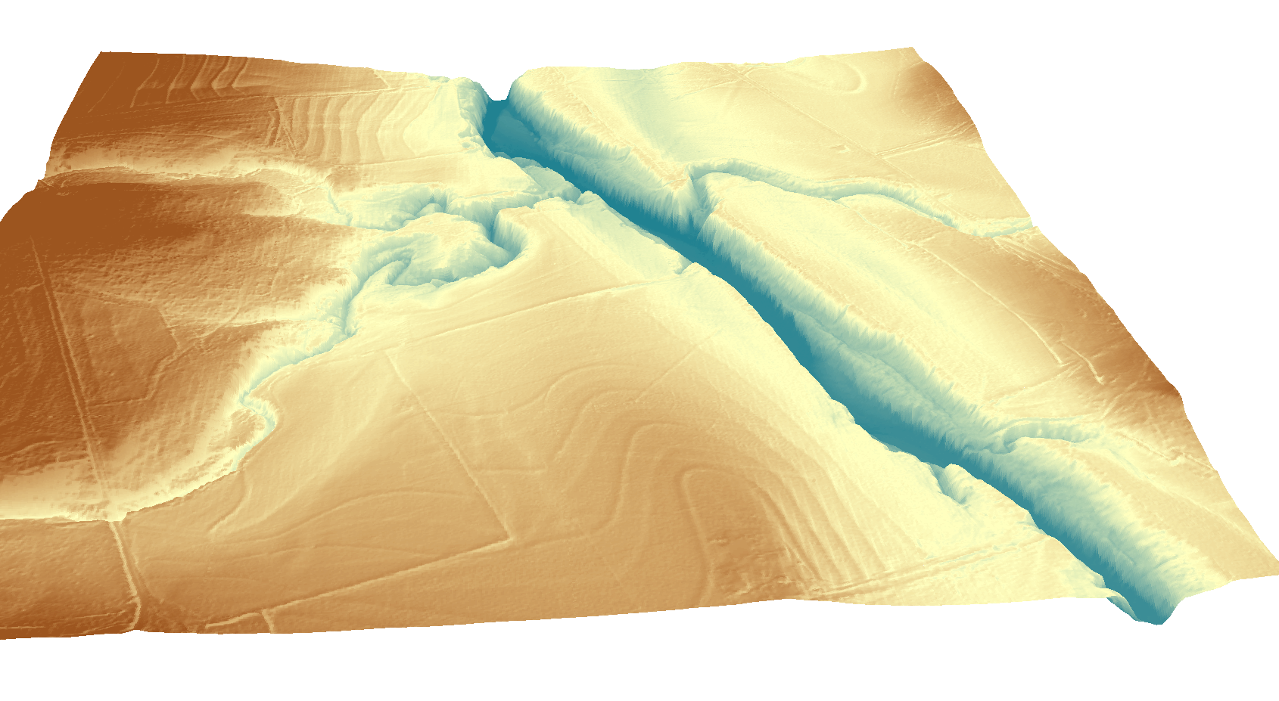
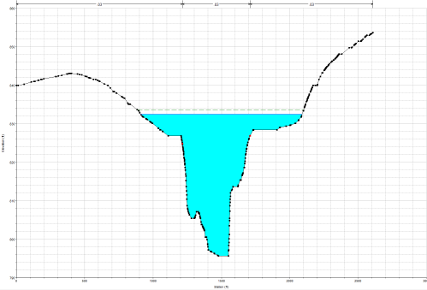
River Modeling: Proposed Workflow
RiverML
(Geometry, Catchment, River Network)
Terrain Processing Software
(ArcGIS, AutoCAD, etc.)
Hydrologic Calculation Software
(HEC-HMS, PondPack, etc.)
RiverML
(Water Surface
Elevation Observations)
RiverML
(Flow Rate Observations)
RiverML
(Geometry, River Network)
Hydraulic Calculation Software
(HEC-RAS, MIKE Flood HD, etc)

Slide 10
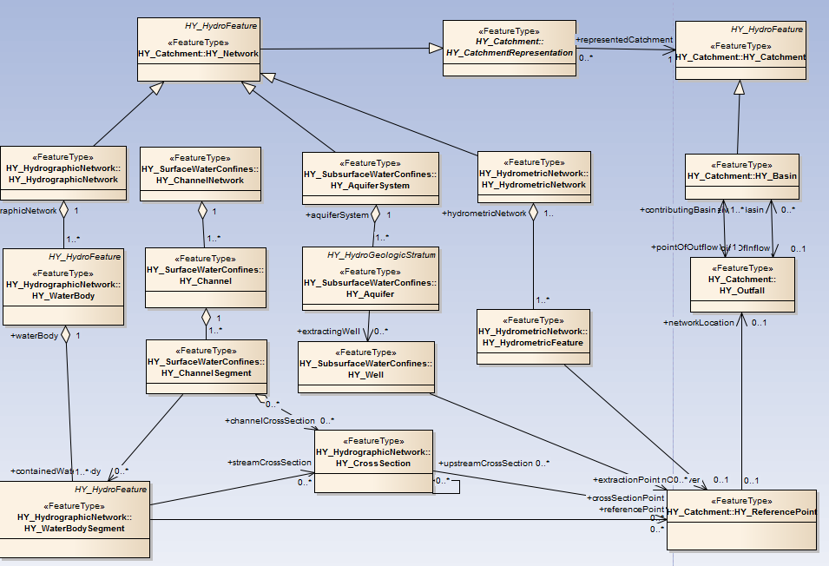
HY_Features – UML Model for Digital Watershed from GRDC
Based on International Glossary of Hydrology

Slide 11
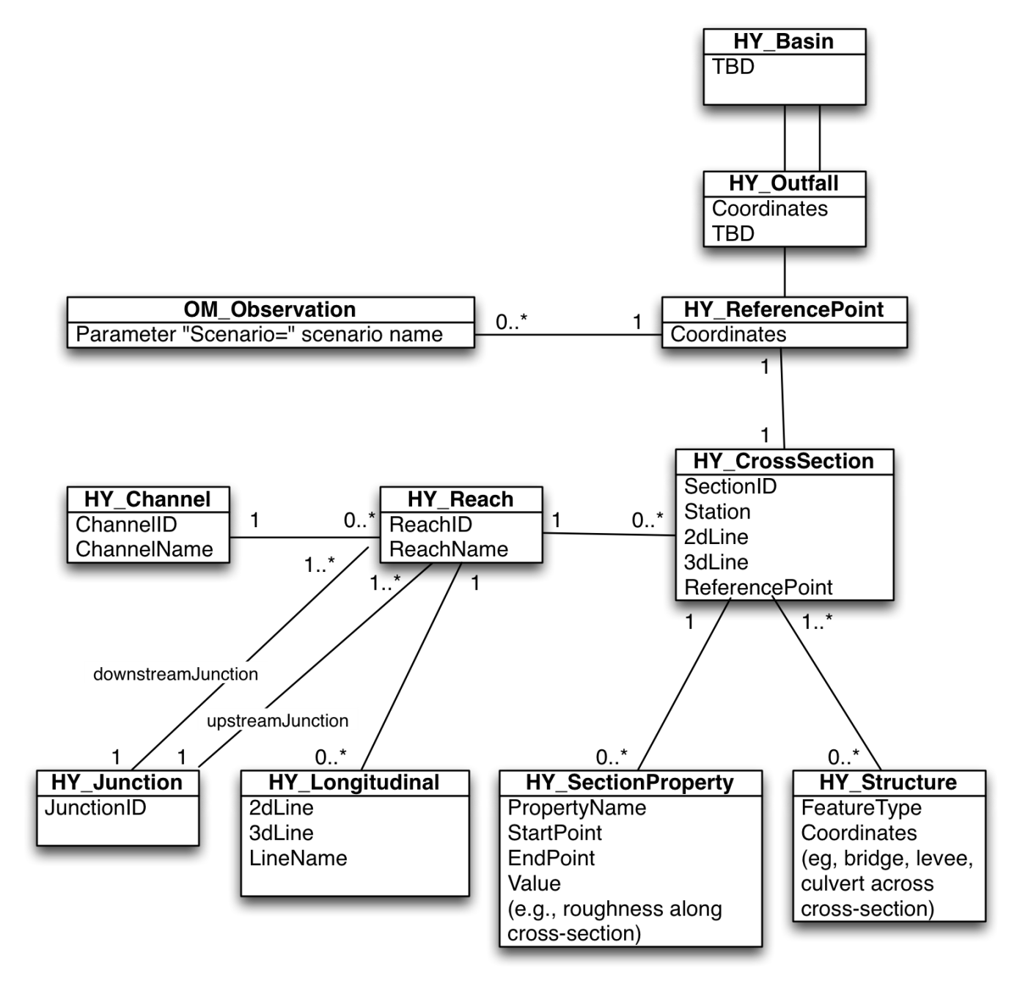
RiverML Templates
Geometry
  Reach
  Flow Line
  Cross Section
  Section Property
  Structure
  Reference Point
A consistent set of RiverML files shares the same set of Cross Section Reference Points. This allows models to be created modularly and joined unambiguously.
River Network
  Channel
  Reach
  Junction
  Cross Section
  Reference Point
Catchments
  Basin
  Outfall
  Reference Point
Observations
  Observation
  Reference Point

Slide 12
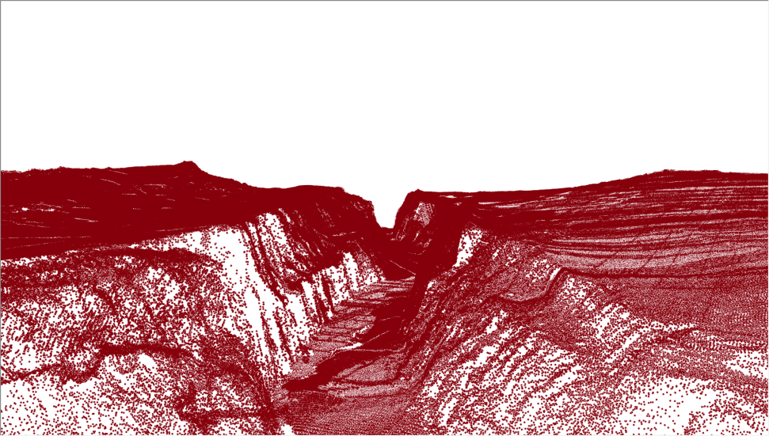
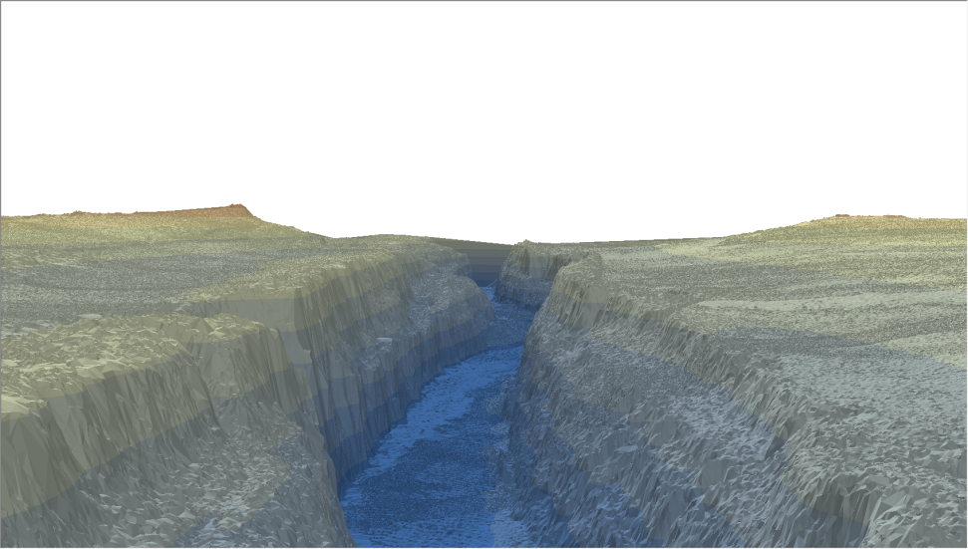
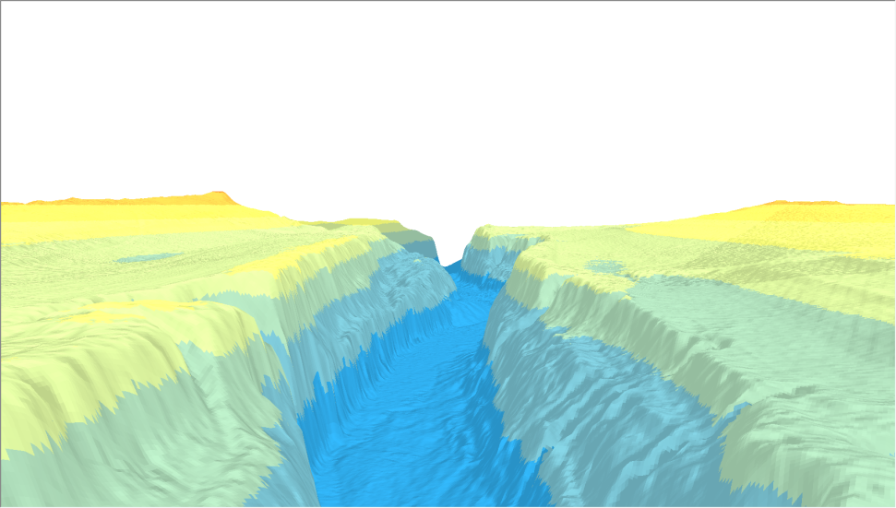
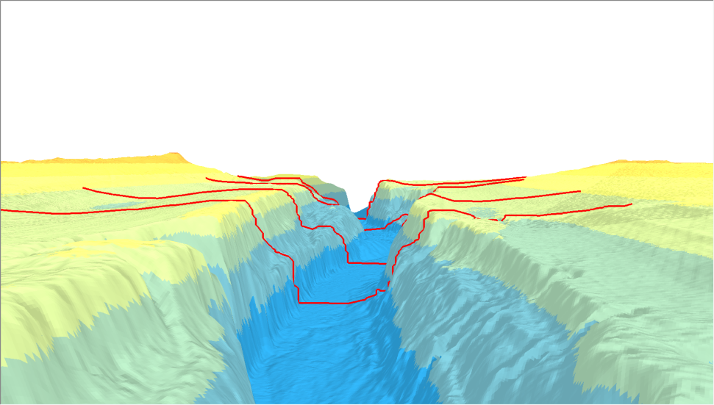
River Geometry
Raw LiDAR Points
Triangulated Irregular Network (TIN)
Raster
Cross Sections

Slide 13
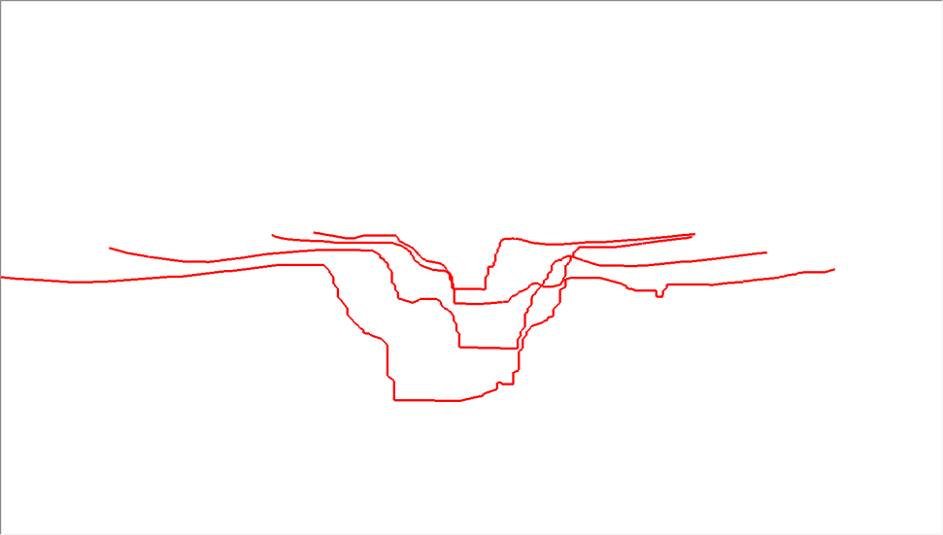
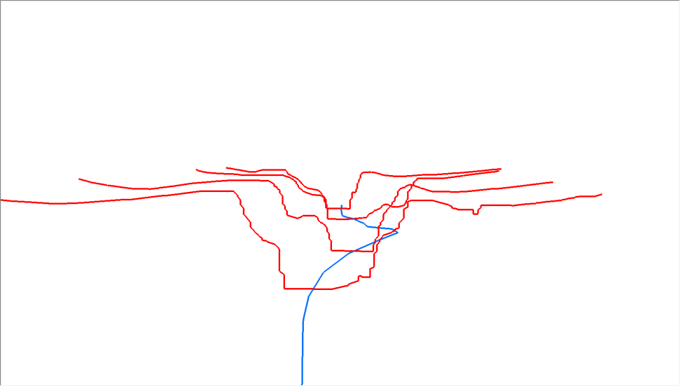
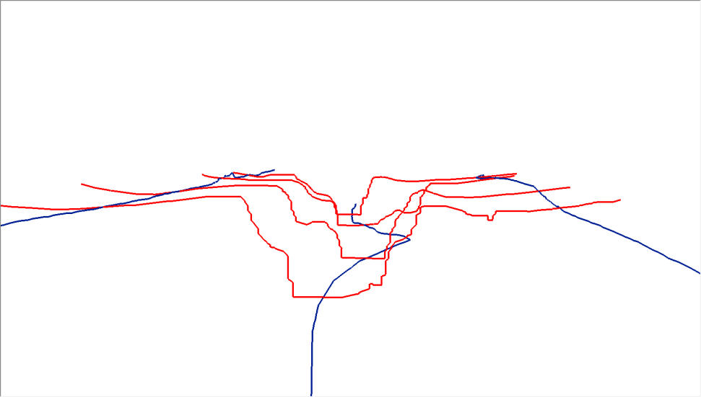
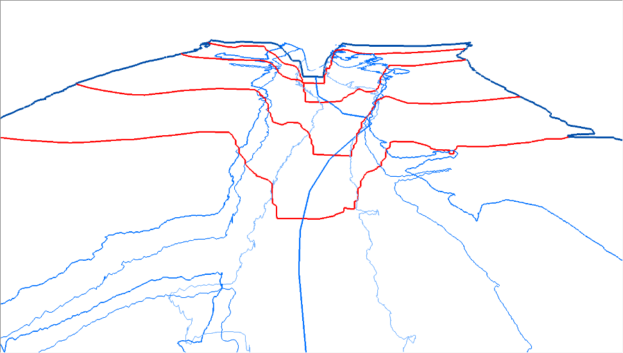
Cross Sections and Flow Lines
Cross Sections
Center Flow Line
Overbank Flow Lines
Topological Flow Lines

Slide 14
HY_Features Classes: Reach-Outfall-Basin
Hydraulic
Hydrologic
Figure 10, OGC 11-039r2

Slide 15
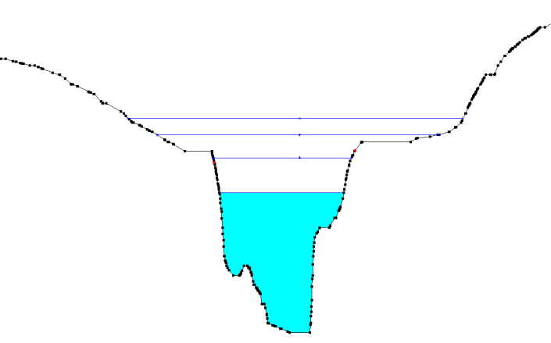
River Observations
Single Value (Steady State)
 | 10-Year | 25-Year | 50-Year | 100-Year
Flow Rate (m³/s) | 10.7 | 22.4 | 42.9 | 68.7
Water Surface Elevation (m) | 2.8 | 4.1 | 6.2 | 7.4
Time Series (Hydrograph)
Time | Flow Rate (m³/s) | Water Surface Elevation (m)
2002-07-12 01:00 | 20.1 | 3.8
2002-07-12 02:00 | 22.6 | 4.1
2002-07-12 03:00 | 27.3 | 5.0
2002-07-12 04:00 | 42.8 | 6.2
2002-07-12 05:00 | 31.9 | 5.3
Flow
Time

Slide 16



RiverML and HydroShare
HydroShare Conference Call
02 July 2013
Stephen R. Jackson
David R. Maidment
David K. Arctur
Center for Research in Water Resources
University of Texas at Austin
OCI-1148453 (2012-2017)
OCI-1148090 (2012-2017)

Slide 17
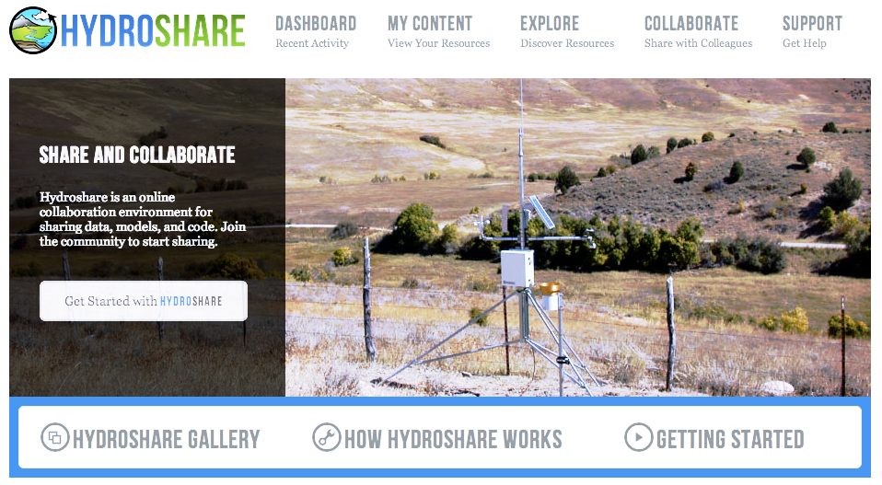
HydroShare.org: Web-based collaborative
environment for sharing data & models

Slide 18
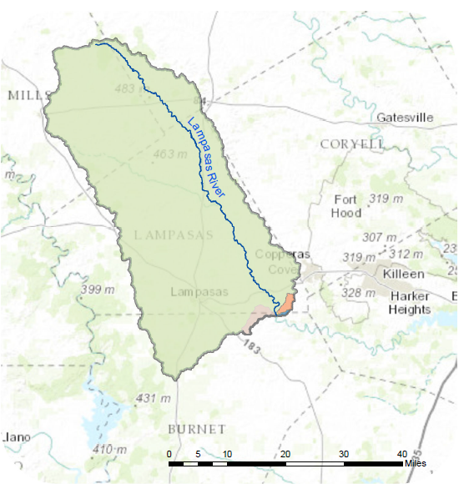
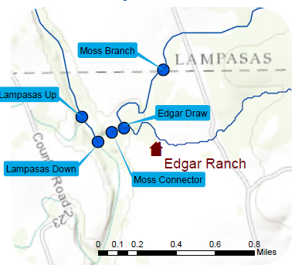
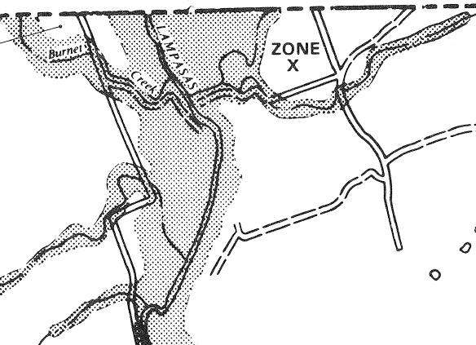
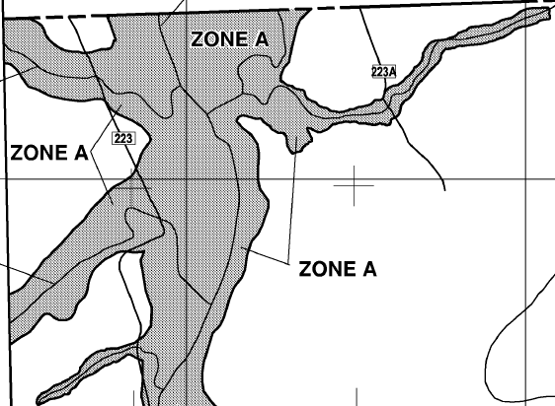
Edgar Ranch: Case Study
Edgar Ranch
1990 FEMA Floodplain
2012 FEMA Floodplain

Slide 19
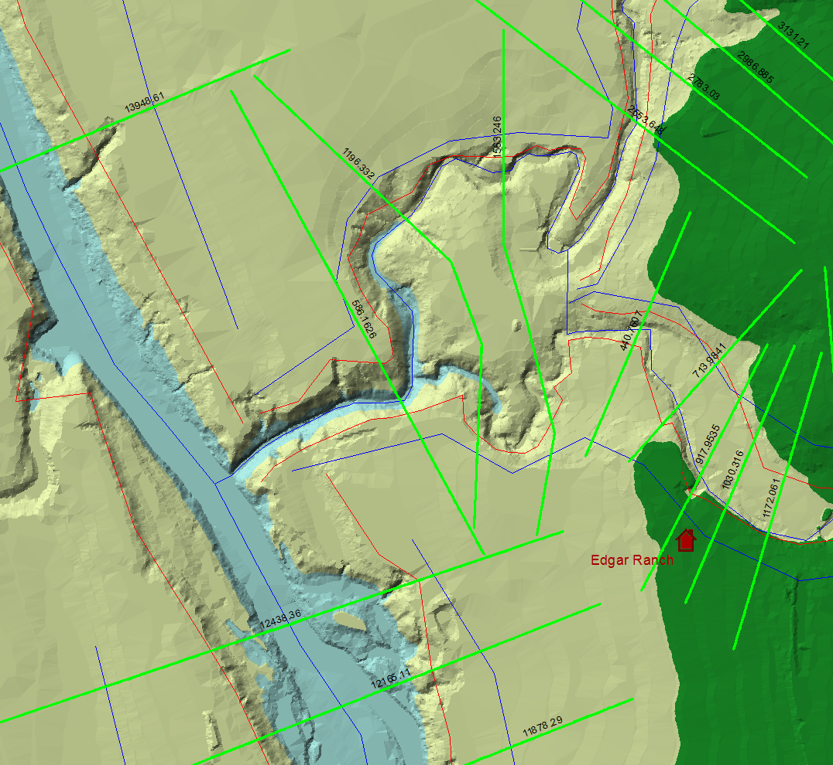
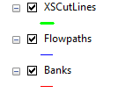
HEC-GeoRAS Model – Input to RAS
Cross Section Geometry and Attributes as Shapefiles

Slide 20
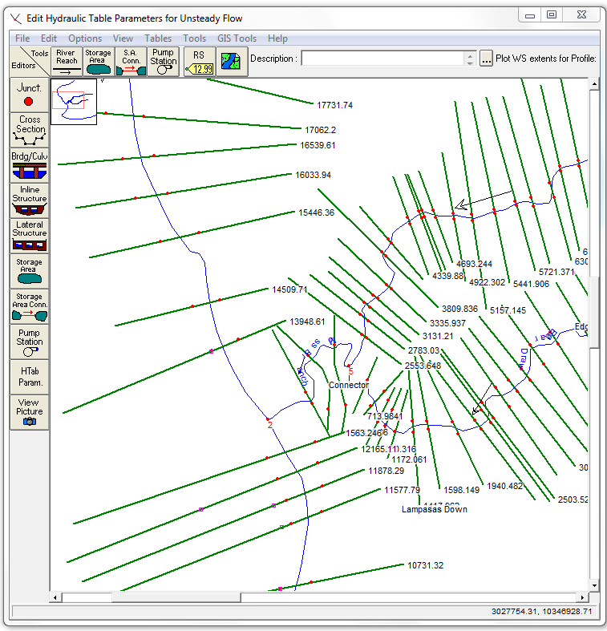
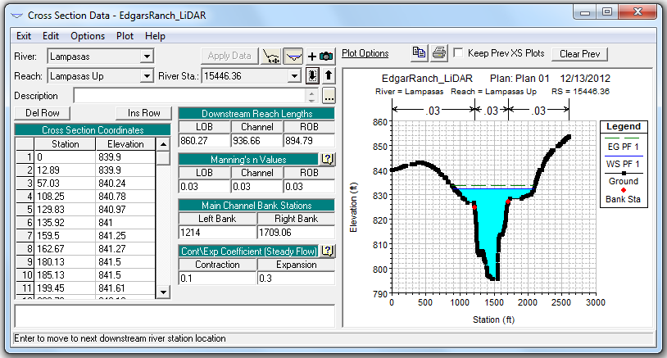
HEC-RAS Model – Computes Water Surface Elevation given the Discharge
Cross Section Data
Georeferenced Cross Sections

Slide 21
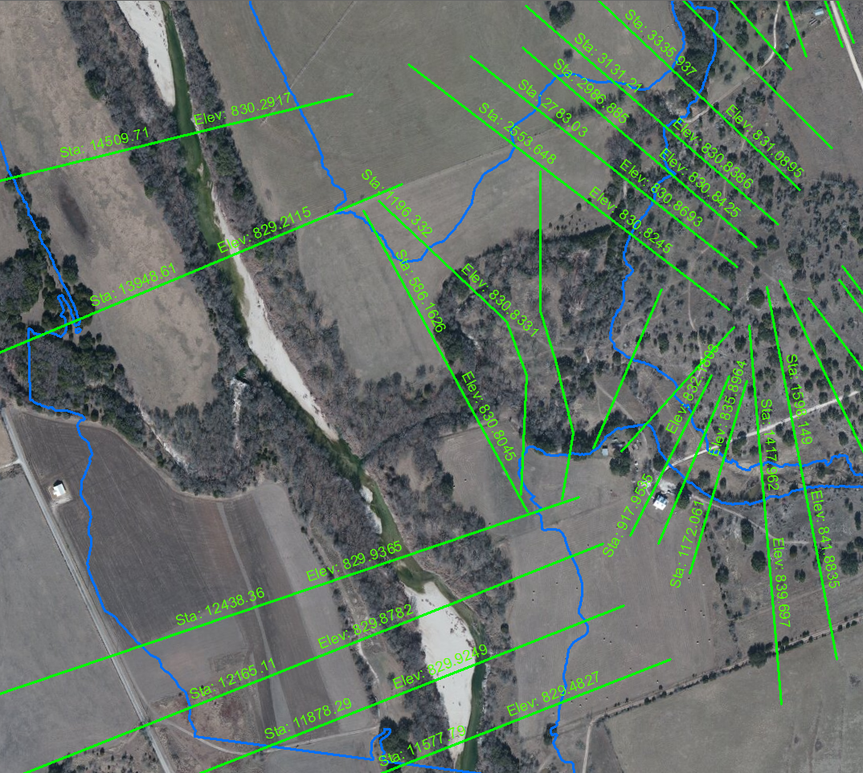
Floodplain Results – Output from RAS in HEC-GeoRAS
Floodplain Results as both Cross Section and Polygon Shapefiles

Slide 22
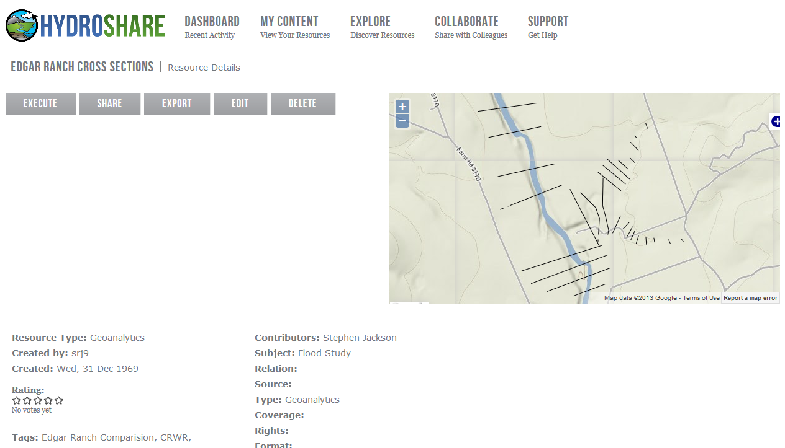
Map Reference Visualization
Uploading a single shapefile to dev.hydroshare.org

Slide 23
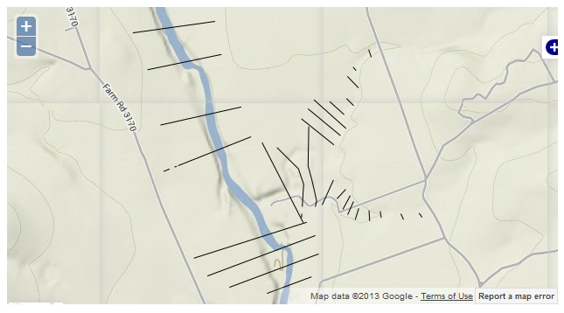
Shapefile Upload Report
Successes:
  Shapefile successfully uploaded
  Metadata added
  Shapefile accurately depicted in map view
  Topographic map provides useful background
Ways to improve:
  Map autozoom to shapefile extents
  Ability to upload multiple files simultaneously
  Unclear that RENCI Geoanalytics means ‘zipped shapefile’
  Recognize shape files without needing to manually zip
  Associate multiple files as a single project

Slide 24
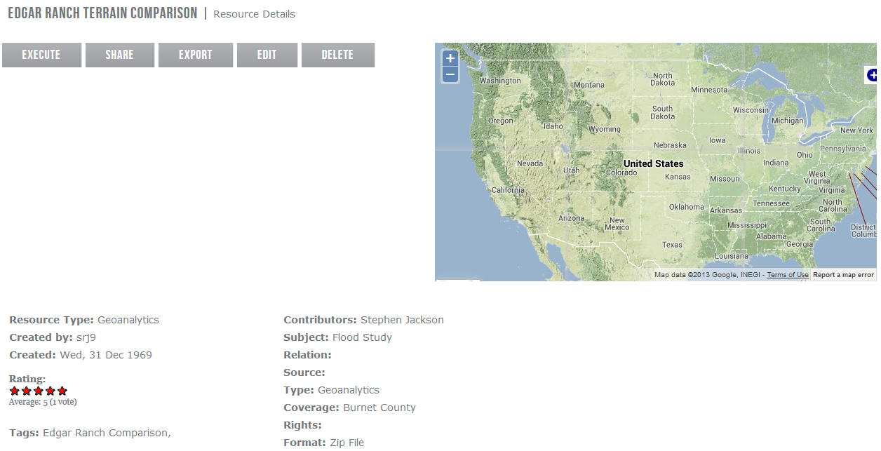
Project Data Sharing
Uploading a large project zip file to dev.hydroshare.org

Slide 25
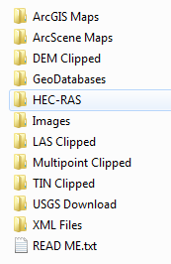
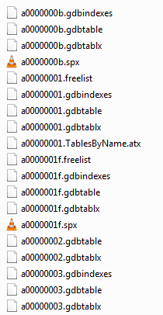
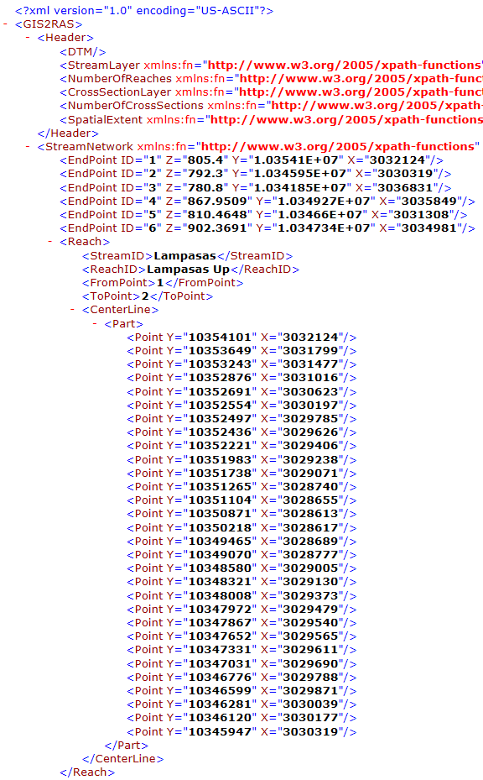
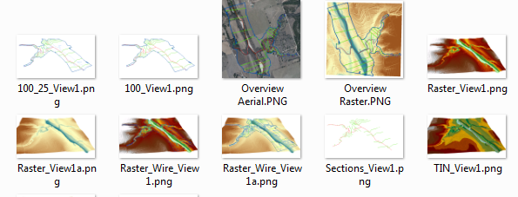
Sample Project File Structure
Folders contained
in uploaded Zip file
GeoDatabases
Image Files
XML Model Files

Slide 26
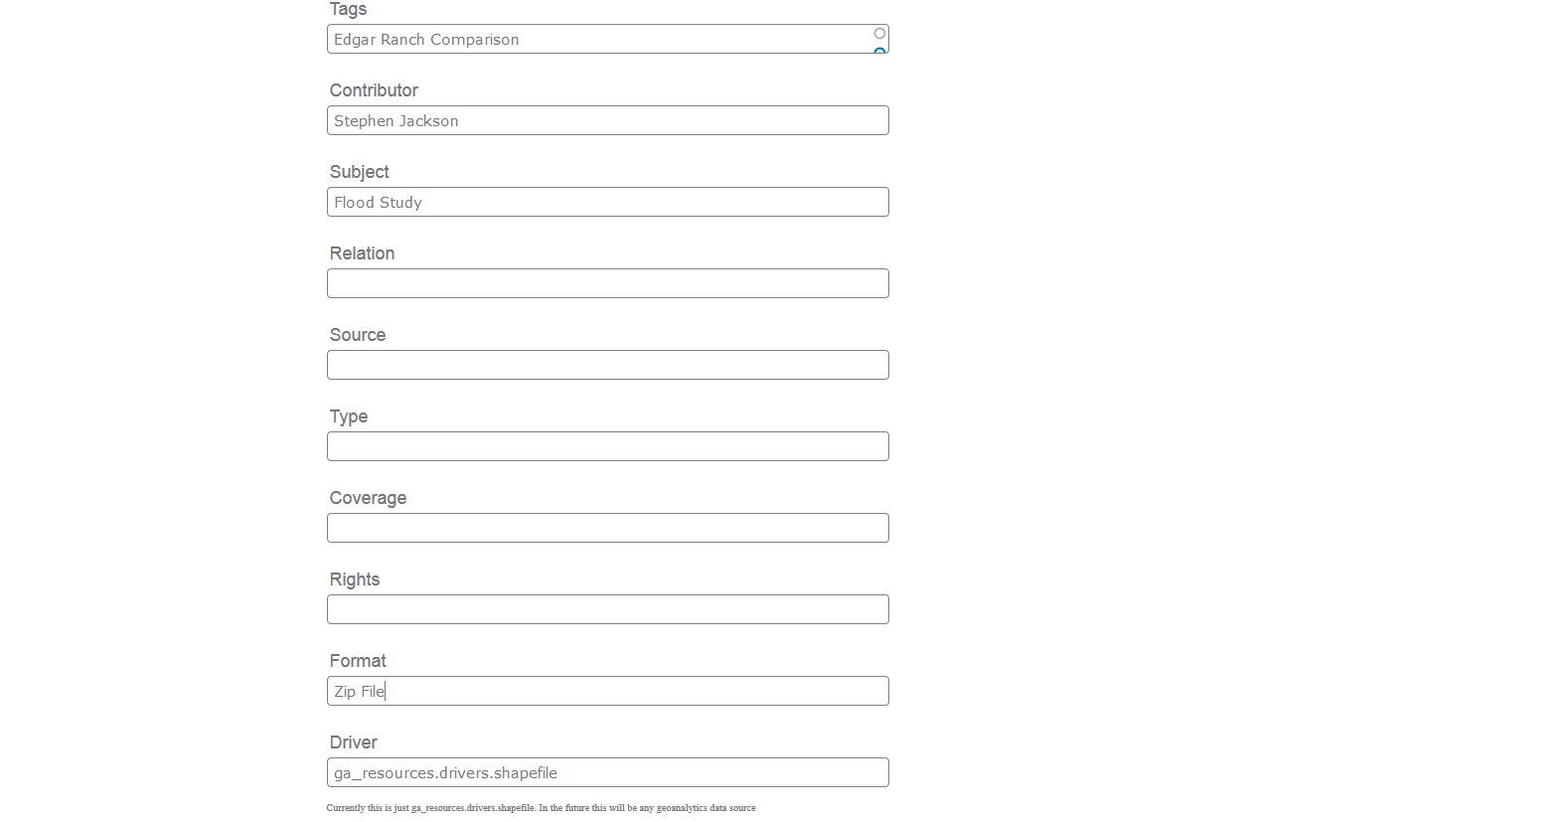
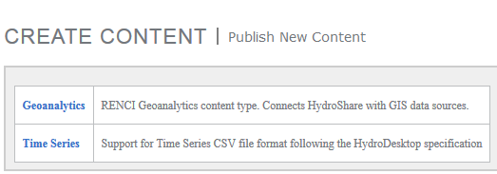
Project Upload Report
Successes:
  Successfully uploaded large file
  Metadata added.
  Comments/Ratings worked well.
Ways to improve:
  Provide upload option for ‘Generic Zip’
  For heterogeneous uploads, perhaps select a ‘representative’ element (image or shapefile) that could be used in visualizations
  Purpose of many metadata tags are currently unclear.
  Distinction between Execute, Share, and Export is unclear.
  File corruption problem:
    Uploaded file: 750MB zip
    Downloaded file: 60MB BagIt zip file containing an invalid zip

Slide 27

RiverML & HydroShare
  RiverML:
  Modular design, linking river geometry, catchment geometry, network topology, and time series observations
  Data is linked by common reference points along the river, which can easily be represented as point or cross section shapefiles and shown on a map.
  Fundamental Question for HydroShare User Interface:
  What happens when you click on an object in a map?

Slide 28
RiverML & HydroShare
  What happens when you click a reference point (or cross section)?
  Selection
    No selection (points are nothing but visualization)
    Select the whole collection of points (marginally useful)
    Does it select the specific reference point (more useful)
  Popup
    No popup
    Metadata popup
    Metadata + Links
  Links
    Link to Resource Author
    Link to list of all RiverML files which contain that point
      Subcategorized by Geometry, Catchment, Network, Observation
    Link to all Resources/Projects which include a RiverML file with contain that point
    Link to all Resources within the catchment area
    (Links could be filterable based on metadata such as author, organization, upload date, etc.)
Standardized, Modular Data
+ Interactive Maps
= User Friendly Data Discovery
  Additional Visualizations (after data discovery):
    Hydrograph for flow at a point
    Time-enabled cross section flow depth
    Time-enabled river profile flow depth (visualize flood wave)
    Time-enabled isometric wireframe flow depth

Slide 29
CUAHSI Survey
Software Programs I use for Terrain Processing/Mapping/Visualization (check all that apply)
A1 Autodesk (Civil 3D, etc.)
A2 Bentley (Microstation, etc.)
A3 ESRI (ArcGIS, etc.)
A4 GRASS GIS
A5 Quantum GIS
A6 Other 1: ___________________________
A7 Other 2: ___________________________
A8 Other 3: ___________________________
A9 N/A
Software Programs I use for Hydrologic Analysis (check all that apply)
B1 HEC-HMS
B2 HYSIM
B3 MIKE-SHE
B4 PondPack
B5 XP SWMM
B6 Other 1: ___________________________
B7 Other 2: ___________________________
B8 Other 3: ___________________________
B9 N/A
Software Programs I use for Hydraulic Analysis (check all that apply)
C1 HEC-RAS
C2 MIKE Flood
C3 WS-PRO
C4 WSP2
C5 XP Storm
C5 Other 1: ___________________________
C6 Other 2: ___________________________
C7 Other 3: ___________________________
C8 N/A
Additional information regarding my workflow:
____________________________________________________________
You may contact me about my workflow (provide email and/or phone #): _________________
Conversion tools I use to exchange data between the above listed programs.
Note whether the process is automatic (same file structure recognized by both source and destination programs) or manual (requires formatting)
Source Destination Tool/Process Automatic/Manual Comment
Example 1: A1 C1 HEC-GeoRAS Automatic
Example 2: B2 C1 Excel Manual
D1 _________ __________ ____________ ______________ ___________________
D2 _________ __________ ____________ ______________ ___________________
D3 _________ __________ ____________ ______________ ___________________

Slide 30
Discussion Questions
What functionality would be desirable in a HydroShare RiverML user interface?
  Visualization (network, individual cross sections, time series graphs, animations of flood waves, etc.)
  Recognition of template structure/ability to link related files
  Conversion tools (HEC-GeoRAS to RiverML, etc.)?
What work can be started before the RiverML 1.0 UML is complete?

Slide 31

Acknowledgements
RiverML is a collaborative effort that has already benefited greatly from the input of many people, including:
David Maidment (UT Austin, USA)
David Arctur (UT Austin, USA)
David Tarboton (Utah State University, USA)
Ulrich Looser (Federal Institute of Hydrology, Germany)
Irina Dornblut (Federal Institute of Hydrology, Germany)
David Valentine (UC San Diego, USA)
Alva Couch (Tufts University, USA)
Peter Taylor (CSIRO, Australia)
Rob Atkinson (CSIRO, Australia)
Simon Cox (CSIRO, Australia)
Dean Djokic (ESRI, USA)
Venkatesh Merwade (Purdue University, USA)
OGC Hydro DWG Working Group
HydroShare Development Team
Funding for this research has been provided by the National Science Foundation
[OCI-1148453 (2012-2017) OCI-1148090 (2012-2017)]

