Slide 1
CE 365K Hydraulic Engineering Design
Concepts using in Exam 1 6 March 2014

Slide 2
Profession
A profession is a vocation founded upon specialized educational training, the purpose of which is to supply objective counsel and service to others, for a direct and definite compensation, wholly apart from expectation of other business gain
http://en.wikipedia.org/wiki/Profession

Slide 3
Evolution of Hydraulic Design
Stormwater runoff disposal
Get the water off the site as quickly and efficiently possible
Stormwater detention
Slow down the stormwater so that peak flow after development is not more than before
Water Quality Control
Retain and filter water on site so that bacteria are reduced and water quality improves
Low Impact Development
Dispersed onsite infiltration, filtration and retention schemes

Slide 4
Definitions from Miriam-Webster Dictionary (10th Edition)
Design (Verb)
To mark, to conceive and plan out; to have a purpose; to devise for a function
Design (Noun)
A deliberate, purposeful plan; the arrangement of elements that go into human production; the underlying scheme
Design as a verb
How to design something
Design as a noun
What to design
How is more important than what

Slide 5
HydroDesign Process
How should the study area be described?
How does the study area operate?
Is the current study area working well?
How might the study area be altered?
What differences would the changes cause?
How should the study area be changed?
Representation
Process
Evaluation
Change
Impact
Decision

Slide 6
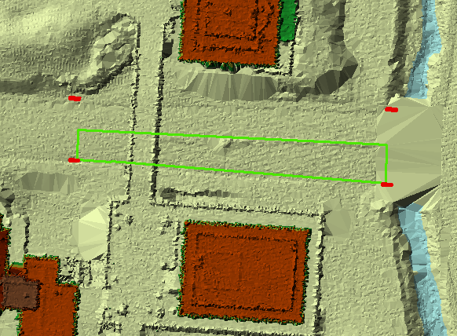
Airborne LIDAR coverage of Dean Keaton St and surroundings
CrossSection 56
Location

Slide 7
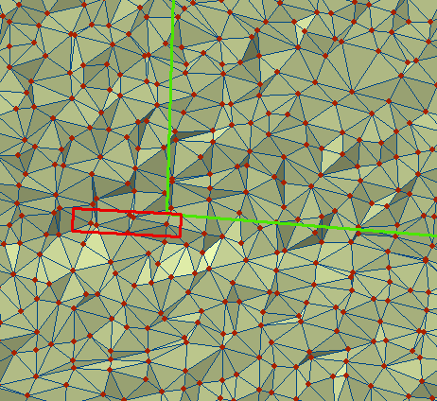
Triangulated Irregular Network (TIN) for part of Dean Keaton St

Slide 8
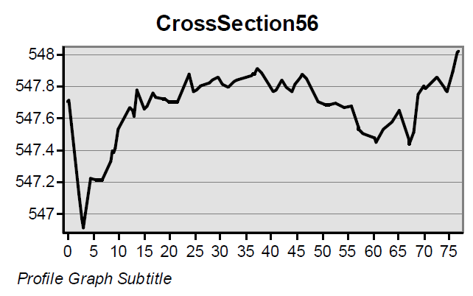
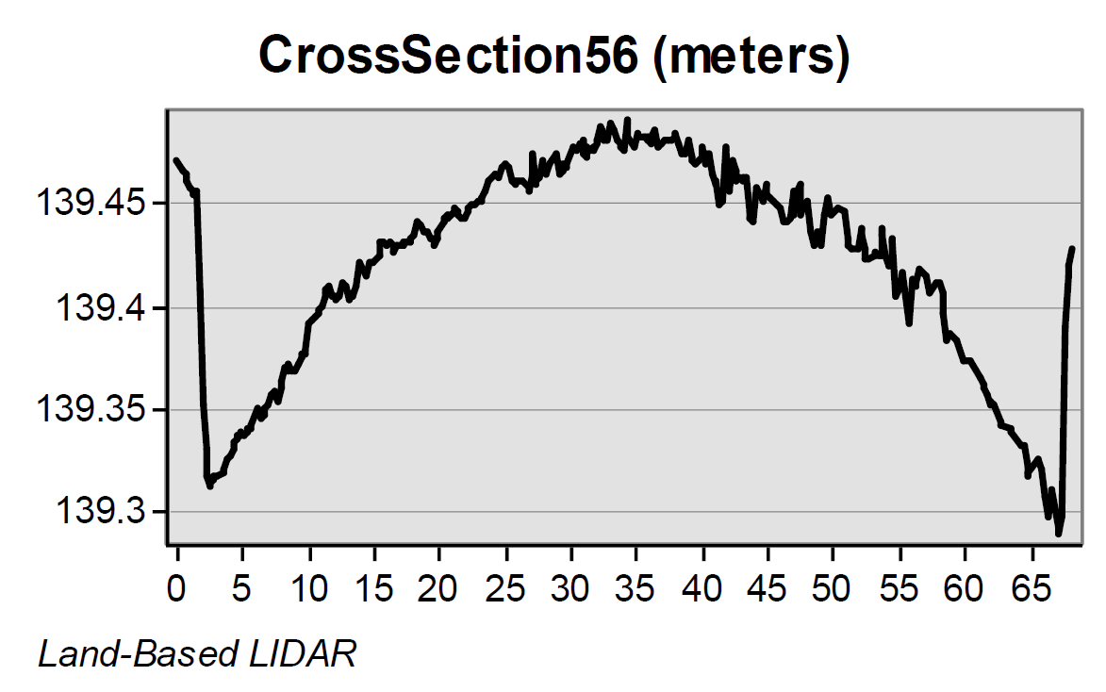
Road CrossSections from LIDAR
Location 5-6 is shown
in previous slides
Airborne LIDAR (ft)
(City of Austin data)
Its clear that the vehicle-based
LIDAR gives a better definition
of the road Cross-Section
Vehicle LIDAR (m) (Mandli Communications)

Slide 9
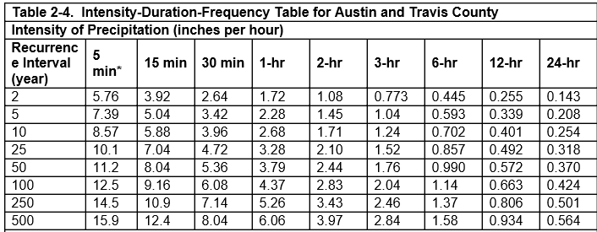
Intensity-Duration-Frequency Curves

Slide 10
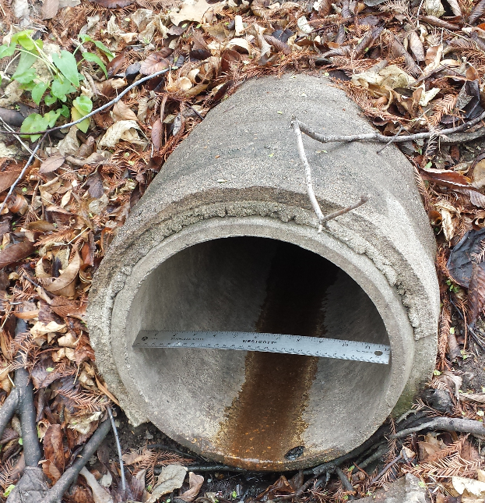
ECJ Pipe Drainage

Slide 11
Sheet Flow
Rainfall intensity, i
L
A
A
1 ft
s
L
1
v
B
B
q, discharge per unit width
q = iL = vy
y

Slide 12
Gutter Flow
$$Q=\frac{C_{f}}{n}{{{S_{x}^{}}^{\frac{5}{3}}T^{\frac{8}{3}}{S_{o}^{}}^{\frac{1}{2}}}_{}^{}}^{}$$
T
d
S_{x}
1
Q = flow in gutter (cfs)
C_{f} = coefficient (0.56 for US units, 0.376 for SI units
S_{o} = longitudinal slope
T = spread (ft)
S_{x} = transverse slope
Ref: SCMD p. 372

Slide 13
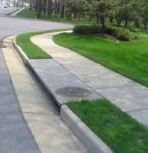
Flow into a Curb Inlet
L_{T}
$$L_{T}={{{C_{f}Q^{0.42}S}_{o}^{}}^{0.3}{\left(\frac{1}{nS_{x}}\right)}^{0.6}}_{}$$
L_{T} = required length to intercept all flow (ft)
Q = flow in gutter (cfs)
C_{f} = coefficient (0.60 for US units, 0.817 for SI units)
S_{o} = longitudinal slope
T = spread (ft)
S_{x} = transverse slope
$$E=1−{\left(1−\frac{L}{L_{T}}\right)}^{1.8}$$
E = efficiency (proportion of flow captured
L = actual length (ft) (for L < L_{T})
Ref: SCMD p. 393

