Slide 1
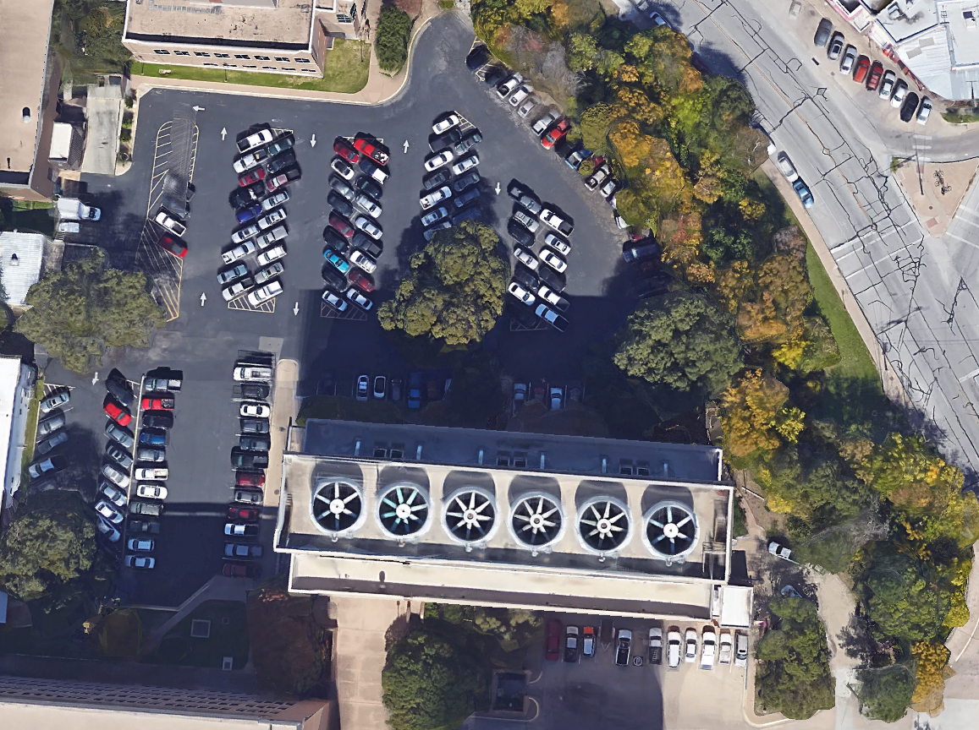
Parking Lot 53 Hydraulic Analysis
Aaron Gutierrez Aaron Libson William Ryman Alejandro Valenzuela

Slide 2
Project Overview
Summary of the Problem
Representation
Process
Evaluation
Change
Impact
Decision

Slide 3
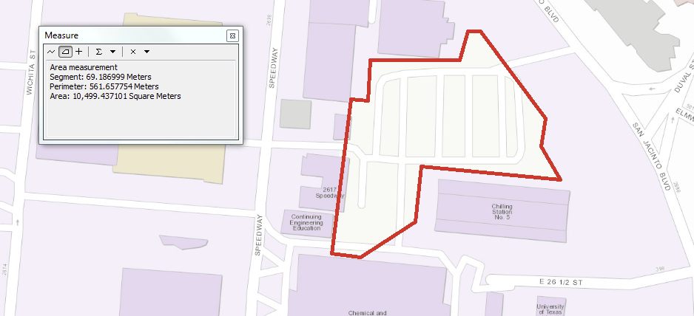
Problems to Consider
Mitigate erosion of the embankment on Waller Creek
Improve the water quality of runoff into the creek
Restore retaining wall
Repair curb outlets damaged by rain flow

Slide 4
Representation
How should study area be described?
1
The parking lot slopes from west to east
There are 3 main outlets (sections 1, 3, and 4) that direct flow from the lot to Waller Creek
A portion of the curb on the eastern side of the lot is damaged
This missing portion of curb acts as a fourth outlet (section 2)
2
3
4

Slide 5
Process
How does the study area operate?
Currently operates as a parking lot for UT facilities
Many students walk through the parking lot to get to the restaurants along San Jacinto street
Parking lot as a whole acts as drainage path into Waller Creek
There are 4 known outlets that we saw
3 designed outlets and 1 that was naturally made by erosion due to water flow

Slide 6
Evaluation
Is the current study area working well?

Slide 7
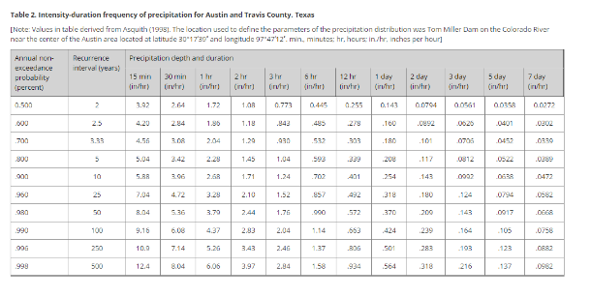
Approximate Estimate of Drainage

Slide 8
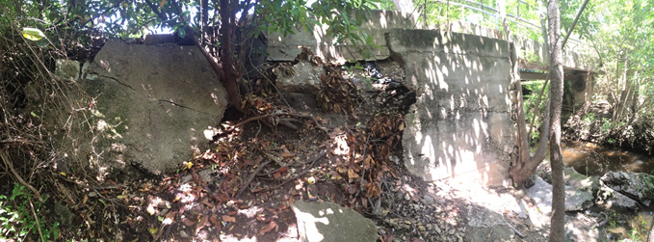
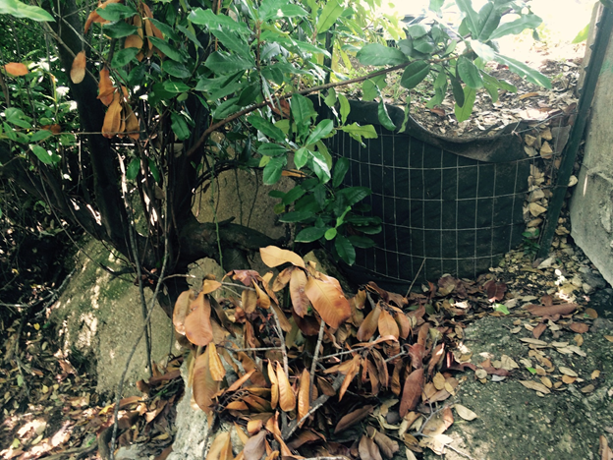
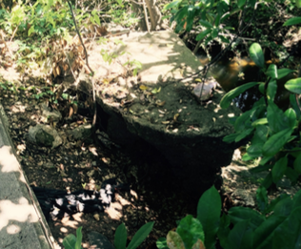
Retaining Wall Restoration
Runoff from northernmost curb outlet has cut through soil and caused retaining wall to collapse
Lack of energy dissipators has led to substantial erosion
Embankment is only being held up by filter fabric
Lack of vegetation fails to filter water

Slide 9
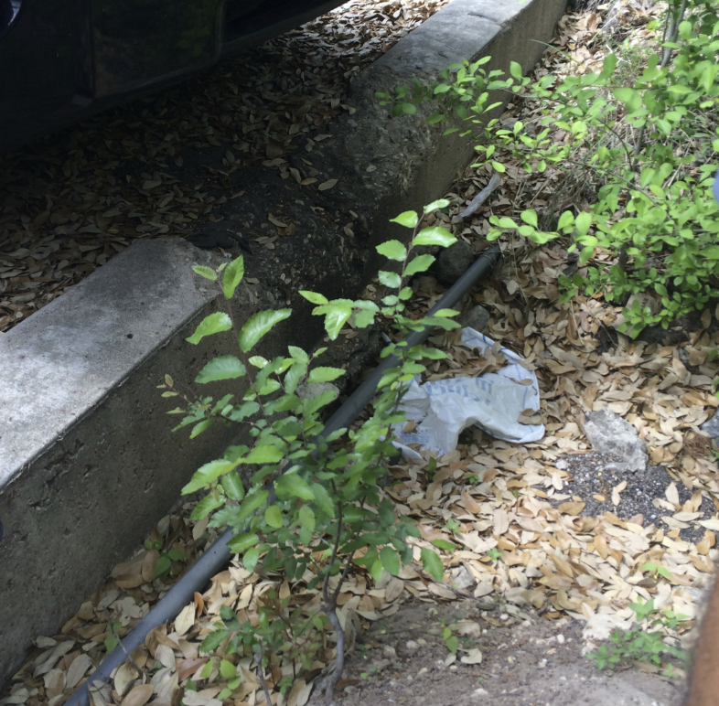
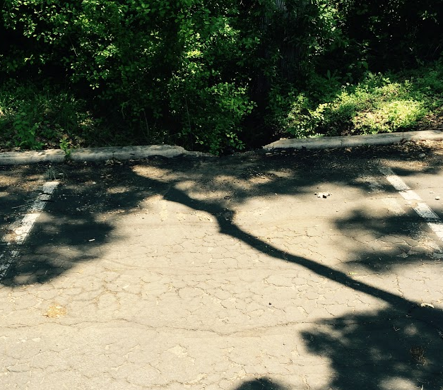
Broken Curb Outlet
Outlet was created naturally by the runoff of water over time
Absence of energy dissipators has created excessive erosion of the embankment
Lack of vegetation fails to filter water before entering the creek

Slide 10
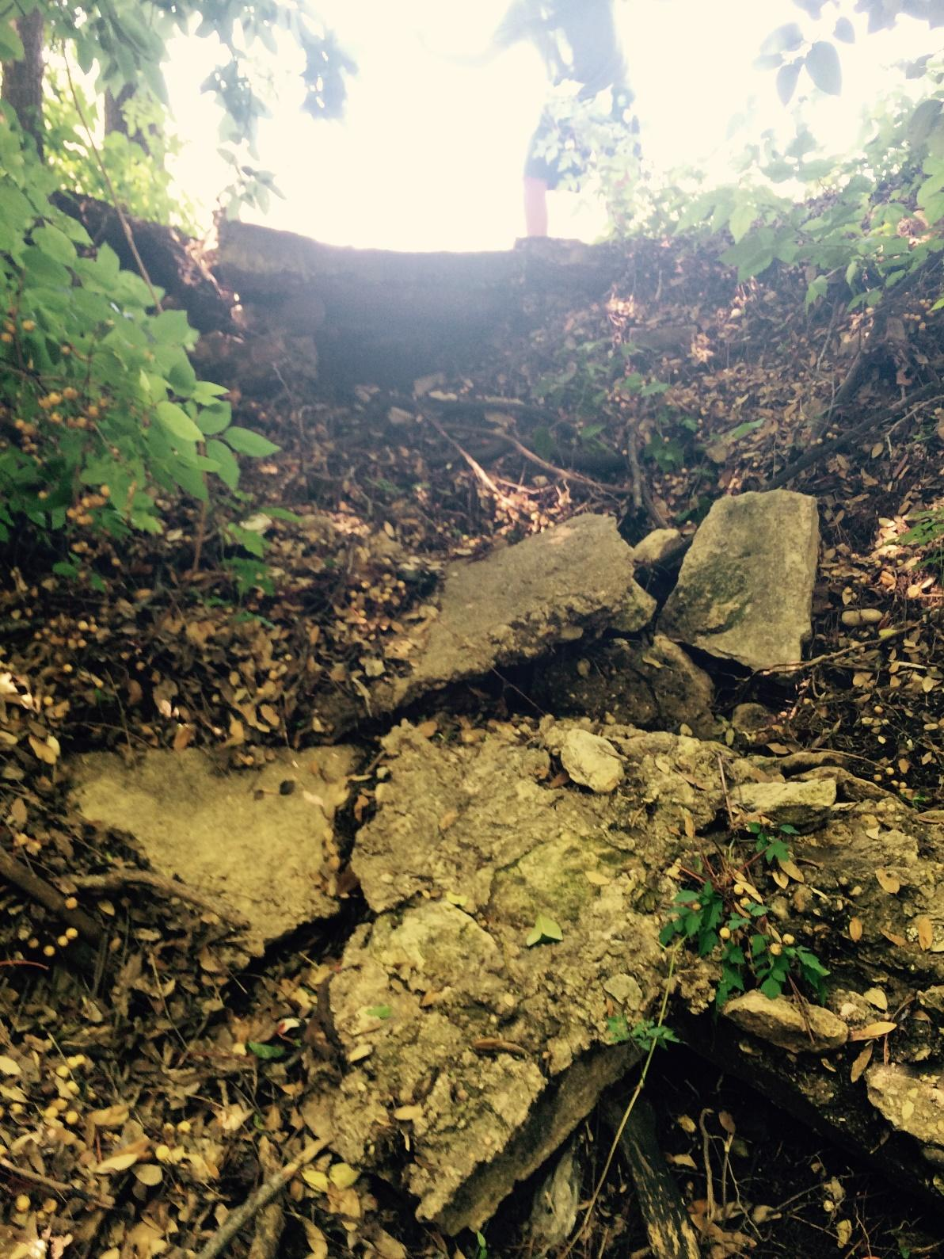
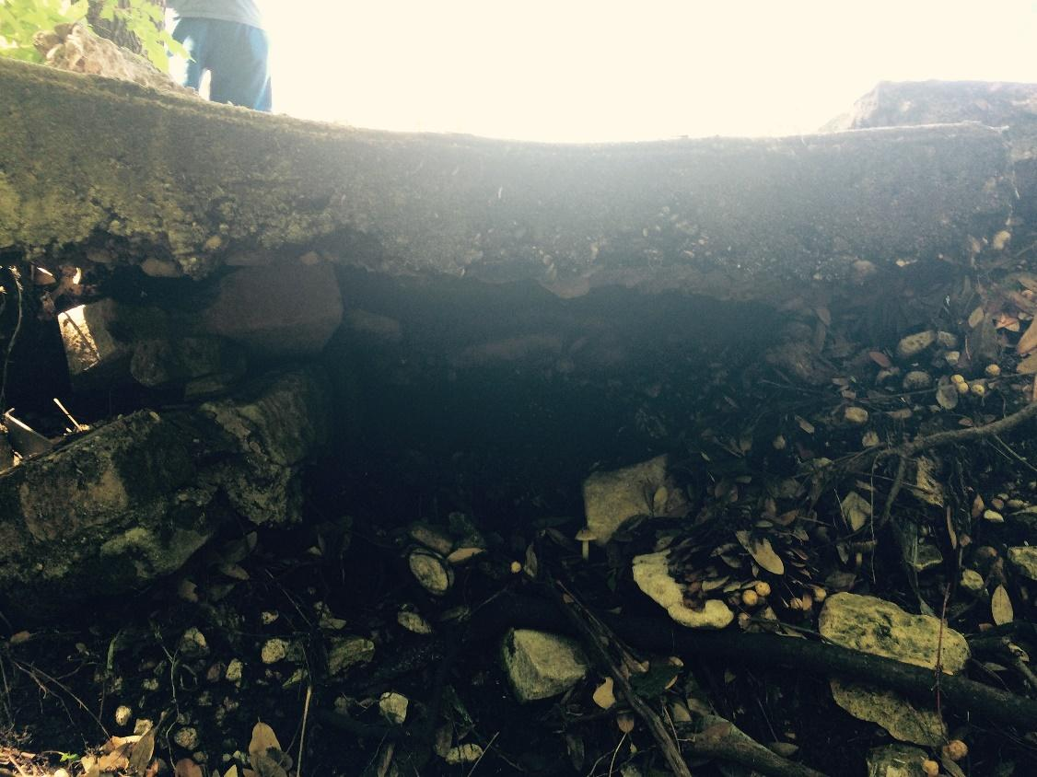
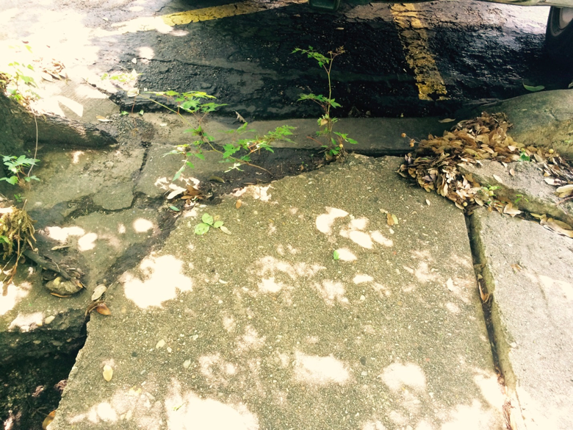
Central Curb Outlet
Runoff from this outlet cascades into a highly eroded trench, causing more erosion
Foundation soil has eroded from underneath the outlet
Drainage pathway is fractured and needs repair
Lack of vegetation fails to filter water before entering creek

Slide 11
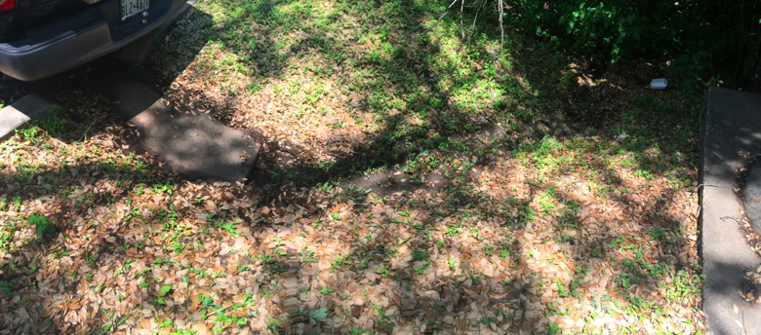
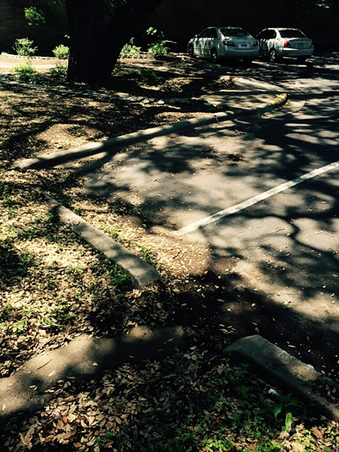
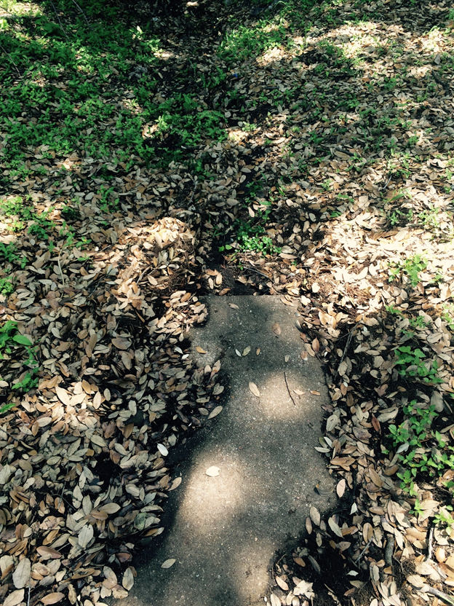
South Curb Outlet
Lack of energy dissipators has caused erosion
Erosion is not severe because of the availability of land
There is plenty of space for the implementation of vegetation to filter water

Slide 12
Changes
How might the study area be altered?

Slide 13
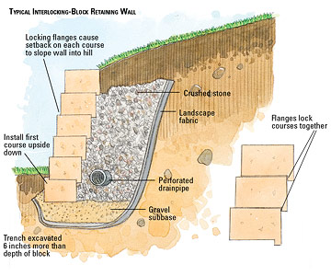
Retaining Wall Restoration
We would ideally like to build a structure like the one pictured to the right in the area that has been eroded away by fast moving runoff
Adding crushed stone and a gravel subbase would help drain the water more efficiently and increase the effluent quality that is currently discharged into Waller Creek
Finally, we would like to repair the retaining wall and create a perforated underdrain through the retaining wall
http://images.meredith.com/diy/images/2008/12/p_SCM_192_02.jpg

Slide 14
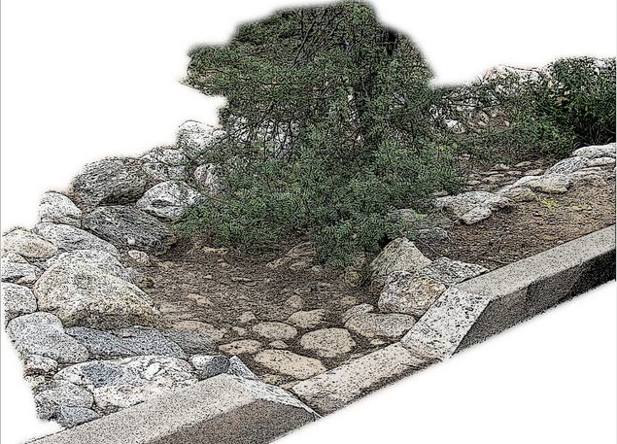
Broken Curb Outlet
Want to convert the naturally made curb outlet into an actual curb cut drainage that matches existing curb outlets
Water will flow through this broken curb regardless as it has already weathered and eroded the current curb
Take advantage of current drainage path and implement this design to supplement other drainage routes
Addition of rocks such as ones shown can act as energy dissipators and prevent erosion
Addition of vegetation might not be required, but can help improve water quality by acting as filter
www.tucsonbotanical.org

Slide 15
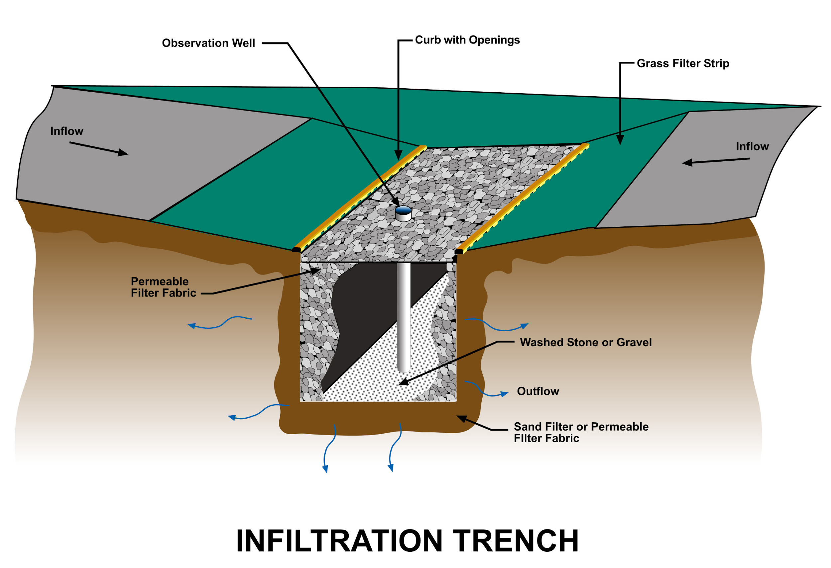
Central Curb Outlet
Much of the soil next to the outlet has eroded away causing a drastic drop from the outlet
We would like fill in this hole created by the erosion of the soil
We would like to add a layer of sand on the bottom to act as a filter for storm water
On top of the sand, we would like to add gravel to help dissipate the energy of the storm water
Also, adding vegetation along the drainage path would help improve the water quality draining into the creek
https://keneulie.wordpress.com/2010/02/06/infiltration-trench/

Slide 16
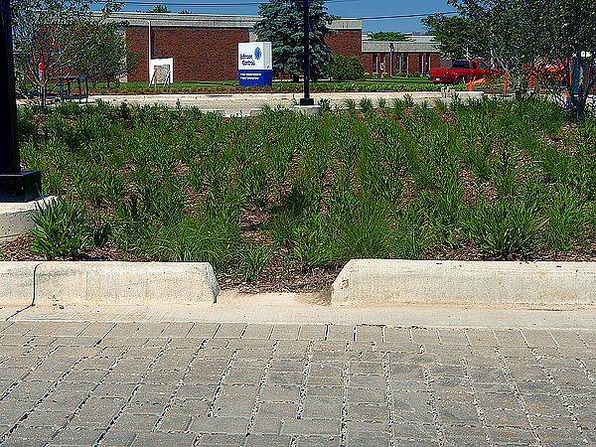
South Curb Outlet
This outlet is in better shape than the other 3 outlets
The addition of gravel to the end of the outlet could act as an energy dissipator for the flow
Also, the addition of some small plants could help increase the water quality
This part isn’t too vital since there is plenty of grass around the outlet

Slide 17
Impact
What differences would the changes cause?
The changes we are proposing may affect the area in a few ways:
Pros
Improved effluent water quality
Reduced erosion
Improved aesthetics
Cons
Reduced number of parking spaces
Possible change in hydraulic characteristics

Slide 18
Decision
How should the study area be changed?
First, we would like to repair the retaining wall and incorporate an infiltration trench into the newly renovated wall
Second, we would like to make the broken curb into a functioning outlet
Third, we would like to fill in the area that has been eroded for the central curb
We would fill the area with a layer of sand topped with gravel
And lastly, we want to add gravel at the end of the south curb outlet and maybe add some small plants along the drainage area

