Slide 1
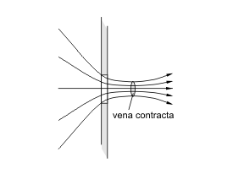
Vena Contracta
Contraction = $\frac{A_{2}}{A_{1}}$ ~ 0.64
A₁
A₂
http://en.wikipedia.org/wiki/Vena_contracta

Slide 2
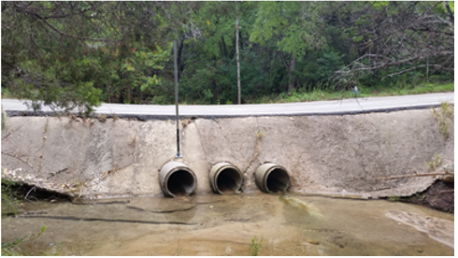
Road Culvert

Slide 3
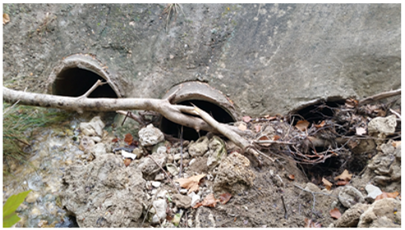
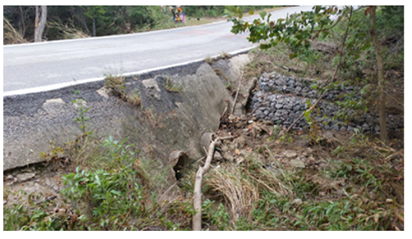
Road Culvert (upstream side!)
How do we deal with potential blockages in design?

Slide 4
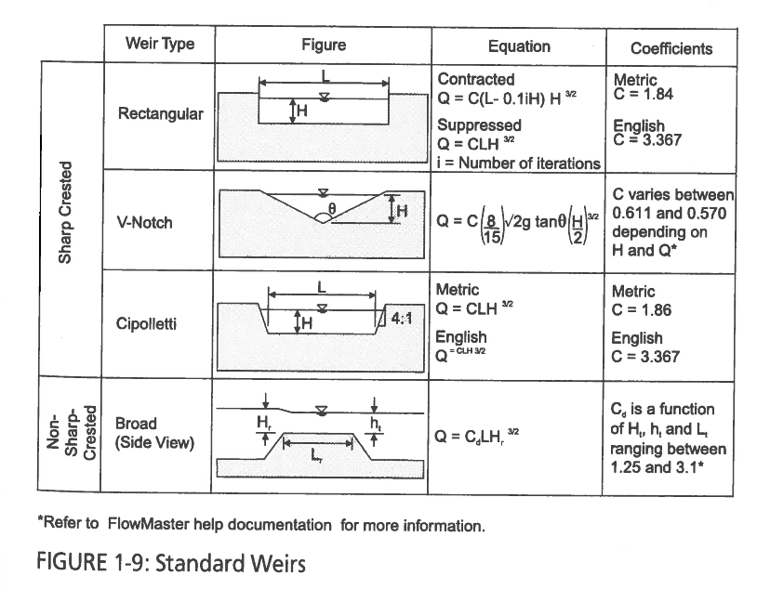
Weir Coefficients
Source: “Computer Applications in Hydraulic Engineering”, 8th Ed. Haested Methods, 2013

