Slide 1
Stormwater Best Management Practices
Michael Barrett, Ph.D., P.E.
University of Texas at Austin

Slide 2
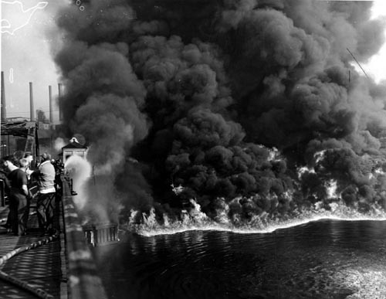
Cuyahoga River, Cleveland

Slide 3
The History
1948 Federal Water Pollution Control Act passed by Congress
1972 Clean Water Act prohibits any discharge of pollutants without National Pollutant Discharge Elimination System (NPDES) permit - (fishable and swimmable)
1987 Clean Water Act amended to require permits for stormwater discharges
2003 NPDES Phase II permits required

Slide 4
Clean Water Act
Requires NPDES permit for stormwater from cities, industry, construction sites
Requires assessment of beneficial uses and impairments of receiving waters
Impaired segments reported to EPA – 303(d) list.
Development of TMDL (total maximum daily load) for impaired segments

Slide 5
Common Impairments
Constituent/Parameter | Number of Water Bodies Impaired
Bacteria | 418
Low Dissolved Oxygen Concentration | 130
PCBs | 104
Salinity | 102
Dioxins | 90
Mercury | 75

Slide 7
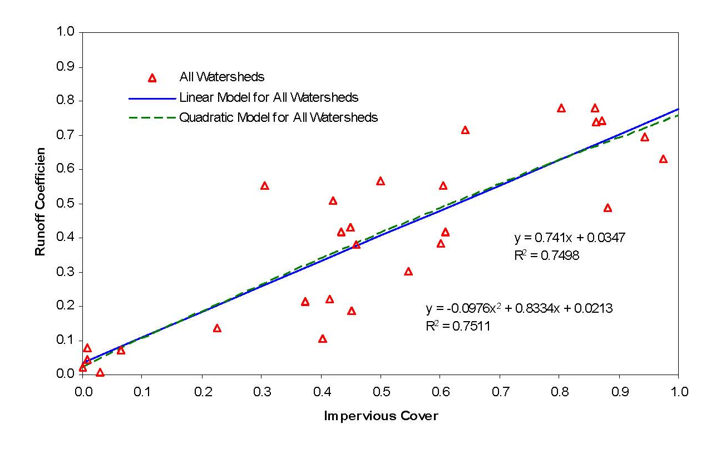
Impervious Cover and Runoff

Slide 8
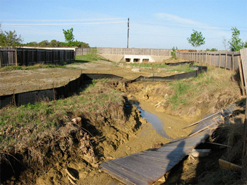
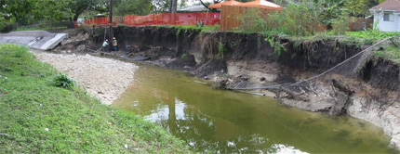
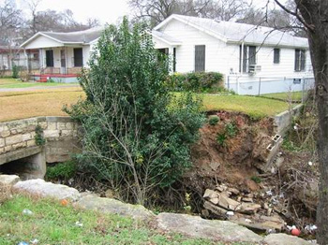
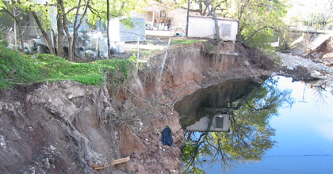
Channel Degradation
Bear Creek
Fort Branch
ShoalCreek
Boggy Creek

Slide 9
Constituents in Urban Runoff
Bacteria
Nutrients
Insecticides
Herbicides
Heavy Metals – zinc, copper, lead
Hydrocarbons – PAHs
Sediment

Slide 10
Sources of Pollutants
Vehicles – Tires, Brake pads, Fluids, Tracking
Atmospheric Deposition
Fertilizers
Pesticides
Pets
Pavement abrasion
Channel Erosion

Slide 11
Requirements for Stormwater Treatment
City of Austin – Required since 1981, mainly sand filters
TCEQ – Requires removal of 80% of sediment in stormwater for Edwards Aquifer
LCRA – Requires 70-75% removal of sediment, phosphorus, and oil & grease for Highland Lakes

Slide 12
Treatment Difficulties
Runoff occurs on an irregular basis
Volume and rate of runoff from storms is highly variable
Quality of runoff varies from storm to storm
Concentrations of constituents of concern often very low

Slide 13
“First Flush” of Pollutants
Stenstrom & Kayhanian, 2005

Slide 14
Best Management Practice (BMP) Selection
End-of-pipe
  Fewer facilities to manage, inspect, and maintain
  Little volume control
  Little redundancy
Onsite
  Maintain pre-development hydrology
  Low Impact Development (LID) – “Green Infrastructure”
  Lower cost
  More facilities

Slide 15
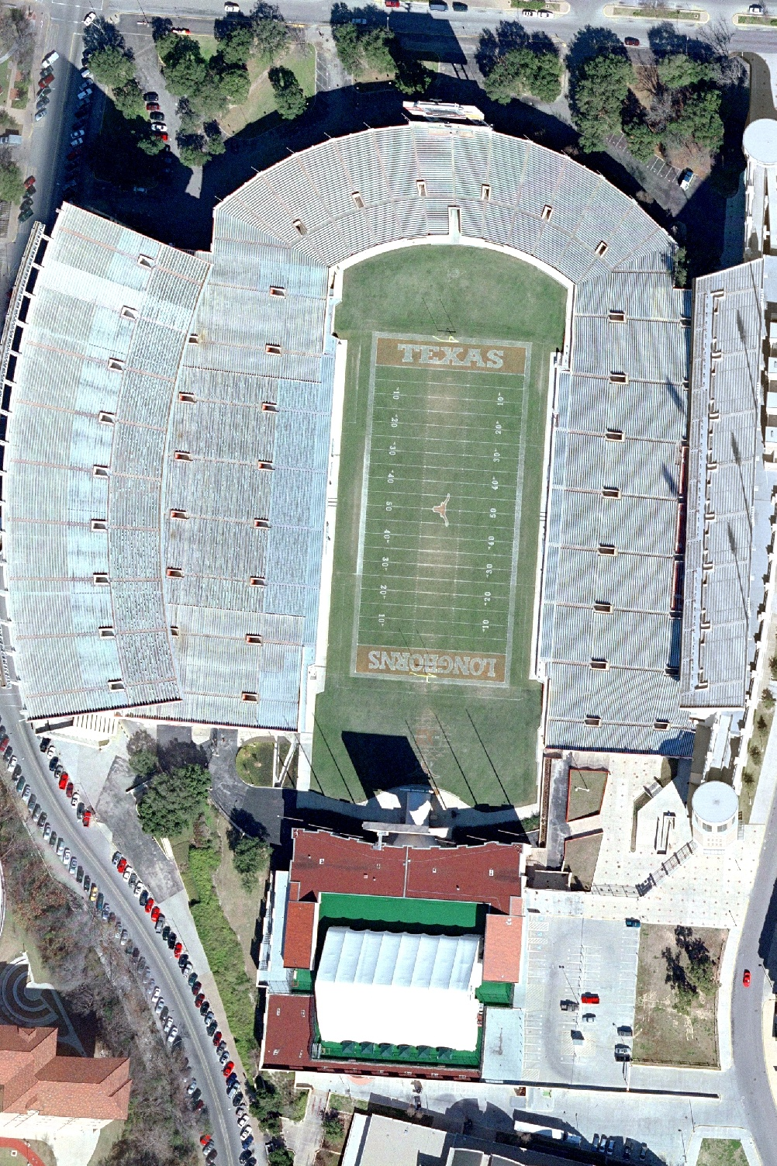
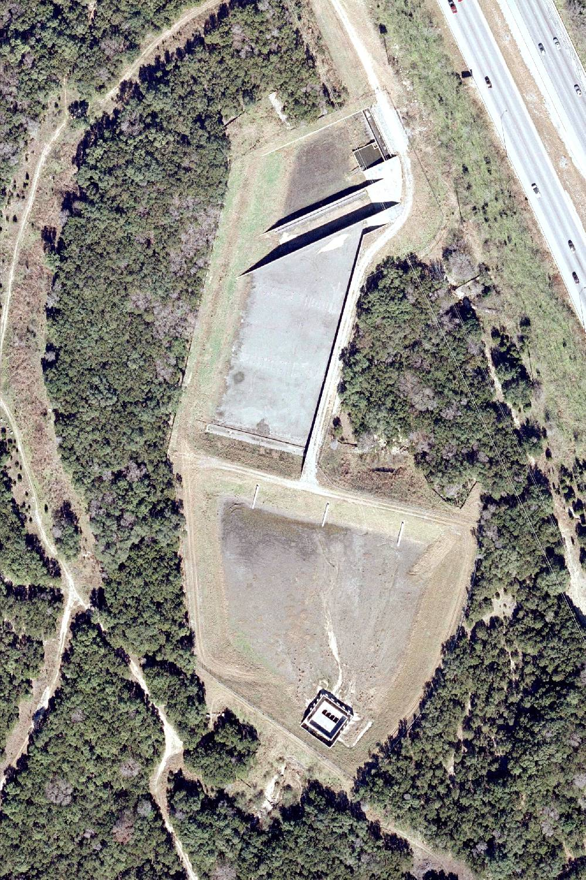
Courtesy Matt Hollon
1,000 ft
Loop 360
TxDOT Pond
Notes:
Extreme example of end of pipe.

Slide 16
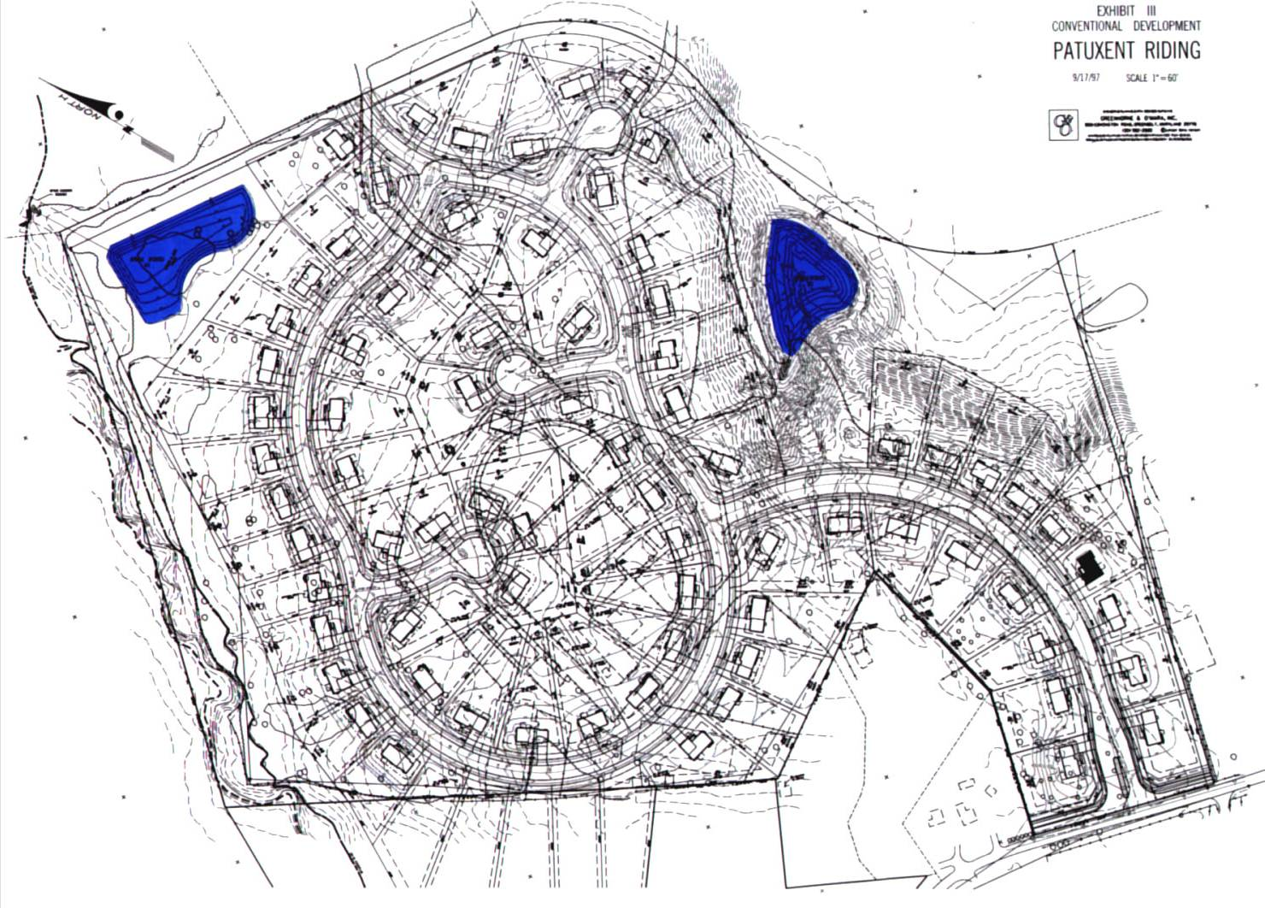
Conventional Development

Slide 17
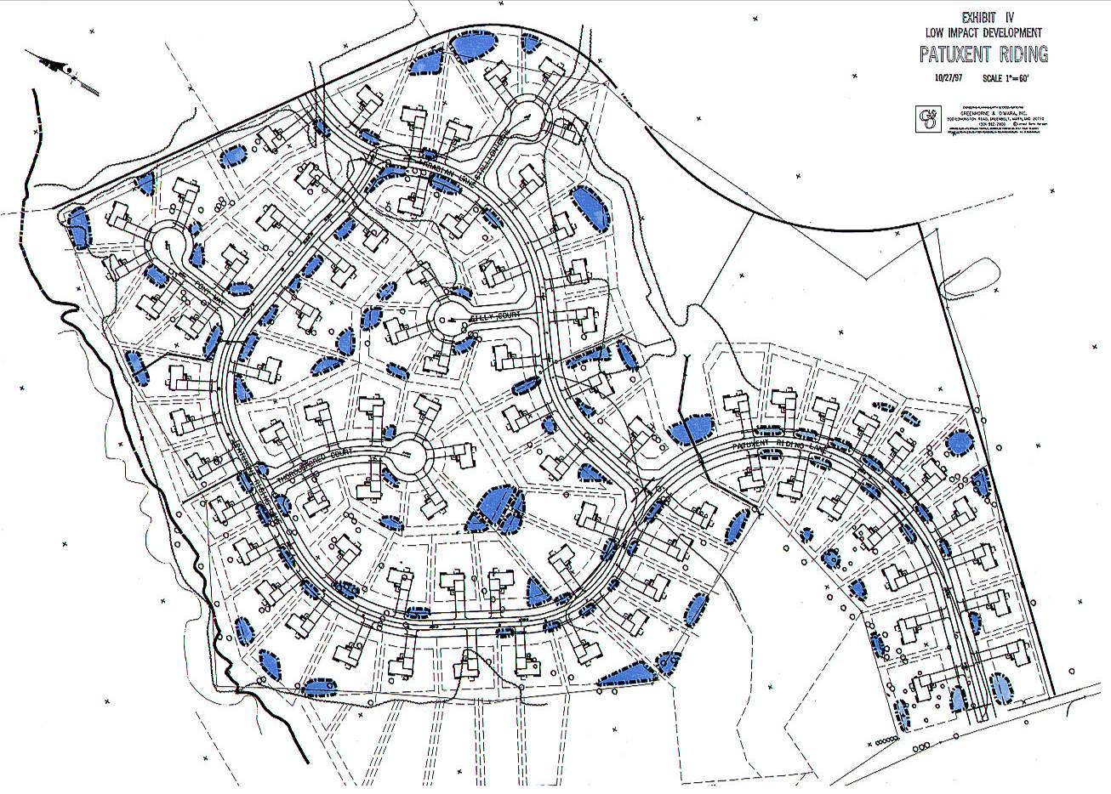
LID Development
Multiple Systems
Disconnected Decentralized Distributed Multi-functional

Slide 18
Pollutant Removal Mechanisms
Particle settling
Filtration
Biological uptake/degradation
Infiltration
Volatilization
Photodegradation
Oxidation

Slide 19
Typical LID Practices
Bioretention/rain gardens
Porous Pavement
Vegetated swales and buffer strips
Green roofs

Slide 20
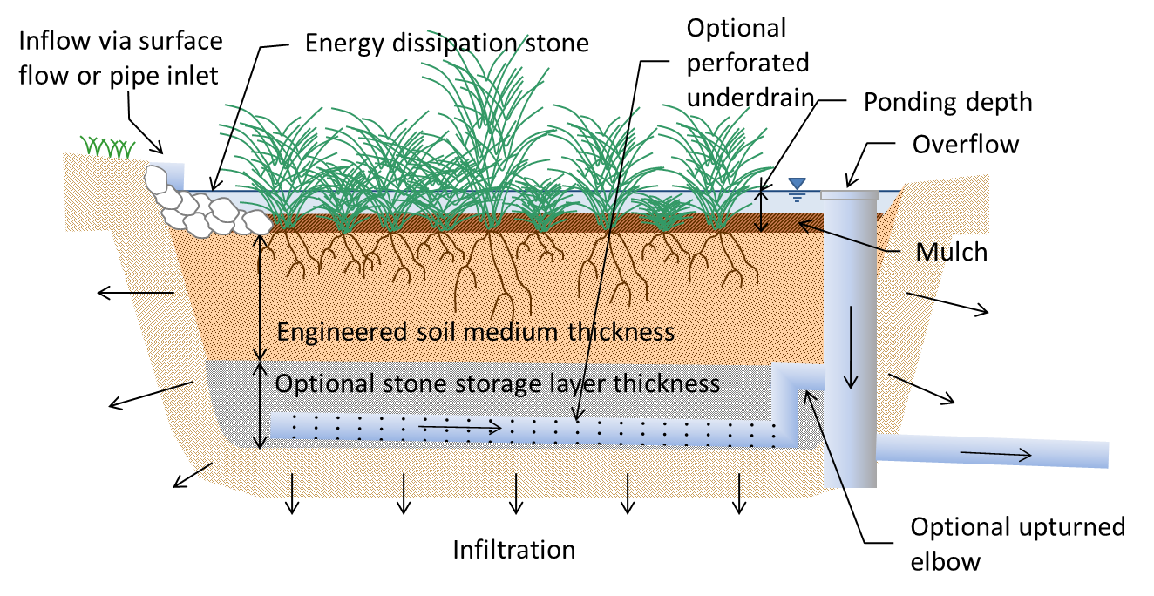
Bioretention

Slide 21
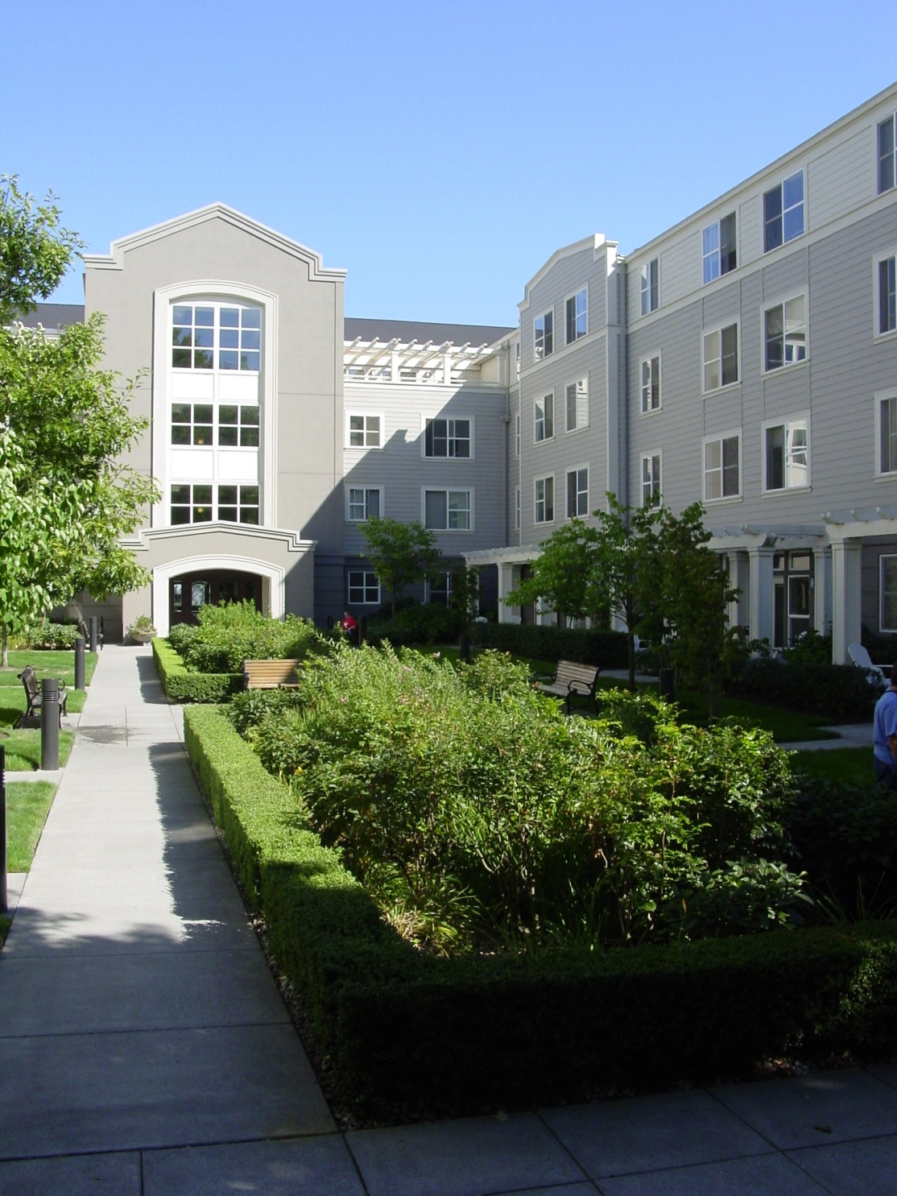
Bioretention

Slide 22
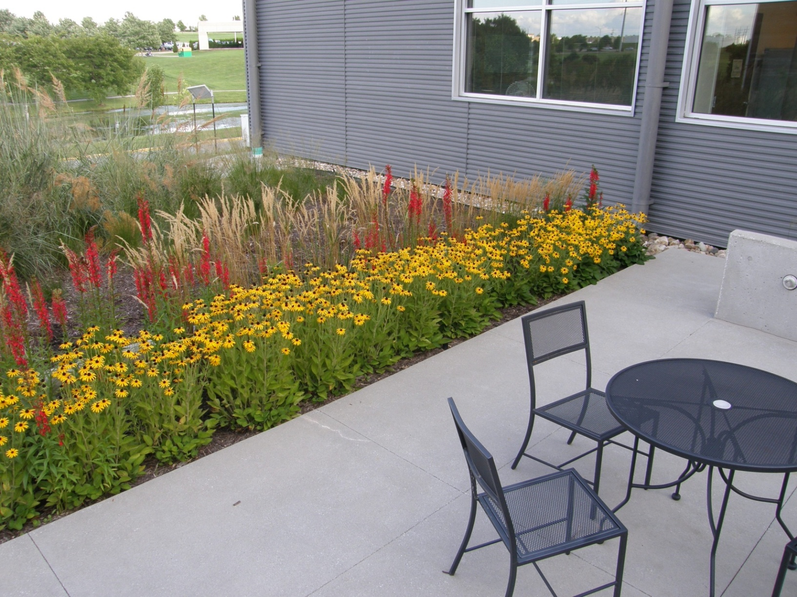

Slide 23
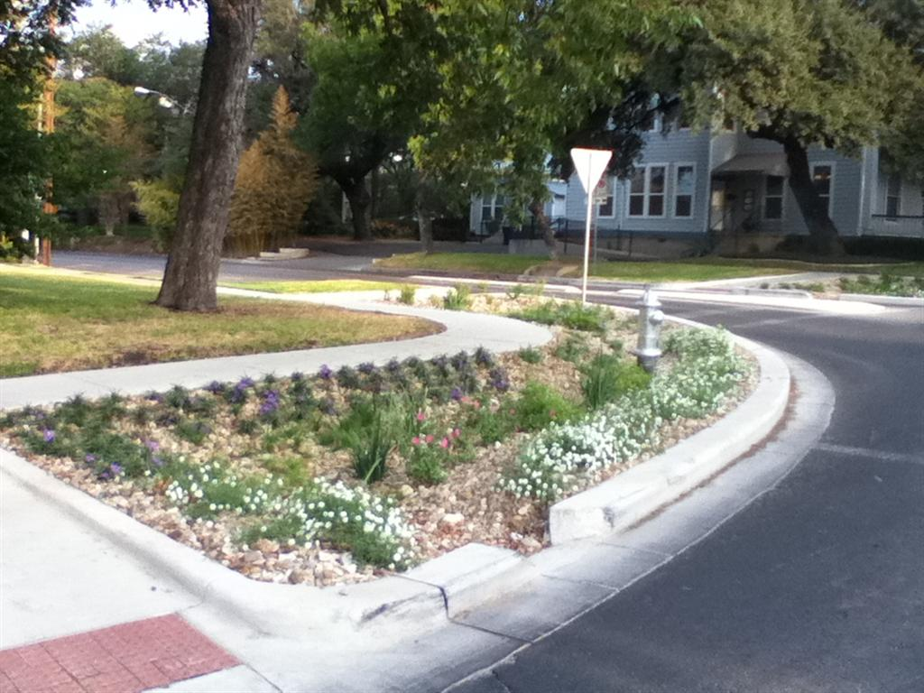
10th & Rio Grande
Image courtesy Tom Franke

Slide 24
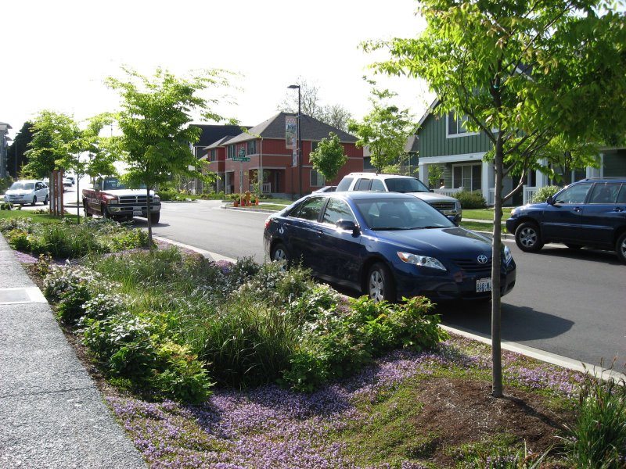
Curbside Bioretention

Slide 25
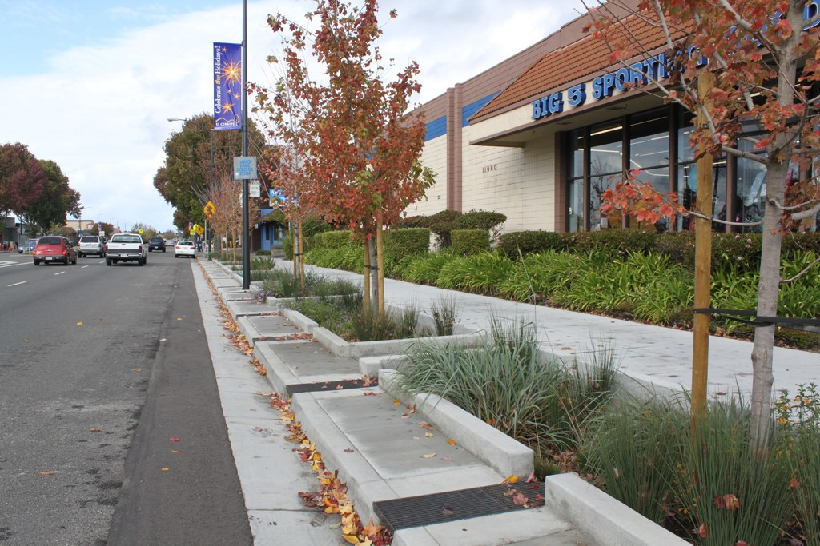
Setback Bioretention

Slide 26
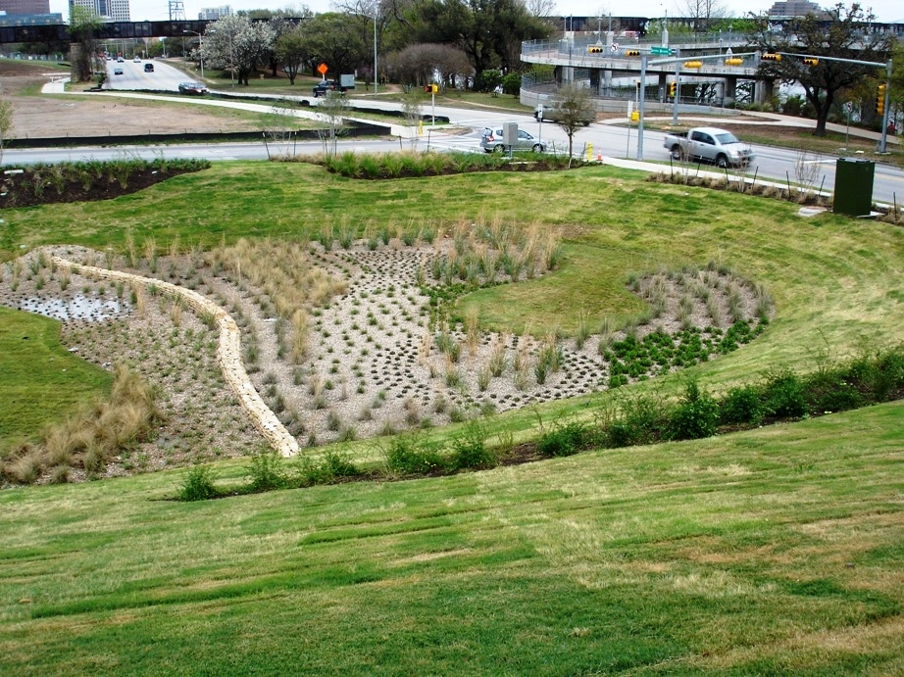
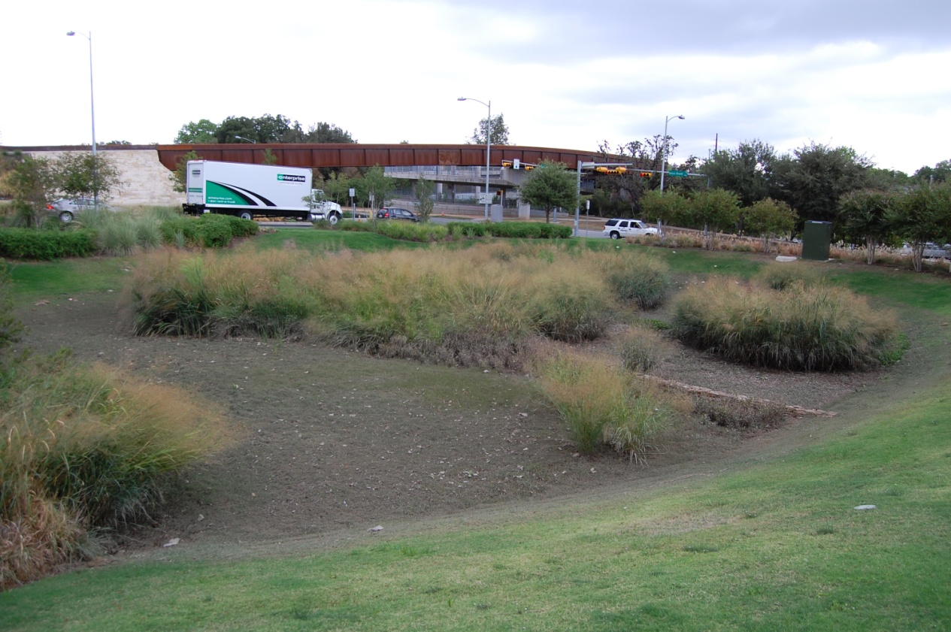
Sand Beach
Biofiltration Pond
March 2009
October 2011

Slide 27
Types of Porous Pavement
Interlocking Concrete Pavers
Pervious Concrete
Porous Asphalt
Grid type systems
Porous overlays (OGFC, PFC)

Slide 28
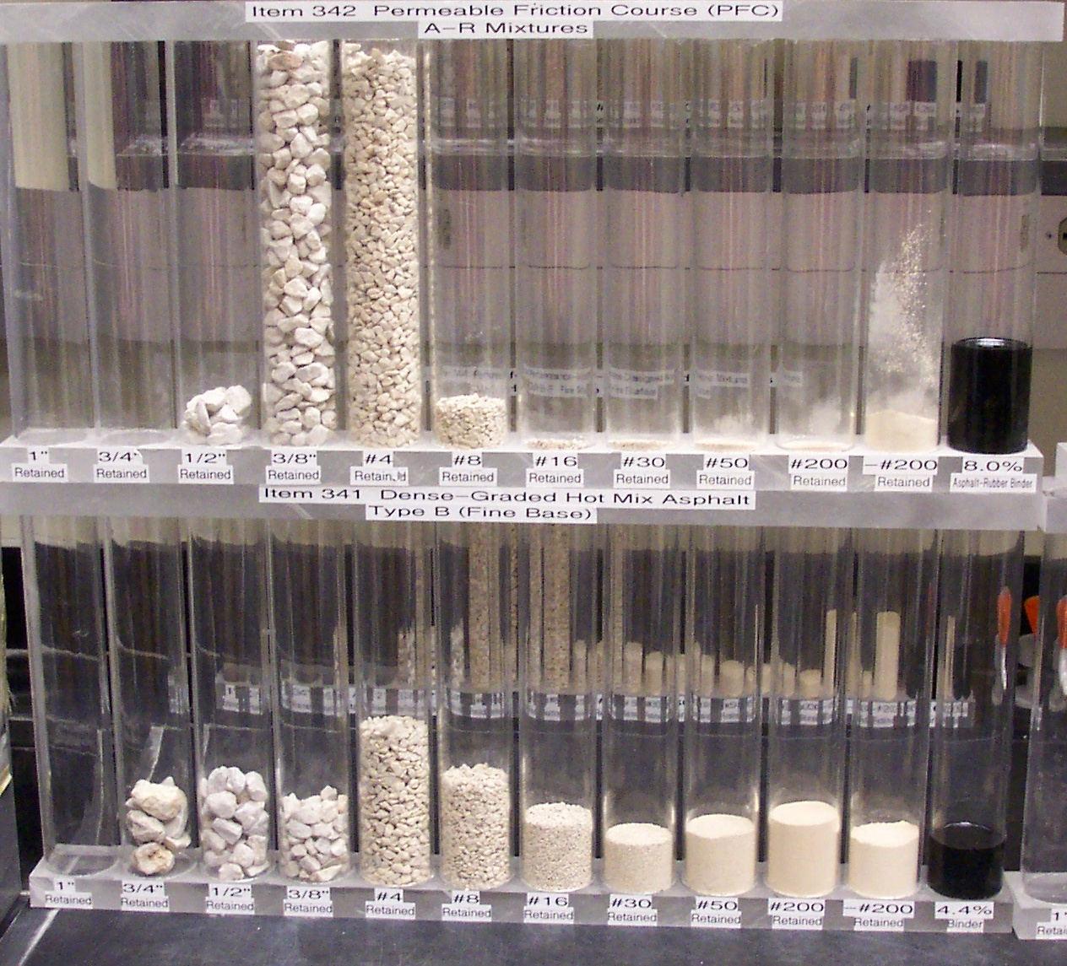
Porous Asphalt and Concrete
Porous Mix
Conventional Mix

Slide 29
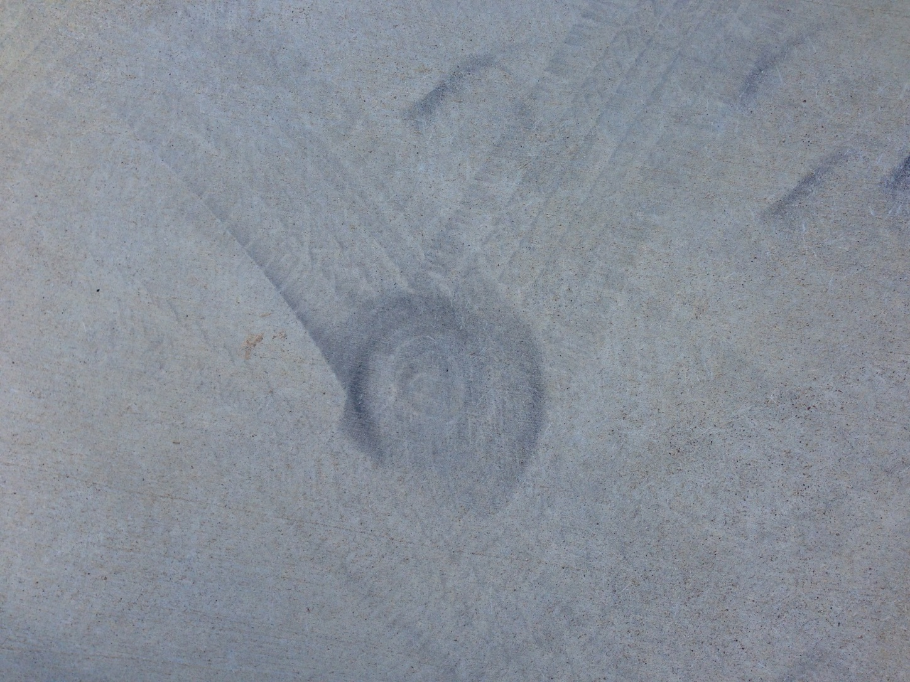
Source of Raveling

Slide 30
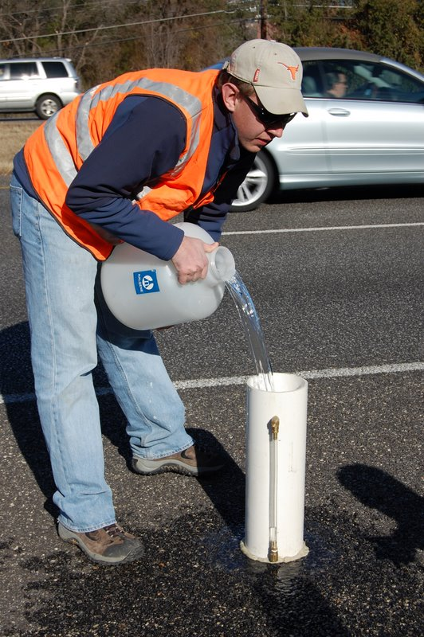
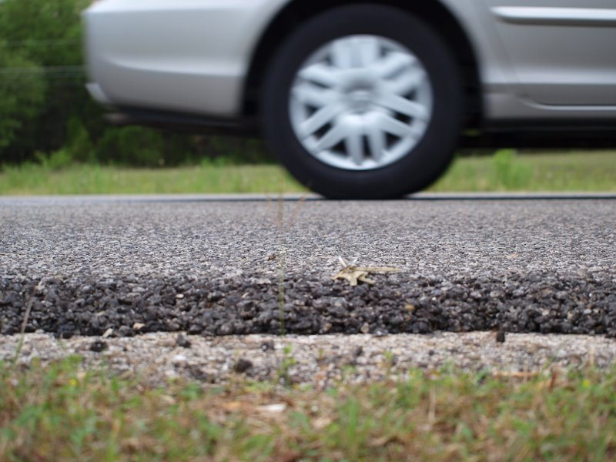
Permeable Friction Course
Overlay of porous asphalt placed on top of regular pavement
Water drains through the pavement rather than across it

Slide 31
Benefits of PFC
Reduce splash and spray
Reduced tendency to hydroplane
Improved visibility
Better traction characteristics
Quieter

Slide 32
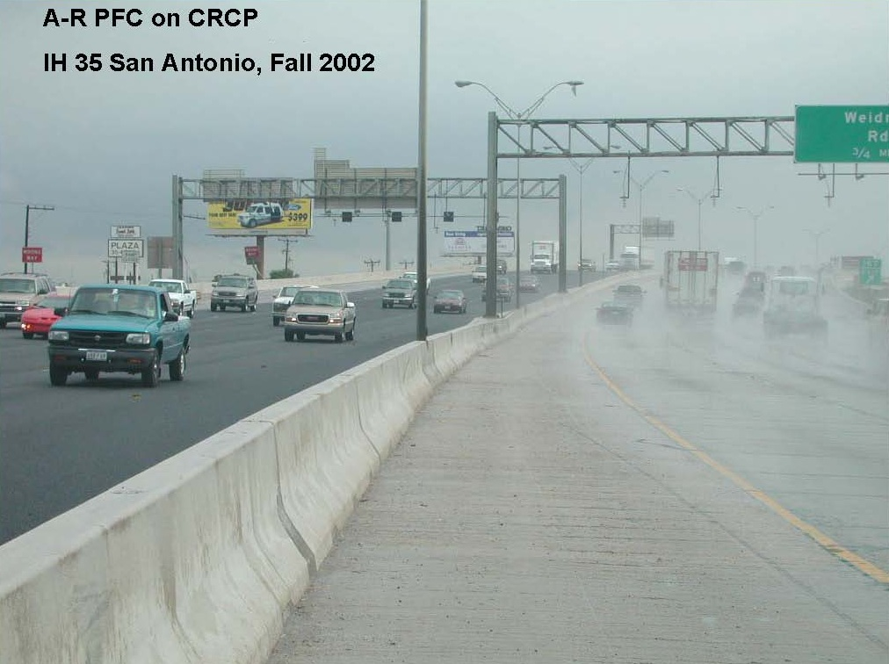

Slide 33
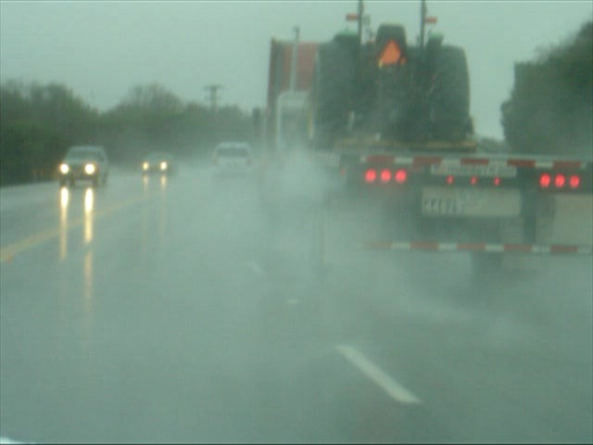
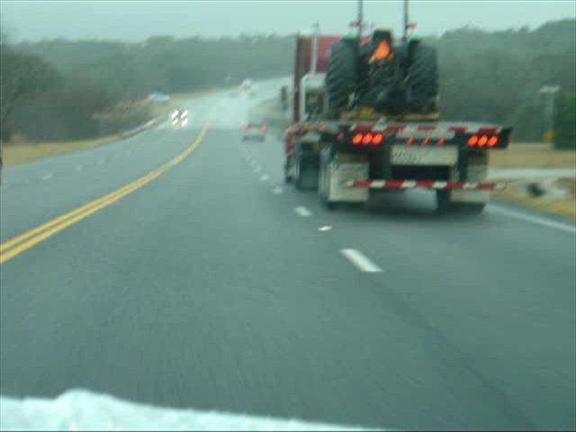
Splash and Spray
Conventional Asphalt
PFC

Slide 34
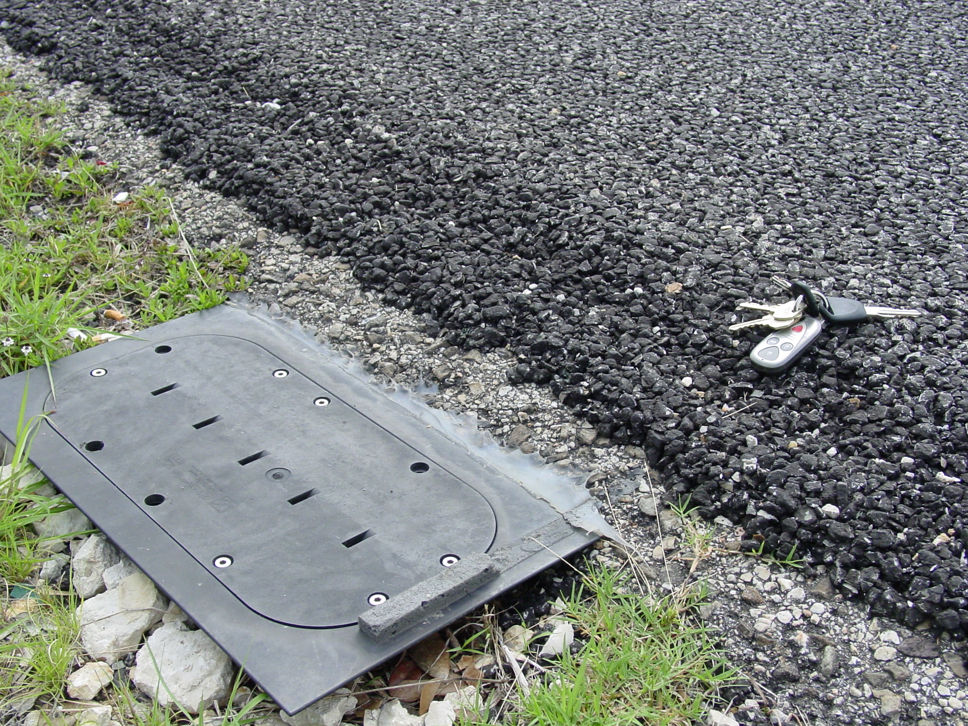

Slide 35
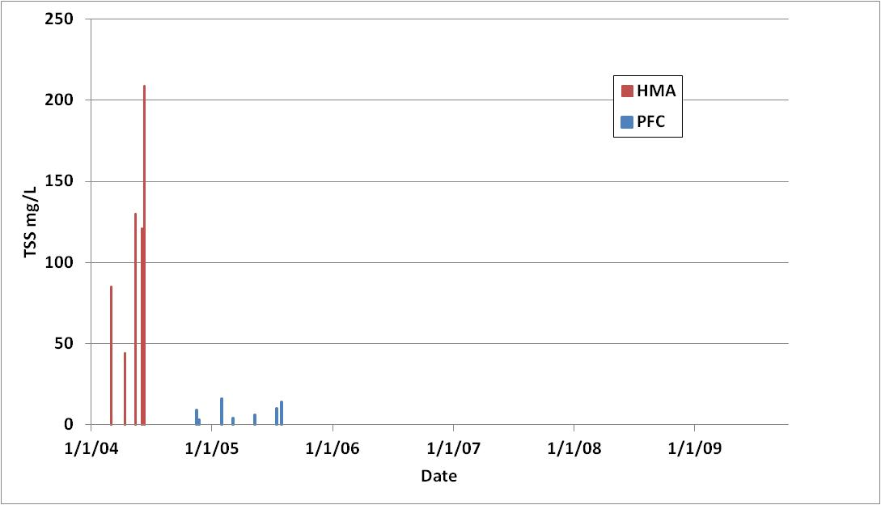
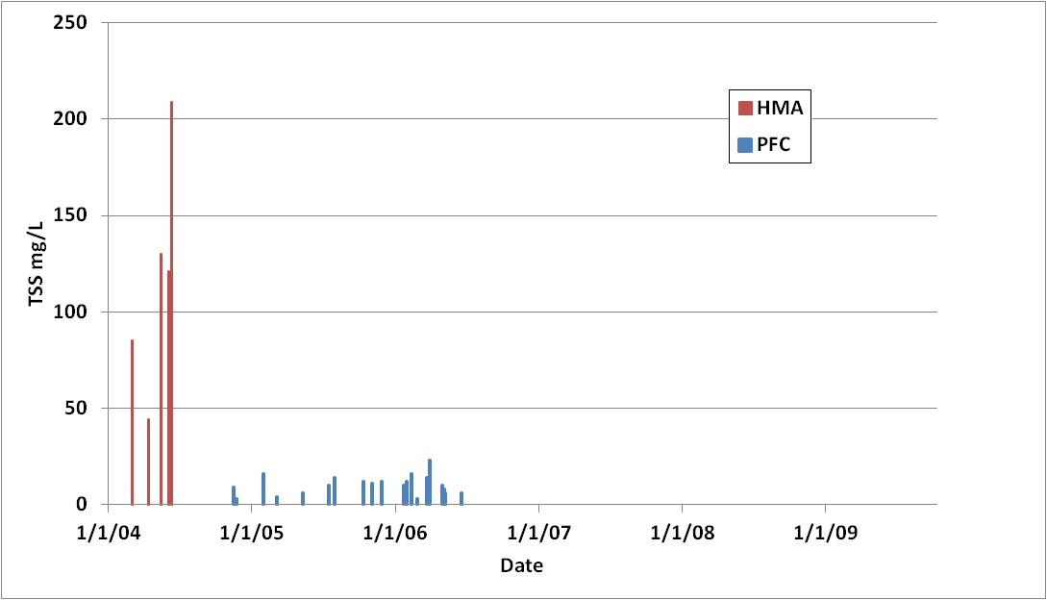
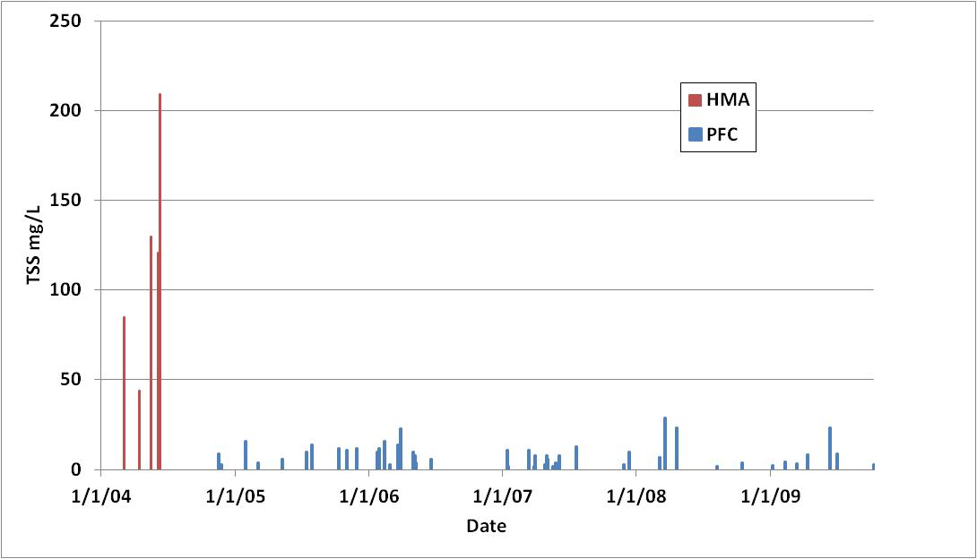
TSS Temporal Trend

Slide 36
Water Quality at TX1
Constituent | Conventional Asphalt | PFC | Reduction % | p-value
TSS | 118 | 8.8 | 92 | 0.016
Total P | 0.13 | 0.07 | 48 | 0.047
Total Copper | 27 | 13 | 50 | 0.010
D. Copper | 6 | 10 | -77 | 0.045
Total Lead | 13 | 1 | 91 | 0.025
Total Zinc | 167 | 29 | 83 | 0.002
Dissolved Zinc | 47 | 22 | 53 | 0.139

Slide 37
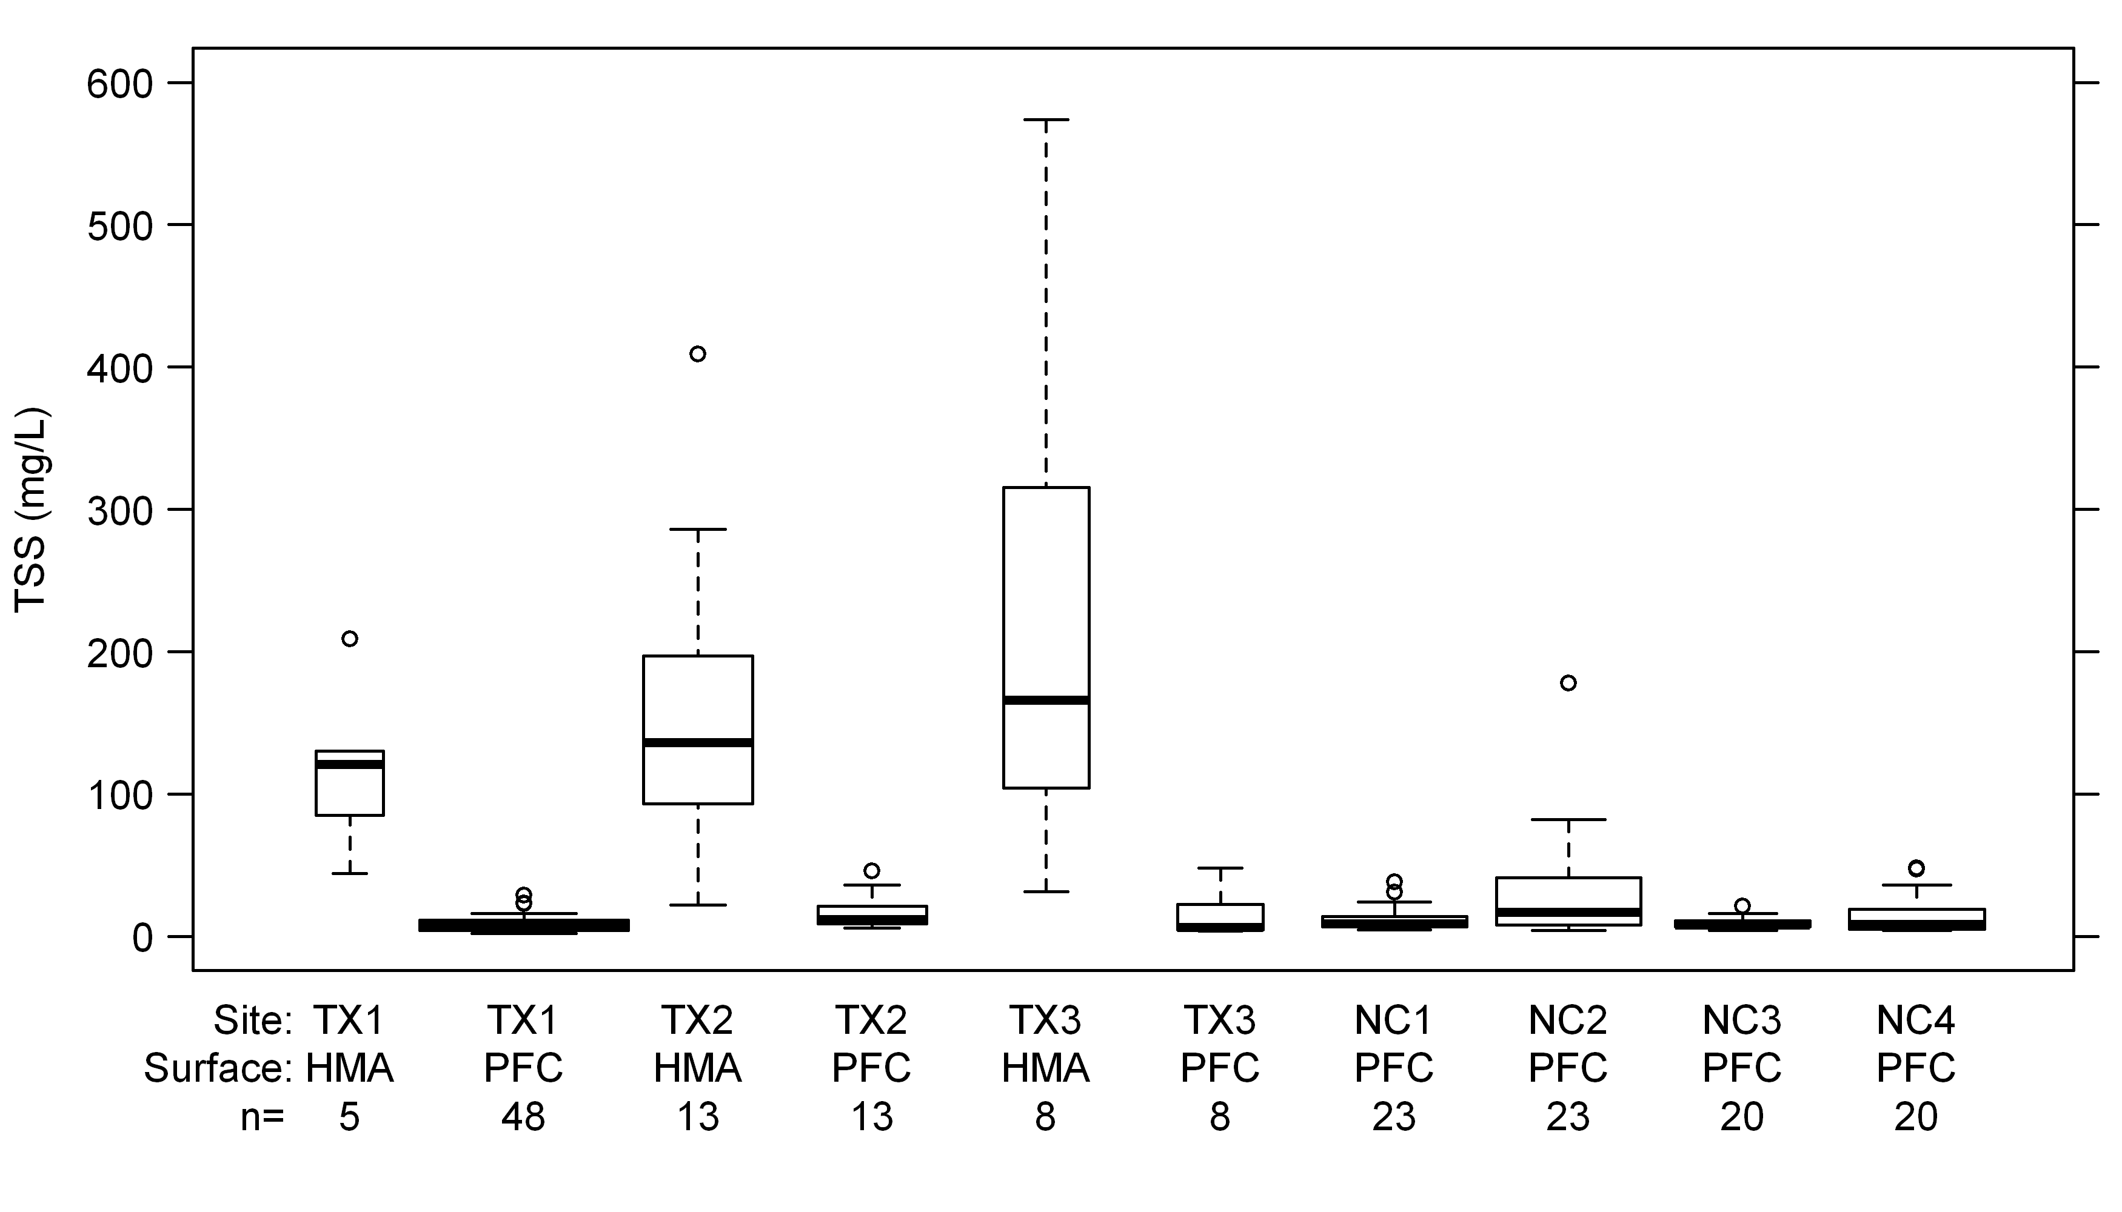
Texas vs. North Carolina

Slide 38
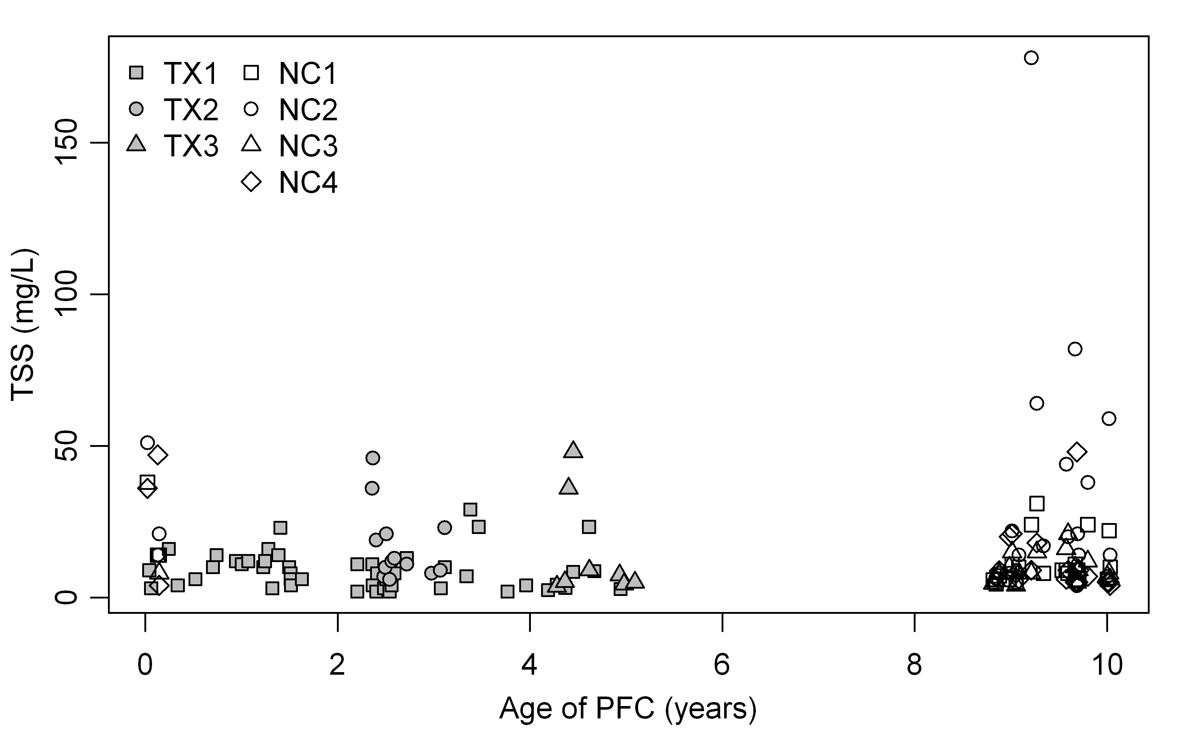
Water Quality Benefits

Slide 39
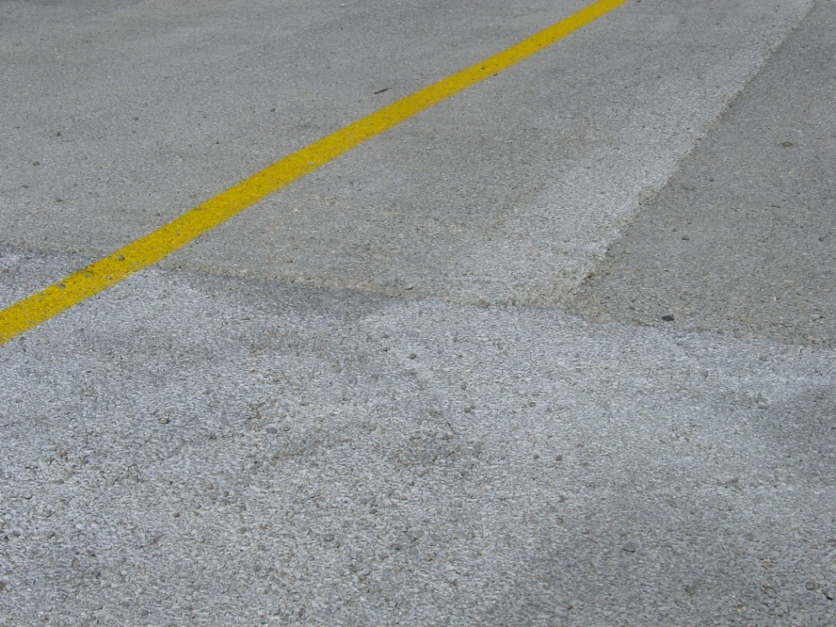
Pervious Concrete
Generally has a lower strength
Water content is critical for proper installation
Requires specialized crew for installation
Each batch tends to have a different color/texture
Tends to ravel in high traffic areas

Slide 40
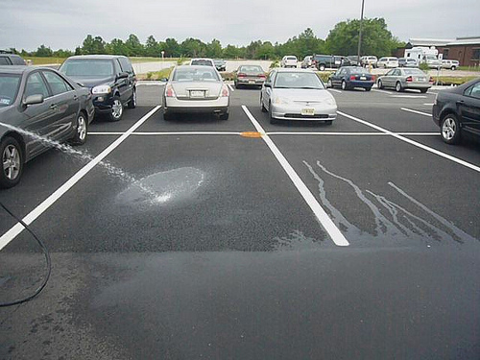
Porous Asphalt
Created by omitting fine material from asphalt
Asphalt is considered flexible pavement, so low strength is not as much an issue.
Less expensive than concrete
No specialized training needed for installation

Slide 41
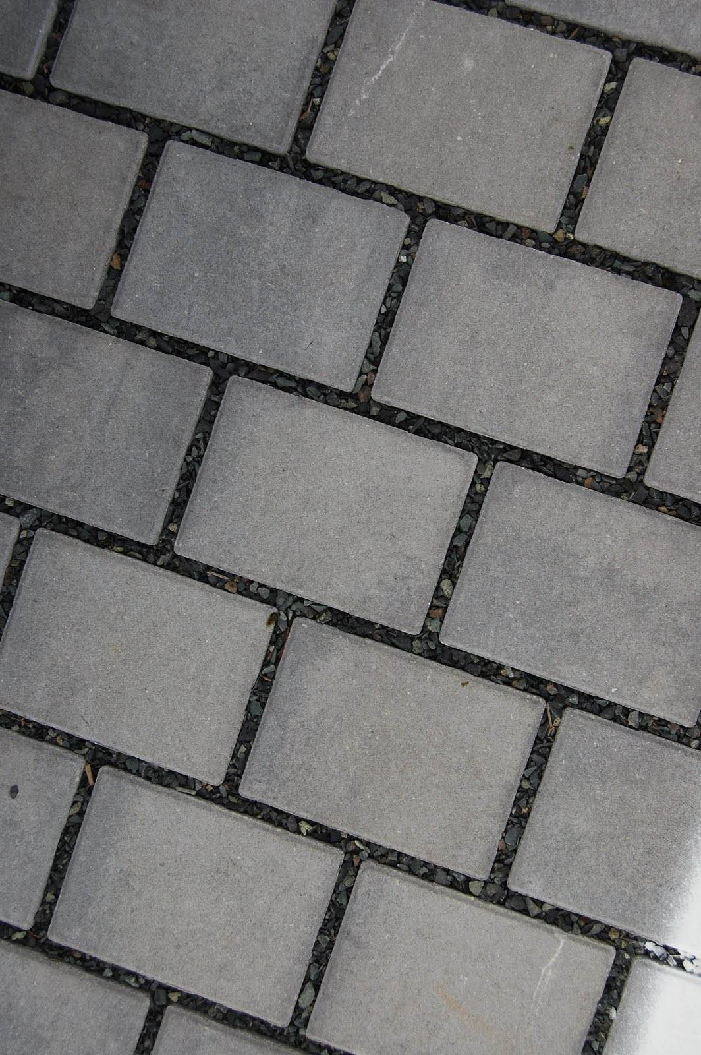
Pavers
Most expensive option
Decorative element
Easily removed and replaced if needed
Highly permeable

Slide 42
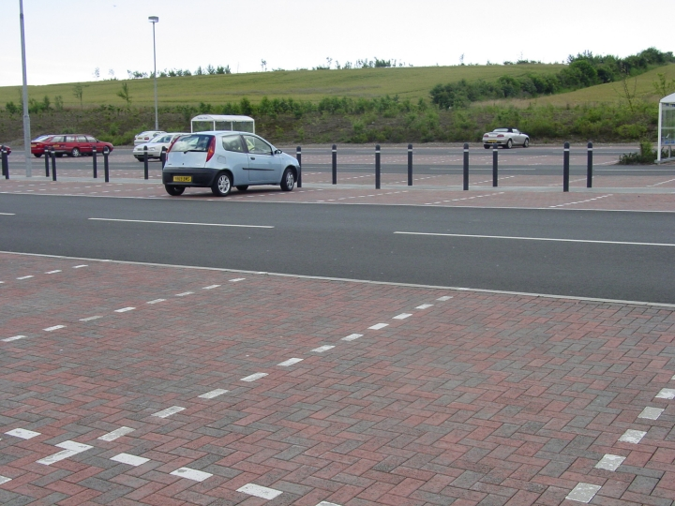
Porous Pavement only in Parking Stalls

Slide 43
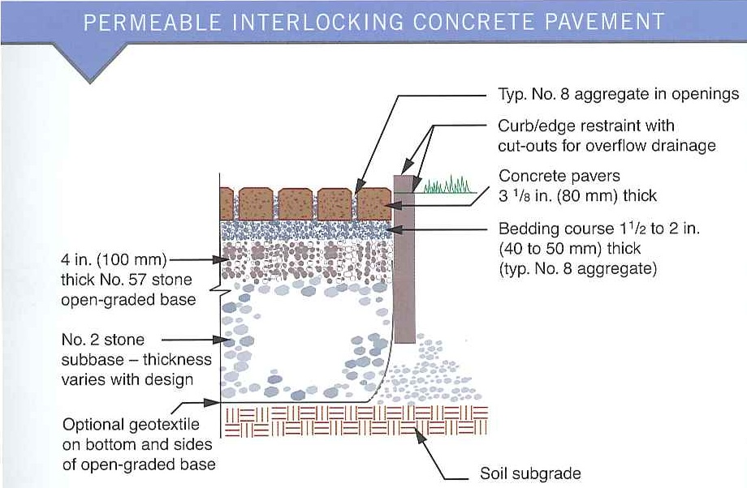
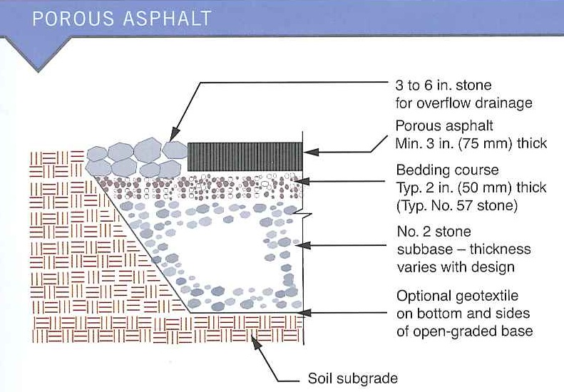
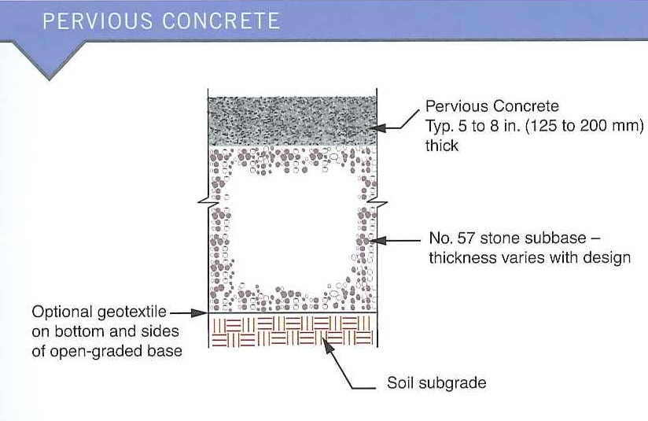
Pavement Installation

Slide 44
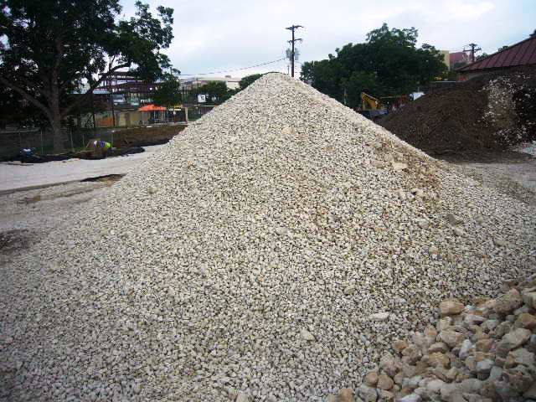
Reservoir Material

Slide 45
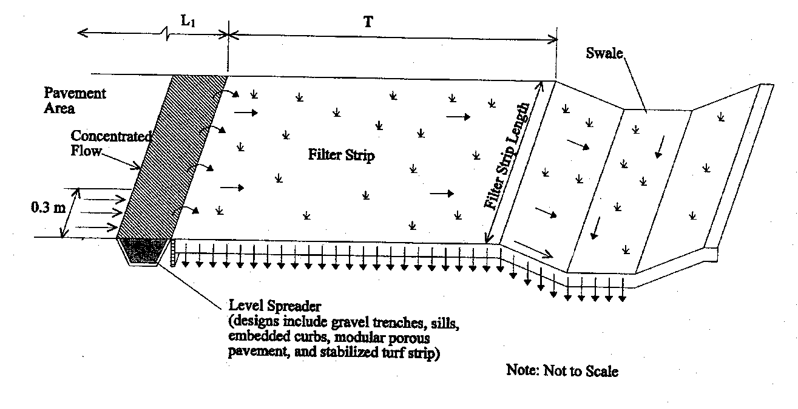
Schematic of Swale and Strip

Slide 46
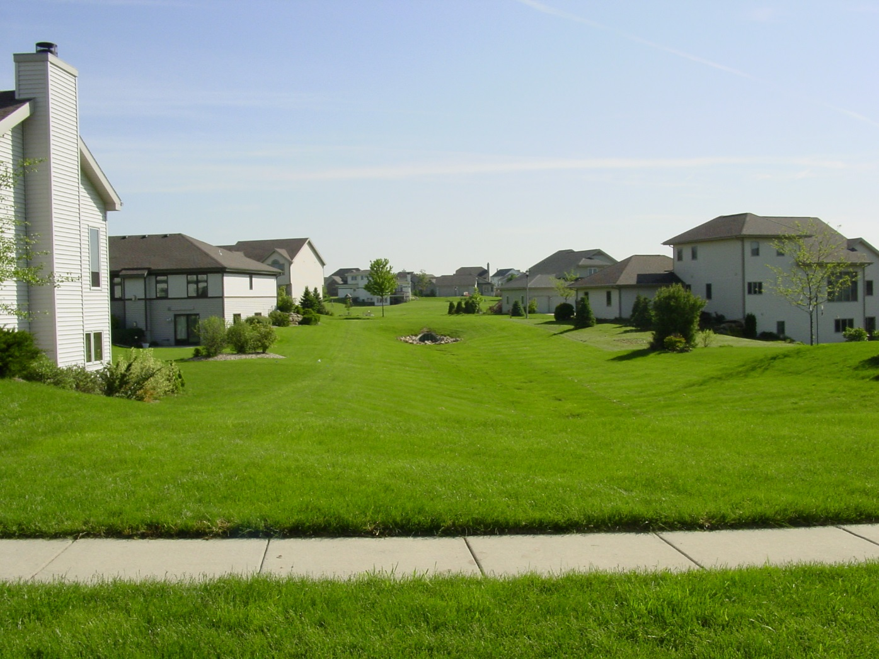

Slide 47
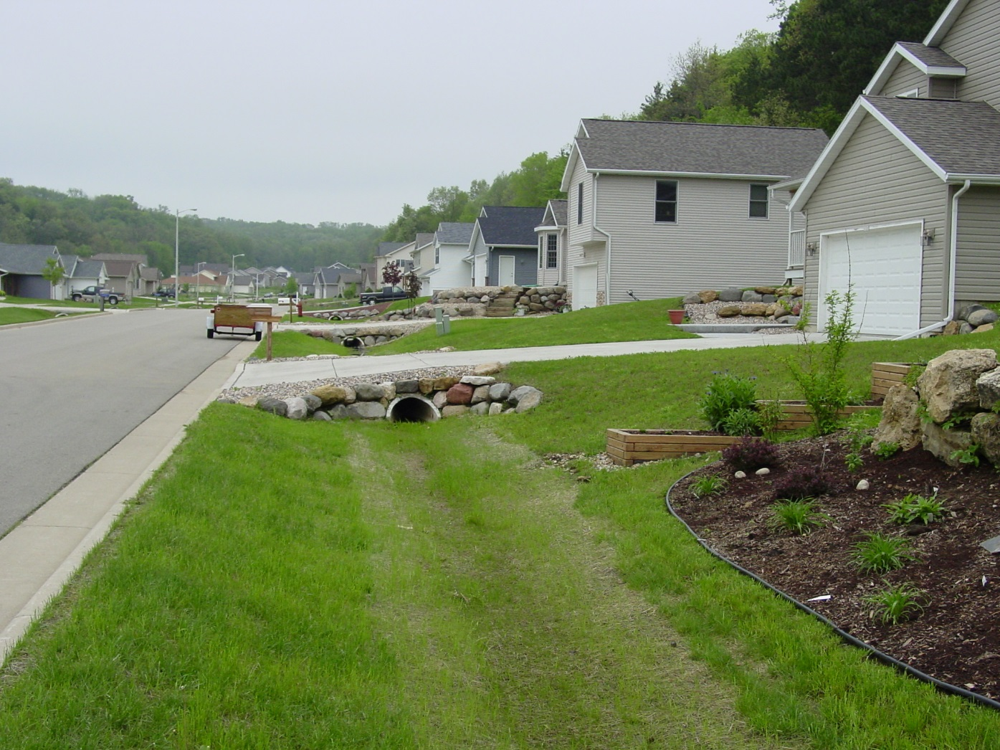

Slide 48
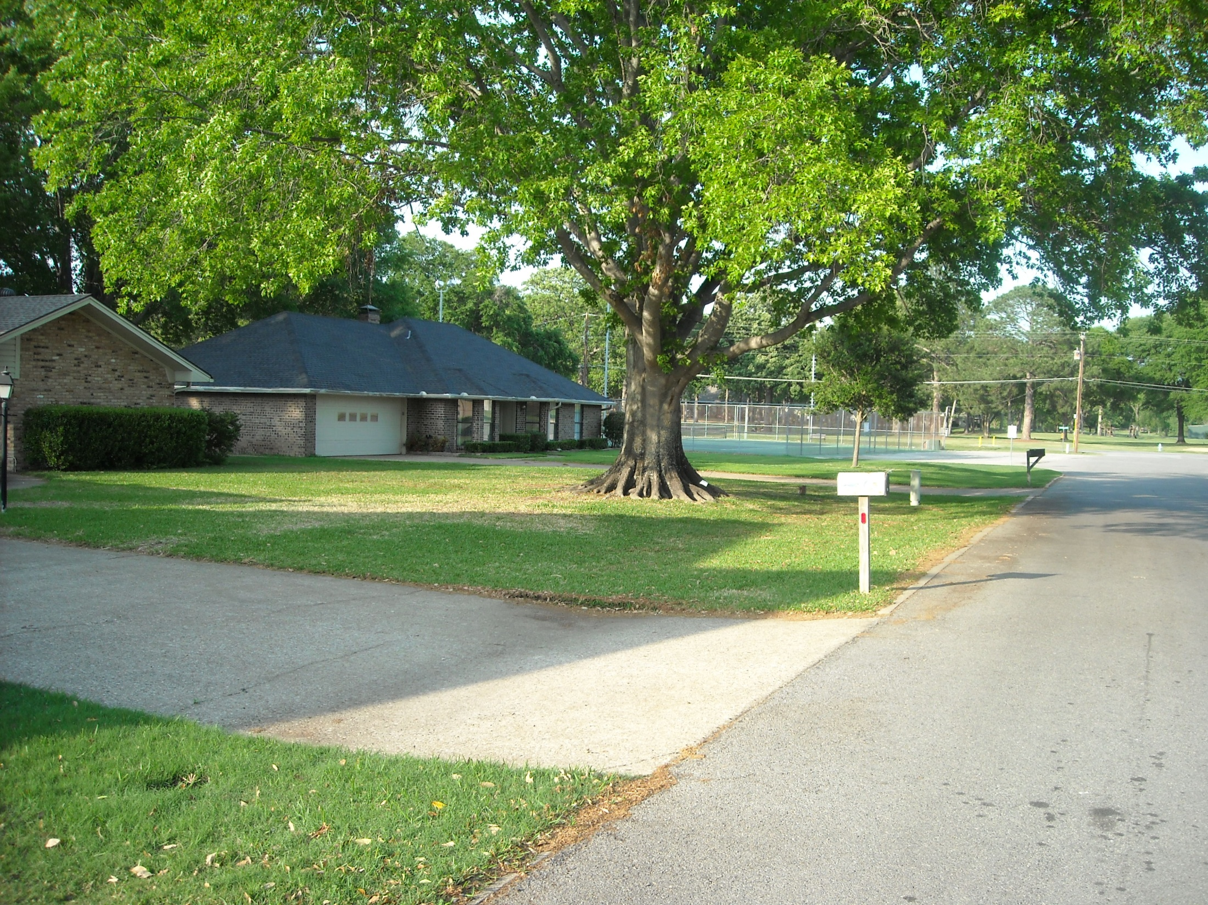

Slide 49
Vegetated Filter Strips

Slide 50
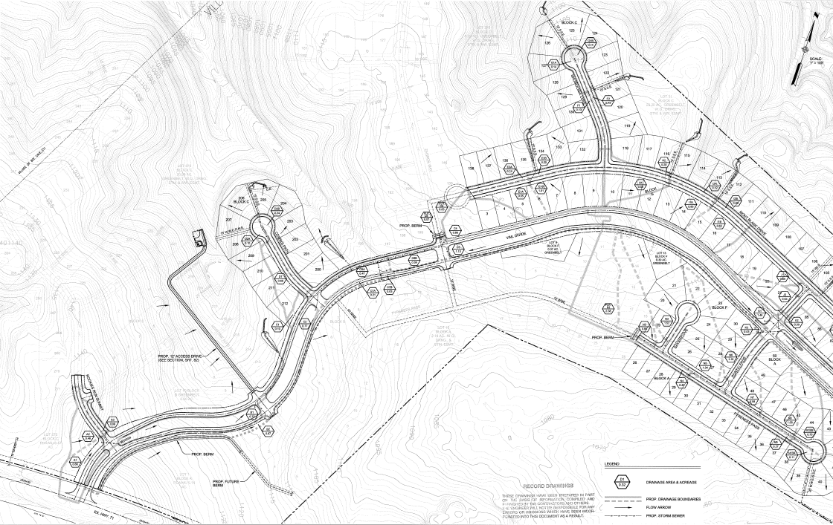
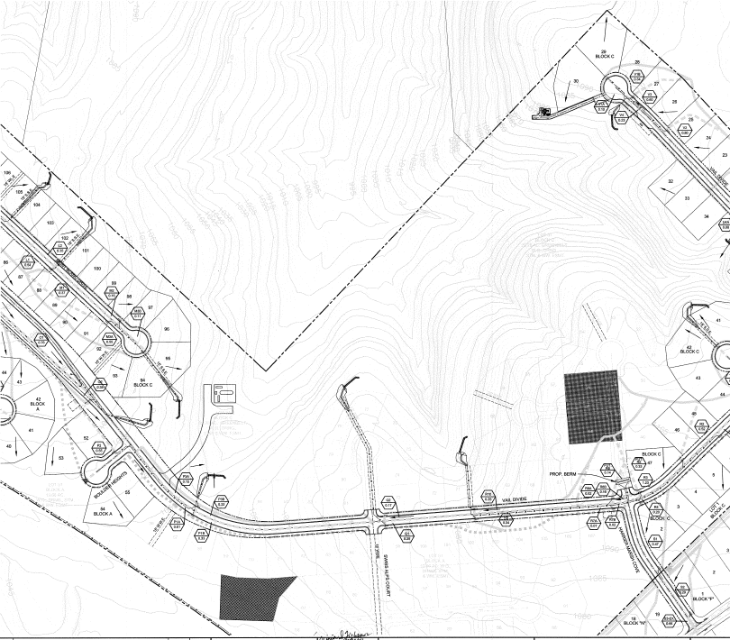
Falconhead West Development
Ozark Path Site
Swiss Alps Site
SH 71

Slide 51
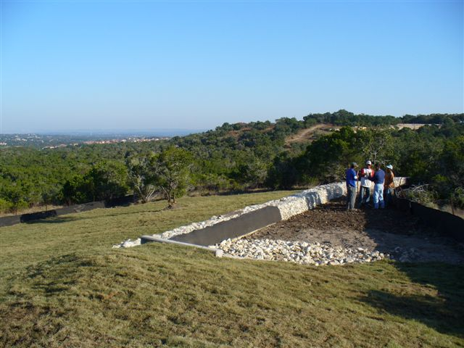

Slide 52
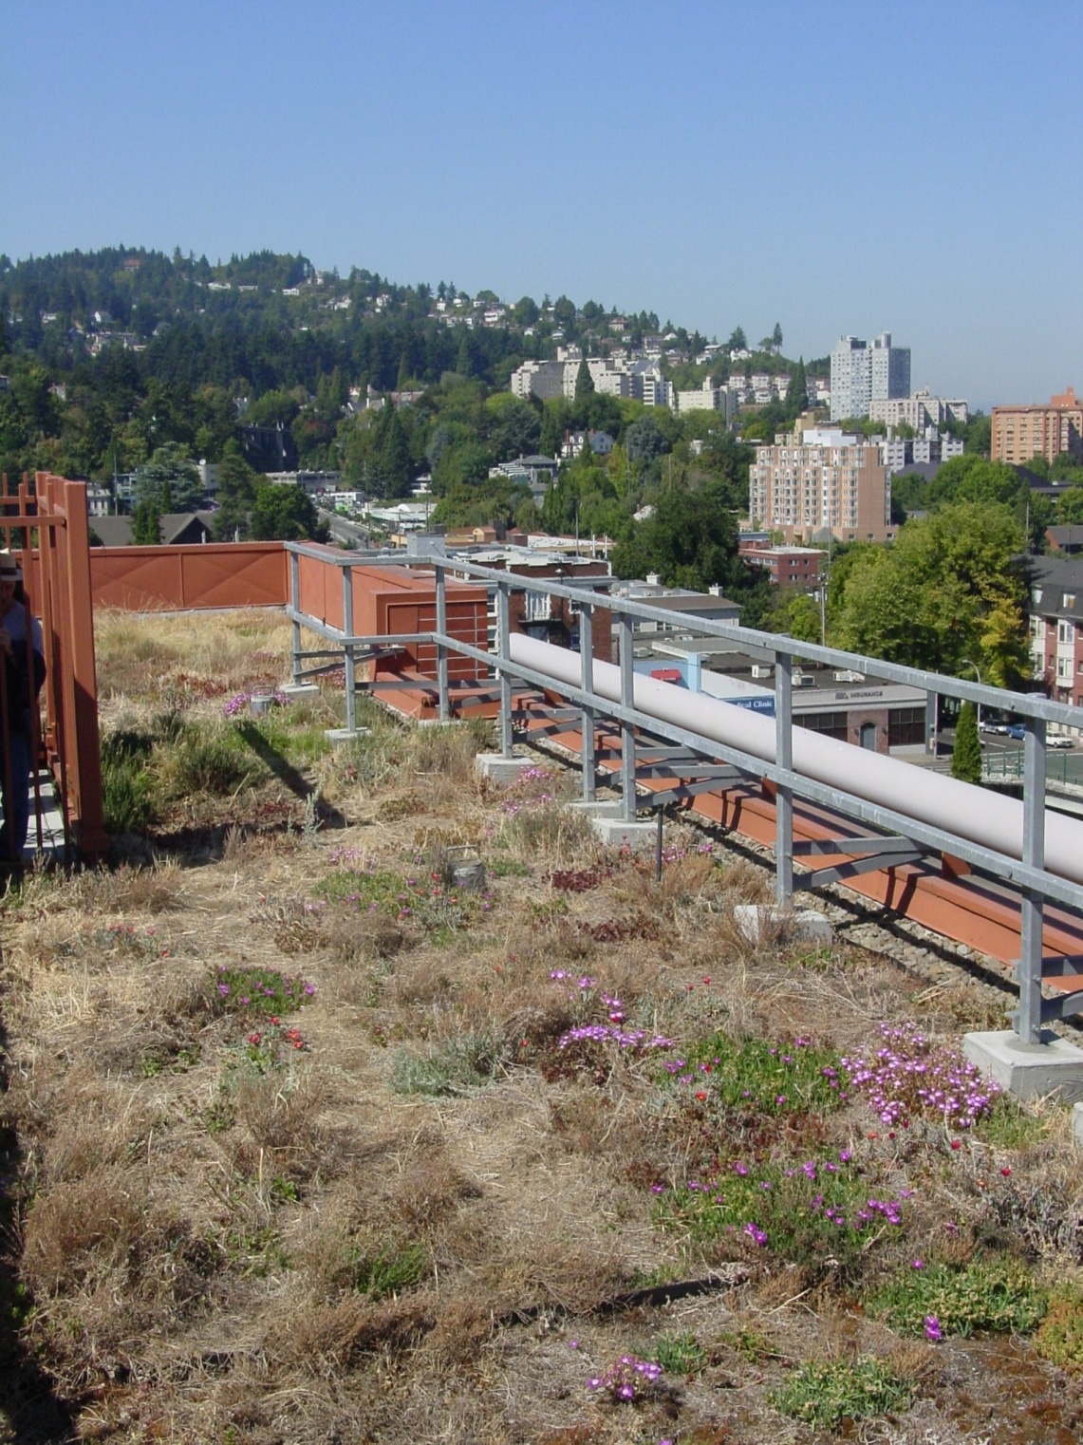
Green Roofs

Slide 53
Summary
Substantial environmental impacts of urbanization
Objectives of BMPs are to reduce concentrations of pollutants and runoff volumes
Move towards LID practices from end-of-pipe
Stormwater treatment is an integral part of urban runoff management

