Slide 1
Drought and Water Supply Planning
Reading: Section 15.6 of Applied Hydrology

Slide 2
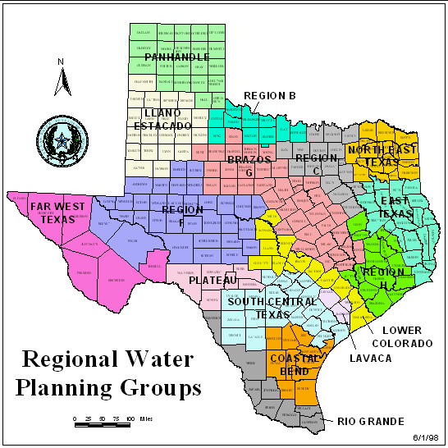
Senate Bill 1 (1997) Water Modeling and Planning
Before Senate Bill 1, water planning was done state-wide by TWDB
SB1 established 14 water planning regional groups, who are now responsible for planning water supply in their area
Water Availability Modeling
(TNRCC)

Slide 3
http://www.regionfwater.org/

Slide 4
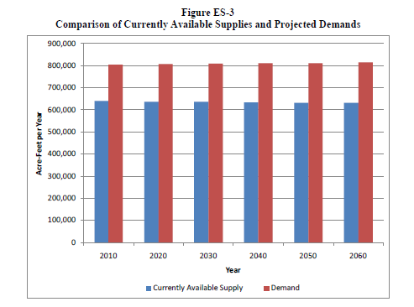
http://regionfwater.org/files/regionf/Final/Final%202011%20Plan/Executive%20Summary.pdf

Slide 5
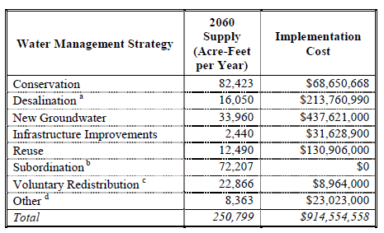
Region F Water Plan for 2060
2000 Census Population: 579,000 2060 Projected Population: 724,000
Increase over 60 years of 145,000
Cost of Water Supply = $915,000,000 or $1580 per person in 2000 or $26/person/year

Slide 6
Colorado River Municipal Water District
http://www.crmwd.org/

Slide 8
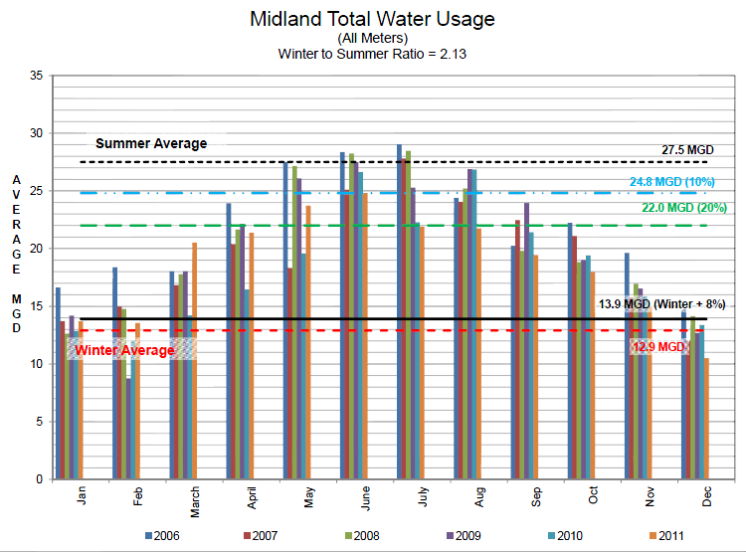

Slide 9
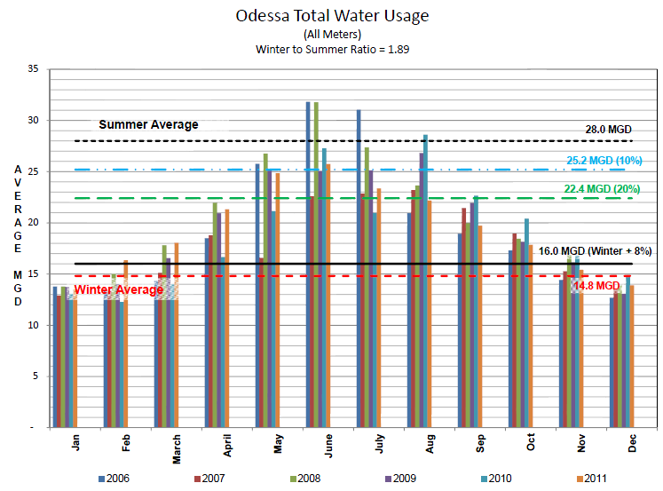

Slide 10
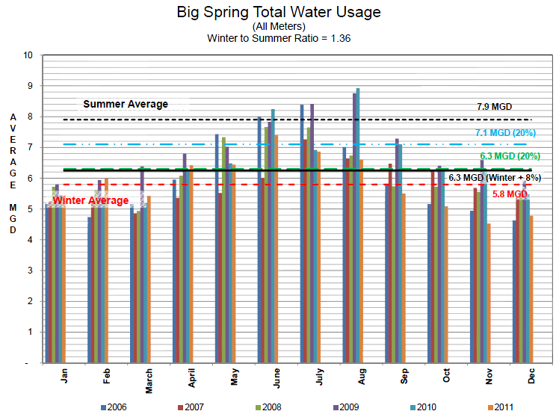

Slide 11
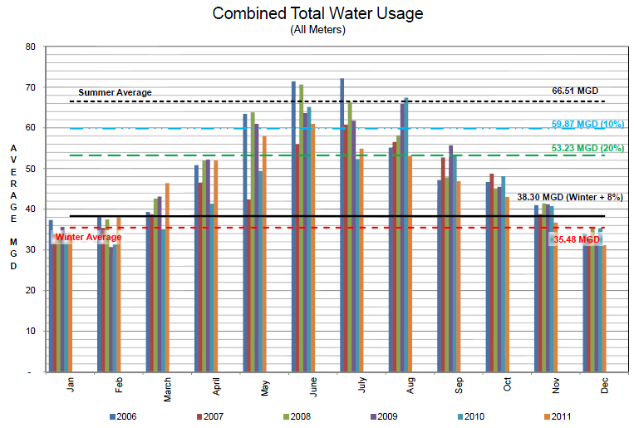

Slide 12
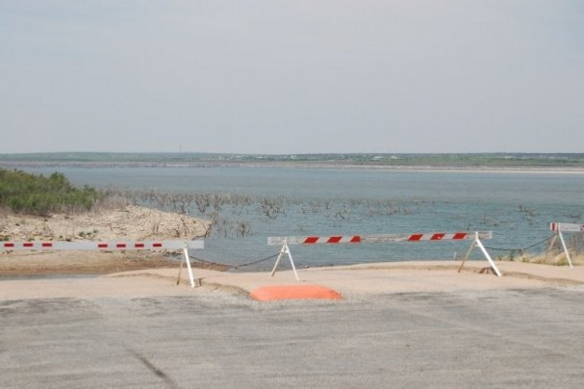
O.H. Ivie Reservoir
Owned and operated by the Colorado River Municipal Water District
Purpose: Water Supply
Supplies: Odessa, Big Spring, Snyder, Midland, Abilene, San Angelo, Ballinger and Millersview-Doole
Storage Capacity: 554,339 acre-feet
Current Storage: 98,400 acre-feet
2011 Change in Storage: -81,820 acre-feet
M. Bewley

Slide 14
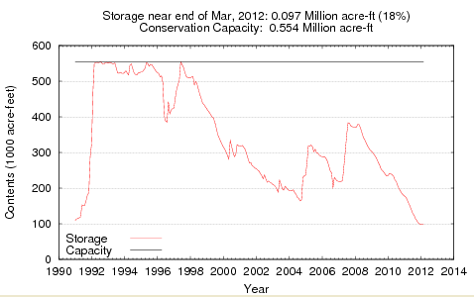
Lake O.H. Ivie

Slide 15
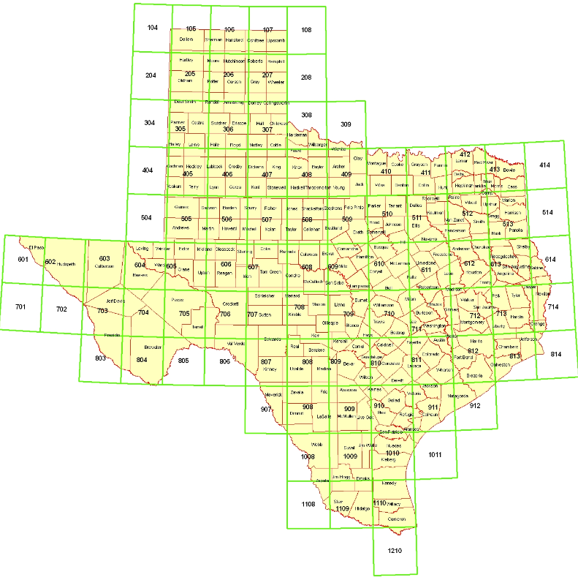
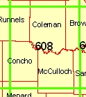
Texas Lake Evaporation
http://midgewater.twdb.texas.gov/Evaporation/evap.html

Slide 16
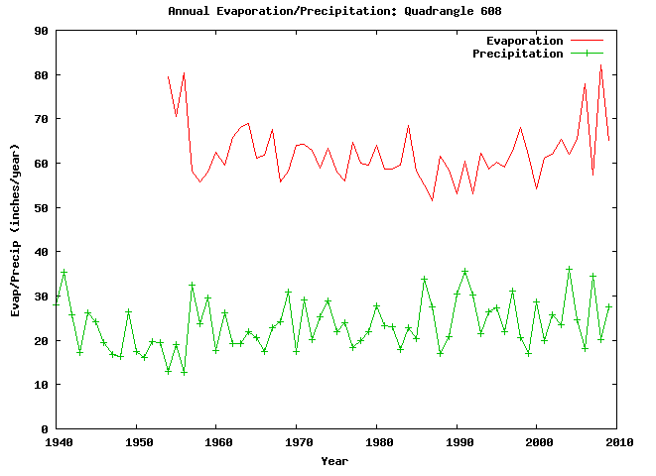
Mean = 64.4 inches = 5.36 ft
Lake surface area at 1 May 2012 ~ 3400 acres,
so evap loss = 3400 * 5.36 = 18,200 acre-ft/year = 25 cfs = 16 MGD
This is equal to the winter water demand of Odessa, Texas, pop. 270,000

Slide 17
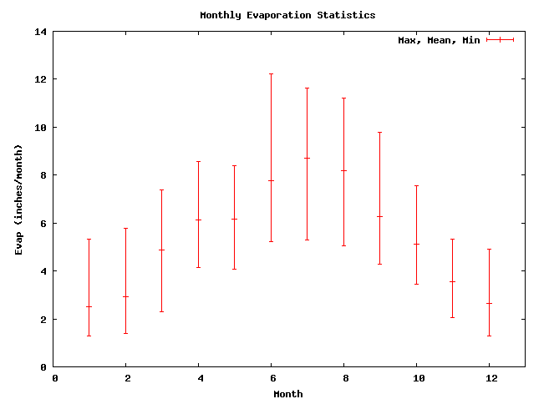
Annual Lake Evaporation = 64.41 inches
8.81
7.69
8.23
6.18
6.00
6.31
4.90
5.03
3.41
2.87
2.35
2.46
Quadrangle 608

Slide 18
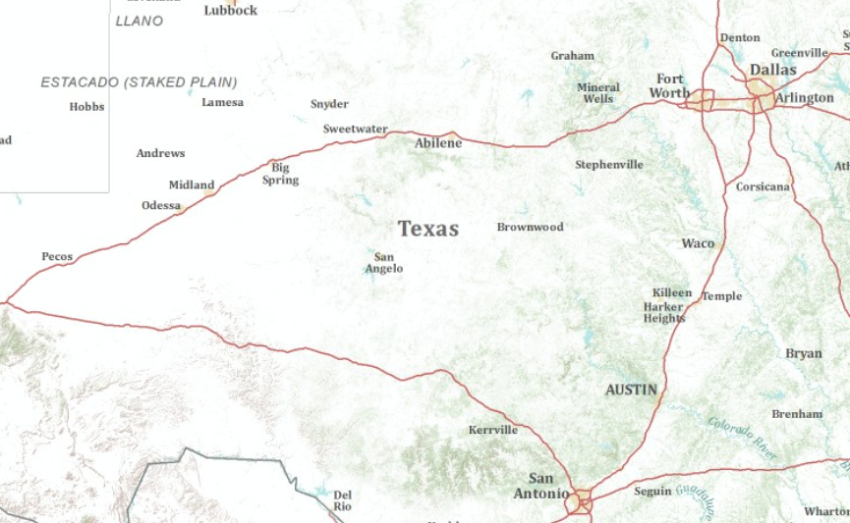
Winters, Texas
Winters, Texas
I-20
I-10

Slide 19
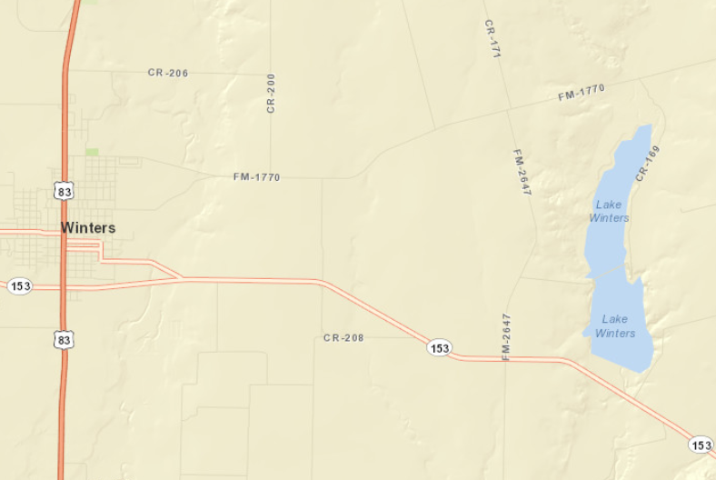
Lake Winters and Winters, Texas

Slide 20
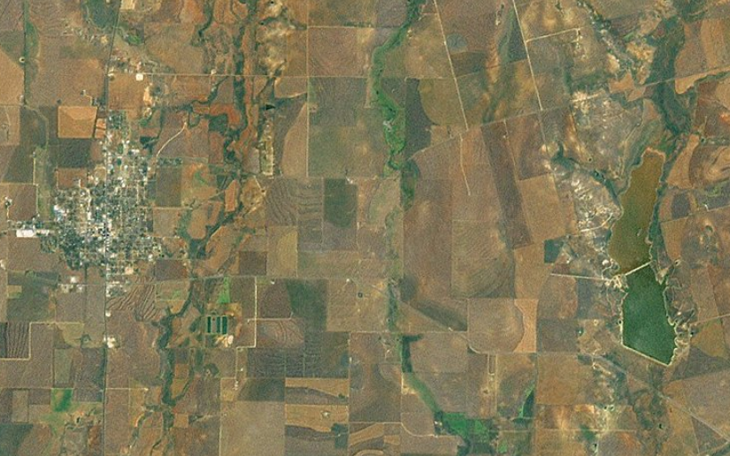
Winters and its Reservoir

Slide 21
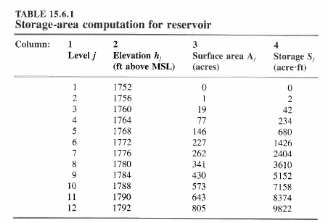

Slide 22
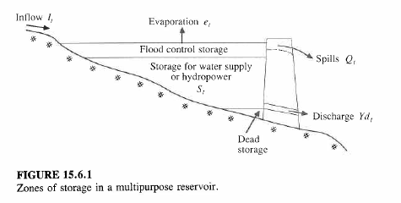
Reservoir Storage Analysis

Slide 23
Firm Yield

Slide 24
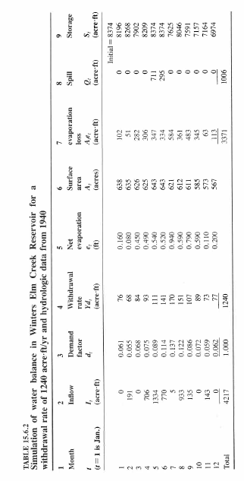
Reservoir Water Balance for Winters Elm Creek, Texas

Slide 25
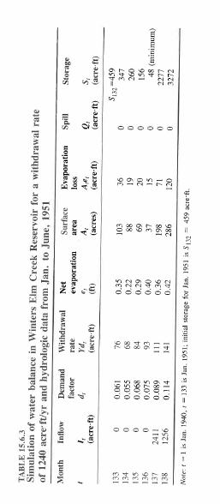
Point of Lowest Reservoir Storage

Slide 26
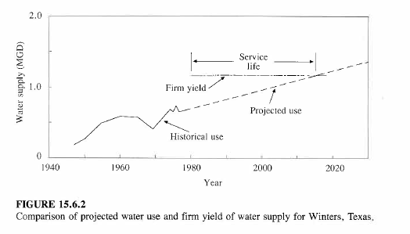
Demand Projection

