Slide 1
Evaporation
What is evaporation?
How is evaporation measured?
How is evaporation estimated?
Reading: Applied Hydrology Sections 4.1 and 4.2 on Infiltration and soil water movement

Slide 2
Evaporation
Evaporation – process by which liquid water becomes water vapor
Transpiration – process by which liquid water passes from liquid to vapor through plant metabolism
Evapotranspiration – evaporation through plants and trees, and directly from the soil and land surface
Potential Evaporation – evaporation from an open water surface or from a well-watered grass surface

Slide 3
Factors Influencing Evaporation
Energy supply for vaporization (latent heat)
Solar radiation
Transport of vapor away from evaporative surface
Wind velocity over surface
Specific humidity gradient above surface
Vegetated surfaces
Supply of moisture to the surface
Evapotranspiration (ET)
Potential Evapotranspiration (PET) – moisture supply is not limited
Net radiation
u
Air Flow
Evaporation

Slide 4
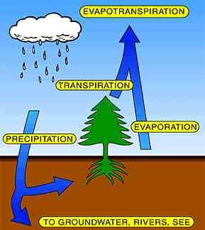
Evapotranspiration (ET)
Over land surfaces, we cannot distinguish between water vapor that evaporated from the soil and water vapor that was transpired through plants

Slide 5
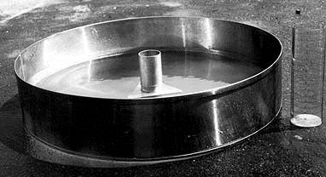
Evaporation from an Open Water Surface
Simplest form of evapotranspiration
This is the amount of water lost from lakes and reservoirs
Often estimating by measuring the loss from a National Weather Service Class A pan
This is referred to as Potential Evapotranspiration (ET_{p}) because it is the maximum potential rate of ET under the given meteorological conditions

Slide 6
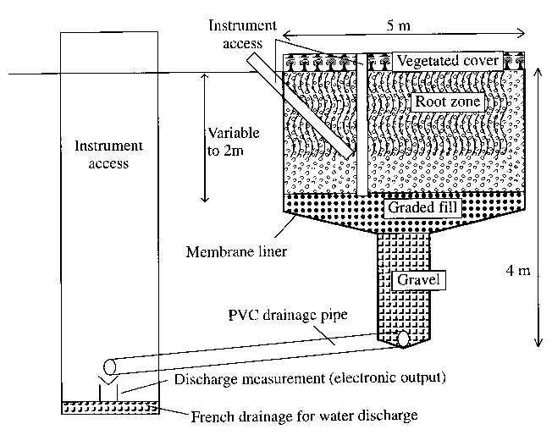
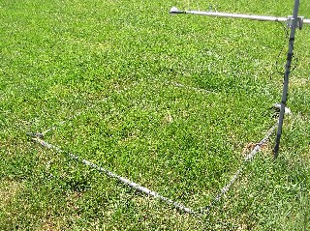
Lysimeters
Measurement of evapotranspiration

Slide 7
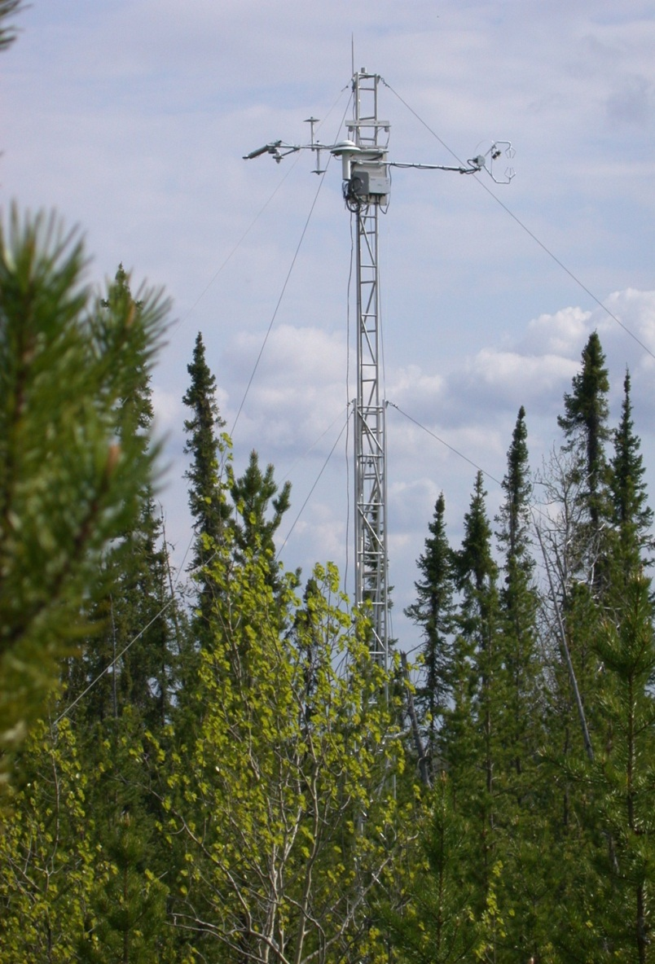
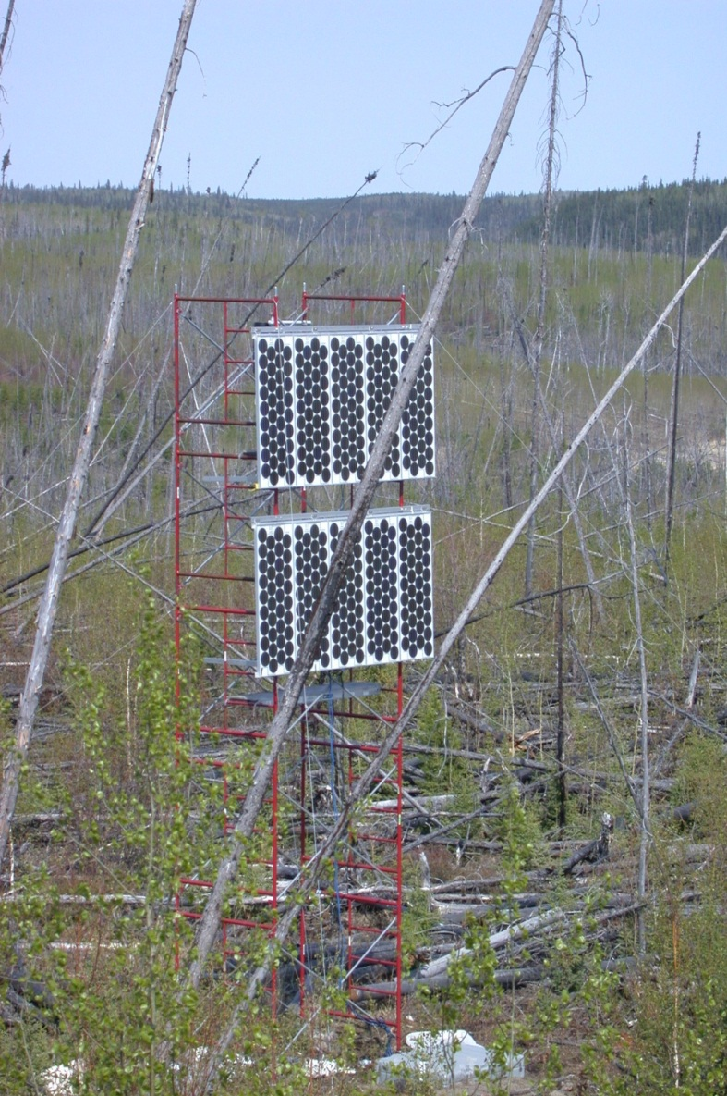
Flux Towers (Marcy Litvak)

Slide 8
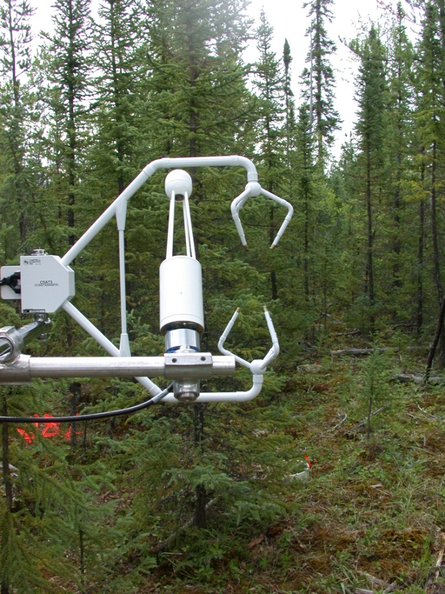
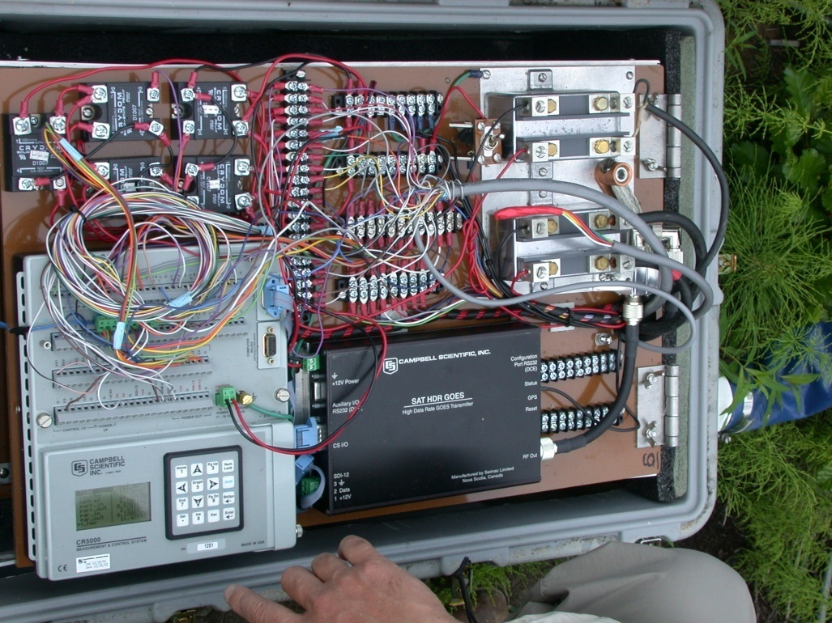
Flux tower instruments
Notes:
The eddy correlation technique is very simple in theory, but quite difficult to put into practice. A major problem has been availability of sufficiently fast instruments to measure the fluctuating signals. Unless an instrument has a sufficiently fast response and logging time to resolve the fastest eddies contributing to the turbulent flux, this portion of the flux will not be recorded. Another effect of slow logging is that the faster eddies may fold around the
Ultrasonic Doppler anemometers are normally used to measure the three components of wind. These instruments are easily fast enough to resolve turbulence under most practical conditions, - they have maximum response and reporting frequencies up to around 100 Hz. The problem with such anemometers tends to be designing logging systems fast enough to log the data.
The potential difficulty in designing working Eddy Covariance systems is often in finding the right instrument to detect the variable of interest to be correlated with the vertical wind fluctuations (the scalar variable). Some instruments simply are not fast enough, for example the DMPS (see section 7), and many chemiluminescent analysers. Also, measuring certain gases is fundamentally problematic, as some ("sticky") gases can adhere to the inside of inlet lines before reaching the analyser. This damps the signal, giving the same problem as a poor frequency response instrument (although without the frequency folding).
The final factor affecting response time of eddy covariance systems is the size of the sensor. Eddies smaller than the size of the transducer array of the anemometer cannot be detected effectively. This places an upper frequency limit on response according to Taylor’s hypothesis (see section 4.1). The effect of this limit has not been observed in measurements referred this work.
The frequency required for the Eddy Covariance method depends upon the mean eddy size at the sensors. This is a function of surface roughness length z0 (see section 4.2.4) and measurement height z. Specifically, larger values of z0 give larger mean eddy sizes and ease the frequency requirements for the system. Equally, larger values of z (larger measurement heights) give larger mean eddy sizes, having the same effect.

Slide 9
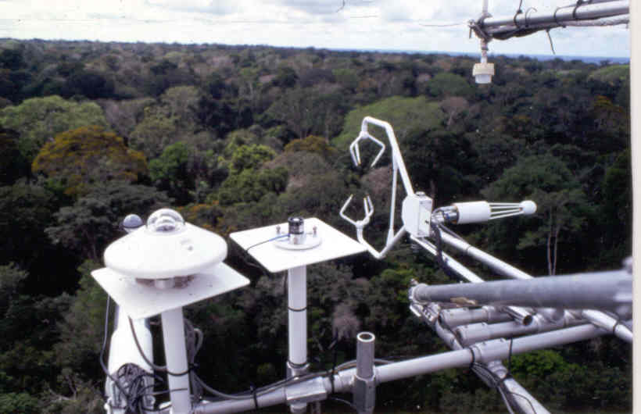
Flux tower instruments
3-D Sonic anemometer
Quantum
sensor
Pyrronometer
IRGA
Net radiometer

Slide 10
Air Temperature at 1m and 10m
Freeman Ranc Flux Tower (Marcy Litvak)

Slide 11
Vapor Pressure and Saturated Vapor Pressure (kPa)

Slide 12
Relative Humidity at 1m and 10m
Average = 0.71
Average = 0.61

Slide 13
Wind Speed (m/s)

Slide 14
Net Radiation (W/m²)

Slide 15
ET -Eddy covariance method
Measurement of vertical transfer of water vapor driven by convective motion
Directly measure flux by sensing properties of eddies as they pass through a measurement level on an instantaneous basis
Statistical tool

Slide 16
Basic Theory
Instantaneous
Perturbation from
The mean
Instantaneous
signal
Time averaged property
All atmospheric entities show short-period fluctuations about their long term mean value
Notes:
All atmospheric entities show short-period fluctuations about their longer term mean value
Overbar indicates time-averaged property
Prime signifies instantaneous deviation from the mean, positive indicates above the mean

Slide 17
Turbulent mixing
Propterties carried by eddies:
Mass, density ρ
Vertical velocity w
Volumetric content q_{v}
Temperature T
Notes:
Eddy mixes air from above downwards, and from below upwards
Concentration of entity is greater below, as it is mixed upwards causes a positive perturbation

Slide 18
Sensible Heat Flux (W/m²)

Slide 19
Latent Heat Flux (W/m²)

Slide 20
Evaporation (mm/day)
Average = 3.15 mm/day

Slide 21
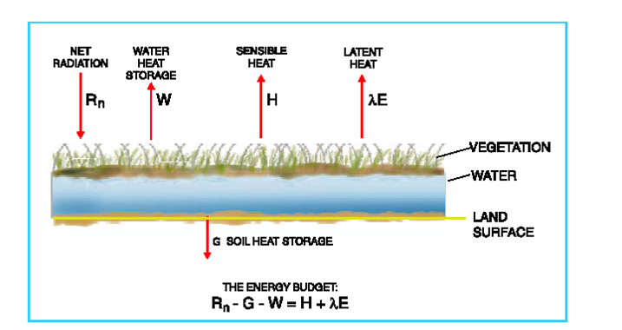
Energy Balance Method
Can directly measure these variables
How do you partition
H and λE??

Slide 22
Energy Balance Method
$$\text{}$$
$$\frac{28.4 \text{W} }{m^{2} }×\frac{J/s}{W}×\frac{1 g}{2450 J}×\frac{3600 s}{ 1 hr}×\frac{24 hr}{1 day}×\frac{m^{3}}{1000 kg}×\frac{1 kg}{1000 g}×\frac{1000 mm}{1 m}=1 \frac{mm}{day}$$
$$ρ﷮w$$
$$ET= \frac{\text{λ}\text{E}}{28.4}=\frac{1}{28.4}(R_{n}−G−H−W)$$
The maximum radiative evaporation rate E_{r} = $\frac{R_{n}}{28.4}$

