Slide 1

The CUAHSI Hydrologic Information System
Presented by Dr. Tim Whiteaker
The University of Texas at Austin
22 February, 2011
Notes:
You’ve seen how easy it is to get water data with HydroDesktop. This presentation introduces you to the underlying system that makes all that possible.

Slide 2


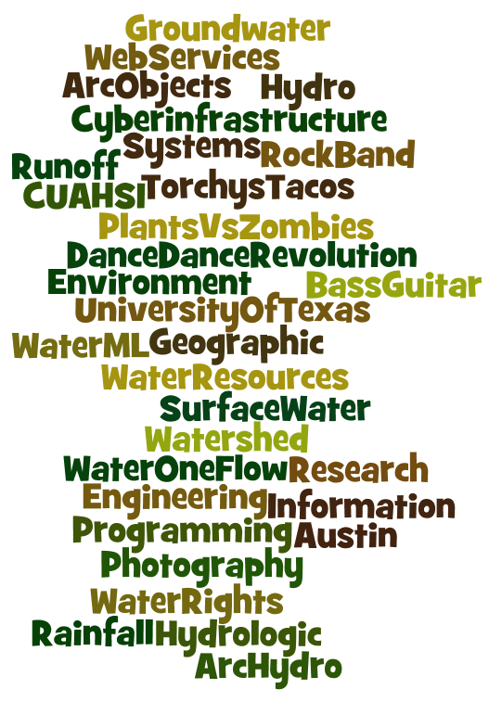

About the Speaker
PhD 2004
Research Associate

Slide 3
What You Will Learn
What is the CUAHSI Hydrologic Information System (HIS)
How to access data in HIS
How to publish data with HIS
Notes:
You’ll what what HIS is and how to use it.

Slide 4

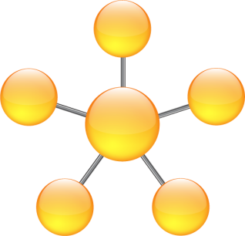
Outline
The HIS Story
HIS components
Putting the pieces together

Slide 5
Outline
The HIS Story
HIS components
Putting the pieces together

Slide 6
HIS Connects People with Data
The CUAHSI Hydrologic Information System (HIS) provides web services, tools, standards and procedures that enhance access to more and better data for hydrologic analysis.
Notes:
This definition is from the HIS website.

Slide 7
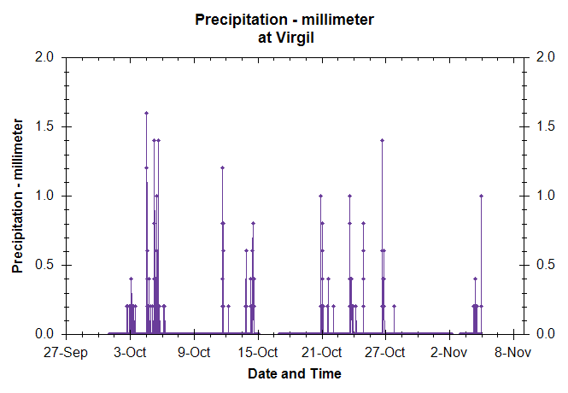
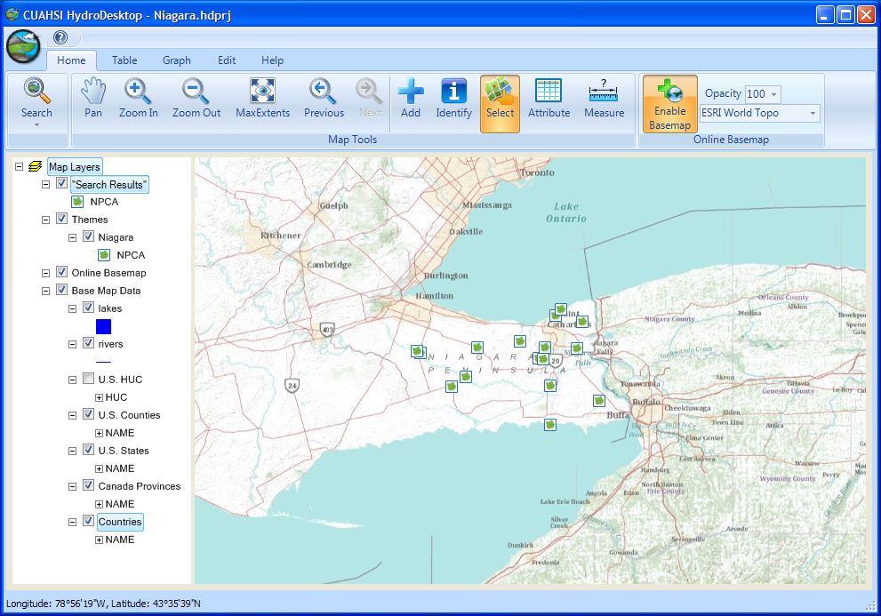
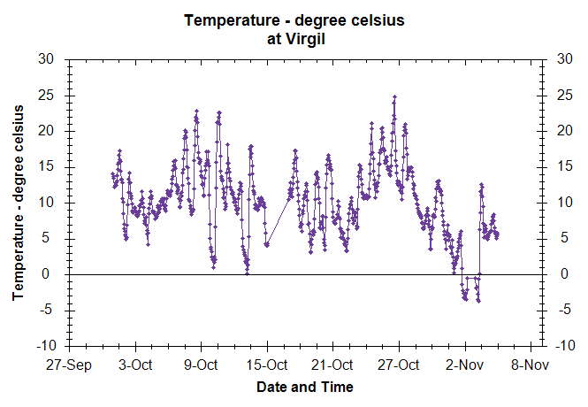

Niagara Peninsula Decision Support
Notes:
My way of thinking about HIS is, all the stuff that’s needed to make it easy for me to find, get, and use hydrologic information.

Slide 8

What is CUAHSI
Consortium of Universities
for the Advancement of Hydrologic Science, Inc
Funded by NSF
Develops infrastructure and services to advance hydrologic science in US universities
www.cuahsi.org
Notes:
The “CUAHSI” in CUAHSI-HIS refers to an organization seeking to improve hydrologic science in the US.

Slide 9
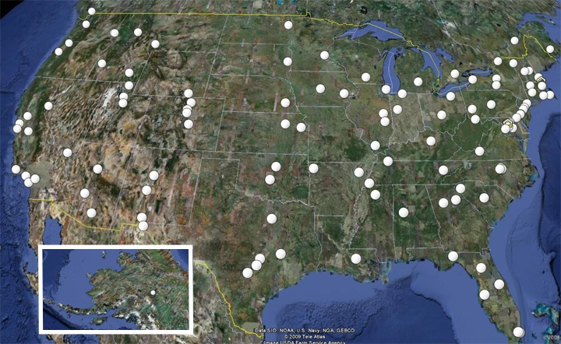
CUAHSI Member Institutions
Notes:
$2000 for qualifying university to join

Slide 10
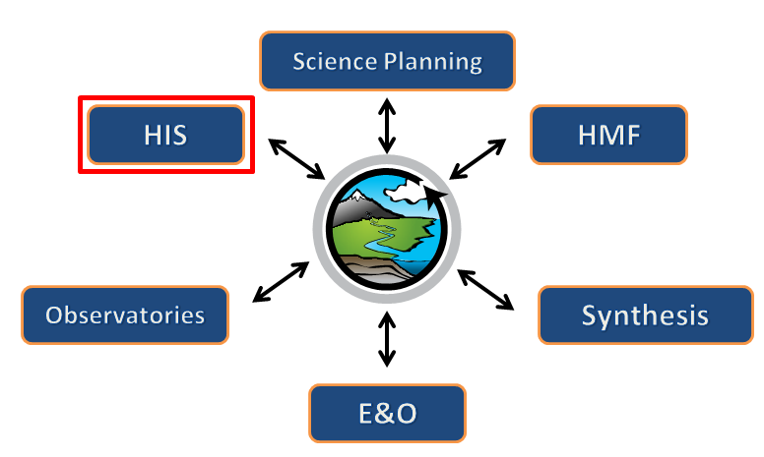
CUAHSI Hydrologic Information Systems Project
David R. Maidment
The University of Texas at Austin
(HIS Project Leader)
Notes:
HIS is one project under CUAHSI
E&O = Education and Outreach
HMF = Hydrologic Measurement Facility - provide the equipment and training required for scientists to accurately collect the necessary data for their studies.

Slide 11
CUAHSI HIS Development
2000
CUAHSI Regional Meetings
2002
2004
HIS Pilot Project
2006
2008
HIS Development Project
2010
Notes:
The HIS project has been underway for almost 10 years

Slide 12
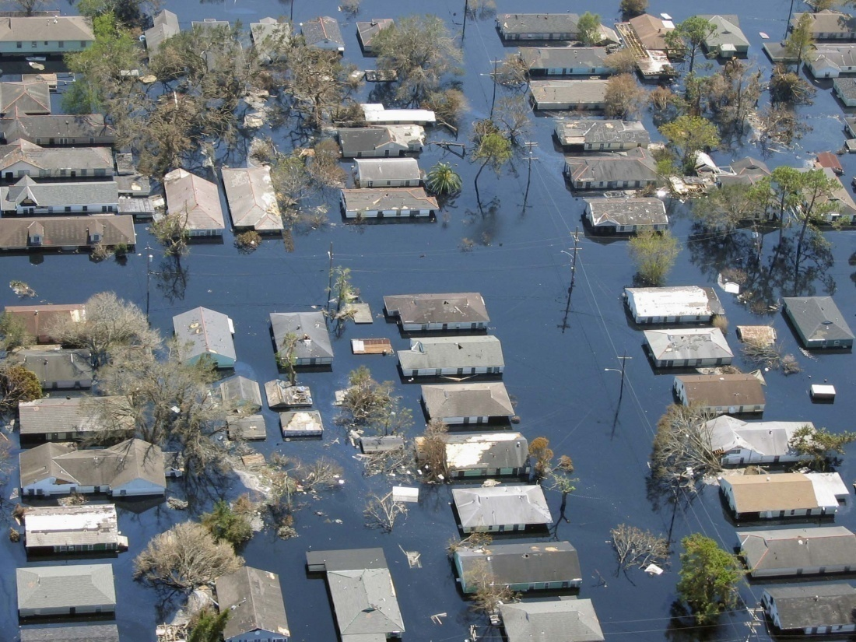
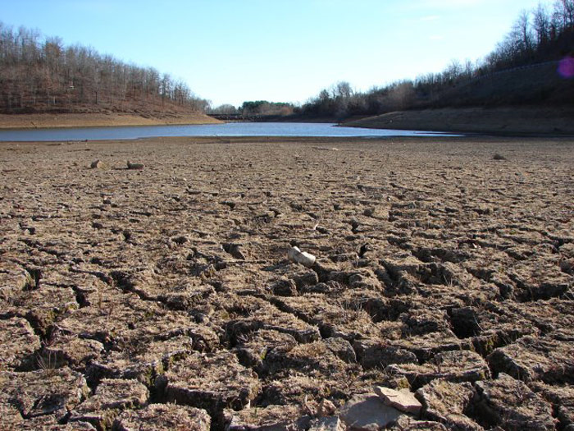
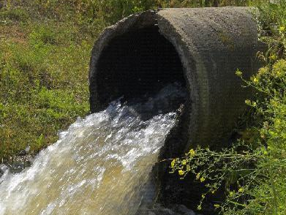
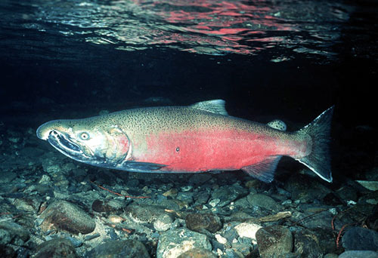
too much water
too little water
dirty water
water environment
Notes:
Our goal is to help people solve water problems.

Slide 13
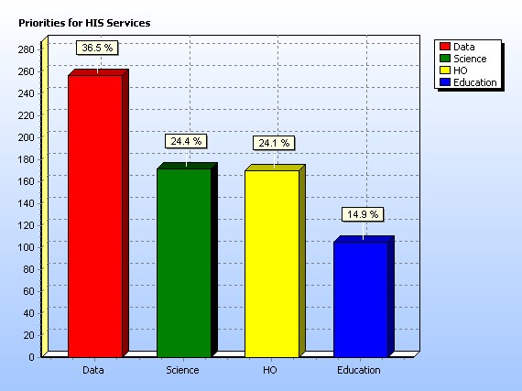
How can HIS help?
Just get me the data!
Notes:
The biggest hurdle: Data

Slide 14
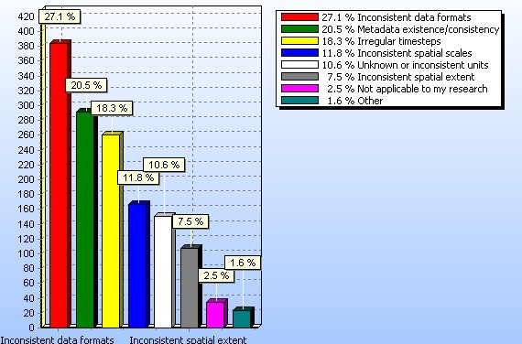
What’s challenging about data?
- Data formats
- Metadata
Notes:
Inconsistent data formats and metadata (a description of the data) make it hard to work with data.

Slide 15
Data Integration
Hydrologic
Observations
GIS Data
Digital
Watershed
Weather and Climate
Remote Sensing
Currently, the focus is on data from monitoring sites at point locations.
Notes:
Thus, HIS focuses on improving access to hydrologic observations at point locations.

Slide 16
The Result
WaterML language for describing water data
National catalog of water data sources
Free software for data access
WaterML
Standards
Metadata Catalog
Services
Software
Notes:
It takes standards, services, and software to pull this off.

Slide 17
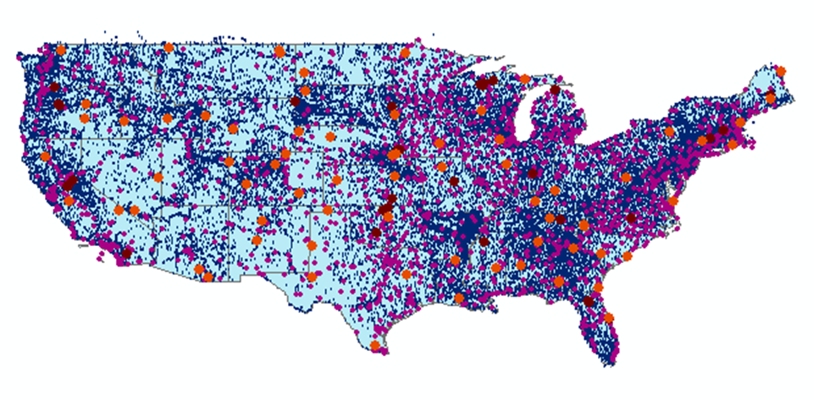
Metadata Catalog, October 2010
Map integrating NWIS, STORET, & Climatic Sites
56 public services
18,000+ variables
1.88+ million sites
23.3 million series
Referencing 5.1 billion data values
Notes:
Now we’ve indexed more than 5 billion data values describing the water environment. Our services get 3000-5000 requests for data each day.

Slide 18
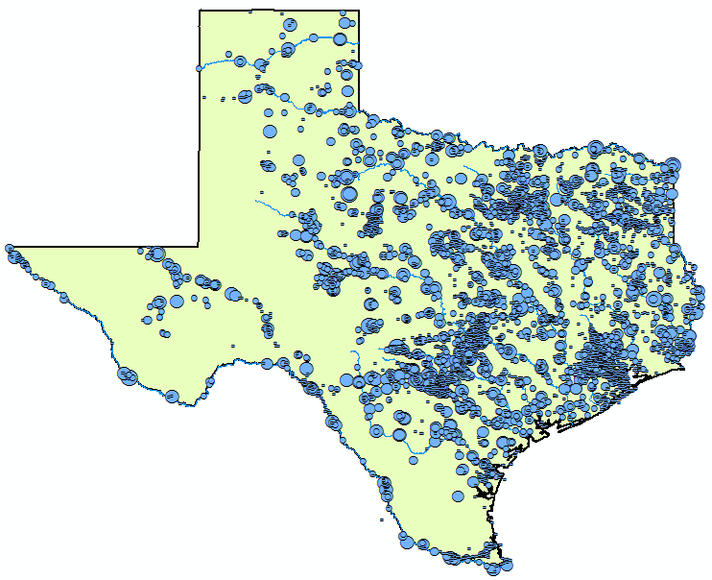

Streamflow
2 services
7 variables
4,363 sites
11,484 series
9,493,968 records
Notes:
Here’s an example showing where streamflow is measured in Texas from two different services (i.e., data providers).

Slide 19
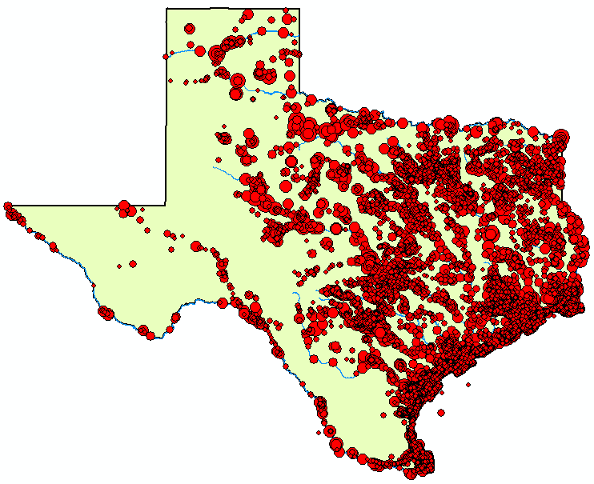
Water
Temperature
6 services
11 variables
11,158 sites
22,953 series
1,546,841 records

Slide 20
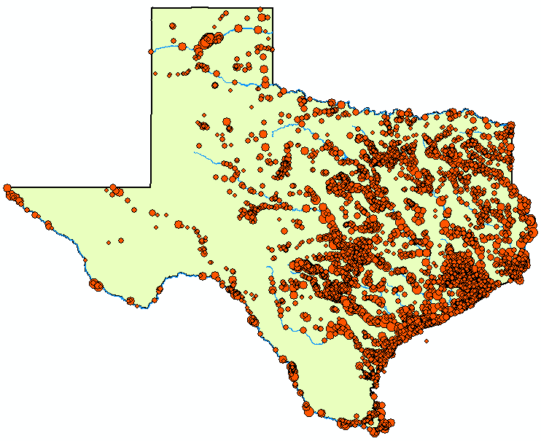
Bacteria
1 service
21 variables
4,801 sites
15,483 series
297,849 records

Slide 21
For more on the HIS Story
his.cuahsi.org

Slide 22
Outline
The HIS Story
HIS components
Putting the pieces together

Slide 23
Web Paradigm
Catalog
(Google)
Catalog harvest
Search
Web Server
(CNN.com)
Access
Browser
(Firefox)

Slide 24
Services-Oriented Architecture for Water Data
HIS Central
Service registration
Search
Catalog harvest
HydroServer
Data access
HydroDesktop

Slide 25
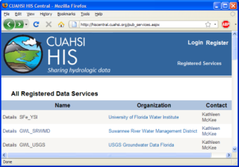
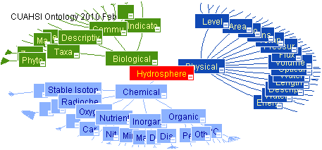
HIS System Overview
USGS
HIS Central
Metadata
Catalog
Data
Web
Service
HIS Central
Hydrologic Ontology
Data
Registration
University
Data
Data Access
Data Discovery
HydroServers
Users
(HydroDesktop)

Slide 26
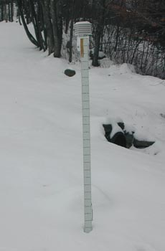


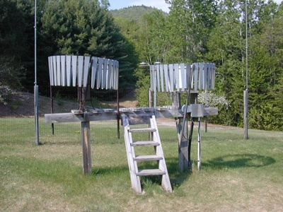
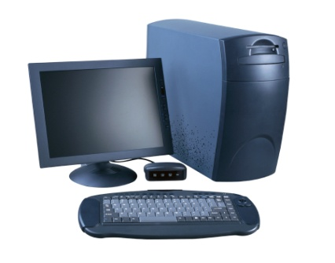
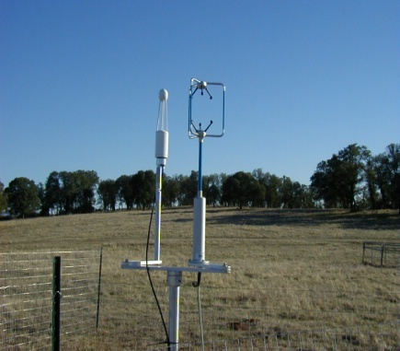
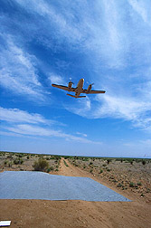
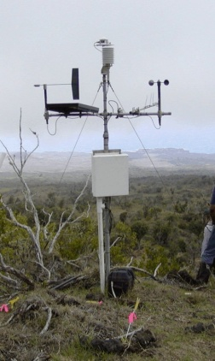
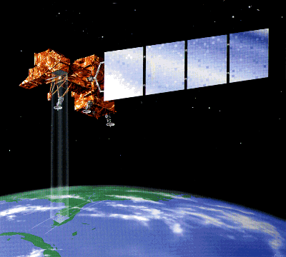
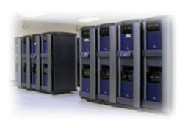
Water Data
Water quantity
and quality
Soil water
Rainfall & Snow
Modeling
Meteorology
Remote sensing
Notes:
There are many types of water data.

Slide 27
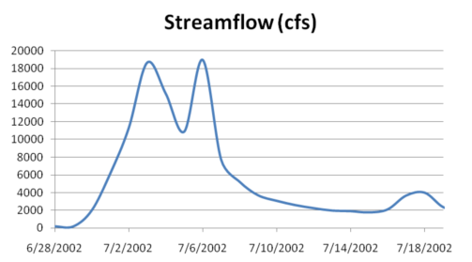
Point Observations Time Series
A point location in space
A series of values in time
Notes:
These data are recorded over time to monitor a hydrologic process or property.

Slide 28
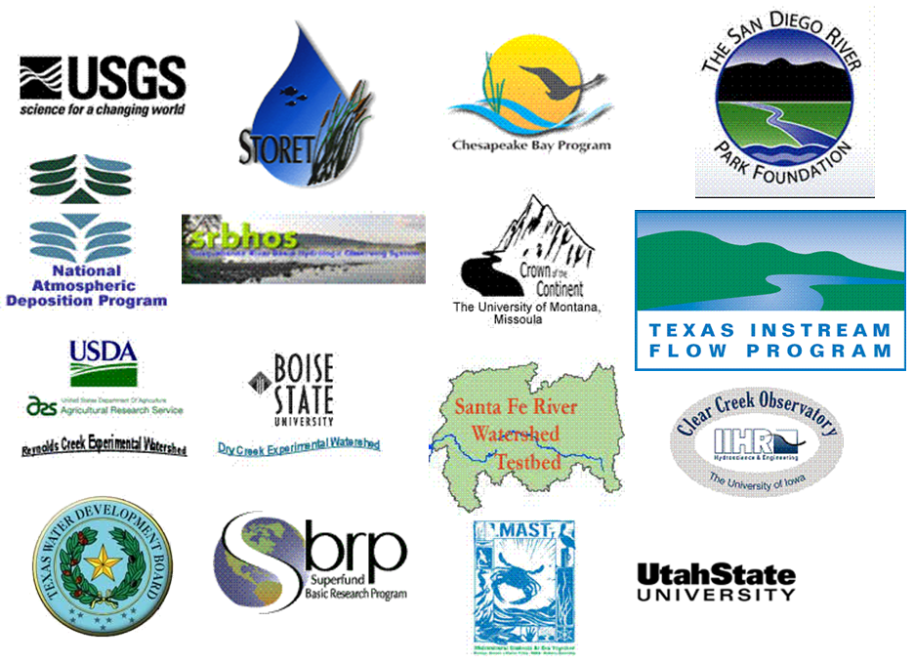
Sources of Observations Data
Notes:
There are many sources of hydrologic data. By the way, all of these data sources are currently represented in HIS.

Slide 29
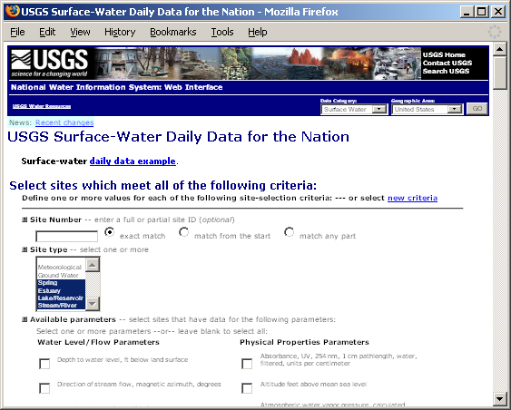
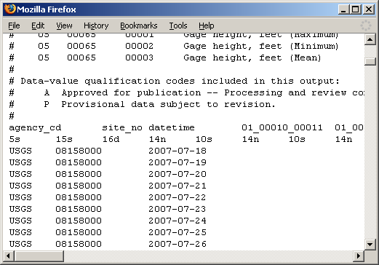
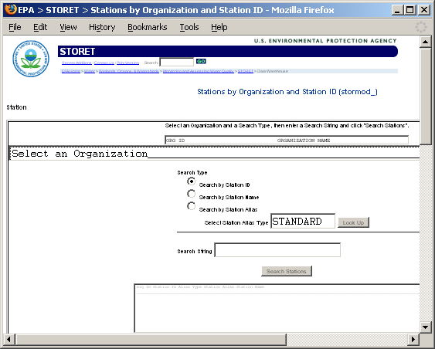
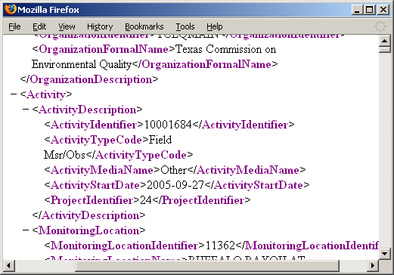
Getting Water Data (the old way)
Asking for data
What comes back
Notes:
Much hydrologic data are online. However, each website has a different form for querying data, and each website returns data in a different format.

Slide 30
Point Observations Information Model
who where
what when
City of Austin
Data Source
Waller Creek Gauges
Network
Waller Creek at Koenig Lane
Sites
Streamflow
Variables
0.15 cfs, 15 February, 2011, 2AM
Values
Notes:
Conceptually, we describe hydrologic observations data with a Point Observations Information Model.

Slide 31
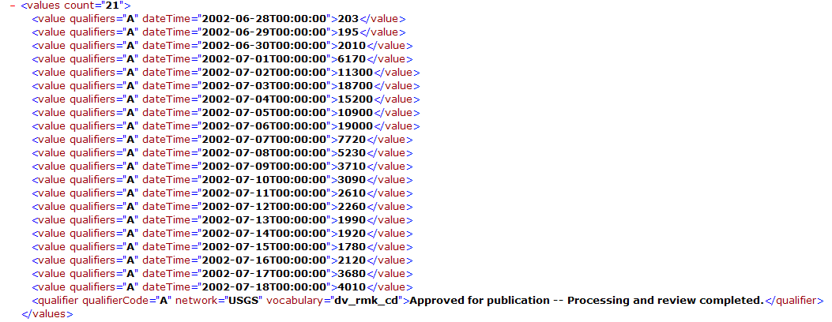
WaterML as a Standard Format
Discharge of the San Marcos River at Luling, June 28 - July 18, 2002
Streamflow data in WaterML
Notes:
WaterML is a language for communicating data described using the point observations information model.

Slide 32
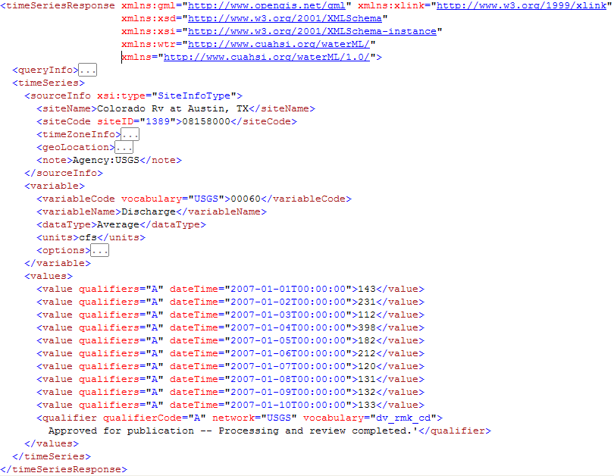

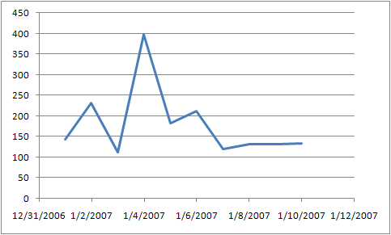
WaterML Includes Sites, Variables, and Time Series
site
variable
time series
Notes:
You don’t have to be able to read WaterML. Just like web browsers turn HTML into a pleasing web page, software turns WaterML into something more appealing to the human eye.

Slide 33
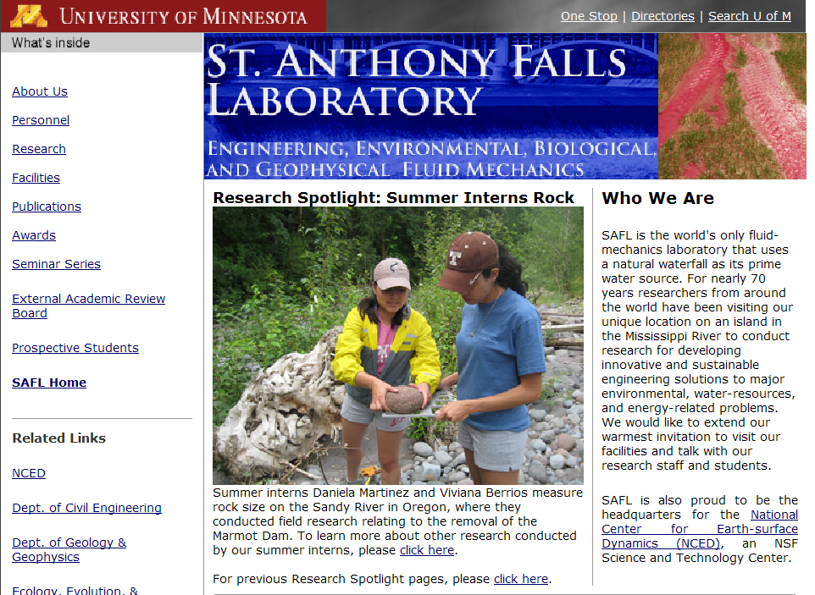
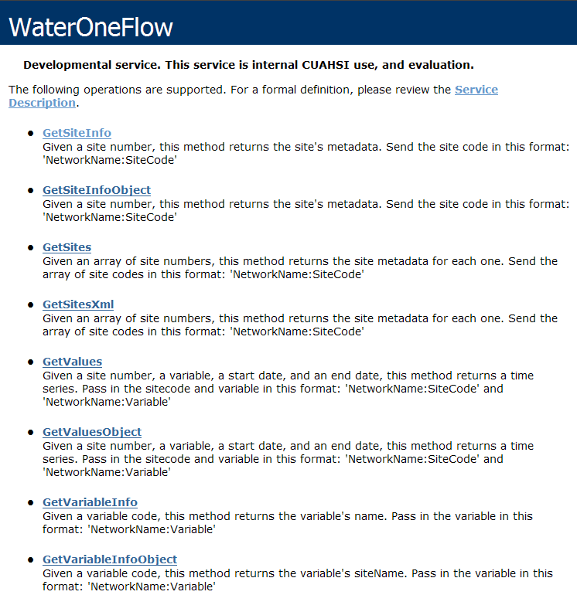
Web Pages and Web Services
http://www.safl.umn.edu/
http://his.safl.umn.edu/SAFLMC/cuahsi_1_0.asmx
Uses HTML
Uses WaterML
Notes:
To standardize data access, we’ll move beyond web pages, and use web services.

Slide 34
Web Service Examples
Convert Temperature
Get Streamflow
Web services are resources that your applications can ask to do work for them
Notes:
What if we could write a web service that has certain functions (i.e., standard queries) for getting data out of the point observations information model?

Slide 35
WaterOneFlow Web Service
Set of query functions
  Get Sites
  Get Site Info
  Get Variable Info
  Get Values
Returns data in WaterML
Data Source
Network
Sites
Variables
Values
Notes:
A WaterOneFlow web service defines a standard set of query functions for accessing water data, and returns the data in WaterML format.

Slide 36
WaterML and WaterOneFlow
EPA
Locations
GetSites
GetSiteInfo
GetVariableInfo
GetValues
Data
Variables
UT
Date Ranges
USGS
Data
Data
WaterML
Data
Repositories
WaterOneFlow
Web Service
Client
WaterOneFlow is how you ask for data
WaterML is the data format
Notes:
Here’s the workflow. The user has some site locations and variables of interest. The user sends the request to a WaterOneFlow web service for the data using those four standard functions. The web service does the leg work of finding the data repository and extracting information from it. The web service then transforms the data into WaterML, and sends the result back to the user. Thus, no matter where the data are coming from, the user only has to know how to make those four standard queries and how to translate a single data format that comes back (WaterML).

Slide 37
HydroExcel Demo: Introducing WaterOneFlow

Slide 38
HIS System – HydroServer
USGS
HIS Central
Metadata
Catalog
Data
Web
Service
HIS Central
Hydrologic Ontology
Data
Registration
University
Data
Data Access
Data Discovery
And Access
HydroServers
Users
Notes:
WaterOneFlow web services are hosted on HydroServers. Let’s now go into more detail about HydroServers.

Slide 39
HydroServer Goals
A platform for publishing space-time hydrologic datasets that:
  Provides local control of data
  Makes data universally available
  Is open source (hydroserver.codeplex.com)
Notes:
We created HydroServer for people who want to publish data but don’t know how to get started.

Slide 40
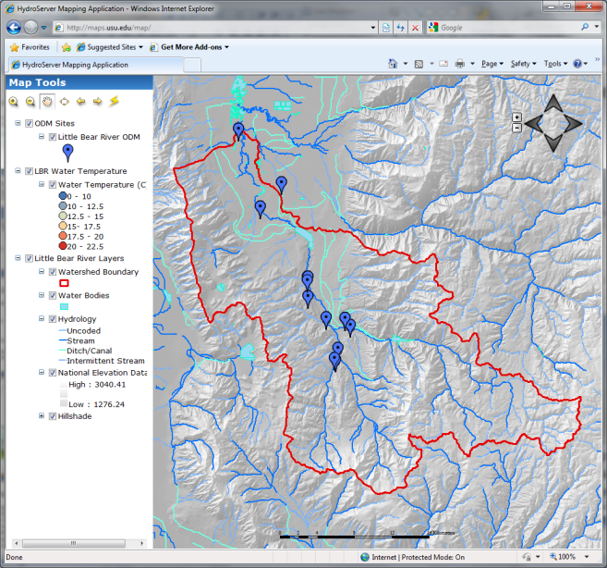

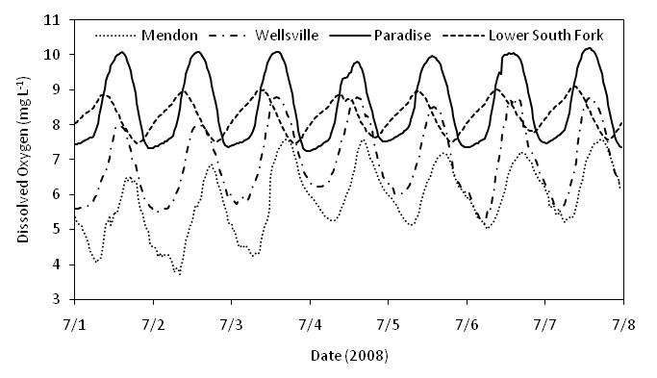

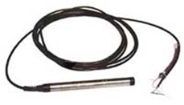
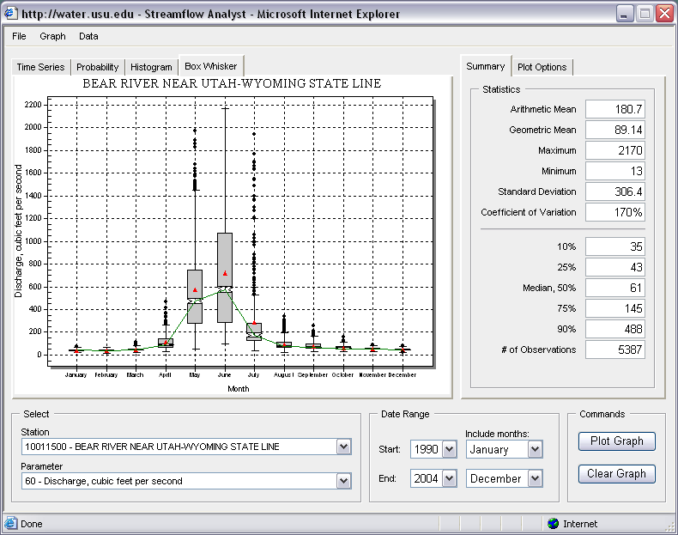

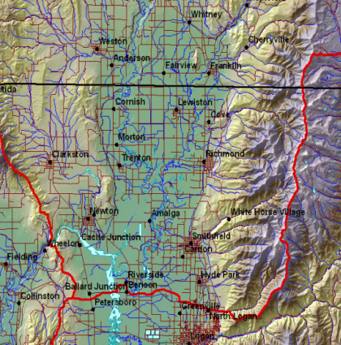
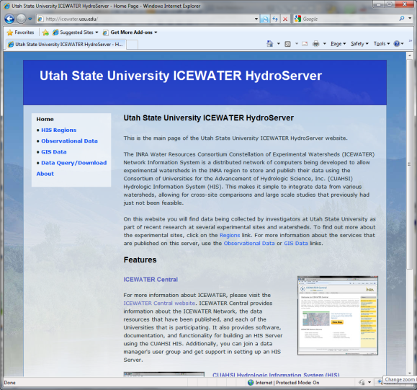
Time Series Data
Internet Applications
Data Collection
Historical Data Files
Database
GetSites
GetSiteInfo
GetVariableInfo
GetValues
GIS Data
WaterML
WaterOneFlow
Web Service
HydroServer
Notes:
HydroServers help you store and publish both time series and geospatial data.

Slide 41
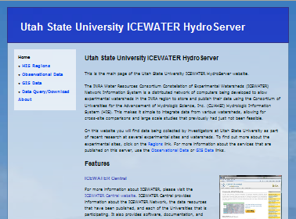
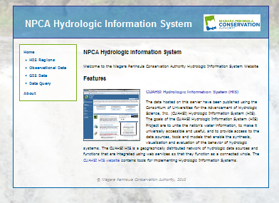
Operational HydroServers
http://icewater.usu.edu/
http://www.his.npca.ca/hydroserver/
Notes:
http://icewater.usu.edu/
http://www.his.npca.ca/hydroserver/

Slide 42


Why Publish Data with HIS
Recognition
Collaboration
Public service
Cost savings
Notes:
When you publish your data, people will recognize and use your work. This tends to appeal to academics, especially when data publication is required by the funding agency. Sharing data promotes collaboration and enables us to better answer big integrative science questions. From a government perspective, sharing data is a public service that helps the public to be better informed about their environment. And from all perspectives, HIS supports cost savings by providing free software for both data publication and data sharing, and by making it easier for people to get the data they want (less technical support phone calls).

Slide 43
What Have We Covered
USGS
HIS Central
Metadata
Catalog
Data
Web
Service
HIS Central
Hydrologic Ontology
Data
Registration
University
Data
Data Access
Data Discovery
And Access
HydroServers
HIS Overview
HydroServer
  WaterOneFlow
  WaterML
Users
Notes:
So far we have covered a basic overview of HIS, with details into HydroServer and WaterOneFlow.

Slide 44
HIS System – HIS Central
USGS
HIS Central
Metadata
Catalog
Data
Web
Service
HIS Central
Hydrologic Ontology
Data
Registration
University
Data
Data Access
Data Discovery
And Access
HydroServers
Users
Notes:
Now let’s look at HIS Central, the catalog part of the system.

Slide 45
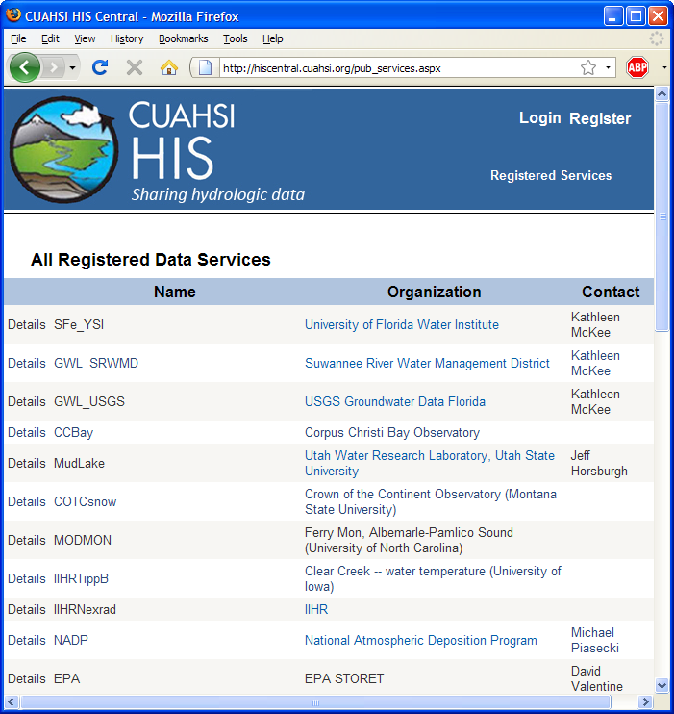
HIS Central
Data publishers
  Register a service
Users
  Find a service
Supported by
  Metadata Catalog
  Hydrologic Ontology
http://hiscentral.cuahsi.org
Notes:
HIS Central keeps a listing of all registered web services, and also maintains a metadata catalog of site and variable information from those services to enable fast data searching.

Slide 46
Metadata Catalog
Stores description of time series, e.g.,
The USGS measures streamflow at Waller Creek & Koenig with data from 7/31/1968 to the present…
…and you can get the data from here.
Registered services harvested weekly
Notes:
The metadata catalog stores the sites and a description of the data series available at those sites. A data series is all the measurements of a certain variable at a given site. HIS Central records the site and variable information as well as the begin date, end date, and number of measurements for each data series.

Slide 47
Metadata Catalog, October 2010
Map integrating NWIS, STORET, & Climatic Sites
56 public services
18,000+ variables
1.88+ million sites
23.3 million series
Referencing 5.1 billion data values

Slide 48
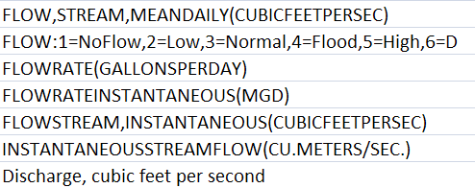
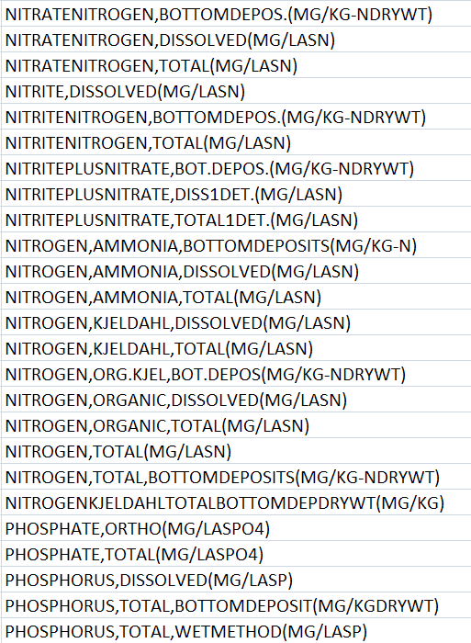
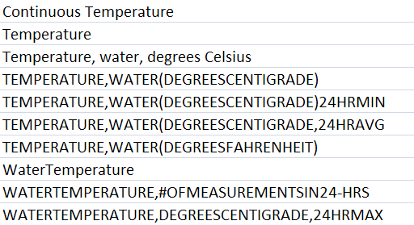
Streamflow
Nutrients
Water Temperature
Notes:
But even though data publishers may use WaterML, they may still have different names for their variables. I don’t want to have to know what all of these names are. I just want to search for water temperature data, for example.

Slide 49
Conceptual Framework
Chemical descriptions from EPA/USGS Substance Registry System
Physical descriptions from CF Conventions
  NetCDF Climate & Forecast; 137 variables
Biological descriptions from Integrated Taxonomic Information System
http://www.epa.gov/srs/
http://cf-pcmdi.llnl.gov/
http://www.itis.gov/
Notes:
We created a system integrating concepts from these domains.

Slide 50
Thematic Concepts
Core Concept
Property
Branch
Leaf
Hydrosphere
Biological
Chemical
Physical
Chlorophyll
Indicator Organisms
Dissolved Oxygen
Suspended Solids
Temperature
Discharge
Air Temperature
Water Temperature
Groundwater Flow
Stream Discharge
Fixed Suspended Solids
Total Suspended Solids
DO Concentration
DO Saturation
Chlorophyll A
E. Coli
Fecal Coliform
Pheophytin
Variables
Notes:
We can organize hydrologic variables in a hierarchical set of concepts.

Slide 51

HydroTagger
Each Variable in your data is connected to a corresponding Concept
Notes:
These concepts are maintained in the HIS ontology. When people register their web service with HIS Central, they match the variables in their database to the concepts in the ontology.

Slide 52
Water
Temperature
6 services
11 variables
11,158 sites
22,953 series
1,546,841 records
Notes:
So, when I want to search for water temperature, I just enter “water temperature” and then the software figures out what variables from various data publishers match that term from the ontology.

Slide 53


HIS Central Web Page
http://hiscentral.cuahsi.org
Notes:
You can see all registered data services at the HIS Central website.

Slide 54

HIS Central Web Service
Programmatic methods to query the national metadata catalog
Search by:
  Location
  Variable
  Date Range
  Data source
Notes:
Programs can also access HIS Central directly.

Slide 55
HIS System – HIS Desktop
USGS
HIS Central
Metadata
Catalog
Data
Web
Service
HIS Central
Hydrologic Ontology
Data
Registration
University
Data
Data Access
Data Discovery
And Access
HydroServers
Users
(HydroDesktop)
Notes:
Now that we’ve covered data publication with HIS, let’s take a brief look at how users use HIS to discover and access data.

Slide 56






HIS in Familiar Software
Notes:
Example applications and tutorials are available for working with HIS in several software or development environments.

Slide 57

HydroExcel
Notes:
HydroExcel is a useful tool for getting data from a single service in Excel.

Slide 58
HydroExcel Limitations
Can’t hold much data
No dates before year 1900
Not truly geospatially enabled
Not free
How can I use HIS in software built to work with HIS from the ground up?
Notes:
But Excel has limitations.

Slide 59

HydroDesktop
Free, open source solution for HIS data access
www.hydrodesktop.org

Slide 60

GIS fully integrated with HIS
- Metadata catalog
- Ontology keywords
- WaterOneFlow/WaterML

Slide 61

Built-in Analysis
Tables
Graphs
Editing
Export

Slide 62

Customizable with Plug-ins
Community development
Build on the HydroDesktop framework
HydroModeler

Slide 63
Outline
The HIS Story
HIS components
Putting the pieces together

Slide 64
Services-Oriented Architecture for Water Data
Catalog
HIS Central
Service registration
WaterML
Search
Catalog harvest
HydroServer
Data access
HydroDesktop
Data Publisher
User

Slide 65


Start Using HIS
HIS Website
  his.cuahsi.org
User Support Specialist
  Yoori Choi
  ychoi@cuahsi.org

