Slide 1
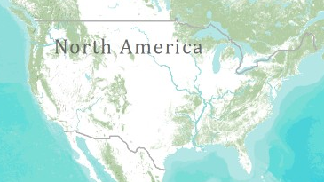
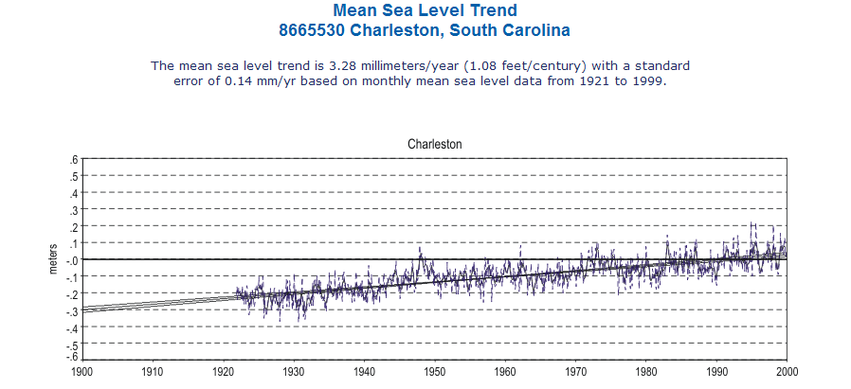
+ 1.08 Feet/Century
http://tidesandcurrents.noaa.gov/sltrends/sltrends_station.shtml?stnid=8665530 Charleston, SC

Slide 2
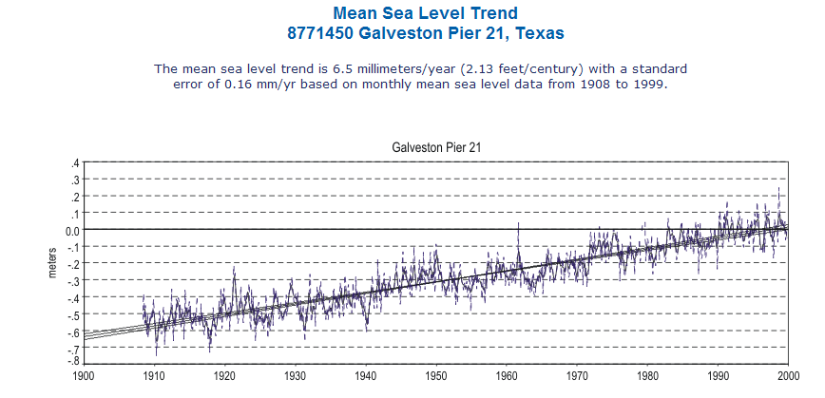
+ 2.13 Feet/Century
http://tidesandcurrents.noaa.gov/sltrends/sltrends_station.shtml?stnid=8771450

Slide 3
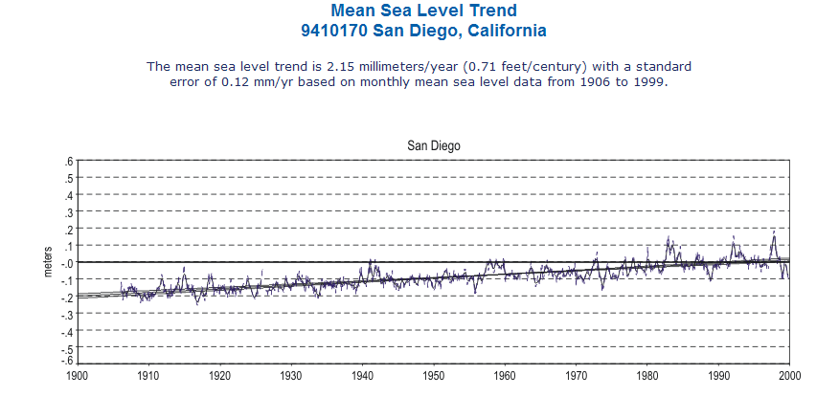
+ 0.71 Feet/Century

Slide 4
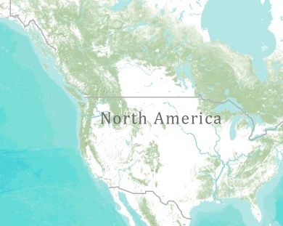
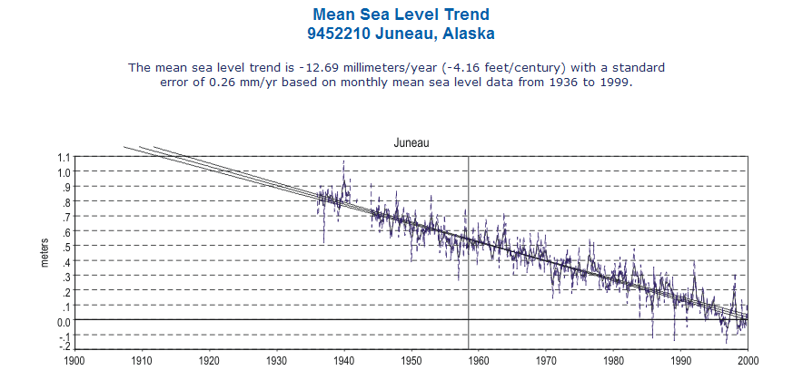
-4.16 Feet/Century

