Slide 1
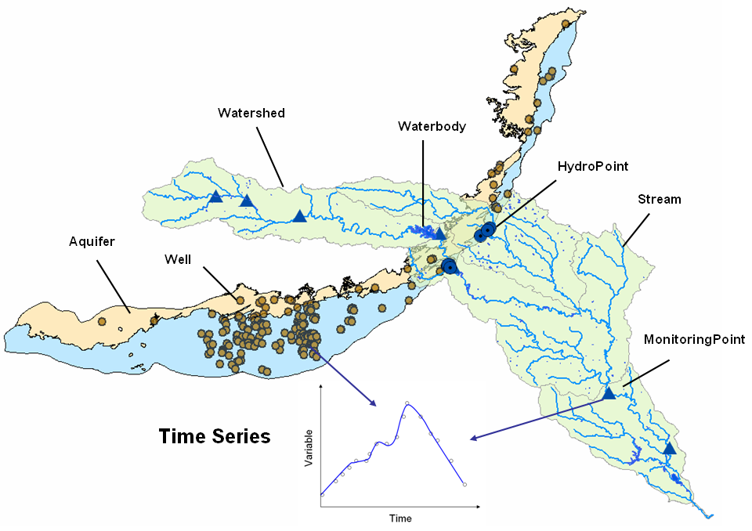
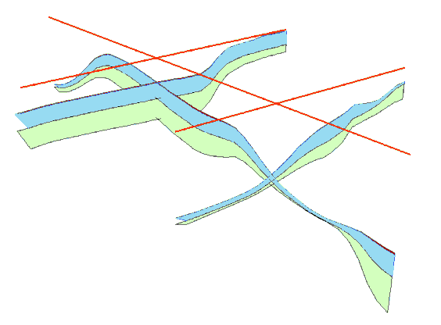
Arc Hydro Groundwater Data Model
CE 374K Groundwater
Spring

Slide 2
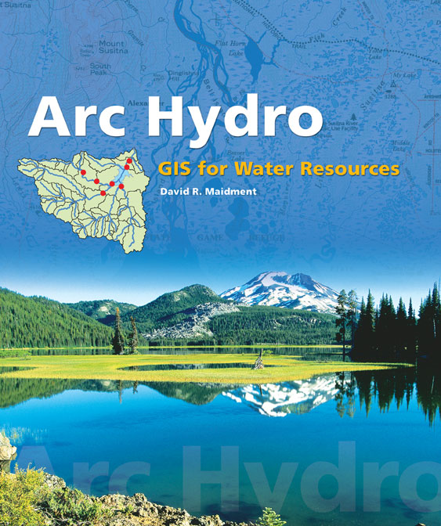
Arc Hydro: GIS for Water Resources
Published in 2002,
Arc Hydro
  An ArcGIS data model for water resources
  Arc Hydro toolset for implementation
  Framework for linking hydrologic simulation models
The Arc Hydro data model and
application tools are in the public
domain
Notes:
Notes:
Industrial partners: ESRI, Danish Hydraulic Institute, Camp,Dresser and McKee, Dodson and Associates
Government partners:
Federal: EPA, USGS, Corps of Engineers (Hydrologic Engineering Center)
State: Texas Natural Resource Conservation Commission, Texas Water Development Board
Local: Lower Colorado River Authority, City of Austin, Dept of Watershed Protection
Academic Partners: University of Texas, Brigham Young University, Utah State University

Slide 3
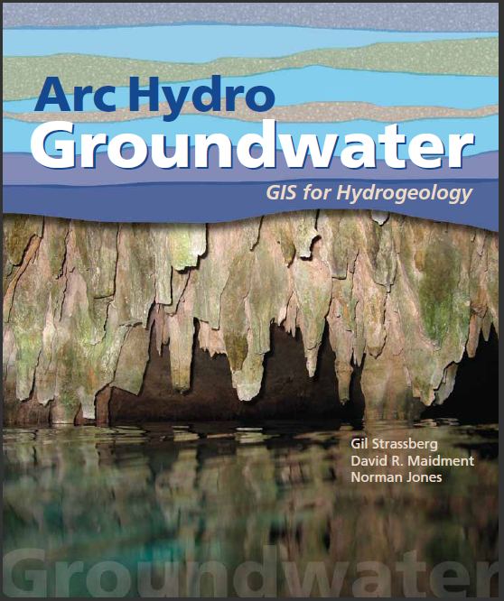
Arc Hydro Groundwater:
GIS For Hydrogeology
Describes the data model – public domain
Chapter for each data model component
Published in 2011
Notes:
Notes:
Industrial partners: ESRI, Danish Hydraulic Institute, Camp,Dresser and McKee, Dodson and Associates
Government partners:
Federal: EPA, USGS, Corps of Engineers (Hydrologic Engineering Center)
State: Texas Natural Resource Conservation Commission, Texas Water Development Board
Local: Lower Colorado River Authority, City of Austin, Dept of Watershed Protection
Academic Partners: University of Texas, Brigham Young University, Utah State University

Slide 4
Arc Hydro Groundwater Data Model
Notes:
This is an overview diagram of the AHGW data model.
You can review the different components, talk about what each component is for:
Framework – includes hydrography, monitoring points, wells, aquifers, tables for managing time series (the framework includes a simplified temporal component). – with the framework you can get started on most water resources projects.
Borehole data – description of vertical information recorded along boreholes (hydrostratigraphy, well construction).
Geology – representation of data from geologic maps.
Hydrostratigraphy – building 2D and 3D hydrogeologic models including surfaces, cross sections, volumes.
Temporal – dealing with time varying data – plots, tracks, animations.
Simulation – integration with groundwater simulation models, especially MODFLOW.

Slide 5
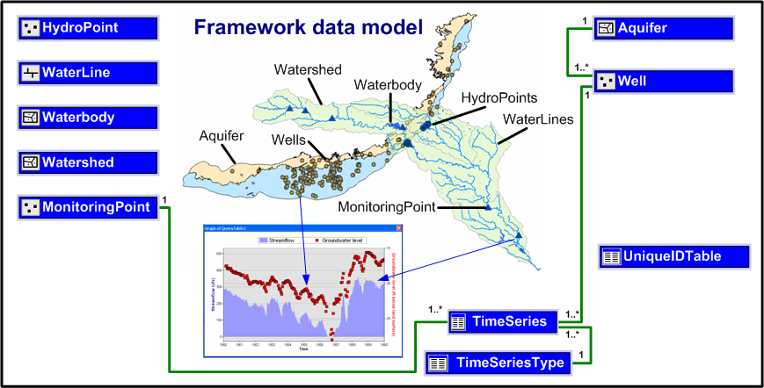
Arc Hydro Framework
Basic representation of surface water and groundwater
Components can be added to the framework to represent specific themes in more detail

Slide 6
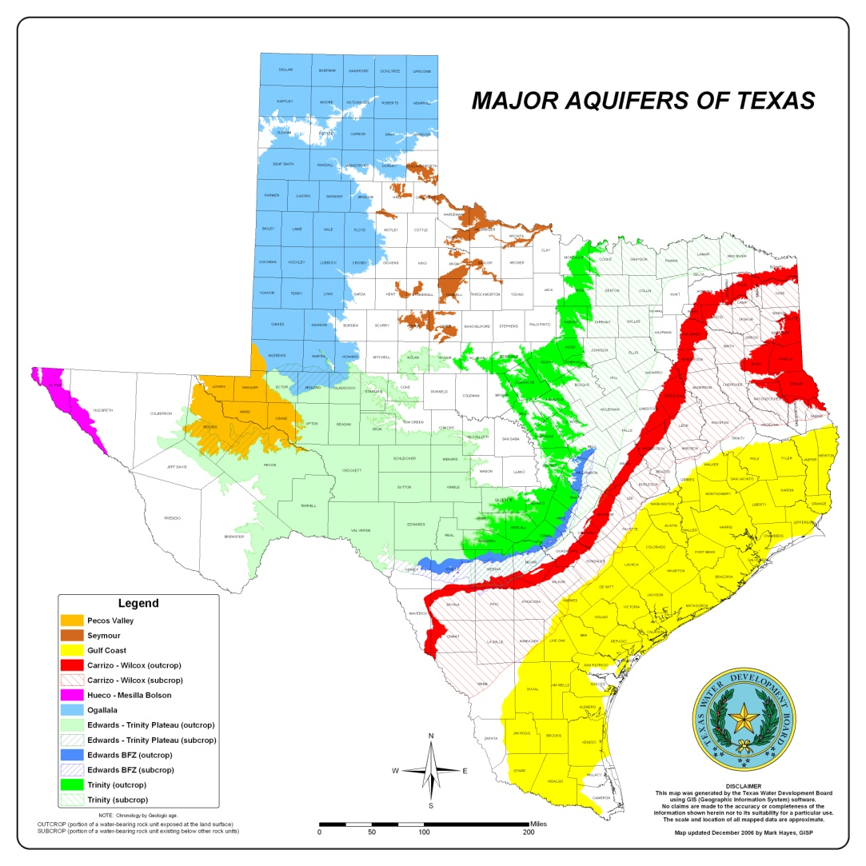
Aquifer features
Polygon features for representing aquifer boundaries

Slide 7
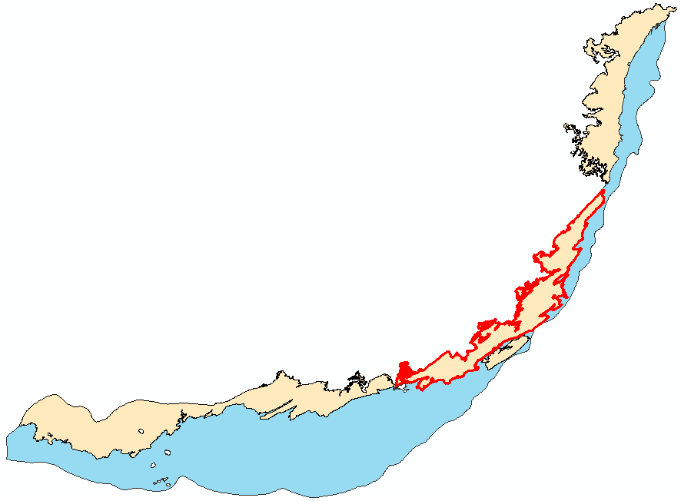
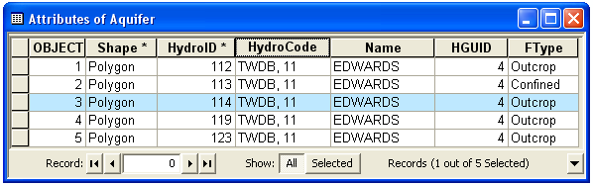

Aquifer features
An aquifer is defined by one or a set of polygon features
Aquifer features can be grouped by HGUID

Slide 8
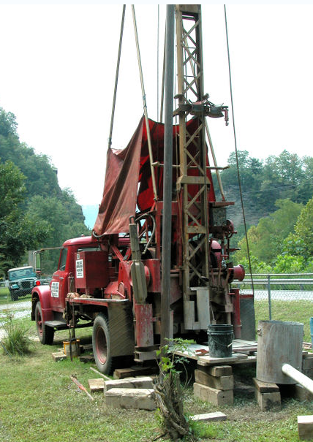
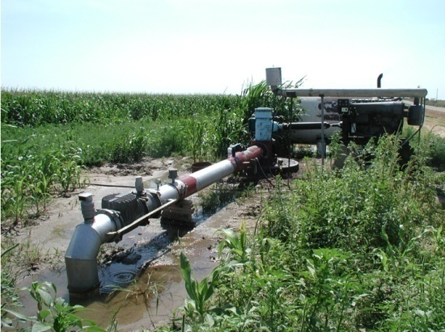
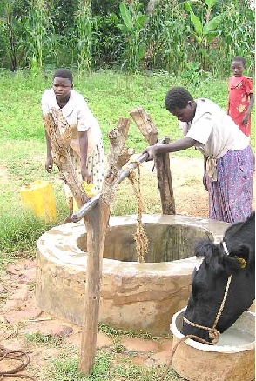
Well
Location where the subsurface has been drilled
Attributes of wells describe the location, depth, water use, owner, etc.

Slide 9
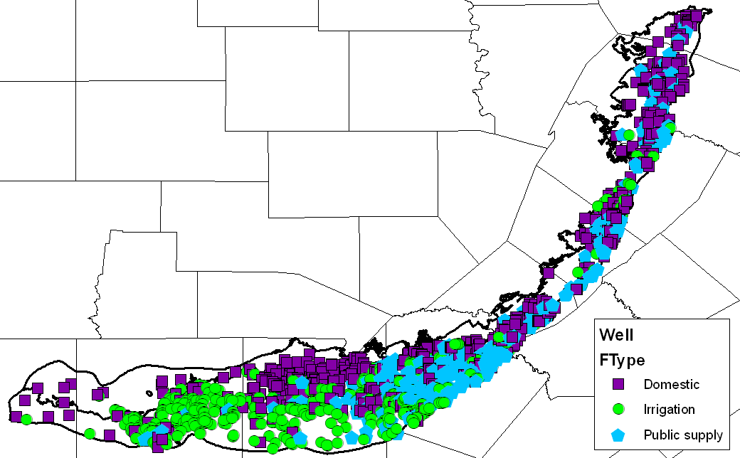
Well
Wells are defined as 2D point features
Only some basic attributes are predefined to describe the well use, and geometry and relationship with aquifers
Wells in the Edwards Aquifer

Slide 10
Aquifer and well
Well features are related to Aquifers
An aquifer can be associated with one or more wells (1:M relationship)
Can take a different approach to support M:N relationship
Aquifer
Well
1
HydroID
HydroID
HydroCode
HydroCode
Name
LandElev
HGUID
WellDepth
*
FType
AquiferID
AqCode
HGUID
FType

Slide 11
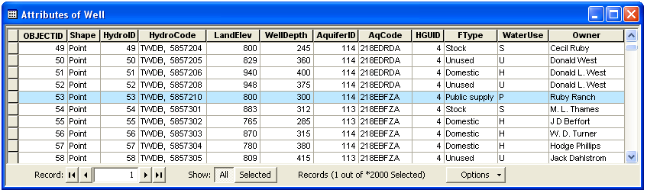
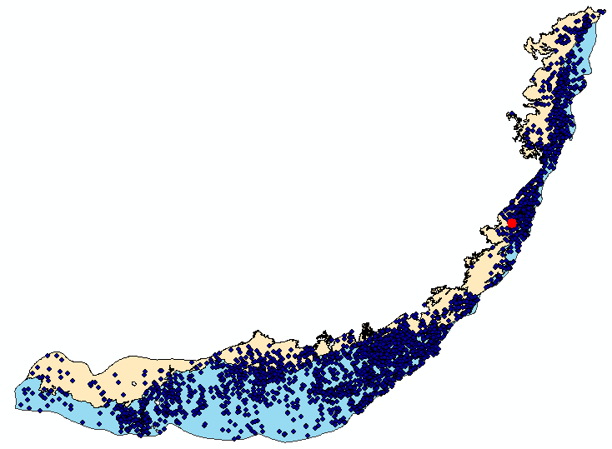
Aquifer and well
Well HydroID = 53

Slide 12
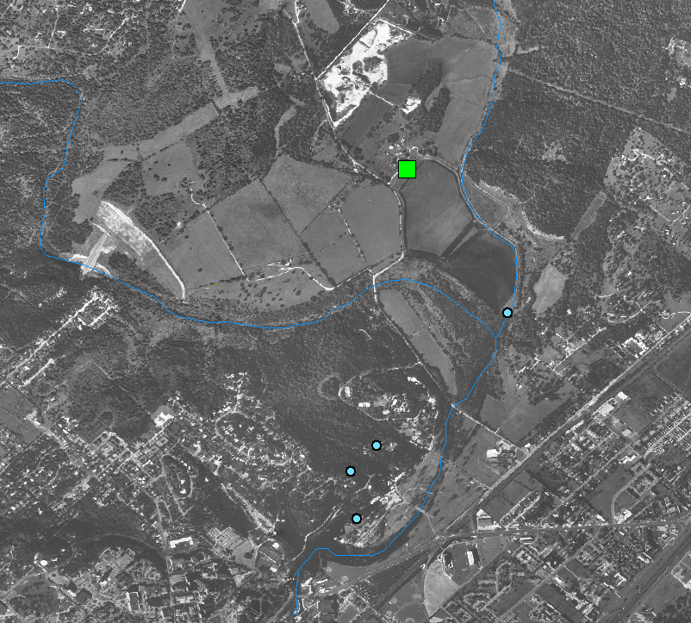
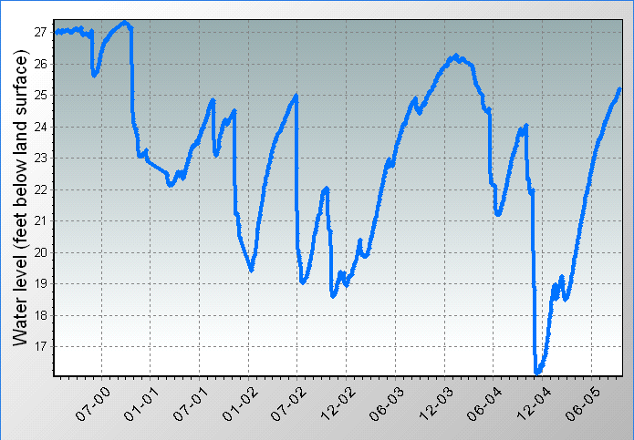
Wells and TimeSeries
Well features are related with time series (water levels, water quality)
Monitoring Well
(
295443097554201
)
Sink Creek
San Marcos springs
Springs
San Marcos

Slide 13
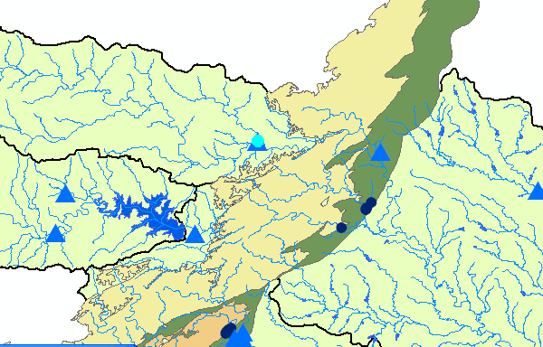
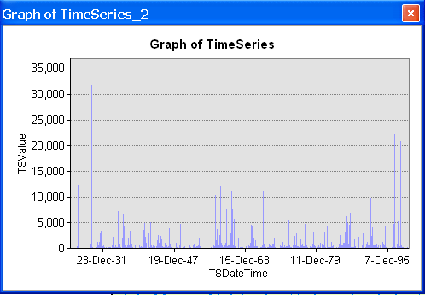
MonitoringPoint has time series
Monitoring points are related with time series (streamflow, water quality, precipitation)

Slide 14
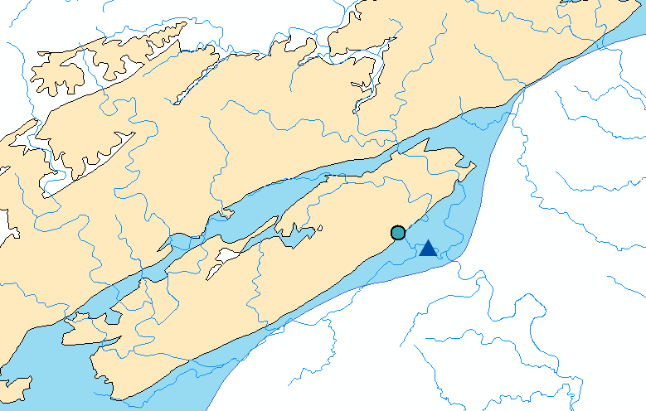
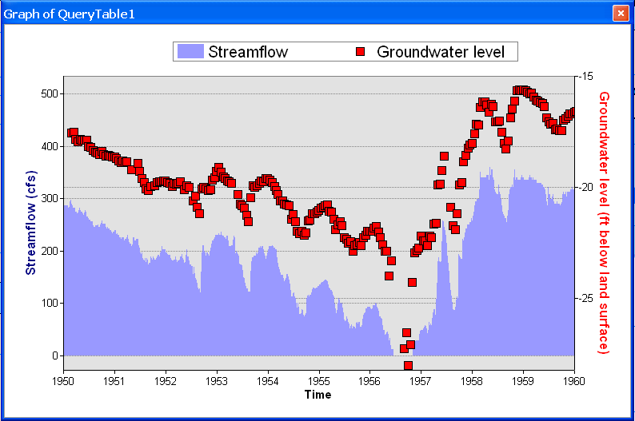
Integration of surface water and groundwater data
The common framework supports analysis of surface water and groundwater data together
Well in the Edwards Aquifer)
Streamflow Gage at Comal Springs, New Braunfels Texas

Slide 15
Components
Geology - Representation of data from geologic maps
Boreholes – Description of well attributes and borehole data
Hydrostratigraphy – 2D and 3D description of hydrostratigraphy
Temporal – Representation of time varying data
Simulation – Representation of groundwater simulation models (focus on MODFLOW)

Slide 16
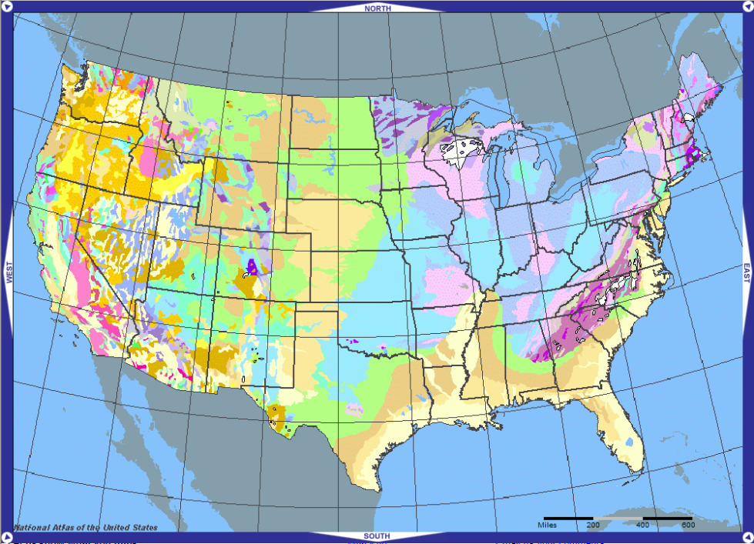
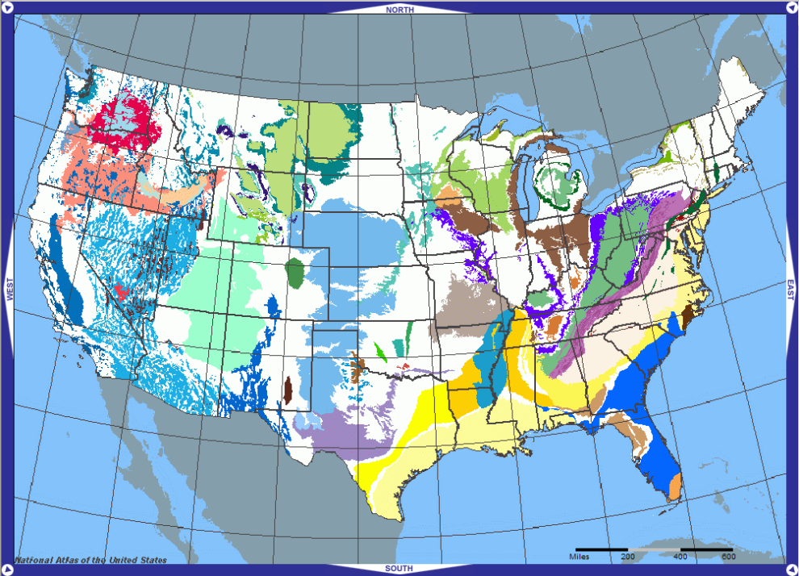
Geologic maps
A geologic map is a cartographic product that portrays information about the geologic character of a specific geographic area
Groundwater features are closely tied to geology
Geologic maps vary in scale (continental, regional, local)
Provide a simple data structure to support mapping
Geology
Aquifers
Maps from the United States National Atlas (http://nationalatlas.gov/).

Slide 17
Geology component
GeologyPoint: Point feature (e.g. springs, caves, sinks, and observation points)
GeologyLine: Line features (e.g. faults, contacts)
GeologyArea: Areal features (e.g. rock units and alteration zones)
Map modified from: Geologic map of the Edwards Aquifer recharge zone, south-central Texas. U.S. Geological Survey SIM 2873

Slide 18
Components
Geology - Representation of data from geologic maps
Boreholes – Description of well attributes and borehole data
Hydrostratigraphy – 2D and 3D description of hydrostratigraphy
Temporal – Representation of time varying data
Simulation – Representation of groundwater simulation models (focus on MODFLOW)

Slide 19
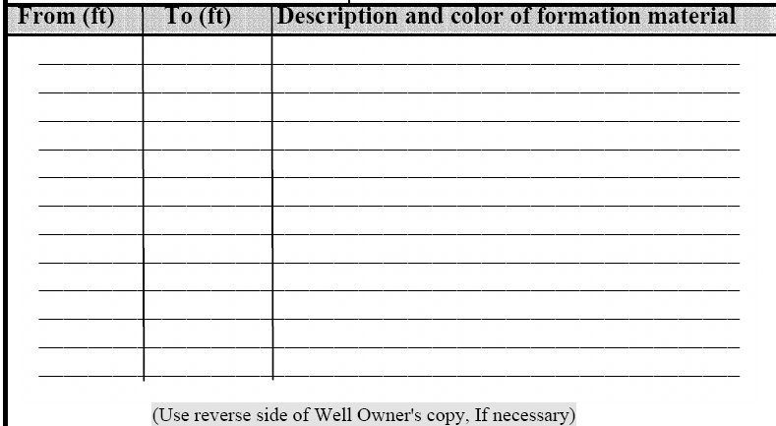

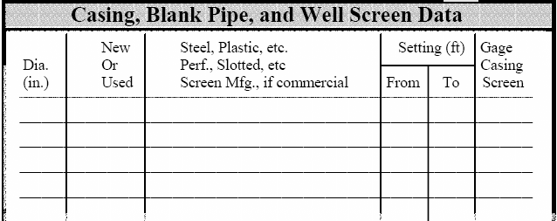
Borehole data
3D data (screens, completion intervals, stratigraphy) are referenced along the well
From depth (top) – To depth (bottom)

Slide 20
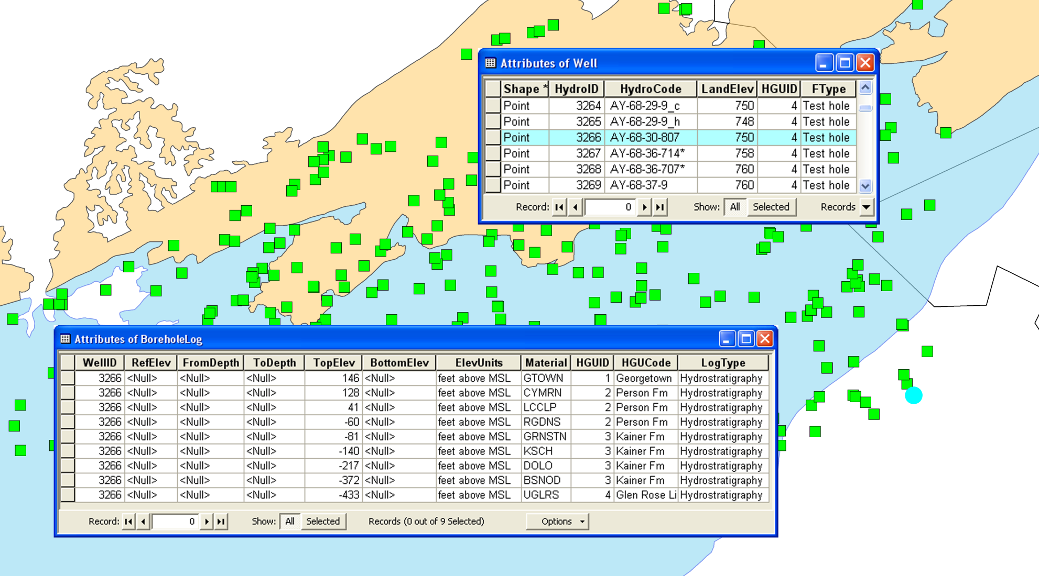
BoreholeLog table
Stores 3D borehole data related with well features
Each row represents a point/interval along a borehole
Data are related to Wells using the WellID attribute
3D geometry is defined by the TopElev and BottomElev attributes

Slide 21
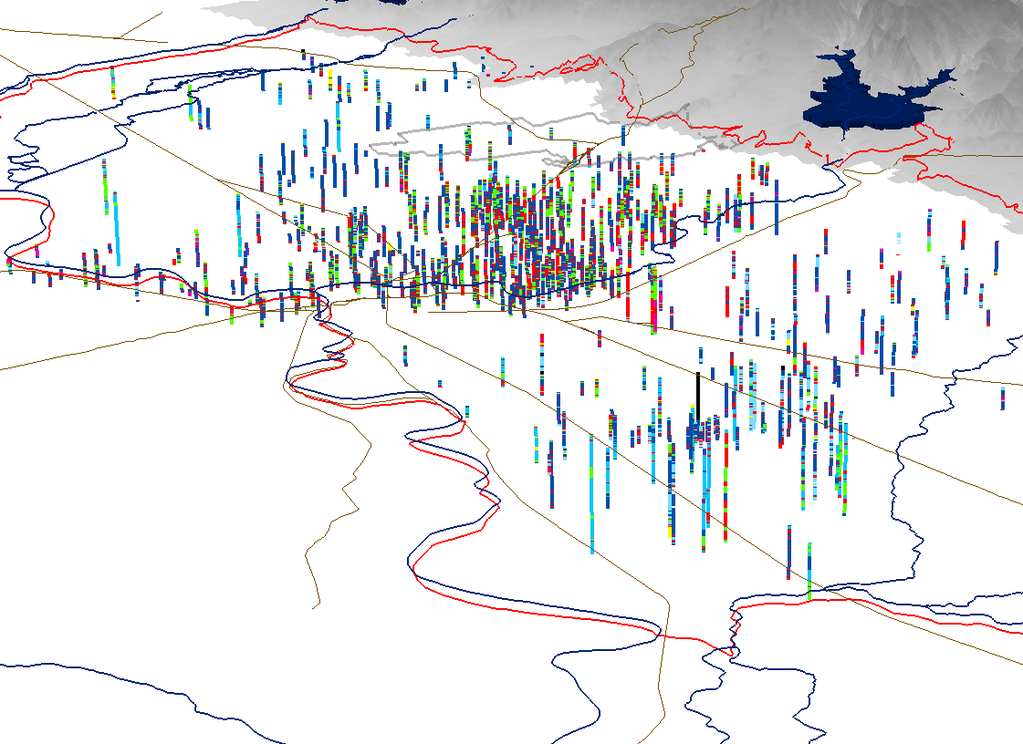
3D features (BorePoints and BoreLines)
Can create 3D features representing data in the BoreholeLog table
BorePoint is a 3D point feature class for representing point locations along a borehole (e.g. geologic contacts, samples)
BoreLine is a 3D line feature class for representing intervals along a borehole

Slide 22
Components
Geology - Representation of data from geologic maps
Boreholes – Description of well attributes and borehole data
Hydrostratigraphy – 2D and 3D description of hydrostratigraphy
Temporal – Representation of time varying data
Simulation – Representation of groundwater simulation models (focus on MODFLOW)

Slide 23
Hydrogeologic units
“Hydrogeologic unit is any soil or rock unit or zone which by virtue of its hydraulic properties has a distinct influence on the storage or movement of ground water” (USGS glossary of hydrologic terms)
Hydrogeology can be derived by classifying stratigraphic units
Stratigraphic units
Hydrogeologic units
Upper confining unit
Georgetown Fm. (GTOWN)
Georgetown Fm.
Cyclic + Marine member (CYMRN)
Leached + collapsed member (LCCLP)
Pearson Fm.
Regional dense member (RGDNS)
Edwards Aquifer
Grainstone member (GRNSTN)
Kirschberg evaporite member (KSCH)
Kainer Fm.
Dolomitic member (DOLO)
Basal Nodular member (BSNOD)
Upper Glen Rose (UGLRS)

Slide 24
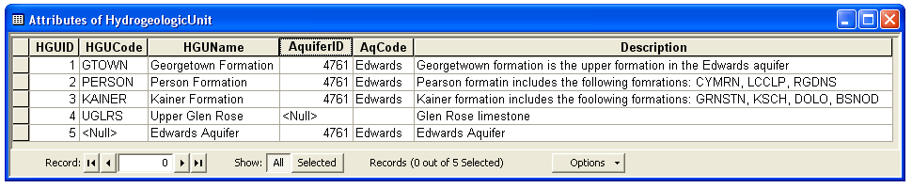
Hydrogeologic unit table
HydroGeologicUnit table provides a conceptual description of hydrogeologic units
Hydrogeologic units can be attributed with an AquiferID such that they can be grouped to represent an aquifer
Spatial features are indexed with a HGUID to relate to the conceptual representation of the units

Slide 25

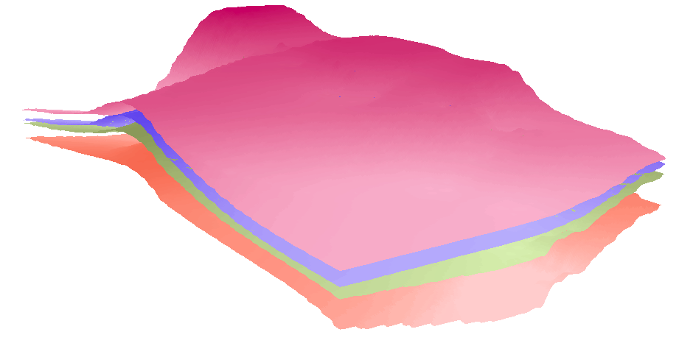
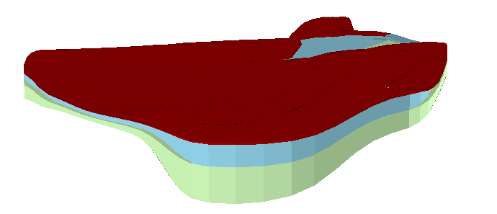
Hydrogeologic unit table
Hydrogeologic units are described with different spatial instances (outcrops, borehole intervals, surfaces, cross sections, and volumes)
HGUID is the key attribute
GeoArea
Polygon
feature class
1
SectionLine
GeoSection
*
PointZ
feature class
HydrogeologicUnit
Multipatch
feature class
Table
HGUID
Conceptual description
GeoRasters
Raster dataset
HGUID
GeoVolume
Spatial description
Multipatch
feature class

Slide 26
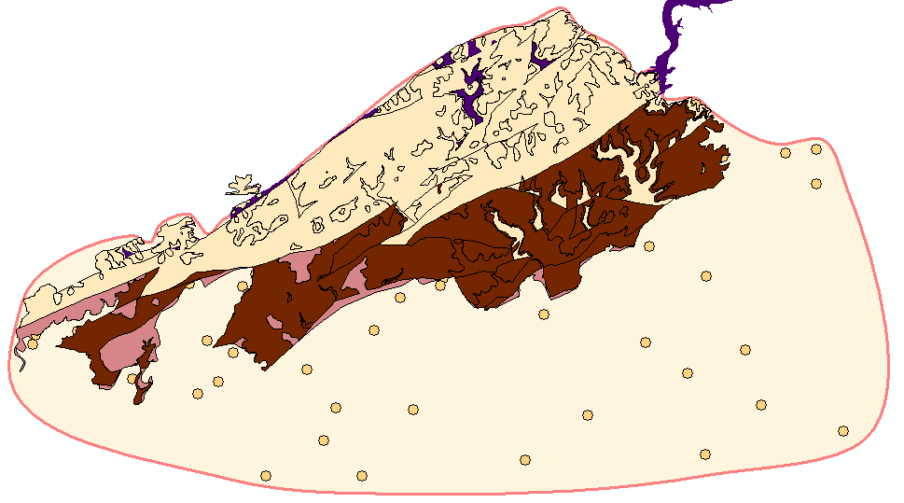

GeoArea
2D polygons defining boundaries of hydrogeologic units
GeoArea (conceptual/interpolated boundary) ≠ GeologyArea (mapped outcrop)
GeologyArea features represent data from geologic maps
GeologyArea
GeoArea feature representing the Kainer hydrogeologic unit
Data points representing top elevations of the Kainer formation

Slide 27
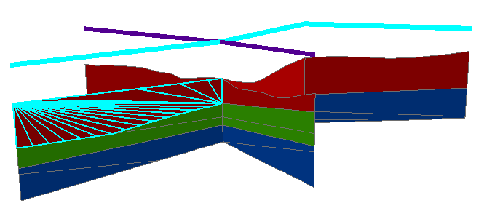
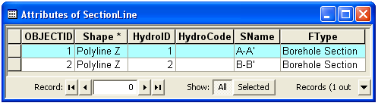
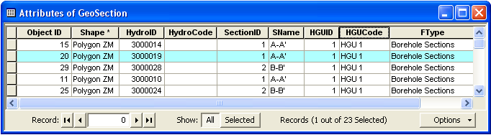
Representation of Cross Sections
SectionLine defines the 2D cross section
GeoSection represent 3D sections as 3D features
SectionID of the polygon relates back to the section line
B
B’
A’
A

Slide 28
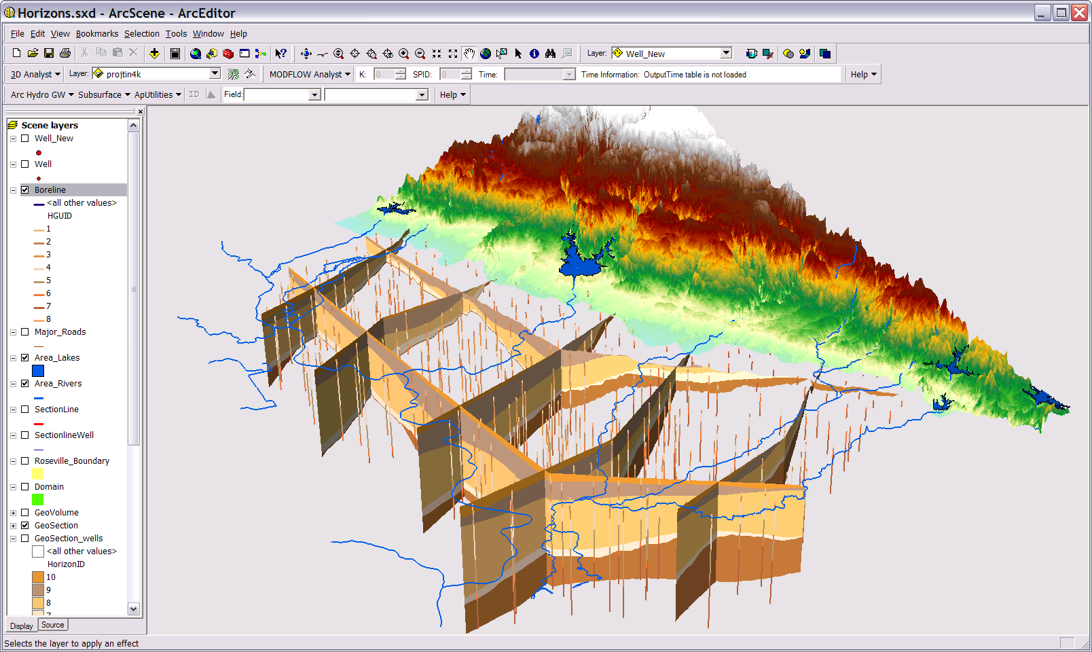
GeoSections

Slide 29
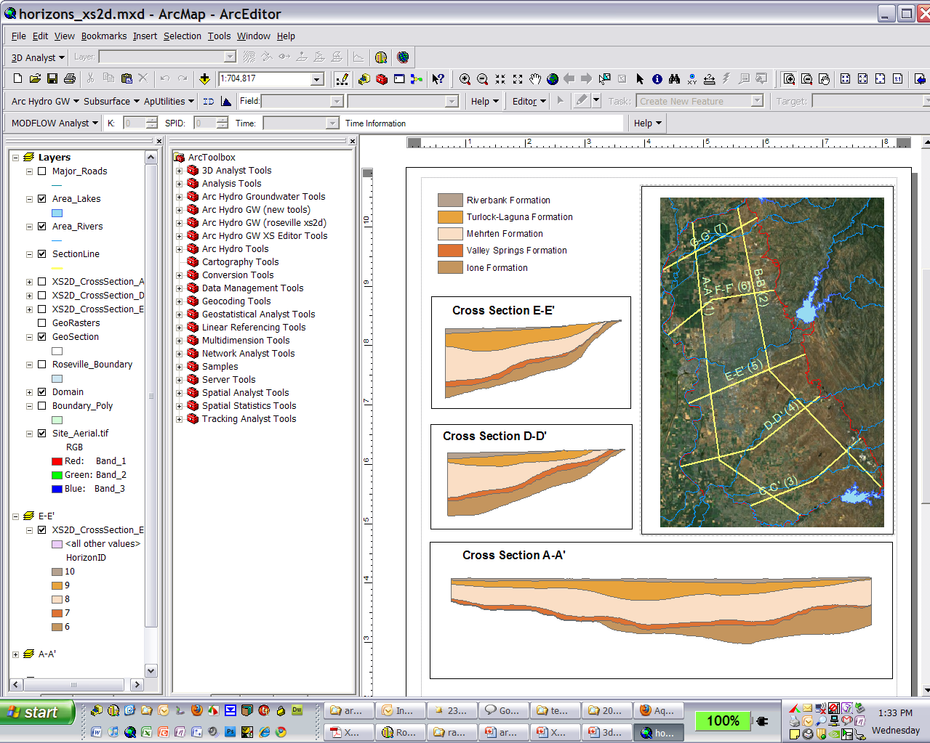
XS2D Component

Slide 30
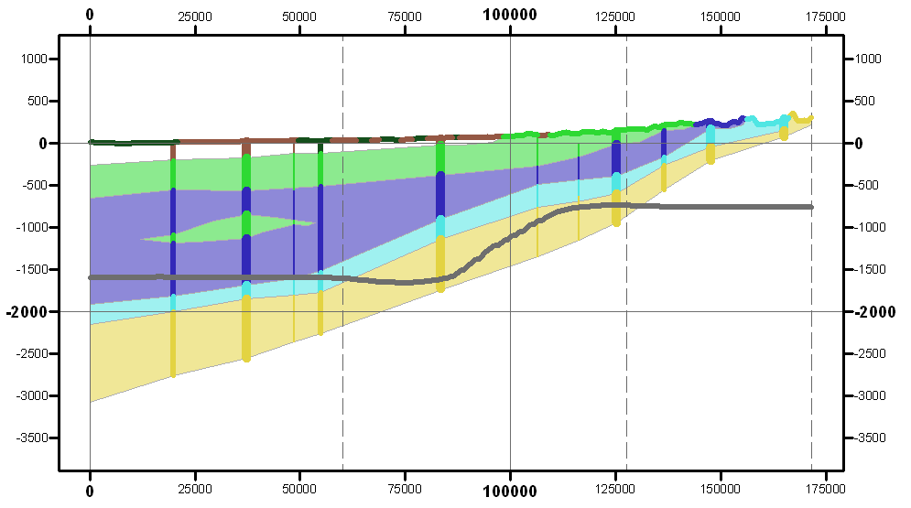
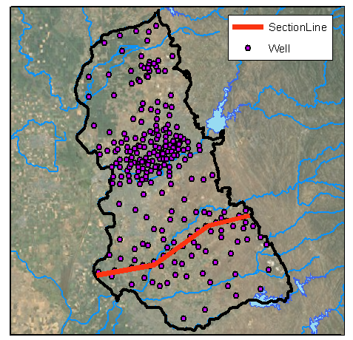
2D Cross Section Editing
Edit cross sections in ArcMap
Borehole data
Outcrop
Salt water interface
Panel divider
Panel

Slide 31
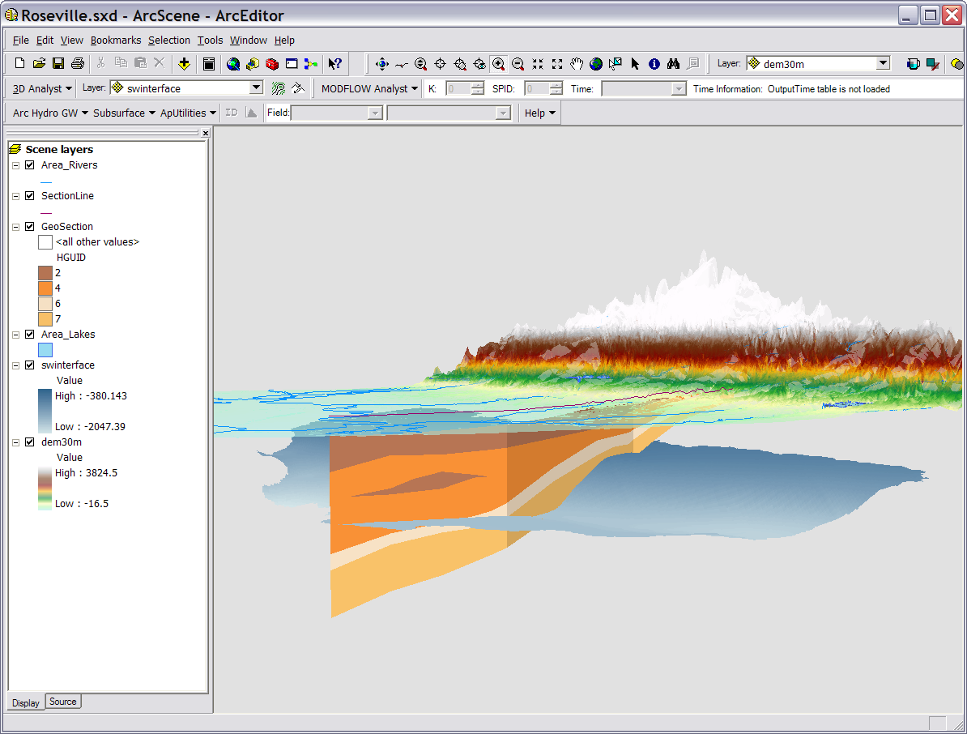
Transform to 3D GeoSection

Slide 32
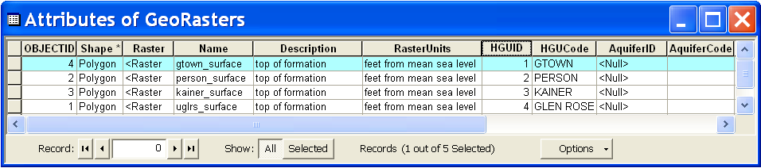
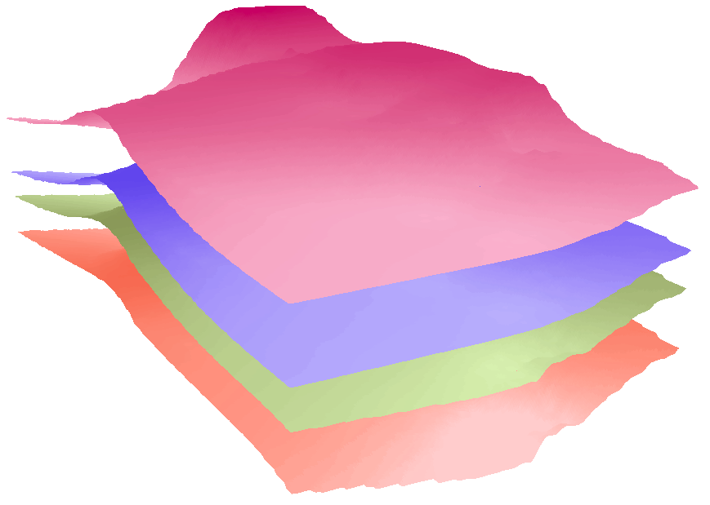
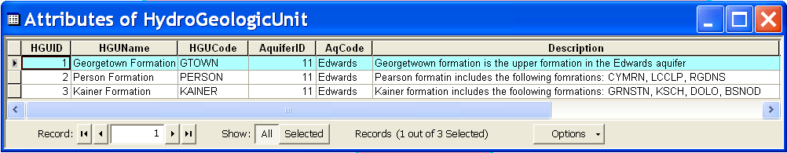
GeoRasters
Raster catalog for storing and indexing raster datasets
Can store top and bottom of formations
Each raster is related with a HGU in the hydrogeologic unit table
Georgetown
Person
Kainer
Glen Rose

Slide 33
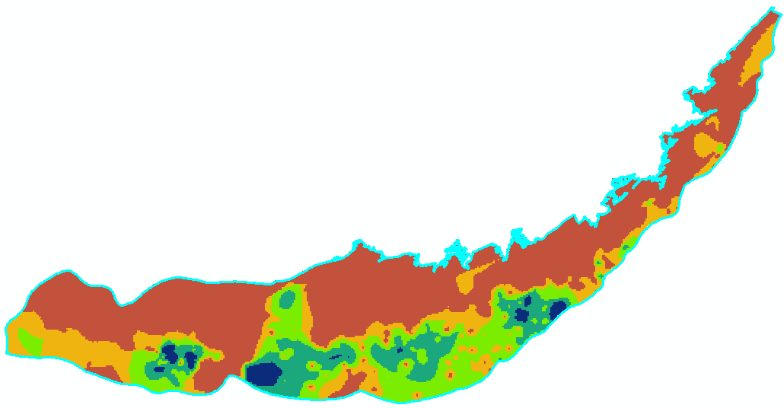
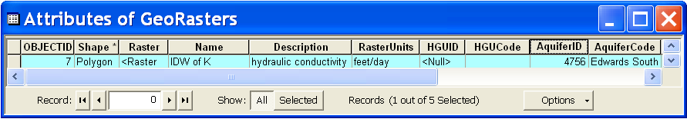
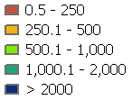
GeoRasters
GeoRasters also store hydraulic properties such as transmissivity, conductivity, and specific yield
K (feet/day)
Raster of hydraulic conductivity in the Edwards Aquifer

Slide 34
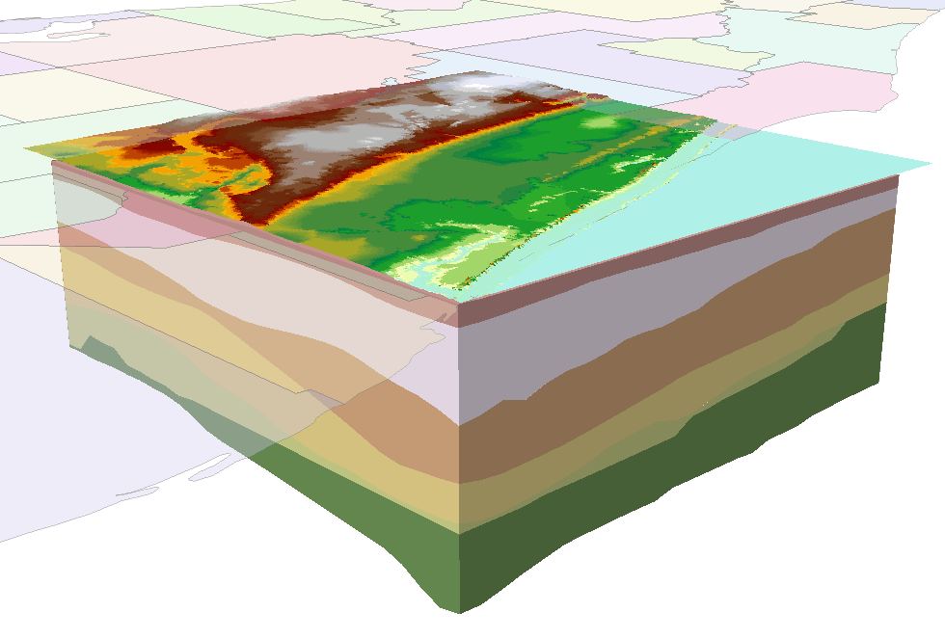
GeoVolume
Objects for representing 3D volume objects
Geometry is multipatch - Can create the volumes as a set of 3D triangles
Not real volume – can’t do any 3D operations

Slide 35
Components
Geology - Representation of data from geologic maps
Boreholes – Description of well attributes and borehole data
Hydrostratigraphy – 2D and 3D description of hydrostratigraphy
Temporal – Representation of time varying data
Simulation – Representation of groundwater simulation models (focus on MODFLOW)

Slide 36
Space-time datasets

Slide 37
Types of time varying datasets

Slide 38
Time series views
We can “slice” through the data cube to get specific views of the data
Where?
What?
Where and What?
Query by location
(FeatureID = 2791)
Query by type
(VarID = 6875)
Query by location and type
(FeatureID = 2791 VarID = 6875)
TsTime
TsTime
TsTime
2791
FeatureID
FeatureID
2791
FeatureID
6875
6875
VarID
VarID
VarID

Slide 39
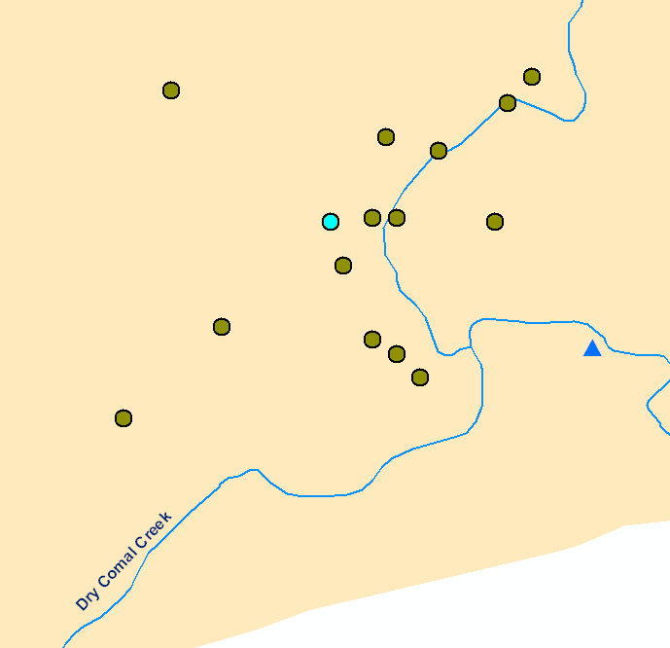
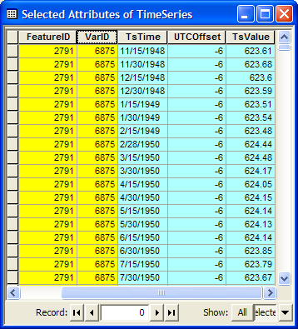
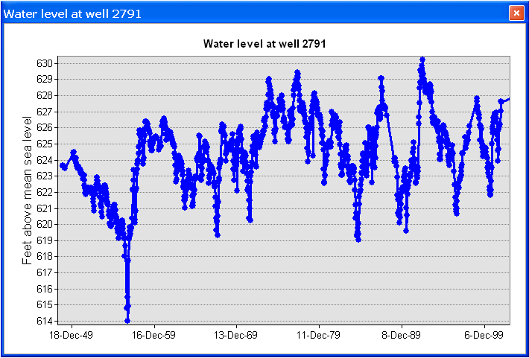
Time series views
Create a plot of time series related to a feature
Get all the data of VarID 6875 measured at Feature 2791
Well HydroID = 2791

Slide 40
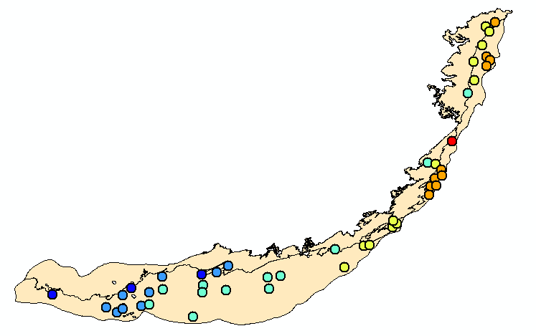
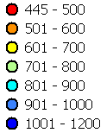

Time series views
A type-time view: Get water levels (TSTypeID =2) for 1/1999
TsTime
Water level in the Edwards Aquifer in 1/1999
1/1991
FeatureID
6875
VarID
Set of layers for different times creates an animation

Slide 41




Raster Series
Raster datasets indexed by time
Each raster represents a continuous surface describing a variable for a given time
January 1991
January 1992
January 1993

Slide 42



Feature Series
A collection of features indexed by time
Example of particle tracks
Features are indexed by VarID, TsTime, and GroupID
Each group of features creates a track over time

Slide 43
Components
Geology - Representation of data from geologic maps
Boreholes – Description of well attributes and borehole data
Hydrostratigraphy – 2D and 3D description of hydrostratigraphy
Temporal – Representation of time varying data
Simulation – Representation of groundwater simulation models (focus on MODFLOW)

Slide 44

Representing simulation models
Georeference model inputs and outputs (in space and time)
Focus on MODFLOW, block centered finite difference grid (nodes are in the center of the cells)
Represent 2D and 3D models
Block-centered finite difference grid

Slide 45

Simulation component
Features for representing data from simulation models

Slide 46


Boundary
Polygon feature class for representing the extent and orientation of a simulation model

Slide 47
Cell2D and Node
Cell2D: polygon feature class that represents cells or elements associated with a two-dimensional simulation model or a single layer of a three-dimensional model
Node: point feature class used in combination with Cell2D to represent the model’s mesh/grid.
Finite element mesh
Mesh centered finite difference grid
Cell centered finite difference grid

Slide 48

Cell2D and Node
Used to create maps of model data

Slide 49

Node3D and Cell3D
Node3D – a Z enabled point feature class
Cell3D - Multipatch feature class
Represent three-dimensional cells and Nodes
Used mostly for visualization of 3D models

Slide 50
Summary Concepts
Arc Hydro Groundwater…
  extends Arc Hydro to represent groundwater datasets in GIS
  includes components for aquifers, wells, hydrogeologic features, time series, and simulation model output
  links features to hydrogeologic layers via HGUID, and to aquifers via AquiferID

Slide 51
Resources
Hydro Resource Center
http://resources.arcgis.com/content/hydro
Groundwater Tools and Data Model
http://www.aquaveo.com/archydro-groundwater
Tutorials
http://www.aquaveo.com/ahgw-learning
Contact for tool support
support@aquaveo.com

